Slide 1
Week 3: CPU Scheduling
CS 162

Slide 2
Today’s Section
Administrivia (2 min)
Quiz (5 min)
Review lecture 8 (10 min)
Worksheet and Discussion (33 min)

Slide 3
Administrivia
Project 1 code is due Tuesday, 2/25.
Project OH on Sunday in 293 and 299 Cory, 1-5pm
Try to use as few slip days as possible
Generally, projects 2 and 4 have more trouble in terms of time crunch, so plan accordingly
Boat - you are now allowed to use a lock on the begin() method’s thread creation
Question: why would this be useful? Please don’t answer aloud.
Midterm 1 is 3/12, 4:00-5:30pm in 245 Li Ka Shing (A-L) and 105 Stanley (M-Z)
Covers lectures 1-12, readings, handouts, projs 1 & 2

Slide 4
Quiz time

Slide 5
Lecture review
Lecture 8: CPU Scheduling

Slide 6
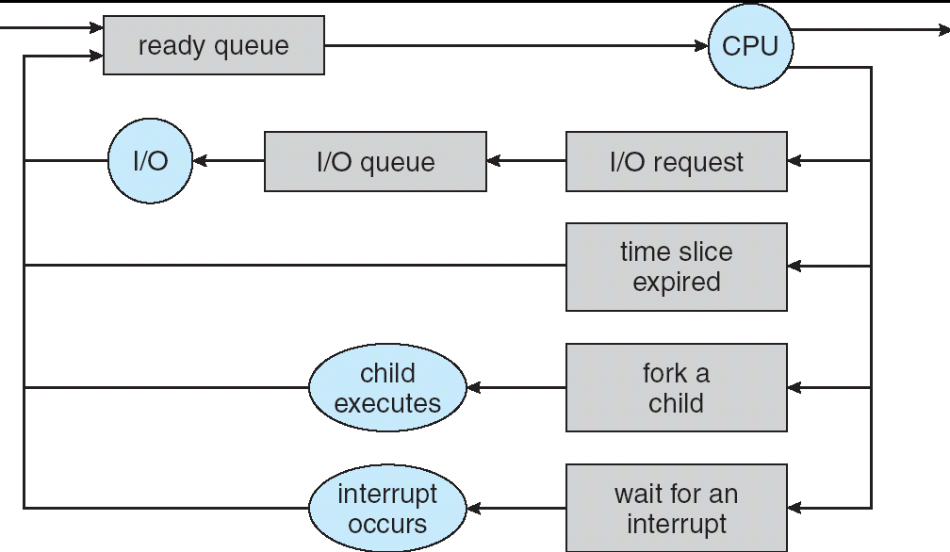
CPU Scheduling
Scheduling – deciding which threads are given access to resources
Many assumptions

Slide 7
Scheduling Assumptions
One program per user
One thread per program
Independent programs
Each program generally consists of bursts of CPU usage punctuated by I/O activity

Slide 8
Scheduling Metrics/Goals
Metrics
Waiting Time: time a job waits on ready queue
Service/Execution Time: time to finish executing
Response Time: time from job creation to completion (waiting time + service time)
Throughput: number of jobs completed per unit time
Goals
Minimize response time
Maximize throughput
“Fairness”: generally being equitable among processes

Slide 9
Scheduling Strategies
First-Come, First-Served (FCFS): pretty self-explanatory, simple, probably not fair
Round-Robin (RR): probably most fair, good for short jobs, has the most context-switching
Shortest Job First (SJF): run whichever job is smallest
Shortest Remaining Time First (SRTF): run whichever job has the least left to do
Lottery: pick next thread at random, weighted (shorter jobs first) by its expected runtime
Multi-Level Feedback: use multiple queues, each getting different priority/CPU timeslice. Tasks start on high-priority queues, then are moved down if timeout

Slide 10
Fairness
Many somewhat fuzzy goals
Giving every process CPU time
Ensuring responsiveness on user-driven tasks?
Stopping user programs from maliciously leveraging scheduler heuristics (Ex: MIT Othello competition)
Implemented in various ways
Increase priority of jobs if they don’t get service (Unix)
Give each queue a fraction of CPU time (however, clogged high-priority queues might make low-priority threads get more time)

