Slide 1
CS162
Operating Systems and
Systems Programming
Lecture 5
Introduction to Networking (Finished),
Concurrency (Processes and Threads)
February 3rd, 2016
Prof. Anthony D. Joseph
http://cs162.eecs.Berkeley.edu

Slide 2
Recall: Namespaces for communication over IP
Hostname
  www.eecs.berkeley.edu
IP address
  128.32.244.172 (IPv4 32-bit)
  fe80::4ad7:5ff:fecf:2607 (IPv6 128-bit)
Port Number
  0-1023 are “well known” or “system” ports
    Superuser privileges to bind to one
  1024 – 49151 are “registered” ports (registry)
    Assigned by IANA for specific services
  49152–65535 (2¹⁵+2¹⁴ to 2¹⁶−1) are “dynamic” or “private”
    Automatically allocated as “ephemeral Ports”

Slide 3
Recall: Use of Sockets in TCP
Socket: an abstraction of a network I/O queue
  Embodies one side of a communication channel
    Same interface regardless of location of other end
    Local machine (“UNIX socket”) or remote machine (“network socket”)
  First introduced in 4.2 BSD UNIX: big innovation at time
    Now most operating systems provide some notion of socket
Using Sockets for Client-Server (C/C++ interface):
  On server: set up “server-socket”
    Create socket, Bind to protocol (TCP), local address, port
    Call listen(): tells server socket to accept incoming requests
    Perform multiple accept() calls on socket to accept incoming connection request
    Each successful accept() returns a new socket for a new connection; can pass this off to handler thread
  On client:
    Create socket, Bind to protocol (TCP), remote address, port
    Perform connect() on socket to make connection
    If connect() successful, have socket connected to server

Slide 4
Recall: Socket Setup over TCP/IP
Server
Socket
Request Connection
new
socket
socket
socket
connection
Client
Server
Server Socket: Listens for new connections
  Produces new sockets for each unique connection
Things to remember:
  Connection involves 5 values:
  [ Client Addr, Client Port, Server Addr, Server Port, Protocol ]
  Often, Client Port “randomly” assigned
    Done by OS during client socket setup
  Server Port often “well known”
    80 (web), 443 (secure web), 25 (sendmail), etc
    Well-known ports from 0—1023

Slide 5
Example: Server Protection and Parallelism
Client
Server
Create Server Socket
Bind it to an Address
(host:port)
Create Client Socket
Connect it to server (host:port)
Listen for Connection
Accept connection
child
Connection Socket
Parent
Close Listen Socket
Close Connection Socket
write request
read request
read response
write response
Close Connection Socket
Close Client Socket
Close Server Socket

Slide 6
Recall: Server Protocol (v3)
listen(lstnsockfd, MAXQUEUE);
while (1) {
consockfd = accept(lstnsockfd, (struct sockaddr *) &cli_addr,
&clilen);
cpid = fork(); /* new process for connection */
if (cpid > 0) { /* parent process */
close(consockfd);
} else if (cpid == 0) { /* child process */
close(lstnsockfd); /* let go of listen socket */
server(consockfd);
close(consockfd);
exit(EXIT_SUCCESS); /* exit child normally */
}
}
close(lstnsockfd);

Slide 7
Server Address - Itself
struct sockaddr_in {
short sin_family;
unsigned short sin_port;
struct in_addr sin_addr;
char sin_zero[8];
} serv_addr;
memset((char *) &serv_addr,0, sizeof(serv_addr));
serv_addr.sin_family = AF_INET;
serv_addr.sin_addr.s_addr = INADDR_ANY;
serv_addr.sin_port = htons(portno);
Simple form
Internet Protocol
accepting any connections on the specified port
In “network byte ordering”

Slide 8
Client: Getting the Server Address
struct hostent *buildServerAddr(struct sockaddr_in *serv_addr,
char *hostname, int portno) {
struct hostent *server;
/* Get host entry associated with a hostname or IP address */
server = gethostbyname(hostname);
if (server == NULL) {
fprintf(stderr,"ERROR, no such host\n");
exit(1);
}
/* Construct an address for remote server */
memset((char *) serv_addr, 0, sizeof(struct sockaddr_in));
serv_addr->sin_family = AF_INET;
bcopy((char *)server->h_addr,
(char *)&(serv_addr->sin_addr.s_addr), server->h_length);
serv_addr->sin_port = htons(portno);
return server;
}

Slide 9

Recall: Traditional UNIX Process
Process: OS abstraction of what is needed to run a single program
  Often called a “HeavyWeight Process”
  No concurrency in a “HeavyWeight Process”
Two parts:
  Sequential program execution stream
  [ACTIVE PART]
    Code executed as a sequential stream of
    execution (i.e., thread)
    Includes State of CPU registers
  Protected resources
  [PASSIVE PART]:
    Main memory state (contents of Address Space)
    I/O state (i.e. file descriptors)

Slide 10
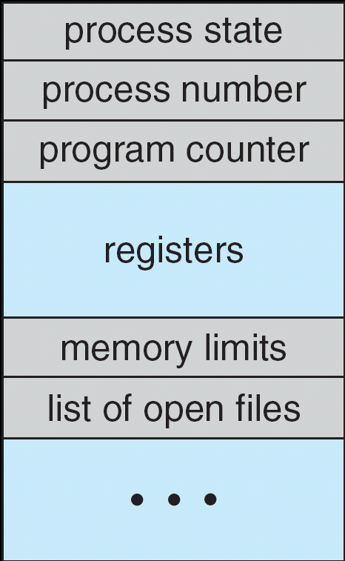
How do we Multiplex Processes?
The current state of process held in a process control block (PCB):
  This is a “snapshot” of the execution and protection environment
  Only one PCB active at a time
Give out CPU time to different processes (Scheduling):
  Only one process “running” at a time
  Give more time to important processes
Give pieces of resources to different processes (Protection):
  Controlled access to non-CPU resources
  Example mechanisms:
    Memory Mapping: Give each process their own address space
    Kernel/User duality: Arbitrary multiplexing of I/O through system calls
Process
Control
Block

Slide 11
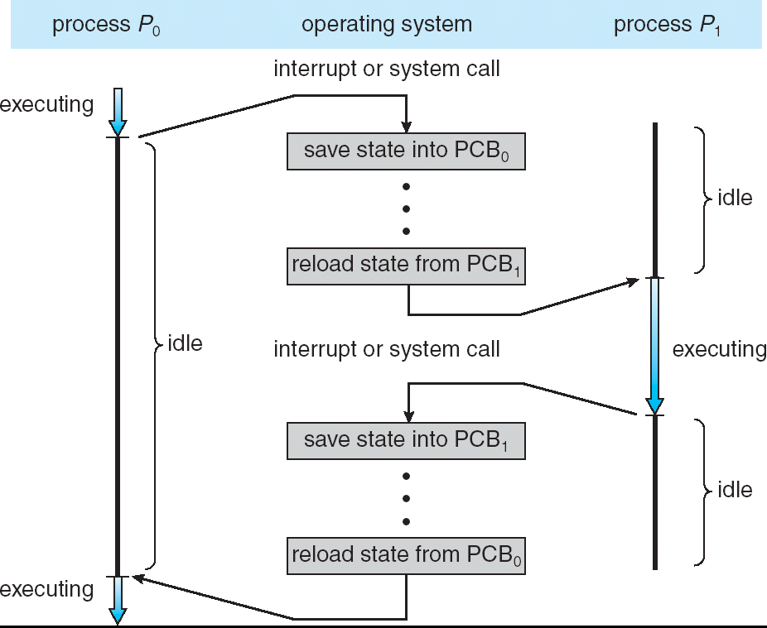
CPU Switch From Process A to Process B
This is also called a “context switch”
Code executed in kernel above is overhead
  Overhead sets minimum practical switching time
  Less overhead with SMT/hyperthreading, but… contention for resources instead

Slide 12
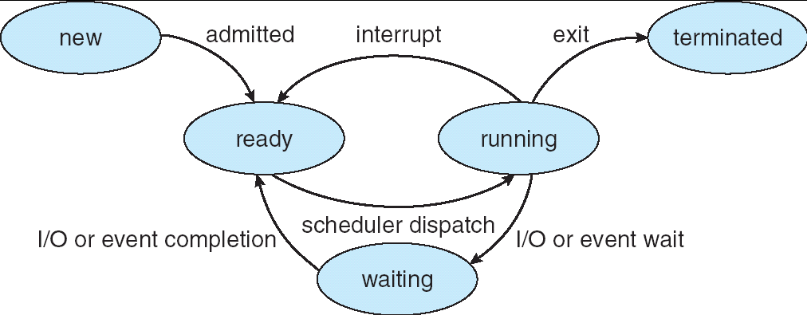
Lifecycle of a Process
As a process executes, it changes state:
  new: The process is being created
  ready: The process is waiting to run
  running: Instructions are being executed
  waiting: Process waiting for some event to occur
  terminated: The process has finished execution

Slide 13
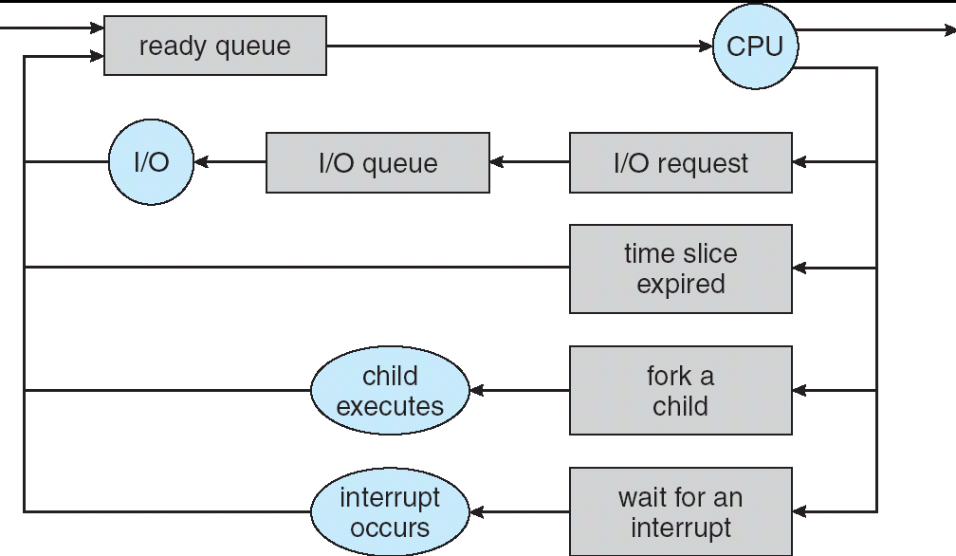
Process Scheduling
PCBs move from queue to queue as they change state
  Decisions about which order to remove from queues are Scheduling decisions
  Many algorithms possible (few weeks from now)

Slide 14
Ready Queue And Various I/O Device Queues
Process not running ⇒ PCB is in some scheduler queue
  Separate queue for each device/signal/condition
  Each queue can have a different scheduler policy
Ready
Queue
Head
Other
State
PCB₉
Link
Other
State
PCB₆
Link
Other
State
PCB₁₆
Link
Tail
Registers
Registers
Registers
USB
Unit 0
Head
Tail
Disk
Unit 0
Head
Other
State
PCB₂
Link
Other
State
PCB₃
Link
Tail
Registers
Registers
Disk
Unit 2
Head
Tail
Other
State
PCB₈
Ether
Netwk 0
Link
Head
Tail
Registers

Slide 15
Modern Process with Threads
Thread: a sequential execution stream within process
(Sometimes called a “Lightweight process”)
  Process still contains a single Address Space
  No protection between threads
Multithreading: a single program made up of a number of different concurrent activities
  Sometimes called multitasking, as in Ada …
Why separate the concept of a thread from that of a process?
  Discuss the “thread” part of a process (concurrency)
  Separate from the “address space” (protection)
  Heavyweight Process ≡ Process with one thread

Slide 16
Single and Multithreaded Processes
Threads encapsulate concurrency: “Active” component
Address spaces encapsulate protection: “Passive” part
  Keeps buggy program from trashing the system
Why have multiple threads per address space?
Notes:
Sometimes need parallelism for a single job, and processes are very expensive – to start, switch between, and to communicate between

Slide 17
Administrivia
Group signups: 4 members/group
  Groups need to be finalized today!
  36 students without groups
  We may add a student to groups of 3
  Sign up with the autograder
TA Signup form
  Form asks for 3 section options (ranked) for your group
  Please sign up by Monday!
  We will try to accommodate your needs, but may not be able to fill over-popular sections – give us options!
Need to get to know your TAs
  Consider moving out of really full sections!

Slide 18
Break

Slide 19
Thread State
State shared by all threads in process/address space
  Content of memory (global variables, heap)
  I/O state (file descriptors, network connections, etc)
State “private” to each thread
  Kept in TCB ≡ Thread Control Block
  CPU registers (including, program counter)
  Execution stack – what is this?
Execution Stack
  Parameters, temporary variables
  Return PCs are kept while called procedures are executing

Slide 20
Shared vs. Per-Thread State

Slide 21
Execution Stack Example
A: tmp=1
ret=exit
A(int tmp) {
if (tmp<2)
B();
printf(tmp);
}
B() {
C();
}
C() {
A(2);
}
A(1);
Stack
Pointer
B: ret=A+2
C: ret=b+1
A: tmp=2
ret=C+1
Stack Growth
Stack holds temporary results
Permits recursive execution
Crucial to modern languages

Slide 22
MIPS: Software conventions for Registers
0 zero constant 0
1 at reserved for assembler
2 v0 expression evaluation &
3 v1 function results
4 a0 arguments
5 a1
6 a2
7 a3
8 t0 temporary: caller saves
. . . (callee can clobber)
15 t7
16 s0 callee saves
. . . (callee must save)
23 s7
24 t8 temporary (cont’d)
25 t9
26 k0 reserved for OS kernel
27 k1
28 gp Pointer to global area
29 sp Stack pointer
30 fp frame pointer
31 ra Return Address (HW)
Before calling procedure:
  Save caller-saves regs
  Save v0, v1
  Save ra
After return, assume
  Callee-saves reg OK
  gp,sp,fp OK (restored!)
  Other things trashed

Slide 23
Motivational Example for Threads
Imagine the following C program:
main() {
ComputePI(“pi.txt”);
PrintClassList(“classlist.txt”);
}
What is the behavior here?
  Program would never print out class list
  Why? ComputePI would never finish

Slide 24
Use of Threads
Version of program with Threads (loose syntax):
main() {
ThreadFork(ComputePI(“pi.txt”));
ThreadFork(PrintClassList(“classlist.txt”));
}
What does “ThreadFork()” do?
  Start independent thread running given procedure
What is the behavior here?
  Now, you would actually see the class list
  This should behave as if there are two separate CPUs
CPU1
CPU2
CPU1
CPU2
CPU1
CPU2
Time

Slide 25
Memory Footprint: Two-Threads
If we stopped this program and examined it with a debugger, we would see
  Two sets of CPU registers
  Two sets of Stacks
Questions:
  How do we position stacks relative to
  each other?
  What maximum size should we choose
  for the stacks?
  What happens if threads violate this?
  How might you catch violations?
Stack 1
Stack 2
Address Space
Heap
Global Data
Code

Slide 26
Actual Thread Operations
thread_fork(func, args)
  Create a new thread to run func(args)
  Pintos: thread_create
thread_yield()
  Relinquish processor voluntarily
  Pintos: thread_yield
thread_join(thread)
  In parent, wait for forked thread to exit, then return
  Pintos: thread_join
thread_exit
  Quit thread and clean up, wake up joiner if any
  Pintos: thread_exit
pThreads: POSIX standard for thread programming
[POSIX.1c, Threads extensions (IEEE Std 1003.1c-1995)]

Slide 27
Dispatch Loop
Conceptually, the dispatching loop of the operating system looks as follows:
Loop {
RunThread();
ChooseNextThread();
SaveStateOfCPU(curTCB);
LoadStateOfCPU(newTCB);
}
This is an infinite loop
  One could argue that this is all that the OS does
Should we ever exit this loop???
  When would that be?
Notes:
Emergency crash of operating system called “panic()”

Slide 28
Running a thread
Consider first portion: RunThread()
How do I run a thread?
  Load its state (registers, PC, stack pointer) into CPU
  Load environment (virtual memory space, etc)
  Jump to the PC
How does the dispatcher get control back?
  Internal events: thread returns control voluntarily
  External events: thread gets preempted
Notes:
OS’s have almost human characteristics – unpredictable, hard to understand, …
Different things share the same CPU – one thread, then another
Similar to schizophrenia, like the movie Sybil, one body shared by several people, say we start with Dave Patterson
Threads are like the personalities of the CPU. First one thread/personality uses the CPU, then another,…

Slide 29
Internal Events
Blocking on I/O
  The act of requesting I/O implicitly yields the CPU
Waiting on a “signal” from other thread
  Thread asks to wait and thus yields the CPU
Thread executes a yield()
  Thread volunteers to give up CPU
  computePI() {
  while(TRUE) {
  ComputeNextDigit();
  yield();
  }
  }
Notes:
Yield is for really nice people – Ever see two people at the supermarket checkout line? You first, no you first, …

Slide 30
Stack for Yielding Thread
ComputePI
yield
Trap to OS
kernel_yield
Stack growth
run_new_thread
switch
How do we run a new thread?
run_new_thread() {
newThread = PickNewThread();
switch(curThread, newThread);
ThreadHouseKeeping(); /* Do any cleanup */
}
How does dispatcher switch to a new thread?
  Save anything next thread may trash: PC, regs, stack
  Maintain isolation for each thread

Slide 31
What Do the Stacks Look Like?
Consider the following code blocks:
proc A() {
B();
}
proc B() {
while(TRUE) {
yield();
}
}
Suppose we have 2 threads:
  Threads S and T
Thread S
Thread T
A
A
B(while)
B(while)
Stack growth
yield
yield
run_new_thread
run_new_thread
switch
switch

Slide 32
Saving/Restoring state (often called “Context Switch)
Switch(tCur,tNew) {
/* Unload old thread */
TCB[tCur].regs.r7 = CPU.r7;
…
TCB[tCur].regs.r0 = CPU.r0;
TCB[tCur].regs.sp = CPU.sp;
TCB[tCur].regs.retpc = CPU.retpc; /*return addr*/
/* Load and execute new thread */
CPU.r7 = TCB[tNew].regs.r7;
…
CPU.r0 = TCB[tNew].regs.r0;
CPU.sp = TCB[tNew].regs.sp;
CPU.retpc = TCB[tNew].regs.retpc;
return; /* Return to CPU.retpc */
}

Slide 33
Switch Details (continued)
What if you make a mistake in implementing switch?
  Suppose you forget to save/restore register 32
  Get intermittent failures depending on when context switch occurred and whether new thread uses register 32
  System will give wrong result without warning
Can you devise an exhaustive test to test switch code?
  No! Too many combinations and inter-leavings
Cautionary tale:
  For speed, Topaz kernel saved one instruction in switch()
  Carefully documented! Only works As long as kernel size < 1MB
  What happened?
    Time passed, People forgot
    Later, they added features to kernel (no one removes features!)
    Very weird behavior started happening
  Moral of story: Design for simplicity

Slide 34
Some Numbers
Frequency of performing context switches: 10-100ms
Context switch time in Linux: 3-4 μsecs (Intel i7 & E5)
  Thread switching faster than process switching (100 ns)
  But switching across cores ~2x more expensive than within-core
Context switch time increases sharply with size of working set*
  Can increase 100x or more
  *The working set is subset of memory used by process in a time window
Moral: Context switching depends mostly on cache limits and the process or thread’s hunger for memory

Slide 35
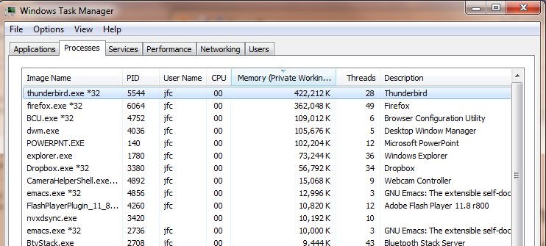
Some Numbers
Many process are multi-threaded, so thread context switches may be either within-process or across-processes

Slide 36
Break

Slide 37
What happens when thread blocks on I/O?
CopyFile
read
Trap to OS
Stack growth
kernel_read
run_new_thread
switch
What happens when a thread requests a block of data from the file system?
  User code invokes a system call
  Read operation is initiated
  Run new thread/switch
Thread communication similar
  Wait for Signal/Join
  Networking

Slide 38
External Events
What happens if thread never does any I/O, never waits, and never yields control?
  Could the ComputePI program grab all resources and never release the processor?
    What if it didn’t print to console?
  Must find way that dispatcher can regain control!
Answer: Utilize External Events
  Interrupts: signals from hardware or software that stop the running code and jump to kernel
  Timer: like an alarm clock that goes off every some many milliseconds
If we make sure that external events occur frequently enough, can ensure dispatcher runs
Notes:
Patterson’s a nice guy, so he gives up the body after using it for awhile and let’s John Kubitowicz have it.
But Kubi’s not so nice, so he won’t give up control…
If you want to wake up for a final, you set your clock, or ask your roommate to pour water over your head – OS does the same

Slide 39
Example: Network Interrupt
Raise priority
Reenable All Ints
Save registers
Dispatch to Handler
…
Transfer Network Packet from hardware
to Kernel Buffers
…
Restore registers
Clear current Int
Disable All Ints
Restore priority
RTI
...
add $r1,$r2,$r3
subi $r4,$r1,#4
slli $r4,$r4,#2
...
PC saved
Disable All Ints
Supervisor Mode
External Interrupt
Pipeline Flush
“Interrupt Handler”
...
lw $r2,0($r4)
lw $r3,4($r4)
add $r2,$r2,$r3
sw 8($r4),$r2
...
Restore PC
User Mode
An interrupt is a hardware-invoked context switch
  No separate step to choose what to run next
  Always run the interrupt handler immediately

Slide 40
Use of Timer Interrupt to Return Control
Solution to our dispatcher problem
  Use the timer interrupt to force scheduling decisions
Timer Interrupt routine:
TimerInterrupt() {
DoPeriodicHouseKeeping();
run_new_thread();
}
Some Routine
Interrupt
TimerInterrupt
Stack growth
run_new_thread
switch

Slide 41
Thread Abstraction
Illusion: Infinite number of processors
Notes:
Execution model: each thread runs on a dedicated virtual processor with unpredictable and variable speed.

Slide 42
Thread Abstraction
Illusion: Infinite number of processors
Reality: Threads execute with variable speed
  Programs must be designed to work with any schedule
Notes:
Execution model: each thread runs on a dedicated virtual processor with unpredictable and variable speed.

Slide 43
Programmer vs. Processor View

Slide 44
Programmer vs. Processor View

Slide 45
Programmer vs. Processor View

Slide 46
Possible Executions

Slide 47
Thread Lifecycle

Slide 48
Summary
Processes have two parts
  One or more Threads (Concurrency)
  Address Spaces (Protection)
Concurrency accomplished by multiplexing CPU Time:
  Unloading current thread (PC, registers)
  Loading new thread (PC, registers)
  Such context switching may be voluntary (yield(), I/O operations) or involuntary (timer, other interrupts)
Guest lecturers next week

