Slide 1
CS162
Operating Systems and
Systems Programming
Lecture 24
Berkeley Data Analytics Stack (BDAS)
April 26th, 2017
Prof. Ion Stoica
http://cs162.eecs.Berkeley.edu

Slide 2

Data Deluge
Billions of users connected through the net
  WWW, FB, twitter, cell phones, …
  80% of the data on FB was produced last year
  FB building Exabyte (2⁶⁰ ≅ 10¹⁸) data centers
It’s all happening online – could record every:
  Click, ad impression, billing event, server request, transaction, network msg, fault, fast forward, pause, skip, …
User Generated Content (Web & Mobile)
  Facebook, Instagram, Yelp, TripAdvisor, Twitter, YouTube, …

Slide 3



Data Grows Faster than Moore’s Law
Projected Growth
Increase over 2010
And Moore’s law is ending!!

Slide 4
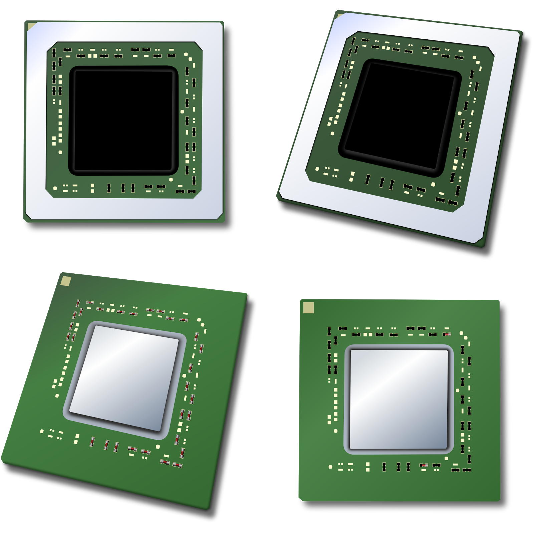
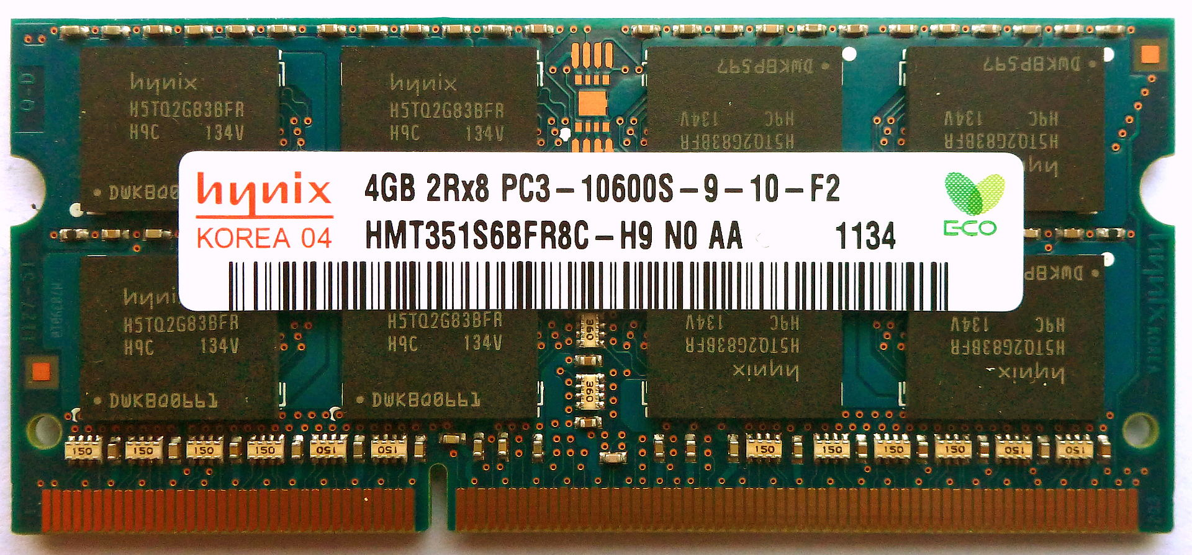
The Big Data Solution: Cloud Computing
One machine can not process or even store all the data!
Solution: distribute data over cluster of cheap machines
Cloud Computing provides:
  Illusion of infinite resources
  Short-term, on-demand resource allocation
  Can be much less expensive than owning computers
  Access to latest technologies (SSDs, GPUs, …)
Cloud Computing
Lots of hard drives
… and CPUs
… and memory!

Slide 5
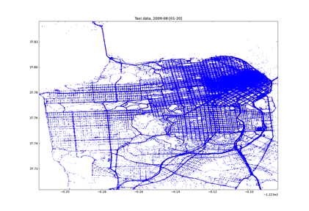
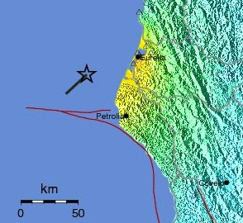

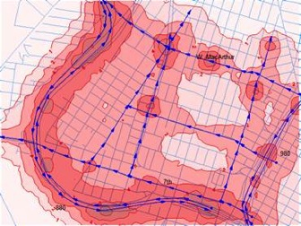
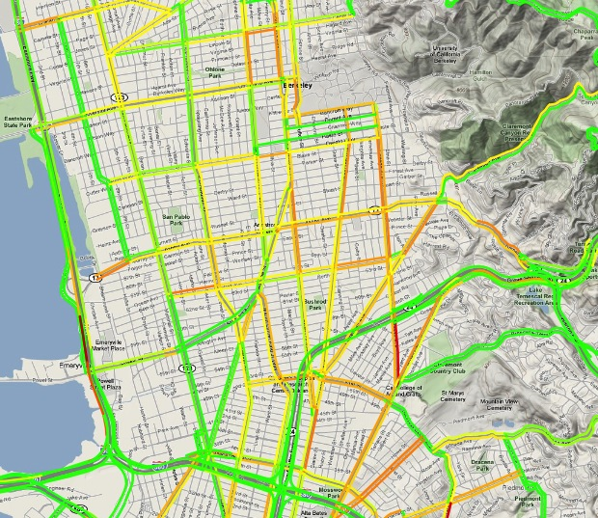
What Can You do with Big Data?
Crowdsourcing + Physical modeling + Sensing + Data Assimilation
=
http://traffic.berkeley.edu

Slide 6
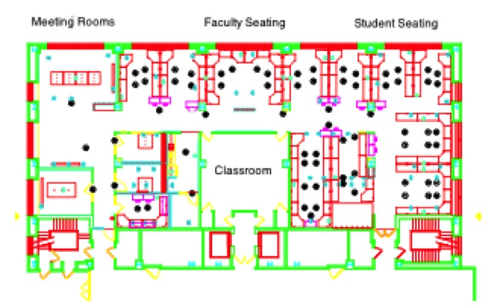


The Berkeley AMPLab
Alogorithms
January 2011 – 2016
  8 faculty
  > 50 students
  3 software engineer team
Organized for collaboration
AMP
Machines
People
AMPCamp (since 2012)
3 day retreats
(twice a year)
400+ campers
(100s companies)

Slide 7














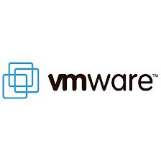






The Berkeley AMPLab
Governmental and industrial funding:
Goal: Next generation of open source data analytics stack for industry & academia:
Berkeley Data Analytics Stack (BDAS)

Slide 8
Generic Big Data Stack
Processing Layer
Resource Management Layer
Storage Layer

Slide 9
Hadoop Stack
Processing Layer
Hive
Pig
Storm
Impala
…
Giraph
Processing
HadoopMR
Resource Management Layer
Res.
Mgmnt
Yarn
Storage Layer
HDFS
Storage

Slide 10
BDAS Stack
Processing Layer
Succinct
Sample
Clean
MLBase
Velox
Spark
Streaming
GraphX
SparkR
Velox
SparkSQL
MLlib
Processing
Spark Core
Resource Management Layer
Res.
Mgmnt
Mesos
Mesos
Hadoop Yarn
Storage Layer
Succinct
HDFS, S3, Ceph, …
Tachyon
Storage
BDAS Stack
3rd party

Slide 11
Today’s Lecture
Processing Layer
Succinct
Sample
Clean
MLBase
Velox
Spark
Streaming
GraphX
SparkR
Velox
SparkSQL
MLlib
Processing
Spark Core
Resource Management Layer
Res.
Mgmnt
Mesos
Mesos
Hadoop Yarn
Storage Layer
Succinct
HDFS, S3, Ceph, …
Tachyon
Storage
BDAS Stack
3rd party

Slide 12
Summary
Mesos
Spark

Slide 13
Summary
Mesos
Spark

Slide 14

A Short History
Started at UC Berkeley in Spring 2009
  A class project of cs294 (Cloud Computing: Infrastructure, Services, and Applications)
Open Source: 2010
Apache Project: 2011
Today: one of the most popular cluster resource management systems (OS for datacenters)

Slide 15
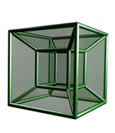









Motivation
Rapid innovation in cloud computing (aka 2008)
No single framework optimal for all applications
Each framework runs on its dedicated cluster or cluster partition
Dryad
Hypertable
Cassandra
Pregel
Notes:
Today we are witnessing rapid innovation in cloud computing.
Over the past decade a large number of cloud computing frameworks have been developed, starting with MapReduce. Other examples, are Hadoop, HDFS, ….,
Framework: software system that manages and runs one or multiple jobs simultaneously on a cluster computer
It is clear that at least today there is no genera framework, and different applications will need to use different frameworks. Unfortunately, existing frameworks assumes they own the cluster. Running each framework on a dedicate cluster or a set of virtual machines is expensive as it does not allow fine grained sharing of resources. Furthermore, more than one frameworks may require to access the same data and this data would be hard, if not infeasible. To replicate.
The challenge we want to address is to run multiple frameworks on some cluster.

Slide 16

Computation Model: Frameworks
A framework (e.g., Hadoop, MPI) manages one or more jobs in a computer cluster
A job consists of one or more tasks
A task (e.g., map, reduce) is implemented by one or more processes running on a single machine
cluster
Executor
(e.g., Task
Tracker)
Executor
(e.g., Task
Traker)
Job 1: tasks 1, 2, 3, 4
Job 2: tasks 5, 6, 7
task 1
task 2
task 5
task 6
Framework
Scheduler (e.g., Job Tracker)
Executor
(e.g., Task
Tracker)
Executor
(e.g., Task
Tracker)
task 3
task 7
task 4

Slide 17
One Framework Per Cluster Challenges
Inefficient resource usage
  E.g., Hadoop cannot use available resources from Pregel’s cluster
  No opportunity for stat. multiplexing
Hard to share data
  Copy or access remotely, expensive
Hard to cooperate
  E.g., Not easy for Pregel to use graphs generated by Hadoop
Hadoop
Pregel
Hadoop
Pregel
Need to run multiple frameworks on same cluster

Slide 18
Solution: Apache Mesos
Common resource sharing layer
  abstracts (“virtualizes”) resources to frameworks
  enable diverse frameworks to share cluster
Hadoop
MPI
Hadoop
MPI
Mesos
Uniprograming
Multiprograming
Notes:
Our solution is Mesos, a resource sharing layer that abstracts resources to framework, and this way allows over which diverse frameworks cab run, by abstracting resources to framework
By doing so we go from uniprograming or one framework per cluster to multiprogramming where we share entire cluster among diverse frameworks.

Slide 19
Fine Grained Resource Sharing
Task granularity both in time & space
  Multiplex node/time between tasks belonging to different jobs/frameworks
Tasks typically short; median ~= 10 sec, minutes
Why fine grained?
  Improve data locality
  Easier to handle node failures
Notes:
Mesos provide fine grained resource sharing. In particular, with Mesos resources are shared at the task granukarity both in time & space. What I mean by this is that Mesos multiplex a node and the tome between tasks belonging to different jobs and frameworks.
In addition, tasks are typically small with median between 10s of seconds and minutes.
Fine grain sharing has two immediate advantages. First, it improves data locality. If the multiple jobs and frameworks have input data stored or cached at a few nodes, fine grained sharing minimizes the time a job needs to wait before running on a node that has its data, Second, it makes it easier to tolerate node failures, as a node failure will result in the loss of relatively little work.

Slide 20
Mesos Goals
High utilization of resources
Support diverse frameworks (existing & future)
Scalability to 10,000’s of nodes
Reliability in face of node failures
Focus of this talk: resource management & scheduling
Notes:
Assumptions
Shared storage
Not all tasks require full node
Not all nodes identical
We have achieved these goals and it’s been deployed

Slide 21
Approach: Global Scheduler
Organization policies
Global
Scheduler
Resource availability
Job requirements
Response time
Throughput
Availability
…
Notes:
…
Complexity. There are two kinds of complexity. The first is the computation complexity. Computing an on-line a schedule for a cluster with 10Ks machines and millions of tasks can be a challenge. This has a negative impact on scale and resilience, and the scheduler needs to recover a non-trivial amount of state upon failure. However, arguable the biggest complexity challenge is that such scheduler needs to provide a rich API or or generic language to allow frameworks and job wide types of requirements, Furthermore such language should cover not only existing frameworks but also of the future requirements. Point in case. Condor’s ClassAds provides a very popular specification language in grid computing. While ClassAds is good, very good. However, despite the fact that its specification is tens of pages, it cannot capture some of the
However despite the fact hat ClassAds’ specification is tens of pages it does not cover all requirements of today;s frameworks, such as delay scheduling, which we are going to discuss later.
Finally, one of our primary goals is to port the existing frameworks which have their won sophisticated scheduling algorithms. This approach oould require to factor these frameowkrs and push their scheduling into the global scheduler. This can be intrusive and time consuming proposition.

Slide 22
Approach: Global Scheduler
Organization policies
Global
Scheduler
Resource availability
Job requirements
Job execution plan
Task DAG
Inputs/outputs
Notes:
…
Complexity. There are two kinds of complexity. The first is the computation complexity. Computing an on-line a schedule for a cluster with 10Ks machines and millions of tasks can be a challenge. This has a negative impact on scale and resilience, and the scheduler needs to recover a non-trivial amount of state upon failure. However, arguable the biggest complexity challenge is that such scheduler needs to provide a rich API or or generic language to allow frameworks and job wide types of requirements, Furthermore such language should cover not only existing frameworks but also of the future requirements. Point in case. Condor’s ClassAds provides a very popular specification language in grid computing. While ClassAds is good, very good. However, despite the fact that its specification is tens of pages, it cannot capture some of the
However despite the fact hat ClassAds’ specification is tens of pages it does not cover all requirements of today;s frameworks, such as delay scheduling, which we are going to discuss later.
Finally, one of our primary goals is to port the existing frameworks which have their won sophisticated scheduling algorithms. This approach oould require to factor these frameowkrs and push their scheduling into the global scheduler. This can be intrusive and time consuming proposition.

Slide 23
Approach: Global Scheduler
Organization policies
Global
Scheduler
Resource availability
Job requirements
Job execution plan
Estimates
Task durations
Input sizes
Transfer sizes
Notes:
…
Complexity. There are two kinds of complexity. The first is the computation complexity. Computing an on-line a schedule for a cluster with 10Ks machines and millions of tasks can be a challenge. This has a negative impact on scale and resilience, and the scheduler needs to recover a non-trivial amount of state upon failure. However, arguable the biggest complexity challenge is that such scheduler needs to provide a rich API or or generic language to allow frameworks and job wide types of requirements, Furthermore such language should cover not only existing frameworks but also of the future requirements. Point in case. Condor’s ClassAds provides a very popular specification language in grid computing. While ClassAds is good, very good. However, despite the fact that its specification is tens of pages, it cannot capture some of the
However despite the fact hat ClassAds’ specification is tens of pages it does not cover all requirements of today;s frameworks, such as delay scheduling, which we are going to discuss later.
Finally, one of our primary goals is to port the existing frameworks which have their won sophisticated scheduling algorithms. This approach oould require to factor these frameowkrs and push their scheduling into the global scheduler. This can be intrusive and time consuming proposition.

Slide 24
Approach: Global Scheduler
Organization policies
Global
Scheduler
Resource availability
Job requirements
Task schedule
Job execution plan
Estimates
Advantages: can achieve optimal schedule
Disadvantages:
  Complexity → hard to scale and ensure resilience
  Hard to anticipate future frameworks’ requirements
  Need to refactor existing frameworks
Notes:
…
Complexity. There are two kinds of complexity. The first is the computation complexity. Computing an on-line a schedule for a cluster with 10Ks machines and millions of tasks can be a challenge. This has a negative impact on scale and resilience, and the scheduler needs to recover a non-trivial amount of state upon failure. However, arguable the biggest complexity challenge is that such scheduler needs to provide a rich API or or generic language to allow frameworks and job wide types of requirements, Furthermore such language should cover not only existing frameworks but also of the future requirements. Point in case. Condor’s ClassAds provides a very popular specification language in grid computing. While ClassAds is good, very good. However, despite the fact that its specification is tens of pages, it cannot capture some of the
However despite the fact hat ClassAds’ specification is tens of pages it does not cover all requirements of today;s frameworks, such as delay scheduling, which we are going to discuss later.
Finally, one of our primary goals is to port the existing frameworks which have their won sophisticated scheduling algorithms. This approach oould require to factor these frameowkrs and push their scheduling into the global scheduler. This can be intrusive and time consuming proposition.

Slide 25
Our Approach: Distributed Scheduler
Organization
policies
Mesos
Master
Framework
Scheduler
Framework
scheduler
Framework
scheduler
Task
schedule
Resource
availability
Fwk
schedule
Advantages:
  Simple → easier to scale and make resilient
  Easy to port existing frameworks, support new ones
Disadvantages:
  Distributed scheduling decision → not optimal

Slide 26
Resource Offers
Unit of allocation: resource offer
  Vector of available resources on a node
  E.g., node1: <1CPU, 1GB>, node2: <4CPU, 16GB>
Master sends resource offers to frameworks
Frameworks select which offers to accept and which tasks to run
Push task scheduling to frameworks
Notes:
The basic abstraction to allocate resources to framework is the resource offer. A resource offer represents the set of available resources on a node.
Push task scheduling to frameworks as they they are in the best position to perform this activity; they have most ssematics about job requirements, constraints, and preferences. This can be viewed as an application of the e2e argument.

Slide 27
Mesos Architecture: Example
Slaves continuously send status updates about resources
Framework executors launch tasks and may persist across tasks
Framework scheduler selects resources and provides tasks
Slave S1
Hadoop Executor
task 1
MPI executor
Hadoop
JobTracker
task 1
8CPU, 8GB
(task1:[S1:<2CPU,4GB>];
task2:[S2:<4CPU,4GB>])
S1:<8CPU,8GB>
Mesos Master
Slave S2
task1:<4CPU,2GB>
S1
S1
S1
<6CPU,4GB>
<8CPU,8GB>
<2CPU,2GB>
Hadoop Executor
task 1:<2CPU,4GB>
task 2
S2
S2
<8CPU,16GB>
<4CPU,12GB>
(S1:<8CPU, 8GB>,
S2:<8CPU, 16GB>)
(S1:<6CPU,4GB>, S3:<16CPU,16GB>)
S3
<16CPU,16GB>
S2:<8CPU,16GB>
task 2:<4CPU,4GB>
8CPU, 16GB
Allocation Module
Slave S3
MPI
JobTracker
S3:<16CPU,16GB>
Pluggable scheduler to
pick framework to
send an offer to
([task1:S1:<4CPU,2GB])
16CPU, 16GB

Slide 28
Why does it Work?
A framework can just wait for an offer that matches its constraints or preferences!
  Reject offers it does not like
Example: Hadoop’s job input is blue file
Accept: both S2 and S3 store the blue file
Reject: S1 doesn’t store blue file
S1
Hadoop
(Job tracker)
(task1:[S2:<…>];
task2:[S3:<..>])
(S2:<…>,S3:<…>)
S1:<…>
Mesos
master
S2
task1:<…>
task2:<…>
S3

Slide 29
Dynamic Resource Sharing
100 node cluster
Notes:
This graph shows the number of CPUS allocated to each of the four frameworks in the macrobenchmark over time for the duration of the 25 minute experiment.
You can see that some frameworks take advantage of the cluster when other frameworks have a lull in activity. For instance, around time 1050, the Torque framework finishes running the MPI job and no more MPI jobs have been queued up to run, so it releases its shares (until another MPI job is queued around time 1250 seconds). The two hadoop jobs are able to take advantage of the resources Torque is not using and get more work done and increase the average percent of the cluster that is allocated at any time.

Slide 30

Apache Mesos Today
Hundreds of of contributors
Hundreds of deployments in productions
  E.g., Twitter, GE, Apple
  Managing 10K node datacenterts!
Mesosphere, startup to commercialize Apache Spark

Slide 31
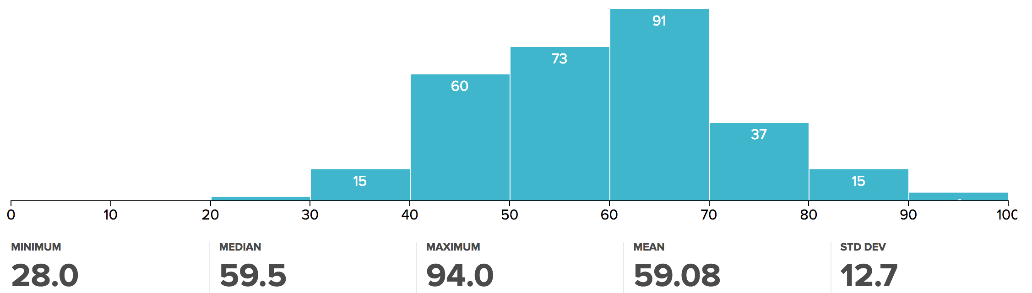
Administrivia
Midterm #3 grades published
  Regrade request deadline Tuesday 5/2 at midnight
  Please only submit regrade requests for grading errors!
Project 3
  Code due Monday 5/1
  Final report due Wednesday 5/5

Slide 32
break

Slide 33
Summary
Mesos
Spark

Slide 34

A Short History
Started at UC Berkeley in 2009
Open Source: 2010
Apache Project: 2013
Today: most popular big data project

Slide 35
What Is Spark?
Parallel execution engine for big data processing
Easy to use: 2-5x less code than Hadoop MR
  High level API’s in Python, Java, and Scala
Fast: up to 100x faster than Hadoop MR
  Can exploit in-memory when available
  Low overhead scheduling, optimized engine
General: support multiple computation models

Slide 36
General
Unifies batch, interactive comp.
Spark SQL
Spark Core

Slide 37
General
Unifies batch, interactive, streaming comp.
Spark SQL
Spark Streaming
Spark Core

Slide 38
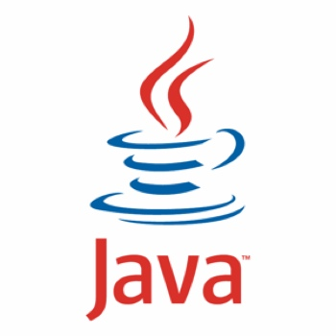

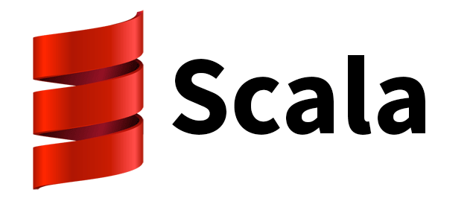
General
Unifies batch, interactive, streaming comp.
Easy to build sophisticated applications
  Support iterative, graph-parallel algorithms
  Powerful APIs in Scala, Python, Java
Spark SQL
Spark Streaming
MLlib
GraphX
Spark Core

Slide 39
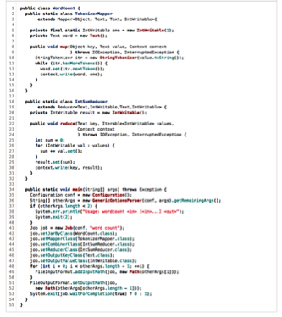

Easy to Write Code
WordCount in 3 lines of Spark
WordCount in 50+ lines of Java MR

Slide 40


Fast: Time to sort 100TB
2013 Record:
Hadoop
2100 machines
72 minutes
2014 Record: Spark
207 machines
23 minutes
Also sorted 1PB in 4 hours
Source: Daytona GraySort benchmark, sortbenchmark.org

Slide 41




Large-Scale Usage
Largest cluster:
8000 nodes
Largest single job:
1 petabyte
Top streaming intake:
1 TB/hour
2014 on-disk sort record

Slide 42
RDD: Core Abstraction
Write programs in terms of distributed datasets
and operations on them
Resilient Distributed Datasets (RDDs)
  Collections of objects distr. across a cluster, stored in RAM or on Disk
  Built through parallel transformations
  Automatically rebuilt on failure
Operations
Transformations
(e.g. map, filter, groupBy)
Actions
(e.g. count, collect, save)
Notes:
transformations, which create a new dataset from an existing one
actions, which return a value to the driver program after running a computation on the dataset.

Slide 43
Operations on RDDs
Transformations f(RDD) => RDD
  Lazy (not computed immediately)
  E.g. “map”
Actions:
  Triggers computation
  E.g. “count”, “saveAsTextFile”

Slide 44
Working With RDDs
textFile = sc.textFile(”SomeFile.txt”)
RDD
Notes:
Let me illustrate this with some bad powerpoint diagrams and animations
This diagram is LOGICAL,

Slide 45
Working With RDDs
textFile = sc.textFile(”SomeFile.txt”)
RDD
RDD
RDD
Transformations
RDD
linesWithSpark = textFile.filter(lambda line: "Spark” in line)
Notes:
Let me illustrate this with some bad powerpoint diagrams and animations
This diagram is LOGICAL,

Slide 46
Working With RDDs
textFile = sc.textFile(”SomeFile.txt”)
RDD
RDD
Action
RDD
Transformations
RDD
Value
linesWithSpark.count()
74
linesWithSpark.first()
# Apache Spark
linesWithSpark = textFile.filter(lambda line: "Spark” in line)
Notes:
Let me illustrate this with some bad powerpoint diagrams and animations
This diagram is LOGICAL,

Slide 47
Example: Log Mining
Load error messages from a log into memory, then interactively search for various patterns
Notes:
Add “variables” to the “functions” in functional programming

Slide 48

Example: Log Mining
Load error messages from a log into memory, then interactively search for various patterns
Worker
Driver
Worker
Worker
Notes:
Add “variables” to the “functions” in functional programming

Slide 49
Example: Log Mining
Load error messages from a log into memory, then interactively search for various patterns
lines = spark.textFile(“hdfs://...”)
Worker
Driver
Worker
Worker
Notes:
Add “variables” to the “functions” in functional programming

Slide 50
Example: Log Mining
Load error messages from a log into memory, then interactively search for various patterns
Base RDD
lines = spark.textFile(“hdfs://...”)
Worker
Driver
Worker
Worker
Notes:
Add “variables” to the “functions” in functional programming

Slide 51
Example: Log Mining
Load error messages from a log into memory, then interactively search for various patterns
lines = spark.textFile(“hdfs://...”)
errors = lines.filter(lambda s: s.startswith(“ERROR”))
Worker
Driver
Worker
Worker
Notes:
Add “variables” to the “functions” in functional programming

Slide 52
Example: Log Mining
Load error messages from a log into memory, then interactively search for various patterns
Transformed RDD
lines = spark.textFile(“hdfs://...”)
errors = lines.filter(lambda s: s.startswith(“ERROR”))
Worker
Driver
Worker
Worker
Notes:
Add “variables” to the “functions” in functional programming

Slide 53
Example: Log Mining
Load error messages from a log into memory, then interactively search for various patterns
lines = spark.textFile(“hdfs://...”)
errors = lines.filter(lambda s: s.startswith(“ERROR”))
messages = errors.map(lambda s: s.split(“\t”)[2])
messages.cache()
Worker
Driver
messages.filter(lambda s: “mysql” in s).count()
Worker
Worker
Notes:
Add “variables” to the “functions” in functional programming

Slide 54
Example: Log Mining
Load error messages from a log into memory, then interactively search for various patterns
lines = spark.textFile(“hdfs://...”)
errors = lines.filter(lambda s: s.startswith(“ERROR”))
messages = errors.map(lambda s: s.split(“\t”)[2])
messages.cache()
Worker
Driver
Action
messages.filter(lambda s: “mysql” in s).count()
Worker
Worker
Notes:
Add “variables” to the “functions” in functional programming

Slide 55
Example: Log Mining
Load error messages from a log into memory, then interactively search for various patterns
lines = spark.textFile(“hdfs://...”)
errors = lines.filter(lambda s: s.startswith(“ERROR”))
messages = errors.map(lambda s: s.split(“\t”)[2])
messages.cache()
Worker
Driver
Block 1
messages.filter(lambda s: “mysql” in s).count()
Worker
Worker
Block 2
Block 3
Notes:
Add “variables” to the “functions” in functional programming

Slide 56
Example: Log Mining
Load error messages from a log into memory, then interactively search for various patterns
lines = spark.textFile(“hdfs://...”)
errors = lines.filter(lambda s: s.startswith(“ERROR”))
messages = errors.map(lambda s: s.split(“\t”)[2])
messages.cache()
Worker
tasks
Block 1
Driver
tasks
messages.filter(lambda s: “mysql” in s).count()
tasks
Worker
Worker
Block 2
Block 3
Notes:
Add “variables” to the “functions” in functional programming

Slide 57
Example: Log Mining
Load error messages from a log into memory, then interactively search for various patterns
lines = spark.textFile(“hdfs://...”)
errors = lines.filter(lambda s: s.startswith(“ERROR”))
messages = errors.map(lambda s: s.split(“\t”)[2])
messages.cache()
Worker
Driver
Block 1
Read
HDFS
Block
messages.filter(lambda s: “mysql” in s).count()
Worker
Worker
Read
HDFS
Block
Block 2
Read
HDFS
Block
Block 3
Notes:
Add “variables” to the “functions” in functional programming

Slide 58
Example: Log Mining
Load error messages from a log into memory, then interactively search for various patterns
Cache 1
lines = spark.textFile(“hdfs://...”)
errors = lines.filter(lambda s: s.startswith(“ERROR”))
messages = errors.map(lambda s: s.split(“\t”)[2])
messages.cache()
Worker
Driver
Block 1
Process
& Cache
Data
messages.filter(lambda s: “mysql” in s).count()
Cache 2
Worker
Cache 3
Worker
Block 2
Process
& Cache
Data
Process
& Cache
Data
Block 3
Notes:
Add “variables” to the “functions” in functional programming

Slide 59
Example: Log Mining
Load error messages from a log into memory, then interactively search for various patterns
Cache 1
lines = spark.textFile(“hdfs://...”)
errors = lines.filter(lambda s: s.startswith(“ERROR”))
messages = errors.map(lambda s: s.split(“\t”)[2])
messages.cache()
Worker
results
Driver
Block 1
results
messages.filter(lambda s: “mysql” in s).count()
Cache 2
results
Worker
Cache 3
Worker
Block 2
Block 3
Notes:
Add “variables” to the “functions” in functional programming

Slide 60
Example: Log Mining
Load error messages from a log into memory, then interactively search for various patterns
Cache 1
lines = spark.textFile(“hdfs://...”)
errors = lines.filter(lambda s: s.startswith(“ERROR”))
messages = errors.map(lambda s: s.split(“\t”)[2])
messages.cache()
Worker
Driver
Block 1
messages.filter(lambda s: “mysql” in s).count()
Cache 2
messages.filter(lambda s: “php” in s).count()
Worker
Cache 3
Worker
Block 2
Block 3
Notes:
Add “variables” to the “functions” in functional programming

Slide 61
Example: Log Mining
Load error messages from a log into memory, then interactively search for various patterns
Cache 1
lines = spark.textFile(“hdfs://...”)
errors = lines.filter(lambda s: s.startswith(“ERROR”))
messages = errors.map(lambda s: s.split(“\t”)[2])
messages.cache()
Worker
tasks
Block 1
Driver
tasks
messages.filter(lambda s: “mysql” in s).count()
Cache 2
tasks
Worker
messages.filter(lambda s: “php” in s).count()
Cache 3
Worker
Block 2
Block 3
Notes:
Add “variables” to the “functions” in functional programming

Slide 62
Example: Log Mining
Load error messages from a log into memory, then interactively search for various patterns
Cache 1
lines = spark.textFile(“hdfs://...”)
errors = lines.filter(lambda s: s.startswith(“ERROR”))
messages = errors.map(lambda s: s.split(“\t”)[2])
messages.cache()
Worker
Driver
Block 1
Process
from
Cache
messages.filter(lambda s: “mysql” in s).count()
Cache 2
messages.filter(lambda s: “php” in s).count()
Worker
Cache 3
Worker
Block 2
Process
from
Cache
Process
from
Cache
Block 3
Notes:
Add “variables” to the “functions” in functional programming

Slide 63
Example: Log Mining
Load error messages from a log into memory, then interactively search for various patterns
Cache 1
lines = spark.textFile(“hdfs://...”)
errors = lines.filter(lambda s: s.startswith(“ERROR”))
messages = errors.map(lambda s: s.split(“\t”)[2])
messages.cache()
Worker
results
Driver
Block 1
results
messages.filter(lambda s: “mysql” in s).count()
Cache 2
results
Worker
messages.filter(lambda s: “php” in s).count()
Cache 3
Worker
Block 2
Block 3
Notes:
Add “variables” to the “functions” in functional programming

Slide 64
Example: Log Mining
Load error messages from a log into memory, then interactively search for various patterns
Cache 1
lines = spark.textFile(“hdfs://...”)
errors = lines.filter(lambda s: s.startswith(“ERROR”))
messages = errors.map(lambda s: s.split(“\t”)[2])
messages.cache()
Worker
Driver
Block 1
messages.filter(lambda s: “mysql” in s).count()
Cache 2
messages.filter(lambda s: “php” in s).count()
Worker
Cache your data ➔ Faster Results
Full-text search of Wikipedia
60GB on 20 EC2 machines
0.5 sec from mem vs. 20s for on-disk
Cache 3
Worker
Block 2
Block 3
Notes:
Add “variables” to the “functions” in functional programming

Slide 65
Language Support
Python
lines = sc.textFile(...)
lines.filter(lambda s: “ERROR” in s).count()
Standalone Programs
Python, Scala, & Java
Interactive Shells
Python & Scala
Performance
Java & Scala are faster due to static typing
…but Python is often fine
Scala
val lines = sc.textFile(...)
lines.filter(x => x.contains(“ERROR”)).count()
Java
JavaRDD<String> lines = sc.textFile(...);
lines.filter(new Function<String, Boolean>() {
Boolean call(String s) {
return s.contains(“error”);
}
}).count();

Slide 66
Expressive API
map
reduce

Slide 67
Expressive API
map
filter
groupBy
sort
union
join
leftOuterJoin
rightOuterJoin
reduce
count
fold
reduceByKey
groupByKey
cogroup
cross
zip
sample
take
first
partitionBy
mapWith
pipe
save ...

Slide 68
Fault Recovery
RDDs track lineage information that can be used to efficiently reconstruct lost partitions

Slide 69
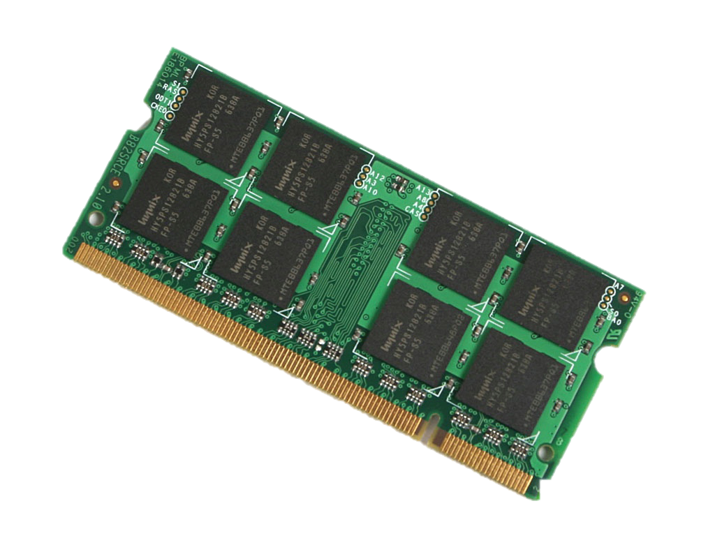
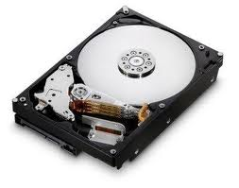
Fault Recovery Example
Two-partition RDD A={A₁, A₂} stored on disk
  filter and cache → RDD B
  join→ RDD C
  aggregate → RDD D
A₁
filter
B₁
join
C₁
RDD A
agg.
D
A₂
filter
B₂
join
C₂

Slide 70
Fault Recovery Example
C₁ lost due to node failure before reduce finishes
A₁
filter
B₁
join
C₁
RDD A
agg.
D
A₂
filter
B₂
join
C₂

Slide 71
Fault Recovery Example
C₁ lost due to node failure before reduce finishes
Reconstruct C₁, eventually, on different node
A₁
filter
B₁
join
C₁
agg.
agg.
D
RDD A
D
A₂
filter
B₂
join
C₂

Slide 72
Fault Recovery Example
Failure happens
Notes:
These are for K-means

Slide 73
Spark Streaming: Motivation
Many important apps must process large data streams at second-scale latencies
  Site statistics, intrusion detection, online ML
To build and scale these apps users want:
  Integration: with offline analytical stack
  Fault-tolerance: both for crashes and stragglers

Slide 74

How does it work?
Data streams are chopped into batches
  A batch is an RDD holding a few 100s ms worth of data
Each batch is processed in Spark
receivers
data streams
batches

Slide 75

How does it work?
Data streams are chopped into batches
  A batch is an RDD holding a few 100s ms worth of data
Each batch is processed in Spark
Results pushed out in batches
Streaming
receivers
data streams
batches
results

Slide 76
Streaming Word Count
val lines = context.socketTextStream(“localhost”, 9999)
val words = lines.flatMap(_.split(" "))
val wordCounts = words.map(x => (x, 1)).reduceByKey(_ + _)
wordCounts.print()
ssc.start()
create DStream
from data over socket
split lines into words
count the words
print some counts on screen
start processing the stream

Slide 77
Word Count
object NetworkWordCount {
def main(args: Array[String]) {
val sparkConf = new SparkConf().setAppName("NetworkWordCount")
val context = new StreamingContext(sparkConf, Seconds(1))
val lines = context.socketTextStream(“localhost”, 9999)
val words = lines.flatMap(_.split(" "))
val wordCounts = words.map(x => (x, 1)).reduceByKey(_ + _)
wordCounts.print()
ssc.start()
ssc.awaitTermination()
}
}

Slide 78
Word Count
public class WordCountTopology {
public static class SplitSentence extends ShellBolt implements IRichBolt {
public SplitSentence() {
super("python", "splitsentence.py");
}
@Override
public void declareOutputFields(OutputFieldsDeclarer declarer) {
declarer.declare(new Fields("word"));
}
@Override
public Map<String, Object> getComponentConfiguration() {
return null;
}
}
public static class WordCount extends BaseBasicBolt {
Map<String, Integer> counts = new HashMap<String, Integer>();
@Override
public void execute(Tuple tuple, BasicOutputCollector collector) {
String word = tuple.getString(0);
Integer count = counts.get(word);
if (count == null)
count = 0;
count++;
counts.put(word, count);
collector.emit(new Values(word, count));
}
@Override
public void declareOutputFields(OutputFieldsDeclarer declarer) {
declarer.declare(new Fields("word", "count"));
}
}
Spark Streaming
Storm
object NetworkWordCount {
def main(args: Array[String]) {
val sparkConf = new SparkConf().setAppName("NetworkWordCount")
val context = new StreamingContext(sparkConf, Seconds(1))
val lines = context.socketTextStream(“localhost”, 9999)
val words = lines.flatMap(_.split(" "))
val wordCounts = words.map(x => (x, 1)).reduceByKey(_ + _)
wordCounts.print()
ssc.start()
ssc.awaitTermination()
}
}
public static void main(String[] args) throws Exception {
TopologyBuilder builder = new TopologyBuilder();
builder.setSpout("spout", new RandomSentenceSpout(), 5);
builder.setBolt("split", new SplitSentence(), 8).shuffleGrouping("spout");
builder.setBolt("count", new WordCount(), 12).fieldsGrouping("split", new Fields("word"));
Config conf = new Config();
conf.setDebug(true);
if (args != null && args.length > 0) {
conf.setNumWorkers(3);
StormSubmitter.submitTopologyWithProgressBar(args[0], conf, builder.createTopology());
}
else {
conf.setMaxTaskParallelism(3);
LocalCluster cluster = new LocalCluster();
cluster.submitTopology("word-count", conf, builder.createTopology());
Thread.sleep(10000);
cluster.shutdown();
}
}
}

Slide 79
Benefits for Users
High performance data sharing
  Data sharing is the bottleneck in many environments
  RDD’s provide in-place sharing through memory
Applications can compose models
  Run a SQL query and then PageRank the results
  ETL your data and then run graph/ML on it
Benefit from investment in shared functionality
  E.g. re-usable components (shell) and performance optimizations

Slide 80
Many Recent Development
RDDs → Dataframes, and DatSets
  Distributed collection of data grouped into named columns (i.e. RDD with schema)
  Think about R and Python Pandas dataframes
Project Tungsten
  Fully managed memory: allowed by Dataframe/DatSets schema
  Code generation
  Vectorized processing
Structured streams
  Adding Dataframe API and optimizations to streaming

Slide 81

Apache Spark Today
> 1,500 contributors
> 300K committers world wide
> 100K students trained
1,000s deployments in productions
  Virtually every large enterprise
  Available in all clouds (e.g., AWS, Google Compute Engine, MS Azure)
  Distributed by IBM, Cloudera, Hortonworks, Oracle
Databricks, startup to commercialize Apache Spark

Slide 82
Summary
Server → Datacenter
OS → Datacenter OS (e.g., Apache Mesos)
Applications → Big data / ML applications (e.g., Apache Spark)
AMPLab
  Massive success in industry,…
  and, academia: faculty at MIT, Stanford, Cornell, etc
New lab starting: RISELab

Slide 83



























RISELab
(Real-time Intelligent Secure Execution)
Notes:
A new lab we are starting at UC Berkeley, as a continuation to Amplab
Amplab is a systems group at Berkeley that created Spark, Mesos and Tachyon, big data systems with a lot of impact. How many know of spark? It is used by hundreds of companies
These labs last 5-6 years and a new lab is created at the end so that we can always be on the next wave
So I will tell you about the new lab, which we believe to be the next big impactful vision
These labs bring together faculty from different disciplines that can help tackle that problem. We collaborate to solve this.
Main people are… a bunch of s ...
An important component of ours is partnering with companies.
Amplab has learned a lot from companies from the feedback they gave, companies got to use products, have students intern, and overall just have a good synergetic collaboration
Speaking of which, please give us any feedback you think of because we are still shaping the next lab
Authors

Slide 84
RISELab
From live data to real-time decisions
AMPLab
From batch data to advanced analytics

Slide 85









DataFrames
ML Pipelines
Spark SQL
Spark Streaming
MLlib
GraphX
unified engine across data sources, workloads and environments
Spark Core
Data Sources
{JSON}

