Slide 1
CS162 Operating Systems and Systems Programming Lecture 3 Processes (con’t), Fork, Introduction to I/O
September 1st, 2016
Prof. Anthony D. Joseph
http://cs162.eecs.Berkeley.edu

Slide 2
Recall: Four fundamental OS concepts
Thread
Single unique execution context
Program Counter, Registers, Execution Flags, Stack
Address Space w/ Translation
Programs execute in an address space that is distinct from the memory space of the physical machine
Process
An instance of an executing program is a process consisting of an address space and one or more threads of control
Dual Mode operation/Protection
Only the “system” has the ability to access certain resources
The OS and the hardware are protected from user programs and user programs are isolated from one another by controlling the translation from program virtual addresses to machine physical addresses

Slide 3
Process Control Block
Kernel represents each process as a process control block (PCB)
Status (running, ready, blocked, …)
Register state (when not ready)
Process ID (PID), User, Executable, Priority, …
Execution time, …
Memory space, translation, …
Kernel Scheduler maintains a data structure containing the PCBs
Scheduling algorithm selects the next one to run

Slide 4
Recall: give the illusion of multiple processors?
vCPU1
vCPU2
vCPU3
vCPU1
vCPU2
vCPU3
vCPU1
vCPU2
Shared Memory
Time
Assume a single processor. How do we provide the illusion of multiple processors?
Multiplex in time!
Multiple “virtual CPUs”
Each virtual “CPU” needs a structure to hold:
Program Counter (PC), Stack Pointer (SP)
Registers (Integer, Floating point, others…?)
How switch from one virtual CPU to the next?
Save PC, SP, and registers in current state block
Load PC, SP, and registers from new state block
What triggers switch?
Timer, voluntary yield, I/O, other things

Slide 5
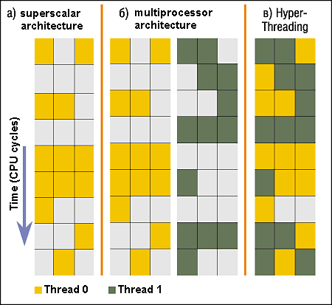
Simultaneous MultiThreading/Hyperthreading
Hardware technique
Superscalar processors can execute multiple instructions that are independent
Hyperthreading duplicates register state to make a second “thread,” allowing more instructions to run
Can schedule each thread as if were separate CPU
But, sub-linear speedup!
Original technique called “Simultaneous Multithreading”
http://www.cs.washington.edu/research/smt/index.html
SPARC, Pentium 4/Xeon (“Hyperthreading”), Power 5
Colored blocks show
instructions executed
Notes:
Intel seems to be discarding SMT in Silvermont because of power problems

Slide 6
Scheduler
if ( readyProcesses(PCBs) ) {
nextPCB = selectProcess(PCBs);
run( nextPCB );
} else {
run_idle_process();
}
Scheduling: Mechanism for deciding which processes/threads receive the CPU
Lots of different scheduling policies provide …
Fairness or
Realtime guarantees or
Latency optimization or ..

Slide 7
Putting it together: web server
syscall
syscall
RTU
RTU
wait
wait
interrupt
interrupt

Slide 8
Recall: 3 types of Kernel Mode Transfer
Syscall
Process requests a system service, e.g., exit
Like a function call, but “outside” the process
Does not have the address of the system function to call
Like a Remote Procedure Call (RPC) – for later
Marshall the syscall ID and arguments in registers and execute syscall
Interrupt
External asynchronous event triggers context switch
eg. Timer, I/O device
Independent of user process
Trap or Exception
Internal synchronous event in process triggers context switch
e.g., Protection violation (segmentation fault), Divide by zero, …

Slide 9
Recall: User/Kernel (Privileged) Mode
User Mode
interrupt
exception
syscall
rtn
rfi
Kernel Mode
exit
exec
Limited HW access
Full HW access

Slide 10
Implementing Safe Kernel Mode Transfers
Important aspects:
Separate kernel stack
Controlled transfer into kernel (e.g. syscall table)
Carefully constructed kernel code packs up the user process state and sets it aside
Details depend on the machine architecture
Should be impossible for buggy or malicious user program to cause the kernel to corrupt itself

Slide 11
Need for Separate Kernel Stacks
Kernel needs space to work
Cannot put anything on the user stack (Why?)
Two-stack model
OS thread has interrupt stack (located in kernel memory) plus User stack (located in user memory)
Syscall handler copies user args to kernel space before invoking specific function (e.g., open)
Interrupts (???)

Slide 12
Before

Slide 13
During

Slide 14
Kernel System Call Handler
Vector through well-defined syscall entry points!
Table mapping system call number to handler
Locate arguments
In registers or on user(!) stack
Copy arguments
From user memory into kernel memory
Protect kernel from malicious code evading checks
Validate arguments
Protect kernel from errors in user code
Copy results back
into user memory

Slide 15
Administrivia: Getting started
We have a new discussion section!
162-112 Th 6:30-7:30P 310 Soda
Joseph Office Hours: Mondays/Tuesdays 11-12 in 465F Soda
THIS Friday (9/2) is early drop day! Very hard to drop afterwards…
Work on Homework 0 immediately ⇒ Due on Monday!
Get familiar with all the cs162 tools
Submit to autograder via git

Slide 16
Break

Slide 17
Hardware support: Interrupt Control
Interrupt processing not be visible to the user process:
Occurs between instructions, restarted transparently
No change to process state
What can be observed even with perfect interrupt processing?
Interrupt Handler invoked with interrupts ‘disabled’
Re-enabled upon completion
Non-blocking (run to completion, no waits)
Pack up in a queue and pass off to an OS thread for hard work
wake up an existing OS thread
OS kernel may enable/disable interrupts
On x86: CLI (disable interrupts), STI (enable)
Atomic section when select next process/thread to run
Atomic return from interrupt or syscall
HW may have multiple levels of interrupt
Mask off (disable) certain interrupts, eg., lower priority
Certain Non-Maskable-Interrupts (NMI)
e.g., kernel segmentation fault

Slide 18
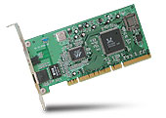
Interrupt Controller
Interrupt Mask
Priority Encoder
IntID
CPU
Interrupt
Int Disable
Timer
Software
Interrupt
Control
NMI
Network
Interrupts invoked with interrupt lines from devices
Interrupt controller chooses interrupt request to honor
Mask enables/disables interrupts
Priority encoder picks highest enabled interrupt
Software Interrupt Set/Cleared by Software
Interrupt identity specified with ID line
CPU can disable all interrupts with internal flag
Non-Maskable Interrupt line (NMI) can’t be disabled

Slide 19
How do we take interrupts safely?
Interrupt vector
Limited number of entry points into kernel
Kernel interrupt stack
Handler works regardless of state of user code
Interrupt masking
Handler is non-blocking
Atomic transfer of control
“Single instruction”-like to change:
Program counter
Stack pointer
Memory protection
Kernel/user mode
Transparent restartable execution
User program does not know interrupt occurred

Slide 20
Can a process create a process ?
Yes! Unique identity of process is the “process ID” (or PID)
Fork() system call creates a copy of current process with a new PID
Return value from Fork(): integer
When > 0:
Running in (original) Parent process
return value is pid of new child
When = 0:
Running in new Child process
When < 0:
Error! Must handle somehow
Running in original process
All state of original process duplicated in both Parent and Child!
Memory, File Descriptors (next topic), etc…

Slide 21
fork1.c
#include <stdlib.h>
#include <stdio.h>
#include <string.h>
#include <unistd.h>
#include <sys/types.h>
#define BUFSIZE 1024
int main(int argc, char *argv[])
{
char buf[BUFSIZE];
size_t readlen, writelen, slen;
pid_t cpid, mypid;
pid_t pid = getpid(); /* get current processes PID */
printf("Parent pid: %d\n", pid);
cpid = fork();
if (cpid > 0) { /* Parent Process */
mypid = getpid();
printf("[%d] parent of [%d]\n", mypid, cpid);
} else if (cpid == 0) { /* Child Process */
mypid = getpid();
printf("[%d] child\n", mypid);
} else {
perror("Fork failed");
exit(1);
}
exit(0);
}

Slide 22
UNIX Process Management
UNIX fork – system call to create a copy of the current process, and start it running
No arguments!
UNIX exec – system call to change the program being run by the current process
UNIX wait – system call to wait for a process to finish
UNIX signal – system call to send a notification to another process
UNIX man pages: fork(2), exec(3), wait(2), signal(3)
Notes:
UNIX splits creating a process into two steps, each of them a lot simpler.

Slide 23
fork2.c
int status;
…
cpid = fork();
if (cpid > 0) { /* Parent Process */
mypid = getpid();
printf("[%d] parent of [%d]\n", mypid, cpid);
tcpid = wait(&status);
printf("[%d] bye %d(%d)\n", mypid, tcpid, status);
} else if (cpid == 0) { /* Child Process */
mypid = getpid();
printf("[%d] child\n", mypid);
}
…

Slide 24
UNIX Process Management
Notes:
How is this used – typically, fork a process, child and parent are now both running the same program. One sets up the child program, and runs exec – becoming the new program
The parent, usually, waits for the child to finish

Slide 25
Administrivia (Con’t)
Participation: Attend section! Get to know your TA!
Please use private Piazza posts only for student logistics issues
Group sign up via autograder then TA form next week (after EDD)
Get finding groups of 4 people ASAP
Priority for same section; if cannot make this work, keep same TA

Slide 26
Break

Slide 27
Shell
A shell is a job control system
Allows programmer to create and manage a set of programs to do some task
Windows, MacOS, Linux all have shells
Example: to compile a C program
cc –c sourcefile1.c
cc –c sourcefile2.c
ln –o program sourcefile1.o sourcefile2.o
./program
HW1

Slide 28
Signals – infloop.c
#include <stdlib.h>
#include <stdio.h>
#include <sys/types.h>
#include <unistd.h>
#include <signal.h>
void signal_callback_handler(int signum)
{
printf("Caught signal %d - phew!\n",signum);
exit(1);
}
int main() {
signal(SIGINT, signal_callback_handler);
while (1) {}
}
Got top?

Slide 29
Process Races: fork3.c
int i;
cpid = fork();
if (cpid > 0) {
mypid = getpid();
printf("[%d] parent of [%d]\n", mypid, cpid);
for (i=0; i<100; i++) {
printf("[%d] parent: %d\n", mypid, i);
// sleep(1);
}
} else if (cpid == 0) {
mypid = getpid();
printf("[%d] child\n", mypid);
for (i=0; i>-100; i--) {
printf("[%d] child: %d\n", mypid, i);
// sleep(1);
}
}
Question: What does this program print?
Does it change if you add in one of the sleep() statements?

Slide 30
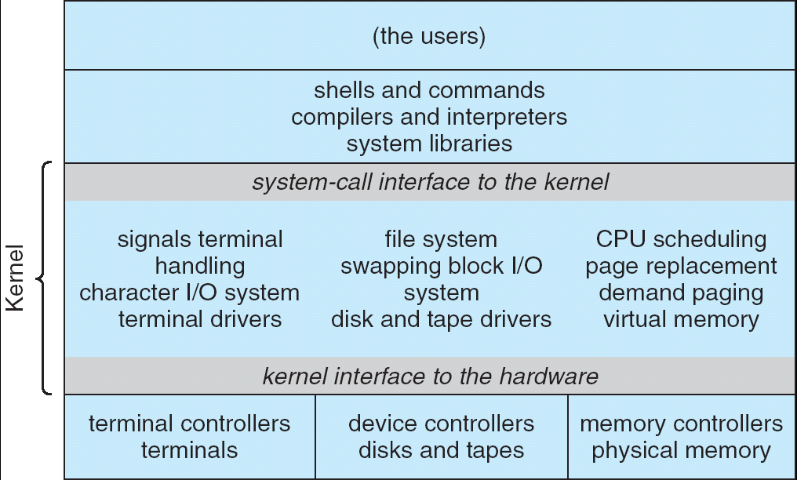
Recall: UNIX System Structure
Applications
User Mode
Standard Libs
Kernel Mode
Hardware

Slide 31
How Does the Kernel Provide Services?
You said that applications request services from the operating system via syscall, but …
I’ve been writing all sort of useful applications and I never ever saw a “syscall” !!!
That’s right.
It was buried in the programming language runtime library (e.g., libc.a)
… Layering

Slide 32
OS Run-Time Library
Proc 1
Proc 2
Proc n
…
OS
Appln
login
Window Manager
…
OS library
OS library
OS library
OS

Slide 33
A Kind of Narrow Waist
Word Processing
Compilers
Web Browsers
Email
Databases
Web Servers
Application / Service
Portable OS Library
OS
User
System Call
Interface
System
Portable OS Kernel
Software
Platform support, Device Drivers
Hardware
x86
PowerPC
ARM
PCI
Ethernet (1Gbs/10Gbs)
802.11 a/g/n/ac
SCSI
Graphics
Thunderbolt

Slide 34
Key Unix I/O Design Concepts
Uniformity
file operations, device I/O, and interprocess communication through open, read/write, close
Allows simple composition of programs
find | grep | wc …
Open before use
Provides opportunity for access control and arbitration
Sets up the underlying machinery, i.e., data structures
Byte-oriented
Even if blocks are transferred, addressing is in bytes
Kernel buffered reads
Streaming and block devices looks the same
read blocks process, yielding processor to other task
Kernel buffered writes
Completion of out-going transfer decoupled from the application, allowing it to continue
Explicit close

Slide 35
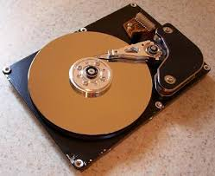
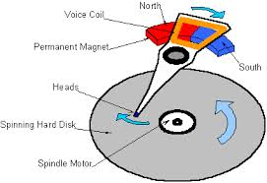
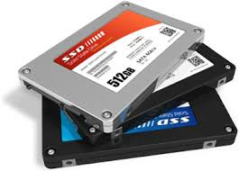
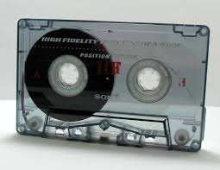
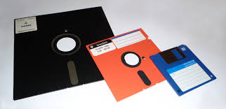
I/O & Storage Layers
Application / Service
streams
High Level I/O
Low Level I/O
handles
Syscall
registers
File System
descriptors
I/O Driver
Commands and Data Transfers
Disks, Flash, Controllers, DMA

Slide 36
The File System Abstraction
High-level idea
Files live in hierarchical namespace of filenames
File
Named collection of data in a file system
File data
Text, binary, linearized objects
File Metadata: information about the file
Size, Modification Time, Owner, Security info
Basis for access control
Directory
“Folder” containing files & Directories
Hierachical (graphical) naming
Path through the directory graph
Uniquely identifies a file or directory
/home/ff/cs162/public_html/fa16/index.html
Links and Volumes (later)

Slide 37
Summary
Process: execution environment with Restricted Rights
Address Space with One or More Threads
Owns memory (address space)
Owns file descriptors, file system context, …
Encapsulate one or more threads sharing process resources
Interrupts
Hardware mechanism for regaining control from user
Notification that events have occurred
User-level equivalent: Signals
Native control of Process
Fork, Exec, Wait, Signal
Basic Support for I/O
Standard interface: open, read, write, seek
Device drivers: customized interface to hardware

