Slide 1
CS162
Operating Systems and
Systems Programming
Lecture 20
Reliability, Transactions
Distributed Systems
April 16th, 2019
Prof. John Kubiatowicz
http://cs162.eecs.Berkeley.edu

Slide 2
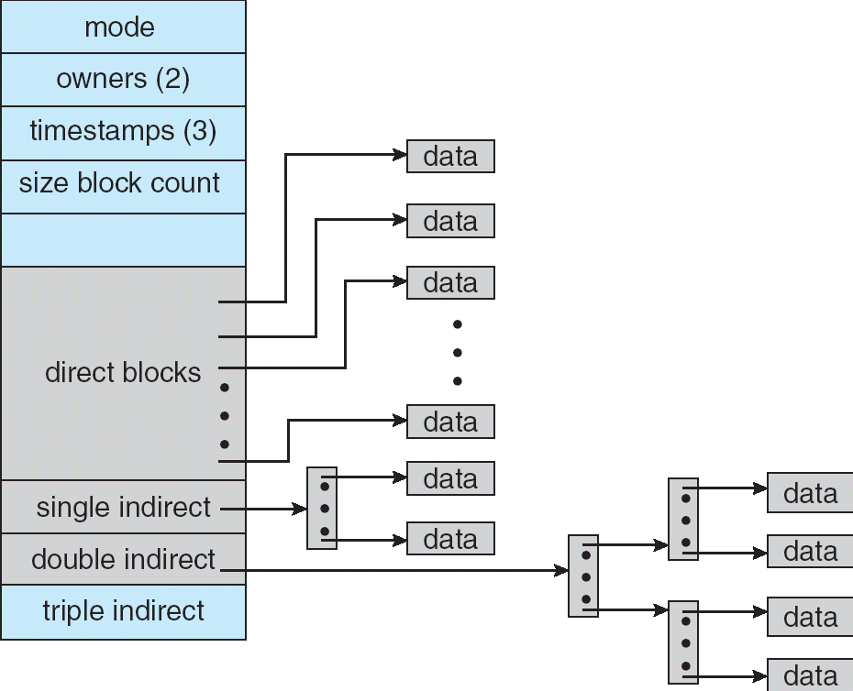
Recall: Multilevel Indexed Files (Original 4.1 BSD)
Sample file in multilevel
indexed format:
  10 direct ptrs, 1K blocks
  How many accesses for
  block #23? (assume file
  header accessed on open)?
    Two: One for indirect block,
    one for data
  How about block #5?
    One: One for data
  Block #340?
    Three: double indirect block,
    indirect block, and data
UNIX 4.1 Pros and cons
  Pros: Simple (more or less)
  Files can easily expand (up to a point)
  Small files particularly cheap and easy
  Cons: Lots of seeks (lead to 4.2 Fast File System Optimizations)
Ext2/3 (Linux):
  12 direct ptrs, triply-indirect blocks,
  settable block size (4K is common)

Slide 3
Recall: File System Caching
Key Idea: Exploit locality by caching data in memory
  Name translations: Mapping from paths→inodes
  Disk blocks: Mapping from block address→disk content
Buffer Cache: Memory used to cache kernel resources, including disk blocks and name translations
  Can contain “dirty” blocks (blocks yet on disk)
Replacement policy? LRU
  Can afford overhead full LRU implementation
  Advantages:
    Works very well for name translation
    Works well in general as long as memory is big enough to accommodate a host’s working set of files.
  Disadvantages:
    Fails when some application scans through file system, thereby flushing the cache with data used only once
    Example: find . –exec grep foo {} \;
Other Replacement Policies?
  Some systems allow applications to request other policies
  Example, ‘Use Once’:
    File system can discard blocks as soon as they are used

Slide 4
File System Caching (con’t)
Cache Size: How much memory should the OS allocate to the buffer cache vs virtual memory?
  Too much memory to the file system cache ⇒ won’t be able to run many applications at once
  Too little memory to file system cache ⇒ many applications may run slowly (disk caching not effective)
  Solution: adjust boundary dynamically so that the disk access rates for paging and file access are balanced
Read Ahead Prefetching: fetch sequential blocks early
  Key Idea: exploit fact that most common file access is sequential by prefetching subsequent disk blocks ahead of current read request (if they are not already in memory)
  Elevator algorithm can efficiently interleave groups of prefetches from concurrent applications
  How much to prefetch?
    Too many imposes delays on requests by other applications
    Too few causes many seeks (and rotational delays) among concurrent file requests

Slide 5
File System Caching (con’t)
Delayed Writes: Writes to files not immediately sent out to disk
  Instead, write() copies data from user space buffer to kernel buffer (in cache)
    Enabled by presence of buffer cache: can leave written file blocks in cache for a while
    If some other application tries to read data before written to disk, file system will read from cache
  Flushed to disk periodically (e.g. in UNIX, every 30 sec)
  Advantages:
    Disk scheduler can efficiently order lots of requests
    Disk allocation algorithm can be run with correct size value for a file
    Some files need never get written to disk! (e..g temporary scratch files written /tmp often don’t exist for 30 sec)
  Disadvantages
    What if system crashes before file has been written out?
    Worse yet, what if system crashes before a directory file has been written out? (lose pointer to inode!)

Slide 6
Important “ilities”
Availability: the probability that the system can accept and process requests
  Often measured in “nines” of probability. So, a 99.9% probability is considered “3-nines of availability”
  Key idea here is independence of failures
Durability: the ability of a system to recover data despite faults
  This idea is fault tolerance applied to data
  Doesn’t necessarily imply availability: information on pyramids was very durable, but could not be accessed until discovery of Rosetta Stone
Reliability: the ability of a system or component to perform its required functions under stated conditions for a specified period of time (IEEE definition)
  Usually stronger than simply availability: means that the system is not only “up”, but also working correctly
  Includes availability, security, fault tolerance/durability
  Must make sure data survives system crashes, disk crashes, other problems

Slide 7
How to Make File System Durable?
Disk blocks contain Reed-Solomon error correcting codes (ECC) to deal with small defects in disk drive
  Can allow recovery of data from small media defects
Make sure writes survive in short term
  Either abandon delayed writes or
  Use special, battery-backed RAM (called non-volatile RAM or NVRAM) for dirty blocks in buffer cache
Make sure that data survives in long term
  Need to replicate! More than one copy of data!
  Important element: independence of failure
    Could put copies on one disk, but if disk head fails…
    Could put copies on different disks, but if server fails…
    Could put copies on different servers, but if building is struck by lightning….
    Could put copies on servers in different continents…

Slide 8
RAID: Redundant Arrays of Inexpensive Disks
Classified by David Patterson, Garth A. Gibson, and Randy Katz here at UCB in 1987
  Classic paper was first to evaluate multiple schemes
Data stored on multiple disks (redundancy)
  Berkeley researchers were looking for alternatives to big expensive disks
  Redundancy necessary because cheap disks were more error prone
Either in software or hardware
  In hardware case, done by disk controller; file system may not even know that there is more than one disk in use
Initially, five levels of RAID (more now)

Slide 9
RAID 1: Disk Mirroring/Shadowing
recovery
group
Each disk is fully duplicated onto its “shadow”
  For high I/O rate, high availability environments
  Most expensive solution: 100% capacity overhead
Bandwidth sacrificed on write:
  Logical write = two physical writes
  Highest bandwidth when disk heads and rotation fully synchronized (hard to do exactly)
Reads may be optimized
  Can have two independent reads to same data
Recovery:
  Disk failure ⇒ replace disk and copy data to new disk
  Hot Spare: idle disk already attached to system to be used for immediate replacement

Slide 10
RAID 5+: High I/O Rate Parity
Stripe
Unit
Data stripped across
multiple disks
  Successive blocks
  stored on successive
  (non-parity) disks
  Increased bandwidth
  over single disk
Parity block (in green)
constructed by XORing
data bocks in stripe
  P0=D0⊕D1⊕D2⊕D3
  Can destroy any one
  disk and still
  reconstruct data
  Suppose Disk 3 fails,
  then can reconstruct:
  D2=D0⊕D1⊕D3⊕P0
Can spread information widely across internet for durability
  RAID algorithms work over geographic scale
D0
D1
D2
D3
P0
D4
D5
D6
P1
Increasing
Logical
Disk
Addresses
D7
D8
D9
P2
D10
D11
D12
P3
D13
D14
D15
P4
D16
D17
D18
D19
D20
D21
D22
D23
P5
Disk 1
Disk 2
Disk 3
Disk 4
Disk 5

Slide 11
Allow more disks to fail!
In general: RAIDX is an “erasure code”
  Must have ability to know which disks are bad
  Treat missing disk as an “Erasure”
Today, Disks so big that: RAID 5 not sufficient!
  Time to repair disk sooooo long, another disk might fail in process!
  “RAID 6” – allow 2 disks in replication stripe to fail
But – must do something more complex that just XORing together blocks!
  Already used up the simple XOR operation across disks
Simple option: Check out EVENODD code in readings
  Will generate one additional check disks to support RAID 6
More general option for general erasure code: Reed-Solomon codes
  Based on polynomials in GF(2^{k}) (I.e. k-bit symbols)
    Gailois Field is finite version of real numbers
  Data as coefficients (a_{j}), code space as values of polynomial:
    P(x)=a₀+a₁x¹+… a_{m-1}x^{m-1}
    Coded: P(0),P(1),P(2)….,P(n-1)
  Can recover polynomial (i.e. data) as long as get any m of n; allows n-m failures!

Slide 12
Allow more disks to fail! (Con’t)
How to use Reed-Solomon code in practice?
  Each coefficient has a fixed (k) number of bits. So, must encode with symbols that size
  Example: k=16 bit symbols, m=4, encoding 16x4 bits at a time
    Take original data, split into 4 chunks. On each encoding step, grab 16 bits from each chunk to use as coefficients
    Each data point yields a 16-bit symbol, which you distributed to final encoded chunks
  (better version of Reed-Solomon code for erasure channels is the “Cauchy Reed-Solomon” code; it is isomorphic to the version here)
Examples (with k=16):
  Suppose have 6 disks, want to tolerate 2 failures
    Split data into 4 chunks, encode 16 bits from each chunk at a time, by generating 6 points (of 16 bits) on 3rd-degree polynomial
    Distribute data from polynomial to 6 disks – each disk will ultimately hold data that is ¼ size of original data
    Can handle 2 lost disks for 50% overhead
  More interesting extreme for Internet-level replication:
    Split data into 4 chunks, produce 16 chunks
    Each chunk is ¼ total size of original data, Overhead = factor of 4
    But – only need 4 of 16 fragments! REALLY DURABLE!

Slide 13
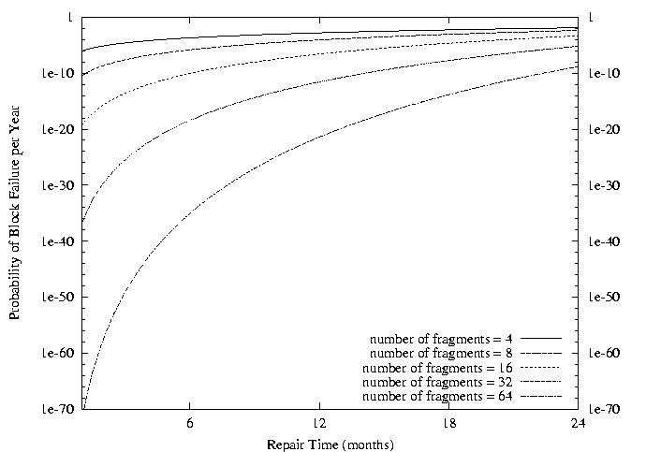
Use of Erasure Coding in general:
High Durability/overhead ratio!
Fraction Blocks Lost
Per Year (FBLPY)
Exploit law of large numbers for durability!
6 month repair, FBLPY with 4x increase in total size of data:
  Replication (4 copies): 0.03
  Fragmentation (16 of 64 fragments needed): 10⁻³⁵

Slide 14
Higher Durability/Reliability through
Geographic Replication
Highly durable – hard to destroy all copies
Highly available for reads
  Simple replication: read any copy
  Erasure coded: read m of n
Low availability for writes
  Can’t write if any one replica is not up
  Or – need relaxed consistency model
Reliability? – availability, security, durability, fault-tolerance
Replica/Frag #1
Replica/Frag #2
Replica/Frag #n

Slide 15
Administrivia
Last Midterm: 5/2
  Can have 3 handwritten sheets of notes – both sides
  Focus on material from lecture 17-24, but all topics fair game!
Don’t forget to do your group evaluations!
  Very important to help us understand your group dynamics
Optional HW4 will come out soon
  Will give you a chance to try out using the language “Go” to build a two-phase commit protocol
  You will be testing it out for next term
    Not sure that we will be giving out points for it. Stay tuned!

Slide 16
File System Reliability:
(Difference from Block-level reliability)
What can happen if disk loses power or software crashes?
  Some operations in progress may complete
  Some operations in progress may be lost
  Overwrite of a block may only partially complete
Having RAID doesn’t necessarily protect against all such failures
  No protection against writing bad state
  What if one disk of RAID group not written?
File system needs durability (as a minimum!)
  Data previously stored can be retrieved (maybe after some recovery step), regardless of failure

Slide 17
Storage Reliability Problem
Single logical file operation can involve updates to multiple physical disk blocks
  inode, indirect block, data block, bitmap, …
  With sector remapping, single update to physical disk block can require multiple (even lower level) updates to sectors
At a physical level, operations complete one at a time
  Want concurrent operations for performance
How do we guarantee consistency regardless of when crash occurs?

Slide 18
Threats to Reliability
Interrupted Operation
  Crash or power failure in the middle of a series of related updates may leave stored data in an inconsistent state
  Example: transfer funds from one bank account to another
  What if transfer is interrupted after withdrawal and before deposit?
Loss of stored data
  Failure of non-volatile storage media may cause previously stored data to disappear or be corrupted

Slide 19
Reliability Approach #1: Careful Ordering
Sequence operations in a specific order
  Careful design to allow sequence to be interrupted safely
Post-crash recovery
  Read data structures to see if there were any operations in progress
  Clean up/finish as needed
Approach taken by
  FAT and FFS (fsck) to protect filesystem structure/metadata
  Many app-level recovery schemes (e.g., Word, emacs autosaves)

Slide 20
FFS: Create a File
Normal operation:
Allocate data block
Write data block
Allocate inode
Write inode block
Update bitmap of free blocks and inodes
Update directory with file name → inode number
Update modify time for directory
Recovery:
Scan inode table
If any unlinked files (not in any directory), delete or put in lost & found dir
Compare free block bitmap against inode trees
Scan directories for missing update/access times
Time proportional to disk size

Slide 21
Reliability Approach #2: Copy on Write File Layout
To update file system, write a new version of the file system containing the update
  Never update in place
  Reuse existing unchanged disk blocks
Seems expensive! But
  Updates can be batched
  Almost all disk writes can occur in parallel
Approach taken in network file server appliances
  NetApp’s Write Anywhere File Layout (WAFL)
  ZFS (Sun/Oracle) and OpenZFS

Slide 22
COW with Smaller-Radix Blocks
old version
new version
Write
If file represented as a tree of blocks, just need to update the leading fringe

Slide 23
ZFS and OpenZFS
Variable sized blocks: 512 B – 128 KB
Symmetric tree
  Know if it is large or small when we make the copy
Store version number with pointers
  Can create new version by adding blocks and new pointers
Buffers a collection of writes before creating a new version with them
Free space represented as tree of extents in each block group
  Delay updates to freespace (in log) and do them all when block group is activated

Slide 24
More General Reliability Solutions
Use Transactions for atomic updates
  Ensure that multiple related updates are performed atomically
  i.e., if a crash occurs in the middle, the state of the systems reflects either all or none of the updates
  Most modern file systems use transactions internally to update filesystem structures and metadata
  Many applications implement their own transactions
Provide Redundancy for media failures
  Redundant representation on media (Error Correcting Codes)
  Replication across media (e.g., RAID disk array)

Slide 25
Transactions
Closely related to critical sections for manipulating shared data structures
They extend concept of atomic update from memory to stable storage
  Atomically update multiple persistent data structures
Many ad-hoc approaches
  FFS carefully ordered the sequence of updates so that if a crash occurred while manipulating directory or inodes the disk scan on reboot would detect and recover the error (fsck)
  Applications use temporary files and rename

Slide 26
Key Concept: Transaction
An atomic sequence of actions (reads/writes) on a storage system (or database)
That takes it from one consistent state to another
transaction
consistent state 1
consistent state 2

Slide 27
Typical Structure
Begin a transaction – get transaction id
Do a bunch of updates
  If any fail along the way, roll-back
  Or, if any conflicts with other transactions, roll-back
Commit the transaction

Slide 28
“Classic” Example: Transaction
BEGIN; --BEGIN TRANSACTION
UPDATE accounts SET balance = balance - 100.00 WHERE name = 'Alice';
UPDATE branches SET balance = balance - 100.00 WHERE name = (SELECT branch_name FROM accounts WHERE name = 'Alice');
UPDATE accounts SET balance = balance + 100.00 WHERE name = 'Bob';
UPDATE branches SET balance = balance + 100.00 WHERE name = (SELECT branch_name FROM accounts WHERE name = 'Bob');
COMMIT; --COMMIT WORK
Transfer $100 from Alice’s account to Bob’s account

Slide 29
The ACID properties of Transactions
Atomicity: all actions in the transaction happen, or none happen
Consistency: transactions maintain data integrity, e.g.,
  Balance cannot be negative
  Cannot reschedule meeting on February 30
Isolation: execution of one transaction is isolated from that of all others; no problems from concurrency
Durability: if a transaction commits, its effects persist despite crashes

Slide 30
Transactional File Systems
Better reliability through use of log
  All changes are treated as transactions
  A transaction is committed once it is written to the log
    Data forced to disk for reliability
    Process can be accelerated with NVRAM
  Although File system may not be updated immediately, data preserved in the log
Difference between “Log Structured” and “Journaled”
  In a Log Structured filesystem, data stays in log form
  In a Journaled filesystem, Log used for recovery
Journaling File System
  Applies updates to system metadata using transactions (using logs, etc.)
  Updates to non-directory files (i.e., user stuff) can be done in place (without logs), full logging optional
  Ex: NTFS, Apple HFS+, Linux XFS, JFS, ext3, ext4
Full Logging File System
  All updates to disk are done in transactions

Slide 31
Journalled File Systems
Instead of modifying data structures on disk directly, write changes to a journal/log
  Intention list: set of changes we intend to make
  Log/Journal is append-only
  Single commit record commits transaction
Once changes are in the log, it is safe to apply changes to data structures on disk
  Recovery can read log to see what changes were intended
  Can take our time making the changes
    As long as new requests consult the log first
Once changes are copied, safe to remove log
But, …
  If the last atomic action is not done … poof … all gone
Basic assumption:
  Updates to sectors are atomic and ordered
  Not necessarily true unless very careful, but key assumption

Slide 32
Redo Logging
Prepare
  Write all changes (in transaction) to log
Commit
  Single disk write to make transaction durable
Redo
  Copy changes to disk
Garbage collection
  Reclaim space in log
Recovery
  Read log
  Redo any operations for committed transactions
  Garbage collect log

Slide 33
Example: Creating a File
Find free data block(s)
Find free inode entry
Find dirent insertion point
-----------------------------------------
Write map (i.e., mark used)
Write inode entry to point to block(s)
Write dirent to point to inode
Free space map
Data blocks
…
Inode table
Directory
entries

Slide 34
Ex: Creating a file (as a transaction)
Find free data block(s)
Find free inode entry
Find dirent insertion point
---------------------------------------------------------
[log] Write map (used)
[log] Write inode entry to point to block(s)
[log] Write dirent to point to inode
Free space map
Data blocks
…
Inode table
Directory
entries
tail
head
done
pending
start
commit
Log: in non-volatile storage (Flash or on Disk)

Slide 35
ReDo Log
After Commit
All access to file system first looks in log
Eventually copy changes to disk
Free space map
Data blocks
…
Inode table
Directory
entries
tail
tail
tail
tail
tail
head
done
start
commit
pending
Log: in non-volatile storage (Flash or Disk)

Slide 36
Crash During Logging – Recover
Upon recovery scan the log
Detect transaction start with no commit
Discard log entries
Disk remains unchanged
Free space map
Data blocks
…
Inode table
Directory
entries
tail
head
done
pending
start
Log: in non-volatile storage (Flash or on Disk)

Slide 37
Recovery After Commit
Scan log, find start
Find matching commit
Redo it as usual
  Or just let it happen later
Free space map
Data blocks
…
Inode table
Directory
entries
tail
head
done
pending
start
commit
Log: in non-volatile storage (Flash or on Disk)

Slide 38
Course Structure: Spiral
File Systems (8)
Address Space (4)
Concurrency (6)
Reliability, Security, Cloud (8)
Distributed Systems (8)
OS Concepts (3)
intro

Slide 39
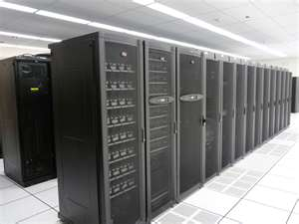

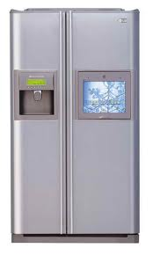
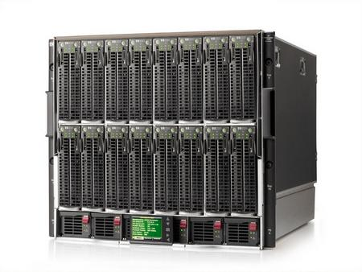


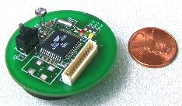

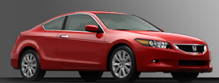

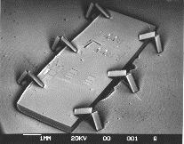

Societal Scale Information Systems
The world is a large distributed system
  Microprocessors in everything
  Vast infrastructure behind them
Internet
Connectivity
Scalable, Reliable,
Secure Services
Databases
Information Collection
Remote Storage
Online Games
Commerce
…
MEMS for
Sensor Nets

Slide 40
Centralized vs Distributed Systems
Server
Client/Server Model
Peer-to-Peer Model
Centralized System: System in which major functions are performed by a single physical computer
  Originally, everything on single computer
  Later: client/server model
Distributed System: physically separate computers working together on some task
  Early model: multiple servers working together
    Probably in the same room or building
    Often called a “cluster”
  Later models: peer-to-peer/wide-spread collaboration

Slide 41
Distributed Systems: Motivation/Issues/Promise
Why do we want distributed systems?
  Cheaper and easier to build lots of simple computers
  Easier to add power incrementally
  Users can have complete control over some components
  Collaboration: much easier for users to collaborate through network resources (such as network file systems)
The promise of distributed systems:
  Higher availability: one machine goes down, use another
  Better durability: store data in multiple locations
  More security: each piece easier to make secure

Slide 42
Distributed Systems: Reality
Reality has been disappointing
  Worse availability: depend on every machine being up
    Lamport: “a distributed system is one where I can’t do work because some machine I’ve never heard of isn’t working!”
  Worse reliability: can lose data if any machine crashes
  Worse security: anyone in world can break into system
Coordination is more difficult
  Must coordinate multiple copies of shared state information (using only a network)
  What would be easy in a centralized system becomes a lot more difficult

Slide 43
Distributed Systems: Goals/Requirements
Transparency: the ability of the system to mask its complexity behind a simple interface
Possible transparencies:
  Location: Can’t tell where resources are located
  Migration: Resources may move without the user knowing
  Replication: Can’t tell how many copies of resource exist
  Concurrency: Can’t tell how many users there are
  Parallelism: System may speed up large jobs by splitting them into smaller pieces
  Fault Tolerance: System may hide various things that go wrong
Transparency and collaboration require some way for different processors to communicate with one another

Slide 44
Networking Definitions
Network: physical connection that allows two computers to communicate
Packet: unit of transfer, sequence of bits carried over the network
  Network carries packets from one CPU to another
  Destination gets interrupt when packet arrives
Protocol: agreement between two parties as to how information is to be transmitted

Slide 45
What Is A Protocol?
A protocol is an agreement on how to communicate
Includes
  Syntax: how a communication is specified & structured
    Format, order messages are sent and received
  Semantics: what a communication means
    Actions taken when transmitting, receiving, or when a timer expires
Described formally by a state machine
  Often represented as a message transaction diagram

Slide 46
Examples of Protocols in Human Interactions
Telephone
  (Pick up / open up the phone)
  Listen for a dial tone / see that you have service
  Dial
  Should hear ringing …
  Callee: “Hello?”
  Caller: “Hi, it’s John….”
  Or: “Hi, it’s me” (← what’s that about?)
  Caller: “Hey, do you think … blah blah blah …” pause
  Callee: “Yeah, blah blah blah …” pause
  Caller: Bye
  Callee: Bye
  Hang up

Slide 47
Clients and Servers
Client program
  Running on end host
  Requests service
  E.g., Web browser
Server program
  Running on end host
  Provides service
  E.g., Web server
GET /index.html
“Site under construction”

Slide 48
Client-Server Communication
Client “sometimes on”
  Initiates a request to the server when interested
  E.g., Web browser on your laptop or cell phone
  Doesn’t communicate directly with other clients
  Needs to know the server’s address
Server is “always on”
  Services requests from many client hosts
  E.g., Web server for the www.cnn.com Web site
  Doesn’t initiate contact with the clients
  Needs a fixed, well-known address

Slide 49
Peer-to-Peer Communication
No always-on server at the center of it all
  Hosts can come and go, and change addresses
  Hosts may have a different address each time
Example: peer-to-peer file sharing (e.g., BitTorrent)
  Any host can request files, send files, query to find where a file is located, respond to queries, and forward queries
  Scalability by harnessing millions of peers
  Each peer acting as both a client and server

Slide 50
Summary
Important system properties
  Availability: how often is the resource available?
  Durability: how well is data preserved against faults?
  Reliability: how often is resource performing correctly?
RAID: Redundant Arrays of Inexpensive Disks
  RAID1: mirroring, RAID5: Parity block
Use of Log to improve Reliability
  Journaled file systems such as ext3, NTFS
Transactions: ACID semantics
  Atomicity
  Consistency
  Isolation
  Durability

