Slide 1
CS162 Operating Systems and Systems Programming Lecture 3 Processes (con’t), Fork, Introduction to I/O
January 29th, 2019
Prof. John Kubiatowicz
http://cs162.eecs.Berkeley.edu

Slide 2
Recall: Four fundamental OS concepts
Thread
Single unique execution context
Program Counter, Registers, Execution Flags, Stack
Address Space w/ translation
Programs execute in an address space that is distinct from the memory space of the physical machine
Process
An instance of an executing program is a process consisting of an address space and one or more threads of control
Dual Mode operation/protection
Only the “system” has the ability to access certain resources
The OS and the hardware are protected from user programs and user programs are isolated from one another by controlling the translation from program virtual addresses to machine physical addresses

Slide 3
Recall: give the illusion of multiple processors?
vCPU1
vCPU2
vCPU3
vCPU1
vCPU2
vCPU3
vCPU1
vCPU2
Shared Memory
Time
Assume a single processor. How do we provide the illusion of multiple processors?
Multiplex in time!
Multiple “virtual CPUs”
Each virtual “CPU” needs a structure to hold:
Program Counter (PC), Stack Pointer (SP)
Registers (Integer, Floating point, others…?)
How switch from one virtual CPU to the next?
Save PC, SP, and registers in current state block
Load PC, SP, and registers from new state block
What triggers switch?
Timer, voluntary yield, I/O, other things

Slide 4
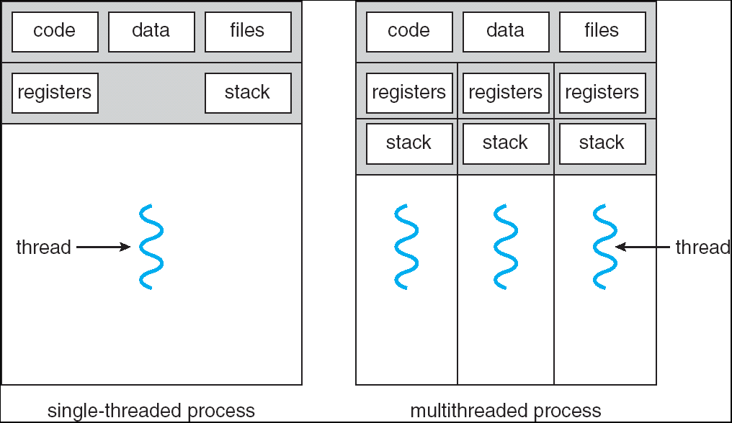
Recall: Single and Multithreaded Processes
Threads encapsulate concurrency: “Active” component
Address spaces encapsulate protection: “Passive” part
Keeps buggy program from trashing the system
Why have multiple threads per address space?
Notes:
Sometimes need parallelism for a single job, and processes are very expensive – to start, switch between, and to communicate between

Slide 5
Recall: Simple address translation with Base and Bound
0000…
code
0000…
code
Static Data
heap
Addresses translated on-the-fly
Static Data
heap
stack
0100…
stack
Base Address
1000…
code
1000…
0010…
Program
address
0010…
Static Data
1010…
heap
Bound
<
stack
1100…
0100…
Can the program touch OS?
Can it touch other programs?
FFFF…

Slide 6
Simple B&B: User => Kernel
0000…
Proc 1
Proc 2
Proc n
code
…
Static Data
OS
heap
stack
sysmode
0
1000…
code
Base
1000 …
0000…
Static Data
Bound
1100…
FFFF…
heap
uPC
xxxx…
stack
1100…
PC
0000 1234
code
3000…
regs
00FF…
Static Data
How to return to system?
…
heap
stack
3080…
FFFF…

Slide 7
Simple B&B: Interrupt
0000…
Proc 1
Proc 2
Proc n
code
…
Static Data
OS
heap
stack
sysmode
1
1000…
code
Base
1000 …
0000…
Static Data
Bound
1100 …
FFFF…
heap
uPC
0000 1234
stack
1100…
PC
IntrpVector[i]
code
3000…
regs
00FF…
Static Data
How to save registers and set up system stack?
…
heap
stack
3080…
FFFF…

Slide 8
Simple B&B: Switch User Process
0000…
Proc 1
Proc 2
Proc n
code
RTU
…
Static Data
OS
heap
stack
sysmode
1
1000…
1000 …
code
Base
3000 …
0000…
Static Data
1100 …
Bound
0080 …
FFFF…
heap
0000 1234
uPC
0000 0248
regs
stack
1100…
PC
0001 0124
00FF…
code
3000…
regs
00D0…
Static Data
How to save registers and set up system stack?
…
heap
stack
3080…
FFFF…

Slide 9
Simple B&B: “resume”
0000…
Proc 1
Proc 2
Proc n
code
RTU
…
Static Data
OS
heap
stack
sysmode
0
1000…
1000 …
code
Base
3000 …
0000…
Static Data
1100 …
Bound
0080 …
FFFF…
heap
0000 1234
uPC
xxxx xxxx
regs
stack
1100…
PC
000 0248
00FF…
code
3000…
regs
00D0…
Static Data
How to save registers and set up system stack?
…
heap
stack
3080…
FFFF…

Slide 10
Running Many Programs
We have the basic mechanism to
switch between user processes and the kernel,
the kernel can switch among user processes,
Protect OS from user processes and processes from each other
Questions ???
How do we represent user processes in the OS?
How do we decide which user process to run?
How do we pack up the process and set it aside?
How do we get a stack and heap for the kernel?
Aren’t we wasting are lot of memory?

Slide 11
Process Control Block
Kernel represents each process as a process control block (PCB)
Status (running, ready, blocked, …)
Register state (when not ready)
Process ID (PID), User, Executable, Priority, …
Execution time, …
Memory space, translation, …
Kernel Scheduler maintains a data structure containing the PCBs
Scheduling algorithm selects the next one to run

Slide 12
Scheduler
if ( readyProcesses(PCBs) ) {
nextPCB = selectProcess(PCBs);
run( nextPCB );
} else {
run_idle_process();
}
Scheduling: Mechanism for deciding which processes/threads receive the CPU
Lots of different scheduling policies provide …
Fairness or
Realtime guarantees or
Latency optimization or ..

Slide 13
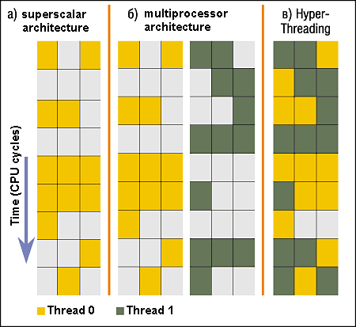
Simultaneous MultiThreading/Hyperthreading
Hardware scheduling technique
Superscalar processors can execute multiple instructions that are independent.
Hyperthreading duplicates register state to make a second “thread,” allowing more instructions to run.
Can schedule each thread as if were separate CPU
But, sub-linear speedup!
Original technique called “Simultaneous Multithreading”
http://www.cs.washington.edu/research/smt/index.html
SPARC, Pentium 4/Xeon (“Hyperthreading”), Power 5
Colored blocks show
instructions executed
Notes:
Intel seems to be discarding SMT in Silvermont because of power problems

Slide 14
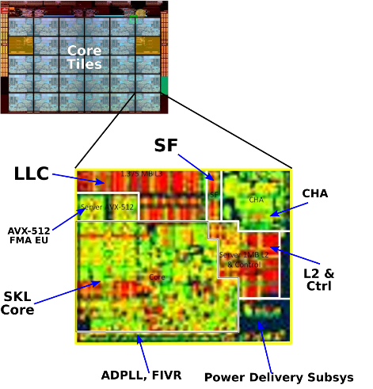
Also Recall: The World Is Parallel
Intel Skylake (2017)
28 Cores
Each core has two hyperthreads!
So: 54 Program Counters(PCs)
Scheduling here means:
Pick which core
Pick which thread
Space of possible scheduling much more interesting
Can afford to dedicate certain cores to housekeeping tasks
Or, can devote cores to services (e.g. Filesystem)

Slide 15
Is Branch and Bound a Good-Enough Protection Mechanism?
NO: Too simplistic for real systems
Inflexible/Wasteful:
Must dedicate physical memory for potential future use
(Think stack and heap!)
Fragmentation:
Kernel has to somehow fit whole processes into contiguous block of memory
After a while, memory becomes fragmented!
Sharing:
Very hard to share any data between Processes or between Process and Kernel
Need to communicate indirectly through the kernel…

Slide 16
Better: x86 – segments and stacks
code
Static Data
Processor Registers
heap
CS
EIP
stack
SS
ESP
CS:
EIP:
code
EAX
DS
EBX
ES
ECX
Static Data
EDX
ESI
EDI
heap
Start address, length and access rights associated with each segment
SS:
ESP:
stack

Slide 17
Alternative: Address Mapping
Code
Data
Heap
Stack
Data 2
Code
Data
Heap
Stack
Stack 1
Heap 1
Code 1
Stack 2
Prog 1
Virtual
Address
Space 1
Data 1
Prog 2
Virtual
Address
Space 2
Heap 2
Code 2
OS code
Translation Map 1
OS data
Translation Map 2
OS heap &
Stacks
Physical Address Space

Slide 18
Administrivia: Getting started
Kubiatowicz Office Hours:
1-2pm, Monday & Thursday
Homework 0 Due Today!
Get familiar with the cs162 tools
configure your VM, submit via git
Practice finding out information:
How to use GDB? How to understand output of unix tools?
We don’t assume that you already know everything!
Learn to use “man” (command line), “help” (in gdb, etc), google
Should be going to sections now – Important information there
Any section will do until groups assigned
THIS Friday is Drop Deadline! HARD TO DROP LATER!
If you know you are going to drop, please do so to leave room for others on waitlist!

Slide 19
Administrivia (Con’t)
Group sign up via autograder form next week
Get finding groups of 4 people ASAP
Priority for same section; if cannot make this work, keep same TA
Remember: Your TA needs to see you in section!
Midterm 1 conflicts
We will handle these conflicts after have final class roster
I know about one problem with Midterm 1 scheduling, and it can be dealt with. Have I missed any others?
Watch for queries by HeadTA to collect information

Slide 20
Recall: 3 types of Kernel Mode Transfer
Syscall
Process requests a system service, e.g., exit
Like a function call, but “outside” the process
Does not have the address of the system function to call
Like a Remote Procedure Call (RPC) – for later
Marshall the syscall id and args in registers and exec syscall
Interrupt
External asynchronous event triggers context switch
eg. Timer, I/O device
Independent of user process
Trap or Exception
Internal synchronous event in process triggers context switch
e.g., Protection violation (segmentation fault), Divide by zero, …

Slide 21
Recall: User/Kernel (Privileged) Mode
User Mode
interrupt
exception
syscall
rtn
rfi
Kernel Mode
exit
exec
Limited HW access
Full HW access

Slide 22
Implementing Safe Kernel Mode Transfers
Important aspects:
Controlled transfer into kernel (e.g., syscall table)
Separate kernel stack
Carefully constructed kernel code packs up the user process state and sets it aside
Details depend on the machine architecture
Should be impossible for buggy or malicious user program to cause the kernel to corrupt itself

Slide 23
Need for Separate Kernel Stacks
Kernel needs space to work
Cannot put anything on the user stack (Why?)
Two-stack model
OS thread has interrupt stack (located in kernel memory) plus User stack (located in user memory)
Syscall handler copies user args to kernel space before invoking specific function (e.g., open)
Interrupts (???)

Slide 24
Before

Slide 25
During

Slide 26
Kernel System Call Handler
Vector through well-defined syscall entry points!
Table mapping system call number to handler
Locate arguments
In registers or on user (!) stack
Copy arguments
From user memory into kernel memory
Protect kernel from malicious code evading checks
Validate arguments
Protect kernel from errors in user code
Copy results back
Into user memory

Slide 27
Hardware support: Interrupt Control
Interrupt processing not visible to the user process:
Occurs between instructions, restarted transparently
No change to process state
What can be observed even with perfect interrupt processing?
Interrupt Handler invoked with interrupts ‘disabled’
Re-enabled upon completion
Non-blocking (run to completion, no waits)
Pack up in a queue and pass off to an OS thread for hard work
wake up an existing OS thread

Slide 28
Hardware support: Interrupt Control
OS kernel may enable/disable interrupts
On x86: CLI (disable interrupts), STI (enable)
Atomic section when select next process/thread to run
Atomic return from interrupt or syscall
HW may have multiple levels of interrupts
Mask off (disable) certain interrupts, eg., lower priority
Certain Non-Maskable-Interrupts (NMI)
e.g., kernel segmentation fault
Also: Power about to fail!

Slide 29
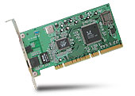
Interrupt Controller
Interrupt Mask
Priority Encoder
IntID
CPU
Interrupt
Int Disable
Timer
Software
Interrupt
Control
NMI
Network
Interrupts invoked with interrupt lines from devices
Interrupt controller chooses interrupt request to honor
Interrupt identity specified with ID line
Mask enables/disables interrupts
Priority encoder picks highest enabled interrupt
Software Interrupt Set/Cleared by Software
CPU can disable all interrupts with internal flag
Non-Maskable Interrupt line (NMI) can’t be disabled

Slide 30
How do we take interrupts safely?
Interrupt vector
Limited number of entry points into kernel
Kernel interrupt stack
Handler works regardless of state of user code
Interrupt masking
Handler is non-blocking
Atomic transfer of control
“Single instruction”-like to change:
Program counter
Stack pointer
Memory protection
Kernel/user mode
Transparent restartable execution
User program does not know interrupt occurred

Slide 31
Putting it together: web server
Request
Reply
(retrieved by web server)
Client
Web Server

Slide 32
Putting it together: web server
Server
4. parse request
9. format reply
request
buffer
reply
buffer
network
socket
read
3. kernel
copy
10. network
socket
write
5. file
read
8. kernel
copy
syscall
syscall
Kernel
wait
RTU
11. kernel copy
from user buffer
to network buffer
RTU
interrupt
interrupt
2. copy arriving
packet (DMA)
12. format outgoing
packet and DMA
6. disk
request
7. disk data
(DMA)
Hardware
Network
interface
Disk interface
Request
Reply

Slide 33
Can a process create a process ?
Yes! Unique identity of process is the “process ID” (or PID)
fork() system call creates a copy of current process with a new PID
Return value from fork(): integer
When > 0:
Running in (original) Parent process
return value is pid of new child
When = 0:
Running in new Child process
When < 0:
Error! Must handle somehow
Running in original process
State of original process duplicated in both Parent and Child!
Memory, File Descriptors (next topic), etc…

Slide 34
Create Process: fork1.c
#include <stdlib.h>
#include <stdio.h>
#include <string.h>
#include <unistd.h>
#include <sys/types.h>
int main(int argc, char *argv[])
{
pid_t cpid, mypid;
pid_t pid = getpid(); /* get current processes PID */
printf("Parent pid: %d\n", pid);
cpid = fork();
if (cpid > 0) { /* Parent Process */
mypid = getpid();
printf("[%d] parent of [%d]\n", mypid, cpid);
} else if (cpid == 0) { /* Child Process */
mypid = getpid();
printf("[%d] child\n", mypid);
} else {
perror("Fork failed");
exit(1);
}
exit(0);
}

Slide 35
UNIX Process Management
UNIX fork – system call to create a copy of the current process, and start it running
No arguments!
UNIX exec – system call to change the program being run by the current process
UNIX wait – system call to wait for a process to finish
UNIX signal – system call to send a notification to another process
UNIX man pages: fork(2), exec(3), wait(2), signal(3)
Notes:
UNIX splits creating a process into two steps, each of them a lot simpler.

Slide 36
UNIX Process Management
Notes:
How is this used – typically, fork a process, child and parent are now both running the same program. One sets up the child program, and runs exec – becoming the new program
The parent, usually, waits for the child to finish

Slide 37
Parent wait for child: fork2.c
int status;
pid_t = tcpid;
…
cpid = fork();
if (cpid > 0) { /* Parent Process */
mypid = getpid();
printf("[%d] parent of [%d]\n", mypid, cpid);
tcpid = wait(&status);
printf("[%d] bye %d(%d)\n", mypid, tcpid, status);
} else if (cpid == 0) { /* Child Process */
mypid = getpid();
printf("[%d] child\n", mypid);
}
…

Slide 38
Process Races: fork3.c
int i;
cpid = fork();
if (cpid > 0) {
mypid = getpid();
printf("[%d] parent of [%d]\n", mypid, cpid);
for (i=0; i<10; i++) {
printf("[%d] parent: %d\n", mypid, i);
// sleep(1);
}
} else if (cpid == 0) {
mypid = getpid();
printf("[%d] child\n", mypid);
for (i=0; i>-10; i--) {
printf("[%d] child: %d\n", mypid, i);
// sleep(1);
}
}
Question: What does this program print?
Does it change if you add in one of the sleep() statements?

Slide 39
Shell
A shell is a job control system
Allows programmer to create and manage a set of programs to do some task
Windows, MacOS, Linux all have shells
Example: to compile a C program
cc –c sourcefile1.c
cc –c sourcefile2.c
ln –o program sourcefile1.o sourcefile2.o
./program
HW1

Slide 40
Signals – infloop.c
#include <stdlib.h>
#include <stdio.h>
#include <sys/types.h>
#include <unistd.h>
#include <signal.h>
void signal_callback_handler(int signum)
{
printf("Caught signal %d - phew!\n",signum);
exit(1);
}
int main() {
signal(SIGINT, signal_callback_handler);
while (1) {}
}

Slide 41
How Does the Kernel Provide Services?
You said that applications request services from the operating system via syscall, but …
I’ve been writing all sort of useful applications and I never ever saw a “syscall” !!!
That’s right.
It was buried in the programming language runtime library (e.g., libc.a)
… Layering

Slide 42
OS Run-Time Library
Proc 1
Proc 2
Proc n
…
OS
Appln
login
Window Manager
…
OS library
OS library
OS library
OS

Slide 43
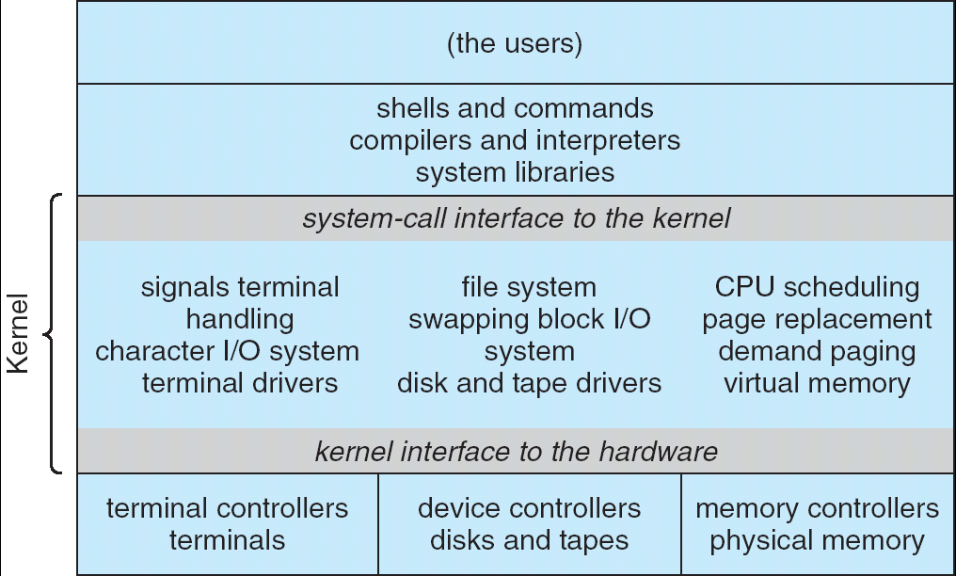
Recall: UNIX System Structure
Applications
User Mode
Standard Libs
Kernel Mode
Hardware

Slide 44
A Kind of Narrow Waist
Word Processing
Compilers
Web Browsers
Email
Databases
Web Servers
Application / Service
Portable OS Library
OS
User
System Call
Interface
System
Portable OS Kernel
Software
Platform support, Device Drivers
Hardware
x86
PowerPC
ARM
PCI
Ethernet (1Gbs/10Gbs)
802.11 a/g/n/ac
SCSI
Graphics
Thunderbolt

Slide 45
Summary
Process: execution environment with Restricted Rights
Address Space with One or More Threads
Owns memory (address space)
Owns file descriptors, file system context, …
Encapsulate one or more threads sharing process resources
Interrupts
Hardware mechanism for regaining control from user
Notification that events have occurred
User-level equivalent: Signals
Native control of Process
Fork, Exec, Wait, Signal

