Slide 1
CS 162: Operating Systems and Systems Programming
Lecture 12: I/O and Storage Devices
July 15, 2019
Instructor: Jack Kolb
https://cs162.eecs.berkeley.edu

Slide 2
Logistics
Midterm Exam: 7/18, 5-7pm
  No Lecture that Day
  Review Session during tomorrow’s normal lecture slot
Homework 2 and Project 2 Released

Slide 3
Recall: RPC
Idea: Make communication look like an ordinary function call
Wrapper library like for system calls
  Called stubs
Also wrappers at the receiving end
  Read messages from socket, dispatch to actual function
Look like local function calls

Slide 4
Recall: RPC Information Flow
bundle
args
Client
(caller)
call
Client
Stub
send
Packet
Handler
return
receive
unbundle
ret vals
Machine A
Network
Network
Machine B
bundle
ret vals
Server
(callee)
return
Server
Stub
send
Packet
Handler
call
receive
unbundle
args

Slide 5
Recall: HTTP
Application protocol for The Web
  Retrieve a specific object, upload data, etc.
Runs on top of TCP (sockets)
Like any protocol, stipulates:
  Syntax: Content sent over socket connection
  Semantics: Meaning of a message
  Valid replies and actions taken upon message receipt
Arguably a form of RPC

Slide 6
Recall: DNS
Distributed system
Purpose: Convert a human readable name (www.google.com) to an IP Address (172.217.6.78)
Why?
  Humans don't want to remember IP addresses
  But IP routes traffic based on IP addresses
Other benefits
  Service can change hosts (IP Address) but keep name
  Fancy things like sending Google users to different hosts

Slide 7
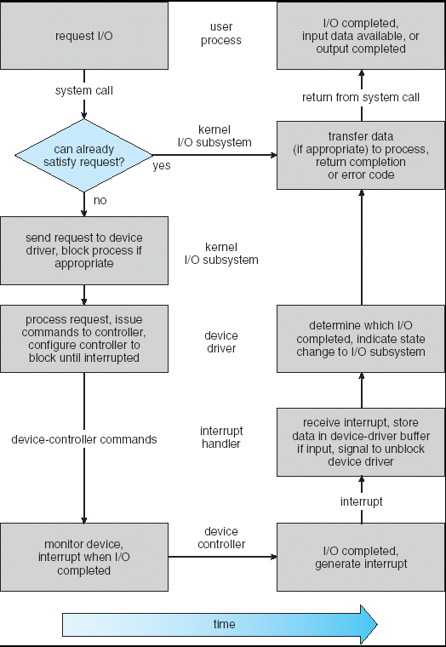
Recall: Life Cycle of An I/O Request
User
Program
Kernel I/O
Subsystem
Device Driver
Top Half
Device Driver
Bottom Half
Device
Hardware

Slide 8
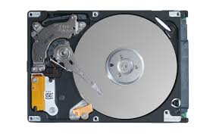
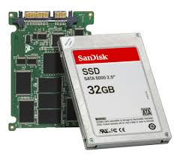
I/O In a Picture
Read / Write
wires
Processor
I/O
Controllers
Secondary
Storage
(Disk)
Core
L2 Cache
Registers
L1 Cache
interrupts
Secondary
Storage
(SSD)
Main
Memory
(DRAM)
Read / Write
DMA transfer
L3 Cache
(shared)
Core
L2 Cache
Registers
L1 Cache

Slide 9
I/O In a Picture
Read / Write
wires
Processor
I/O
Controllers
Secondary
Storage
(Disk)
Core
L2 Cache
Registers
L1 Cache
interrupts
Secondary
Storage
(SSD)
Main
Memory
(DRAM)
I/O Controllers – hardware to support communication between processor and HW
Processor accesses controller’s registers as if memory
  Using memory bus or (sometimes) separate bus
Controllers signal processor through interrupts
Read / Write
DMA transfer
L3 Cache
(shared)
Core
L2 Cache
Registers
L1 Cache

Slide 10
I/O In a Picture
Read / Write
wires
Processor
I/O
Controllers
Secondary
Storage
(Disk)
Core
L2 Cache
Registers
L1 Cache
interrupts
Secondary
Storage
(SSD)
Controllers communicate results through registers or direct memory access to main memory
Main
Memory
(DRAM)
Read / Write
DMA transfer
L3 Cache
(shared)
Core
L2 Cache
Registers
L1 Cache

Slide 11
I/O Requirements
Without I/O, computers are useless!
Thousands of devices, each slightly different
Devices unreliable: media failures and transmission errors
Devices unpredictable and/or slow

Slide 12
Operational Parameters for I/O
Data Granularity: byte (e.g., keyboard) versus block (e.g., disks and network)
Access pattern: sequential (e.g., tape) versus random (e.g., hard drive)
Transfer Notification: Polling vs. Interrupts
Transfer Mechanism: Programmed I/O versus direct memory access

Slide 13

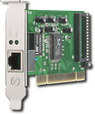
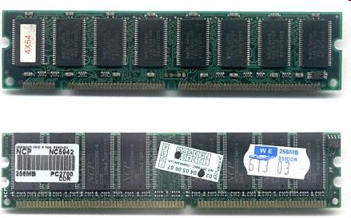
Kernel Device Structure
The System Call Interface
Process
Management
Memory
Management
Filesystems
Device
Control
Networking
Concurrency,
multitasking
Virtual
memory
Files and dirs:
the VFS
TTYs and
device access
Connectivity
Architecture
Dependent
Code
Memory
Manager
File System Types
Device
Control
Network
Subsystem
Block
Devices
IF drivers

Slide 14
Kernel Device Structure
The System Call Interface
Process
Management
Memory
Management
Filesystems
Device
Control
Networking
Concurrency,
multitasking
Virtual
memory
Files and dirs:
the VFS
TTYs and
device access
Connectivity
Architecture
Dependent
Code
Memory
Manager
File System Types
Device
Control
Network
Subsystem
Block
Devices
IF drivers
Sometimes a lot of (architecture-neutral) layers in front of actual device operations

Slide 15
Kernel Device Structure
The System Call Interface
Process
Management
Memory
Management
Filesystems
Device
Control
Networking
Concurrency,
multitasking
Virtual
memory
Files and dirs:
the VFS
TTYs and
device access
Other times just providing relatively direct access to devices
Connectivity
Architecture
Dependent
Code
Memory
Manager
File System Types
Device
Control
Network
Subsystem
Block
Devices
IF drivers

Slide 16
Kernel Device Structure
The System Call Interface
Process
Management
Memory
Management
Filesystems
Device
Control
Networking
Sometimes primary “users” are parts of the OS – not user programs – but similar interface
Concurrency,
multitasking
Virtual
memory
Files and dirs:
the VFS
TTYs and
device access
Connectivity
Architecture
Dependent
Code
Memory
Manager
File System Types
Device
Control
Network
Subsystem
Block
Devices
IF drivers

Slide 17
Goal of the I/O Subsystem
Provide uniform interfaces (“everything is a file”)
The following code works for many devices:
FILE *fh = fopen("/dev/something", "w");
for (int i = 0; i < 10; i++) {
fprintf(fd, "Count %d\n", i);
}
fclose(fh);
Code that actually controls devices (device drivers) provides a standard interface to kernel I/O subsystem
Kernel handles I/O syscalls by dispatching to proper driver

Slide 18
Options for User I/O Timing
So far we’ve said read, write blocks calling thread
Might want other choices:
  Handle multiple I/O devices in one thread
  Read data as it is available
  Queue lots of work at once without using lots of buffering in the kernel

Slide 19
Non-Block I/O “Don’t Wait”
read: Just return whatever data is available
write: Just write whatever the kernel can buffer in its memory for now
So read/write calls may not read or write anything
Makes sense for network/terminal/etc.
Questionable for regular files on disk
  How much space to allocate for kernel buffers?
  What starts a read or write?
On POSIX: fcntl(fd, F_SETFL, flags | O_NONBLOCK)

Slide 20
I/O Multiplexing: select/poll
POSIX way to wait for one of several files to have data available
Supports event-loop style programming
Indicates which file descriptors can read or write data without the need to block
Mix with non-blocking I/O

Slide 21
Asynchronous I/O – “Tell Me Later”
Invoke callback function with I/O op completes
User makes a call to start I/O
  Specifies buffer in userspace – source of a write or destination for a read
  Program can run on CPU while I/O happens (once it is started)
Notification might be signal, system call to poll, …

Slide 22
Types of Devices
Block Devices: Hard Drives, Tape Drives, etc.
  Access data in blocks (e.g. 4KB)
  open(), read(), write(), seek()
  Raw I/O or file-system access
Character Devices: Keyboards, mice, serial ports, some USB devices
  Read/write one character at a time
  Commands include get(), put()
  Libraries layered on top to allow line editing

Slide 23
Types of Devices
Network Devices: Ethernet, Wireless, Bluetooth
  Distinct enough from block/character devices to have its own interface
  Unix and Windows include socket interface
    Separates network protocol from network operation
    Includes select (multiplexing) functionality
  Usage: pipes, FIFOs, streams, queues, …

Slide 24
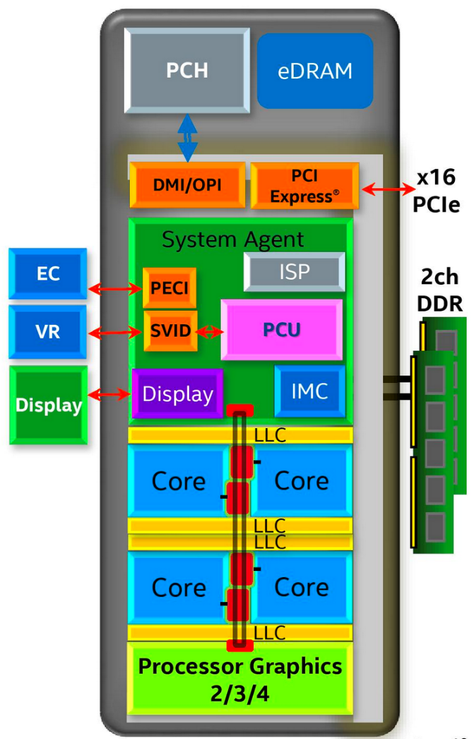
Chip-scale Features of 2015 x86
Significant pieces:
  Four CPU cores
  Integrated GPU
  System Agent (Memory and Fast I/O)
  Shared L3 cache
Integrated I/O
  Integrated memory controller (IMC)
    Two independent channels of DRAM
  High-speed PCI-Express (for GPUs)
  Direct Media Interface (DMI) Connection to PCH (Platform Control Hub)

Slide 25
Sky Lake I/O: PCH
Platform Controller Hub
  Connected to processor with proprietary bus
    Direct Media Interface
Types of I/O on PCH:
  USB
  Ethernet
  Audio
  BIOS support
  More PCI Express
  SATA (for Disks)
Sky Lake
System Configuration

Slide 26
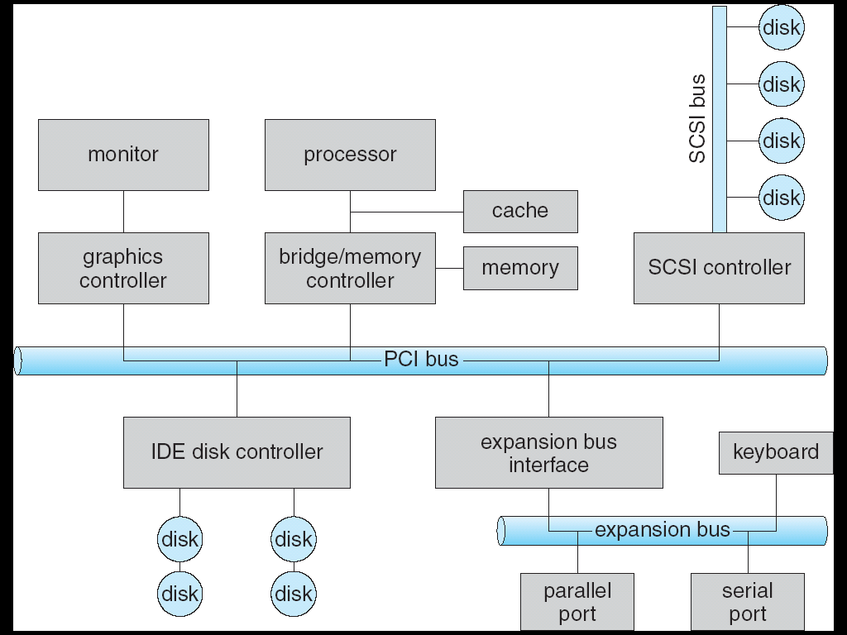

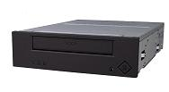
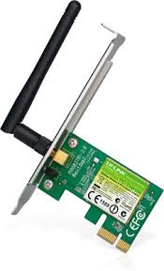
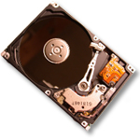
Modern I/O Systems
network

Slide 27
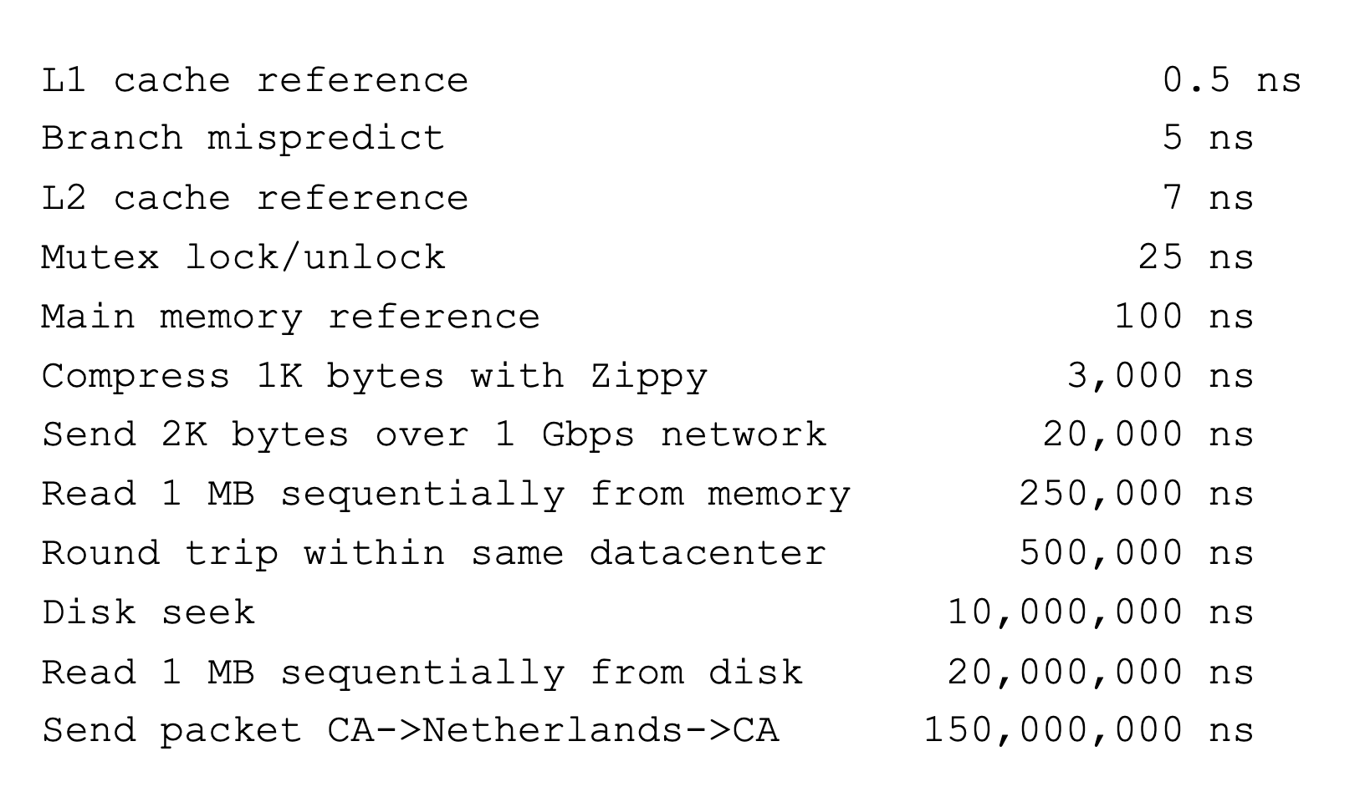
Flashback: Range of Timescales
Jeff Dean: "Numbers Everyone Should Know"

Slide 28
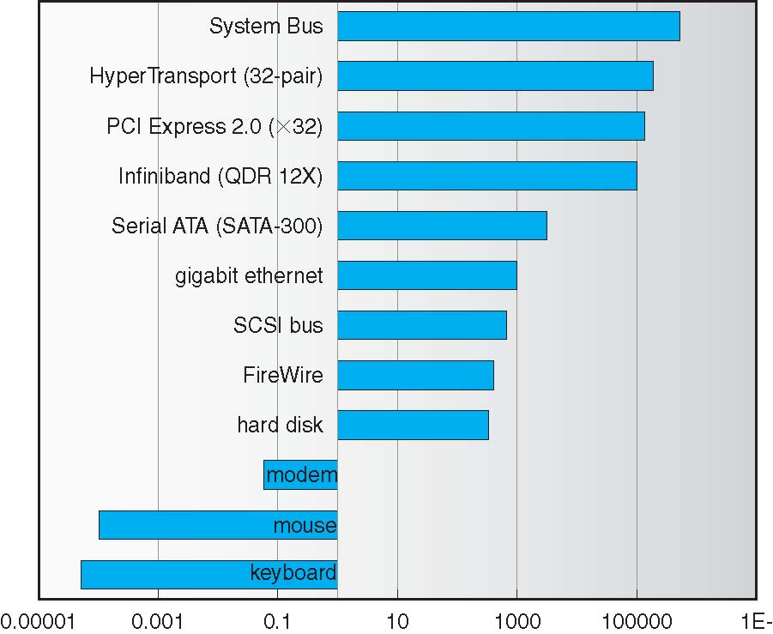
Challenge: Range of Device Data Transfer Rates
Spans over 12 orders of magnitude
OS Goal: Low overhead for fast and slow devices

Slide 29
How does the processor talk to the device?
Processor Memory Bus
Regular
Memory
CPU
Bus
Adaptor
Bus
Adaptor
Device
Controller
Address +
Data
Other Devices
or Buses
Bus
Interface
Hardware
Controller
Interrupt
Controller
Interrupt Request
read
Addressable
Memory
and/or
Queues
write
control
CPU interacts with a Controller
  Contains a set of registers that
  can be read and written
  May contain memory for request
  queues or bit-mapped images
status
Registers
(port 0x20)
Memory Mapped
Region: 0x8f008020

Slide 30
How does the processor talk to the device?
Processor Memory Bus
Regular
Memory
CPU
Bus
Adaptor
Bus
Adaptor
Device
Controller
Address +
Data
Other Devices
or Buses
Bus
Interface
Hardware
Controller
Interrupt
Controller
Interrupt Request
read
Addressable
Memory
and/or
Queues
write
control
Processor accesses controller’s registers in two ways
  I/O-specific instructions: in/out
    Intel: out 0x21, AL
  Memory/mapped I/O: load or store
    Registers appear in physical address space
status
Registers
(port 0x20)
Memory Mapped
Region: 0x8f008020

Slide 31
Ex: Memory-Mapped Display Controller
Hardware maps control registers and display memory into physical address space
Addresses set at boot time (on modern OSs)
Simply writing to display memory (“frame buffer”) changes image on screen
  Addr: 0x8000F000 — 0x8000FFFF
Writing graphics description to cmd queue
  Set of triangles describing some scene
  Addr: 0x80010000 — 0x8001FFFF
Writing to the command register may cause on-board graphics hardware to do something
    Process current command queue
    Addr: 0x0007F004
Can protect with address translation
0x80020000
Graphics
Command
Queue
0x80010000
Display
Memory
0x8000F000
0x0007F004
Command
0x0007F000
Status
Physical
Address
Space

Slide 32
Transferring Data to/from Controller
Programmed I/O: Processor reads/writes data from/to device registers
  Pro: Simple hardware (control and data interfaces are the same)
  Con: I/O can consume a lot of CPU time
Direct Memory Access (DMA): I/O controller reads/writes from/to RAM without CPU
  OS specifies physical address range to use via device controller registers
  Pro: CPU can now do other things during large I/O ops

Slide 33
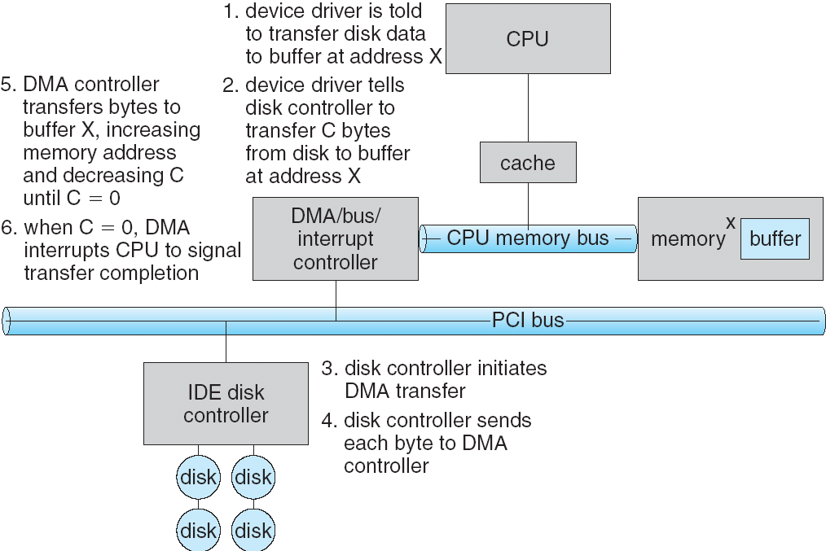
Transferring Data: DMA
1
2
3

Slide 34
Transferring Data: DMA
6
5
4

Slide 35
I/O Devices: Notifying the OS
The OS needs to know when:
  The I/O device has completed an operation
  The I/O device has encountered an error
Two options:
  Interrupts
  Polling

Slide 36
I/O Devices: Notifying the OS
Interrupt: Device generates an interrupt whenever it needs CPU’s attention
  Pro: Handles unpredictable events well
  Con: Handling each interrupt relatively high overhead
Polling: OS periodically checks a device-specific status register
  Pro: Low overhead to run this check
  Con: May waste cycles checking for infrequent events

Slide 37
I/O Devices: Notifying the OS
Actual devices combine both interrupts and polling
Example: High-bandwidth network adapter
  Interrupt for first new incoming packet
  OS polls for any subsequent packets until hardware queues are emptied

Slide 38
Basic Performance Concepts
Response Time or Latency: Time to perform an operation(s)
Bandwidth or Throughput: Rate at which operations are performed (op/s)
  Files: MB/s, Networks: Mb/s, Arithmetic: GFLOP/s
Startup or Overhead: time to initiate an operation
Most I/O operations are roughly linear in n bytes
  Latency(n) = Overhead + n/TransferCapacity

Slide 39
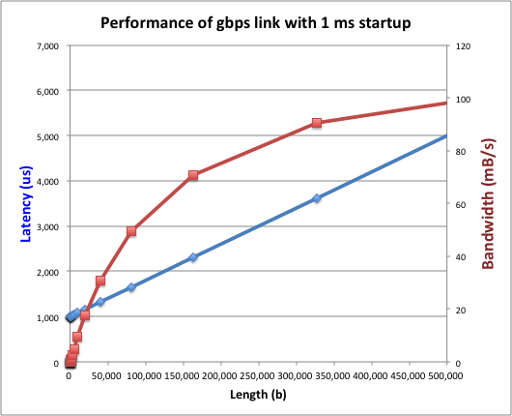
Example: Fast Network
Consider a 1 Gb/s link (B = 125 MB/s)
  With a startup cost S = 1 ms

Slide 40
Example: At 10ms startup
(More Like a Disk)

Slide 41
What determines peak bandwidth for I/O?
Bus Speed
  PCI-X: 1064 MB/s = 133MHz x 64 bit (per lane)
  Ultra Wide SCSI = 40 MB/s
  USB 3.0 = 5 GB/s
  Thunderbolt 3 = 40 Gb/s
Device Transfer Bandwidth
  Rotational speed of spinning metal hard drive
  Write/Read rate of NAND flash
  Signaling rate of network link

Slide 42
Break

Slide 43
Popular Storage Devices
Magnetic Disks
Flash Memory
Rarely becomes corrupted
Traditionally: large capacity at low cost
Block level random access
Slow performance for random access
Better performance for sequential access
Rarely becomes corrupted
Increasingly larger and cheaper
Block level random access
Good performance for reads, worse for random writes
Have to erase data in large blocks
Challenge: Wear Levelling

Slide 44
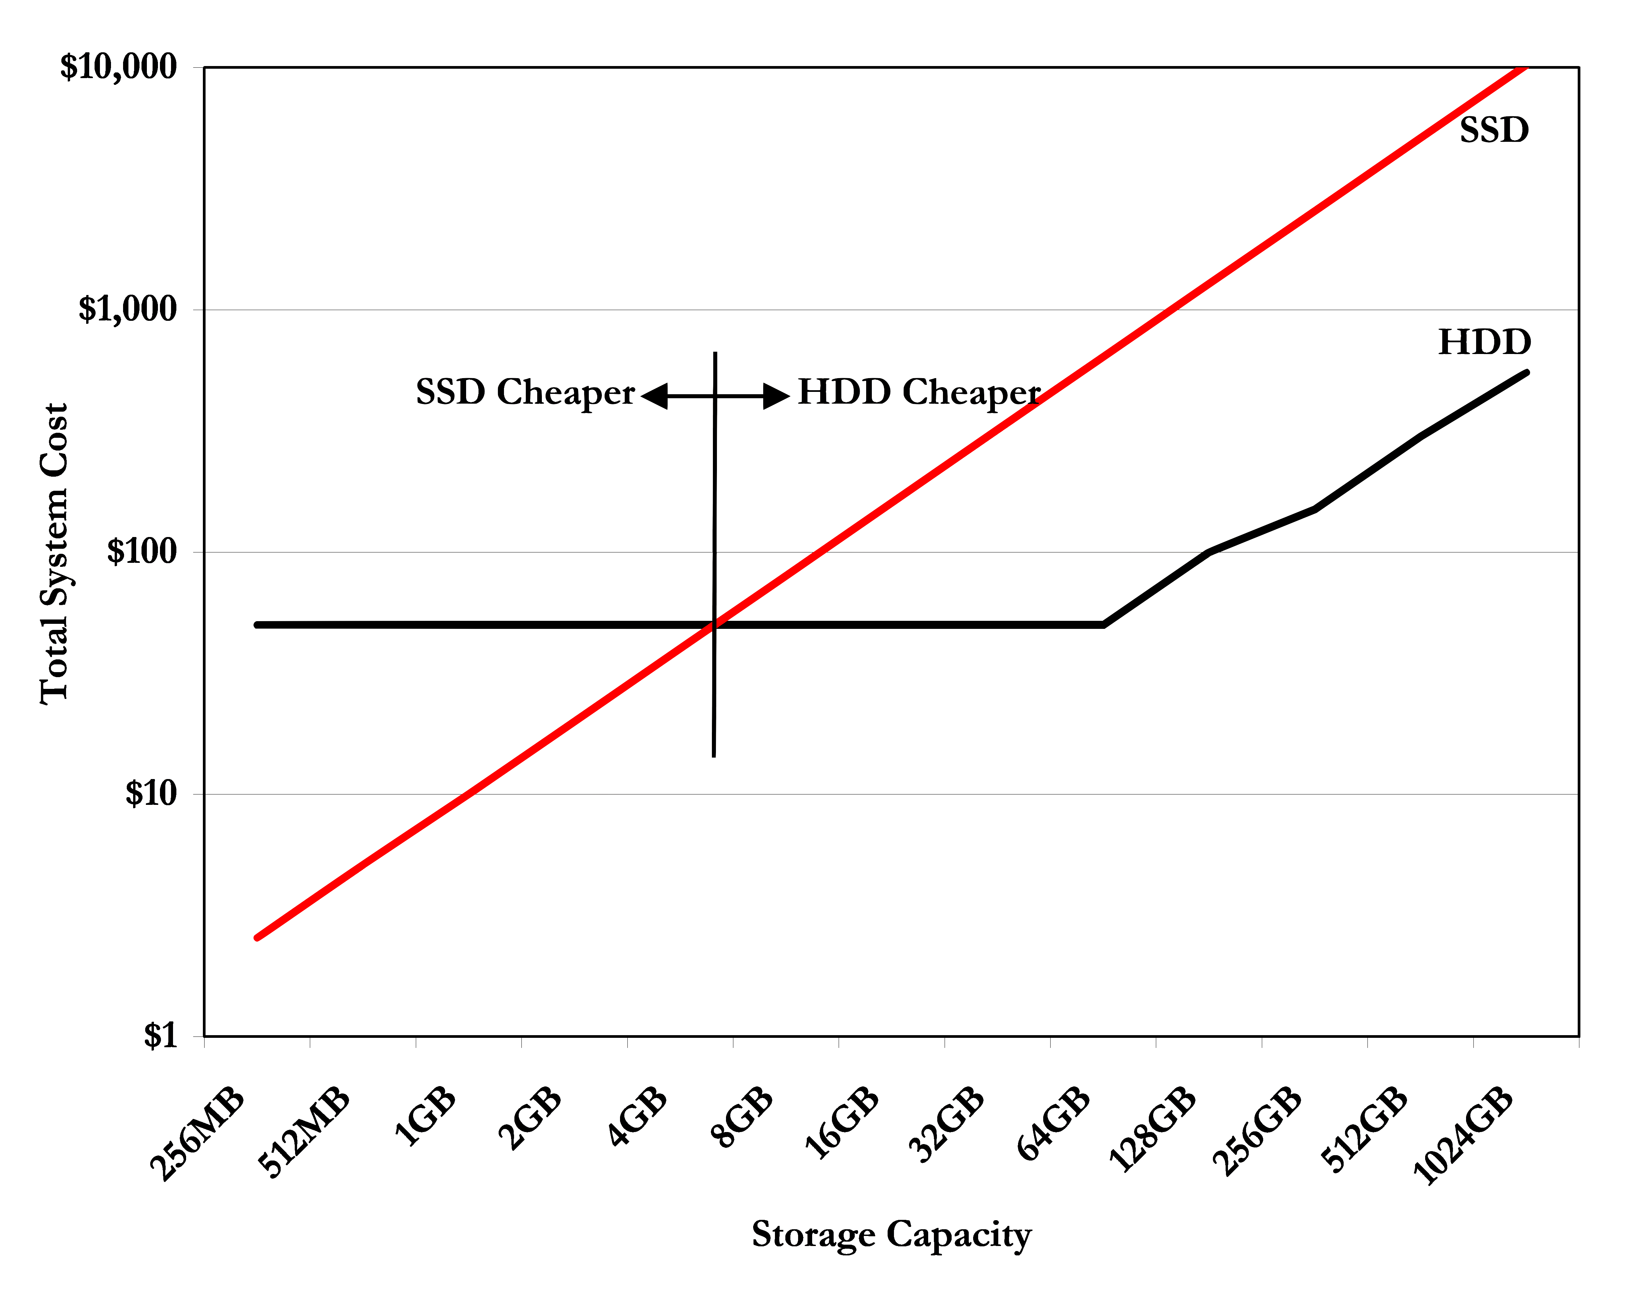
The Emergence of SSDs
In 2007
Source: Storage Newsletter

Slide 45
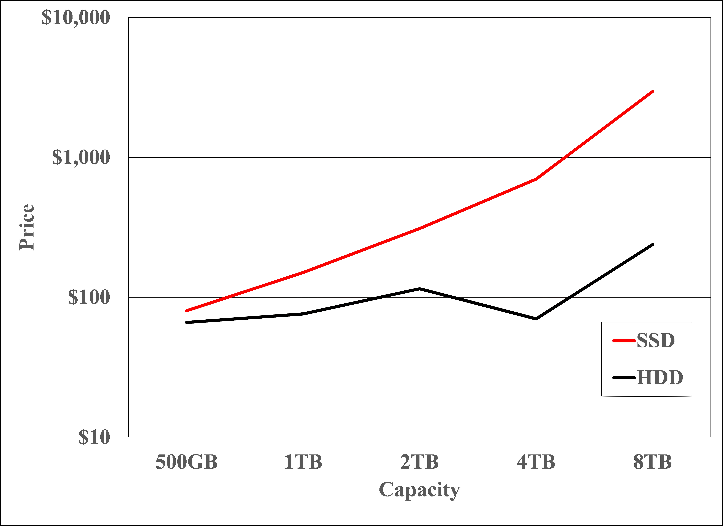
The Emergence of SSDs
Today
Source: Storage Newsletter

Slide 46
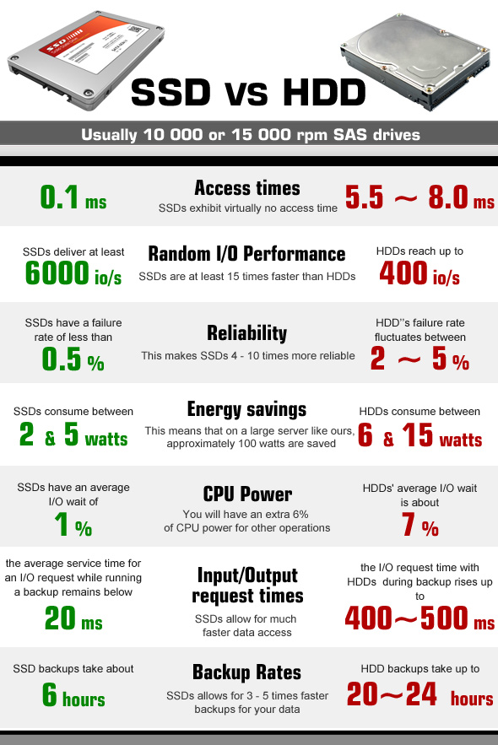
The Emergence of SSDs
Faster
Lower power
No moving parts
But HDDs have their place
  Cheapest online storage per byte
  Application: Archival storage

Slide 47
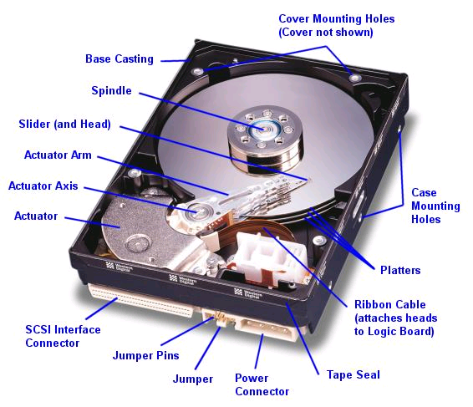
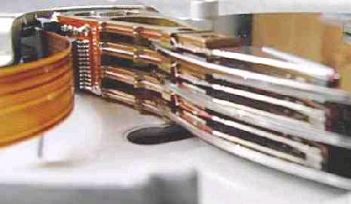
Hard Disk Drives (HDDs)
IBM Personal Computer (1986)
  30 MB hard disk - $500
  30-40ms seek time
  0.7-1 MB/s (est.)
Western Digital Drive
http://www.storagereview.com/guide/
Read/Write Head
Side View
Notes:
Winchester disk drives developed by IBM: 1973 first drive
Uses “sealed” assembly with heads floating on air bearings – Bernoulli effect

Slide 48
Magnetic Disk
Unit of Transfer: Sector
  Ring of sectors form a track
  Stack of tracks form a cylinder
Read/Write heads position on cylinders
Impressive Engineering
  Track is ~1um wide
  Data Density > 250GB/in²
  Head sits 15nm above platter surface

Slide 49
Reading and Writing
Seek Time: Move head to correct cylinder
  Average of 5-10 ms
  Faster if reads adjacent
Rotational Latency: Wait for right sector within cylinder to come under head
  4-8ms (3600-7200 RPM) 2-4ms (15000 RPM)
  Faster if reads adjacent
Transfer Time: Time to actually read sectors
  50-100 MB/sec.

Slide 50
Bigger Picture
Software
Queue
(Device Driver)
Hardware
Controller
Media Time
(Seek+Rot+Xfer)
Request
Result
Latency = Queue Time + Controller Time +
Seek Time + Rotational Latency +
Transfer Time
To Achieve Best Bandwidth: Large Transfers of Physically Adjacent Sectors from one track

Slide 51
HDD Controllers
Old Days: Device driver would address block of data by cylinder number, head (platter) number, and sector number
Now: Hard drive is just an array of sectors
  Sector number mapped internally to physical location
  Numerically close sectors are probably physically close
Lots of other intelligent features
  Error Correcting Codes
  Sector Sparing: Remap sector nums to avoid faulty regions of physical disk

Slide 52
Summary
Diversity of I/O Devices
  Many different speeds (0.1 bytes/sec. to GB/sec.)
  Different access patterns (block, character, network)
I/O Controllers: HW that controls actual device
  Process access through specific instructions or load/store to specially mapped physical addresses
  Report results either via polling or via interrupts
Hard Disk Drives
  Faster for sequential access than random access
  Modern OS only sees sector numbers

