Slide 1
CS 162: Operating Systems and Systems Programming
Lecture 15: Queueing Theory, Intro to File Systems
July 22, 2019
Instructor: Jack Kolb
https://cs162.eecs.berkeley.edu

Slide 2
Logistics
Homework 2 Due Friday
Project 2 Due Next Monday
HW/Project "Party" on Friday
  3-5 PM, Wozniak Lounge
  Full Course Staff to Help You!
  Can also discuss conceptual questions

Slide 3
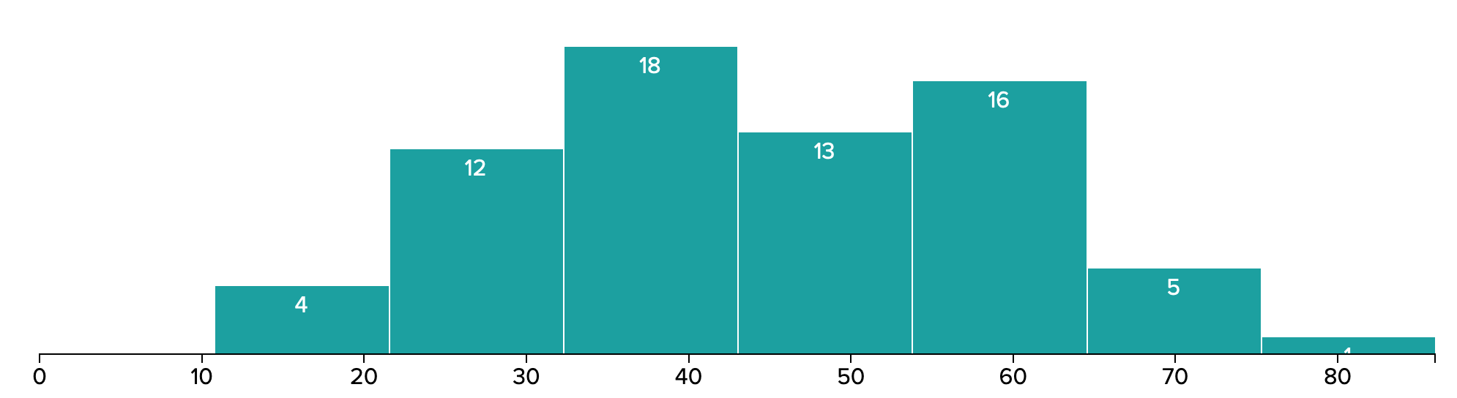
Midterm
Mean: 44, Std. Dev: 14
If you need help with course material:
  Come to office hours (or email for alternate time)
  Read the course text(s)
Still chance to improve on the Final

Slide 4

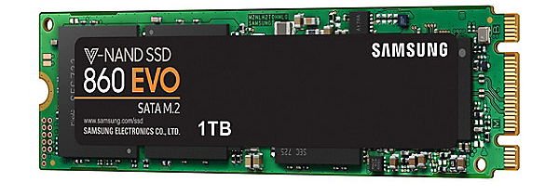
Recall: Solid State Disks (SSDs)
NAND flash memory
Trapped electrons distinguish between 1 and 0
  Two-level cells: distinguish between 0, 01, 10, 11
  Today: Three-level cells common, four-level emerging
No moving parts – no seek or rotational delay!
Limited write cycles

Slide 5
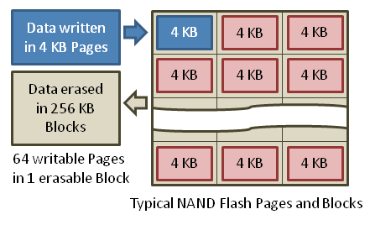
Recall: SSD Erasures

Slide 6
Recall: Flash Translation Layer
Layer of Indirection
  Map virtual block numbers (which OS uses) to physical page numbers (which flash mem. controller uses)
  Can now freely relocate data w/o OS knowing
Copy on Write
  Don't overwrite a page when OS updates its data
  Instead, write new version in a free page
  Update FTL mapping to point to new location

Slide 7
Recall: I/O Startup Cost
Syscall Overhead
Operating System Processing
Controller Overhead
Device Startup
  Mechanical Latency for Disk
  Media Access + Propagation Delay for network
Queuing

Slide 8
A Simple Deterministic World
arrivals
Queue
Server
departures
T_{Q}
T_{S}
T_{A}
T_{A}
T_{A}
T_{q}
T_{S}
Requests arrived at fixed intervals and take a constant amount of time to service
Service Rate: μ = 1/T_{S}
Arrival Rate: λ = 1/T_{A}
Utilization: U = λ / μ (Here, T_{S}/T_{A}), where λ < μ

Slide 9
An Ideal Linear World
Saturation
1
1
Delivered Throughput
Delivered Throughput
Empty Queue
Unbounded
0
1
0
1
Offered Load (T_{S}/T_{A})
Offered Load (T_{S}/T_{A})
Queue delay
Queue delay
time
time

Slide 10
A Bursty World
arrivals
Queue
Server
departures
T_{Q}
T_{S}
Arrivals
Q depth
Server
Same average arrival time, but almost all of the requests experience large queue delays
Even though average utilization is low
  Periods of high activity followed by quiet

Slide 11
Modeling Uneven Arrival Times
Simplest Assumption: Arrivals are equally likely at any point in time and independent of each other
Memoryless: Doesn't matter when last arrival happened
  i.e., Likelihood of an even is independent of how long we've been waiting
May remember from probability & statistics:
  Poisson Distribution: Number of events per interval
  Exponential Distribution: Time until event occurs

Slide 12
Modeling Uneven Arrivals
Memoryless property: time between arrivals follows exponential distribution
f(x) = λe^{-λx} Mean = 1/λ
Likelihood of an event occurring is independent of how long we’ve been waiting
mean arrival interval (1/λ)
Lots of short arrival intervals (i.e., high instantaneous rate)
Few long gaps (i.e., low instantaneous rate)
x (λ)

Slide 13
General Use of Random Distributions
Mean
(m)
Server spends variable time (T) for request
  Mean (Average) m = Σp(T)×T
  Variance (stddev²) σ² = Σp(T)×(T-m)² = Σp(T)×T²-m²
  Squared coefficient of variance: C = σ²/m²
  Aggregate description of the distribution
Important values of C:
  No variance or deterministic ⇒ C=0
  “Memoryless” or exponential ⇒ C=1
  Disk response times C ≈ 1.5 (majority seeks < average)
σ
Distribution
of service times
mean
Memoryless

Slide 14
Introduction to Queuing Theory
Controller
Arrivals
Disk
Departures
Queue
Queuing System
Queueing Theory: Studies long-term, steady-state behavior of queueing systems
Based on queue behavior, and probability distributions of arrival, service times

Slide 15
Little’s Law
N
arrivals
departures
λ
L
Assumption: Stable System
  Avg. Arrival Rate = Avg. Departure Rate = Throughput
  Otherwise queues are growing without bound!
Average Response Time (Latency) = L

Slide 16
Little’s Law
N
arrivals
departures
λ
L
How many items are in the system?
  Arrival Rate: λ items come in per unit time
  Each averages L units in the system
N (# requests in system) = λ × L
  Need unit agreement (e.g. ops/sec. × seconds)

Slide 17
Little’s Law
N
arrivals
departures
λ
L
N (# requests in system) = λ × L
  Need unit agreement (e.g. ops/sec. × seconds)
About averages
Works regardless of arrival, service time distributions (assuming stable system)

Slide 18
Example
L = 5
λ = 1
L = 5
N = 5 jobs
Jobs
0
1
2
3
4
5
6
7
8
9
10
11
12
13
14
15
16
time
A: N = λ x L = 5

Slide 19
Naming Queueing Systems
X/X/N
# Requests Processed at a Time
Distribution of Service Times
Distribution of Arrivals
Distributions
  M: Memoryless (exponential)
  G: General (anything)
  D: Deterministic (constant)

Slide 20
Results for Memoryless Arrivals
Queue
Server
M/G/1
Arrival Rate
λ
Service Rate
μ=1/T_{ser}
λ | Mean Number of Requests/Second
T_{ser} | Mean Time to Service Requests (m)
C | Squared Coeff. of Variance = σ²/m²
μ | Service Rate = 1/T_{ser}
U | Server Utilization = λ/μ = λ × T_{ser}
T_{q} | Time In Queue = T_{ser} × U/(1-U) × (1+C)/2
L_{q} | Length of Queue = λ × T_{q} (Little's Law)

Slide 21
Memoryless Arrivals and Service
Queue
Server
M/M/1
Arrival Rate
λ
Service Rate
μ=1/T_{ser}
λ | Mean Number of Requests/Second
T_{ser} | Mean Time to Service Requests (m)
C=1 | Squared Coeff. of Variance = σ²/m²
μ | Service Rate = 1/T_{ser}
U | Server Utilization = λ/μ = λ × T_{ser}
T_{q} | Time In Queue = T_{ser} × U/(1-U) × (1+C)/2
L_{q} | Length of Queue = λ × T_{q} (Little's Law)

Slide 22
Queueing Theory Example
Example Usage Statistics:
  User requests ten 8KB disk I/O ops per second
  Requests & service exponentially distributed (C=1.0)
  Avg. service = 20 ms (controller + seek + rotation + transfer)
Questions:
How utilized is the disk (server utilization)? u = λT_{ser}
What is the average time spent in the queue? T_{q}
What is the number of requests in the queue? L_{q}
What is the avg response time for disk request? T_{sys} = T_{q} + T_{ser}

Slide 23
Queueing Theory Example
Questions:
  How utilized is the disk (server utilization)? U = λT_{ser}
  What is the average time spent in the queue? T_{q}
  What is the number of requests in the queue? L_{q}
  What is the avg response time for disk request? T_{sys} = T_{q} + T_{ser}
Computation:
λ (avg # arriving requests/s) = 10/s
T_{ser} (avg time to service request) = 20 ms (0.02s)
U (server utilization) = λ x T_{ser}= 10/s x .02s = 0.2
T_{q} (avg time/customer in queue) = T_{ser} x U/(1 – U)
= 20 x 0.2/(1-0.2) = 20 x 0.25 = 5 ms (0 .005s)
L_{q} (avg length of queue) = λ x T_{q}=10/s x .005s = 0.05 reqs
T_{sys} (avg time/customer in system) =T_{q} + T_{ser}= 25 ms

Slide 24
Queueing Theory Resources
Under "Resources" page on course website
  Excerpt from Patterson & Hennessy Textbook
  Entire website with list of sources to consult
Assume queueing theory is in scope for the final

Slide 25
Utilization
Remember: response time will start to suffer well before utilization approaches 100%
Response
Time (ms)
300
200
100
0
0%
100%
Throughput (Utilization)
(% total BW)

Slide 26
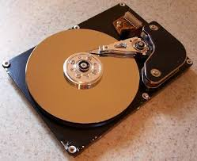
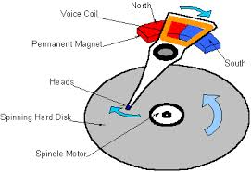
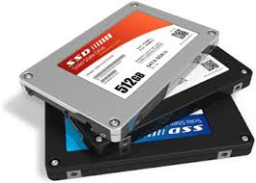

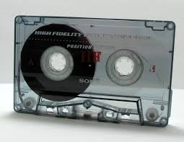
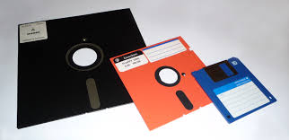
I/O & Storage Layers
Application / Service
High Level I/O
streams
Low Level I/O
handles
Syscall
registers
File System
descriptors
I/O Driver
Commands and Data Transfers
Disks, Flash, Controllers, DMA

Slide 27
Terminology at Different Layers
I/O API and
syscalls
Variable-Size Buffer
Memory Address
Logical Index,
Typically 4 KB
File System
Block
Flash Trans. Layer
Hardware Devices
Sector(s)
Sector(s)
Sector(s)
Phys. Block
Phys Index., 4KB
Physical Index,
512B or 4KB
Erasure Page
HDD
SSD

Slide 28
User vs. System View of a File
User’s view:
  Durable Data Structures
System’s view (system call interface):
  Collection of Bytes (UNIX)
  Oblivious to specific data structures user wants to store
System’s view (inside OS):
  File is a collection of blocks

Slide 29
Building a File System
Classic OS situation
  Take limited hardware interface (array of blocks) and provide a more convenient/useful interface with:
  Naming: Find file by name, not block numbers
    Organize file names with directories
  Organization: Map files to blocks
  Protection: Enforce access restrictions
  Reliability: Keep files intact despite crashes, hardware failures, etc.

Slide 30

Translating from User to Sys. View
File
(Bytes)
File
System
What happens if user says: "give me bytes 2 – 12?"
  Fetch block corresponding to those bytes
  Return just the correct portion of the block
What about writing bytes 2 – 12?
  Fetch block, modify relevant portion, write out block

Slide 31
Translating from User to Sys. View
File
(Bytes)
File
System
Everything inside file system is in terms of whole-size blocks
  Actual disk I/O happens in blocks
  read/write smaller than block size needs to translate and buffer

Slide 32
What does the file system need?
Track free disk blocks
  Need to know where to put newly written data
Track which blocks contain data for which files
  Need to know where to read a file from
Track files in a directory
  Find list of file's blocks given its name
Where do we maintain all of this?
  Somewhere on disk

Slide 33
Data Structures on Disk
Bit different than data structures in memory
Access a block at a time
  Can't efficiently read/write a single word
  Have to read/write full block containing it
  Ideally want sequential access patterns
Durability
  Ideally, file system is in meaningful state upon shutdown
  This obviously isn't always the case…

Slide 34
Tracking Free Blocks
Bitmap stored at fixed block #
  Bit i is 0 if free, 1 if allocated
  First fit: Scan sequentially until find a 0
  Rewrite whole block to update
Isn't this slow?
  Make faster by caching in memory
  Finding free block: sequential access pattern

Slide 35
Basic File System Components
File path
Directory
Structure
File Index
Structure
File number
Data blocks
…

Slide 36
Components of a file system
file name
file number
offset
Storage block
directory
index structure
Open performs Name Resolution
  Translates pathname into a “file number”
    Used as an “index” to locate the blocks
  Creates a file descriptor in PCB within kernel
  Returns a file descriptor (int) to user process
read, write, seek, and sync operate on handle
  Mapped to file descriptor and to blocks

Slide 37
Directory
A hierarchical structure
Each directory entry is a collection of file name to file number mappings
  Some of these mappings could be subdirectories: simply a link to another collection of mappings
Directories actually form a DAG, not just a tree. Why?
  Hard Link: Mapping from name to file number
  File number could be pointed to by multiple names (in different directories)
  Soft link: Mapping from one name to another

Slide 38
File
Named permanent storage
Contains
  Data: Blocks on disk somewhere
  Metadata (Attributes)
    Owner, size, last opened, …
    Access rights
Data blocks
File handle
…
File descriptor
File object (index)
Position

Slide 39
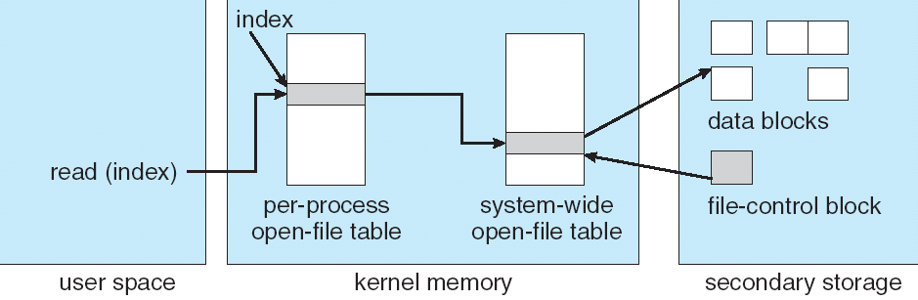
File System Structures
read/write system calls:
  Use file handle to locate file's index structure
  Perform appropriate reads or writes

Slide 40
FAT: (File Allocation Table)
Simple way to store blocks of a file: Linked List structure
File number is just the first block
One entry in table per data block
FAT contains pointer to the next block for each entry (or special END value)
FAT
Disk Blocks
0:
0:
File number
31:
File 31, Block 0
File 31, Block 1
File 31, Block 2
N-1:
N-1:
memory

Slide 41
FAT: (File Allocation Table)
Example: read file 31, block 2
  Index into FAT with file num
  Follow linked list to block 2
  Read block from disk into mem.
FAT
Disk Blocks
0:
0:
File number
31:
File 31, Block 0
File 31, Block 1
File 31, Block 2
N-1:
N-1:
memory

Slide 42
FAT Free Space Tracking
Entries in table corresponding to free block have value 0
Must scan through FAT to
find free space
FAT
Disk Blocks
0:
0:
File 31, Block 0
File 31, Block 1
Free
File 31, Block 2
N-1:
N-1:

Slide 43
FAT: Expanding a File
Find a new free block
Link it in with its predecessor
FAT
Disk Blocks
0:
0:
File 31, Block 0
File 31, Block 1
Free
File 31, Block 2
N-1:
N-1:

Slide 44
Storing the FAT
FAT
Disk Blocks
Saved to disk when system is shut down
Copied into memory when OS is running
  Makes accesses, updates fast
  Otherwise lots of random reads to locate the blocks of a file
When drive is formatted, make all FAT entries 0
0:
0:
File 1 number
31:
File 31, Block 0
File 31, Block 1
File 63, Block 1
File 31, Block 3
63:
File 63, Block 0
File 2 number
File 31, Block 2
N-1:
N-1:

Slide 45
FAT Assessment
FAT
Disk Blocks
Used all over the place
  MS-DOS
  Windows (sometimes)
  External drives
Super simple
  Can implement in firmware
  E.g., digital cameras
0:
0:
File 1 number
31:
File 31, Block 0
File 31, Block 1
File 63, Block 1
File 31, Block 3
63:
File 63, Block 0
File 2 number
File 31, Block 2
N-1:
N-1:

Slide 46
Maximum Sizes in FAT
What is the maximum size of a FAT file system?
  Table entry indexes are 32 bits, top 4 bits are reserved
  2²⁸ * 2¹² = 2⁴⁰ = 1 TB
What is the maximum size of a FAT file?
  A file's size in bytes is represented by a 4-byte int
  2³² bytes = 4 GB

Slide 47
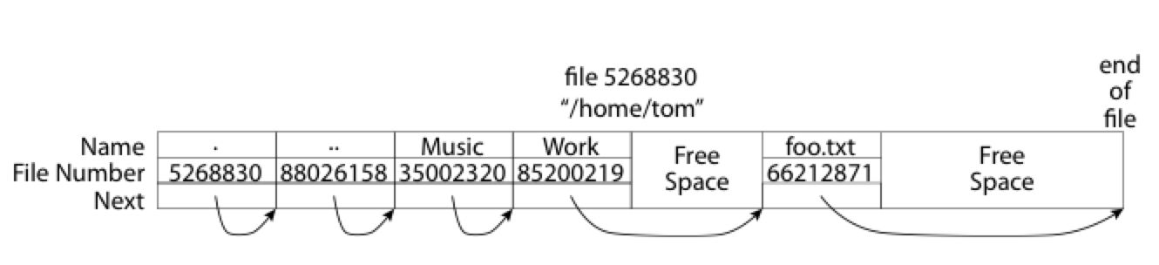
What About Directories?
Essentially a file containing file names to file numbers
Free space for new entries
In FAT: file attributes are kept in directory
Each directory a linked list of entries
Where do you find root directory ( “/” )?

Slide 48
Directory Structure (cont’d)
How many disk accesses to resolve /my/book/count?
  Read in first data block for root dir (fixed spot on disk)
    Table of file name/index pairs. Search linearly – ok since directories typically very small
  Look up my's file number in FAT table
  Read in first data block for my; search for book
  Look up book's file number in FAT table
  Read in first data block for book search for count
  Look up count's file number in FAT table

Slide 49
FAT Security Holes
FAT has no notion of access rights
Any user can access any file
Freely look up file blocks from its number

Slide 50
How do we design better file systems?
Helps to know what use cases we are optimizing for
"Ancient" systems design wisdom: "Optimize for the common case"

Slide 51
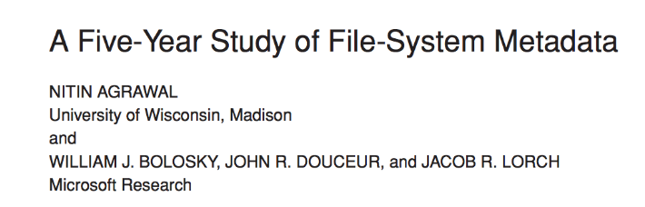
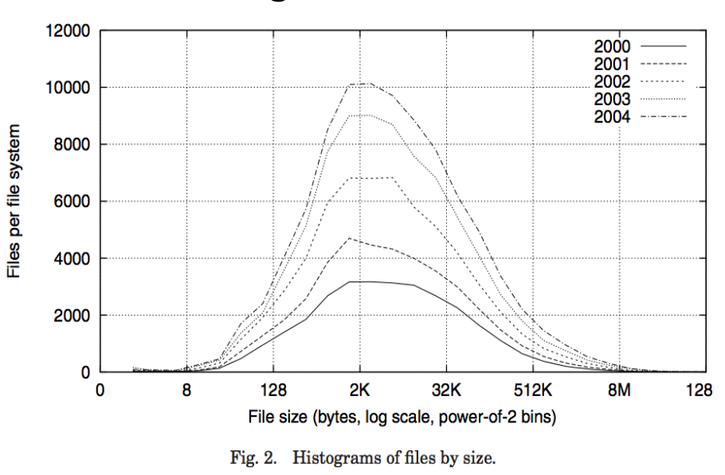
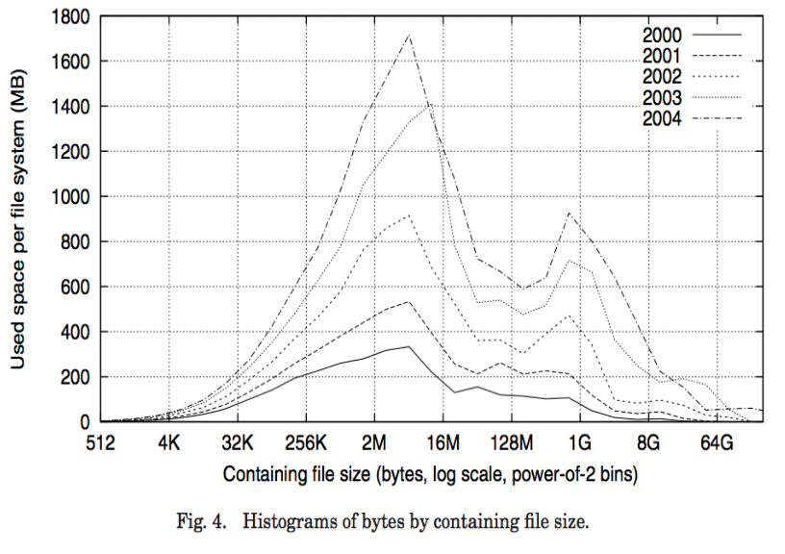
Empirical Characteristics of Files

Slide 52
Empirical Characteristics of Files
Most files are small
Most of the space is occupied by rare, big files
Most file opens are read-only
Most files short-lived (e.g., application-specific temporary files)
Most file accesses are sequential

Slide 53
Unix FFS: inode File Structure

Slide 54
BSD FFS: inode File Structure
Array on disk at a well-known block number
Reserved when disk is formatted

Slide 55
File Attributes
User
Group
9 basic access control bits
- UGO x RWX
Setuid bit
- execute at owner permissions
rather than user
Setgid bit
- execute at group’s permissions

Slide 56
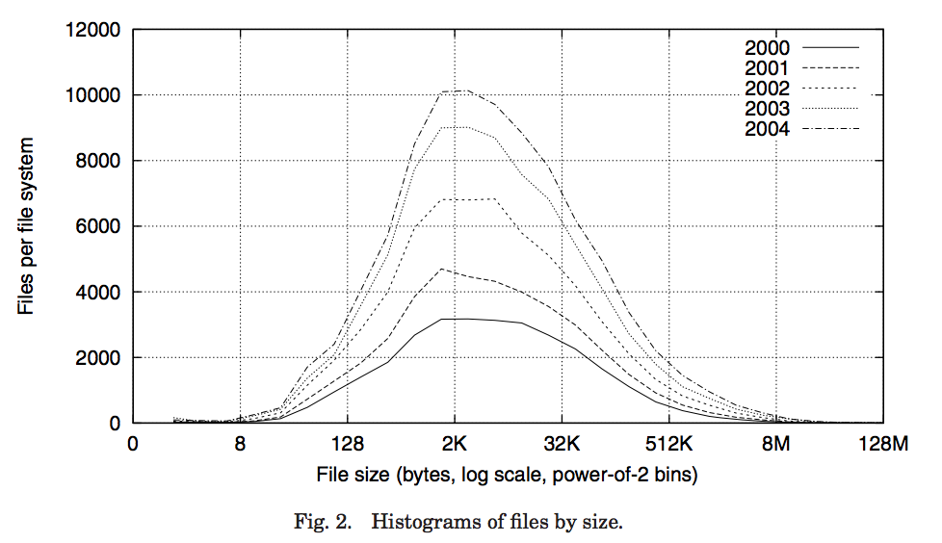
Data Storage
Small files: 12 pointers direct to data blocks
Direct pointers
4kB blocks ⇒ sufficient for files up to 48KB

Slide 57
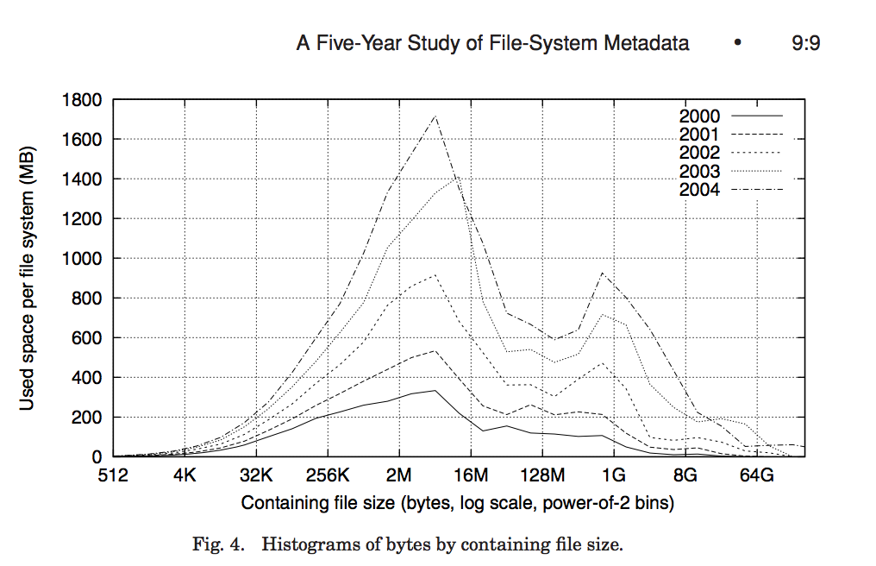
Data Storage
Large files: 1,2,3 level indirect pointers
Indirect pointers
- point to a disk block
containing only pointers
- 4 kB blocks => 1024 ptrs
=> 4 MB @ level 2
=> 4 GB @ level 3
=> 4 TB @ level 4
48 KB
+4 MB
+4 GB
+4 TB

Slide 58
Fast File System
Origin of the inode concept still used in modern Linux filesystems (e.g., ext4)
File number is index into inode array
Multi-Level Index Structure
  Great for small to large files
  Asymmetric tree with fixed-size blocks

Slide 59
Fast File System
Metadata associated with file itself (in inode) rather than its directory mapping
  Enables hard/soft links
Locality heuristics for HDDs
  Keep blocks from same file in same physical region of disk to minimize seek, rotational delay
  Same for files in same directory
  Arguably less significant in age of SSDs

Slide 60
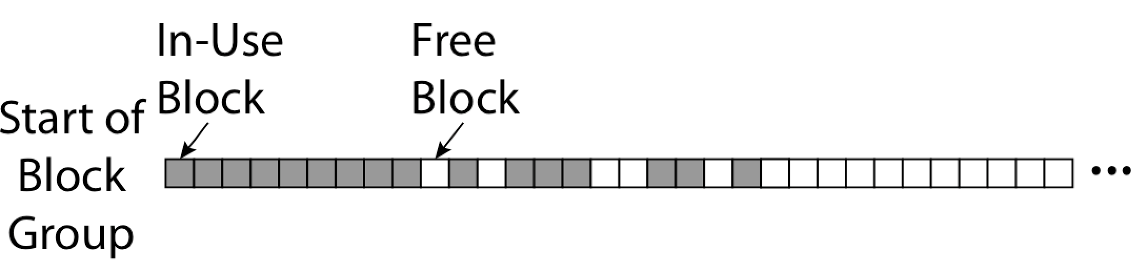
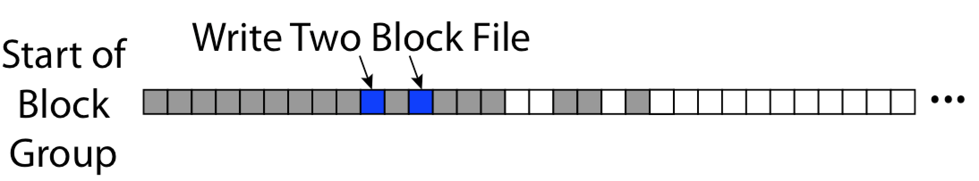
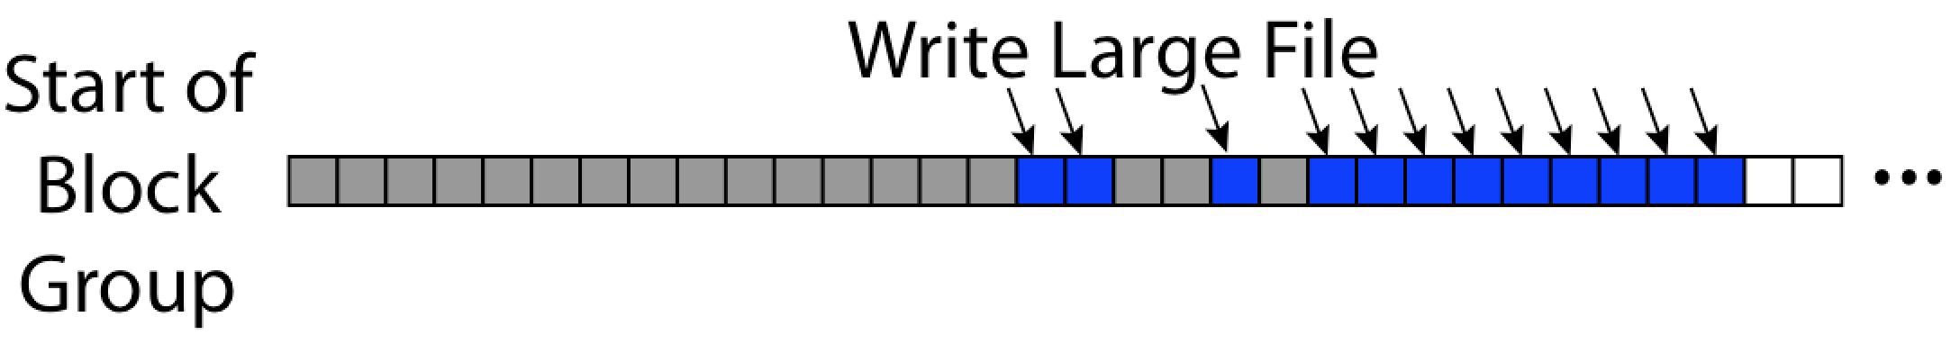
FFS First Fit Block Allocation
Fills in the small holes at the start of block group
Avoids fragmentation, leaves contiguous free space at end

Slide 61
FFS Assessment
Efficient storage for large and small files
Locality for both file contents and metadata
Inefficient for tiny files
  E.g., a one-byte file requires 8KB of space on disk:
  inode and data block
Inefficient encoding for contiguous ranges of blocks belonging to same file (e.g. blocks 4815 – 162342)

Slide 62
Summary
File System maps files and directories onto blocks within persistent storage
FAT: File number indexes into simple table, find blocks by traversing linked list
FFS Key Innovation: inode file index structure
  Asymmetric, multi-level tree
  One block per leaf of tree

