Slide 1
CS 162: Operating Systems and Systems Programming
Lecture 17: Journaling File Systems, CoW
July 24, 2019
Instructor: Jack Kolb
https://cs162.eecs.berkeley.edu

Slide 2
Logistics
Midterm Regrades Open, Close Friday
Project 2 Milestone Tonight
HW/Project "Party" on Friday
And happy to answer questions on material or midterm exam problems
Mid-Summer Course Survey: https://tinyurl.com/cs162midsummer

Slide 3
Empirical Characteristics of Files
Most files are small
Most of the space is occupied by rare, big files
Most file opens are read-only
Many files short-lived (e.g., application-specific temporary files)
Most file accesses are sequential

Slide 4
Unix FFS: inode File Structure

Slide 5
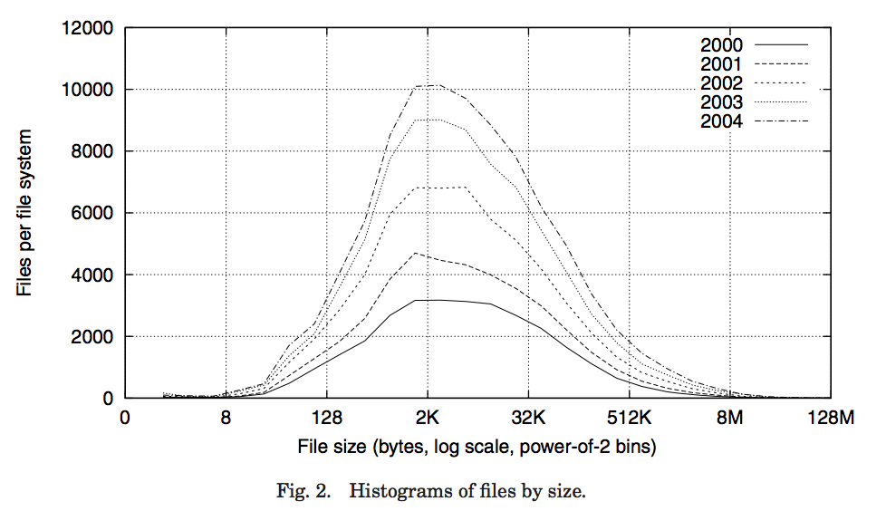
Data Storage
Small files: 12 pointers direct to data blocks
Direct pointers
4kB blocks ⇒ sufficient for files up to 48KB

Slide 6
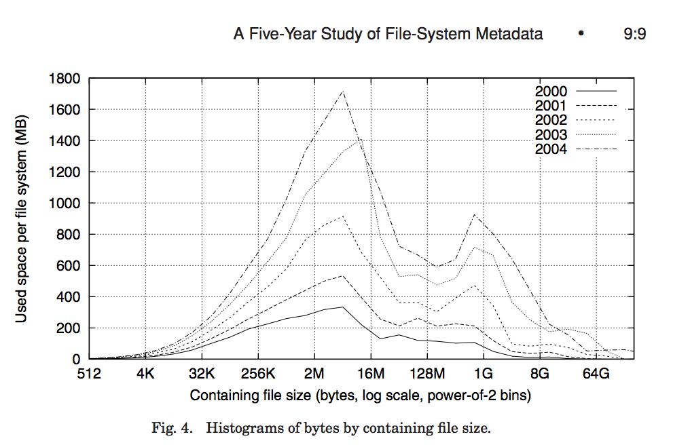
Data Storage
Large files: 1,2,3 level indirect pointers
Indirect pointers
- point to a disk block
containing only pointers
- 4 kB blocks => 1024 ptrs
=> 4 MB @ level 2
=> 4 GB @ level 3
=> 4 TB @ level 4
48 KB
+4 MB
+4 GB
+4 TB

Slide 7
A Bit More on Directories
Directories are just specialized files
Contents: List of pairs <file name, file number>
libc support
DIR * opendir (const char *dirname)
struct dirent * readdir (DIR *dirstream)
/usr
/usr/lib
/usr/lib4.3
/usr/lib/foo
/usr/lib4.3/foo

Slide 8
New Technology File System (NTFS)
Default on modern Windows systems
Instead of FAT or inode array: Master File Table
Max 1 KB size for each table entry
Each entry in MFT contains metadata plus
File's data directly (for small files)
A list of extents (start block, size) for file's data
For big files: pointers to other MFT entries with more extent lists

Slide 9
NTFS Small File
Create time, modify time, access time,
Owner id, security specifier, flags (RO, hidden, sys)
data attribute
Attribute list

Slide 10
NTFS Medium File

Slide 11
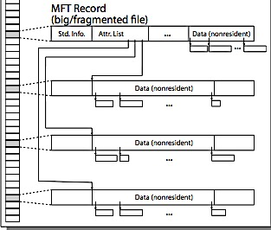
NTFS Multiple Indirect Blocks

Slide 12
Comparing File Systems
Imagine we have a 49KB file stored sequentially
How much space does it require in FFS?
Assume Each inode is 128 Bytes and contains 12 direct pointers, 1 indirect pointer, etc.
Assume disk pointers are 4-byte ints
What about on NTFS?
Assume each MFT entry is 1 KB
Again assume disk pointers are 4-byte ints
Assume length of extent represented as 4-byte int

Slide 13
Storage Reliability Challenge
Single logical file operation can involve updates to multiple physical disk blocks (e.g. creating a file)
Allocating free data block, allocating inode, updating dir.
At physical level, operations complete one at a time
How do we guarantee file system is in a sane state even if a crash interrupts these steps?

Slide 14
Key Concept: Transaction
Closely related to critical sections for manipulating shared data structures
Extend concept of an atomic update from memory to persistent storage
Atomically update multiple persistent data structures

Slide 15
Key Concept: Transaction
Defined as an atomic sequence of reads/writes
Takes system from one consistent state to another
transaction
consistent state 1
consistent state 2

Slide 16
The ACID properties of Transactions
Atomicity: all actions in the transaction happen, or none happen
Consistency: transactions maintain data integrity, e.g.,
Bank Balance cannot be negative
Cannot reschedule meeting on February 30
Isolation: execution of one transaction is isolated from that of all others; no problems from concurrency
Durability: if a transaction commits, its effects persist despite crashes

Slide 17
Typical Transaction Structure
Begin a transaction – get transaction id
Do a bunch of updates
If any fail along the way, roll-back
Or, if any conflicts with other transactions, roll-back
Commit the transaction

Slide 18
Journaling File Systems
Don't modify data structures on disk directly
Write each update as transaction recorded in a log
Commonly called a journal or intention list
Also maintained on disk (allocate blocks for it when formatting)
Once changes are in the log, they can be safely applied
e.g. modify inode pointers and directory mapping
Garbage collection: once a change is applied, remove its entry from the log

Slide 19
Example: Creating a File
Find free data block(s)
Find free inode entry
Find dirent insertion point
-----------------------------------------
Write map (i.e., mark used)
Write inode entry to point to block(s)
Write dirent to point to inode
Free space map
Data blocks
…
Inode table
Directory
entries

Slide 20
Ex: Creating a file (as transaction)
Find free data block(s)
Find free inode entry
Find dirent insertion point
---------------------------------------------------------
[log] Write map (used)
[log] Write inode entry to point to block(s)
[log] Write dirent to point to inode
Free space map
Data blocks
…
Inode table
Directory
entries
tail
head
done
pending
start
commit
Log: in non-volatile storage (Flash or on Disk)

Slide 21
"Redo Log" – Replay Transactions
After Commit
All access to file system first looks in log
Eventually copy changes to disk
Free space map
Data blocks
…
Inode table
Directory
entries
tail
tail
tail
tail
tail
head
done
start
commit
pending
Log: in non-volatile storage (Flash or Disk)

Slide 22
Crash During Logging – Recover
Upon recovery scan the log
Detect transaction start with no commit
Discard log entries
Disk remains unchanged
Free space map
Data blocks
…
Inode table
Directory
entries
tail
head
done
pending
start
Log: in non-volatile storage (Flash or on Disk)

Slide 23
Recovery After Commit
Scan log, find start
Find matching commit
Redo it as usual
Or just let it happen later
Free space map
Data blocks
…
Inode table
Directory
entries
tail
head
done
pending
start
commit
Log: in non-volatile storage (Flash or on Disk)

Slide 24
Journaling Summary
Why go through all this trouble?
Updates atomic, even if we crash:
Update either gets fully applied or discarded
All physical operations treated as a logical unit
Isn't this expensive?
Yes! We're now writing all data twice (once to log, once to actual data blocks in target file)
Modern filesystems journal metadata updates only
Record modifications to file system data structures
But apply updates to a file's contents directly

Slide 25
Evolution of Linux File Systems
ext2: Heavily influenced by FFS, inode structures
ext3: Added journaling for durability
ext4: Improved journaling, transitioned from block representation to extent representation

Slide 26
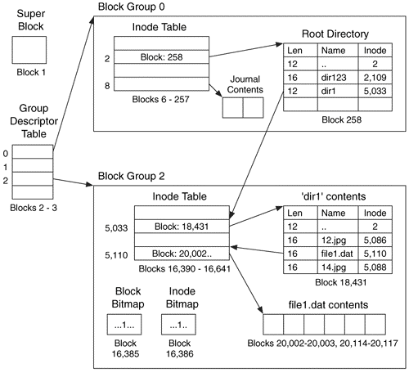
Ext2/3 Disk Layout
Disk divided into block groups
Provides locality
Each group has two block-sized bitmaps (free blocks/inodes)
Actual inode structure similar to FFS, with 12 direct pointers
Example: create a file1.dat under /dir1/ in Ext3

Slide 27
Copy-on-Write (CoW) File Sys.
What if we apply copy-on-write at the file system level, not just within SSDs?
Key Idea: Don't overwrite a block in place. Instead, write a new version in a new block
Update pointer structures to refer to new version
Example File Systems: ZFS, BTRFS

Slide 28
Copy-on-Write (CoW) File Sys.
Sounds expensive, but:
Updates can be batched together
Almost all disk writes can occur in parallel
Most of the cost is in seeks (for HDDS), not transfer
Applications often overwrite the whole file anyways

Slide 29
Copy-on-Write (CoW) File Sys.
To change a file:
Write new version of data block
Propagate changes "upwards" through FS tree structure
Write new copy of indirect blocks (if necessary)
Write new copy of inode
Write new copy of directory entry pointing to new inode copy

Slide 30
CoW with Smaller-Radix Blocks
old version
new version
Write
If file represented as a tree of blocks, just need to update the leading fringe

Slide 31
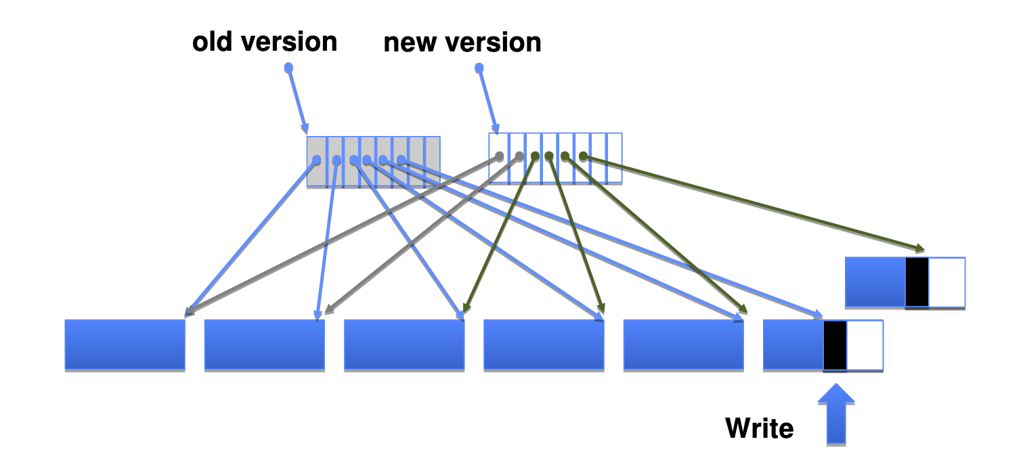
Copy-on-Write
Remember: Tree nodes in real file systems have many children (one node = 1 block of space)

Slide 32
CoW Filesystems
Store version number with pointers
Buffer a group of writes before making a version update
Represent free space with extents
Most prominent example: ZFS
Also BTRFS, but it has been "in development" since 2007
Immediately garbage collect old versions?
Maybe not: can keep snapshots of previous FS state
User can reclaim deleted files or revert changes!

Slide 33
File System Summary
File System | Data Structure | Space Repr. | Journaling? | Copy on Write?
FAT | File Alloc. Table | Blocks | No | No
FFS | Inode Array | Blocks | No | No
ext2 | Inode Array | Blocks | No | No
ext3 | Inode Array | Blocks | Yes | No
ext4 | Inode Array | Extents | Yes | No
NTFS | Master File Table | Extents | Yes | No
ZFS | "D-Nodes" | Extents | No | Yes

Slide 34
Break

Slide 35
OS Job: Virtualizing Resources
Run multiple processes and threads at once, sharing machine
Multiplex CPU: Scheduling
Multiplex I/O and Disk: Kernel I/O subsytem
Memory: Address Translation

Slide 36
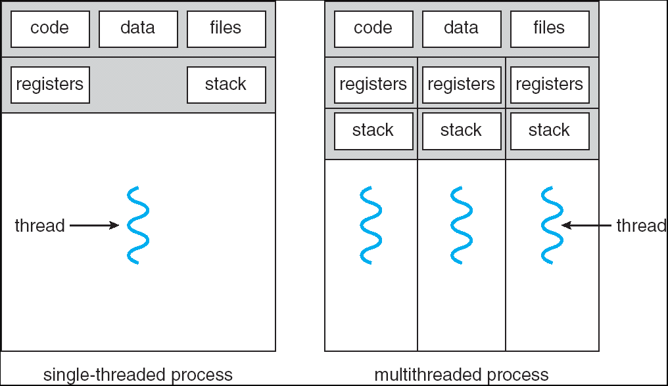
Recall: Multithreaded Processes
Threads + Shared Address Space
Multiple Stacks in one Address Space

Slide 37
Memory Multiplexing Goals
Protection
Private memory of other processes/OS remains private
Even from malicious processes
Controlled Overlap
Want processes and OS to share memory for communication, cooperation
Or just to save space (e.g., shared libraries)
Uniform View of Memory
No need to change binary file's addresses when we want to execute two instances of it
No need to change a program to let it use more memory

Slide 38
Address Translation
Program sees and uses virtual addresses
Kernel-controlled mapping to convert from a virtual address to physical address
Implemented by hardware
The preferred mechanism for memory multiplexing

Slide 39
Binding Instructions and Data to Memory
Process view of memory
Physical addresses
data1: dw 32
…
start: lw r1,0(data1)
jal checkit
loop: addi r1, r1, -1
bnz r1, loop …
checkit: …
0x0300 00000020
… …
0x0900 8C2000C0
0x0904 0C000280
0x0908 2021FFFF
0x090C 14200242
…
0x0A00

Slide 40
Binding Instructions and Data to Memory
Physical
Memory
0x0000
0x0300
00000020
Process view of memory
Physical addresses
data1: dw 32
…
start: lw r1,0(data1)
jal checkit
loop: addi r1, r1, -1
bnz r1, loop …
checkit: …
0x0300 00000020
… …
0x0900 8C2000C0
0x0904 0C000280
0x0908 2021FFFF
0x090C 14200242
…
0x0A00
0x0900
8C2000C0
0C000340
2021FFFF
14200242
0xFFFF

Slide 41
Execute Second Instance of Program?
Physical
Memory
0x0000
0x0300
App X
Process view of memory
Physical addresses
data1: dw 32
…
start: lw r1,0(data1)
jal checkit
loop: addi r1, r1, -1
bnz r1, loop …
checkit: …
0x0300 00000020
… …
0x0900 8C2000C0
0x0904 0C000280
0x0908 2021FFFF
0x090C 14200242
…
0x0A00
0x0900
?
0xFFFF

Slide 42
Execute Second Instance of Program?
Physical Memory
0x0000
0x0300
App X
Process view of memory
Physical addresses
data1: dw 32
…
start: lw r1,0(data1)
jal checkit
loop: addi r1, r1, -1
bnz r1, loop …
checkit: …
0x1300 00000020
… …
0x1900 8C2004C0
0x1904 0C000680
0x1908 2021FFFF
0x190C 14200642
…
0x1A00
0x0900
0x1300
00000020
0x1900
8C2004C0
0C000680
2021FFFF
14200642
0xFFFF

Slide 43
When do we decide on addresses?
At compile time?
Tricky – we don't know state of physical memory when program is executed
At load time?
Scan through binary and modify addresses
Expensive – what if we have a large program?
Still using physical addresses directly
At run time? Translation
Modify addresses issued by CPU on the fly

Slide 44
Uniprogramming
No translation
No protection
Application can access any physical address directly
Application always runs at same location
0xFFFFFFFF
Operating
System
Valid 32-bit
Addresses
Application
0x00000000
Not just illusion of dedicate machine, it really is a dedicated machine!

Slide 45
Primitive Multiprogramming
No translation
No protection
Programs need to use different address ranges
Rely on loader to modify addrs at execution time
Common on early operating systems
0xFFFFFFFF
Operating
System
Application2
0x00020000
Application1
0x00000000

Slide 46
Multiprogramming with Protection
0xFFFFFFFF
Operating
System
BoundAddr=0x10000
0x00020000
BaseAddr=0x20000
Application2
Application1
0x00000000
Hardware Support: Base and Bound Registers
Access outside of range: Error! (Unless in Kernel Mode)
Modify from kernel mode only
Kernel loads register values from PCB when context switch occurs

Slide 47
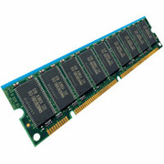
General Address Translation
Virtual
Addresses
Physical
Addresses
CPU
MMU
Each process, kernel have a different address space
Address Space = All addresses a process can touch
Two views of memory:
View from the CPU – what the program sees (virtual)
View from physical memory (physical)
MMU is hardware that converts between the two

Slide 48
General Address Translation
Virtual
Addresses
Physical
Addresses
CPU
MMU
Implementing protection with translation
No virtual address in one process refers to a physical address being used by another process
Also possible: controlled Sharing (some physical addresses in common)

Slide 49
Where We Are Going
Code
Data
Heap
Stack
Data 2
Code
Data
Heap
Stack
Stack 1
Heap 1
Code 1
Stack 2
Prog 1
Virtual
Address
Space 1
Data 1
Prog 2
Virtual
Address
Space 2
Heap 2
Code 2
OS code
Translation Map 1
OS data
Translation Map 2
OS heap &
Stacks
Physical Address Space

