Slide 1
CS 162: Operating Systems and Systems Programming
Lecture 18: Address Translation, Paging, Protection
July 25, 2019
Instructor: Jack Kolb
https://cs162.eecs.berkeley.edu

Slide 2
Logistics
Midterm Regrades Open, Close Friday
Project 2 Milestone Tonight
HW/Project "Party" on Friday
And happy to answer questions on material or midterm exam problems
Mid-Summer Course Survey: https://tinyurl.com/cs162midsummer

Slide 3
Recall: Transaction
Defined as an atomic sequence of reads/writes
Takes system from one consistent state to another
transaction
consistent state 1
consistent state 2

Slide 4
Recall: Journaling File Systems
Don't modify data structures on disk directly
Write each update as transaction recorded in a log
Also maintained on disk (allocate blocks for it when formatting)
Once changes are in the log, they can be safely applied to “real” on-disk data structures
In background, scan for complete log entries, apply their actions, and remove from log

Slide 5
Ex: Creating a file (as transaction)
Find free data block(s)
Find free inode entry
Find dirent insertion point
---------------------------------------------------------
[log] Write map (used)
[log] Write inode entry to point to block(s)
[log] Write dirent to point to inode
Free space map
Data blocks
…
Inode table
Directory
entries
tail
head
done
pending
start
commit
Log: in non-volatile storage (Flash or on Disk)

Slide 6
Recovering from a System Crash
Scan the log
Detect transaction start with no commit
Discard log entries
Disk remains unchanged
Free space map
Data blocks
…
Inode table
Directory
entries
tail
head
done
pending
start
Log: in non-volatile storage (Flash or on Disk)

Slide 7
Recovering from a System Crash
If a log entry has matching commit, apply transaction
Redo it as usual
Free space map
Data blocks
…
Inode table
Directory
entries
tail
head
done
pending
start
commit
Log: in non-volatile storage (Flash or on Disk)

Slide 8
Copy-on-Write (CoW) File Sys.
To change a file:
Write new version of data block
Propagate changes "upwards" through FS tree structure
Write new copy of indirect blocks (if necessary)
Write new copy of inode
Write new copy of directory entry pointing to new inode copy
Change does not take effect unless we finish last step – provides atomicity and durability

Slide 9
CoW with Smaller-Radix Blocks
old version
new version
Write

Slide 10
CoW with Smaller-Radix Blocks
old version
new version

Slide 11
Memory Multiplexing Goals
Protection
Private memory of other processes/OS remains private
Even from malicious processes
Controlled Overlap
Want processes and OS to share memory for communication, cooperation
Or just to save space (e.g., shared libraries)
Uniform View of Memory
No need to change binary file's addresses when we want to execute two instances of it
No need to change a program to let it use more memory

Slide 12
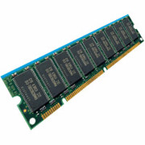
General Address Translation
Virtual
Addresses
Physical
Addresses
CPU
MMU
Each process, kernel have a different address space
Address Space = All addresses a process can touch
Two views of memory:
View from the CPU – what the program sees (virtual)
View from physical memory (physical)
MMU is hardware that converts between the two

Slide 13
Base and Bound w/ Translation
0000…
code
0000…
code
Static Data
heap
Static Data
heap
stack
0100…
stack
Base Address
1000…
code
1000…
0010…
Program
address
0010…
Static Data
1010…
heap
Bound
<
stack
1100…
0100…
Program cannot touch OS
Program cannot touch other progs.
FFFF…

Slide 14
Problems with Base and Bound
process 6
process 6
process 6
process 6
process 5
process 5
process 5
process 9
process 9
process 11
process 2
process 10
OS
OS
OS
OS
External Fragmentation – no contiguous free region big enough to accommodate new process
Not every process needs the same amount of space
Needs change over time
No way to plan memory layout ahead of time

Slide 15
Problems with Base and Bound
Internal Fragmentation
Large gap in address space between stack and heap
Range of memory is unused, but still allocated to process
Stack
Heap

Slide 16
Base and Bound: Sharing
Want to share code to save space
Example: OS Libraries
May also want to share memory for communication
Process 1
libc.so
Process 2
libc.so
Process 2
libc.so
OS

Slide 17
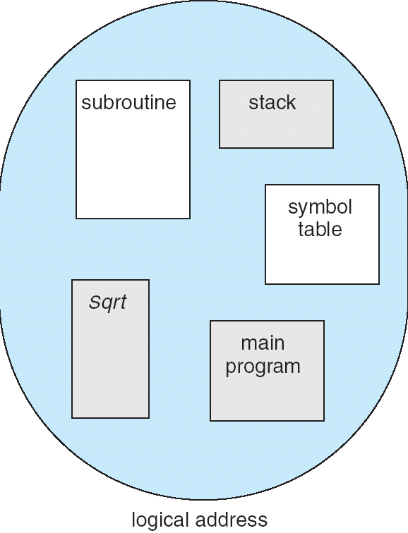
Segmentation
1
1
1
4
2
3
2
2
4
3
user view of
memory space
physical
memory space
Manage each region of address space as an independent unit
One process uses multiple contiguous allocations of memory, called segments

Slide 18
Segmentation Implementation
Virtual
Address
offset
>
Error
Seg #
Offset
Base0
Limit0
V
Base1
Limit1
V
Base2
Limit2
V
Base2
Limit2
V
Physical
Address
Base3
Limit3
N
+
Base4
Limit4
V
Base5
Limit5
N
Base6
Limit6
N
Base7
Limit7
V
Segment map stored in processor
Segment # extracted from virtual address
Base added to generate physical address
Bound checked, error if out of range

Slide 19
Segmentation Implementation
Virtual
Address
offset
>
Error
Seg #
Offset
Base0
Limit0
V
Base1
Limit1
V
Base2
Limit2
V
Base2
Limit2
V
Physical
Address
Base3
Limit3
N
+
Base4
Limit4
V
Base5
Limit5
N
Base6
Limit6
N
Base7
Limit7
V
Check Valid
Access
Error
Valid Bit: Did we actually allocate this region of mem?
Access error if No
Can’t have a negative bound

Slide 20
Example: Four Segments (16-bit Addresses)
Seg ID # | Base | Limit
0 (code) | 0x4000 | 0x0800
1 (data) | 0x4800 | 0x1400
2 (shared) | 0xF000 | 0x1000
3 (stack) | 0x0000 | 0x3000
Seg
Offset
15
14
13
0
Virtual Address Format
SegID = 0
0x0000
0x0000
SegID = 1
0x4000
0x4000
0x4800
0x5C00
0x8000
Space for
Other Apps
0xC000
0xF000
Virtual
Address Space
Physical
Address Space

Slide 21
Segmentation vs. Base & Bound
Internal fragmentation?
We can have large, unused gaps in virtual address space that don’t correspond to any allocated segment
But segments must be contiguous in physical memory
Reserve extra space at beginning?
Expansion is difficult
0x0000
0x4000
0x4800
0x5C00
0xF000
Virtual
Address Space

Slide 22
Segmentation vs. Base & Bound
External fragmentation?
Yes – may need to rearrange chunks of memory
Segments are smaller than full process memory image, hopefully less work
0x0000
0x4000
0x4800
0x5C00
0xF000
Virtual
Address Space

Slide 23
Segmentation vs. Base & Bound
Sharing?
Yes! Allow virtual addresses in two processes to map to same segment in physical mem.
But can only share at segment granularity
One shared library per segment?
Will we run out of segments?
0x0000
0x4000
0x4800
0x5C00
0xF000
Virtual
Address Space

Slide 24
Swapping
Problem: What if all segments don’t fit in memory?
Breaks the illusion of a dedicated machine
Potential solution: When process isn’t running, move one or more segments to disk
Load segment back into main memory before resuming
An “extreme context switch”
Need to track whether or not a segment is resident in memory in processor segment map

Slide 25
Swapping
Disks are orders of magnitude slower than memory
Sure, SSDs are faster, but not that much faster
For modern systems, swapping performance is unacceptable
Maybe swap some idle memory to disk, but never something active
Why talk about it?
One of the original motivations for paging
Program loading still involves this mechanism

Slide 26
How can we do better?
Allocate at finer granularity than segments
Allocate memory in fixed-size chunks: pages
All allocations are full pages
All holes are multiples of a page size
Remember blocks in file systems? Same concept
Expanding memory footprint: allocate new page
No need to relocate existing allocations
No struggle to find free region of proper size

Slide 27
What’s the catch?
More bookkeeping
Need to track physical memory location of each page
Need to track metadata (valid, permissions) per page
Page size represents a tradeoff
Larger: Fewer pages to keep track of, more internal fragmentation
Smaller: Less wasted space, more pages to track
Less locality: Sequential access in virtual space is not necessarily sequential in physical space
Jumping across page boundaries

Slide 28
Implementing Paging
Virtual Address:
Virtual
Page #
Offset
PageTablePtr
page #0
V,R
Physical
Frame #
Offset
page #1
V,R
page #1
V,R
page #2
V,R,W
Physical Address
PageTableSize
>
page #3
V,R,W
Check Perm
Access Error
page #4
N
page #5
V,R,W
Access
Error
Page Table: Process-Specific map for bookkeeping
Tells us in which physical page frame our virtual page is stored
Virtual page number is index into table
Table itself resides in physical memory
Trigger fault if page access is not permitted

Slide 29
Paging: Address Mapping
Virtual Address:
Virtual
Page #
Offset
PageTablePtr
page #0
V,R
Physical
Frame #
Offset
page #1
V,R
page #1
V,R
page #2
V,R,W
Physical Address
PageTableSize
>
page #3
V,R,W
Check Perm
Access Error
page #4
N
page #5
V,R,W
Access
Error
Offset: copied from virtual addr to physical addr
Example: 4K pages require a 12-bit offset
Virtual page # is all remaining bits
32-bit address space with 4K Pages: 2²⁰ = 1 Million pages
Physical page # replaces virtual page # to form physical addr
May be different length (fewer physical frames than virtual pages)

Slide 30
Address Translation: Overhead
Base and Bound: Two Registers
Segmentation: Segment Table
One table entry per segment
Few segments, so typically small
Potentially store in registers
Paging: Page Table
Allocate physical memory to store table
Extra memory access per operation
Once to translate address, second to do actual work
Tables can get large (1 million entries on 32-bit machine)

Slide 31
Simple Page Table Example
Example (4-byte pages)
0x00
0000 0000
0x00
a
b
c
d
0001 0000
0x04
0
4
i
j
k
l
0x04
0000 0100
1
0000 1100
0x05!
e
f
g
h
3
2
1
0000 0100
0x08
0x06?
0x08
0000 1000
Page
Table
0x0C
i
j
k
l
e
f
g
h
0x09?
0x0E!
0x10
Virtual
Memory
0000 0110
0000 1110
a
b
c
d
0000 1001
0000 0101
Physical
Memory

Slide 32
What about Sharing?
Virtual Address
(Process A):
Virtual
Page #
Offset
PageTablePtrA
page #0
V,R
page #1
V,R
page #2
V,R,W
page #2
V,R,W
page #3
V,R,W
Shared
Page
page #4
N
page #5
V,R,W
PageTablePtrB
page #0
V,R
page #1
N
This physical page
appears in address
space of both processes
page #2
V,R,W
page #3
N
page #4
V,R
page #4
V,R
page #5
V,R,W
Virtual Address
(Process B):
Virtual
Page #
Offset

Slide 33
Paging: Allocation
Virtual memory view
Page Table
11111 11101
11110 11100
11101 null
11100 null
11011 null
11010 null
11001 null
11000 null
10111 null
10110 null
10101 null
10100 null
10011 null
10010 10000
10001 01111
10000 01110
01111 null
01110 null
01101 null
01100 null
01011 01101
01010 01100
01001 01011
01000 01010
00111 null
00110 null
00101 null
00100 null
00011 00101
00010 00100
00001 00011
00000 00010
Physical memory view
1111 1111
stack
1110 0000
stack
1110 0000
1100 0000
What happens if stack grows to 1110 0000?
heap
1000 0000
heap
0111 000
data
data
0101 000
0100 0000
code
code
0001 0000
0000 0000
0000 0000
page #
offset

Slide 34
Summary: Paging
Virtual memory view
Page Table
11111 11101
11110 11100
11101 10111
11100 10110
11011 null
11010 null
11001 null
11000 null
10111 null
10110 null
10101 null
10100 null
10011 null
10010 10000
10001 01111
10000 01110
01111 null
01110 null
01101 null
01100 null
01011 01101
01010 01100
01001 01011
01000 01010
00111 null
00110 null
00101 null
00100 null
00011 00101
00010 00100
00001 00011
00000 00010
Physical memory view
1111 1111
stack
1110 0000
stack
1110 0000
1100 0000
stack
Allocate new pages where room!
heap
1000 0000
heap
0111 000
data
data
0101 000
0100 0000
code
code
0001 0000
0000 0000
0000 0000
page #
offset

Slide 35
Paging: Hardware Support
Special Register to store page table pointer
Like base and bound, modified in kernel mode only
Change register values on context switch
Page Table Lookup
Two physical memory accesses per virtual access
Later: making this faster
Modern systems do all of this in hardware

Slide 36
Page Table Issues
What if address space is mostly unused?
Say we have 4K pages and 2GB of virtual address space
512K page table entries
Megabytes of space for table itself
How about 64-bit x86 machine? ~256 TB of virt addr space
64 billion page table entries
Gigabytes of space for table itself
Even though most of this address space is unused by the process in its lifetime

Slide 37
Break

Slide 38
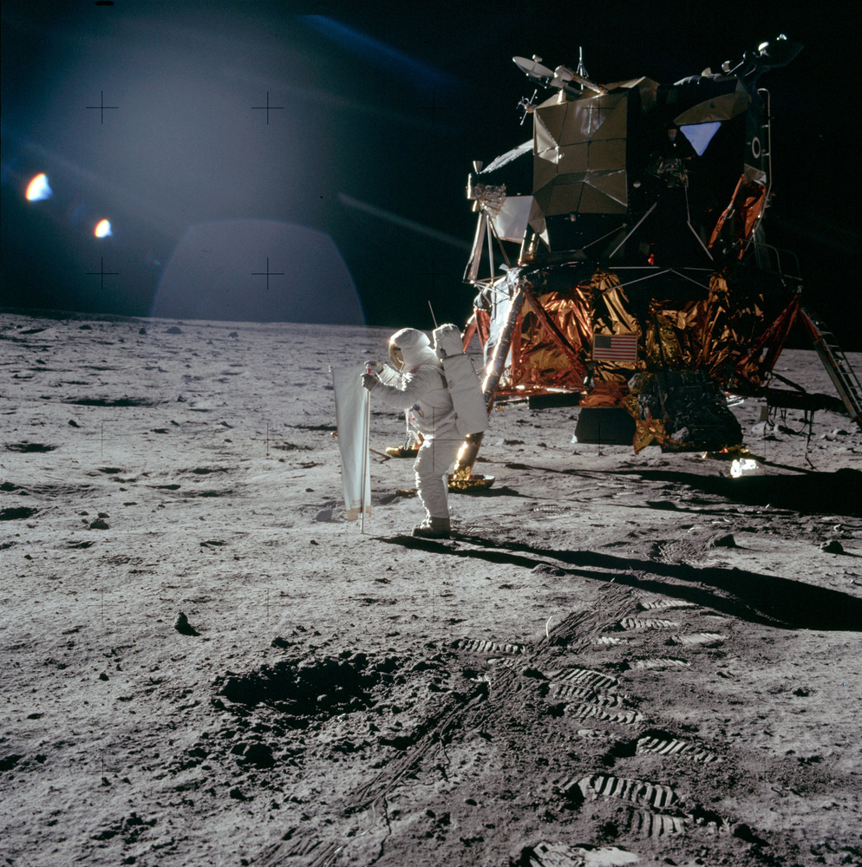
Historical Digression
We just passed the 50th anniversary of an important scientific/technological event!
July 20th, 1969

Slide 39
What does this have to do with computers?
A critical part of why this effort was successful
Many important roles:
Recording sensor data
Monitoring fuel oxygen, battery levels
Carefully managing these limited resources

Slide 40
Navigating in Space
Computer-controlled rockets
Burn just the right amount of fuel
For precisely the right amount of time
To apply the perfect amount of acceleration

Slide 41
Lots and lots of code…
All assembly
C didn’t appear until 1972!
You can go read it if you want:
https://github.com/chrislgarry/Apollo-11/
Think of the complexity and danger of bugs

Slide 42
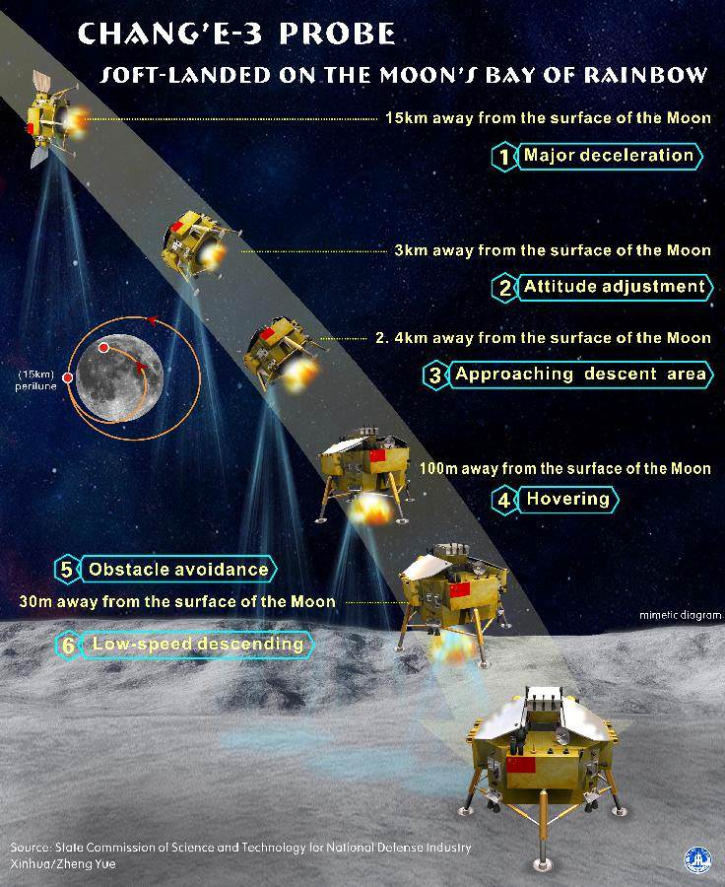
Landing on the Moon is Hard
No atmosphere
Parachutes useless
Powered Descent
Burn rockets to slow down falling spacecraft
Requires computer assistance if not full automation
Bad time for things to go wrong…

Slide 43
What does this have to do with Operating Systems?
Apollo guidance computer ran a very primitive OS
Called “Executive System”
Only running special purpose code, no peripherals or IO
But still need protection!
Important Element: Real-Time Scheduling
Like we have discussed in class
“A priority-scheduled multiprogramming operating system”

Slide 44
And Things Did Go Wrong
Right in the middle of the lunar descent
But would have been much worse without careful OS design!
“The design of the Executive almost certainly saved Apollo 11” – great article on this

Slide 45
Apollo Executive
Cycle through prioritized list of tasks to run
Check for interrupts once every 960 msec.
Unfortunate combination of events during landing:
Antenna sensors reading garbage data
12,800 interrupts to Executive per second
Could no longer meet deadlines for tasks
Storage capacity exceeded
What do you do now?
Reboot the computer?

Slide 46
Apollo Executive
This was never supposed to happen – memory intentionally overprovisioned for expected set of tasks
But the OS was still ready to deal with this
Very careful restart sequence:
Drop tasks and flush memory
Except keep current velocity and trajectory around
Restart tasks in order of priority
Resume navigation

Slide 47
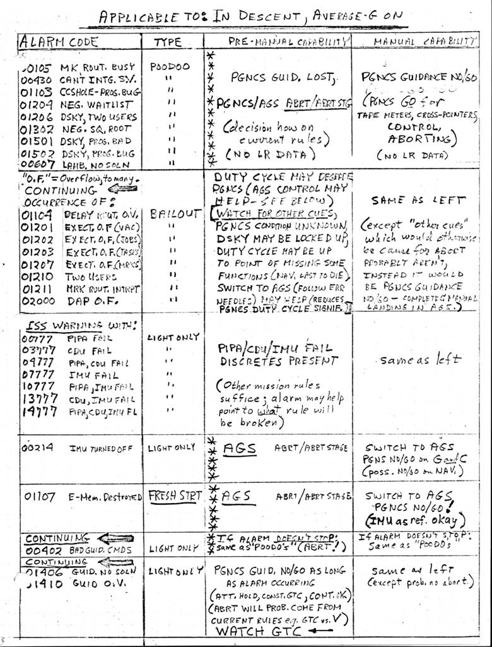
Quick Debugging
Keep in mind, mission controllers had to realize this wasn’t a fatal problem while the landing was ongoing
1202 Alarm – no need to abort landing

Slide 48
Apollo’s Technological Legacy
Some estimates say Apollo advanced Computing by 10 years all on its own
Integrated Circuits were a huge part of this
Motivated to have small and light computers
Getting something into orbit costs $10K per pound
Many more contributions…

Slide 49
World’s Best Software Engineers?
In terms of bugs per lines of code
Probably: Space Shuttle software team at Lockheed Martin (“They Write the Right Stuff”)
“The last three versions of the program – each 420,000 lines long – had just one error each.”
Compare that to the Toyota developers we discussed earlier!

Slide 50
Not Your Typical CS Team
Very little if any overtime hours worked
Not located in Silicon Valley
Members from different backgrounds
Very strict on process (documentation, specs, etc.)
Very expensive: costs thousands per line of code

