Slide 1
CS 162: Operating Systems and Systems Programming
Lecture 21: TLB, Buffer Cache, Demand Paging
July 31, 2019
Instructor: Jack Kolb
https://cs162.eecs.berkeley.edu

Slide 2
Logistics
Proj 3 Due on August 12
Design Doc Due Thursday
HW3 Due on August 13
Last Tuesday of the class

Slide 3
Recall: Paging Tricks
Demand Paging: Swapping for pages
Keep only active pages in memory
Remember: not common on modern systems, except perhaps when first loading program
Response: Load in page from disk, retry operation
Copy on Write (remember fork?)
Temporarily mark pages as read-only
Allocate new pages when OS receives protection fault
Zero-Fill on Demand
Slow to overwrite new pages with all zeros
Page starts as invalid, zero it out when it's actually used

Slide 4
Making Exceptions Transparent
Faulting Inst.
Faulting Inst.
User
OS
Load Page
Exception prompts OS to fix something, e.g. finally load copy a page from disk
Can we return just like with a system call?
Not Quite
Need to repeat instruction that caused exception, not advance past it

Slide 5
Precise Exceptions
Definition: Machine's state is as if the program executed up to the offending instruction
Hardware has to complete previous instructions
Remember pipelining
May need to revert side effects if instruction was partially executed
OS relies on hardware to enforce this property

Slide 6
Recall: Caching
Cache: Repository for copies that can be accessed more quickly than the originals
Goal: Improve performance
We'll see lots of applications!
Memory
Address translations
File contents, file name to number mappings
DNS records (name to IP addr mappings)

Slide 7
Recall: Memory Hierarchy
Take advantage of the principle of locality to:
Present as much memory as in the cheapest technology
Provide access at speed offered by the fastest technology
Processor
Control
Tertiary
Storage
(Tape)
Secondary
Storage
(Disk)
Second
Level
Cache
(SRAM)
Main
Memory
(DRAM)
Datapath
On-Chip
Cache
Registers
Speed (ns):
1s
10s-100s
100s
10,000,000s
(10s ms)
10,000,000,000s
(10s sec)
Size (bytes):
100s
Ks-Ms
Ms-Gs
Gs-Ts
Ts-Ps

Slide 8
Recall: Locality
Probability
of reference
0
Address Space
2^{n} - 1
Temporal Locality (Locality in Time):
Keep recently accessed data items closer to processor
Spatial Locality (Locality in Space):
Move contiguous blocks to the upper levels
Main
Memory
To Processor
Cache
Blk X
From Processor
Blk Y

Slide 9
How is a Block found in a Cache?
Block Address
Block
offset
Tag
Index
Set Select
Data Select
Block is minimum unit of caching (recall spatial locality)
Data Select: Which part of block to retrieve
Index Used to Lookup Candidates in Cache
Index identifies the set
Tag used to identify actual copy
If no candidates match, then declare cache miss

Slide 10
Recall: Where Can a Block Go?
Example: Block 12 placed in 8 block cache
32-Block Address Space:
Block
no.
1 1 1 1 1 1 1 1 1 1 2 2 2 2 2 2 2 2 2 2 3 3
0 1 2 3 4 5 6 7 8 9 0 1 2 3 4 5 6 7 8 9 0 1 2 3 4 5 6 7 8 9 0 1
Direct mapped:
block 12 can go only into block 4 (12 mod 8)
Set associative:
block 12 can go anywhere in set 0 (12 mod 4)
Fully associative:
block 12 can go anywhere
Block
no.
0 1 2 3 4 5 6 7
Block
no.
0 1 2 3 4 5 6 7
Block
no.
0 1 2 3 4 5 6 7
Set
0
Set
1
Set
2
Set
3

Slide 11
Caching Applied to Address Translation
Virtual
Address
TLB
Physical
Memory
CPU
Physical
Address
Cached?
Yes
No
Save
Result
Translate
(MMU)
Data Read or Write
(untranslated)

Slide 12
Caching Address Translations
Locality in page accesses?
Yes: Spatial locality, just like CPU cache
TLB: Cache of page table entries

Slide 13
TLB and Context Switches
Do nothing upon context switch?
New process could use old process's address space!
Option 1: Invalidate ("flush") entire TLB
Simple, but very poor performance
Option 2: TLB entries store a process ID
Called tagged TLB
Requires additional hardware

Slide 14
TLB and Page Table Changes
Think about what happens we we use fork
OS marks all pages in address space as read-only
After parent returns from fork, it tries to write to its stack
Triggers a protection fault. OS makes a copy of the stack page, updates page table.
Restarts instruction.

Slide 15
TLB and Page Table Changes
What if TLB had cached the old read/write page table entry for the stack page?
OS marks all pages in address space as read-only
After parent returns from fork, it tries to write to its stack
Triggers a protection fault. OS makes a copy of the stack page, updates page table.
Restarts instruction.

Slide 16
How do we invalidate TLB entries?
Hardware could keep track of where page table for each entry is and monitor that memory for updates…
Very complicated!
Especially for multi-level page tables and tagged TLBs
Instead: The OS must invalidate TLB entries
So TLB is not entirely transparent to OS

Slide 17
TLB and Page Table Changes
Think about what happens we we use fork
OS marks all pages in address space as read-only and tells MMU to clear those TLB entries.
After parent returns from fork, it tries to write to its stack
Triggers a protection fault. OS makes a copy of the stack page, updates page table. Also tells MMU to clear that TLB entry.
Restarts instruction.

Slide 18
Designing a TLB
CPU
TLB
Cache
Memory
Critical path of every memory access
Caches use physical addresses (Why?)
Very high miss penalty
Needs to be fast. Low Associativity?
Problem: Conflict Misses
Index bits could easily coincide
Code: 0x0040 0000
Data: 0x1000 0000
Stack: 0x7FFF 0FFC

Slide 19
Designing a TLB
CPU
TLB
Cache
Memory
Critical path of every memory access
Caches use physical addresses (Why?)
Very high miss penalty
Needs to be fast. Low Associativity?
More associativity: we pay a cost for each cache lookup
But this is worth it because misses are so slow

Slide 20
Typical TLB Organization
128-1024 Entries
Modern CPUs: Multi-level TLBs, just like caches
Maybe128, then 1024 entries in L1, L2 TLBs
2048 entries in brand new Intel CPUs
Often Highly Associative
Contains: Virtual to Physical Address Mapping
Other Info: Tagged TLB – Process ID
Aspects of page table entry: permission bits, etc.

Slide 21
Example: MIPS R3000
Virtual Address Physical Address Dirty Ref Valid Access ASID
0xFA00 0x0003 Y N Y R/W 34 0x0040 0x0010 N Y Y R 0 0x0041 0x0011 N Y Y R 0
TLB
64 entry, on-chip, fully associative, software TLB fault handler
Virtual Address Space
ASID
V. Page Number
Offset
6
20
12
0xx User segment (caching based on PT/TLB entry)
100 Kernel physical space, cached
101 Kernel physical space, uncached
11x Kernel virtual space
Allows context switching among
64 user processes without TLB flush

Slide 22
Overlapping TLB & Cache Access
Idea: Cache access shouldn’t need physical page number immediately
Cache access starts off with index + byte
In parallel, check TLB for physical page number
Then we can check tag bits last
virtual address
Virtual Page #
Offset
physical address
tag / page #
index
byte

Slide 23
Overlapping TLB & Cache Access
TLB
assoc
lookup
4K Cache
32
index
1 K
20
10
2
4 bytes
virtual page #
disp
00
Hit/
Miss
page #
=
Tag
Data
Hit/
Miss
What if cache is larger?
Need something more sophisticated (CS 152)
Alternative: Just use virtual addresses in caches

Slide 24
Exercise
Assume we have a machine with 4KB pages and want to overlap the cache and TLB lookups
What is the maximum amount of data we can store in a direct-mapped cache?
What about a 2-way set associative cache?
4-way set associative cache?

Slide 25
Putting Everything Together: Address Translation
Physical
Memory:
Virtual Address:
Virtual
P1 index
Virtual
P2 index
Offset
PageTablePtr
Physical Address:
Physical
Page #
Offset
Page Table
(1st level)
Page Table
(2nd level)

Slide 26
Putting Everything Together: TLB
Physical
Memory:
Virtual Address:
Virtual
P1 index
Virtual
P2 index
Offset
PageTablePtr
Physical Address:
Physical
Page #
Offset
Page Table
(1st level)
Page Table
(2nd level)
TLB:
…

Slide 27
Putting Everything Together: Cache
Physical
Memory:
Virtual Address:
Virtual
P1 index
Virtual
P2 index
Offset
PageTablePtr
Physical Address:
Physical
Page #
Offset
Page Table
(1st level)
tag
index
byte
cache:
Page Table
(2nd level)
tag:
block:
TLB:
…
…

Slide 28
More Caching Coming Up
Paged Virtual Memory (memory as cache for disk)
File Systems (Buffer Cache)

Slide 29
Impact of Caches on OS
Need to deal with consequences of having a cache
Maintaining correctness (e.g., clear entries from TLB if the underlying page table changes)
Process and Thread Scheduling
Rapid interleaving may degrade cache performance
Designing operating system data structures to account for caching (want good performance)

Slide 30
Break

Slide 31
Buffer Cache
Copies of disk blocks cached in main memory for the kernel's use
Could be data blocks or contain inodes, directory contents, etc.
Possibly dirty (modified and not written back)

Slide 32
Buffer Cache Replacement Policy
Replacement Policy: Least Recently Used
Can afford to record and maintain timestamp for each disk block (already going through a read/write op)
Keep in kernel memory
This is in contrast to demand paging
LRU Weakness: Scan through filesystem, e.g. to search for file by name – no block reuse
Alternative option: application gives a hint, "this file is only used once"

Slide 33
Prefetching/Read Ahead
Goal: Avoid compulsory misses in buffer cache
Think of spatial locality in traditional mem cache
Idea: Guess that files/directories read together
If process reads part of a file, fetch and cache the rest of its blocks before the process asks for them
"Almost" Free: Sequential Read

Slide 34
Delayed Writes
Writes not immediately sent to disk
So buffer cache is a write back cache
write copies data from user space to kernel buffer
Other apps read data from cache instead of disk
Cache is transparent to user programs
Flushed to disk periodically
In Linux: kernel threads flush buffer cache very 30 sec. in default setup

Slide 35
Delayed Writes
Delay block allocation: May be able to allocate multiple blocks at same time for file, keep them contiguous
Some files never actually make it all the way to disk
Remember all those short-lived files we discussed when studying real file system usage patterns?
But what if system crashes before buffer cache block is flushed to disk?
And what if this was for a directory file?
Lose pointer to inode
As we've seen: file systems have recovery mechanisms

Slide 36
Demand Paging
Main memory as a cache for SSD/Disks
Idea: Present illusion we have the speed of RAM and the capacity of disk at program’s disposal
Processor
Control
Caching
Tertiary
Storage
(Tape)
Second
Level
Cache
(SRAM)
Main
Memory
(DRAM)
Secondary
Storage
(Disk)
Datapath
On-Chip
Cache

Slide 37
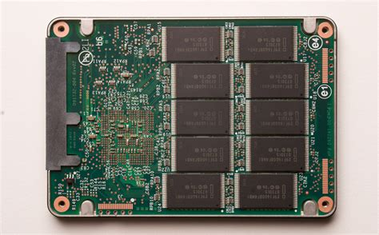
Illusion of Infinite Memory
∞
TLB
Page
Table
Physical
Memory
Disk/SSD
Virtual
Memory
How? Layer of indirection: Page table & fault handlers
Transparent?
Performance: No, disk is much slower
Correctness: Yes

Slide 38
Memory as a Cache for Disk
Block Size: 1 Page
Associativity: Fully Associative
Any page can go in any frame
Write Policy: Write Back (disk writes are slow)
Replacement Policy: LRU Approximation

Slide 39
32-bit x86 Page Table Entry
10/10/12 Split of Virtual Address
Top-level page tables called directories
A: Set by hardware when page is first accessed
D: Page marked dirty if it is ever modified
Page Table entry tells OS about usage patterns
Page Frame Number
(Physical Page Number)
Unused
(OS)
0
L
D
A
PCD
PWT
U
W
P
31-12
11-9
8
7
6
5
4
3
2
1
0

Slide 40
Why Might this Approach Work? Working Set Model
Theory: Programs transition through sequence of “working sets” – subsets of their address spaces
Address
Time

Slide 41
Cache Behavior under WS model
1
new working set fits
Hit Rate
0
Cache Size

Slide 42
Another model: Zipf/Power Law
“Heavy-Tailed” distribution
Lots of rare items – lots of unavoidable misses
A few very common items – caching very helpful

Slide 43
Demand Paging: Page Replacement
Process access page on disk, PTE indicates invalid
MMU traps to OS – Page Fault
OS chooses a page to replace
If dirty bit set, must write back to disk
OS loads new page into memory
OS updates page table entries (for new and evicted pages) and invalidates relevant TLB entries
OS restarts process from just before access
Precise Exceptions!

Slide 44
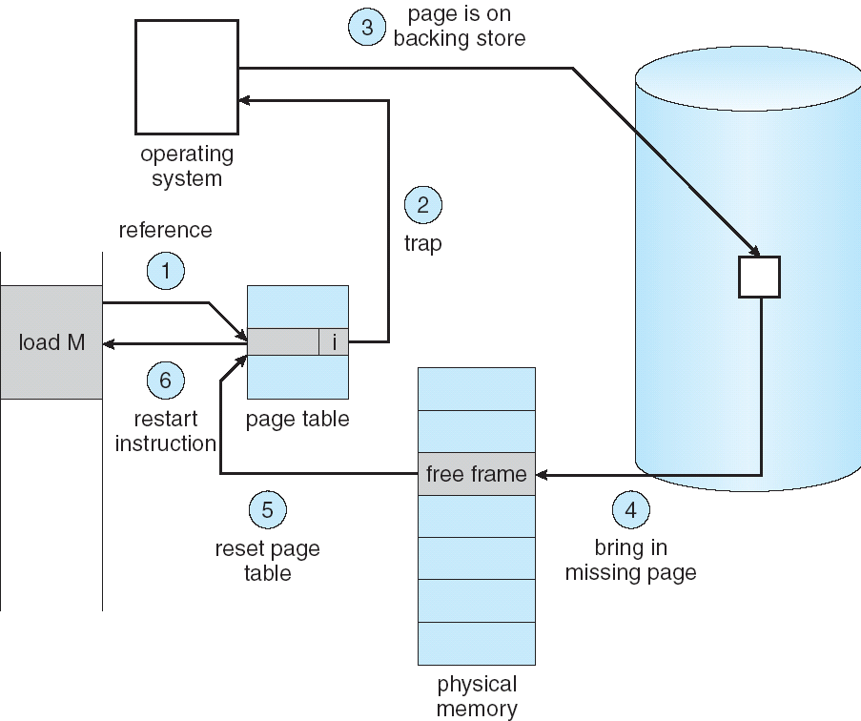
Summary: Page Fault

Slide 45
Aside: Swapping in Modern Sys?
Recall: We've already said that swapping performance is unacceptable in a modern system
Hardware has changed since the idea of demand paging was introduced
CPUs have gotten much faster
Disks/SSDs have gotten faster, but still several orders of magnitude slower than CPU
Capacity of RAM has gotten larger
Modern OSs only swap out something very idle or when under memory pressure

Slide 46
So why talk about it?
Shows power of indirection – OS can play tricks with memory, all unseen by user program
Could imagine lazily loading an executable
"Compulsory Misses" in memory prompt read from disk
As an instance of caching
Very expensive miss time
Cache Eviction Policy => Page Replacement Policy

Slide 47
Page Replacement
Where does a free page frame come from?
Hopefully: Free List
Clear out space in background, ahead of time
Maintain pool of free pages for future use
Bad case: Have to evict a page from physical memory on demand at time of replacement

Slide 48
How bad is a miss?
Recall: Expected Access Time
= Hit Rate x Hit Time + Miss Rate x Miss Time
= Hit Time + Miss Rate x Miss Penalty
Reasonable Numbers:
Hit Time = Memory Access Time = 200ns
Miss Penalty = Page Fault Service Time = 8 ms
EAT = 200 ns + Miss Rate x 8 ms
Miss Rate of 0.1%: EAT = 8200 ns
Want EAT 220ns: Miss Rate = 0.00025%

Slide 49
How do we limit misses?
Compulsory Misses: Prefetching
Capacity Misses: Can't quickly add more RAM
Conflict Misses: Don't technically occur, RAM acts as fully associative cache
Comes down to having a good page replacement policy

Slide 50
Summary: Applications of Caching
TLB: Cache address mappings
Crucial for reasonable memory access times
Not transparent: OS does some management
Buffer Cache: Cache file system blocks
LRU Replacement Policy: Have necessary space and time
Read ahead to avoid compulsory misses
Delay writes
Demand Paging: Memory behaves as disk cache
Handle page fault by loading necessary page into mem
A miss is so expensive, it must be highly unlikely
Replacement policy important (more to come)

