Slide 1
CS 162: Operating Systems and Systems Programming
Lecture 27: CAP Theorem, More Networking
August 12, 2019
Instructor: Jack Kolb
https://cs162.eecs.berkeley.edu

Slide 2
Logistics
Proj 3 Due Tonight, 11:59 PM
HW3 Due Tomorrow, 11:59 PM
Course Evals Fixed
Review Session for Wednesday's Lecture
Final Exam: Thursday, 5-8PM

Slide 3
Recall: Two-Phase Commit
We can’t solve the General’s Paradox
  No simultaneous action
  But we can solve a related problem
Distributed Transaction: Two (or more) machines agree to do something or not do it atomically
Extra tool: Persistent Log
  If machine fails, it will remember what happened
  Assume log itself can’t be corrupted

Slide 4
Recall: Two-Phase Commit
One machine (coordinator) initiates the protocol
It asks every machine to vote on transaction
Two possible votes:
  Commit
  Abort
Commit transaction only if unanimous approval

Slide 5
Recall: Coordinator’s State Machine
INIT
Recv: START
Send: VOTE-REQ
WAIT
Recv: VOTE-ABORT
Send: GLOBAL-ABORT
Recv: all VOTE-COMMIT
Send: GLOBAL-COMMIT
ABORT
COMMIT

Slide 6
Recall: Worker’s State Machine
INIT
Recv: VOTE-REQ
Send: VOTE-ABORT
Recv: VOTE-REQ
Send: VOTE-COMMIT
READY
Recv: GLOBAL-ABORT
Recv: GLOBAL-COMMIT
ABORT
COMMIT

Slide 7
Recall: Blocking
What if both coordinator and a worker fail?
The remaining workers can still consult each other
But they can’t reach a conclusion on what to do!
Why?
If all remaining workers in INIT, we still don’t know state of failed worker w
w may have been first to be notified of a commit, and then coordinator and w crashed

Slide 8
Distributed Consensus
Two- and Three-Phase commit make a decentralized decision
Example: Changing the value of a key among all replicas for the key
But they are hardly the only solutions to this problem

Slide 9
Better Agreement in Face of Failure
Idea: If a majority of nodes agree, commit
If a minority don’t participate, ignore them
Assumes a fail-stop model: if a machine breaks, it won’t send/receive messages
Algorithms that do this: Paxos, Raft

Slide 10
Beyond Fail-Stop
What if nodes don’t just stop talking when they fail?
What if they send incorrect information?
Or what if nodes are actively malicious?
This is called the Byzantine Failure Model
Do Paxos/Raft still work even if just a minority of nodes exhibit Byzantine failures? No

Slide 11
CAP Theorem
Originally proposed by Eric Brewer (Berkeley)
Consistency – changes appear to everyone in same sequential order
Availability – can get a result at any time
Partition Tolerance – system continues to work even when one part of network can't communicate with the other
Impossible to achieve all 3 at the same time (pick two)

Slide 12
CAP Theorem
What do we do if a network partition occurs?
Prefer Availability: Allow the state at some nodes to disagree with the state at other nodes (AP)
Prefer Consistency: Reject requests until the partition is resolved (CP)
Partition B
Partition A

Slide 13
Example: Two-Phase Commit
When a partition occurs, 2PC is:
Consistent: Reads never return wrong values
Not Available: Writes block until partition is resolved and unanimous approval is possible
So 2PC is arguably a CP system
Could also consider it a CA system if we enforce timeouts, give up on transactions rather than blocking

Slide 14
What about AP Systems?
Partition occurs, but both groups of nodes continue to accept requests
Consequence: State might diverge between the two groups (e.g., different updates are executed)
When communication is restored, there needs to be an explicit recovery process
  Resolve conflicting updates so everyone agrees on system state once again
Relevant Systems: Dynamo, Coda File System

Slide 15
Recall: Networking Challenge
Many different applications
  Email, Web, Online Games, etc.
Many different network styles and technologies
  Wireless, Wired, Optical, etc.
How do we organize all of this complexity?

Slide 16
Layering
Complex services from simpler ones
  Physical and Link Layers (Wi-Fi, Ethernet, …)
    Unreliable, local exchange of limited-size frames
  Network (IP) – routing between local networks
    Unreliable, global exchange of limited-size packets
  Transport (e.g., TCP) – Glue
    Reliable (with retries), ordering, stream of bytes
  Application – Everything on top of sockets

Slide 17
The Internet Hourglass
SMTP
HTTP
DNS
NTP
Applications
TCP
UDP
Transport
Waist
IP
Data Link
Ethernet
SONET
802.11
Physical
Copper
Fiber
Radio
The Hourglass Model

Slide 18
Implications of Hourglass
There is only one Network-Layer Protocol: IP
Allows networks to interoperate
Above IP: Applications function on all networks
Below IP: Change network’s construction without disturbing applications
One drawback: Changing IP itself (e.g. transitioning to IPv6) very involved

Slide 19
Sockets
Programmer's interface to transport layer
Looks just like a file with a file descriptor
  read adds to queue, write removes from it
Same abstraction for any kind of network
This class has covered TCP sockets

Slide 20
Recall: HTTP
Application protocol for The Web
  Retrieve a specific object, upload data, etc.
Runs on top of TCP (sockets)
Like any protocol, stipulates:
  Syntax: Content sent over socket connection
  Semantics: Meaning of a message
  Valid replies and actions taken upon message receipt
Arguably a form of RPC

Slide 21
HTTP Messages
Text-based: We just send character strings over our TCP socket connection
To make a request, browser might write something like the following on a socket:
GET /hello.html HTTP/1.0\r\n
Host: 128.32.4.8:8000\r\n
Accept: text/html\r\n
User-Agent: Chrome/45.0.2454.93\r\n
Accept-Language: en-US,en;q=0.8\r\n
\r\n

Slide 22
Reliable Byte Streams: TCP
Sequence Numbers
Sent
acked
Sent
not acked
Not yet
sent
Sender
Received
Given to app
Received
Buffered
Not yet
received
Receiver
Sliding window of unacknowledged packets
Deliver to user process in correct order
Resend if no acknowledgement received

Slide 23
Recall: Using Acknowledgements
A
B
A
B
Packet
Packet
Timeout
ack
Packet
ack
Checksum: Detect garbled packets
Receiver sends a packet to acknowledge when a packet received and ungarbled
  No acknowledgement? Resend after timeout
What if acknowledgement dropped?
  Packet is resent (wasteful), second chance to acknowledge

Slide 24
Window-Based Acknowledgements
Send up to N packets without ack
Both source and destination need to store N packets
Each packet has sequence number
A
B
N=5
pkt#0
pkt#4
Queue
ack#0
ack#4

Slide 25
Internet Protocol Features
Routing – an IP packet goes anywhere
  Just need the destination IP address
Fragmentation – split big messages into smaller pieces
  Think about downloading a file
  Maximum size 64K
  Reassemble at destination
  Hides differences in physical layers
Multiple protocols running on top
  ICMP, TCP, UDP, …

Slide 26
IP Addresses
In IPv4: a 32-bit integer used as the destination of an IP packet
  Often written as four dot-separated integers (0-255)
  Example: DNS for "eecs.berkeley.edu" resolves to 23.185.0.1
Extended to 128 bits in IPv6

Slide 27
Internet: Hierarchical Network
Not every host connected to every other one
Use a network of Routers to connect subnets together
Other
subnets
subnet1
Router
Transcontinental
Link
Router
Other
subnets
Router
subnet3
subnet2

Slide 28
IP Address Subnets
With IP, all addresses in same subnet share same prefix of bits
  e.g. all hosts have addresses of the form 128.32.x.y
Mask: Number of matching prefixing bits
  Expressed as single number, e.g. 24
  Or all matching bits set to one address notation, e.g. 255.255.255.0
Subnet is identified by 32-bit value, with all bits that differ among machines set to 0, followed by slash and mask, e.g. 128.32.0.0/16

Slide 29
Special Reserved Subnets in IPv4
127.0.0.0/8: loopback (same machine)
  127.0.0.1: Localhost
10.0.0.0/8, 172.16.0.0/12, 192.168.0.0/16: private
  Not available globally

Slide 30
Hosts in IP
Internet Host: A computer connected to the internet, assigned one or more IP addresses for routing
Each host does not necessarily have a globally unique IP address
  Groups of machines may share an IP address
  In this case, machines have private addresses behind a Network Address Translation Gateway
  Very typical for residential networks

Slide 31
Simple Network Terminology
Local Area Network (LAN): Designed to cover a small geographical area
  Topology: multi-access bus, ring, or star network
  Very fast communication speeds (e.g. 1 Gbps)
  Fast and cheap to broadcast to all nodes
Wide Area Network (WAN): Links geographically separated sites
  Point-to-point connections over long-haul lines
  Slower communication speeds
  Broadcast usually requires multiple messages

Slide 32
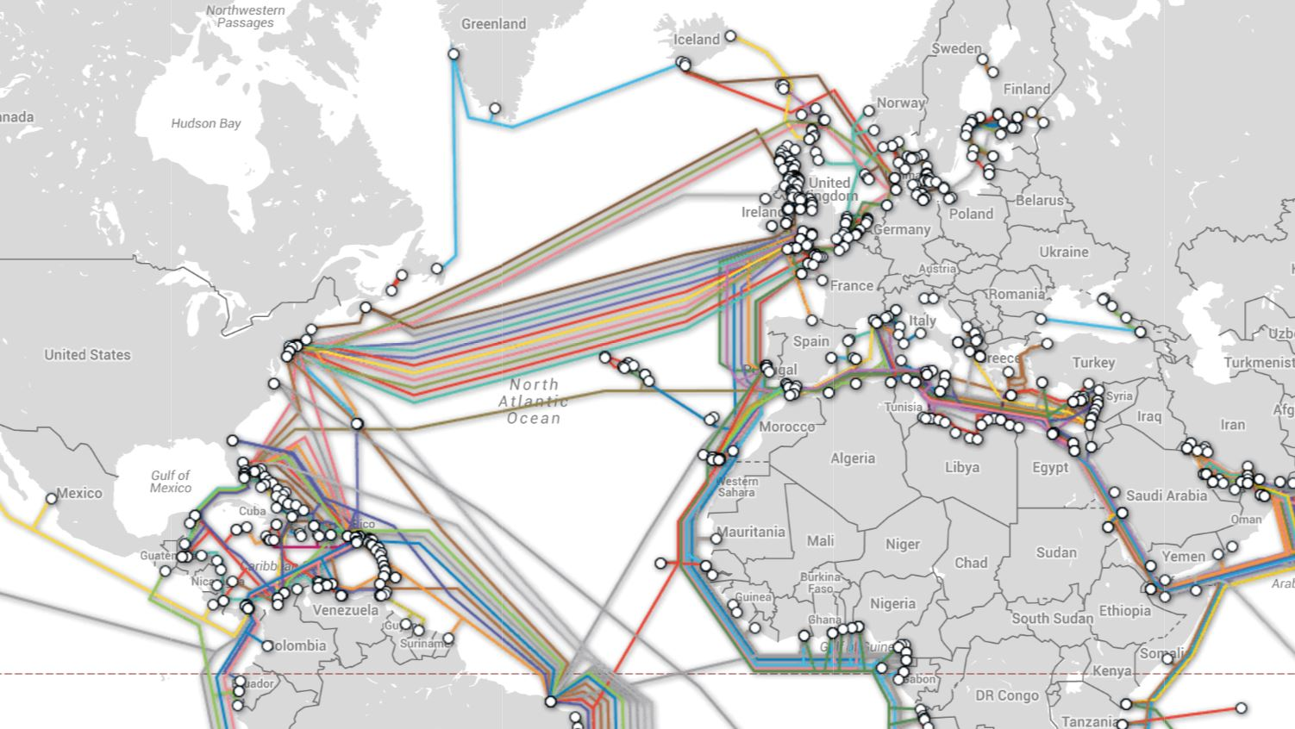
Wide Area Networks
If you want to know more: https://www.submarinecablemap.com/

Slide 33
IP Routing
Routing: The process of forwarding packets hop by hop through routers to reach their destination
Need more than just a destination address!
  Need a path
Think about an Amazon package: destination address in Berkeley isn't enough to get it here
  Needs to go to nearest airport, fly to SF
  Go from SF to East Bay distribution center
  And so on…

Slide 34
IP Routing
Each router maintains a routing table
Look up destination address in table
Decide which outgoing link to use to send packet, gets it closer to destination
Don't need 1 entry per IP address, instead routing is by subnet
Routing table entry contains:
  Destination address range + output link closer to dest.
Routing table also has a default entry as a fallback

Slide 35
Setting up Routing Tables
Internet has no centralized state!
  No single machine knows entire topology
  Topology is constantly changing (faults, reconfiguration)
Instead, routers use a dynamic algorithm to populate their routing tables
  Neighboring routers (with a direct link between them) exchange information

Slide 36
Setting up Routing Tables
Possible algorithm to set up routing table:
  Each entry has a cost, includes number of hops to destination, congestion, etc.
  Neighbors periodically exchange routing tables
  If my neighbor knows a cheaper route to a subnet, forward traffic for that subnet to the neighbor
  Factor in +1 hop for sending to neighbor itself
In reality: Internet has networks of different scales
  Different algorithms run at different scales

Slide 37
IP Packet Format
IP Header
Length
Size of packet
(header+data)
Flags &
Fragmentation
to split large
messages
0
15
16
31
IP Ver4
4
IHL
ToS
Total length(16-bits)
16-bit identification
flags
13-bit frag off
IP header
20 bytes
Time to
Live (hops)
TTL
protocol
16-bit header checksum
32-bit source IP address
Type of
transport
protocol
32-bit destination IP address
options (if any)
Data

Slide 38
What does a router care about?
IP Header
Length
Size of packet
(header+data)
Flags &
Fragmentation
to split large
messages
0
15
16
31
IP Ver4
4
IHL
ToS
Total length(16-bits)
16-bit identification
flags
13-bit frag off
IP header
20 bytes
Time to
Live (hops)
TTL
protocol
16-bit header checksum
32-bit source IP address
Type of
transport
protocol
32-bit destination IP address
options (if any)
Data

Slide 39
Layering
Complex services from simpler ones
  Physical and Link Layers (Wi-Fi, Ethernet, …)
    Unreliable, local exchange of limited-size frames
  Network (IP) – routing between local networks
    Unreliable, global exchange of limited-size packets
  Transport (e.g., TCP) – Glue
    Reliable (with retries), ordering, stream of bytes
  Application – Everything on top of sockets

Slide 40

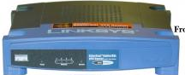
Broadcast Networks
Processor
I/O
Device
I/O
Device
I/O
Device
Memory
Internet
Shared communication medium: A Bus

Slide 41
Broadcast Networks
Shared Communication Medium
Examples:
  Original Ethernet
  All types of wireless (WiFi, Cellular Networks, …)
  Coaxial Cable (e.g., Cable Internet)

Slide 42
Broadcast Networks
Header
(Dest:2)
Body
(Data)
ID:1
(ignore)
Message
ID:3
(sender)
ID:4
(ignore)
ID:2
(receive)
How do we get unicast (message to one host) from broadcast (message to all hosts)?
Put Header on Front of Packet: Dest | Packet
  Often handled directly in hardware

Slide 43
How do we specify a destination?
Link Layer has its own addressing scheme: Media Access Control (MAC) Addresses
MAC Address: 48 bits uniquely bound to your hardware device (hard coded by manufacturer)
Remember: MAC Addresses only used for exchange of a frame across a single link/broadcast domain
IP Address can change (e.g. you move from campus to home network)
  MAC address is constant

Slide 44
Data Link Layer
MAC Dest. Address
MAC Src. Address
…
Network
Layer
Network
Layer
Datalink Layer
Frame
Hdr.
Frame Payload
Frame
Hdr.
Frame Payload
Datalink Layer
Physical Layer
Physical Layer
101010100110101110
101010100110101110

Slide 45
Media Access Control
Arbitration: Who can use the broadcast medium when?
Early example: Aloha Network (1970's), packet radio within Hawaii
  Use checksum in frame header to detect error
  If two senders try to send at same time, both packets get garbled, wait and re-send later
Problems:
  If network is too busy, no one gets through
  Need senders to retry again at different times

Slide 46
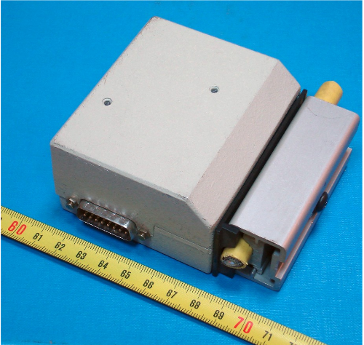
Example: Original
Ethernet
All computers communicate on shared wire (bus)
CSMA/CD: Carrier Sense Multiple Access with Collision Detection
Carrier Sense: Don't send unless medium is idle
  Listen before Speaking
Collision Detection: Determine if sent packet was trampled by someone else on bus
  If so, abort, wait and retry

Slide 47
Adaptive Randomized Backoff
Wait a random amount of time before retransmitting again
Why? Two machines involved in collision don't want to retransmit at same time
  Just causes another collision!
Increase wait time after each retry to adjust to how busy the shared medium is

Slide 48



Original Ethernet
All frames delivered to all hosts
If host is not intended recipient, drops frame
MAC Addr: A
MAC Addr: B
MAC Addr: C
B
B

Slide 49
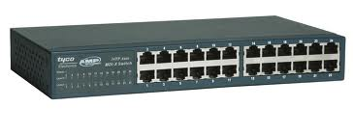

Link Layer Switches
Inspects destination MAC address of incoming packet
Forwards on relevant outgoing link
MAC Addr: B
MAC Addr: D
Switch
MAC Addr: C
MAC Addr: A
B

Slide 50
Switches vs Routers
Routers operate at network layer, understand IP addresses
  Build routing tables by exchanging information with neighbors, can also manually configure
Switches operate at link layer, understand MAC addresses
  "Self Learning" – build switching tables automatically by inspecting source MAC address of frames received on different links
  Unknown MAC address: just broadcast

Slide 51
Point-to-Point Networks
Switch
Router
Internet
Switches make an Ethernet LAN operate more like a point-to-point network
No shared medium: Physical wire connected to only two specific nodes

Slide 52
Putting it all together
Application Layer
Application Layer
Data
Data
Transport Layer
Trans.
Hdr.
Data
Trans.
Hdr.
Data
Transport Layer
Network Layer
Net.
Hdr.
Trans.
Hdr.
Data
Net.
Hdr.
Trans.
Hdr.
Data
Network Layer
Datalink Layer
Frame
Hdr.
Net.
Hdr.
Trans.
Hdr.
Data
Frame
Hdr.
Net.
Hdr.
Trans.
Hdr.
Data
Datalink Layer
Physical Layer
Physical Layer
101010100110101110
101010100110101110

Slide 53
Putting it all Together
Application
Application
Transport
Transport
Network
Network
Network
Datalink
Datalink
Datalink
Datalink
Physical
Physical
Physical
Physical
Host A
Switch
Router
Host B
One technicality: a Switch works at the data link layer (can parse frame headers) but is transparent to communication endpoints
Host does not specify Switch MAC address as destination of frame

