Slide 1
CS 162: Operating Systems and Systems Programming
Lecture 4: Threads & Synchronization
June 27, 2019
Instructor: Jack Kolb
https://cs162.eecs.berkeley.edu

Slide 2
Recall: Process Management
fork – copy the current process
exec – change the program being run by the current process
wait – wait for a process to finish
kill – send a signal (interrupt-like notification) to another process
sigaction – set handlers for signals

Slide 3
Recall: Process Management

Slide 4
Recall: Multiplexing Processes
Snapshot of each process in its PCB
Only one active at a time (for now…)
Give out CPU to different processes
Scheduling
Policy Decision
Give out non-CPU resources
Memory/IO
Another policy decision
Process Control
Block

Slide 5
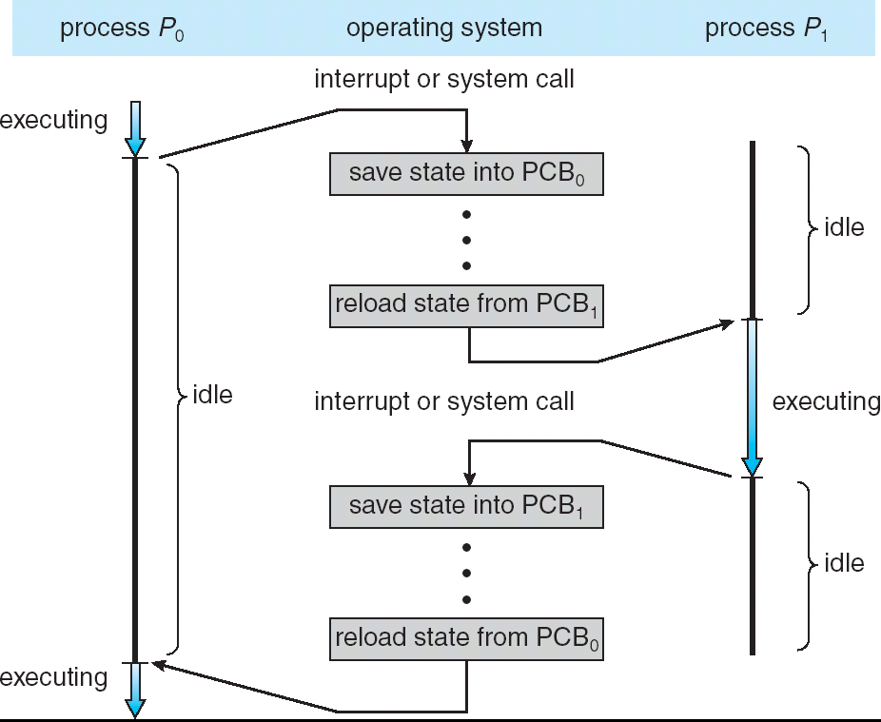
Recall: Context Switch Overhead
Overhead!

Slide 6
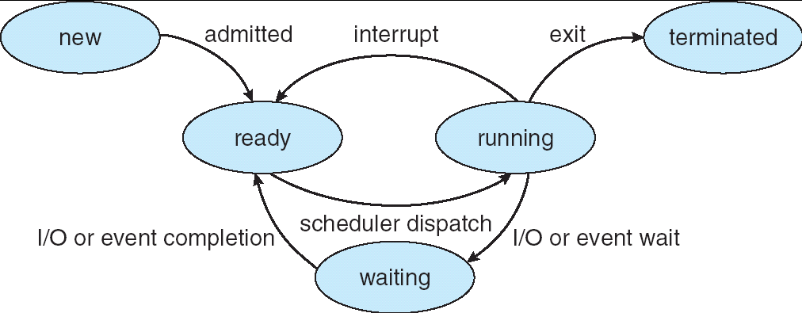
Recall: Lifecycle of a Process
As a process executes, it changes state:
new: being created
ready: waiting to run
running: instructions executing on the CPU
waiting: waiting for some event to occur (e.g., keypress)
terminated: finished execution

Slide 7
Recall: Adding Threads
Version of program with Threads (loose syntax):
main() {
thread_fork(ReadLargeFile, “pi.txt” );
thread_fork(RenderUserInterface, “classlist.txt”);
}
thread_fork: Start independent thread running given procedure
What is the behavior here?
Now, you would actually see the class list
This should behave as if there are two separate CPUs
CPU1
CPU2
CPU1
CPU2
CPU1
CPU2
Time

Slide 8
Recall: Switching Threads
Consider the following code blocks:
func A() {
B();
}
func B() {
while(TRUE) {
yield();
}
}
Two threads, S and T, each run A
Thread S
Thread T
A
A
B(while)
B(while)
Stack growth
yield
yield
run_new_thread
run_new_thread
switch
switch
Thread S's switch returns to Thread T's (and vice versa)

Slide 9
Aren't we still "context switching" between threads?
Yes, but much cheaper than switching processes
No need to change address space
Some numbers from Linux:
Frequency of context switch: 10-100ms
Switching between processes: 3-4 μsec.
Switching between threads: 100 ns

Slide 10
Processes vs. Threads
Process 1
Process N
Switch overhead:
Same process: low
Different proc.: high
Protection
Same proc: low
Different proc: high
Sharing overhead
Same proc: low
Different proc: high
threads
threads
Mem.
Mem.
…
IO
state
…
…
IO
state
CPU
state
CPU
state
CPU
state
CPU
state
CPU sched.
OS
1 thread at a time
CPU
(1 core)

Slide 11
Processes vs. Threads
Process 1
Process N
Switch overhead:
Same process: low
Different proc.: high
Protection
Same proc: low
Different proc: high
Sharing overhead
Same proc: low
Different proc: high
threads
threads
Mem.
Mem.
…
IO
state
…
…
IO
state
CPU
state
CPU
state
CPU
state
CPU
state
CPU sched.
OS
4 threads at a time
Core 1
Core 2
Core 3
Core 4

Slide 12
Example: Multithreaded Server
serverLoop() {
connection = AcceptNewConnection();
thread_fork(ServiceWebPage, connection);
}
One thread per connection
Problem: How fast is creating threads?
Better than fork(), but still overhead
Problem: What if we get a lot of requests?
Might run out of memory (thread stacks)
Schedulers usually have trouble with too many threads

Slide 13
Web Server: Thread Pools
Bounded pool of worker threads
Allocated in advance: no thread creation overhead
Queue of pending requests
Master Thread
Client
Request
Queue
Thread Pool
Response

Slide 14
Multiprocessing vs Multiprogramming
Multiprocessing: Multiple cores
Multiprogramming: Multiple Jobs/Processes
Multithreading: Multiple threads/processes
What does it mean to run two threads concurrently?
Scheduler is free to run threads in any order and interleaving
A
Multiprocessing
B
C
A
B
C
Multiprogramming
A
B
C
A
B
C
B

Slide 15
Yield is covered, what about I/O?
CopyFile
read
Trap to OS
Stack growth
kernel_read
run_new_thread
switch
User code invokes syscall
IO operation initiated (more later)
Run new thread, switch
Really, same thing as before
Just put the thread on a different queue

Slide 16
Preempting a Thread
What happens if thread never does any I/O, never waits, and never yields control?
Must find way that dispatcher can regain control!
Interrupts: signals from hardware or software that stop the running code and jump to kernel
Timer: like an alarm clock that goes off every some milliseconds
Interrupt is a hardware-invoked mode switch
Handled immediately, no scheduling required

Slide 17
Example: Network Interrupt
Raise priority
(set mask)
Reenable All Ints
Save registers
Dispatch to Handler
…
Transfer Network Packet from hardware to Kernel Buffers
…
Restore registers
Clear current Int
Disable All Ints
Restore priority
(clear Mask)
RTI
...
add $r1,$r2,$r3
subi $r4,$r1,#4
slli $r4,$r4,#2
...
PC saved
Disable All Ints
Kernel Mode
External Interrupt
Pipeline Flush
“Interrupt Handler”
...
lw $r2,0($r4)
lw $r3,4($r4)
add $r2,$r2,$r3
sw 8($r4),$r2
...
Restore PC
Enable all Ints
User Mode
An interrupt is a hardware-invoked context switch
No separate step to choose what to run next
Always run the interrupt handler immediately

Slide 18
Switching Threads from Interrupts
Prevent thread from running forever with timer interrupt
TimerInterrupt() {
DoPeriodicHouseKeeping();
run_new_thread(); }
Same thing from IO interrupts
Example: immediately start process waiting for keypress
Some Routine
Interrupt
TimerInterrupt
Stack growth
run_new_thread
switch

Slide 19
How does a thread get started?
Can't call switch() without starting a thread
How do we make a new thread?
Other Thread
ThreadRoot
SetupNewThread(tNew) {
…
TCB[tNew].regs.sp =
newStack;
TCB[tNew].regs.retpc =
&ThreadRoot;
}
A
B(while)
Stack growth
yield
run_new_thread
New Thread
switch
ThreadRoot stub

Slide 20
How does a thread get started?
So when does the new thread really start executing?
Other Thread
ThreadRoot
A
run_new_thread selects this thread's TCB, "returns" into beginning of ThreadRoot
B(while)
Stack growth
yield
run_new_thread
New Thread
switch
ThreadRoot stub

Slide 21
Bootstrapping Threads: ThreadRoot
ThreadRoot() {
DoStartupHousekeeping();
UserModeSwitch(); /* enter user mode */
call fcnPtr(fcnArgPtr);
ThreadFinish();
}
Stack will grow and shrink with execution of thread
ThreadRoot() never returns
ThreadFinish() destroys thread, invokes scheduler
ThreadRoot
*fcnPtr
Stack growth
Running Stack

Slide 22
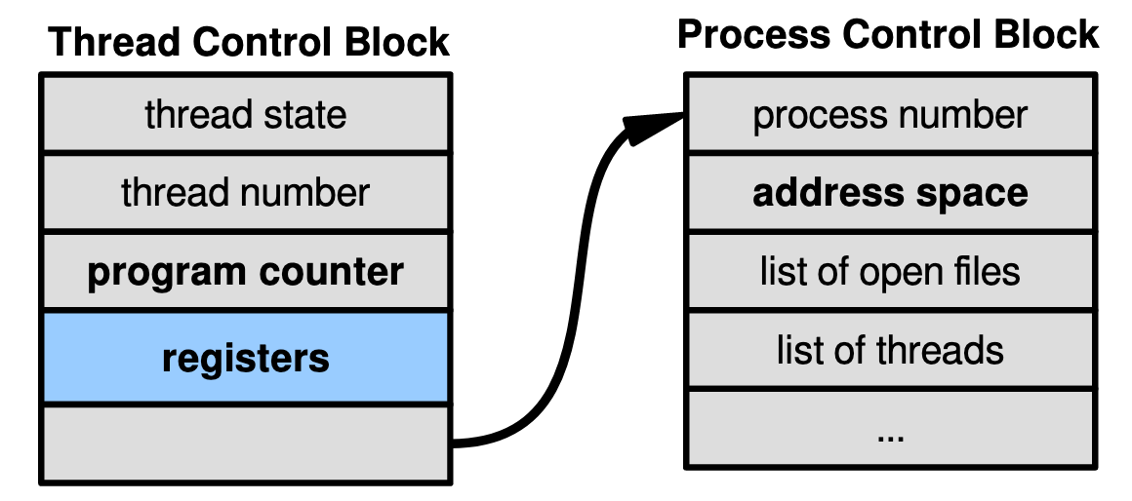
So Far: Kernel-Supported Threads
Each thread has a thread control block
CPU registers, including PC, pointer to stack
Scheduling info: priority, etc.
Pointer to Process control block
OS scheduler uses TCBs, not PCBs

Slide 23
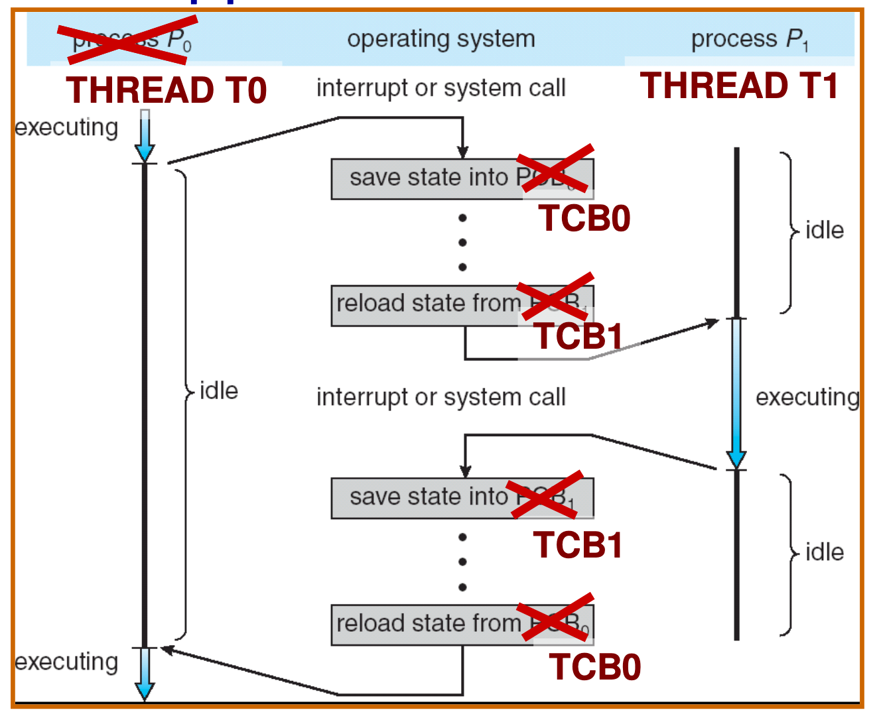
Kernel-Supported Threads

Slide 24
Kernel-Supported Threads
Threads run and block (e.g., on I/O) independently
One process may have multiple threads waiting on different things
Two mode switches for every context switch (expensive)
Create threads with syscalls
Alternative: multiplex several streams of execution (at user level) on top of a single kernel thread

Slide 25
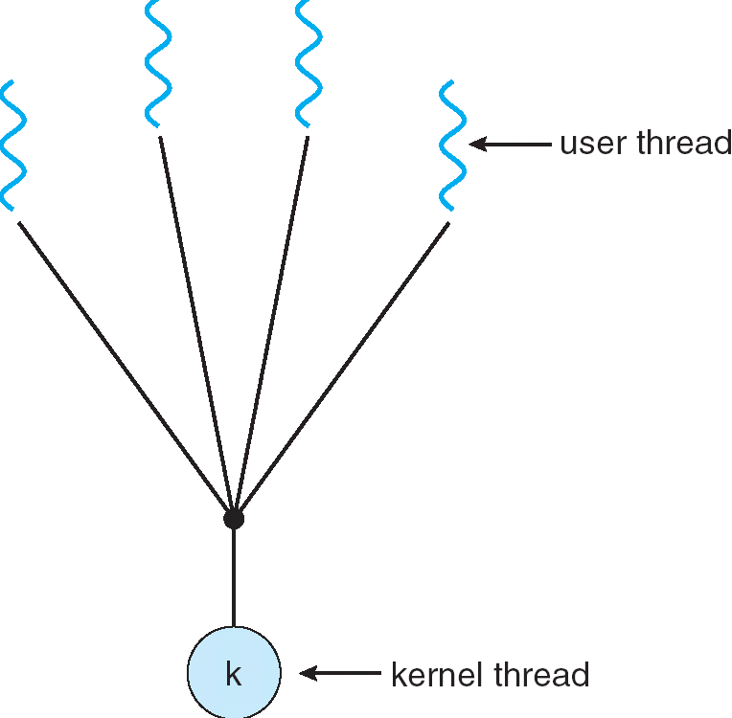
User-Mode Threads
User program contains its own scheduler
Several user threads per kernel thd.
User threads may be scheduled non-preemptively
Only switch on yield
Context switches cheaper
Copy registers and jump (switch in userspace)

Slide 26
User-Mode Threads: Problems
One user-level thread blocks on I/O: they all do
Kernel cannot adjust scheduling among threads it doesn’t know about
Multiple Cores?
Can't completely avoid blocking (syscalls, page fault)
Solution: Scheduler Activations
Have kernel inform user-level scheduler when a thread blocks

Slide 27
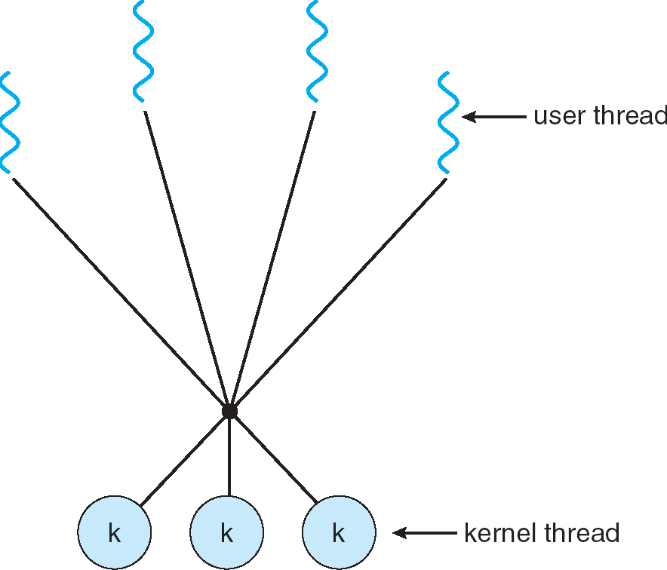
Some Threading Models
Simple One-to-One
Threading Model
Almost all current implementations
Many-to-One
Many-to-Many

Slide 28
Logistics
Group formation enabled on autograder
Sign up by Friday 11:59 PM
HW0 due on Friday, 11:59 PM
C Review & Pintos Intro: 11am-1pm Friday
Wozniak Lounge (438 Soda Hall)
Project 1 Released Friday
Design Reviews with your TA next week

Slide 29
Thread Abstraction
Illusion: Infinite number of processors

Slide 30
Thread Abstraction
Illusion: Infinite number of processors
Reality: Threads execute with variable “speed”
Programs must be designed to work with any schedule

Slide 31
Programmer vs. Processor View

Slide 32
Possible Executions

Slide 33
Correctness with Concurrent Threads
Non-determinism:
Scheduler can run threads in any order
Scheduler can switch threads at any time
This can make testing very difficult
Independent Threads
No state shared with other threads
Deterministic, reproducible conditions
Cooperating Threads
Shared state between multiple threads
Goal: Correctness by Design

Slide 34
Remember: Multiprogramming
A
B
C
Multiprogramming
A
B
C
A
B
C
B
Scheduler can run threads in any order
And with multiple cores:
Even more interleaving
Could truly be running at the same time

Slide 35
Race Conditions
What are the possible values of x below?
Initially x = y = 0;
Thread A
x = 1;
Thread B
y = 2;
Must be 1. Thread B cannot interfere.

Slide 36
Race Conditions
What are the possible values of x below?
Initially x = y = 0;
Thread A
x = y + 1;
Thread B
y = 2;
y = y * 2;
1 or 3 or 5 (non-deterministic)
Race Condition: Thread A races against Thread B

Slide 37
Race Conditions
What are the possible values of x below?
Initially x = y = 0;
Thread A
x = 1;
Thread B
y = 2;
Why not 3?
Write a bit at a time

Slide 38
Atomic Operations
Definition: An operation that runs to completion or not at all
Need some to allow threads to work together
Example: Loading or storing words
Result of 3 is not possible on most machines
Some instructions are not atomic
Ex: double-precision floating point store

Slide 39
Real-Life Analogy: Too Much Milk
Time
Person A
Person B
3:00
Look in Fridge. Out of milk
3:05
Leave for store
3:10
Arrive at store
Look in Fridge. Out of milk
3:15
Buy milk
Leave for store
3:20
Arrive home, put milk away
Arrive at store
3:25
Buy milk
3:30
Arrive home, put milk away

Slide 40
Too Much Milk: Correctness
At most one person buys milk
At least one person buys milk if needed

Slide 41
Solution Attempt #1
Leave a note
Place on fridge before buying
Remove after buying
Don’t go to store if there’s already a note
Leaving/checking a note is atomic (word load/store)
if (noMilk) {
if (noNote) {
leave Note;
buy milk;
remove Note;
}
}

Slide 42
Attempt #1in Action
Alice
if (noMilk) {
if (noNote) {
leave Note;
buy milk;
remove Note;
}
}
Bob
if (noMilk) {
if (noNote) {
leave Note;
buy milk;
remove note;
}
}

Slide 43
Solution Attempt #2
leave Note;
if (noMilk) {
if (noNote) {
leave Note;
buy milk;
}
}
remove Note;
But there’s always a note – you just left one!
At least you don’t buy milk twice…

Slide 44
Solution Attempt #3
Leave a named note – each person ignores their own
Alice
leave note Alice
if (noMilk) {
if (noNote Bob) {
buy milk
}
}
remove note Alice;
Bob
leave note Bob
if (noMilk) {
if (noNote Alice) {
buy milk
}
}
remove note Bob;

Slide 45
Attempt #3 in Action
Alice
leave note Alice
if (noMilk) {
if (noNote Bob) {
buy milk
}
}
remove note Alice
Bob
leave note Bob
if (noMilk) {
if (noNote Alice) {
buy milk
}
remove note Bob

Slide 46
Solution Attempt #4
Alice
leave note Alice
while (note Bob) {
do nothing
}
if (noMilk) {
buy milk
}
remove note Alice;
Bob
leave note Bob
if (noNote Alice) {
if (noMilk) {
buy milk
}
}
remove note Bob;
This is a correct solution

Slide 47
Issues with Solution 4
Complexity
Proving that it works is hard
How do you add another thread?
Busy-waiting
Alice consumes CPU time to wait

Slide 48
Break

Slide 49
Relevant Definitions
Mutual Exclusion: Ensuring only one thread does a particular thing at a time (one thread excludes the others)
Critical Section: Code exactly one thread can execute at once
Result of mutual exclusion

Slide 50
Relevant Definitions
Lock: An object only one thread can hold at a time
Provides mutual exclusion
Offers two atomic operations:
Lock.Acquire() – wait until lock is free; then grab
Lock.Release() – Unlock, wake up waiters

Slide 51
Using Locks
MilkLock.Acquire()
if (noMilk) {
buy milk
}
MilkLock.Release()
But how do we implement this?

Slide 52
Implementing Locks: Sigle Core
Idea: A context switch can only happen (assuming threads don’t yield) if there’s an interrupt
“Solution”: Disable interrupts while holding lock

Slide 53
Naïve Interrupt Enable/Disable
Acquire() {
disable interrupts;
}
Release() {
enable interrupts;
}
Problem: User can stall the entire system
Lock.Acquire()
While (1) {}
Problem: What if we want to do I/O?
Lock.Acquire()
Read from disk
/* OS waits for (disabled) interrupt)! */

Slide 54
Implementing Locks: Sigle Core
Idea: Disable interrupts for mutual exclusion on accesses to value indicating lock status
Acquire() {
disable interrupts;
if (value == BUSY) {
put thread on wait queue;
run_new_thread()
// Enable interrupts?
} else {
value = BUSY;
}
enable interrupts;
}
Release() {
disable interrupts;
if (anyone waiting) {
take a thread off queue;
} else {
Value = FREE;
}
enable interrupts;
}

Slide 55
Reenabling Interrupts When Waiting
Acquire() {
disable interrupts;
if (value == BUSY) {
put thread on wait queue;
run_new_thread()
} else {
value = BUSY;
}
enable interrupts;
}
enable interrupts
enable interrupts
Before on the queue?
Release might not wake up this thread!
After putting the thread on the queue?
Gets woken up, but immediately switches away

Slide 56
Reenabling Interrupts When Waiting
Acquire() {
disable interrupts;
if (value == BUSY) {
put thread on wait queue;
run_new_thread()
} else {
value = BUSY;
}
enable interrupts;
}
enable interrupts
Best solution: after the current thread suspends
How?
run_new_thread() should do it!
Part of returning from switch()

Slide 57
Summary
Kernel vs. User-Mode Threads
Kernel threads: no fate-sharing with IO, but requires syscalls and mode transitions
User-mode threads: Lightweight, rely on yield, invisible to kernel scheduler
Synchronization
Concurrency useful for overlapping computation and IO
But makes it harder to write correct code:
Arbitrary interleavings
Could access shared resources while in bad state
Solution: careful design
Building block: atomic operations

