Slide 1
CS 162: Operating Systems and Systems Programming
Lecture 8: Deadlock, Introduction to I/O
July 8, 2019
Instructor: Jack Kolb
https://cs162.eecs.berkeley.edu

Slide 2
Logistics
Project 1 Milestone Due Wednesday
Homework 1 Due Friday
Project/HW “Party” Friday 3-5PM
Wozniak Lounge, Soda Hall
Full course staff will be there to help you

Slide 3
Recall: Producer/Consumer
Producer(item) {
emptySlots.P();
mutex.P();
Enqueue(item); mutex.V();
fullSlots.V();
}
Consumer() {
fullSlots.P();
mutex.P();
item = Dequeue();
mutex.V();
emptySlots.V();
return item;
}

Slide 4
Recall: Producer/Consumer
Producer(item) {
mutex.P();
emptySlots.P();
Enqueue(item); mutex.V();
fullSlots.V();
}
Consumer() {
fullSlots.P();
mutex.P();
item = Dequeue();
mutex.V();
emptySlots.V();
return item;
}
Deadlock

Slide 5
Recall: Why deadlock?
Assume we currently have a full buffer
mutex = 1 emptySlots = 0 fullSlots = N
mutex = 0 emptySlots = 0 fullSlots = N
mutex = 0 emptySlots = 0 fullSlots = N-1
Producer(item) {
mutex.P();
emptySlots.P();
// Stuck!
Consumer() {
fullSlots.P();
mutex.P();
// Stuck!

Slide 6
Recall: Condition Variables
A queue of threads waiting inside a critical section
Operations:
wait(&lock): Atomically release lock and go to sleep. Re-acquire the lock before returning.
signal(): Wake up on waiting thread (if there is one)
broadcast(): Wake up all waiting threads
Rule: Hold lock when using a condition variable

Slide 7
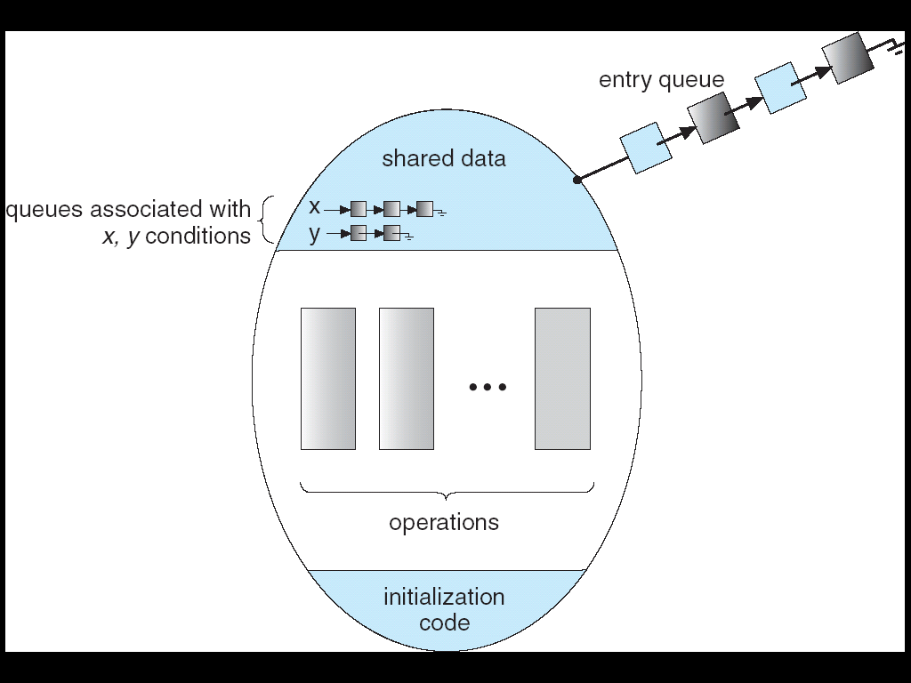
Recall: Monitors
Lock: protects access to shared data
Condition Variables: queue of threads waiting for something to become true inside critical sect.

Slide 8
Recall: Hoare vs. Mesa Semantics
while (queue.isEmpty()) {
dataready.wait(&lock); }
if (queue.isEmpty()) {
dataready.wait(&lock); }
Mesa Monitors
A signaled thread becomes ready again
But another thread may acquire lock and enter monitor before signaled thread runs
Need to re-check condition upon wakeup
Hoare Monitors
A signaled thread acquires the lock and runs immediately
No other thread can “sneak in” and change the monitor’s state
Described in many textbooks

Slide 9
Recall: Reader/Writer Sync.
Readers can access when no writers
Writers can access when no readers and no other writers
A lock will satisfy these requirements
But we want to allow multiple readers
Better efficiency

Slide 10
Recall: RW Sync. With a Monitor
Reader() {
Wait until no active or waiting writers
Access database
Maybe wake up a writer
}
Writer() {
Wait until no active readers or writers
Access database
If waiting writer, wake it up;
Otherwise, wakeup readers;
}
int activeReaders;
int activeWriters;
int waitingWriters

Slide 11
Definition: Resources
Entities needed by threads to do work
CPU Time
Disk Space
Memory
Preemptible vs. Non-Preemptible
Can OS safely take it away from a thread?
Yes: CPU
No: Disk space, printer, right to enter a critical section
Shareable vs Exclusive

Slide 12
Starvation vs. Deadlock
Starvation: A thread waits indefinitely
Ex: Low-priority threads, when other high-priority threads are always present
Deadlock: Circular waiting for resources
A case of starvation
Thread
A
Wait
For
Owned
By
Res 1
Res 2
Owned
By
Wait
For
Thread
B

Slide 13
Deadlock with Locks
Thread A
x.Acquire();
y.Acquire();
…
y.Release();
x.Release();
Thread B
y.Acquire();
x.Acquire();
…
x.Release();
y.Release();
Nondeterministic Deadlock
Thread
A
Owned
By
Wait
For
Lock x
Lock y
Wait
For
Thread
B
Owned
By

Slide 14
Deadlock with Locks: “Lucky” Case
Thread A
x.Acquire();
y.Acquire();
…
y.Release();
x.Release();
Thread B
y.Acquire();
x.Acquire();
…
x.Release();
y.Release();
Sometimes schedule won’t trigger deadlock

Slide 15
Deadlock with Locks: Unlucky Case
Thread A
x.Acquire();
y.acquire(); <stalled>
<unreachable>
…
y.Release();
x.Release();
Thread B
y.Acquire();
x.Acquire(); <stalled>
<unreachable>
…
x.Release();
y.Release();
Thread
A
Owned
By
Wait
For
Lock x
Lock y
Wait
For
Thread
B
Owned
By

Slide 16
Deadlock with Space
Thread A
AllocateOrWait(1 MB)
AllocateOrWait(1 MB)
Free(1 MB)
Free(1 MB)
Thread B
AllocateOrWait(1 MB)
AllocateOrWait(1 MB)
Free(1 MB)
Free(1 MB)
If only 2 MB of space, we get same deadlock situation

Slide 17
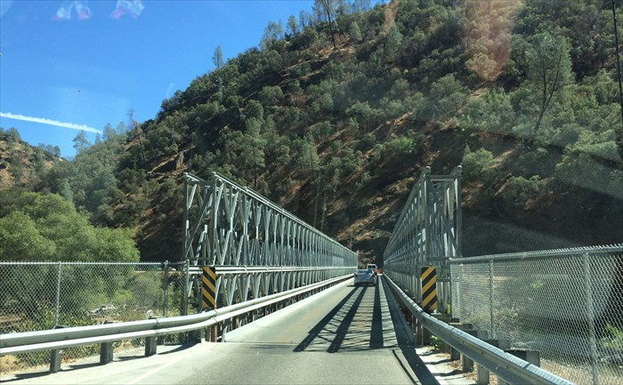
Real Example: Single-Lane Bridge Crossing
Each segment of road is a resource
Car must obtain next segment to progress
Deadlock: Two cars in opposite directions meet in middle
Resolving deadlock: “Preempt” road segment, force one car to back up
Starvation (not deadlock): Eastbound traffic doesn’t stop for westbound traffic
CA 140 to Yosemite National Park

Slide 18
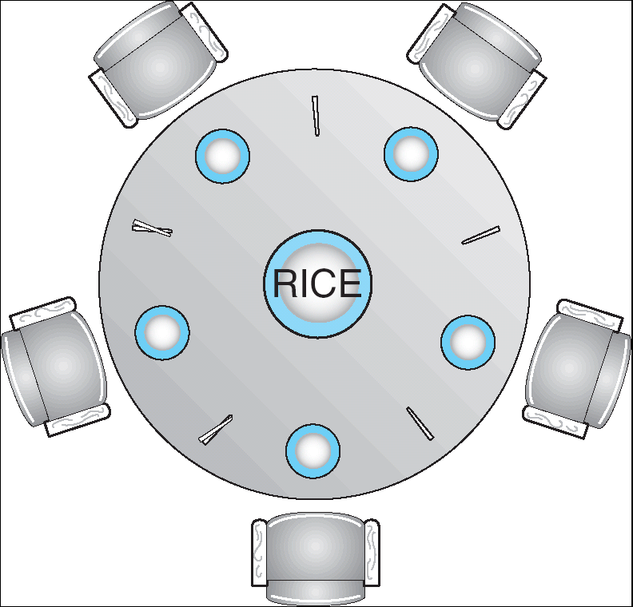
The Dining Philosophers Problem
Five chopsticks, five philosophers
Goal: Grab two chopsticks to eat
Deadlock if they all grab chopstick to their right
Fix: Never take the last chopstick if no one will have two afterwards

Slide 19
Formalizing: Four Requirements for Deadlock to Occur
Mutual Exclusion: One thread at a time can use a resource (not shareable)
Hold and Wait: Thread holding a resource waits to acquire another resource
No Preemption: Resources are released voluntarily, threads can’t steal instead of waiting
Circular Wait: There exists a set {T₁, …, T_{n}} of waiting threads such that:
T₁ is waiting for a resource held by T₂
T₂ is waiting for a resource held by T₃
…
T_{n} is waiting for a resource held by T₁

Slide 20
Resource-Allocation Graph
Symbols
System Model
A set of Threads T₁, T₂, . . ., T_{n}
Resource types R₁, R₂, . . ., R_{m}
CPU cycles, memory space, I/O devices
Each resource type R_{i} has W_{i} instances
Each thread utilizes a resource as follows:
Request() / Use() / Release()
Resource-Allocation Graph:
V is partitioned into two types:
T = {T₁, T₂, …, T_{n}}, the set of threads in the system.
R = {R₁, R₂, …, R_{m}}, the set of resource types in system
Request edge – directed edge T_{i} → R_{j}
Assignment edge – directed edge R_{j} → T_{i}
T₁
T₂
R₁
R₂

Slide 21
Resource-Allocation Graph Examples
T_{i} → R_{j}: Thread requests a resource
R_{j} → T_{i}: Resource is assigned to a thread
R₁
R₂
Does this graph represent a deadlock?
T₃ Finishes, releases R₄, R₂
T₂ Finishes, releases R₁, R₂, R₃
T₁ Finishes, releases R₁, R₃
T₁
T₂
T₃
R₃
R₄
Simple Resource
Allocation Graph

Slide 22
Resource-Allocation Graph Examples
T_{i} → R_{j}: Thread requests a resource
R_{j} → T_{i}: Resource is assigned to a thread
R₁
R₂
R₁
T₂
T₁
T₂
T₃
T₁
T₃
T₄
R₃
R₂
R₄
Yes
No
What about these graphs?

Slide 23
Options for Handling Deadlocks
Recover by preempting resources
Need to detect deadlock first
Resources must be preemptible, e.g., terminate thread
Prevent by monitoring or design
Deny/don’t attempt resource acquisitions that might lead to a deadlock
Do Nothing
Most operating systems do this

Slide 24
Deadlock Detection Algorithm
If only one type of resource: Look for loops in resource allocation graph
More general deadlock detection algorithm:
For each resource in the system, record:
Fraction of resource currently free
Fraction requested by each thread in the system
Fraction already allocated to each thread in the system
Key Idea: Find a task that can finish on its own (all of its pending requests for resources can be satisfied)
Mark those task’s resources as free for future iterations (assume task finishes)
Repeat this until no remaining task can have its requests satisfied
Unfinished threads remaining? => Deadlock

Slide 25
Deadlock Detection Algorithm
// Assign each resource an index i
Avail[i] = Free[i] for all i
Add all nodes to UNFINISHED
do {
done = true;
for each node in UNFINISHED {
if (Requested_{node}[i] <= Avail[i] for all i) {
remove node from UNFINISHED
Avail[i] += Allocated_{node}[i] for all i
done = false
}
}
} until(done)
Nodes left in UNFINISHED => Deadlocked

Slide 26
Deadlock Detected: Options?
Terminate thread, force it to give up resources
Ex: Kick a philosopher out of the restaurant
Not always possible
Preempt resources without terminating thread
Not always correct
Revert actions of deadlocked threads
Databases do this (transaction rollback) – not easy for an operating system
Ex: Back up cars on single-lane bridge to clear a path

Slide 27
Recall: Four Requirements for Deadlock to Occur
Mutual Exclusion: One thread at a time can use a resource (not shareable)
Hold and Wait: Thread holding a resource waits to acquire another resource
No Preemption: Resources are released voluntarily, threads can’t steal instead of waiting
Circular Wait: There exists a set {T₁, …, T_{n}} of waiting threads such that:
T₁ is waiting for a resource held by T₂
T₂ is waiting for a resource held by T₃
…
T_{n} is waiting for a resource held by T₁

Slide 28
Deadlock Prevention
Infinite resources
Or just large enough capacity so that no one runs out
Ex: Virtual memory gives the illusion of infinite space
Avoid sharing of resources
Don’t allow waiting
Phone system: busy signal
Networking: transmission collision – back off and retry later
Attacks mutual exclusion
Attacks mutual exclusion
Attacks hold and wait / no preemption

Slide 29
Deadlock Prevention
Get resources in consistent order
Prevents cycles
Ex: Acquire locks in order by name
Request all necessary resources at once
Get two chopsticks at once or not at all
Attacks circular wait
Attacks hold and wait

Slide 30
Prevention: Maximum Resources
Relax the all resources at once solution
Extra information:
Maximum resources a thread might need in its lifetime
Strawman solutions:
Reserve maximum resources when thread starts
Reserve maximum resource when any resource is requested
Something less conservative/wasteful?

Slide 31
Prevention: Banker’s Algorithm
Still need to know each thread’s maximum resource requirements
Block a thread from getting a resource unless system would remain in a safe state
There is an ordering of threads T₁, T₂, …, T_{n} such that running T₁ to completion, T₂ to completion, and so on would not deadlock
Use modified version of deadlock detection algo.
Pretend each resource request has been satisfied
Pretend each running thread is requesting its maximum
If no deadlock, then an ordering exists

Slide 32
Banker’s Algorithm
// Assign each resource an index i
Avail[i] = Free[i] for all i
Add all nodes to UNFINISHED
do {
done = true;
for each node in UNFINISHED {
if (Max_{node}[i] – Alloc_{Node}[i] <= Avail[i] for all i) {
remove node from UNFINISHED
Avail[i] += Allocated_{node}[i] for all i
done = false
}
}
} until(done)
Nodes left in UNFINISHED => Unsafe State

Slide 33
Banker’s Algorithm Example
With dining philosophers, safe state:
Not acquiring the last chopstick or
Is last chopstick but someone will have two chopsticks
What if we needed k chopsticks to eat? Block if:
Last Chopstick: No one would have k chopsticks
Second to last: No one would be k-1 chopsticks
Third to last: No one would have k-2 chopsticks
And so on…

Slide 34
Break

Slide 35
POSIX I/O: Everything is a “File”
Identical interface for:
Devices (terminals, printers, etc.)
Regular files on disk
Networking (sockets)
Local interprocess communication (pipes, sockets)
Based on open(), read(), write(), and close()

Slide 36
POSIX I/O Design Patterns
Open before use
Access control check, setup happens here
Byte-oriented
Least common denominator
OS responsible for hiding the fact that real devices may not work this way (e.g. hard drive stores data in blocks)
Explicit close

Slide 37
POSIX I/O: Kernel Buffering
Reads are buffered
Part of making everything byte-oriented
Process is blocked while waiting for device
Let other processes run while gathering result
Writes are buffered
Complete in background (more later on)
Return to user when data is “handed off” to kernel

Slide 38
Putting it together: web server
Kernel buffer reads
Server
4. parse request
9. format reply
request
buffer
reply
buffer
network
socket
read
3. kernel
copy
10. network
socket
write
5. file
read
8. kernel
copy
syscall
syscall
Kernel
wait
RTU
11. kernel copy
from user buffer
to network buffer
RTU
interrupt
interrupt
2. copy arriving
packet (DMA)
12. format outgoing
packet and DMA
6. disk
request
7. disk data
(DMA)
Hardware
Network
interface
Disk interface
Request
Reply

Slide 39
Putting it together: web server
Kernel buffer write
Server
4. parse request
9. format reply
request
buffer
reply
buffer
network
socket
read
3. kernel
copy
10. network
socket
write
5. file
read
8. kernel
copy
syscall
syscall
Kernel
wait
RTU
11. kernel copy
from user buffer
to network buffer
RTU
interrupt
interrupt
2. copy arriving
packet (DMA)
12. format outgoing
packet and DMA
6. disk
request
7. disk data
(DMA)
Hardware
Network
interface
Disk interface
Request
Reply

Slide 40
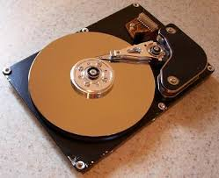
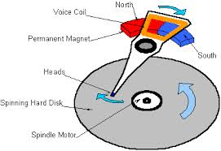
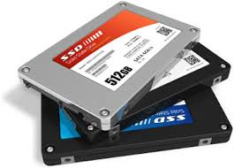
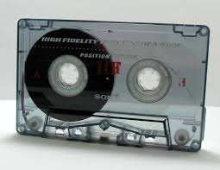
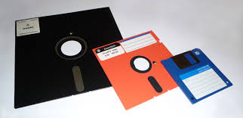
I/O & Storage Layers
Application / Service
High Level I/O
streams
Low Level I/O
handles
Syscall
registers
File System
descriptors
I/O Driver
Commands and Data Transfers
Disks, Flash, Controllers, DMA

Slide 41
The File System Abstraction
Regular File
Named collection of data
POSIX: Sequence of bytes
Could really be text, binary, serialized objects, etc.
Also size, modification time, owner, access control info
Directory
“Folder” containing files and other directories
Hierarchical Naming: /home/oski/cs162

Slide 42
C stdio (High Level) File API: Streams
FILE* - stream, sequence of bytes and position
#include <stdio.h>
FILE *fopen( const char *filename, const char *mode );
int fclose( FILE *fp );
Mode Text | Binary | Descriptions
r | rb | Open existing file for reading
w | wb | Open for writing; created if does not exist
a | ab | Open for appending; created if does not exist
r+ | rb+ | Open existing file for reading & writing.
w+ | wb+ | Open for reading & writing; truncated to zero if exists, create otherwise
a+ | ab+ | Open for reading & writing. Created if does not exist. Read from beginning, write as append

Slide 43
Connecting Processes and the Filesystem
Each process has a current working directory (CWD)
Absolute paths: /home/oski/cs162
Relative paths
index.html, ./index.html (in CWD)
../index.html (Parent of CWD)
~, ~oski (home directory, shell only)

Slide 44
stdio Standard Streams
Three predefined streams
FILE* stdin – Normal source of input
FILE* stdout – Normal source of output
FILE* stderr – For error output
All can be redirected
cat hello.txt | grep “World!”
cat’s stdout goes to grep’s stdin

Slide 45
C Streams: Read/Write
#include <stdio.h>
// character oriented
int fputc(int c, FILE *fp); // rtn c or EOF on err
int fputs(const char *s, FILE *fp); // rtn >0 or EOF
int fgetc( FILE * fp );
char *fgets( char *buf, int n, FILE *fp );
// block oriented
size_t fread(void *ptr, size_t size_of_elements,
size_t number_of_elements, FILE *a_file);
size_t fwrite(const void *ptr, size_t size_of_elements,
size_t number_of_elements, FILE *a_file);
// formatted
int fprintf(FILE *restrict stream, const char *restrict format, ...);
int fscanf(FILE *restrict stream, const char *restrict format, ...);

Slide 46
C Streams: char by char I/O
#include <stdio.h>
int main(void) {
FILE* input = fopen(“input.txt”, “r”);
FILE* output = fopen(“output.txt”, “w”);
int c;
c = fgetc(input);
while (c != EOF) {
fputc(output, c);
c = fgetc(input);
}
fclose(input);
fclose(output);
}

Slide 47
What if we wanted block by block I/O?
#include <stdio.h>
// character oriented
int fputc(int c, FILE *fp); // rtn c or EOF on err
int fputs(const char *s, FILE *fp); // rtn >0 or EOF
int fgetc( FILE * fp );
char *fgets( char *buf, int n, FILE *fp );
// block oriented
size_t fread(void *ptr, size_t size_of_elements,
size_t number_of_elements, FILE *a_file);
size_t fwrite(const void *ptr, size_t size_of_elements,
size_t number_of_elements, FILE *a_file);
// formatted
int fprintf(FILE *restrict stream, const char *restrict format, ...);
int fscanf(FILE *restrict stream, const char *restrict format, ...);

Slide 48
stdio Block-by-Block I/O
#include <stdio.h>
#define BUFFER_SIZE 1024
int main(void) {
FILE* input = fopen("input.txt", "r");
FILE* output = fopen("output.txt", "w");
char buffer[BUFFER_SIZE];
size_t length;
length = fread(buffer, BUFFER_SIZE, sizeof(char), input);
while (length > 0) {
fwrite(buffer, length, sizeof(char), output);
length = fread(buffer, BUFFER_SIZE, sizeof(char), input);
}
fclose(input);
fclose(output);
}

Slide 49
stdio Block-by-Block I/O
#include <stdio.h>
#define BUFFER_SIZE 1024
int main(void) {
FILE* input = fopen("input.txt", "r");
FILE* output = fopen("output.txt", "w");
char buffer[BUFFER_SIZE];
size_t length;
length = fread(buffer, BUFFER_SIZE, sizeof(char), input);
while (length > 0) {
fwrite(buffer, length, sizeof(char), output);
length = fread(buffer, BUFFER_SIZE, sizeof(char), input);
}
fclose(input);
fclose(output);
}

Slide 50
Aside: Systems Programming
Systems programmers are paranoid
We should really be writing things like:
FILE* input = fopen(“input.txt”, “r”);
if (input == NULL) {
// Prints our string and error msg.
perror(“Failed to open input file”)
}
Be thorough about checking return values
Want failures to be systematically caught and dealt with

Slide 51
C Streams: Positioning
int fseek(FILE *stream, long int offset, int whence);
long int ftell (FILE *stream)
void rewind (FILE *stream)
offset (SEEK_SET)
offset (SEEK_END)
whence
offset (SEEK_CUR)

Slide 52
I/O & Storage Layers
Application / Service
High Level I/O
streams
Low Level I/O
handles
Syscall
registers
File System
descriptors
I/O Driver
Commands and Data Transfers
Disks, Flash, Controllers, DMA

Slide 53
POSIX Low-Level I/O
Operations on file descriptors (represented as ints)
Per-process table pointing to open file descriptors
Created by open(), removed by close()
#include <fcntl.h>
#include <unistd.h>
#include <sys/types.h>
int open (const char *filename, int flags [, mode_t mode])
int creat (const char *filename, mode_t mode)
int close (int filedes)
Bit vector of:
Access modes (Rd, Wr, …)
Open Flags (Create, …)
Operating modes (Appends, …)
Bit vector of Permission Bits:
User|Group|Other × R|W|X

Slide 54
Low-Level I/O: Standard Descriptors
#include <unistd.h>
STDIN_FILENO - macro has value 0
STDOUT_FILENO - macro has value 1
STDERR_FILENO - macro has value 2
Correspond to stdio.h’s stdin, stdout, stderr
Don’t mix them!

Slide 55
C Low Level Operations
ssize_t read (int filedes, void *buffer, size_t maxsize)
- returns bytes read, 0 => EOF, -1 => error
ssize_t write (int filedes, const void *buffer, size_t size)
- returns bytes written
off_t lseek (int filedes, off_t offset, int whence)
int fsync (int fildes) – wait for i/o to finish
void sync (void) – wait for ALL to finish
When write returns, data is on its way to disk (for regular files), but it may not actually be permanent

Slide 56
Low-Level I/O: Example
#include <fcntl.h>
#include <unistd.h>
#define BUFFER_SIZE 1024
int main(void) {
int input_fd = open(“input.txt”, O_RDONLY);
int output_fd = open(“output.txt”, O_WRONLY);
char buffer[BUFFER_SIZE];
ssize_t length;
length = read(input_fd, buffer, BUFFER_SIZE);
while (length > 0) {
write(output_fd, buffer, length);
length = read(input_fd, buffer, BUFFER_SIZE);
}
close(input_fd);
close(output_fd);
}

Slide 57
Low-Level I/O: Other Operations
Operations specific to terminals, devices, networking, …
Memory-Mapping Files
File Locking
Asynchronous I/O
Duplicating descriptors
int dup2(int old, int new);
int dup(int old);

Slide 58
Streams vs. File Descriptors
Streams are buffered in user memory:
printf("Beginning of line ");
sleep(10); // sleep for 10 seconds
printf("and end of line\n");
Prints out everything at once
Operations on file descriptors are visible immediately
write(STDOUT_FILENO, "Beginning of line ", 18);
sleep(10);
write("and end of line \n", 16);
Outputs "Beginning of line" 10 seconds earlier

Slide 59
Why Buffer in Userspace? Overhead!
Avoid system call overhead
Time to copy registers, transition to kernel mode, jump to system call handler, etc.
Minimum syscall time: ~100s of nanoseconds
Read/write a file byte by byte?
Max throughput of ~10MB/second
With fgetc? Keeps up with your SSD

Slide 60
Why Buffer in Userspace? Functionality.
System call operations less capable
Simplifies operating system
Example: No "read until new line" operation
Solution: Make a big read syscall, find first new line in userspace
Could simulate by one syscall per character, but we already know this is a bad idea

Slide 61
Summary
Starvation (indefinite wait) vs. Deadlock (circular wait)
Conditions for Deadlock
Mutual Exclusion
Hold and Wait
No Preemption
Circular Wait
Dealing with Deadlock
Detect and recover (preemption, rollback)
Prevent by blocking on certain resource requests
File I/O: open, read, write, seek, close
POSIX: Files are the universal interface

