Slide 1
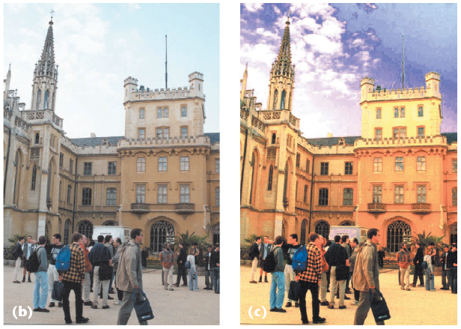
Image Processing I
CS180: Intro to Comp. Vision, and Comp. Photo
Alexei Efros & Angjoo Kanazawa, UC Berkeley, Fall 2023

Slide 2
What is an image?
We can think of an image as a function, f, from R² to R:
  f( x, y ) gives the intensity at position ( x, y )
  Realistically, we expect the image only to be defined over a rectangle, with a finite range:
    f: [a,b]x[c,d] → [0,1]
A color image is just three functions pasted together. We can write this as a “vector-valued” function:
Notes:
As opposed to [0..255]

Slide 3
Images as functions
Notes:
Render with scanalyze????

Slide 4

Image Formation
f(x,y) = reflectance(x,y) * illumination(x,y)
Reflectance in [0,1], illumination in [0,inf]

Slide 5
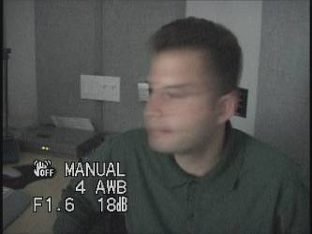

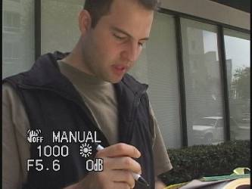
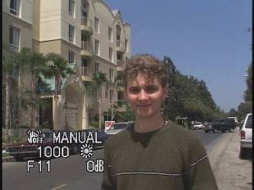
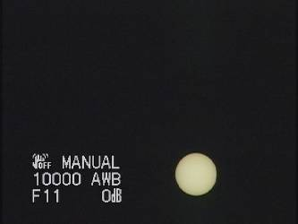
Problem: Dynamic Range
The real world is
High dynamic range
1
1500
25,000
400,000
2,000,000,000

Slide 6
Long Exposure
10⁻⁶
High dynamic range
10⁶
Real world
10⁻⁶
10⁶
Picture
^{0 to 255}

Slide 7
Short Exposure
10⁻⁶
High dynamic range
10⁶
Real world
10⁻⁶
10⁶
Picture
^{0 to 255}

Slide 8
Image Acquisition Pipeline
Lens
Shutter
scene
radiance
(W/sr/m )
sensor
irradiance
∫
sensor
exposure
2
Δt
CCD
ADC
Remapping
analog
voltages
digital
values
pixel
values
Notes:
3

Slide 9
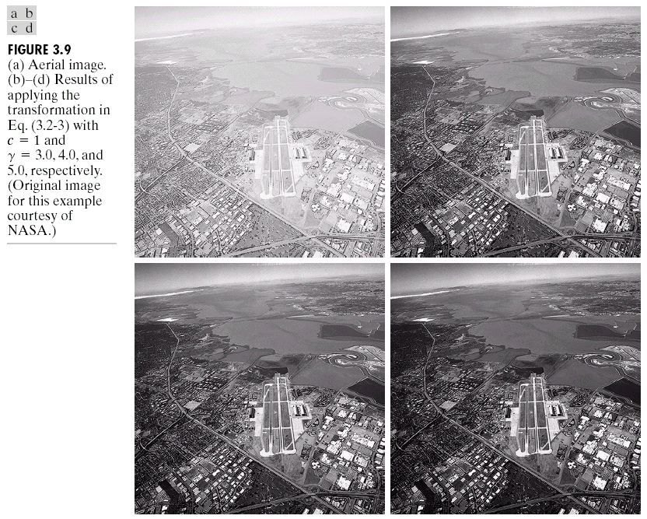
Simple Point Processing: Enhancement

Slide 10
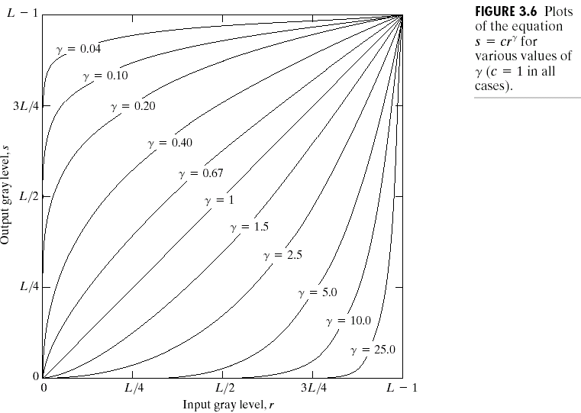
Power-law transformations

Slide 11
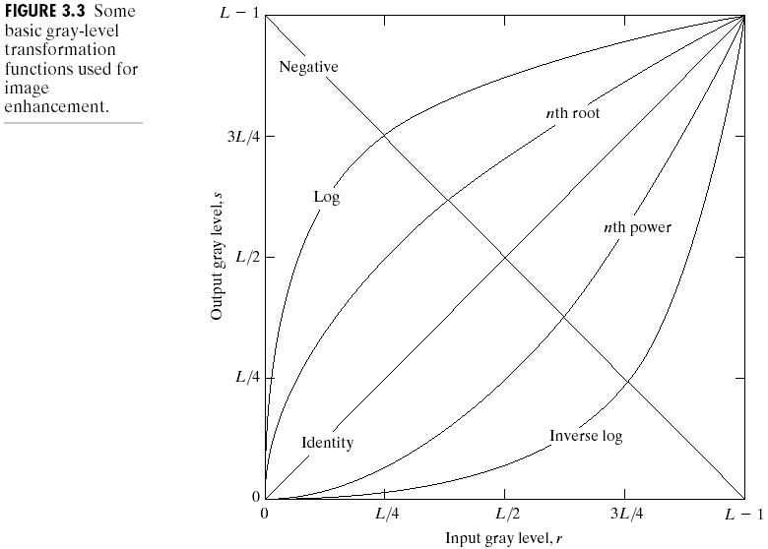
Basic Point Processing

Slide 12
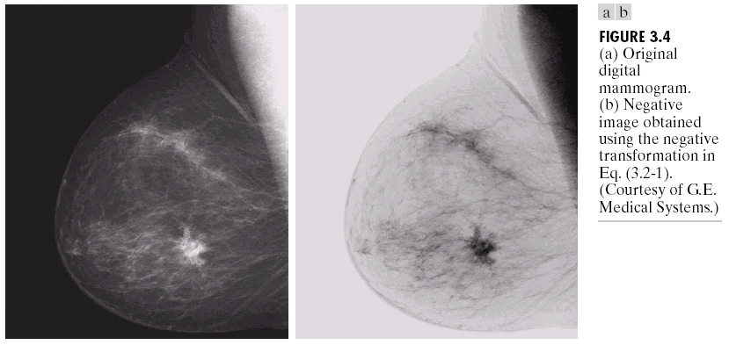
Negative

Slide 13
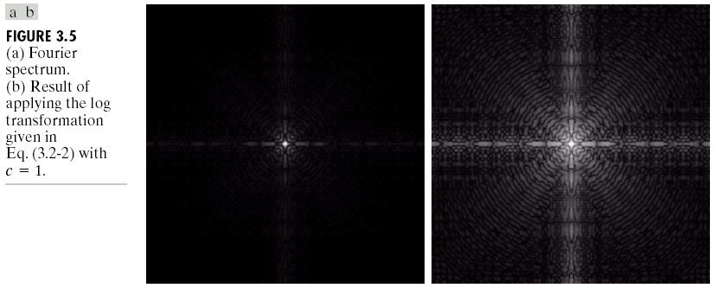
Log

Slide 14
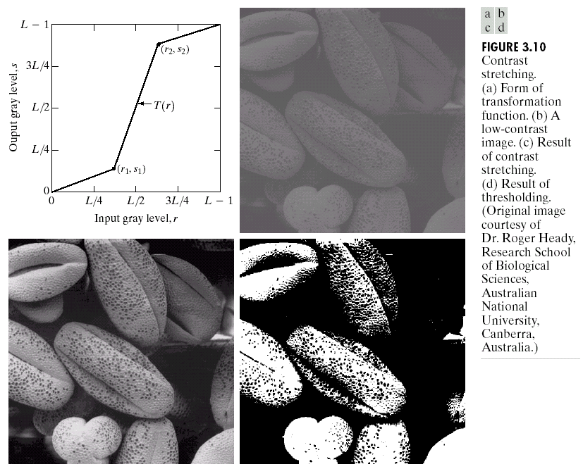
Contrast Stretching

Slide 15
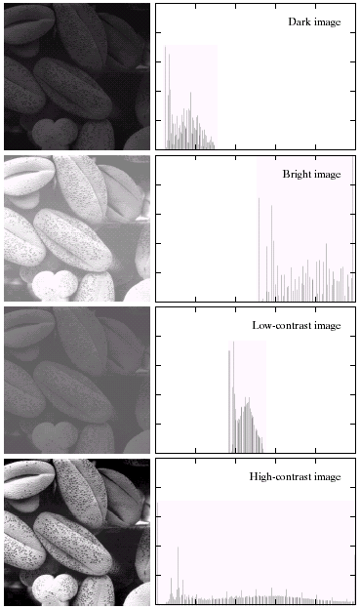
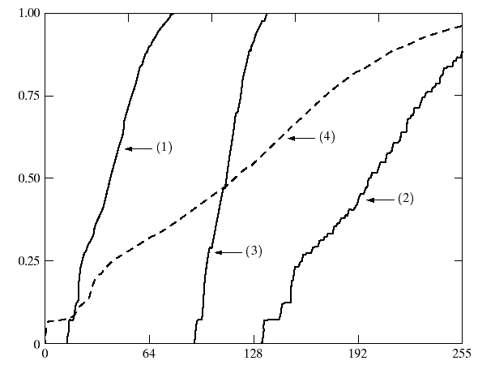

Image Histograms
Cumulative Histograms
s = T(r)

Slide 16
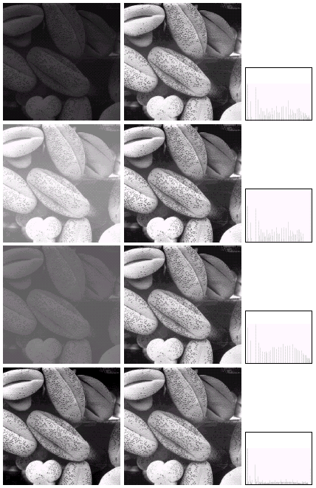

Histogram Equalization

Slide 17
Color Transfer [Reinhard, et al, 2001]
Erik Reinhard, Michael Ashikhmin, Bruce Gooch, Peter Shirley, Color Transfer between Images. IEEE Computer Graphics and Applications, 21(5), pp. 34–41. September 2001.

Slide 18
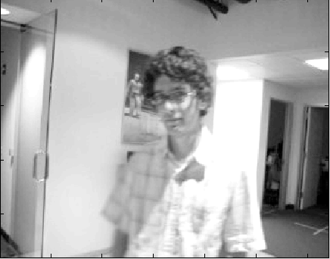
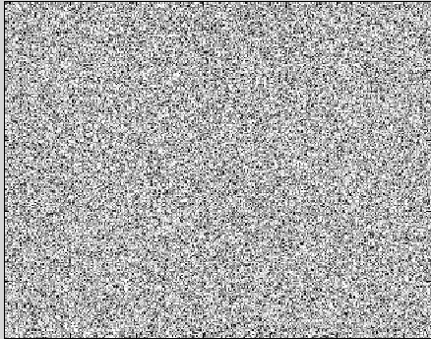
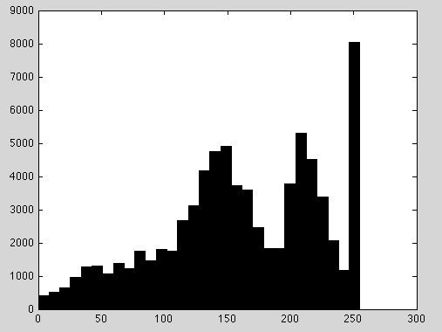
Limitations of Point Processing…
Slide by Erik Learned-Miller

Slide 19

Sampling and Reconstruction

Slide 20
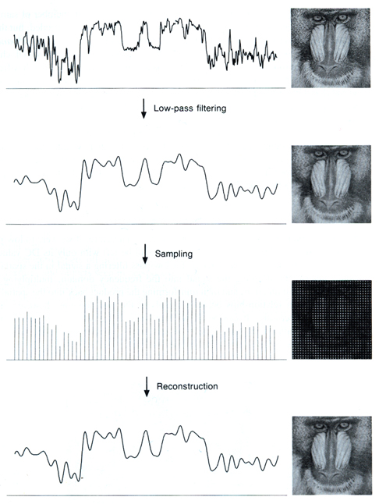
Sampled representations
How to store and compute with continuous functions?
Common scheme for representation: samples
  write down the function’s values at many points
[FvDFH fig.14.14b / Wolberg]

Slide 21
Reconstruction
Making samples back into a continuous function
  for output (need realizable method)
  for analysis or processing (need mathematical method)
  amounts to “guessing” what the function did in between
[FvDFH fig.14.14b / Wolberg]

Slide 22
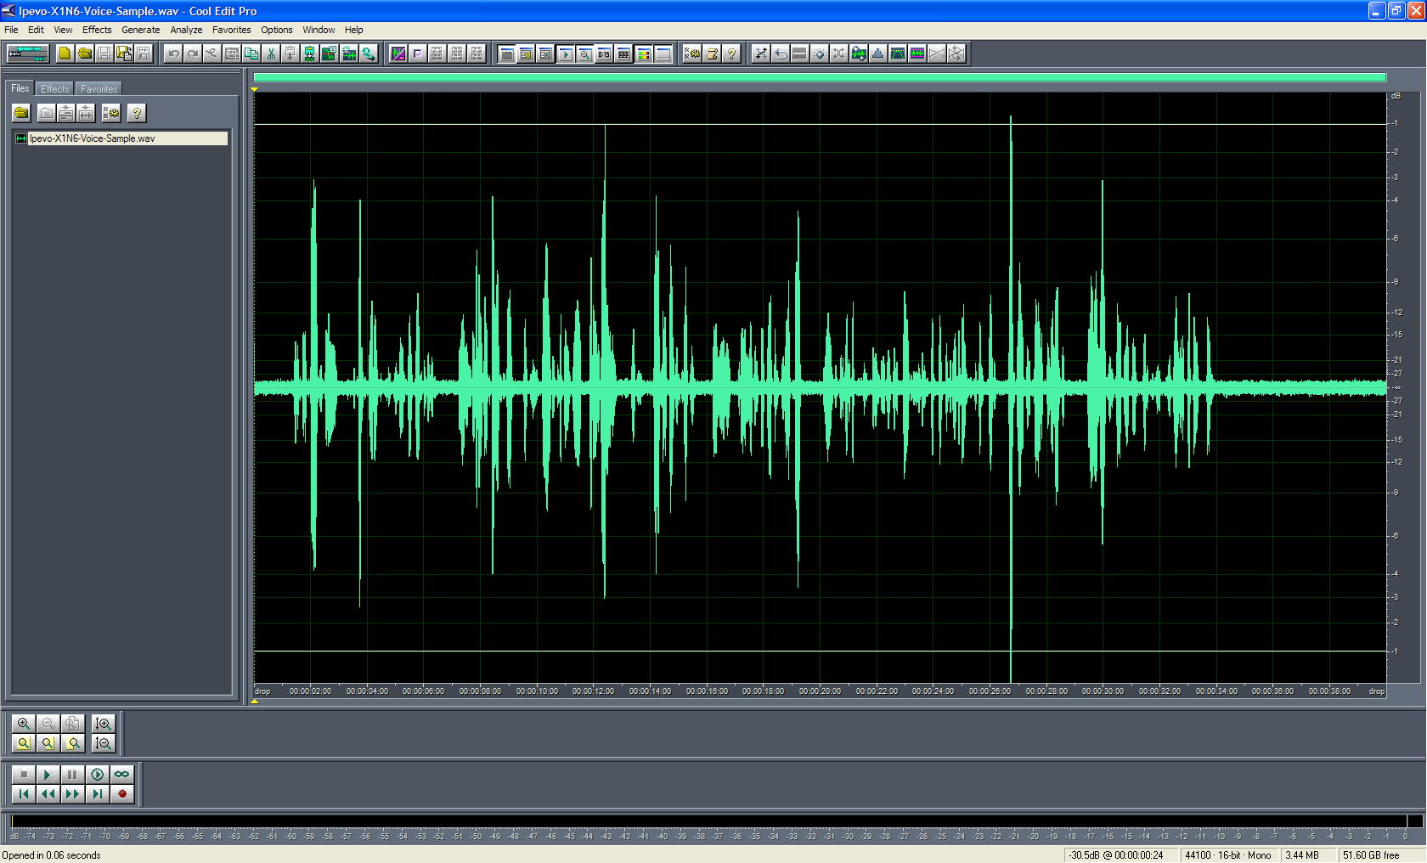
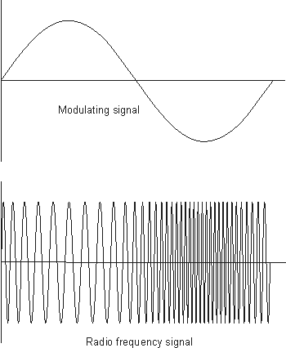
1D Example: Audio
low
high
frequencies

Slide 23
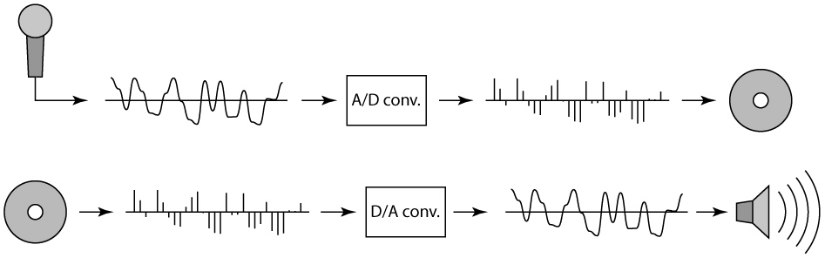
Sampling in digital audio
Recording: sound to analog to samples to disc
Playback: disc to samples to analog to sound again
  how can we be sure we are filling in the gaps correctly?

Slide 24
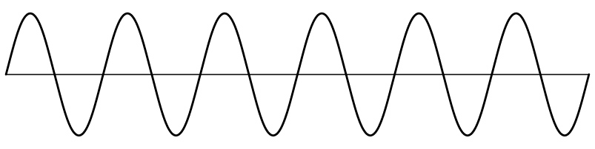
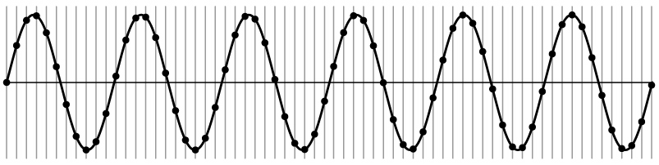
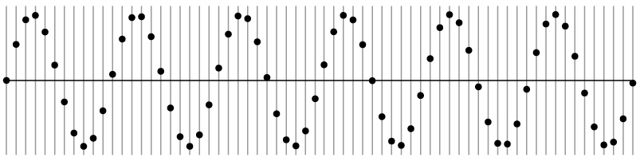
Sampling and Reconstruction
Simple example: a sign wave

Slide 25
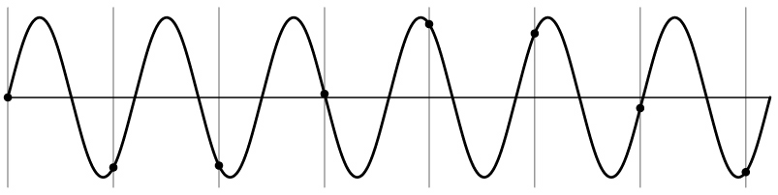
Undersampling
What if we “missed” things between the samples?
Simple example: undersampling a sine wave
  unsurprising result: information is lost

Slide 26
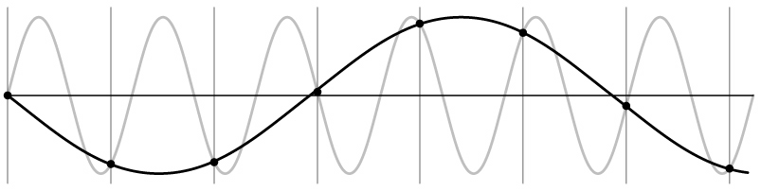
Undersampling
What if we “missed” things between the samples?
Simple example: undersampling a sine wave
  unsurprising result: information is lost
  surprising result: indistinguishable from lower frequency

Slide 27
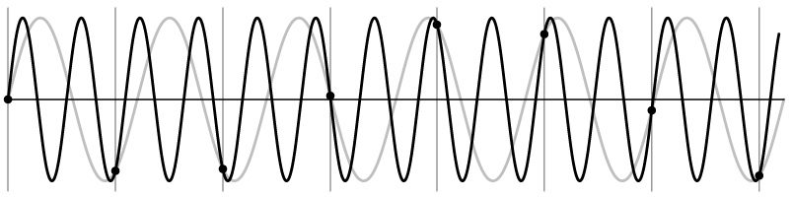
Undersampling
What if we “missed” things between the samples?
Simple example: undersampling a sine wave
  unsurprising result: information is lost
  surprising result: indistinguishable from lower frequency
  also, was always indistinguishable from higher frequencies
  aliasing: signals “traveling in disguise” as other frequencies

Slide 28
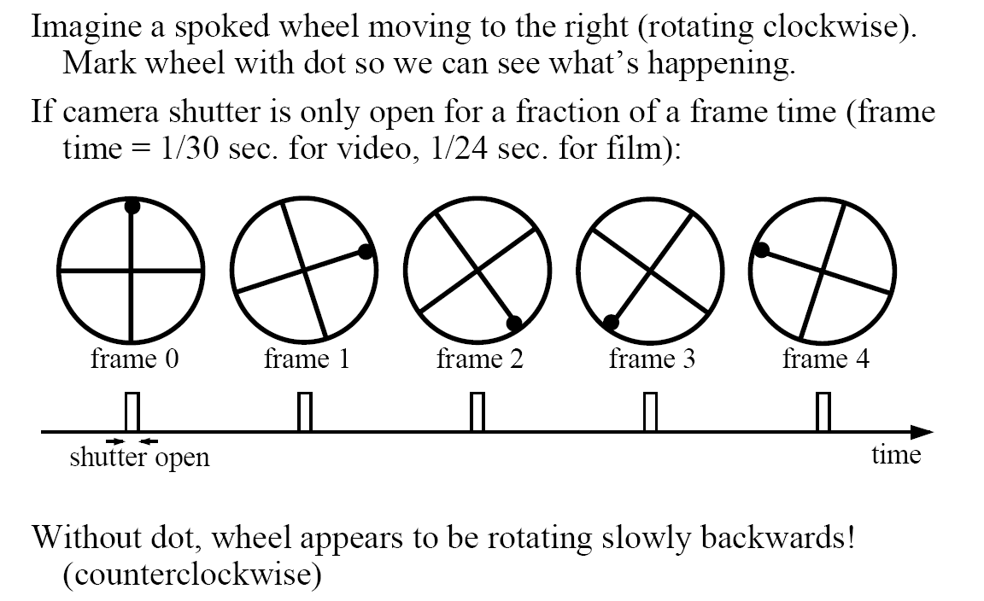
Aliasing in video
Slide by Steve Seitz

Slide 29
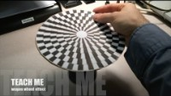

Slide 30
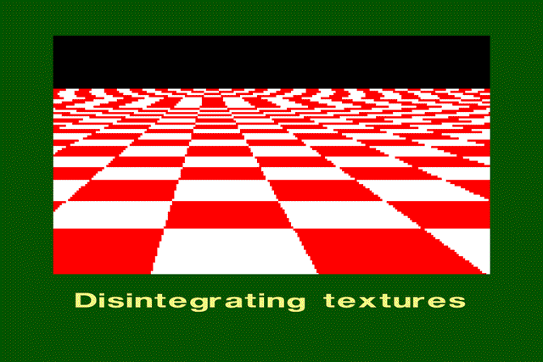
Aliasing in images

Slide 31
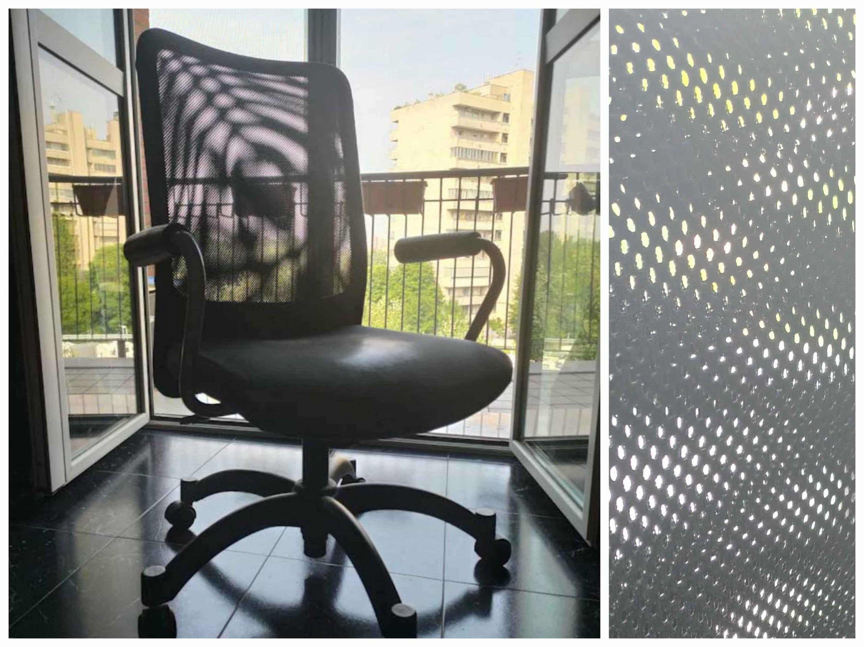
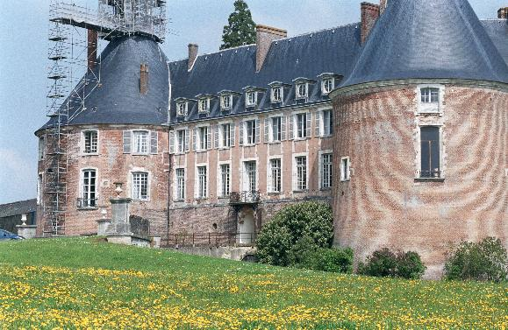
Aliasing in real images

Slide 32
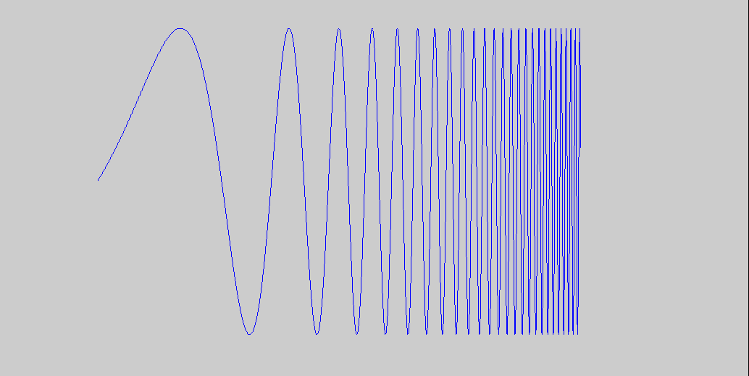
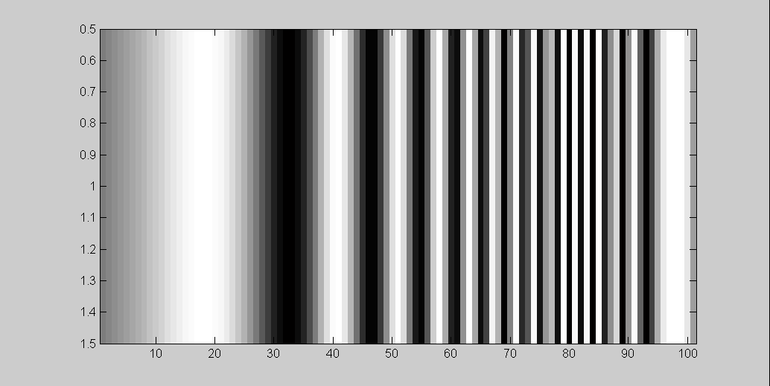
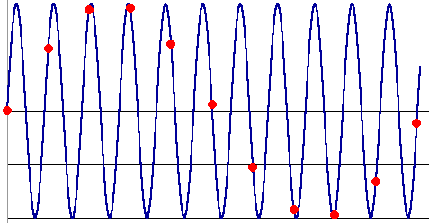
What’s happening?
Input signal:
Plot as image:
x = 0:.05:5; imagesc(sin((2.^x).*x))
Alias!
Not enough samples

Slide 33
Antialiasing
What can we do about aliasing?
Sample more often
  Join the Mega-Pixel craze of the photo industry
  But this can’t go on forever
Make the signal less “wiggly”
  Get rid of some high frequencies
  Will loose information
  But it’s better than aliasing

Slide 34
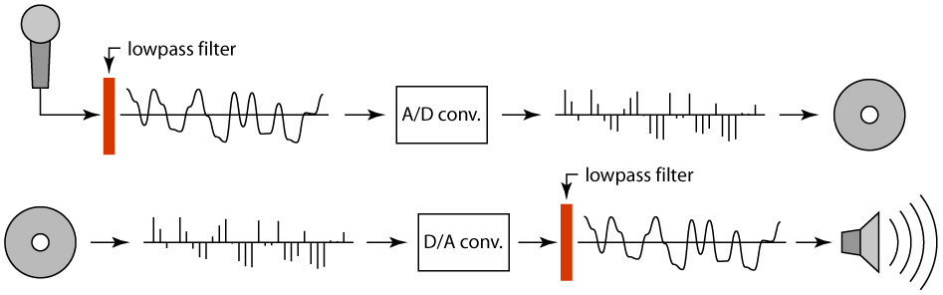
Preventing aliasing
Introduce lowpass filters:
  remove high frequencies leaving only safe, low frequencies
  choose lowest frequency in reconstruction (disambiguate)

Slide 35
Linear filtering: a key idea
Transformations on signals; e.g.:
  bass/treble controls on stereo
  blurring/sharpening operations in image editing
  smoothing/noise reduction in tracking
Key properties
  linearity: filter(f + g) = filter(f) + filter(g)
  shift invariance: behavior invariant to shifting the input
    delaying an audio signal
    sliding an image around
Can be modeled mathematically by convolution

Slide 36
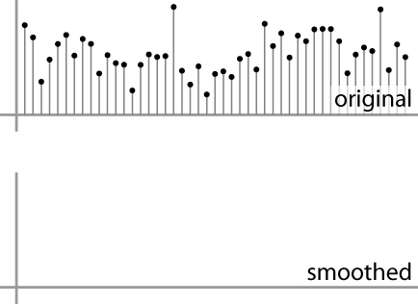
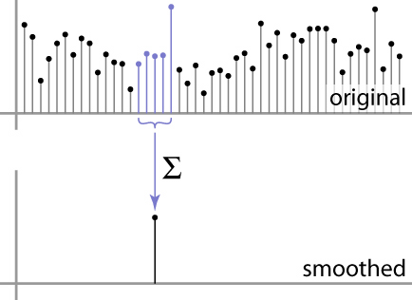
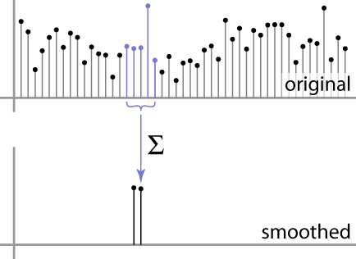
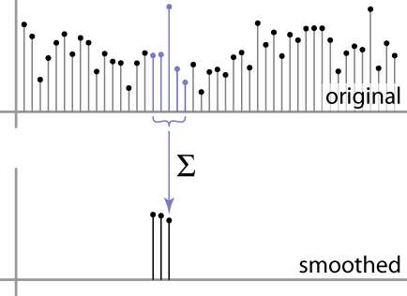
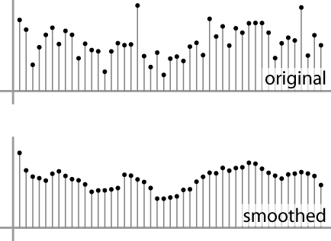
Moving Average
basic idea: define a new function by averaging over a sliding window
a simple example to start off: smoothing

Slide 37
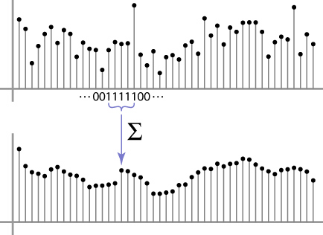
Moving Average
Can add weights to our moving average
Weights […, 0, 1, 1, 1, 1, 1, 0, …] / 5

Slide 38

In 2D: box filter
1
1
1
1
1
1
1
1
1
Slide credit: David Lowe (UBC)

Slide 39
Image filtering
1
1
1
1
1
1
1
1
1
0 | 0 | 0 | 0 | 0 | 0 | 0 | 0 | 0 | 0
0 | 0 | 0 | 0 | 0 | 0 | 0 | 0 | 0 | 0
0 | 0 | 0 | 90 | 90 | 90 | 90 | 90 | 0 | 0
0 | 0 | 0 | 90 | 90 | 90 | 90 | 90 | 0 | 0
0 | 0 | 0 | 90 | 90 | 90 | 90 | 90 | 0 | 0
0 | 0 | 0 | 90 | 0 | 90 | 90 | 90 | 0 | 0
0 | 0 | 0 | 90 | 90 | 90 | 90 | 90 | 0 | 0
0 | 0 | 0 | 0 | 0 | 0 | 0 | 0 | 0 | 0
0 | 0 | 90 | 0 | 0 | 0 | 0 | 0 | 0 | 0
0 | 0 | 0 | 0 | 0 | 0 | 0 | 0 | 0 | 0
 | 0
0 | 0 | 0 | 0 | 0 | 0 | 0 | 0 | 0 | 0
0 | 0 | 0 | 0 | 0 | 0 | 0 | 0 | 0 | 0
0 | 0 | 0 | 90 | 90 | 90 | 90 | 90 | 0 | 0
0 | 0 | 0 | 90 | 90 | 90 | 90 | 90 | 0 | 0
0 | 0 | 0 | 90 | 90 | 90 | 90 | 90 | 0 | 0
0 | 0 | 0 | 90 | 0 | 90 | 90 | 90 | 0 | 0
0 | 0 | 0 | 90 | 90 | 90 | 90 | 90 | 0 | 0
0 | 0 | 0 | 0 | 0 | 0 | 0 | 0 | 0 | 0
0 | 0 | 90 | 0 | 0 | 0 | 0 | 0 | 0 | 0
0 | 0 | 0 | 0 | 0 | 0 | 0 | 0 | 0 | 0
Credit: S. Seitz
Notes:
ones, divide by 9

Slide 40
Image filtering
1
1
1
1
1
1
1
1
1
0 | 0 | 0 | 0 | 0 | 0 | 0 | 0 | 0 | 0
0 | 0 | 0 | 0 | 0 | 0 | 0 | 0 | 0 | 0
0 | 0 | 0 | 90 | 90 | 90 | 90 | 90 | 0 | 0
0 | 0 | 0 | 90 | 90 | 90 | 90 | 90 | 0 | 0
0 | 0 | 0 | 90 | 90 | 90 | 90 | 90 | 0 | 0
0 | 0 | 0 | 90 | 0 | 90 | 90 | 90 | 0 | 0
0 | 0 | 0 | 90 | 90 | 90 | 90 | 90 | 0 | 0
0 | 0 | 0 | 0 | 0 | 0 | 0 | 0 | 0 | 0
0 | 0 | 90 | 0 | 0 | 0 | 0 | 0 | 0 | 0
0 | 0 | 0 | 0 | 0 | 0 | 0 | 0 | 0 | 0
 | 0 | 10
0 | 0 | 0 | 0 | 0 | 0 | 0 | 0 | 0 | 0
0 | 0 | 0 | 0 | 0 | 0 | 0 | 0 | 0 | 0
0 | 0 | 0 | 90 | 90 | 90 | 90 | 90 | 0 | 0
0 | 0 | 0 | 90 | 90 | 90 | 90 | 90 | 0 | 0
0 | 0 | 0 | 90 | 90 | 90 | 90 | 90 | 0 | 0
0 | 0 | 0 | 90 | 0 | 90 | 90 | 90 | 0 | 0
0 | 0 | 0 | 90 | 90 | 90 | 90 | 90 | 0 | 0
0 | 0 | 0 | 0 | 0 | 0 | 0 | 0 | 0 | 0
0 | 0 | 90 | 0 | 0 | 0 | 0 | 0 | 0 | 0
0 | 0 | 0 | 0 | 0 | 0 | 0 | 0 | 0 | 0
Credit: S. Seitz
Notes:
ones, divide by 9

Slide 41
Image filtering
1
1
1
1
1
1
1
1
1
0 | 0 | 0 | 0 | 0 | 0 | 0 | 0 | 0 | 0
0 | 0 | 0 | 0 | 0 | 0 | 0 | 0 | 0 | 0
0 | 0 | 0 | 90 | 90 | 90 | 90 | 90 | 0 | 0
0 | 0 | 0 | 90 | 90 | 90 | 90 | 90 | 0 | 0
0 | 0 | 0 | 90 | 90 | 90 | 90 | 90 | 0 | 0
0 | 0 | 0 | 90 | 0 | 90 | 90 | 90 | 0 | 0
0 | 0 | 0 | 90 | 90 | 90 | 90 | 90 | 0 | 0
0 | 0 | 0 | 0 | 0 | 0 | 0 | 0 | 0 | 0
0 | 0 | 90 | 0 | 0 | 0 | 0 | 0 | 0 | 0
0 | 0 | 0 | 0 | 0 | 0 | 0 | 0 | 0 | 0
 | 0 | 10 | 20
0 | 0 | 0 | 0 | 0 | 0 | 0 | 0 | 0 | 0
0 | 0 | 0 | 0 | 0 | 0 | 0 | 0 | 0 | 0
0 | 0 | 0 | 90 | 90 | 90 | 90 | 90 | 0 | 0
0 | 0 | 0 | 90 | 90 | 90 | 90 | 90 | 0 | 0
0 | 0 | 0 | 90 | 90 | 90 | 90 | 90 | 0 | 0
0 | 0 | 0 | 90 | 0 | 90 | 90 | 90 | 0 | 0
0 | 0 | 0 | 90 | 90 | 90 | 90 | 90 | 0 | 0
0 | 0 | 0 | 0 | 0 | 0 | 0 | 0 | 0 | 0
0 | 0 | 90 | 0 | 0 | 0 | 0 | 0 | 0 | 0
0 | 0 | 0 | 0 | 0 | 0 | 0 | 0 | 0 | 0
Credit: S. Seitz
Notes:
ones, divide by 9

Slide 42
Image filtering
1
1
1
1
1
1
1
1
1
0 | 0 | 0 | 0 | 0 | 0 | 0 | 0 | 0 | 0
0 | 0 | 0 | 0 | 0 | 0 | 0 | 0 | 0 | 0
0 | 0 | 0 | 90 | 90 | 90 | 90 | 90 | 0 | 0
0 | 0 | 0 | 90 | 90 | 90 | 90 | 90 | 0 | 0
0 | 0 | 0 | 90 | 90 | 90 | 90 | 90 | 0 | 0
0 | 0 | 0 | 90 | 0 | 90 | 90 | 90 | 0 | 0
0 | 0 | 0 | 90 | 90 | 90 | 90 | 90 | 0 | 0
0 | 0 | 0 | 0 | 0 | 0 | 0 | 0 | 0 | 0
0 | 0 | 90 | 0 | 0 | 0 | 0 | 0 | 0 | 0
0 | 0 | 0 | 0 | 0 | 0 | 0 | 0 | 0 | 0
 | 0 | 10 | 20 | 30
0 | 0 | 0 | 0 | 0 | 0 | 0 | 0 | 0 | 0
0 | 0 | 0 | 0 | 0 | 0 | 0 | 0 | 0 | 0
0 | 0 | 0 | 90 | 90 | 90 | 90 | 90 | 0 | 0
0 | 0 | 0 | 90 | 90 | 90 | 90 | 90 | 0 | 0
0 | 0 | 0 | 90 | 90 | 90 | 90 | 90 | 0 | 0
0 | 0 | 0 | 90 | 0 | 90 | 90 | 90 | 0 | 0
0 | 0 | 0 | 90 | 90 | 90 | 90 | 90 | 0 | 0
0 | 0 | 0 | 0 | 0 | 0 | 0 | 0 | 0 | 0
0 | 0 | 90 | 0 | 0 | 0 | 0 | 0 | 0 | 0
0 | 0 | 0 | 0 | 0 | 0 | 0 | 0 | 0 | 0
Credit: S. Seitz
Notes:
ones, divide by 9

Slide 43
Image filtering
1
1
1
1
1
1
1
1
1
0 | 0 | 0 | 0 | 0 | 0 | 0 | 0 | 0 | 0
0 | 0 | 0 | 0 | 0 | 0 | 0 | 0 | 0 | 0
0 | 0 | 0 | 90 | 90 | 90 | 90 | 90 | 0 | 0
0 | 0 | 0 | 90 | 90 | 90 | 90 | 90 | 0 | 0
0 | 0 | 0 | 90 | 90 | 90 | 90 | 90 | 0 | 0
0 | 0 | 0 | 90 | 0 | 90 | 90 | 90 | 0 | 0
0 | 0 | 0 | 90 | 90 | 90 | 90 | 90 | 0 | 0
0 | 0 | 0 | 0 | 0 | 0 | 0 | 0 | 0 | 0
0 | 0 | 90 | 0 | 0 | 0 | 0 | 0 | 0 | 0
0 | 0 | 0 | 0 | 0 | 0 | 0 | 0 | 0 | 0
 | 0 | 10 | 20 | 30 | 30
Credit: S. Seitz
Notes:
ones, divide by 9

Slide 44
Image filtering
1
1
1
1
1
1
1
1
1
0 | 0 | 0 | 0 | 0 | 0 | 0 | 0 | 0 | 0
0 | 0 | 0 | 0 | 0 | 0 | 0 | 0 | 0 | 0
0 | 0 | 0 | 90 | 90 | 90 | 90 | 90 | 0 | 0
0 | 0 | 0 | 90 | 90 | 90 | 90 | 90 | 0 | 0
0 | 0 | 0 | 90 | 90 | 90 | 90 | 90 | 0 | 0
0 | 0 | 0 | 90 | 0 | 90 | 90 | 90 | 0 | 0
0 | 0 | 0 | 90 | 90 | 90 | 90 | 90 | 0 | 0
0 | 0 | 0 | 0 | 0 | 0 | 0 | 0 | 0 | 0
0 | 0 | 90 | 0 | 0 | 0 | 0 | 0 | 0 | 0
0 | 0 | 0 | 0 | 0 | 0 | 0 | 0 | 0 | 0
 | 0 | 10 | 20 | 30 | 30
?
Credit: S. Seitz
Notes:
ones, divide by 9

Slide 45
Image filtering
1
1
1
1
1
1
1
1
1
0 | 0 | 0 | 0 | 0 | 0 | 0 | 0 | 0 | 0
0 | 0 | 0 | 0 | 0 | 0 | 0 | 0 | 0 | 0
0 | 0 | 0 | 90 | 90 | 90 | 90 | 90 | 0 | 0
0 | 0 | 0 | 90 | 90 | 90 | 90 | 90 | 0 | 0
0 | 0 | 0 | 90 | 90 | 90 | 90 | 90 | 0 | 0
0 | 0 | 0 | 90 | 0 | 90 | 90 | 90 | 0 | 0
0 | 0 | 0 | 90 | 90 | 90 | 90 | 90 | 0 | 0
0 | 0 | 0 | 0 | 0 | 0 | 0 | 0 | 0 | 0
0 | 0 | 90 | 0 | 0 | 0 | 0 | 0 | 0 | 0
0 | 0 | 0 | 0 | 0 | 0 | 0 | 0 | 0 | 0
 | 0 | 10 | 20 | 30 | 30
 |  |  |  | 50
?
Credit: S. Seitz
Notes:
ones, divide by 9

Slide 46
Image filtering
1
1
1
1
1
1
1
1
1
0 | 0 | 0 | 0 | 0 | 0 | 0 | 0 | 0 | 0
0 | 0 | 0 | 0 | 0 | 0 | 0 | 0 | 0 | 0
0 | 0 | 0 | 90 | 90 | 90 | 90 | 90 | 0 | 0
0 | 0 | 0 | 90 | 90 | 90 | 90 | 90 | 0 | 0
0 | 0 | 0 | 90 | 90 | 90 | 90 | 90 | 0 | 0
0 | 0 | 0 | 90 | 0 | 90 | 90 | 90 | 0 | 0
0 | 0 | 0 | 90 | 90 | 90 | 90 | 90 | 0 | 0
0 | 0 | 0 | 0 | 0 | 0 | 0 | 0 | 0 | 0
0 | 0 | 90 | 0 | 0 | 0 | 0 | 0 | 0 | 0
0 | 0 | 0 | 0 | 0 | 0 | 0 | 0 | 0 | 0
 | 0 | 10 | 20 | 30 | 30 | 30 | 20 | 10
 | 0 | 20 | 40 | 60 | 60 | 60 | 40 | 20
 | 0 | 30 | 60 | 90 | 90 | 90 | 60 | 30
 | 0 | 30 | 50 | 80 | 80 | 90 | 60 | 30
 | 0 | 30 | 50 | 80 | 80 | 90 | 60 | 30
 | 0 | 20 | 30 | 50 | 50 | 60 | 40 | 20
 | 10 | 20 | 30 | 30 | 30 | 30 | 20 | 10
 | 10 | 10 | 10 | 0 | 0 | 0 | 0 | 0
Credit: S. Seitz

Slide 47



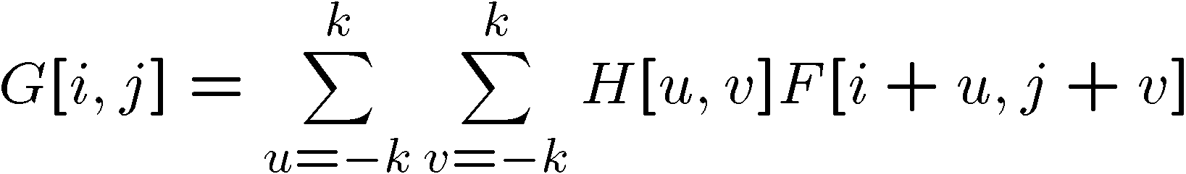

Cross-correlation
Let be the image, be the kernel (of size 2k+1 x 2k+1), and be the output image
Can think of as a “dot product” between local neighborhood and kernel for each pixel
This is called a cross-correlation operation:

Slide 48
Box Filter
What does it do?
Replaces each pixel with an average of its neighborhood
Achieve smoothing effect (remove sharp features)
1
1
1
1
1
1
1
1
1
Slide credit: David Lowe (UBC)

Slide 49

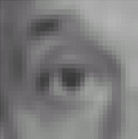
Linear filters: examples
1
1
1
=
1
1
1
1
1
1
Original
Blur (with a mean filter)
Source: D. Lowe

Slide 50
Practice with linear filters
0
0
0
?
0
1
0
0
0
0
Original
Source: D. Lowe

Slide 51
Practice with linear filters
0
0
0
0
1
0
0
0
0
Original
Filtered
(no change)
Source: D. Lowe

Slide 52
Practice with linear filters
0
0
0
?
0
0
1
0
0
0
Original
Source: D. Lowe

Slide 53
Practice with linear filters
0
0
0
0
0
1
0
0
0
Original
Shifted left
By 1 pixel
Source: D. Lowe

Slide 54


Other filters
1
0
-1
2
0
-2
1
0
-1
Sobel
Vertical Edge
(absolute value)

Slide 55

Other filters
Q?
1
2
1
0
0
0
-1
-2
-1
Sobel
Horizontal Edge
(absolute value)
Notes:
Questions at this point?
55

Slide 56


Back to the box filter

