Slide 1
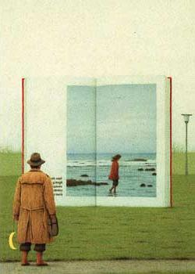
CS 180/280A: Intro to Computer Vision and Computational Photography
Instructors: Alexei Efros
Angjoo Kanazawa
GSIs: Ruilong Li
Jack Austin
Readers: Morgan Lyu
Preston McCrary
Max Vogel
UC Berkeley, Fall 2023
© Quint Buchholz

Slide 2

Covid Precautions

Slide 3
Today
Introductions
Why this Course?
Administrative stuff
Brief History of Visual Data

Slide 4
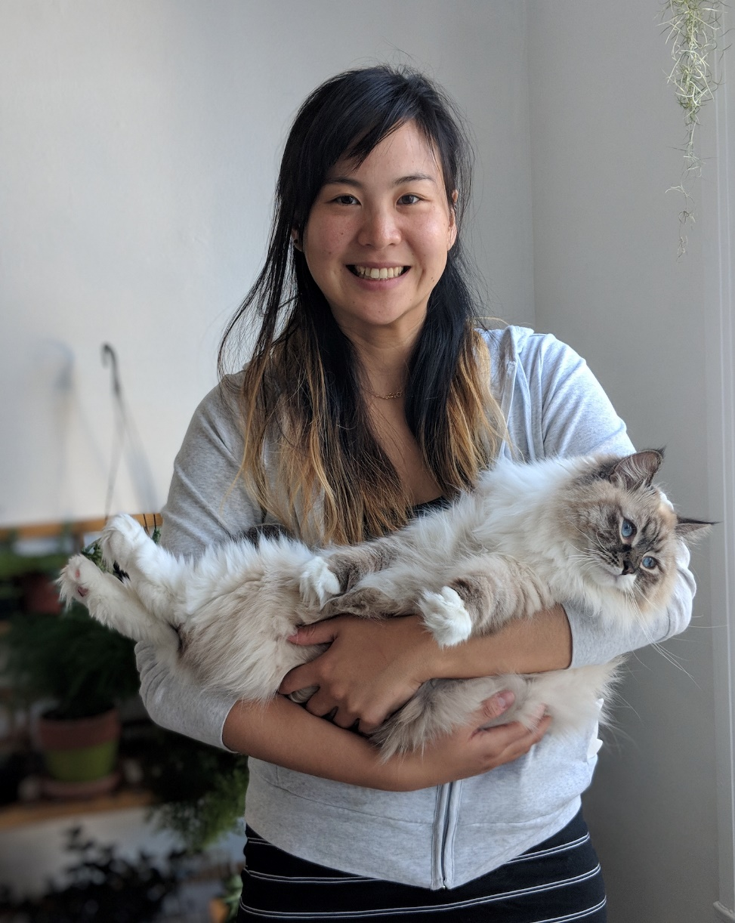

Teaching Team: professors
Angjoo Kanazawa
Alexei Efros

Slide 5
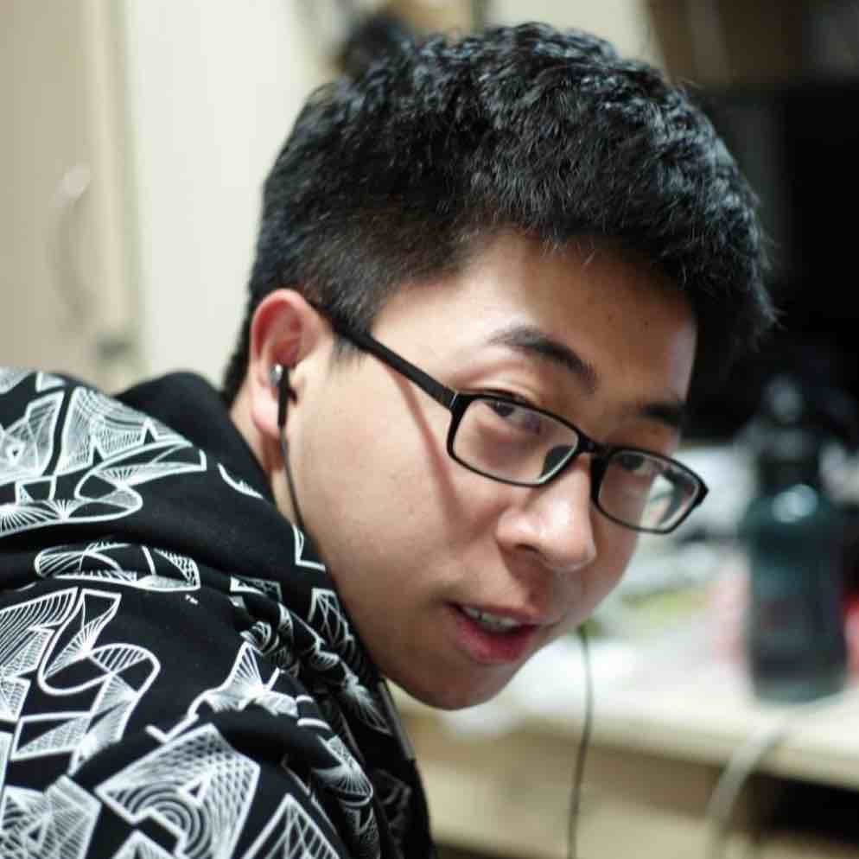

Teaching Team: GSIs
Ruilong Li
Jake Austin

Slide 6
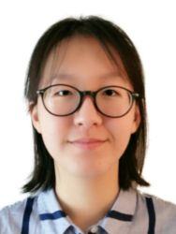
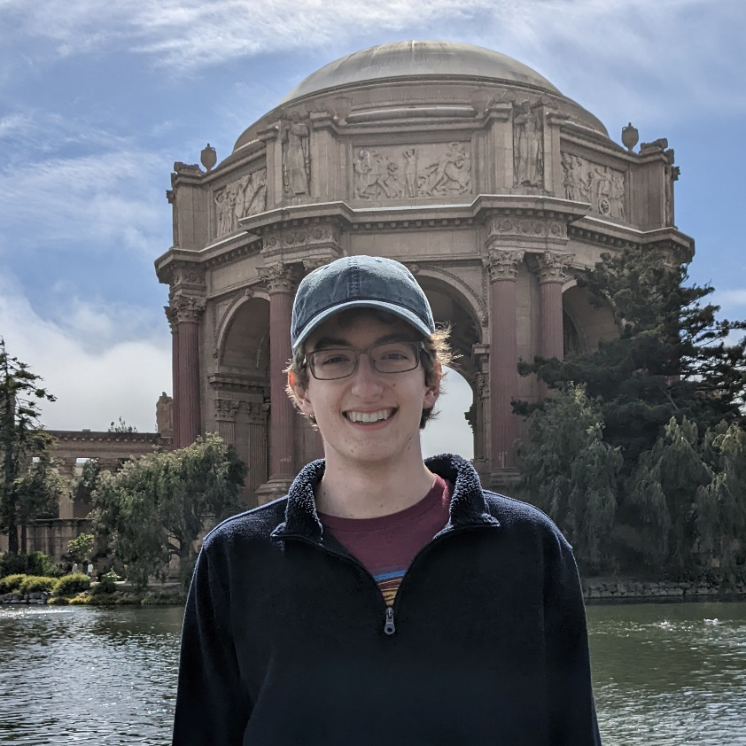

Teaching Team: Readers/Tutors
Morgan Lyu
Max
Vogel
Preston McCrary

Slide 7
Why This Course?

Slide 8
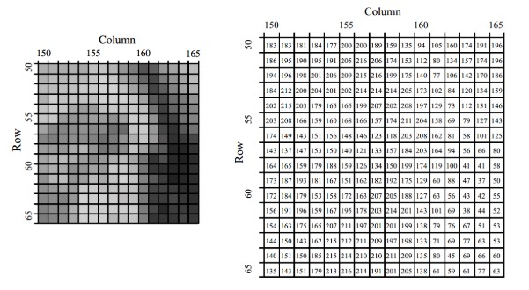
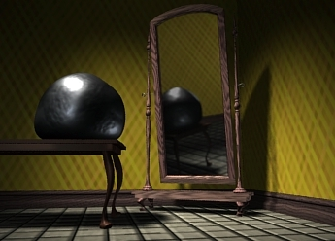
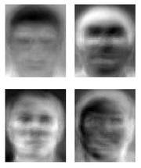
Visual Computing in the old days…
Image Processing
EECS 225B
Computer Graphics
CS 184
Computer Vision CS 280

Slide 9
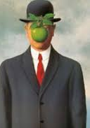

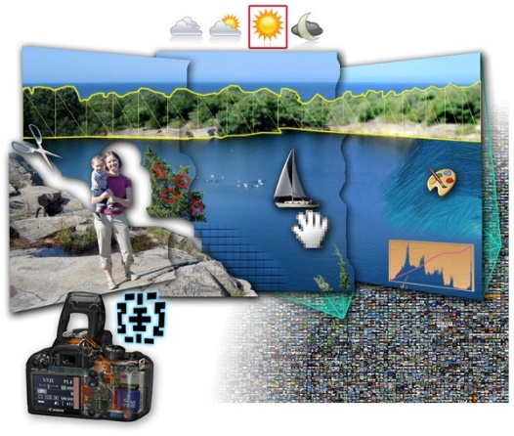

Visual Computing gets interconnected
Image Processing
EECS 225B
Art History
ART 10
Computer Graphics
CS 184
Computational
Photography
Visual Perception
PSYCH
Machine
Learning
Computer Vision CS 280

Slide 10
Visual Computing gets interconnected
CS180
Image Processing
EECS 225B
Art History
ART 10
Computer Graphics
CS 184
Computational
Photography
Visual Perception
PSYCH
Machine
Learning
Computer Vision CS 280

Slide 11
CS180: Focus on Visual Data
The key objective of this class is to become friends with every pixel!

Slide 12
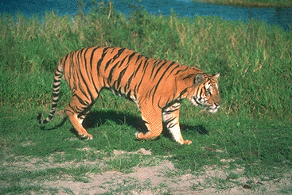

Course objectives
You will appreciate the fundamental difficulty of understanding and computing with visual data
Notes:
Foundation for computer vision. We want machines to watch for us, do our work, and make us live longer, more healthy, and more entertaining lives. This course will give you a good hands-on background for learning more or developing new computer vision applications.

Slide 13
Course objectives
2. You will get a foundation in image processing and computer vision, from the ground up:
  Camera basics, image formation
  Convolutions, filtering
  Image and Video Processing (filtering, anti-aliasing, pyramids)
  Image Manipulation (warping, morphing, mosaicing, matting, compositing)
  Data-driven Generative Models
  Projection, 3D, stereo
  NeRFs
  …
Notes:
Foundation for computer vision. We want machines to watch for us, do our work, and make us live longer, more healthy, and more entertaining lives. This course will give you a good hands-on background for learning more or developing new computer vision applications.

Slide 14
Course objectives
3. You will get a more intuitive understanding of important mathematical and computational concepts
  Gradients
  Change of basis, interpolation, extrapolation, PCA
  FFT
  Dynamic programming, recursion
  Machine learning, Convolutional Neural Networks
  Large-Pixel-Models
  …

Slide 15
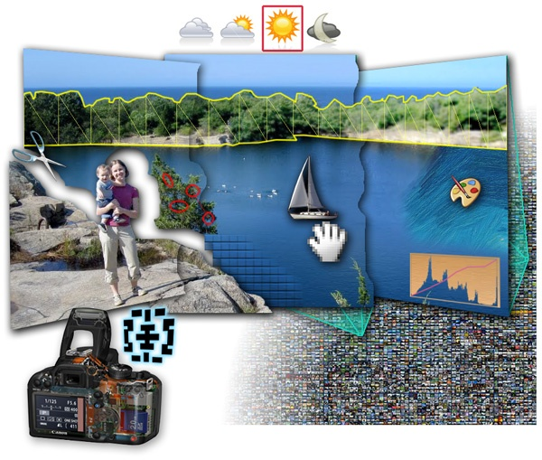

Course objectives
4. You will learn approaches for visual synthesis
Graphic by James Hays
DALL-E + Danielle Baskin
Notes:
Visual creation is no longer just pure graphics or pure photography. There is a growing need to blend the two. We want to edit photos, work with photo collections, create cool special effects, etc. After this course, you should have the background and experience that you need to do these things.

Slide 16
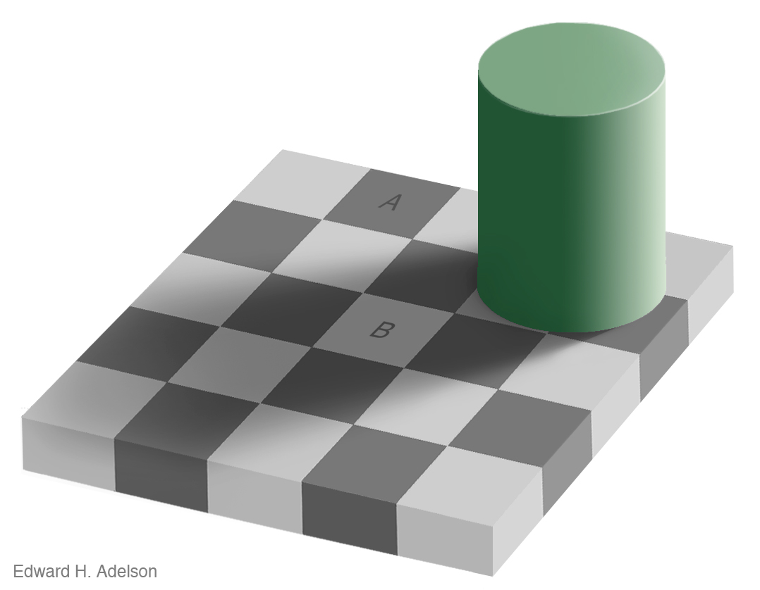
Course objectives
4. You’ll better appreciate human visual perception
Notes:
You'll gain an appreciation for your own visual ability. We tend to take it for granted, but half of our brain is cranking away on the vision problem. Interestingly, we are usually aware only of the interpretation, not what we actually see. By working with pixels, you'll see how messy images actually are and how incredible it is that we can interpret anything from them.

Slide 17
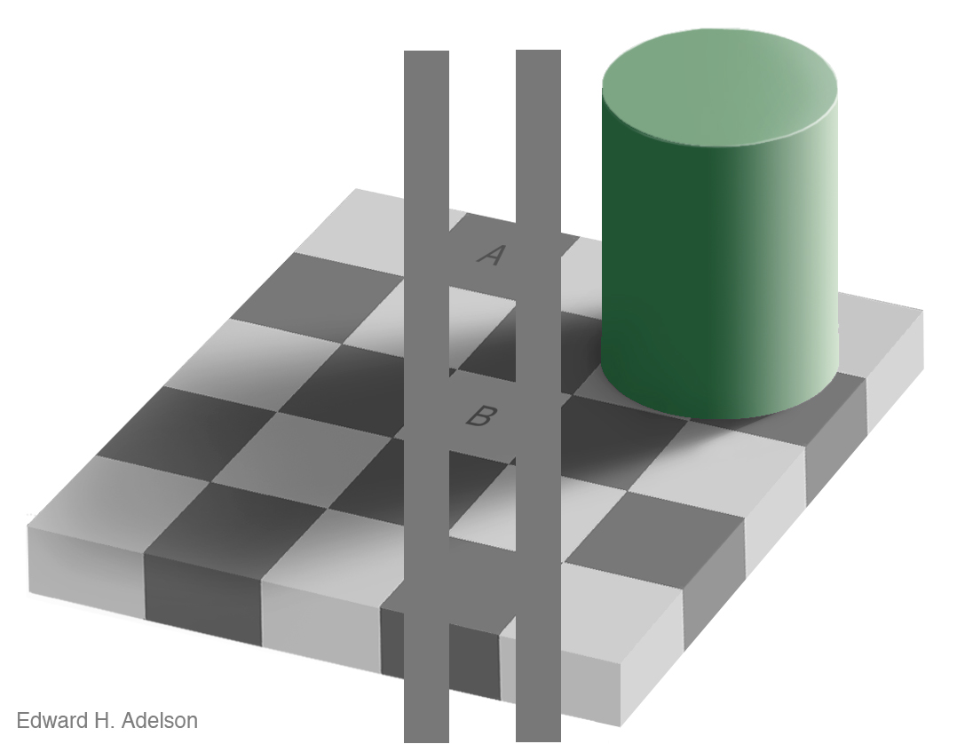
Course objectives
4. You’ll better appreciate human visual perception
Notes:
You'll gain an appreciation for your own visual ability. We tend to take it for granted, but half of our brain is cranking away on the vision problem. Interestingly, we are usually aware only of the interpretation, not what we actually see. By working with pixels, you'll see how messy images actually are and how incredible it is that we can interpret anything from them.

Slide 18
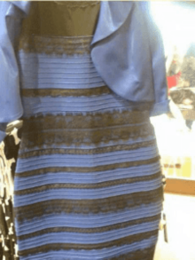
Different people see different things
https://en.wikipedia.org/wiki/The_dress

Slide 19

People see things that aren’t there
Video by Antonio Torralba (starring Rob Fergus)

Slide 20
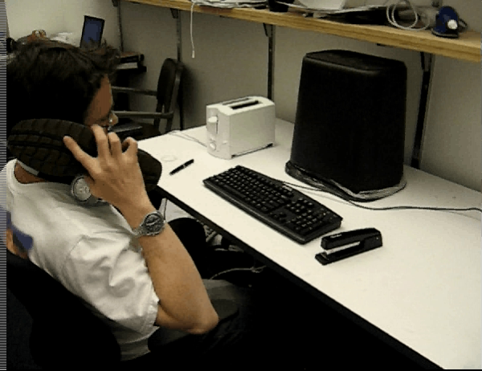
But actually…
Video by Antonio Torralba (starring Rob Fergus)

Slide 21
Course objectives
5. You will learn about the history of ideas in visual computing
  Did you know Large Generative Models go back to 1940s?
  Or that Deep Learning started with a Nobel Prize in Neuroscience in the 1960s?
  …

Slide 22
Course objectives
6. You’ll have fun doing cool stuff, coding up a storm, while you befriend the pixels
Notes:
Do cool stuff. You'll get the opportunity to implement a variety of fun projects that work with your own photos. You can be creative. You can also go beyond the minimum and do some "bells and whistles" or additional projects that I offer. You'll get to do a final project on whatever you want. You'll also be able to see the work that everyone else does.

Slide 23

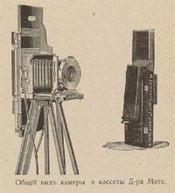
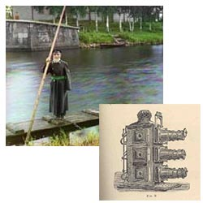
Programming Project #1
Prokudin-Gorskii’s Color Photography (1907)

Slide 24
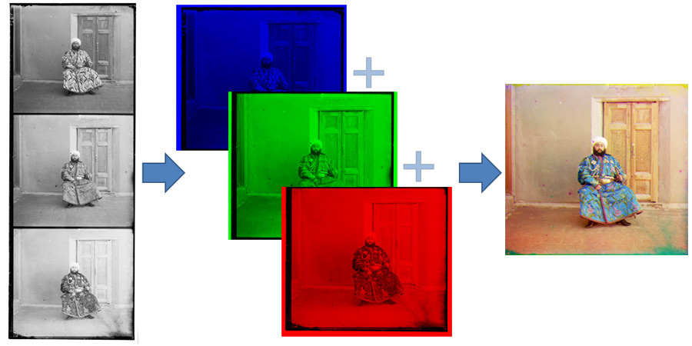
Programming Project #1

Slide 25
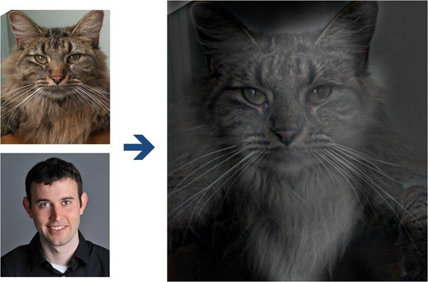
Project 2: Fun with frequencies

Slide 26
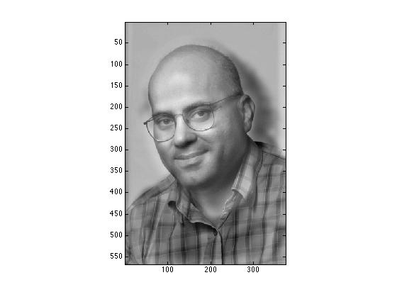
Project 2: Fun with frequencies
Prof. Christos Papadimalik
© Riyaz Faizullabhoy

Slide 27
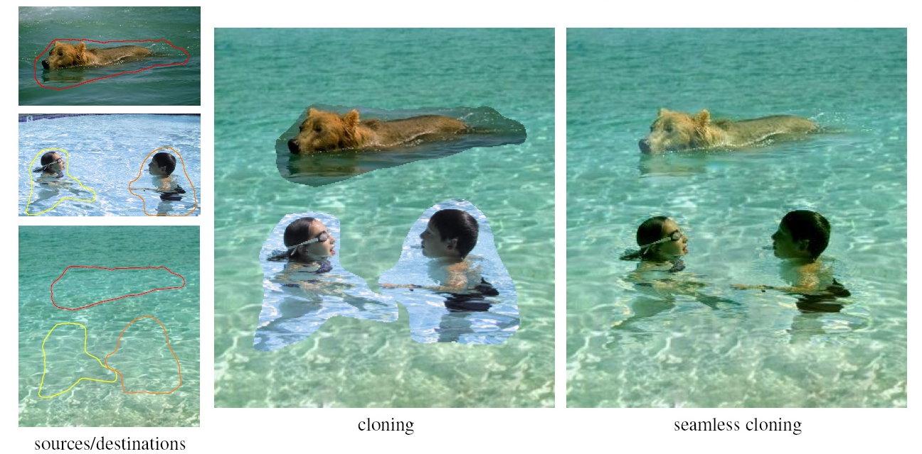
Project 2: Fun with Frequencies

Slide 28
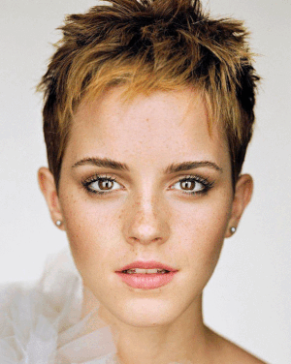
Project 3: Face modeling and morphing

Slide 29
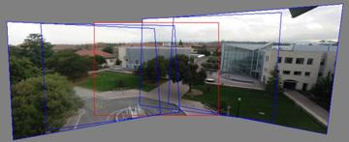
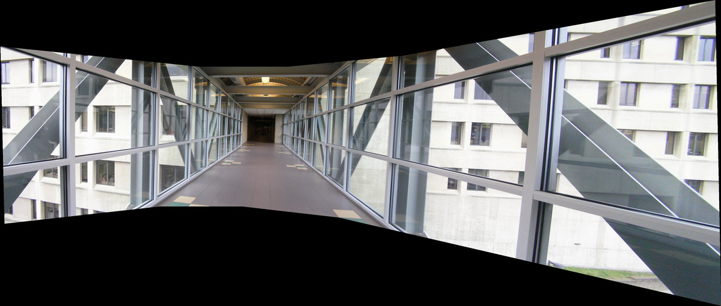
Project 4: Panorama Stitching
Photo Mosaics

Slide 30
Project 5: TBD
(depends on if we could get GPU donation)

Slide 31
Final Project
Something cool!!!
We will have some pre-canned projects
Will also have some suggestions, cool datasets, etc
Or you can do whatever you want!
(can be done in groups of 2 or 3)

Slide 32
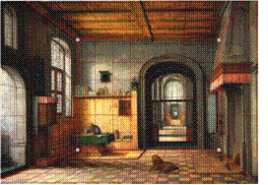
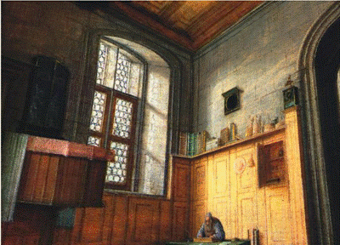
Example Pre-canned Project
Tour Into the Picture

Slide 33
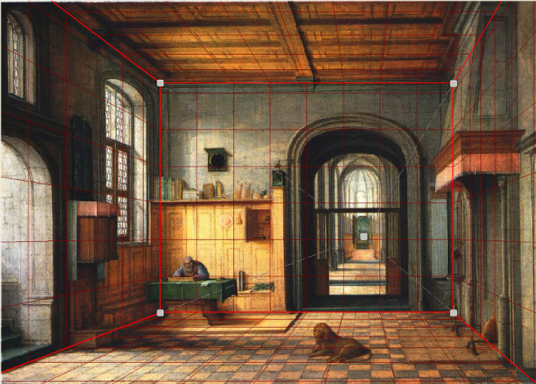
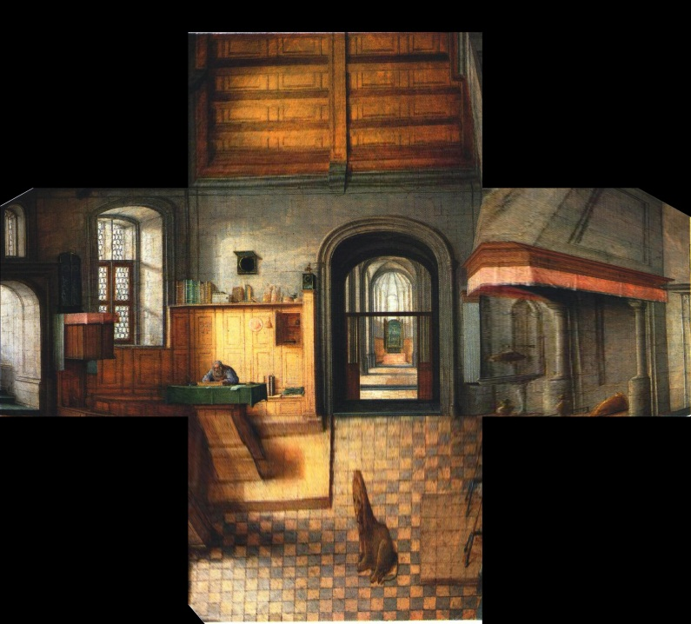
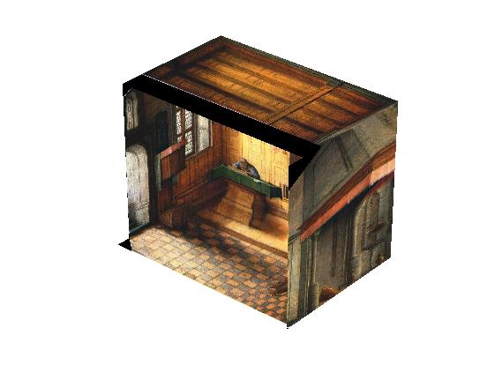
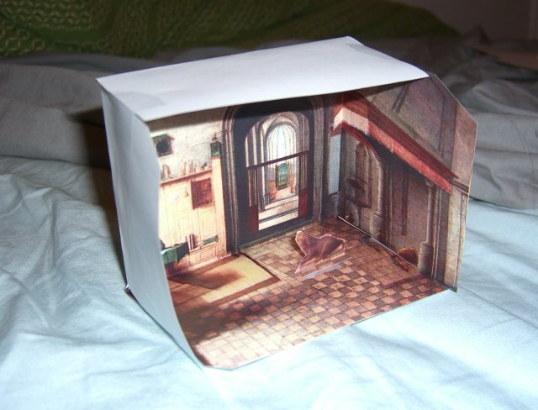
Paper Pop-up
Step 1: define planes
Step 2: rectify each plane
Step 3: compute 3D box coords

Slide 34

Sample final project in my class

Slide 35
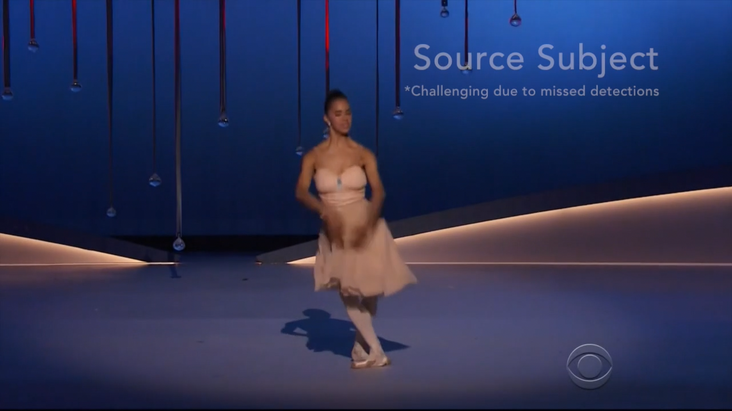
Everybody Dance Now
https://www.youtube.com/watch?v=PCBTZh41Ris&feature=youtu.be

Slide 36
For each project:
Derive the math, implement stuff from scratch, and apply it to your own photos
Every person does their own project (except final projects)
Reporting via web page (plus submit code)
Afterwards, vote for class favorite(s)!

Slide 37

Textbook
http://szeliski.org/Book/

Slide 38
Class Organization / Administrivia

Slide 39
General
Prerequisites
  Linear algebra!!! (EE16A, Math 54, or Math 110)
  Good programming skills (at least CS61B)
  Deep Learning experience strongly recommended!
Emphasis on programming projects!
  Building something from scratch
Graduate Version:
  Final project required (not pre-canned), including conference-style report paper

Slide 40
Administrative Stuff
Grading
  Programming Project (60%)
  Exam + possible popup quizzes (20%)
  Final Project (20%)
  Class Participation: priceless
Late Policy
  Five (5) emergency late days for semester. The expectation is you will never use them.
  Max 10% of full credit afterwards
Extra Points
  Most projects will have optional “bells & whistles”
  These extra points could be used to pad scores on other projects (but not exams!)

Slide 41
Rule # 1:
No lecture recordings
This is an in-person class. You are to come to the lecture and ask questions! Attendance is required.
Only available by request for truly exceptional circumstances, e.g. severe illness

Slide 42
Rule # 2:
Deadline is a deadline
In real life there’s no slip days
This is a FUN but INTENSE class, projects come one after another
Slip days are for emergencies. If nothing dramatic happened to you during the semester, you should have all your slip days left.
Projects are time consuming. Start early!!!

Slide 43
Rule # 3:
TA’s don’t debug code
TA’s don’t debug code for you.
Part of the skill is to learn how to ask questions to debug the issue without presenting the code
Visualize the results and send those to figure out what is wrong
Use the pixels – become friends with visual debugging

Slide 44
Getting help outside of class
Course Web Page
  http://inst.eecs.berkeley.edu/~cs180
Discussion board:
Ed
Discussion Section:
Ruilong: Tuesdays, Cory 247 1pm - 2pm (Capacity 63)
Jake: TBD
Office hours
For instructors: after lecture
For others, see webpage

Slide 45
Academic Integrity
Can discuss projects, but never share code
Don’t search for code or copy from a friend
If you’re not sure if it’s allowed, ask
Cite any sources and inspirations

Slide 46
Our GPT policy
GPT is a wonderful tool
  And so is calculator, Wolfram Alpha, Wikipedia, Stack Overflow, etc.
but before you use a calculator, it’s important to learn how to do long division by hand.
In this course, we want you to do things from scratch.
  So, no Stack Overflow, no searching for code, no fancy libraries, and no GPT
You can use GPT (sparingly) to debug your code (if nothing else works), but please acknowledge and submit transcript
Can use whatever for “bells and whistles”

Slide 47
Waitlists
To keep this course live, we are limited by room size (~300 people)
However, we expect 50-70 people to drop after the first two projects ☺
  So, if you are on waitlist, etc, you have good chance to get into class
  But need to start doing projects!

Slide 48
Warning: historically high GPA of this course
Survivor bias
High class GPA != easy course
This is a FUN but INTENSE class
You write the code from scratch, that’s the point.
Rubrics are fuzzy, goals are ill-defined, that’s the point.

Slide 49
Why you should NOT take this class
Project-based class
  No canned problem sets
  Not theory-heavy (but will read a few research papers)
  No clean rubrics
  Open-ended by design
  Will not copy advanced topics, but will try to make sure everyone understands the basics super-well
Need time to think, not just hack
  Creativity is a class requirement
  We already expect you to know Deep Learning!
Lots of work…There are easier classes if
  you just need some units
  you care more about the grade than about learning stuff
Not worth it if you don’t enjoy it

Slide 50
Now… reasons TO take this class
It’s your reward after 3 grueling years ☺
You get to work with pictures, unleash your creative potential
Interested in grad school? ☺

Slide 51
A Brief History of the Visual Data

Slide 52
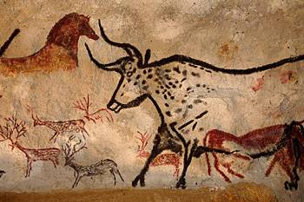
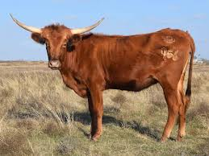
Depicting Our World: The Beginning
Prehistoric Painting, Lascaux Cave, France
~ 13,000 -- 15,000 B.C.

Slide 53
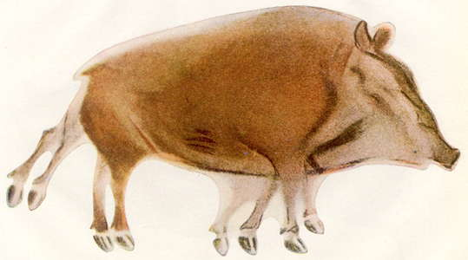
Prehistoric Cave Painting, Altamira
~ 20,000 – 15,000 B.C.

Slide 54
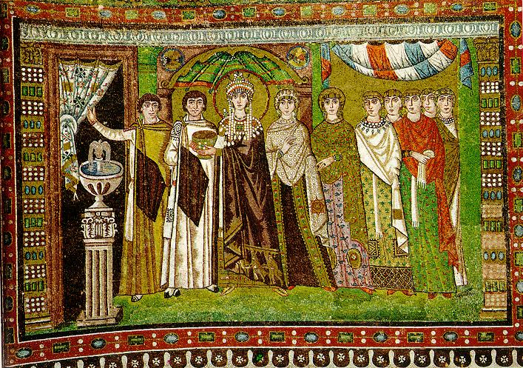
Depicting Our World: Middle Ages
The Empress Theodora with her court.
Ravenna, St. Vitale 6th c.

Slide 55
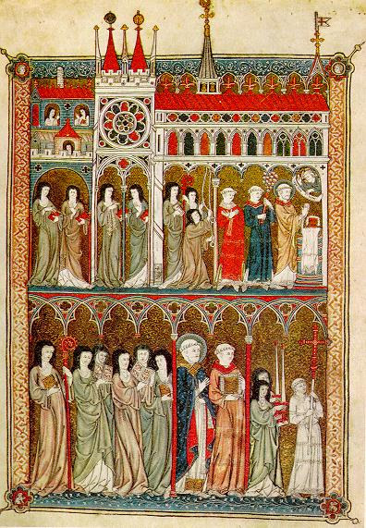
Depicting Our World: Middle Ages
Nuns in Procession. French ms. ca. 1300.

Slide 56
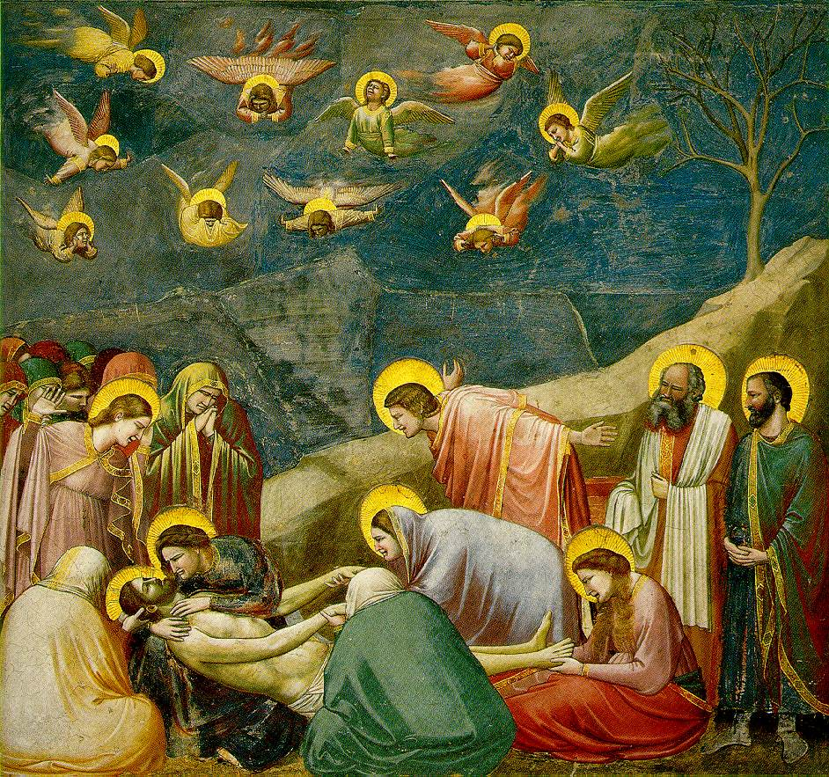
Beginnings of the Renaissance
  Giotto, The Mourning of Christ, c.1305

Slide 57
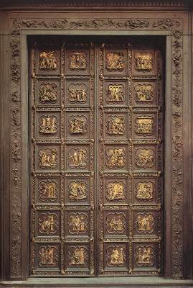
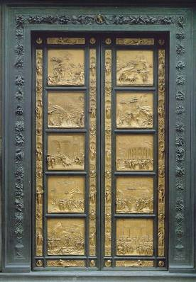
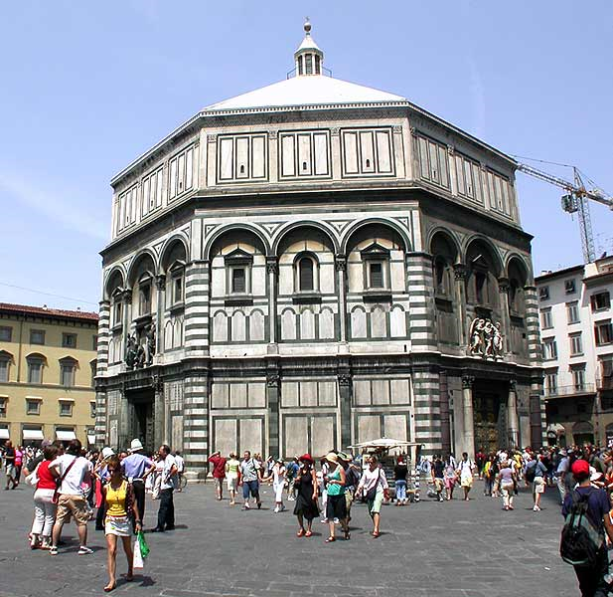
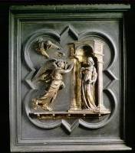
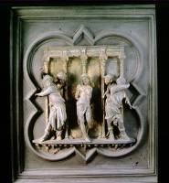
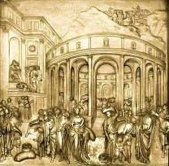
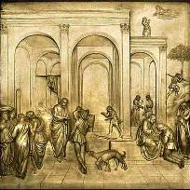
Depicting Our World: Renaissance
North Doors (1424)
Lorenzo
Ghiberti
(1378-1455)
East Doors (1452)

Slide 58
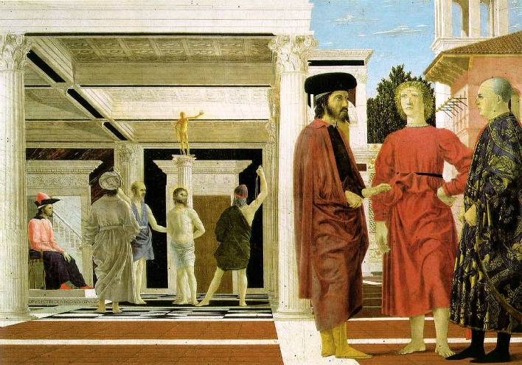
Depicting Our World: Renaissance
Piero della Francesca,
The Flagellation (c.1469)

Slide 59
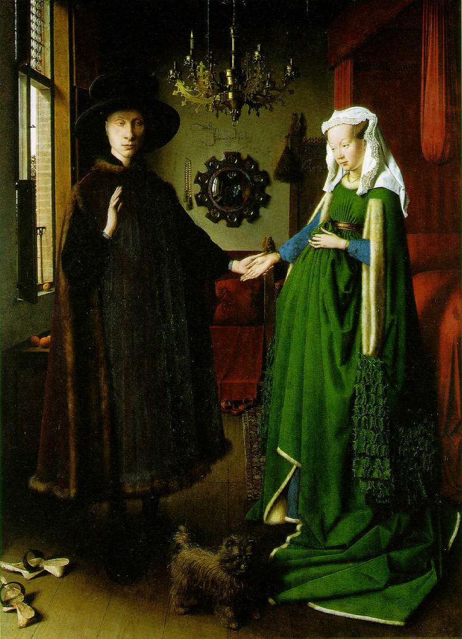
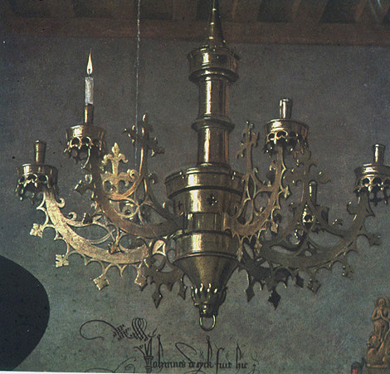
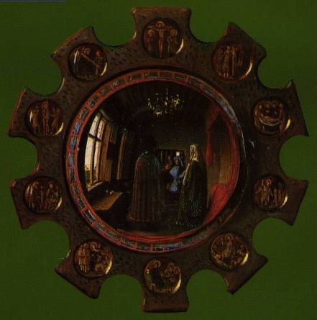
Depicting Our World: Toward Perfection
Jan van Eyck, The Arnolfini Marriage (c.1434)

Slide 60
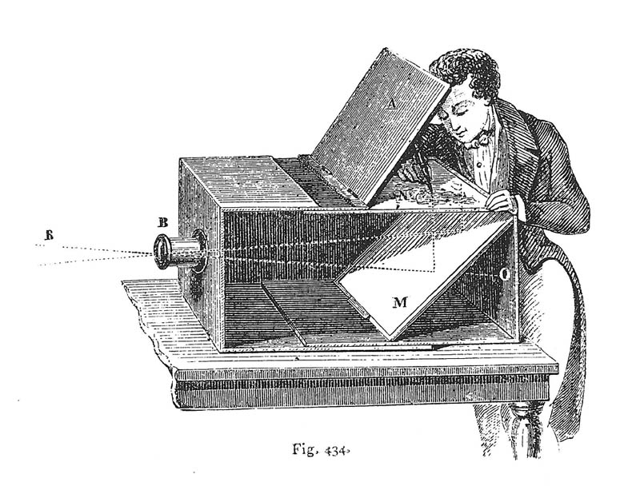
Depicting Our World: Toward Perfection
Lens Based Camera Obscura, 1568

Slide 61

Depicting Our World: Perfection!
Boulevard du Temple, Louis Daguerre, 1838

Slide 62


Depicting Our World: Realism?

Slide 63







Paris, according to
Flickr

Slide 64








Paris, according to Google
StreetView
Knopp, Sivic, Pajdla, ECCV 2010

Slide 65












Paris, according to me

Slide 66

After realism…
Monet,
La rue Montorgueil

Slide 67


Depicting Our World: Ongoing Quest
Pablo Picasso
David Hockney

Slide 68

Better than realism?
David Hockney, Place Furstenberg (1985)

Slide 69

Which one is right?
Multiple viewpoints
Single viewpoint
David Hockney,
Place Furstenberg, 1985
Alyosha Efros
Place Furstenberg, 2009

Slide 70

Depicting Our World: Ongoing Quest
Antonio Torralba & Aude Oliva (2002)

Slide 71

Enter Computer Graphics...

Slide 72



Traditional Computer Graphics
3D geometry
projection
Simulation
physics
GRAPHICS

Slide 73

Modern Computer Graphics
Amazingly real
But so sterile, lifeless, futuristic (why?)

Slide 74

The richness of our everyday world
Photo by Svetlana Lazebnik

Slide 75

Beauty in complexity
University Parks, Oxford

Slide 76

Which parts are hard to model?
Photo by Svetlana Lazebnik

Slide 77
Creating Realistic Imagery
Computational
Photography
Computer Graphics
Photography
Realism
Manipulation
Ease of capture
+ great creative possibilities
+ easy to manipulate objects/viewpoint
Tremendous expertise and effort to obtain realism
+ instantly realistic
+ easy to aquire
- very hard to manipulate objects/viewpoint

