Slide 1
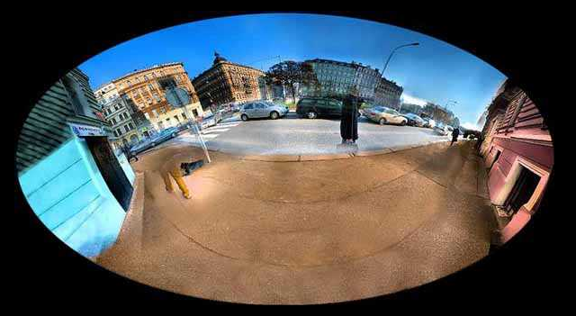
More Mosaic Madness
© Jeffrey Martin (jeffrey-martin.com)
with a lot of slides stolen from
Steve Seitz and Rick Szeliski
CS180: Intro to Computer Vision and Comp. Photo
Angjoo Kanazawa and Alexei Efros, UC Berkeley, Fall 2023

Slide 2

Project 4: Panorama
Pick one image (red)
Warp the other images towards it (usually, one by one)
blend

Slide 3
Think about this: When is this not true?
We can generate any synthetic camera view
as long as it has the same center of projection!
real camera
synthetic camera
What happens if there are two center of projection?
(you move your head)

Slide 4
changing camera center
Does it still work?
synthetic PP
PP1
PP2

Slide 5

Planar scene (or far away)
PP3
PP1
PP2
PP3 is a projection plane of both centers of projection, so we are OK!
This is how big aerial photographs are made

Slide 6
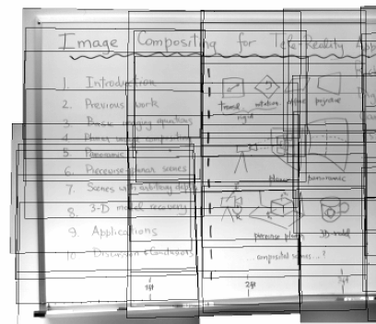
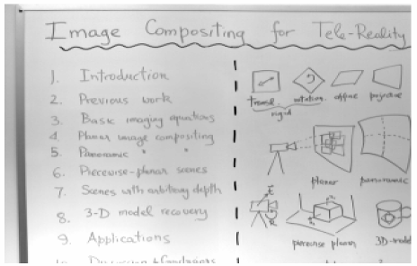
Planar mosaic

Slide 7
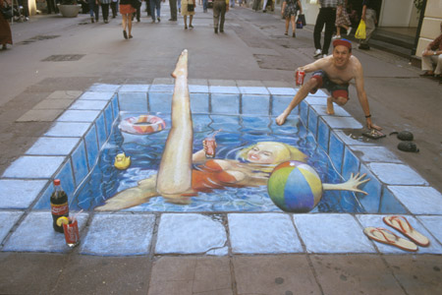
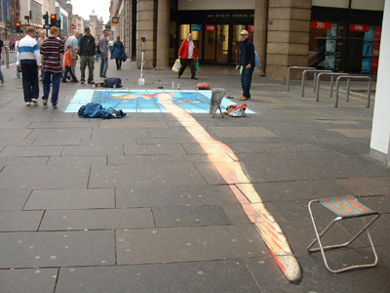
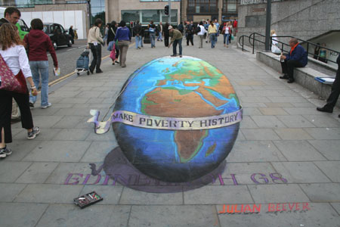
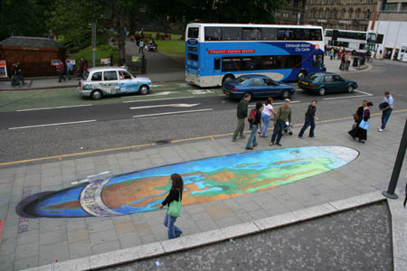
Julian Beever: Manual Homographies
http://users.skynet.be/J.Beever/pave.htm

Slide 8
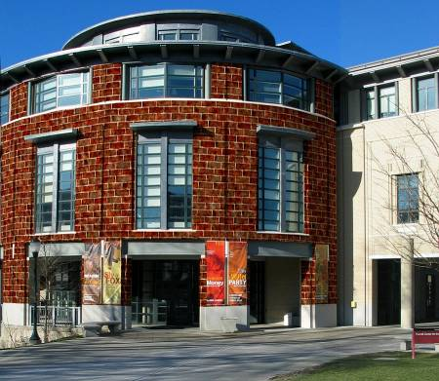
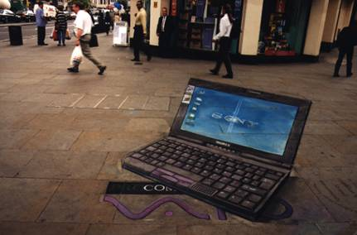
Bells and Whistles
Blending and Compositing
  use homographies to combine images or video and images together in an interesting (fun) way. E.g.
    put fake graffiti on buildings or chalk drawings on the ground
    replace a road sign with your own poster
    project a movie onto a building wall
    etc.

Slide 9
Bells and Whistles
Virtual Camera rorate
  Similar to face morphing, produce a video of virtual camera rotation from a single image
  Can also do it for translation, if looking at a planar object
Other interesting ideas?
  talk to me

Slide 10
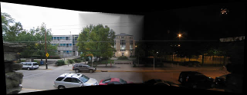
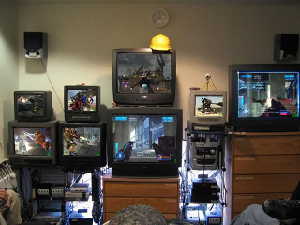

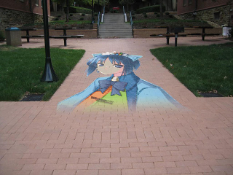
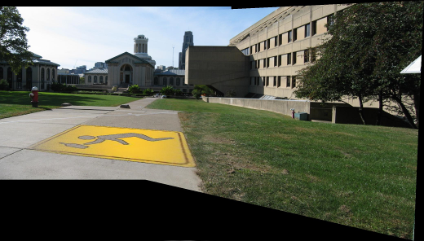
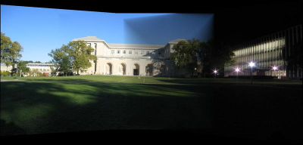
From previous year’s classes
Ben Hollis, 2004
Ben Hollis, 2004
Eunjeong Ryu (E.J), 2004
Matt Pucevich , 2004

Slide 11
Bells and Whistles
Capture creative/cool/bizzare panoramas
  Example from UW (by Brett Allen):
  Ever wondered what is happening inside your fridge while you are not looking?
Capture a 360 panorama (quite tricky…)

Slide 12
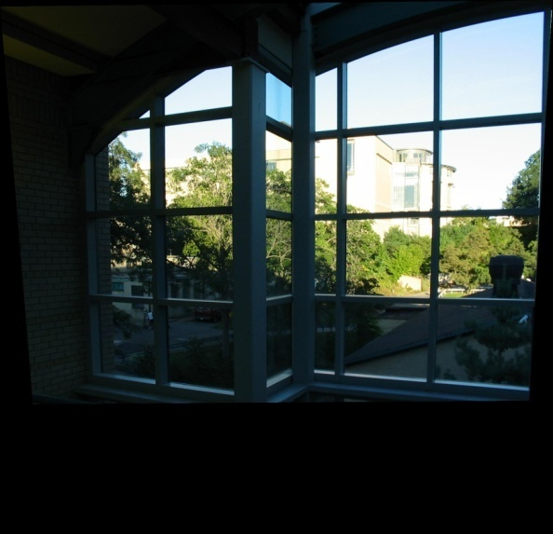
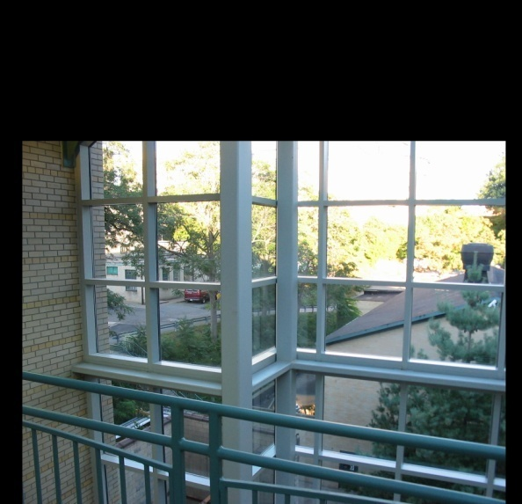

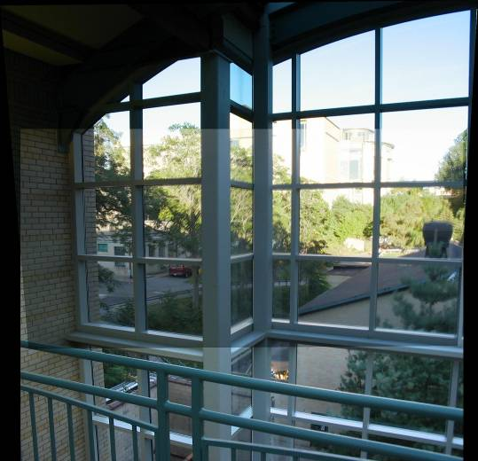
Setting alpha: simple averaging
Alpha = .5 in overlap region

Slide 13



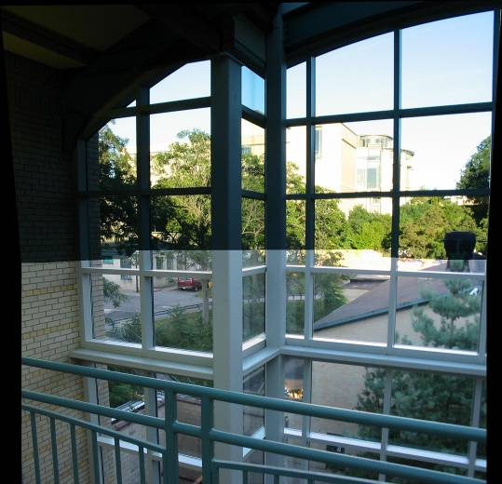
Setting alpha: center seam
Distance
Transform
bwdist
Alpha = logical(dtrans1>dtrans2)

Slide 14

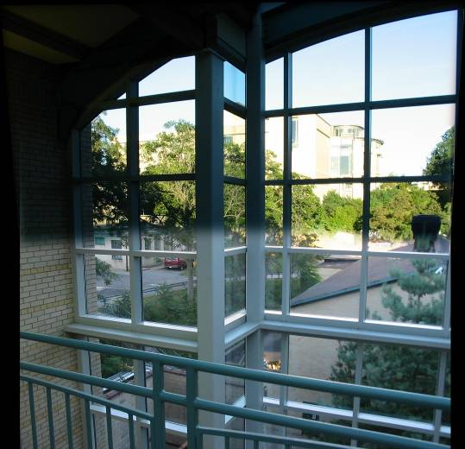
Setting alpha: blurred seam
Distance
transform
Alpha = blurred

Slide 15
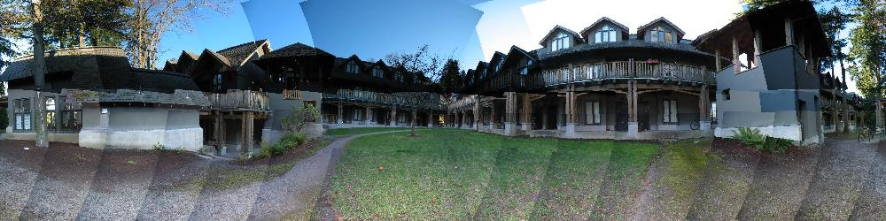
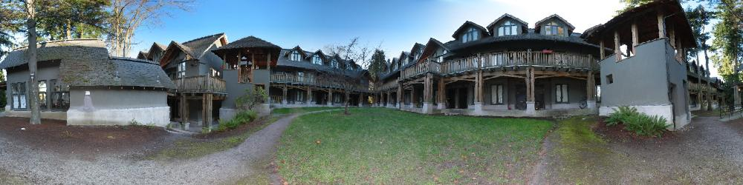
Simplification: Two-band Blending
Brown & Lowe, 2003
  Only use two bands: high freq. and low freq.
  Blends low freq. smoothly
  Blend high freq. with no smoothing: use binary alpha

Slide 16
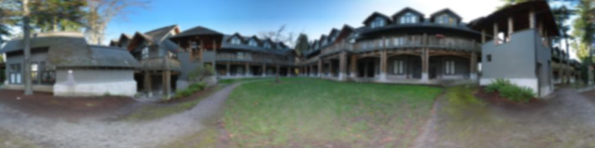
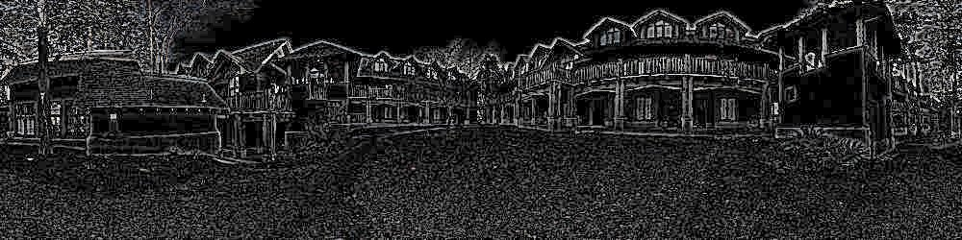
2-band “Laplacian Stack” Blending
Low frequency (λ > 2 pixels)
High frequency (λ < 2 pixels)

Slide 17
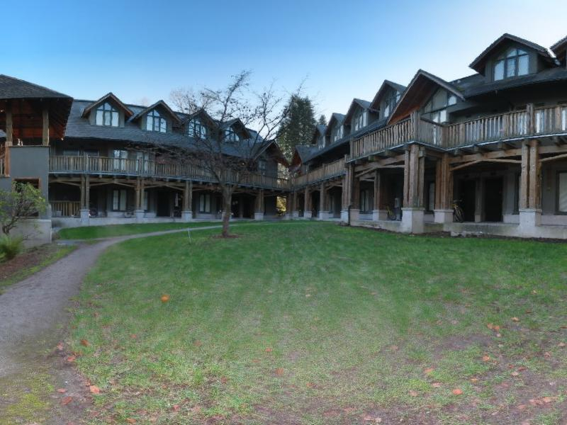
Linear Blending

Slide 18

2-band Blending

Slide 19
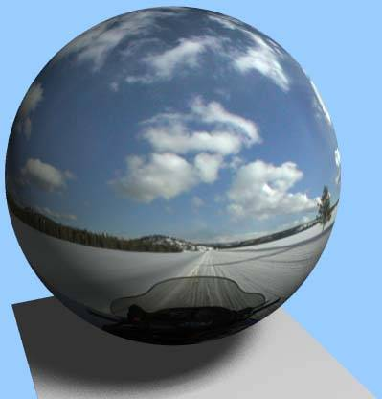
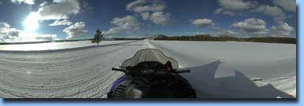
Spherical Panoramas
See also: Time Square New Years Eve
http://www.panoramas.dk/fullscreen3/f1.html
All light rays through a point form a panorama
Totally captured in a 2D array -- P(θ,φ)
Where is the geometry???

Slide 20
Homography
A: Projective – mapping between any two PPs with the same center of projection
  rectangle should map to arbitrary quadrilateral
  parallel lines aren’t
  but must preserve straight lines
  same as: project, rotate, reproject
called Homography
PP2
p’
H
p
PP1
To apply a homography H
  Compute p’ = Hp (regular matrix multiply)
  Convert p’ from homogeneous to image coordinates

Slide 21
Rotational Mosaics
Can we say something more about rotational mosaics?
i.e. can we further constrain our H?
Notes:
How to reduce the parameter?

Slide 22
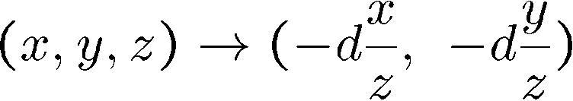
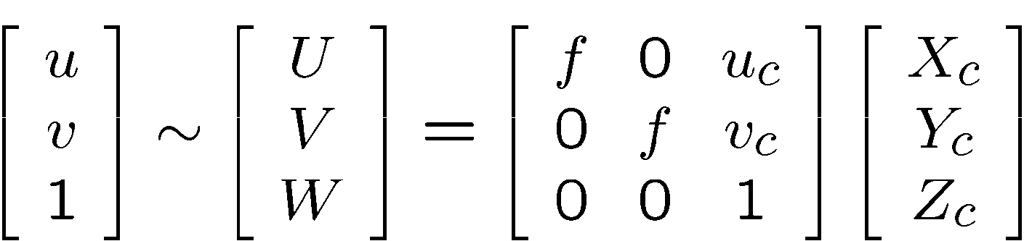
3D → 2D Perspective Projection
f
f
(X_{c},Y_{c},Z_{c})
f
u_{c}
u
K
Notes:
The way to think about this is that it’s a rotation of the rays (the pencil of rays). Take the rays and rotate them!, Just rotation in weird ray space.
How do we get to the ray space??
U = (fX + f*u_c) / Z = fX/Z + u_c
Z*U = fX + u_c
Z*U – u_c = f X

Slide 23
3D Rotation Model
Projection equations
Project from image to 3D ray
(x₀,y₀,z₀) = (u₀-u_{c},v₀-v_{c},f)
Rotate the ray by camera motion
(x₁,y₁,z₁) = R₀₁ (x₀,y₀,z₀)
Project back into new (source) image
(u₁,v₁) = (fx₁/z₁+u_{c},fy₁/z₁+v_{c})
Therefore:
Our homography has only 3,4 or 5 DOF, depending if focal length is known, same, or different.
  This makes image registration much better behaved
(x,y,z)
(u,v,f)
R
(x,y,z)
f
(u,v,f)
Notes:
Punt on the depth = doesn’t matter where it actually is bc we assume it’s same projection
Let’s just put 3D point on a unit sphere, which is basically a ray.

Slide 24
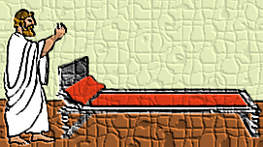
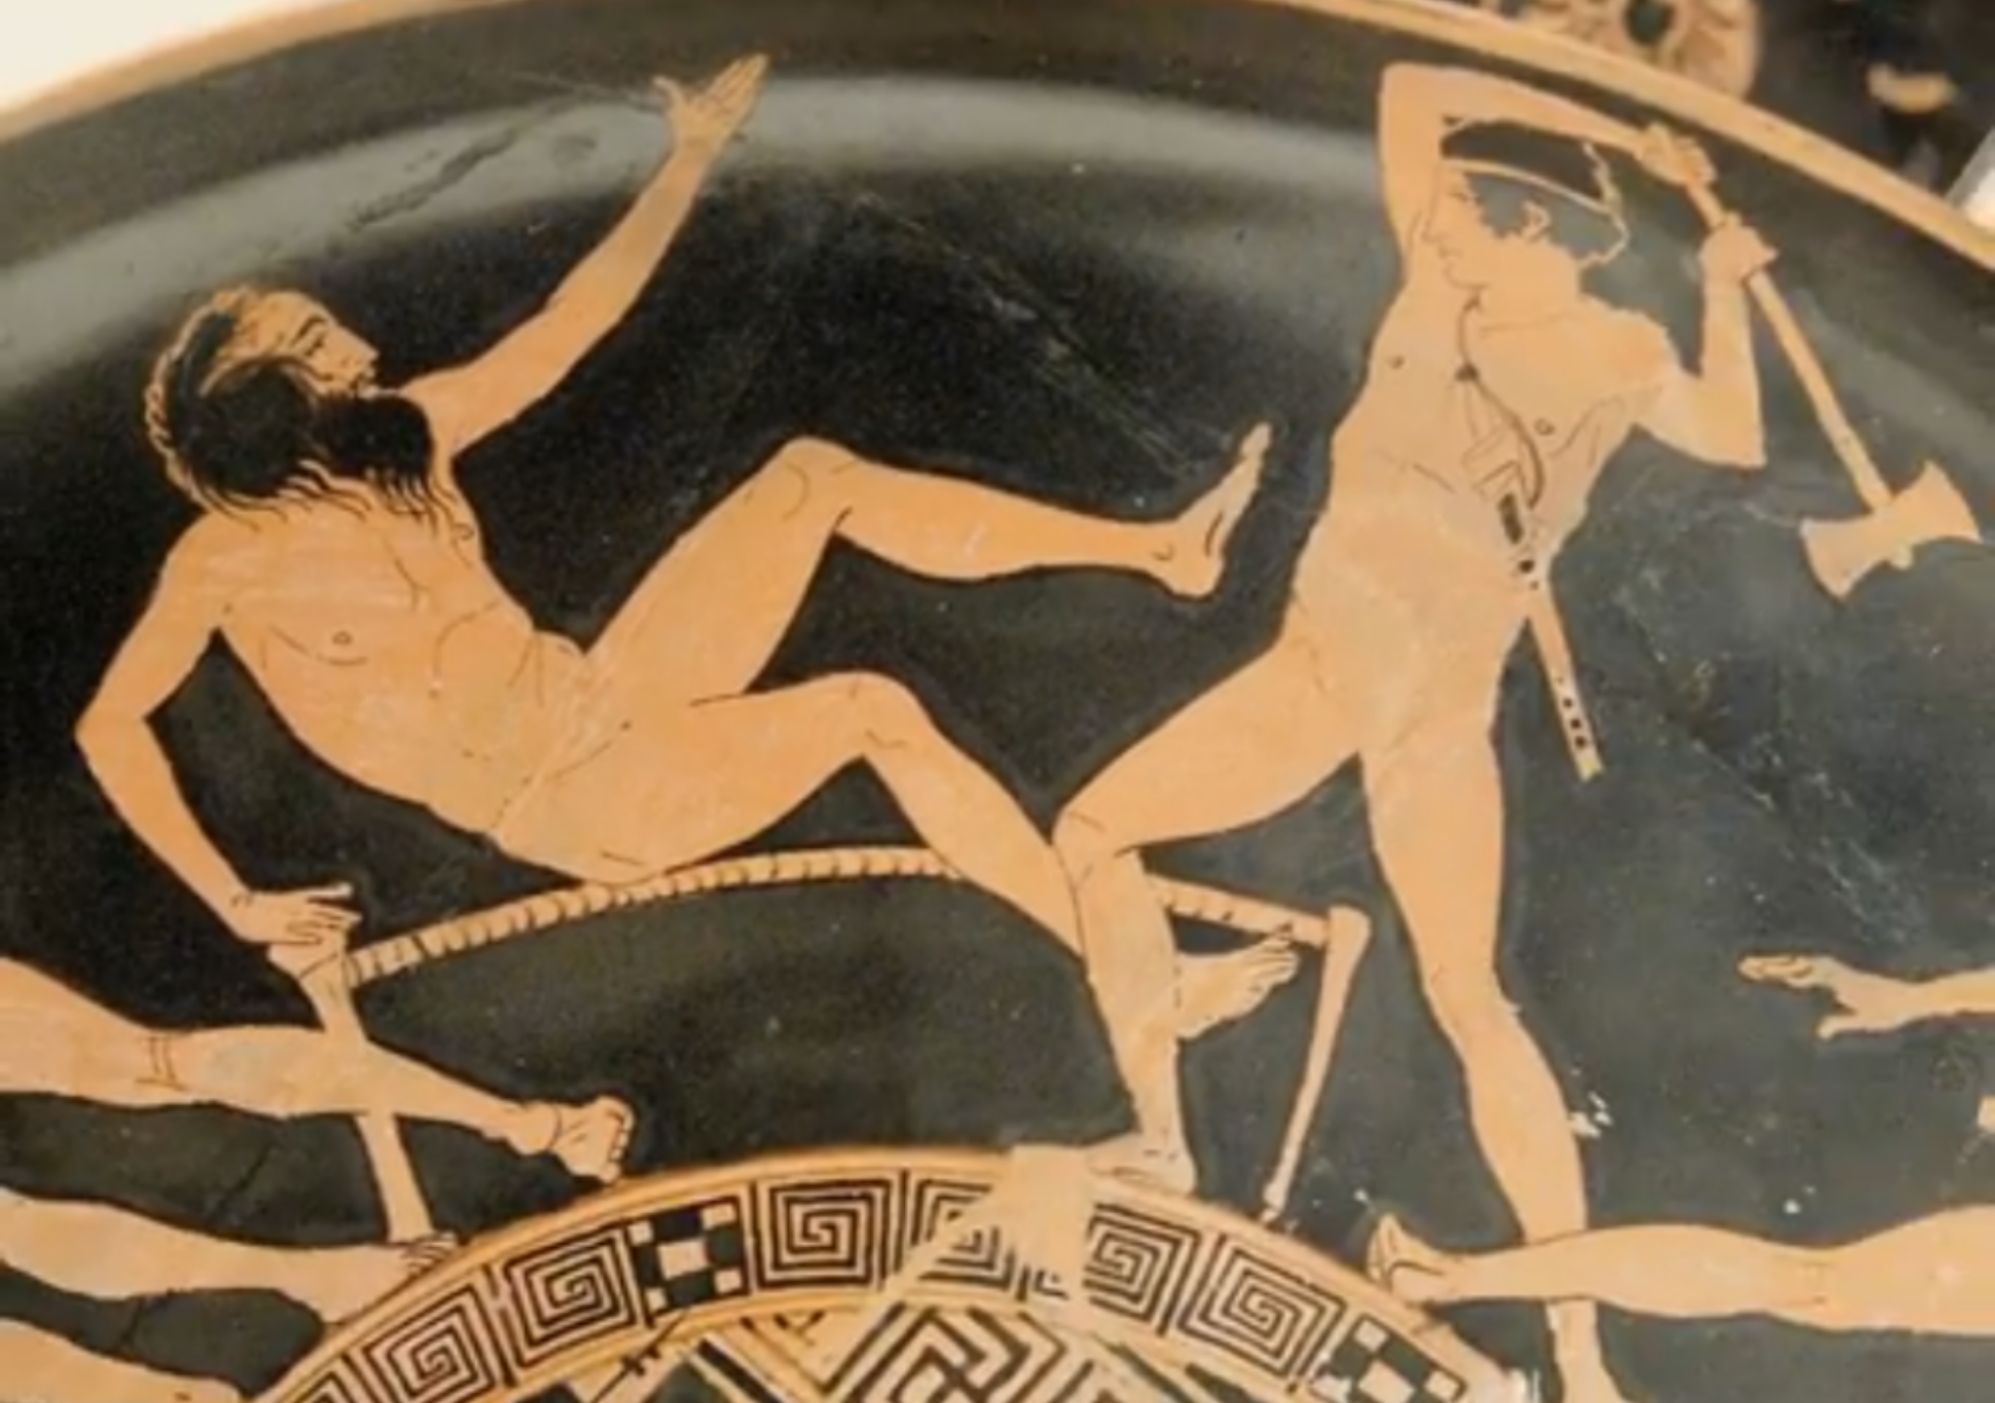
Pairwise alignment
Procrustes Algorithm [Golub & VanLoan]
Given two sets of matching points, compute R
p_{i}’ = R p_{i} with 3D rays
p_{i} = N(x_{i},y_{i},z_{i}) = N(u_{i}-u_{c},v_{i}-v_{c},f)
Can be solved in closed form with SVD:
A = Σ_{i} p_{i} p_{i}’^{T} = Σ_{i} p_{i} p_{i}^{T} R^{T} = U S V^{T} = (U S U^{T}) R^{T}
V^{T} = U^{T} R^{T}
R = V U^{T}
https://igl.ethz.ch/projects/ARAP/svd_rot.pdf
Notes:
The name Procrustes (Greek: Προκρούστης) refers to a bandit from Greek mythology who made his victims fit his bed either by stretching their limbs or cutting them off.
N (is what we just did)
Write this product
A = outer product
Closed form solution with SVD!

Slide 25
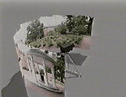
Rotation about vertical axis
What if our camera rotates on a tripod?
What’s the structure of H?

Slide 26
Do we have to project onto a plane?
mosaic PP
Notes:
Problem with plane is that we can’t do 360 view
But you can do it in an any surface!

Slide 27
Full Panoramas
What if you want a 360° field of view?
mosaic Projection Cylinder

Slide 28


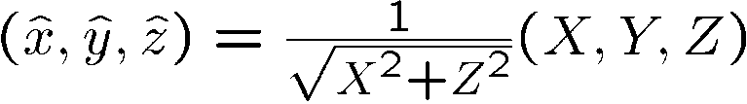





Cylindrical projection
  Map 3D point (X,Y,Z) onto cylinder
Y
Z
X
  Convert to cylindrical coordinates
unit cylinder
  Convert to cylindrical image coordinates
unwrapped cylinder
cylindrical image
Notes:
Not going to go through the math, here it is.
F = focal length, the radius (This determines where the ray intersects the )

Slide 29

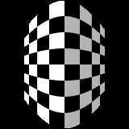
Cylindrical Projection
Y
X

Slide 30
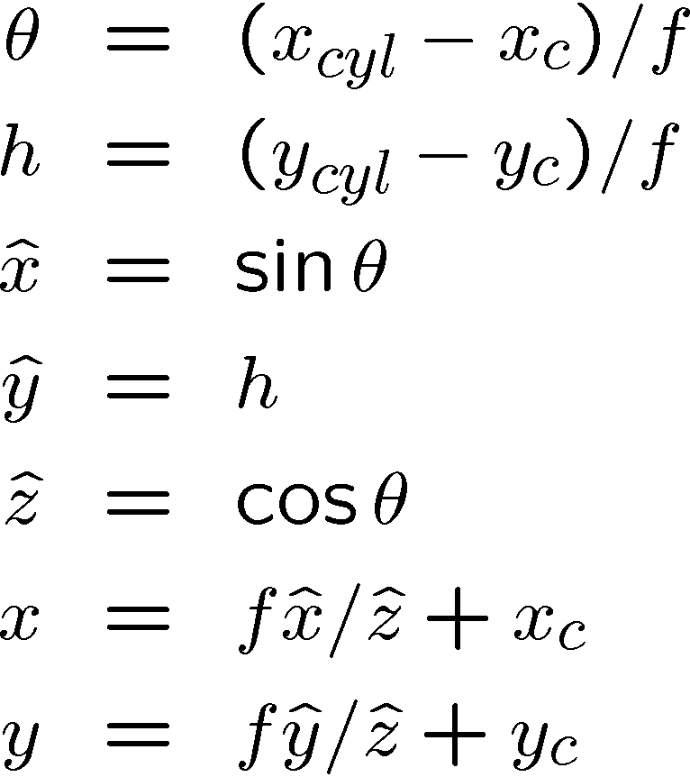
Inverse Cylindrical projection
(X,Y,Z)
(sinθ,h,cosθ)
Y
Z
X
Notes:
the hats are the 3D points on the unit cylinder, x_c, y_c are the center of the unwrapped cylinder

Slide 31
Cylindrical panoramas
Steps
  Reproject each image onto a cylinder
  Blend
  Output the resulting mosaic

Slide 32
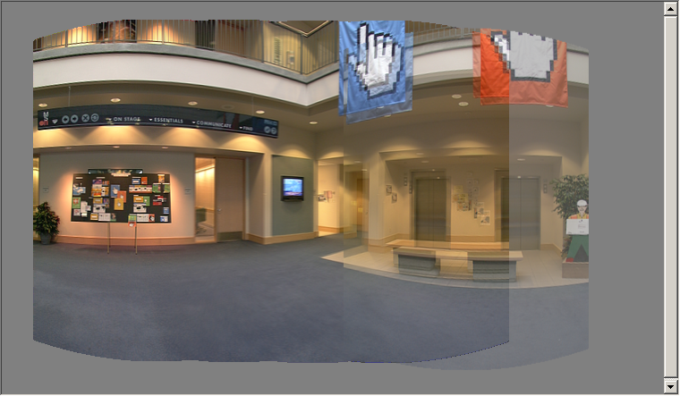
Cylindrical image stitching
What if you don’t know the camera rotation?
  Solve for the camera rotations
    Note that a rotation of the camera is a translation of the cylinder!

Slide 33
Assembling the panorama
Stitch pairs together, blend, then crop

Slide 34
Problem: Drift
Vertical Error accumulation
  small (vertical) errors accumulate over time
  apply correction so that sum = 0 (for 360° pan.)
Horizontal Error accumulation
  can reuse first/last image to find the right panorama radius
Notes:
Noise, campera not quite aligned with the ground. Sometimes when you have a bad noise this could happen. But you can just find the correction so that things wrap

Slide 35
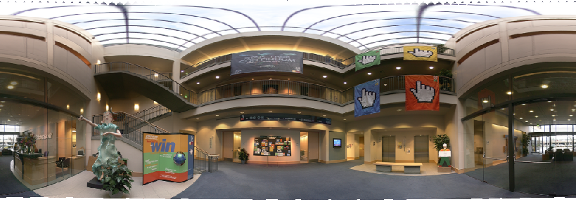
Full-view (360°) panoramas

Slide 36
Spherical projection
  Map 3D point (X,Y,Z) onto sphere
Y
Z
X
  Convert to spherical coordinates
  Convert to spherical image coordinates
φ
unwrapped sphere
spherical image

Slide 37

Spherical Projection
Y
X

Slide 38
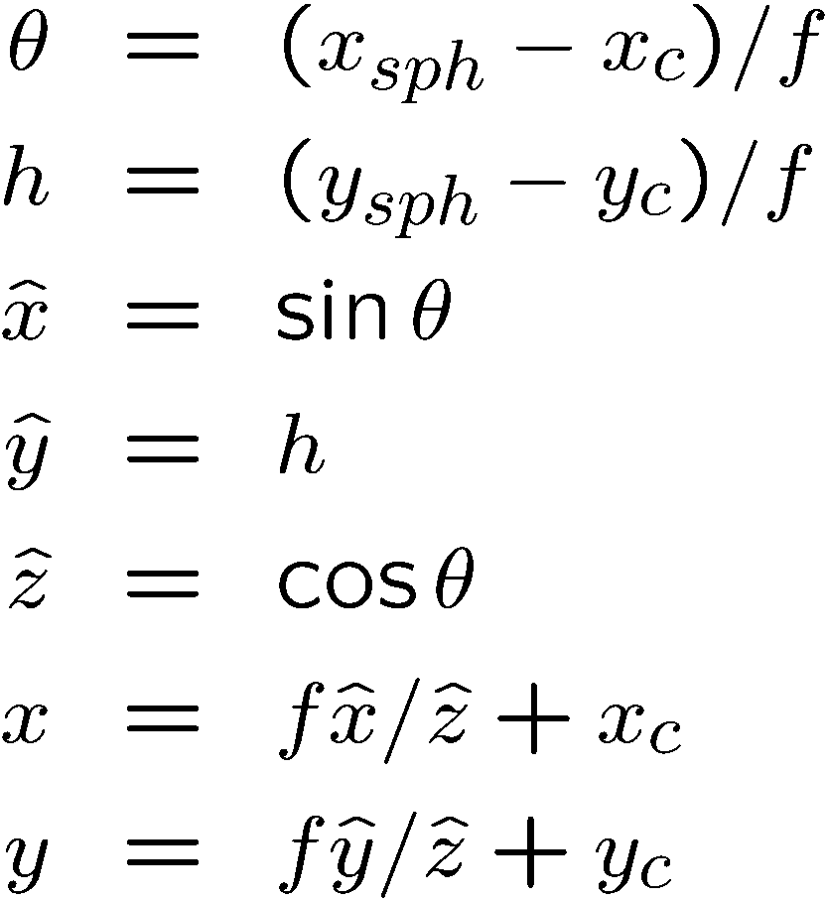
Inverse Spherical projection
φ
(x,y,z)
cos φ
(sinθcosφ,cosθcosφ,sinφ)
sin φ
Y
Z
cos θ cos φ
X
Notes:
map it onto the sphere and solve for rotation

Slide 39
3D rotation
Rotate image before placing on unrolled sphere
φ
(x,y,z)
cos φ
(sinθcosφ,cosθcosφ,sinφ)
sin φ
Y
Z
cos θ cos φ
X
p = R p
_ _
_ _
Notes:
Rotate it after you get it on the sphere.

Slide 40
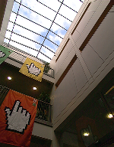
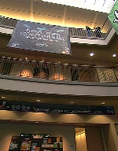
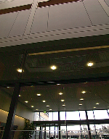
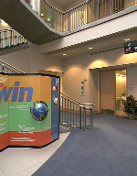
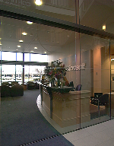
Full-view Panorama
+
+
+
+

Slide 41
Other projections are possible
You can stitch on the plane and then warp the resulting panorama
  What’s the limitation here?
Or, you can use these as stitching surfaces
  But there is a catch…
Notes:
Other surfaces, any surface you can write it down.
Or the cheating way is to create panorama on the plane, then visualize it using a different projection (panorama plane → project to cylindrical later to visualize it. )
Problem??

Slide 42




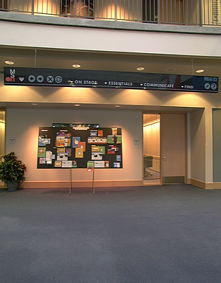
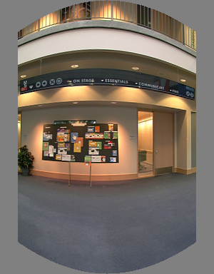
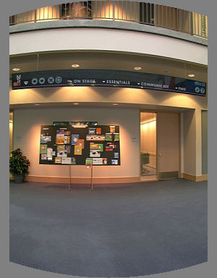
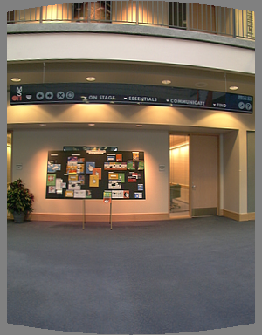
Cylindrical reprojection
top-down view
Focal length – the dirty secret…
Image 384x300
f = 180 (pixels)
f = 280
f = 380
Notes:
Really really sensitive to focal length!!!
Therefore, it is desirable if the global motion model we need to recover is translation, which has only two parameters. It turns out that for a pure panning motion, if we convert two images to their cylindrical maps with known focal length, the relationship between them can be represented by a translation.
Here is an example of how cylindrical maps are constructed with differently with f’s. Note how straight lines are curved.
Similarly, we can map an image to its longitude/latitude spherical coordinates as well if f is given.

Slide 43
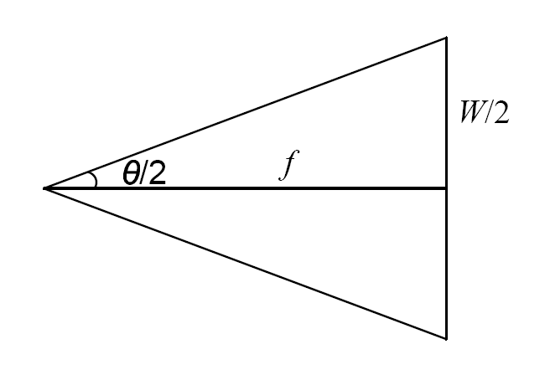
What’s your focal length, buddy?
Focal length is (highly!) camera dependant
  Can get a rough estimate by measuring FOV:
  Can use the EXIF data tag (might not give the right thing)
  Can use several images together and try to find f that would make them match
  Can use a known 3D object and its projection to solve for f
  Etc.
There are other camera parameters too:
  Optical center, non-square pixels, lens distortion, etc.

Slide 44
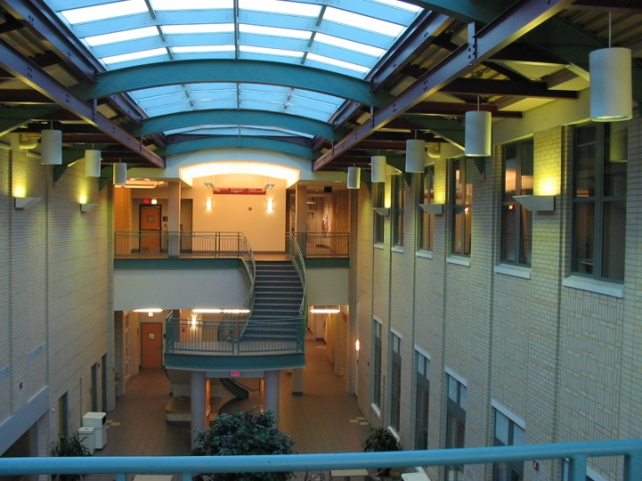
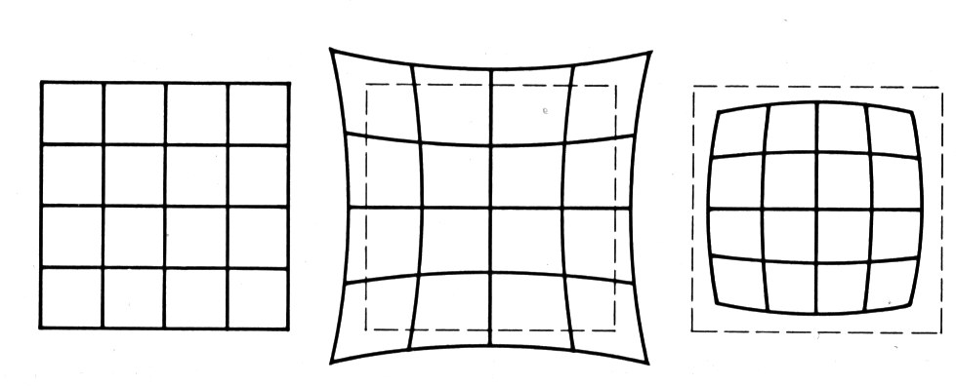
Distortion
No distortion
Pin cushion
Barrel
Radial distortion of the image
  Caused by imperfect lenses
  Deviations are most noticeable for rays that pass through the edge of the lens

Slide 45
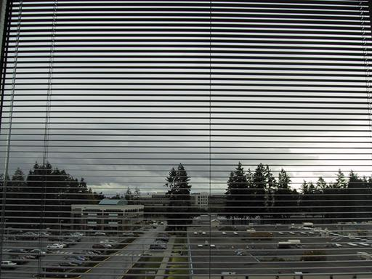


Radial distortion
Correct for “bending” in wide field of view lenses
Use this instead of normal projection

Slide 46



Polar Projection
Extreme “bending” in ultra-wide fields of view

Slide 47
Up till now:
Known correspondences via clicking!
How to make it automatic??

Slide 48

Live Homography…

Slide 49
Image Alignment
How do we align two images automatically?
Two broad approaches:
  Feature-based alignment
    Find a few matching features in both images
    compute alignment
  Direct (pixel-based) alignment
    Search for alignment where most pixels agree

Slide 50
Direct Alignment
The simplest approach is a brute force search (hw1)
  Need to define image matching function
    SSD, Normalized Correlation, edge matching, etc.
  Search over all parameters within a reasonable range:
e.g. for translation:
for tx=x0:step:x1,
for ty=y0:step:y1,
compare image1(x,y) to image2(x+tx,y+ty)
end;
end;
Need to pick correct x0,x1 and step
  What happens if step is too large?

Slide 51
Direct Alignment (brute force)
What if we want to search for more complicated transformation, e.g. homography?
for a=a0:astep:a1,
for b=b0:bstep:b1,
for c=c0:cstep:c1,
for d=d0:dstep:d1,
for e=e0:estep:e1,
for f=f0:fstep:f1,
for g=g0:gstep:g1,
for h=h0:hstep:h1,
compare image1 to H(image2)
end; end; end; end; end; end; end; end;

Slide 52
Problems with brute force
Not realistic
  Search in O(N⁸) is problematic
  Not clear how to set starting/stopping value and step
What can we do?
  Use pyramid search to limit starting/stopping/step values
  For special cases (rotational panoramas), can reduce search slightly to O(N⁴):
    H = K₁R₁R₂⁻¹K₂⁻¹ (4 DOF: f and rotation)
Alternative: gradient decent on the error function
  i.e. how do I tweak my current estimate to make the SSD error go down?
  Can do sub-pixel accuracy
  BIG assumption?
    Images are already almost aligned (<2 pixels difference!)
    Can improve with pyramid
  Same tool as in motion estimation

Slide 53
Problems with brute force
Not realistic
  Search in O(N⁸) is problematic
  Not clear how to set starting/stopping value and step
What can we do?
  Use pyramid search to limit starting/stopping/step values
Alternative: gradient decent on the error function
  i.e. how do I tweak my current estimate to make the SSD error go down?
  Can do sub-pixel accuracy
  BIG assumption?
    Images are already almost aligned (<2 pixels difference!)
    Can improve with pyramid
  Same tool as in motion estimation

Slide 54


Image alignment

Slide 55
Feature-based alignment
Feature Detection: find a few important features (aka Interest Points) in each image separately
Feature Matching: match them across two images
Compute image transformation: as per Project 5, Part I
How do we choose good features automatically?
  They must be prominent in both images
  Easy to localize
  Think how you did that by hand in Project #6 Part I
  Corners!

Slide 56


A hard feature matching problem
NASA Mars Rover images

Slide 57


Answer below (look for tiny colored squares…)
NASA Mars Rover images
with SIFT feature matches
Figure by Noah Snavely

Slide 58


Feature Detection

Slide 59
Feature Matching
How do we match the features between the images?
  Need a way to describe a region around each feature
    e.g. image patch around each feature
  Use successful matches to estimate homography
    Need to do something to get rid of outliers
Issues:
  What if the image patches for several interest points look similar?
    Make patch size bigger
  What if the image patches for the same feature look different due to scale, rotation, etc.
    Need an invariant descriptor

Slide 60




Invariant Feature Descriptors
Schmid & Mohr 1997, Lowe 1999, Baumberg 2000, Tuytelaars & Van Gool 2000, Mikolajczyk & Schmid 2001, Brown & Lowe 2002, Matas et. al. 2002, Schaffalitzky & Zisserman 2002

Slide 61

Invariant Local Features
Image content is transformed into local feature coordinates that are invariant to translation, rotation, scale, and other imaging parameters
Features Descriptors

Slide 62
Applications
Feature points are used for:
  Image alignment (homography, fundamental matrix)
  3D reconstruction
  Motion tracking
  Object recognition
  Indexing and database retrieval
  Robot navigation
  … other

