Slide 1

Epipolar Geometry
A lot of slides from Noah Snavely +
Shree Nayar’s YT series: First principals of Computer Vision
CS180: Intro to Computer Vision and Comp. Photo
Angjoo Kanazawa & Alexei Efros, UC Berkeley, Fall 2023

Slide 2
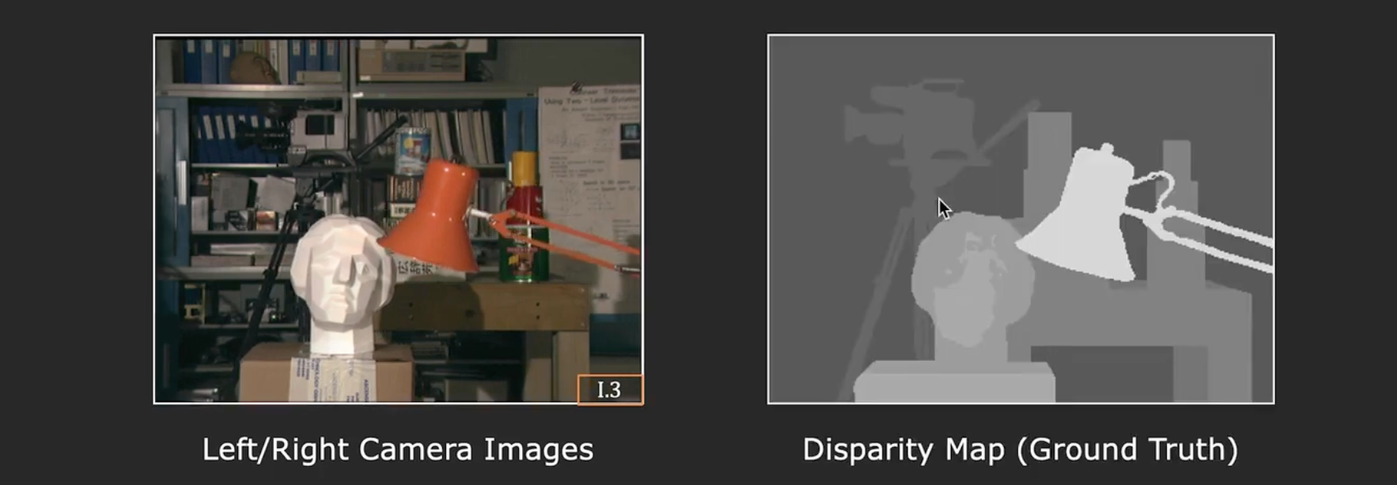
So how do we get depth?
of corresponding points!
Find the disparity!
Called: Stereo Matching

Slide 3
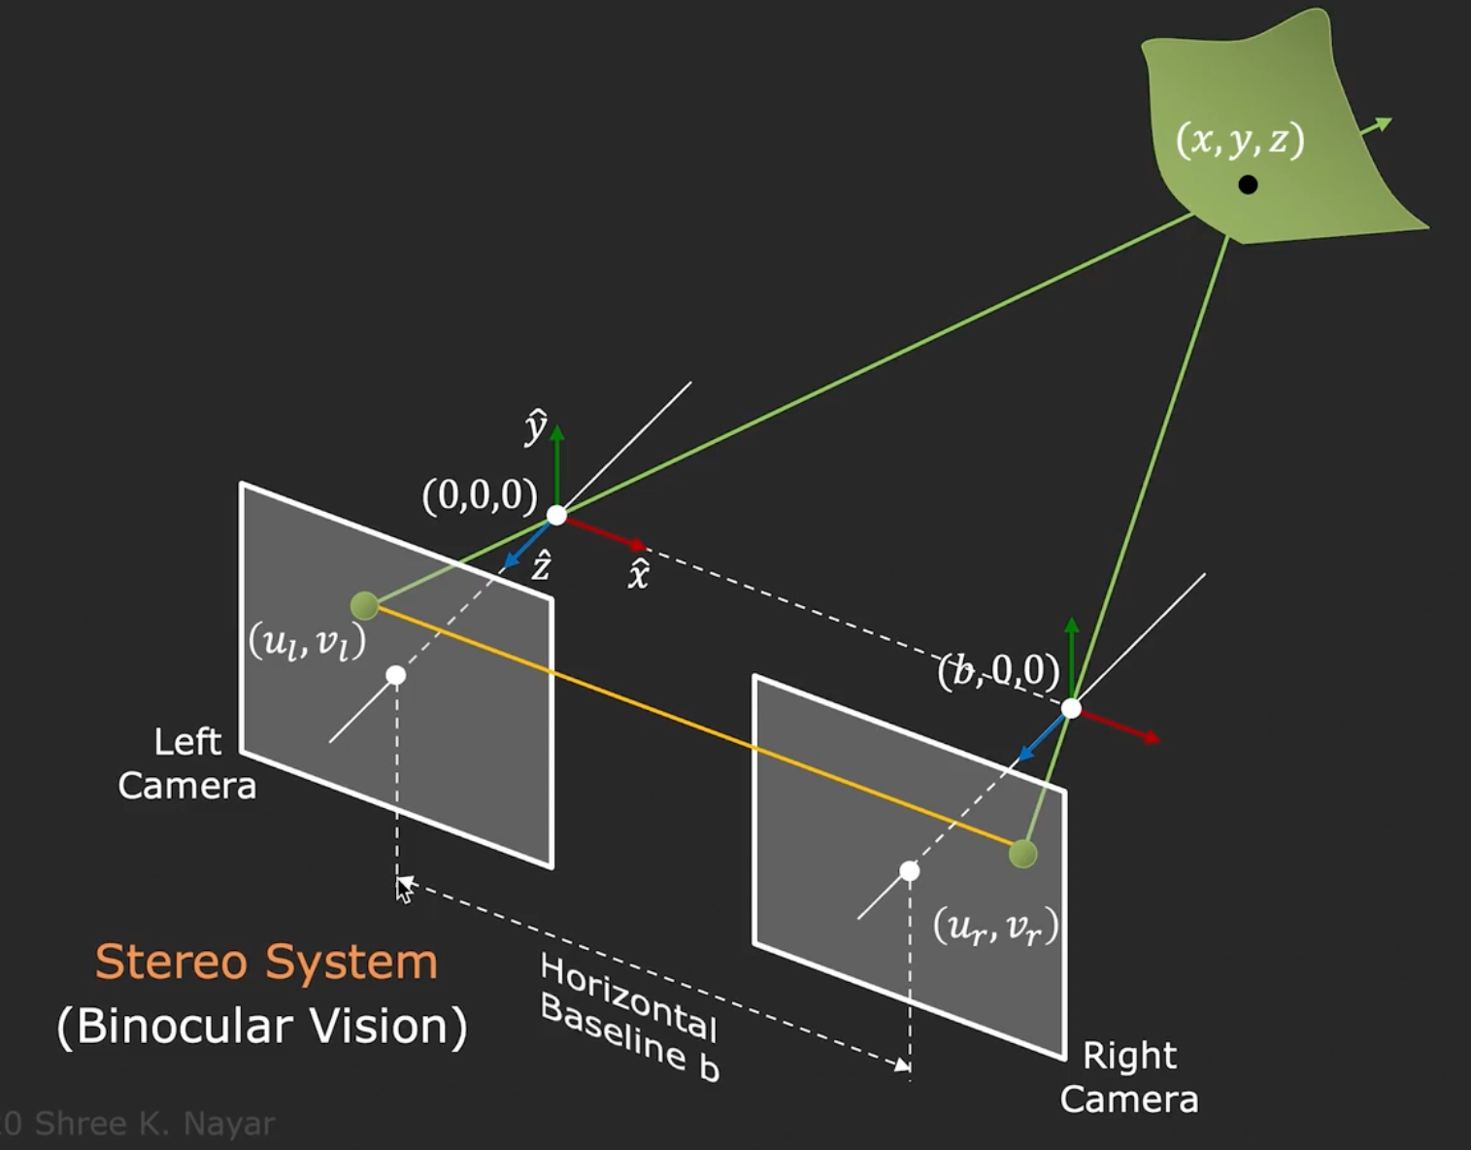
Where is the corresponding point going to be?
Hint

Slide 4


Epipolar Line
epipolar lines
(x₁, y₁)
(x₂, y₁)
Two images captured by a purely horizontal translating camera
(rectified stereo pair)
x₁ –x₂ = the disparity of pixel (x₁, y₁)

Slide 5
Your basic stereo algorithm
For every epipolar line:
For each pixel in the left image
    compare with every pixel on same epipolar line in right image
    pick pixel with minimum match cost
Improvement: match windows, + clearly lots of matching strategies
Slide credit: Noah Snavely

Slide 6
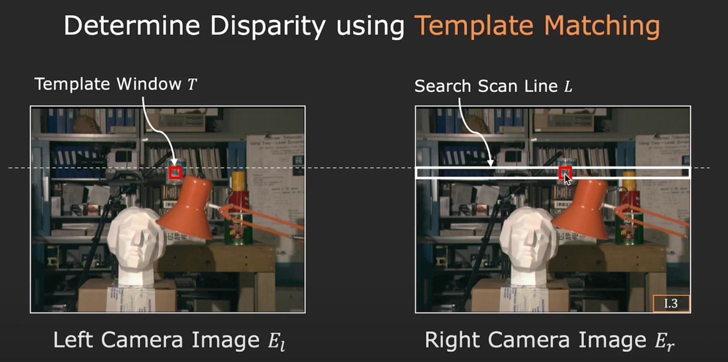
Your basic stereo algorithm

Slide 7
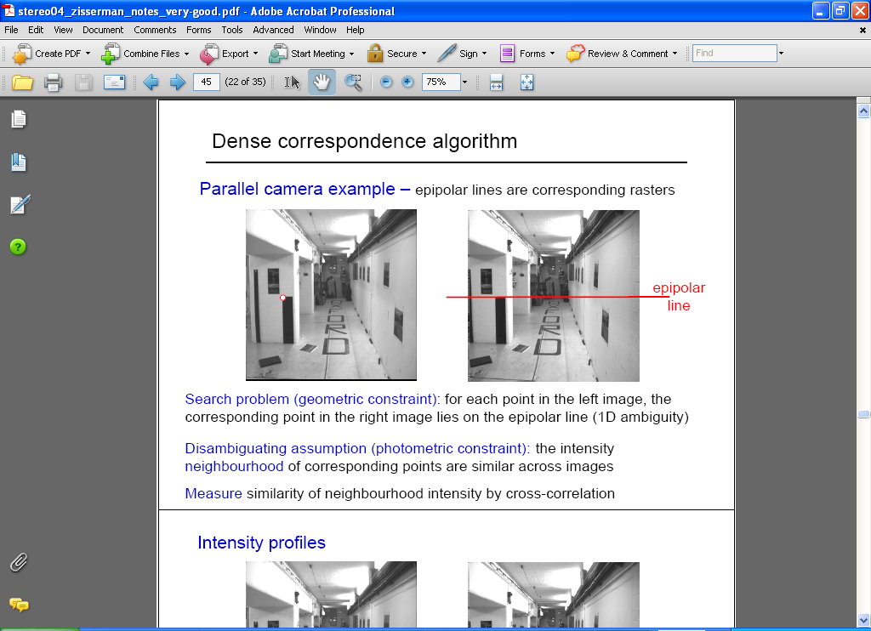
Correspondence problem
Source: Andrew Zisserman

Slide 8
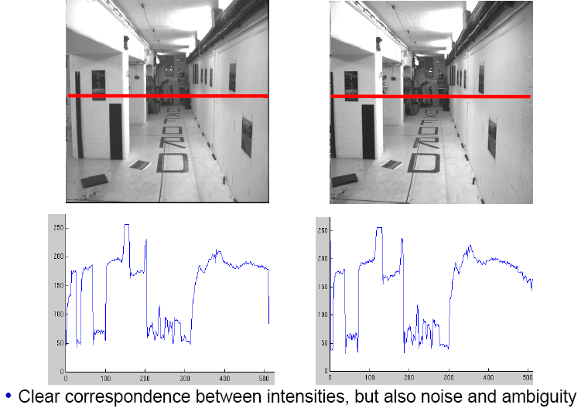
Intensity profiles
Source: Andrew Zisserman

Slide 9
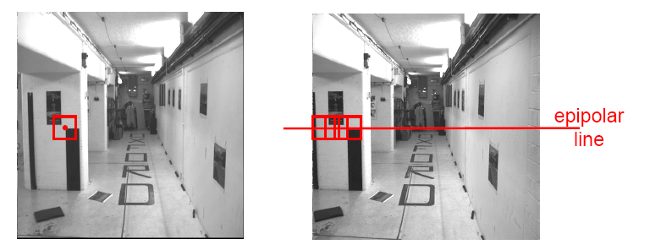
Correspondence problem
Neighborhood of corresponding points are similar in intensity patterns
- Use Normalized Cross Correlation (NCC)
or a distance in some descriptor within a window
Source: Andrew Zisserman

Slide 10
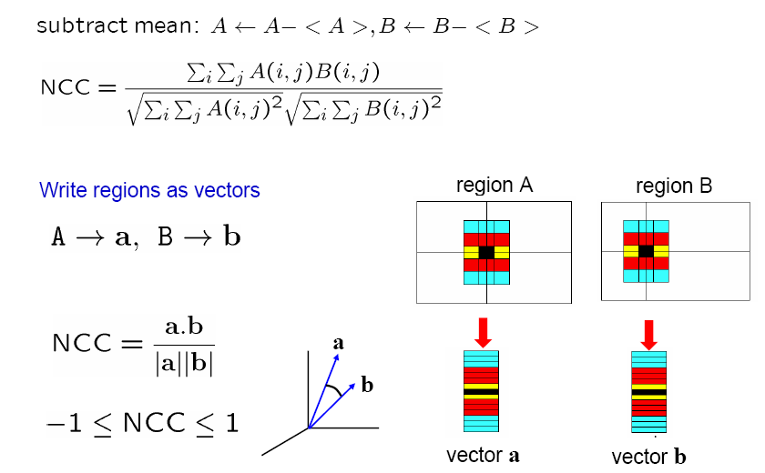
Normalized cross correlation
Similar to MOPS descriptor computation
Source: Andrew Zisserman

Slide 11
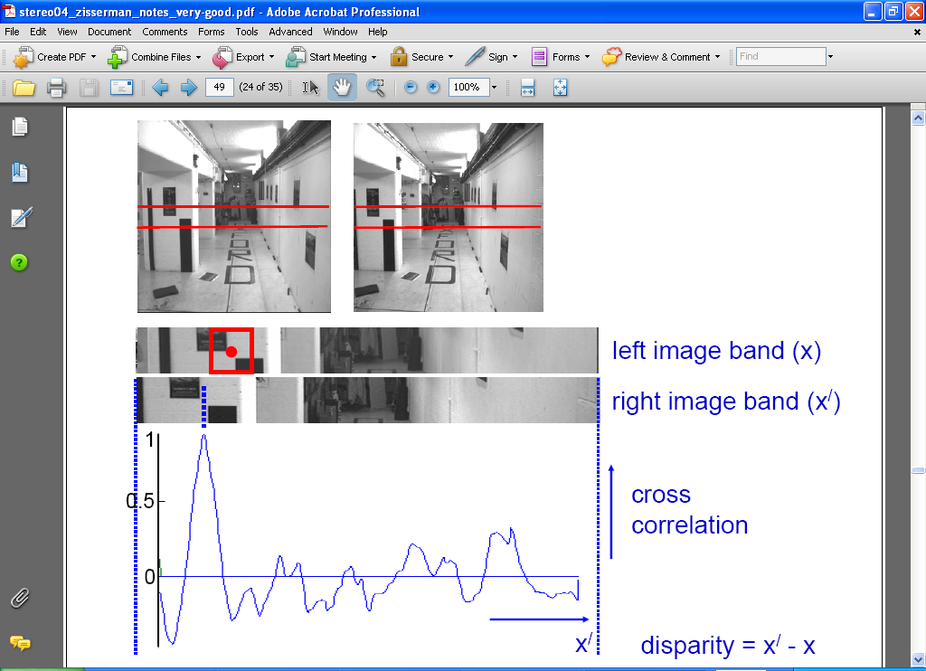
Correlation-based window matching
Source: Andrew Zisserman

Slide 12
Dense correspondence search
For each epipolar line
For each pixel / window in the left image
    compare with every pixel / window on same epipolar line in right image
    pick position with minimum match cost (e.g., SSD, correlation)
Adapted from Li Zhang
Grauman
Notes:
12

Slide 13
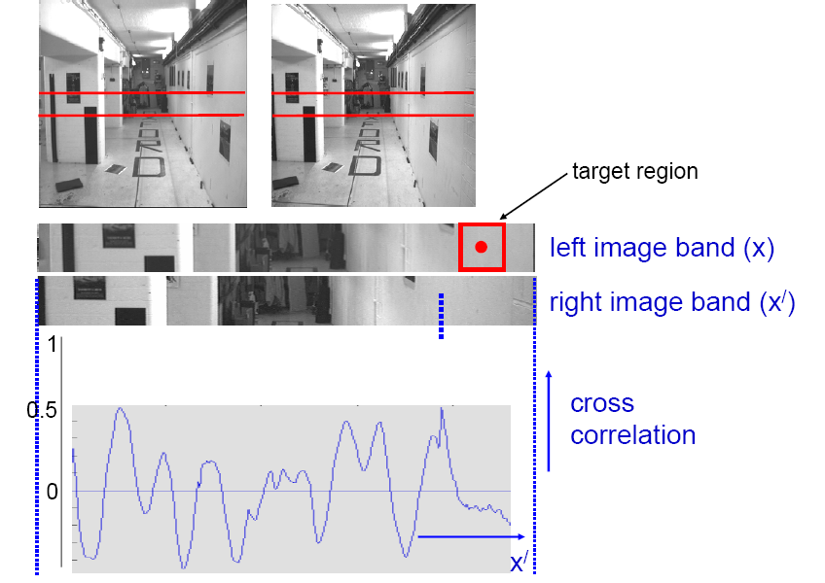
Textureless regions
Textureless regions are non-distinct; high ambiguity for matches.
Source: Andrew Zisserman
Grauman

Slide 14
Effect of window size
Source: Andrew Zisserman
Grauman
Notes:
Have to pick a window size, can’t do it at a pixel. But window ➔ area in the scene, projected area will be different from two views

Slide 15


Effect of window size
W = 3
W = 20
Want window large enough to have sufficient intensity variation, yet small enough to contain only pixels with about the same disparity.
Figures from Li Zhang
Grauman

Slide 16


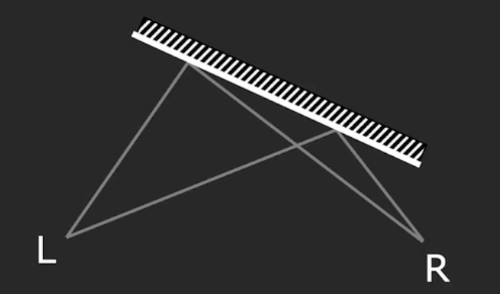
Issues with Stereo
Surface must have non-repetitive texture
Foreshortening effect makes matching a challenge
Slide Credit: Shree Nayar
Notes:
Projected area is smaller → causes distortion

Slide 17


Stereo Results
  Data from University of Tsukuba
Scene
Ground truth

Slide 18


Results with Window Search
Window-based matching
(best window size)
Ground truth

Slide 19

Better methods exist...
Energy Minimization
  Boykov et al., Fast Approximate Energy Minimization via Graph Cuts,
  International Conference on Computer Vision, September 1999.
Ground truth

Slide 20
Summary
With a simple stereo system, how much pixels move, or “disparity” give information about the depth
Correspondences to measure the pixel disparity

Slide 21
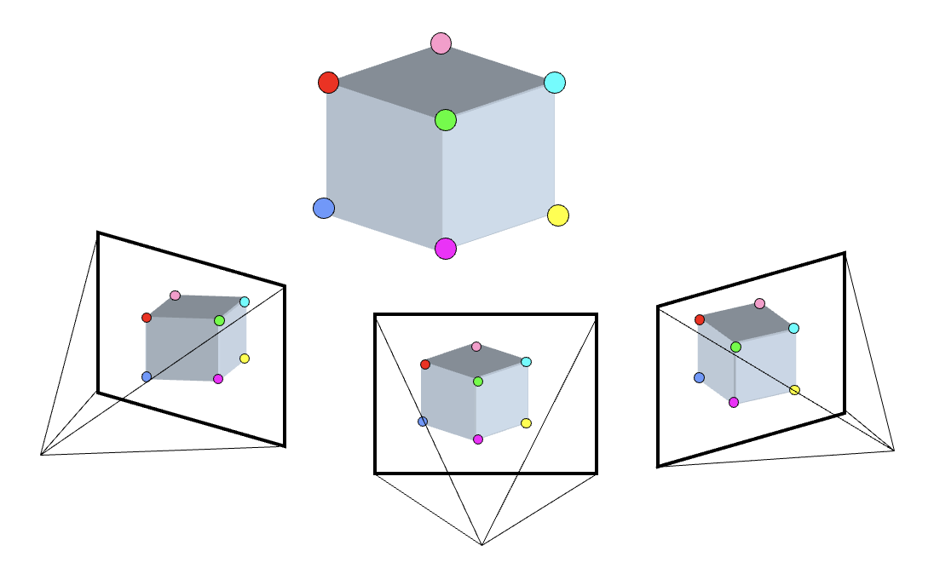
Many problems in 3D
3D Points
(Structure)
Correspondences
Camera
(Motion)
Notes:
You have to start from something, always. It’s chicken and egg if you don’t know anything
What was this problem called?
3D points + Correspondences ➔ Camera
Camera ➔ Correspondences
Correspondences + Camera ➔ 3D points

Slide 22
Camera Calibration
KNOWN
3D Points
(Structure)
Correspondences
Camera
(Motion)
UNKNOWN
KNOWN
Notes:
You have to start from something, always. It’s chicken and egg if you don’t know anything
What was this problem called?
3D points + Correspondences ➔ Camera
Camera ➔ Correspondences
Correspondences + Camera ➔ 3D points

Slide 23
Stereo (w/2 cameras);
Multi-view Stereo / Triangulation
UNKNOWN
3D Points
(Structure)
Correspondences
Camera
(Motion)
KNOWN
(Estimated)
Notes:
You have to start from something, always. It’s chicken and egg if you don’t know anything
What was this problem called?
3D points + Correspondences ➔ Camera
Camera ➔ Correspondences
Correspondences + Camera ➔ 3D points

Slide 24
Camera helps Correspondence:
Epipolar Geometry
3D Points
(Structure)
Correspondences
Camera
(Motion)
Relationship
Notes:
You have to start from something, always. It’s chicken and egg if you don’t know anything
What was this problem called?
3D points + Correspondences ➔ Camera
Camera ➔ Correspondences
Correspondences + Camera ➔ 3D points

Slide 25
Correspondence gives camera:
Epipolar Geometry
3D Points
(Structure)
Correspondences
Camera
(Motion)
Relationship
Notes:
You have to start from something, always. It’s chicken and egg if you don’t know anything
What was this problem called?
3D points + Correspondences ➔ Camera
Camera ➔ Correspondences
Correspondences + Camera ➔ 3D points

Slide 26
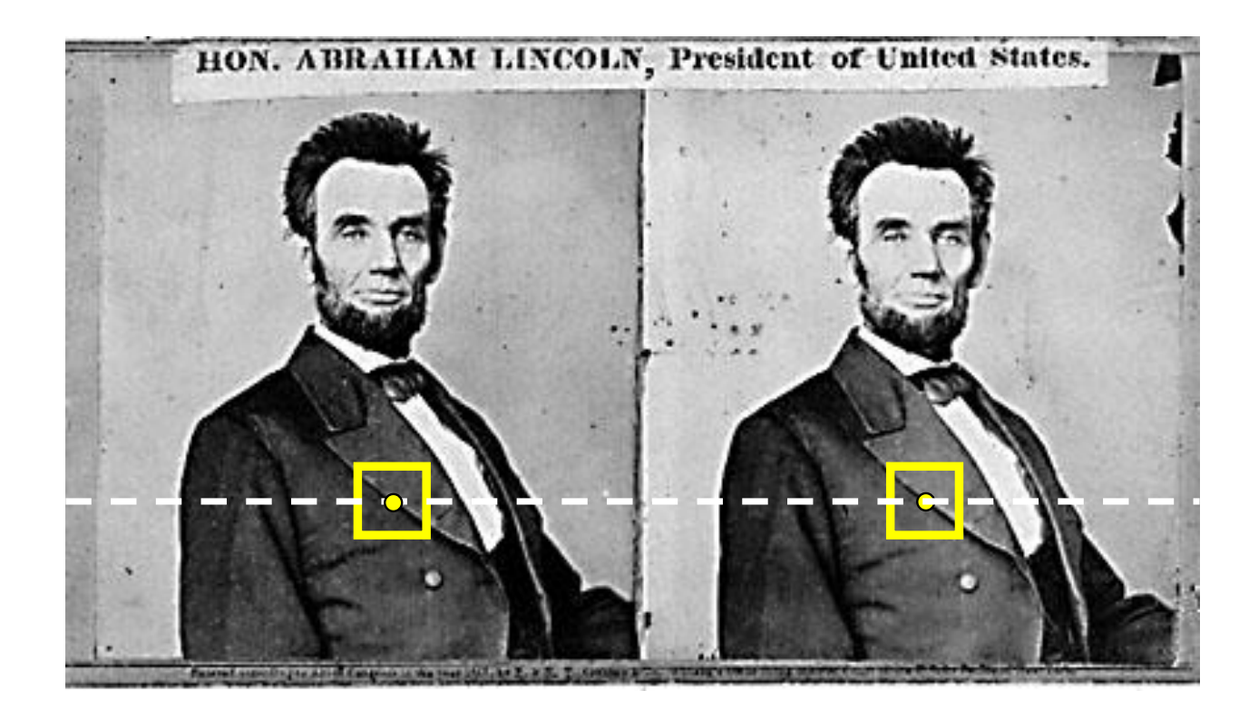
Recap
We covered:
How to estimate the camera parameters
  “Calibration”
  Solve for intrinsics & extrinsics
With a simple stereo, correspondences lie on horizontal lines
depth is inversely proportional to disparity (how much the pixel moves)

Slide 27
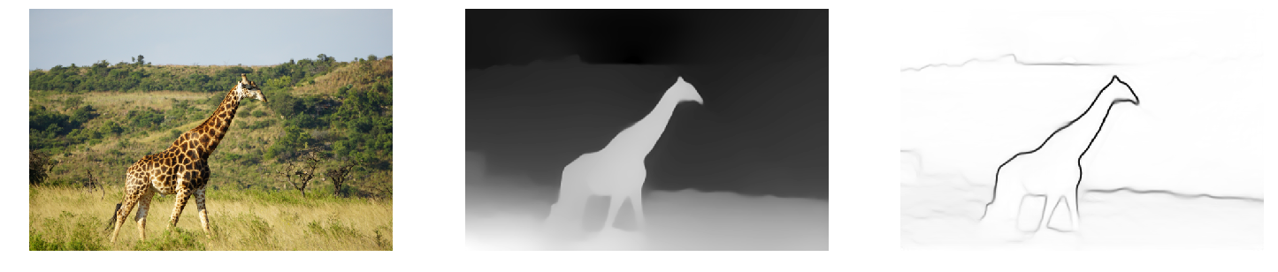
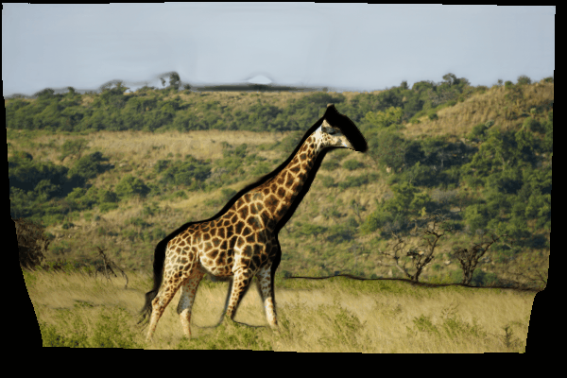
What Depth Map provides
warping the pixel based on its depth as you change the views
Monocular Depth Prediction [Ranftl et al. PAMI’20]
Notes:
2.5D!

Slide 28

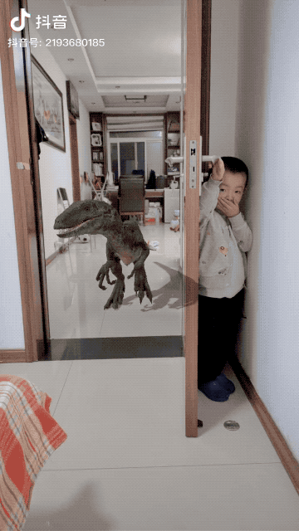
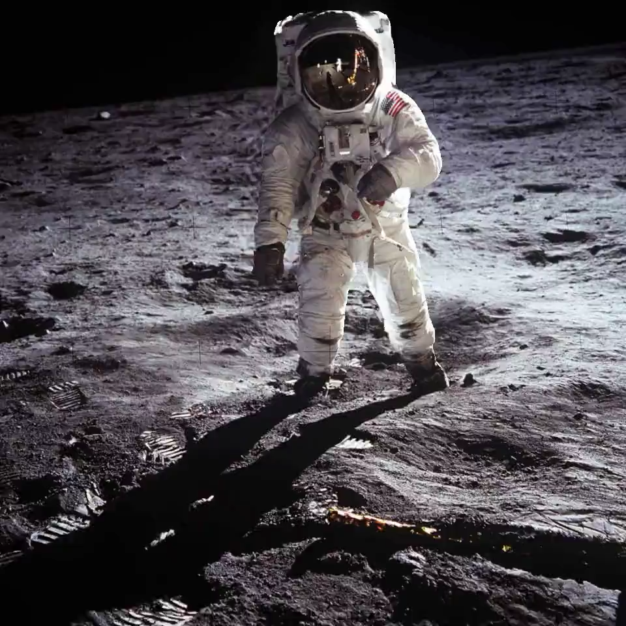
More cool things with Depth
Niklaus et al. ToG 2019
Shih et al. CVPR 2020
3D photo
AR

Slide 29
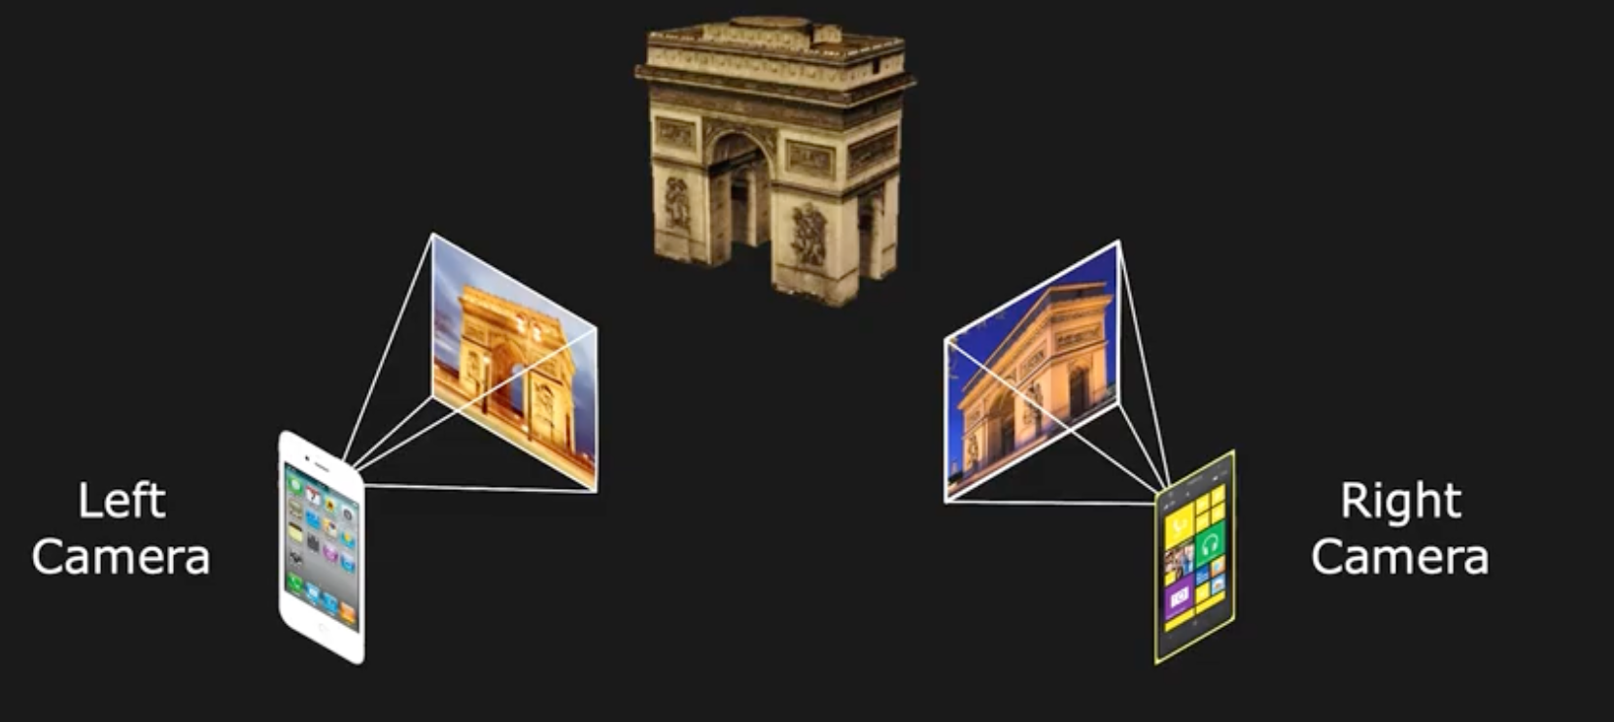
Next: Uncalibrated Stereo
From two arbitrary views
Assume intrinsics are known (fx, fy, ox, oy)
Slide Credit: Shree Nayar

Slide 30
Next: General case
The two cameras need not have parallel optical axes.
Assume camera intrinsics are calibrated
Same hammer:
Find the correspondences, then solve for structure
Notes:
But what was nice about the left?
Any idea as to how to go from right to left?

Slide 31
Option 1: Rectify via homography
reproject image planes onto a common plane
  plane parallel to the line between optical centers
pixel motion is horizontal after this transformation
Two homographies, one for each input image reprojection
  C. Loop and Z. Zhang. Computing Rectifying Homographies for Stereo Vision. CVPR 1999.
Slide courtesy of Noah Snavely
Notes:
First rotate the image plane so it’s parallel to the baseline
then align the v-coordinates to

Slide 32
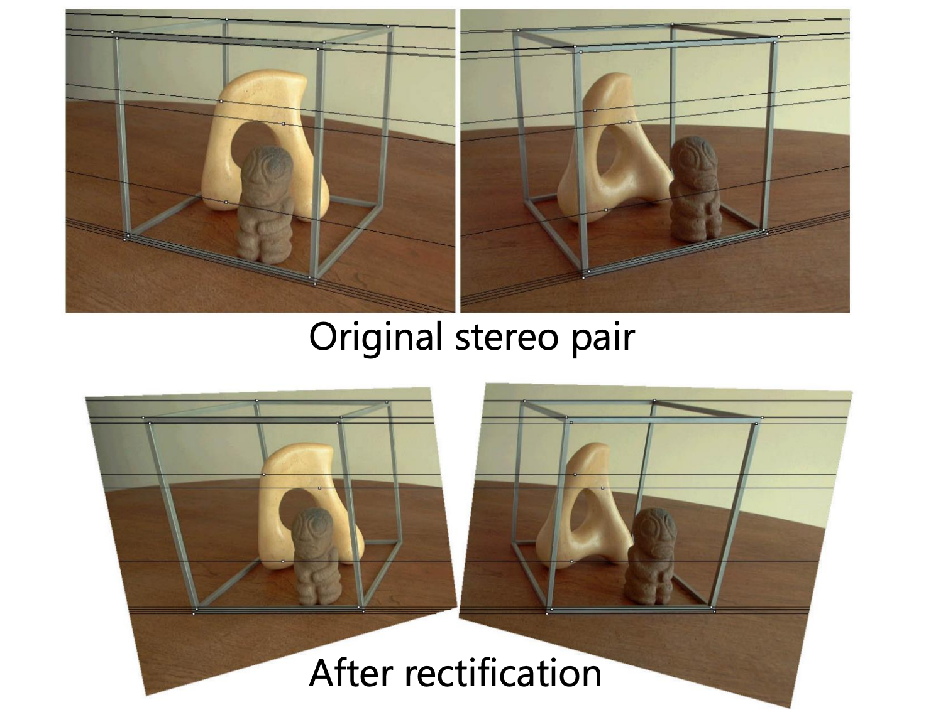
Option 1: Rectify via homography
Then find correspondences on the horizontal scan line
Slide courtesy of Noah Snavely

Slide 33
General case, known camera, find depth: Option 2
Find correspondences
Triangulate

Slide 34
General case, known camera, find depth: Option 2
Find correspondences
Triangulate
Can we restrict the search space again to 1D?
What is the relationship between the camera + the corresponding points?
Notes:
This is answered by epipolar geometry

Slide 35
Where do epipolar lines come from?
Slide courtesy of Noah Snavely
Notes:
35

Slide 36
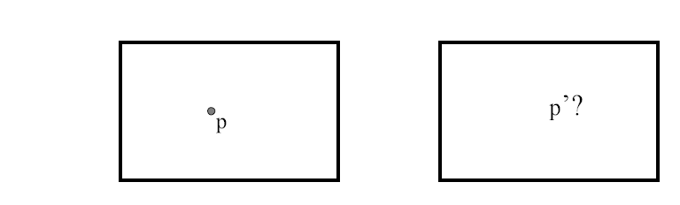
Stereo correspondence constraints
Given p in left image, where can corresponding point p’ be?

Slide 37
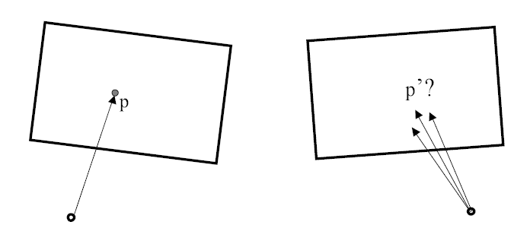
Stereo correspondence constraints
Given p in left image, where can corresponding point p’ be?

Slide 38
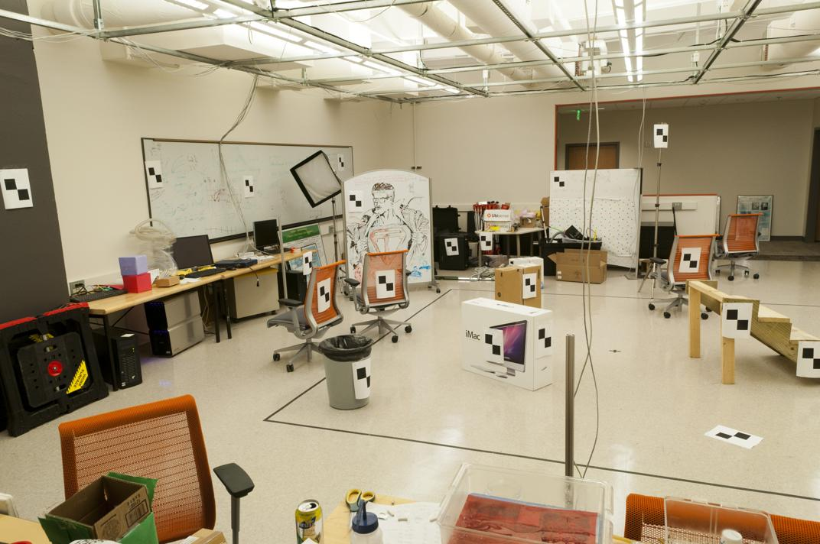
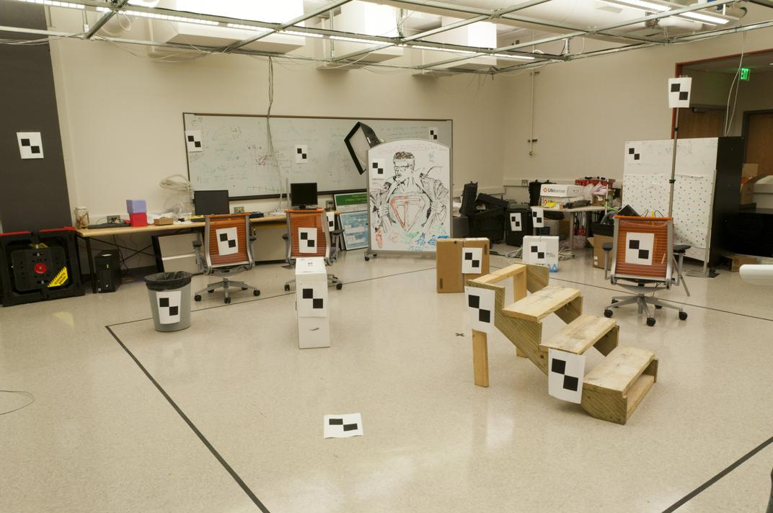
Where do we need to search?
Slide by James Hays

Slide 39
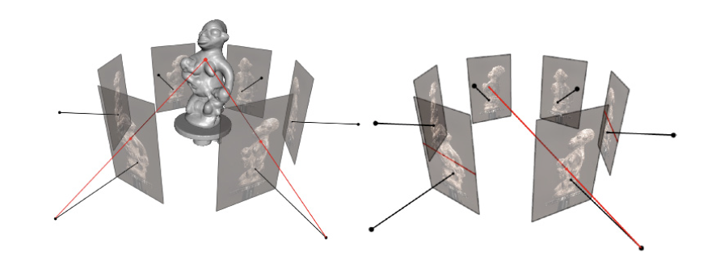
Epipolar Geometry
Figures by Carlos Hernandez
If you get confused with the following math,
look at this picture again, it just describes this.

Slide 40
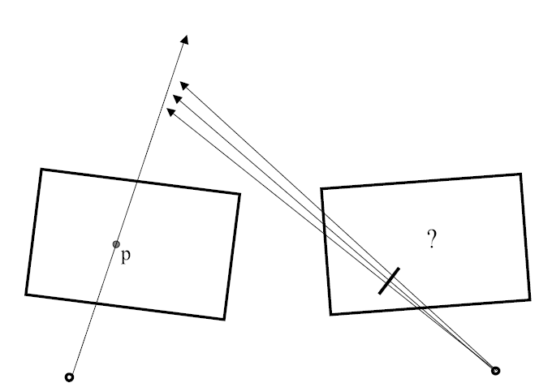
Stereo correspondence constraints
Notes:
the way to think about this is just that its nothing but the ray of the left image projected on to the right

Slide 41

Epipolar constraint
Potential matches for p have to lie on the corresponding
epipolar line l’.
Potential matches for p’ have to lie on the corresponding
epipolar line l.
Source: M. Pollefeys
Notes:
41

Slide 42
Stereo correspondence constraints
Geometry of two views allows us to constrain where the corresponding pixel for some image point in the first view must occur in the second view.
epipolar line
epipolar line
epipolar plane
Epipolar constraint: Why is this useful?
  Reduces correspondence problem to 1D search along conjugate epipolar lines
http://www.ai.sri.com/~luong/research/Meta3DViewer/EpipolarGeo.html
Adapted from Steve Seitz

Slide 43

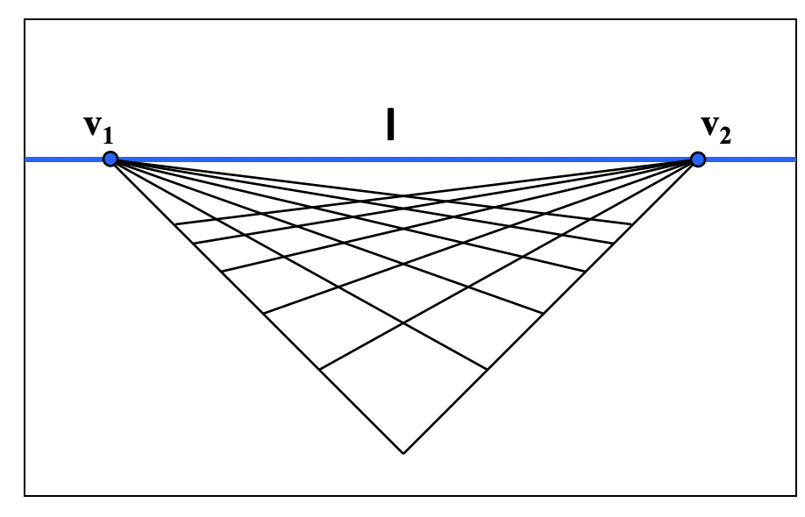
Parts of Epipolar geometry
X
x
x’
Baseline – line connecting the two camera centers
Epipolar Plane – plane containing baseline (1D family)
Epipoles
= intersections of baseline with image planes
= projections of the other camera center
= vanishing points of the baseline

Slide 44
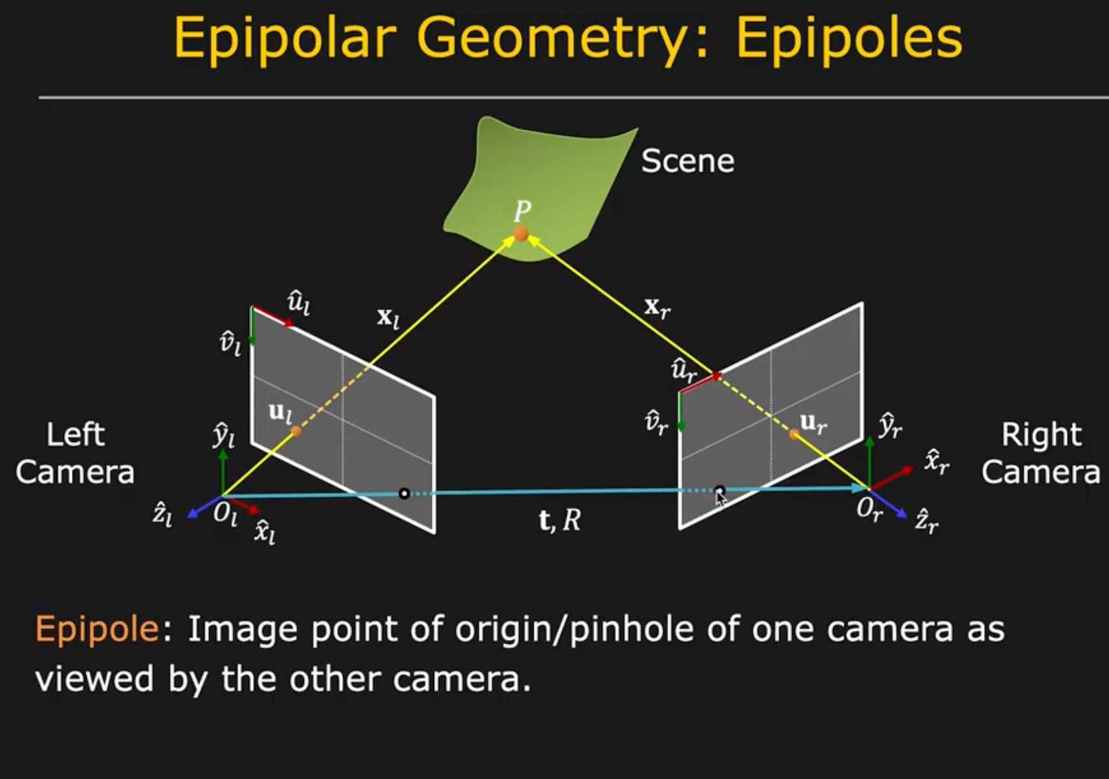

Slide 45
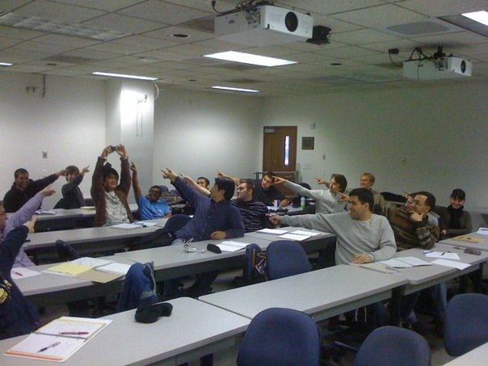
The Epipole
Photo by Frank Dellaert
Notes:
Where the students are pointing is the epipole!!! (there’s the other camera)

Slide 46
Epipolar geometry: terms
Baseline: line joining the camera centers
Epipole: point of intersection of baseline with the image plane
Epipolar plane: plane containing baseline and world point
Epipolar line: intersection of epipolar plane with the image plane
All epipolar lines intersect at the epipole
An epipolar plane intersects the left and right image planes in epipolar lines
Grauman

Slide 47
Epipolar constraint
Potential matches for p have to lie on the corresponding
epipolar line l’.
Potential matches for p’ have to lie on the corresponding
epipolar line l.
Source: M. Pollefeys
Notes:
47

Slide 48
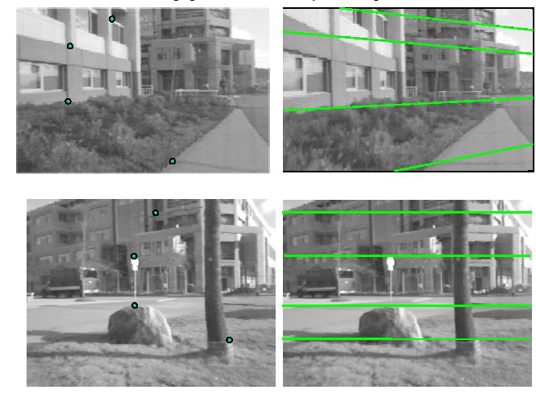
Example

Slide 49



Example: converging cameras
As position of 3d point varies, epipolar lines “rotate” about the baseline
Figure from Hartley & Zisserman
Notes:
49

Slide 50
Example: Parallel to Image Plane
Where is the epipole?
p
p'
e'
e
Epipoles infinitely far away, epipolar lines parallel
Slide credit: David Fouhey

Slide 51



Example: motion parallel with image plane
Figure from Hartley & Zisserman
Notes:
51

Slide 52
Example: Forward Motion
Epipole is focus of expansion / principal point of the camera.
Epipolar lines go out from principal point

Slide 53
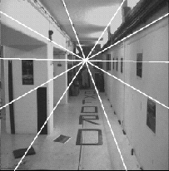
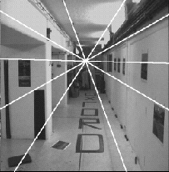
Example: forward motion
e’
e
Epipole has same coordinates in both images.
Points move along lines radiating from e: “Focus of expansion”
Figure from Hartley & Zisserman
Notes:
53

Slide 54

Motion perpendicular to image plane
http://vimeo.com/48425421
Slide credit: David Fouhey
Notes:
kubrick

Slide 55
Ok so where were we?
Setup: Calibrated Camera (both extrinsic & intrinsic)
Goal: 3D reconstruction of corresponding points in the image
We need to find correspondences!
➔ 1D search along the epipolar line!

Slide 56
For a given stereo rig, how do we express the epipolar constraints algebraically?
For calibrated cameras, with Essential Matrix
For uncalibrated cameras, with Fundamental Matrix

Slide 57
Ok so what exactly are l and l’?

Slide 58
Step 0: Normalized image coordinates
X
x
x’
Let’s factor out the effect of K (do everything in 3D)
Since we know the intrinsics K, apply its inverse to x with depth = 1
This is called the normalized image coordinates. It may be thought of as a set of points with K = Identity
Assume that the points are normalized from here on
Notes:
f(x / z) + ox → (x – ox) / f = x / z
basically just [ x / z, y / z, 1 ] (think of it as image plane coordinates with focal length = 1)
T: is position of the right camera in left camera’s frame
R:orientation of left camera in right camera’s frame.
Then, expand x_l = R*x_r + t

Slide 59
Epipolar constraint: Calibrated case
X
= (x,1)^{T}
x
x’ = Rx+t
t
R
The vectors x, t, and x’ are coplanar
What can you say about their relationships, given ?
0
Notes:
X’ is X in the second camera’s coordinate system
We can identify the non-homogeneous 3D vectors X and X’ with the homogeneous coordinate vectors x and x’ of the projections of the two points into the two respective images
if co planar cross product of the vector with the point is 0

Slide 60
Epipolar constraint: Calibrated case
X
x
x’ = Rx+t
Recall:
The vectors x, t, and x’ are coplanar

Slide 61
Epipolar constraint: Calibrated case
X
x
x’ = Rx+t
Essential Matrix
(Longuet-Higgins, 1981)
Recall:
The vectors x, t, and x’ are coplanar
Notes:
x
T is green, Rx + t is the point on the right
X’ (t_x Rx + t_x*t) = x’[t_xRx] = 0

Slide 62
Epipolar constraint: Calibrated case
X
x
x’
E x is the epipolar line associated with x (l’ = E x)
  Recall: a line is given by ax + by + c = 0 or

Slide 63
Epipolar constraint: Calibrated case
X
x
x’
E x is the epipolar line associated with x (l' = E x)
E^{T}x' is the epipolar line associated with x' (l = E^{T}x')
E e = 0 and E^{T}e' = 0
E is singular (rank two)
E has five degrees of freedom
Notes:
Say that E is not a transformation, it maps a point to a line
why 5? R + T = > 6 DoF, with the projective scale ambiguity -> 5
(i.e. T can be unit vector in the above cross product relationship, scale doesn’t matter) , i.e. scale ambiguity is in T!
why Rank 2? → 2D plane gets mapped to a single line in the other image. (Also skew symm is rank2)

Slide 64
Epipolar constraint: Uncalibrated case
Recall that we normalized the coordinates
where is the image coordinates
But in the uncalibrated case, K and K’ are unknown!
We can write the epipolar constraint in terms of unknown normalized coordinates:
Fundamental Matrix
(Faugeras and Luong, 1992)
Notes:
F = unknown intrinsics

Slide 65
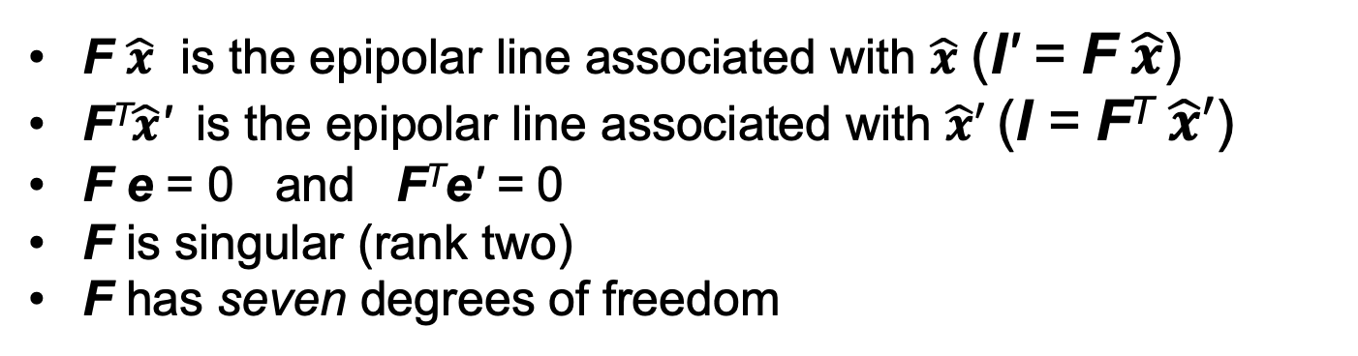
Epipolar constraint: Uncalibrated case
X
x
x’
with
F $\hat{x}$ is the epipolar line associated with $\hat{x}$ (l' = F $\hat{x}$)
F^{T}$\hat{x}$' is the epipolar line associated with $\hat{x}′$(l = F^{T} $\hat{x}′$)
F e = 0 and F^{T}e' = 0
F is singular (rank two)
F has seven degrees of freedom
Notes:
F is 3 x 3 = 9 total, but 8 bc of ambiguity, -1 because rank 2 (detF = 0)..

Slide 66
Where are we? (in the original setup)
We have two images with calibrated cameras, want the 3D points!
Solve for correspondences using epipolar constraints from known camera (1D search)
  Now we know the exact equation of this line
Triangulate to get depth!

Slide 67

Finally: computing depth by triangulation
We know about the camera, K₁, K₂ and [R t]:
X
$$=X^{′}=RX+T$$
x
x’
and found the corresponding points:
How many unknowns + how many equations do we have?
only unknowns!
Solve by least squares
Notes:
In general you solve for the 3D point all together, because although the only thing you should need is the depth of a single point, in practice due to noise it may not exactly lie on the ray
3 unknowns, 6 equations (3 per point), only 2 are linearly independent ➔ 4 Equations (2 points in image space, or just 1 correspondences)

Slide 68
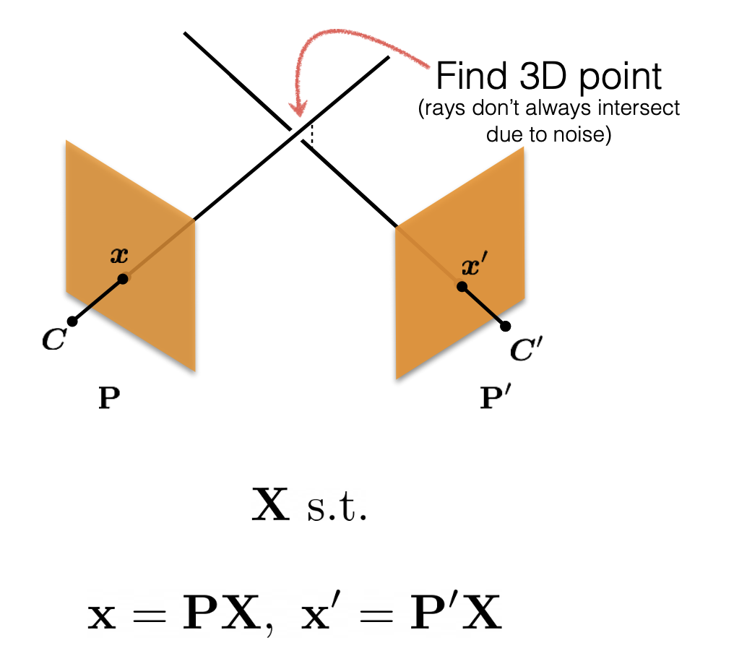
Triangulation Disclaimer: Noise
Ray’s don’t always intersect because of noise!!!
Least squares get you to a reasonable solution but it’s not the actual geometric error (it’s how far away the solution is from Ax = 0)
In practice with noise, you do non-linear least squares, or “bundle adjustment” (more than 2 image case, next lecture..)
Slide credit: Shubham Tulsiani
Notes:
non-linear bc of the division by z in the projective function

Slide 69
Summary: Two-view, known camera
0. Calibrate the camera.
1. Find correspondences:
- Reduce this to 1D search with Epipolar Geometry!
2. Get depth:
- If simple stereo, disparity (difference of corresponding points) is inversely proportional to depth
- In the general case, triangulate.

Slide 70
What if we don’t know the camera?
3D Points
(Structure)
Correspondences
Camera
(Motion)
Notes:
3D points + Correspondences ➔ Camera
Camera ➔ Correspondences
Correspondences + Camera ➔ 3D points

Slide 71

What if we don’t know the camera?
Assume we know the correspondences:
$\hat{x}′$ and $\hat{x}$ in the image
How many correspondences do we need?
Notes:
F has 7 DoF
Each correspondence gives 1 equation → at least 7, usually 8 (7solution is complicated)

Slide 72
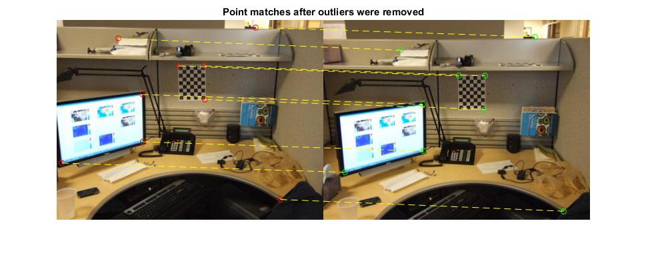
Estimating the fundamental matrix

Slide 73
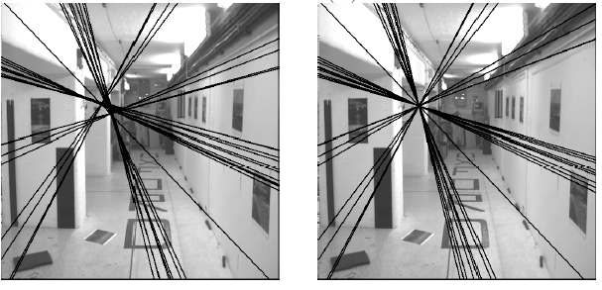
The eight-point algorithm
Solve homogeneous linear system using eight or more matches
Enforce rank-2 constraint (take SVD
of F and throw out the smallest singular value)

Slide 74
Problem with eight-point algorithm

Slide 75
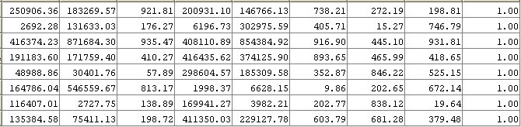
Problem with eight-point algorithm
Poor numerical conditioning
Can be fixed by rescaling the data

Slide 76
The normalized eight-point algorithm
(Hartley, 1995)
Center the image data at the origin, and scale it so the mean squared distance between the origin and the data points is 2 pixels
Use the eight-point algorithm to compute F from the normalized points
Enforce the rank-2 constraint (for example, take SVD of F and throw out the smallest singular value)
Transform fundamental matrix back to original units: if T and T’ are the normalizing transformations in the two images, than the fundamental matrix in original coordinates is T’^{T} F T

Slide 77
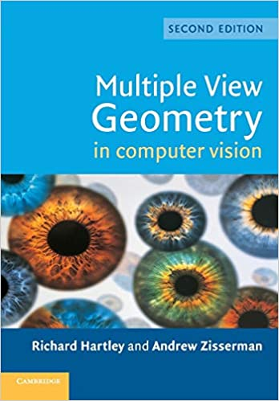
The Bible by Hartley & Zisserman

Slide 78
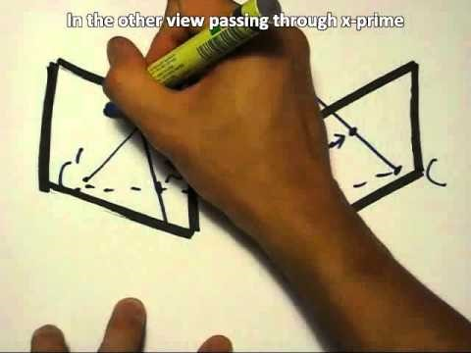
The Fundamental Matrix Song
http://danielwedge.com/fmatrix/
https://www.youtube.com/watch?time_continue=8&v=DgGV3l82NTk&feature=emb_title

Slide 79
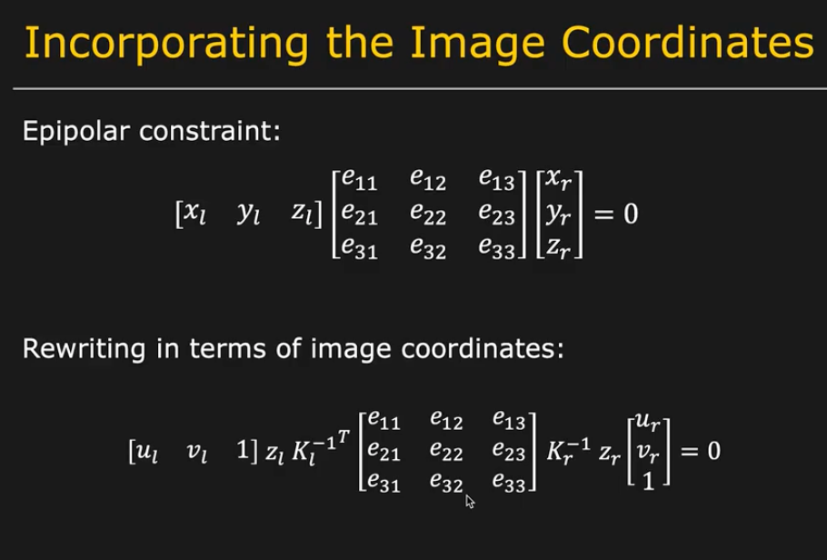
Finding E: But we know the image coord
z’s are still unknown! (they are > 0 and !=0)
But this whole equation goes to 0 so we can skip it

Slide 80

Going from F to the Camera
Get the essential matrix with K (or some estimates of K)
How the 2D lines relate with 3D lines is captured by intrinsics!
Notes:
fundamental matrix only tells you how lines project between frames, but that doesn't tell you anything about the actual 3D transforms unless you have something that tells you about how 2D lines relate with 3D lines (i.e. intrinsics)

Slide 81
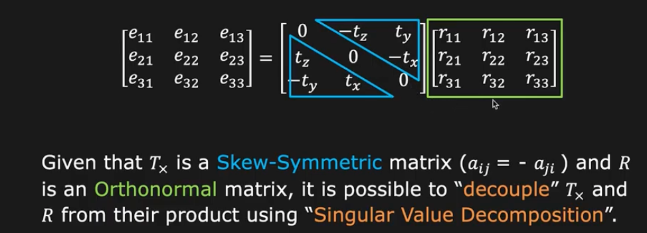
Essential matrix can be decomposed
E = T_{x}R
If we know E, we can recover t and R
Slide from Shree Nayar
Notes:
Get the E by taking away intrinsics from both images: E = K’^T*F*K

Slide 82
This completes: Corresp to Camera
3D Points
(Structure)
Correspondences
Camera
(Motion)
Notes:
3D points + Correspondences ➔ Camera
Camera ➔ Correspondences
Correspondences + Camera ➔ 3D points

Slide 83
What about more than two views?
The geometry of three views is described by a 3 x 3 x 3 tensor called the trifocal tensor
The geometry of four views is described by a 3 x 3 x 3 x 3 tensor called the quadrifocal tensor
After this it starts to get complicated…
Slide courtesy of Noah Snavely

Slide 84
Putting it all together
Structure-from-Motion: You know nothing! (except ok maybe intrinsics)
3D Points
(Structure)
UNKNOWN
Correspondences
Camera
(Motion)
ESTIMATED
UNKNOWN
Notes:
How this works: Corresp → Camera, for ransac verification, then you get initial estimate for points with triangulation, then you update the camera etc..

Slide 85
(Next lecture) Ultimate:
Structure-from-Motion/SLAM
UNKNOWN
3D Points
(Structure)
Correspondences
Camera
(Motion)
ESTIMATED
UNKNOWN
The starting point for all problems where you can’t calibrate actively
Notes:
You have to start from something, always. It’s chicken and egg if you don’t know anything
What was this problem called?
3D points + Correspondences ➔ Camera
Camera ➔ Correspondences
Correspondences + Camera ➔ 3D points

Slide 86
(after that): Neural Rendering
UNKNOWN
3D Representation
(Structure)
Correspondences
Camera
(Motion)
KNOWN
A form of multi-view stereo, more on this in the NeRF lecture.
Notes:
You have to start from something, always. It’s chicken and egg if you don’t know anything
What was this problem called?
3D points + Correspondences ➔ Camera
Camera ➔ Correspondences
Correspondences + Camera ➔ 3D points

Slide 87

Next: Large-scale structure from motion
Dubrovnik, Croatia. 4,619 images (out of an initial 57,845).
Total reconstruction time: 23 hours
Number of cores: 352
Building Rome in a Day, Agarwal et al. ICCV 2009
Slide courtesy of Noah Snavely

Slide 88
Large-scale structure from motion
Result using COLMAP: Schönberger et al. CVPR ’16

