Slide 1
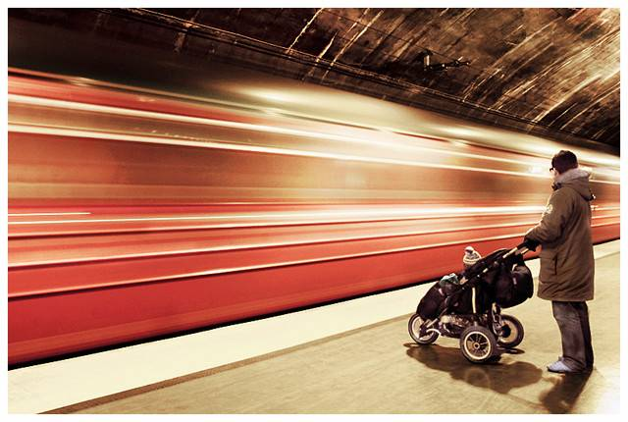
Automatic Image Alignment
© Mike Nese
with a lot of slides stolen from
Steve Seitz and Rick Szeliski
CS180: Intro to Comp. Vision and Comp. Photo
Guest Lecturer: George Pavlakos, UC Berkeley, Fall 2023

Slide 2
Feature-based alignment
Feature Detection: find a few important features (aka Interest Points) in each image separately
Feature Matching: match them across two images
Compute image transformation: as per Project 5, Part I
How do we choose good features automatically?
  They must be prominent in both images
  Easy to localize
  Think how you did that by hand in Project #6 Part I
  Corners!

Slide 3


A hard feature matching problem
NASA Mars Rover images

Slide 4


Answer below (look for tiny colored squares…)
NASA Mars Rover images
with SIFT feature matches
Figure by Noah Snavely

Slide 5
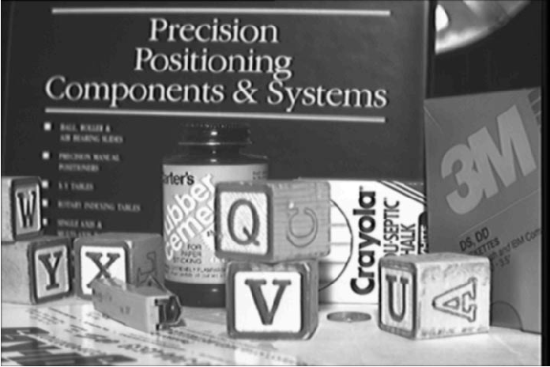
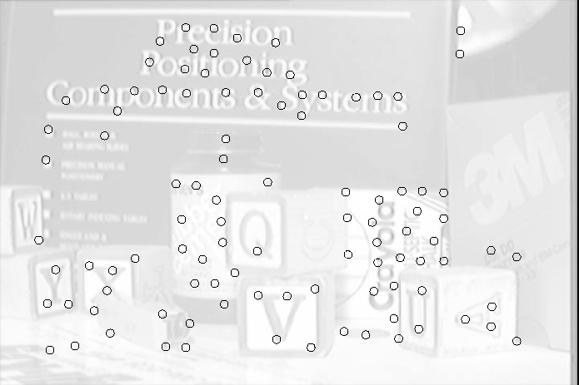
Feature Detection

Slide 6
Feature Matching
How do we match the features between the images?
  Need a way to describe a region around each feature
    e.g. image patch around each feature
  Use successful matches to estimate homography
    Need to do something to get rid of outliers
Issues:
  What if the image patches for several interest points look similar?
    Make patch size bigger
  What if the image patches for the same feature look different due to scale, rotation, etc.
    Need an invariant descriptor

Slide 7




Invariant Feature Descriptors
Schmid & Mohr 1997, Lowe 1999, Baumberg 2000, Tuytelaars & Van Gool 2000, Mikolajczyk & Schmid 2001, Brown & Lowe 2002, Matas et. al. 2002, Schaffalitzky & Zisserman 2002

Slide 8

Invariant Local Features
Image content is transformed into local feature coordinates that are invariant to translation, rotation, scale, and other imaging parameters
Features Descriptors

Slide 9
Applications
Feature points are used for:
  Image alignment (homography, fundamental matrix)
  3D reconstruction
  Motion tracking
  Object recognition
  Indexing and database retrieval
  Robot navigation
  … other

Slide 10
Invariant Local Features
Image content is transformed into local feature coordinates that are invariant to translation, rotation, scale, and other imaging parameters
Features Descriptors

Slide 11
Today’s lecture
1 Feature detector
  scale invariant Harris corners
1 Feature descriptor
  patches, oriented patches
Reading:
Multi-image Matching using Multi-scale image patches, CVPR 2005

Slide 12
Feature Detector – Harris Corner

Slide 13
Harris corner detector
C.Harris, M.Stephens. “A Combined Corner and Edge Detector”. 1988

Slide 14
The Basic Idea
We should easily recognize the point by looking through a small window
Shifting a window in any direction should give a large change in intensity

Slide 15
Harris Detector: Basic Idea
“flat” region:
no change in all directions
“edge”:
no change along the edge direction
“corner”:
significant change in all directions

Slide 16
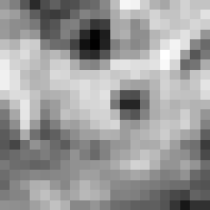

Corner Detection: Mathematics
Change in appearance of window W for the shift [u,v]:
I(x, y)
E(u, v)
E(3,2)

Slide 17
Corner Detection: Mathematics
Change in appearance of window W for the shift [u,v]:
I(x, y)
E(u, v)
E(0,0)

Slide 18
Corner Detection: Mathematics
Change in appearance of window W for the shift [u,v]:
We want to find out how this function behaves for small shifts
E(u, v)
Notes:
Specifically, E has to have a unique minimum at (0,0)

Slide 19
Corner Detection: Mathematics
First-order Taylor approximation for small motions [u, v]:
Let’s plug this into

Slide 20
Corner Detection: Mathematics

Slide 21
Corner Detection: Mathematics
The quadratic approximation simplifies to
where M is a second moment matrix computed from image derivatives:

Slide 22
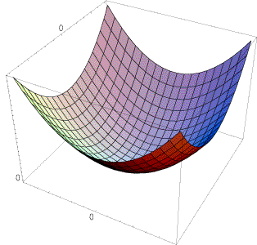
Interpreting the second moment matrix
The surface E(u,v) is locally approximated by a quadratic form. Let’s try to understand its shape.
  Specifically, in which directions
  does it have the smallest/greatest
  change?
E(u, v)

Slide 23
Interpreting the second moment matrix
First, consider the axis-aligned case (gradients are either horizontal or vertical)
If either a or b is close to 0, then this is not a corner, so look for locations where both are large.

Slide 24
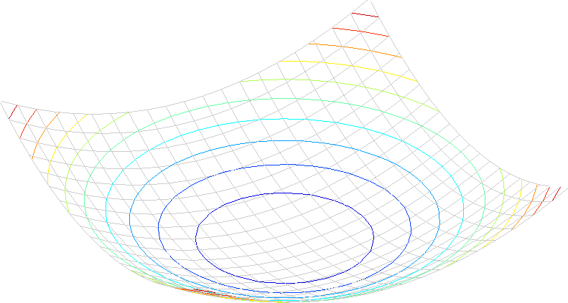
Interpreting the second moment matrix
Consider a horizontal “slice” of E(u, v):
This is the equation of an ellipse.

Slide 25
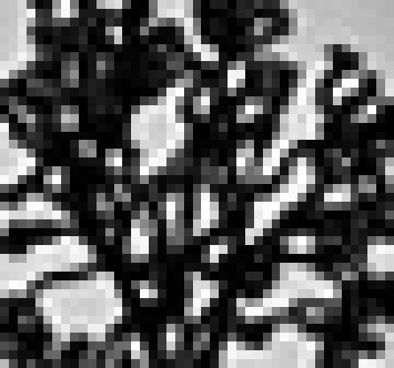
Visualization of second moment matrices

Slide 26
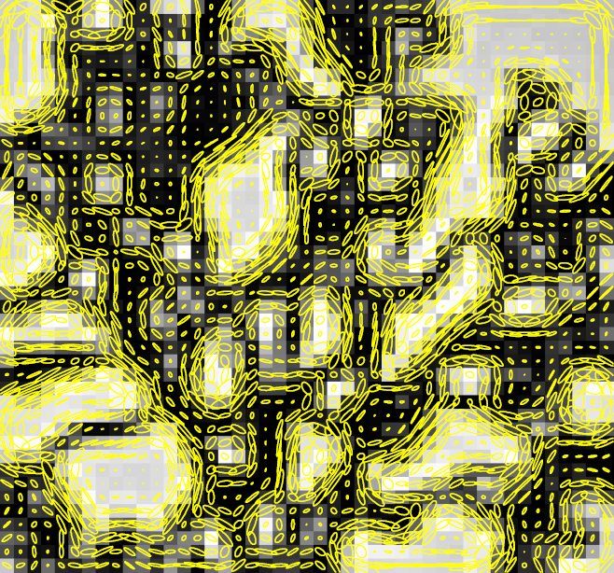
Visualization of second moment matrices

Slide 27
Interpreting the second moment matrix
Consider a horizontal “slice” of E(u, v):
This is the equation of an ellipse.
Diagonalization of M:
The axis lengths of the ellipse are determined by the eigenvalues and the orientation is determined by R
direction of the fastest change
direction of the slowest change
(λ_{max})^{-1/2}
(λ_{min})^{-1/2}

Slide 28
Interpreting the eigenvalues
Classification of image points using eigenvalues of M:
λ₂
“Edge”
λ₂ >> λ₁
“Corner”
λ₁ and λ₂ are large,
λ₁ ~ λ₂;
E increases in all directions
λ₁ and λ₂ are small;
E is almost constant in all directions
“Flat” region
“Edge”
λ₁ >> λ₂
λ₁

Slide 29
Harris Detector: Mathematics
Measure of corner response:

Slide 30
Harris detector: Steps
Compute Gaussian derivatives at each pixel
Compute second moment matrix M in a Gaussian window around each pixel
Compute corner response function R
Threshold R
Find local maxima of response function (nonmaximum suppression)
C.Harris and M.Stephens. “A Combined Corner and Edge Detector.” Proceedings of the 4th Alvey Vision Conference: pages 147—151, 1988.

Slide 31

Harris Detector: Workflow

Slide 32

Harris Detector: Workflow
Compute corner response R

Slide 33

Harris Detector: Workflow
Find points with large corner response: R>threshold

Slide 34
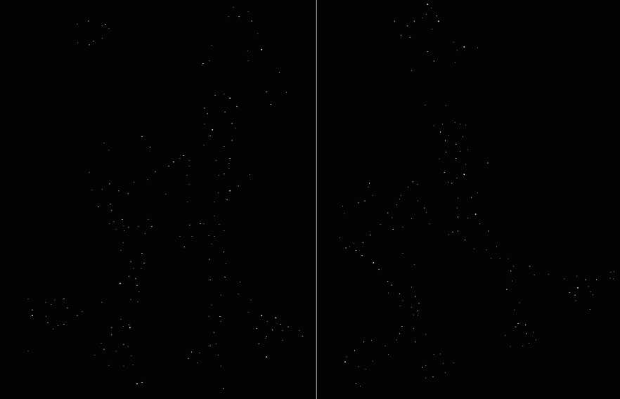
Harris Detector: Workflow
Take only the points of local maxima of R

Slide 35

Harris Detector: Workflow

Slide 36
Harris Detector: Some Properties
Rotation invariance
Ellipse rotates but its shape (i.e. eigenvalues) remains the same
Corner response R is invariant to image rotation

Slide 37
Harris Detector: Some Properties
Partial invariance to affine intensity change
Only derivatives are used => invariance to intensity shift I → I + b
Intensity scale: I → a I
R
R
threshold
x (image coordinate)
x (image coordinate)

Slide 38
Harris Detector: Some Properties
But: non-invariant to image scale!
All points will be classified as edges
Corner !

Slide 39
Scale Invariant Detection
Consider regions (e.g. circles) of different sizes around a point
Regions of corresponding sizes will look the same in both images

Slide 40
Scale Invariant Detection
The problem: how do we choose corresponding circles independently in each image?
Choose the scale of the “best” corner

Slide 41
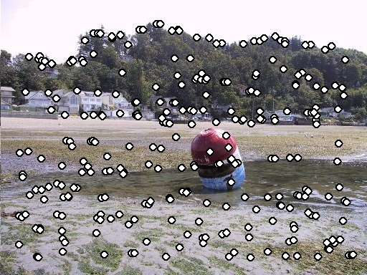
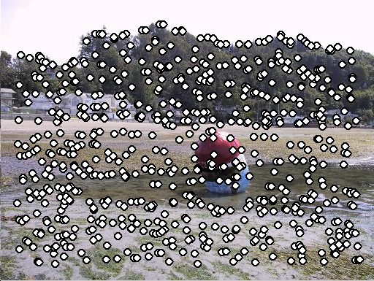
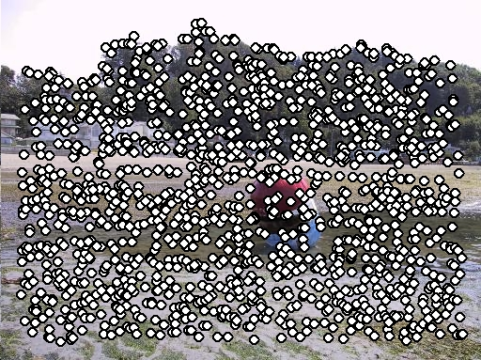
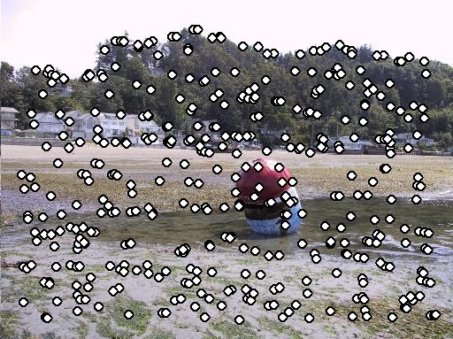
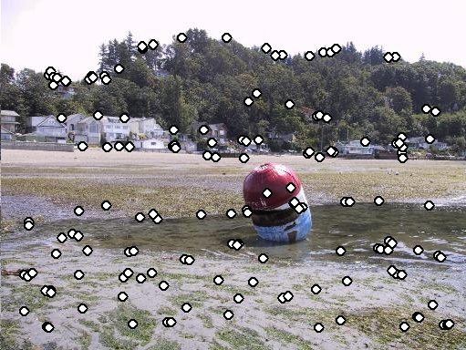
Feature selection
Distribute points evenly over the image

Slide 42
Adaptive Non-maximal Suppression
Desired: Fixed # of features per image
  Want evenly distributed spatially…
  Sort points by non-maximal suppression radius
  [Brown, Szeliski, Winder, CVPR’05]

Slide 43


Feature descriptors
We know how to detect points
Next question: How to match them?
?
Point descriptor should be:
  Invariant 2. Distinctive

Slide 44
Feature Descriptor – MOPS

Slide 45
Multi-Scale Oriented Patches
Interest points
  Multi-scale Harris corners
  Orientation from blurred gradient
  Geometrically invariant to rotation
Descriptor vector
  Bias/gain normalized sampling of local patch (8x8)
  Photometrically invariant to affine changes in intensity
[Brown, Szeliski, Winder, CVPR’2005]

Slide 46

Detect Features, setup Frame
Orientation = blurred gradient
Rotation Invariant Frame
  Scale-space position (x, y, s) + orientation (θ)

Slide 47
Detections at multiple scales

Slide 48

MOPS descriptor vector
8x8 oriented patch
  Sampled at 5 x scale
Bias/gain normalisation: I’ = (I – μ)/σ
40 pixels
8 pixels

