Slide 1

Stereo (Binocular)
A lot of slides from Noah Snavely +
Shree Nayar’s YT series: First principals of Computer Vision
credit: clavivs
CS180: Intro to Computer Vision and Comp. Photo
Angjoo Kanazawa & Alexei Efros, UC Berkeley, Fall 2023

Slide 2
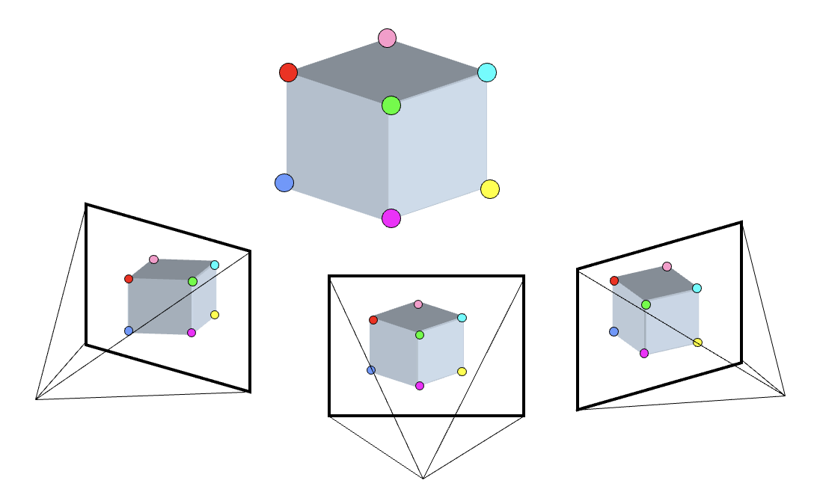
Last week: 3 key components in 3D
3D Points
(Structure)
Correspondences
Camera
(Motion)
Notes:
You have to start from something, always. It’s chicken and egg if you don’t know anything
What was this problem called?
3D points + Correspondences ➔ Camera
Camera ➔ Correspondences
Correspondences + Camera ➔ 3D points

Slide 3
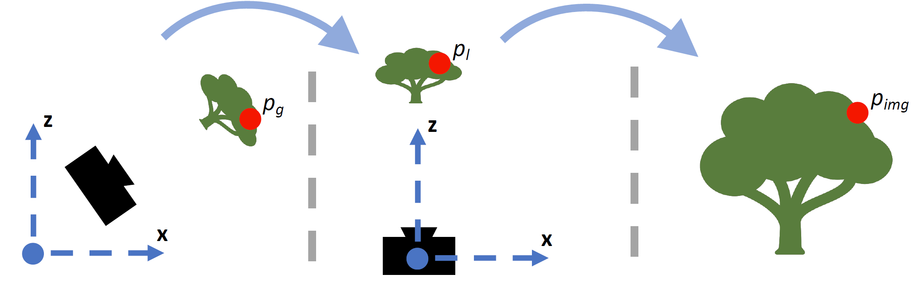
Coordinate frames + Transforms
Orientation + Location of the camera in the World
How the camera maps a point in 3D to image
Extrinsics (R, T)
Intrinsics (K)
World coordinates
Camera coordinates
Image coordinates
Figure credit: Peter Hedman

Slide 4
Camera: Specifics
Image Plane
pinhole
y’_{w}
y’_{c}
P
X_{w}
x’_{i}
X_{c}
x’_{w}
z’_{c}
z’_{w}
x_{i}
y’_{i}
x’_{c}
f
Image Coordinates
Camera Coordinates
World Coordinates
Perspective
Projection
(3D to 2D)
Coordinate Transformation
(3D to 3D)
Slide inspired by Shree Nayar
Notes:
Xw to Xc is 3D to 3D transformation
3D to 2D is the forward imaging model

Slide 5
Camera: Specifics
Image Plane
pinhole
y’_{w}
y’_{c}
P
X_{w}
x’_{i}
X_{c}
x’_{w}
z’_{c}
z’_{w}
x_{i}
y’_{i}
x’_{c}
f
Image Coordinates
Camera Coordinates
World Coordinates
Perspective
Projection
(3D to 2D)
Coordinate Transformation
(3D to 3D)
Notes:
Xw to Xc is 3D to 3D transformation
3D to 2D is the forward imaging model

Slide 6
Camera Transformation (3D-to-3D)
pinhole
P
X_{w}
X_{c}
Camera Coordinates
World Coordinates
Coordinate Transformation
Extrinsic Matrix
Notes:
\begin{bmatrix}
{u}\\
{v}\\
1
\end{bmatrix}
\equiv
\begin{bmatrix}
\tilde{u}\\
\tilde{v}\\
\tilde{w}\\
\end{bmatrix}
=
\begin{bmatrix}
f_x & 0 & o_x & 0\\
0 & f_y & o_y & 0 \\
0 & 0 & 1 & 0
\end{bmatrix}
\begin{bmatrix}
x_c\\
y_c \\
z_c
\end{bmatrix}

Slide 7
Camera: Specifics
Image Plane
pinhole
y’_{w}
y’_{c}
P
X_{w}
x’_{i}
X_{c}
x’_{w}
z’_{c}
z’_{w}
x_{i}
y’_{i}
x’_{c}
f
Image Coordinates
Camera Coordinates
World Coordinates
Perspective
Projection
(3D to 2D)
Coordinate Transformation
(3D to 3D)
Notes:
Xw to Xc is 3D to 3D transformation
3D to 2D is the forward imaging model

Slide 8
Perspective Projection
Image Plane
pinhole
P
X_{c}
x_{i}
f
Image Coordinates
Camera Coordinates
Notes:
From the Camera lecture

Slide 9
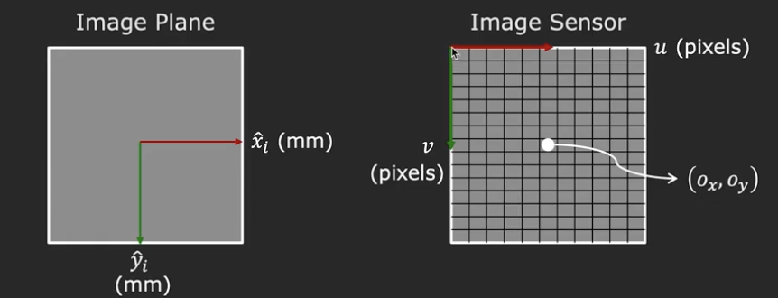
Image Plane to Image Sensor Mapping
1. Scale: For pixel density (pixel/mm) & aspect ratio:
2. Shift: In an image, top left corner is the origin. But in the image plane, the origin is where the optical axis pierces the plane! Need to shift by:
Putting it all together, pixel coordinates:
where

Slide 10
With homogeneous coordinates
Perspective projection + Transformation to Pixel Coordinates:
Intrinsic Matrix
Notes:
Linear (just multiplication) with homogenous coordinates!
\begin{bmatrix}
{u}\\
{v}\\
1
\end{bmatrix}
\equiv
\begin{bmatrix}
\tilde{u}\\
\tilde{v}\\
\tilde{w}\\
\end{bmatrix}
=
\begin{bmatrix}
f_x & 0 & o_x & 0\\
0 & f_y & o_y & 0 \\
0 & 0 & 1 & 0
\end{bmatrix}
\begin{bmatrix}
x_c\\
y_c \\
z_c
\end{bmatrix}

Slide 11
Putting it all together
Image Plane
pinhole
y’_{w}
y’_{c}
P
X_{w}
x’_{i}
X_{c}
x’_{w}
z’_{c}
z’_{w}
x_{i}
y’_{i}
x’_{c}
f
Image Coordinates
Camera Coordinates
World Coordinates
Intrinsics: Perspective
Projection & pixel conversion
Extrinsics: Coordinate Transformation
Slide inspired by Shree Nayar
Notes:
\begin{bmatrix}
x_c\\
y_c \\
z_c \\
1
\end{bmatrix} =
\begin{bmatrix}
R_{3\times 3} & \textbf{t} \\
\textbf{0}_{1 \times 3} & 1
\end{bmatrix}
\begin{bmatrix}
x_w\\
y_w \\
z_w\\
1
\end{bmatrix}

Slide 12
Projection Matrix
3 x 4 Projection matrix
What’s the Degrees of Freedom?
For completeness, we need to add skew (this is 0 unless pixels are shaped like rhombi/parallelograms)
Intrinsics: 4 + 1 (skew)
Extrinsic: 3 + 3 = 6
11 unknowns (up to scale)
Notes:
10 if you ignore skew.
\begin{bmatrix}
{u}\\
{v}\\
1
\end{bmatrix}
\equiv
\begin{bmatrix}
\tilde{u}\\
\tilde{v}\\
\tilde{w}\\
\end{bmatrix}
=
\begin{bmatrix}
f_x & 0 & o_x & 0\\
0 & f_y & o_y & 0 \\
0 & 0 & 1 & 0
\end{bmatrix}
\begin{bmatrix}
R_{3\times 3} & \textbf{t} \\
\textbf{0}_{1 \times 3} & 1
\end{bmatrix}
\begin{bmatrix}
x_w\\
y_w \\
z_w\\
1
\end{bmatrix}
DoG: 4 + 6 = 10

Slide 13
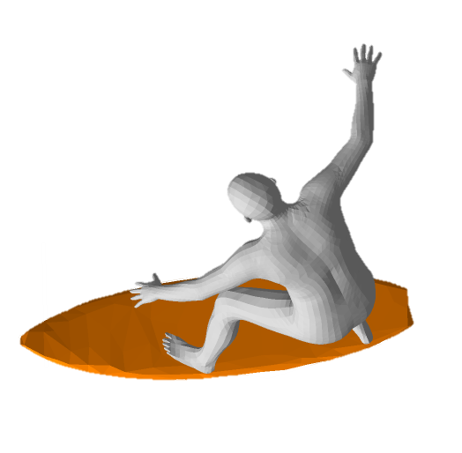
Fundamental Scale Ambiguity
scale by some factor S
Camera
Camera
Reconstruction is only possible up to global scale
Scaling the world & camera doesn’t change the projection
Unless you know something metric about the scene
e.g. surfboard is 2.1m
Notes:
Double the size of everything (world & Camera), gets the identical image. Scaling the projection means simultaneously scaling world & camera
This is a different ambiguity that arises from the single-view case (Here, where the person can be is fixed due to multi-view

Slide 14
Exercises

Slide 15
Going from World to Camera
Camera Coordinates
World Coordinates
Extrinsic Matrix:

Slide 16
Going from Camera to World
Camera Coordinates
World Coordinates
Extrinsic Matrix:

Slide 17
Where is the camera center in the world?
Set X_{c} to zero (origin in camera = camera center)
Now you can derive Camera to World transform as well

Slide 18
Camera to Image
Image Coordinates
Camera Coordinates
Intrinsic Matrix:

Slide 19
Image to Camera?
Image Coordinates
Camera Coordinates
Intrinsic Matrix:
What’s the problem?
Notes:
u = fx*xc + zc*ox , v = fy*yc + zc * oy, w = zc
so now div by zc -> u = fx * xc/zc + ox, v = fy*yc/zc + oy
1/f*(u – ox) / fx

Slide 20
We don’t know the depth! but we know it will be:
on the ray!
Ray
Camera coord frame
y’_{c}
3D to 2D:
(point)
x’_{c}
z’_{c}
(u,v)
2D to 3D:
(ray)
Back projection
Image Plane
Slide credit: Shree Nayar
Notes:
At least it’s on the ray. We need at least another view.

Slide 21
What is your coordinate space?
In Project 5 (and in life) always make sure you’re in the right coordinate space.
eg. Which space is the ray defined in?
2D to 3D:
(ray)
Back projection

Slide 22
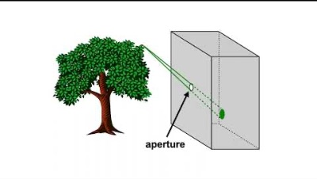
Watch these 5 min videos
https://www.youtube.com/watch?v=F5WA26W4JaM
https://www.youtube.com/watch?v=g7Pb8mrwcJ0

Slide 23

Calibration: What are my cameras?

Slide 24
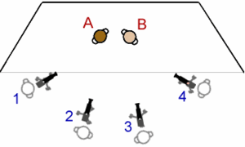
Problem Setup
What are the Extrinsic and Intrinsic matrices for each camera?
Notes:
What can you assume?

Slide 25
How to calibrate the camera?
If we know the points in 3D we can estimate the camera!!

Slide 26
Problem setup: Camera Calibration
KNOWN
3D Points
(Structure)
Correspondences
Camera
(Motion)
UNKNOWN
KNOWN
Notes:
You have to start from something, always. It’s chicken and egg if you don’t know anything
What was this problem called?
3D points + Correspondences ➔ Camera
Camera ➔ Correspondences
Correspondences + Camera ➔ 3D points
Also called Perspective-n-Point (PnP)

Slide 27
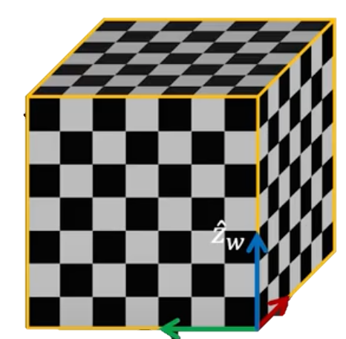
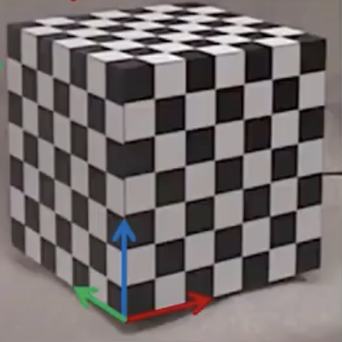
Step 1: With a known 3D object
1. Take a picture of an object with known 3D geometry
x’_{w}
y’_{w}
2. Identify correspondences
Slide from Shree Nayar

Slide 28
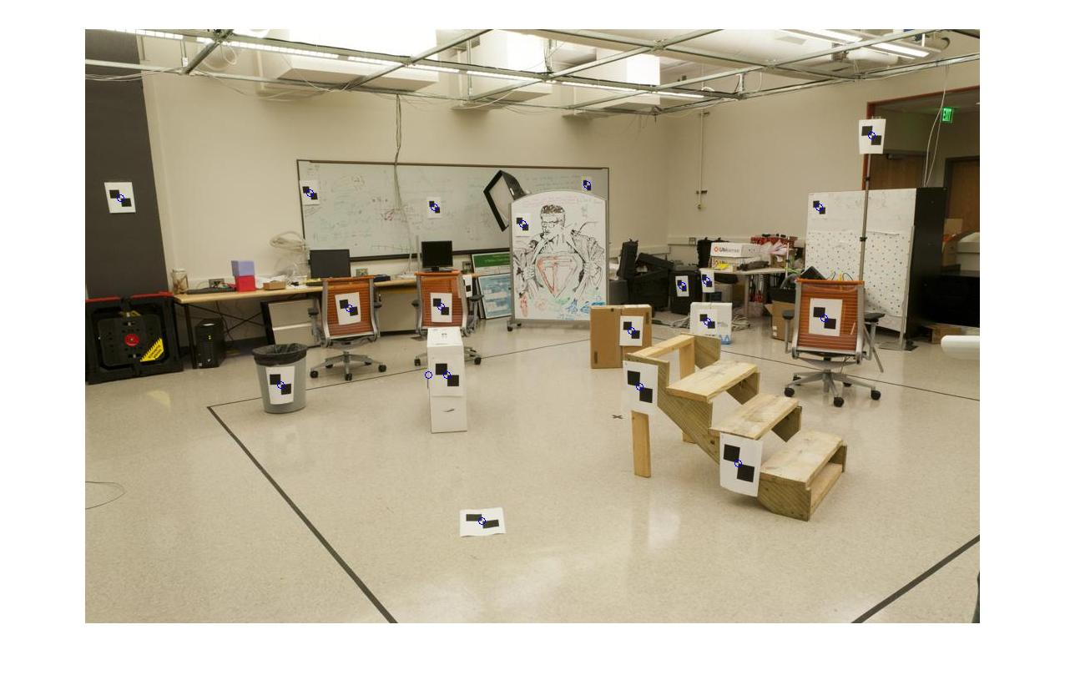
How do we calibrate a camera?
880 214
43 203
270 197
886 347
745 302
943 128
476 590
419 214
317 335
783 521
235 427
665 429
655 362
427 333
412 415
746 351
434 415
525 234
716 308
602 187
312.747 309.140 30.086
305.796 311.649 30.356
307.694 312.358 30.418
310.149 307.186 29.298
311.937 310.105 29.216
311.202 307.572 30.682
307.106 306.876 28.660
309.317 312.490 30.230
307.435 310.151 29.318
308.253 306.300 28.881
306.650 309.301 28.905
308.069 306.831 29.189
309.671 308.834 29.029
308.255 309.955 29.267
307.546 308.613 28.963
311.036 309.206 28.913
307.518 308.175 29.069
309.950 311.262 29.990
312.160 310.772 29.080
311.988 312.709 30.514
Notes:
Point in 3D to known point in 2D

Slide 29
Method: Set up a linear system
Solve for m’s entries using linear least squares
Ax=0 form
Just like how you solved for homography!
Notes:
write as linear equation for every point.
same way you solved for H
Set m_34 to 1 for scale or enforce ||p||^2 = 1
Exactly the same as Homography! (but here we have 11 unknowns instead of 8)
solve with eigen value p is smallest eigenvalue of A^TA

Slide 30
Can we factorize M back to K [R | T]?
Yes.
Why? because K and R have a very special form:
QR decomposition
Practically, use camera calibration packages (there is a good one in OpenCV)
Notes:
R is orthonormal & K is upper triangular → QR factorization
T can be recovered as K^{-1} [m14; m24; m34]
There’s lens parameters.. we’re ignoring distortions

Slide 31
Now that our cameras are calibrated, can we find the 3D scene point of a pixel?
Notes:
At least it’s on the ray.

Slide 32



Stereo reconstruction: main steps
  Calibrate cameras
  Compute disparity
  Estimate depth
disparity
Grauman

Slide 33
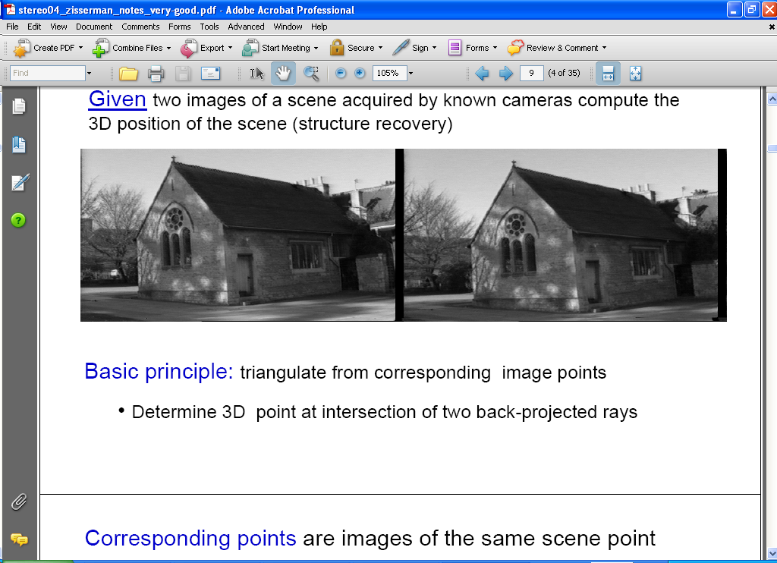
Estimating depth with stereo
Stereo: shape from “motion” between two views
We’ll need to consider:
1. Camera pose (“calibration”)
2. Image point correspondences
scene point
image plane
optical center
Notes:
33

Slide 34
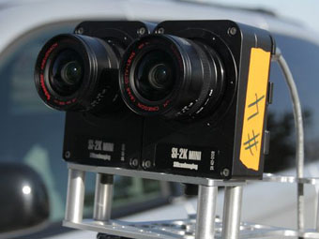
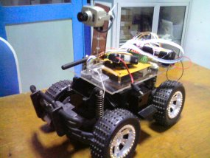
Stereo vision
Two cameras, simultaneous views
Single moving camera and static scene

Slide 35
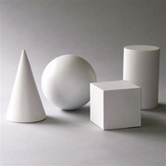
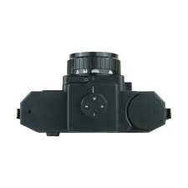
Simple Stereo Setup
Assume parallel optical axes
Two cameras are calibrated
Find relative depth
Key Idea: difference in corresponding points to understand shape
Slide credit: Noah Snavely

Slide 36
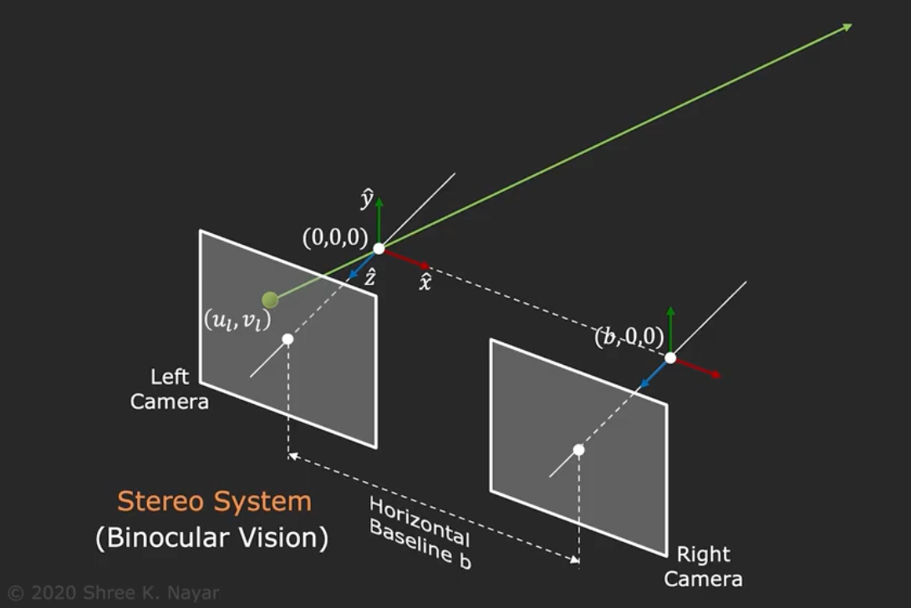
Triangulation using two cameras
Notes:
Left and right camera are identical

Slide 37
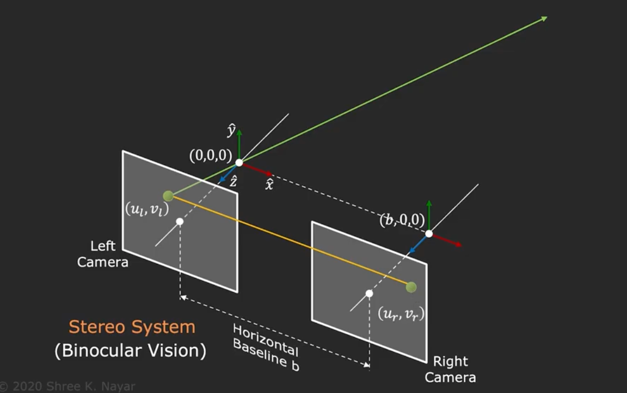
Triangulation using two cameras
Notes:
Left and right camera are identical

Slide 38
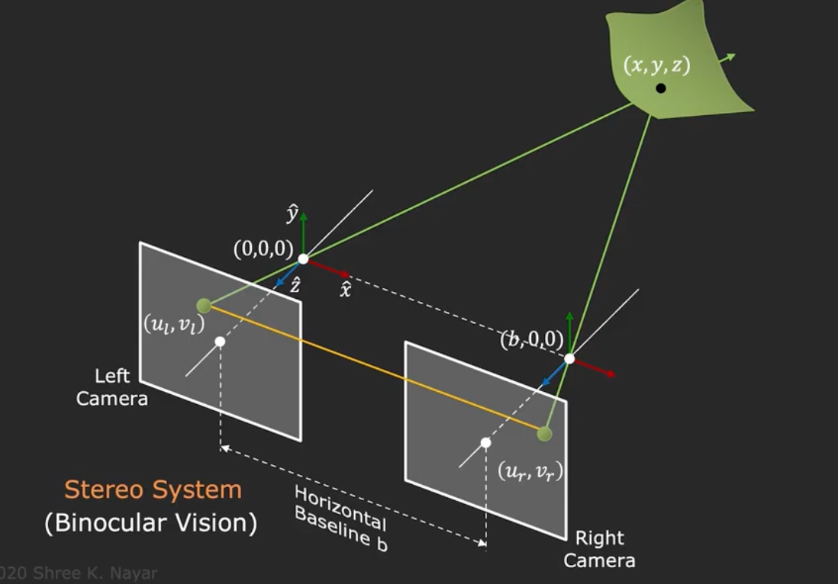
Triangulation using two cameras
Notes:
Left and right camera are identical

Slide 39
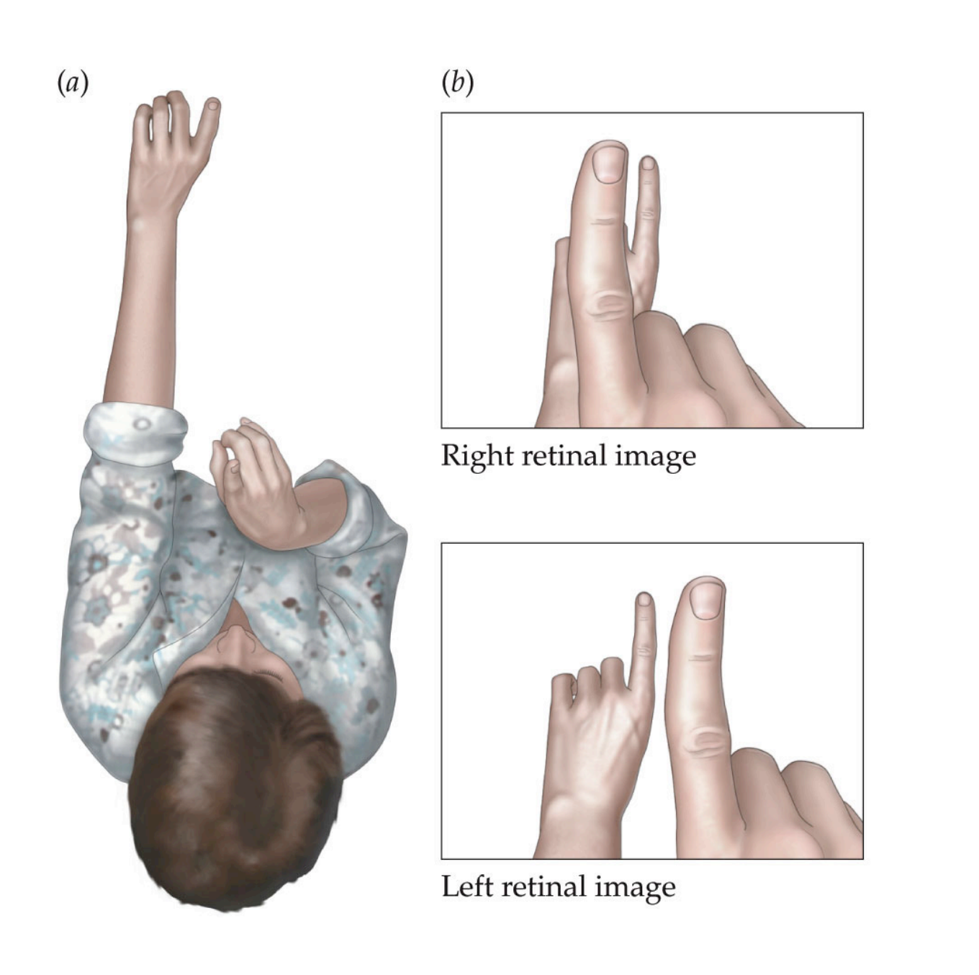
We are equipped with binocular vision. Let’s try!

Slide 40

Solving for Depth in Simple Stereo
X
Do we have enough to know what is Z?
Yes, similar triangles!
u_{l}
z?
u_{r}
f
disparity
(how much corrsp. pixels move)
B
Base of :
in image coordinates:
Notes:
dx = B(x_l

Slide 41
Try with your hands!
Notes:
the finger further away moves less than the closer finger why?

Slide 42
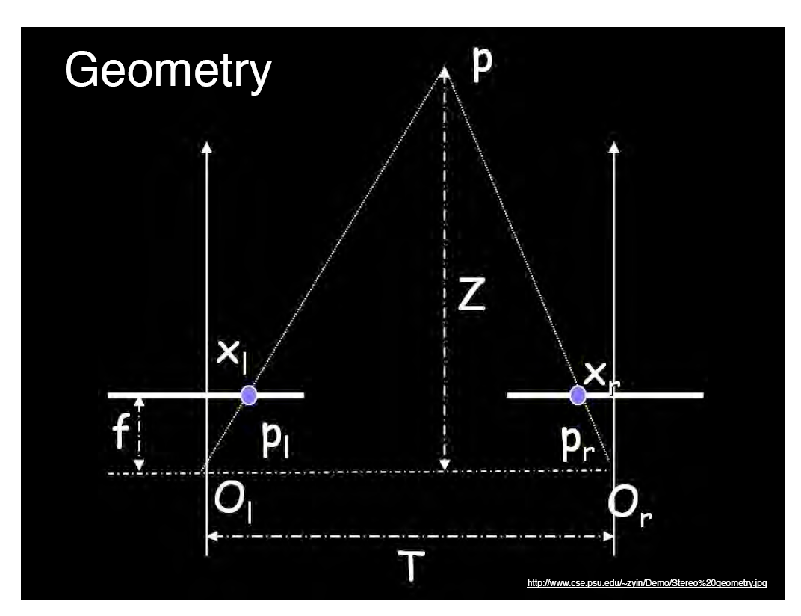
Geometry for a simple stereo system
Assume parallel optical axes, known camera parameters (i.e., calibrated cameras).
Use similar triangles (p_{l}, P, p_{r}) and (O_{l}, P, O_{r}):
want Z
disparity
Grauman
Notes:
42

Slide 43

Depth is inversely proportional to disparity
$$∞$$
0
disparity
depth
disparity
0
Max disparity
what is the disparity of the closer point?
what is the disparity of the far away point?
Disparity gives you the depth information!
Notes:
larger disparity = lower depth

Slide 44
Try again
Setup so your fingers are on the same line of sight from one eye
Now look in the other eye
They move!
Relative displacement is higher as the relative distance grows
== Parallax

Slide 45
A
C
B

Slide 46
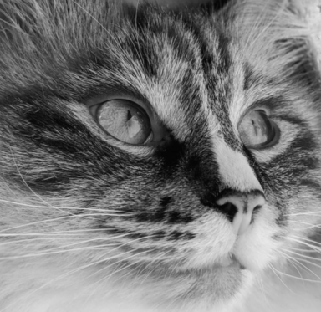
50 cm
optical center
5 px
f = 10 mm

Slide 47

Parallax
parallax!
Parallax = from ancient Greek parállaxis
= Para (side by side) + allássō, (to alter)
= Change in position from different view point
Two eyes give you parallax, you can also move to see more parallax = “Motion Parallax”
Notes:
para = side by side
allassein (vary / change)

Slide 48
Why you need translation to see parallax i.e. relative depth

Slide 49
Why you need translation to see parallax i.e. relative depth
Notes:
Try again by making the fingers overlap for a single eye, then look in the other eye
Bottom line, you need more than 1 view is important!!

Slide 50
Bottom line
Disparity (how much points move in two images ) gives depth
Parallax reveals relative depth difference
$$∞$$
0
disparity
depth
disparity
0
Max disparity

Slide 51
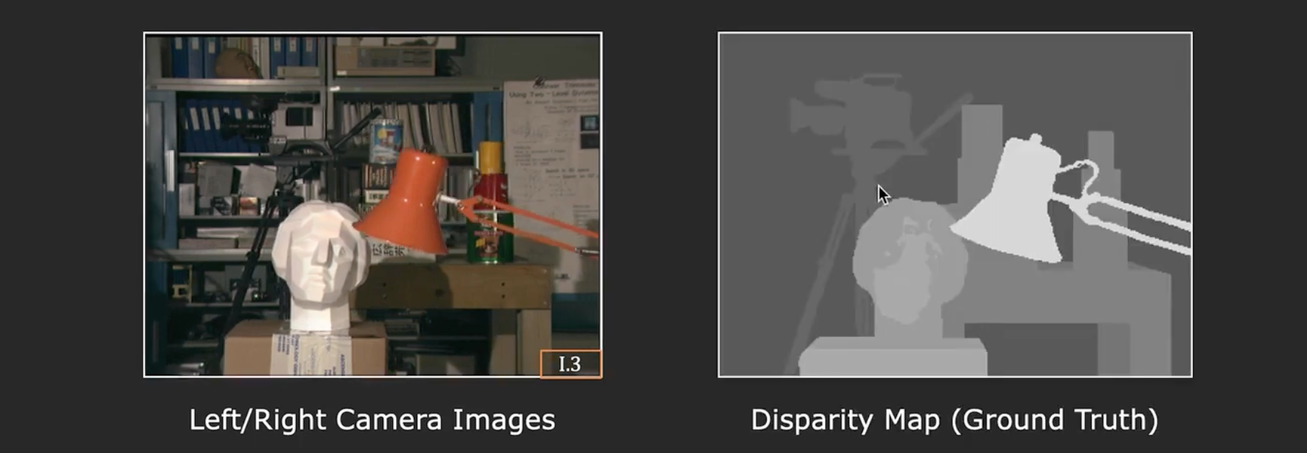
So how do we get depth?
of corresponding points!
Find the disparity!
Called: Stereo Matching

Slide 52
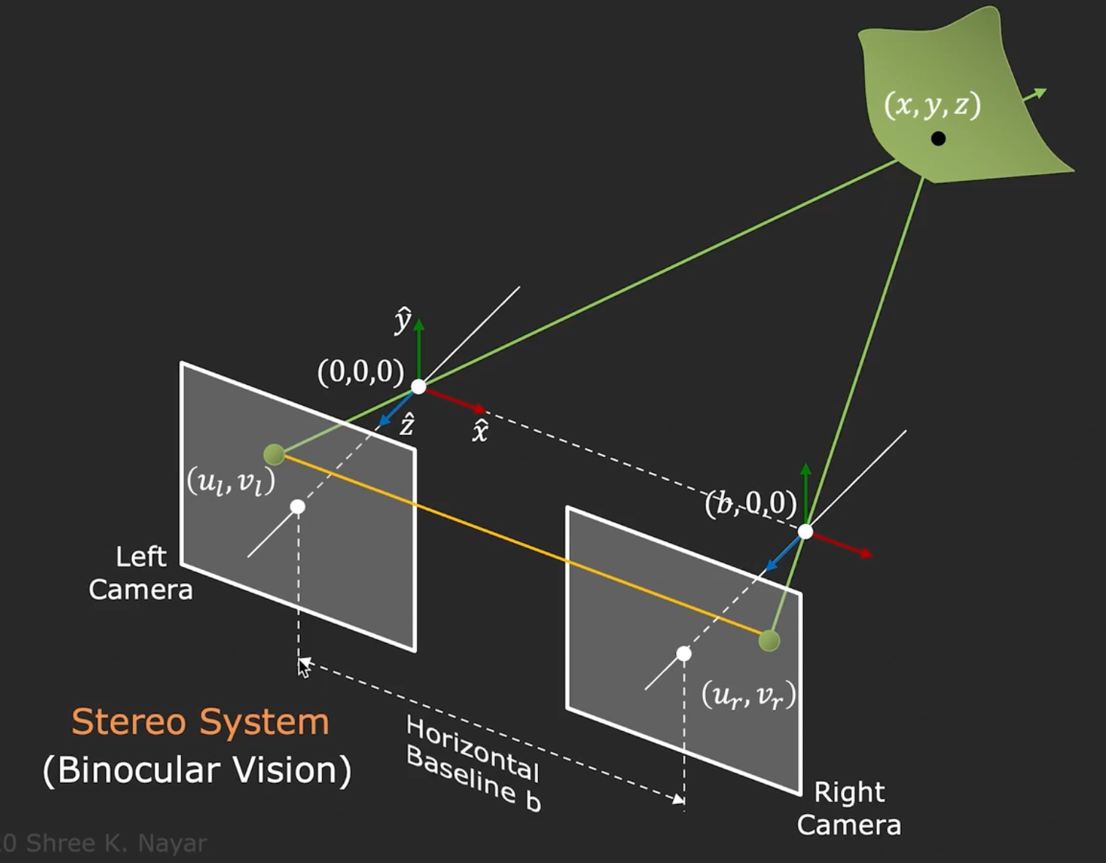
Where is the corresponding point going to be?
Hint

Slide 53

Epipolar Line
epipolar lines
(x₁, y₁)
(x₂, y₁)
Two images captured by a purely horizontal translating camera
(rectified stereo pair)
x₁ –x₂ = the disparity of pixel (x₁, y₁)

Slide 54
Your basic stereo algorithm
For every epipolar line:
For each pixel in the left image
    compare with every pixel on same epipolar line in right image
    pick pixel with minimum match cost
Improvement: match windows, + clearly lots of matching strategies
Slide credit: Noah Snavely

Slide 55
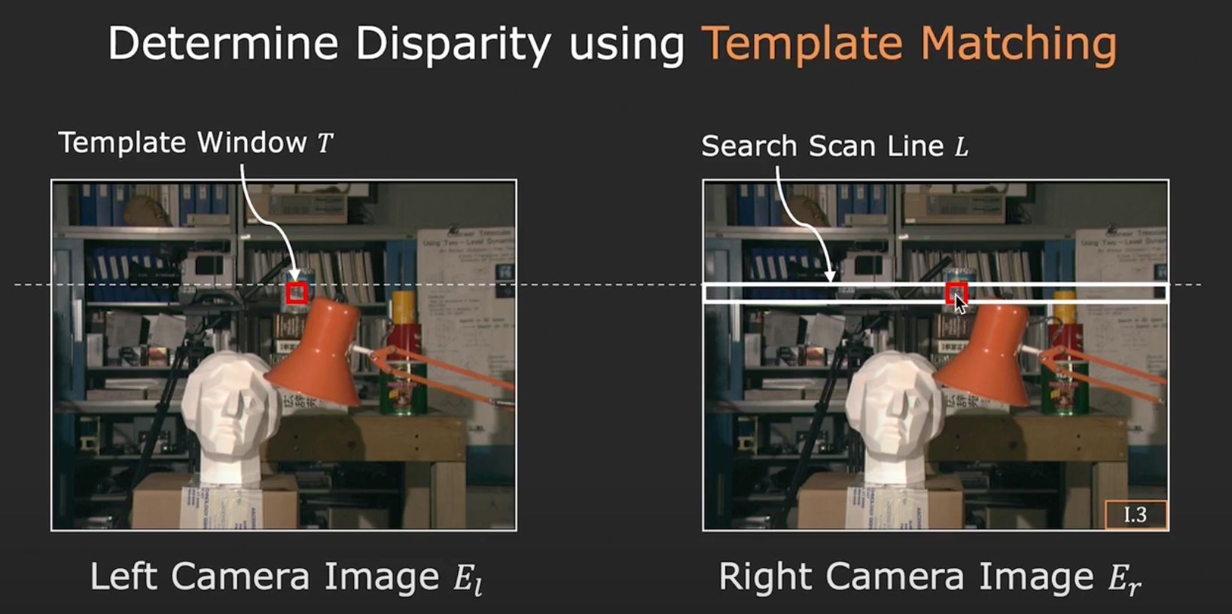
Your basic stereo algorithm

Slide 56
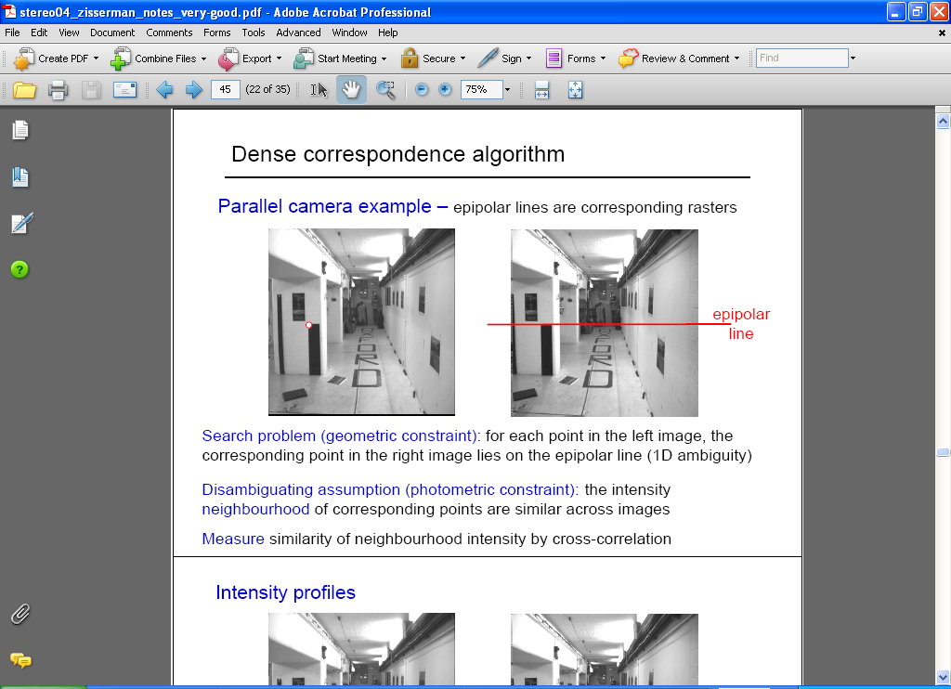
Correspondence problem
Source: Andrew Zisserman

Slide 57
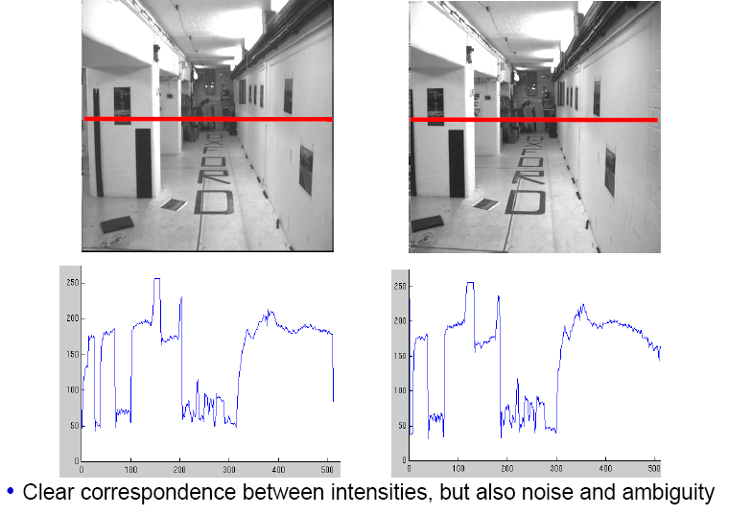
Intensity profiles
Source: Andrew Zisserman

Slide 58
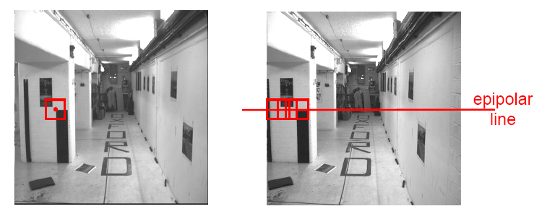
Correspondence problem
Neighborhood of corresponding points are similar in intensity patterns.
Source: Andrew Zisserman

Slide 59
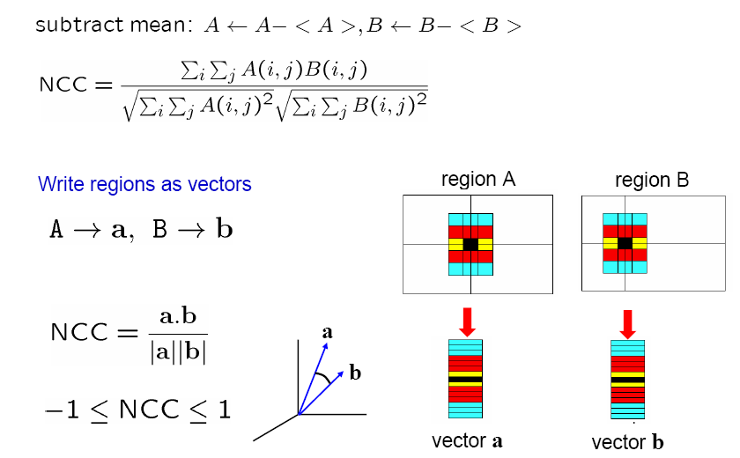
Normalized cross correlation
Similar to MOPS descriptor computation
Source: Andrew Zisserman

Slide 60
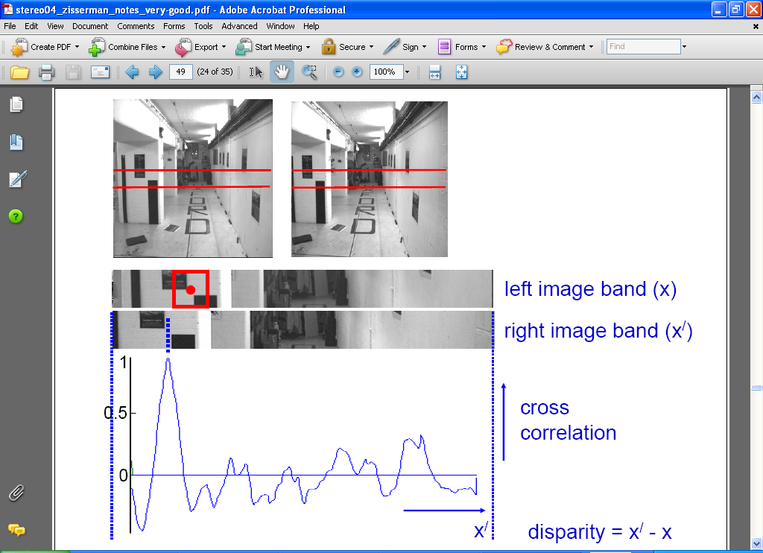
Correlation-based window matching
Source: Andrew Zisserman

Slide 61
Dense correspondence search
For each epipolar line
For each pixel / window in the left image
    compare with every pixel / window on same epipolar line in right image
    pick position with minimum match cost (e.g., SSD, correlation)
Adapted from Li Zhang
Grauman
Notes:
61

Slide 62
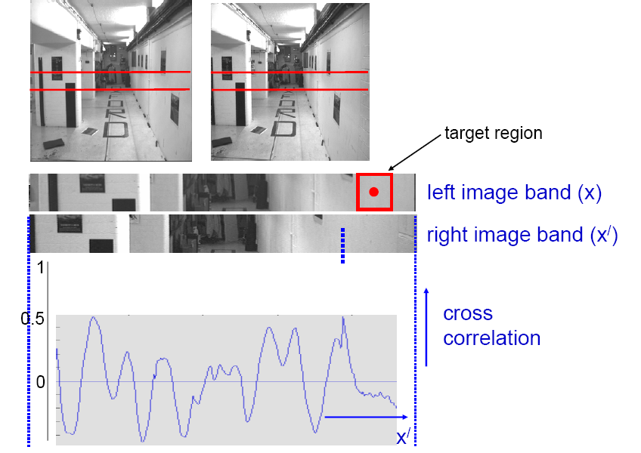
Textureless regions
Textureless regions are non-distinct; high ambiguity for matches.
Source: Andrew Zisserman
Grauman

Slide 63
Effect of window size
Source: Andrew Zisserman
Grauman
Notes:
Have to pick a window size, can’t do it at a pixel. But window ➔ area in the scene, projected area will be different from two views

Slide 64


Effect of window size
W = 3
W = 20
Want window large enough to have sufficient intensity variation, yet small enough to contain only pixels with about the same disparity.
Figures from Li Zhang
Grauman

Slide 65


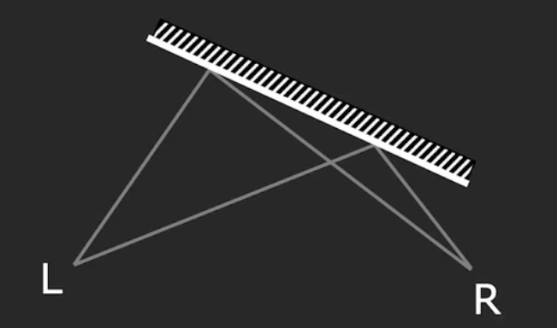
Issues with Stereo
Surface must have non-repetitive texture
Foreshortening effect makes matching a challenge
Slide Credit: Shree Nayar
Notes:
Projected area is smaller → causes distortion

Slide 66


Stereo Results
  Data from University of Tsukuba
Scene
Ground truth

Slide 67


Results with Window Search
Window-based matching
(best window size)
Ground truth

Slide 68

Better methods exist...
Energy Minimization
  Boykov et al., Fast Approximate Energy Minimization via Graph Cuts,
  International Conference on Computer Vision, September 1999.
Ground truth

Slide 69
Summary
With a simple stereo system, how much pixels move, or “disparity” give information about the depth
Correspondences to measure the pixel disparity

Slide 70
Many problems in 3D
3D Points
(Structure)
Correspondences
Camera
(Motion)
Notes:
You have to start from something, always. It’s chicken and egg if you don’t know anything
What was this problem called?
3D points + Correspondences ➔ Camera
Camera ➔ Correspondences
Correspondences + Camera ➔ 3D points

Slide 71
Camera Calibration
KNOWN
3D Points
(Structure)
Correspondences
Camera
(Motion)
UNKNOWN
KNOWN
Notes:
You have to start from something, always. It’s chicken and egg if you don’t know anything
What was this problem called?
3D points + Correspondences ➔ Camera
Camera ➔ Correspondences
Correspondences + Camera ➔ 3D points

Slide 72
Stereo (w/2 cameras);
Multi-view Stereo
UNKNOWN
3D Points
(Structure)
Correspondences
Camera
(Motion)
KNOWN
(Estimated)
Notes:
You have to start from something, always. It’s chicken and egg if you don’t know anything
What was this problem called?
3D points + Correspondences ➔ Camera
Camera ➔ Correspondences
Correspondences + Camera ➔ 3D points

Slide 73
Camera helps Correspondence:
Epipolar Geometry
3D Points
(Structure)
Correspondences
Camera
(Motion)
Relationship
Notes:
You have to start from something, always. It’s chicken and egg if you don’t know anything
What was this problem called?
3D points + Correspondences ➔ Camera
Camera ➔ Correspondences
Correspondences + Camera ➔ 3D points

Slide 74
Correspondence gives camera:
Epipolar Geometry
3D Points
(Structure)
Correspondences
Camera
(Motion)
Relationship
Notes:
You have to start from something, always. It’s chicken and egg if you don’t know anything
What was this problem called?
3D points + Correspondences ➔ Camera
Camera ➔ Correspondences
Correspondences + Camera ➔ 3D points

Slide 75
(Next lecture) Ultimate:
Structure-from-Motion/SLAM
UNKNOWN
3D Points
(Structure)
Correspondences
Camera
(Motion)
ESTIMATED
UNKNOWN
The starting point for all problems where you can’t calibrate actively
Notes:
You have to start from something, always. It’s chicken and egg if you don’t know anything
What was this problem called?
3D points + Correspondences ➔ Camera
Camera ➔ Correspondences
Correspondences + Camera ➔ 3D points

Slide 76
New: Neural Rendering
UNKNOWN
3D Representation
(Structure)
Correspondences
Camera
(Motion)
KNOWN
A form of multi-view stereo, more on this in the NeRF lecture.
Notes:
You have to start from something, always. It’s chicken and egg if you don’t know anything
What was this problem called?
3D points + Correspondences ➔ Camera
Camera ➔ Correspondences
Correspondences + Camera ➔ 3D points

Slide 77
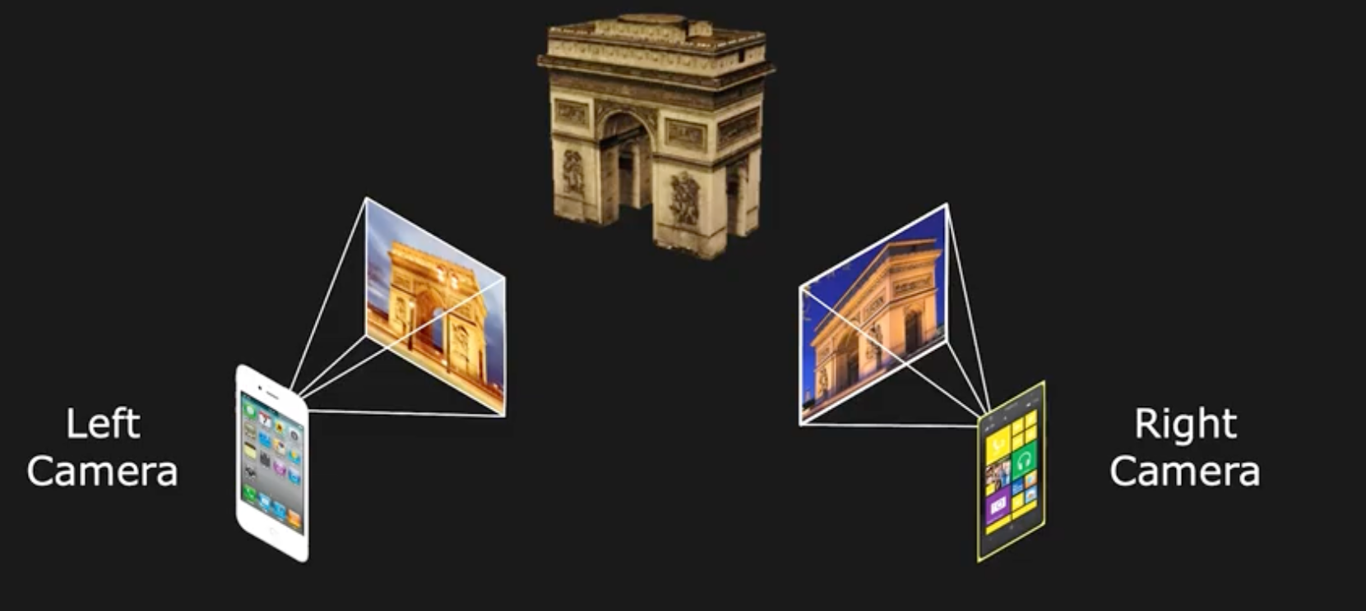
Next: Uncalibrated Stereo
From two arbitrary views
Assume intrinsics are known (fx, fy, ox, oy)
Slide Credit: Shree Nayar

Slide 78
General case, with calibrated cameras
The two cameras need not have parallel optical axes.

Slide 79
Option 1: Rectify via homography
reproject image planes onto a common plane
  plane parallel to the line between optical centers
pixel motion is horizontal after this transformation
two homographies, one for each input image reprojection
  C. Loop and Z. Zhang. Computing Rectifying Homographies for Stereo Vision. CVPR 1999.
Slide courtesy of Noah Snavely

Slide 80
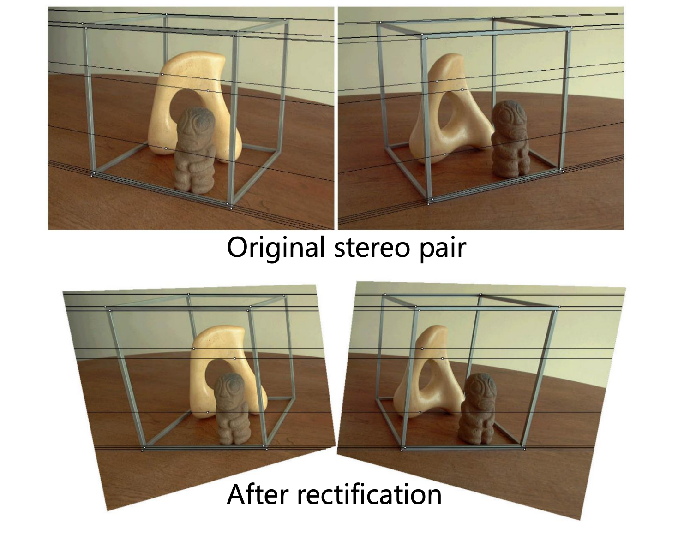
Option 1: Rectify via homography
Slide courtesy of Noah Snavely

Slide 81
Option 2
Solve for correspondences
Estimate camera
Triangulate

Slide 82
Option 2
Solve for correspondences
Estimate camera
  What is the relationship between the camera + correspondences?
Triangulate

Slide 83
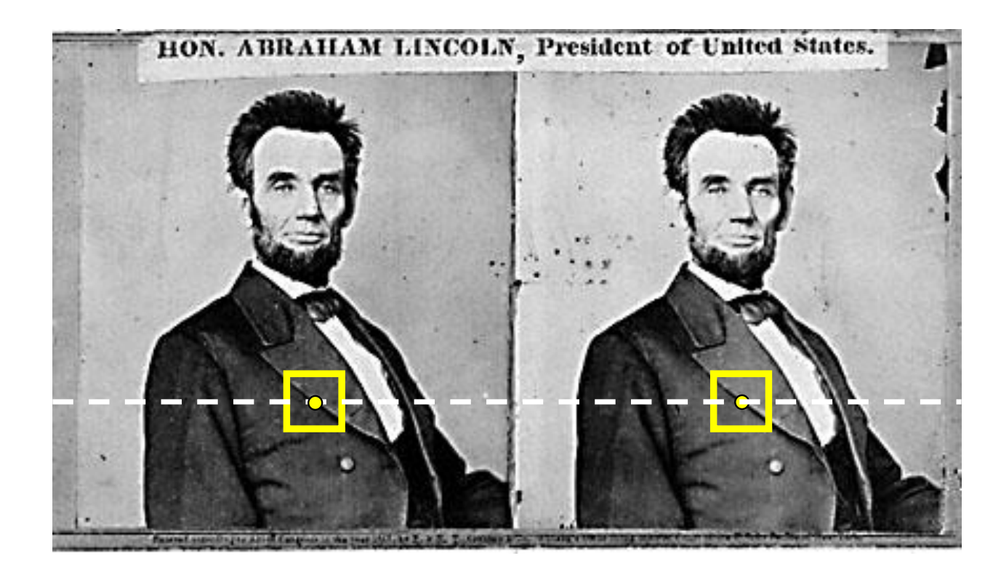
Where do epipolar lines come from?
Slide courtesy of Noah Snavely
Notes:
83

Slide 84
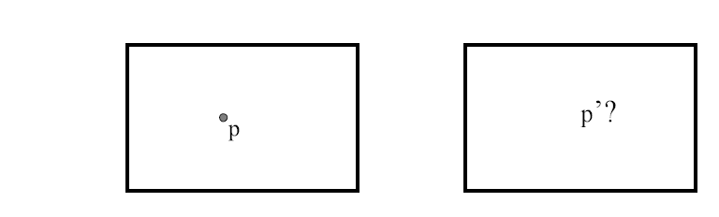
Stereo correspondence constraints
Given p in left image, where can corresponding point p’ be?

Slide 85
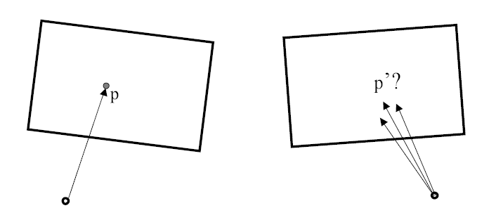
Stereo correspondence constraints
Given p in left image, where can corresponding point p’ be?

Slide 86
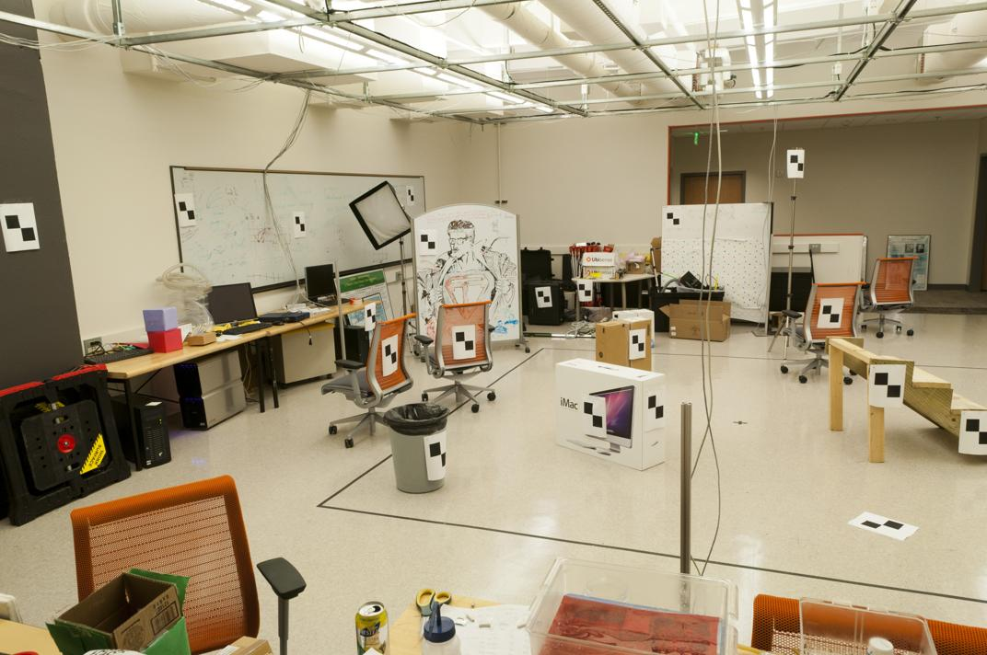
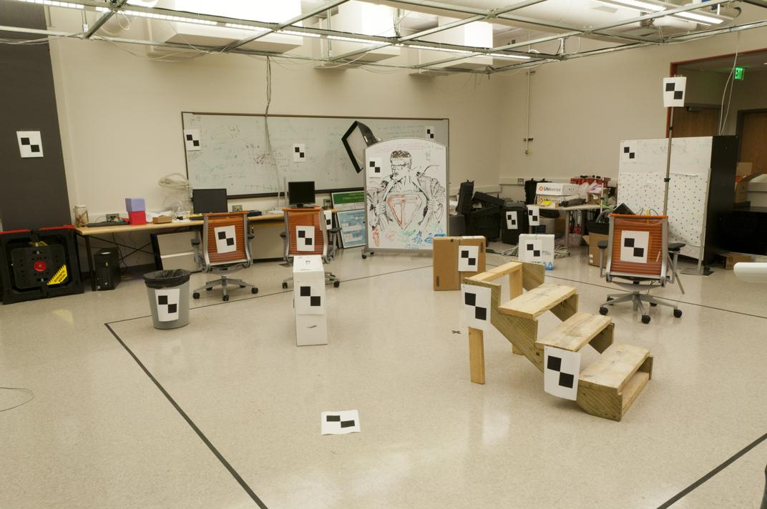
Where do we need to search?
Slide by James Hays

Slide 87
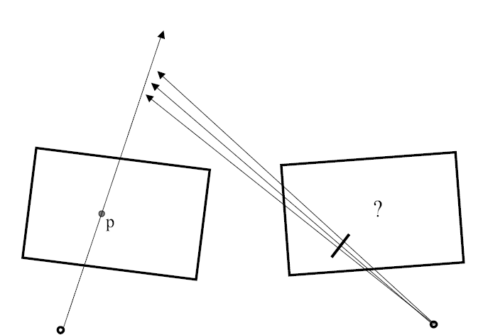
Stereo correspondence constraints

Slide 88
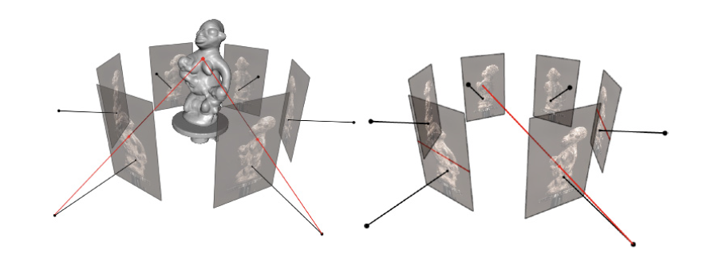
Epipolar Geometry
Figures by Carlos Hernandez

Slide 89
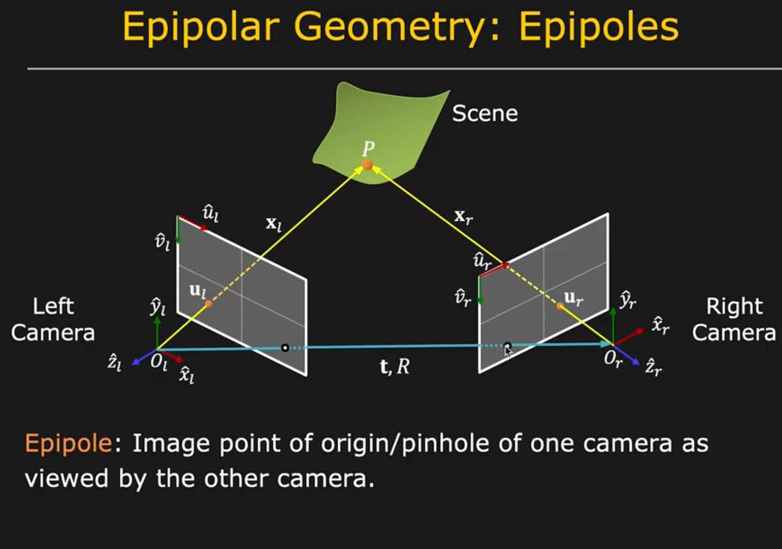

Slide 90
Stereo correspondence constraints
Geometry of two views allows us to constrain where the corresponding pixel for some image point in the first view must occur in the second view.
epipolar line
epipolar line
epipolar plane
Epipolar constraint: Why is this useful?
  Reduces correspondence problem to 1D search along conjugate epipolar lines
http://www.ai.sri.com/~luong/research/Meta3DViewer/EpipolarGeo.html
Adapted from Steve Seitz

Slide 91

Epipolar geometry
X
x
x’
Baseline – line connecting the two camera centers
Epipolar Plane – plane containing baseline (1D family)
Epipoles
= intersections of baseline with image planes
= projections of the other camera center
= vanishing points of the motion direction

Slide 92
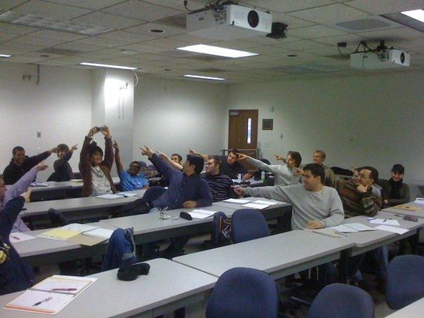
The Epipole
Photo by Frank Dellaert
Notes:
Where the students are pointing is the epipole!!! (there’s the other camera)

Slide 93
Epipolar geometry: terms
Baseline: line joining the camera centers
Epipole: point of intersection of baseline with the image plane
Epipolar plane: plane containing baseline and world point
Epipolar line: intersection of epipolar plane with the image plane
All epipolar lines intersect at the epipole
An epipolar plane intersects the left and right image planes in epipolar lines
Grauman

Slide 94

Epipolar constraint
Potential matches for p have to lie on the corresponding
epipolar line l’.
Potential matches for p’ have to lie on the corresponding
epipolar line l.
Source: M. Pollefeys
Notes:
94

Slide 95
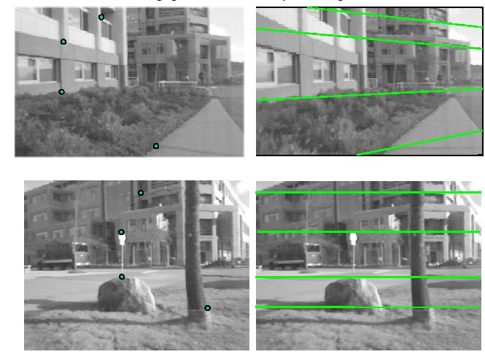
Example

Slide 96



Example: converging cameras
As position of 3d point varies, epipolar lines “rotate” about the baseline
Figure from Hartley & Zisserman
Notes:
96

Slide 97



Example: motion parallel with image plane
Figure from Hartley & Zisserman
Notes:
97

Slide 98
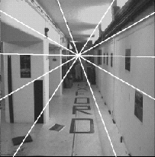
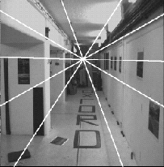
Example: forward motion
e’
e
Epipole has same coordinates in both images.
Points move along lines radiating from e: “Focus of expansion”
Figure from Hartley & Zisserman
Notes:
98

Slide 99
For a given stereo rig, how do we express the epipolar constraints algebraically?
For calibrated cameras, with Essential Matrix
For uncalibrated cameras, with Fundamental Matrix

Slide 100
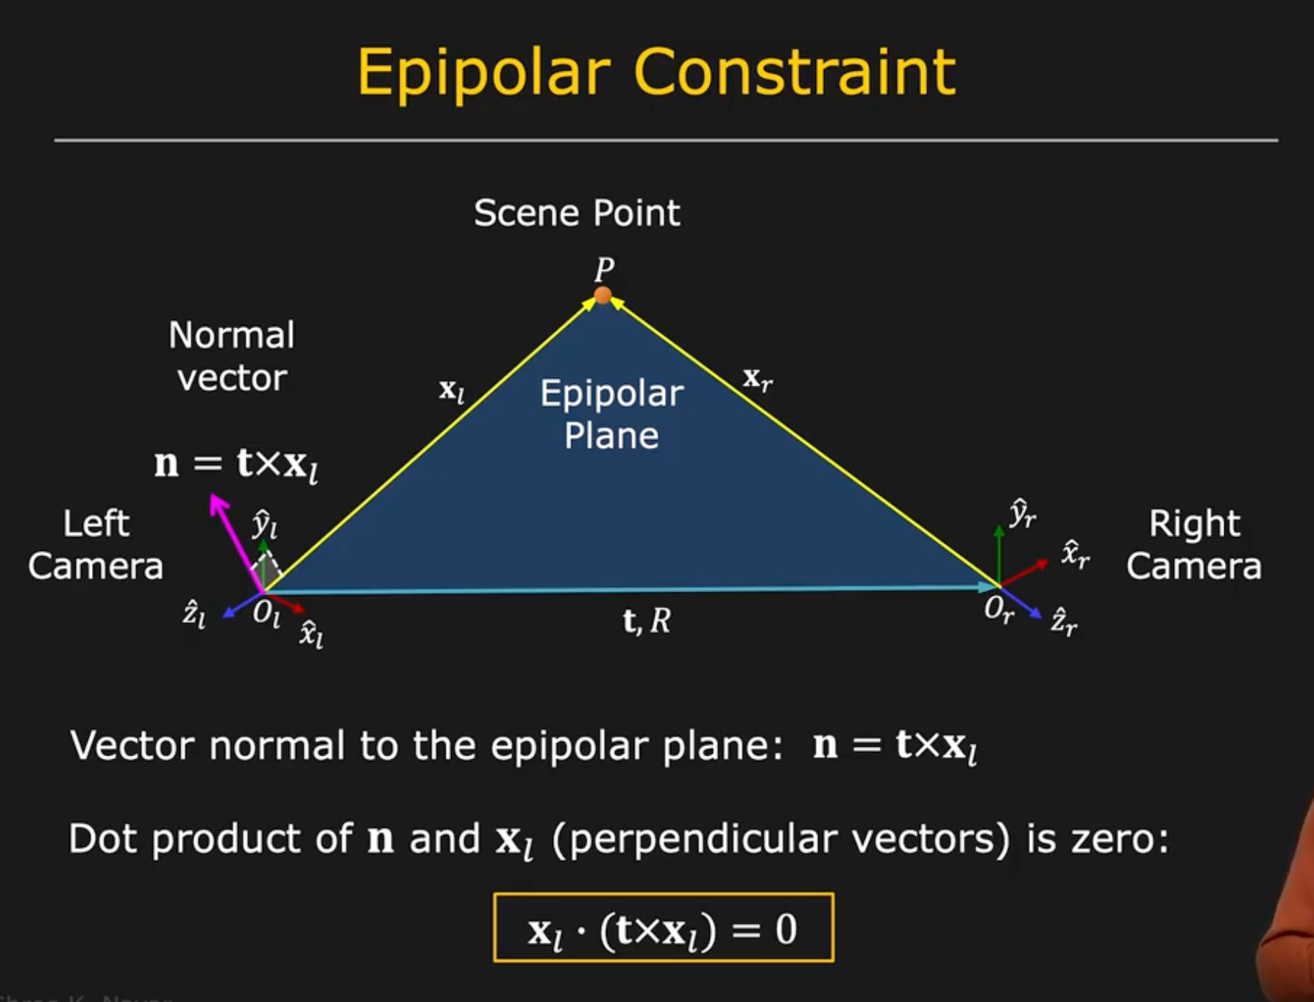
X
x
x’
Slide Credit: Shree Nayar
Notes:
T: is position of the right camera in left camera’s frame
R:orientation of left camera in right camera’s frame.
Then, expand x_l = R*x_r + t

Slide 101
Epipolar constraint: Calibrated case
X
= (x,1)^{T}
x
x’ = Rx+t
t
R
The vectors Rx, t, and x’ are coplanar
Notes:
X’ is X in the second camera’s coordinate system
We can identify the non-homogeneous 3D vectors X and X’ with the homogeneous coordinate vectors x and x’ of the projections of the two points into the two respective images

Slide 102
Epipolar constraint: Calibrated case
X
x
x’
Intrinsic and extrinsic parameters of the cameras are known, world coordinate system is set to that of the first camera
Then the projection matrices are given by K[I | 0] and K’[R | t]
We can multiply the projection matrices (and the image points) by the inverse of the calibration matrices to get normalized image coordinates:
Notes:
T: is position of the right camera in left camera’s frame
R:orientation of left camera in right camera’s frame.
Then, expand x_l = R*x_r + t

Slide 103
Epipolar constraint: Calibrated case
X
x
x’ = Rx+t
Recall:
The vectors Rx, t, and x’ are coplanar

Slide 104
Epipolar constraint: Calibrated case
X
x
x’ = Rx+t
Essential Matrix
(Longuet-Higgins, 1981)
The vectors Rx, t, and x’ are coplanar
Notes:
x
T is green, Rx + t is the point on the right
X’ (t_x Rx + t_x*t) = x’[t_xRx] = 0

Slide 105
Epipolar constraint: Calibrated case
X
x
x’
E x is the epipolar line associated with x (l' = E x)
  Recall: a line is given by ax + by + c = 0 or

Slide 106
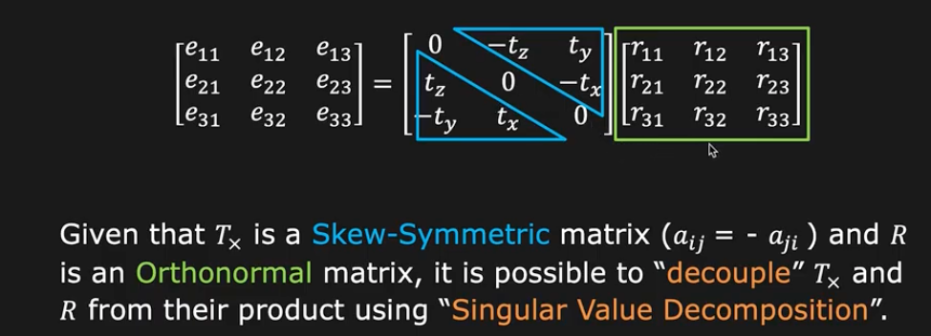
Essential matrix can be decomposed
E = T_{x}R
If we know E, we can recover t and R

Slide 107
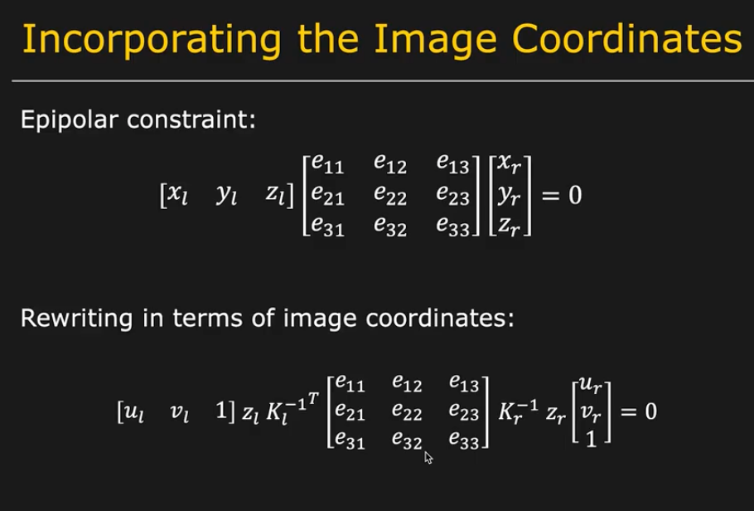
Finding E: But we know the image coord
z’s are still unknown! (they are > 0 and !=0)
But this whole equation goes to 0 so we can skip it

Slide 108
Epipolar constraint: Calibrated case
X
x
x’
E x is the epipolar line associated with x (l' = E x)
E^{T}x' is the epipolar line associated with x' (l = E^{T}x')
E e = 0 and E^{T}e' = 0
E is singular (rank two)
E has five degrees of freedom
Notes:
why 5? R + T = > 6 DoF, with the projective scale ambiguity -> 5
Rank 2 → 2D plane gets mapped to a single line in the other image. (Also skew symm is rank2)

Slide 109
Epipolar constraint: Uncalibrated case
X
x
x’
The calibration matrices K and K’ of the two cameras are unknown
We can write the epipolar constraint in terms of unknown normalized coordinates:

Slide 110
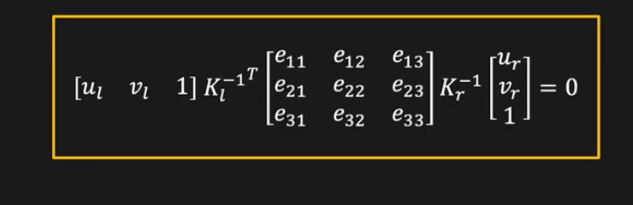
Epipolar constraint: Uncalibrated case
X
x
x’
Fundamental Matrix
(Faugeras and Luong, 1992)
Notes:
F is 3 x 3 = 9 total, but 8 bc of ambiguity, -1 because rank 2..

Slide 111
Epipolar constraint: Uncalibrated case
X
x
x’
F x is the epipolar line associated with x (l' = F x)
F^{T}x' is the epipolar line associated with x' (l = F^{T}x')
F e = 0 and F^{T}e' = 0
F is singular (rank two)
F has seven degrees of freedom
Notes:
F is 3 x 3 = 9 total, but 8 bc of ambiguity, -1 because rank 2..

Slide 112
Recall the homography
Homography Matrix: 3x3
Fundamental Matrix is also 3x3.
Homography is a special case of the Fundamental matrix, for planar scenes

Slide 113
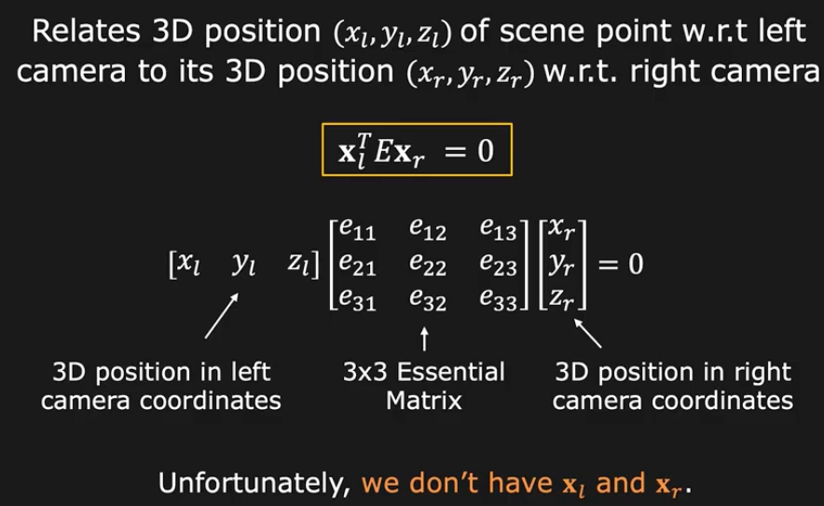
How do we find E or F?
But we know the image coordinates!
z’s are still unknown, but they are > 0 and !=0

Slide 114
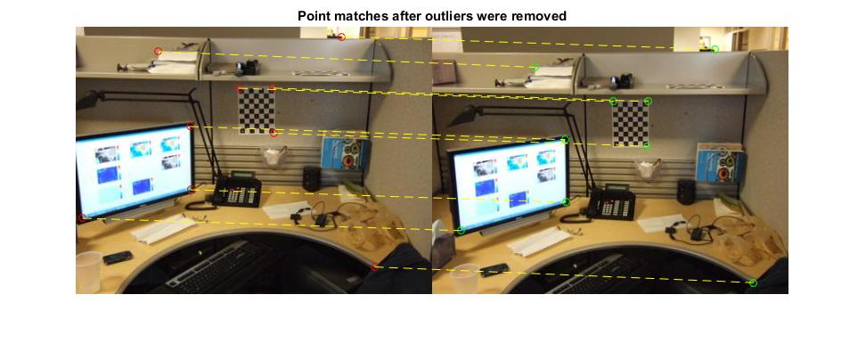
Estimating the fundamental matrix

Slide 115

The eight-point algorithm
Solve homogeneous linear system using eight or more matches
Enforce rank-2 constraint (take SVD
of F and throw out the smallest singular value)

Slide 116
Problem with eight-point algorithm

Slide 117

Problem with eight-point algorithm
Poor numerical conditioning
Can be fixed by rescaling the data

Slide 118
The normalized eight-point algorithm
(Hartley, 1995)
Center the image data at the origin, and scale it so the mean squared distance between the origin and the data points is 2 pixels
Use the eight-point algorithm to compute F from the normalized points
Enforce the rank-2 constraint (for example, take SVD of F and throw out the smallest singular value)
Transform fundamental matrix back to original units: if T and T’ are the normalizing transformations in the two images, than the fundamental matrix in original coordinates is T’^{T} F T

Slide 119

The Bible by Hartley & Zisserman

Slide 120

The Fundamental Matrix Song
http://danielwedge.com/fmatrix/
https://www.youtube.com/watch?time_continue=8&v=DgGV3l82NTk&feature=emb_title

Slide 121
Option 2: Depth from arbitrary two cameras
Solve for correspondences
Estimate camera
  What is the relationship between the camera + correspondences? → Epipolar geometry!
Triangulate

Slide 122

Finally: computing depth by triangulation
Now we know about the camera, K₁, K₂ and [R t]:
Substitute in terms of
Then solve for with least squares!
Notes:
In general you solve for the 3D point all together, because although the only thing you should need is the depth of a single point, in practice due to noise it may not exactly lie on the ray

Slide 123
The Bible by Hartley & Zisserman

Slide 124
What we just did for stereo
Rectified stereo → use similar triangles to solve for per-pixel disparity, which gives you depth
  Difference between calibrated + uncalibrated case?
General Stereo: First calibrate cameras from correspondences
by solving for Essential or Fundamental matrices
Then triangulate corresponding points to get the depth.

Slide 125
What about more than two views?
The geometry of three views is described by a 3 x 3 x 3 tensor called the trifocal tensor
The geometry of four views is described by a 3 x 3 x 3 x 3 tensor called the quadrifocal tensor
After this it starts to get complicated…
Slide courtesy of Noah Snavely

Slide 126

Large-scale structure from motion
Dubrovnik, Croatia. 4,619 images (out of an initial 57,845).
Total reconstruction time: 23 hours
Number of cores: 352
Building Rome in a Day, Agarwal et al. ICCV 2009
Slide courtesy of Noah Snavely

Slide 127
Large-scale structure from motion
Result using COLMAP: Schönberger et al. CVPR ’16

