Slide 1
CS 182
Sections 103 - 104
Leon Barrett
with acknowledgements to Eva Mok and Joe Makin
April 4, 2007

Slide 2
The Last Stretch
Psycholinguistics Experiments
Spatial Relation
Motor Control
Metaphor
Grammar
Cognition and Language
Computation
Chang Model
Bailey Model
Narayanan Model
Structured Connectionism
abstraction
Neural Net & Learning
Regier Model
SHRUTI
Computational Neurobiology
Triangle Nodes
Visual System
Biology
Neural Development
Quiz
Midterm
Finals

Slide 3
Homework
A6 (model merging) is due next Tuesday
A7 (metaphor) is due next Thursday
Any homework questions?

Slide 4
Questions
Is there experimental evidence for metaphorical thinking?
What is tense?
What is aspect?
How does an X-Net relate to aspect?
How can you diagram tense?
How do aspect and tense interact?

Slide 5
Metaphor
There are LOTS of metaphors we use
  Power is size
  Knowing is seeing
  Event structure is motion

Slide 6
Event Structure Metaphor
States are Locations
Changes are Movements
Causes are Forces
Causation is Forced Movement
Actions are Self-propelled Movements
Purposes are Destinations
Means are Paths
Difficulties are Impediments to Motion
External Events are Large, Moving Objects
Long-term, Purposeful Activities are Journeys

Slide 7
Metaphor
Is there evidence that people use metaphor to think?
  If so, what?

Slide 8
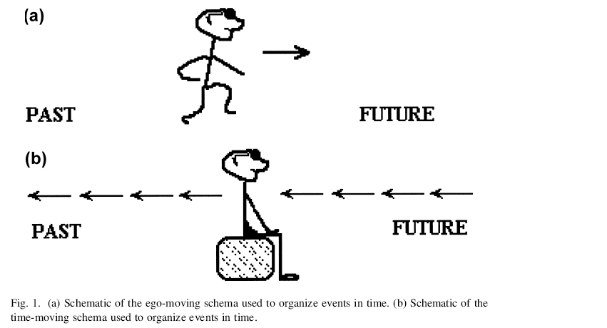
Ego Moving versus Time Moving

Slide 9
Ego Moving and Object Moving Spatial Primes

Slide 10
Do people use Spatial Metaphors for time?
Participants answered several priming questions about spatial relations of objects in pictures.
  Ego-moving or object moving
Then, participants interpreted an ambiguous temporal statement such as `Next Wednesday's meeting has been moved forward two days'.
If the above statement is interpreted using the ego-moving schema, then forward is in the direction of motion of the observer, and the meeting should now fall on a Friday.
In the time-moving interpretation, however, forward is in the direction of motion of time, and the meeting should now be on a Monday.

Slide 11
Hypothesis
If space and time do share some relational structure, then participants primed in the ego-moving spatial perspective should thus think that the meeting will be on Friday.
Participants primed in the object-moving perspective should prefer the time-moving interpretation and think that the meeting will be on Monday.
However, if the domains of space and time do not share any relational structure, then spatial primes should have no effect on the way participants think about time.

Slide 12
Results
PRIME
Meeting is Monday
Meeting is Friday
Ego Moving
26.7%
73.3%
Object Moving
69.2%
30.8%

Slide 13
Tense
What is tense?
Time information
Present, Reference point, Event

Slide 14
He talked
E
S
R

Slide 15
He will talk
S
E
R

Slide 16
He will have talked
S
E
R

Slide 17
Aspect
What is aspect?
Aspect is different from tense in that it deals with the temporal structure of events
Viewpoints
  looking at the same event at different granularity
  He was walking / He has walked / He walks
Phases of Events
  stages of an event
  He is about to walk / He finished walking
Inherent Aspect
  perfective / imperfective (telic / atelic)
  He is walking / He is tapping his finger

Slide 18
Controller X-Schema
The controller x-schema is meant to capture the generic structure of events.
Aspect therefore marks (or profiles) certain states or transitions.
suspended
interrupt
resume
start
finish
ready
ongoing
done
abort
iterate
cancelled

Slide 19
The car is on the verge of falling into the ditch.
suspended
interrupt
resume
start
finish
ready
ongoing
done
abort
iterate
cancelled
FALL

Slide 20
He stumbled on the uneven road.
suspended
interrupt
resume
start
finish
ready
ongoing
done
abort
iterate
cancelled
WALK

Slide 21
She cancelled her trip to Paris.
suspended
interrupt
resume
start
finish
ready
ongoing
done
abort
iterate
cancelled
TRAVEL

Slide 22
X-Schema Embedding
You can ‘blow up’ any state or transition into a lower level x-schema, allowing embedding
suspended
interrupt
resume
ready
start
finish
ongoing
done
abort
iterate
cancelled
start
finish
done
ready
ongoing

Slide 23
He is concluding his talk.
suspended
interrupt
resume
start
finish
ready
ongoing
done
abort
iterate
cancelled
start
finish
done
ready
ongoing

Slide 24
They are getting ready to continue their journey across the desert.
suspended
interrupt
resume
start
finish
ready
ongoing
done
abort
iterate
cancelled
start
finish
done
ready
ongoing

Slide 25
She smokes. (habitual reading)
start
finish
ready
ongoing
done
suspended
interrupt
resume
start
finish
ready
ongoing
done
abort
iterate
cancelled

Slide 26
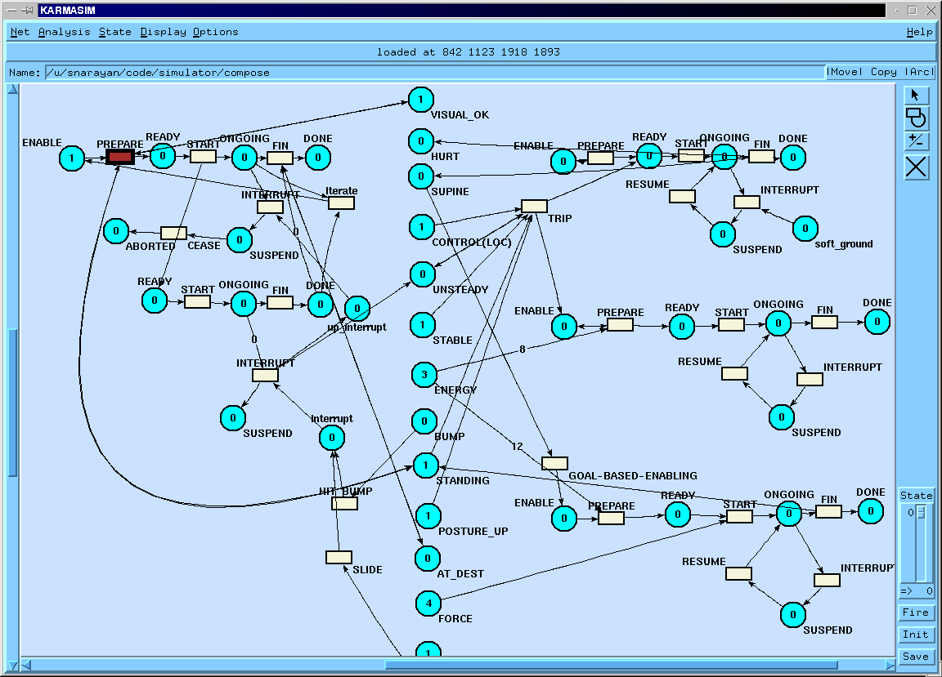

Slide 27
Mapping down to the time line
we can use Reichenbach’s system to map the controller X-schema down to a time line and get tenses
Speech Time (S)
Reference Time (R)
Event Time (E)
start
finish
done
ready
ongoing
E
R
S

Slide 28
He is talking
start
finish
done
ready
ongoing
S
E
R

Slide 29
He has talked
start
finish
done
ready
ongoing
E
S
R

Slide 30
He will have talked
start
finish
done
ready
ongoing
S
E
R

Slide 31
The Present Triumvirate
JAN RUNS
JAN IS RUNNING
R
S
P
F
R
S
P
F
D
r
r
i
S
i
S
C
C
R
S
P
F
r
i
S
C
R
S
P
F
r
i
S
C
JAN HAS BEEN RUNNING
R
S
P
F
D
r
i
S
C

