Slide 1
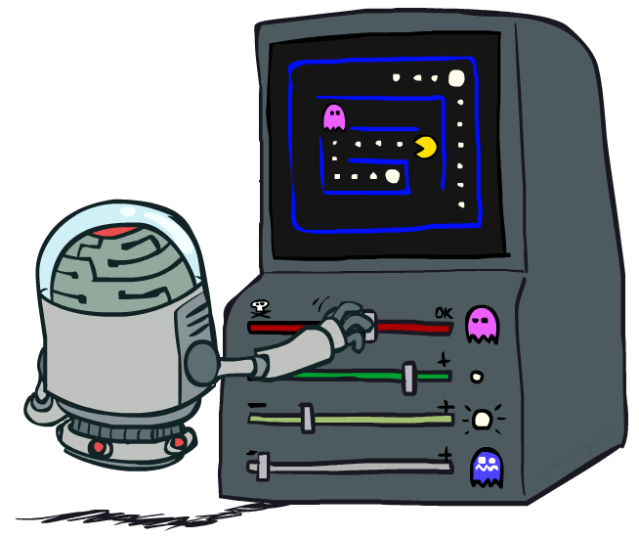
CS 188: Artificial Intelligence
Reinforcement Learning III
Instructor: Anca Dragan, University of California, Berkeley
[These slides were created by Dan Klein, Pieter Abbeel, and Anca Dragan. http://ai.berkeley.edu.]
Notes:
Please retain proper attribution and the reference to ai.berkeley.edu. Thanks!

Slide 2
Reinforcement Learning
We still assume an MDP:
A set of states s ∈ S
A set of actions (per state) A
A model T(s,a,s’)
A reward function R(s,a,s’)
Still looking for a policy π(s)
New twist: don’t know T or R, so must try out actions
Big idea: Compute all averages over T using sample outcomes

Slide 3
The Story So Far: MDPs and RL
Known MDP: Offline Solution
Goal Technique
Compute V*, Q*, π* Value / policy iteration
Evaluate a fixed policy π Policy evaluation
Unknown MDP: Model-Based
Unknown MDP: Model-Free
Goal Technique
Compute V*, Q*, π* VI/PI on approx. MDP
Evaluate a fixed policy π PE on approx. MDP
Goal Technique
Compute V*, Q*, π* Q-learning
Evaluate a fixed policy π Value Learning

Slide 4
Q-Learning
Q-Learning: sample-based Q-value iteration
Learn Q(s,a) values as you go
Receive a sample (s,a,s’,r)
Consider your old estimate:
Consider your new sample estimate:
Incorporate the new estimate into a running average:
no longer policy evaluation!
[Demo: Q-learning – gridworld (L10D2)]
[Demo: Q-learning – crawler (L10D3)]

Slide 5
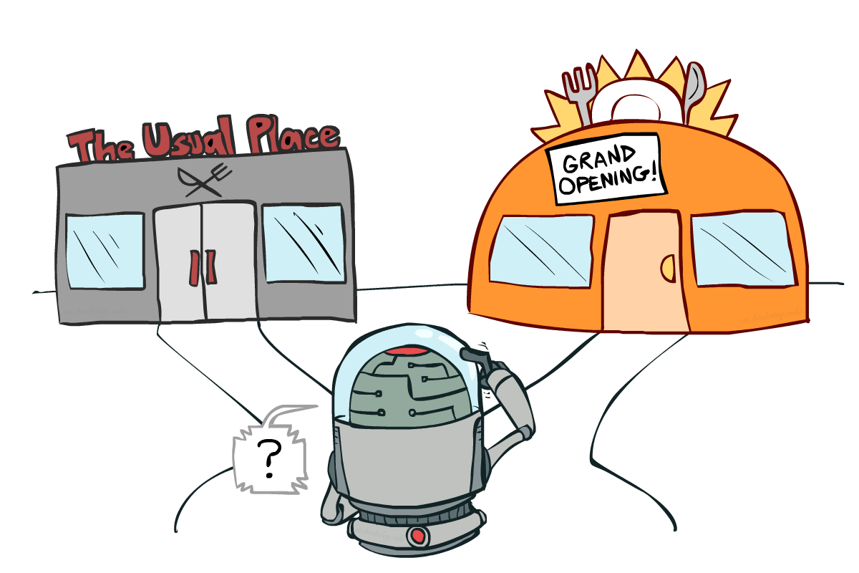
Exploration vs. Exploitation
Notes:
might be missing out on your favorite restaurant till end of time

Slide 6
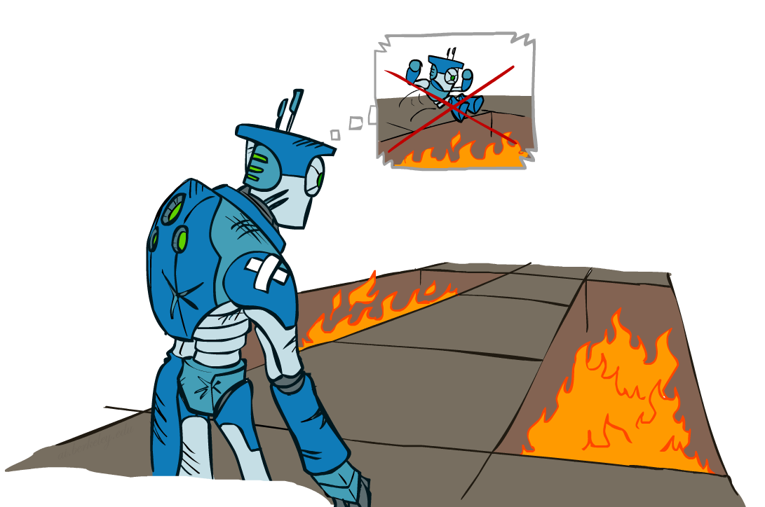
Regret
Even if you learn the optimal policy, you still make mistakes along the way!
Regret is a measure of your total mistake cost: the difference between your (expected) rewards, including youthful suboptimality, and optimal (expected) rewards
Minimizing regret goes beyond learning to be optimal – it requires optimally learning to be optimal
Example: random exploration and exploration functions both end up optimal, but random exploration has higher regret

Slide 7
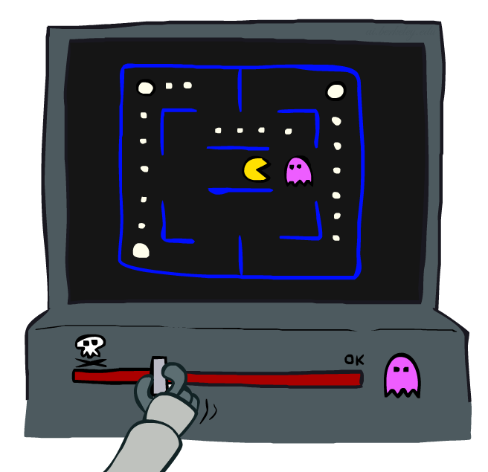
Approximate Q-Learning

Slide 8
Generalizing across States: Pacman
Let’s say we discover through experience that this state is bad:
In naïve q-learning, we know nothing about this state:
Or even this one!
[Demo: Q-learning – pacman – tiny – watch all (L11D5)]
[Demo: Q-learning – pacman – tiny – silent train (L11D6)]
[Demo: Q-learning – pacman – tricky – watch all (L11D7)]

Slide 9
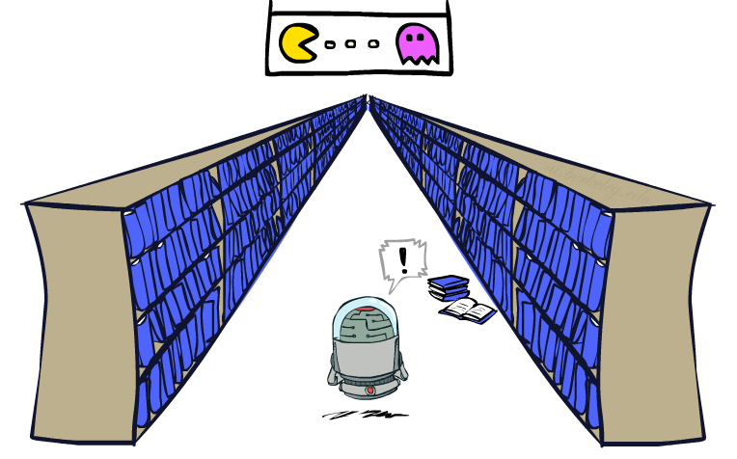
Generalizing Across States
Basic Q-Learning keeps a table of all q-values
In realistic situations, we cannot possibly learn about every single state!
Too many states to visit them all in training
Too many states to hold the q-tables in memory
Instead, we want to generalize:
Learn about some small number of training states from experience
Generalize that experience to new, similar situations
This is a fundamental idea in machine learning, and we’ll see it over and over again
[demo – RL pacman]

Slide 10
Video of Demo Q-Learning Pacman – Tiny – Watch All

Slide 11
Video of Demo Q-Learning Pacman – Tiny – Silent Train

Slide 12
Video of Demo Q-Learning Pacman – Tricky – Watch All

Slide 13
Feature-Based Representations
Solution: describe a state using a vector of features (properties)
Features are functions from states to real numbers (often 0/1) that capture important properties of the state
Example features:
Distance to closest ghost
Distance to closest dot
Number of ghosts
1 / (dist to dot)²
Is Pacman in a tunnel? (0/1)
…… etc.
Is it the exact state on this slide?
Can also describe a q-state (s, a) with features (e.g. action moves closer to food)

Slide 14
Linear Value Functions
Using a feature representation, we can write a q function (or value function) for any state using a few weights:
Advantage: our experience is summed up in a few powerful numbers
Disadvantage: states may share features but actually be very different in value!

Slide 15
Approximate Q-Learning
Q-learning with linear Q-functions:
Intuitive interpretation:
Adjust weights of active features
E.g., if something unexpectedly bad happens, blame the features that were on: disprefer all states with that state’s features
Formal justification: online least squares
Exact Q’s
Approximate Q’s

Slide 16
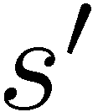
Example: Q-Pacman
[Demo: approximate Q-learning pacman (L11D10)]
Notes:
now when you run into ghosts you can figure out ghosts are bad; dots are good

Slide 17
Video of Demo Approximate Q-Learning -- Pacman

Slide 18
DeepMind Atari (©Two Minute Lectures) approximate Q-learning with neural nets

Slide 19
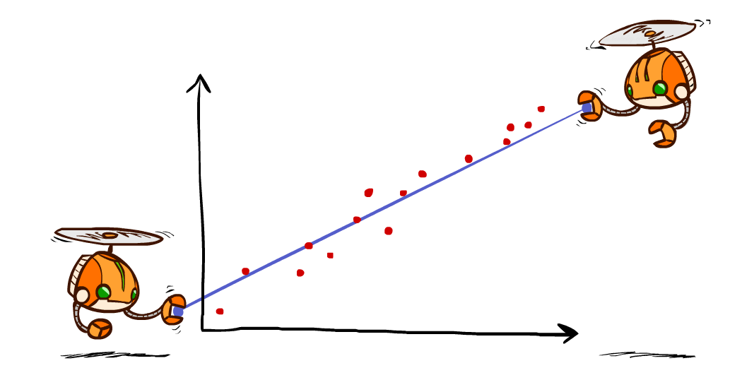
Q-Learning and Least Squares

Slide 20
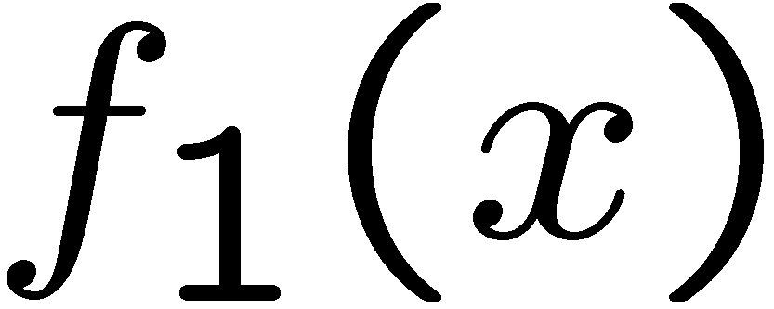
Linear Approximation: Regression
40
26
24
20
22
20
30
20
40
0
0
20
30
10
20
0
10
0
Prediction:
Prediction:
Notes:
Figure 1: scatter(1:20,10+(1:20)+2*randn(1,20),'k','filled'); a=axis; a(3)=0; axis(a);

Slide 21
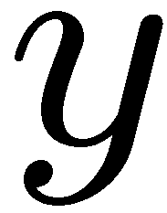
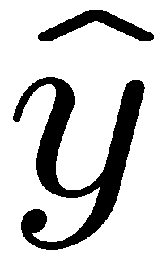
Optimization: Least Squares
Error or “residual”
Observation
Prediction
0
0
20
Notes:
Figure 1: scatter(1:20,10+(1:20)+2*randn(1,20),'k','filled'); a=axis; a(3)=0; axis(a);

Slide 22
Minimizing Error
Imagine we had only one point x, with features f(x), target value y, and weights w:
Approximate q update explained:
“target”
“prediction”

Slide 23
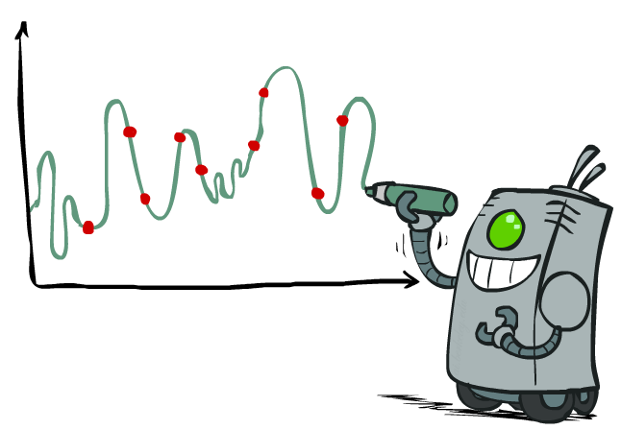
Overfitting: Why Limiting Capacity Can Help
30
25
20
Degree 15 polynomial
15
10
5
0
-5
-10
-15
0
2
4
6
8
10
12
14
16
18
20

Slide 24
Policy Search

Slide 25
Policy Search
Problem: often the feature-based policies that work well (win games, maximize utilities) aren’t the ones that approximate V / Q best
E.g. your value functions from project 2 were probably horrible estimates of future rewards, but they still produced good decisions
Q-learning’s priority: get Q-values close (modeling)
Action selection priority: get ordering of Q-values right (prediction)
We’ll see this distinction between modeling and prediction again later in the course
Solution: learn policies that maximize rewards, not the values that predict them
Policy search: start with an ok solution (e.g. Q-learning) then fine-tune by hill climbing on feature weights

Slide 26
Policy Search
Simplest policy search:
Start with an initial linear value function or Q-function
Nudge each feature weight up and down and see if your policy is better than before
Problems:
How do we tell the policy got better?
Need to run many sample episodes!
If there are a lot of features, this can be impractical
Better methods exploit lookahead structure, sample wisely, change multiple parameters…

Slide 27
example from Pieter Abbeel

Slide 28
MDPs and RL
Known MDP: Offline Solution
Goal Technique
Compute V*, Q*, π* Value / policy iteration
Evaluate a fixed policy π Policy evaluation
Unknown MDP: Model-Based
Unknown MDP: Model-Free
*use features
to generalize
*use features
to generalize
Goal Technique
Compute V*, Q*, π* VI/PI on approx. MDP
Evaluate a fixed policy π PE on approx. MDP
Goal Technique
Compute V*, Q*, π* Q-learning
Evaluate a fixed policy π Value Learning

Slide 29
Discussion: Model-Based vs Model-Free RL

Slide 30
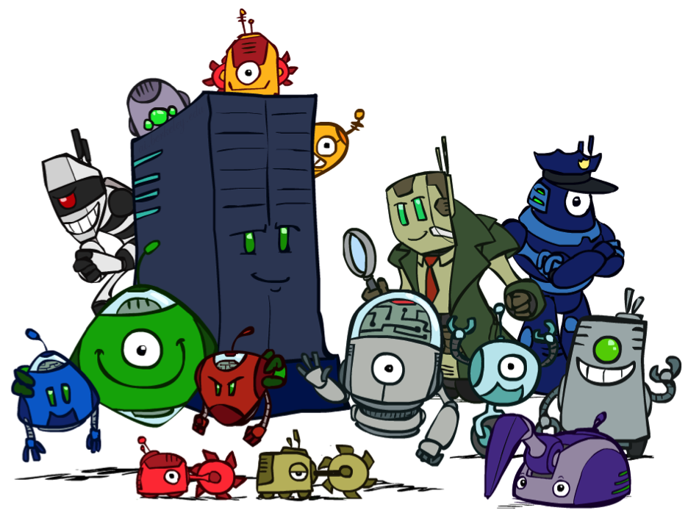
Conclusion
We’re done with Part I: Search and Planning!
We’ve seen how AI methods can solve problems in:
Search
Constraint Satisfaction Problems
Games
Markov Decision Problems
Reinforcement Learning
Next up: Part II: Uncertainty and Learning!

