Slide 1
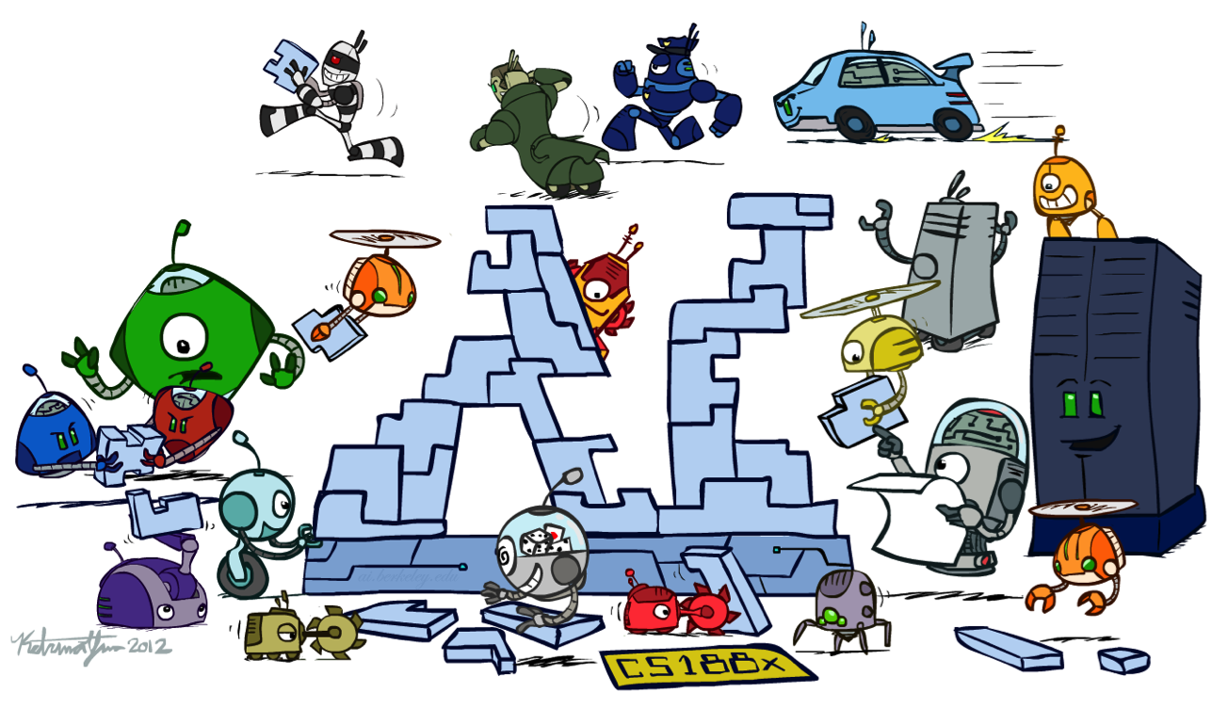
CS 188: Artificial Intelligence
Conclusion
Instructors: Anca Dragan and Pieter Abbeel --- University of California, Berkeley
These slides were created by Dan Klein, Pieter Abbeel, Anca Dragan for CS188 Intro to AI at UC Berkeley.
All CS188 materials are available at http://ai.berkeley.edu.
Notes:
Please retain proper attribution, including the reference to ai.berkeley.edu. Thanks!

Slide 2
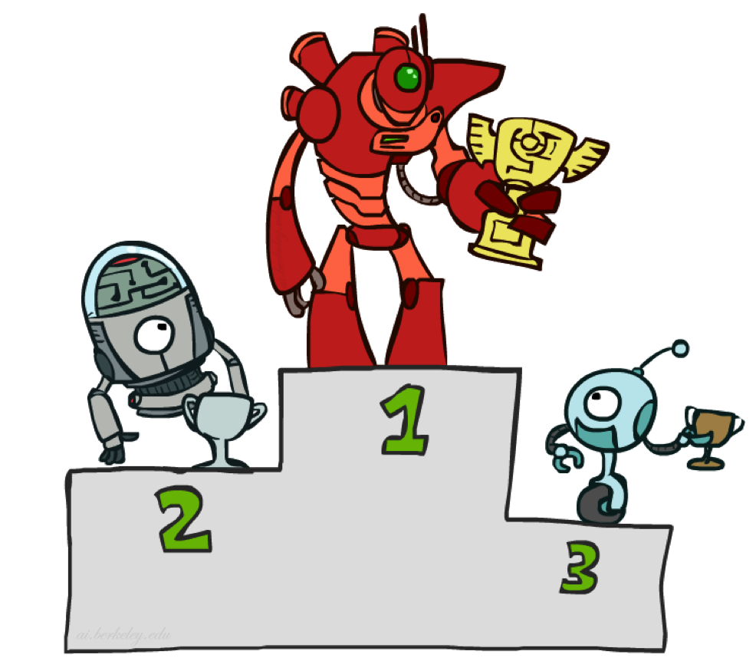
Contest Results

Slide 3
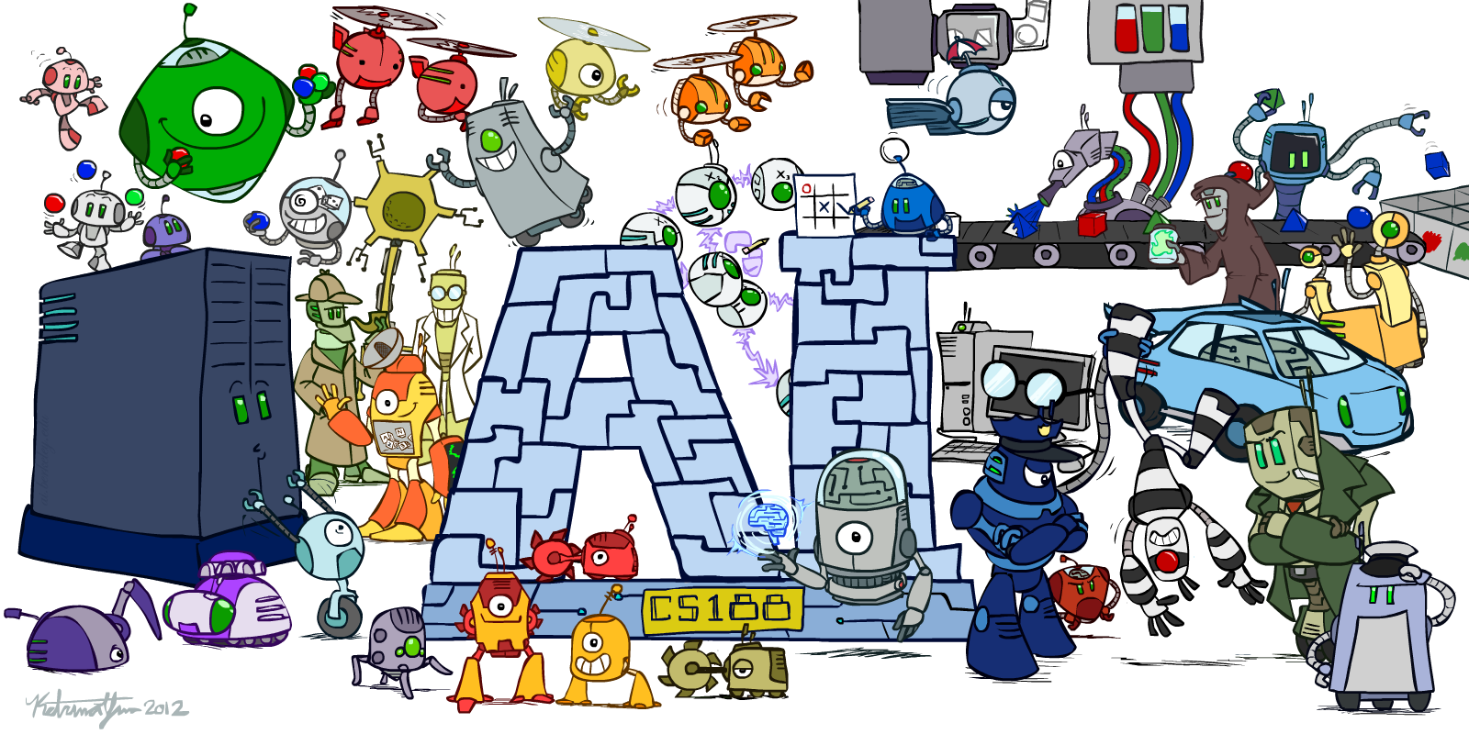

Slide 4
Ketrina Yim
CS188 Artist

Slide 5
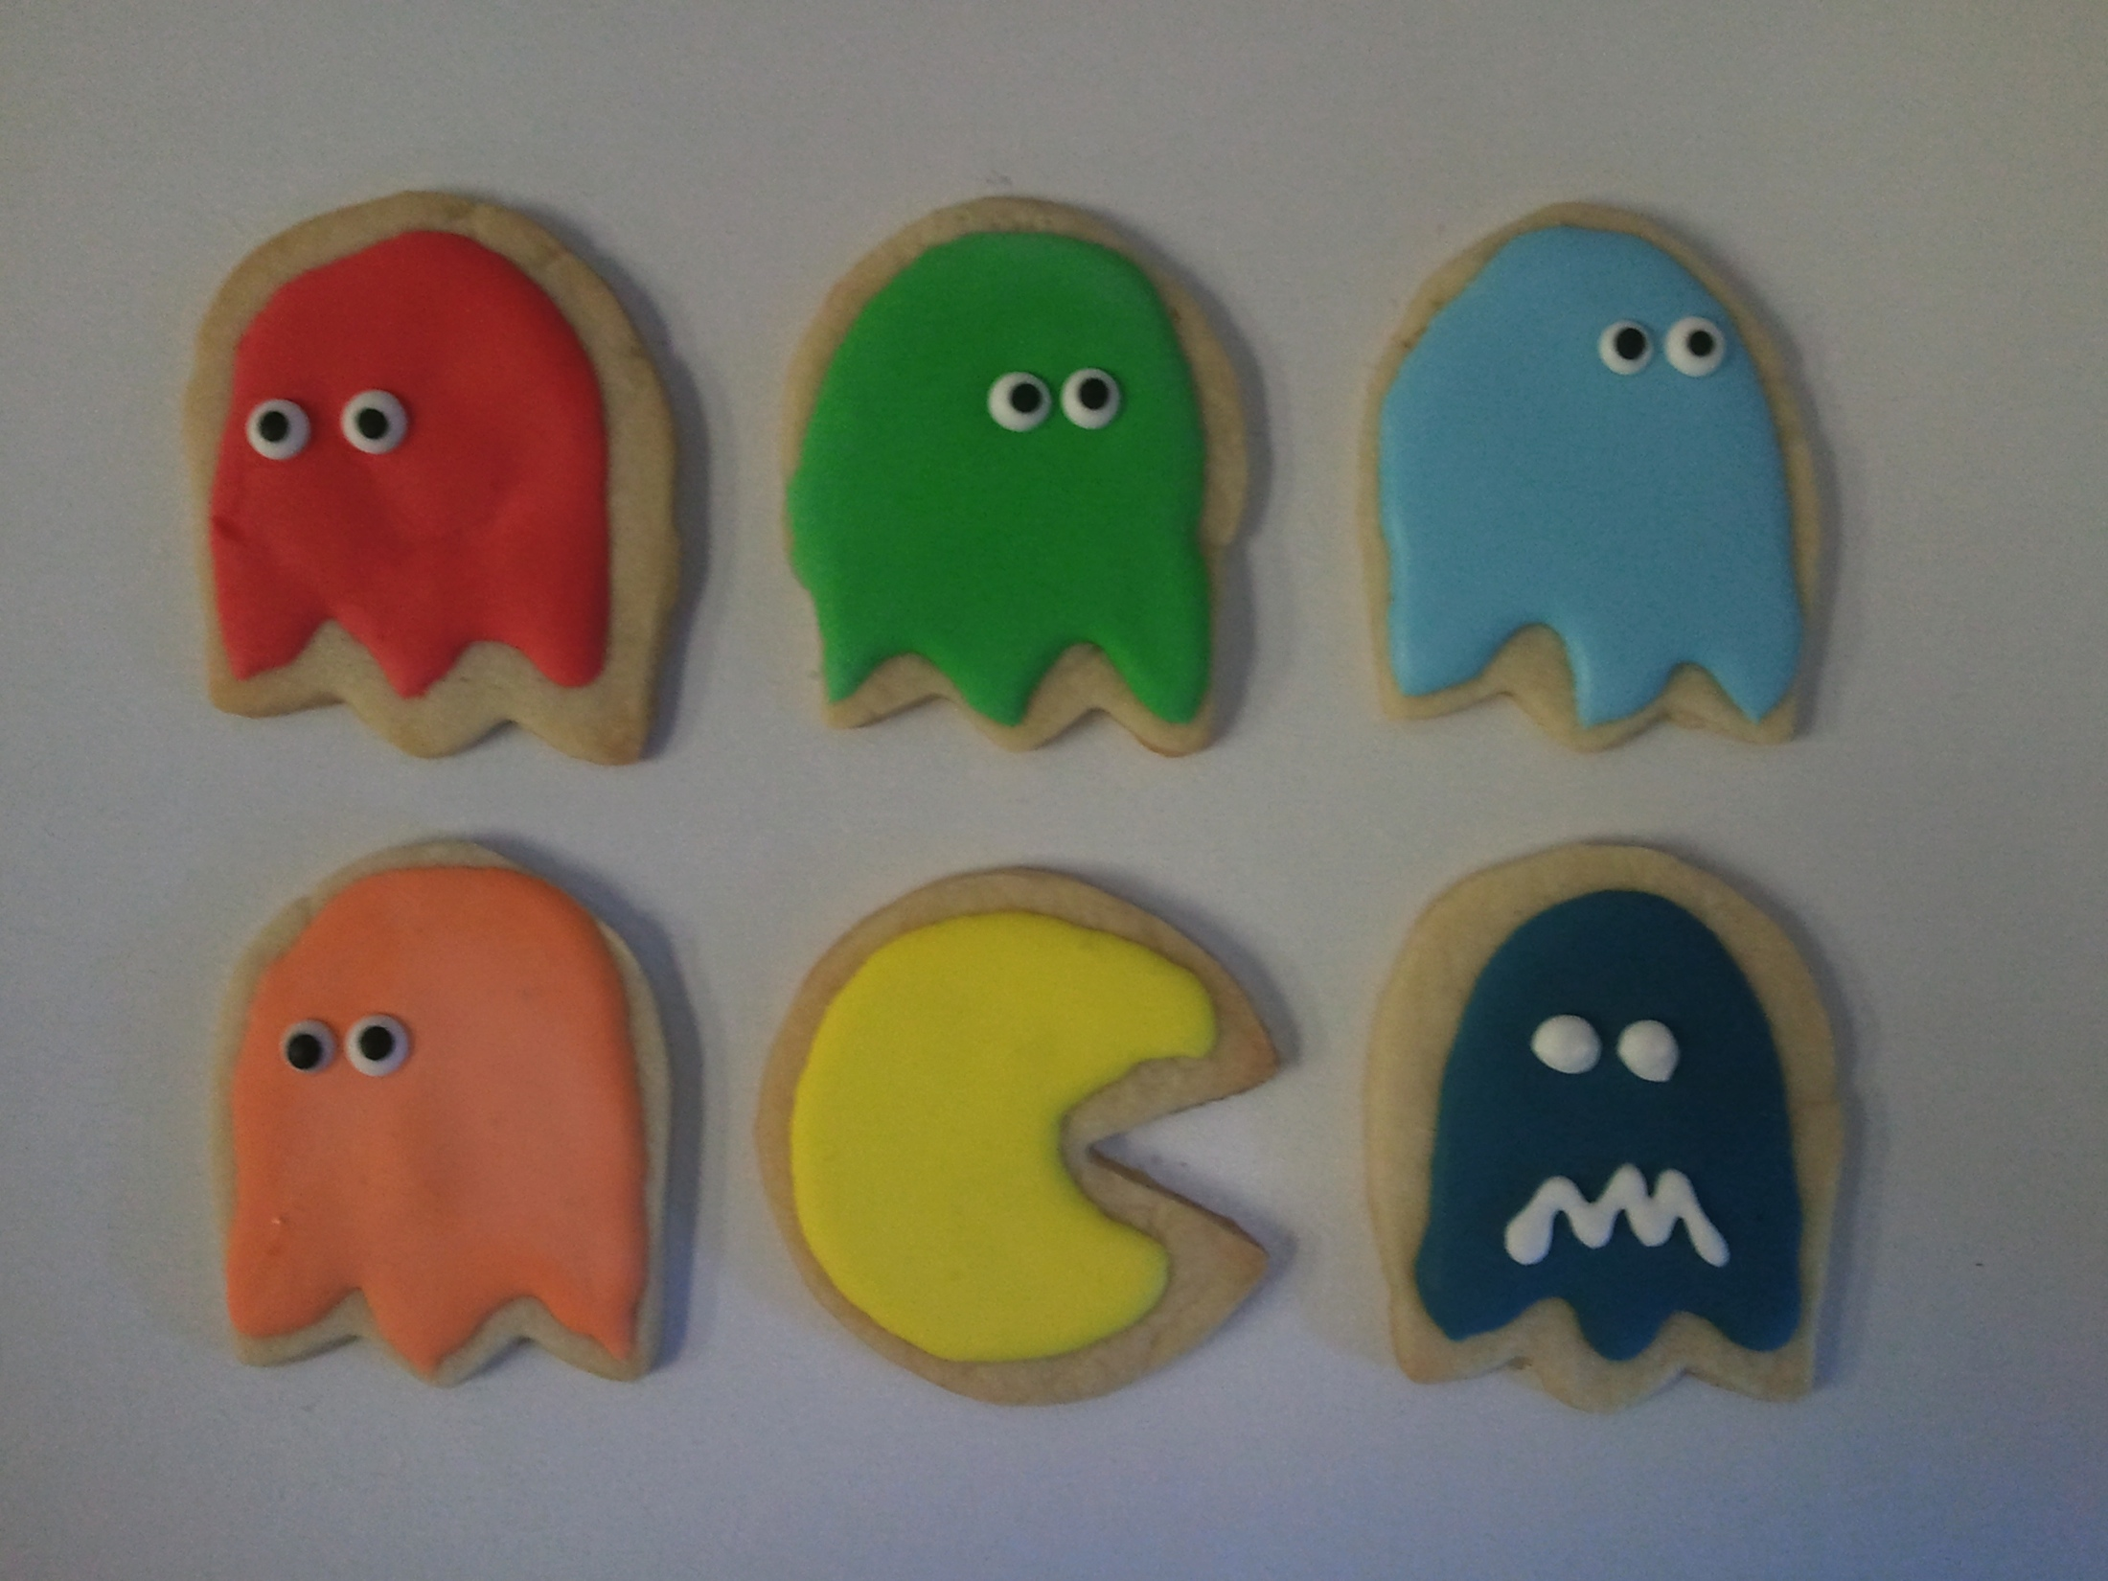

Slide 7
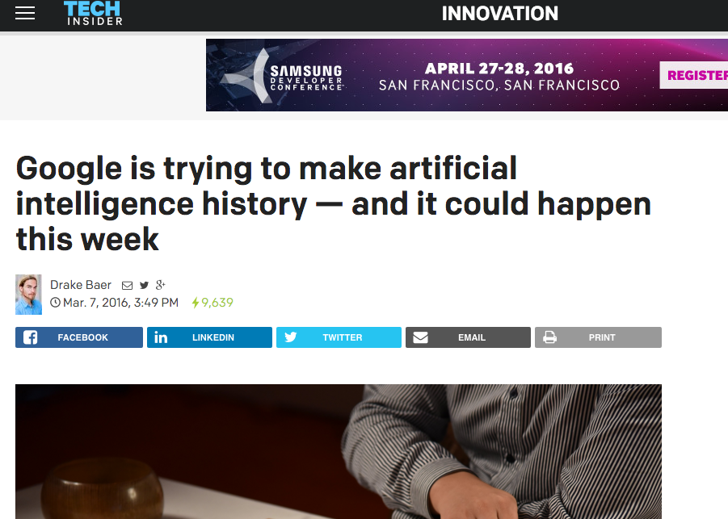

Slide 8
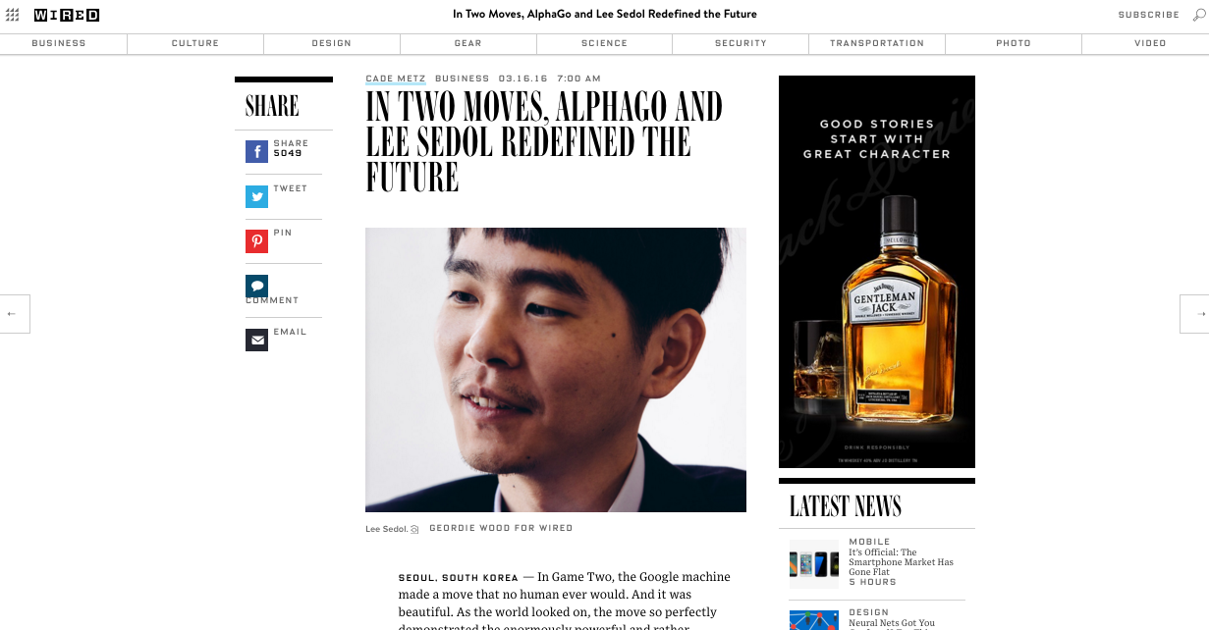
Notes:
NOTES: Explain what Kyu ratings and Dan Ratings are

Slide 9
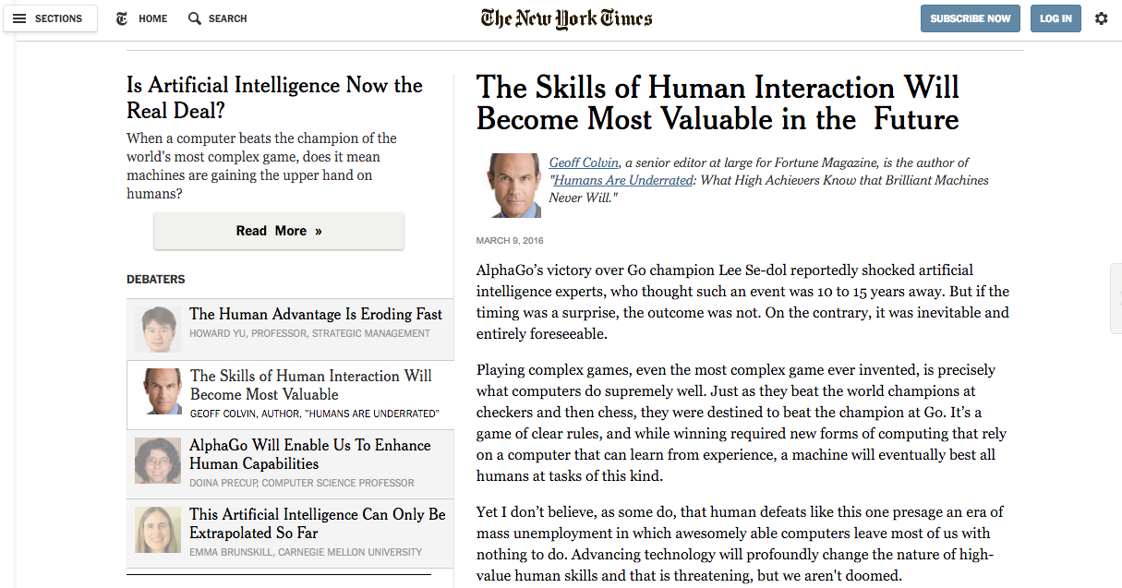
Notes:
NOTES: Explain what Kyu ratings and Dan Ratings are

Slide 10
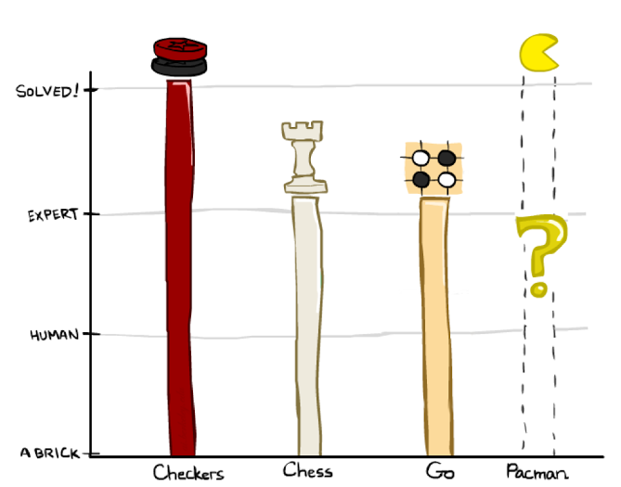

Slide 11
How would you make an AI for Go?

Slide 12
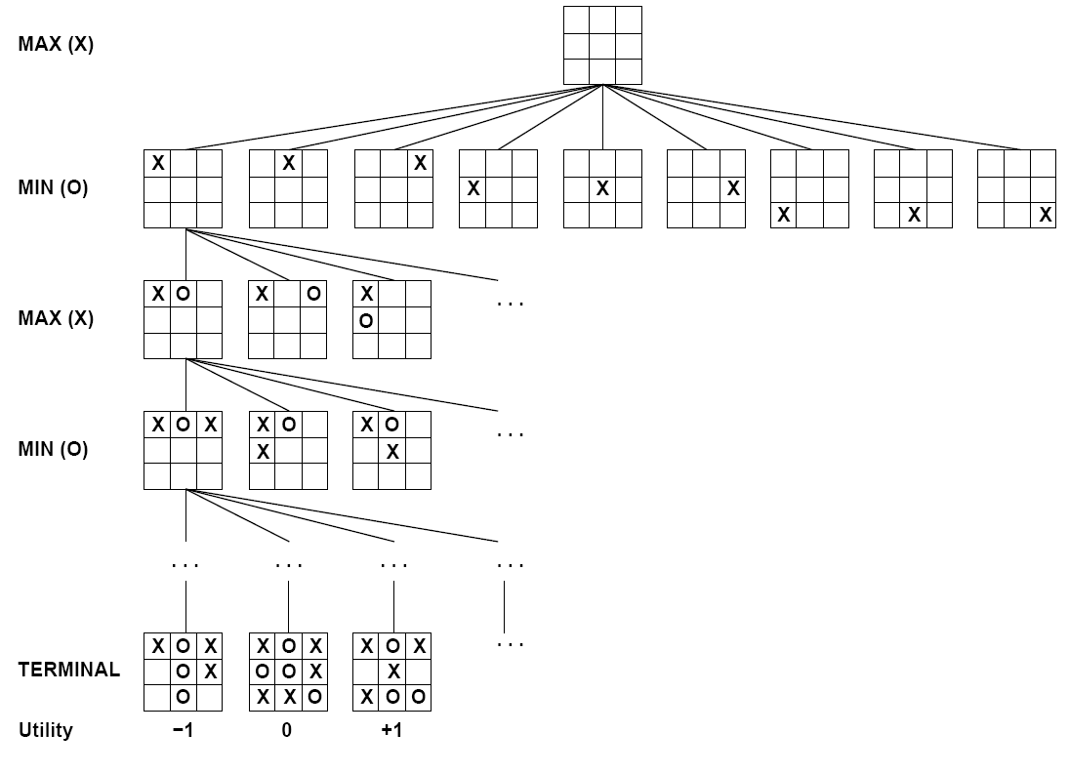
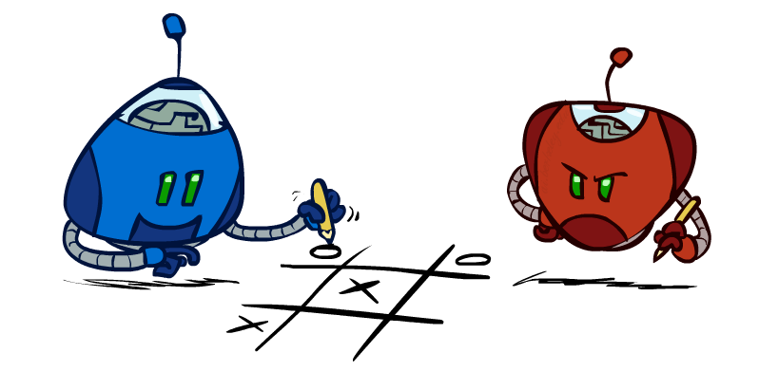
MiniMax!

Slide 13
Why is it hard?
In particular, why is it harder than chess?

Slide 14
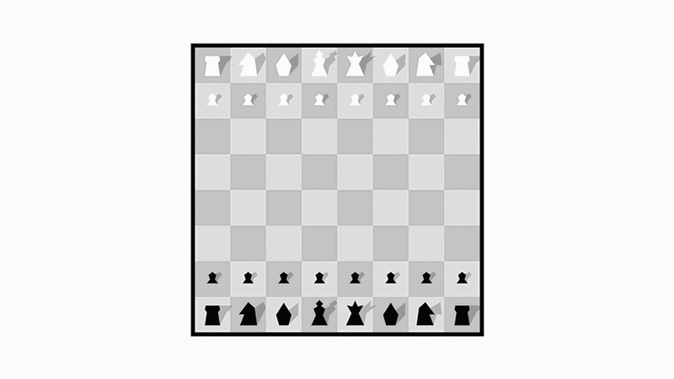

Slide 15
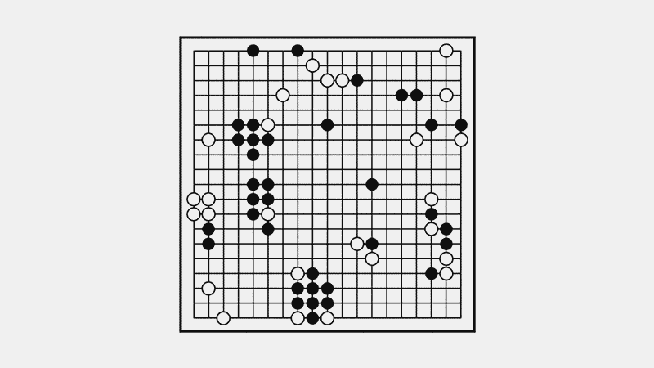

Slide 17
Reducing depth with value network

Slide 18
Value network
Evaluation
v (s)
𝜃
𝜃
s
Position

Slide 19
Reducing breadth with policy network

Slide 20
Policy network
Move probabilities
_{𝜎}
p (a|s)
_{𝜎}
s
Position

Slide 21
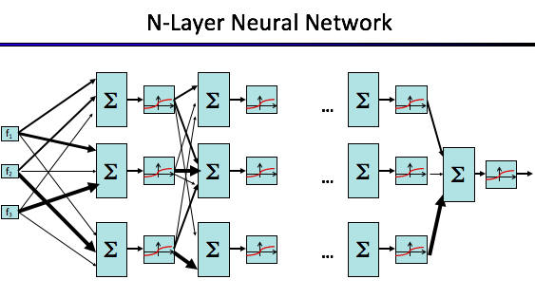
Neural network training pipeline
Human expert
positions
Supervised Learning
policy network
Reinforcement Learning
policy network
Self-play data
Value network

Slide 23
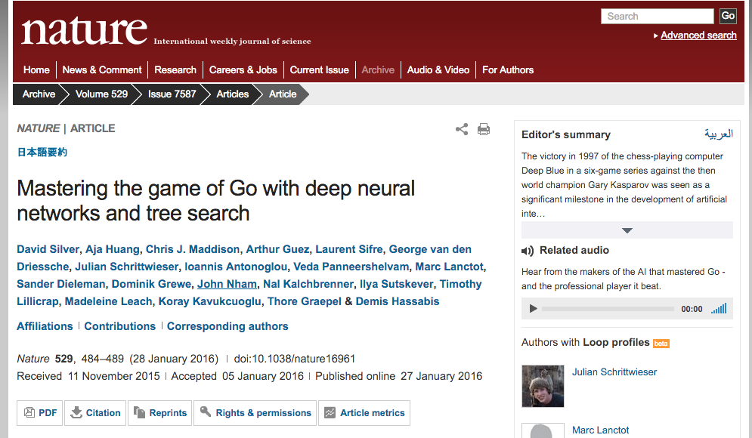

Slide 24
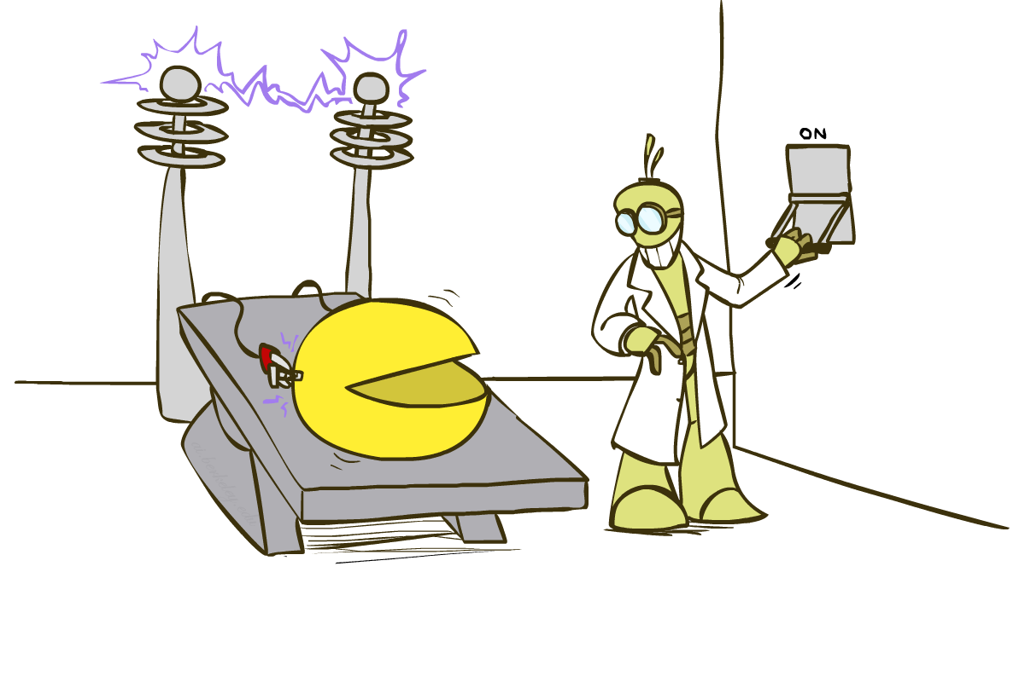
Pac-Man Beyond the Game!

Slide 25
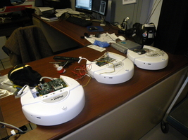
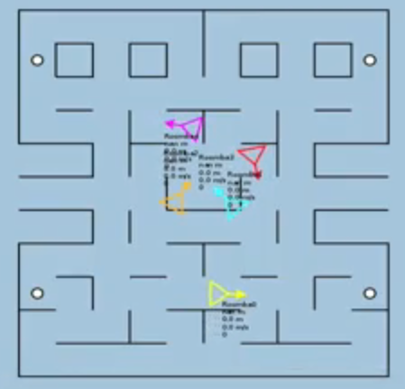
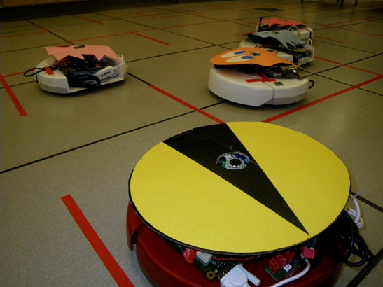
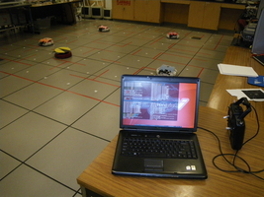
Pacman: Beyond Simulation?
Students at Colorado University: http://pacman.elstonj.com
Notes:
Roomba .flv

Slide 26
Pacman: Beyond Simulation!
[VIDEO: Roomba Pacman.mp4]

Slide 27
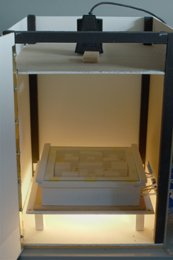
Bugman?
AI = Animal Intelligence?
Wim van Eck at Leiden University
Pacman controlled by a human
Ghosts controlled by crickets
Vibrations drive crickets toward or away from Pacman’s location
http://pong.hku.nl/~wim/bugman.htm

Slide 28
Bugman
[VIDEO: bugman_movie_1.mov]

Slide 29
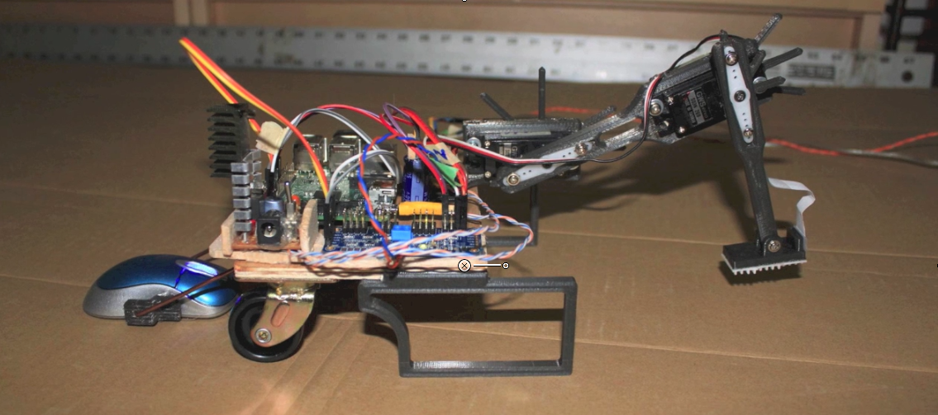
Crawler

Slide 30
Q-learning with Robot Crawler
[Jan Balewski]
Notes:
Super-cool, thanks for sharing!
How did you design your reactive policy?
The reward is the distance traveled by mouse for given step.
I wrote a small python driver for servos & mouse, which for every state of the state machine (Environment) would move arm+hand and 0.3sec later return the y-difference of mouse coordinates.
I have matched the crawler dimensions and conversion of y-pixels of the mouse to mm with your virtual crawler-body. It is shown 50sec in the movie,
left column is virtual crawler and right column is physical crawler:
the virtual & physical reward and total distance agree within ~10%.
Then, I could safely assume that the learning algo which was part of our homework would be able to learn the q-value based policy if I simply switch the source of reward from the virtual position differences to my
mouse position differences.
And did you also record the result of Q-learning?
The move 1m35se to 1m55sec shows a snippet of 20 minutes long q-learnig phase.
The movie 2m0sec - 2m20sec shows how this learned policy is followed ( noise is set to 5%)
Clever trick with the mouse-based reward there!
Right. At first I considered some tracking camera for $70 which would require special light and some contrasting color markers,
but later I realized an inexpensive $3 mouse from eBay would give me all I need with resolution 20x better than I need.
Now I’m working on replacing the external power source with some rechargeable batteries, so one could operate the crawler truly wireless.
Thanks
see, so the "reflex agent" is executing the learned Q-values?
No, sorry, I tried to cram all what I did in to this short 2.5 minutes movie.
(The pages with text meant to explain what is shown.)
The manually programmed reflex agent is shown in movie time 40s to 1m10s.
The execution of q-learned values is in movie time: 2m0sec to 2m20sec

Slide 31
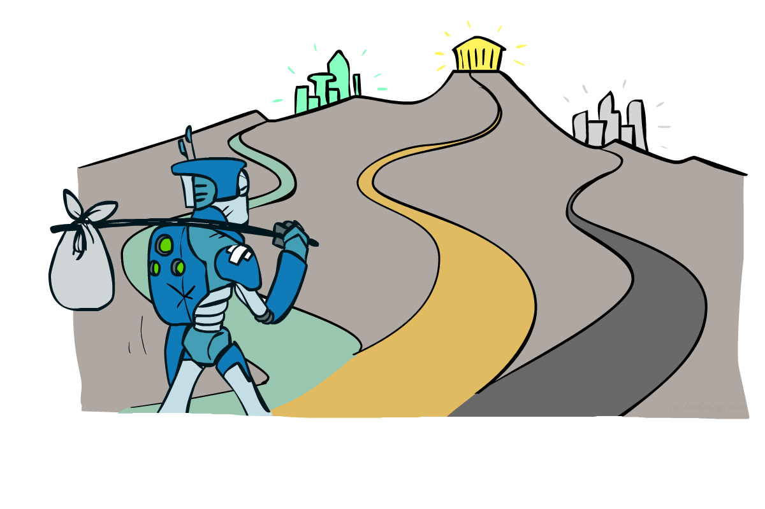
Where to Go Next?

Slide 32
Where to go next?
Congratulations, you’ve seen the basics of modern AI
… and done some amazing work putting it to use!
How to continue:
Machine learning: cs189, stat154
Intro to Data Science: CS194-16 (Franklin)
Probability: ee126, stat134
Optimization: ee127
Cognitive modeling: cog sci 131
Machine learning theory: cs281a/b
Vision: cs280
Robotics: cs287
Algorithmic Human Robot Interaction: CS294-115
NLP: cs288
… and more; ask if you’re interested

Slide 33
That’s It!
Help us out with some course evaluations
Have a great summer, and always maximize your expected utilities!

Slide 34
