Slide 1
CS 188: Artificial Intelligence
Reinforcement Learning
Instructor: Anca Dragan
University of California, Berkeley
[Slides by Dan Klein, Pieter Abbeel, Anca Dragan. http://ai.berkeley.edu.]
Notes:
Please retain proper attribution, including the reference to ai.berkeley.edu. Thanks!

Slide 2
Reinforcement Learning

Slide 3
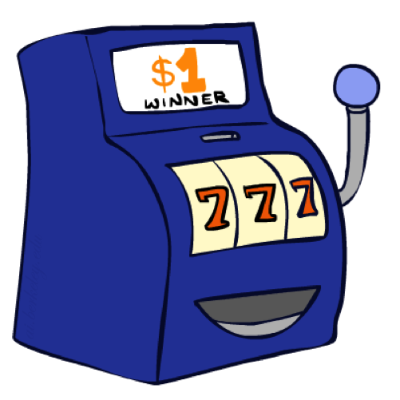
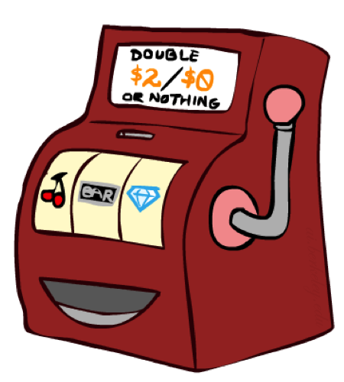
Double Bandits

Slide 4
Double-Bandit MDP
Actions: Blue, Red
States: Win, Lose
No discount
10 time steps
Both states have the same value
0.25 $0
0.75
$2
W
L
0.25
$0
$1
1.0
$1
1.0
0.75 $2

Slide 5
Offline Planning
Solving MDPs is offline planning
You determine all quantities through computation
You need to know the details of the MDP
You do not actually play the game!
No discount
10 time steps
Both states have the same value
0.25 $0
Value
0.75
$2
W
0.25
$0
Play Red
15
L
$1
1.0
$1
1.0
0.75 $2
Play Blue
10
Notes:
Did we play the game yet? No, we just thought really hard about what to do. Did we get 150? No.

Slide 6
Let’s Play!
$2
$2
$0
$2
$2
$2
$2
$0
$0
$0
Notes:
The playing actually happened! Real fake money!

Slide 7
Online Planning
Rules changed! Red’s win chance is different.
?? $0
??
$2
W
L
??
$0
$1
?
$1
??
?? $2
Notes:
Whats the optimal policy? We don’t know the mdp so no offline planning. What do we do? Give up and go home?

Slide 8
Let’s Play!
$1
$1
$1
$0
$0
$0
$2
Notes:
Need to spend money to figure out what’s optimal

Slide 9
What Just Happened?
That wasn’t planning, it was learning!
Specifically, reinforcement learning
There was an MDP, but you couldn’t solve it with just computation
You needed to actually act to figure it out
Important ideas in reinforcement learning that came up
Exploration: you have to try unknown actions to get information
Exploitation: eventually, you have to use what you know
Regret: even if you learn intelligently, you make mistakes
Sampling: because of chance, you have to try things repeatedly
Difficulty: learning can be much harder than solving a known MDP

Slide 10
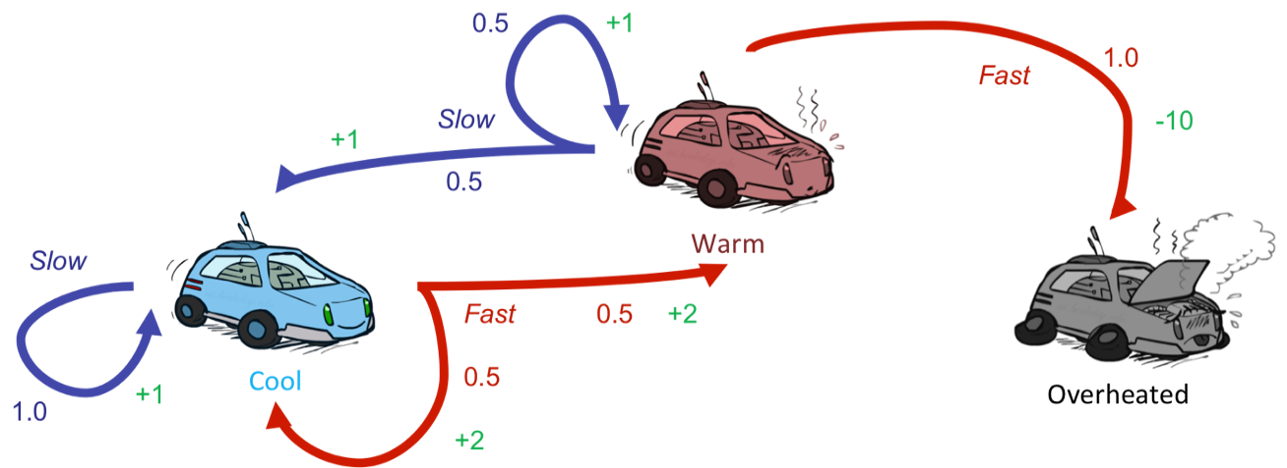
Reinforcement Learning
Still assume a Markov decision process (MDP):
A set of states s ∈ S
A set of actions (per state) A
A model T(s,a,s’)
A reward function R(s,a,s’)
Still looking for a policy π(s)
New twist: don’t know T or R
I.e. we don’t know which states are good or what the actions do
Must actually try actions and states out to learn

Slide 11
Reinforcement Learning
Agent
State: s
Reward: r
Actions: a
Environment
Basic idea:
Receive feedback in the form of rewards
Agent’s utility is defined by the reward function
Must (learn to) act so as to maximize expected rewards
All learning is based on observed samples of outcomes!

Slide 12
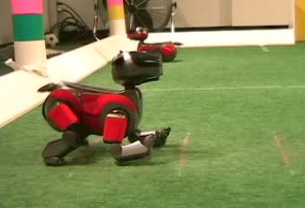
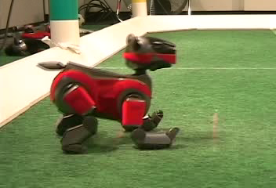
Example: Learning to Walk
Initial
A Learning Trial
After Learning [1K Trials]
[Kohl and Stone, ICRA 2004]

Slide 13
Example: Learning to Walk
Initial
[Kohl and Stone, ICRA 2004]
[Video: AIBO WALK – initial]

Slide 14
Example: Learning to Walk
Training
[Kohl and Stone, ICRA 2004]
[Video: AIBO WALK – training]

Slide 15
Example: Learning to Walk
Finished
[Kohl and Stone, ICRA 2004]
[Video: AIBO WALK – finished]

Slide 16
Example: Sidewinding
[Andrew Ng]
[Video: SNAKE – climbStep+sidewinding]

Slide 17
Example: Toddler Robot
[Tedrake, Zhang and Seung, 2005]
[Video: TODDLER – 40s]

Slide 18
The Crawler!
[Demo: Crawler Bot (L10D1)] [You, in Project 3]
Notes:
Hard because at times it gets not reward as it is repositioning its arm

Slide 19
Video of Demo Crawler Bot

Slide 20
DeepMind Atari (©Two Minute Lectures)

Slide 21
Reinforcement Learning
Still assume a Markov decision process (MDP):
A set of states s ∈ S
A set of actions (per state) A
A model T(s,a,s’)
A reward function R(s,a,s’)
Still looking for a policy π(s)
New twist: don’t know T or R
I.e. we don’t know which states are good or what the actions do
Must actually try actions and states out to learn

Slide 22
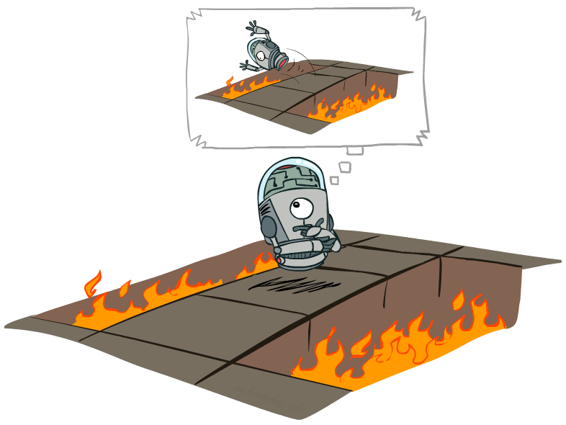
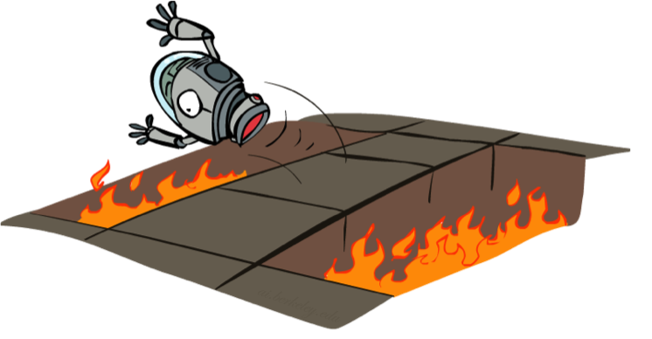
Offline (MDPs) vs. Online (RL)
Offline Solution
Online Learning

Slide 23
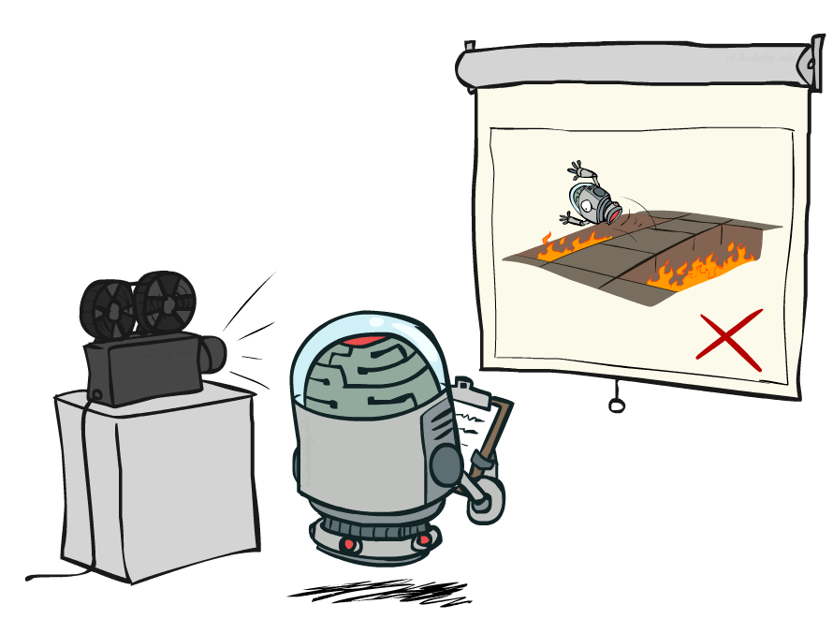
Passive Reinforcement Learning

Slide 24
Model-Based Learning

Slide 25
Model-Based Learning
Model-Based Idea:
Learn an approximate model based on experiences
Solve for values as if the learned model were correct
Step 1: Learn empirical MDP model
Count outcomes s’ for each s, a
Normalize to give an estimate of
Discover each when we experience (s, a, s’)
Step 2: Solve the learned MDP
For example, use value iteration, as before

Slide 26
Example: Model-Based Learning
Input Policy π
Observed Episodes (Training)
Learned Model
Episode 1
Episode 2
T(s,a,s’).
T(B, east, C) = 1.00
T(C, east, D) = 0.75
T(C, east, A) = 0.25
…
R(s,a,s’).
R(B, east, C) = -1
R(C, east, D) = -1
R(D, exit, x) = +10
…
 | A
B | C | D
 | E
B, east, C, -1
C, east, D, -1
D, exit, x, +10
B, east, C, -1
C, east, D, -1
D, exit, x, +10
Episode 3
Episode 4
E, north, C, -1
C, east, D, -1
D, exit, x, +10
E, north, C, -1
C, east, A, -1
A, exit, x, -10
Assume: γ = 1

Slide 27
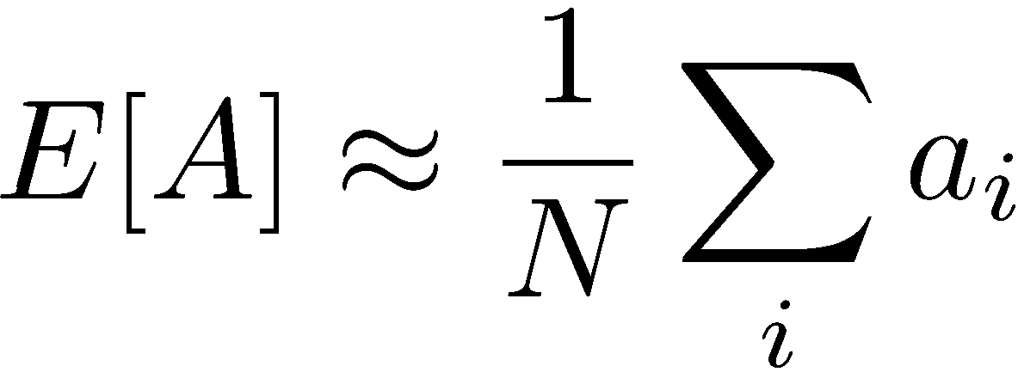
Analogy: Expected Age
Goal: Compute expected age of cs188 students
Known P(A)
Without P(A), instead collect samples [a₁, a₂, … a_{N}]
Unknown P(A): “Model Based”
Unknown P(A): “Model Free”
Why does this work? Because eventually you learn the right model.
Why does this work? Because samples appear with the right frequencies.

Slide 28
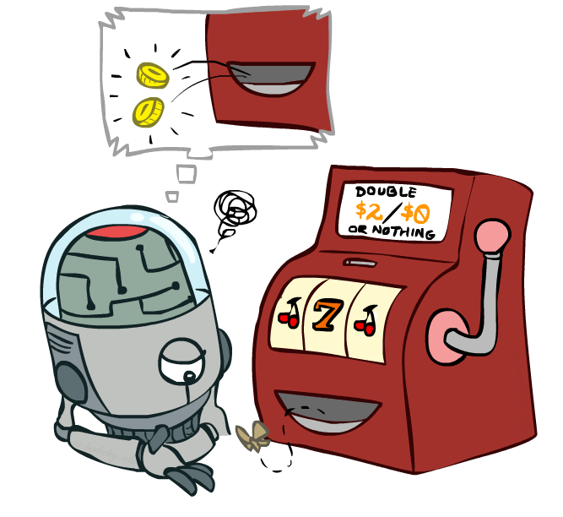
Model-Free Learning

Slide 29
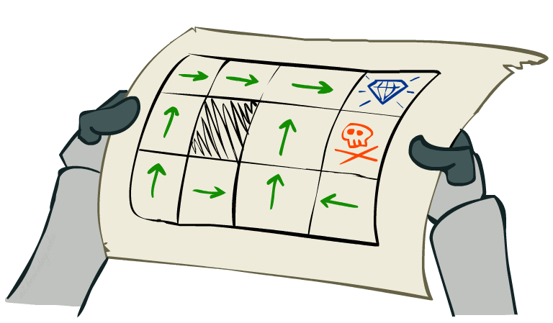
Passive Reinforcement Learning
Simplified task: policy evaluation
Input: a fixed policy π(s)
You don’t know the transitions T(s,a,s’)
You don’t know the rewards R(s,a,s’)
Goal: learn the state values
In this case:
Learner is “along for the ride”
No choice about what actions to take
Just execute the policy and learn from experience
This is NOT offline planning! You actually take actions in the world.

Slide 30
Direct Evaluation
Goal: Compute values for each state under π
Idea: Average together observed sample values
Act according to π
Every time you visit a state, write down what the sum of discounted rewards turned out to be
Average those samples
This is called direct evaluation

Slide 31
Example: Direct Evaluation
Input Policy π
Observed Episodes (Training)
Output Values
Episode 1
Episode 2
 | A
B | C | D
 | E
 | A
B | C | D
 | E
B, east, C, -1
C, east, D, -1
D, exit, x, +10
B, east, C, -1
C, east, D, -1
D, exit, x, +10
-10
+8
+4
+10
Episode 3
Episode 4
-2
E, north, C, -1
C, east, D, -1
D, exit, x, +10
E, north, C, -1
C, east, A, -1
A, exit, x, -10
If B and E both go to C under this policy, how can their values be different?
Assume: γ = 1

Slide 32
Problems with Direct Evaluation
What’s good about direct evaluation?
It’s easy to understand
It doesn’t require any knowledge of T, R
It eventually computes the correct average values, using just sample transitions
What bad about it?
It wastes information about state connections
Each state must be learned separately
So, it takes a long time to learn
Output Values
 | A
B | C | D
 | E
-10
+8
+4
+10
-2
If B and E both go to C under this policy, how can their values be different?

Slide 33
Why Not Use Policy Evaluation?
s
Simplified Bellman updates calculate V for a fixed policy:
Each round, replace V with a one-step-look-ahead layer over V
This approach fully exploited the connections between the states
Unfortunately, we need T and R to do it!
Key question: how can we do this update to V without knowing T and R?
In other words, how to we take a weighted average without knowing the weights?
π(s)
s, π(s)
s, π(s),s’
s’

Slide 34
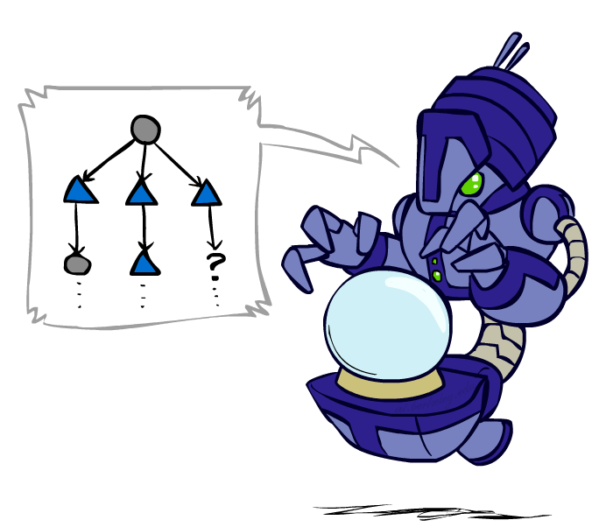
Sample-Based Policy Evaluation?
We want to improve our estimate of V by computing these averages:
Idea: Take samples of outcomes s’ (by doing the action!) and average
s
π(s)
s, π(s)
s, π(s),s’
s₁'
s₂'
s'
s₃'
Almost! But we can’t rewind time to get sample after sample from state s.
Notes:
If we could do this, we would be implementing the policy evaluation update

Slide 35
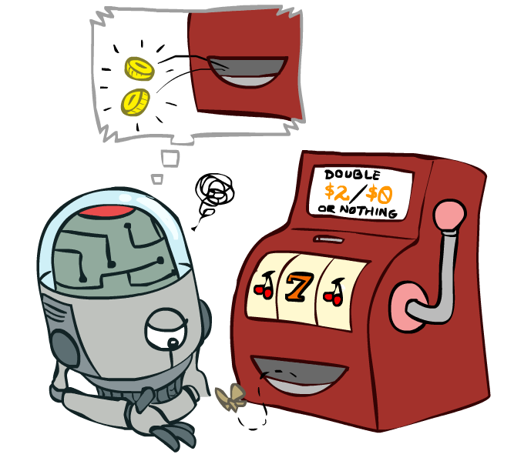
Temporal Difference Learning

Slide 36
Temporal Difference Learning
Big idea: learn from every experience!
Update V(s) each time we experience a transition (s, a, s’, r)
Likely outcomes s’ will contribute updates more often
Temporal difference learning of values
Policy still fixed, still doing evaluation!
Move values toward value of whatever successor occurs: running average
s
π(s)
s, π(s)
s’
Sample of V(s):
Update to V(s):
Same update:

Slide 37
Exponential Moving Average
Exponential moving average
The running interpolation update:
Makes recent samples more important
Forgets about the past (distant past values were wrong anyway)
Decreasing learning rate (alpha) can give converging averages
Notes:
More recent samples are better because the estimates for vk are better

Slide 38
Example: Temporal Difference Learning
States
Observed Transitions
B, east, C, -2
C, east, D, -2
 | A
B | C | D
 | E
 | 0
0 | 0 | 8
 | 0
 | 0
-1 | 0 | 8
 | 0
 | 0
-1 | 3 | 8
 | 0
Assume: γ = 1, α = 1/2

Slide 39
Problems with TD Value Learning
TD value leaning is a model-free way to do policy evaluation, mimicking Bellman updates with running sample averages
However, if we want to turn values into a (new) policy, we’re sunk:
Idea: learn Q-values, not values
Makes action selection model-free too!
s
a
s, a
s,a,s’
s’

Slide 40
Detour: Q-Value Iteration
Value iteration: find successive (depth-limited) values
Start with V₀(s) = 0, which we know is right
Given V_{k}, calculate the depth k+1 values for all states:
But Q-values are more useful, so compute them instead
Start with Q₀(s,a) = 0, which we know is right
Given Q_{k}, calculate the depth k+1 q-values for all q-states:

Slide 41
Q-Learning
Q-Learning: sample-based Q-value iteration
Learn Q(s,a) values as you go
Receive a sample (s,a,s’,r)
Consider your old estimate:
Consider your new sample estimate:
Incorporate the new estimate into a running average:
no longer policy evaluation!
[Demo: Q-learning – gridworld (L10D2)]
[Demo: Q-learning – crawler (L10D3)]

Slide 42
Video of Demo Q-Learning -- Gridworld

Slide 43
Video of Demo Q-Learning -- Crawler

Slide 44
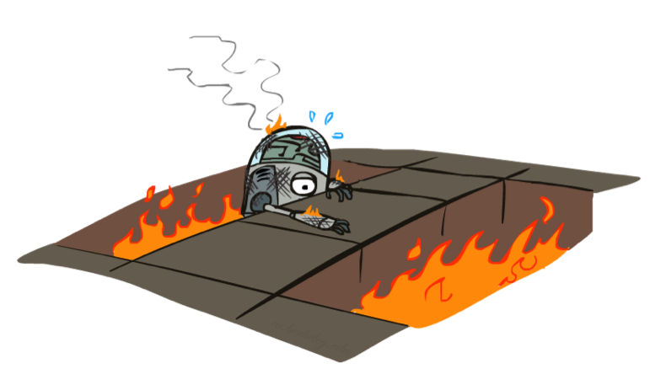
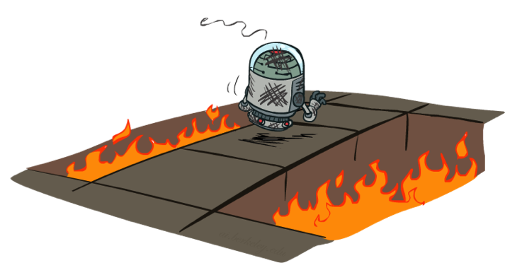
Active Reinforcement Learning

Slide 45
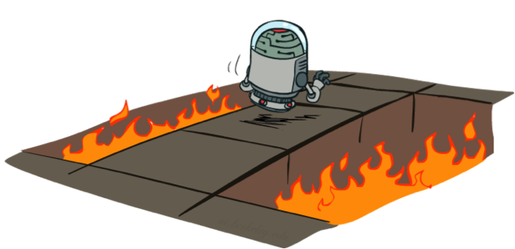
Q-Learning: act according to current optimal (and also explore…)
Full reinforcement learning: optimal policies (like value iteration)
You don’t know the transitions T(s,a,s’)
You don’t know the rewards R(s,a,s’)
You choose the actions now
Goal: learn the optimal policy / values
In this case:
Learner makes choices!
Fundamental tradeoff: exploration vs. exploitation
This is NOT offline planning! You actually take actions in the world and find out what happens…

Slide 46
Q-Learning Properties
Amazing result: Q-learning converges to optimal policy -- even if you’re acting suboptimally!
This is called off-policy learning
Caveats:
You have to explore enough
You have to eventually make the learning rate
small enough
… but not decrease it too quickly
Basically, in the limit, it doesn’t matter how you select actions (!)

Slide 47
Model-Based Learning
Input Policy π
 | A
B | C | D
 | E
act according to current optimal
also explore!

Slide 48
Discussion: Model-Based vs Model-Free RL

