Slide 1
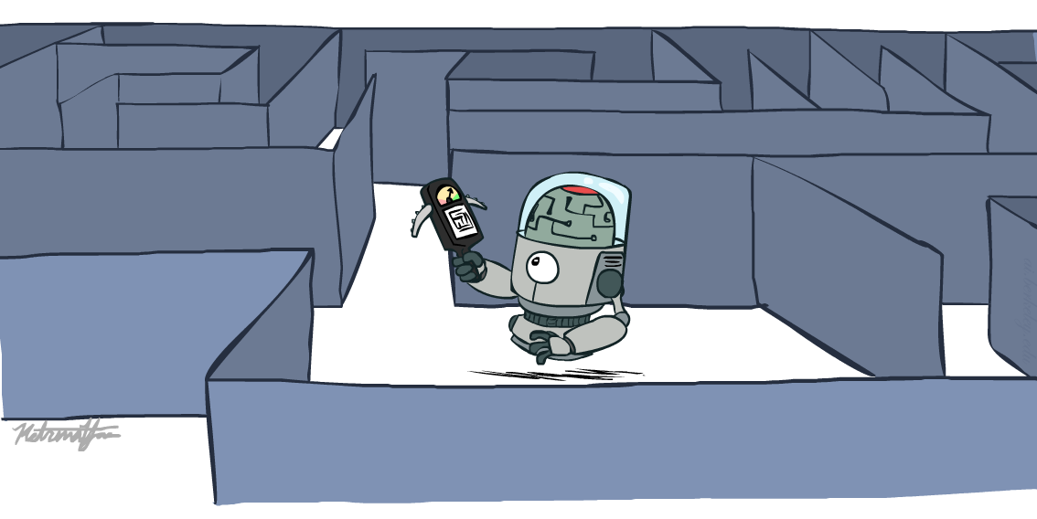
CS 188: Artificial Intelligence
Search Continued
Instructors: Anca Dragan
University of California, Berkeley
[These slides adapted from Dan Klein and Pieter Abbeel; ai.berkeley.edu]
Notes:
Please retain proper attribution, including the reference to ai.berkeley.edu. Thanks!

Slide 2
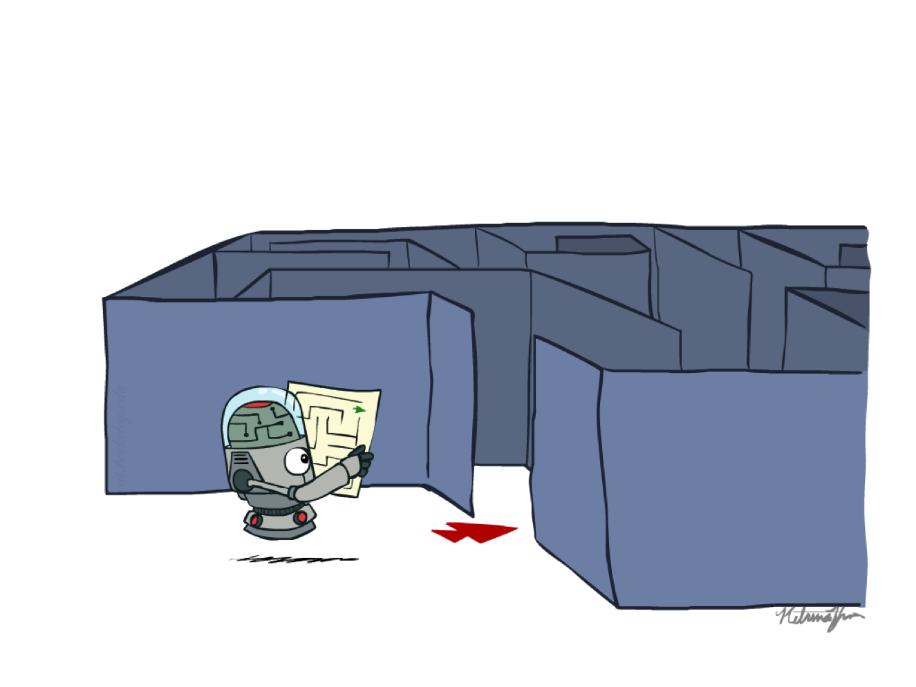
Recap: Search

Slide 3
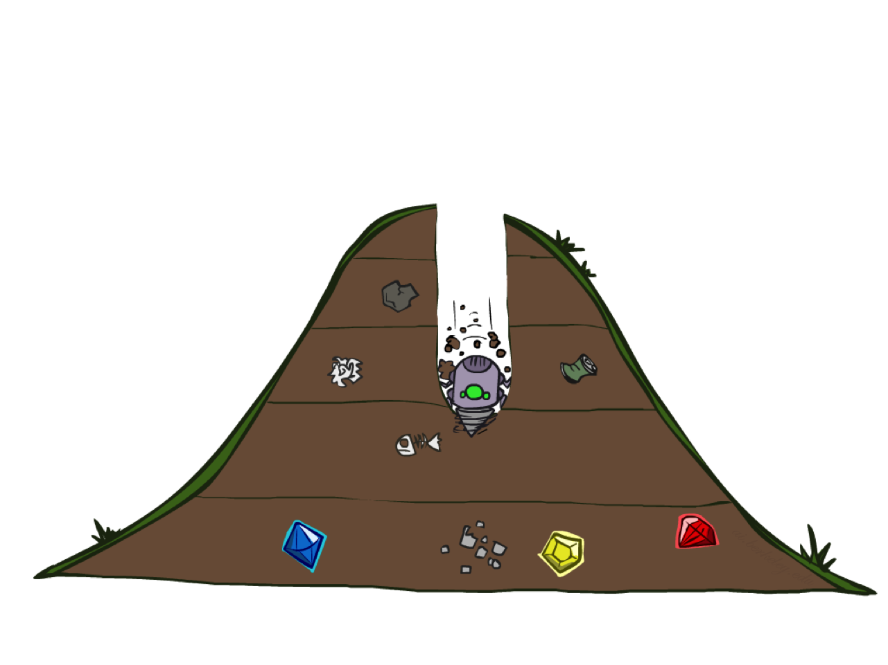
Depth-First (Tree) Search
Notes:
That was generic. Now specific strategy – dfs
Go deep!
Exponentially large at the bottom.

Slide 4
Depth-First Search
Strategy: expand a deepest node first
Implementation: Fringe is a LIFO stack
a
G
a
c
b
c
b
e
d
e
d
f
f
S
h
h
p
p
r
q
r
q
S
d
e
p
b
c
e
h
r
q
a
a
h
r
p
q
f
p
q
f
q
c
G
q
c
G
a
a
Notes:
S D B A C A E H P Q
Ties alphabetically in this case.

Slide 5
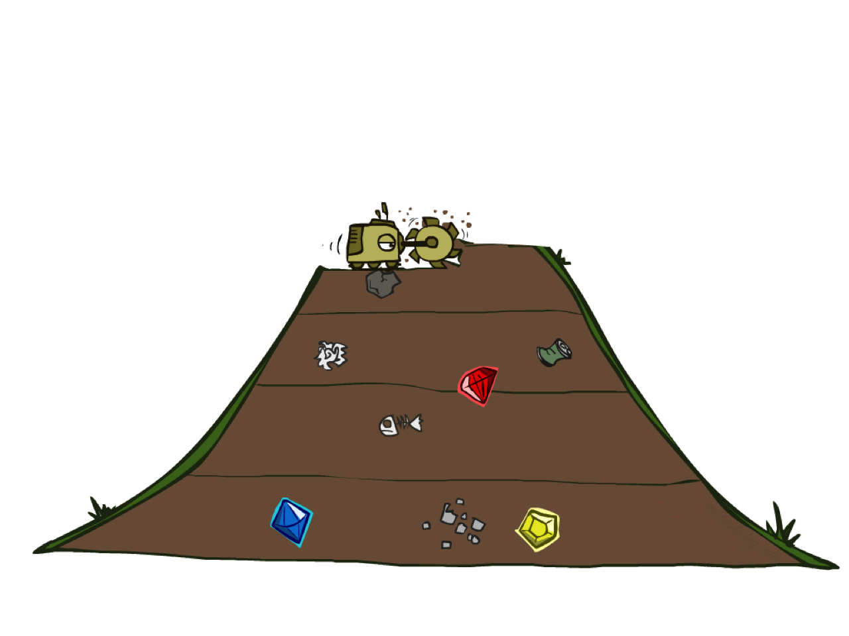
Breadth-First (Tree) Search
Notes:
Another strategy. Layer by layer.
Strip-mining
BFS

Slide 6
Breadth-First Search
Strategy: expand a shallowest node first
Implementation: Fringe is a FIFO queue
a
G
b
c
d
e
f
S
h
p
q
r
S
d
e
p
Search
Tiers
b
c
e
h
r
q
a
a
h
r
p
q
f
p
q
f
q
c
G
q
c
G
a
a
Notes:
Same general algorithm. Shallowest node.
S D E P B C E H R Q

Slide 7
Iterative Deepening
Idea: get DFS’s space advantage with BFS’s time / shallow-solution advantages
Run a DFS with depth limit 1. If no solution…
Run a DFS with depth limit 2. If no solution…
Run a DFS with depth limit 3. …..
Isn’t that wastefully redundant?
Generally most work happens in the lowest level searched, so not so bad!
b
…
Notes:
Another strategy. Combine best of both.
DFS – successor says if deeper than one, stop.
Really common.

Slide 8
Cost-Sensitive Search
a
GOAL
b
c
e
d
f
START
h
p
r
q
Notes:
“Cost Search” What if you have costs associated with arcs? Could you rewrite with what we already know?
Lowest number of actions S->e->r->f->G. Expensive!

Slide 9
Cost-Sensitive Search
a
GOAL
2
2
b
c
3
2
1
8
2
e
d
f
3
9
8
2
START
h
1
4
2
p
4
r
15
q
BFS finds the shortest path in terms of number of actions.
It does not find the least-cost path. We will now cover
a similar algorithm which does find the least-cost path.
How?
Notes:
“Cost Search” What if you have costs associated with arcs? Could you rewrite with what we already know?
Lowest number of actions S->e->r->f->G. Expensive!

Slide 10
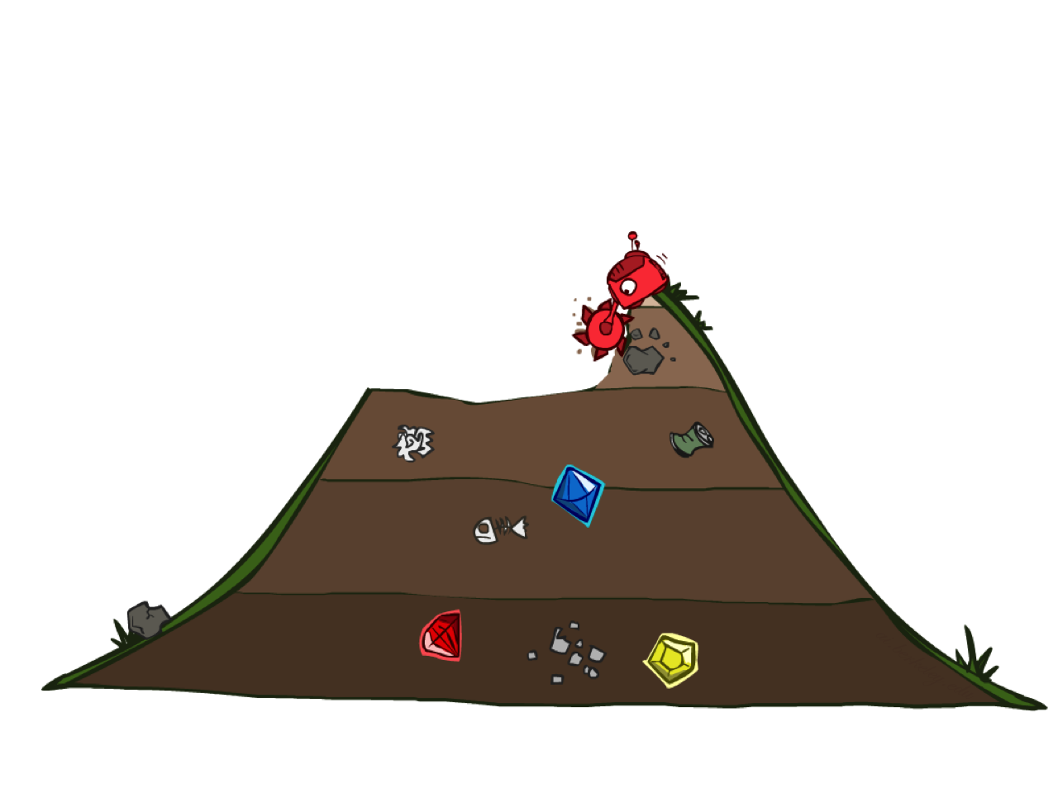
Uniform Cost Search
Notes:
Unfortunate name. It’s a “cost search” that is uniform, not a uniform cost.
Instead of depth, go by cost. Cheap things first, even if multiple actions.

Slide 11
Uniform Cost Search
2
G
a
Strategy: expand a cheapest node first:
Fringe is a priority queue (priority: cumulative cost)
b
c
1
8
2
2
e
3
d
f
9
8
2
S
h
1
1
p
q
r
15
0
S
d
3
e
9
p
1
b
4
e
5
h
17
r
11
q
16
c
11
Cost contours
a
6
a
h
13
r
7
p
q
f
p
q
f
8
q
c
G
q
c
a
11
G
10
a
Notes:
Like breadth first, but with costs. Label with cumulative cost.
Goal path not victory until try to expanded.
Contours show equal cost.

Slide 12
Uniform Cost Search (UCS) Properties
What nodes does UCS expand?
Processes all nodes with cost less than cheapest solution!
If that solution costs C* and arcs cost at least ε , then the “effective depth” is roughly C*/ε
Takes time O(b^{C*/ε}) (exponential in effective depth)
How much space does the fringe take?
Has roughly the last tier, so O(b^{C*/ε})
Is it complete?
Assuming best solution has a finite cost and minimum arc cost is positive, yes! (if no solution, still need depth != ∞)
Is it optimal?
Yes! (Proof via A*)
b
c ≤ 1
…
C*/ε “tiers”
c ≤ 2
c ≤ 3
Notes:
Let’s say C* is 10 and minimum step size is 2. How deep in the tree? C*/e = 5. How many nodes is that?

Slide 13
Uniform Cost Issues
Remember: UCS explores increasing cost contours
The good: UCS is complete and optimal!
The bad:
Explores options in every “direction”
No information about goal location
We’ll fix that soon!
…
c ≤ 1
c ≤ 2
c ≤ 3
Start
Goal
[Demo: empty grid UCS (L2D5)]
[Demo: maze with deep/shallow water DFS/BFS/UCS (L2D7)]
Notes:
What if you know the goal?

Slide 14
Video of Demo Empty UCS
Notes:
L2D5
Then L2D7, Breadth, Uniform, Depth

Slide 15
Video of Demo Maze with Deep/Shallow Water --- DFS, BFS, or UCS? (part 1)
Notes:
Let students guess which one of the three it is. (This is BFS.)
L2D7 B U D

Slide 16
Video of Demo Maze with Deep/Shallow Water --- DFS, BFS, or UCS? (part 2)
Notes:
Let students guess which one of the three it is. (This is UCS.)
expansion slows down when you hit deep water

Slide 17
Video of Demo Maze with Deep/Shallow Water --- DFS, BFS, or UCS? (part 3)
Notes:
Let students guess which one of the three it is. (This is DFS.)
<3 dfs

Slide 18
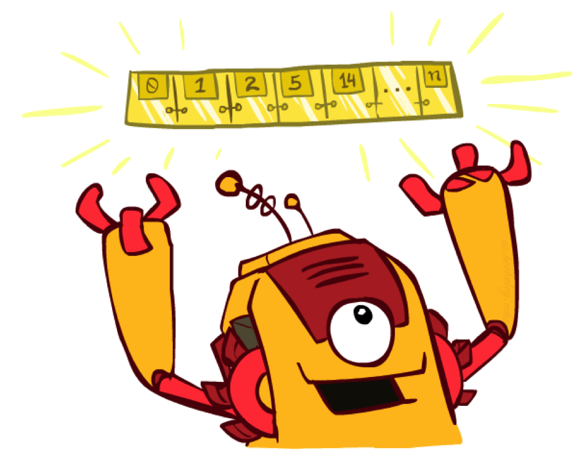
The One Queue
All these search algorithms are the same except for fringe strategies
Conceptually, all fringes are priority queues (i.e. collections of nodes with attached priorities)
Practically, for DFS and BFS, you can avoid the log(n) overhead from an actual priority queue, by using stacks and queues
Can even code one implementation that takes a variable queuing object

Slide 19
Up next: Informed Search
Uninformed Search
DFS
BFS
UCS
Informed Search
Heuristics
Greedy Search
A* Search
Graph Search
Notes:
Blind search vs. “warmer” “colder”
Info about where goal is.
Optimal solution, explore less of the tree.

Slide 20
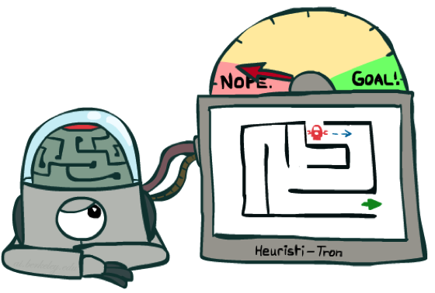
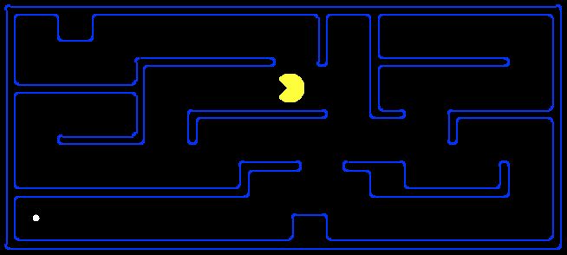
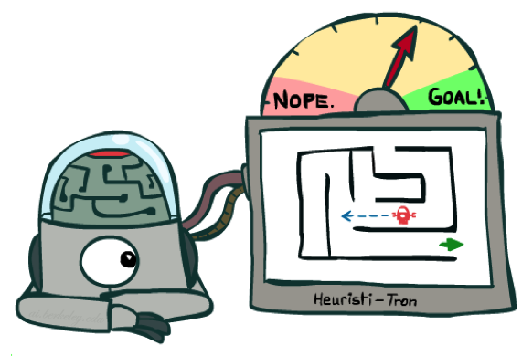
Search Heuristics
A heuristic is:
A function that estimates how close a state is to a goal
Designed for a particular search problem
Pathing?
Examples: Manhattan distance, Euclidean distance for pathing
10
5
11.2
Notes:
Function takes a state, returns a number.
Not everyday term. Not “Look both ways before you cross the street”
How far I am? Could run search, but that defeats the purpose!
Not perfect, but something!

Slide 21
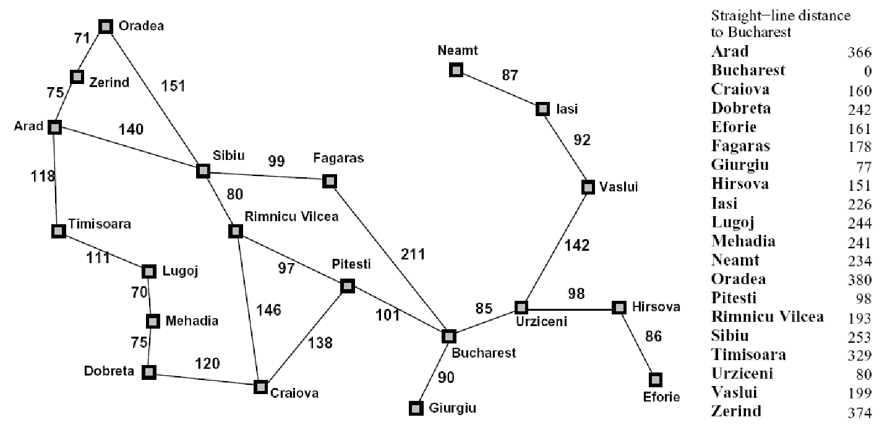
Example: Heuristic Function
h(x)
Notes:
Another heuristic. Straight line distance (as the crow flies; not as the snail crawls). Better close to Bucharest.
Not always distances, but that’s easiest to understand.
What do you do with it?

Slide 22
Example: Heuristic Function
Heuristic?
E.g. the number of the largest pancake that is still out of place
3
h(x)
4
3
4
3
0
4
4
3
4
4
2
3
Notes:
A* expanded 8100 ; Path cost = 33
UCS expanded 25263 . Path cost = 33
Greedy expanded 10 . Path cost = 41
[0, 7, 5, 3, 2, 1, 4, 6]
(7, 0, 5, 3, 2, 1, 4, 6)
(6, 4, 1, 2, 3, 5, 0, 7)
(3, 2, 1, 4, 6, 5, 0, 7)
(1, 2, 3, 4, 6, 5, 0, 7)
(5, 6, 4, 3, 2, 1, 0, 7)
(6, 5, 4, 3, 2, 1, 0, 7)
(0, 1, 2, 3, 4, 5, 6, 7)

Slide 23
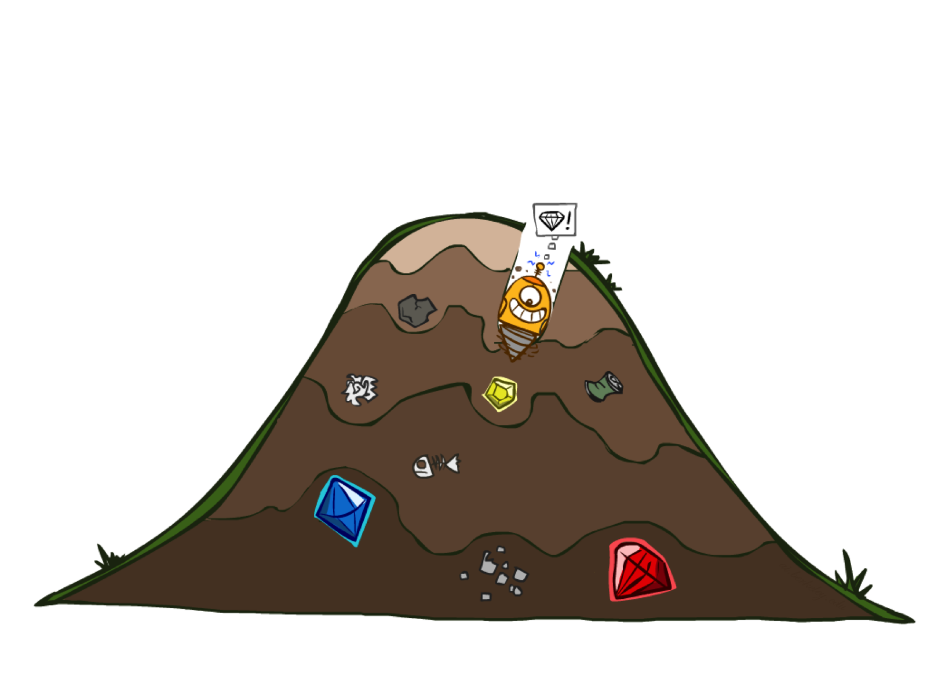
Greedy Search

Slide 24
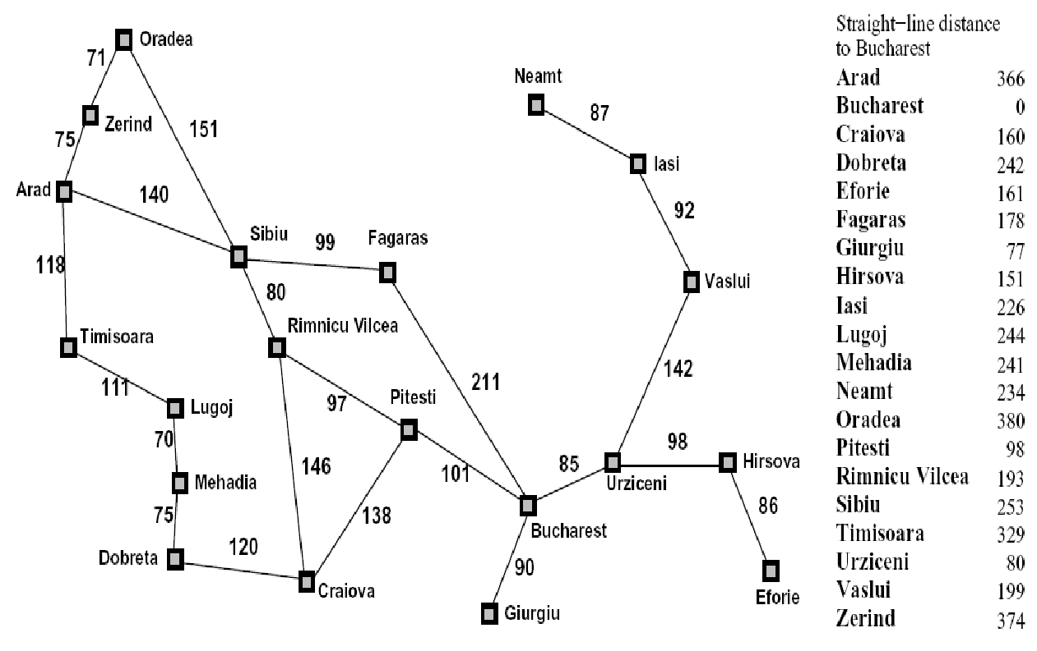
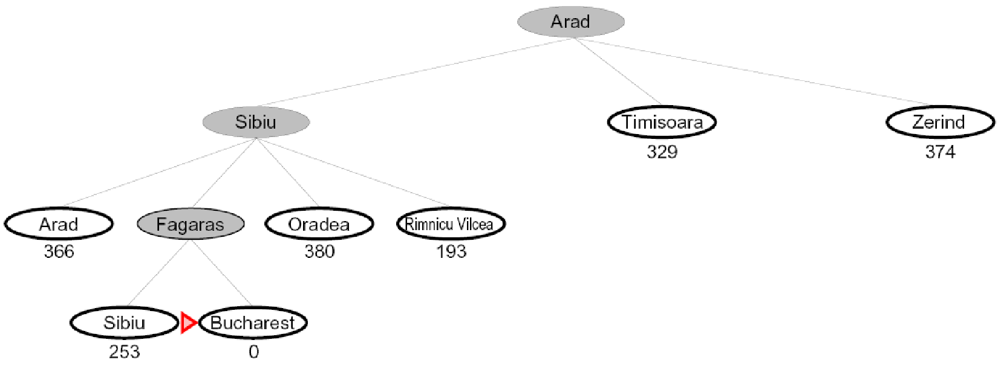
Greedy Search
Expand the node that seems closest…
Is it optimal?
No. Resulting path to Bucharest is not the shortest!
Notes:
Numbers of heuristic, since that’s what greedy cares about.
Got to Bucharest, but not by shortest path.
End up with some kind of goal, but not what you want. You get a smelly shoe instead of to the airport on time.

Slide 25
Greedy Search
b
Strategy: expand a node that you think is closest to a goal state
Heuristic: estimate of distance to nearest goal for each state
A common case:
Best-first takes you straight to the (wrong) goal
Worst-case: like a badly-guided DFS
…
b
…
[Demo: contours greedy empty (L3D1)]
[Demo: contours greedy pacman small maze (L3D4)]
Notes:
Same algorithm as before, new strategy.
For any search problem, you know the goal. Now, you have an idea of how far away you are from the goal.
Worst: heuristic always wrong. Carefully avoid goal searching all tree.
If your heuristic were really good, sure. But if heuristic is good, easy problem!

Slide 26
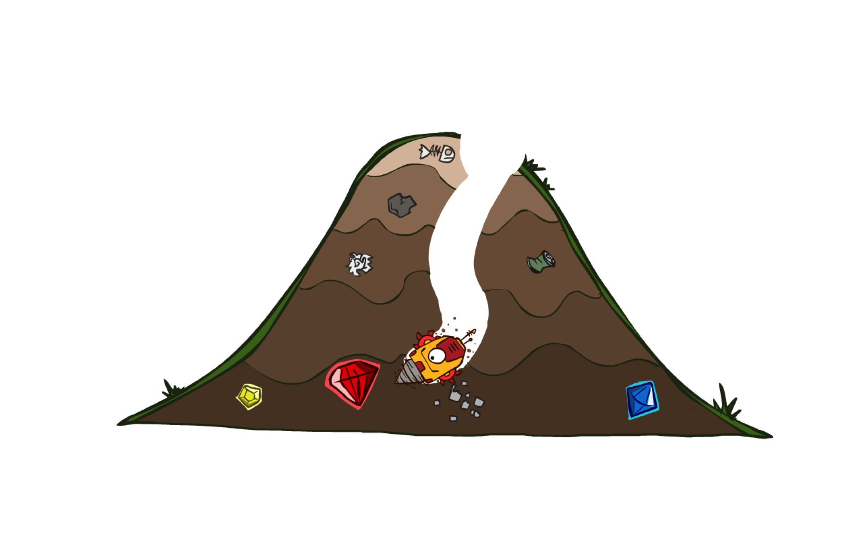
A* Search
Notes:
What we’ve been building to. Cornerstone. Goes to the goal like greedy, but backtracks as needed.
When it works, it’s magic!

Slide 27
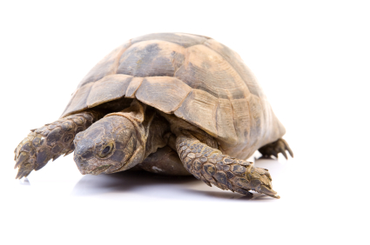
A* Search
UCS
Greedy
A*
Notes:
Notes: these images licensed from iStockphoto for UC Berkeley use.
UCS / Greedy
Goal: The thing that should not be! Hedge bets, be directed.

Slide 28
Combining UCS and Greedy
Uniform-cost orders by path cost, or backward cost g(n)
Greedy orders by goal proximity, or forward cost h(n)
A* Search orders by the sum: f(n) = g(n) + h(n)
8
g = 0 h=6
S
e
h=1
g = 1 h=5
a
1
1
3
2
g = 2 h=6
g = 9 h=1
S
a
d
G
b
d
g = 4 h=2
e
h=6
1
h=5
h=2
h=0
1
g = 3 h=7
g = 6 h=0
g = 10 h=2
c
b
c
G
d
h=7
h=6
g = 12 h=0
G
Example: Teg Grenager
Notes:
UCS. Cumulative cost of arcs back to root. backward cost g(n). Computed as you go as part of the fringe.
Greedy. Heuristic forward cost h(n). NOT cumulative. Just a function of the state.
What is A*. Sum of the two! Doesn’t go to c early cuz h is high (far from goal).
Doesn’t do a->e branch g is high (expensive).

Slide 29
When should A* terminate?
Should we stop when we enqueue a goal?
No: only stop when we dequeue a goal
h = 2
g h +
A
2
2
S 0 3 3
S
h = 3
h = 0
G
S->A 2 2 4
S->B 2 1 3
2
B
3
S->B->G 5 0 5
h = 1
S->A->G 4 0 4

Slide 30
Is A* Optimal?
h = 6
1
A
3
g h +
S 0 7 7
S
h = 7
G
h = 0
S->A 1 6 7
S->G 5 0 5
5
What went wrong?
Actual bad goal cost < estimated good goal cost
We need estimates to be less than actual costs!
Notes:
Dequeue a goal state, got the wrong answer.
Abandon all hope! Heuristic is too high. Overestimated actual cost 3.

Slide 31
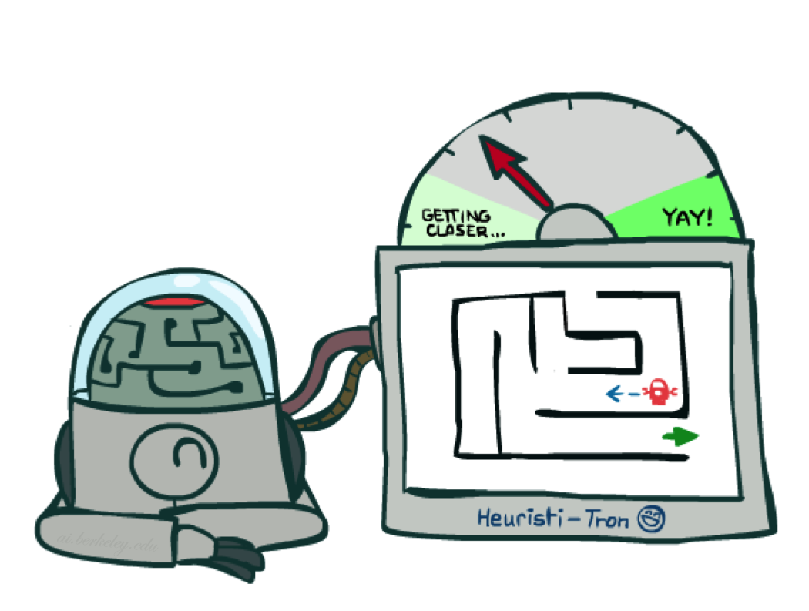
Admissible Heuristics
Notes:
~10:15am

Slide 32
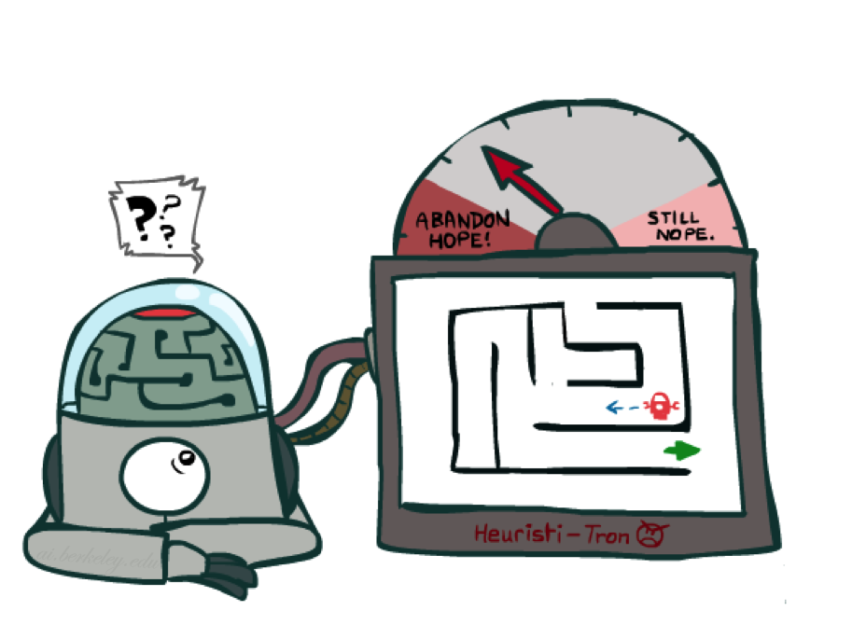
Idea: Admissibility
Inadmissible (pessimistic) heuristics
break optimality by trapping
good plans on the fringe
Admissible (optimistic) heuristics
slow down bad plans but
never outweigh true costs
Notes:
If heuristic lies, and overestimates. Mistake.
Underestimate might reduce to UCS.

Slide 33
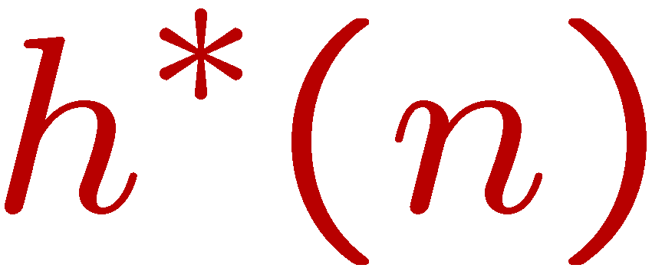
Admissible Heuristics
A heuristic h is admissible (optimistic) if:
where is the true cost to a nearest goal
Examples:
Coming up with admissible heuristics is most of what’s involved in using A* in practice.
0.0
15
11.5
Notes:
True cost – what we’re trying to solve! Need to prove beforehand.

Slide 34
Optimality of A* Tree Search

Slide 35
Optimality of A* Tree Search
Assume:
A is an optimal goal node
B is a suboptimal goal node
h is admissible
Claim:
A will exit the fringe before B
…

Slide 36
Optimality of A* Tree Search: Blocking
Proof:
Imagine B is on the fringe
Some ancestor n of A is on the fringe, too (maybe A!)
Claim: n will be expanded before B
f(n) is less or equal to f(A)
…
Definition of f-cost
Admissibility of h
h = 0 at a goal

Slide 37
Optimality of A* Tree Search: Blocking
Proof:
Imagine B is on the fringe
Some ancestor n of A is on the fringe, too (maybe A!)
Claim: n will be expanded before B
f(n) is less or equal to f(A)
f(A) is less than f(B)
…
B is suboptimal
h = 0 at a goal

Slide 38
Optimality of A* Tree Search: Blocking
Proof:
Imagine B is on the fringe
Some ancestor n of A is on the fringe, too (maybe A!)
Claim: n will be expanded before B
f(n) is less or equal to f(A)
f(A) is less than f(B)
n expands before B
All ancestors of A expand before B
A expands before B
A* search is optimal
…

Slide 39
Properties of A*
Uniform-Cost
A*
b
b
…
…
Notes:
UCS ragged based on cost.
A* narrows when near goal, heuristic

Slide 40
UCS vs A* Contours
Uniform-cost expands equally in all “directions”
A* expands mainly toward the goal, but does hedge its bets to ensure optimality
Start
Goal
Start
Goal
[Demo: contours UCS / greedy / A* empty (L3D1)]
[Demo: contours A* pacman small maze (L3D5)]
Notes:
~10:30

Slide 41
Video of Demo Contours (Empty) -- UCS
Notes:
Uniform ignores where goal is until you hit it.

Slide 42
Video of Demo Contours (Empty) -- Greedy
Notes:
Goes right there! Fast.

Slide 43
Video of Demo Contours (Empty) – A*
Notes:
Splits the diff.
Heuristic leave open possibility that you’ve gone in the wrong direction.
Maybe going to left has a really, really low cost. Wormhole.
How much trade off is a function of the heuristic. If 0, UCS.

Slide 44
Video of Demo Contours (Pacman Small Maze) – A*
Notes:
Same thing, more complex problem.
Search in ”wrong” direction because heuristic wants to go towards goal.
But find the shortest eventually.

Slide 45
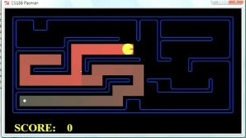
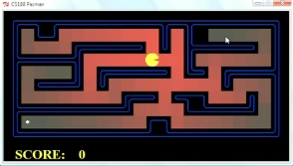
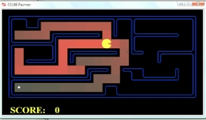
Comparison
Greedy
Uniform Cost
A*

Slide 46
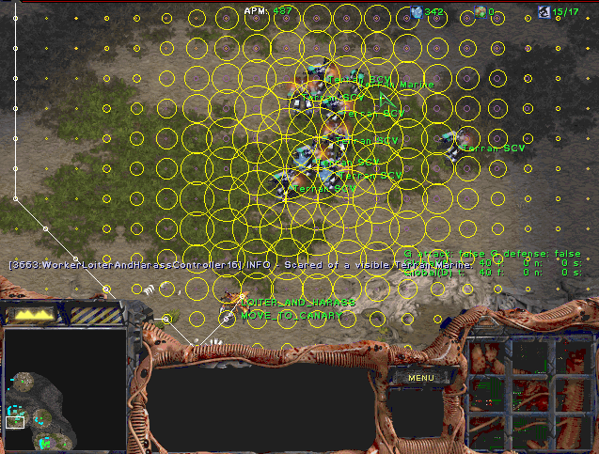
A* Applications
Notes:
Starcraft Overmind

Slide 47
A* Applications
Video games
Pathing / routing problems
Resource planning problems
Robot motion planning
Language analysis
Machine translation
Speech recognition
…
[Demo: UCS / A* pacman tiny maze (L3D6,L3D7)]
[Demo: guess algorithm Empty Shallow/Deep (L3D8)]
Notes:
Starcraft Overmind

Slide 48
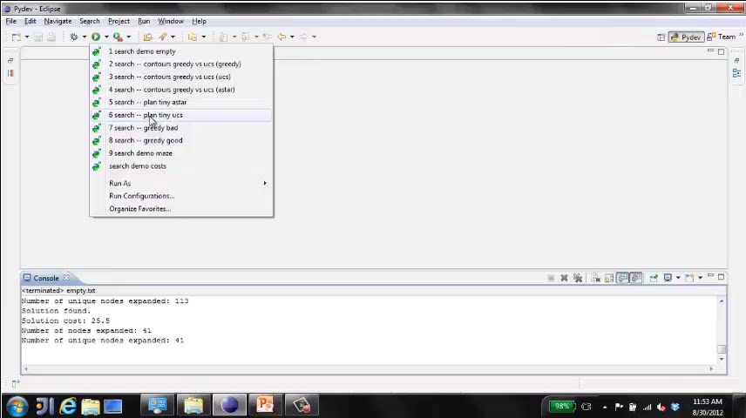
Video of Demo Pacman (Tiny Maze) – UCS / A*
Notes:
UCS. Not replanning.
9000 nodes expanded. Optimal.
182 nodes expanded. So much faster.
A* not crazy!
What heuristics work well? That’s P1

Slide 49
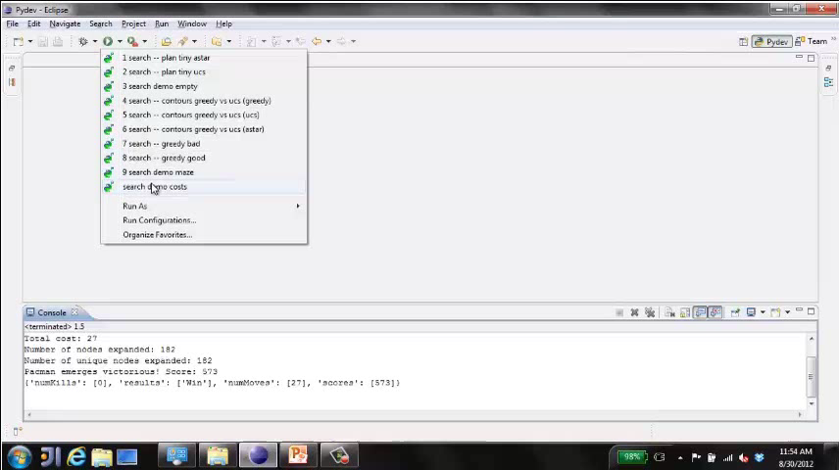
Video of Demo Empty Water Shallow/Deep – Guess Algorithm
Notes:
BFS UCS greedy DFS A*

Slide 50
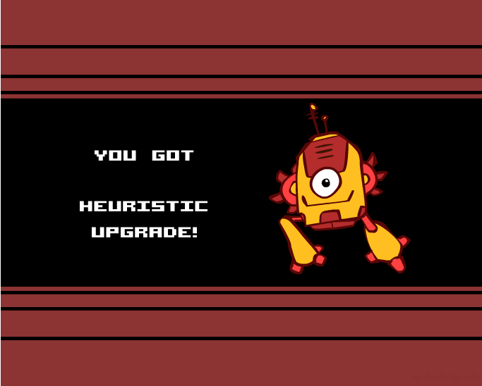
Creating Heuristics
Notes:
Upgrade planning agents with heuristics.
How do we do it?

Slide 51
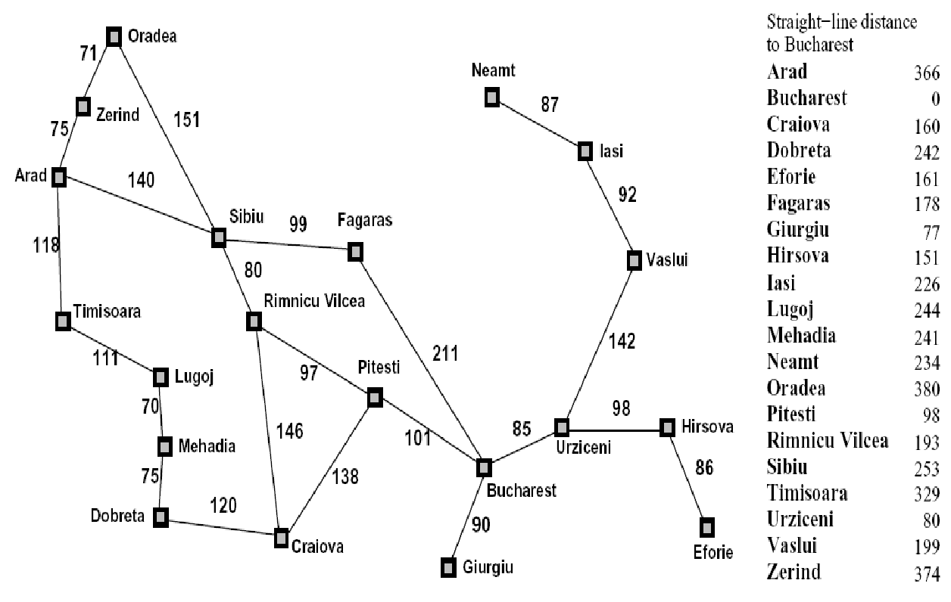
Creating Admissible Heuristics
Most of the work in solving hard search problems optimally is in coming up with admissible heuristics
Often, admissible heuristics are solutions to relaxed problems, where new actions are available
Inadmissible heuristics are often useful too
366
15
Notes:
Change problem – same or easier. And cheaper.
Imagine a new direct road.
Walk through walls spell.
Inadmissible – a little bit suboptimal is okay.

Slide 52
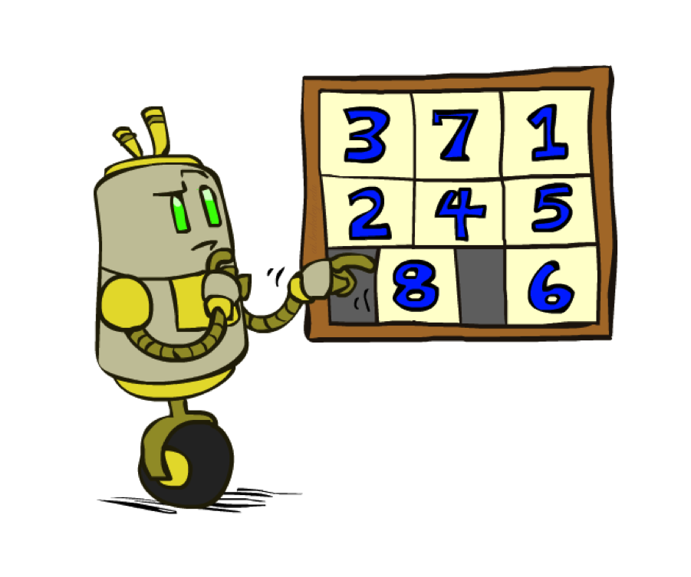
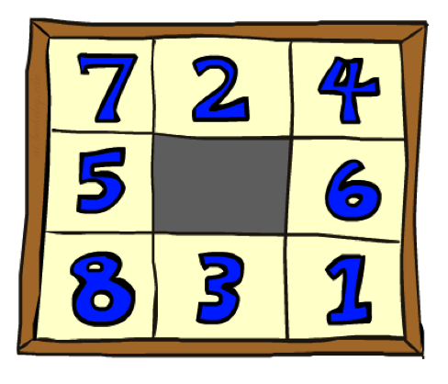
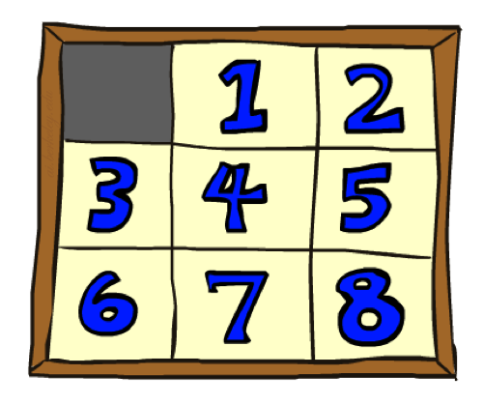
Example: 8 Puzzle
Start State
Actions
Goal State
What are the states?
How many states?
What are the actions?
How many successors from the start state?
What should the costs be?
Admissibleheuristics?
Notes:
Like the xbox of my time.
Branching factor.

Slide 53
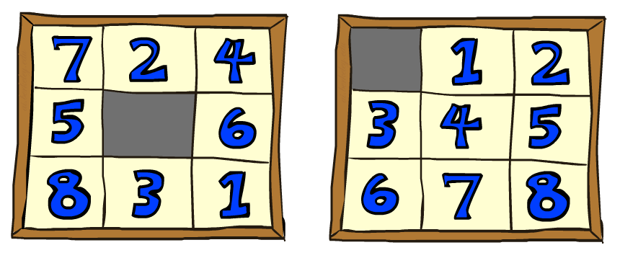
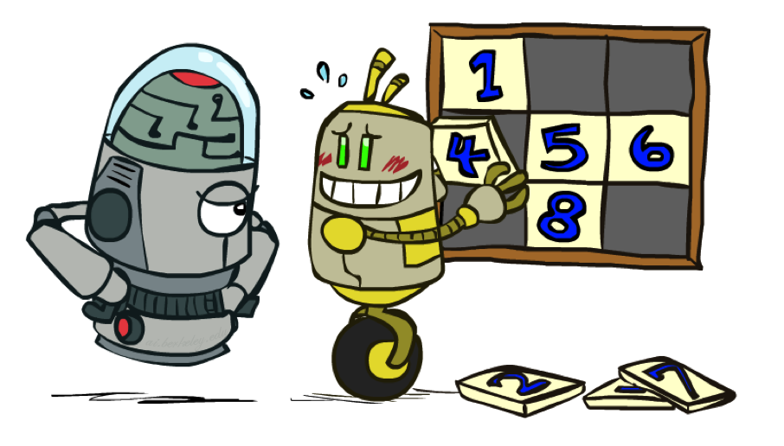
8 Puzzle I
Heuristic: Number of tiles misplaced
Why is it admissible?
h(start) =
This is a relaxed-problem heuristic
8
Start State
Goal State
 | Average nodes expanded when the optimal path has…
 | …4 steps | …8 steps | …12 steps
UCS | 112 | 6,300 | 3.6 x 10⁶
TILES | 13 | 39 | 227
Statistics from Andrew Moore
Notes:
All are out of position. 8
Each tile either goes into it’s right position or not. Fix one mistake, never more than 1.
Cheating is easier.

Slide 54
8 Puzzle II
What if we had an easier 8-puzzle where any tile could slide any direction at any time, ignoring other tiles?
Total Manhattan distance
Why is it admissible?
h(start) =
Start State
Goal State
 | Average nodes expanded when the optimal path has…
 | …4 steps | …8 steps | …12 steps
TILES | 13 | 39 | 227
MANHATTAN | 12 | 25 | 73
3 + 1 + 2 + … = 18
Notes:
Another relaxation, but “harder” than previous.
Lower bound.
Show it’s relaxed or prove.
At LEAST 18 away.
As heuristic gets close to the true cost, you do less search.

Slide 55
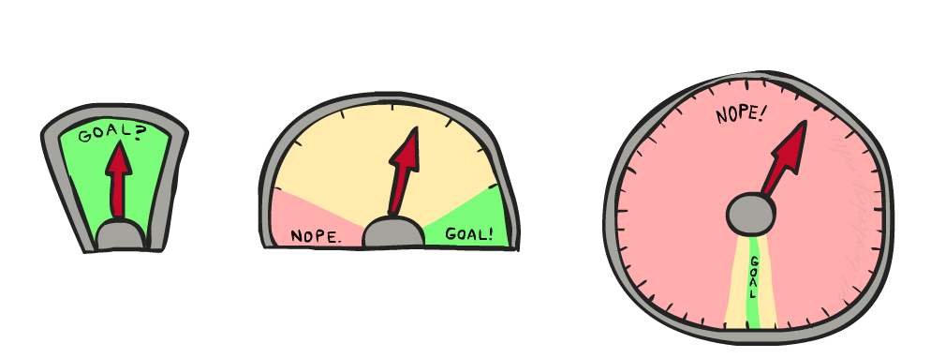
8 Puzzle III
How about using the actual cost as a heuristic?
Would it be admissible?
Would we save on nodes expanded?
What’s wrong with it?
With A*: a trade-off between quality of estimate and work per node
As heuristics get closer to the true cost, you will expand fewer nodes but usually do more work per node to compute the heuristic itself
Notes:
Looks great. Each node launches search as hard as the original problem.
You’ll might see this in P1. Come up with great heuristic, makes solution slower.

Slide 56
Semi-Lattice of Heuristics

Slide 57
Trivial Heuristics, Dominance
Dominance: h_{a} ≥ h_{c} if
Heuristics form a semi-lattice:
Max of admissible heuristics is admissible
Trivial heuristics
Bottom of lattice is the zero heuristic (what does this give us?)
Top of lattice is the exact heuristic
Notes:
Semi-lattice: x <= y <-> x = x ^ y

Slide 58
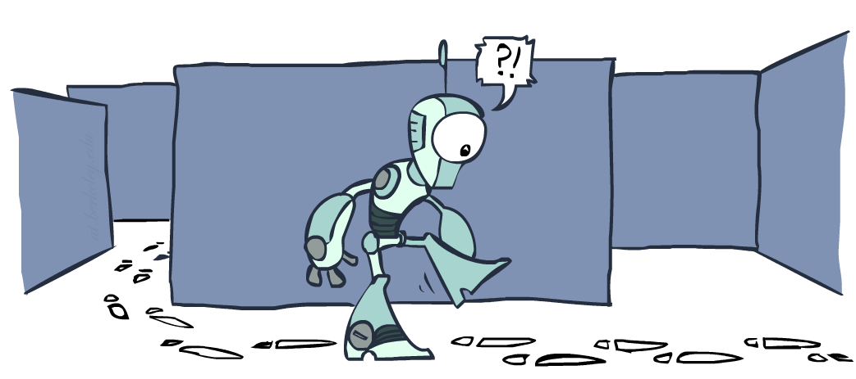
Graph Search
Notes:
~10:40
Lots of repeated work in Tree. Unrolls graph.
Avoid repeated work.

Slide 59
Tree Search: Extra Work!
Failure to detect repeated states can cause exponentially more work.
State Graph
Search Tree
Notes:
Exponential unrolling. Generally what happens.
May need to consider both paths to B, but what’s underneath B is the same.
Should be able to save the work.

Slide 60
Graph Search
In BFS, for example, we shouldn’t bother expanding the circled nodes (why?)
S
d
e
p
b
c
e
h
r
q
a
a
h
r
p
q
f
p
q
f
q
c
G
q
c
G
a
a
Notes:
Breadth first, so s->e before s->d->e
Everything under is identical. If we know best path from this e to G, we know best path from this e to G.
The circled nodes were already visited earlier. BFS, so earlier means higher or equal and to the left.
How to change algorithm? Easy. Consequences hard.

Slide 61
Graph Search
Idea: never expand a state twice
How to implement:
Tree search + set of expanded states (“closed set”)
Expand the search tree node-by-node, but…
Before expanding a node, check to make sure its state has never been expanded before
If not new, skip it, if new add to closed set
Important: store the closed set as a set, not a list
Can graph search wreck completeness? Why/why not?
How about optimality?
Notes:
Expand = GetSuccessor called on it.
Don’t enqueue onto fringe if you already did it.
Warning: Some books call it closed list. It is a set, not a list. Membership check is cheap with set.
Completeness okay. Still a path to the goal.
Optimality is tricky. Maybe got the wrong one.

Slide 62
A* Graph Search Gone Wrong?
State space graph
Search tree
A
S (0+2)
1
S
1
C
h=4
A (1+4)
B (1+1)
h=1
h=2
1
2
C (2+1)
C (3+1)
B
3
G (5+0)
G (6+0)
h=1
G
h=0
Closed Set:
S
B
C
A
Notes:
Need heuristic. This is specification of our abstract problem.
Refuse to expand. Only thing left on fringe is bad G.
Admissible, but not optimal.
If we weren’t doing graph, good G would have appeared, won over bad G.
C used up at the wrong time,

Slide 63
Consistency of Heuristics
Main idea: estimated heuristic costs ≤ actual costs
Admissibility: heuristic cost ≤ actual cost to goal
h(A) ≤ actual cost from A to G
Consistency: heuristic “arc” cost ≤ actual cost for each arc
h(A) – h(C) ≤ cost(A to C)
Consequences of consistency:
The f value along a path never decreases
h(A) ≤ cost(A to C) + h(C)
A* graph search is optimal
A
1
C
h=4
h=1
h=2
3
G
Notes:
Need stronger condition than admisibility.
Single arc. Heuristic don’t score arcs, so take difference.

Slide 64
Optimality of A* Search
With a admissible heuristic, Tree A* is optimal.
With a consistent heuristic, Graph A* is optimal.
See slides, also video lecture from past years for details.
With h=0, the same proof shows that UCS is optimal.
Notes:
I like fall 2013 on edx.org by Dan Klein because it’s edited.

Slide 65
Optimality of A* Graph Search

Slide 66
Optimality of A* Graph Search
Sketch: consider what A* does with a consistent heuristic:
Fact 1: In tree search, A* expands nodes in increasing total f value (f-contours)
Fact 2: For every state s, nodes that reach s optimally are expanded before nodes that reach s suboptimally
Result: A* graph search is optimal
…
f ≤ 1
f ≤ 2
f ≤ 3

Slide 67
Optimality
Tree search:
A* is optimal if heuristic is admissible
UCS is a special case (h = 0)
Graph search:
A* optimal if heuristic is consistent
UCS optimal (h = 0 is consistent)
Consistency implies admissibility
In general, most natural admissible heuristics tend to be consistent, especially if from relaxed problems

Slide 68
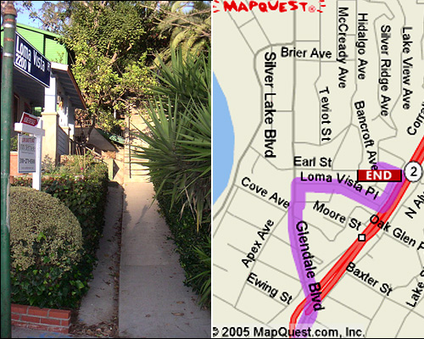
Search Gone Wrong?
Notes:
Search operates over MODELS.
Agent doesn’t actually try the paths – all in simulation.
Search is only as good as model.
Probably end here. If time, go through summary.

Slide 69
A*: Summary

Slide 70
A*: Summary
A* uses both backward costs and (estimates of) forward costs
A* is optimal with admissible / consistent heuristics
Heuristic design is key: often use relaxed problems
Notes:
Heuristic is cheaper than reality.

Slide 71
Tree Search Pseudo-Code

Slide 72
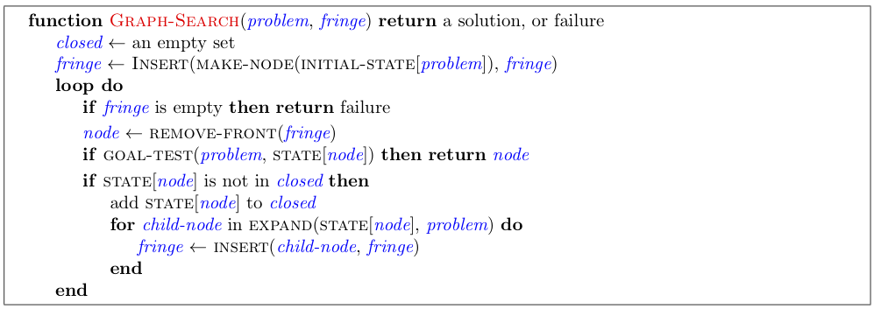
Graph Search Pseudo-Code

Slide 73
Optimality of A* Graph Search
Consider what A* does:
Expands nodes in increasing total f value (f-contours) Reminder: f(n) = g(n) + h(n) = cost to n + heuristic
Proof idea: the optimal goal(s) have the lowest f value, so it must get expanded first
…
f ≤ 1
There’s a problem with this argument. What are we assuming is true?
f ≤ 2
f ≤ 3

Slide 74
Optimality of A* Graph Search
Proof:
New possible problem: some n on path to G* isn’t in queue when we need it, because some worse n’ for the same state dequeued and expanded first (disaster!)
Take the highest such n in tree
Let p be the ancestor of n that was on the queue when n’ was popped
f(p) < f(n) because of consistency
f(n) < f(n’) because n’ is suboptimal
p would have been expanded before n’
Contradiction!

Slide 75
The One Queue
All these search algorithms are the same except for fringe strategies
Conceptually, all fringes are priority queues (i.e. collections of nodes with attached priorities)
Practically, for DFS and BFS, you can avoid the log(n) overhead from an actual priority queue, by using stacks and queues
Can even code one implementation that takes a variable queuing object

Slide 76
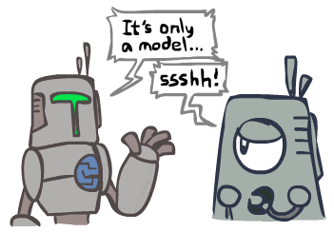
Search and Models
Search operates over models of the world
The agent doesn’t actually try all the plans out in the real world!
Planning is all “in simulation”
Your search is only as good as your models…
Notes:
All in your head.

Slide 77
Search Gone Wrong?
Notes:
Next time – guided search where you know something about direction of solution.

