Slide 1
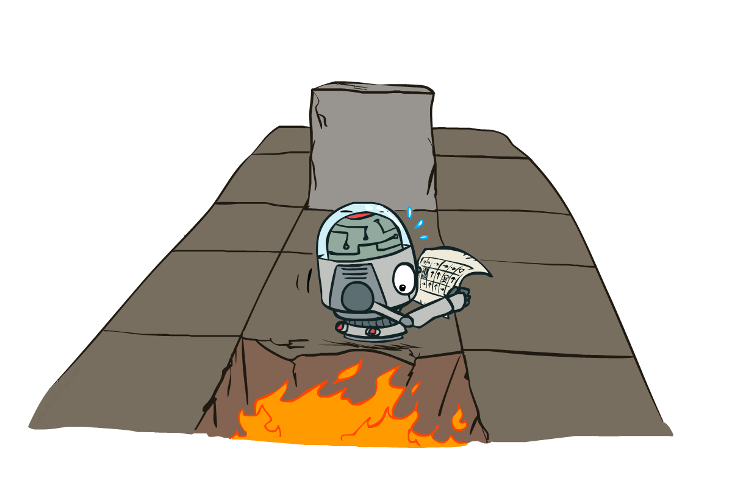
CS 188: Artificial Intelligence
Markov Decision Processes II
Instructor: Anca Dragan
University of California, Berkeley
[These slides adapted from Dan Klein and Pieter Abbeel]
Notes:
Please retain proper attribution, including the reference to ai.berkeley.edu. Thanks!

Slide 2

Recap: Defining MDPs
Markov decision processes:
  Set of states S
  Start state s₀
  Set of actions A
  Transitions P(s’|s,a) (or T(s,a,s’))
  Rewards R(s,a,s’) (and discount γ)
MDP quantities so far:
  Policy = Choice of action for each state
  Utility = sum of (discounted) rewards
s
a
s, a
s,a,s’
s’

Slide 3

Solving MDPs

Slide 4




Racing Search Tree

Slide 5




Racing Search Tree

Slide 6
Optimal Quantities
The value (utility) of a state s:
  V*(s) = expected utility starting in s and acting optimally
The value (utility) of a q-state (s,a):
  Q*(s,a) = expected utility starting out having taken action a from state s and (thereafter) acting optimally
The optimal policy:
  π*(s) = optimal action from state s
s
s is a state
a
(s, a) is a q-state
s, a
s,a,s’
(s,a,s’) is a
transition
s’
[Demo – gridworld values (L8D4)]
Notes:
[Note: this demo doesn’t show anything in action, just pops up V and Q values.]

Slide 7

Snapshot of Demo – Gridworld V Values
Noise = 0.2
Discount = 0.9
Living reward = 0
Notes:
This demo doesn’t show anything in action, it just shows the V and Q values.

Slide 8

Snapshot of Demo – Gridworld Q Values
Noise = 0.2
Discount = 0.9
Living reward = 0
Notes:
This demo doesn’t show anything in action, it just shows the V and Q values.

Slide 9
Values of States
Recursive definition of value:
s
a
s, a
s,a,s’
s’

Slide 10





Time-Limited Values
Key idea: time-limited values
Define V_{k}(s) to be the optimal value of s if the game ends in k more time steps
  Equivalently, it’s what a depth-k expectimax would give from s
[Demo – time-limited values (L8D6)]
Notes:
This demo generates the time-limited values for gridworld as snapshotted onto the next slides.

Slide 11

k=0
Noise = 0.2
Discount = 0.9
Living reward = 0
Notes:
Assuming zero living reward

Slide 12

k=1
Noise = 0.2
Discount = 0.9
Living reward = 0
Notes:
Assuming zero living reward
Next: .8*.9=.72

Slide 13

k=2
Noise = 0.2
Discount = 0.9
Living reward = 0
Notes:
Assuming zero living reward

Slide 14

k=3
Noise = 0.2
Discount = 0.9
Living reward = 0
Notes:
Assuming zero living reward
Just went up – because you can try to get back now if you get carried out by the noise

Slide 15

k=4
Noise = 0.2
Discount = 0.9
Living reward = 0
Notes:
Assuming zero living reward

Slide 16

k=5
Noise = 0.2
Discount = 0.9
Living reward = 0
Notes:
Assuming zero living reward

Slide 17

k=6
Noise = 0.2
Discount = 0.9
Living reward = 0
Notes:
Assuming zero living reward

Slide 18

k=7
Noise = 0.2
Discount = 0.9
Living reward = 0
Notes:
Assuming zero living reward

Slide 19

k=8
Noise = 0.2
Discount = 0.9
Living reward = 0
Notes:
Assuming zero living reward

Slide 20

k=9
Noise = 0.2
Discount = 0.9
Living reward = 0
Notes:
Assuming zero living reward

Slide 21

k=10
Noise = 0.2
Discount = 0.9
Living reward = 0
Notes:
Assuming zero living reward

Slide 22

k=11
Noise = 0.2
Discount = 0.9
Living reward = 0
Notes:
Assuming zero living reward

Slide 23

k=12
Noise = 0.2
Discount = 0.9
Living reward = 0
Notes:
Assuming zero living reward

Slide 24

k=100
Noise = 0.2
Discount = 0.9
Living reward = 0
Notes:
Assuming zero living reward

Slide 25





Computing Time-Limited Values

Slide 26

Value Iteration

Slide 27
Value Iteration
Start with V₀(s) = 0: no time steps left means an expected reward sum of zero
Given vector of V_{k}(s) values, do one ply of expectimax from each state:
Repeat until convergence
Complexity of each iteration: O(S²A)
V_{k+1}(s)
a
s, a
s,a,s’
V_{k}(s’)
Notes:
Discuss computational complexity: S * A * S times number of iterations
Note: updates not in place

Slide 28

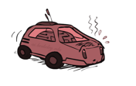

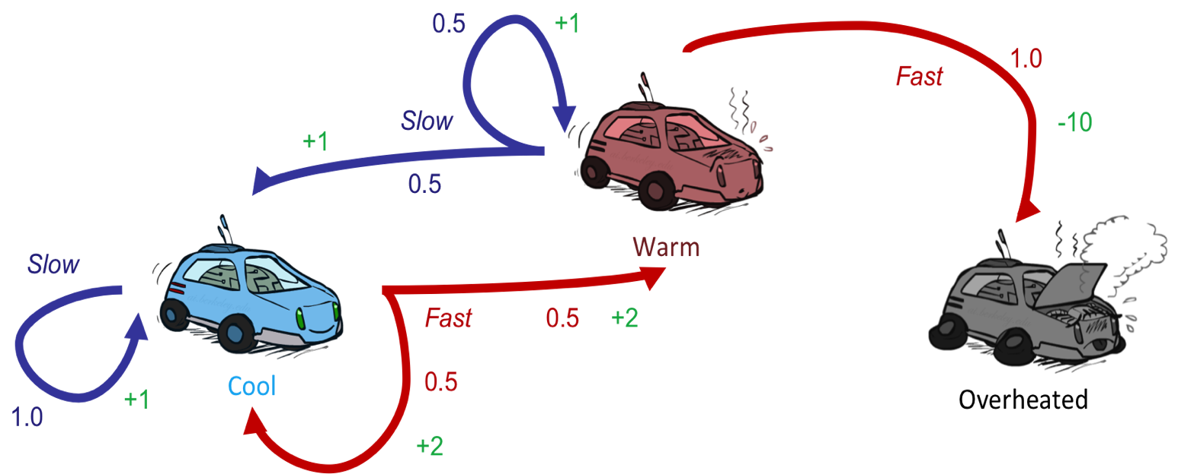



Example: Value Iteration
S: 1
F: .5*2+.5*2=2
Assume no discount!
0 0 0

Slide 29
Example: Value Iteration
2
S: .5*1+.5*1=1
F: -10
Assume no discount!
0 0 0

Slide 30
Example: Value Iteration
2
1
0
Assume no discount!
0 0 0

Slide 31
Example: Value Iteration
S: 1+2=3
F: .5*(2+2)+.5*(2+1)=3.5
2
1
0
Assume no discount!
0 0 0

Slide 32
Example: Value Iteration
3.5
2.5
0
2
1
0
Assume no discount!
0 0 0

Slide 33


Convergence*
How do we know the V_{k} vectors are going to converge?
Case 1: If the tree has maximum depth M, then V_{M} holds the actual untruncated values
Case 2: If the discount is less than 1
  Sketch: For any state V_{k} and V_{k+1} can be viewed as depth k+1 expectimax results in nearly identical search trees
  The difference is that on the bottom layer, V_{k+1} has actual rewards while V_{k} has zeros
  That last layer is at best all R_{MAX}
  It is at worst R_{MIN}
  But everything is discounted by γ^{k} that far out
  So V_{k} and V_{k+1} are at most γ^{k} max|R| different
  So as k increases, the values converge

Slide 34
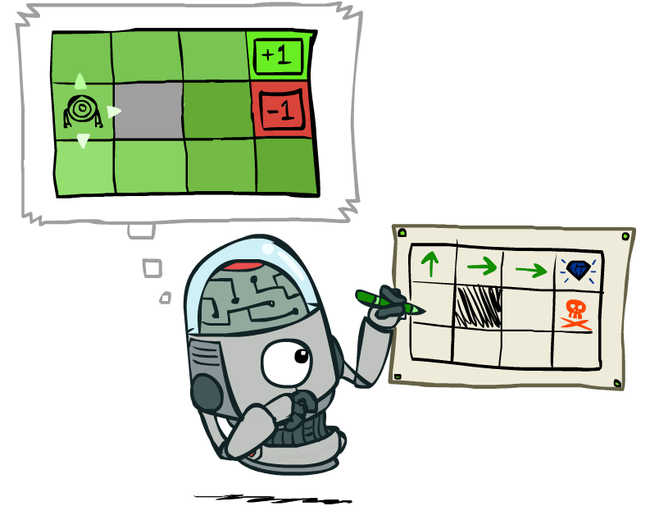
Policy Extraction

Slide 35
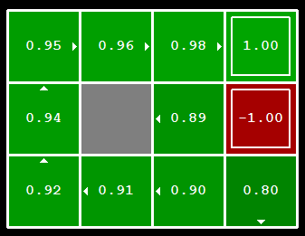


Computing Actions from Values
Let’s imagine we have the optimal values V*(s)
How should we act?
  It’s not obvious!
We need to do a mini-expectimax (one step)
This is called policy extraction, since it gets the policy implied by the values

Slide 36
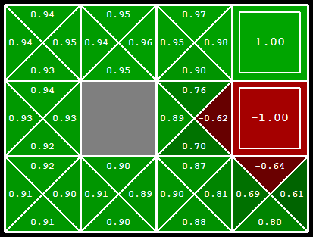
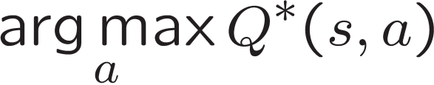
Computing Actions from Q-Values
Let’s imagine we have the optimal
q-values:
How should we act?
  Completely trivial to decide!
Important lesson: actions are easier to select from q-values than values!

Slide 37
Let’s think.
Take a minute, think about value iteration.
Write down the biggest question you have about it.

Slide 38
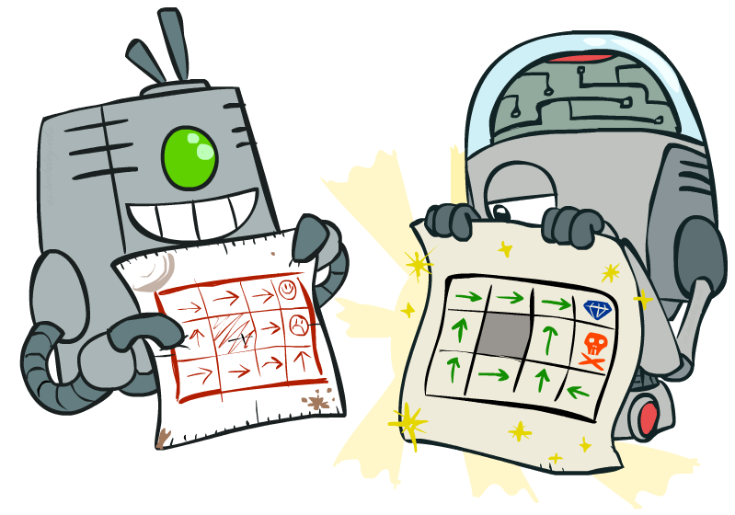
Policy Methods

Slide 39
Problems with Value Iteration
Value iteration repeats the Bellman updates:
Problem 1: It’s slow – O(S²A) per iteration
Problem 2: The “max” at each state rarely changes
Problem 3: The policy often converges long before the values
s
a
s, a
s,a,s’
s’
[Demo: value iteration (L9D2)]
Notes:
Demo steps through value iteration; snapshots of values shown on next slides.

Slide 40
k=12
Noise = 0.2
Discount = 0.9
Living reward = 0
Notes:
Assuming zero living reward

Slide 41
k=100
Noise = 0.2
Discount = 0.9
Living reward = 0
Notes:
Assuming zero living reward

Slide 42
Policy Iteration
Alternative approach for optimal values:
  Step 1: Policy evaluation: calculate utilities for some fixed policy (not optimal utilities!) until convergence
  Step 2: Policy improvement: update policy using one-step look-ahead with resulting converged (but not optimal!) utilities as future values
  Repeat steps until policy converges
This is policy iteration
  It’s still optimal!
  Can converge (much) faster under some conditions

Slide 43

Policy Evaluation

Slide 44
Fixed Policies
Do the optimal action
Do what π says to do
s
s
a
π(s)
s, a
s, π(s)
s,a,s’
s, π(s),s’
s’
s’
Expectimax trees max over all actions to compute the optimal values
If we fixed some policy π(s), then the tree would be simpler – only one action per state
  … though the tree’s value would depend on which policy we fixed

Slide 45
Utilities for a Fixed Policy
Another basic operation: compute the utility of a state s under a fixed (generally non-optimal) policy
Define the utility of a state s, under a fixed policy π:
  V^{π}(s) = expected total discounted rewards starting in s and following π
Recursive relation (one-step look-ahead / Bellman equation):
s
π(s)
s, π(s)
s, π(s),s’
s’

Slide 46

Policy Evaluation
s
How do we calculate the V’s for a fixed policy π?
Idea 1: Turn recursive Bellman equations into updates
(like value iteration)
Efficiency: O(S²) per iteration
Idea 2: Without the maxes, the Bellman equations are just a linear system
  Solve with Matlab (or your favorite linear system solver)
π(s)
s, π(s)
s, π(s),s’
s’

Slide 47
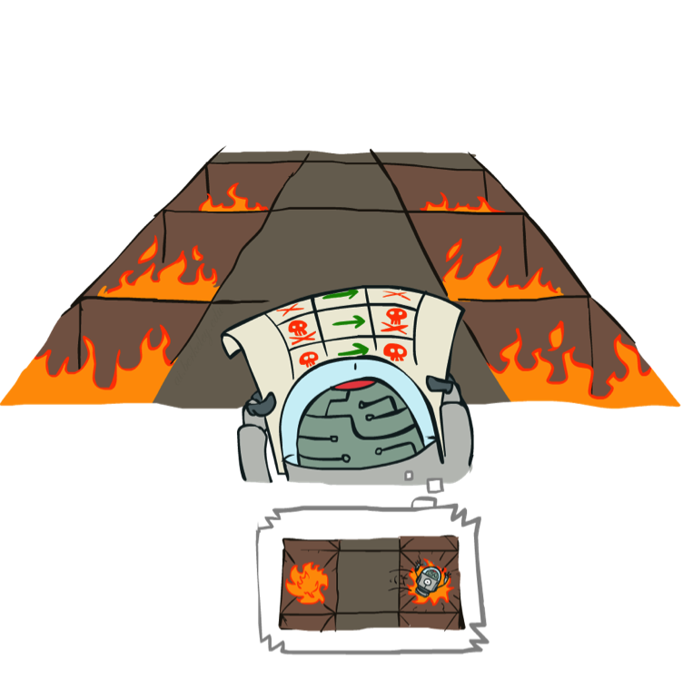
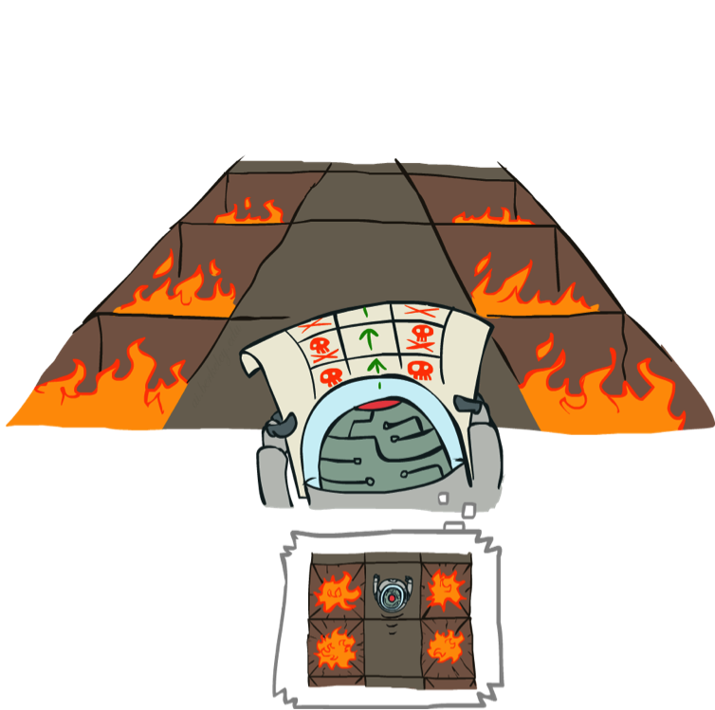
Example: Policy Evaluation
Always Go Right
Always Go Forward

Slide 48
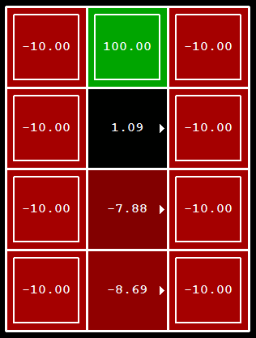
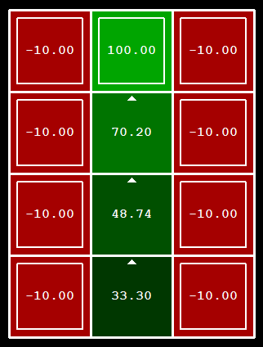
Example: Policy Evaluation
Always Go Right
Always Go Forward

Slide 49

Policy Iteration

Slide 50
Policy Iteration
Evaluation: For fixed current policy π, find values with policy evaluation:
  Iterate until values converge:
Improvement: For fixed values, get a better policy using policy extraction
  One-step look-ahead:

Slide 51
Comparison
Both value iteration and policy iteration compute the same thing (all optimal values)
In value iteration:
  Every iteration updates both the values and (implicitly) the policy
  We don’t track the policy, but taking the max over actions implicitly recomputes it
In policy iteration:
  We do several passes that update utilities with fixed policy (each pass is fast because we consider only one action, not all of them)
  After the policy is evaluated, a new policy is chosen (slow like a value iteration pass)
  The new policy will be better (or we’re done)
Both are dynamic programs for solving MDPs

Slide 52
Summary: MDP Algorithms
So you want to….
  Compute optimal values: use value iteration or policy iteration
  Compute values for a particular policy: use policy evaluation
  Turn your values into a policy: use policy extraction (one-step lookahead)
These all look the same!
  They basically are – they are all variations of Bellman updates
  They all use one-step lookahead expectimax fragments
  They differ only in whether we plug in a fixed policy or max over actions

Slide 53

The Bellman Equations
How to be optimal:
Step 1: Take correct first action
Step 2: Keep being optimal

Slide 54
Next Time: Reinforcement Learning!

Slide 55

Asynchronous Value Iteration*
In value iteration, we update every state in each iteration
  Actually, any sequences of Bellman updates will converge if every state is visited infinitely often
In fact, we can update the policy as seldom or often as we like, and we will still converge
Idea: Update states whose value we expect to change:
If is large then update predecessors of s

