Slide 1

CS 188: Artificial Intelligence
Perceptrons and Logistic Regression
Nathan Lambert
University of California, Berkeley

Slide 2
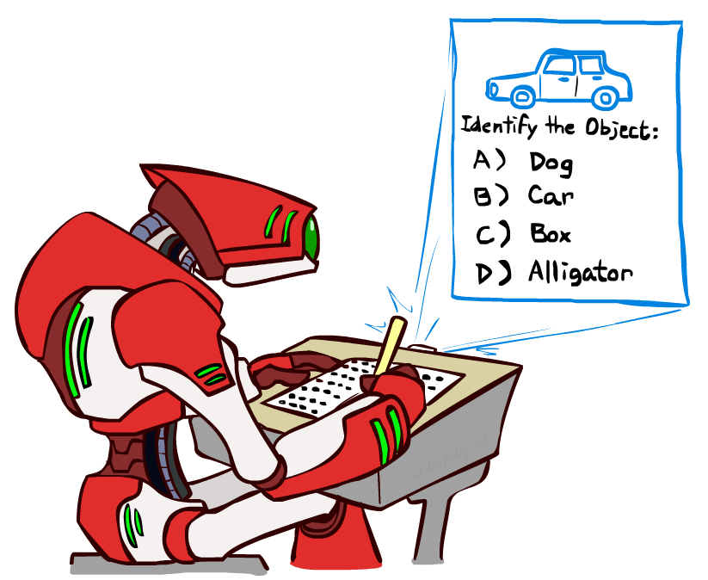


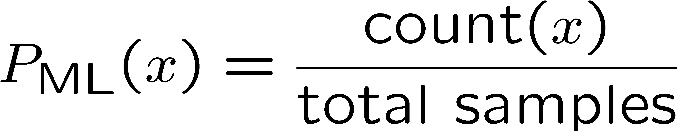
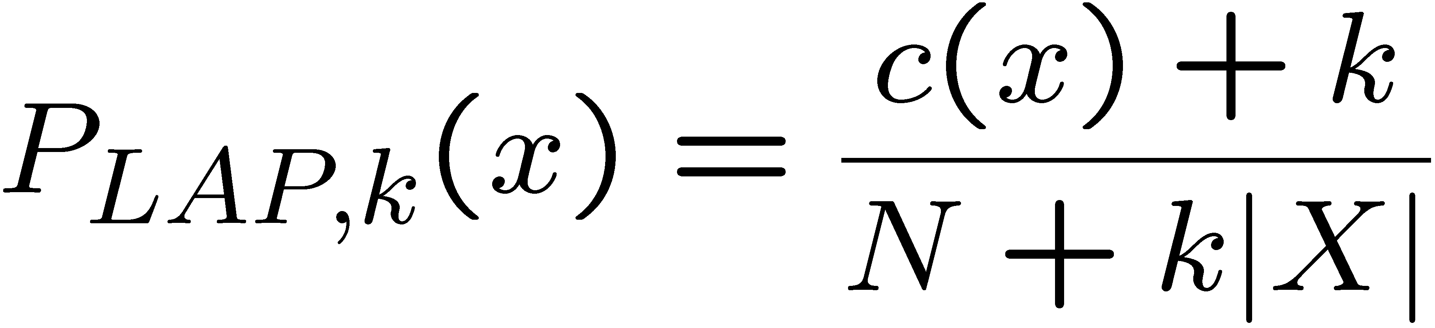
Last Times
Classification: given inputs x, predict labels (classes) y
Naïve Bayes
Parameter estimation:
  MLE, MAP, priors
Laplace smoothing
Training set, held-out set, test set
Y
F₁
F₂
F_{n}

Slide 3
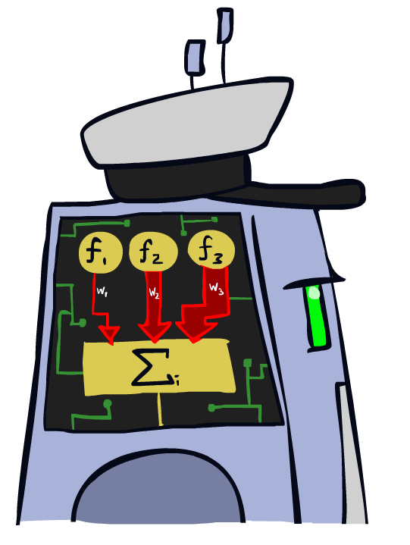
Linear Classifiers

Slide 4
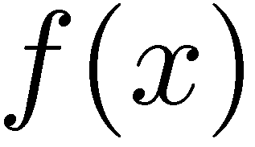

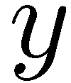

Feature Vectors
Hello,
Do you want free printr cartriges? Why pay more when you can get them ABSOLUTELY FREE! Just
# free : 2
YOUR_NAME : 0
MISSPELLED : 2
FROM_FRIEND : 0
...
SPAM
or
+
PIXEL-7,12 : 1
PIXEL-7,13 : 0
...
NUM_LOOPS : 1
...
“2”

Slide 5
Some (Simplified) Biology
Very loose inspiration: human neurons

Slide 6
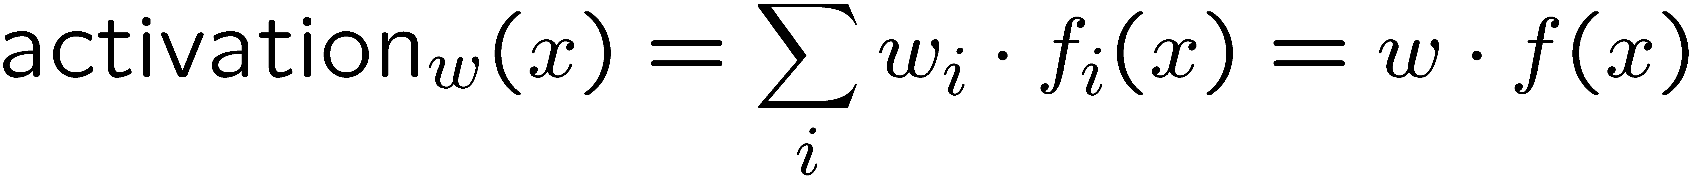
Linear Classifiers
Inputs are feature values
Each feature has a weight
Sum is the activation
If the activation is:
  Positive, output +1
  Negative, output -1
w₁
f₁
Σ
w₂
>0?
f₂
w₃
f₃

Slide 7

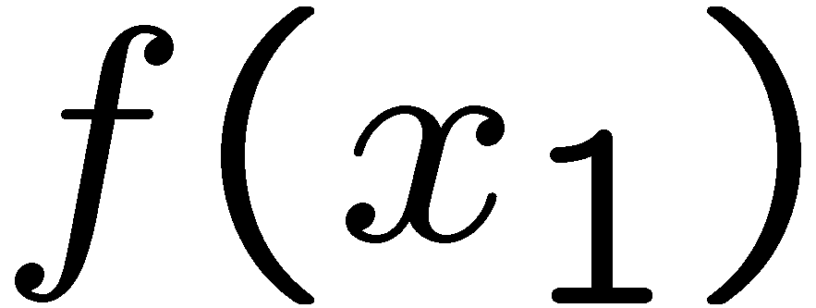
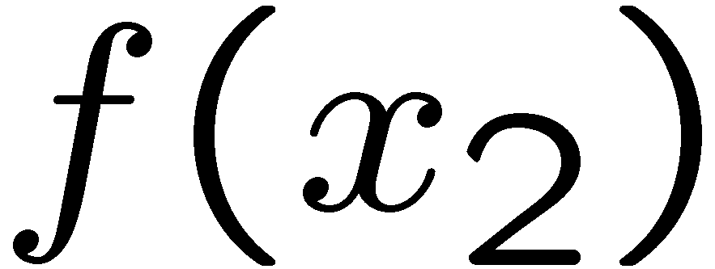
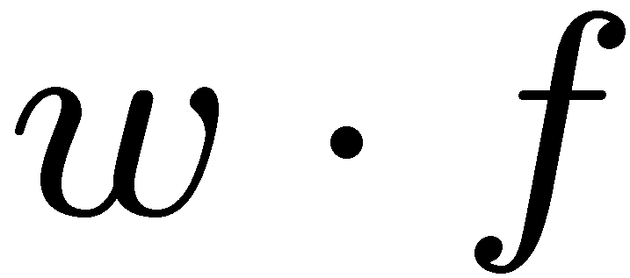
Weights
Binary case: compare features to a weight vector
Learning: figure out the weight vector from examples
# free : 4
YOUR_NAME :-1
MISSPELLED : 1
FROM_FRIEND :-3
...
# free : 2
YOUR_NAME : 0
MISSPELLED : 2
FROM_FRIEND : 0
...
# free : 0
YOUR_NAME : 1
MISSPELLED : 1
FROM_FRIEND : 1
...
Dot product positive means the positive class

Slide 8
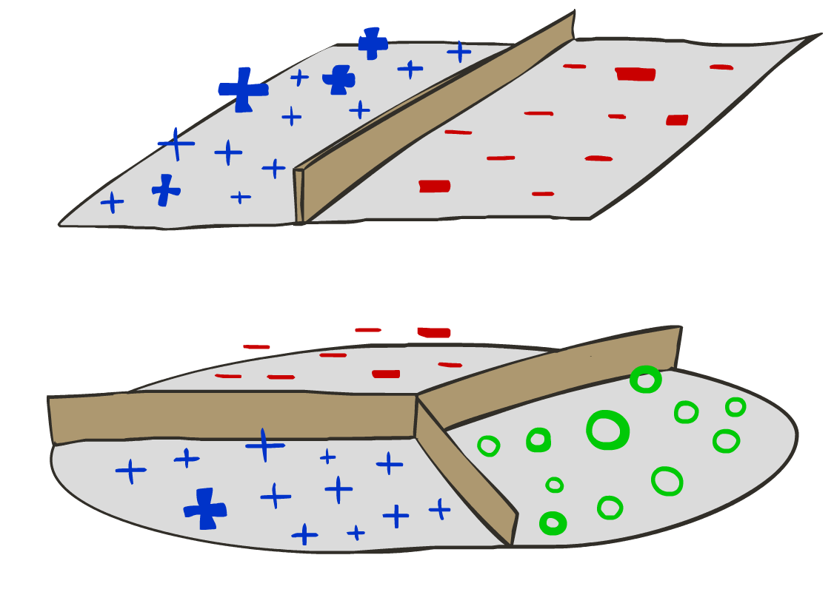
Decision Rules

Slide 9

Binary Decision Rule
In the space of feature vectors
  Examples are points
  Any weight vector is a hyperplane
  One side corresponds to Y=+1
  Other corresponds to Y=-1
money
2
1
BIAS : -3
free : 4
money : 2
...
0
0
1
free

Slide 10
Binary Decision Rule
In the space of feature vectors
  Examples are points
  Any weight vector is a hyperplane
  One side corresponds to Y=+1
  Other corresponds to Y=-1
money
2
1
BIAS : -3
free : 4
money : 2
...
0
0
1
free

Slide 11
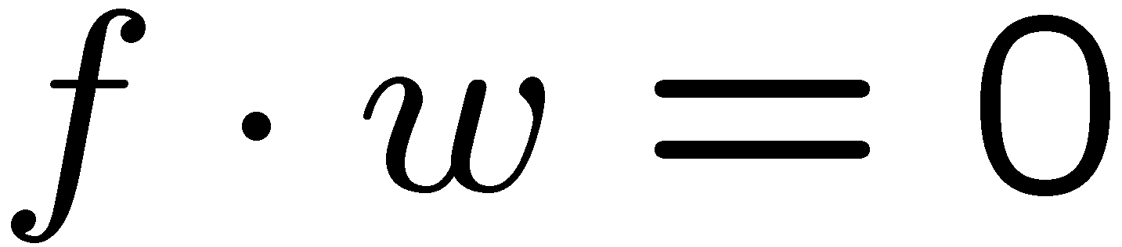
Binary Decision Rule
In the space of feature vectors
  Examples are points
  Any weight vector is a hyperplane
  One side corresponds to Y=+1
  Other corresponds to Y=-1
money
2
+1 = SPAM
1
BIAS : -3
free : 4
money : 2
...
0
-1 = HAM
0
1
free

Slide 12
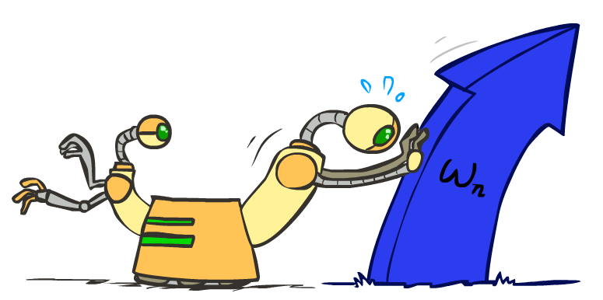
Weight Updates

Slide 13
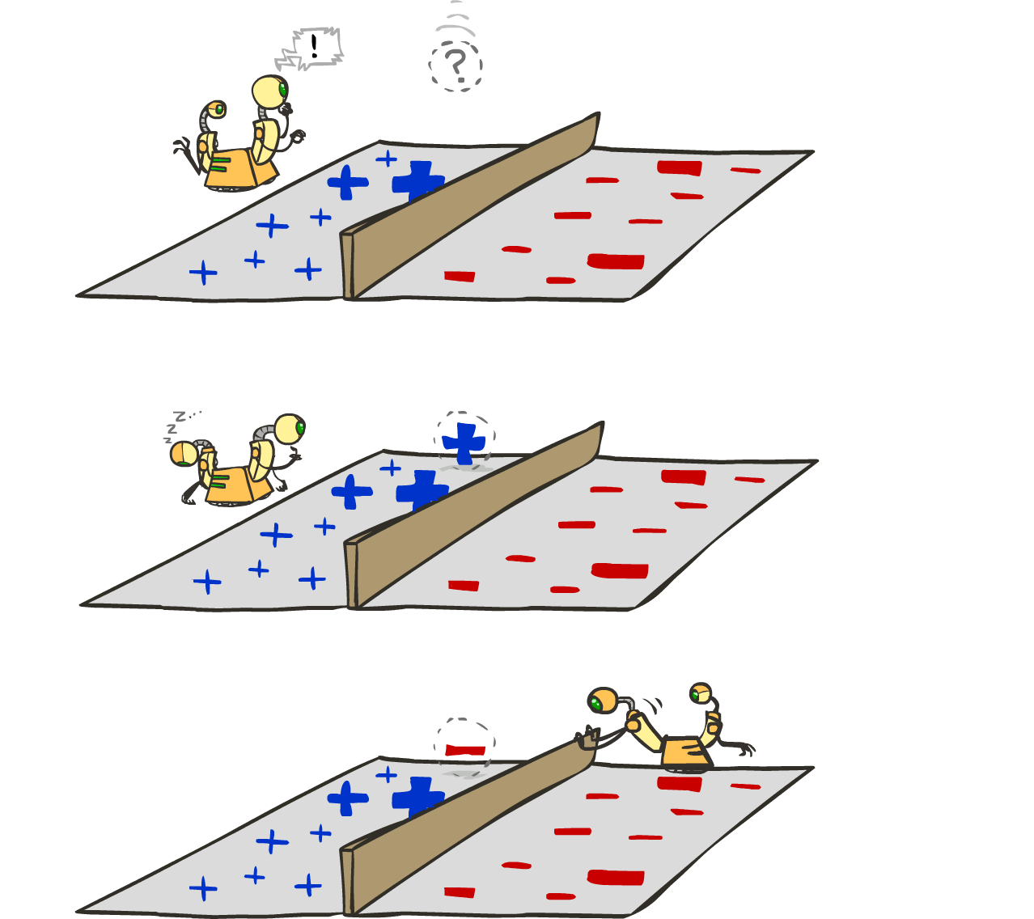
Learning: Binary Perceptron
Start with weights = 0
For each training instance:
  Classify with current weights
  If correct (i.e., y=y*), no change!
  If wrong: adjust the weight vector
Notes:
http://isl.ira.uka.de/neuralNetCourse/2004/VL_11_5/Perceptron.html

Slide 14
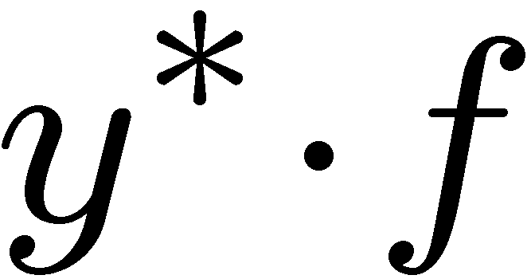
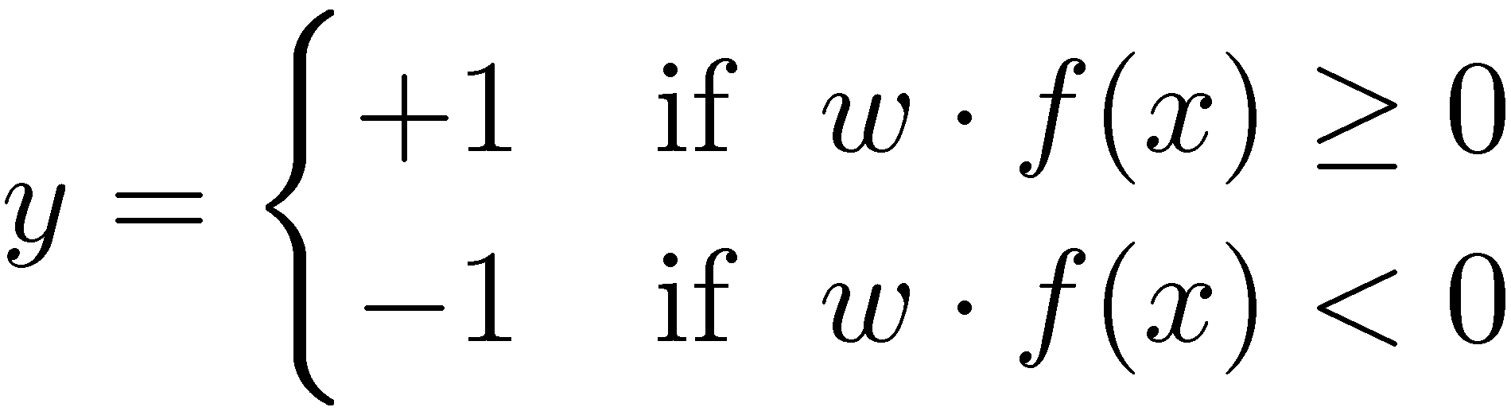

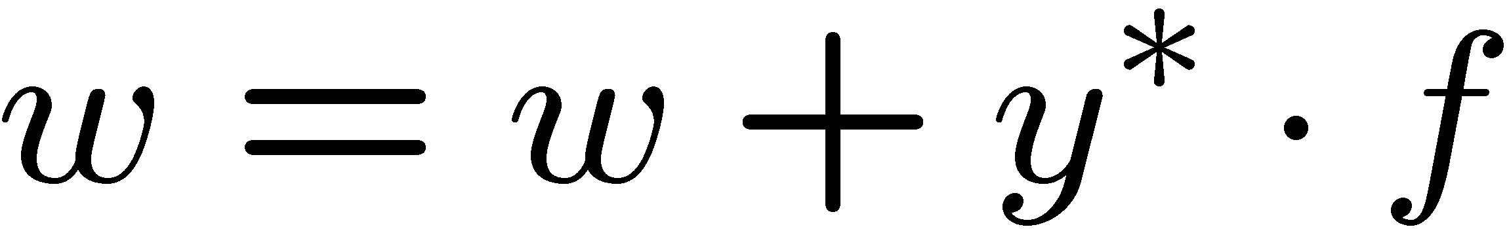
Learning: Binary Perceptron
Start with weights = 0
For each training instance:
  Classify with current weights
  If correct (i.e., y=y*), no change!
  If wrong: adjust the weight vector by adding or subtracting the feature vector. Subtract if y* is -1.
Before: w f
After: wf + y*f f
f f >=0
Notes:
http://isl.ira.uka.de/neuralNetCourse/2004/VL_11_5/Perceptron.html

Slide 15
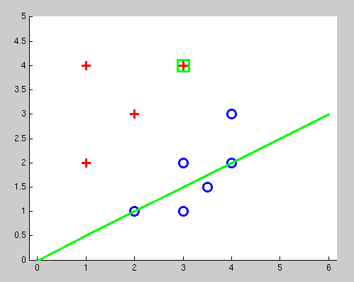
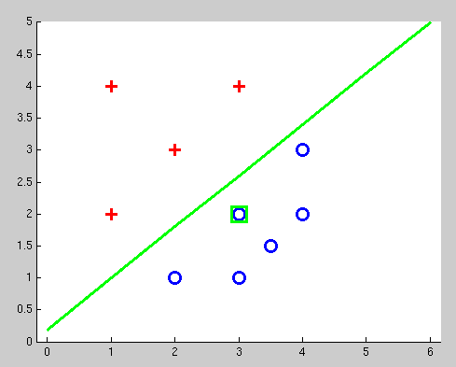
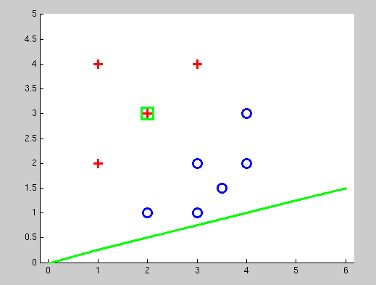
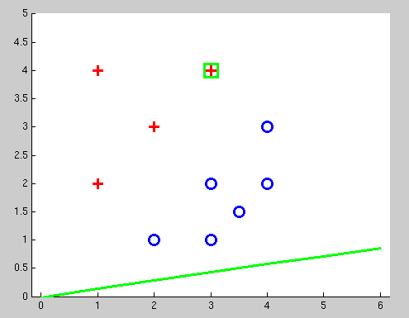
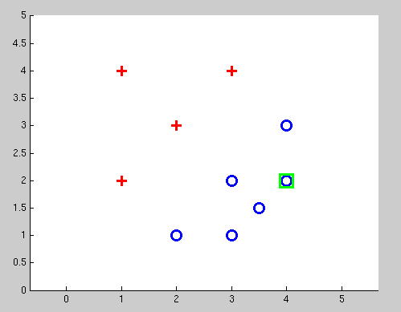
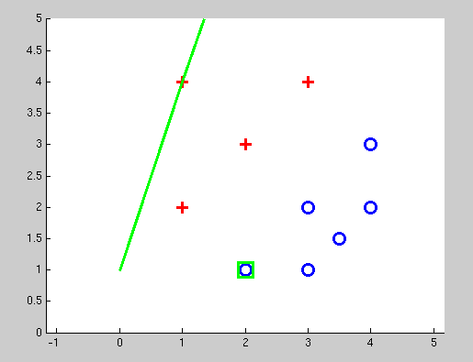
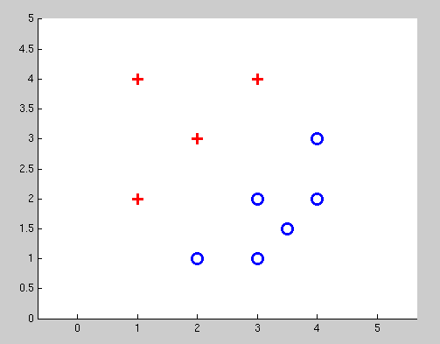
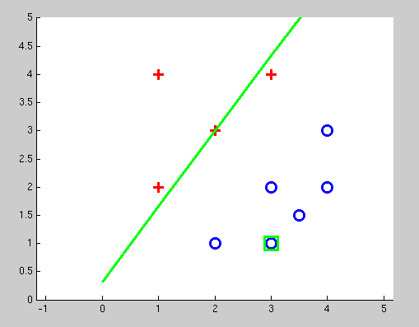
Examples: Perceptron
Separable Case

Slide 16


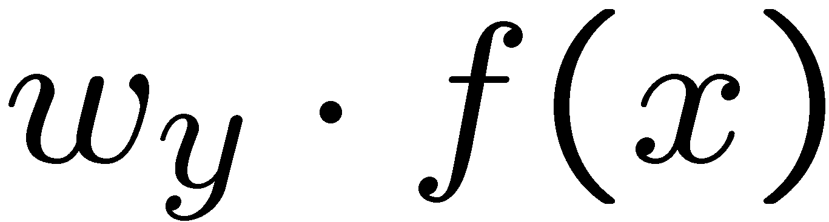


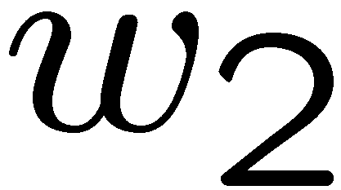
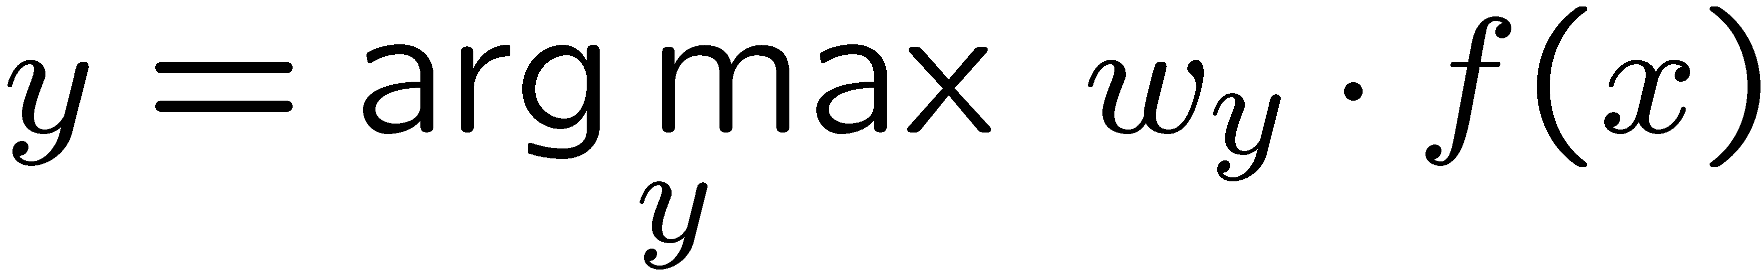
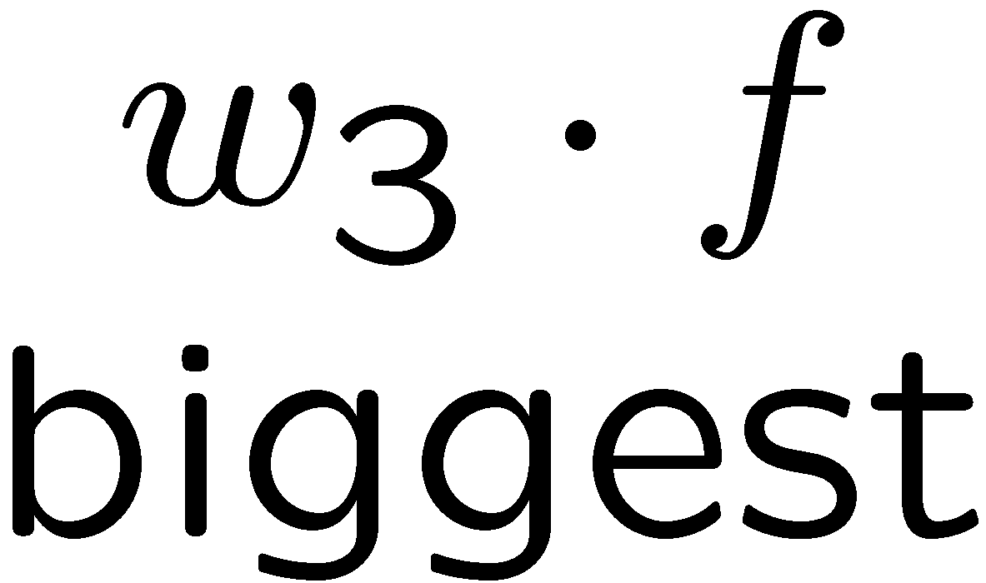
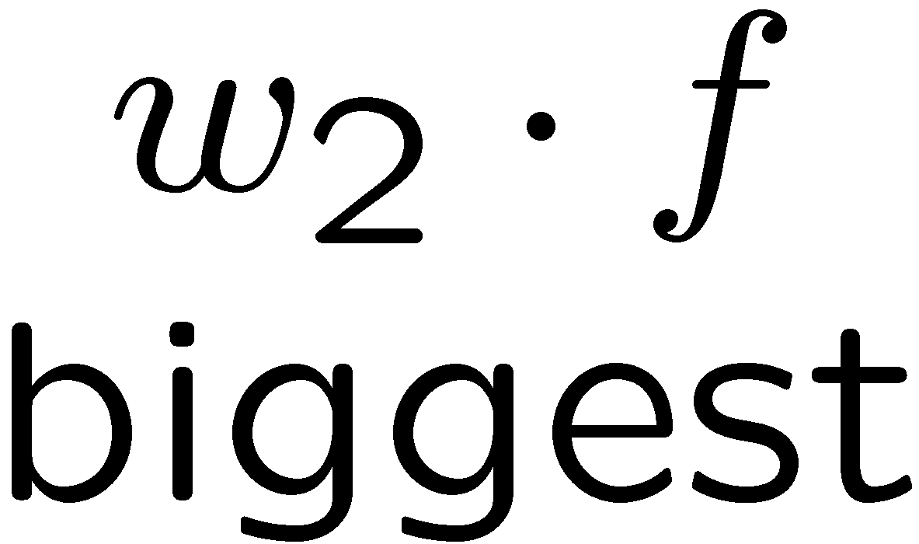
Multiclass Decision Rule
If we have multiple classes:
  A weight vector for each class:
  Score (activation) of a class y:
  Prediction highest score wins
Binary = multiclass where the negative class has weight zero
Notes:
Picture only true for equal size ws; if we had a really big or really small w1 yellow are would change

Slide 17

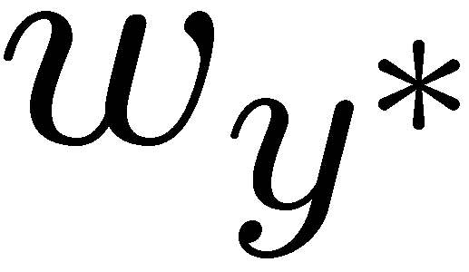

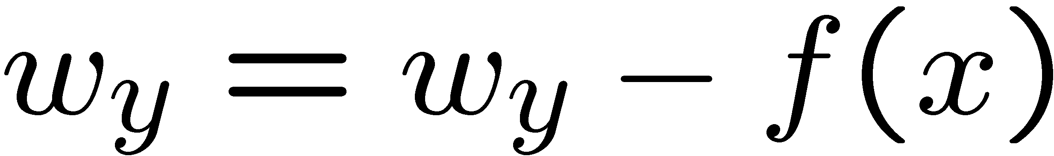
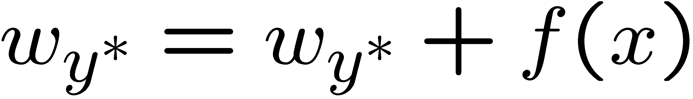
Learning: Multiclass Perceptron
Start with all weights = 0
Pick up training examples one by one
Predict with current weights
If correct, no change!
If wrong: lower score of wrong answer, raise score of right answer

Slide 18



Example: Multiclass Perceptron
“win the vote”
[1 1 0 1 1]
“win the election”
[1 1 0 0 1]
“win the game”
[1 1 1 0 1]
3
0
1
-2
0
3
0
-2
BIAS : 1
win : 0
game : 0
vote : 0
the : 0
...
0
-1
0
-1
-1
1
0
1
-1
0
BIAS : 0
win : 0
game : 0
vote : 0
the : 0
...
1
1
0
1
1
0
0
-1
1
0
BIAS : 0
win : 0
game : 0
vote : 0
the : 0
...

Slide 19
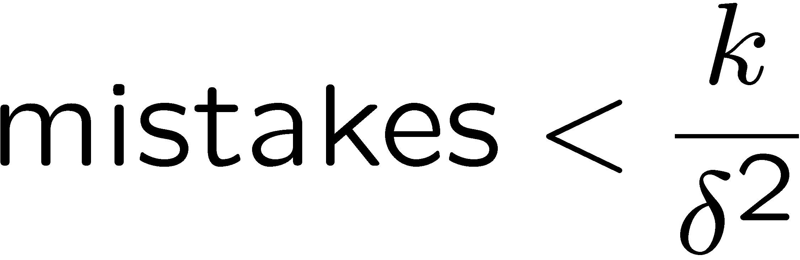
Properties of Perceptrons
Separable
Separability: true if some parameters get the training set perfectly correct
Convergence: if the training is separable, perceptron will eventually converge (binary case)
Mistake Bound: the maximum number of mistakes (binary case) related to the margin or degree of separability
Non-Separable

Slide 20
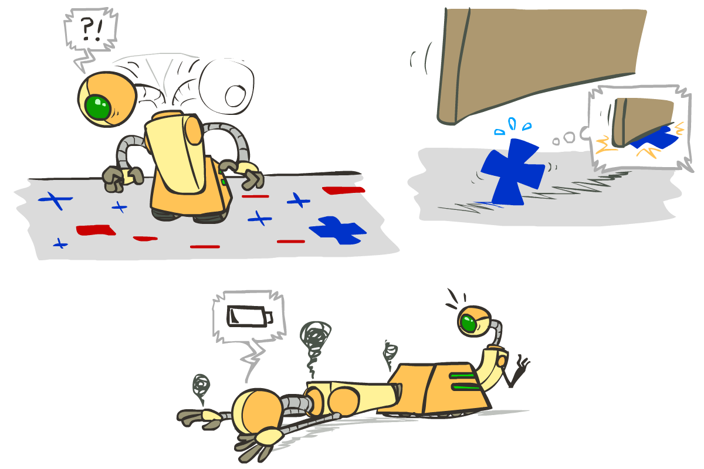





Problems with the Perceptron
Noise: if the data isn’t separable, weights might thrash
  Averaging weight vectors over time can help (averaged perceptron)
Mediocre generalization: finds a “barely” separating solution
Overtraining: test / held-out accuracy usually rises, then falls
  Overtraining is a kind of overfitting

Slide 21
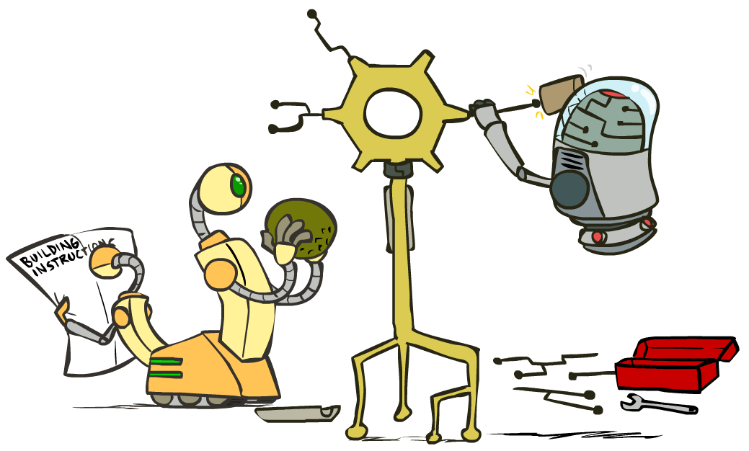
Improving the Perceptron

Slide 22
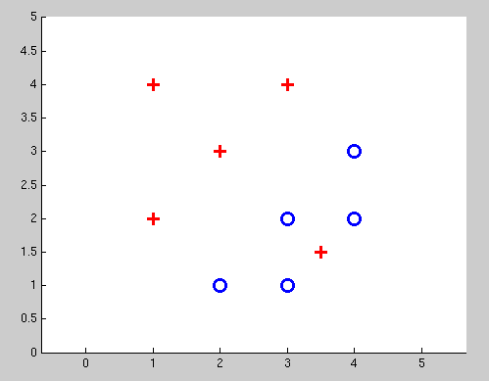
Non-Separable Case: Deterministic Decision
Even the best linear boundary makes at least one mistake

Slide 23
Non-Separable Case: Probabilistic Decision
0.9 | 0.1
0.7 | 0.3
0.5 | 0.5
0.3 | 0.7
0.1 | 0.9

Slide 24
How to get probabilistic decisions?
Perceptron scoring:
If very positive → want probability going to 1
If very negative → want probability going to 0
Sigmoid function

Slide 25



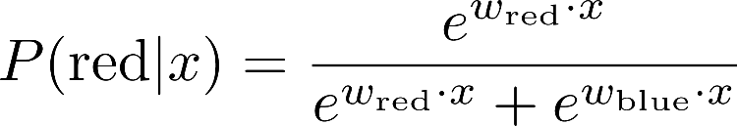
A 1D Example
definitely blue
not sure
definitely red
probability increases exponentially as we move away from boundary
normalizer

Slide 26
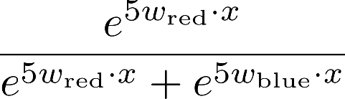
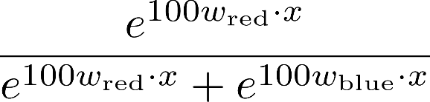

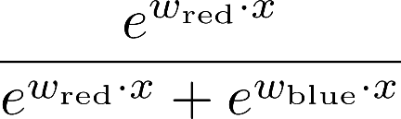
The Soft Max

Slide 27
Best w?
Maximum likelihood estimation:
with:
= Logistic Regression

Slide 28
Separable Case: Deterministic Decision – Many Options

Slide 29
Separable Case: Probabilistic Decision – Clear Preference
0.7 | 0.3
0.5 | 0.5
0.7 | 0.3
0.3 | 0.7
0.5 | 0.5
0.3 | 0.7

Slide 30
Multiclass Logistic Regression
Recall Perceptron:
  A weight vector for each class:
  Score (activation) of a class y:
  Prediction highest score wins
How to make the scores into probabilities?
original activations
softmax activations

Slide 31
Best w?
Maximum likelihood estimation:
with:
= Multi-Class Logistic Regression

Slide 32
Next Lecture
Optimization
  i.e., how do we solve:

