Slide 1
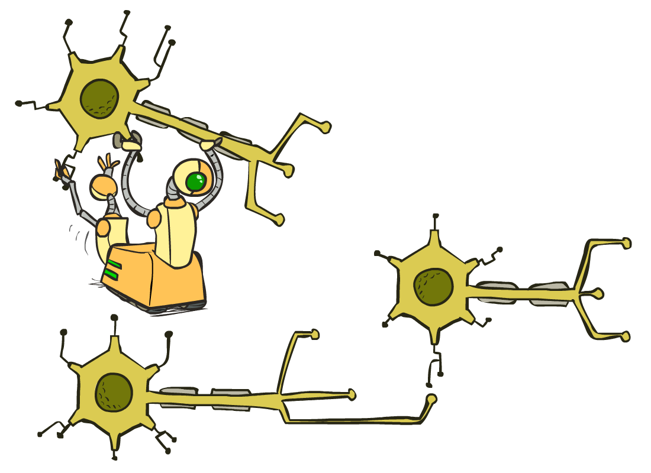
CS 188: Artificial Intelligence
Neural Nets
Instructor: Nathan Lambert --- University of California, Berkeley
[These slides were created by Dan Klein and Pieter Abbeel for CS188 Intro to AI at UC Berkeley. All CS188 materials are available at http://ai.berkeley.edu.]
Notes:
Please retain proper attribution, including the reference to ai.berkeley.edu. Thanks!

Slide 2

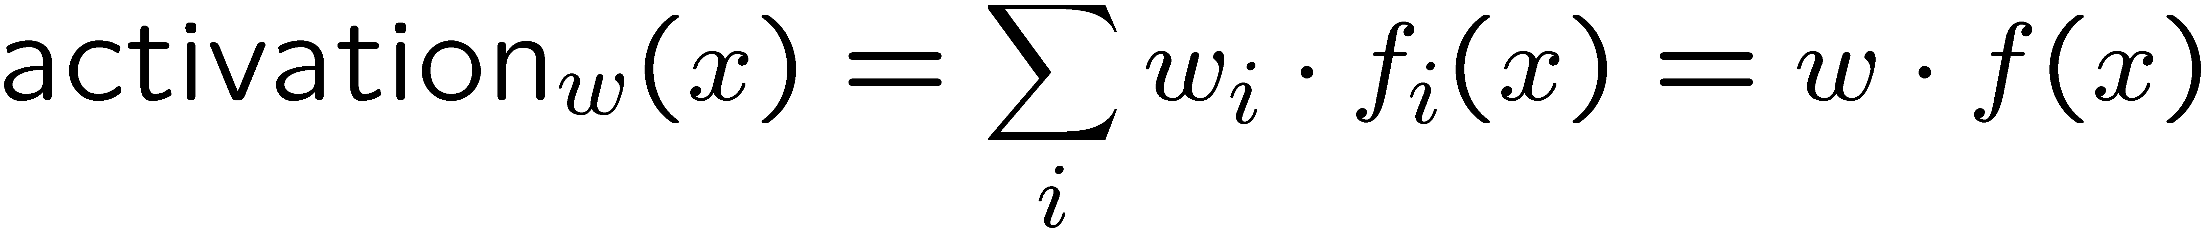
Reminder: Linear Classifiers
Inputs are feature values
Each feature has a weight
Sum is the activation
If the activation is:
  Positive, output +1
  Negative, output -1
w₁
f₁
Σ
w₂
>0?
f₂
w₃
f₃

Slide 3
Canonical Optimization
Optimization
  i.e., how do we solve:

Slide 4
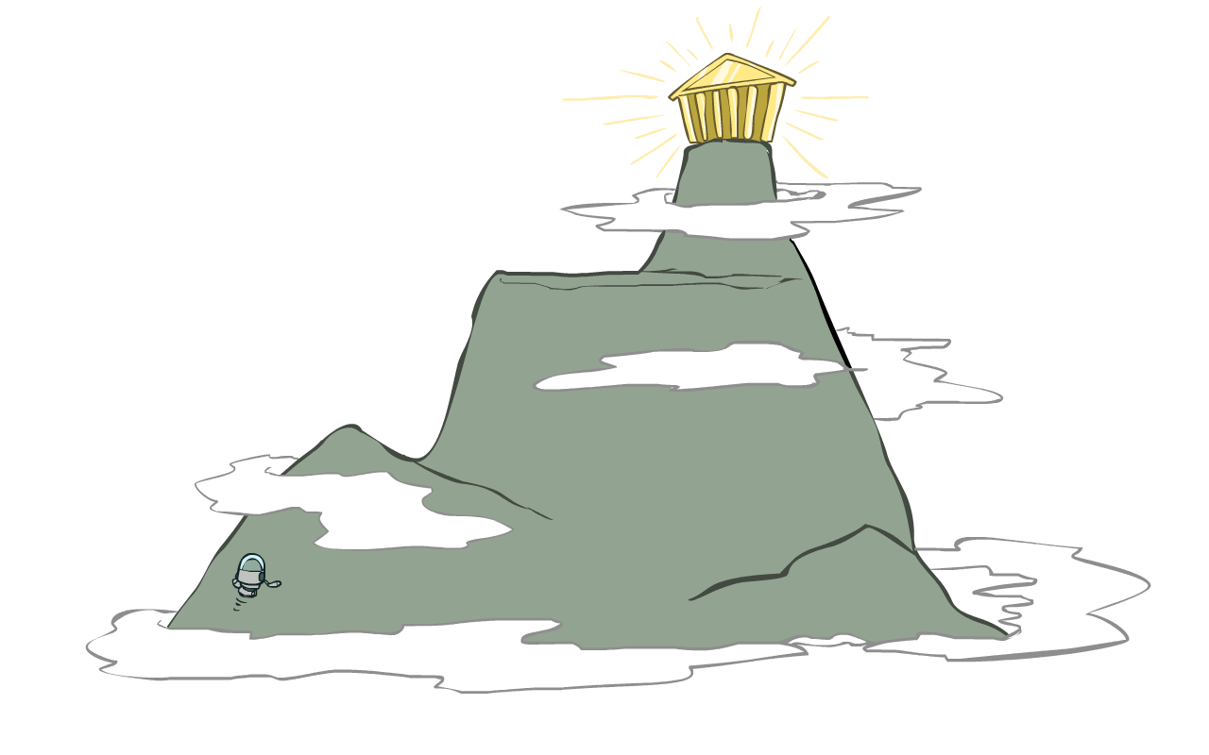
Hill Climbing
Recall from CSPs lecture: simple, general idea
  Start wherever
  Repeat: move to the best neighboring state
  If no neighbors better than current, quit
What’s particularly tricky when hill-climbing for multiclass logistic regression?
  Optimization over a continuous space
    Infinitely many neighbors!
    How to do this efficiently?

Slide 5
Gradient Ascent
Perform update in uphill direction for each coordinate
The steeper the slope (i.e. the higher the derivative) the bigger the step for that coordinate
E.g., consider:
    Updates:
  Updates in vector notation:
  with:
= gradient

Slide 6
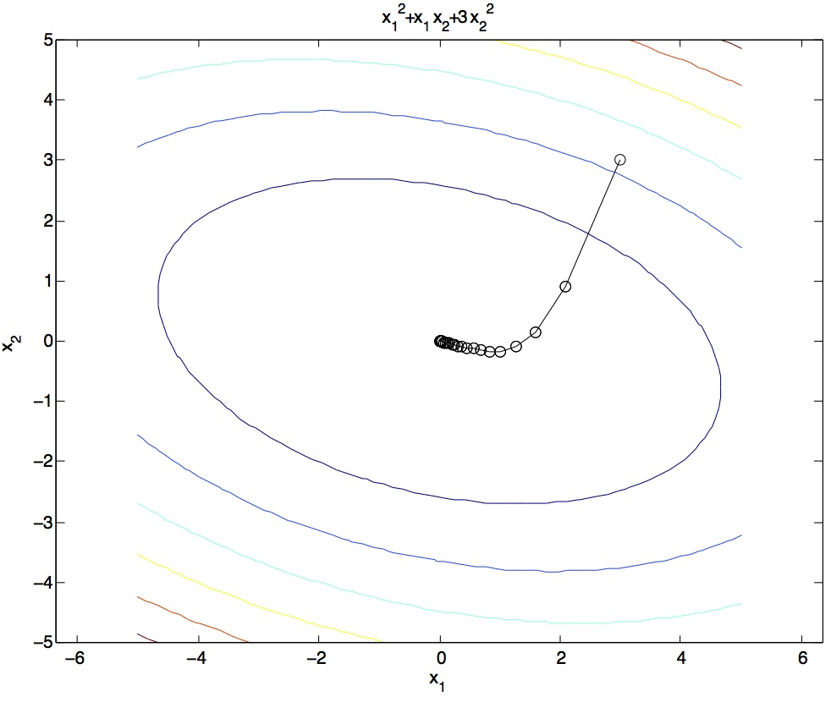
Gradient Ascent
Idea:
  Start somewhere
  Repeat: Take a step in the gradient direction
Figure source: Mathworks

Slide 7
Mini-Batch Gradient Ascent on the Log Likelihood Objective
Observation: gradient over small set of training examples (=mini-batch) can be computed in parallel, might as well do that instead of a single one
init
for iter = 1, 2, …
  pick random subset of training examples J

Slide 8
Neural Networks

Slide 9
Deep Neural Network = Also learn the features!
f₁(x)
z₁
softmax
f₂(x)
z₂
f₃(x)
…
z₃
f_{K}(x)

Slide 10
Deep Neural Network = Also learn the features!
x₁
softmax
x₂
…
x₃
…
…
…
…
…
x_{L}
g = nonlinear activation function

Slide 11
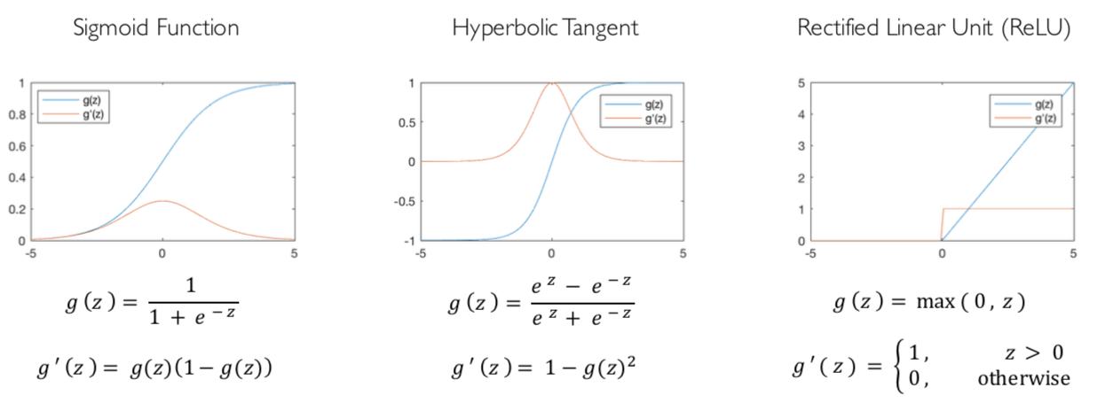
Common Activation Functions
[source: MIT 6.S191 introtodeeplearning.com]

Slide 12
Deep Neural Network: Also Learn the Features!
Training the deep neural network is just like logistic regression:
  just w tends to be a much, much larger vector ☺
  just run gradient ascent
  + stop when log likelihood of hold-out data starts to decrease

Slide 13
Neural Networks Properties
Theorem (Universal Function Approximators). A two-layer neural network with a sufficient number of neurons can approximate any continuous function to any desired accuracy.
Practical considerations
  Can be seen as learning the features
  Large number of neurons
    Danger for overfitting
    (hence early stopping!)

Slide 14
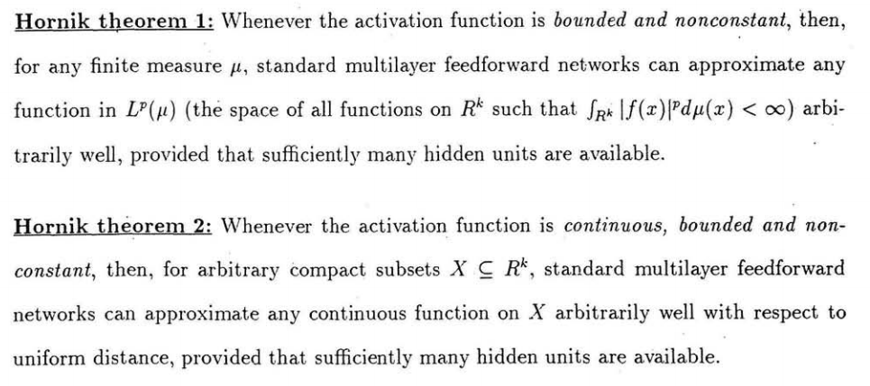
Universal Function Approximation Theorem*
In words: Given any continuous function f(x), if a 2-layer neural network has enough hidden units, then there is a choice of weights that allow it to closely approximate f(x).
Cybenko (1989) “Approximations by superpositions of sigmoidal functions”
Hornik (1991) “Approximation Capabilities of Multilayer Feedforward Networks”
Leshno and Schocken (1991) ”Multilayer Feedforward Networks with Non-Polynomial Activation Functions Can Approximate Any Function”

Slide 15
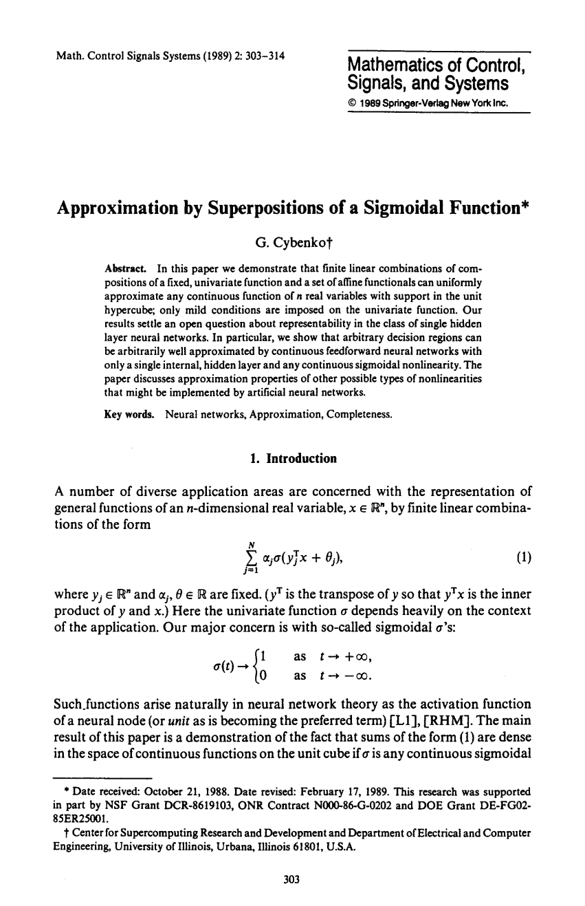
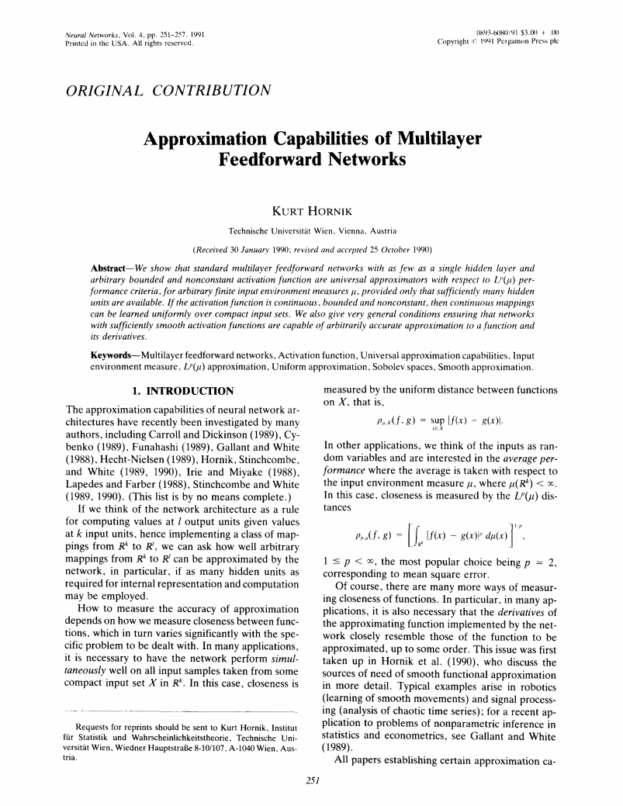
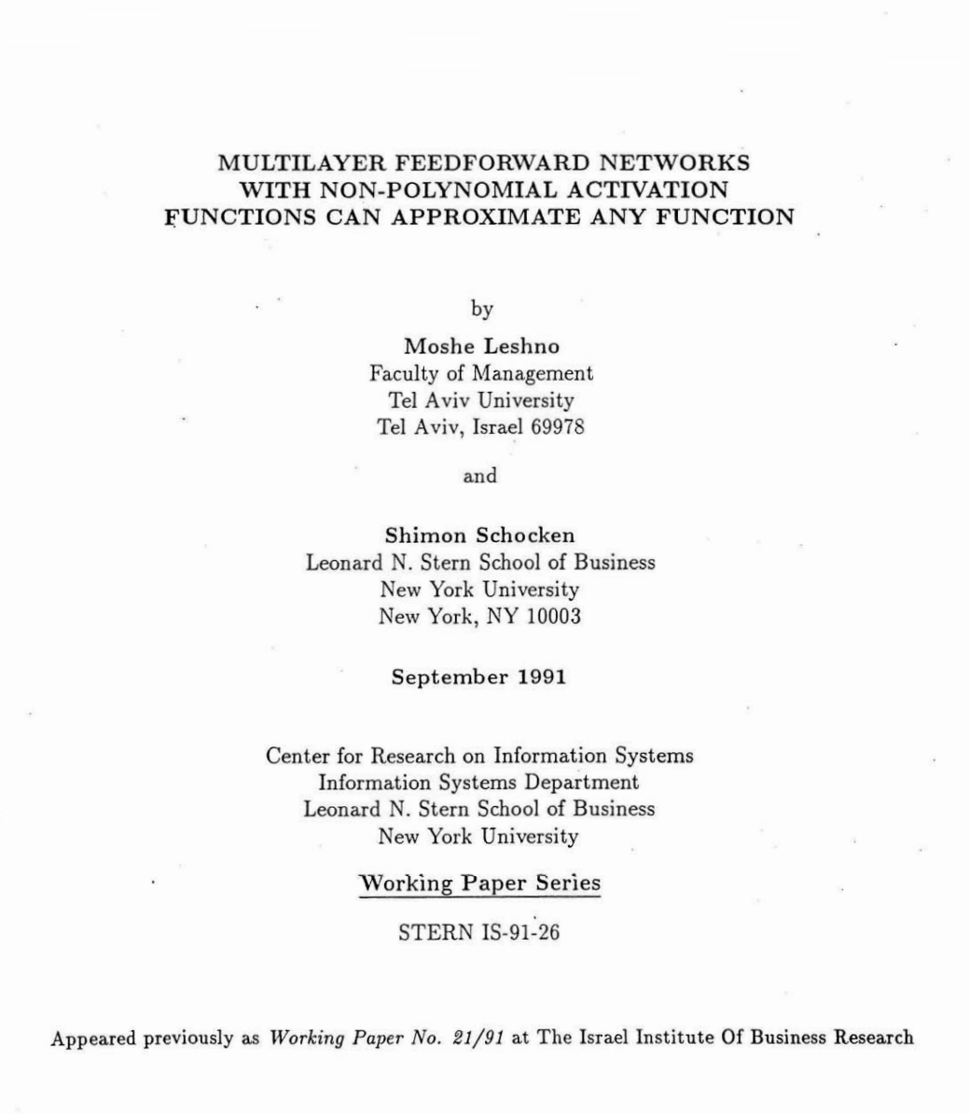
Universal Function Approximation Theorem*
Cybenko (1989) “Approximations by superpositions of sigmoidal functions”
Hornik (1991) “Approximation Capabilities of Multilayer Feedforward Networks”
Leshno and Schocken (1991) ”Multilayer Feedforward Networks with Non-Polynomial Activation Functions Can Approximate Any Function”

Slide 16
Fun Neural Net Demo Site
Demo-site:
  http://playground.tensorflow.org/

Slide 17
How about computing all the derivatives?
Derivatives tables:
[source: http://hyperphysics.phy-astr.gsu.edu/hbase/Math/derfunc.html

Slide 18
How about computing all the derivatives?
But neural net f is never one of those?
  No problem: CHAIN RULE:
    If
    Then
    → Derivatives can be computed by following well-defined procedures

Slide 19
Automatic Differentiation
Automatic differentiation software
  e.g. Theano, TensorFlow, PyTorch, Chainer
  Only need to program the function g(x,y,w)
  Can automatically compute all derivatives w.r.t. all entries in w
  This is typically done by caching info during forward computation pass of f, and then doing a backward pass = “backpropagation”
  Autodiff / Backpropagation can often be done at computational cost comparable to the forward pass
Need to know this exists
How this is done? -- outside of scope of CS188

Slide 20
Summary of Key Ideas
Optimize probability of label given input
Continuous optimization
  Gradient ascent:
    Compute steepest uphill direction = gradient (= just vector of partial derivatives)
    Take step in the gradient direction
    Repeat (until held-out data accuracy starts to drop = “early stopping”)
Deep neural nets
  Last layer = still logistic regression
  Now also many more layers before this last layer
    = computing the features
    → the features are learned rather than hand-designed
  Universal function approximation theorem
    If neural net is large enough
    Then neural net can represent any continuous mapping from input to output with arbitrary accuracy
    But remember: need to avoid overfitting / memorizing the training data → early stopping!
  Automatic differentiation gives the derivatives efficiently (how? = outside of scope of 188)

Slide 21
How well does it work?

Slide 22

Computer Vision
Notes:
22

Slide 23
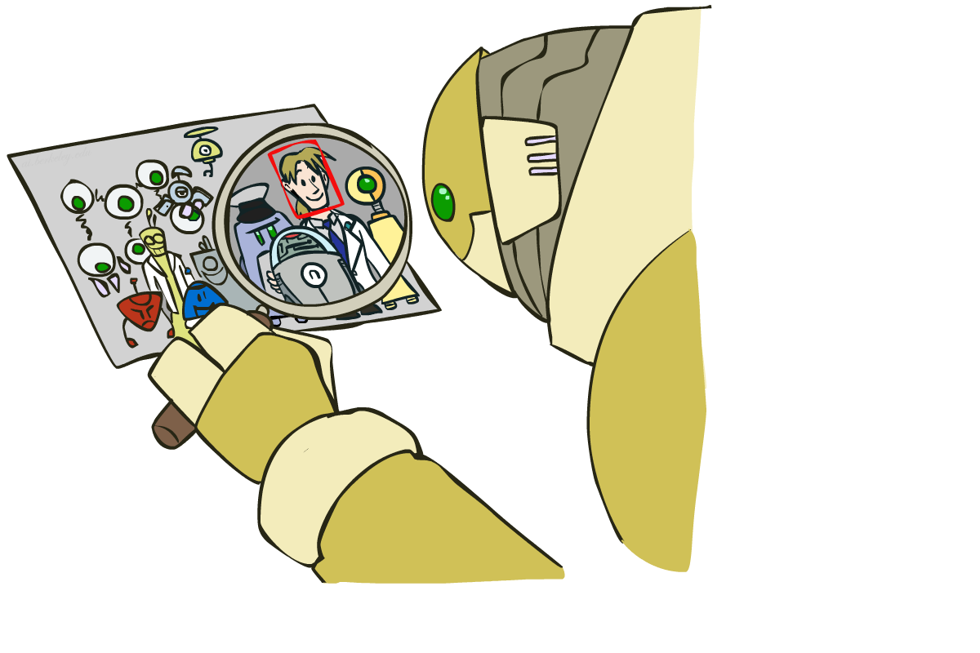
Object Detection
Notes:
23

Slide 24



Manual Feature Design
Notes:
24

Slide 25
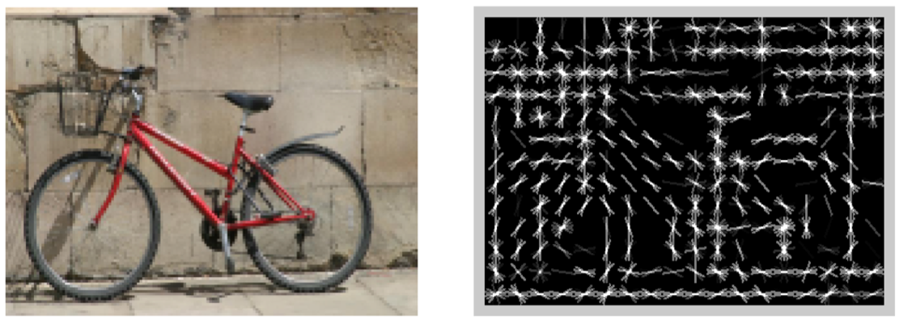
Features and Generalization
[HoG: Dalal and Triggs, 2005]
Notes:
25

Slide 26
Features and Generalization
Image
HoG
Notes:
HoG, SIFT, Daisy
Deformable part models
26

Slide 27
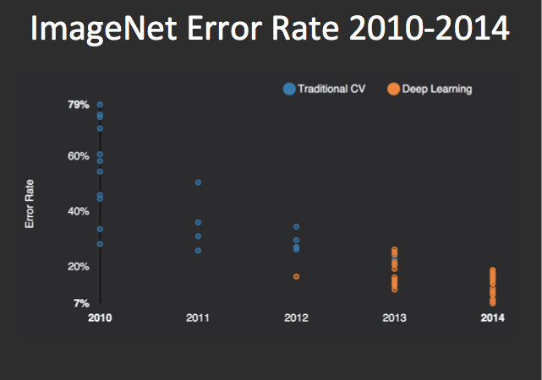
Performance
graph credit Matt Zeiler, Clarifai

Slide 28
Performance
graph credit Matt Zeiler, Clarifai

Slide 29
Performance
AlexNet
graph credit Matt Zeiler, Clarifai

Slide 30
Performance
AlexNet
graph credit Matt Zeiler, Clarifai

Slide 31
Performance
AlexNet
graph credit Matt Zeiler, Clarifai

Slide 32
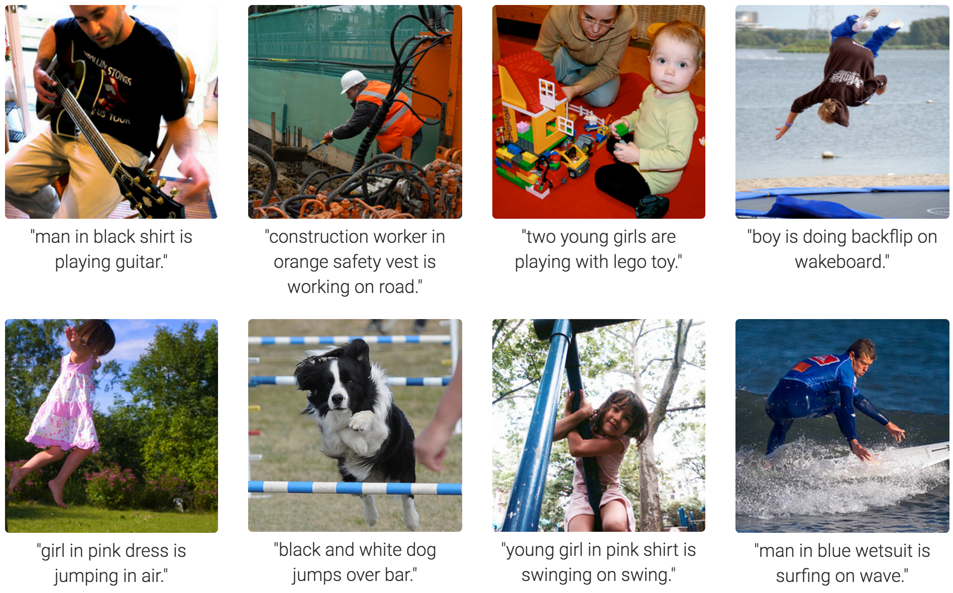
MS COCO Image Captioning Challenge
Karpathy & Fei-Fei, 2015; Donahue et al., 2015; Xu et al, 2015; many more

Slide 33
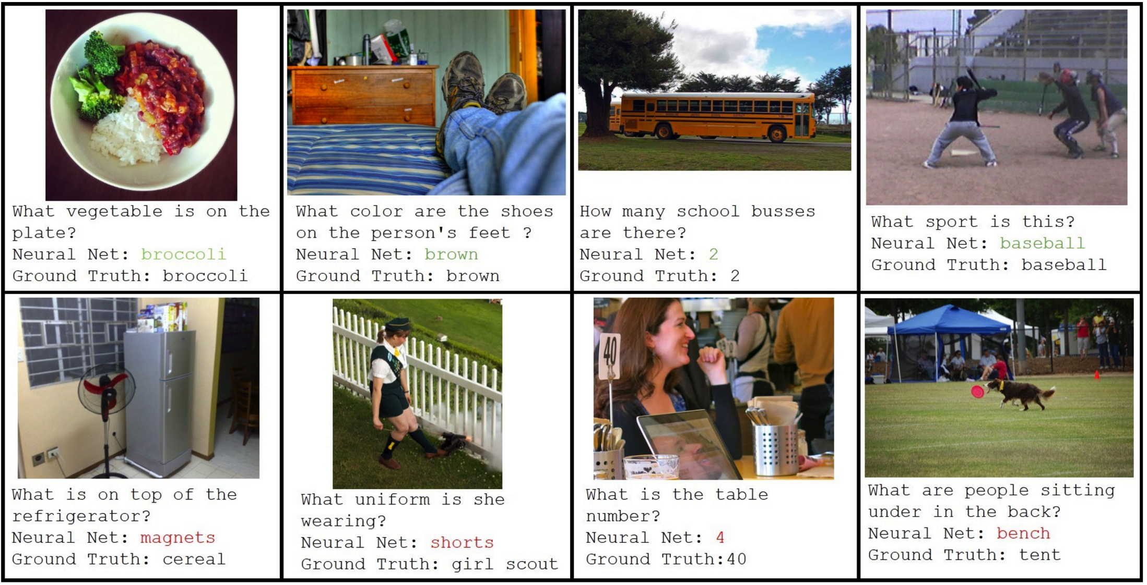
Visual QA Challenge
Stanislaw Antol, Aishwarya Agrawal, Jiasen Lu, Margaret Mitchell, Dhruv Batra, C. Lawrence Zitnick, Devi Parikh

Slide 34
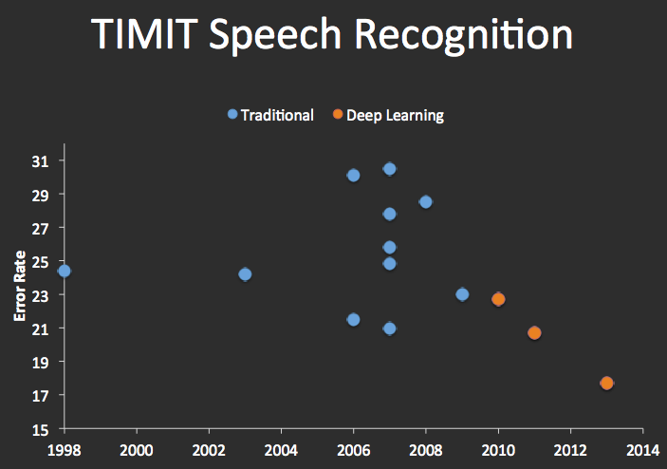


Speech Recognition
graph credit Matt Zeiler, Clarifai

Slide 35
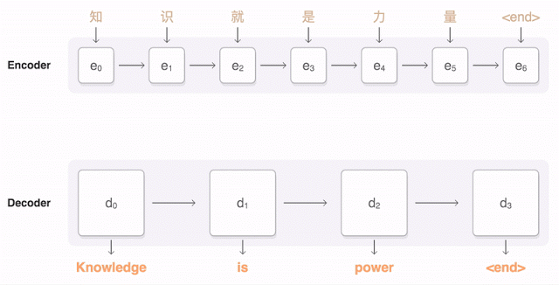
Machine Translation
Google Neural Machine Translation (in production)
Notes:
https://research.googleblog.com/2016/09/a-neural-network-for-machine.html

Slide 36
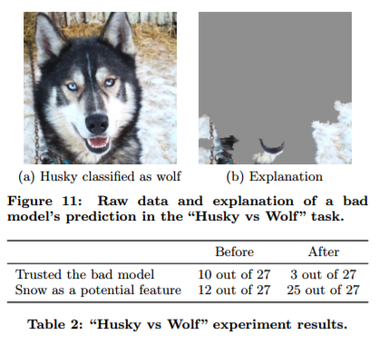
What’s still missing? – correlation \neq causation
[Ribeiro et al.]

Slide 37
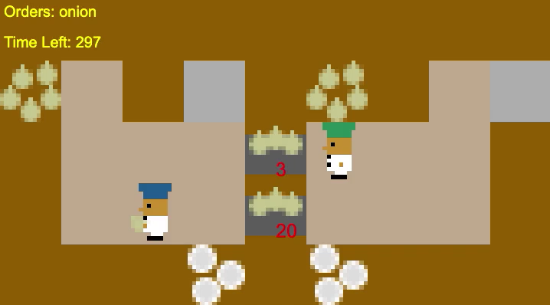
What’s still missing? – covariate shift
[Carroll et al.]

Slide 38
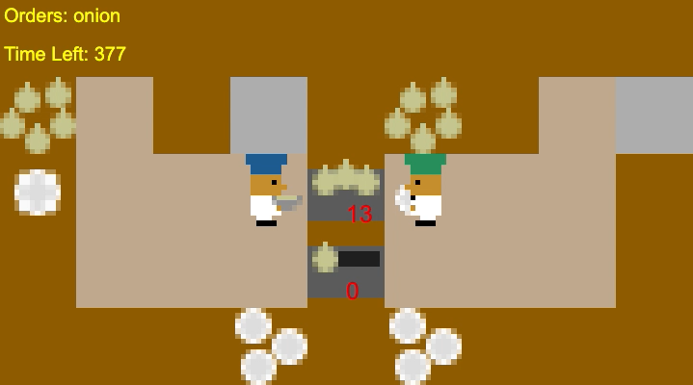
What’s still missing? – covariate shift
[Carroll et al.]

