Slide 1
Fairness and Machine Learning: Limitations and Opportunities
Moritz Hardt
UC Berkeley

Slide 2
Where to start?
We live in a world of pervasive inequality, oppression, and discrimination.
As we use machine learning to formalize, scale, accelerate processes in this world, we run danger of perpetuating existing patterns of injustice.
But there’s also a (somewhat fragile) opportunity to revisit decision making in various domains and reform existing processes for the better.

Slide 3
Important work to start with
Ruha Benjamin. Race After Technology: Abolitionist Tools for the New Jim Code
Meredith Broussard. Artificial Unintelligence: How Computers Misunderstand the World
Virginia Eubanks. Automating Inequality: How High-Tech Tools Profile, Police, and Punish the Poor
Safiya Noble. Algorithms of Oppression: How Search Engines Reinforce Racism
Cathy O’Neil. Weapons of math destruction
Joy Boulamwini, Kate Crawford, Timnit Gebru, Latanya Sweeney, Meredith Whitaker and many others.

Slide 4
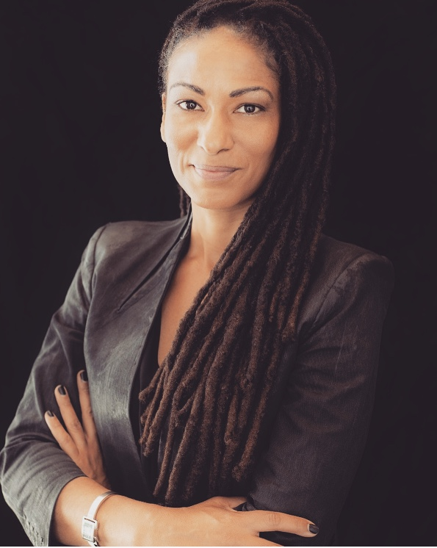
“the New Jim Code”: the employment of new technologies that reflect and reproduce existing inequities but that are promoted and perceived as more objective or progressive than the discriminatory systems of a previous era.
Ruha Benjamin

Slide 5
Focus for this tutorial
Discrimination in consequential decision making settings
This excludes many other forms of injustice (and even unfairness)
US centric perspective (insofar as the examples and legal backdrop go)
Formal models and frameworks
This is not meant to decenter the scholarship just mentioned
This decidedly leaves room for non-technical interventions

Slide 6
Is discrimination not the point of machine learning?
Our concern is with unjustified basis for differentiation
Practical irrelevance
Sexual orientation in employment decisions
Moral irrelevance
Disability status in hiring decisions
Notes:
Practical irrelevance

Slide 7
Discrimination is not a general concept
Domain specific:
Concerned with important opportunities that affect people’s lives
Group specific:
Concerned with socially salient categories that have served as the basis for unjustified and systematically adverse treatment in the past

Slide 8
Regulated domains (based on US law)
Credit (Equal Credit Opportunity Act)
Education (Civil Rights Act of 1964; Education Amendments of 1972)
Employment (Civil Rights Act of 1964)
Housing (Fair Housing Act)
‘Public Accommodation’ (Civil Rights Act of 1964)
Extends to marketing and advertising; not limited to final decision
This list sets aside complex web of laws that regulates the government

Slide 9
Legally recognized ‘protected classes’ in the US
Race (Civil Rights Act of 1964); Color (Civil Rights Act of 1964); Sex (Equal Pay Act of 1963; Civil Rights Act of 1964); Religion (Civil Rights Act of 1964); National origin (Civil Rights Act of 1964); Citizenship (Immigration Reform and Control Act); Age (Age Discrimination in Employment Act of 1967); Pregnancy (Pregnancy Discrimination Act); Familial status (Civil Rights Act of 1968); Disability status (Rehabilitation Act of 1973; Americans with Disabilities Act of 1990); Veteran status (Vietnam Era Veterans' Readjustment Assistance Act of 1974; Uniformed Services Employment and Reemployment Rights Act); Genetic information (Genetic Information Nondiscrimination Act)

Slide 10
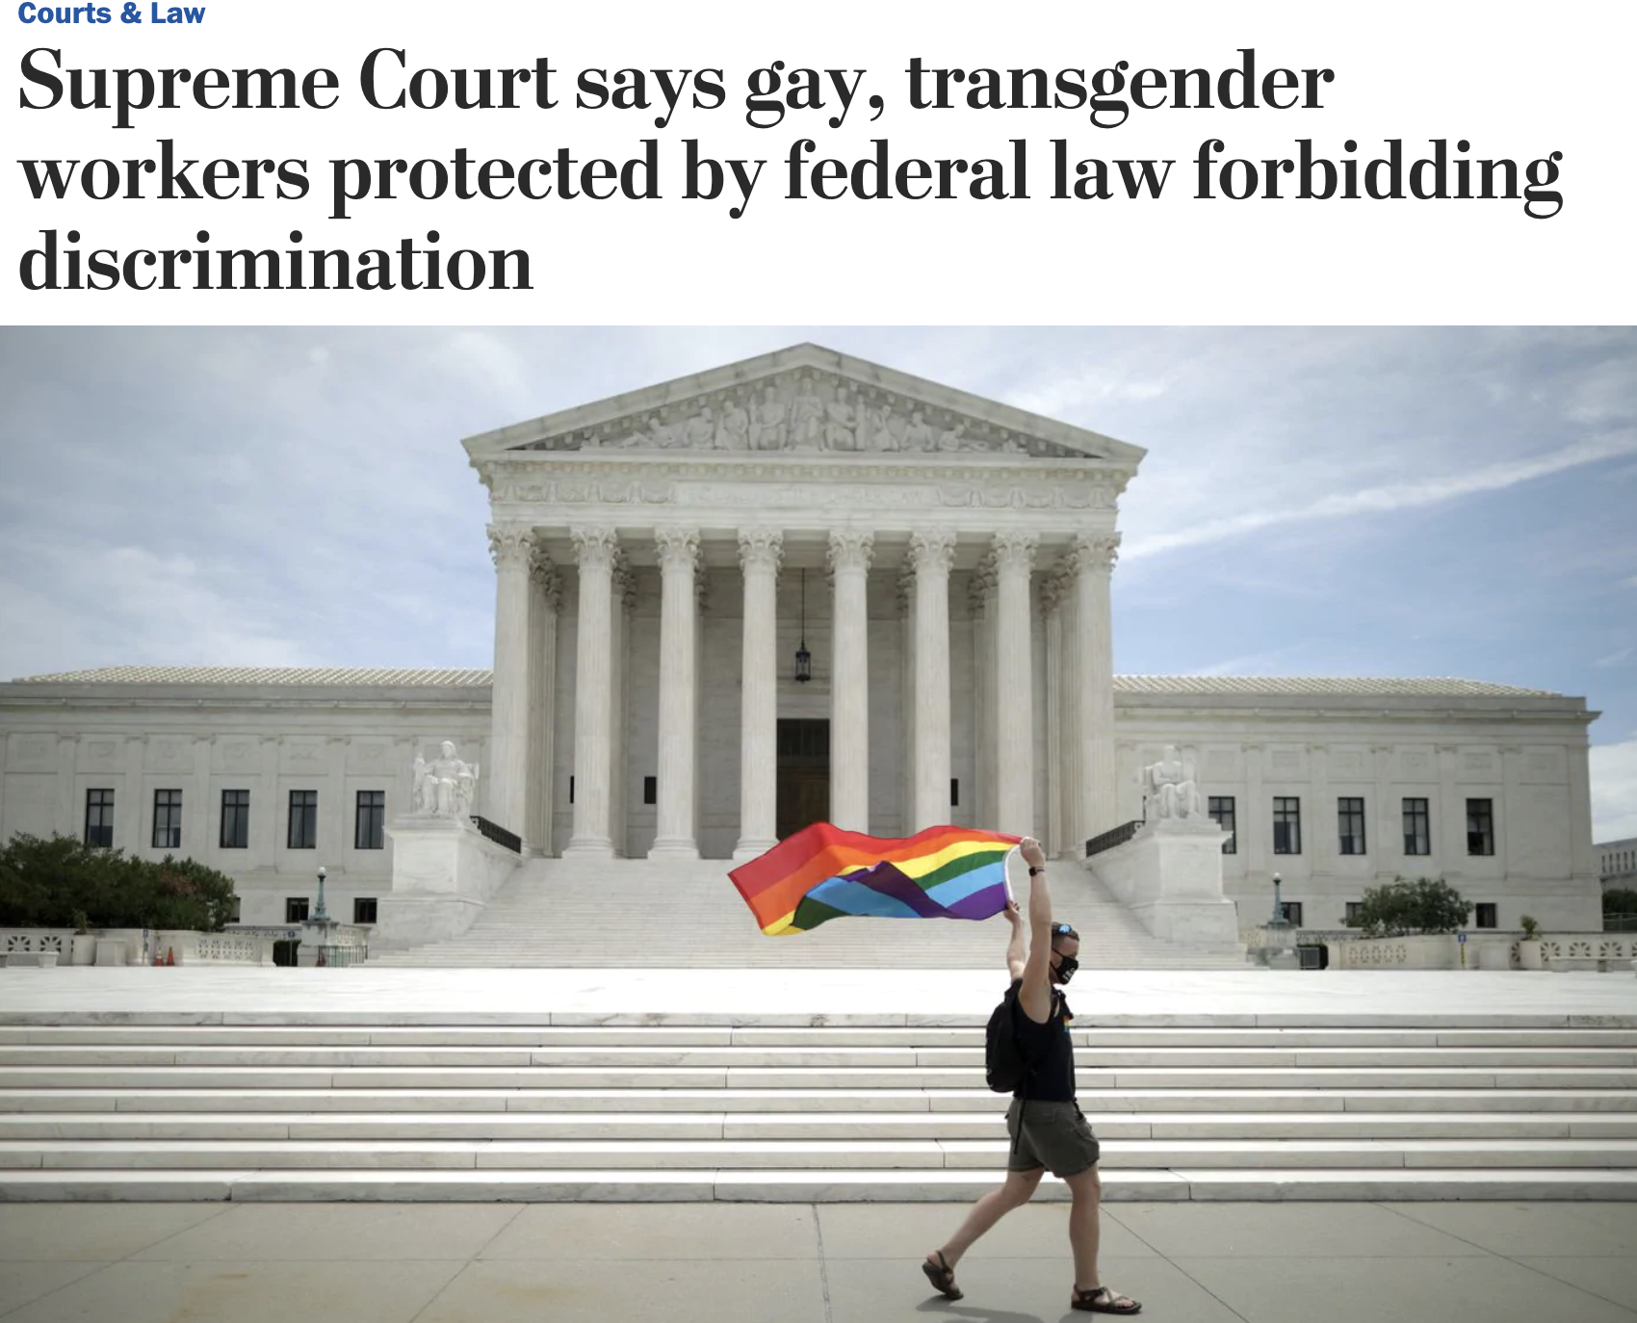
Source: Washington Post
June 15, 2020

Slide 11
Two legal doctrines in the US
Disparate treatment
Purposeful consideration of group membership
Intentional discrimination without consideration of group membership
Goal: Procedural fairness
Disparate impact
Avoidable or unjustified harm, possibly indirect
Goal: Distributive justice, minimize differences in outcomes
Some well-recognized tension between the two.

Slide 12
Some caveats about the law
Anti-discrimination law does not reflect one moral theory
Legislations often were responses to civil rights movements, each hard fought through decades of activism
The law does not give us a “fairness definition” that we could readily formalize and operationalize

Slide 13
The failure of fairness through unawareness
Removing (or not including) “sensitive attributes” is no cure for fairness concerns and can exacerbate them.

Slide 14
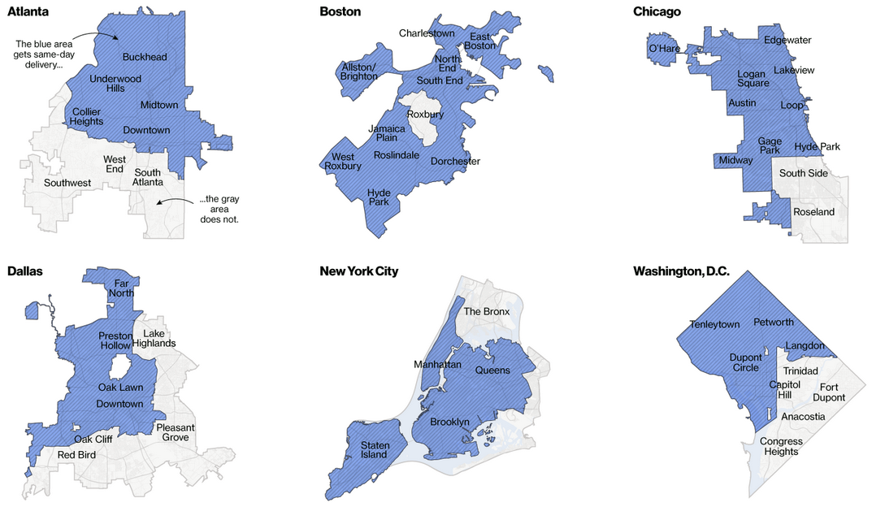
Amazon same-day delivery coverage
Source: https://www.bloomberg.com/graphics/2016-amazon-same-day/

Slide 15
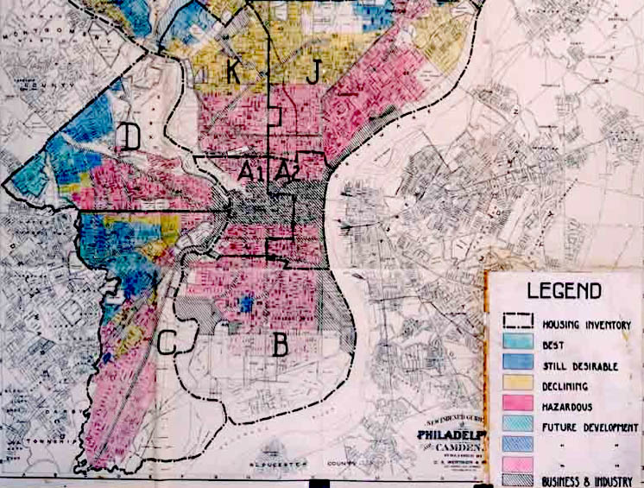
Notes:
A 1936 HOLC "residential security" map of Philadelphia, classifying various neighborhoods by estimated riskiness of mortgage loans.^{[1]}

Slide 16
The failure of fairness through unawareness
Perhaps Amazon was just predicting number of purchases, which correlates with affluence, which correlates with race in the United States. Amazon almost certainly did not look at their customers’ race when they built this product.

Slide 17
“We don’t consider that in our data” is never a valid argument.

Slide 18
So what should we do instead?

Slide 19
Overview
Part I (today): From a narrower perspective
Fairness criteria in classification
Part II (Thu): Toward a broader perspective
Causal models of decision-making settings
Dynamic models of socio-technical systems

Slide 20
Part I

Slide 21
Formal work on fairness in classification and decision-making
Pioneering work in educational testing (Cleary 1968) and economics (Becker 1957, Phelps 1972, Arrow 1973) on the heels of civil rights movement.
Computer science: Mostly post 2010, explosive increase in work since 2016
Why today? Urgency, scale, reach, and impact of algorithmic decisions
Machine learning fuels adoption and motivates some new technical problems, but also forces us to revisit fundamental normative questions

Slide 22
Formal prediction and decision making setting
Data described by covariates X
Outcome variable Y (often binary, sometimes called target variable)
Our goal is to predict Y from X
Use supervised machine learning to produce a score function R = r(X)
Make binary decisions according to threshold rule D = 1{R > t}
Note: Think of these as random variables in the same probability space.

Slide 23
Where do score functions come from
Score R could be:
Based on parametric model of the data (X, Y), e.g. likelihood ratio test
Non-parametric score, such as, Bayes optimal score R = E[ Y | X ]
Most commonly, learned from labeled data using supervised learning

Slide 24
Decision theory 101
Decision D
True positive rate = Pr[D = 1 | Y = 1]
False positive rate = Pr[D = 1 | Y = 0]
True negative rate = Pr[D = 0 | Y = 0]
False negative rate = Pr[D = 0 | Y = 1]
0
1
True negative | False positive
False negative | True positive
0
Outcome Y
1

Slide 25
Statistical fairness criteria
Introduce additional random variable A encoding membership status in a protected class
Equalize different statistical quantities involving group membership A
Idea dates back at least to the 1960s with work of Anne Cleary about group differences in educational testing*
We’ll review three common criteria
* See Hutchinson, Mitchell (2018).

Slide 26
Equalizing acceptance rate
Equal positive rate: For any two groups a, b, require Pr[D = 1 | A = a] = Pr[D = 1 | A = b]
“Acceptance rate” equal in all groups
Generalization: Require D to be independent of A (Independence)
All sorts of variants, relaxations, equivalent formulations

Slide 27
Why this does not rule out unfair practices
One unfair situation: Make good/informed decisions in one group, poor/arbitrary decisions in other groups. Equalize positive rate.
This can happen on its own if we have less data or poor data in one group.
Example: Old Framingham risk score for coronary heart disease was created on cohort of white men, then used for other patients.
A positive call could be a false positive or a true positive. Moral intuition: You shouldn’t get to match true positives in one group with false positives in another.

Slide 28
Achieving independence through representation learning
Lots of work out there on “fair representation” starting with work by Zemel et al. (2015).
General idea: Use deep learning tricks, such as adversarial learning, to train a representation of the data that is independent of group membership A, while representing original data as well as possible.
Z
X
Z ⟂ A

Slide 29
Equalizing error rates
For any two groups a, b, require Pr[D = 1 | Y = 0, A = a] = Pr[D = 1 | Y = 0, A = b] (equal false positive rate) Pr[D = 0 | Y = 1, A = a] = Pr[D = 0 | Y = 1, A = b] (equal false negative rate)
Generalization: Require D to be independent of A given Y
Also makes sense for score: Require R to be independent of A given Y

Slide 30
Error rate parity is a post-hoc criterion
At decision time, the decision maker doesn’t know who is a positive/negative instance
In hindsight, somebody can collect a group of positive instances and a group of negative instances and check how they were classified.
Group differences in this kind of post-hoc “audit” often strike people as unfair.

Slide 31
Interpretation in terms of ROC curve
Group a
Suppose D is threshold of a score R
1
Group b
True positive rate
Error rate parity implies that ROC curve of score conditional on group must be under all curves.
0
False positive rate
1

Slide 32
Interpretation in terms of ROC curve
Group a
Suppose D is threshold of a score R
1
Group b
True positive rate
Error rate parity implies that ROC curve of score conditional on group must be under all curves.
Area under all curves
0
False positive rate
1

Slide 33
Column-wise criteria?
We could equalize expressions of the form Pr[Y = y | D = d, A = a]
These are called “column-wise” rates, i.e., false omission and false discovery rate.
Nothing wrong with this, but something closely related but different is more common.
Decision
0
1
n₀₀ | n₀₁
n₁₀ | n₁₁
0
Reality
1

Slide 34
Calibration
A score R is calibrated if: Pr[Y = 1 | R = r] = r
“You can pretend score is a probability” - although it may not actually be one!
Score value r corresponds to positive outcome rate r
Calibration by group: Pr[Y = y | R = r, A = a] = r
Follows from: Y independent of A conditional on R

Slide 35
Calibration is an a priori guarantee
The decision maker sees the score value r and knows based on this what the frequency of positive outcomes is.
E.g., score 0.8 means 80% rate of heart failure on average over people who receive score 0.8.
This guarantee (usually) does not hold at the individual level, e.g., “Mary’s individual risk of heart failure is 80%.”

Slide 36
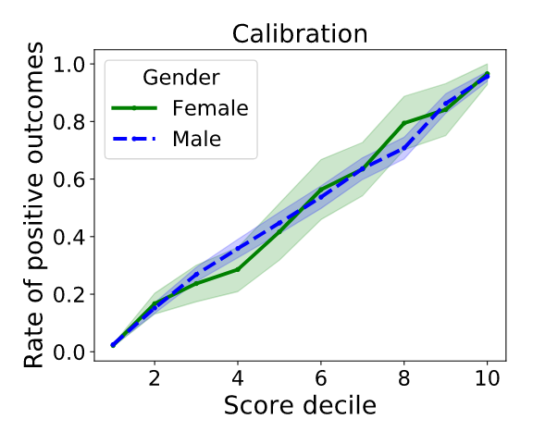
Group calibration often follows from unconstrained learning
Informal theorem: Under reasonable conditions, the deviation from satisfying group calibration is upper bounded by the excess risk of the learned score relative to the Bayes optimal score function.
See Liu, Simchowitz, H (2019)
In other words, you shouldn’t be surprised to see calibration follow approximately from unconstrained supervised learning.
Example calibration of unconstrained
learning on UCI adult data set.

Slide 37
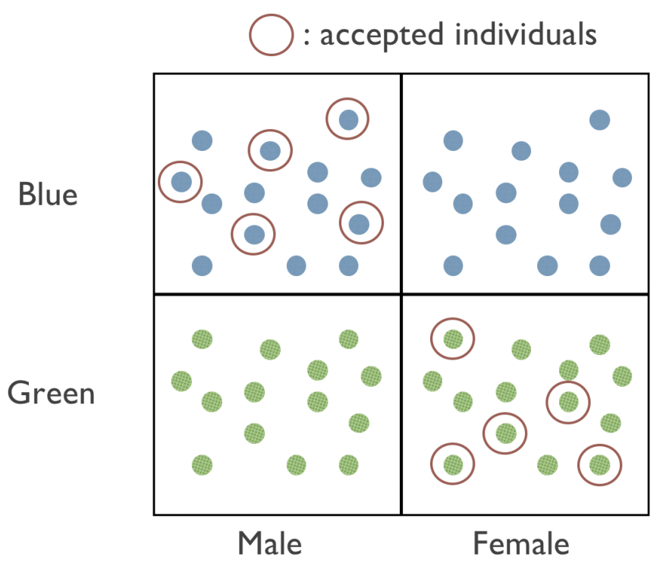
Subgroup fairness
Ensuring fairness criteria between two groups can lead to violations within groups.
This motivated work on ensuring subgroup fairness.
See Kearns, Neel, Roth, Wu (2018), and Hébert-Johnson, Kim, Reingold, Rothblum (2018).
Illustrative example
from Kearns et al. (2018)

Slide 38
Recap
We saw three criteria:
R independent of A (implies equal acceptance rate)
R independent of A conditional on Y (implies equal error rates)
Y independent of A conditional on R (implies calibration by group)
Can we have them all?

Slide 39
Incompatibility results
Informal theorem: Any two of these criteria are mutually exclusive in general.

Slide 40
Error rate parity vs calibration
Theorem: 1. Assume unequal base rates: Pr[Y = 1 | A = a] ≠ Pr[Y = 1 | A = b] 2. Assume imperfect decision rule: D has nonzero error rates
Then, calibration by group implies that error rate parity fails.
Related result due to Chouldechova (2016), Kleinberg, Mullainathan, Raghavan (2017)

Slide 42
Essence of COMPAS debate
There’s a risk score used, called COMPAS, used by many jurisdictions in the United States to assess “risk of recidivism”. Judges may detain defendant in part based on this score.
ProPublica: Black defendants face higher false positive rate, i.e., more Black defendants labeled “high risk” end up not committing a crime upon release than among Whites labeled “high risk”
COMPAS maker Northpointe: But our scores are calibrated by group and Black defendants have a higher recidivism rate! Hence, this is unavoidable.

Slide 43
A first word of caution about COMPAS debate
Neither error rate parity nor calibration rule out blatantly unfair practices.
What’s fair in criminal justice is not settled by appeal to one or the other criterion.
These properties are not meant to be “fairness certificates”.

Slide 44
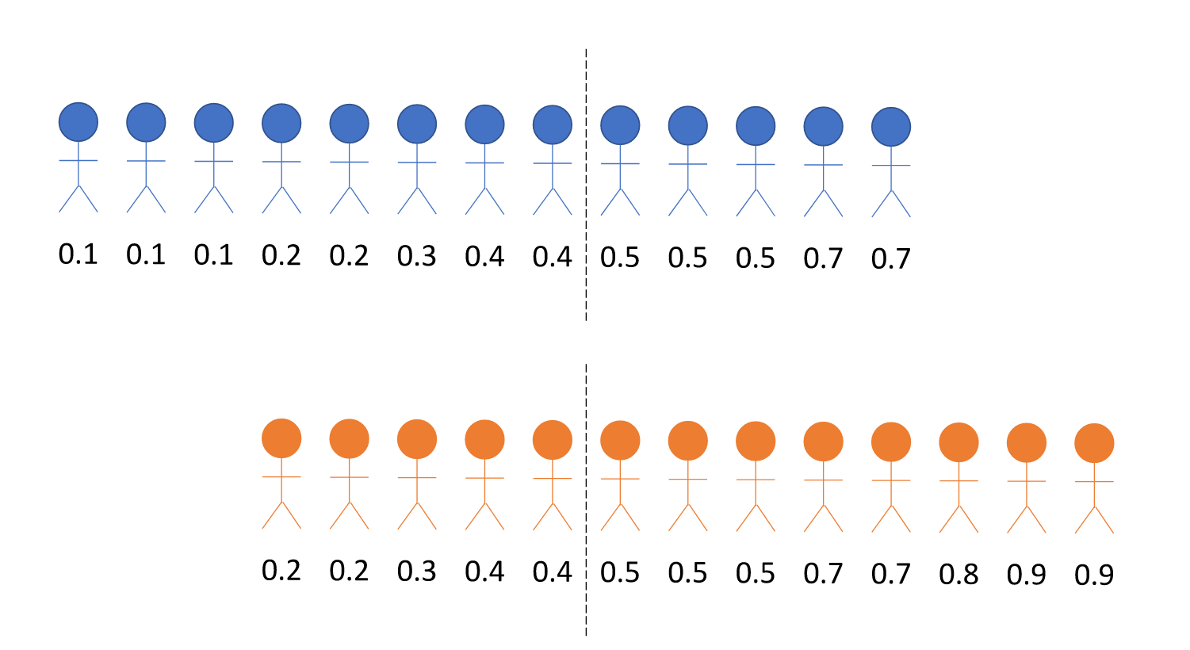
Consider these two groups
Detain everyone above 0.5
Detention rate | False pos. rate
38% | 25%
61% | 42%

Slide 45
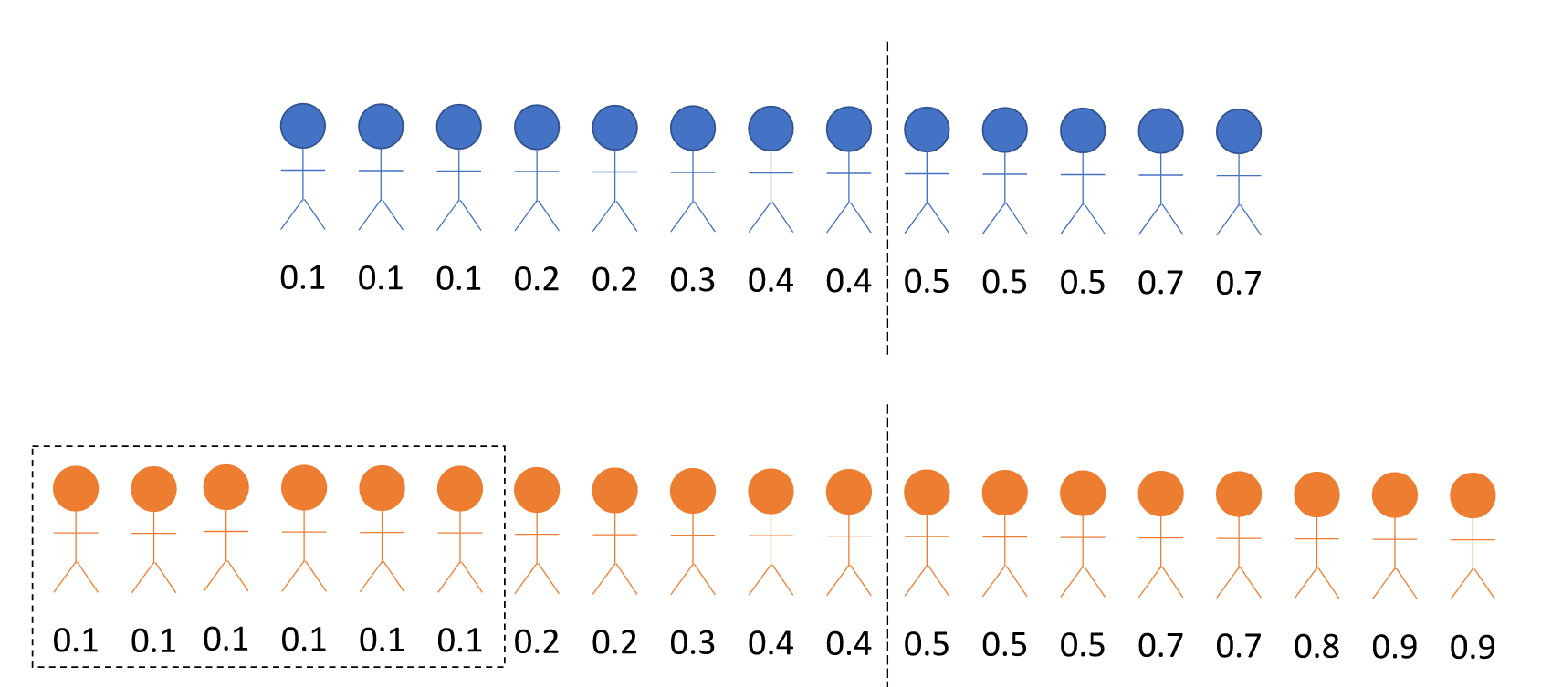
Equalizing rates may lead to undesired outcomes
Detention rate | False pos. rate
38% | 25%
61% 42% | 42% 26%
Arrest more low risk individuals in orange group!

Slide 46
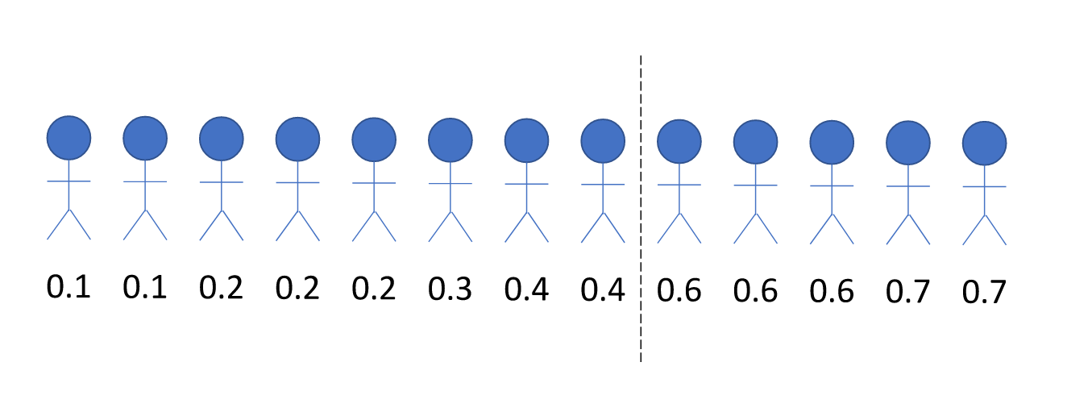
An issue with calibration
Detain everyone above 0.5
True probabilities of reoffending
(hypothetically, suppose we know them!)
Examples from: Corbett-Davies, Pierson, Feller, Goel, Huq (2017)

Slide 47
An issue with calibration
Average probability of re-offense is 0.4 in this subgroup
No one is detained!
Calibrated new scores

Slide 48
Is prediction too narrow a perspective?
Scholarly debate around COMPAS was largely about tension between fairness criteria.
Some rightfully point out data and measurement problems (e.g., policing patterns influence variables such as criminal history and recidivism)
When is the issue not how we predict but that we predict?

Slide 49
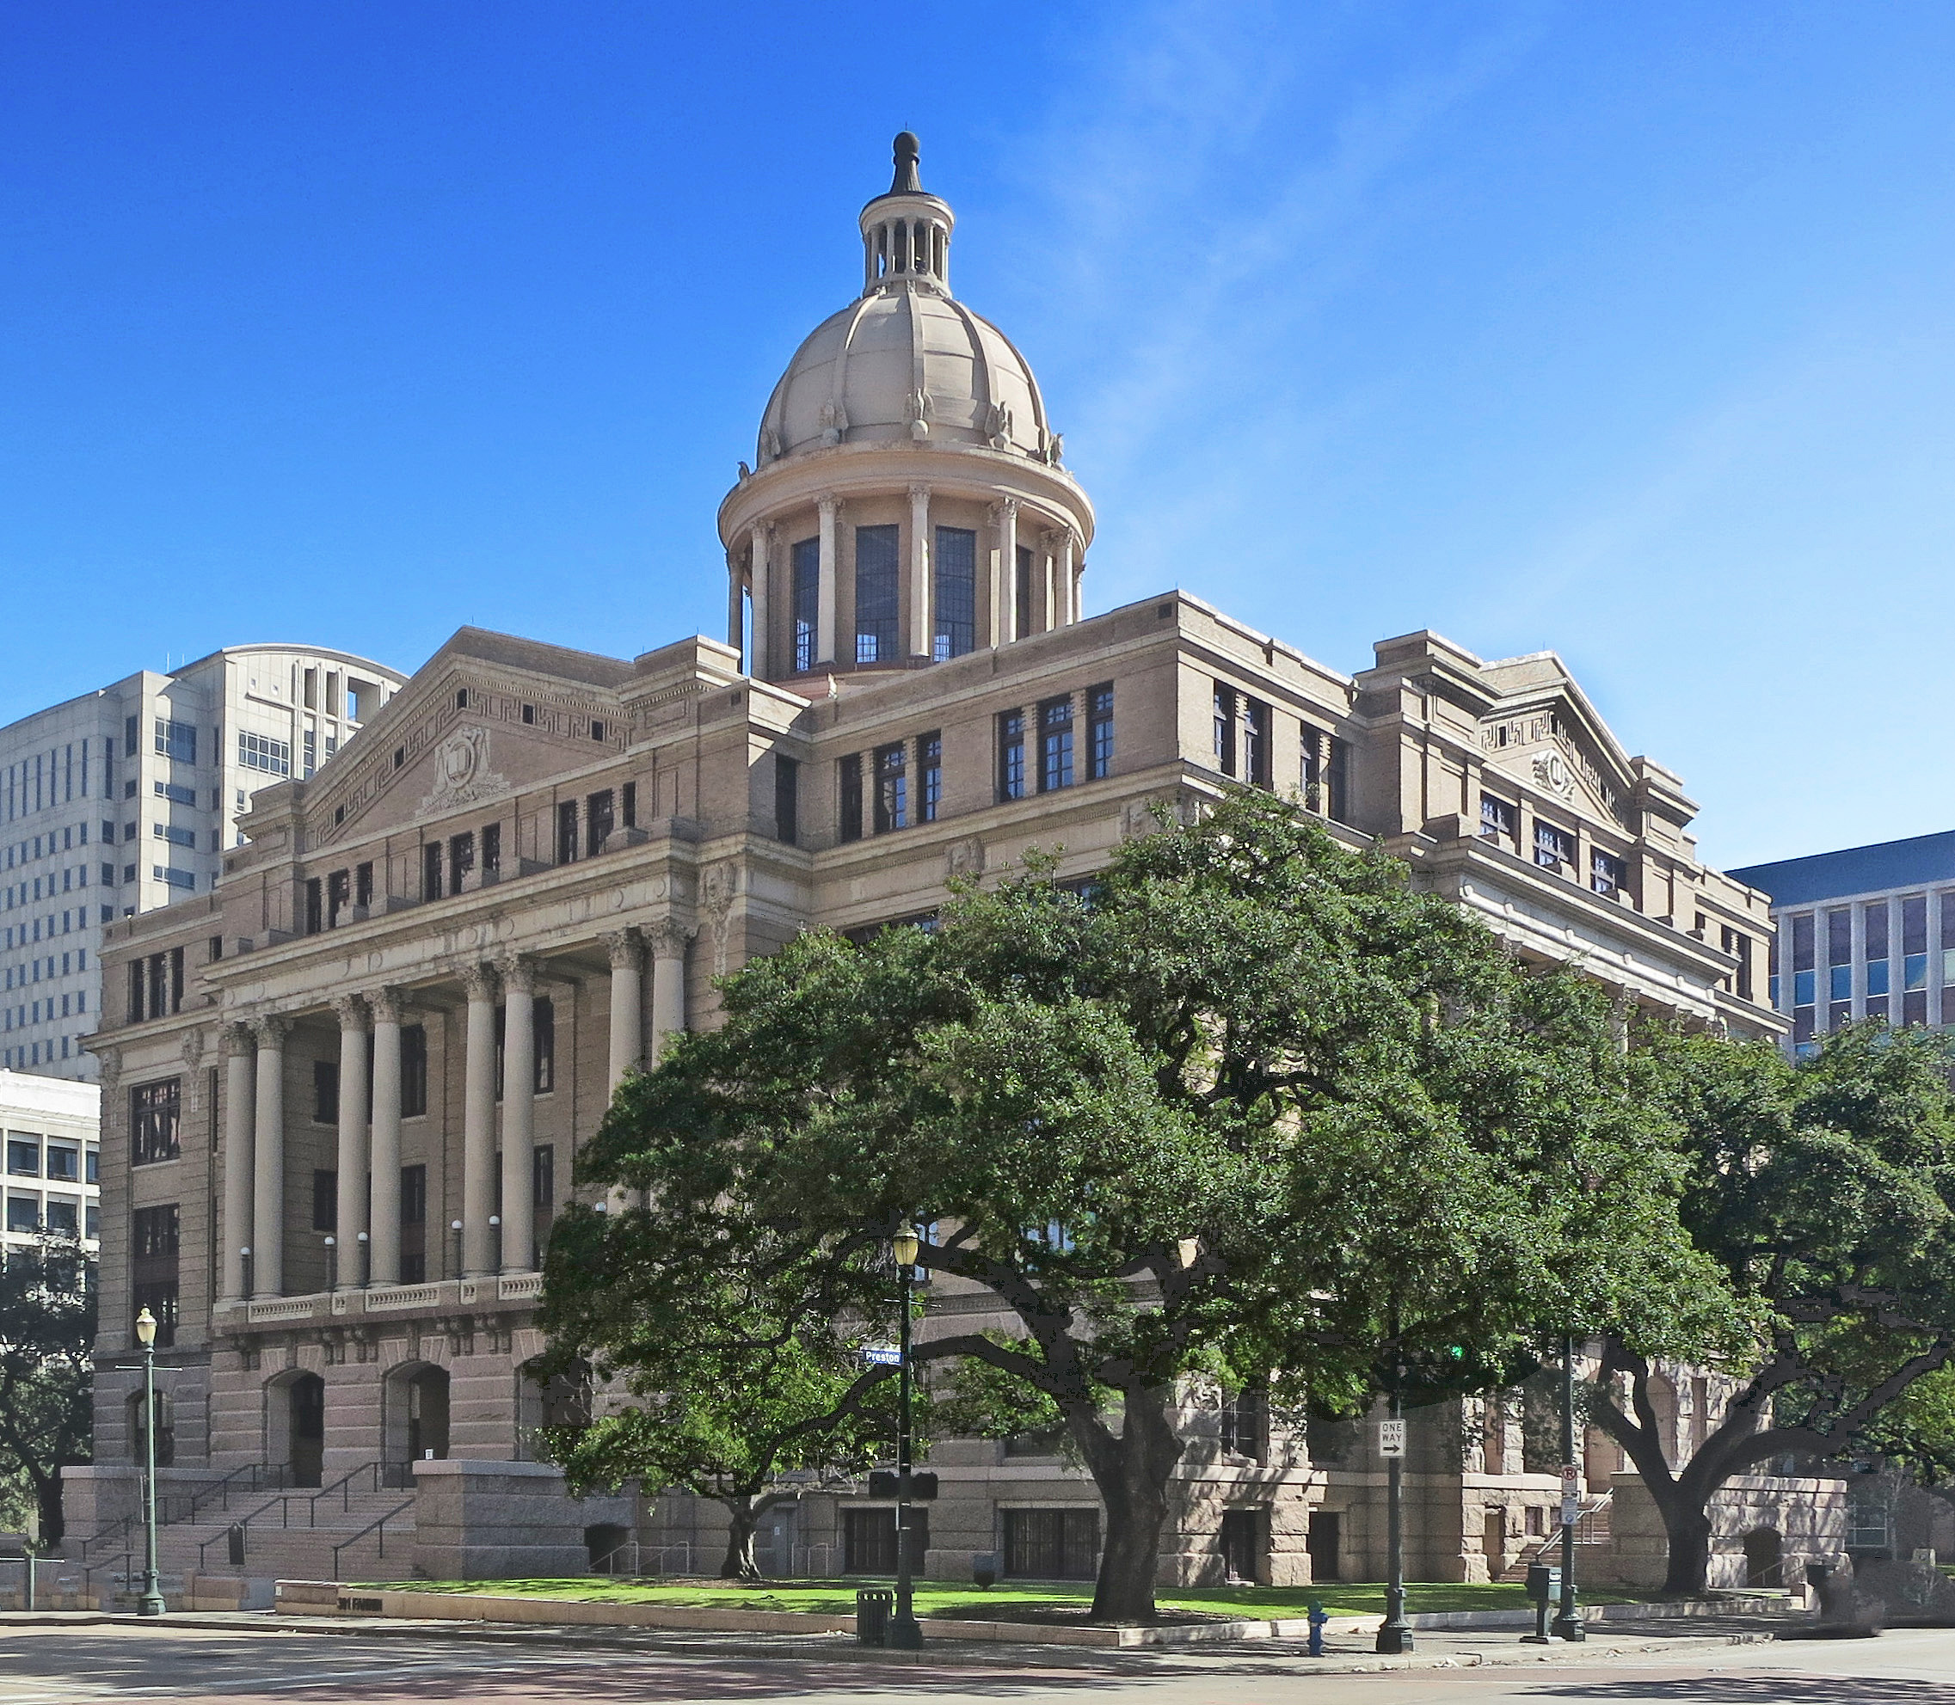
Failure to appear in court
One approach: Predict failure to appear, jail if risk is high.
Alternative: Recognize that people fail to appear in court due to lack of child care and transportation, work schedules, or too many court appointments. Implement steps to mitigate these issues.
Alternative is part of the Harris County Lawsuit settlement: "require Harris County to provide free child care at courthouses, develop a two-way communication system between courts and defendants, give cell phones to poor defendants and pay for public transit or ride share services for defendants without access to transportation to court." (Source: Houston Chronicle, April 2019)

Slide 50
Toward a broader perspective
Statistical fairness criteria take data generating distribution as given and work with nothing but the joint statistics of (X, Y, R, A).
If this statistical perspective is too narrow, how do we take salient social facts and context into account?
This will be the subject of Part II on Thursday.

Slide 51
Wrapping up
Fairness through unawareness fails!
Violations of fairness criteria trigger valid moral intuitions, and can surface normative questions about decision-making, as well as trade-offs and tensions between different interpretations of fairness.
However, statistical fairness criteria on their own cannot be a “proof of fairness”.
Nor are fairness criteria on their own a good objective function.

Slide 52
Background reading
A textbook in progress (mostly available online):
Barocas, H, Narayanan. Fairness and Machine Learning: Limitations and Opportunities. fairmlbook.org
Today’s lecture roughly corresponds to Chapters 1 & 2.

