Slide 1
CS 188: Artificial Intelligence
Markov Models
Instructors: Stuart Russell and Dawn Song
University of California, Berkeley
Notes:
Please retain proper attribution, including the reference to ai.berkeley.edu. Thanks!
Note: pretty short lecture, good one to present mini-contest results or anything else not exactly lecture.

Slide 2
Uncertainty and Time
Often, we want to reason about a sequence of observations
Speech recognition
Robot localization
User attention
Medical monitoring
Need to introduce time into our models

Slide 3
Markov Models (aka Markov chain/process)
Value of X at a given time is called the state (usually discrete, finite)
The transition model P(X_{t} | X_{t-1}) specifies how the state evolves over time
Stationarity assumption: transition probabilities are the same at all times
Markov assumption: “future is independent of the past given the present”
X_{t+1} is independent of X₀,…, X_{t-1} given X_{t}
This is a first-order Markov model (a kth-order model allows dependencies on k earlier steps)
Joint distribution P(X₀,…, X_{T}) = P(X₀) ∏_{t} P(X_{t} | X_{t-1})
X₀
X₁
X₂
X₃
P(X₀)
P(X_{t} | X_{t-1})

Slide 4
Quiz: are Markov models a special case of Bayes nets?
Yes and no!
Yes:
Directed acyclic graph, joint = product of conditionals
No:
Infinitely many variables (unless we truncate)
Repetition of transition model not part of standard Bayes net syntax

Slide 5
Example: Random walk in one dimension
-4
-3
-2
-1
0
1
2
3
4
State: location on the unbounded integer line
Initial probability: starts at 0
Transition model: P(X_{t} = k| X_{t-1}= k±1) = 0.5
Applications: particle motion in crystals, stock prices, gambling, genetics, etc.
Questions:
How far does it get as a function of t?
Expected distance is O(√t)
Does it get back to 0 or can it go off for ever and not come back?
In 1D and 2D, returns w.p. 1; in 3D, returns w.p. 0.34053733

Slide 6
Example: n-gram models
We call ourselves Homo sapiens—man the wise—because our intelligence is so important to us.
For thousands of years, we have tried to understand how we think; that is, how a mere handful of matter can
perceive, understand, predict, and manipulate a world far larger and more complicated than itself. ….
State: word at position t in text (can also build letter n-grams)
Transition model (probabilities come from empirical frequencies):
Unigram (zero-order): P(Word_{t} = i)
“logical are as are confusion a may right tries agent goal the was . . .”
Bigram (first-order): P(Word_{t} = i | Word_{t-1}= j)
“systems are very similar computational approach would be represented . . .”
Trigram (second-order): P(Word_{t} = i | Word_{t-1}= j, Word_{t-2}= k)
“planning and scheduling are integrated the success of naive bayes model is . . .”
Applications: text classification, spam detection, author identification, language classification, speech recognition

Slide 7
Example: Web browsing
State: URL visited at step t
Transition model:
With probability p, choose an outgoing link at random
With probability (1-p), choose an arbitrary new page
Question: What is the stationary distribution over pages?
I.e., if the process runs forever, what fraction of time does it spend in any given page?
Application: Google page rank

Slide 8
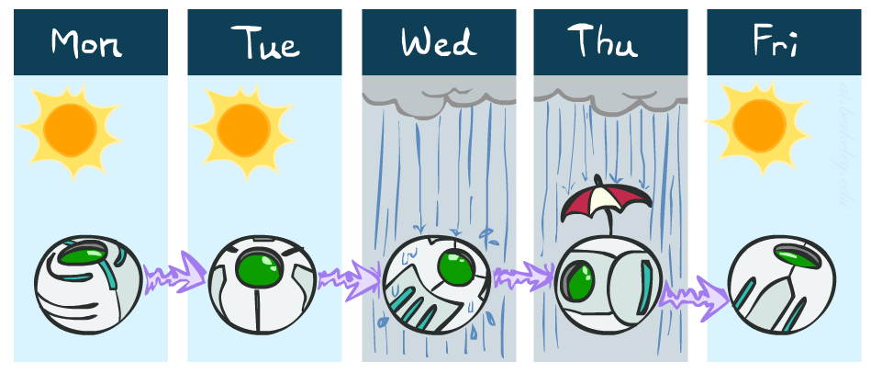
Example: Weather
States {rain, sun}
Initial distribution P(X₀)
Transition model P(X_{t} | X_{t-1})
P(X₀)
sun | rain
0.5 | 0.5
Two new ways of representing the same CPT
0.9
0.3
0.9
X_{t-1} | P(X_{t}|X_{t-1})
 | sun | rain
sun | 0.9 | 0.1
rain | 0.3 | 0.7
rain
sun
sun
sun
0.1
0.3
rain
rain
0.7
0.7
0.1

Slide 9
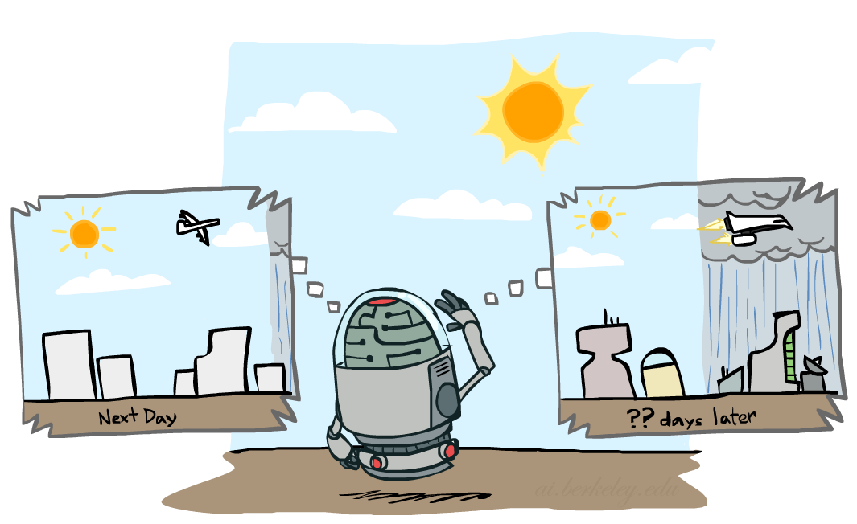
Weather prediction
X_{t-1} | P(X_{t}|X_{t-1})
 | sun | rain
sun | 0.9 | 0.1
rain | 0.3 | 0.7
Time 0: <0.5,0.5>
What is the weather like at time 1?
P(X₁) = ∑_{x0} P(X₁,X₀=x₀)
= ∑_{x0} P(X₀=x₀) P(X₁| X₀=x₀)
= 0.5<0.9,0.1> + 0.5<0.3,0.7> = <0.6,0.4>

Slide 10
Weather prediction, contd.
X_{t-1} | P(X_{t}|X_{t-1})
 | sun | rain
sun | 0.9 | 0.1
rain | 0.3 | 0.7
Time 1: <0.6,0.4>
What is the weather like at time 2?
P(X₂) = ∑_{x1} P(X₂,X₁=x₁)
= ∑_{x1} P(X₁=x₁) P(X₂| X₁=x₁)
= 0.6<0.9,0.1> + 0.4<0.3,0.7> = <0.66,0.34>

Slide 11
Weather prediction, contd.
X_{t-1} | P(X_{t}|X_{t-1})
 | sun | rain
sun | 0.9 | 0.1
rain | 0.3 | 0.7
Time 2: <0.66,0.34>
What is the weather like at time 3?
P(X₃) = ∑_{x2} P(X₃,X₂=x₂)
= ∑_{x2} P(X₂=x₂) P(X₃| X₂=x₂)
= 0.66<0.9,0.1> + 0.34<0.3,0.7> = <0.696,0.304>

Slide 12
Forward algorithm (simple form)
What is the state at time t?
P(X_{t}) = ∑_{xt-1} P(X_{t},X_{t-1}=x_{t-1})
= ∑_{xt-1} P(X_{t-1}=x_{t-1}) P(X_{t}| X_{t-1}=x_{t-1})
Iterate this update starting at t=0
Probability from previous iteration
Transition model

Slide 13
And the same thing in linear algebra
What is the weather like at time 2?
P(X₂) = 0.6<0.9,0.1> + 0.4<0.3,0.7> = <0.66,0.34>
In matrix-vector form:
P(X₂) = ( ) ( ) = ( )
I.e., multiply by T^{T}, transpose of transition matrix
X_{t-1} | P(X_{t}|X_{t-1})
 | sun | rain
sun | 0.9 | 0.1
rain | 0.3 | 0.7
0.9 0.3
0.1 0.7
0.6
0.4
0.66
0.34

Slide 14
Stationary Distributions
The limiting distribution is called the stationary distribution P∞ of the chain
It satisfies P∞ = P_{∞+1} = T^{T} P∞
Solving for P∞ in the example:
( ) ( ) = ( )
0.9p + 0.3(1-p) = p
p = 0.75
Stationary distribution is <0.75,0.25> regardless of starting distribution
0.9 0.3
0.1 0.7
p
1-p
p
1-p

Slide 15
Hidden Markov Models

Slide 16
Hidden Markov Models
Usually the true state is not observed directly
Hidden Markov models (HMMs)
Underlying Markov chain over states X
You observe evidence E at each time step
X_{t} is a single discrete variable; E_{t} may be continuous and may consist of several variables
X₀
X₁
X₂
X₃
X₅
E₁
E₂
E₃
E₅

Slide 17
Example: Weather HMM
An HMM is defined by:
Initial distribution: P(X₀)
Transition model: P(X_{t}| X_{t-1})
Sensor model: P(E_{t}| X_{t})
W_{t-1} | P(W_{t}|W_{t-1})
 | sun | rain
sun | 0.9 | 0.1
rain | 0.3 | 0.7
Weather_{t-1}
Weather_{t}
Weather_{t+1}
W_{t} | P(U_{t}|W_{t})
 | true | false
sun | 0.2 | 0.8
rain | 0.9 | 0.1
Umbrella_{t-1}
Umbrella_{t}
Umbrella_{t+1}
Notes:
demo

Slide 18
HMM as probability model
Joint distribution for Markov model: P(X₀,…, X_{T}) = P(X₀) ∏_{t=1:T} P(X_{t} | X_{t-1})
Joint distribution for hidden Markov model: P(X₀,X₁,…, X_{T},E_{T}) = P(X₀) ∏_{t=1:T} P(X_{t} | X_{t-1}) P(E_{t} | X_{t})
Future states are independent of the past given the present
Current evidence is independent of everything else given the current state
Are evidence variables independent of each other?
X₀
X₁
X₂
X₃
X₅
Useful notation:
X_{a:b} = X_{a} , X_{a+1}, …, X_{b}
E₁
E₂
E₃
E₅
Notes:
Add conditional independence consequences here

Slide 19
Real HMM Examples
Speech recognition HMMs:
Observations are acoustic signals (continuous valued)
States are specific positions in specific words (so, tens of thousands)
Machine translation HMMs:
Observations are words (tens of thousands)
States are translation options
Robot tracking:
Observations are range readings (continuous)
States are positions on a map (continuous)
Molecular biology:
Observations are nucleotides ACGT
States are coding/non-coding/start/stop/splice-site etc.

Slide 20
Inference tasks
Filtering: P(X_{t}|e_{1:t})
belief state—input to the decision process of a rational agent
Prediction: P(X_{t+k}|e_{1:t}) for k > 0
evaluation of possible action sequences; like filtering without the evidence
Smoothing: P(X_{k}|e_{1:t}) for 0 ≤ k < t
better estimate of past states, essential for learning
Most likely explanation: arg max_{x1:t} P(x_{1:t} | e_{1:t})
speech recognition, decoding with a noisy channel

Slide 21
Filtering / Monitoring
Filtering, or monitoring, or state estimation, is the task of maintaining the distribution f_{1:t} = P(X_{t}|e_{1:t}) over time
We start with f₀ in an initial setting, usually uniform
Filtering is a fundamental task in engineering and science
The Kalman filter (continuous variables, linear dynamics, Gaussian noise) was invented in 1960 and used for trajectory estimation in the Apollo program; core ideas used by Gauss for planetary observations
Notes:
Dan has some demo for this

Slide 22
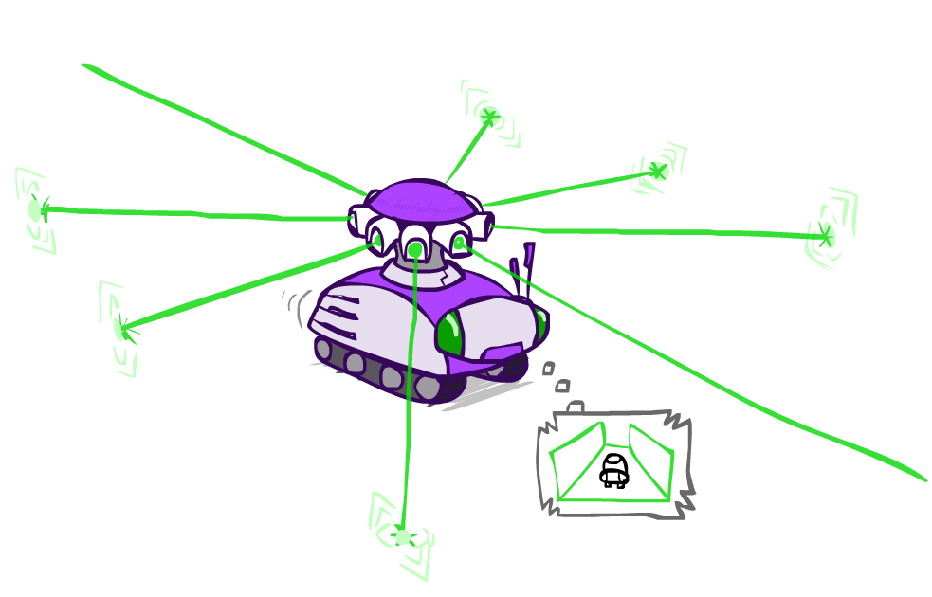
Example: Robot Localization
Example from Michael Pfeiffer
Prob
0
1
t=0
Sensor model: four bits for wall/no-wall in each direction, never more than 1 mistake
Transition model: action may fail with small prob.

Slide 23
Example: Robot Localization
Prob
0
1
t=1
Lighter grey: was possible to get the reading,
but less likely (required 1 mistake)

Slide 24
Example: Robot Localization
Prob
0
1
t=2

Slide 25
Example: Robot Localization
Prob
0
1
t=3

Slide 26
Example: Robot Localization
Prob
0
1
t=4

Slide 27
Example: Robot Localization
Prob
0
1
t=5

Slide 28
Filtering algorithm
Aim: devise a recursive filtering algorithm of the form
P(X_{t+1}|e_{1:t+1}) = g(e_{t+1}, P(X_{t}|e_{1:t}) )
P(X_{t+1}|e_{1:t+1}) =

Slide 29
Filtering algorithm
Aim: devise a recursive filtering algorithm of the form
P(X_{t+1}|e_{1:t+1}) = g(e_{t+1}, P(X_{t}|e_{1:t}) )
P(X_{t+1}|e_{1:t+1}) = P(X_{t+1}|e_{1:t}, e_{t+1})
= α P(e_{t+1}|X_{t+1}, e_{1:t}) P(X_{t+1}| e_{1:t})
= α P(e_{t+1}|X_{t+1}) P(X_{t+1}| e_{1:t})
= α P(e_{t+1}|X_{t+1}) ∑_{xt} P(x_{t} | e_{1:t}) P(X_{t+1}| x_{t}, e_{1:t})
= α P(e_{t+1}|X_{t+1}) ∑_{xt} P(x_{t} | e_{1:t}) P(X_{t+1}| x_{t})
Apply Bayes’ rule
Apply conditional independence
Condition on X_{t}
Apply conditional
independence
Normalize
Update
Predict

Slide 30
Filtering algorithm
P(X_{t+1}|e_{1:t+1}) = α P(e_{t+1}|X_{t+1}) ∑_{xt} P(x_{t} | e_{1:t}) P(X_{t+1}| x_{t})
f_{1:t+1} = Forward(f_{1:t} , e_{t+1})
Cost per time step: O(|X|²) where |X| is the number of states
Time and space costs are constant, independent of t
O(|X|²) is infeasible for models with many state variables
We get to invent really cool approximate filtering algorithms
Normalize
Update
Predict

Slide 31
And the same thing in linear algebra
Transition matrix T, observation matrix O_{t}
Observation matrix has state likelihoods for E_{t} along diagonal
E.g., for U₁ = true, O₁ = ( )
Filtering algorithm becomes
f_{1:t+1} = α O_{t+1}T^{T} f_{1:t}
0.2 0
0 0.9
X_{t-1} | P(X_{t}|X_{t-1})
 | sun | rain
sun | 0.9 | 0.1
rain | 0.3 | 0.7
W_{t} | P(U_{t}|W_{t})
 | true | false
sun | 0.2 | 0.8
rain | 0.9 | 0.1

Slide 32
Example: Weather HMM
0.6
0.4
0.45
0.55
predict
predict
update
update
W_{t-1} | P(W_{t}|W_{t-1})
 | sun | rain
sun | 0.9 | 0.1
rain | 0.3 | 0.7
f(sun) = 0.5
f(rain) = 0.5
f(sun) = 0.25
f(rain) = 0.75
f(sun) = 0.154
f(rain) = 0.846
Weather₀
Weather₁
Weather₂
W_{t} | P(U_{t}|W_{t})
 | true | false
sun | 0.2 | 0.8
rain | 0.9 | 0.1
P(W₀)
sun | rain
0.5 | 0.5
Umbrella₁
Umbrella₂
Notes:
Fix numbers

Slide 33
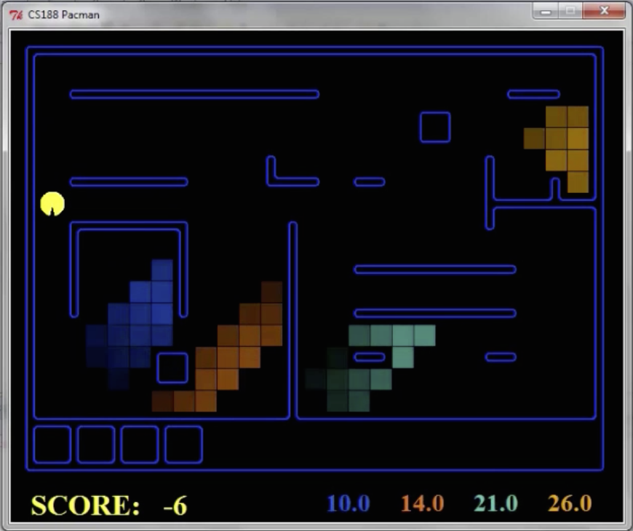
Pacman – Hunting Invisible Ghosts with Sonar
[Demo: Pacman – Sonar – No Beliefs(L14D1)]

Slide 34
Video of Demo Pacman – Sonar

