Slide 1
Announcements
Midterm 2
  Midterm 2 is on Wednesday 7/29, 12pm-2pm
  Practice Midterm released
  Monday and Tuesday discussions will be replaced with review sections
Midterm 1 Grades Released
  Regrades will open tonight, until Monday 7/27 at 11:59pm
Written Assessment 2 & Homework 5
  Due Friday 7/24 at 11:59pm
Project 4
  Due Friday 7/31 at 11:59pm

Slide 2
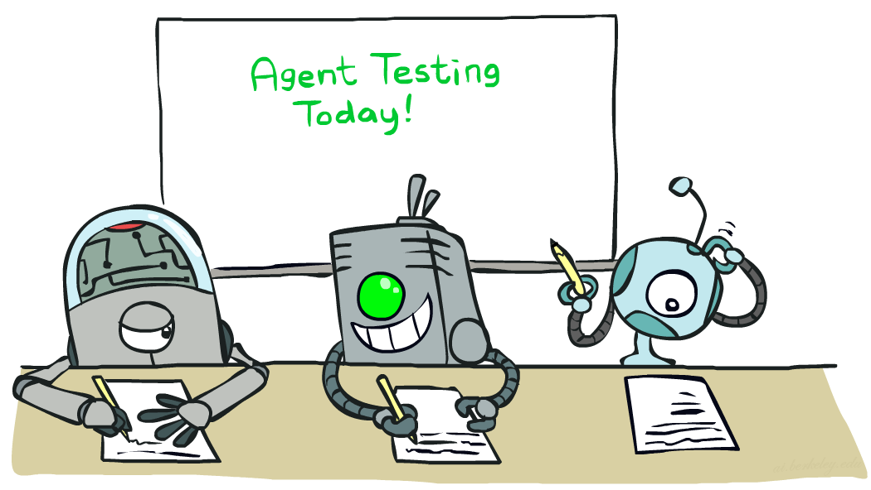

CS 188: Artificial Intelligence
Naïve Bayes
Instructor: Nikita Kitaev --- University of California, Berkeley
[These slides were created by Dan Klein and Pieter Abbeel for CS188 Intro to AI at UC Berkeley. All CS188 materials are available at http://ai.berkeley.edu.]
Notes:
Please retain proper attribution, including the reference to ai.berkeley.edu. Thanks!

Slide 3

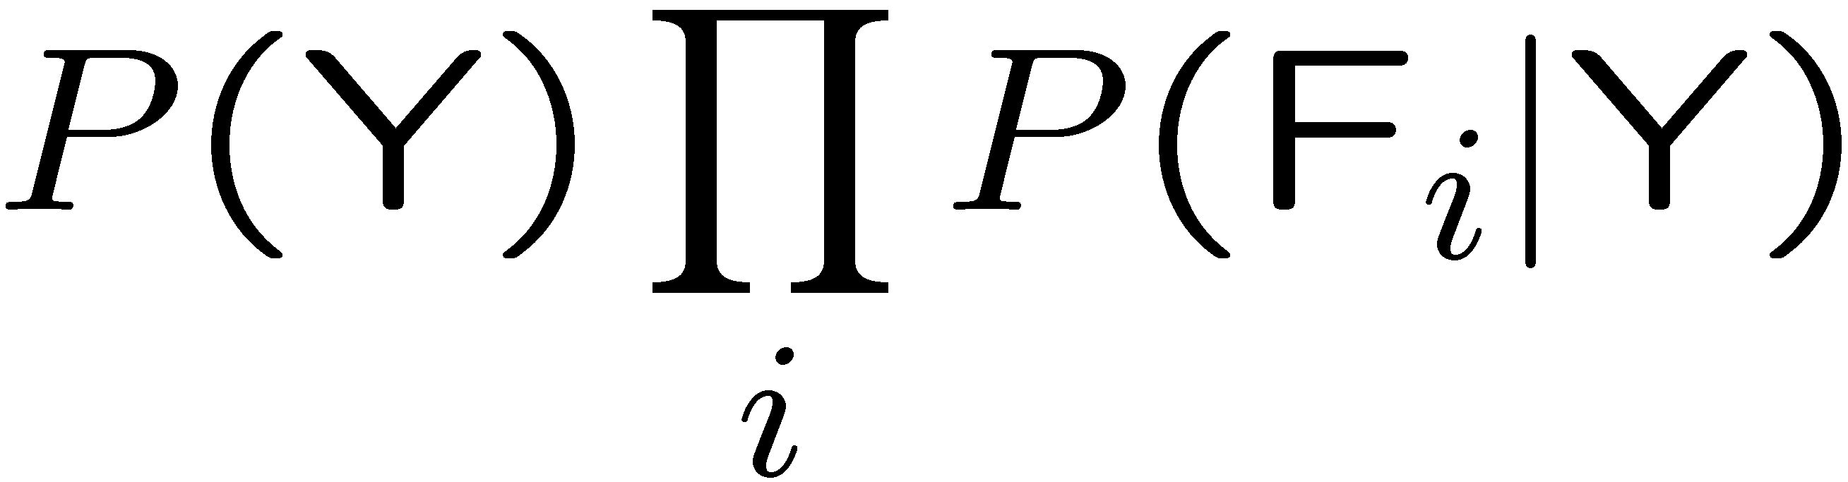

General Naïve Bayes
A general Naive Bayes model:
Y
F₁
F₂
F_{n}

Slide 4
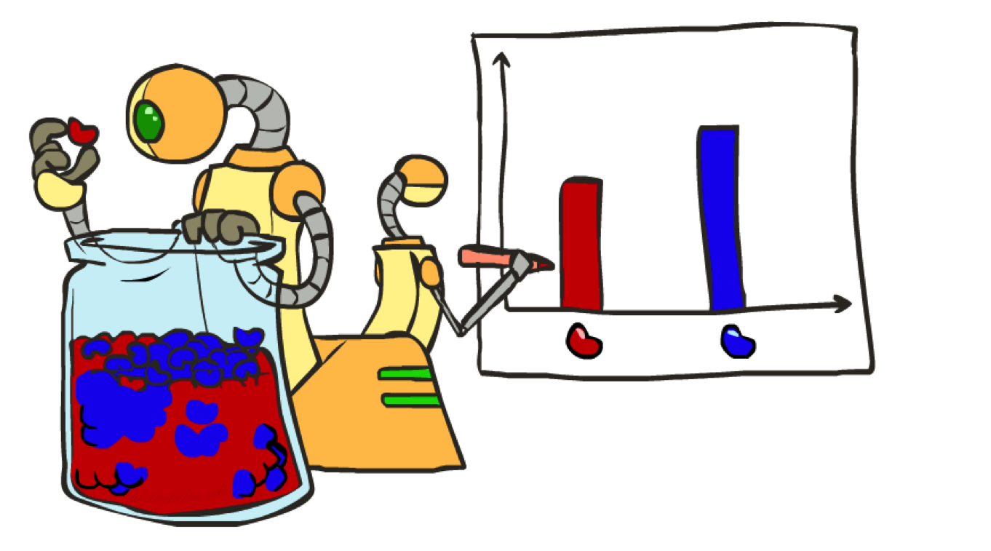
Parameter Estimation

Slide 5
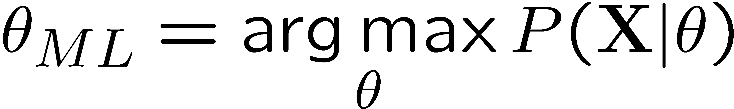
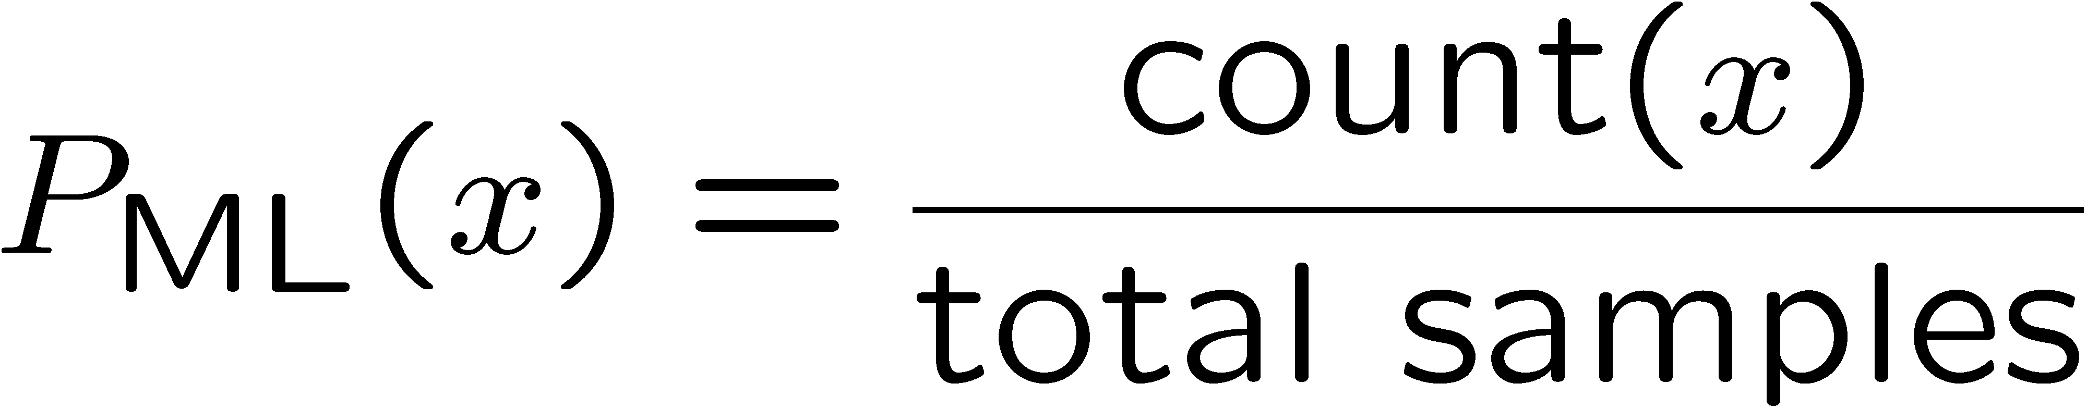
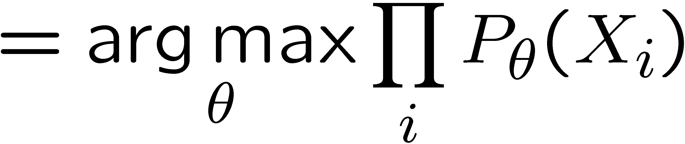
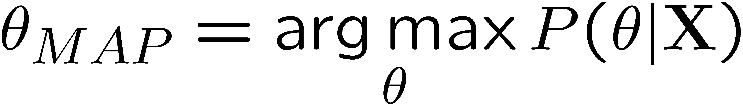
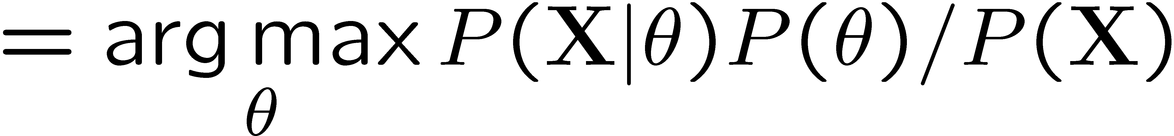
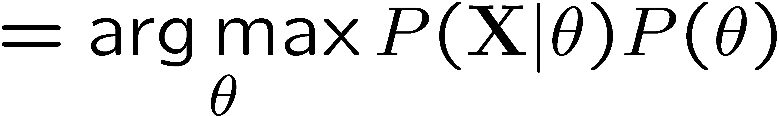
Maximum Likelihood?
Relative frequencies are the maximum likelihood estimates
Another option is to consider the most likely parameter value given the data
????

Slide 6













Example: Overfitting
2 wins!!

Slide 7
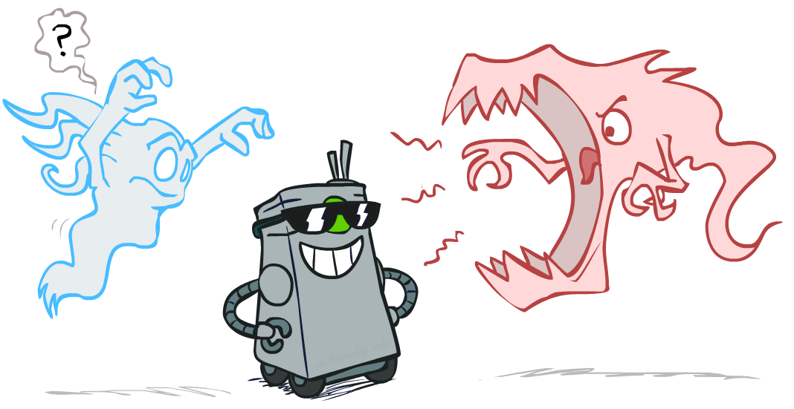
Smoothing

Slide 8

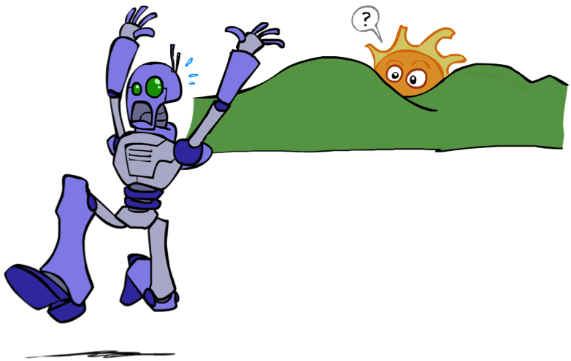
Unseen Events

Slide 9
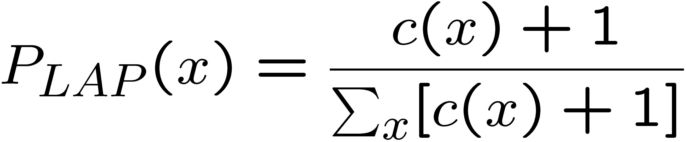
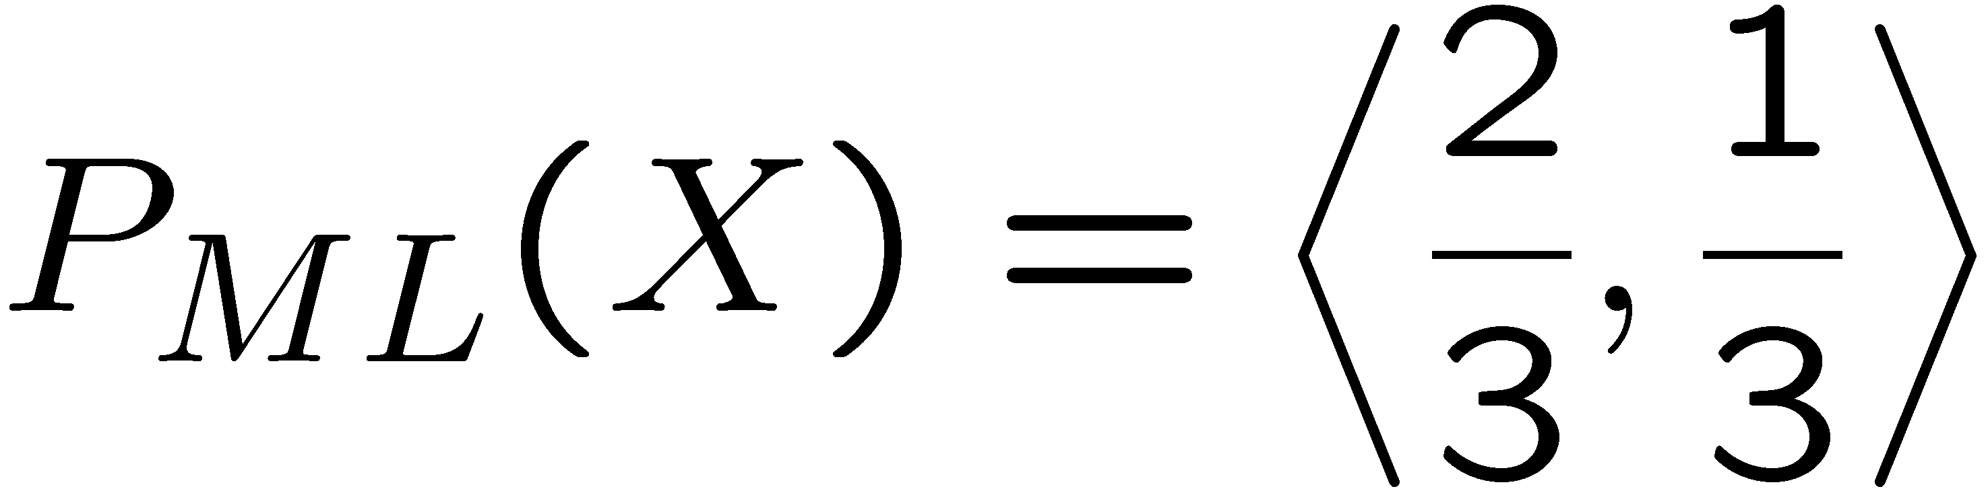
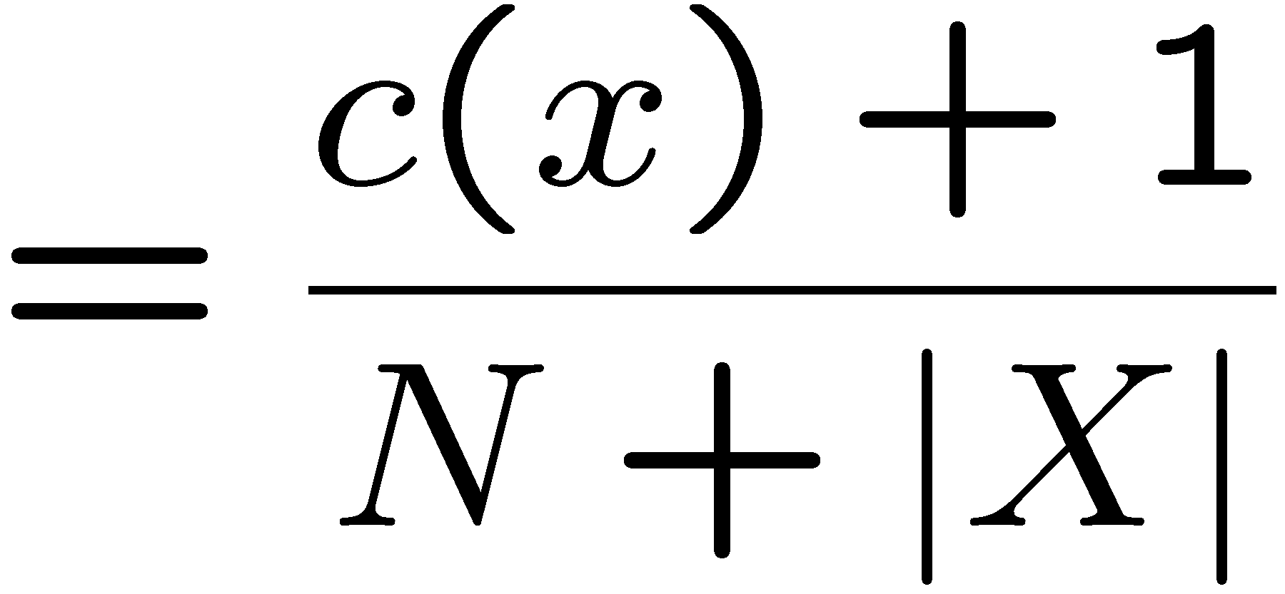
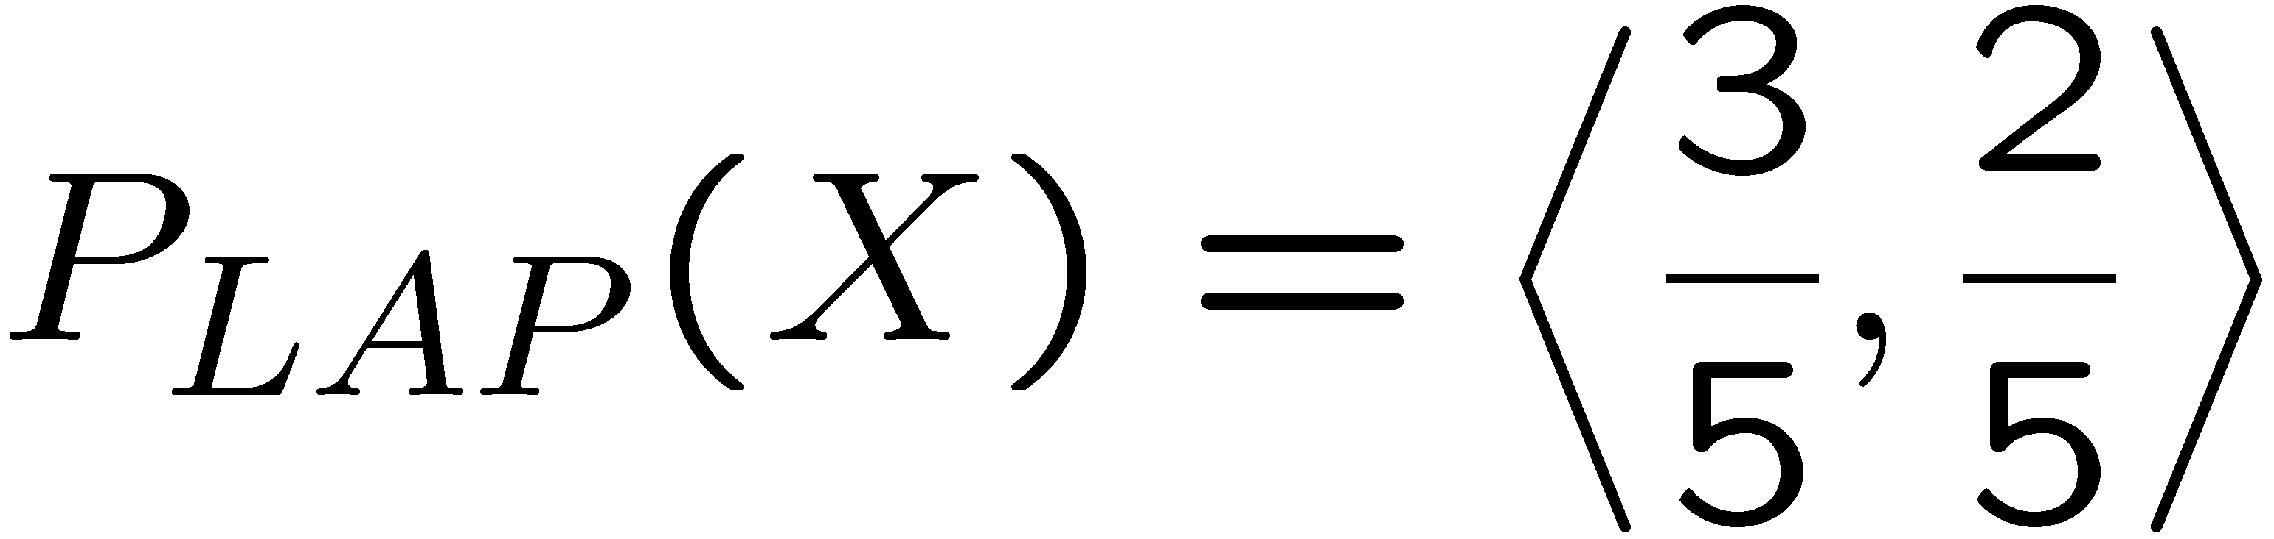
Laplace Smoothing
Laplace’s estimate:
  Pretend you saw every outcome once more than you actually did
  Can derive this estimate with Dirichlet priors (see cs281a)
r
r
b

Slide 10
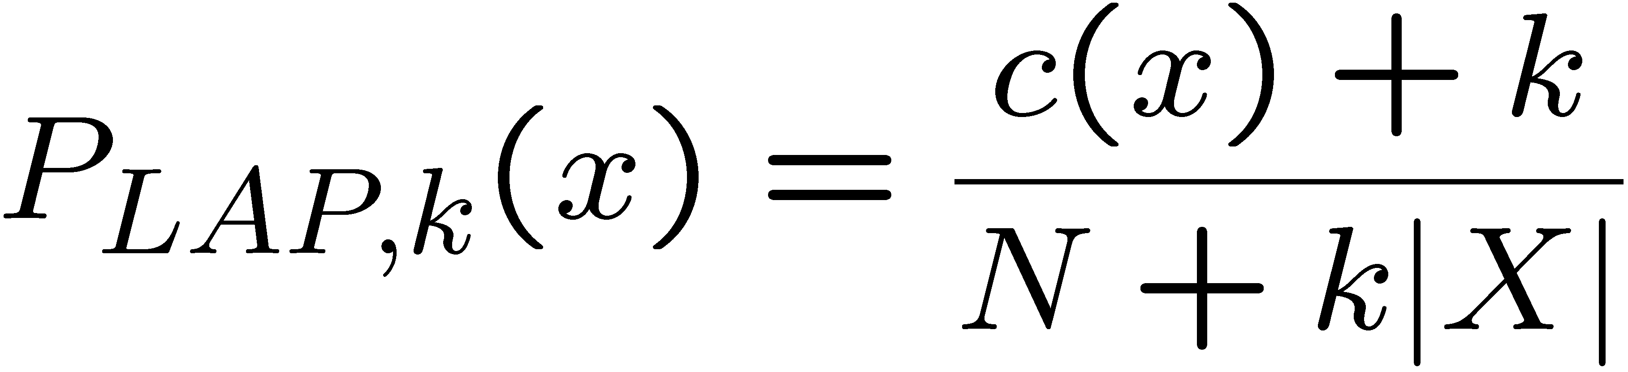
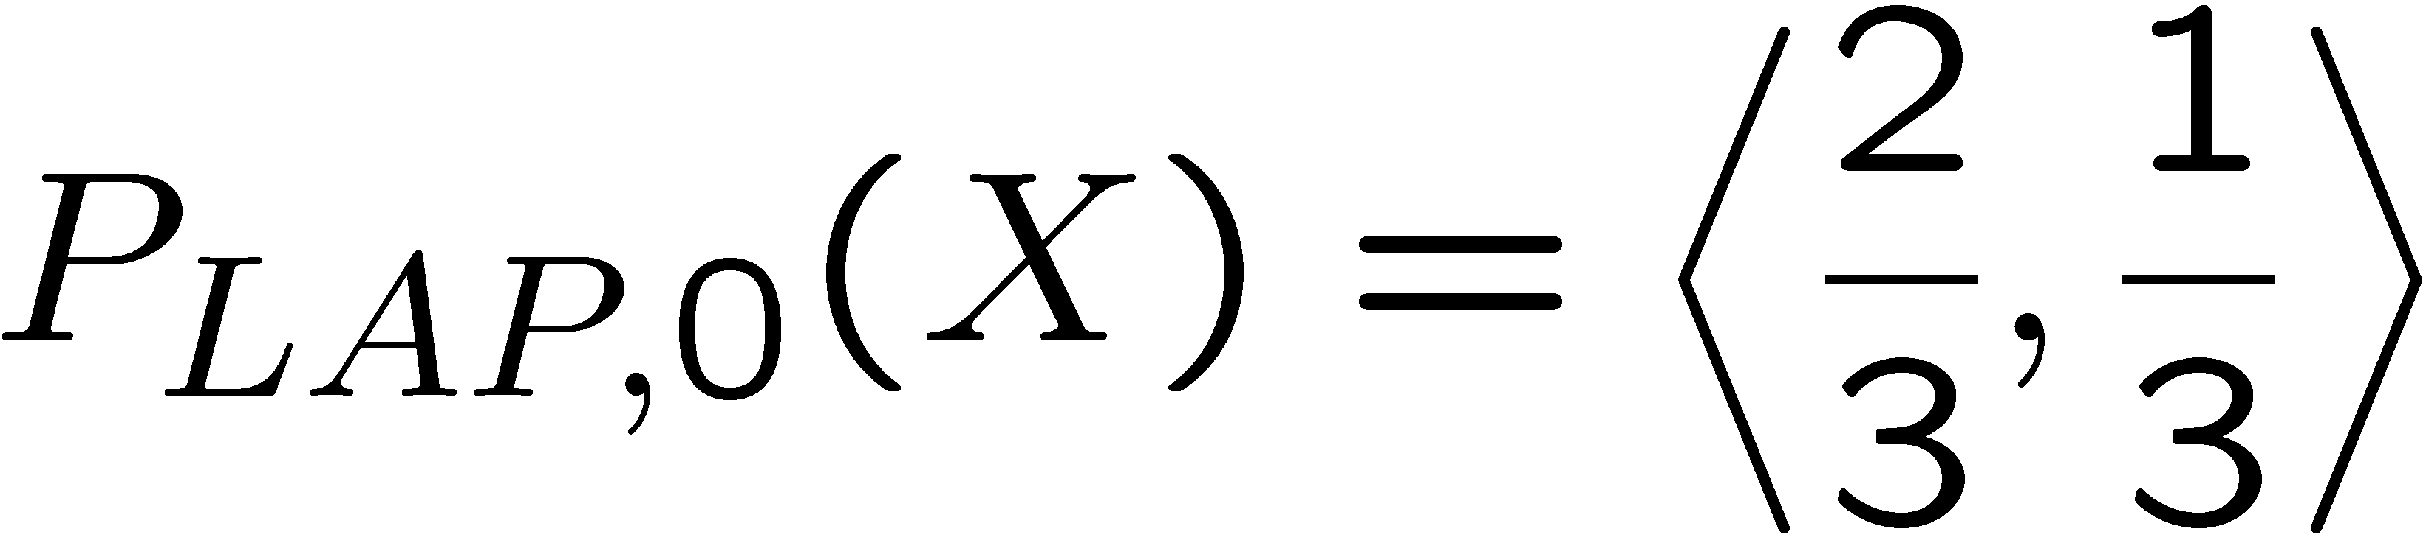
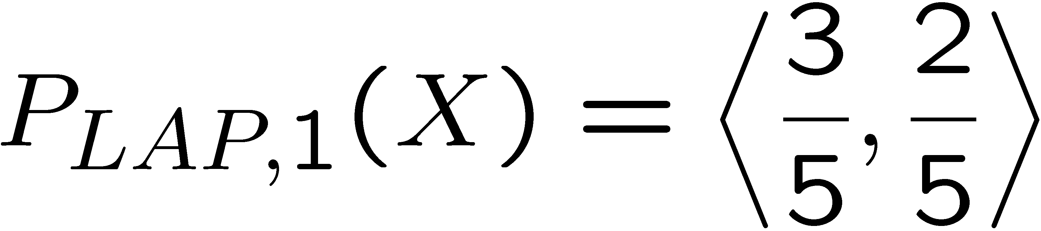
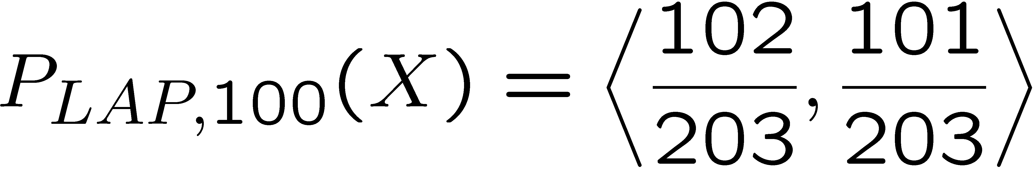
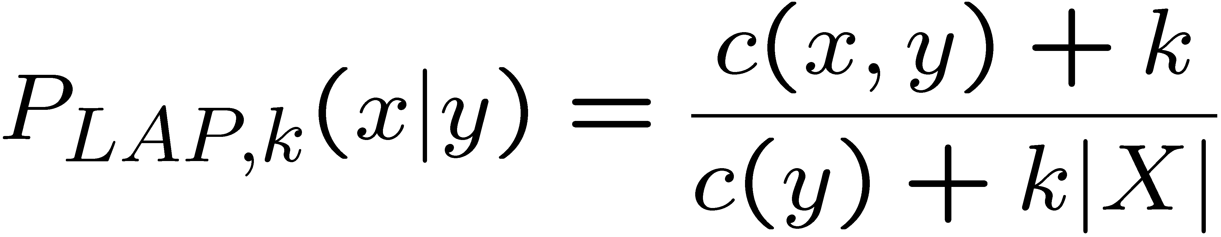
Laplace Smoothing
Laplace’s estimate (extended):
  Pretend you saw every outcome k extra times
  What’s Laplace with k = 0?
  k is the strength of the prior
Laplace for conditionals:
  Smooth each condition independently:
r
r
b

Slide 11
Estimation: Linear Interpolation*
In practice, Laplace can perform poorly for P(X|Y):
  When |X| is very large
  When |Y| is very large
Another option: linear interpolation
  Also get the empirical P(X) from the data
  Make sure the estimate of P(X|Y) isn’t too different from the empirical P(X)
  What if α is 0? 1?
For even better ways to estimate parameters, as well as details of the math, see cs281a, cs288

Slide 12

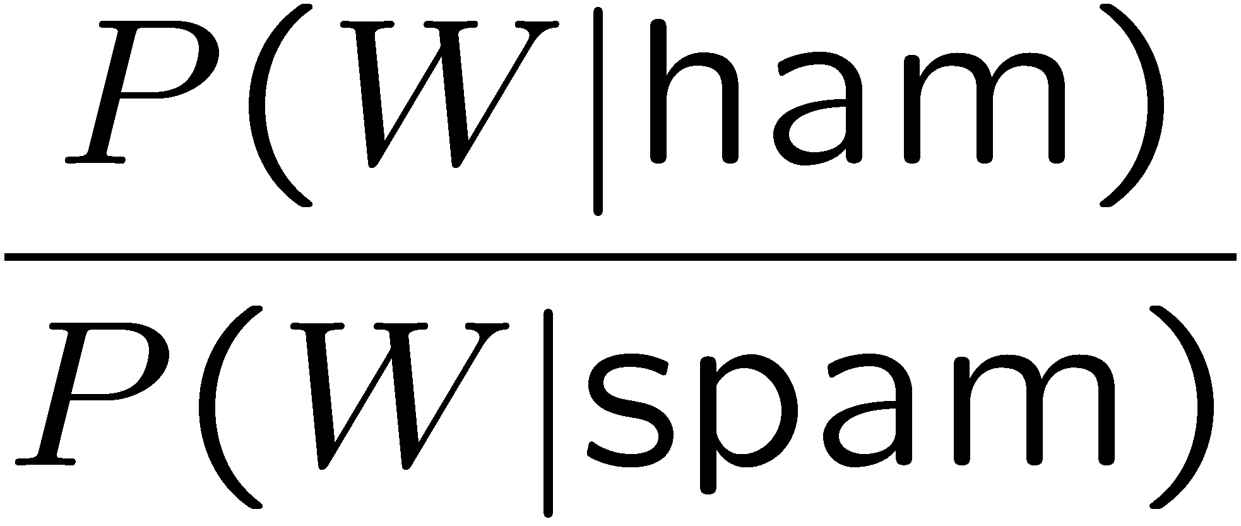
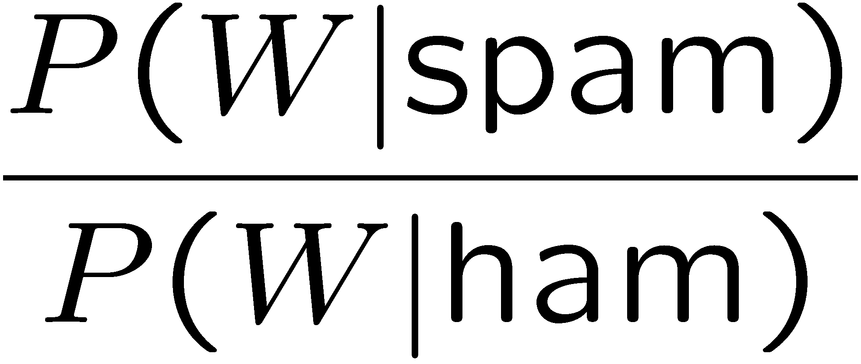
Real NB: Smoothing
For real classification problems, smoothing is critical
New odds ratios:
helvetica : 11.4
seems : 10.8
group : 10.2
ago : 8.4
areas : 8.3
...
verdana : 28.8
Credit : 28.4
ORDER : 27.2
<FONT> : 26.9
money : 26.5
...
Do these make more sense?

Slide 13
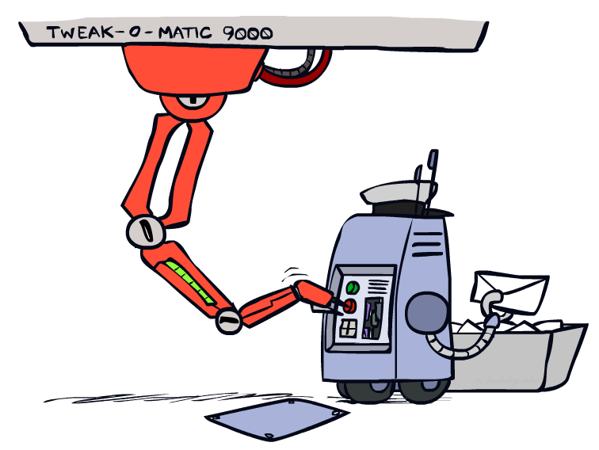
Tuning

Slide 14








Tuning on Held-Out Data
Now we’ve got two kinds of unknowns
  Parameters: the probabilities P(X|Y), P(Y)
  Hyperparameters: e.g. the amount / type of smoothing to do, k, α
What should we learn where?
  Learn parameters from training data
  Tune hyperparameters on different data
    Why?
  For each value of the hyperparameters, train and test on the held-out data
  Choose the best value and do a final test on the test data

Slide 15
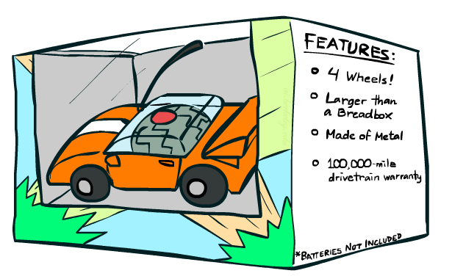
Features

Slide 16
Errors, and What to Do
Examples of errors
Dear GlobalSCAPE Customer,
GlobalSCAPE has partnered with ScanSoft to offer you the latest version of OmniPage Pro, for just $99.99* - the regular list price is $499! The most common question we've received about this offer is - Is this genuine? We would like to assure you that this offer is authorized by ScanSoft, is genuine and valid. You can get the . . .
. . . To receive your $30 Amazon.com promotional certificate, click through to
http://www.amazon.com/apparel
and see the prominent link for the $30 offer. All details are there. We hope you enjoyed receiving this message. However, if you'd rather not receive future e-mails announcing new store launches, please click . . .

Slide 17
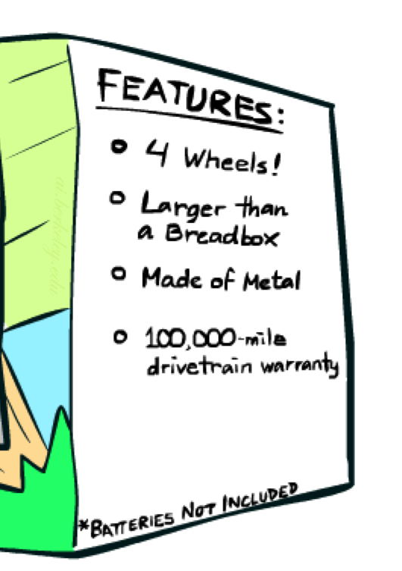
What to Do About Errors?
Need more features– words aren’t enough!
  Have you emailed the sender before?
  Have 1K other people just gotten the same email?
  Is the sending information consistent?
  Is the email in ALL CAPS?
  Do inline URLs point where they say they point?
  Does the email address you by (your) name?
Can add these information sources as new variables in the NB model
Next we’ll talk about classifiers which let you easily add arbitrary features more easily, and, later, how to induce new features

Slide 18
Baselines
First step: get a baseline
  Baselines are very simple “straw man” procedures
  Help determine how hard the task is
  Help know what a “good” accuracy is
Weak baseline: most frequent label classifier
  Gives all test instances whatever label was most common in the training set
  E.g. for spam filtering, might label everything as ham
  Accuracy might be very high if the problem is skewed
  E.g. calling everything “ham” gets 66%, so a classifier that gets 70% isn’t very good…
For real research, usually use previous work as a (strong) baseline

Slide 19
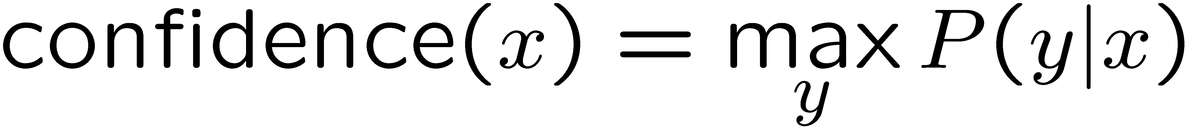

Confidences from a Classifier
The confidence of a probabilistic classifier:
  Posterior probability of the top label
  Represents how sure the classifier is of the classification
  Any probabilistic model will have confidences
  No guarantee confidence is correct
Calibration
  Weak calibration: higher confidences mean higher accuracy
  Strong calibration: confidence predicts accuracy rate
  What’s the value of calibration?

Slide 20
Summary
Bayes rule lets us do diagnostic queries with causal probabilities
The naïve Bayes assumption takes all features to be independent given the class label
We can build classifiers out of a naïve Bayes model using training data
Smoothing estimates is important in real systems
Classifier confidences are useful, when you can get them

Slide 21

CS 188: Artificial Intelligence
Perceptrons and Logistic Regression
Instructor: Nikita Kitaev
University of California, Berkeley

Slide 22
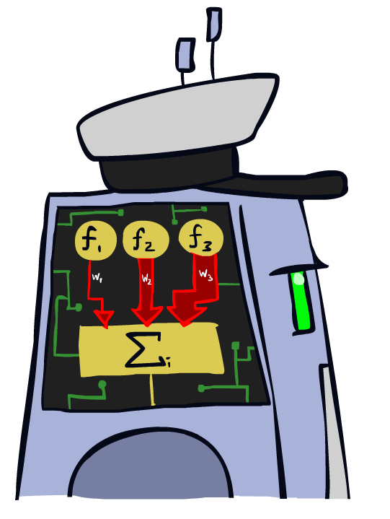
Linear Classifiers

Slide 23
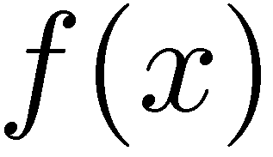



Feature Vectors
Hello,
Do you want free printr cartriges? Why pay more when you can get them ABSOLUTELY FREE! Just
# free : 2
YOUR_NAME : 0
MISSPELLED : 2
FROM_FRIEND : 0
...
SPAM
or
+
PIXEL-7,12 : 1
PIXEL-7,13 : 0
...
NUM_LOOPS : 1
...
“2”

Slide 24
Some (Simplified) Biology
Very loose inspiration: human neurons

Slide 25
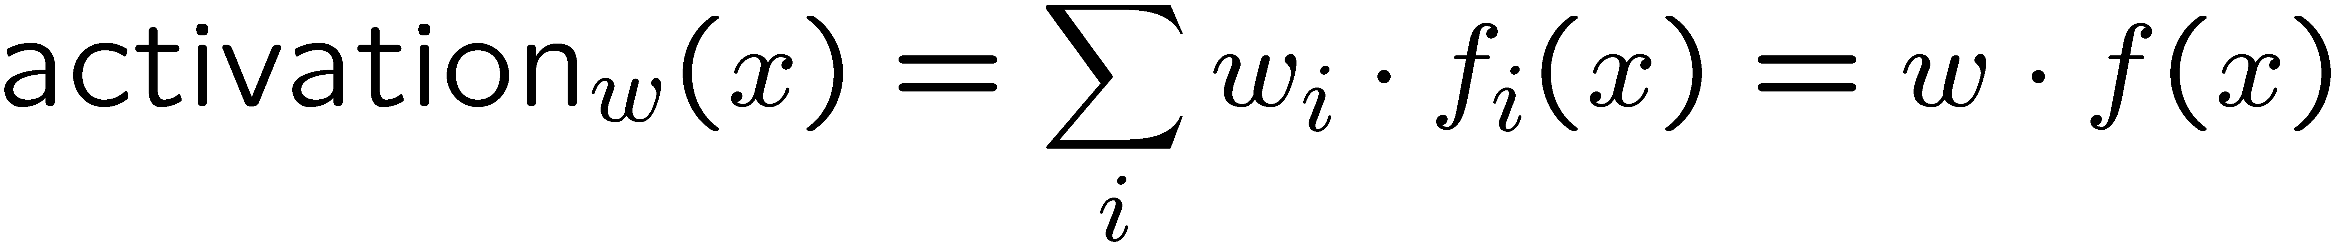
Linear Classifiers
Inputs are feature values
Each feature has a weight
Sum is the activation
If the activation is:
  Positive, output +1
  Negative, output -1
w₁
f₁
Σ
w₂
>0?
f₂
w₃
f₃

Slide 26


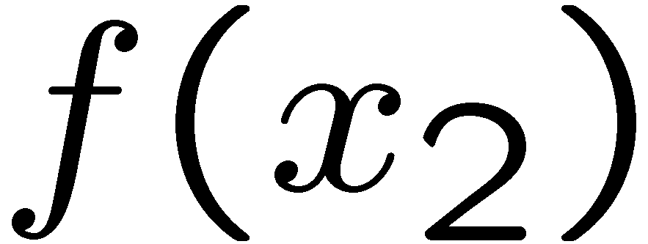
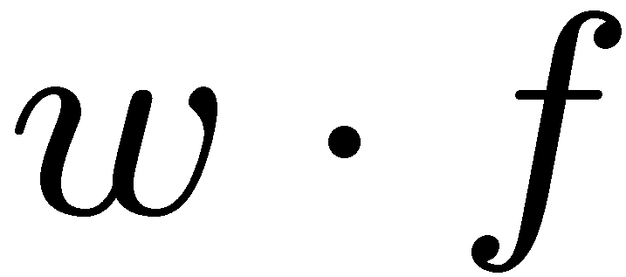
Weights
Binary case: compare features to a weight vector
Learning: figure out the weight vector from examples
# free : 4
YOUR_NAME :-1
MISSPELLED : 1
FROM_FRIEND :-3
...
# free : 2
YOUR_NAME : 0
MISSPELLED : 2
FROM_FRIEND : 0
...
# free : 0
YOUR_NAME : 1
MISSPELLED : 1
FROM_FRIEND : 1
...
Dot product positive means the positive class

Slide 27
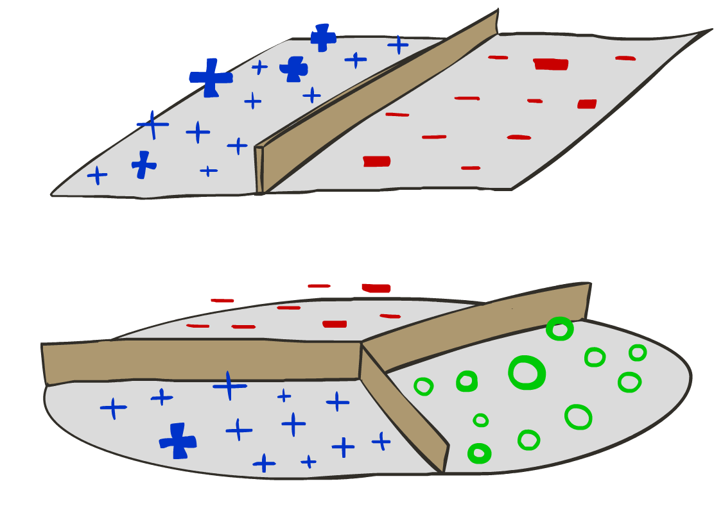
Decision Rules

Slide 28

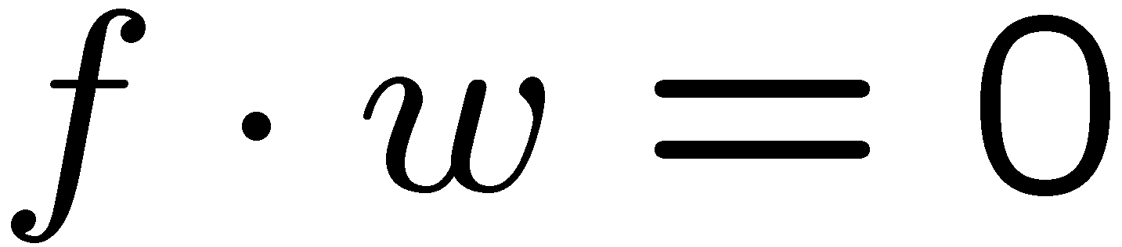
Binary Decision Rule
In the space of feature vectors
  Examples are points
  Any weight vector is a hyperplane
  One side corresponds to Y=+1
  Other corresponds to Y=-1
money
2
+1 = SPAM
1
BIAS : -3
free : 4
money : 2
...
0
-1 = HAM
0
1
free

Slide 29
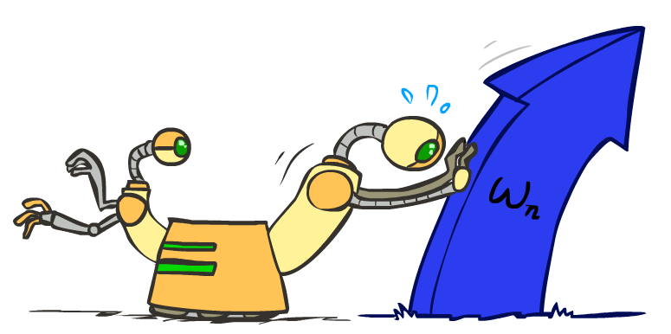
Weight Updates

Slide 30
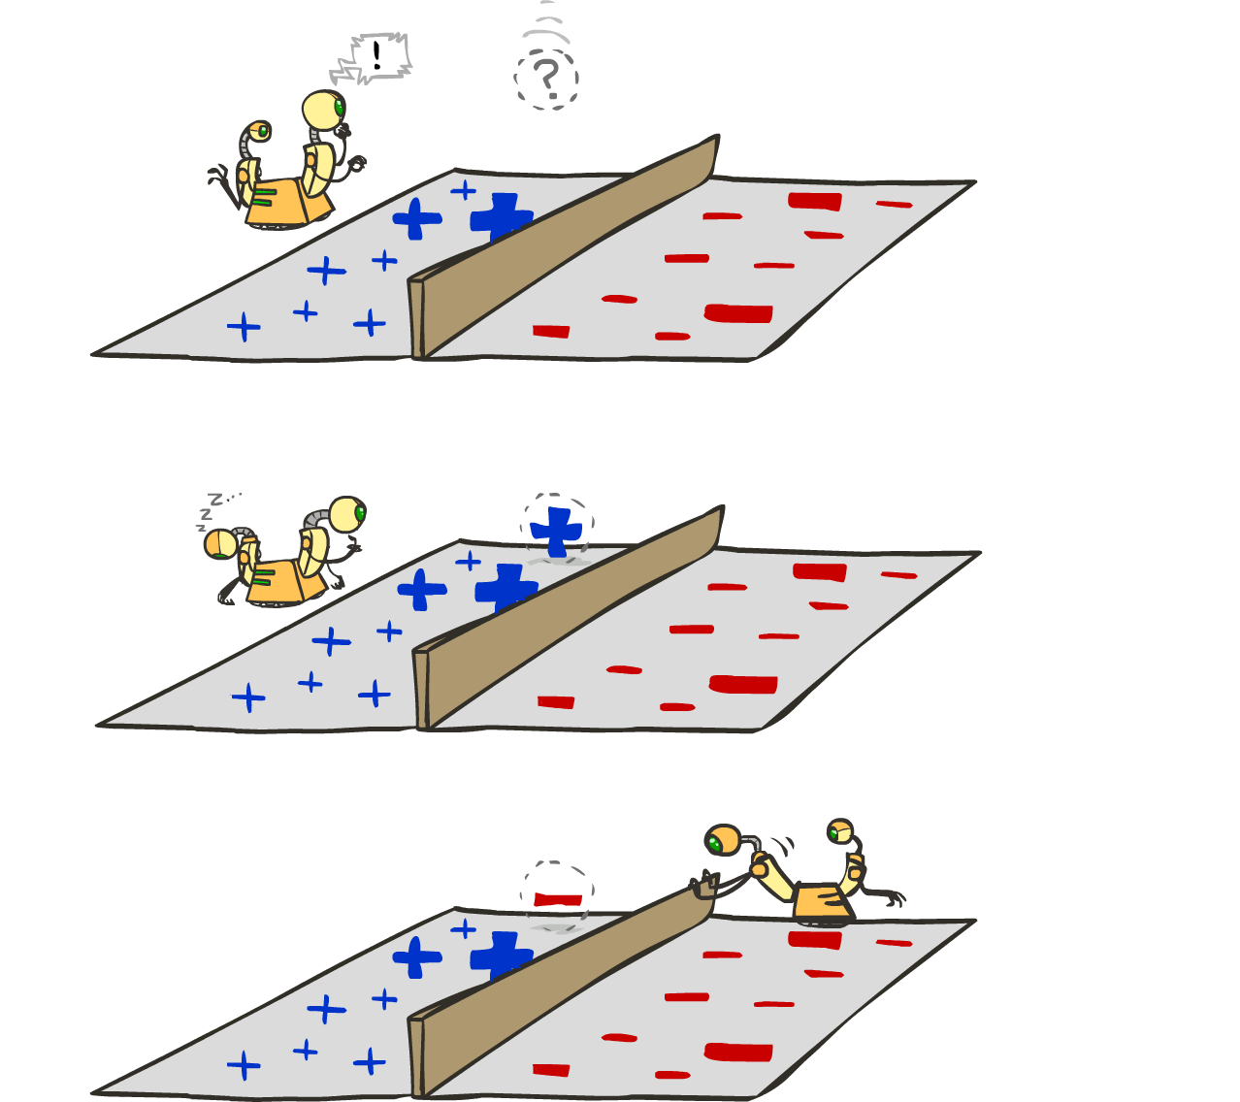
Learning: Binary Perceptron
Start with weights = 0
For each training instance:
  Classify with current weights
  If correct (i.e., y=y*), no change!
  If wrong: adjust the weight vector
Notes:
http://isl.ira.uka.de/neuralNetCourse/2004/VL_11_5/Perceptron.html

Slide 31

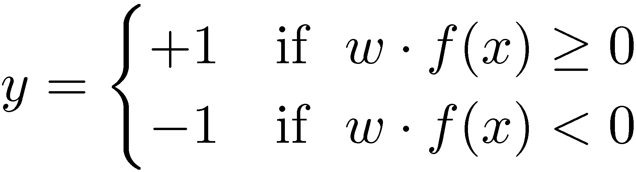

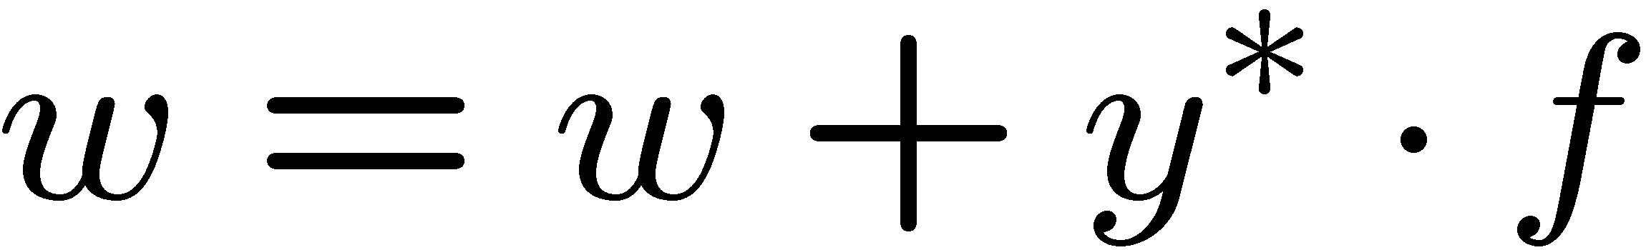
Learning: Binary Perceptron
Start with weights = 0
For each training instance:
  Classify with current weights
  If correct (i.e., y=y*), no change!
  If wrong: adjust the weight vector by adding or subtracting the feature vector. Subtract if y* is -1.
Notes:
http://isl.ira.uka.de/neuralNetCourse/2004/VL_11_5/Perceptron.html

Slide 32
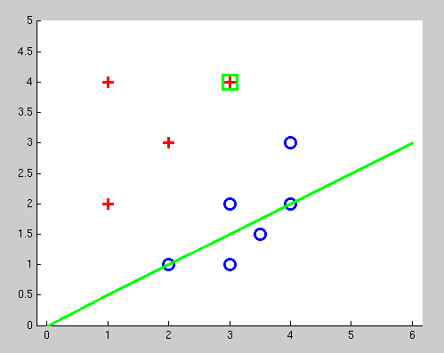
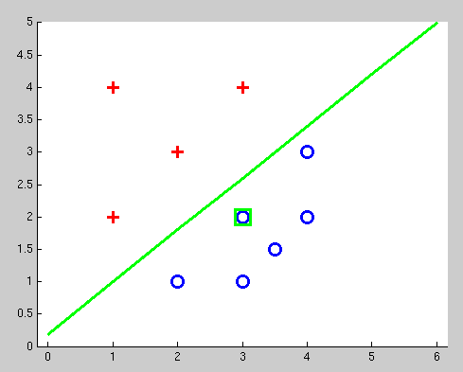
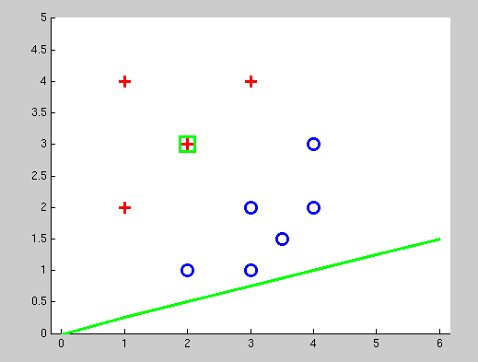
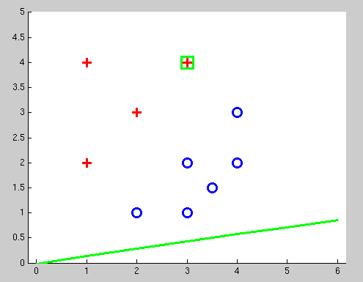
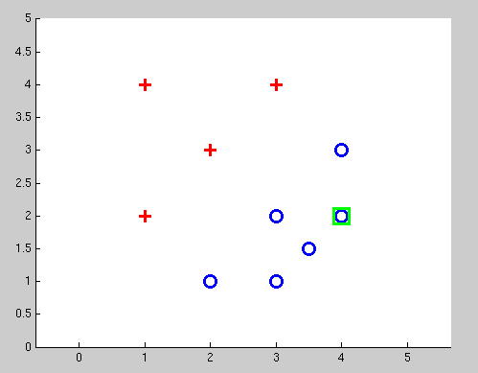
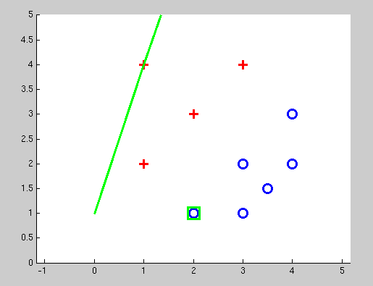
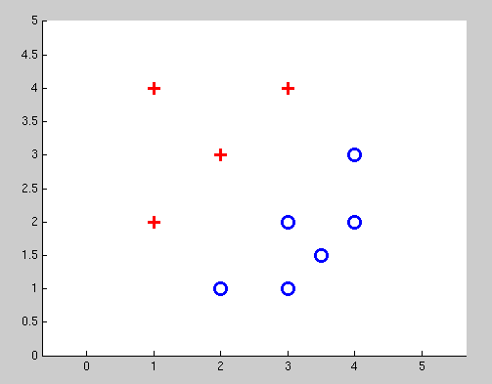
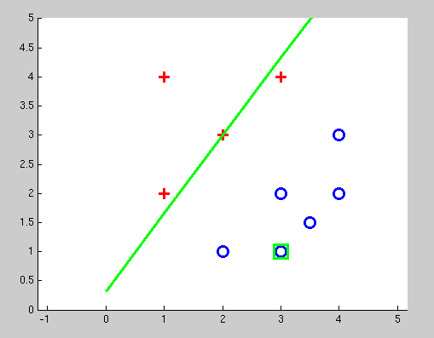
Examples: Perceptron
Separable Case

Slide 33


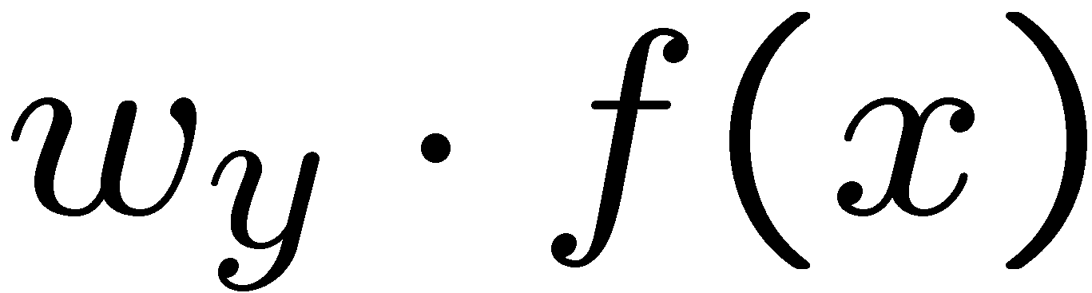



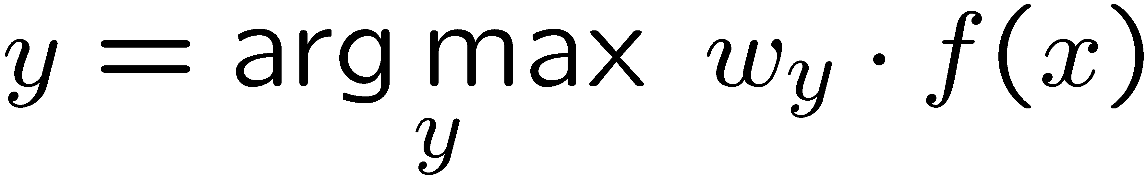
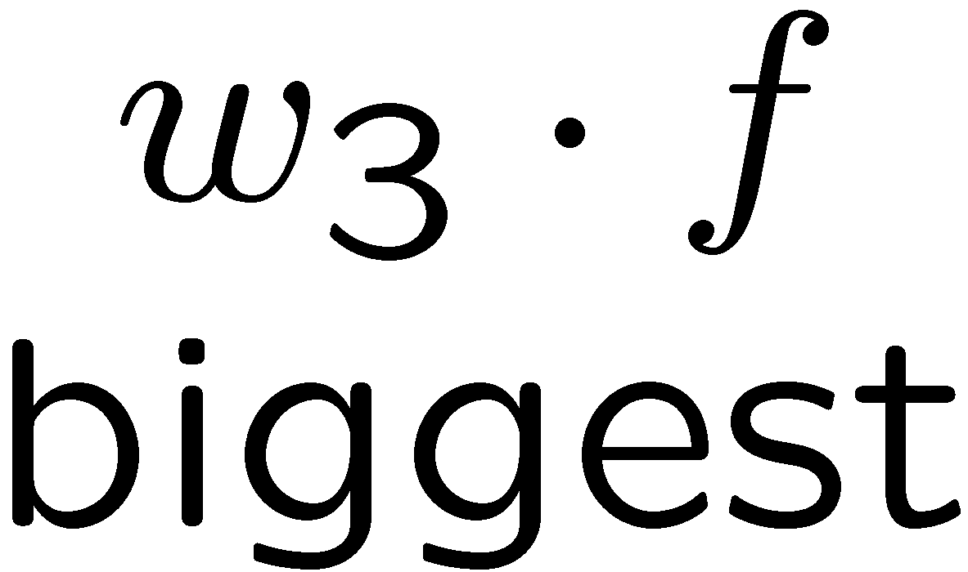
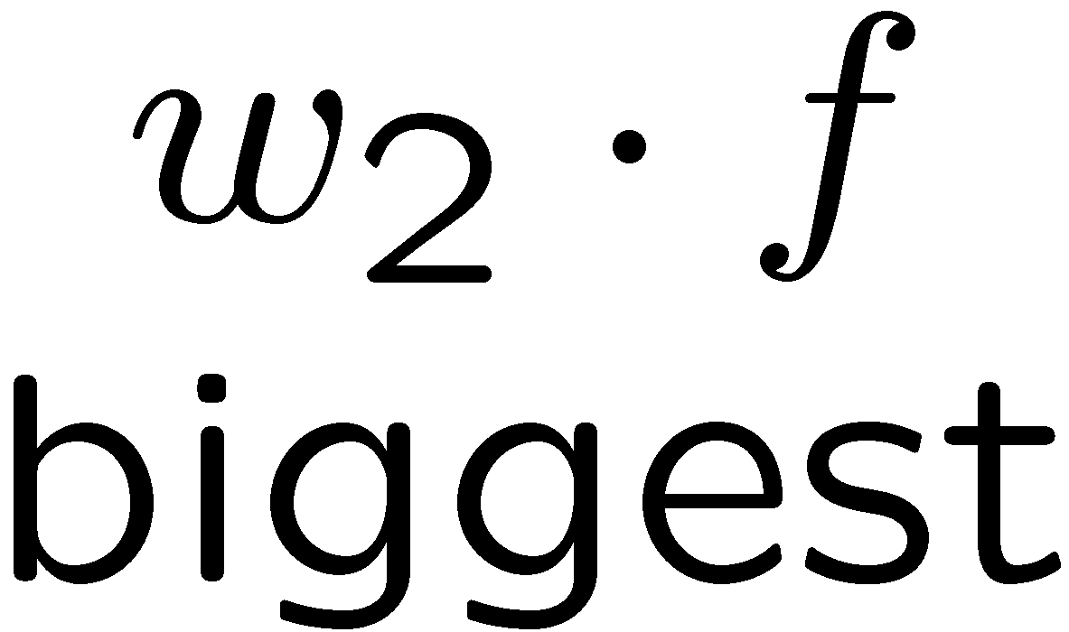
Multiclass Decision Rule
If we have multiple classes:
  A weight vector for each class:
  Score (activation) of a class y:
  Prediction highest score wins
Binary = multiclass where the negative class has weight zero

Slide 34



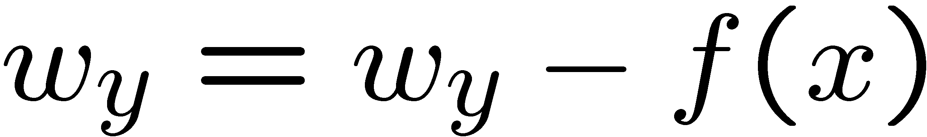

Learning: Multiclass Perceptron
Start with all weights = 0
Pick up training examples one by one
Predict with current weights
If correct, no change!
If wrong: lower score of wrong answer, raise score of right answer

Slide 35



Example: Multiclass Perceptron
“win the vote”
“win the election”
“win the game”
BIAS : 1
win : 0
game : 0
vote : 0
the : 0
...
BIAS : 0
win : 0
game : 0
vote : 0
the : 0
...
BIAS : 0
win : 0
game : 0
vote : 0
the : 0
...

Slide 36

Properties of Perceptrons
Separable
Separability: true if some parameters get the training set perfectly correct
Convergence: if the training is separable, perceptron will eventually converge (binary case)
Mistake Bound: the maximum number of mistakes (binary case) related to the margin or degree of separability
Non-Separable

Slide 37





Problems with the Perceptron
Noise: if the data isn’t separable, weights might thrash
  Averaging weight vectors over time can help (averaged perceptron)
Mediocre generalization: finds a “barely” separating solution
Overtraining: test / held-out accuracy usually rises, then falls
  Overtraining is a kind of overfitting

Slide 38

Improving the Perceptron

Slide 39

Non-Separable Case: Deterministic Decision
Even the best linear boundary makes at least one mistake

Slide 40
Non-Separable Case: Probabilistic Decision
0.9 | 0.1
0.7 | 0.3
0.5 | 0.5
0.3 | 0.7
0.1 | 0.9

Slide 41
How to get probabilistic decisions?
Perceptron scoring:
If very positive → want probability going to 1
If very negative → want probability going to 0
Sigmoid function

Slide 42
Best w?
Maximum likelihood estimation:
with:
= Logistic Regression

Slide 43
Separable Case: Deterministic Decision – Many Options

Slide 44
Separable Case: Probabilistic Decision – Clear Preference
0.7 | 0.3
0.5 | 0.5
0.7 | 0.3
0.3 | 0.7
0.5 | 0.5
0.3 | 0.7

Slide 45




A 1D Example
definitely blue
not sure
definitely red
probability increases exponentially as we move away from boundary
normalizer

Slide 46




The Soft Max

Slide 47
Multiclass Logistic Regression
Recall Perceptron:
  A weight vector for each class:
  Score (activation) of a class y:
  Prediction highest score wins
How to make the scores into probabilities?
original activations
softmax activations

Slide 48
Best w?
Maximum likelihood estimation:
with:
= Multi-Class Logistic Regression

Slide 49
Next Lecture
Optimization
  i.e., how do we solve:

