Slide 1
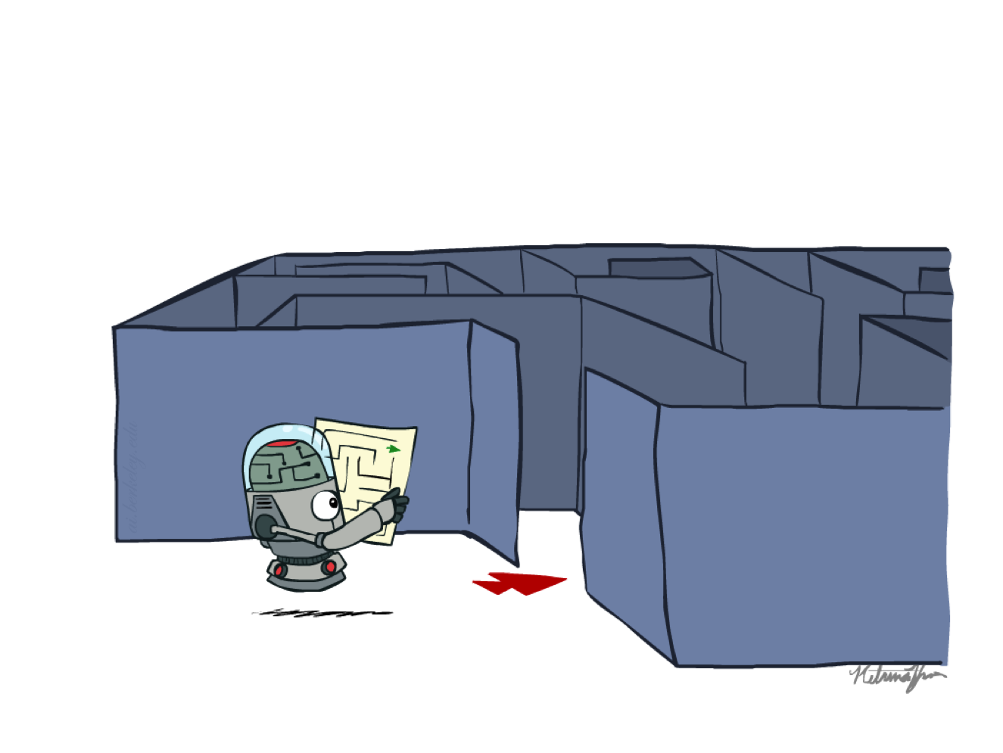
CS 188: Artificial Intelligence
Search
Instructor: Nikita Kitaev
University of California, Berkeley
[These slides adapted from Dan Klein and Pieter Abbeel]
Notes:
Please retain proper attribution, including the reference to ai.berkeley.edu. Thanks!

Slide 2
Announcements
Exam Times
  Midterm 1: July 13, 12pm-2pm (Alternative 12 hours later at 12am-2am)
  Midterm 2: July 29, 12pm-2pm (Alternative 12 hours later at 12am-2am)
  Final: August 13, 12pm-3pm (Alternative 12 hours later at 12am-3am)
Sections
  Start tomorrow, see Piazza for times
  You can go to any section
Office Hours
  Start today
  Ryan’s OH are today at 3pm-5pm. Cathy’s OH today at 11pm-12am. Nathan’s OH tomorrow at 7am-9am
Written Assessment 1 will be released tonight
  due next Monday before start of lecture
Lecture 1 slides and recording
  See Piazza

Slide 3
CS 188: Artificial Intelligence
Search
Instructor: Nikita Kitaev
University of California, Berkeley
[These slides adapted from Dan Klein and Pieter Abbeel]
Notes:
Please retain proper attribution, including the reference to ai.berkeley.edu. Thanks!

Slide 4
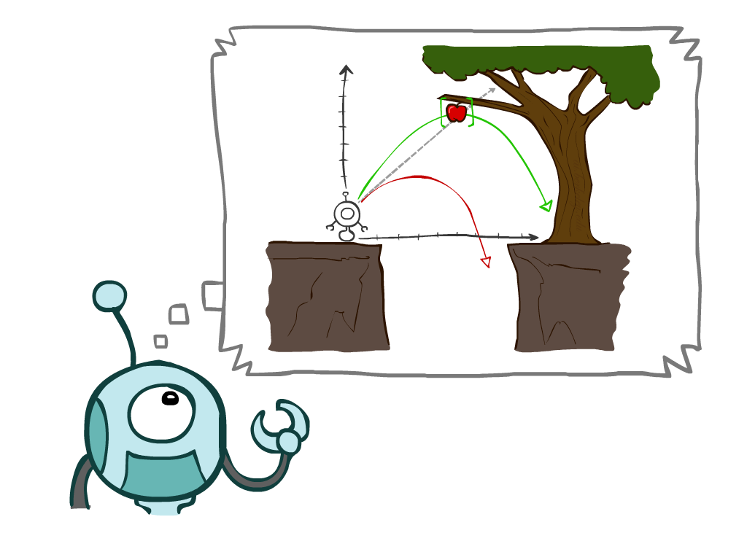
Today
Agents that Plan Ahead
Search Problems
Uninformed Search Methods
  Depth-First Search
  Breadth-First Search
  Uniform-Cost Search

Slide 5
Agents that Plan

Slide 6

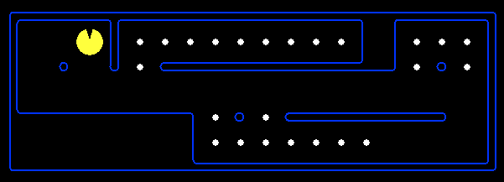
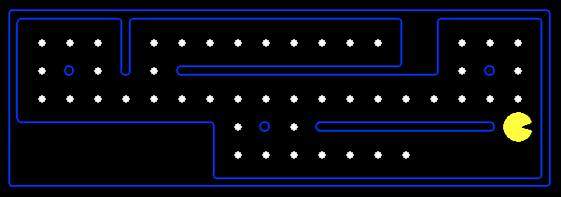
Reflex Agents
Reflex agents:
  Choose action based on current percept (and maybe memory)
  May have memory or a model of the world’s current state
  Do not consider the future consequences of their actions
  Consider how the world IS
Can a reflex agent be rational?

Slide 7
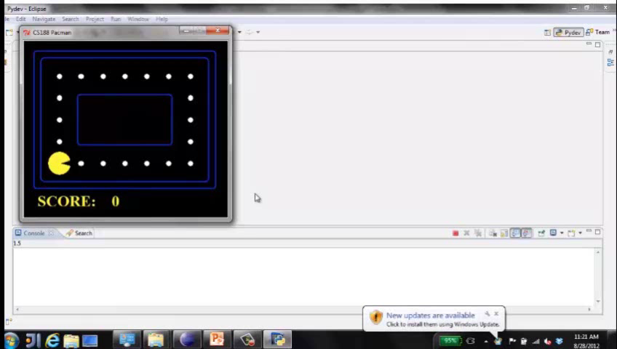
Video of Demo Reflex Optimal

Slide 8
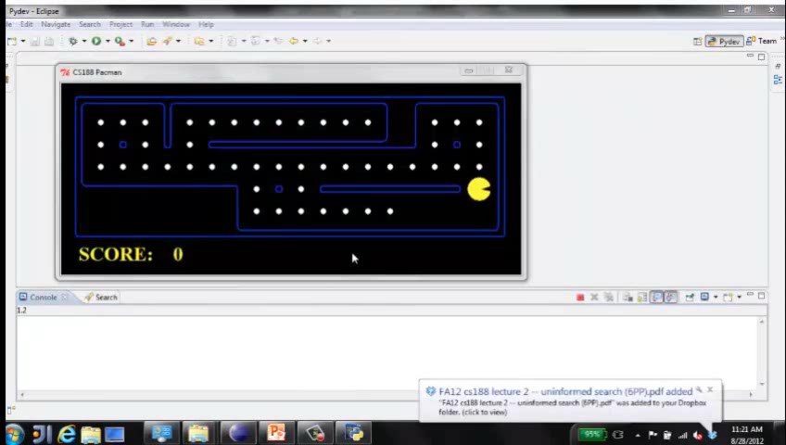
Video of Demo Reflex Odd

Slide 9
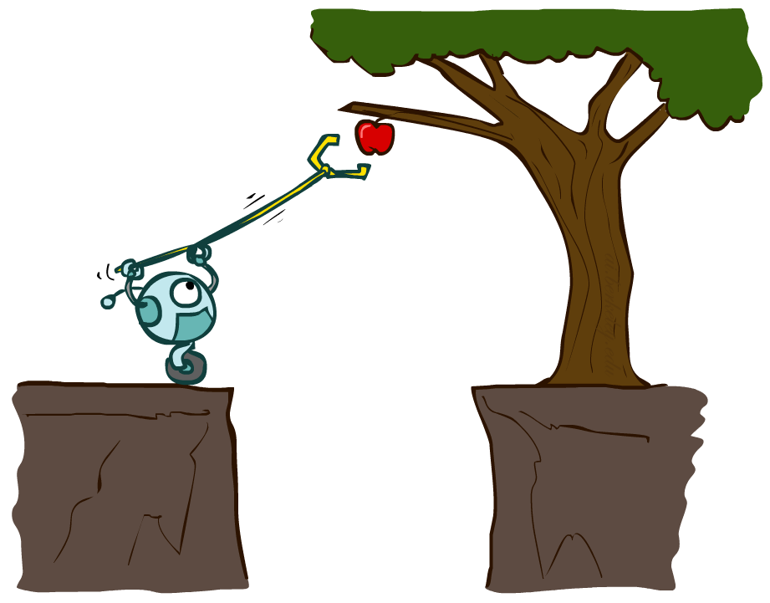
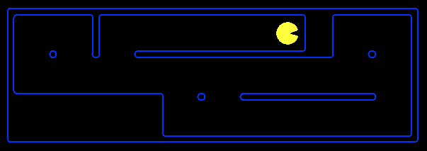
Planning Agents
Planning agents:
  Ask “what if”
  Decisions based on (hypothesized) consequences of actions
  Must have a model of how the world evolves in response to actions
  Must formulate a goal (test)
  Consider how the world WOULD BE
Optimal vs. complete planning
Planning vs. replanning

Slide 10
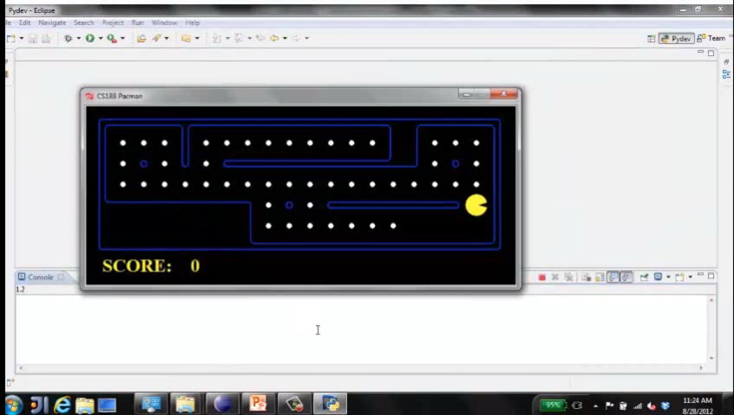
Video of Demo Replanning

Slide 11
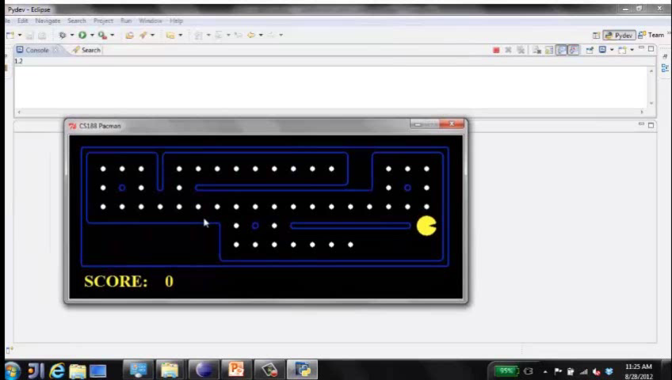
Video of Demo Mastermind

Slide 12

Search Problems

Slide 13







Search Problems
A search problem consists of:
  A state space
  A successor function
  (with actions, costs)
  A start state and a goal test
A solution is a sequence of actions (a plan) which transforms the start state to a goal state
“N”, 1.0
“E”, 1.0

Slide 14

Search Problems Are Models

Slide 15
Example: Traveling in Romania
State space:
  Cities
Successor function:
  Roads: Go to adjacent city with cost = distance
Start state:
  Arad
Goal test:
  Is state == Bucharest?
Solution?

Slide 16
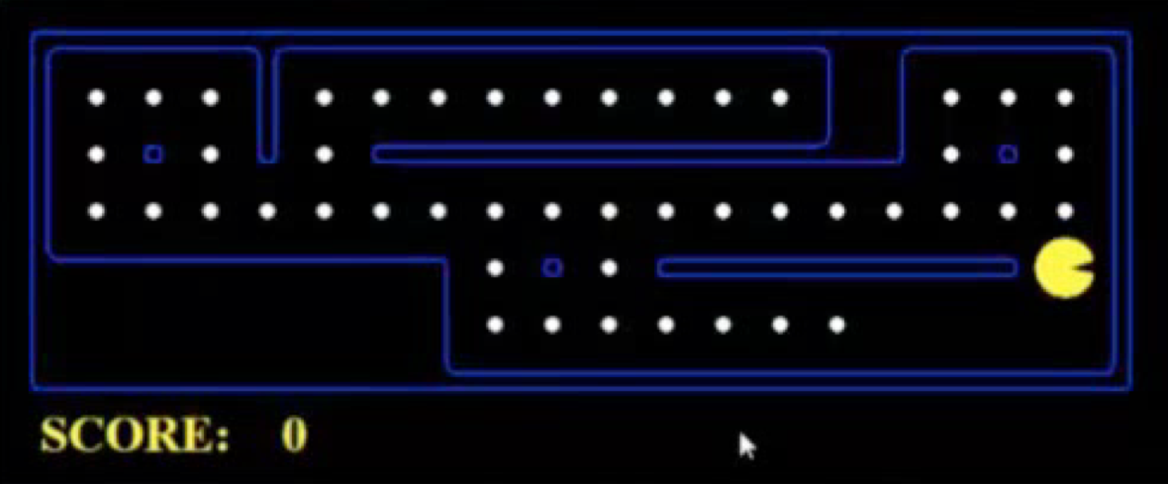
What’s in a State Space?
The world state includes every last detail of the environment
A search state keeps only the details needed for planning (abstraction)
Problem: Pathing
  States: (x,y) location
  Actions: NSEW
  Successor: update location only
  Goal test: is (x,y)=END
Problem: Eat-All-Dots
  States: {(x,y), dot booleans}
  Actions: NSEW
  Successor: update location and possibly a dot boolean
  Goal test: dots all false

Slide 17
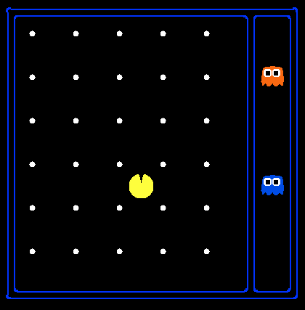
State Space Sizes?
World state:
  Agent positions: 120
  Food count: 30
  Ghost positions: 12
  Agent facing: NSEW
How many
  World states?
  120x(2³⁰)x(12²)x4
  States for pathing?
  120
  States for eat-all-dots?
  120x(2³⁰)

Slide 18
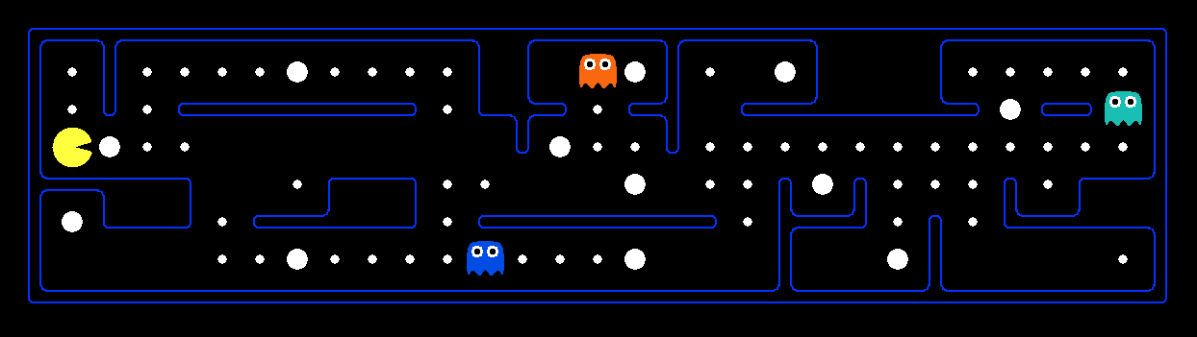
Quiz: Safe Passage
Problem: eat all dots while keeping the ghosts perma-scared
What does the state space have to specify?
  (agent position, dot booleans, power pellet booleans, remaining scared time)

Slide 19
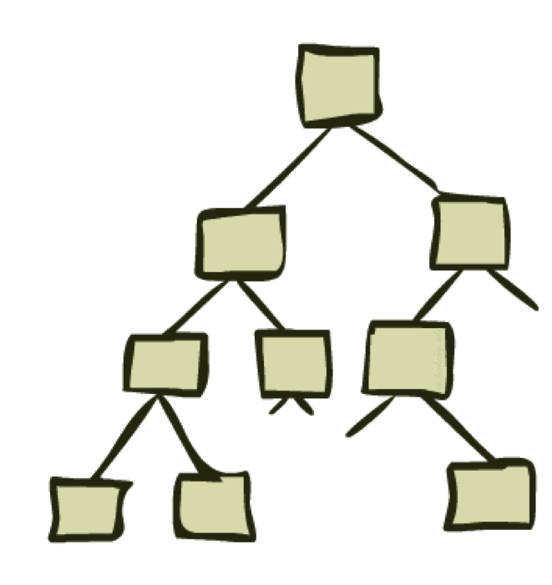
State Space Graphs and Search Trees

Slide 20
State Space Graphs
State space graph: A mathematical representation of a search problem
  Nodes are (abstracted) world configurations
  Arcs represent successors (action results)
  The goal test is a set of goal nodes (maybe only one)
In a state space graph, each state occurs only once!
We can rarely build this full graph in memory (it’s too big), but it’s a useful idea

Slide 21
State Space Graphs
State space graph: A mathematical representation of a search problem
  Nodes are (abstracted) world configurations
  Arcs represent successors (action results)
  The goal test is a set of goal nodes (maybe only one)
In a state space graph, each state occurs only once!
We can rarely build this full graph in memory (it’s too big), but it’s a useful idea
a
G
b
c
e
d
f
S
h
p
q
r
Tiny state space graph for a tiny search problem

Slide 22
Search Trees
This is now / start
“N”, 1.0
“E”, 1.0
Possible futures
A search tree:
  A “what if” tree of plans and their outcomes
  The start state is the root node
  Children correspond to successors
  Nodes show states, but correspond to PLANS that achieve those states
  For most problems, we can never actually build the whole tree

Slide 23
State Space Graphs vs. Search Trees
State Space Graph
Each NODE in in the search tree is an entire PATH in the state space graph.
Search Tree
S
a
G
d
e
p
b
c
q
b
c
e
h
r
d
e
f
a
a
h
r
p
q
f
S
h
We construct both on demand – and we construct as little as possible.
p
q
f
q
c
G
p
q
r
q
c
G
a
a

Slide 24

Quiz: State Space Graphs vs. Search Trees
Consider this 4-state graph:
How big is its search tree (from S)?
a
S
G
b

Slide 25
Quiz: State Space Graphs vs. Search Trees
Consider this 4-state graph:
How big is its search tree (from S)?
a
s
a
b
S
G
b
G
a
G
b
a
G
b
G
…
…
Important: Lots of repeated structure in the search tree!

Slide 26
Tree Search

Slide 27
Search Example: Romania

Slide 28
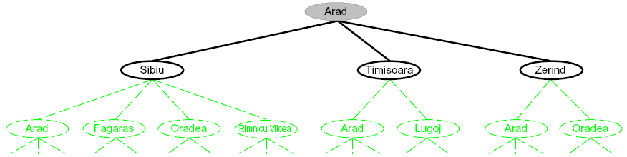
Searching with a Search Tree
Search:
  Expand out potential plans (tree nodes)
  Maintain a fringe of partial plans under consideration
  Try to expand as few tree nodes as possible

Slide 29
General Tree Search
Important ideas:
  Fringe
  Expansion
  Exploration strategy
Main question: which fringe nodes to explore?

Slide 30
Example: Tree Search
a
G
b
c
d
e
f
S
h
p
q
r

Slide 31
Example: Tree Search
a
G
b
c
e
d
e
d
f
f
S
h
p
r
q
r
S
s
s → d
s → e
s → p
s → d → b
s → d → c
s → d → e
s → d → e → h
s → d → e → r
s → d → e → r → f
s → d → e → r → f → c
s → d → e → r → f → G
d
e
p
b
c
e
h
r
q
a
a
h
r
p
q
f
p
q
f
q
c
G
q
c
G
a
a

Slide 32
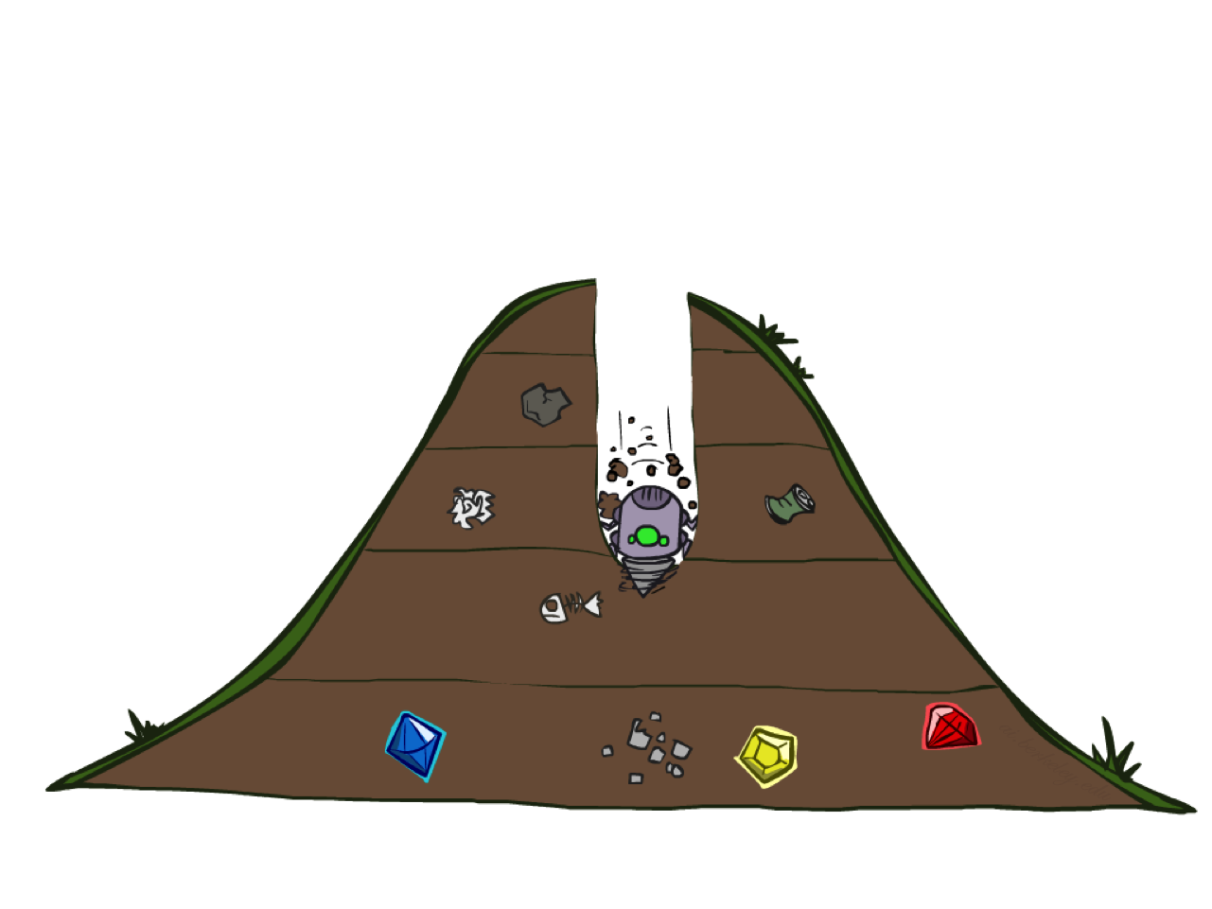
Depth-First Search

Slide 33
Depth-First Search
Strategy: expand a deepest node first
Implementation: Fringe is a LIFO stack
a
G
a
c
b
c
b
e
d
e
d
f
f
S
h
h
p
p
r
q
r
q
S
d
e
p
b
c
e
h
r
q
a
a
h
r
p
q
f
p
q
f
q
c
G
q
c
G
a
a

Slide 34
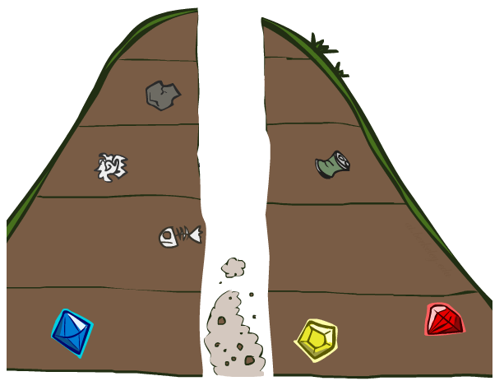
Search Algorithm Properties

Slide 35
Search Algorithm Properties
Complete: Guaranteed to find a solution if one exists?
Optimal: Guaranteed to find the least cost path?
Time complexity?
Space complexity?
Cartoon of search tree:
  b is the branching factor
  m is the maximum depth
  solutions at various depths
Number of nodes in entire tree?
  1 + b + b² + …. b^{m} = O(b^{m})
1 node
b
…
b nodes
b² nodes
m tiers
b^{m} nodes

Slide 36
Depth-First Search (DFS) Properties
What nodes DFS expand?
  Some left prefix of the tree.
  Could process the whole tree!
  If m is finite, takes time O(b^{m})
How much space does the fringe take?
  Only has siblings on path to root, so O(bm)
Is it complete?
  m could be infinite, so only if we prevent cycles (more later)
Is it optimal?
  No, it finds the “leftmost” solution, regardless of depth or cost
1 node
b
…
b nodes
b² nodes
m tiers
b^{m} nodes

Slide 37
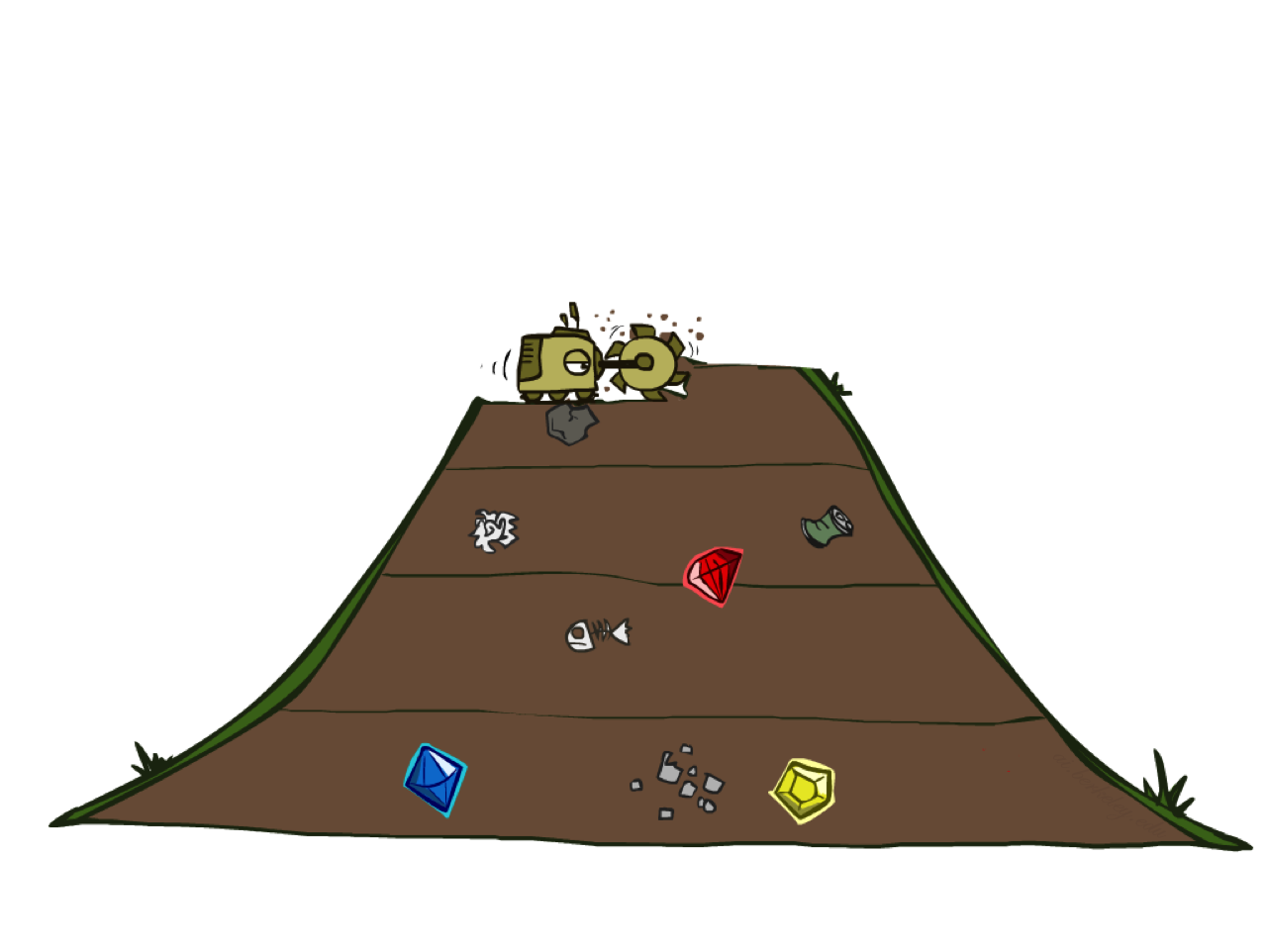
Breadth-First Search

Slide 38
Breadth-First Search
Strategy: expand a shallowest node first
Implementation: Fringe is a FIFO queue
a
G
b
c
d
e
f
S
h
p
q
r
S
d
e
p
Search
Tiers
b
c
e
h
r
q
a
a
h
r
p
q
f
p
q
f
q
c
G
q
c
G
a
a

Slide 39
Breadth-First Search (BFS) Properties
What nodes does BFS expand?
  Processes all nodes above shallowest solution
  Let depth of shallowest solution be s
  Search takes time O(b^{s})
How much space does the fringe take?
  Has roughly the last tier, so O(b^{s})
Is it complete?
  s must be finite if a solution exists, so yes!
Is it optimal?
  Only if costs are all 1 (more on costs later)
1 node
b
…
b nodes
s tiers
b² nodes
b^{s} nodes
b^{m} nodes

Slide 40
Quiz: DFS vs BFS

Slide 41

Video of Demo Maze Water DFS/BFS (part 1)

Slide 42
Video of Demo Maze Water DFS/BFS (part 2)

Slide 43
Quiz: DFS vs BFS
When will BFS outperform DFS?
When will DFS outperform BFS?

Slide 44
Iterative Deepening
Idea: get DFS’s space advantage with BFS’s time / shallow-solution advantages
  Run a DFS with depth limit 1. If no solution…
  Run a DFS with depth limit 2. If no solution…
  Run a DFS with depth limit 3. …..
Isn’t that wastefully redundant?
  Generally most work happens in the lowest level searched, so not so bad!
b
…

Slide 45
Cost-Sensitive Search
a
GOAL
2
2
b
c
3
2
1
8
2
e
d
f
3
9
8
2
START
h
1
4
2
p
4
r
15
q
BFS finds the shortest path in terms of number of actions.
It does not find the least-cost path. We will now cover
a similar algorithm which does find the least-cost path.

Slide 46
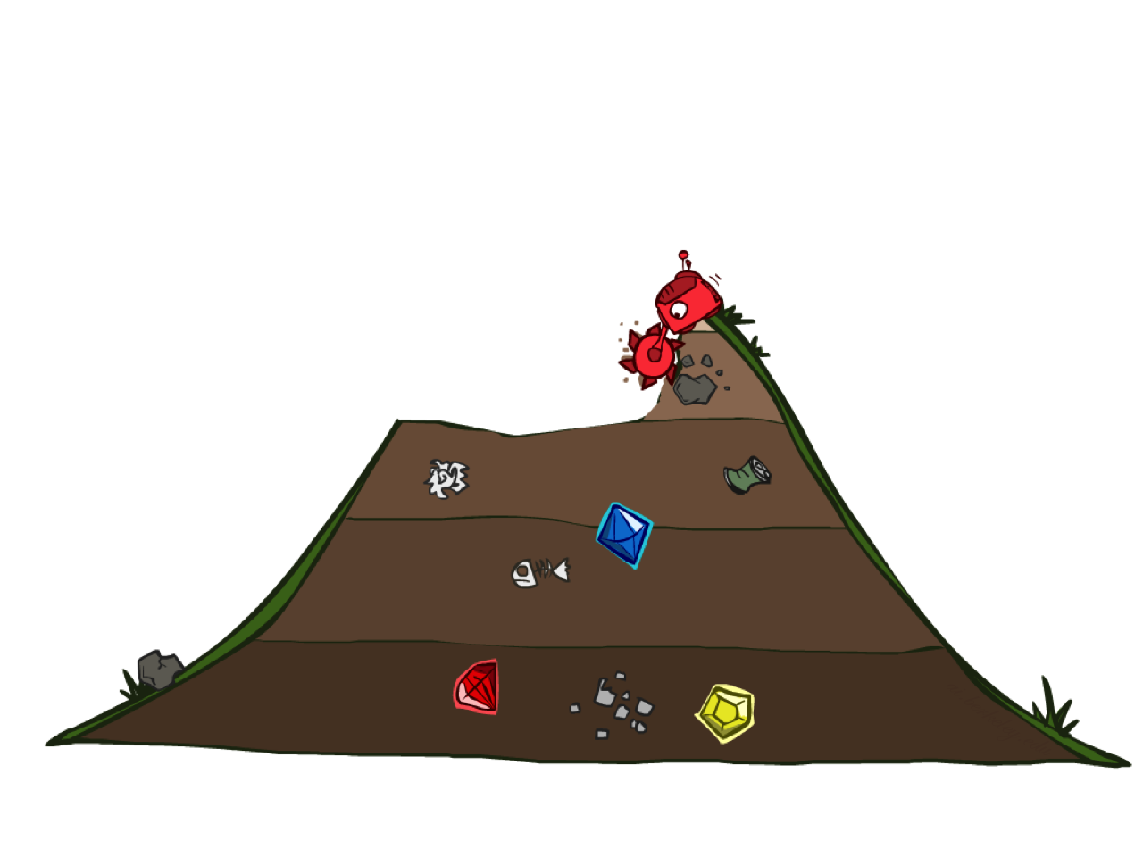
Uniform Cost Search

Slide 47
Uniform Cost Search
2
G
a
Strategy: expand a cheapest node first:
Fringe is a priority queue (priority: cumulative cost)
b
c
1
8
2
2
e
3
d
f
9
8
2
S
h
1
1
p
q
r
15
0
S
d
3
e
9
p
1
b
4
e
5
h
17
r
11
q
16
c
11
Cost contours
a
6
a
h
13
r
7
p
q
f
p
q
f
8
q
c
G
q
c
a
11
G
10
a

Slide 48
Uniform Cost Search (UCS) Properties
What nodes does UCS expand?
  Processes all nodes with cost less than cheapest solution!
  If that solution costs C* and arcs cost at least ε , then the “effective depth” is roughly C*/ε
  Takes time O(b^{C*/ε}) (exponential in effective depth)
How much space does the fringe take?
  Has roughly the last tier, so O(b^{C*/ε})
Is it complete?
  Assuming best solution has a finite cost and minimum arc cost is positive, yes!
Is it optimal?
  Yes! (Proof next lecture via A*)
b
c ≤ 1
…
C*/ε “tiers”
c ≤ 2
c ≤ 3

Slide 49
Uniform Cost Issues
Remember: UCS explores increasing cost contours
The good: UCS is complete and optimal!
The bad:
  Explores options in every “direction”
  No information about goal location
We’ll fix that soon!
…
c ≤ 1
c ≤ 2
c ≤ 3
Start
Goal

Slide 50
Video of Demo Empty UCS

Slide 51
Video of Demo Maze with Deep/Shallow Water --- DFS, BFS, or UCS? (part 1)

Slide 52
Video of Demo Maze with Deep/Shallow Water --- DFS, BFS, or UCS? (part 2)

Slide 53
Video of Demo Maze with Deep/Shallow Water --- DFS, BFS, or UCS? (part 3)

Slide 54

The One Queue
All these search algorithms are the same except for fringe strategies
  Conceptually, all fringes are priority queues (i.e. collections of nodes with attached priorities)
  Practically, for DFS and BFS, you can avoid the log(n) overhead from an actual priority queue, by using stacks and queues
  Can even code one implementation that takes a variable queuing object

Slide 55
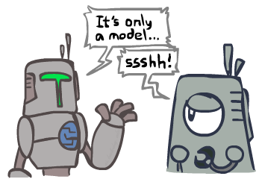
Search and Models
Search operates over models of the world
  The agent doesn’t actually try all the plans out in the real world!
  Planning is all “in simulation”
  Your search is only as good as your models…

Slide 56
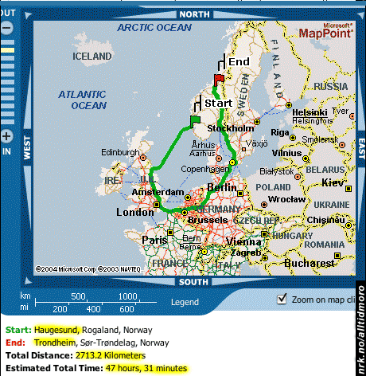
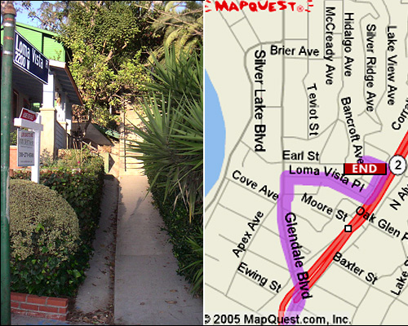

Search Gone Wrong?

