Slide 1
Announcements
Midterm 2
  Midterm 2 is this Wednesday 7/29, 12pm-2pm
  Practice Midterm due tonight (7/27) at 11:59pm
Monday/Tuesday review sections
  Today (7/27)
    HMMs (2-3pm), Bayes Nets + Probability (3-4pm), Decision Nets + VPI (7-8pm)
  Tomorrow:
    Decision Nets + VPI (11am-12pm), BN + Probability (2-3pm), HMMs (10-11pm)
Midterm 1 regrades open until tonight (7/27) at 11:59pm
Homework 6
  Due Friday 7/31 at 11:59pm
Project 4
  Due Friday 7/31 at 11:59pm

Slide 2
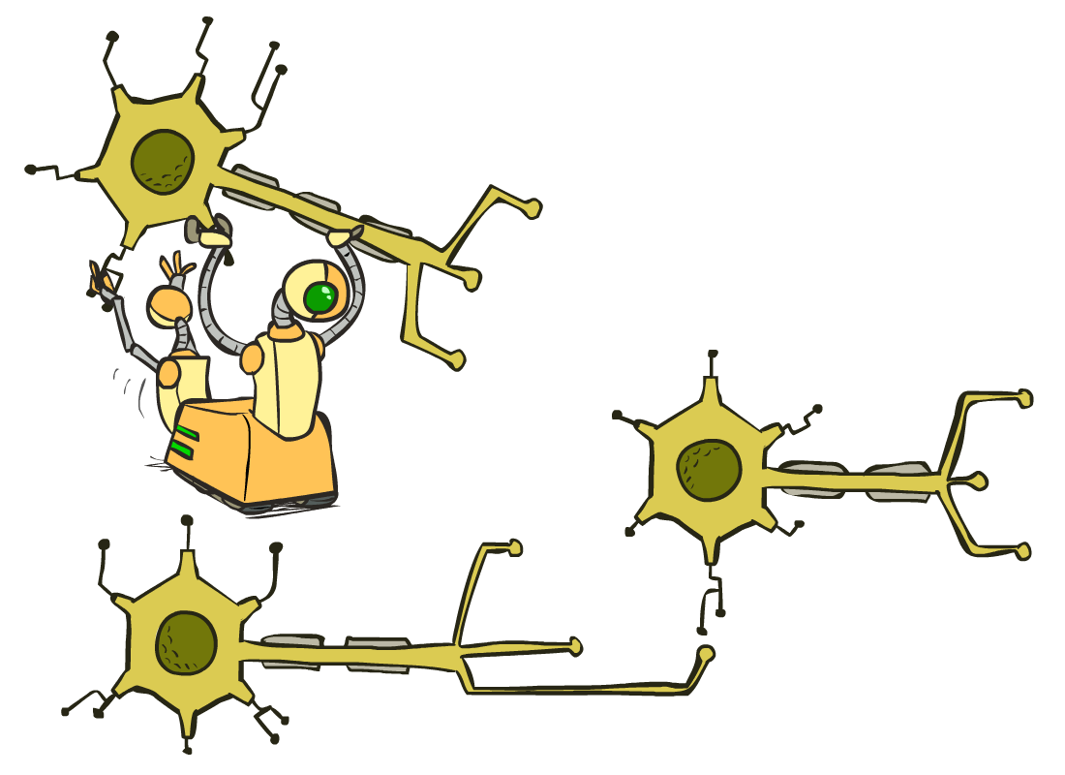
CS 188: Artificial Intelligence
Optimization and Neural Nets
Instructor: Nikita Kitaev --- University of California, Berkeley
[These slides were created by Dan Klein and Pieter Abbeel for CS188 Intro to AI at UC Berkeley. All CS188 materials are available at http://ai.berkeley.edu.]
Notes:
Please retain proper attribution, including the reference to ai.berkeley.edu. Thanks!

Slide 3

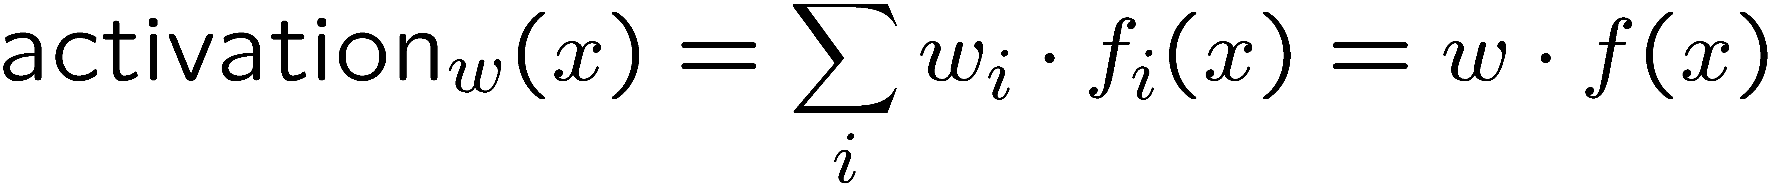
Reminder: Linear Classifiers
Inputs are feature values
Each feature has a weight
Sum is the activation
If the activation is:
  Positive, output +1
  Negative, output -1
w₁
f₁
Σ
w₂
>0?
f₂
w₃
f₃

Slide 4
How to get probabilistic decisions?
Activation:
If very positive → want probability going to 1
If very negative → want probability going to 0
Sigmoid function

Slide 5
Best w?
Maximum likelihood estimation:
with:
= Logistic Regression

Slide 6



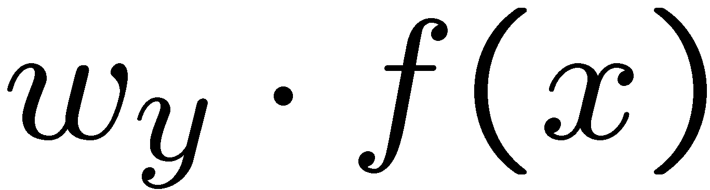


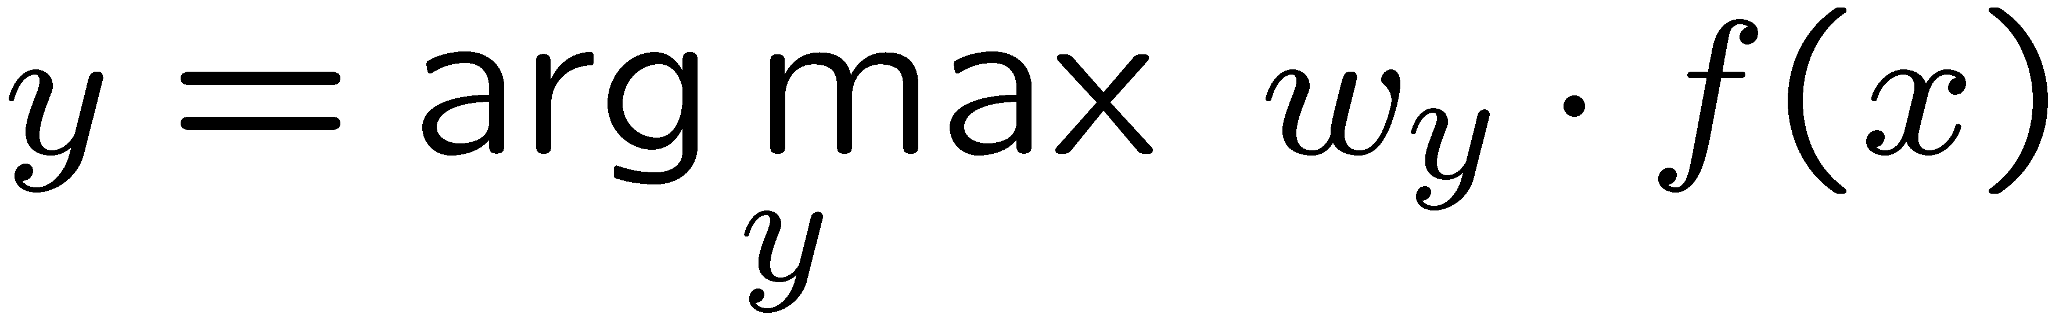
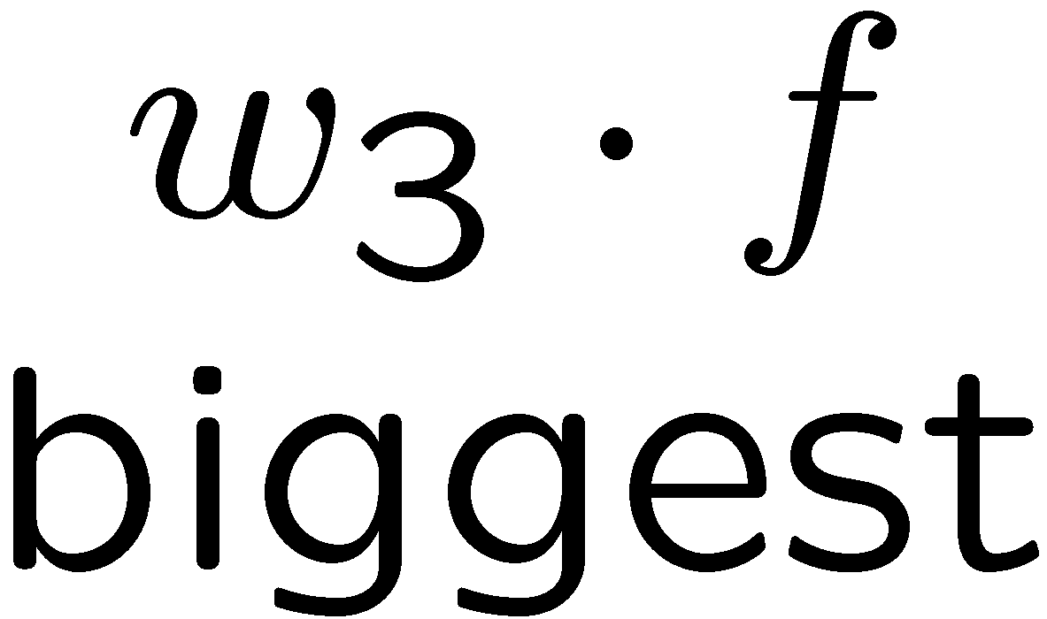
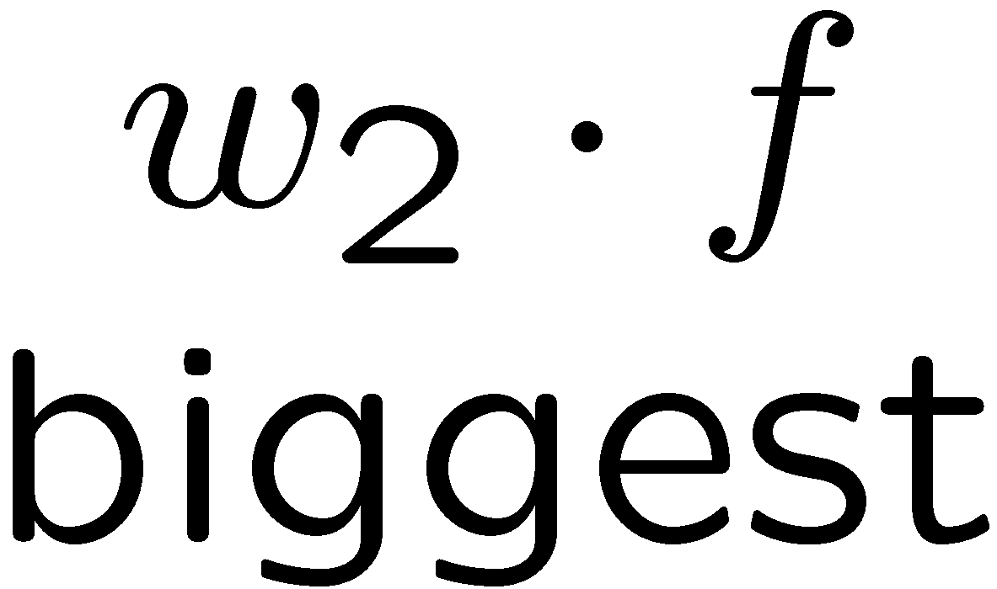
Multiclass Logistic Regression
Multi-class linear classification
  A weight vector for each class:
  Score (activation) of a class y:
  Prediction w/highest score wins:
How to make the scores into probabilities?
original activations
softmax activations

Slide 7
Best w?
Maximum likelihood estimation:
with:
= Multi-Class Logistic Regression

Slide 8
This Lecture
Optimization
  i.e., how do we solve:

Slide 9

Hill Climbing
General idea
  Start wherever
  Repeat: move to the best neighboring state
  If no neighbors better than current, quit
What’s particularly tricky when hill-climbing for multiclass logistic regression?
  Optimization over a continuous space
    Infinitely many neighbors!
    How to do this efficiently?

Slide 10
1-D Optimization
Could evaluate and
  Then step in best direction
Or, evaluate derivative:
  Tells which direction to step into

Slide 11
2-D Optimization
Source: offconvex.org

Slide 12
Gradient Ascent
Perform update in uphill direction for each coordinate
The steeper the slope (i.e. the higher the derivative) the bigger the step for that coordinate
E.g., consider:
    Updates:
  Updates in vector notation:
  with:
= gradient

Slide 13
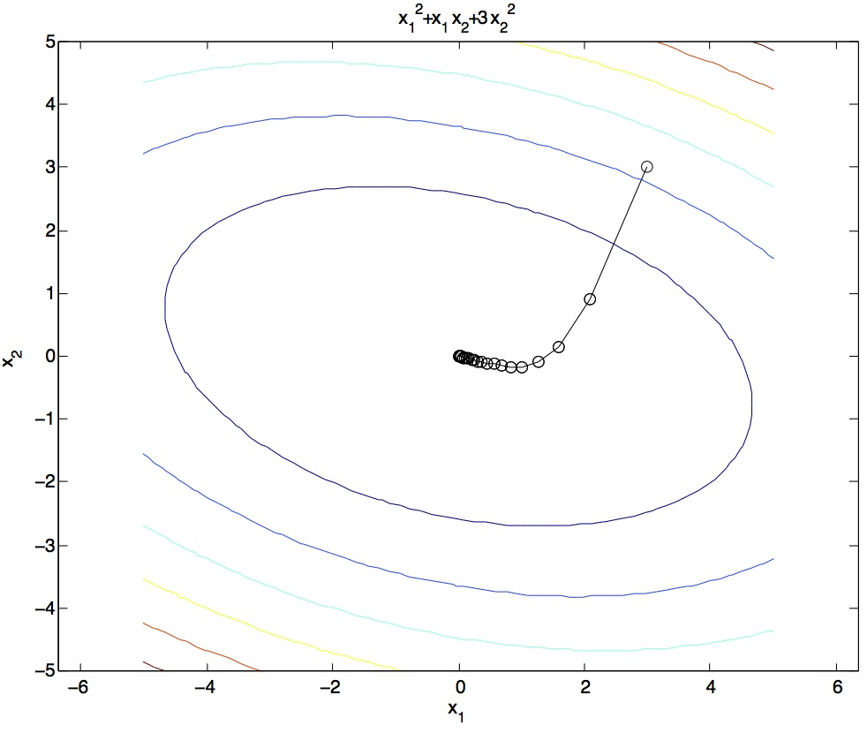
Gradient Ascent
Idea:
  Start somewhere
  Repeat: Take a step in the gradient direction
Figure source: Mathworks

Slide 14
What is the Steepest Direction?
First-Order Taylor Expansion:
Steepest Ascent Direction:
Recall: →
Hence, solution:
Gradient direction = steepest direction!

Slide 15
Gradient in n dimensions

Slide 16
Optimization Procedure: Gradient Ascent
init
for iter = 1, 2, …
: learning rate --- tweaking parameter that needs to be chosen carefully
How? Try multiple choices
  Crude rule of thumb: update changes about 0.1 – 1 %

Slide 17
Batch Gradient Ascent on the Log Likelihood Objective
init
for iter = 1, 2, …

Slide 18
What will gradient ascent do?
adds f to the correct class weights
for y’ weights:
subtracts f from y’ weights in proportion to the probability current weights give to y’

Slide 19
Stochastic Gradient Ascent on the Log Likelihood Objective
Observation: once gradient on one training example has been computed, might as well incorporate before computing next one
init
for iter = 1, 2, …
  pick random j

Slide 20
Mini-Batch Gradient Ascent on the Log Likelihood Objective
Observation: gradient over small set of training examples (=mini-batch) can be computed in parallel, might as well do that instead of a single one
init
for iter = 1, 2, …
  pick random subset of training examples J

Slide 21
How about computing all the derivatives?
We’ll talk about that once we covered neural networks, which are a generalization of logistic regression

Slide 22
Neural Networks

Slide 23
Multi-class Logistic Regression
= special case of neural network
f₁(x)
z₁
softmax
f₂(x)
z₂
f₃(x)
…
z₃
f_{K}(x)

Slide 24
Deep Neural Network = Also learn the features!
f₁(x)
z₁
softmax
f₂(x)
z₂
f₃(x)
…
z₃
f_{K}(x)

Slide 25
Deep Neural Network = Also learn the features!
x₁
f₁(x)
softmax
x₂
f₂(x)
…
x₃
f₃(x)
…
…
…
…
…
x_{L}
f_{K}(x)
g = nonlinear activation function

Slide 26
Deep Neural Network = Also learn the features!
x₁
softmax
x₂
…
x₃
…
…
…
…
…
x_{L}
g = nonlinear activation function

Slide 27
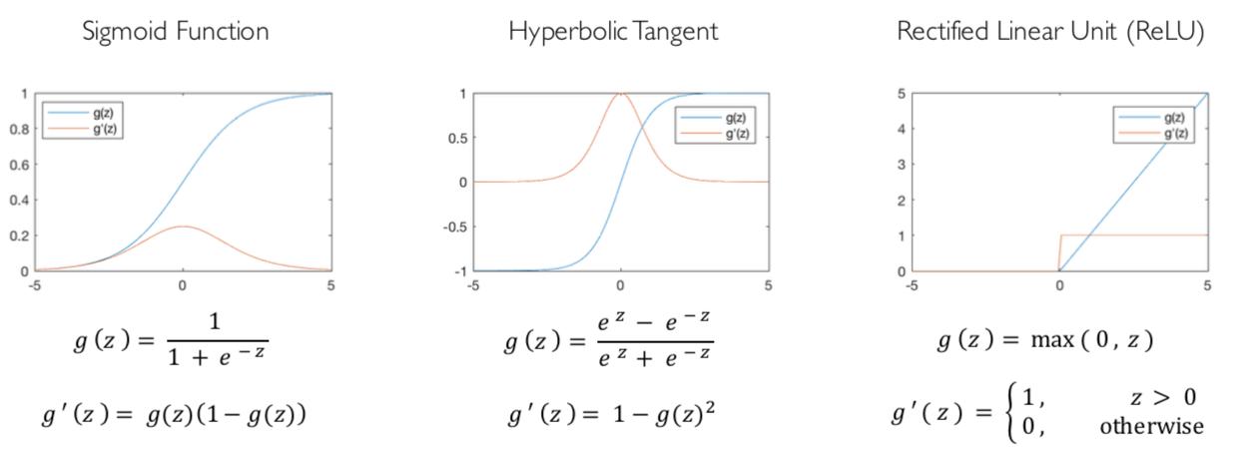
Common Activation Functions
[source: MIT 6.S191 introtodeeplearning.com]

Slide 28
Deep Neural Network: Also Learn the Features!
Training the deep neural network is just like logistic regression:
  just w tends to be a much, much larger vector ☺
  just run gradient ascent
  + stop when log likelihood of hold-out data starts to decrease

Slide 29
Neural Networks Properties
Theorem (Universal Function Approximators). A two-layer neural network with a sufficient number of neurons can approximate any continuous function to any desired accuracy.
Practical considerations
  Can be seen as learning the features
  Large number of neurons
    Danger for overfitting
    (hence early stopping!)

Slide 30
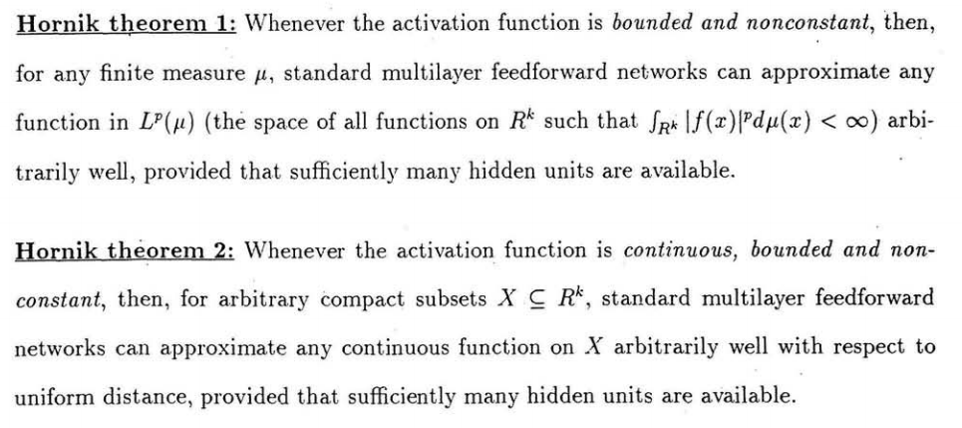
Universal Function Approximation Theorem*
In words: Given any continuous function f(x), if a 2-layer neural network has enough hidden units, then there is a choice of weights that allow it to closely approximate f(x).
Cybenko (1989) “Approximations by superpositions of sigmoidal functions”
Hornik (1991) “Approximation Capabilities of Multilayer Feedforward Networks”
Leshno and Schocken (1991) ”Multilayer Feedforward Networks with Non-Polynomial Activation Functions Can Approximate Any Function”

Slide 31
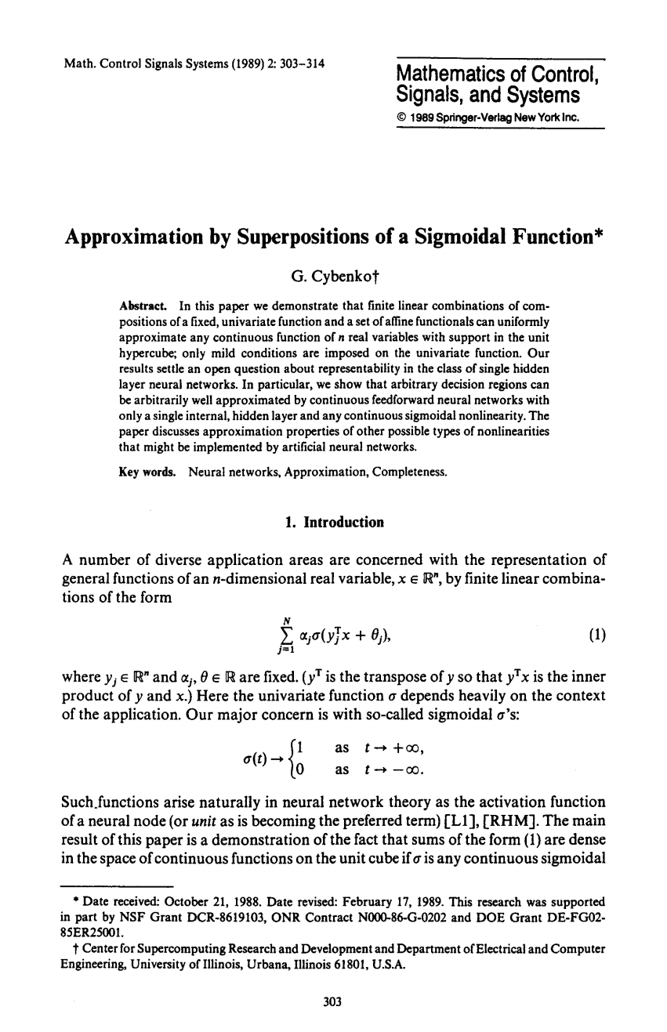
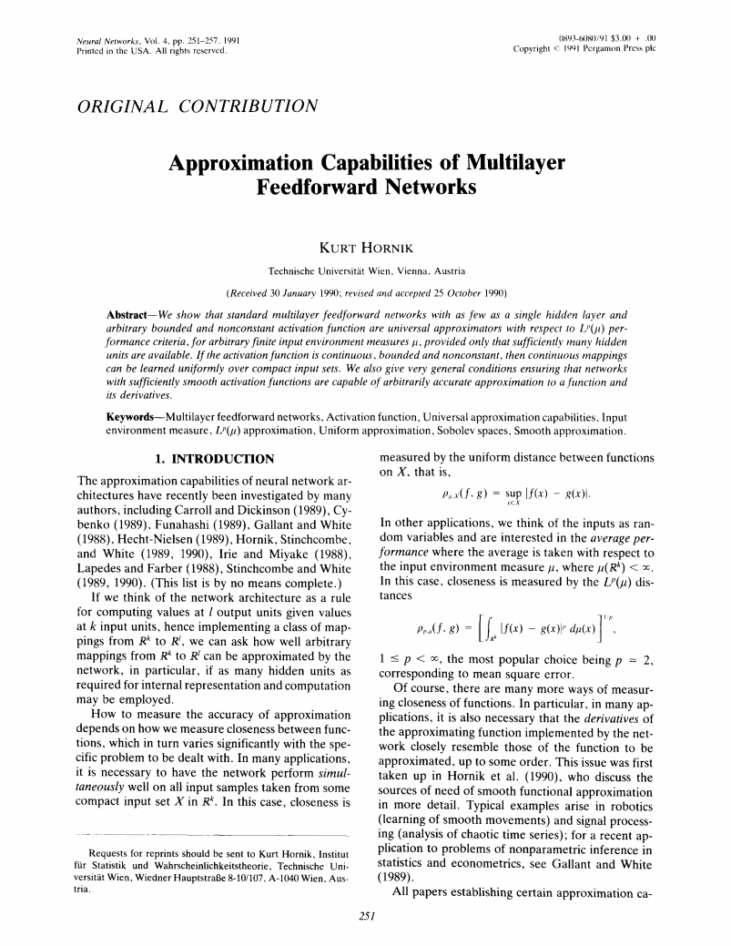
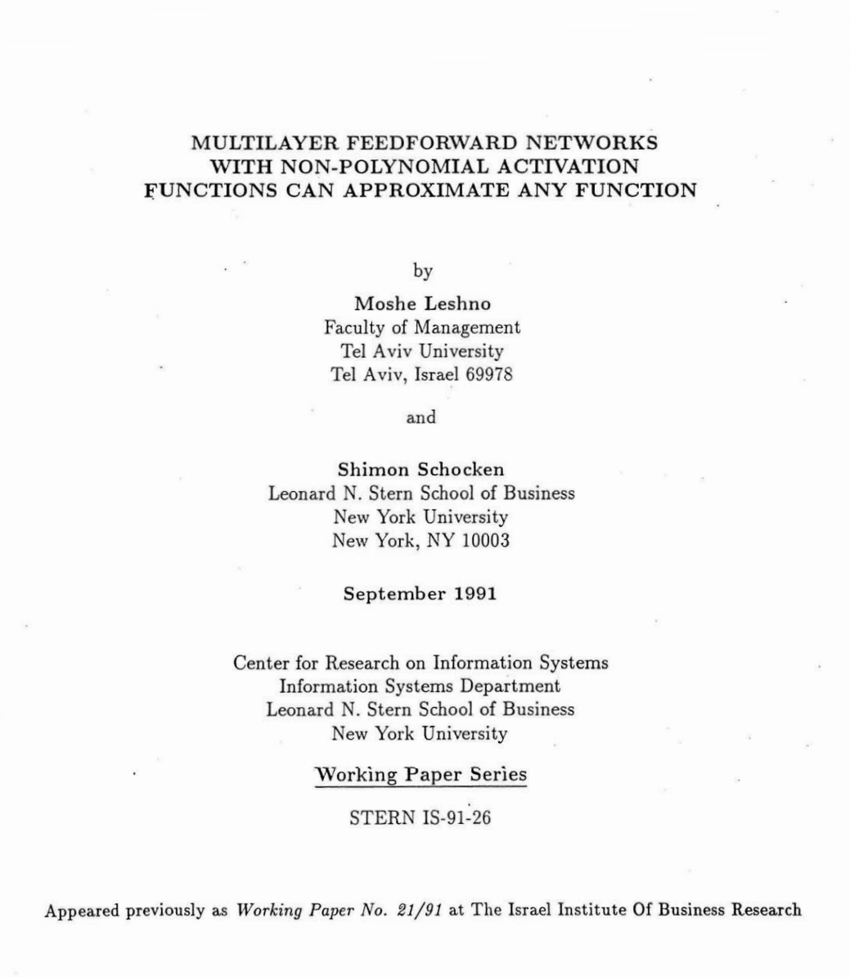
Universal Function Approximation Theorem*
Cybenko (1989) “Approximations by superpositions of sigmoidal functions”
Hornik (1991) “Approximation Capabilities of Multilayer Feedforward Networks”
Leshno and Schocken (1991) ”Multilayer Feedforward Networks with Non-Polynomial Activation Functions Can Approximate Any Function”

Slide 32
Fun Neural Net Demo Site
Demo-site:
  http://playground.tensorflow.org/

Slide 33
How about computing all the derivatives?
Derivatives tables:
[source: http://hyperphysics.phy-astr.gsu.edu/hbase/Math/derfunc.html

Slide 34
How about computing all the derivatives?
But neural net f is never one of those?
  No problem: CHAIN RULE:
    If
    Then
    → Derivatives can be computed by following well-defined procedures

Slide 35
Automatic Differentiation
Automatic differentiation software
  e.g. PyTorch, TensorFlow, JAX
  Only need to program the function g(x,y,w)
  Can automatically compute all derivatives w.r.t. all entries in w
  This is typically done by caching info during forward computation pass of f, and then doing a backward pass = “backpropagation”
  Autodiff / Backpropagation can often be done at computational cost comparable to the forward pass
Need to know this exists
How this is done? -- outside of scope of CS188

Slide 36
Summary of Key Ideas
Optimize probability of label given input
Continuous optimization
  Gradient ascent:
    Compute steepest uphill direction = gradient (= just vector of partial derivatives)
    Take step in the gradient direction
    Repeat (until held-out data accuracy starts to drop = “early stopping”)
Deep neural nets
  Last layer = still logistic regression
  Now also many more layers before this last layer
    = computing the features
    → the features are learned rather than hand-designed
  Universal function approximation theorem
    If neural net is large enough
    Then neural net can represent any continuous mapping from input to output with arbitrary accuracy
    But remember: need to avoid overfitting / memorizing the training data → early stopping!
  Automatic differentiation gives the derivatives efficiently (how? = outside of scope of 188)

Slide 37
How well does it work?

Slide 38

Computer Vision
Notes:
38

Slide 39
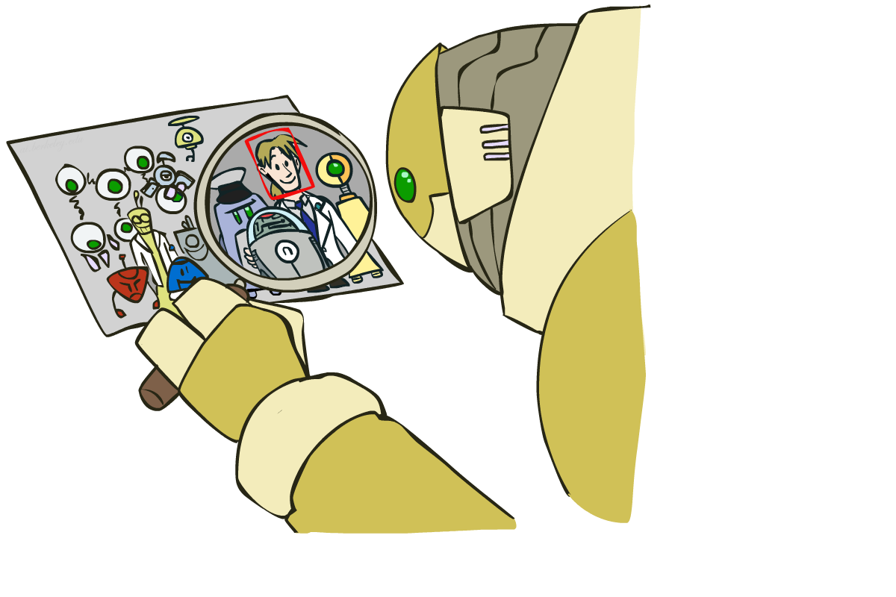
Object Detection
Notes:
39

Slide 40



Manual Feature Design
Notes:
40

Slide 41
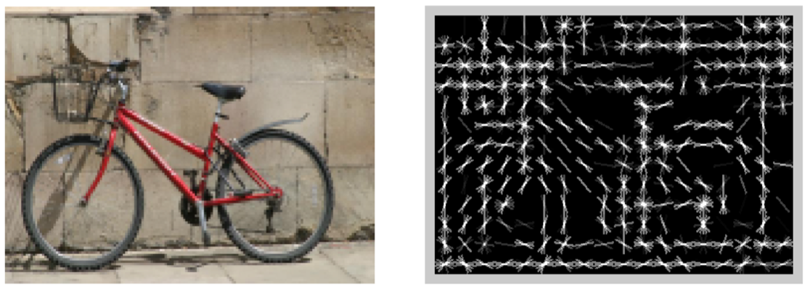
Features and Generalization
[HoG: Dalal and Triggs, 2005]
Notes:
41

Slide 42
Features and Generalization
Image
HoG
Notes:
HoG, SIFT, Daisy
Deformable part models
42

Slide 43
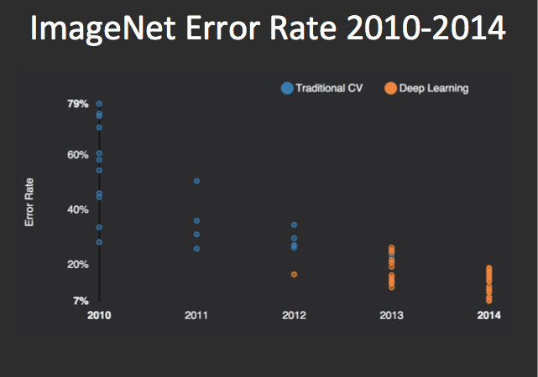
Performance
graph credit Matt Zeiler, Clarifai

Slide 44
Performance
graph credit Matt Zeiler, Clarifai

Slide 45
Performance
AlexNet
graph credit Matt Zeiler, Clarifai

Slide 46
Performance
AlexNet
graph credit Matt Zeiler, Clarifai

Slide 47
Performance
AlexNet
graph credit Matt Zeiler, Clarifai

Slide 48
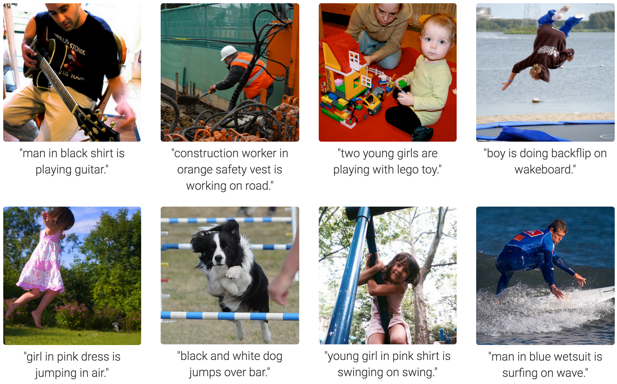
MS COCO Image Captioning Challenge
Karpathy & Fei-Fei, 2015; Donahue et al., 2015; Xu et al, 2015; many more

Slide 49
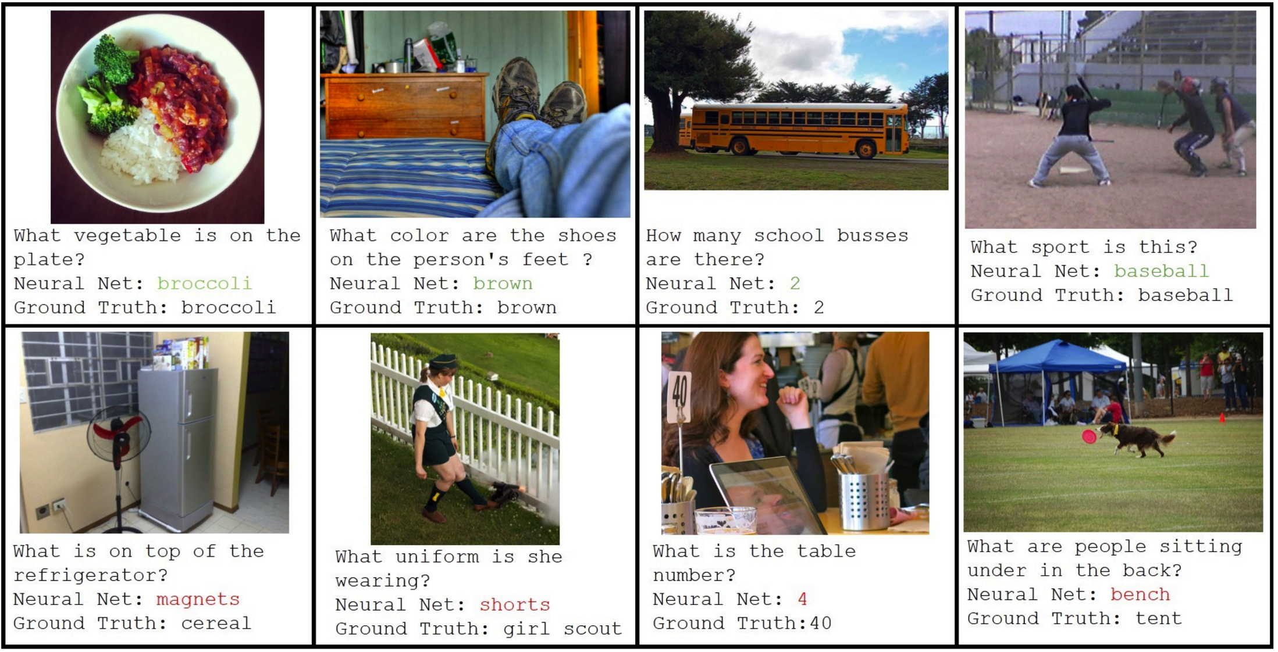
Visual QA Challenge
Stanislaw Antol, Aishwarya Agrawal, Jiasen Lu, Margaret Mitchell, Dhruv Batra, C. Lawrence Zitnick, Devi Parikh

Slide 50
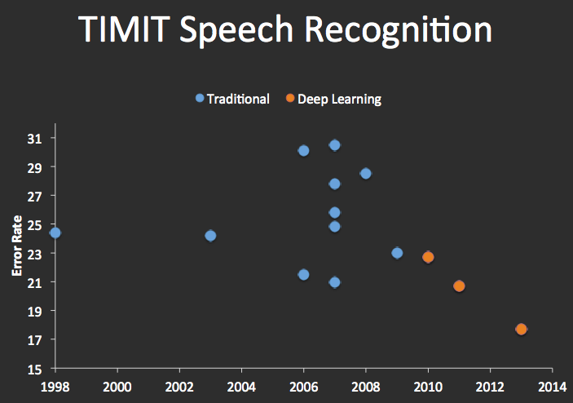


Speech Recognition
graph credit Matt Zeiler, Clarifai

Slide 51
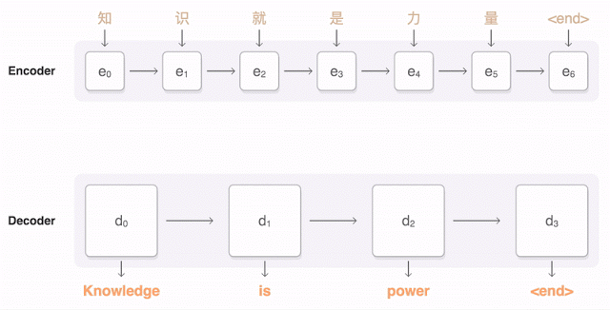
Machine Translation
Google Neural Machine Translation (in production)
Notes:
https://research.googleblog.com/2016/09/a-neural-network-for-machine.html

Slide 52
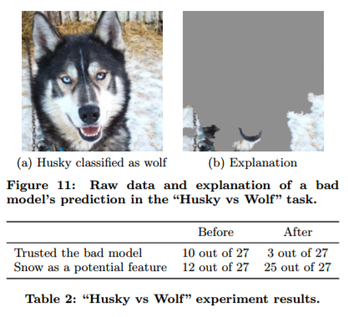
What’s still missing? – correlation ≠ causation
[Ribeiro et al.]

Slide 53
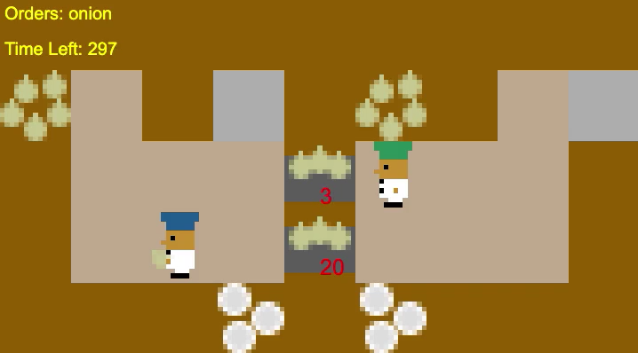
What’s still missing? – covariate shift
[Carroll et al.]

Slide 54
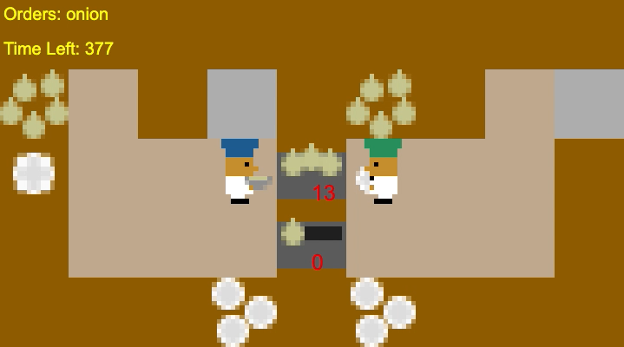
What’s still missing? – covariate shift
[Carroll et al.]

