Slide 1

CS 188: Artificial Intelligence
Search and Planning (Review I)
Instructor: Nikita Kitaev
University of California, Berkeley
(slides adapted from Dan Klein, Pieter Abbeel, Anca Dragan, and others)

Slide 2

What is AI?
The science of making machines that:
Think like people
Think rationally
Act like people
Act rationally

Slide 3

Modern AI: Making Machines that Act Rationally

Slide 4
Rational Decisions
We’ll use the term rational in a very specific, technical way:
  Rational: maximally achieving pre-defined goals
  Rationality only concerns what decisions are made
  (not the thought process behind them)
  Goals are expressed in terms of the utility of outcomes
  Being rational means maximizing your expected utility
A better title for this course would be:
Computational Rationality

Slide 5

Course Topics
Part I: Intelligence from Computation
  Fast search / planning
  Adversarial and uncertain search
Part II: Intelligence from Data
  Bayes nets
  Decision theory
  Machine learning

Slide 6
Course Topics
Part I: Intelligence from Computation
  Fast search / planning
  Adversarial and uncertain search
Part II: Intelligence from Data
  Bayes nets (Review II, tomorrow)
  Decision theory (Review II, tomorrow)
  Machine learning (Review III, Wednesday)

Slide 7
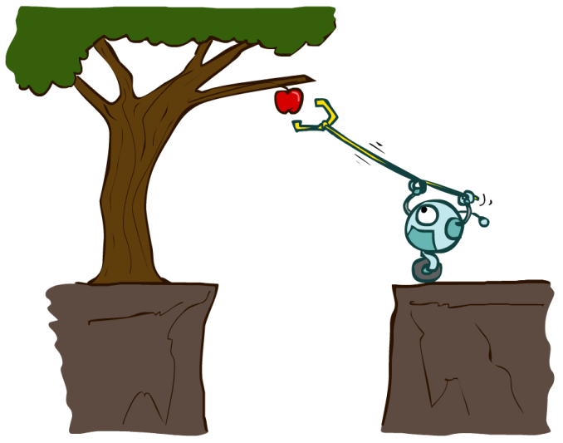
Designing Rational Agents
An agent is an entity that perceives and acts.
A rational agent selects actions that maximize its (expected) utility.
Characteristics of the percepts, environment, and action space dictate techniques for selecting rational actions
This course is about:
  General AI techniques for a variety of problem types
  Learning to recognize when and how a new problem can be solved with an existing technique
Sensors
Agent
Percepts
Environment
?
Actuators
Actions
Notes:
Quick recap: what will we do in this class?

Slide 8
Designing Rational Agents
An agent is an entity that perceives and acts.
A rational agent selects actions that maximize its (expected) utility.
Characteristics of the percepts, environment, and action space dictate techniques for selecting rational actions
This course is about:
  General AI techniques for a variety of problem types
  Learning to recognize when and how a new problem can be solved with an existing technique
Sensors
Agent
Percepts
Environment
?
Actuators
Actions
Notes:
Quick recap: what will we do in this class?

Slide 9
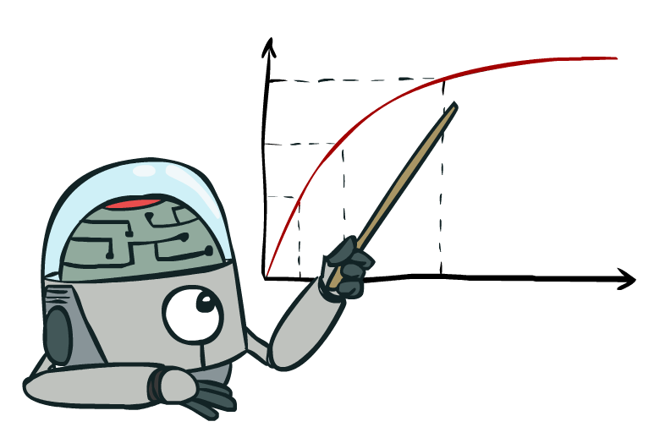
Maximize Your
Expected Utility

Slide 10
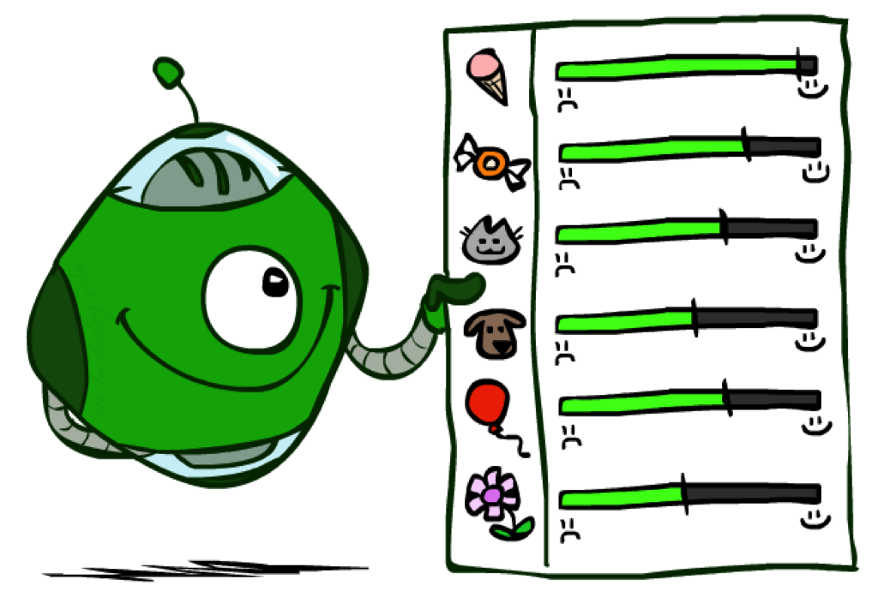
Utilities

Slide 11

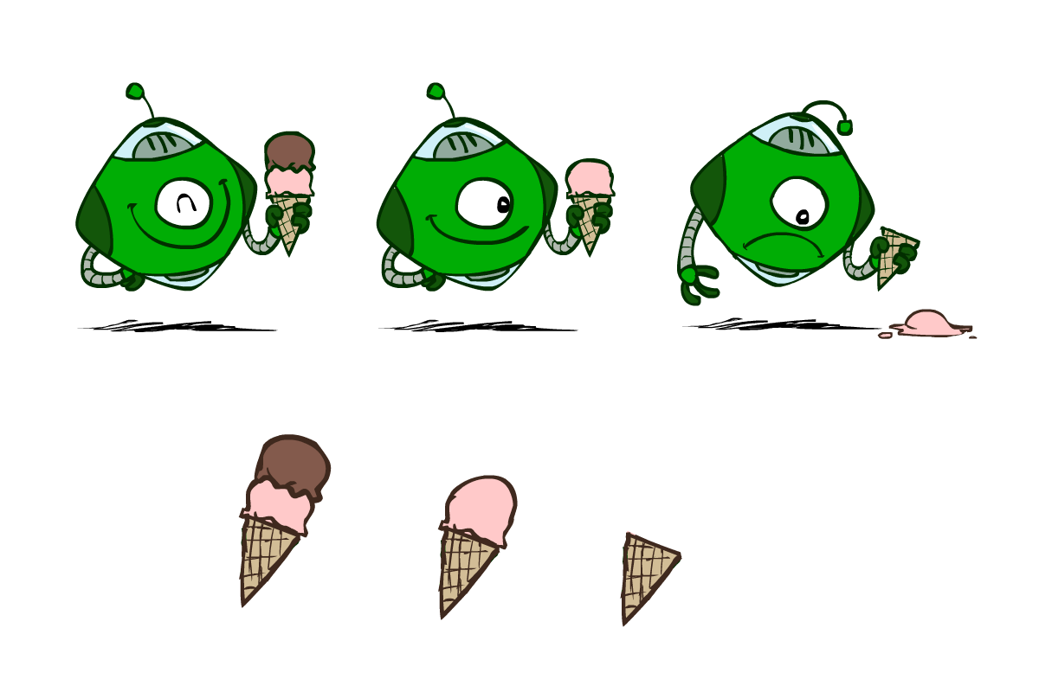
Preferences
An agent must have preferences among:
  Prizes: A, B, etc.
Notation:
  Preference:
  Indifference:

Slide 12

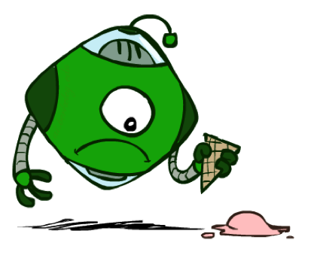

Preferences
Getting ice cream
An agent must have preferences among:
  Prizes: A, B, etc.
Notation:
  Preference:
  Indifference:
Just the cone…
Get Single
Get Double

Slide 13
Preferences
Getting ice cream
An agent must have preferences among:
  Prizes: A, B, etc.
Notation:
  Preference:
  Indifference:
Get Single
Get Double
Oops
Whew!

Slide 14
Preferences
Getting ice cream
An agent must have preferences among:
  Prizes: A, B, etc.
  Lotteries: situations with uncertain prizes
Notation:
  Preference:
  Indifference:
Get Single
Get Double
Oops
Whew!

Slide 15
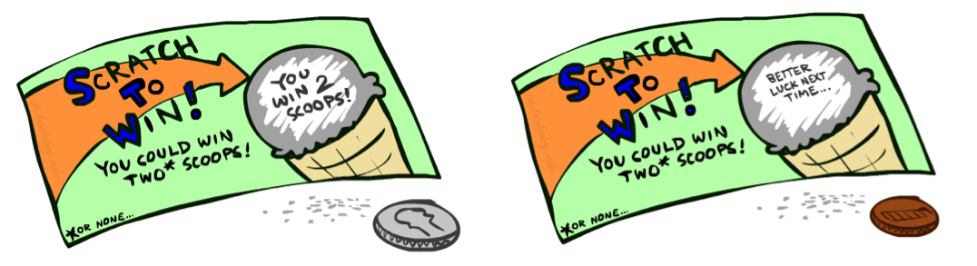
Preferences
A Prize
A Lottery
An agent must have preferences among:
  Prizes: A, B, etc.
  Lotteries: situations with uncertain prizes
Notation:
  Preference:
  Indifference:
A
p 1-p
A B

Slide 16
Utilities
We program the desired behavior of our AI agents by specifying the preferences an agent should have
  Typically: prefer behavior that is useful or beneficial to humans
It is not practical to specify pairwise preferences for all pairs of outcomes
  Especially when we would need to consider all possible lotteries
Solution: specify a utility function instead
  Theorem: any “rational” preferences can be summarized as a utility function
Utilities are functions from outcomes (states of the world) to real numbers that describe an agent’s preferences

Slide 17
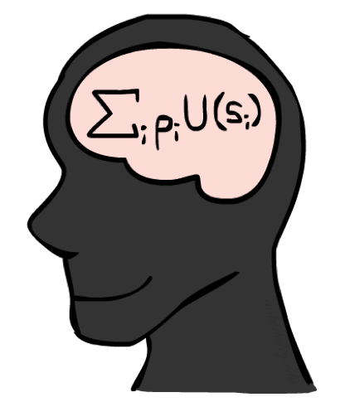
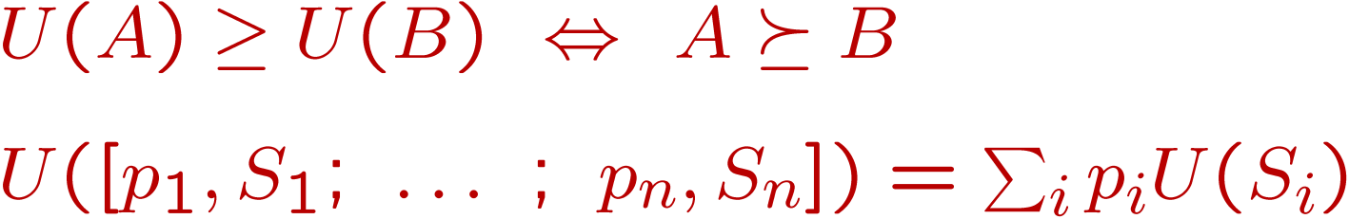
MEU Principle
Theorem [Ramsey, 1931; von Neumann & Morgenstern, 1944]
  Given any preferences satisfying these constraints, there exists a real-valued
  function U such that:
  I.e. values assigned by U preserve preferences of both prizes and lotteries!
Maximum expected utility (MEU) principle:
  Choose the action that maximizes expected utility

Slide 18

Utilities of Sequences

Slide 19





Utilities of Sequences
Now suppose an agent receives a sequence of rewards, over time
It’s reasonable to maximize the sum of rewards
  We can define utility as a sum of rewards
It’s also reasonable to prefer rewards now to rewards later
  One solution: values of rewards decay exponentially
Worth Now
Worth Next Step
Worth In Two Steps
Notes:
Might think its easy – more or less; sure
But what about now or later; vote!

Slide 20

A Rational Agent…
Maximizes expected utility
Maximizes sums of rewards
Minimizes expected loss
Minimizes sums of costs
Loss is just negative utility, and costs are just negative rewards

Slide 21
Designing Rational Agents
An agent is an entity that perceives and acts.
A rational agent selects actions that maximize its (expected) utility.
Characteristics of the percepts, environment, and action space dictate techniques for selecting rational actions
This course is about:
  General AI techniques for a variety of problem types
  Learning to recognize when and how a new problem can be solved with an existing technique
Sensors
Agent
Percepts
Environment
?
Actuators
Actions
Notes:
Quick recap: what will we do in this class?

Slide 22
Designing Rational Agents
An agent is an entity that perceives and acts.
A rational agent selects actions that maximize its (expected) utility.
Characteristics of the percepts, environment, and action space dictate techniques for selecting rational actions
This course is about:
  General AI techniques for a variety of problem types
  Learning to recognize when and how a new problem can be solved with an existing technique
Sensors
Agent
Percepts
Environment
?
Actuators
Actions
Notes:
Quick recap: what will we do in this class?

Slide 23

Problem Types Are Abstractions

Slide 24
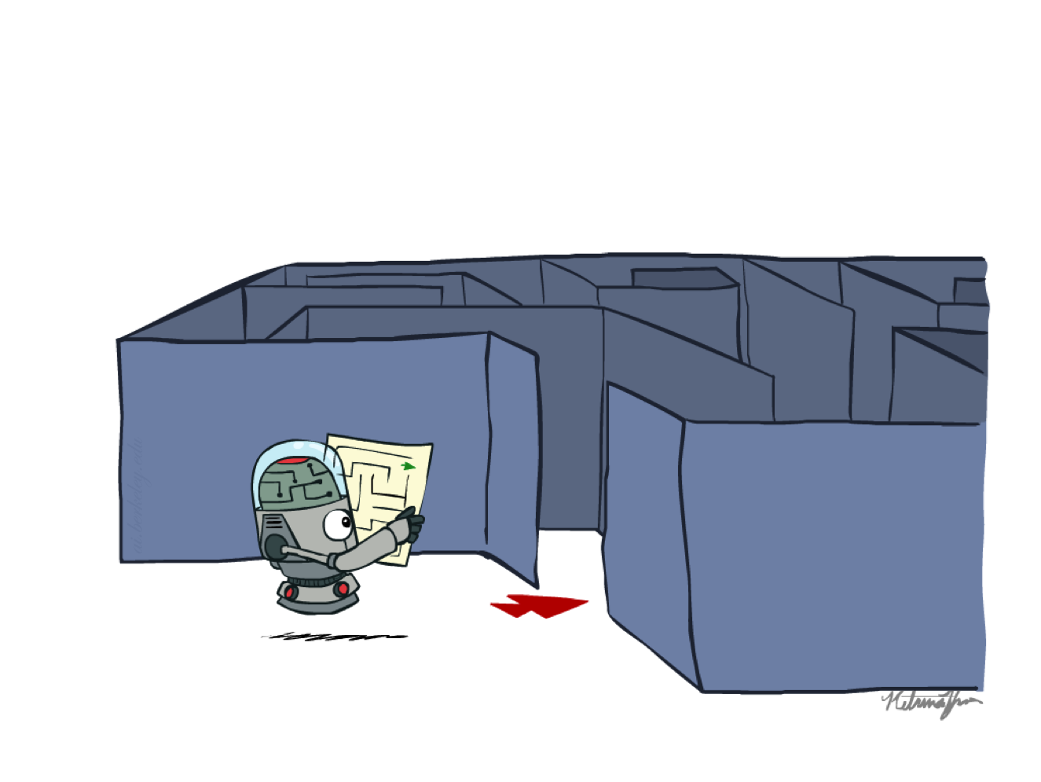
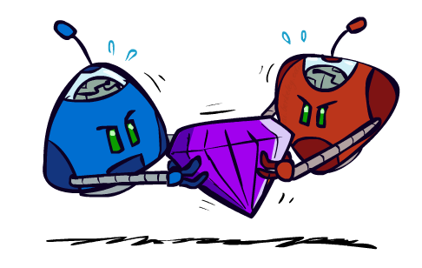


Problem Types
Search Problems
Deterministic Games
MDPs
RL

Slide 25

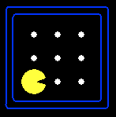
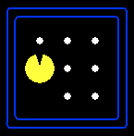
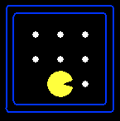
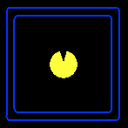


Search Problems
A search problem consists of:
  A state space
  A successor function
  (with actions, costs)
  A start state and a goal test
A solution is a sequence of actions (a plan) which transforms the start state to a goal state
“N”, 1.0
“E”, 1.0

Slide 26
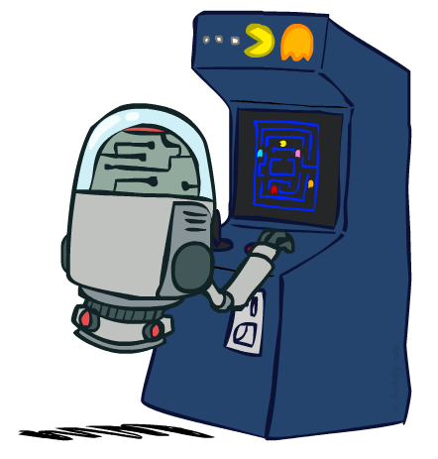
Deterministic Games
Many possible formalizations, one is:
  States: S (start at s₀)
  Players: P={1...N} (usually take turns)
  Actions: A (may depend on player / state)
  Transition Function: SxA → S
  Terminal Test: S → {t,f}
  Terminal Utilities: SxP → R
Solution for a player is a policy: S → A

Slide 27





Markov Decision Processes
An MDP is defined by:
  A set of states s ∈ S
  A set of actions a ∈ A
  A transition function T(s, a, s’)
    Probability that a from s leads to s’, i.e., P(s’| s, a)
    Also called the model or the dynamics
  A reward function R(s, a, s’)
    Sometimes just R(s) or R(s’)
  A start state
  Maybe a terminal state
MDPs are non-deterministic search problems
Notes:
In search problems: did not talk about actions, but about successor functions --- now the information inside the successor function is unpacked into actions, transitions and reward
Write out S, A, example entry in T, entry in R
Reward function different from the book : R(s,a,s’)
In book simpler for equations, but not useful for the projects.
Need to modify expectimax a tiny little bit to account for rewards along the way, but that’s something you should be able to do, and so you can already solve MDP’s (not in most efficient way)

Slide 28
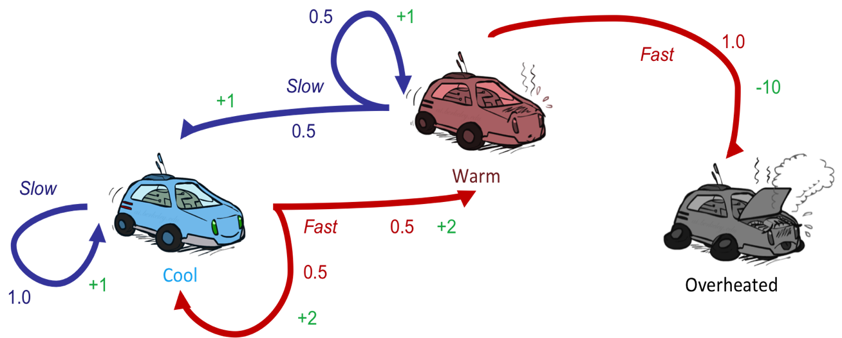
Reinforcement Learning
Still assume a Markov decision process (MDP):
  A set of states s ∈ S
  A set of actions (per state) A
  A model T(s,a,s’)
  A reward function R(s,a,s’)
Still looking for a policy π(s)
New twist: don’t know T or R
  I.e. we don’t know which states are good or what the actions do
  Must actually try out actions and states to learn

Slide 29
Search Problems

Slide 30
Search Problems
A search problem consists of:
  A state space
  A successor function
  (with actions, costs)
  A start state and a goal test
A solution is a sequence of actions (a plan) which transforms the start state to a goal state
“N”, 1.0
“E”, 1.0

Slide 31
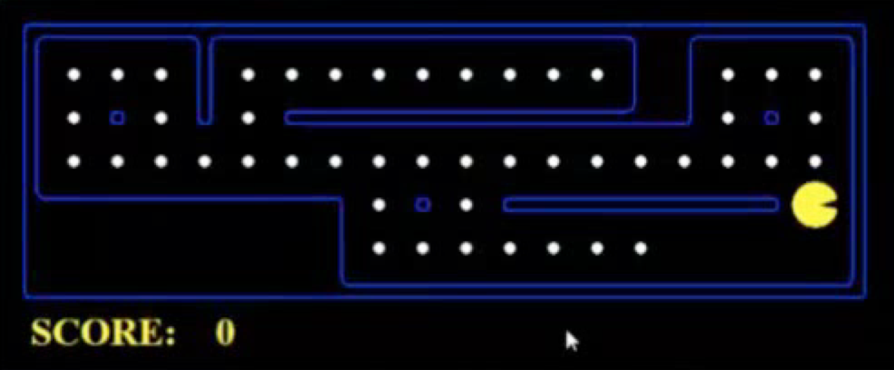
What’s in a State Space?
The world state includes every last detail of the environment
A search state keeps only the details needed for planning (abstraction)
Problem: Pathing
  States: (x,y) location
  Actions: NSEW
  Successor: update location only
  Goal test: is (x,y)=END
Problem: Eat-All-Dots
  States: {(x,y), dot booleans}
  Actions: NSEW
  Successor: update location and possibly a dot boolean
  Goal test: dots all false

Slide 32
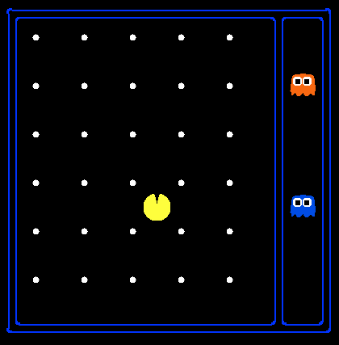
State Space Sizes?
World state:
  Agent positions: 120
  Food count: 30
  Ghost positions: 12
  Agent facing: NSEW
How many
  World states?
  120x(2³⁰)x(12²)x4
  States for pathing?
  120
  States for eat-all-dots?
  120x(2³⁰)

Slide 33
State Space Graphs
State space graph: A mathematical representation of a search problem
  Nodes are (abstracted) world configurations
  Arcs represent successors (action results)
  The goal test is a set of goal nodes (maybe only one)
In a state space graph, each state occurs only once!
We can rarely build this full graph in memory (it’s too big), but it’s a useful idea

Slide 34
State Space Graphs
State space graph: A mathematical representation of a search problem
  Nodes are (abstracted) world configurations
  Arcs represent successors (action results)
  The goal test is a set of goal nodes (maybe only one)
In a state space graph, each state occurs only once!
We can rarely build this full graph in memory (it’s too big), but it’s a useful idea
a
G
b
c
e
d
f
S
h
p
q
r
Tiny state space graph for a tiny search problem

Slide 35
Search Trees
This is now / start
“N”, 1.0
“E”, 1.0
Possible futures
A search tree:
  A “what if” tree of plans and their outcomes
  The start state is the root node
  Children correspond to successors
  Nodes show states, but correspond to PLANS that achieve those states
  For most problems, we can never actually build the whole tree

Slide 36
State Space Graphs vs. Search Trees
State Space Graph
Each NODE in in the search tree is an entire PATH in the state space graph.
Search Tree
S
a
G
d
e
p
b
c
q
b
c
e
h
r
d
e
f
a
a
h
r
p
q
f
S
h
We construct both on demand – and we construct as little as possible.
p
q
f
q
c
G
p
q
r
q
c
G
a
a

Slide 37
Recap: Search
Search problem:
  States (configurations of the world)
  Actions and costs
  Successor function (world dynamics)
  Start state and goal test
Search tree:
  Nodes: represent plans for reaching states
  Plans have costs (sum of action costs)
Search algorithm:
  Systematically builds a search tree
  Chooses an ordering of the fringe (unexplored nodes)
  Optimal: finds least-cost plans

Slide 38
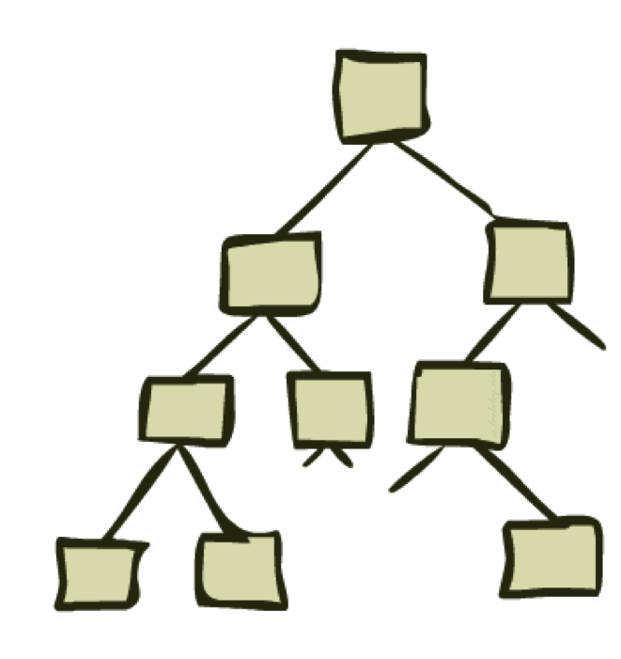
Algorithms for Solving Search Problems

Slide 39
Tree Search

Slide 40
Tree Search
Important ideas:
  Fringe
  Expansion
  Exploration strategy
Main question: which fringe nodes to explore?

Slide 41
The One Queue
Many search algorithms are the same except for fringe strategies
  Depth-First Search: expand the deepest node first
  Breadth-First Search: expand the shallowest node first
  Uniform Cost Search: expand the cheapest node first
  Greedy Search: expand the node with lowest heuristic value first
  A* Search: expand the node with lowest sum of path cost and heuristic value

Slide 42
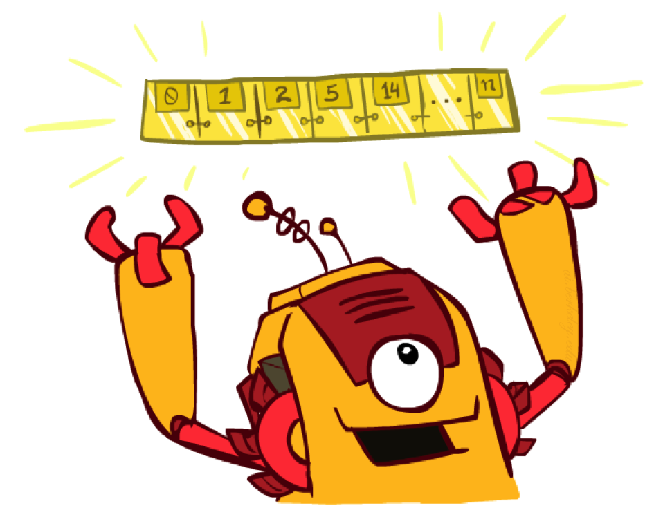
The One Queue
Many search algorithms are the same except for fringe strategies
  Conceptually, all fringes are priority queues (i.e. collections of nodes with attached priorities)
  Can even code one implementation that takes a variable queuing object

Slide 43
Search Algorithm Properties
Complete: Guaranteed to find a solution if one exists?
Optimal: Guaranteed to find the least cost path?
Time complexity?
Space complexity?
Cartoon of search tree:
  b is the branching factor
  m is the maximum depth
  solutions at various depths
Number of nodes in entire tree?
  1 + b + b² + …. b^{m} = O(b^{m})
1 node
b
…
b nodes
b² nodes
m tiers
b^{m} nodes

Slide 44
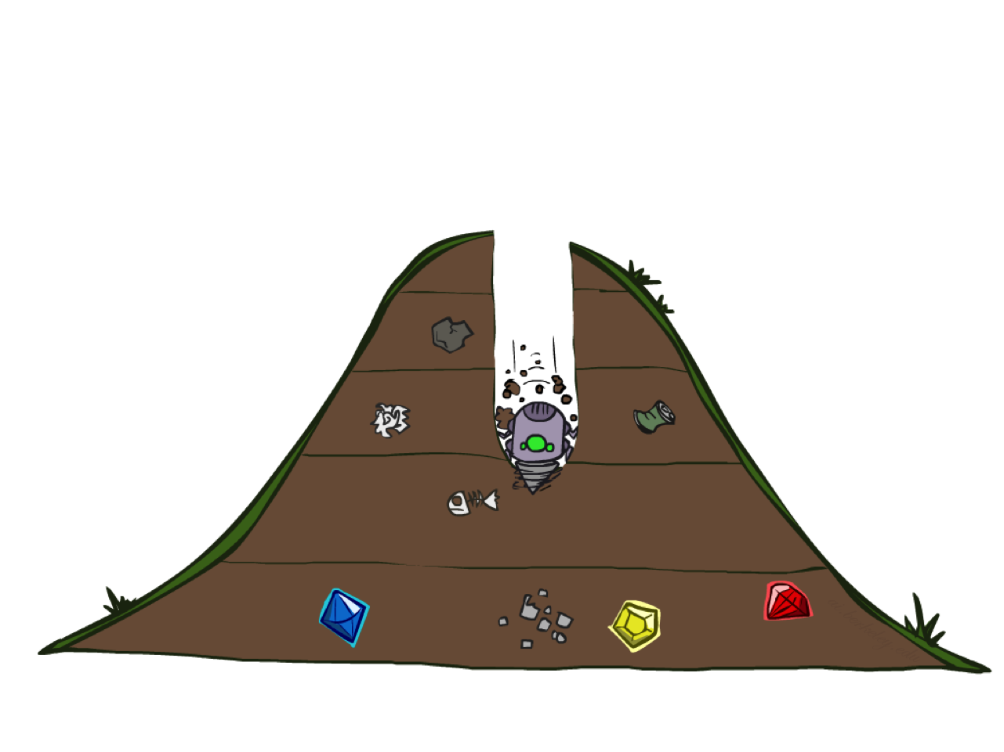
Depth-First Search

Slide 45
Depth-First Search (DFS) Properties
What nodes DFS expand?
  Some left prefix of the tree.
  Could process the whole tree!
  If m is finite, takes time O(b^{m})
How much space does the fringe take?
  Only has siblings on path to root, so O(bm)
Is it complete?
  m could be infinite, so only if we prevent cycles (more later)
Is it optimal?
  No, it finds the “leftmost” solution, regardless of depth or cost
1 node
b
…
b nodes
b² nodes
m tiers
b^{m} nodes

Slide 46
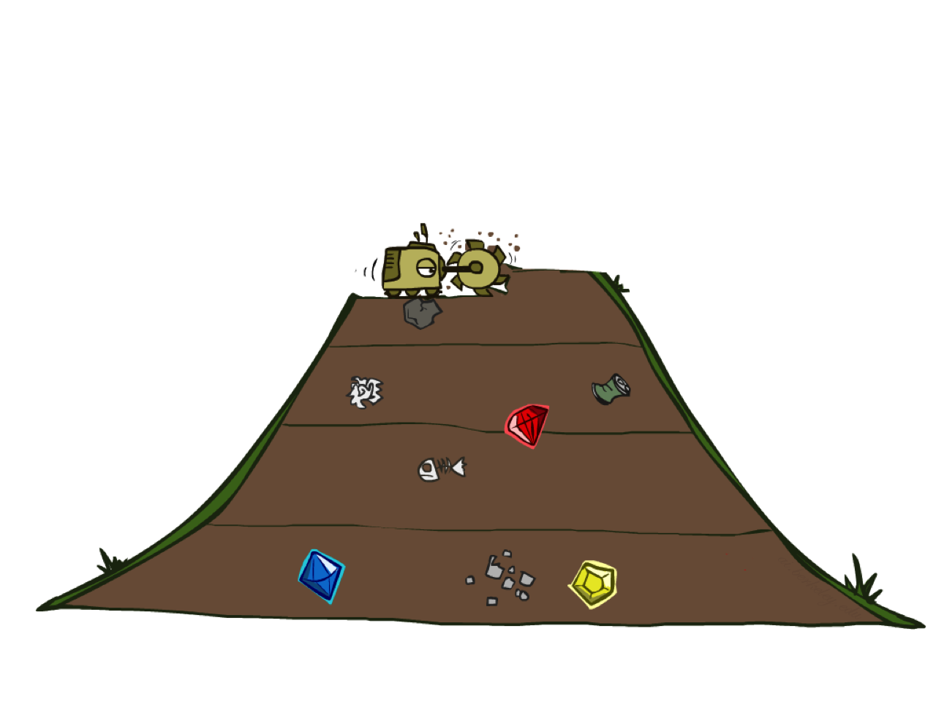
Breadth-First Search

Slide 47
Breadth-First Search (BFS) Properties
What nodes does BFS expand?
  Processes all nodes above shallowest solution
  Let depth of shallowest solution be s
  Search takes time O(b^{s})
How much space does the fringe take?
  Has roughly the last tier, so O(b^{s})
Is it complete?
  s must be finite if a solution exists, so yes!
Is it optimal?
  Only if costs are all 1 (more on costs later)
1 node
b
…
b nodes
s tiers
b² nodes
b^{s} nodes
b^{m} nodes

Slide 48
Combining DFS and BFS
DFS
Lower space usage
BFS
Lower running time
Finds shallow solutions

Slide 49
Iterative Deepening
Idea: get DFS’s space advantage with BFS’s time / shallow-solution advantages
  Run a DFS with depth limit 1. If no solution…
  Run a DFS with depth limit 2. If no solution…
  Run a DFS with depth limit 3. …..
Isn’t that wastefully redundant?
  Generally most work happens in the lowest level searched, so not so bad!
b
…

Slide 50
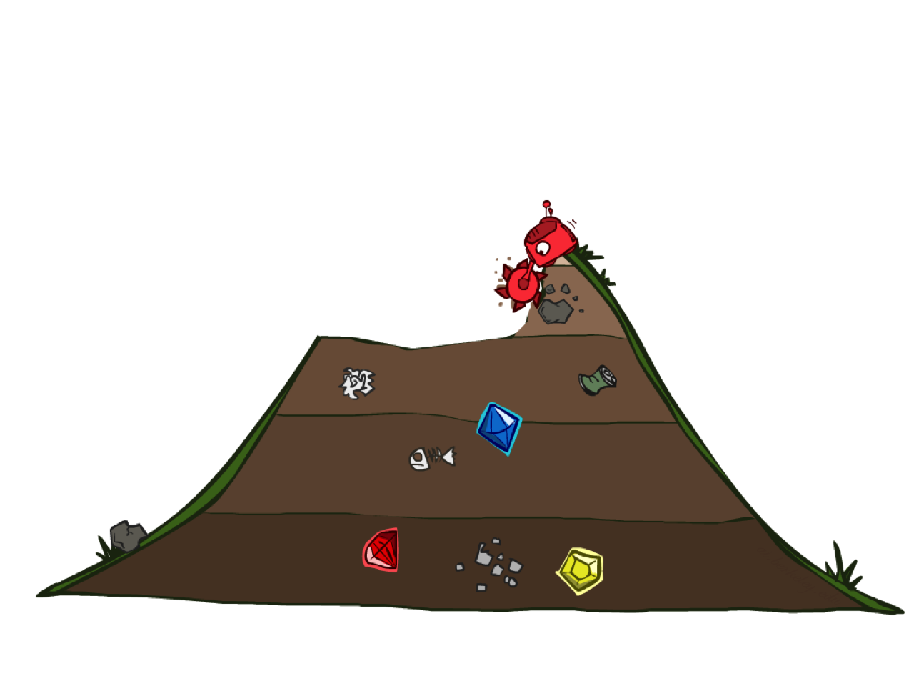
Uniform Cost Search

Slide 51
Uniform Cost Search (UCS) Properties
What nodes does UCS expand?
  Processes all nodes with cost less than cheapest solution!
  If that solution costs C* and arcs cost at least ε , then the “effective depth” is roughly C*/ε
  Takes time O(b^{C*/ε}) (exponential in effective depth)
How much space does the fringe take?
  Has roughly the last tier, so O(b^{C*/ε})
Is it complete?
  Assuming best solution has a finite cost and minimum arc cost is positive, yes!
Is it optimal?
  Yes!
b
c ≤ 1
…
C*/ε “tiers”
c ≤ 2
c ≤ 3

Slide 52
Uniform Cost Issues
Remember: UCS explores increasing cost contours
The good: UCS is complete and optimal!
The bad:
  Explores options in every “direction”
  No information about goal location
…
c ≤ 1
c ≤ 2
c ≤ 3
Start
Goal

Slide 53
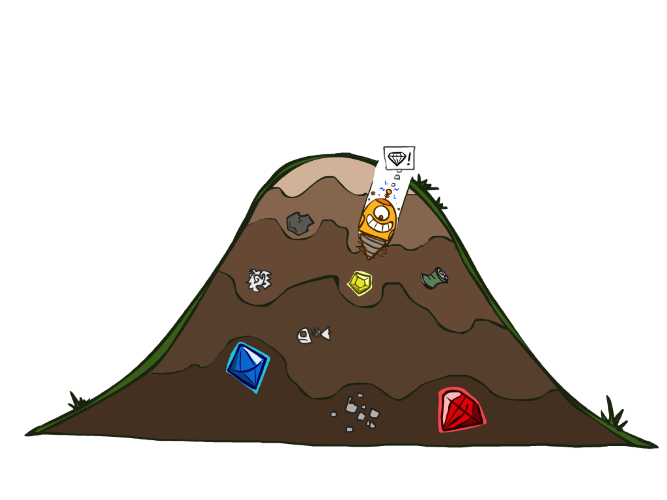
Greedy Search

Slide 54
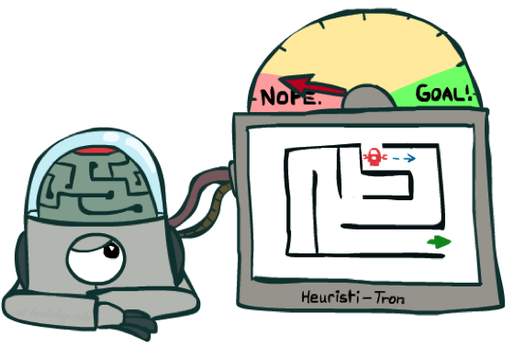
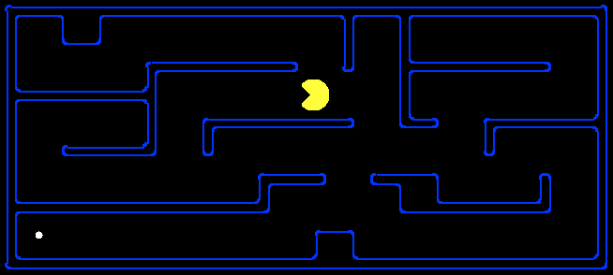
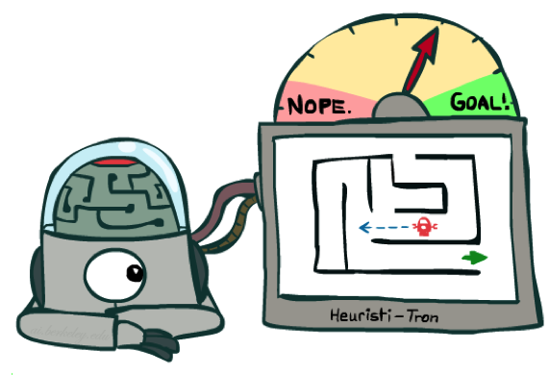
Search Heuristics
A heuristic is:
  A function that estimates how close a state is to a goal
  Designed for a particular search problem
  Examples: Manhattan distance, Euclidean distance for pathing
10
5
11.2

Slide 55
Greedy Search
b
Strategy: expand a node that you think is closest to a goal state
  Heuristic: estimate of distance to nearest goal for each state
A common case:
  Best-first takes you straight to the (wrong) goal
Worst-case: like a badly-guided DFS
…
b
…

Slide 56

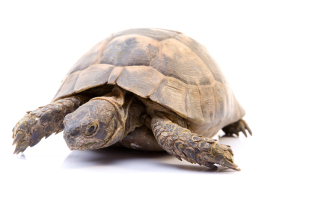
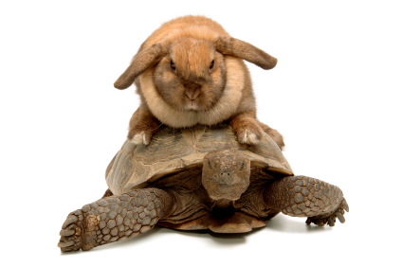
A* Search
UCS
Greedy
A*
Notes:
Notes: these images licensed from iStockphoto for UC Berkeley use.

Slide 57
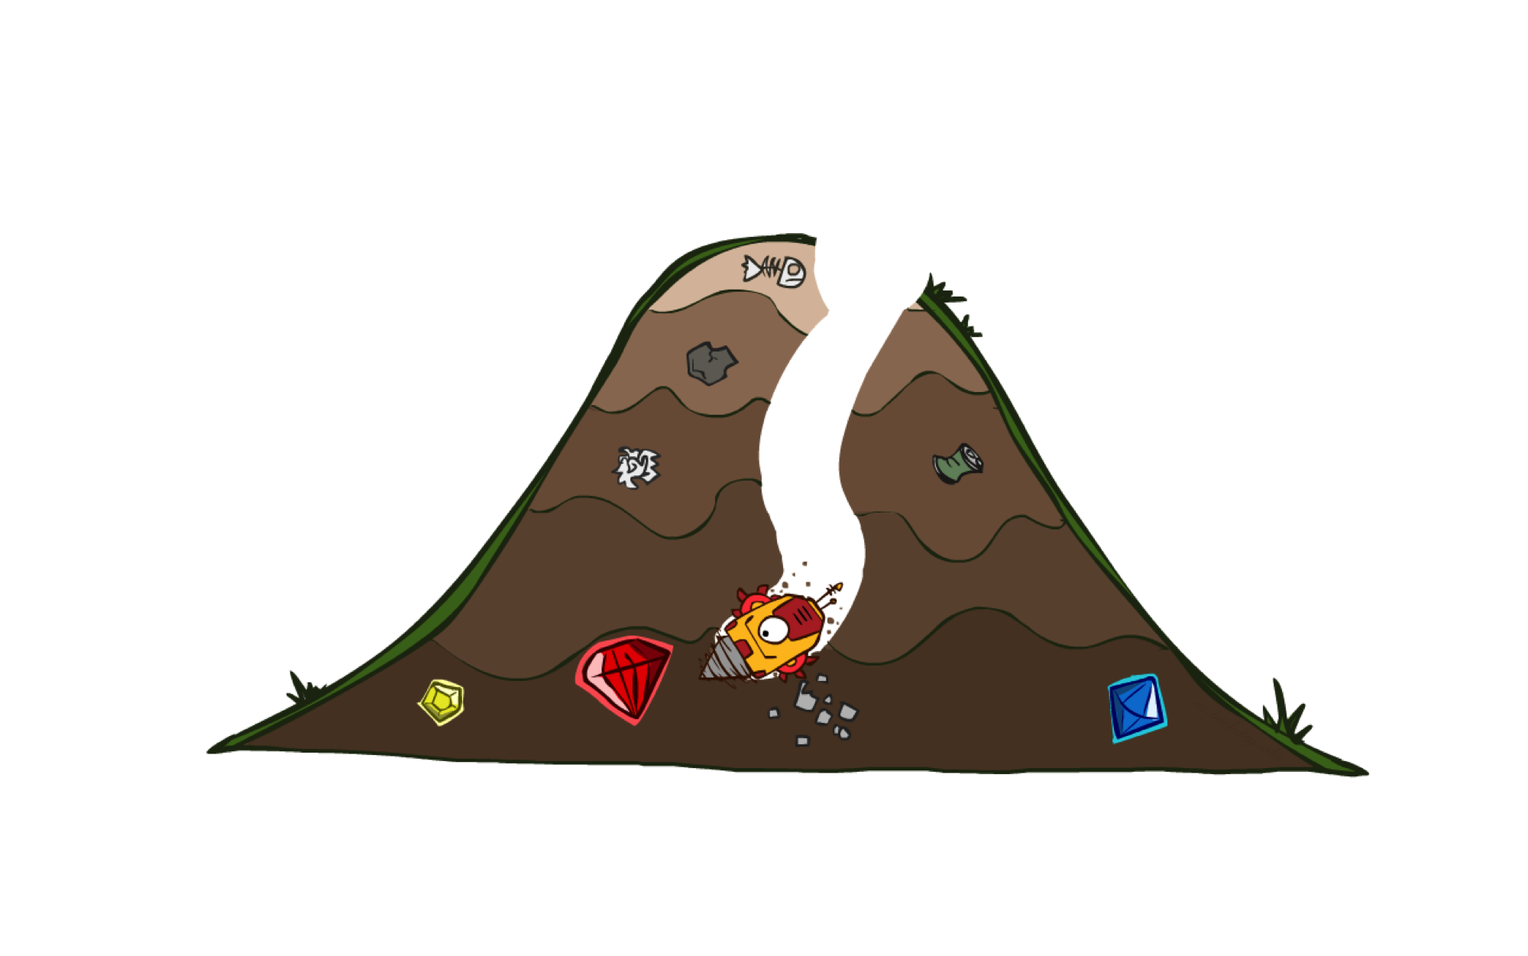
A* Search

Slide 58
Combining UCS and Greedy
Uniform-cost orders by path cost, or backward cost g(n)
Greedy orders by goal proximity, or forward cost h(n)
A* Search orders by the sum: f(n) = g(n) + h(n)
8
g = 0 h=6
S
e
h=1
g = 1 h=5
a
1
1
3
2
g = 2 h=6
g = 9 h=1
S
a
d
G
b
d
g = 4 h=2
e
h=6
1
h=5
h=2
h=0
1
g = 3 h=7
g = 6 h=0
g = 10 h=2
c
b
c
G
d
h=7
h=6
g = 12 h=0
G
Example: Teg Grenager

Slide 59
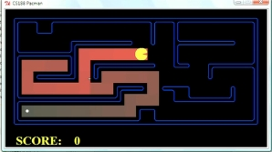
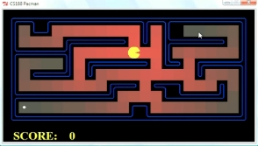
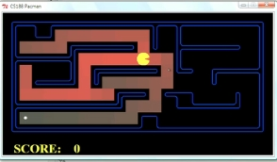
Comparison
Greedy
Uniform Cost
A*

Slide 60
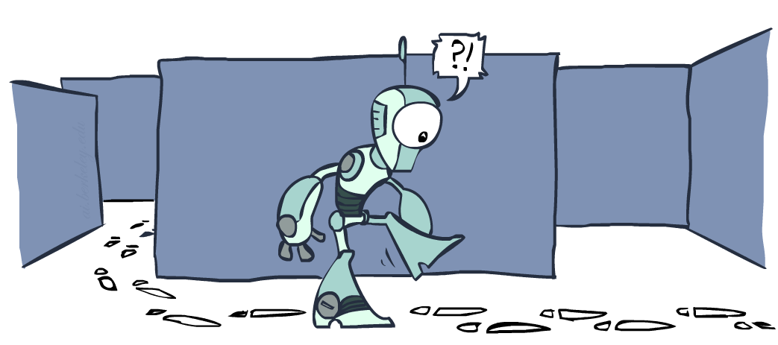
Graph Search

Slide 61
Tree Search: Extra Work!
Failure to detect repeated states can cause exponentially more work.
State Graph
Search Tree

Slide 62
Graph Search
Idea: never expand a state twice
How to implement:
  Tree search + set of expanded states (“closed set”)
  Expand the search tree node-by-node, but…
  Before expanding a node, check to make sure its state has never been expanded before
  If not new, skip it, if new add to closed set
Important: store the closed set as a set, not a list
Can graph search wreck completeness? Why/why not?
How about optimality?

Slide 63
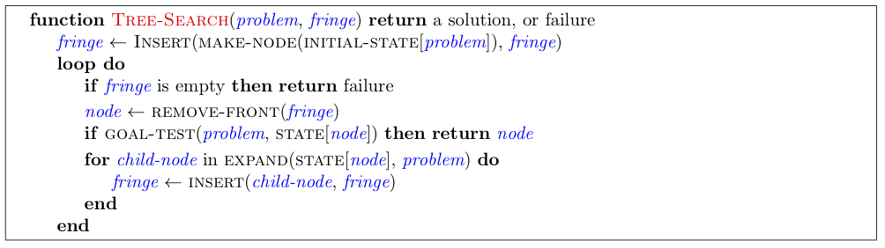
Tree Search Pseudo-Code

Slide 64
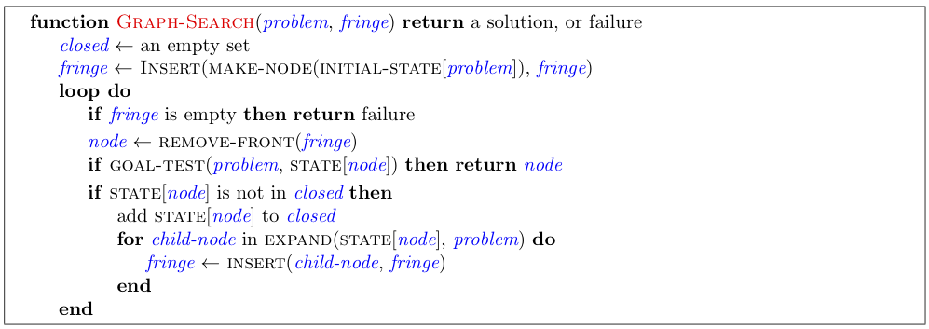
Graph Search Pseudo-Code

Slide 65
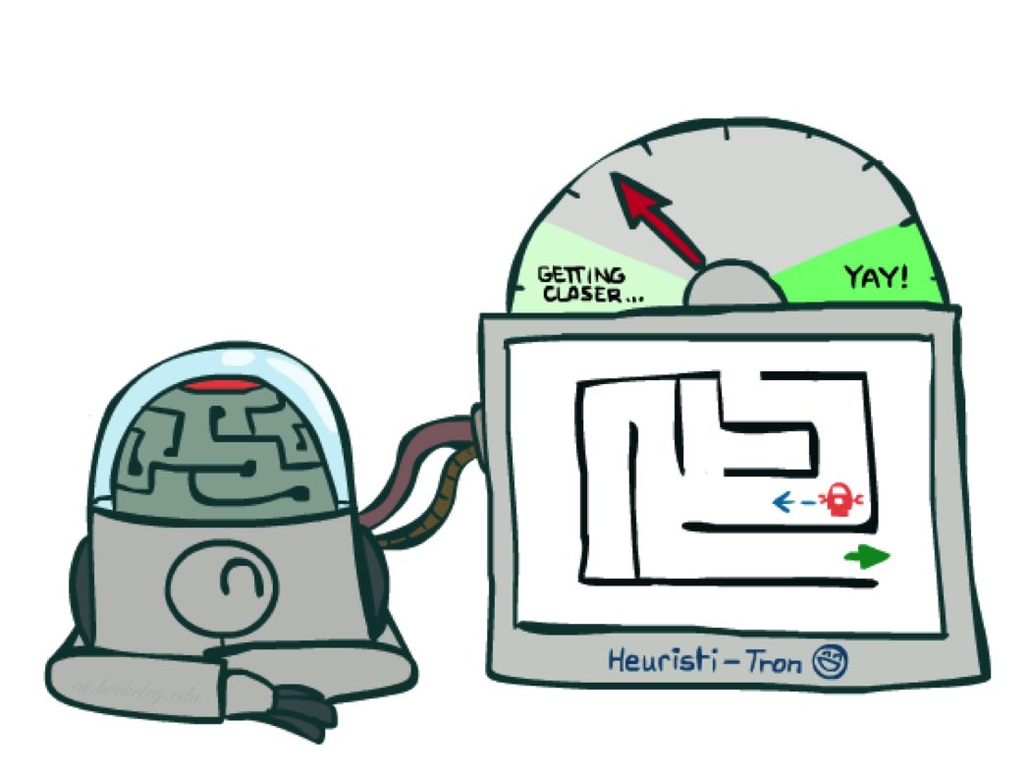
Admissible and Consistent Heuristics

Slide 66
An Inadmissible Heuristic
h = 6
1
A
3
S
h = 7
G
h = 0
5
Why does A* tree search return a suboptimal solution?
Actual bad goal cost < estimated good goal cost
We need estimates to be less than actual costs!

Slide 67
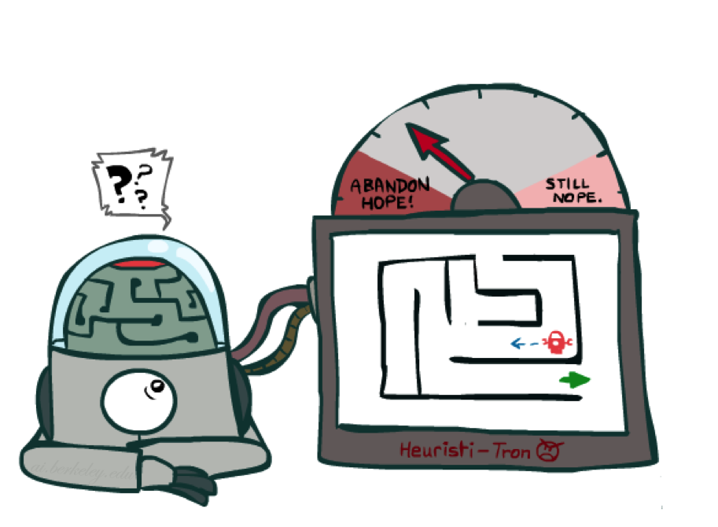
Idea: Admissibility
Inadmissible (pessimistic) heuristics break optimality by trapping good plans on the fringe
Admissible (optimistic) heuristics slow down bad plans but never outweigh true costs

Slide 68
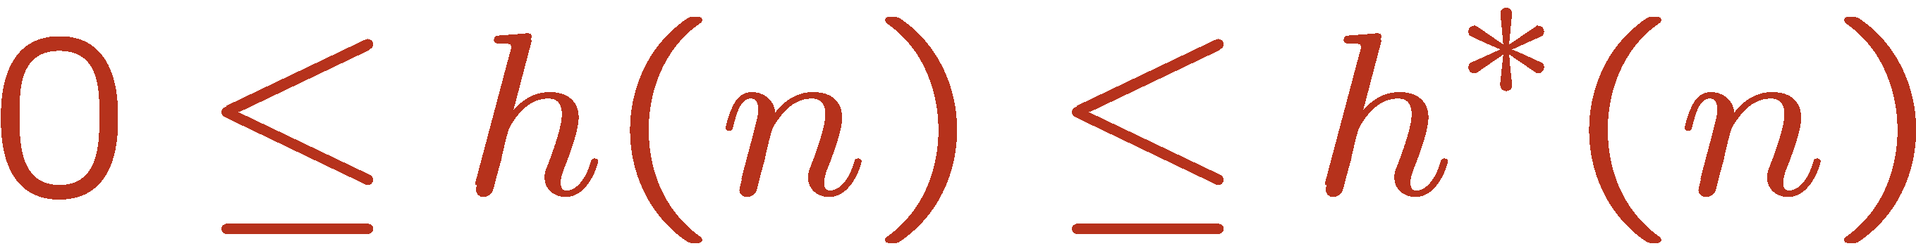
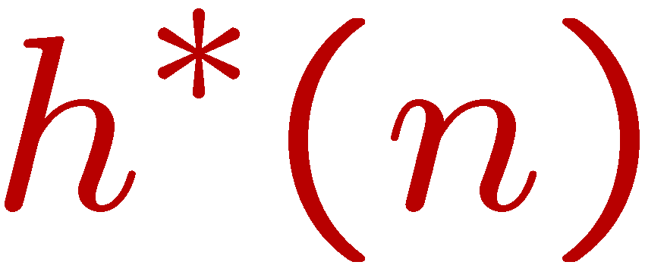
Admissible Heuristics
A heuristic h is admissible (optimistic) if:
where is the true cost to a nearest goal
Examples:
Coming up with admissible heuristics is most of what’s involved in using A* in practice.
4
15

Slide 69
Idea: Consistency
Main idea: estimated heuristic costs ≤ actual costs
  Admissibility: heuristic cost ≤ actual cost to goal
  h(A) ≤ actual cost from A to G
  Consistency: heuristic “arc” cost ≤ actual cost for each arc
  h(A) – h(C) ≤ cost(A to C)
Consequences of consistency:
  The f value along a path never decreases
  h(A) ≤ cost(A to C) + h(C)
  A* graph search is optimal
A
1
C
h=4
h=1
h=2
3
G

Slide 70
Creating Admissible Heuristics
Most of the work in solving hard search problems optimally is in coming up with admissible heuristics
Often, admissible heuristics are solutions to relaxed problems, where new actions are available
Inadmissible heuristics are often useful too
366
15

Slide 71

A*: Summary
A* uses both backward costs and (estimates of) forward costs
A* tree search is optimal with an admissible heuristic
A* graph search is optimal with a consistent heuristic
Heuristic design is key: often use relaxed problems

Slide 72
Games

Slide 73
Deterministic Games
Many possible formalizations, one is:
  States: S (start at s₀)
  Players: P={1...N} (usually take turns)
  Actions: A (may depend on player / state)
  Transition Function: SxA → S
  Terminal Test: S → {t,f}
  Terminal Utilities: SxP → R
Solution for a player is a policy: S → A

Slide 74
Zero-Sum Games
Zero-Sum Games
  Agents have opposite utilities (values on outcomes)
  Lets us think of a single value that one maximizes and the other minimizes
  Adversarial, pure competition

Slide 75
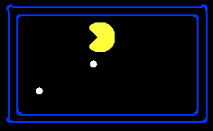
Single-Agent Trees
8
2
0
…
2
6
…
4
6

Slide 76
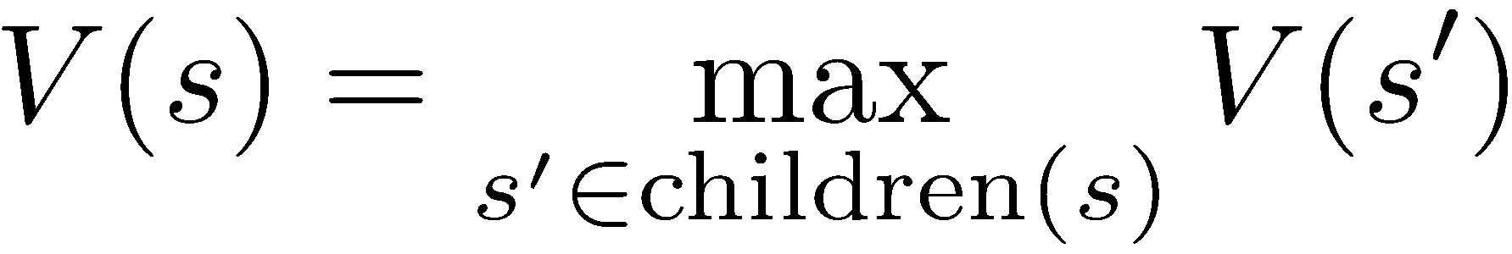
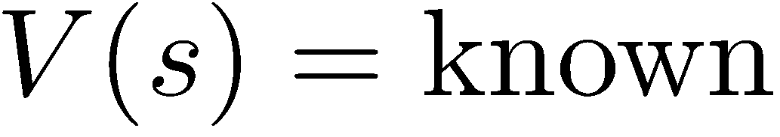
Value of a State
Value of a state: The best achievable outcome (utility) from that state
Non-Terminal States:
8
2
0
…
2
6
…
4
6
Terminal States:

Slide 77

Adversarial Game Trees
-20
-8
…
-18
-5
…
-10
+4
-20
+8

Slide 78
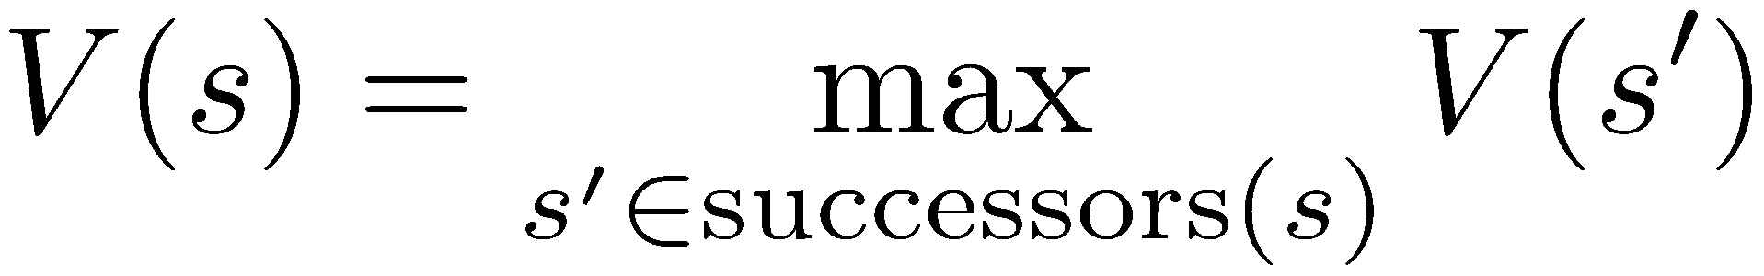
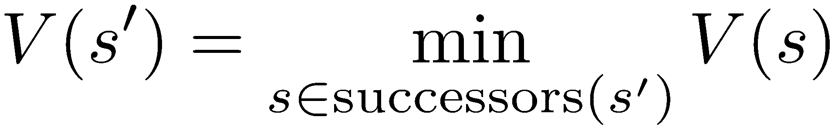
Minimax Values
States Under Agent’s Control:
States Under Opponent’s Control:
-8
-5
-10
+8
Terminal States:

Slide 79
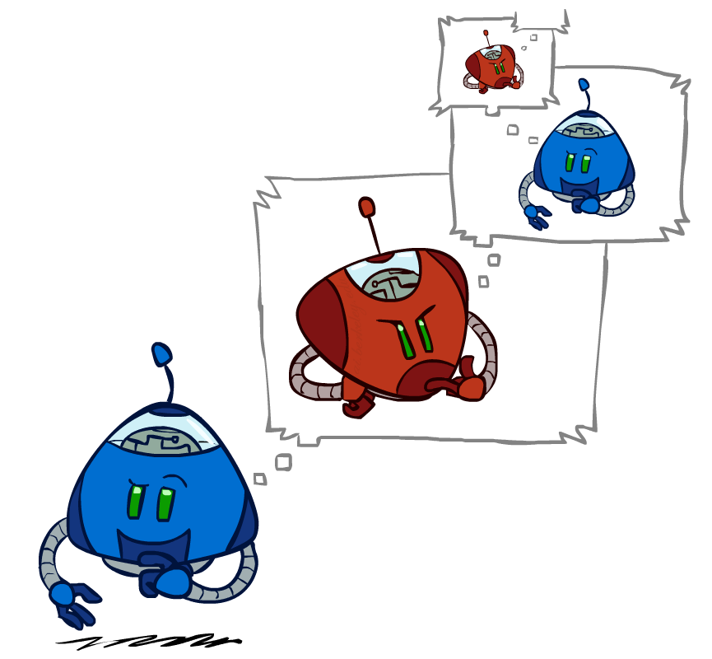
Algorithms for Games

Slide 80
Adversarial Search (Minimax)
Deterministic, zero-sum games:
  Tic-tac-toe, chess, checkers
  One player maximizes result
  The other minimizes result
Minimax search:
  A state-space search tree
  Players alternate turns
  Compute each node’s minimax value: the best achievable utility against a rational (optimal) adversary
Minimax values:
computed recursively
5
max
2
5
min
8
2
5
6
Terminal values:
part of the game

Slide 81
Minimax Implementation (Dispatch)
def value(state):
  if the state is a terminal state: return the state’s utility
  if the next agent is MAX: return max-value(state)
  if the next agent is MIN: return min-value(state)
def max-value(state):
  initialize v = -∞
  for each successor of state:
    v = max(v, value(successor))
  return v
def min-value(state):
  initialize v = +∞
  for each successor of state:
    v = min(v, value(successor))
  return v

Slide 82
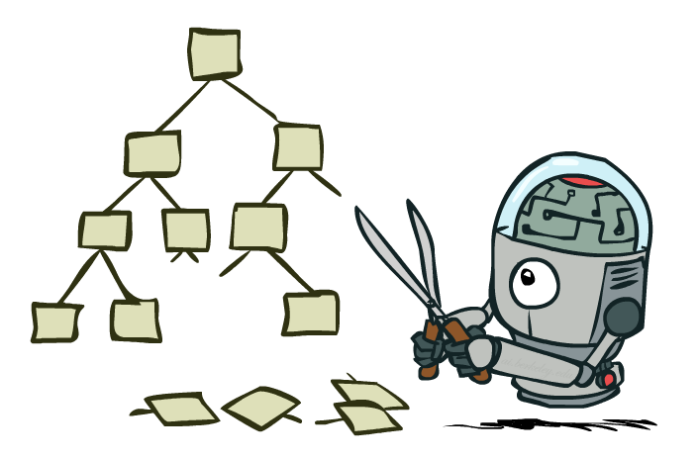
Minimax Efficiency: Pruning

Slide 83
Alpha-Beta Pruning
General configuration (MIN version)
  We’re computing the MIN-VALUE at some node n
  We’re looping over n’s children
  n’s estimate of the childrens’ min is dropping
  Who cares about n’s value? MAX
  Let a be the best value that MAX can get at any choice point along the current path from the root
  If n becomes worse than a, MAX will avoid it, so we can stop considering n’s other children (it’s already bad enough that it won’t be played)
MAX version is symmetric
MAX
MIN
a
MAX
MIN
n

Slide 84
Alpha-Beta Implementation
  α: MAX’s best option on path to root
  β: MIN’s best option on path to root
def max-value(state, α, β):
  initialize v = -∞
  for each successor of state:
    v = max(v, value(successor, α, β))
    if v ≥ β return v
    α = max(α, v)
  return v
def min-value(state, α, β):
  initialize v = +∞
  for each successor of state:
    v = min(v, value(successor, α, β))
    if v ≤ α return v
    β = min(β, v)
  return v

Slide 85
Alpha-Beta Pruning Properties
This pruning has no effect on minimax value computed for the root!
Values of intermediate nodes might be wrong
  Important: children of the root may have the wrong value
  So the most naïve version won’t let you do action selection
max
min
10
10
0

Slide 86

Minimax Efficiency: Depth-Limited Search

Slide 87
Resource Limits
Problem: In realistic games, cannot search to leaves!
Solution: Depth-limited search
  Instead, search only to a limited depth in the tree
  Replace terminal utilities with an evaluation function for non-terminal positions
Depth limit can be adjusted based on computation time budget
Guarantee of optimal play is gone
max
4
-2
4
min
-1
-2
4
9
?
?
?
?

Slide 88
Evaluation Functions
Evaluation functions score non-terminals in depth-limited search
Ideal function: returns the actual minimax value of the position
In practice: typically weighted linear sum of features:
e.g. f₁(s) = (num white queens – num black queens), etc.

Slide 89

Other Game Types

Slide 90
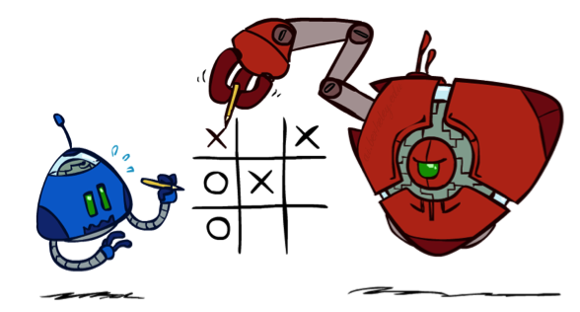
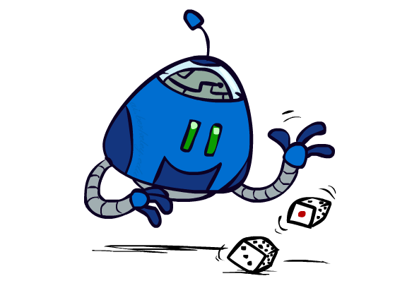
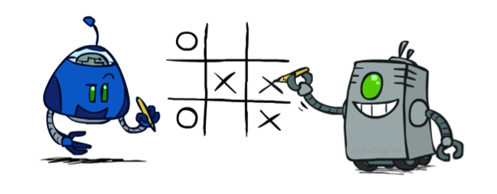
Uncertain Outcomes
max
min
10
10
9
100
Idea: Uncertain outcomes controlled by chance, not an adversary!

Slide 91
Expectimax Search
Why wouldn’t we know what the result of an action will be?
  Explicit randomness: rolling dice
  Unpredictable opponents: the ghosts respond randomly
  Actions can fail: when moving a robot, wheels might slip
Values should now reflect average-case (expectimax) outcomes, not worst-case (minimax) outcomes
Expectimax search: compute the average score under optimal play
max
chance
10
10
4
10
5
9
7
100

Slide 92
Expectimax Pseudocode
def value(state):
  if the state is a terminal state: return the state’s utility
  if the next agent is MAX: return max-value(state)
  if the next agent is EXP: return exp-value(state)
def max-value(state):
  initialize v = -∞
  for each successor of state:
    v = max(v, value(successor))
  return v
def exp-value(state):
  initialize v = 0
  for each successor of state:
  p = probability(successor)
    v += p * value(successor)
  return v

Slide 93

Expectimax Pruning?
3
12
9
2

Slide 94



Depth-Limited Expectimax
Estimate of true expectimax value (which would require a lot of work to compute)
400
300
…
…
492
362
…

Slide 95




Mixed Layer Types
E.g. Backgammon
Expectiminimax
  Environment is an extra “random agent” player that moves after each min/max agent
  Each node computes the appropriate combination of its children

Slide 96


Multi-Agent Utilities
What if the game is not zero-sum, or has multiple players?
Generalization of minimax:
  Terminals have utility tuples
  Node values are also utility tuples
  Each player maximizes its own component
  Can give rise to cooperation and
  competition dynamically…
1,6,6
7,1,2
6,1,2
7,2,1
5,1,7
1,5,2
7,7,1
5,2,5

Slide 97
Markov Decision Processes

Slide 98
Markov Decision Processes
An MDP is defined by:
  A set of states s ∈ S
  A set of actions a ∈ A
  A transition function T(s, a, s’)
    Probability that a from s leads to s’, i.e., P(s’| s, a)
    Also called the model or the dynamics
  A reward function R(s, a, s’)
    Sometimes just R(s) or R(s’)
  A start state
  Maybe a terminal state
MDPs are non-deterministic search problems
  One way to solve them is with expectimax search
  But there are more efficient algorithms, too
Notes:
In search problems: did not talk about actions, but about successor functions --- now the information inside the successor function is unpacked into actions, transitions and reward
Write out S, A, example entry in T, entry in R
Reward function different from the book : R(s,a,s’)
In book simpler for equations, but not useful for the projects.
Need to modify expectimax a tiny little bit to account for rewards along the way, but that’s something you should be able to do, and so you can already solve MDP’s (not in most efficient way)

Slide 99


MDP Search Trees
Each MDP state projects an expectimax-like search tree
s
s is a state
a
(s, a) is a q-state
s, a
(s,a,s’) called a transition
T(s,a,s’) = P(s’|s,a)
R(s,a,s’)
s,a,s’
s’
Notes:
In MDP chance node represents uncertainty about what might happen based on (s,a) [as opposed to being a random adversary]
Q-state (s,a) is when you were in a state and took an action

Slide 100

Policies
In deterministic single-agent search problems, we wanted an optimal plan, or sequence of actions, from start to a goal
For MDPs, we want an optimal policy π*: S → A
  A policy π gives an action for each state
  An optimal policy is one that maximizes expected utility if followed
  An explicit policy defines a reflex agent
Optimal policy when R(s, a, s’) = -0.03 for all non-terminals s

Slide 101
Optimal Quantities
The value (utility) of a state s:
  V*(s) = expected utility starting in s and acting optimally
The value (utility) of a q-state (s,a):
  Q*(s,a) = expected utility starting out having taken action a from state s and (thereafter) acting optimally
The optimal policy:
  π*(s) = optimal action from state s
s
s is a state
a
(s, a) is a q-state
s, a
s,a,s’
(s,a,s’) is a
transition
s’
Notes:
[Note: this demo doesn’t show anything in action, just pops up V and Q values.]

Slide 102

The Bellman Equations
How to be optimal:
Step 1: Take correct first action
Step 2: Keep being optimal

Slide 103


The Bellman Equations
Definition of “optimal utility” via expectimax recurrence gives a simple one-step lookahead relationship amongst optimal utility values
These are the Bellman equations, and they characterize optimal values in a way we’ll use over and over
s
a
s, a
s,a,s’
s’
Notes:
Let’s start by equations that characterize these quantities through mutual recursions. [step through this by writing on slide, one step at a time]
Recursive characterization of V* in terms of V*; not necessarily helpful; but it is a characterization.
Note: this is a set of equations that needs to be satisfied; but it could have multiple solutions (it does not, but at this stage of our knowledge it could).

Slide 104
Algorithms for Solving MDPs

Slide 105
MDPs
Known MDP: Offline Solution
Goal Technique
Compute V*, Q*, π* Value / policy iteration
Evaluate a fixed policy π Policy evaluation

Slide 106

Value Iteration

Slide 107
Value Iteration
Bellman equations characterize the optimal values:
Value iteration computes them:
Value iteration is just a fixed point solution method
  … though the V_{k} vectors are also interpretable as time-limited values
V(s)
a
s, a
s,a,s’
V(s’)
Notes:
Discuss computational complexity: S * A * S times number of iterations
Note: updates not in place [if in place, it means something else and not even clear what it means]

Slide 108













Computing Time-Limited Values

Slide 109
Problems with Value Iteration
Value iteration repeats the Bellman updates:
Problem 1: It’s slow – O(S²A) per iteration
Problem 2: The “max” at each state rarely changes
Problem 3: The policy often converges long before the values
s
a
s, a
s,a,s’
s’
Notes:
Demo steps through value iteration; snapshots of values shown on next slides.

Slide 110

Policy Methods

Slide 111

Policy Evaluation

Slide 112

Policy Evaluation
s
How do we calculate the V’s for a fixed policy π?
Idea 1: Turn recursive Bellman equations into updates
(like value iteration)
Efficiency: O(S²) per iteration
Idea 2: Without the maxes, the Bellman equations are just a linear system
  Solve with Matlab (or your favorite linear system solver)
π(s)
s, π(s)
s, π(s),s’
s’

Slide 113

Policy Extraction

Slide 114



Computing Actions from Values
Let’s imagine we have the optimal values V*(s)
How should we act?
  It’s not obvious!
We need to do a mini-expectimax (one step)
This is called policy extraction, since it gets the policy implied by the values

Slide 115

Policy Iteration

Slide 116
Policy Iteration
Alternative approach for optimal values:
  Step 1: Policy evaluation: calculate utilities for some fixed policy (not optimal utilities!) until convergence
  Step 2: Policy improvement: update policy using one-step look-ahead with resulting converged (but not optimal!) utilities as future values
  Repeat steps until policy converges
This is policy iteration
  It’s still optimal!
  Can converge (much) faster under some conditions

Slide 117
Policy Iteration
Evaluation: For fixed current policy π, find values with policy evaluation:
  Iterate until values converge:
Improvement: For fixed values, get a better policy using policy extraction
  One-step look-ahead:

Slide 118
Comparison
Both value iteration and policy iteration compute the same thing (all optimal values)
In value iteration:
  Every iteration updates both the values and (implicitly) the policy
  We don’t track the policy, but taking the max over actions implicitly recomputes it
In policy iteration:
  We do several passes that update utilities with fixed policy (each pass is fast because we consider only one action, not all of them)
  After the policy is evaluated, a new policy is chosen (slow like a value iteration pass)
  The new policy will be better (or we’re done)
Both are dynamic programs for solving MDPs

Slide 119
Summary: MDP Algorithms
So you want to….
  Compute optimal values: use value iteration or policy iteration
  Compute values for a particular policy: use policy evaluation
  Turn your values into a policy: use policy extraction (one-step lookahead)
These all look the same!
  They basically are – they are all variations of Bellman updates
  They all use one-step lookahead expectimax fragments
  They differ only in whether we plug in a fixed policy or max over actions

Slide 120
Reinforcement Learning

Slide 121

Reinforcement Learning
We still assume an MDP:
  A set of states s ∈ S
  A set of actions (per state) A
  A model T(s,a,s’)
  A reward function R(s,a,s’)
Still looking for a policy π(s)
New twist: don’t know T or R, so must try out actions
Big idea: Compute all averages over T using sample outcomes

Slide 122
MDPs and RL
Known MDP: Offline Solution
Goal Technique
Compute V*, Q*, π* Value / policy iteration
Evaluate a fixed policy π Policy evaluation
Unknown MDP: Model-Based
Unknown MDP: Model-Free
Goal Technique
Compute V*, Q*, π* VI/PI on approx. MDP
Evaluate a fixed policy π PE on approx. MDP
Goal Technique
Compute V*, Q*, π* Q-learning
Evaluate a fixed policy π Value Learning

Slide 123



Model-Based Learning
Model-Based Idea:
  Learn an approximate model based on experiences
  Solve for values as if the learned model were correct
Step 1: Learn empirical MDP model
  Count outcomes s’ for each s, a
  Normalize to give an estimate of
  Discover each when we experience (s, a, s’)
Step 2: Solve the learned MDP
  For example, use value iteration, as before

Slide 124

Model-Free Learning
s
Model-free learning
  Experience world through episodes
  Update estimates each transition
  Over time, updates will mimic Bellman updates
a
s, a
r
s’
a’
s’, a’
s’’

Slide 125
Passive Reinforcement Learning
Simplified task: policy evaluation
  Input: a fixed policy π(s)
  You don’t know the transitions T(s,a,s’)
  You don’t know the rewards R(s,a,s’)
  Goal: learn the state values
In this case:
  Learner is “along for the ride”
  No choice about what actions to take
  Just execute the policy and learn from experience
  This is NOT offline planning! You actually take actions in the world.

Slide 126
Why Not Use Policy Evaluation?
s
Recall: Policy Evaluation
  Unfortunately, we need T and R to perform this update!
Key question: how can we do this update to V without knowing T and R?
  In other words, how to we take a weighted average without knowing the weights?
π(s)
s, π(s)
s, π(s),s’
s’

Slide 127
Temporal Difference Learning
s
Recall: Policy Evaluation
Temporal Difference Learning
π(s)
s, π(s)
s, π(s),s’
s’
Sample of V(s):
s
Update to V(s):
π(s)
s, π(s)
Same update:
s’

Slide 128


Problems with TD Value Learning
TD value leaning is a model-free way to do policy evaluation, mimicking Bellman updates with running sample averages
However, if we want to turn values into a (new) policy, we’re sunk:
Idea: learn Q-values, not values
Makes action selection model-free too!
s
a
s, a
s,a,s’
s’

Slide 129
Detour: Q-Value Iteration
Value iteration: find successive (depth-limited) values
  Start with V₀(s) = 0, which we know is right
  Given V_{k}, calculate the depth k+1 values for all states:
But Q-values are more useful, so compute them instead
  Start with Q₀(s,a) = 0, which we know is right
  Given Q_{k}, calculate the depth k+1 q-values for all q-states:

Slide 130


Q-Learning
Q-Learning: sample-based Q-value iteration
Learn Q(s,a) values as you go
  Receive a sample (s,a,s’,r)
  Consider your old estimate:
  Consider your new sample estimate:
  Incorporate the new estimate into a running average:

Slide 131

Active Reinforcement Learning
Full reinforcement learning: optimal policies
  You don’t know the transitions T(s,a,s’)
  You don’t know the rewards R(s,a,s’)
  You choose the actions now
  Goal: learn the optimal policy / values
In this case:
  Learner makes choices!
    Current Q-values can be used to decide which action to take
  This is NOT offline planning! You actually take actions in the world and find out what happens…

Slide 132
Q-Learning Properties
Amazing result: Q-learning converges to optimal policy -- even if you’re acting suboptimally!
This is called off-policy learning
Caveats:
  You have to explore enough
  You have to eventually make the learning rate
  small enough
  … but not decrease it too quickly
  Basically, in the limit, it doesn’t matter how you select actions (!)

Slide 133

Exploration vs. Exploitation

Slide 134


How to Explore?
Several schemes for forcing exploration
  Simplest: random actions (ε-greedy)
    Every time step, flip a coin
    With (small) probability ε, act randomly
    With (large) probability 1-ε, act on current policy
  Another approach: exploration functions
    Takes a value estimate u and a visit count n, and returns an optimistic utility, e.g.
    Regular Q-Update:
    Modified Q-Update:

Slide 135

Approximate Q-Learning

Slide 136


Generalizing Across States
Basic Q-Learning keeps a table of all q-values
In realistic situations, we cannot possibly learn about every single state!
  Too many states to visit them all in training
  Too many states to hold the q-tables in memory
Instead, we want to generalize:
  Learn about some small number of training states from experience
  Generalize that experience to new, similar situations
  This is a fundamental idea in machine learning, and we’ll see it over and over again
[demo – RL pacman]

Slide 137
Feature-Based Value Functions
Solution: describe a state using a vector of features (properties)
Using a feature representation, we can write a q function (or value function) for any state using a few weights:
Advantage: our experience is summed up in a few powerful numbers
Disadvantage: states may share features but actually be very different in value!

Slide 138


Approximate Q-Learning
Q-learning with linear Q-functions:
Intuitive interpretation:
  Adjust weights of active features
  E.g., if something unexpectedly bad happens, blame the features that were on: disprefer all states with that state’s features
Formal justification: online least squares
Exact Q’s
Approximate Q’s

Slide 139




Minimizing Error
Imagine we had only one point x, with features f(x), target value y, and weights w:
Approximate q update explained:
“target”
“prediction”

Slide 140
More Powerful Function Approximation
Linear:
Polynomial:
Neural Network:
Learn These Too

Slide 141
More Powerful Function Approximation
Summary of iterative feature update equation!

Slide 142
MDPs and RL
Known MDP: Offline Solution
Goal Technique
Compute V*, Q*, π* Value / policy iteration
Evaluate a fixed policy π Policy evaluation
Unknown MDP: Model-Based
Unknown MDP: Model-Free
Goal Technique
Compute V*, Q*, π* VI/PI on approx. MDP
Evaluate a fixed policy π PE on approx. MDP
Goal Technique
Compute V*, Q*, π* Q-learning
Evaluate a fixed policy π Value Learning

Slide 143

Policy Search

Slide 144
Policy Search
Problem: often the feature-based policies that work well (win games, maximize utilities) aren’t the ones that approximate V / Q best
  E.g. your value functions from project 2 were probably horrible estimates of future rewards, but they still produced good decisions
  Q-learning’s priority: get Q-values close (modeling)
  Action selection priority: get ordering of Q-values right (prediction)
  We’ll see this distinction between modeling and prediction again later in the course
Solution: learn policies that maximize rewards, not the values that predict them
Policy search: start with an ok solution (e.g. Q-learning) then fine-tune by hill climbing on feature weights

Slide 145

Conclusion

Slide 146

Example: Snakes and Ladders

Slide 147


Snakes and Ladders: Search
Player may be located anywhere on a 4x3 board
Start at square 1
Goal is to reach square 12
At each turn, move either 2 or 3 squares forward, but…
  Landing on the bottom of a ladder moves the player to the top of the ladder
  Landing on the head of a snake moves the player to the tail square of the snake
9 | 10 | 11 | 12
8 | 7 | 6 | 5
1 | 2 | 3 | 4

Slide 148
Snakes and Ladders: Search
9 | 10 | 11 | 12
8 | 7 | 6 | 5
1 | 2 | 3 | 4
Move 2 or 3 squares each turn

Slide 149
Snakes and Ladders: Search
9 | 10 | 11 | 12
8 | 7 | 6 | 5
1 | 2 | 3 | 4
Move 2 or 3 squares each turn

Slide 150
Snakes and Ladders: Search
9 | 10 | 11 | 12
8 | 7 | 6 | 5
1 | 2 | 3 | 4
Move 2 or 3 squares each turn

Slide 151
Snakes and Ladders: Adversarial Games
Player may be located anywhere on a 4x3 board
Start at square 1
Goal is to reach square 12
At each turn, move either 2 or 3 squares forward, but…
  Landing on the bottom of a ladder moves the player to the top of the ladder
  Landing on the head of a snake moves the player to the tail square of the snake
After each turn, adversary can move the head of the snake to either square 9 or 10
9 | 10 | 11 | 12
8 | 7 | 6 | 5
1 | 2 | 3 | 4

Slide 152
Snakes and Ladders: Adversarial Games
9 | 10 | 11 | 12
8 | 7 | 6 | 5
1 | 2 | 3 | 4
Move 2 or 3 squares each turn
Adversary can move snake head!

Slide 153
Snakes and Ladders: Adversarial Games
9 | 10 | 11 | 12
8 | 7 | 6 | 5
1 | 2 | 3 | 4
Move 2 or 3 squares each turn
Adversary can move snake head!

Slide 154
Snakes and Ladders: Adversarial Games
9 | 10 | 11 | 12
8 | 7 | 6 | 5
1 | 2 | 3 | 4
Move 2 or 3 squares each turn
Adversary can move snake head!

Slide 155

Snakes and Ladders: MDP
Player may be located anywhere on a 4x3 board
Start at square 1
Goal is to reach square 12
At each turn, either
  advance 1 square
  roll a 4-sided die and advance that many squares
After each move…
  Landing on the bottom of a ladder moves the player to the top of the ladder
  Landing on the head of a snake moves the player to the tail square of the snake
9 | 10 | 11 | 12
8 | 7 | 6 | 5
1 | 2 | 3 | 4

Slide 156
Snakes and Ladders: MDP
9 | 10 | 11 | 12
8 | 7 | 6 | 5
1 | 2 | 3 | 4
Advance 1 square
Or roll a
4-sided die

Slide 157
Snakes and Ladders: MDP
9 | 10 | 11 | 12
8 | 7 | 6 | 5
1 | 2 | 3 | 4
Advance 1 square
Or roll a
4-sided die

Slide 158
Snakes and Ladders: MDP
9 | 10 | 11 | 12
8 | 7 | 6 | 5
1 | 2 | 3 | 4
Advance 1 square
Or roll a
4-sided die

Slide 159
Snakes and Ladders: MDP
9 | 10 | 11 | 12
8 | 7 | 6 | 5
1 | 2 | 3 | 4
Advance 1 square
Or roll a
4-sided die

Slide 160
Snakes and Ladders: MDP
9 | 10 | 11 | 12
8 | 7 | 6 | 5
1 | 2 | 3 | 4
Advance 1 square
Or roll a
4-sided die

Slide 161
Snakes and Ladders: MDP
9 | 10 | 11 | 12
8 | 7 | 6 | 5
1 | 2 | 3 | 4
Advance 1 square
Or roll a
4-sided die

Slide 162
Snakes and Ladders: RL
Player may be located anywhere on a 4x3 board
Start at square 1
Goal is to reach square 12
At each turn, either
  advance 1 square
  roll a mystery die that determines how many squares to advance
After each move…
  Landing on the bottom of a ladder moves the player to the top of the ladder
  Landing on the head of a snake moves the player to the tail square of the snake
9 | 10 | 11 | 12
8 | 7 | 6 | 5
1 | 2 | 3 | 4

Slide 163
Snakes and Ladders: RL
9 | 10 | 11 | 12
8 | 7 | 6 | 5
1 | 2 | 3 | 4
Advance 1 square
Or roll a
mystery die

Slide 164
Snakes and Ladders: RL
9 | 10 | 11 | 12
8 | 7 | 6 | 5
1 | 2 | 3 | 4
Advance 1 square
Or roll a
mystery die

Slide 165
Snakes and Ladders: RL
9 | 10 | 11 | 12
8 | 7 | 6 | 5
1 | 2 | 3 | 4
Advance 1 square
Or roll a
mystery die

Slide 166
Snakes and Ladders: RL
9 | 10 | 11 | 12
8 | 7 | 6 | 5
1 | 2 | 3 | 4
Advance 1 square
Or roll a
mystery die

Slide 167
Snakes and Ladders: RL
9 | 10 | 11 | 12
8 | 7 | 6 | 5
1 | 2 | 3 | 4
Advance 1 square
Or roll a
mystery die

Slide 168
Snakes and Ladders: RL
9 | 10 | 11 | 12
8 | 7 | 6 | 5
1 | 2 | 3 | 4
Advance 1 square
Or roll a
mystery die

Slide 169
Snakes and Ladders: RL
9 | 10 | 11 | 12
8 | 7 | 6 | 5
1 | 2 | 3 | 4
Advance 1 square
Or roll a
mystery die

Slide 170
Snakes and Ladders: RL
9 | 10 | 11 | 12
8 | 7 | 6 | 5
1 | 2 | 3 | 4
Advance 1 square
Or roll a
mystery die

Slide 171
Snakes and Ladders: RL
9 | 10 | 11 | 12
8 | 7 | 6 | 5
1 | 2 | 3 | 4
Advance 1 square
Or roll a
mystery die

Slide 172
Snakes and Ladders: RL
9 | 10 | 11 | 12
8 | 7 | 6 | 5
1 | 2 | 3 | 4
Advance 1 square
Or roll a
mystery die

