Slide 1
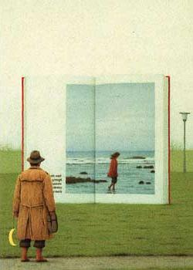
CS 194/294-26: Image Manipulation and Computational Photography
Instructor: Alexei Efros
GSIs: Shiry Ginosar
Shubham Tulsiani
UC Berkeley, Fall 2014
© Quint Buchholz

Slide 2
Today
Introductions
Why Computational Photography?
Overview of the course
Administrative stuff

Slide 3
A bit about me
Alexei (Alyosha) Efros
Moved to UC Berkeley in 2013, after decade at CMU
(also work with colleagues in Paris)
Teaching
The plan is to have fun and learn cool things, both you and me!
Social warning: I don’t see well
Research
Computer Vision, Computer Graphics, Machine Learning, Visual Perception

Slide 4
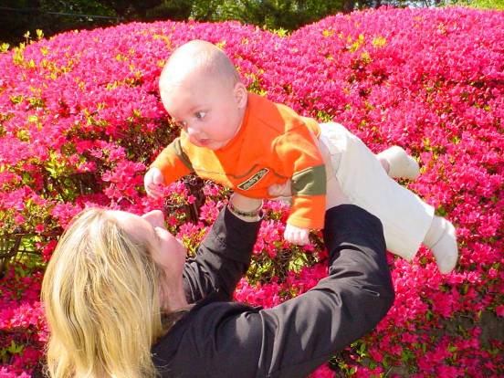
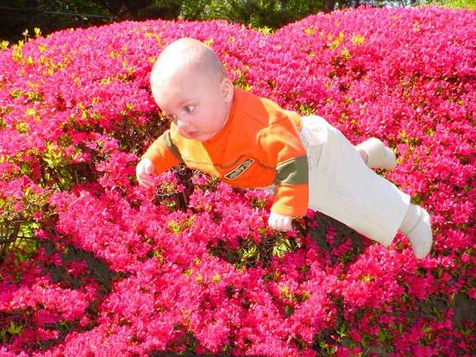
PhD 2003 on Texture and Action Synthesis
Inspired Photoshop’s “Context-aware Fill” and
Microsoft “Smart Erase” buttons:
© Antonio Criminisi

Slide 5
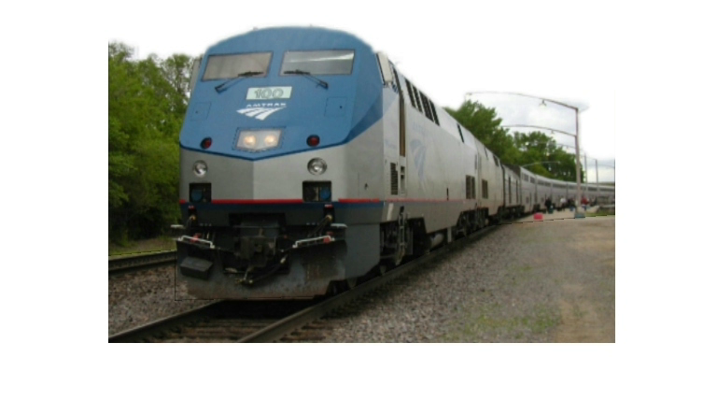
Other work
Automatic Photo Pop-Up (SIGGRAPH 2005)
Notes:
5
If we restrict our attention to just a single snapshot in space and time, how much information can we hope to extract?

Slide 6
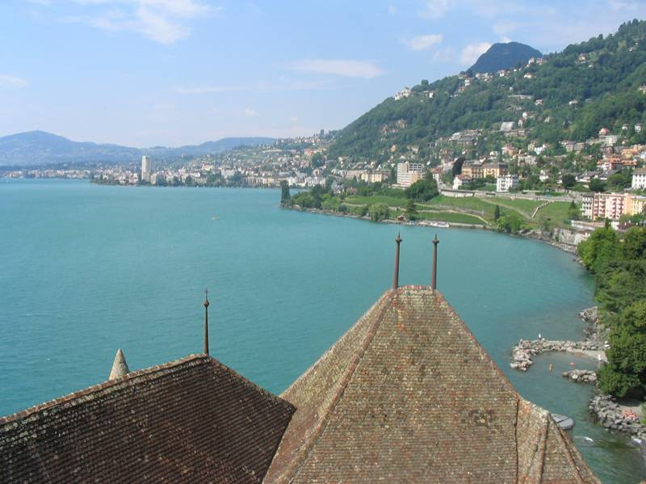

Slide 7
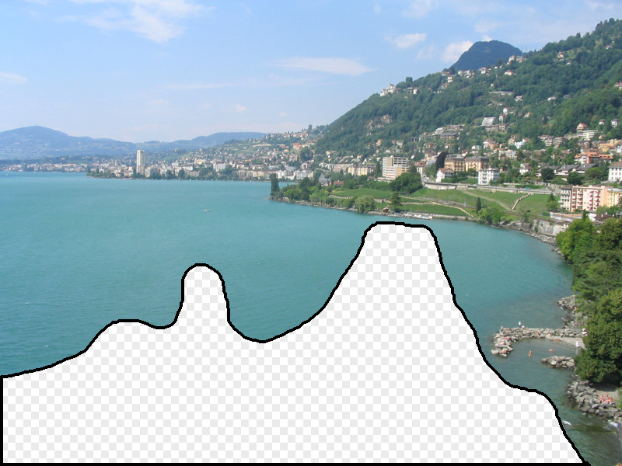

Slide 8
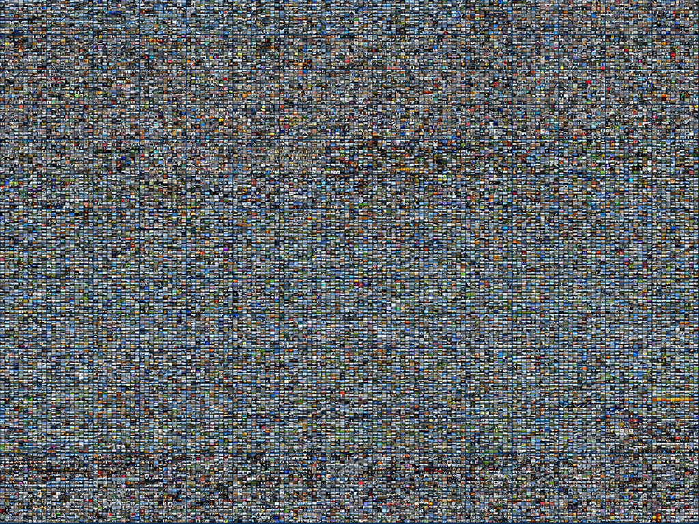

Slide 9
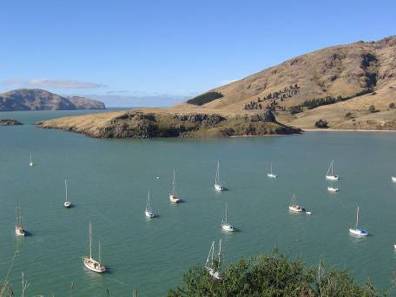

Slide 10
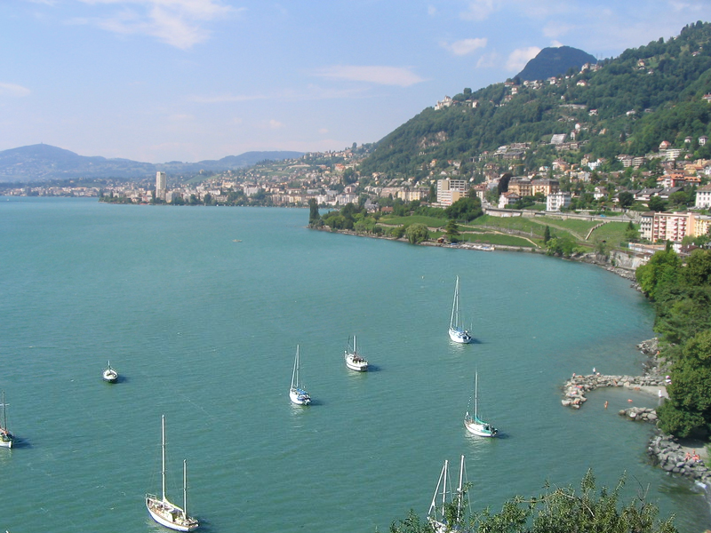

Slide 11
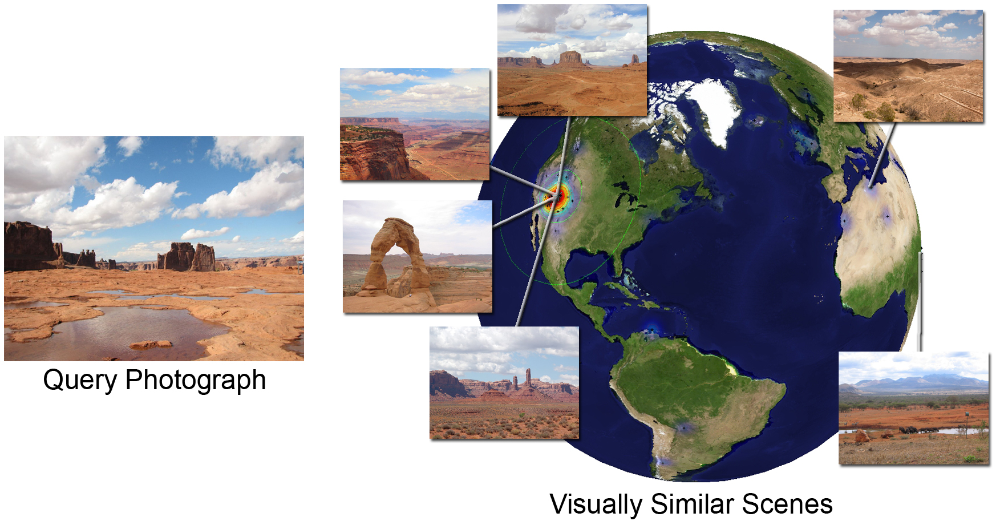
im2GPS
(using 6 million GPS-tagged Flickr images)
Im2gps [Hays & Efros, CVPR’08]

Slide 12
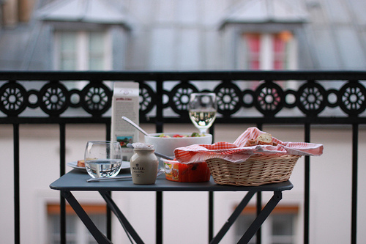
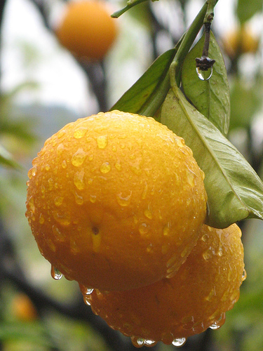
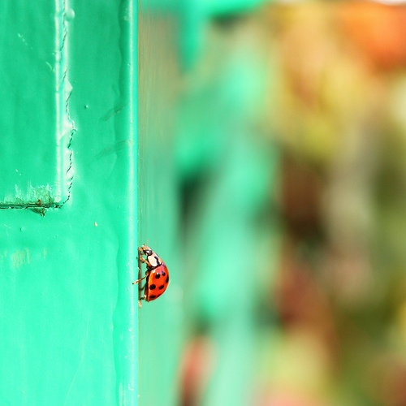
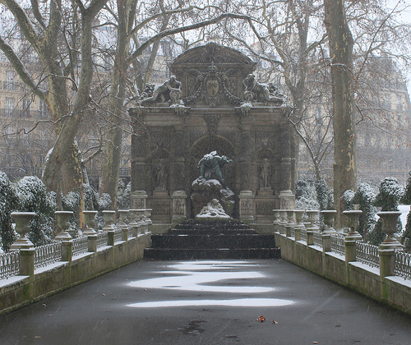
Amateur Photographer

Slide 13
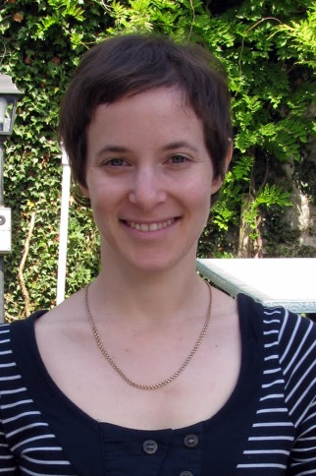
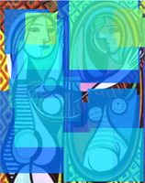
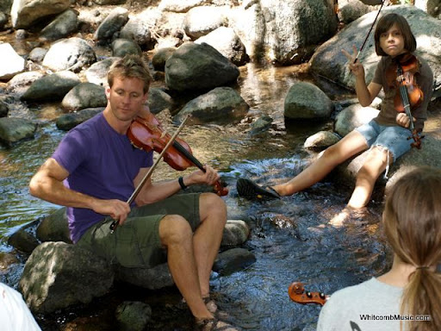
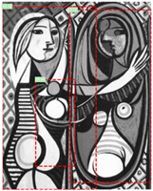
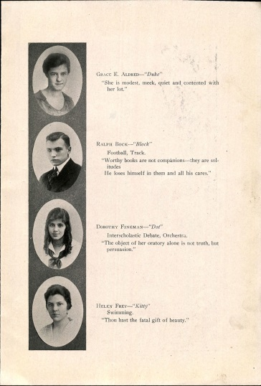
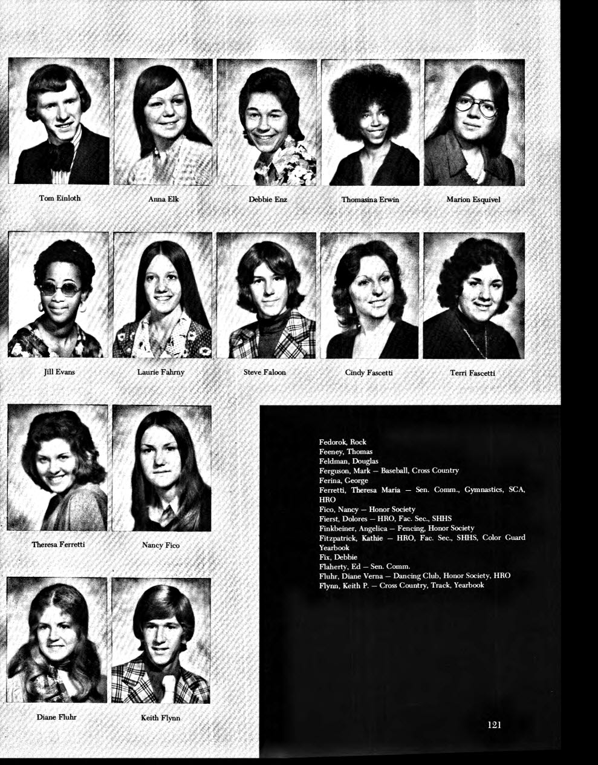
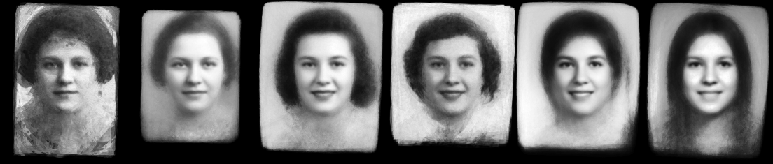
Where is Shiry?
GSI: Shiry Ginosar

Slide 14
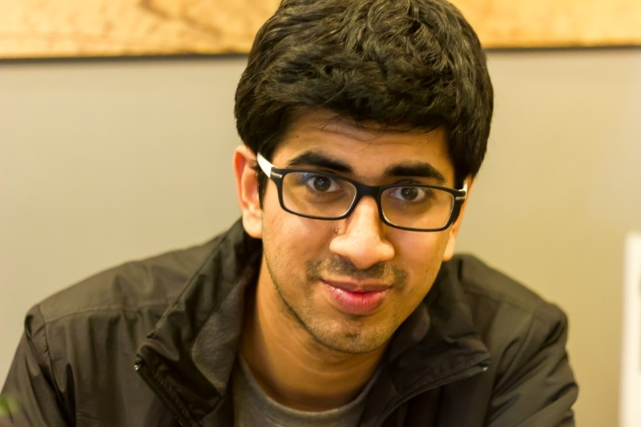
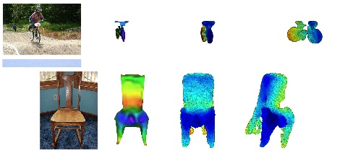
Where is Shubham?
Here ! [He’s terrible at playing fiddle so they kicked him out of the group ☹ ]
GSI: Shubham Tulsiani
(Random pictures for reconstructions of random objects. Any correlation with actual research is purely coincidental ! )

Slide 15
A Brief History of Visual Media
Why Computational Photography?

Slide 16
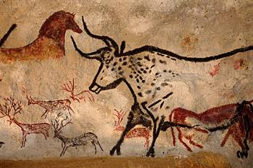
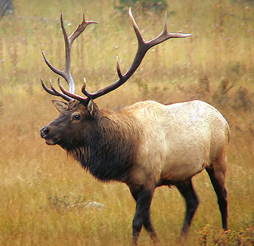
Depicting Our World: The Beginning
Prehistoric Painting, Lascaux Cave, France
~ 13,000 -- 15,000 B.C.

Slide 17
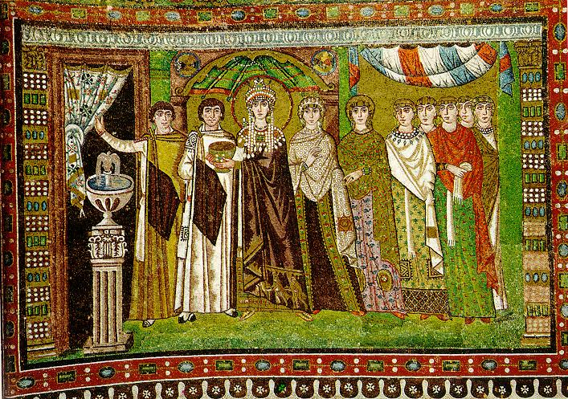
Depicting Our World: Middle Ages
The Empress Theodora with her court.
Ravenna, St. Vitale 6th c.

Slide 18
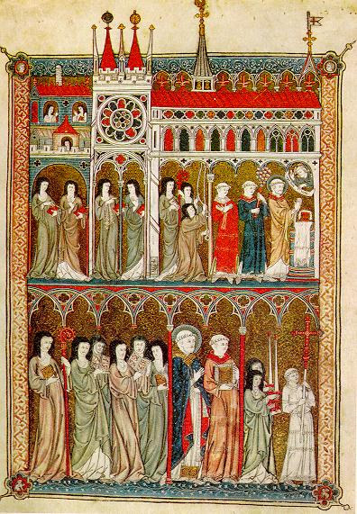
Depicting Our World: Middle Ages
Nuns in Procession. French ms. ca. 1300.

Slide 19
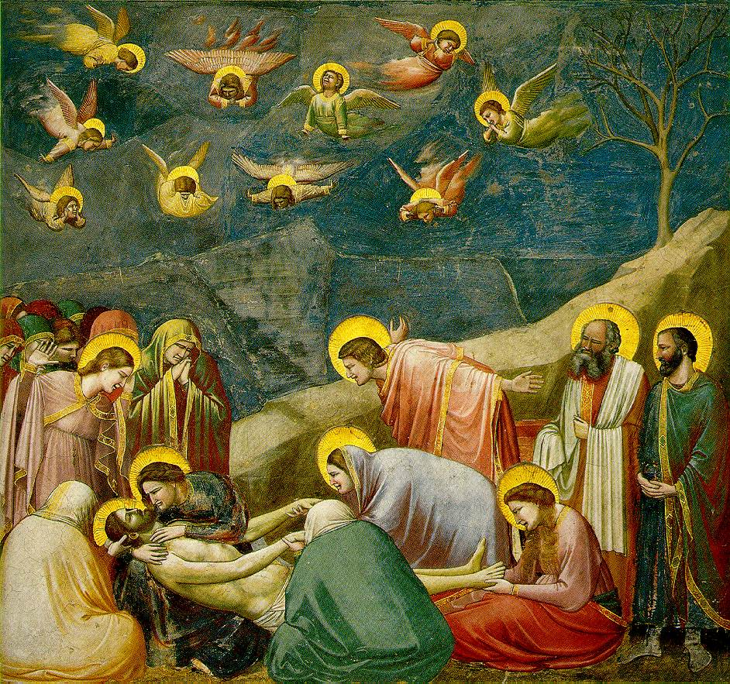
Beginnings of the Renaissance
  Giotto, The Mourning of Christ, c.1305

Slide 20
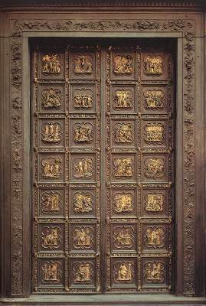
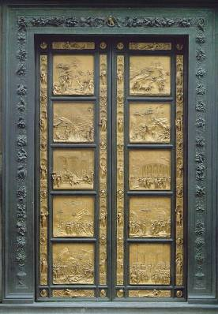
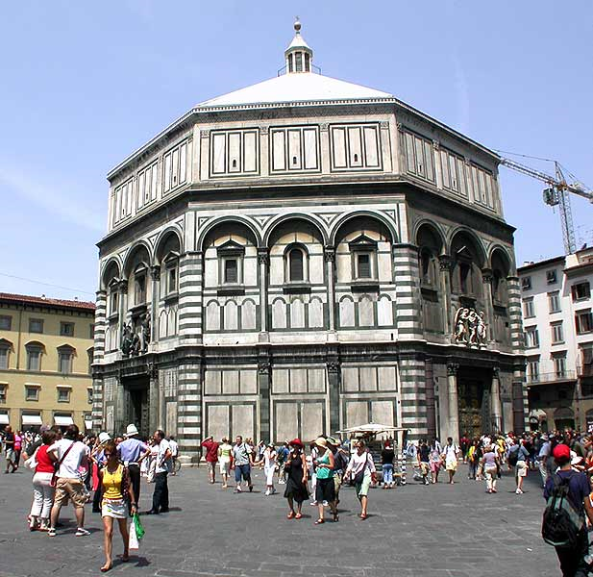
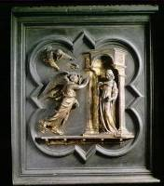
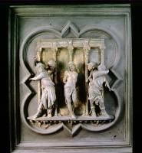
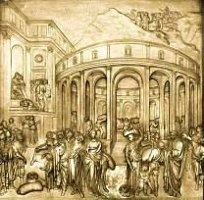
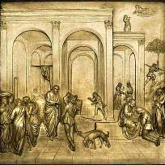
Depicting Our World: Renaissance
North Doors (1424)
East Doors (1452)
Lorenzo
Ghiberti
(1378-1455)

Slide 21
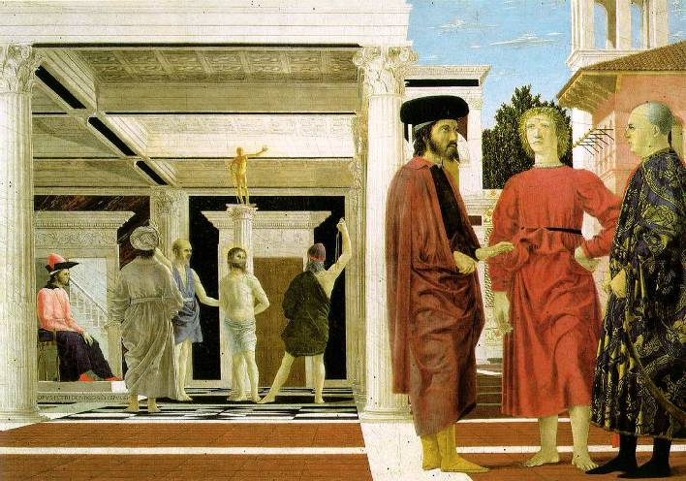
Depicting Our World: Renaissance
Piero della Francesca,
The Flagellation (c.1469)

Slide 22
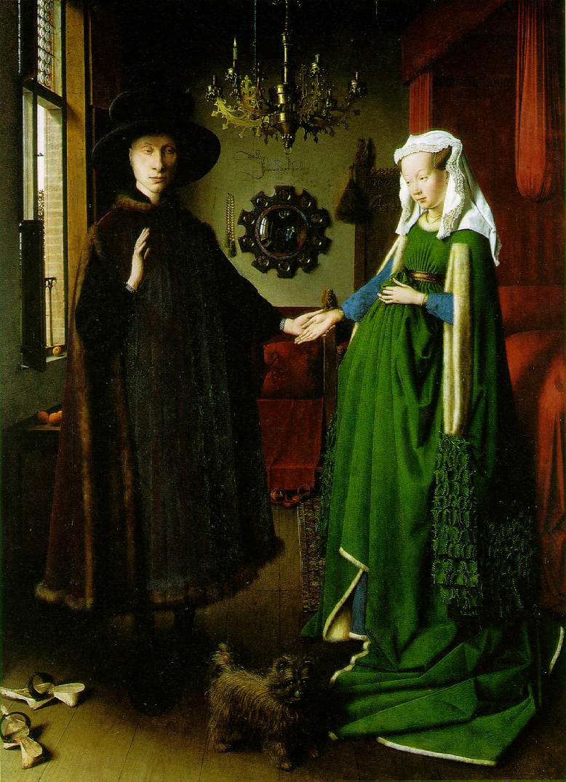
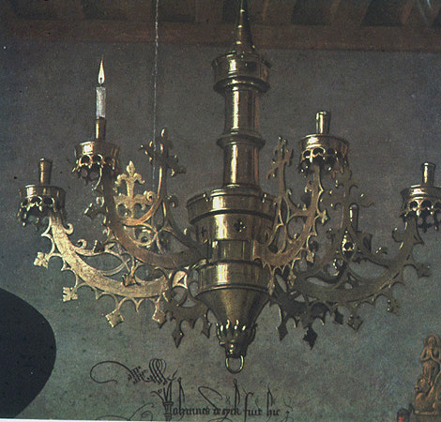
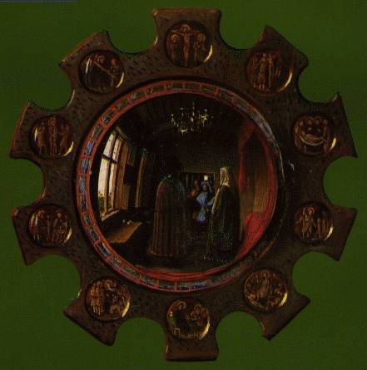
Depicting Our World: Toward Perfection
Jan van Eyck, The Arnolfini Marriage (c.1434)

Slide 23
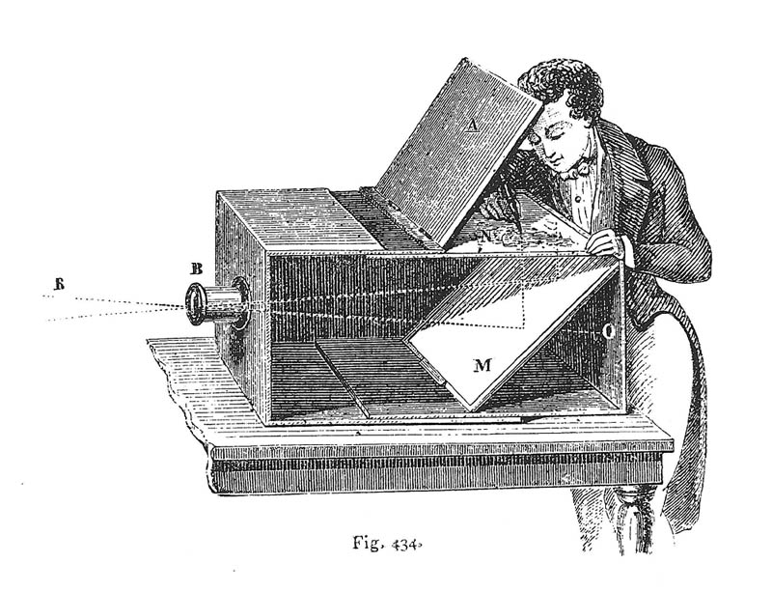
Depicting Our World: Toward Perfection
Lens Based Camera Obscura, 1568

Slide 24
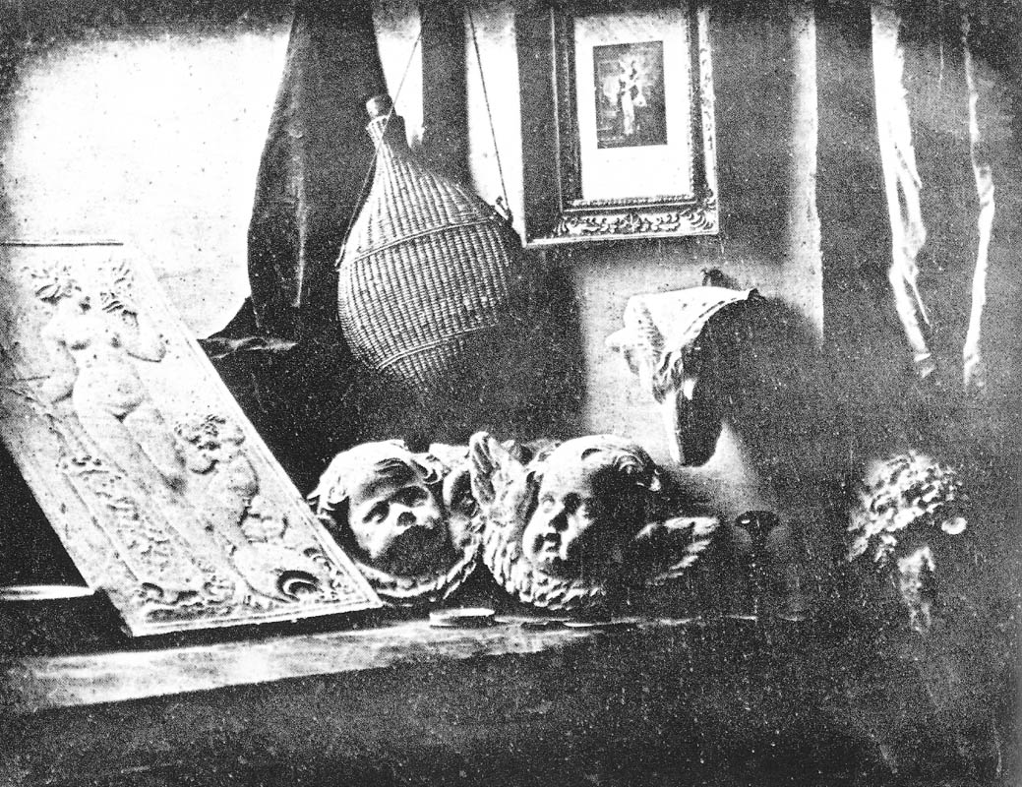
Depicting Our World: Perfection!
Still Life, Louis Jaques Mande Daguerre, 1837

Slide 25
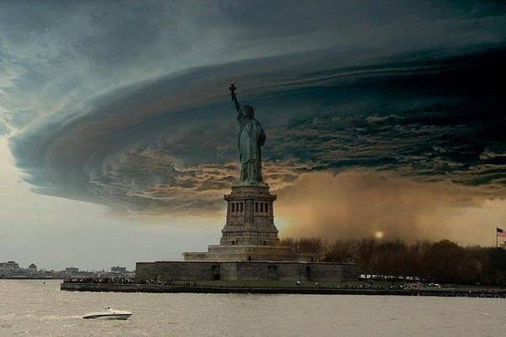
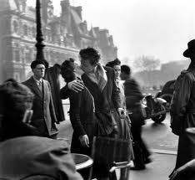
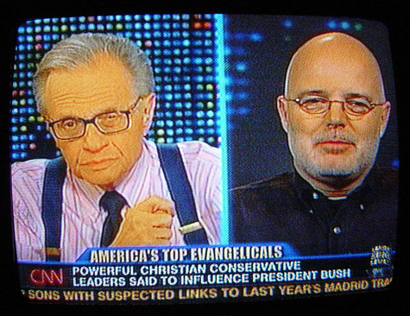
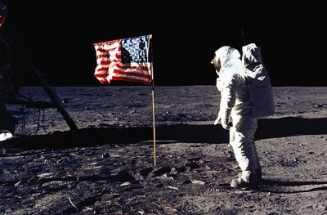
Depicting Our World: Realism?

Slide 26
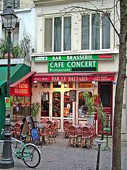
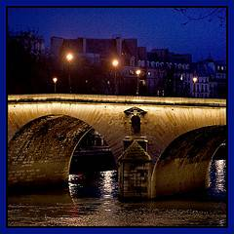
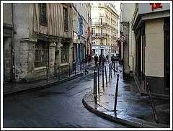
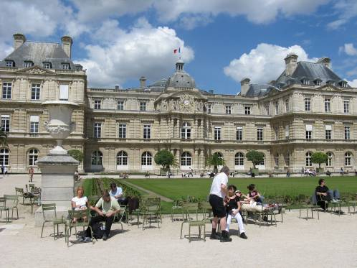
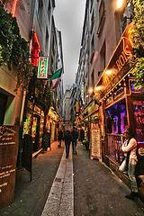


Paris, according to
Flickr

Slide 27








Paris, according to Google
StreetView
Knopp, Sivic, Pajdla, ECCV 2010

Slide 28












Paris, according to me

Slide 29

After realism…
Monet,
La rue Montorgueil

Slide 30


Depicting Our World: Ongoing Quest
Pablo Picasso
David Hockney

Slide 31

Better than realism?
David Hockney, Place Furstenberg, (1985)

Slide 32

Which one is right?
Multiple viewpoints
Single viewpoint
David Hockney,
Place Furstenberg, 1985
Alyosha Efros
Place Furstenberg, 2009

Slide 33

Depicting Our World: Ongoing Quest
Antonio Torralba & Aude Oliva (2002)

Slide 34

Enter Computer Graphics...

Slide 35



Traditional Computer Graphics
3D geometry
projection
Simulation
physics
GRAPHICS

Slide 36

Modern Computer Graphics
Amazingly real
But so sterile, lifeless, futuristic (why?)

Slide 37

The richness of our everyday world
Photo by Svetlana Lazebnik

Slide 38

Beauty in complexity
University Parks, Oxford

Slide 39

Which parts are hard to model?
Photo by Svetlana Lazebnik

Slide 40


People
On the Tube, London
From “Final Fantasy”

Slide 41


Faces / Hair
From “Final Fantasy”
Photo by Joaquin Rosales Gomez

Slide 42


Hyper-humans

Slide 43

Creating Realistic Imagery
Computational
Photography
Computer Graphics
Photography
Realism
Manipulation
Ease of capture
+ great creative possibilities
+ easy to manipulate objects/viewpoint
Tremendous expertise and effort to obtain realism
+ instantly realistic
+ easy to aquire
- very hard to manipulate objects/viewpoint

Slide 44



Computational Photography
How can I use computational techniques to capture light in new ways?
How can I use computational techniques to breathe new life into the photograph?
How can I use computational techniques to visualize, organize, and navigate the captured visual world?

Slide 45
Relationship to Vision and Graphics
Computer Graphics: Models to Images
Computer Vision: Images to Models
Comp. Photography: Images to Images
3D Model
2D image

Slide 46
Virtual Real World
Campanile Movie
http://www.debevec.org/Campanile/

Slide 47

Course objectives
You will have new abilities for visual creation.
Graphic by James Hays
Notes:
Visual creation is no longer just pure graphics or pure photography. There is a growing need to blend the two. We want to edit photos, work with photo collections, create cool special effects, etc. After this course, you should have the background and experience that you need to do these things.

Slide 48






Course objectives
2. You will get a foundation in computer vision.
Safety
Health
Security
Comfort
Fun
Access
Notes:
Foundation for computer vision. We want machines to watch for us, do our work, and make us live longer, more healthy, and more entertaining lives. This course will give you a good hands-on background for learning more or developing new computer vision applications.

Slide 49

Course objectives
3. You’ll better appreciate your own visual ability.
Is that a queen or a bishop?
Notes:
You'll gain an appreciation for your own visual ability. We tend to take it for granted, but half of our brain is cranking away on the vision problem. Interestingly, we are usually aware only of the interpretation, not what we actually see. By working with pixels, you'll see how messy images actually are and how incredible it is that we can interpret anything from them.

Slide 50

Seeing less than you think…

Slide 51


Seeing less than you think…

Slide 52

Video by Antonio Torralba (starring Rob Fergus)

Slide 53

But actually…
Video by Antonio Torralba (starring Rob Fergus)

Slide 54
Course objectives
4. You’ll have fun doing cool stuff!
Notes:
Do cool stuff. You'll get the opportunity to implement a variety of fun projects that work with your own photos. You can be creative. You can also go beyond the minimum and do some "bells and whistles" or additional projects that I offer. You'll get to do a final project on whatever you want. You'll also be able to see the work that everyone else does.

Slide 55



Programming Project #1
Prokudin-Gorskii’s Color Photography (1907)

Slide 56

Programming Project #1

Slide 57


Programming Project #1
How to compare R,G,B channels?
No right answer
  Sum of Squared Differences (SSD):
  Normalized Correlation (NCC):

Slide 58


Project 2: Building a Camera Obscura

Slide 59

Project 3: Hybrid Images

Slide 60

Project 4: Gradient Domain Editing

Slide 61

Project 5: Face morphing and caricatures

Slide 62


Project 6: Automatic Mosaic Stitching
Photo Mosaics
Full screen panoramas (cubic): http://www.panoramas.dk/
Mars: http://www.panoramas.dk/fullscreen3/f2_mars97.html
2003 New Years Eve: http://www.panoramas.dk/fullscreen3/f1.html

Slide 63



Image warping with homographies
image plane in front
image plane below
black area
where no pixel
maps to

Slide 64


Project 6’
Tour Into the Picture

Slide 65




Paper Pop-up
Step 1: define planes
Step 2: rectify each plane
Step 3: compute 3D box coords

Slide 66
Project 7: post-capture focus

Slide 67


Slide 68


Slide 69


Slide 70


Slide 71


Slide 72
Results

Slide 73


Slide 74


Slide 75
Final Project
Something cool!!!
We will have some pre-canned projects
Will also have some suggestions, cool datasets, etc
Or you can do whatever you want!
(can be done in groups up to 3)

Slide 76

Sample Project

Slide 77
Project details
Implement stuff from scratch and apply it to your own photos
Every person does their own project (except final projects and camera obscura)
Reporting via web page (plus submit code)
Afterwards, vote for class favorite(s)!
Software
  Matlab!
  (you can use other languages, but expect no help from GSIs).

Slide 78

Textbook
http://szeliski.org/Book/

Slide 79
General Comments
Prerequisites
  Linear algebra!!!
  Good programming skills (at least 61B?)
  Some computer graphics, vision, or image processing is useful, but not required.
Emphasis on programming projects!
  Building something from scratch
Graduate Version:
  Need to do more on each project, plus a final paper
Misc:
  No laptops, no cell phones, smartphones, etc.

Slide 80
Getting help outside of class
Course Web Page
  http://inst.eecs.berkeley.edu/~cs194-26/fa14/
Discussion board:
piazza.com
Office hours
TBA… see webpage and piazza
Matlab
Tentitively: 6-7pm Tuesday, Sept 2

Slide 81
Administrative Stuff
Grading
  Programming Project (60%)
  Exam (20%)
  Final Project (20%)
  Class Participation: priceless
Late Policy
  Five late days total, to be spent wisely
  20% off from each extra late day
Cheating
  Let’s not embarrass ourselves

Slide 82
Academic Integrity
Can discuss projects, but don’t share code
Don’t look up code (even to get hints) or copy from a friend
If you’re not sure if it’s allowed, ask
Acknowledge any inspirations
If you get stuck, come talk to us

Slide 83
Why you should NOT take this class
Project-based class
  No canned problem sets
  Not theory-heavy (but will read a few research papers)
  No clean rubrics
  Open-ended by design
Need time to think, not just hack
  Creativity is a class requirement
Lots of work…There are easier classes if
  you just need some units
  you care more about the grade than about learning stuff
Not worth it if you don’t enjoy it

Slide 84
Now… reasons TO take this class
It’s your reward after 3 grueling years ☺
You get to create pictures, unleash your creative potential
Interested in grad school? ☺

Slide 85
Questions?

