Slide 1
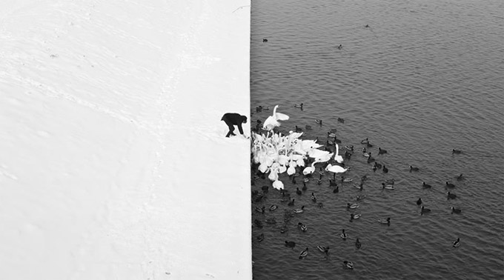
Other Filters, etc.
Winter in Kraków photographed by Marcin Ryczek
Alexei Efros, Fall 2014

Slide 2
Taking derivative by convolution

Slide 3
Partial derivatives with convolution
For 2D function f(x,y), the partial derivative is:
For discrete data, we can approximate using finite differences:
To implement above as convolution, what would be the associated filter?
Source: K. Grauman

Slide 4
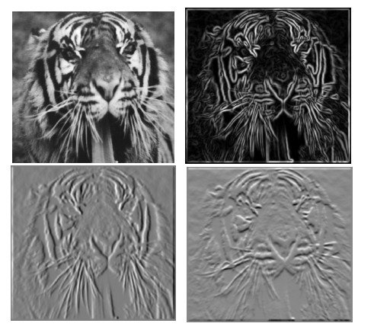
Partial derivatives of an image
-1 1
1 -1
-1 1
or
Which shows changes with respect to x?

Slide 5
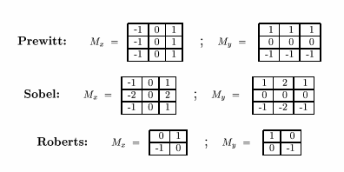
Finite difference filters
Other approximations of derivative filters exist:
Source: K. Grauman

Slide 6






Image gradient
The gradient of an image:
The gradient points in the direction of most rapid increase in intensity
How does this direction relate to the direction of the edge?
The gradient direction is given by
The edge strength is given by the gradient magnitude
Source: Steve Seitz
Notes:
give definition of partial derivative: lim h->0 [f(x+h,y) – f(x,y)]/h

Slide 7
Image Gradient

Slide 8




Effects of noise
Consider a single row or column of the image
  Plotting intensity as a function of position gives a signal
Where is the edge?
Source: S. Seitz
Notes:
How to fix?

Slide 9
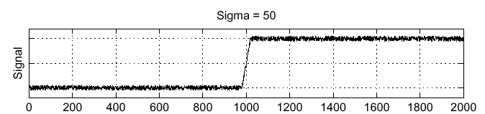
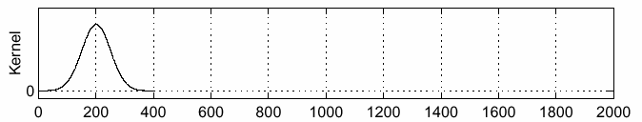
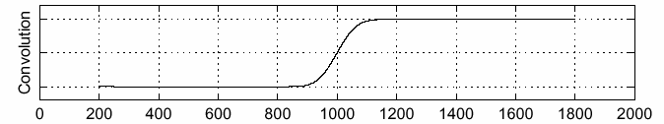
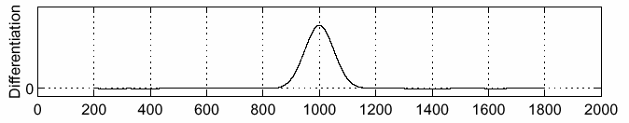
Solution: smooth first
f
g
f * g
To find edges, look for peaks in
Source: S. Seitz

Slide 10
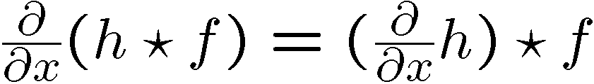
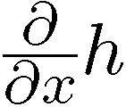
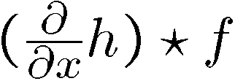

Derivative theorem of convolution
This saves us one operation:

Slide 11


Derivative of Gaussian filter
* [1 -1] =

Slide 12


Derivative of Gaussian filter
x-direction
y-direction
Which one finds horizontal/vertical edges?

Slide 13

Example
input image (“Lena”)

Slide 14
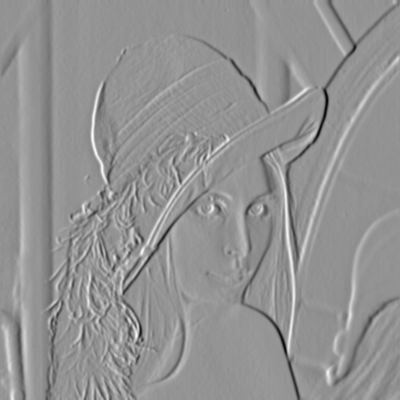
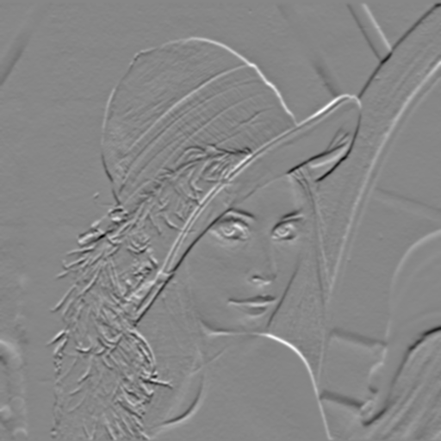
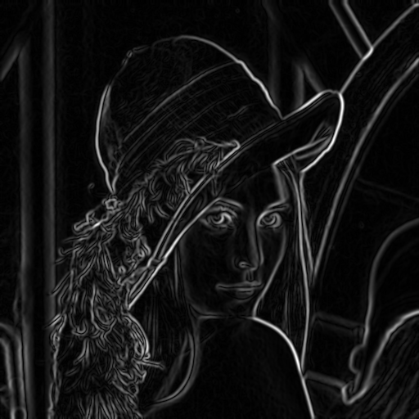
Compute Gradients (DoG)
X-Derivative of Gaussian
Y-Derivative of Gaussian
Gradient Magnitude

Slide 15
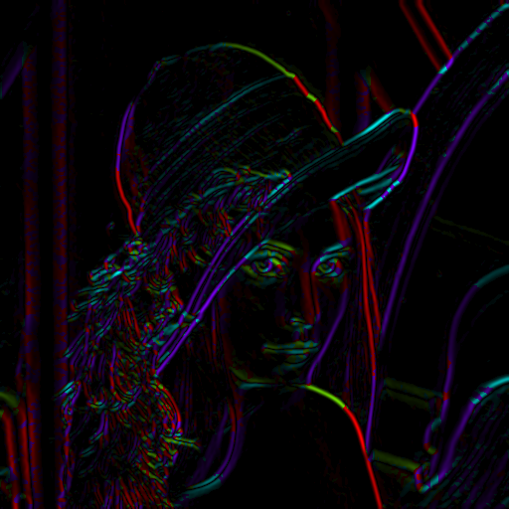
Get Orientation at Each Pixel
Threshold at minimum level
Get orientation
theta = atan2(-gy, gx)
Notes:
-gy because y=2 is below y=1, and we typically want 90 degrees to point up

Slide 16
MATLAB demo
im = im2double(imread(filemane));
g = fspecial('gaussian',15,2);
imagesc(g);
surfl(g);
gim = conv2(im,g,'same');
imagesc(conv2(im,[-1 1],'same'));
imagesc(conv2(gim,[-1 1],'same'));
dx = conv2(g,[-1 1],'same');
Surfl(dx);
imagesc(conv2(im,dx,'same'));

Slide 17
Review: Smoothing vs. derivative filters
Smoothing filters
  Gaussian: remove “high-frequency” components;
  “low-pass” filter
  Can the values of a smoothing filter be negative?
  What should the values sum to?
    One: constant regions are not affected by the filter
Derivative filters
  Derivatives of Gaussian
  Can the values of a derivative filter be negative?
  What should the values sum to?
    Zero: no response in constant regions
  High absolute value at points of high contrast

Slide 18
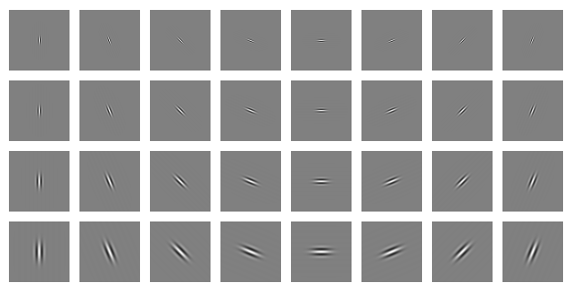
Clues from Human Perception
Early processing in humans filters for various orientations and scales of frequency
Perceptual cues in the mid frequencies dominate perception
When we see an image from far away, we are effectively subsampling it
Early Visual Processing: Multi-scale edge and blob filters

Slide 19

Frequency Domain and Perception
Campbell-Robson contrast sensitivity curve
Notes:
19

Slide 20
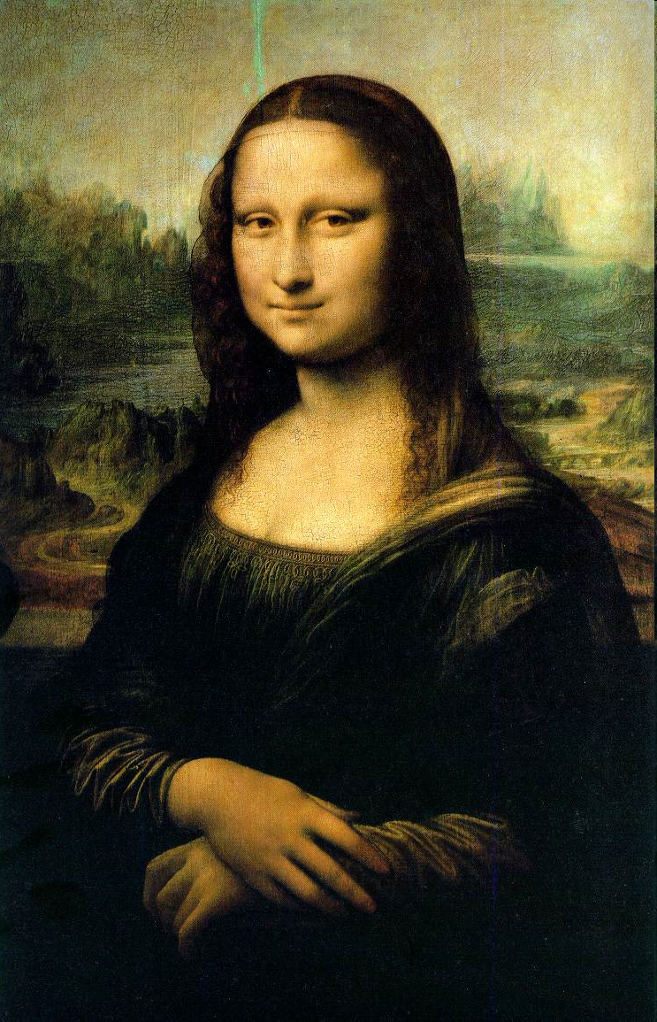
Da Vinci and Peripheral Vision

Slide 21
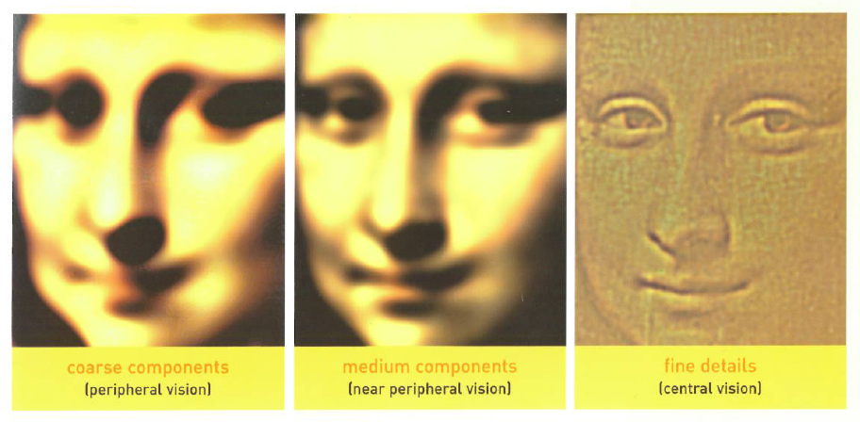
Leonardo playing with peripheral vision

Slide 22
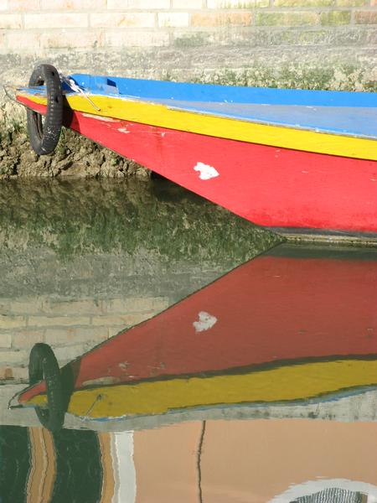
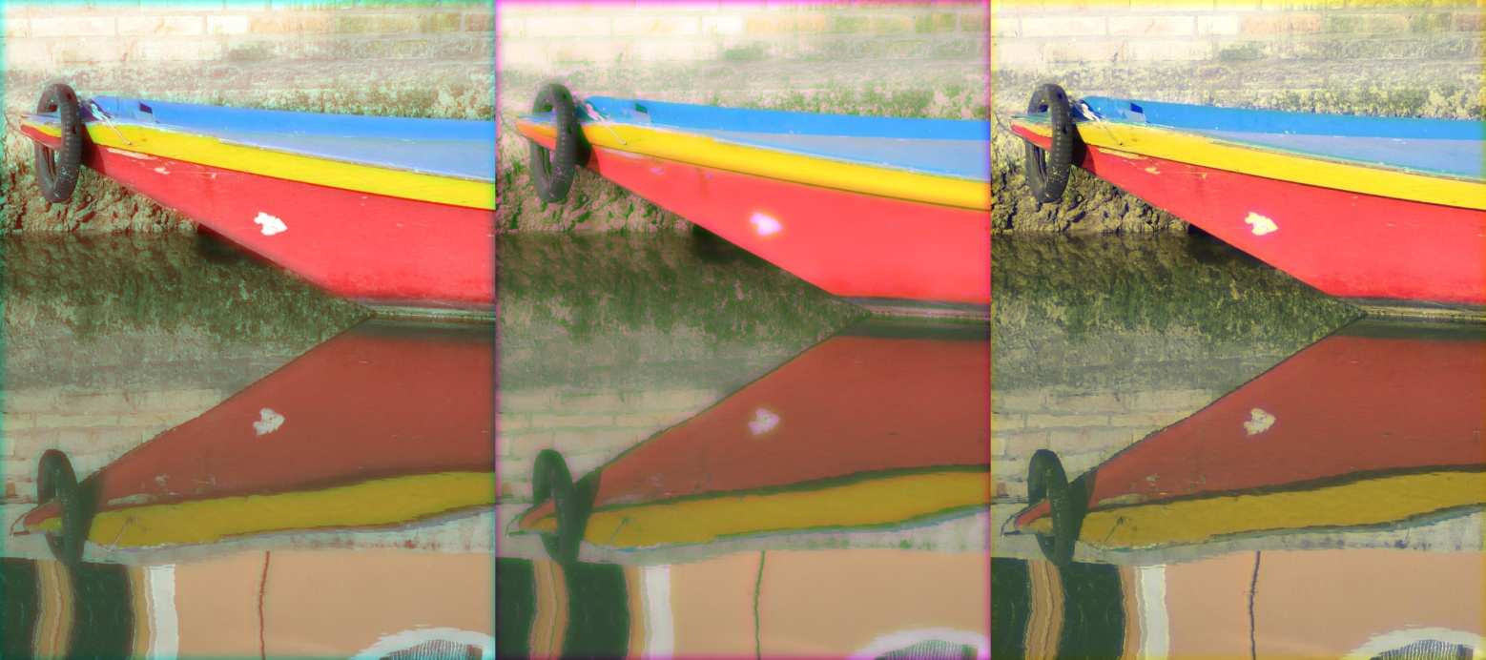
Freq. Perception Depends on Color
R
G
B

Slide 23
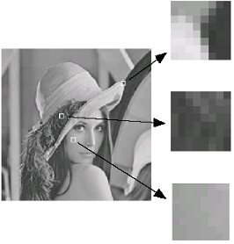
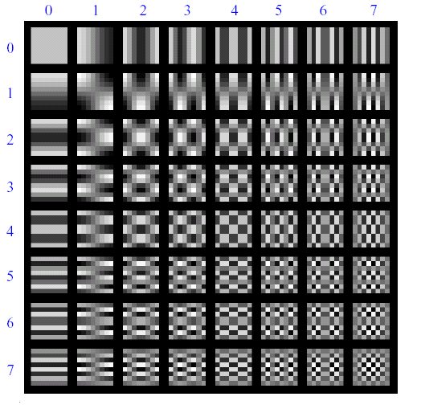
Lossy Image Compression (JPEG)
Block-based Discrete Cosine Transform (DCT)

Slide 24
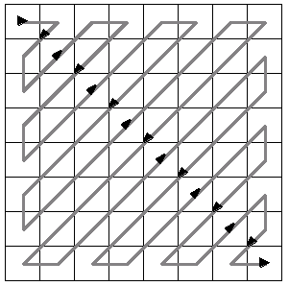
Using DCT in JPEG
The first coefficient B(0,0) is the DC component, the average intensity
The top-left coeffs represent low frequencies, the bottom right – high frequencies

Slide 25
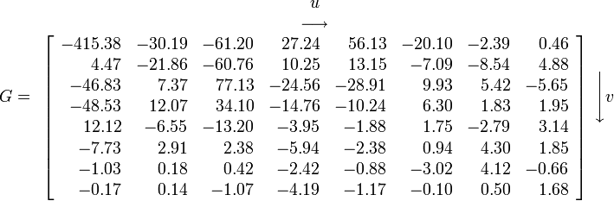
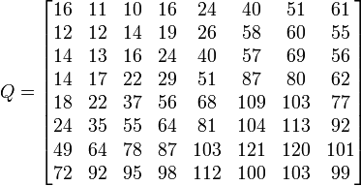
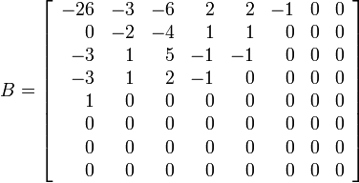
Image compression using DCT
Quantize
  More coarsely for high frequencies (which also tend to have smaller values)
  Many quantized high frequency values will be zero
Encode
  Can decode with inverse dct
Filter responses
Quantization table
Quantized values

Slide 26
JPEG Compression Summary
Subsample color by factor of 2
  People have bad resolution for color
Split into blocks (8x8, typically), subtract 128
For each block
  Compute DCT coefficients for
  Coarsely quantize
    Many high frequency components will become zero
  Encode (e.g., with Huffman coding)
http://en.wikipedia.org/wiki/YCbCr
http://en.wikipedia.org/wiki/JPEG

Slide 27
Block size in JPEG
Block size
  small block
    faster
    correlation exists between neighboring pixels
  large block
    better compression in smooth regions
  It’s 8x8 in standard JPEG

Slide 28
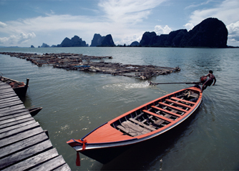

JPEG compression comparison
89k
12k

Slide 29

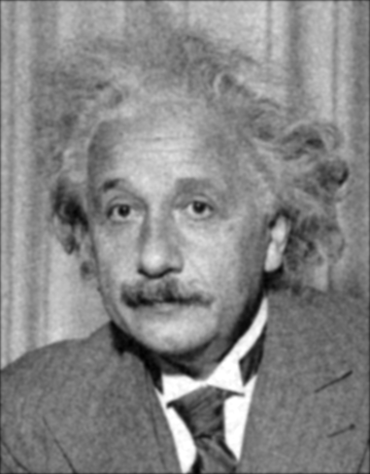
Denoising
Gaussian Filter
Additive Gaussian Noise

Slide 30
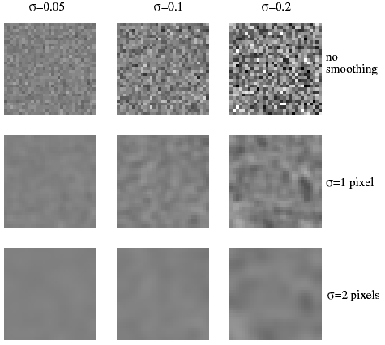
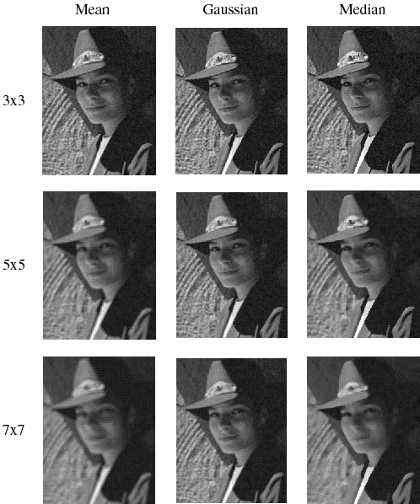
Reducing Gaussian noise
Smoothing with larger standard deviations suppresses noise, but also blurs the image
Source: S. Lazebnik
Notes:
30

Slide 31
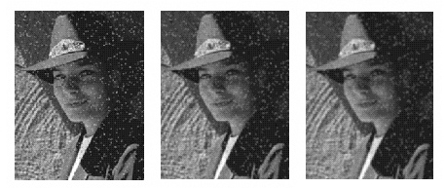
Reducing salt-and-pepper noise by Gaussian smoothing
3x3
5x5
7x7
Notes:
31
What’s wrong with these results?

Slide 32
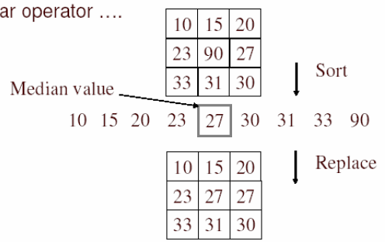
Alternative idea: Median filtering
A median filter operates over a window by selecting the median intensity in the window
Is median filtering linear?
Source: K. Grauman
Notes:
32
Better at salt’n’pepper noise
Not convolution: try a region with 1’s and a 2, and then 1’s and a 3

Slide 33
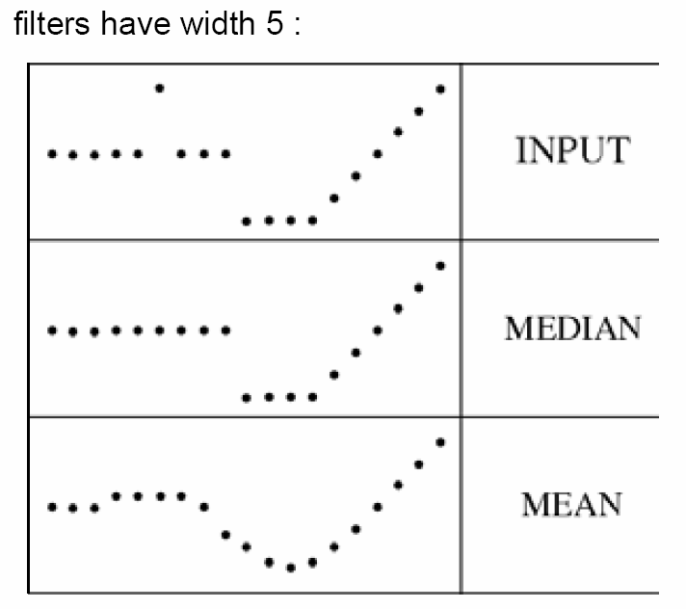
Median filter
What advantage does median filtering have over Gaussian filtering?
  Robustness to outliers
Source: K. Grauman
Notes:
33

Slide 34
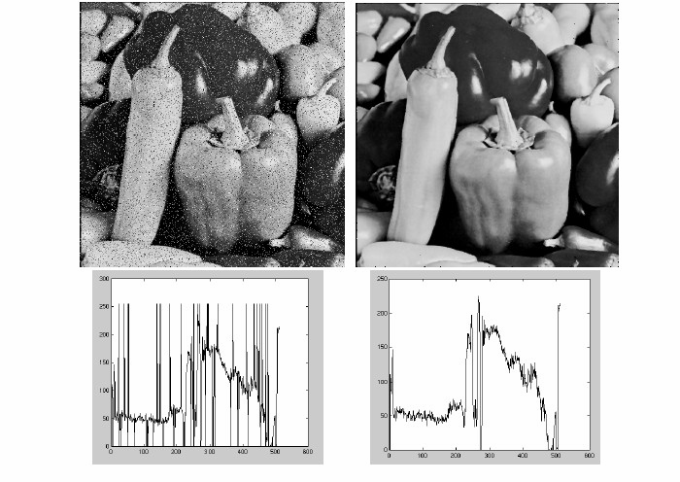
Median filter
Salt-and-pepper noise
Median filtered
MATLAB: medfilt2(image, [h w])
Source: M. Hebert
Notes:
34

Slide 35
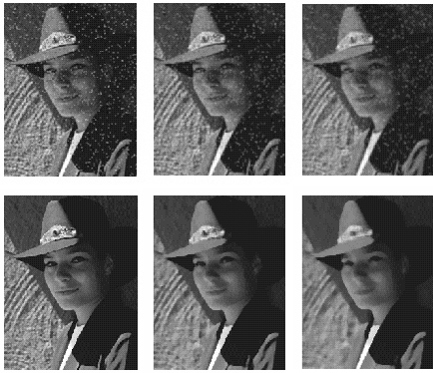
Median vs. Gaussian filtering
3x3
5x5
7x7
Gaussian
Median
Notes:
35

Slide 36
A Gentle Introduction to Bilateral Filtering and its Applications
“Fixing the Gaussian Blur”:
the Bilateral Filter
Sylvain Paris – MIT CSAIL

Slide 37


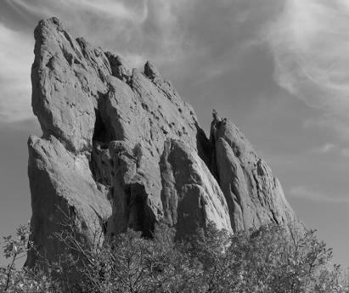
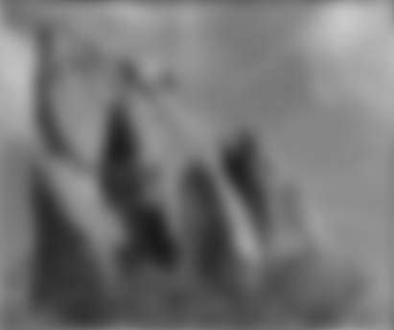


Blur Comes from
Averaging across Edges
*
input
output
*
*
Same Gaussian kernel everywhere.

Slide 38

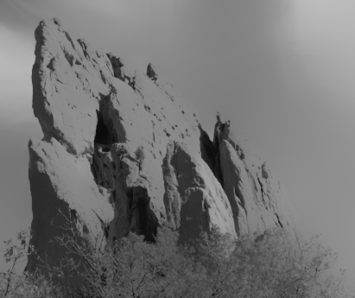


Bilateral Filter
No Averaging across Edges
[Aurich 95, Smith 97, Tomasi 98]
*
input
output
*
*
The kernel shape depends on the image content.

Slide 39
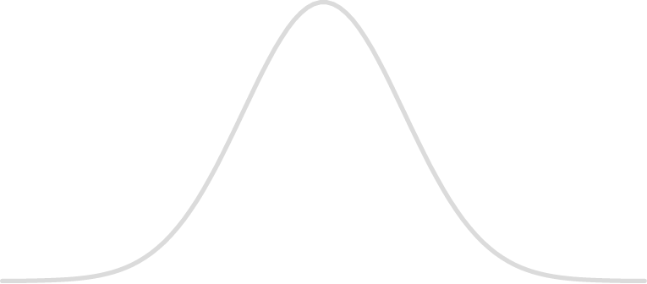
Bilateral Filter Definition: an Additional Edge Term
Same idea: weighted average of pixels.
new
not new
new
normalization
factor
space weight
range weight
I

Slide 40
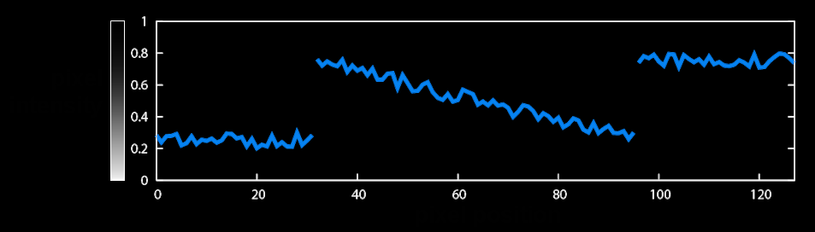
Illustration a 1D Image
1D image = line of pixels
Better visualized as a plot
pixel
intensity
pixel position

Slide 41
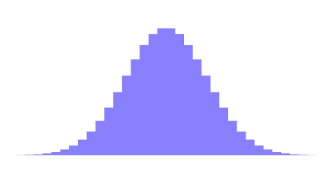

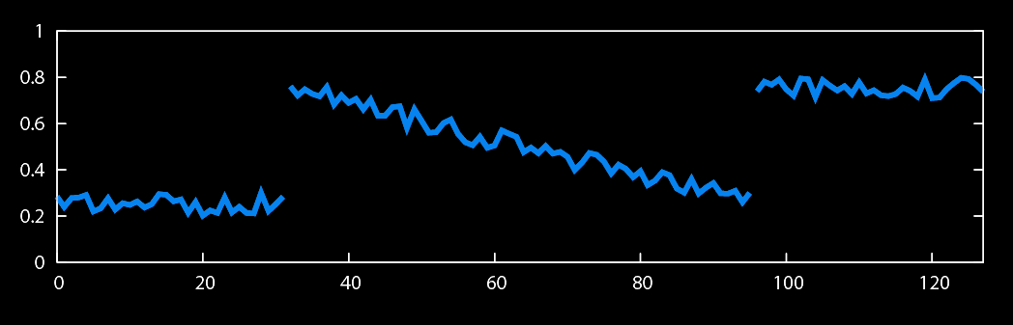
Gaussian Blur and Bilateral Filter
Gaussian blur
p
q
space
space
Bilateral filter
[Aurich 95, Smith 97, Tomasi 98]
p
range
q
space
range
normalization
space

Slide 42
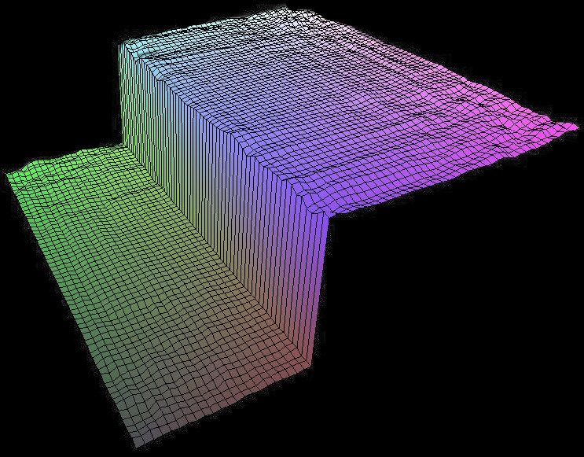
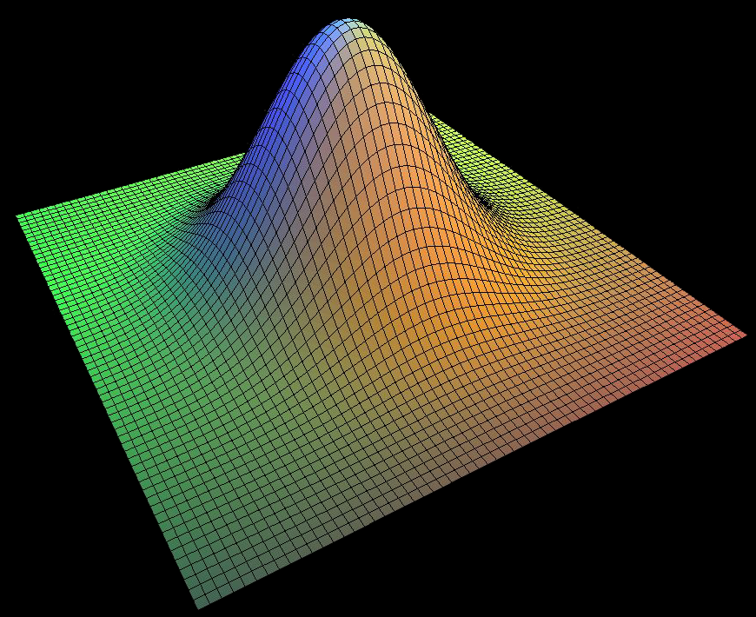
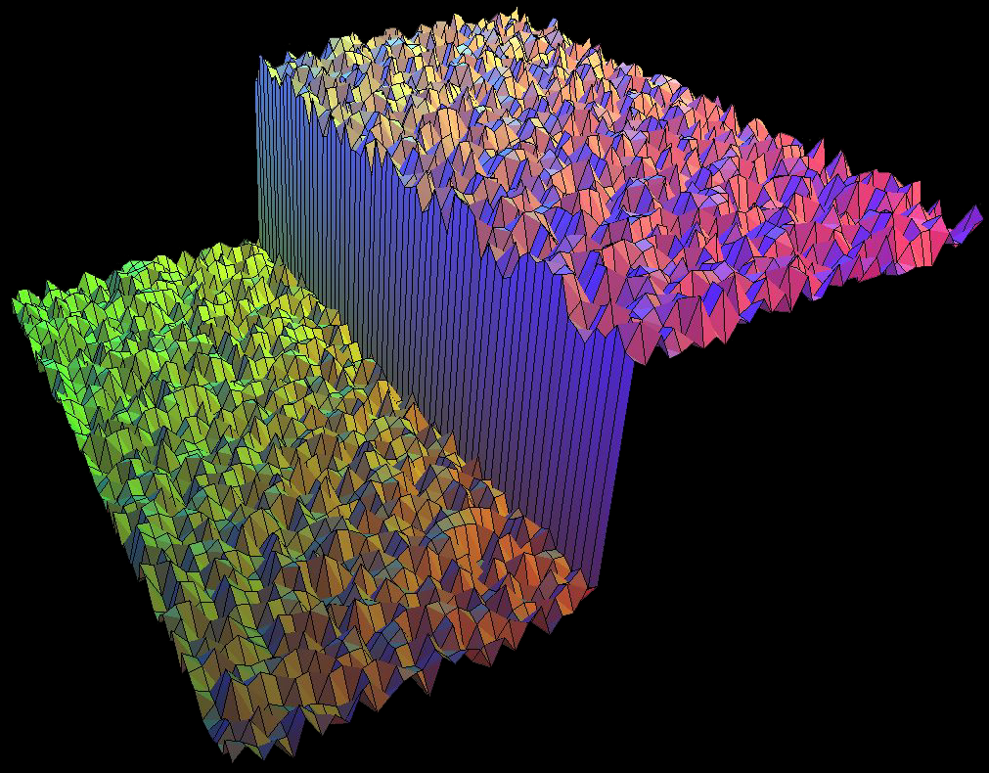
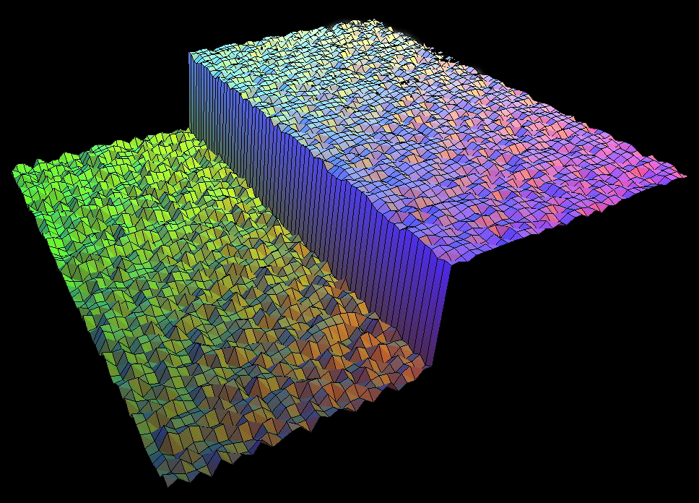
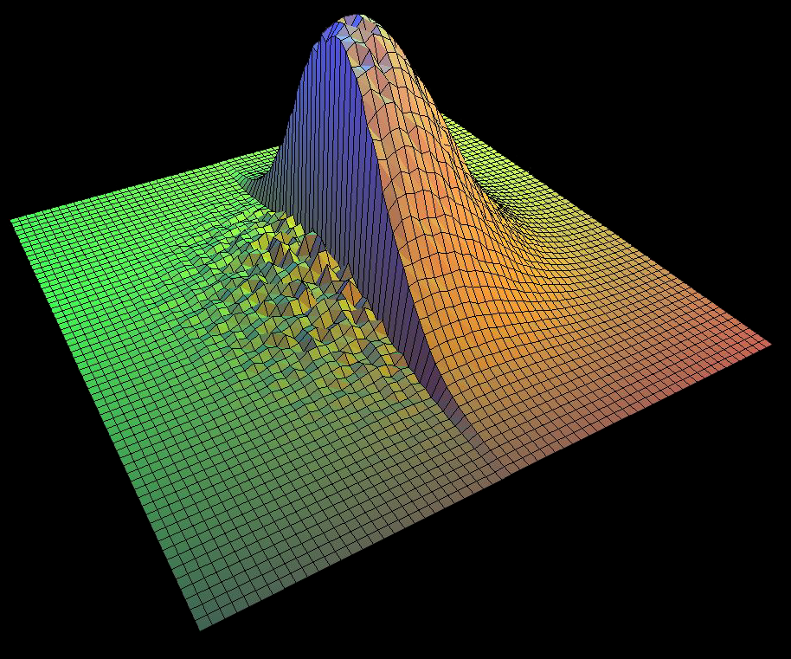
Bilateral Filter on a Height Field
output
input
reproduced
from [Durand 02]

Slide 43
Space and Range Parameters
space σ_{s} : spatial extent of the kernel, size of the considered neighborhood.
range σ_{r} : “minimum” amplitude of an edge

Slide 44
Influence of Pixels
Only pixels close in space and in range are considered.
space
range
p

Slide 45

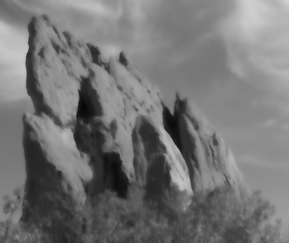


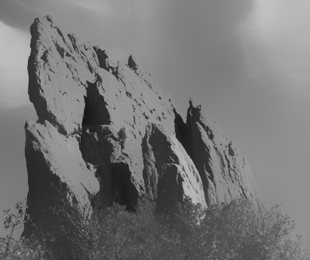
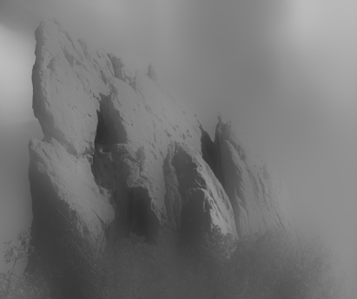



Exploring the Parameter Space
σ_{r} = ∞
(Gaussian blur)
σ_{r} = 0.1
σ_{r} = 0.25
input
σ_{s} = 2
σ_{s} = 6
σ_{s} = 18

Slide 46
Varying the Range Parameter
σ_{r} = ∞
(Gaussian blur)
σ_{r} = 0.1
σ_{r} = 0.25
input
σ_{s} = 2
σ_{s} = 6
σ_{s} = 18

Slide 47
input

Slide 48
σ_{r} = 0.1

Slide 49
σ_{r} = 0.25

Slide 50
σ_{r} = ∞
(Gaussian blur)

Slide 51
Varying the Space Parameter
σ_{r} = ∞
(Gaussian blur)
σ_{r} = 0.1
σ_{r} = 0.25
input
σ_{s} = 2
σ_{s} = 6
σ_{s} = 18

Slide 52
input

Slide 53
σ_{s} = 2

Slide 54
σ_{s} = 6

Slide 55
σ_{s} = 18

