Slide 1
Yet another possible outline
Big data for graphics
Hays & Efros
Deep nets to the rescue
CNNs as image processing pyramids
Learning with CNNs
Doing graphics with CNNs
Texture synthesis / inpainting: PixelCNN
Colorization
Parametric texture, content, and style
GANs
Inpainting: Deepak

Slide 2
Data-driven methods: Deep Learning for Graphics I
CS194, Fall 2016
Phillip Isola

Slide 3
Deep Learning for Graphics I
With slides from Alexei Efros, James Hays, and Andrea Vedaldi
CS194: Image Manipulation & Computational Photography
Alexei Efros, UC Berkeley, Fall 2015

Slide 4
Today:
Phillip Isola: Big data, Deep learning, Predicting pixels
Next time:
Andrew Owens: More applications of deep learning to graphics

Slide 5
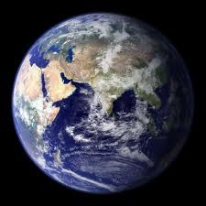
6 billion images
1 billion images served daily
140 billion images
6 billion added monthly
72 hours uploaded every minute
3.5 trillion photographs
90% of net traffic will be visual!
Notes:
The story of deep learning starts with the story of data. And the data these days is really big.

Slide 6
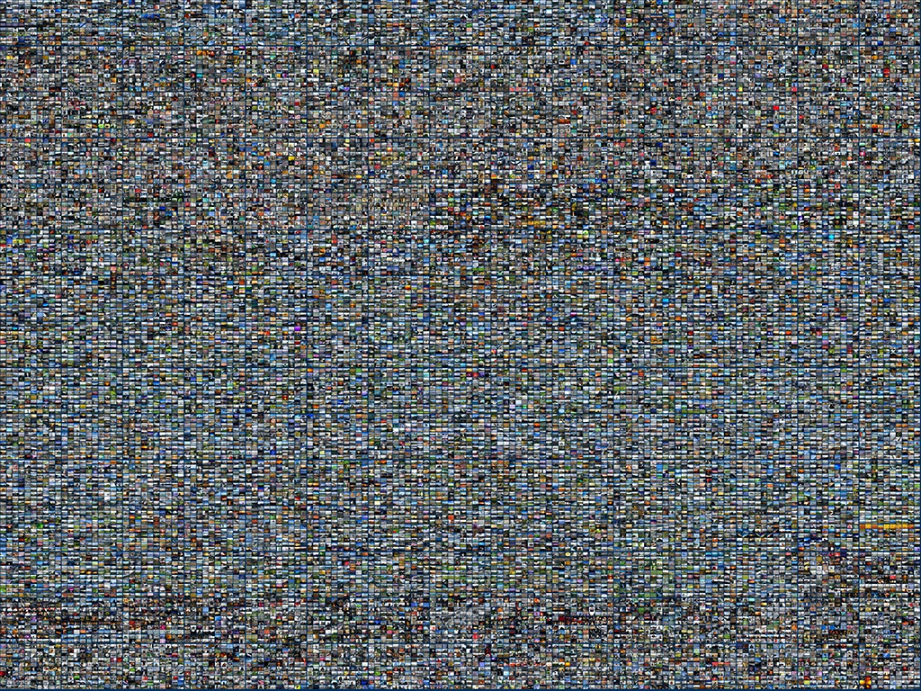
Too Big for Humans
Digital Dark Matter
[Perona 2010]
Notes:
In fact, much of the visual data on the Internet has never been seen by a Human Being.
In the words of “Pietro Perona”, visual data is the digital dark matter of the Internet.
So how can we see what’s in the data?

Slide 7
Big Issue
How can we efficiently make use of all the knowledge in big visual datasets?
—> deep learning!

Slide 8
Graphics using big data
A motivating example…

Slide 9
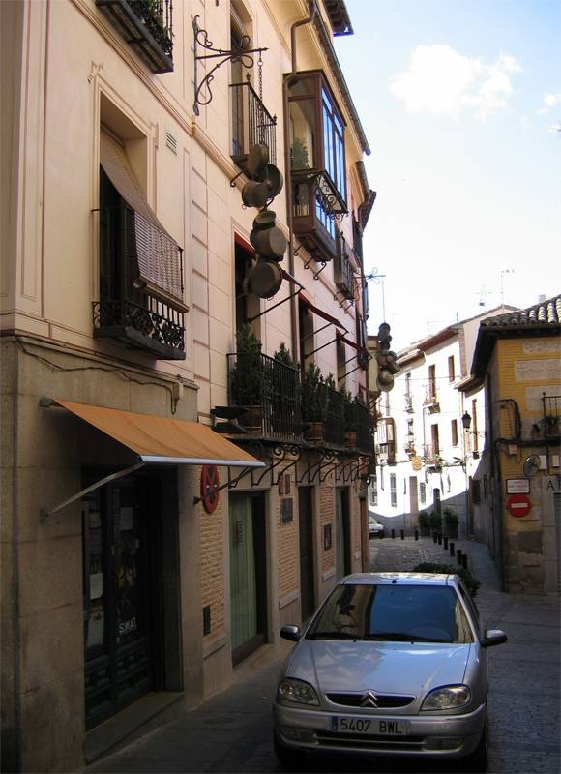
[Hays and Efros. Scene Completion Using Millions of Photographs. SIGGRAPH 2007 and CACM October 2008.]
Notes:
Change references to italics title

Slide 10
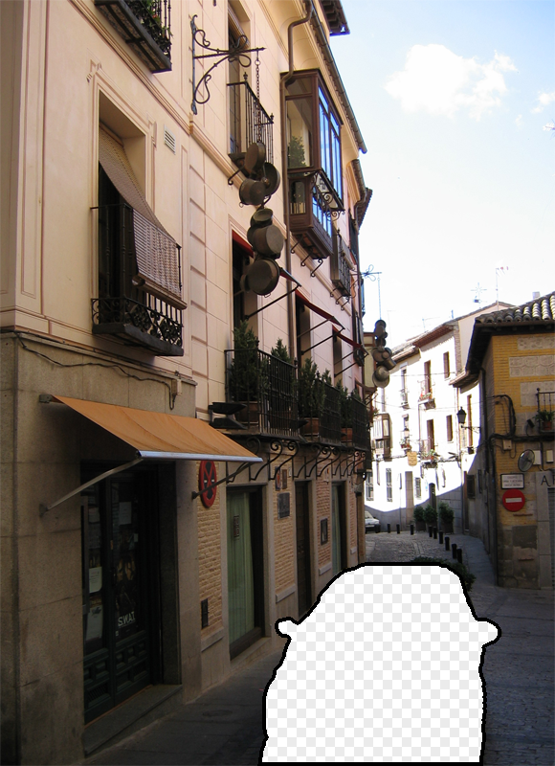
Notes:
Can justify broader use of image completion here

Slide 11
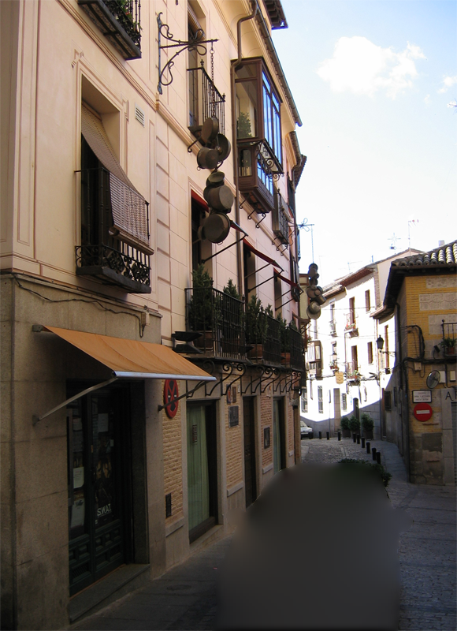
Diffusion Result

Slide 12
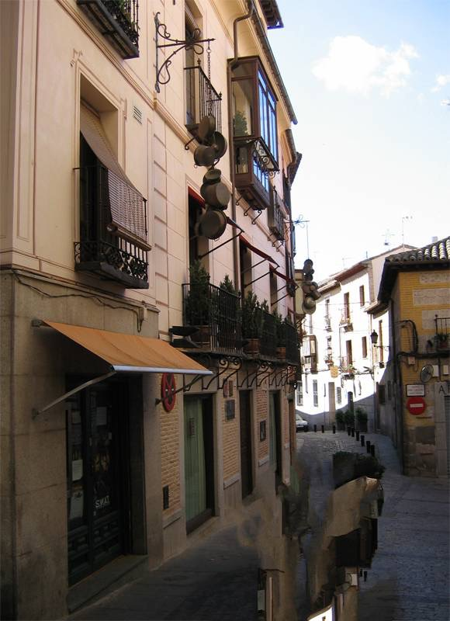
Efros and Leung result
Notes:
Efros and leung result

Slide 13
Notes:
We don’t want to manually specify any semantics- contours or region labels.
We want to try and get our semantics (and our data) from other images
What semantics? This should be road, the building stops here, the vanishing point is in that direction.

Slide 14
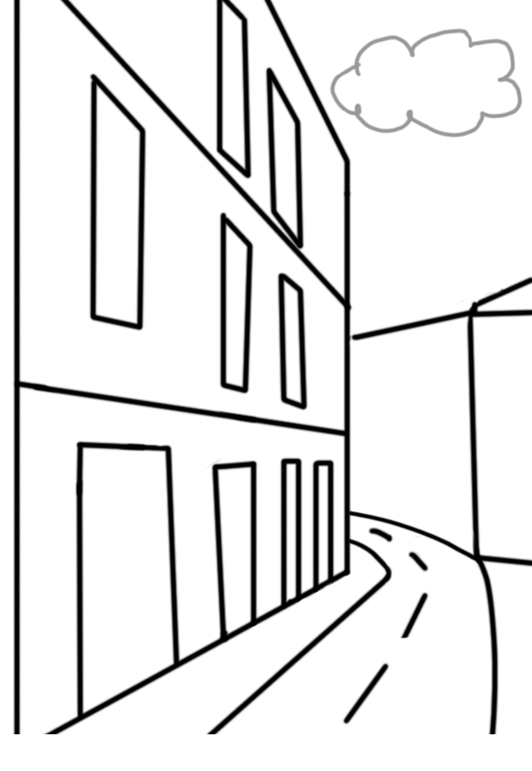
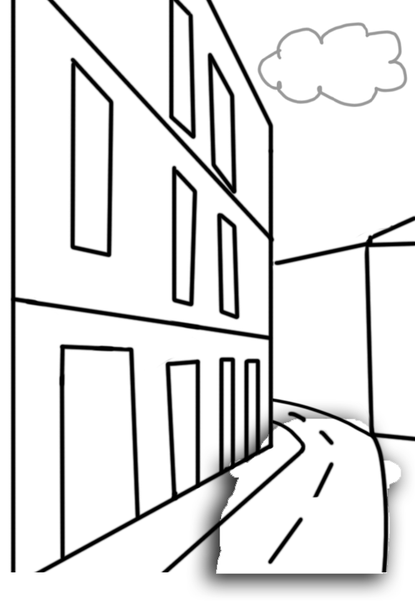
Scene Matching for Image Completion
Notes:
How does a human do it? Interesting point – we don’t use labels.
We don’t want to manually specify any semantics- contours or region labels.
We want to try and get our semantics (and our data) from other images
What semantics? This should be road, the building stops here, the vanishing point is in that direction.
But can you find such a close match? That is the biggest question, and we certainly didn’t know the answer when we set out.
------
We’re going to try and find a similar scene and steal content from it
But this doesn’t answer any questions yet. Is scene matching good enough?
How big is the space of images?
Can we really expect to find a match that’s good enough for a generic image?

Slide 15
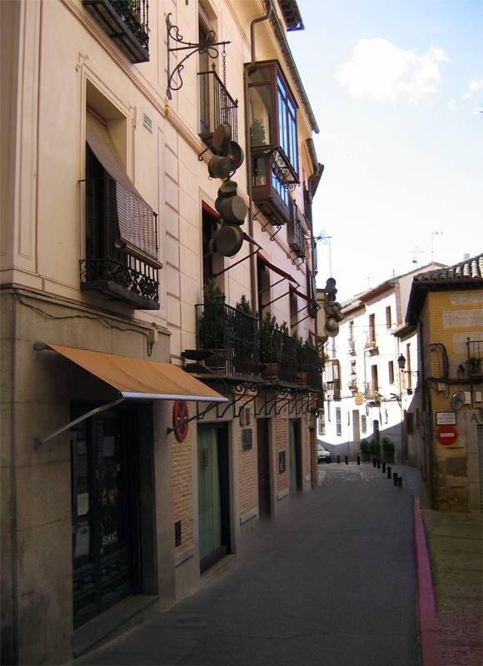
Scene Completion Result

Slide 16
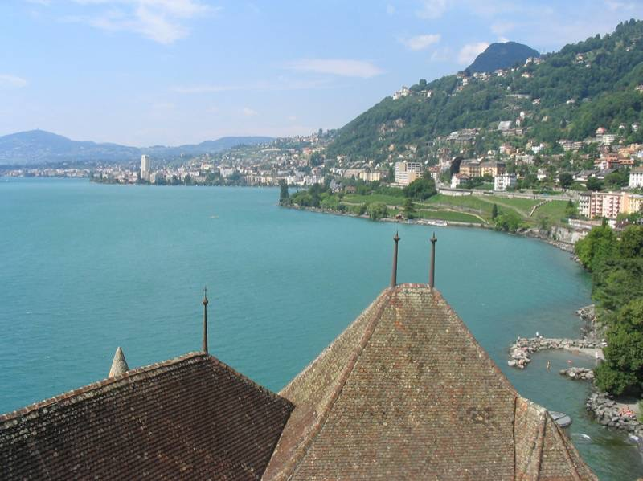
The Algorithm
Notes:
Introduce gist.

Slide 17
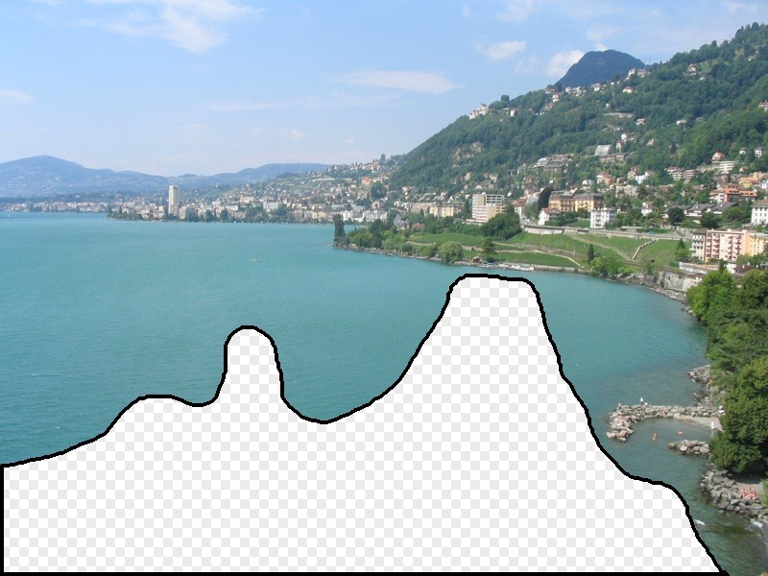
Scene Matching
Notes:
Introduce gist.

Slide 18
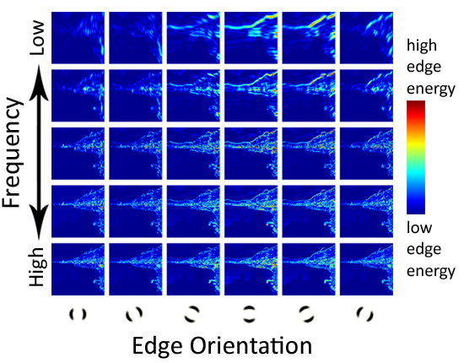
Scene Descriptor
Notes:
Edge energy is just the magnitude of directional derivatives of image intensity.

Slide 19
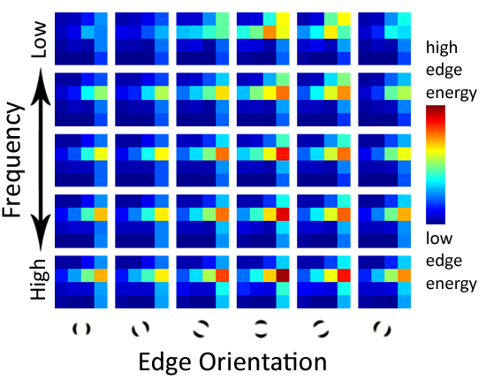
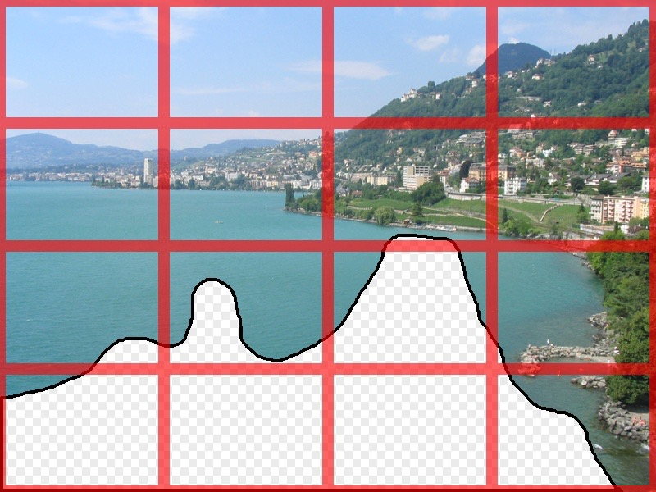
Scene Descriptor
Scene Gist Descriptor (Oliva and Torralba 2001)

Slide 20
Scene Descriptor
+
Scene Gist Descriptor (Oliva and Torralba 2001)

Slide 21
2 Million Flickr Images
Notes:
Now we take our gist (and mask and color image) and find it’s L2 nearest neighbors in the database of 2.3 million images, and here they are

Slide 22
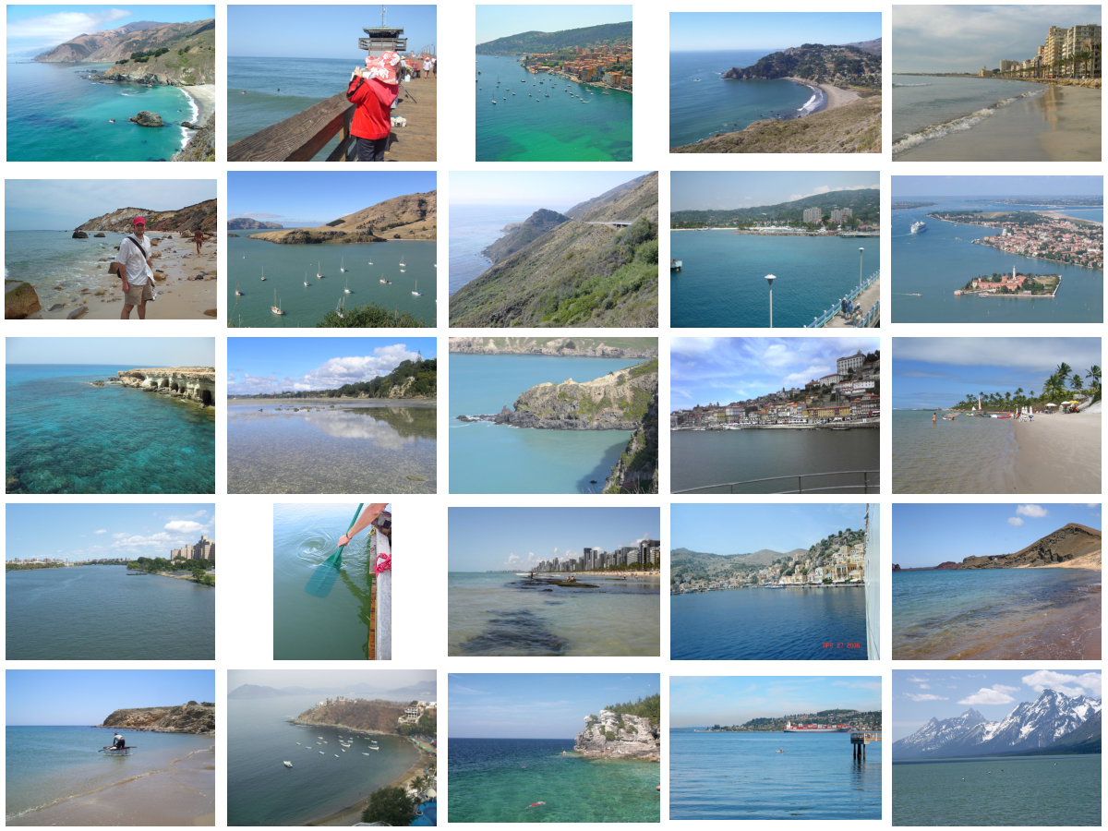
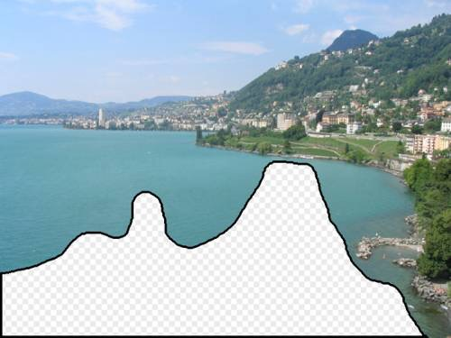
… 200 total

Slide 23
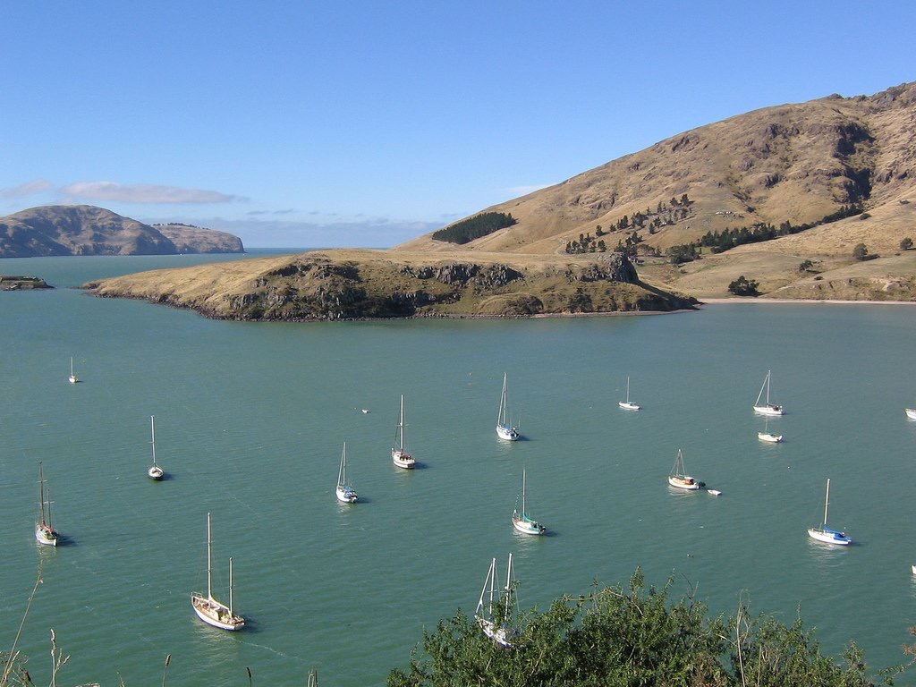
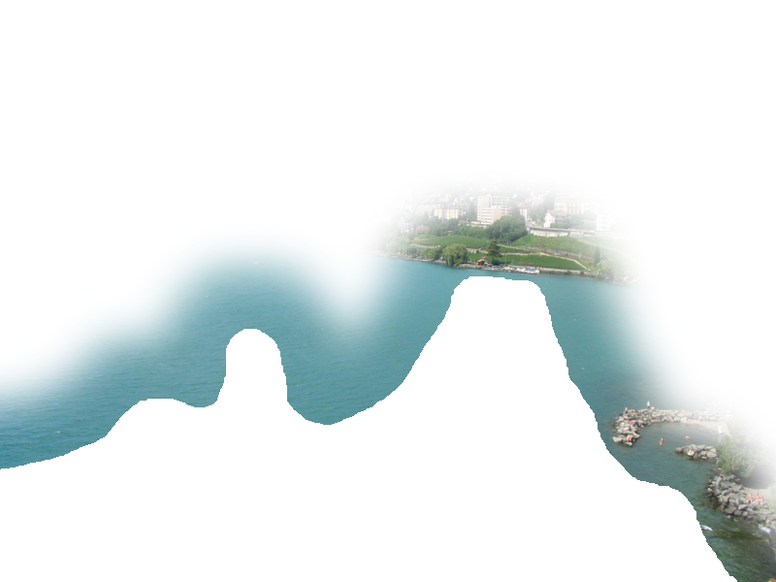
Context Matching

Slide 24
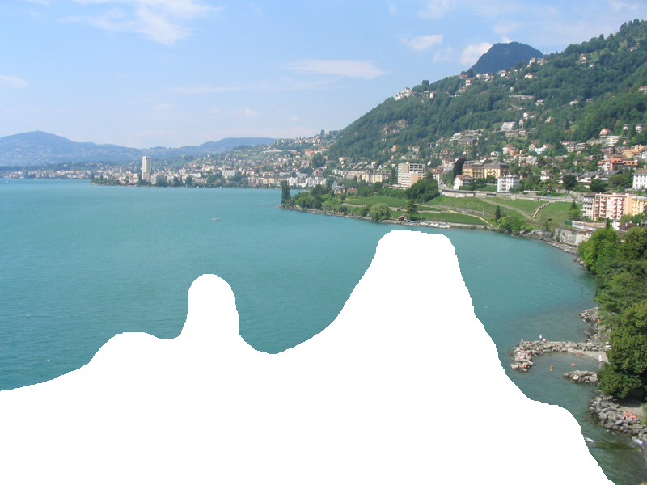
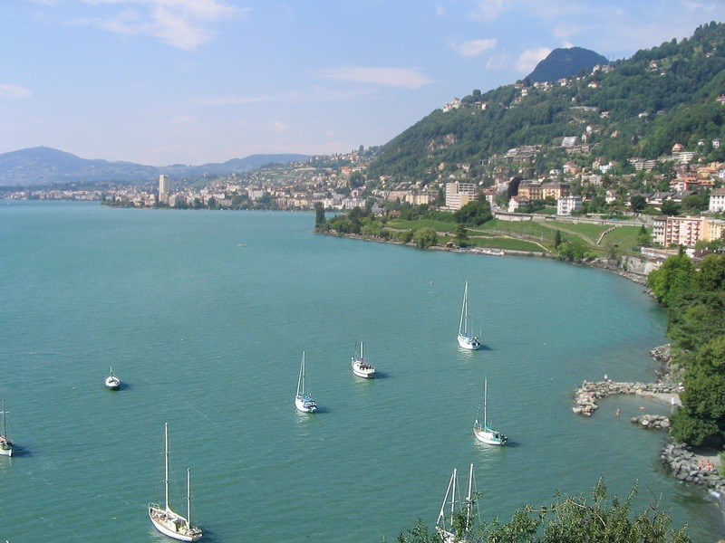
Graph cut + Poisson blending

Slide 25
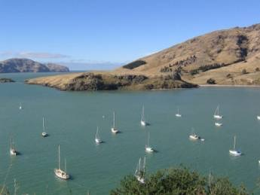
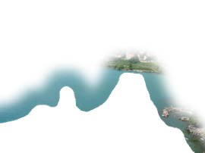
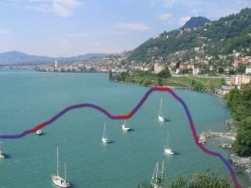
Result Ranking
We assign each of the 200 results a score which is the sum of:
The scene matching distance
The context matching distance (color + texture)
The graph cut cost
Notes:
Johnson et al. used the graph cut cost to sort results for users in Semantic Photo Synthesis

Slide 26
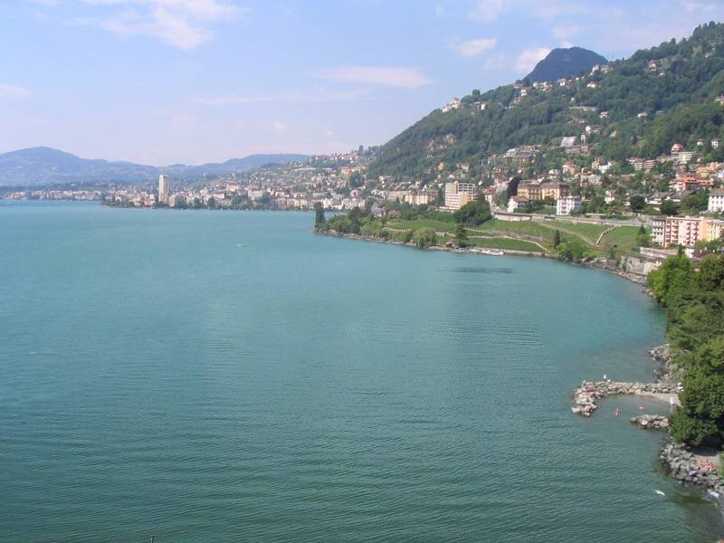

Slide 27
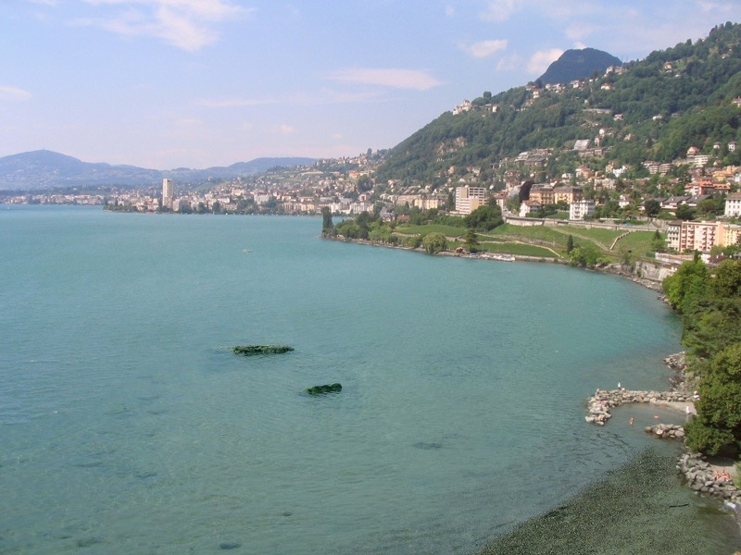

Slide 28
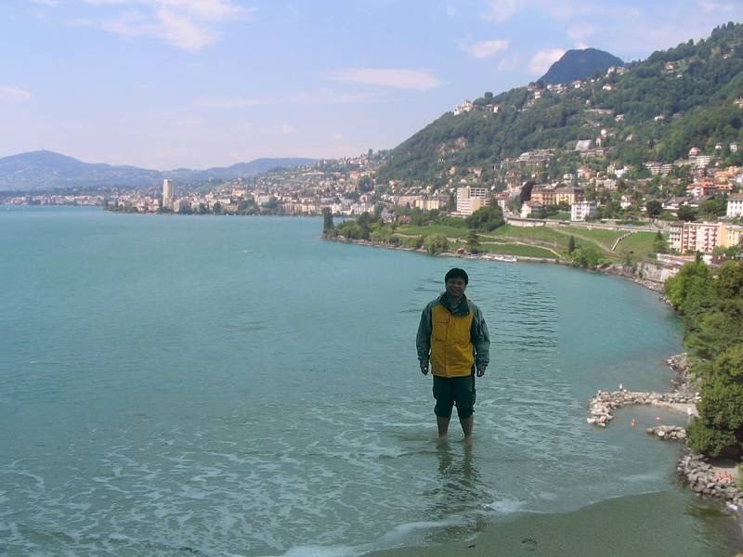

Slide 30
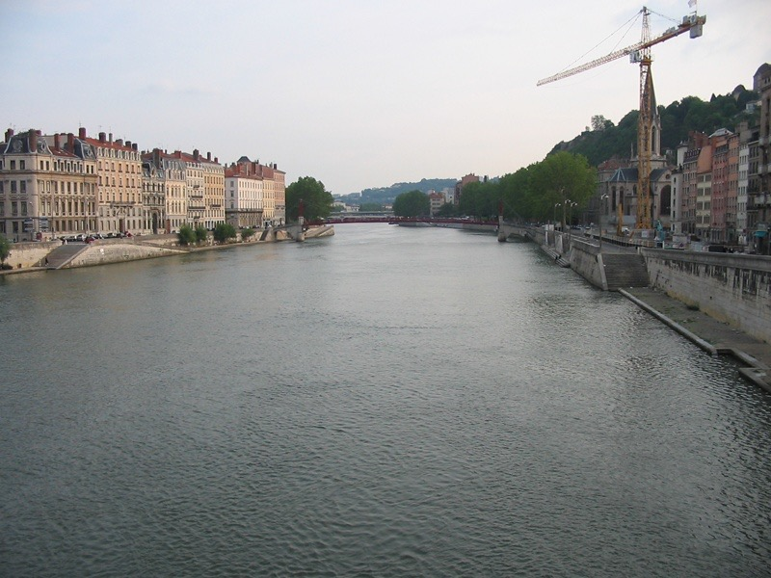

Slide 31
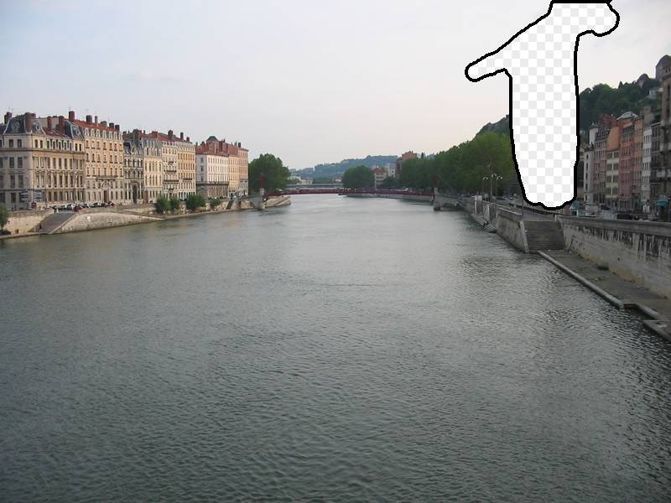

Slide 32
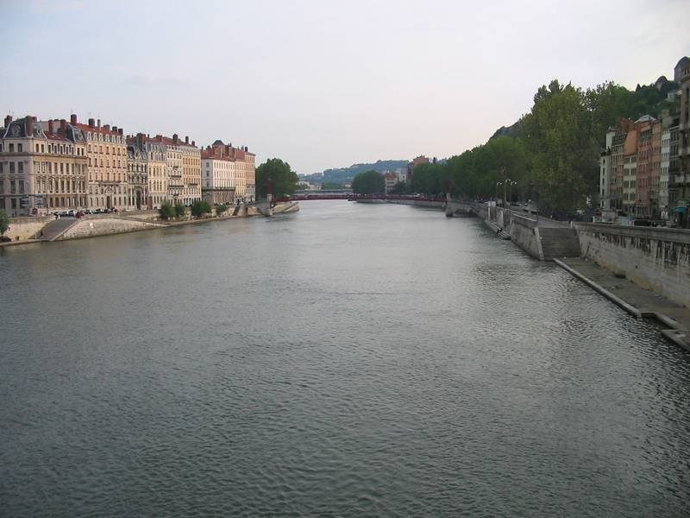

Slide 33
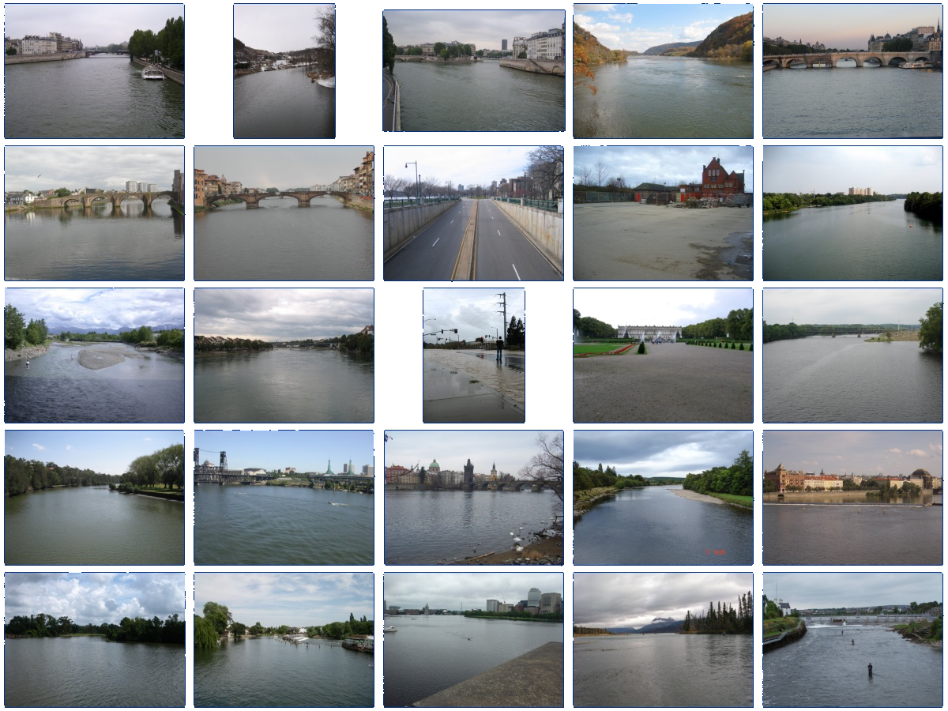
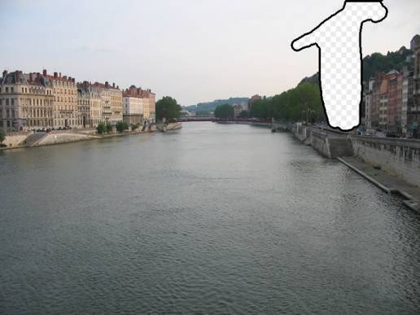
… 200 scene matches

Slide 34
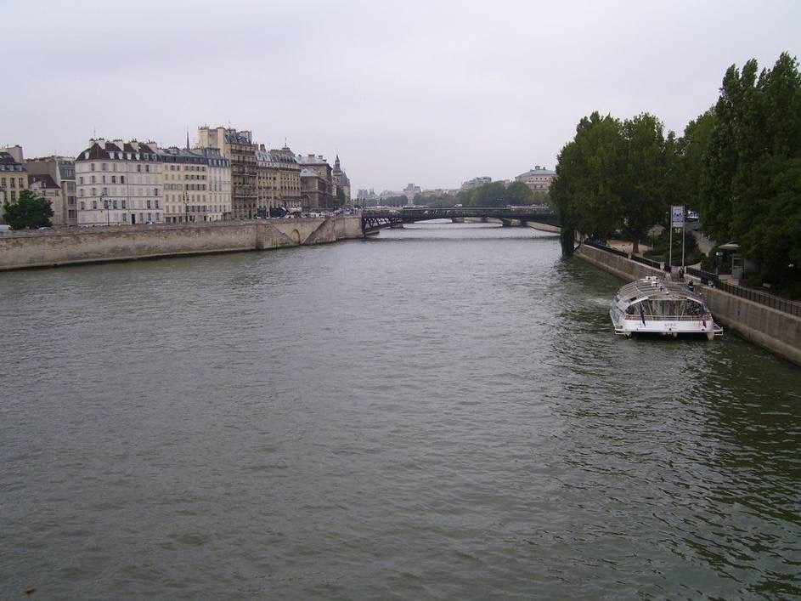
Notes:
Not actually the same scene, even though they’re startlingly similar

Slide 36
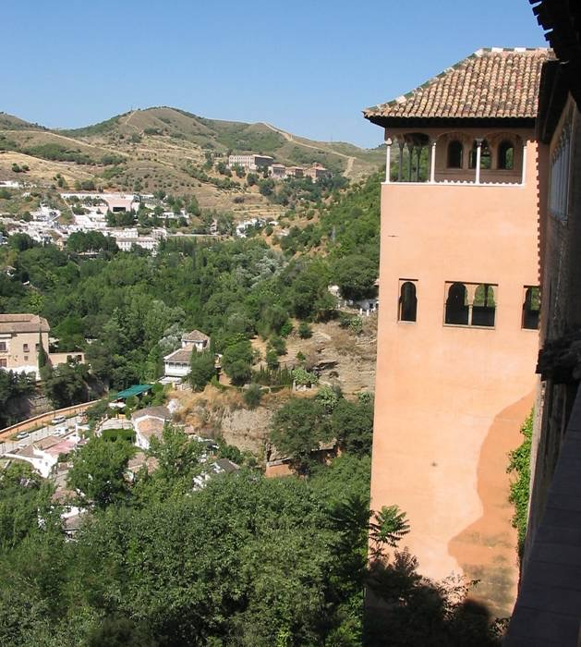

Slide 37
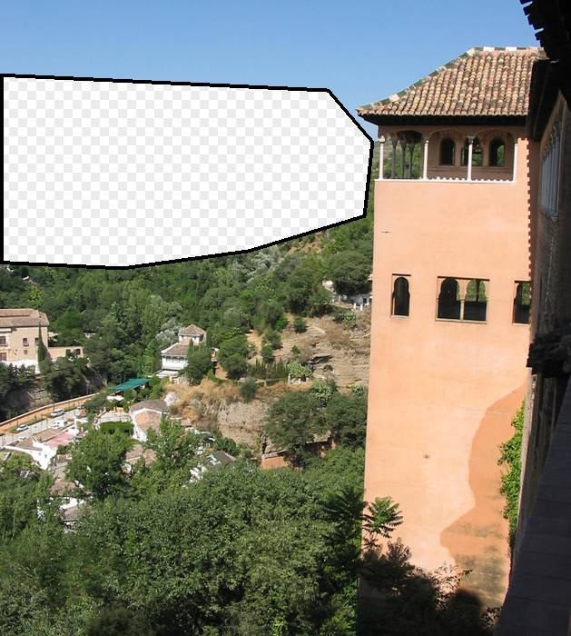

Slide 38
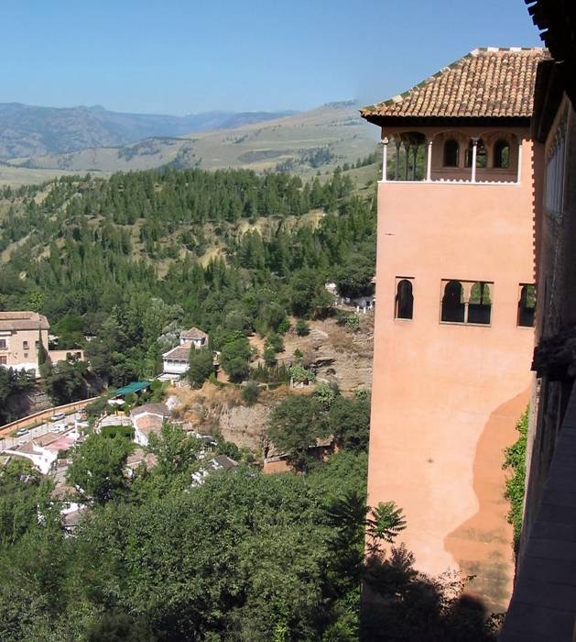

Slide 39
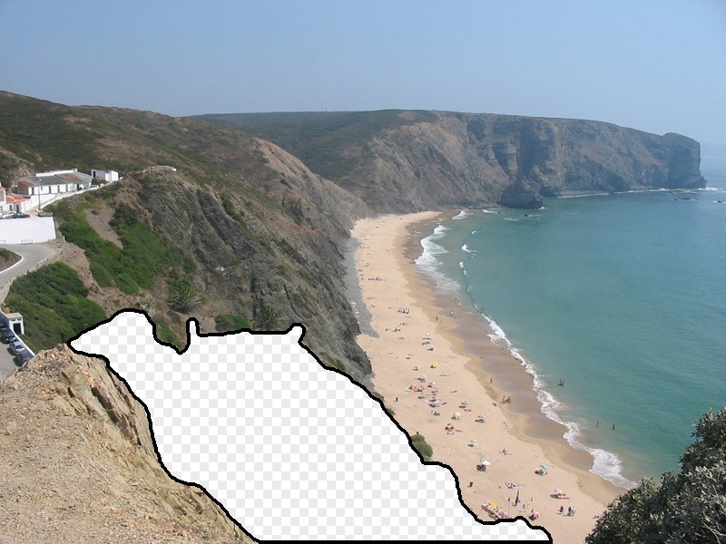
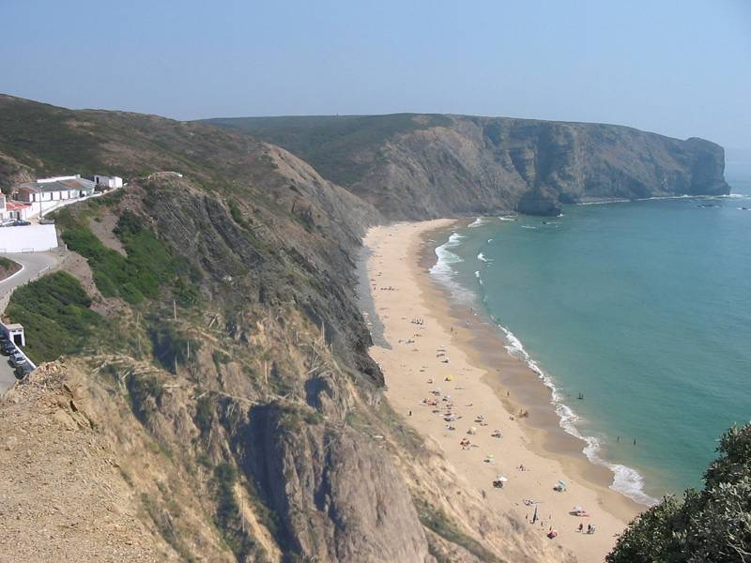
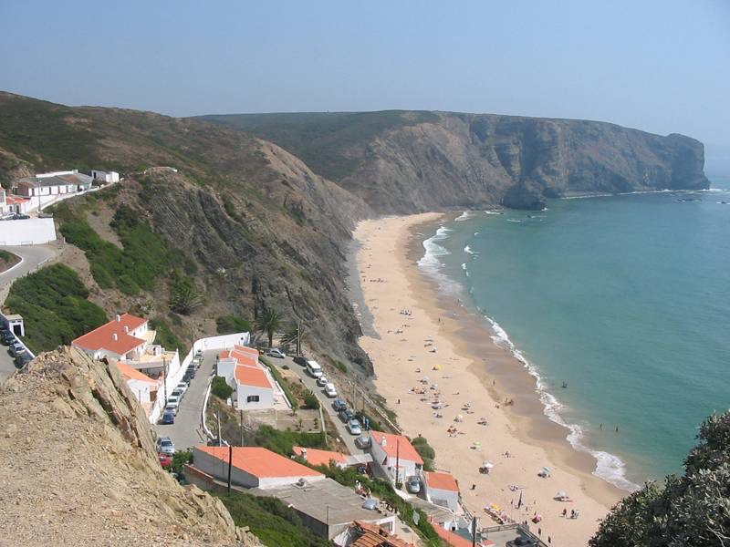

Slide 40
Why does it work?

Slide 41
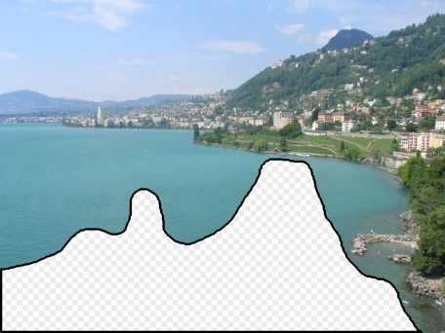
Notes:
10 nearest neighbors, 20,000 image database

Slide 42
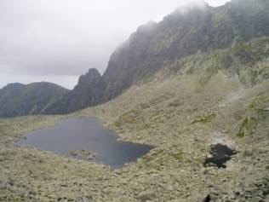
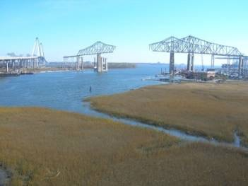
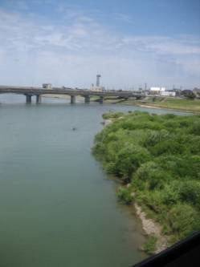
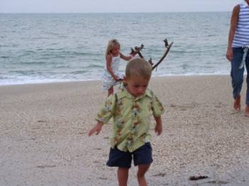
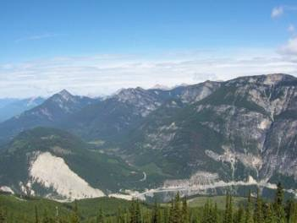
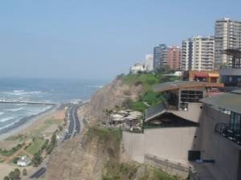
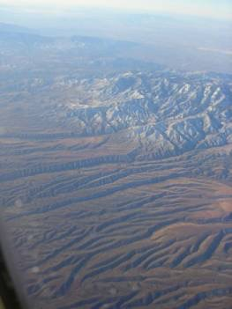
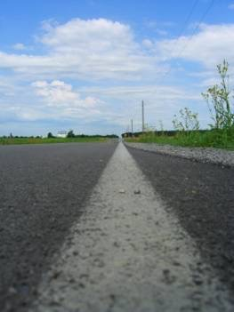
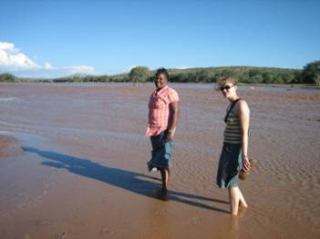
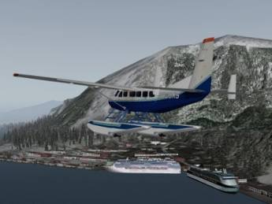
Nearest neighbors from a collection of 20 thousand images
Notes:
10 nearest neighbors, 20,000 image database
20000 images is still 5 times larger than the PASCAL training set

Slide 43
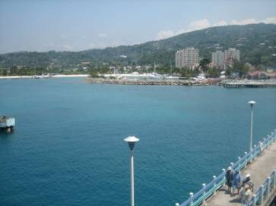
Nearest neighbors from a collection of 2 million images
Notes:
10 nearest neighbors, 2.3 million image database
This is one of the key results from my research – I’ve discovered that it’s possible to sample the space of scenes densely enough to permit photorealistic image manipulations, short circuiting the typical graphics pipelines. Say that this is surprising
DATA is the key

Slide 44
“Unreasonable Effectiveness of Data”
[Halevy, Norvig, Pereira 2009]
Parts of our world can be explained by elegant mathematics
physics, chemistry, astronomy, etc.
But much cannot
psychology, economics, genetics, etc.
Enter The Data!
Great advances in several fields:
e.g., speech recognition, machine translation
Case study: Google

Slide 45
Limitations
p
Slow
Hand-engineered matching function
Each method only works in special settings (e.g., outdoor scene photos, textures)
Notes:
I’m going to introduce an alternate way to model textures, which we will see has advantages, the main one being that it is a compact representation of texture, and intimately connected to other modeling problems…
We will eventually see how this alternate approach is related to image modeling more generally, and the same kinds of techniques can then be applied to other image modeling problems, besides just texture synthesis.

Slide 46
Serre, 2014
Notes:
Now we introduce deep nets as a more compact way of representing the knowledge in all that data. Rather than recording all the pixels, we compress the information into an abstracted representation, that can be quickly queried.
The previous methods we saw were basically lookup tables. Lookup tables are learned functions. They tell us what to output by matching to a memory. There are other and better ways to learn a mapping between input and output. These other methods basically assume the world has some simple structure that can be exploited. For example, neural nets factor the world into a hierarchy of parts, so that search can be done much faster. E.g., a T detector is the composition of two line detectors, at orthogonal angles. So we don’t need to make the T detector from scratch but can instead reuse our line detectors.

Slide 47
Basic idea
“clown fish”
Brain/Machine
Notes:
Take some data input. Process it through a hierarchy of simple computational units. Units are reused in stereotyped fashion. Produce some output.

Slide 48
Object recognition
Edges
Segments
“clown fish”
Texture
Parts
Colors
Feature extractors
Classifier
Notes:
Take some data input. Process it through a hierarchy of simple computational units. Units are reused in stereotyped fashion. Produce some output.

Slide 49
Object recognition
Learned
Edges
Segments
“clown fish”
Texture
Parts
Colors
Feature extractors
Classifier
Notes:
Take some data input. Process it through a hierarchy of simple computational units. Units are reused in stereotyped fashion. Produce some output.

Slide 50
Neural network
Learned
“clown fish”
Notes:
Generic hierarchical architecture. The world factors nicely into a hierarchy of increasingly abstracted representations.

Slide 51
Neural network
Learned
“clown fish”
Notes:
Take some data input. Process it through a hierarchy of simple computational units. Units are reused in stereotyped fashion. Produce some output.

Slide 52
Deep neural network
Learned
“clown fish”
Notes:
Take some data input. Process it through a hierarchy of simple computational units. Units are reused in stereotyped fashion. Produce some output.

Slide 53
Computation in a neural net
Input representation
Output representation
Notes:
What do the arrows mean? What computation do they do? A cool thing about neural nets is they reuse the same simple computational units over and over again. So the arrows here are all mostly doing the same class of computation.

Slide 54
Computation in a neural net
Input representation
Output representation

Slide 55
Computation in a neural net
Rectified linear unit (ReLU)

Slide 56
Computation in a neural net
Rectified linear unit (ReLU)

Slide 57
Computation in a neural net
Filter
Pool
Notes:
mention bias term?

Slide 58
Pooling across feature channels (filter outputs) can achieve invariance.
large response for any edge, regardless of its orientation
Slide from Andrea Vedaldi
Notes:
What’s the role of pooling?

Slide 59
Computation in a neural net
One “layer” of a CNN
Filter
ReLU
Pool
…
…

Slide 60
Computation in a neural net
Filter
ReLU
Pool
Classify
“clown fish”
…
Notes:
Cascade of repeated simple computations. With each increasing layer we get more abstracted representations, we get a higher capacity model. This means it can perform more complex and abstract calculations. A shallow network can only efficiently compute simple things, like finding edges. A deep network can efficiently compute harder things like recognizing a clown fish or translating English to Chinese.

Slide 61
Convolutional Neural Nets
Slide from Andrea Vedaldi

Slide 62
Convolutional Neural Nets
Convolution
filter
Notes:
The advantage of convolution is that parameters are shared. All spatial windows are treated the same way during each filtering operation. This means there are far fewer parameters, weights, to learn. So we can learn more efficiently and avoid overfitting.
This works because stuff in the world is mostly translation invariant. For example, a clown fish looks the same no matter where it is in the image. (Technically, a clown fish on the left looks like a clown fish on the right, except translated to the left, which means the clown fish semantic labels are equivariant with translation.)

Slide 63
Slide from Andrea Vedaldi

Slide 64
Computation in a neural net
Threshold
Filter
Classify
“clown fish”
…
Notes:
Cascade of repeated simple computations. With each increasing layer we get more abstracted representations, we get a higher capacity model. This means it can perform more complex and abstract calculations. A shallow network can only efficiently compute simple things, like finding edges. A deep network can efficiently compute harder things like recognizing a clown fish or translating English to Chinese.

Slide 65
Computation in a neural net
Last layer
dolphin
cat
grizzly bear
angel fish
“clown fish”
…
argmax
chameleon
clown fish
iguana
elephant
…

Slide 66
Serre, 2014

Slide 67
Ingredients
Select important features of the data
— linear filters
— pointwise nonlinearity
Group features that all indicate the same thing
— pooling
Repeat to achieve greater abstraction

Slide 68
Learning with deep nets
Learned
“clown fish”
Notes:
The basic idea is that you fiddle all the weights until you match the desired output.

Slide 69
Learning with deep nets
“clown fish”
Train network to associate the right label with each image
“grizzly bear”
“chameleon”

Slide 70
Learning with deep nets
Learned
“clown fish”
Loss
Notes:
The basic idea is that you fiddle all the weights until you match the desired output.

Slide 71
Loss function
Network output
Ground truth label
“clown fish”
dolphin
cat
grizzly bear
angel fish
Loss
error
…
chameleon
clown fish
iguana
elephant
…

Slide 72
Loss function
Network output
Ground truth label
“clown fish”
dolphin
cat
grizzly bear
angel fish
Loss
small
…
chameleon
clown fish
iguana
elephant
…

Slide 73
Loss function
Network output
Ground truth label
“grizzly bear”
dolphin
cat
grizzly bear
angel fish
Loss
large
…
chameleon
clown fish
iguana
elephant
…

Slide 74
Loss function for classification
Network output
Ground truth label
dolphin
Probability of the observed data under the model
cat
grizzly bear
angel fish
…
chameleon
clown fish
iguana
Results in learning a probability model !
elephant
…
…
Notes:
H(\hat{\mathbf{z}},\mathbf{z}) = -\sum_c \hat{\mathbf{z}}_c \log \mathbf{z}_c
When the net output is a normalized vector, we can think of it as a probability distribution over possible object classes. This loss function on the right tells the network to maximize the probability of the training data, which forces the output to be a good probability model of object class given image.

Slide 75
Learning with deep nets
Learned
“clown fish”
Loss
Notes:
The basic idea is that you fiddle all the weights until you match the desired output.
\underset{\mathbf{w}}{\operatorname{argmin}} \quad \sum_i \ell(\mathbf{z}_i,f(\mathbf{x}_i;\mathbf{w}))

Slide 76
Learning with deep nets
Learned
“grizzly bear”
Loss
Notes:
The basic idea is that you fiddle all the weights until you match the desired output.
\underset{\mathbf{w}}{\operatorname{argmin}} \quad \sum_i \ell(\mathbf{z}_i,f(\mathbf{x}_i;\mathbf{w}))

Slide 77
Learning with deep nets
Learned
“chameleon”
Loss
Notes:
The basic idea is that you fiddle all the weights until you match the desired output.
\underset{\mathbf{w}}{\operatorname{argmin}} \quad \sum_i \ell(\mathbf{z}_i,f(\mathbf{x}_i;\mathbf{w}))

Slide 78
Gradient descent
One iteration of gradient descent:
learning rate
Notes:
\underset{\mathbf{w}}{\operatorname{argmin}} \quad \sum_i \ell(\mathbf{z}_i,f(\mathbf{x}_i;\mathbf{w})) = L(\mathbf{w})
\mathbf{w}^{t+1} = \mathbf{w}^t - \eta_t \frac{\partial L(\mathbf{w^t})}{\partial \mathbf{w}}

Slide 79
Gradient descent

Slide 80
[Krizhevsky et al. NIPS 2012]

Slide 81
Texture synthesis by non-parametric sampling
non-parametric
sampling
p
Input image
Synthesizing a pixel
Models
[Efros & Leung 1999]
Notes:
PixelCNN

Slide 82
Texture synthesis with a deep net
Input partial image
Predicted color of next pixel
“white”
[van der Oord et al. 2016]
Notes:
The layers have encoded implicit knowledge about brick patterns, among many other stored patterns.

Slide 83
Texture synthesis with a deep net
…
“white”
[van der Oord et al. 2016]
Notes:
The layers have encoded implicit knowledge about brick patterns, among many other stored patterns.

Slide 84
Sampling
Network output
turquoise
blue
p
green
red
…
orange
white
gray
black
…

Slide 85
Sampling
Network output
turquoise
blue
p
green
red
…
orange
white
probability
gray
black
…

Slide 86
Sampling
Network output
turquoise
blue
green
red
…
orange
white
probability
gray
black
…

Slide 87
Sampling
Network output
turquoise
blue
green
red
…
orange
white
probability
gray
black
…

Slide 88
Sampling
Network output
turquoise
blue
green
red
…
orange
probability
white
gray
black
…

Slide 89
Sampling
Network output
turquoise
blue
green
red
…
orange
probability
white
gray
black
…

Slide 90
Sampling full images

Slide 91
Predicting pixels gives a probability model of a whole image!
This factorization is valid for any probability distribution (chain rule).

Slide 92
Inpainting

Slide 93
Synthesizing sounds
Wavenet
[van den Oord et al. 2016]

Slide 95
[Zhang et al. 2016]

Slide 96
Grayscale image: L channel
Color information: ab channels
L
ab
Notes:
So formally, we are working in the Lab color space. The grayscale information is contained in the L, or lightness channel of the image, and is the input to our system.
The output is the ab, or color channels.
We’re looking to learn the mapping from L to ab using a CNN.
We can then take the predicted ab channels, concatenate them with the input, and hopefully get a plausible colorization of the input image. This is the graphics benefit of this problem.

Slide 97
Grayscale image: L channel
Concatenate (L,ab)
L
ab
Notes:
We note that any image can be broken up into its grayscale and color components, and in this manner, can serve as a free supervisory signal for training a CNN. So perhaps by learning to color, we can achieve a deep representation which has higher level abstractions, or semantics.
Now, this learning problem is less straightforward than one may expect.

Slide 98
Colors in ab space
(continuous)
Notes:
This indicates that any loss which assumes a unimodal output distribution, such as an L2 regression loss, is likely to be inadequate.

Slide 99
Colors in ab space
(discrete)
Notes:
We reformulate the problem as multinomial classification. We divide the output ab space into discrete bins of size 10.

Slide 100
…
“yellow”

Slide 101
Inherent Ambiguity
Grayscale
Notes:
For example, consider this grayscale image.

Slide 102
Inherent Ambiguity
Our Output
Ground Truth
Notes:
This is the output after passing it through our system. Now, it seems to look plausible. Now here is the ground truth. So notice that these two look very different. But even though red and blue are far apart in ab space, we are just as happy with the red colorization as we are with the blue, and perhaps the red is even better...

Slide 103
Notes:
So given the input grayscale image of the bird on the upper left, here is a predicted distribution from out system. Each tile corresponds to one output color bins in our multinomial classification problem, which are subsampled for visual clarity. For each tile, spatial regions inside which have high lightness values indicate high probability for that color.
Note that the foreground object, the bird, has been predicted to be blue, purple, or perhaps red.
Meanwhile, the background vegetation has been classified to be either green, yellow, or perhaps brown.

Slide 104
Some of the better results

Slide 105
Failure Cases
Notes:
The system does have some interesting failure cases. We find that many man-made objects can be multiple colors. The system sometimes has a difficult time deciding which one to go with, leading to this type of tie-dye effect.

Slide 106
Ground Truth
L2 Regression
Input
Class w/ Rebalancing
Notes:
So how do we do? Well consider the image of the boat. Using L2 regression fares quite well. Since sky is always blue and the vegetation is always green, there is only 1 plausible color, so L2 regression will works just fine. Our full system does just as well.
However, consider this bird. Because of the multimodality of the output, L2 regression gives us a sepia result, whereas our full system results in a bright blue bird with a yellow belly.
Now you may be wondering what the ground truth colors look like. Notice that the bird is actually yellow in ground truth! Even though the L2 distance between the blue bird and the yellow bird is rather far, we are satisfied with the output, since blue is a plausible colorization of the bird.

Slide 107
Better Loss Function
log₁₀ probability
Histogram over ab space
Regression with L2 loss inadequate
Use multinomial classification
Class rebalancing to encourage learning of rare colors
Notes:
But this is not the end of the story. We also have to take into consideration the statistics of natural images. To the right, we have a 2d histogram showing the occurrences of colors over all pixels in ImageNet on a log scale. You can see that most of the distribution is at the center of the gamut, where colors are desaturated and bland. This is because almost all pixels in images belong to background. For example, if you look around this room, almost every pixel will be white.
Without taking this into account, given any uncertainty, the predictions will tend to be desaturated.

Slide 108
Better Loss Function
log₁₀ probability
Histogram over ab space
Regression with L2 loss inadequate
Use multinomial classification
Class rebalancing to encourage learning of rare colors
Notes:
As such, we add a class rebalancing term in the training objective, effectively oversampling rarer, more vibrant colors relative to their representation in the training set.
It is the combination of these modifications, using classification instead of regression, and adding the class-rebalancing, that makes our results qualitatively more colorful than previous and concurrent work, hence the name of our project, "Colorful Image Colorization"

Slide 109
Biases
Notes:
Caution: biases in the data! The net will learn to match whatever it was trained on, and if the training set is not representative of what you want then it will be “biased”.

Slide 110
from Reddit /u/SherySantucci
Notes:
We have also found some additional examples of this behavior. This example was submitted from a reddit user.

Slide 111
Recolorized by Reddit ColorizeBot
Notes:
Our algorithm makes him normal colored. This was processed by the Reddit ColorizeBot, which is running our system under the hood.

Slide 112
Photo taken by Reddit /u/Timteroo,
Mural from street artist Eduardo Kobra
Notes:
Colorfully tiled Yoda becomes

Slide 113
Recolorized by Reddit ColorizeBot
Notes:
Normal green yoda.

Slide 114
Next time:
Andrew Owens — more deep learning!

