Slide 1
Synthesizing Images with Generative Adversarial Networks
Phillip Isola
OpenAI/Berkeley
10/26/17
CS194: Image Manipulation & Computational Photography
Alexei Efros, UC Berkeley, Fall 2017

Slide 2
Outline
1. (Structured) image prediction
two parts to consider: network and loss function
network is just same as image classification, but applied per-pixel in sliding window fashion
Loss is what we will focus on in this lecture
why designing the loss is hard
2. GANs as learned loss
handles multi-modal outputs
penalizes errors in joint structure
3. What if we don’t have paired data?
4. Unconditional GANs
if we remove all the constraints, GANs map distribution to distribution
we can apply this to map random noise to images
this can be used for creative applications
also can be used for representation learning

Slide 3
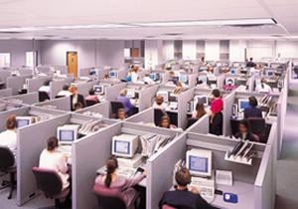
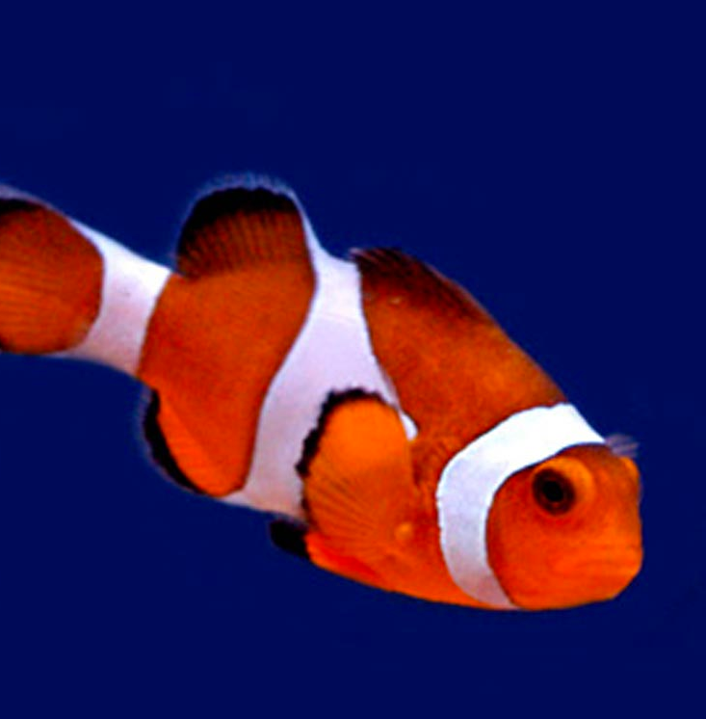
Image classification
Learner
“Fish”
image X
label Y

Slide 4
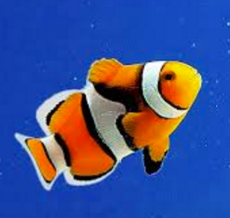
Image classification
Learner
“Fish”
image X
label Y

Slide 5
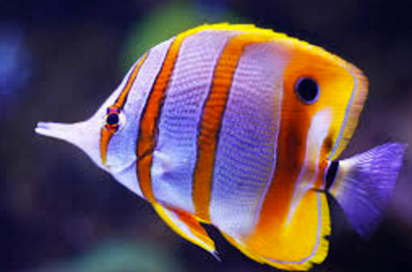
Image classification
Learner
“Fish”
image X
label Y

Slide 6
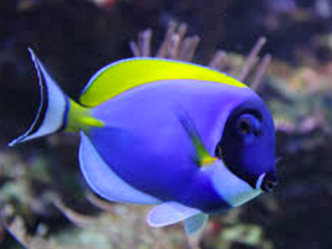
Image classification
Learner
“Fish”
…
image X
label Y

Slide 7
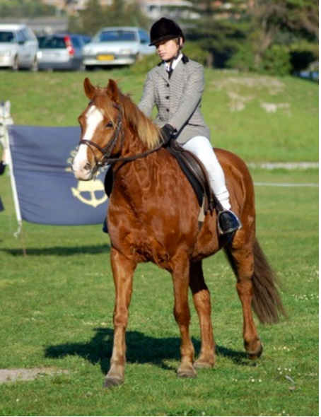
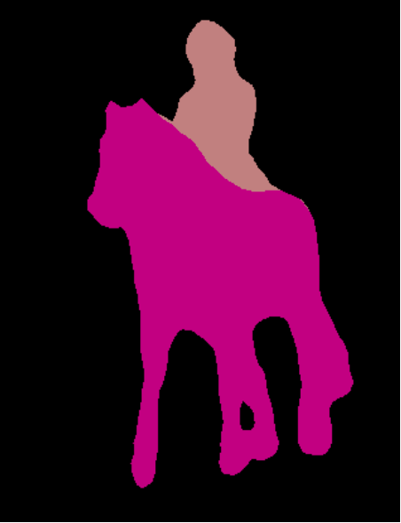
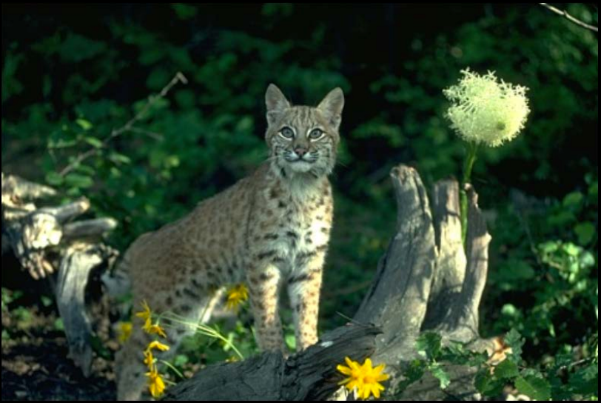
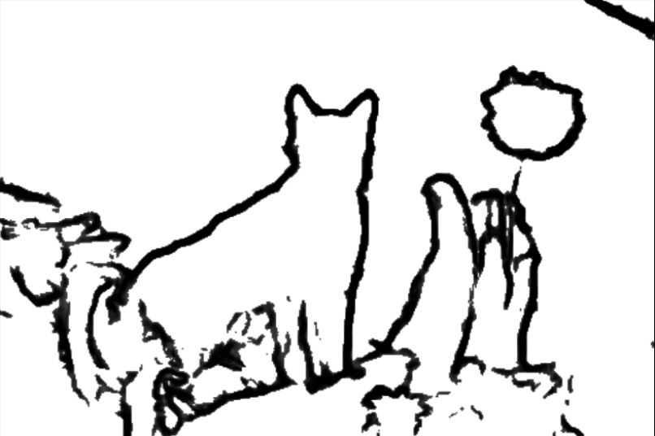
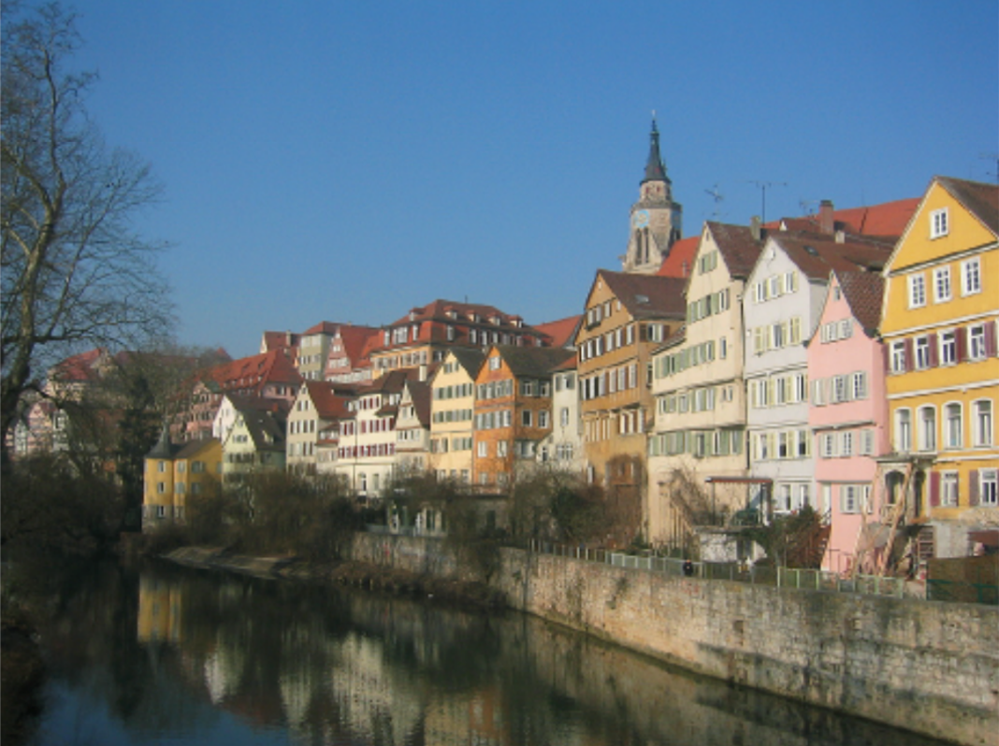
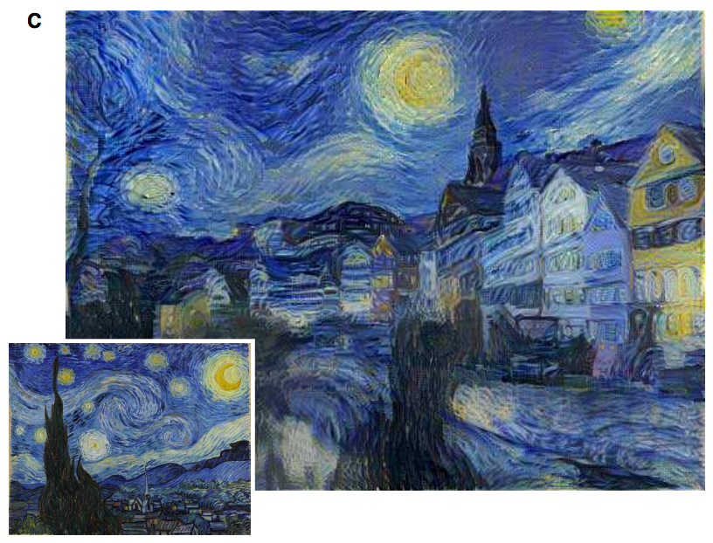
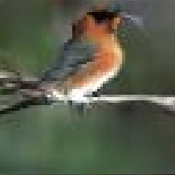
Image prediction (“structured prediction”)
Object labeling
Edge Detection
[Xie et al. 2015, …]
[Long et al. 2015, …]
Text-to-photo
Style transfer
“this small bird has a pink breast and crown…”
[Reed et al. 2014, …]
[Gatys et al. 2016, …]

Slide 8
Challenges
Output is high-dimensional, structured object
Uncertainty in mapping; many plausible outputs
Lack of supervised training data
“this small bird has a pink breast and crown…”

Slide 9
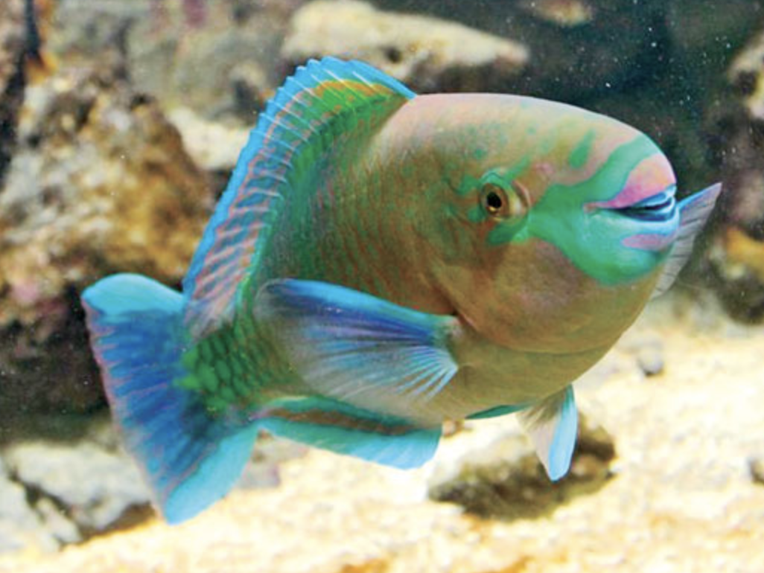
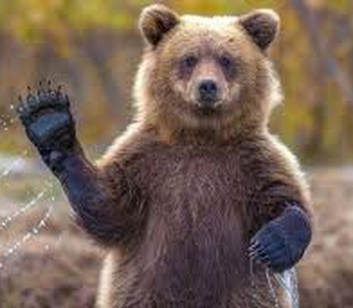
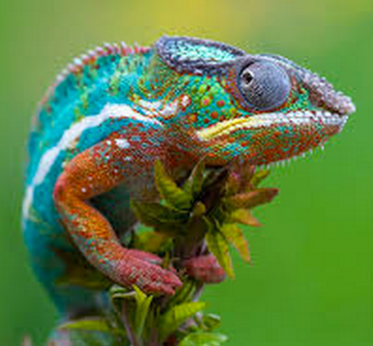
Training data
“Fish”
“Fish”
“Grizzly”
“Chameleon”
…
Objective function
(loss)
Neural Network
Notes:
So formally, we are working in the Lab color space. The grayscale information is contained in the L, or lightness channel of the image, and is the input to our system.
The output is the ab, or color channels.
We’re looking to learn the mapping from L to ab using a CNN.
We can then take the predicted ab channels, concatenate them with the input, and hopefully get a plausible colorization of the input image. This is the graphics benefit of this problem.

Slide 10
“Fish”
“What should I do”
“How should I do it?”
Notes:
So formally, we are working in the Lab color space. The grayscale information is contained in the L, or lightness channel of the image, and is the input to our system.
The output is the ab, or color channels.
We’re looking to learn the mapping from L to ab using a CNN.
We can then take the predicted ab channels, concatenate them with the input, and hopefully get a plausible colorization of the input image. This is the graphics benefit of this problem.

Slide 11
Basic loss functions
Prediction:
Truth:
Classification (cross-entropy):
How many extra bits it takes to correct the predictions
Least-squares regression:
How far off we are in Euclidean distance
Notes:
H(\hat{\mathbf{z}},\mathbf{z}) = -\sum_c \hat{\mathbf{z}}_c \log \mathbf{z}_c
When the net output is a normalized vector, we can think of it as a probability distribution over possible object classes. This loss function on the right tells the network to maximize the probability of the training data, which forces the output to be a good probability model of object class given image.

Slide 12
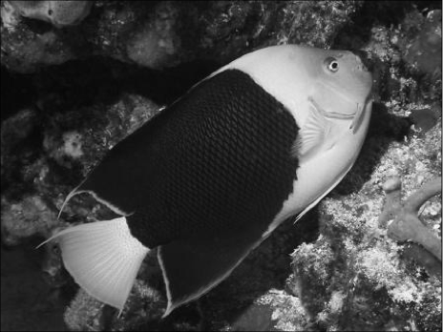
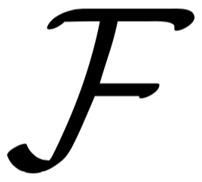
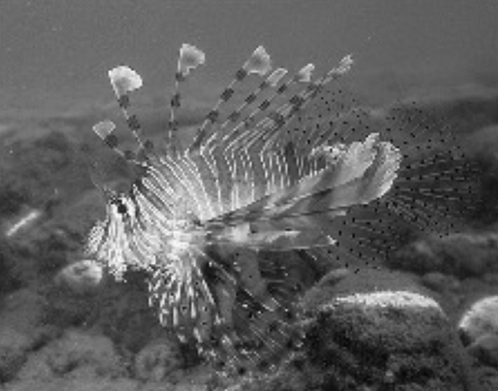
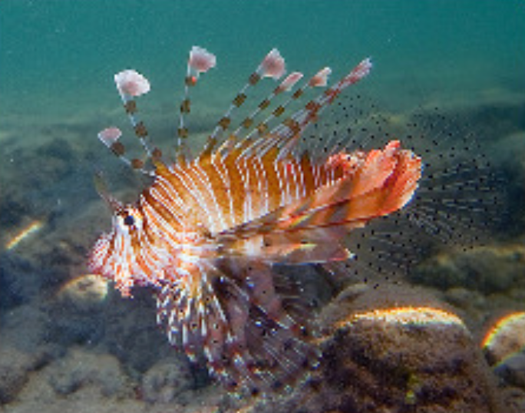
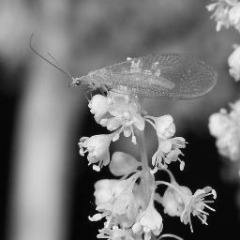
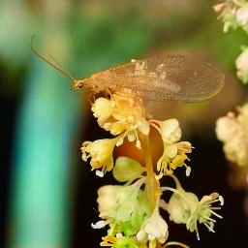
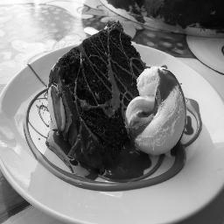
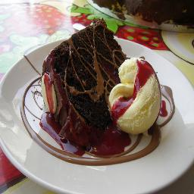
Training data
Grayscale image: L channel
Color information: ab channels
…
Objective function
(loss)
Neural Network
Notes:
So formally, we are working in the Lab color space. The grayscale information is contained in the L, or lightness channel of the image, and is the input to our system.
The output is the ab, or color channels.
We’re looking to learn the mapping from L to ab using a CNN.
We can then take the predicted ab channels, concatenate them with the input, and hopefully get a plausible colorization of the input image. This is the graphics benefit of this problem.

Slide 13
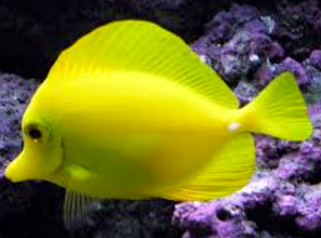
…
“rockfish”

Slide 14
…
“yellow”

Slide 15
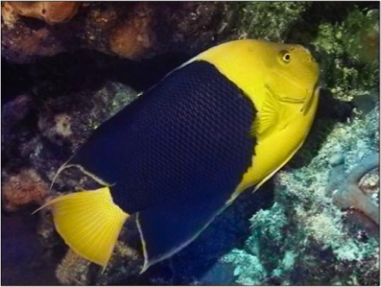
…

Slide 16
Loss Function

Slide 17
Image classification with a neural net
“clown fish”
Input image

Slide 18
Can we generate images using a neural net?
“clown fish”
Synthesized image

Slide 19
In structured prediction, you shouldn’t treat every output as independent!

Slide 20
In one-to-many prediction, you need to predict a set of possibilities

Slide 21
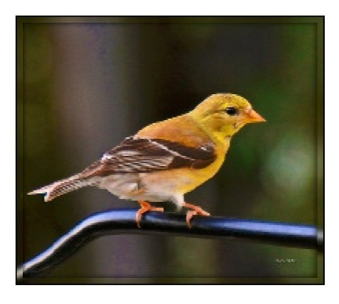
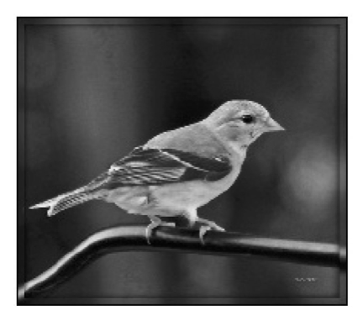
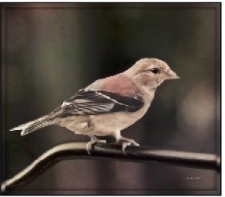
Designing loss functions
Input
Output
Ground truth
Notes:
Sounds reasonable, right?
“Minimize Euclidean distance between each predicted pixel color and its ground truth value.”

Slide 22
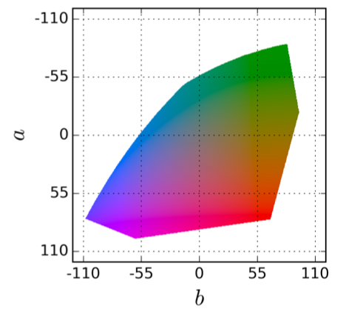
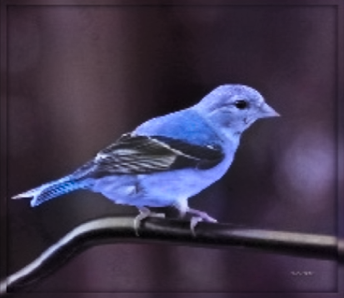
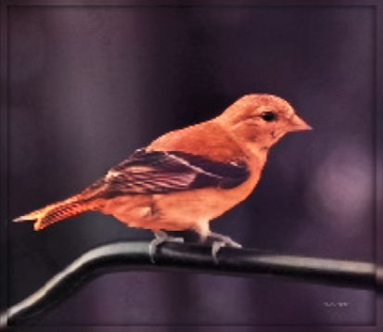
Notes:
Suppose there is an equal chance that the actual color is red or blue. Then the solution that minimizes the L2 norm is to output average of red and blue, which gives a grayish result.

Slide 23
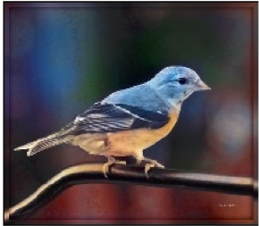
Designing loss functions
Input
Zhang et al. 2016
Ground truth
Color distribution cross-entropy loss with colorfulness enhancing term.
[Zhang, Isola, Efros, ECCV 2016]
Notes:
Required lots of engineering. Choose a color space, discretization scheme, soft-encoding, class-rebalancing with regularization, annealed-mean, etc.
Can we just automatically learn all this?

Slide 24
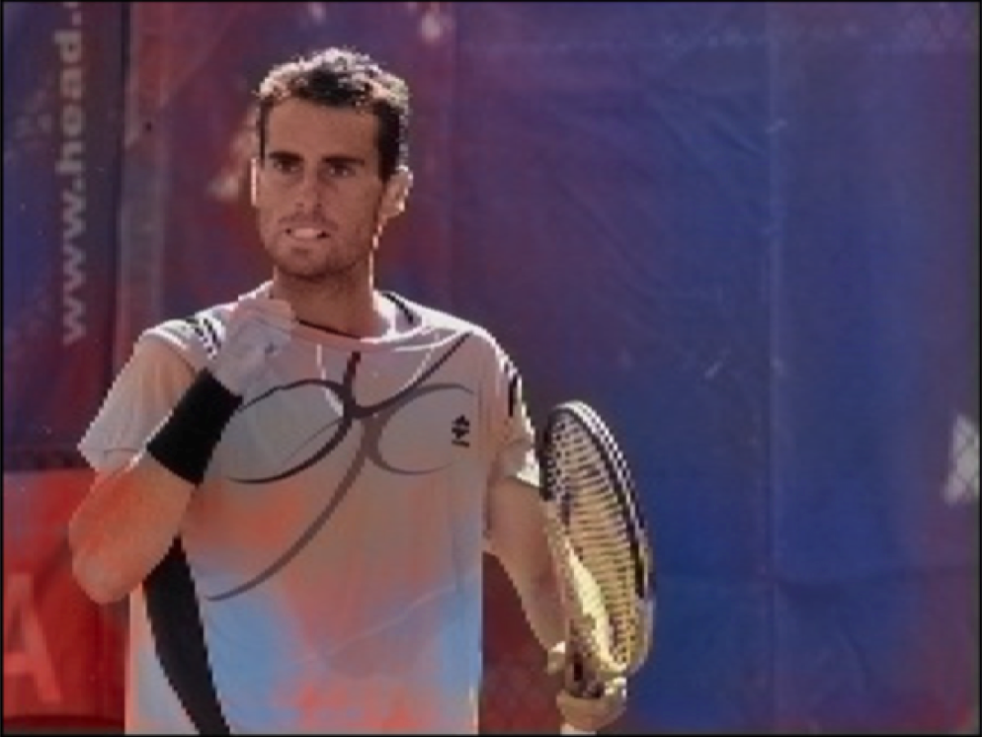
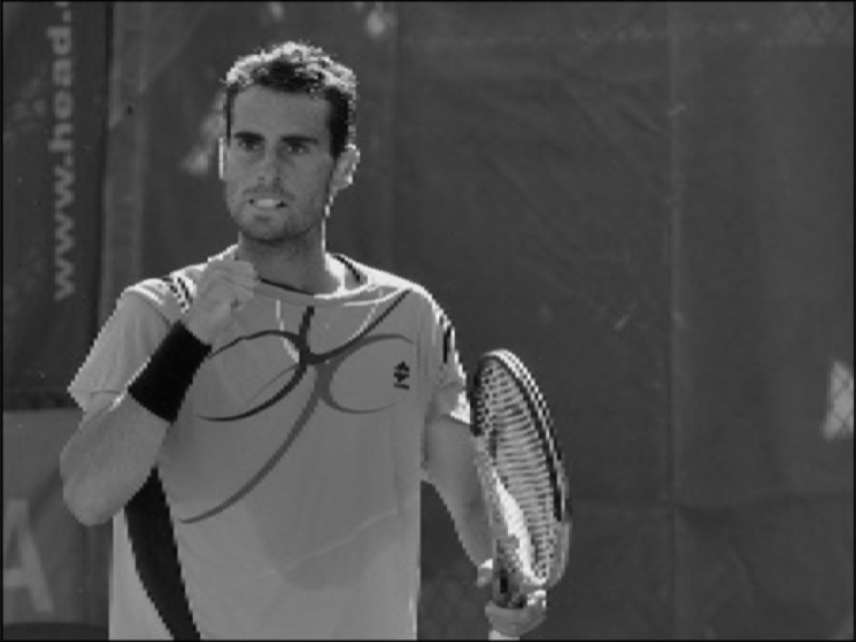
Notes:
But, it still messes up!

Slide 25
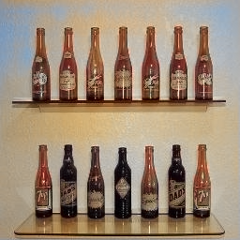
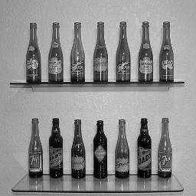

Slide 26
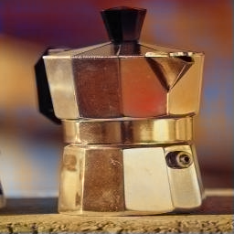
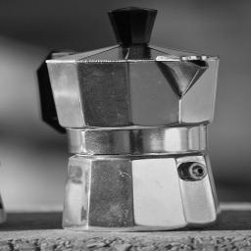

Slide 27
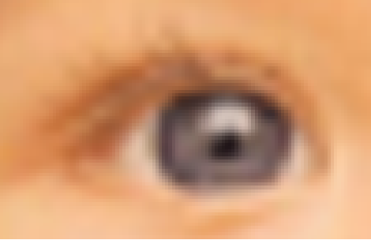
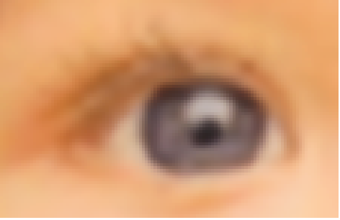
Designing loss functions
Input
Output
“Minimize Euclidean distance between each predicted pixel color and its ground truth value.”
[Johnson, Alahi, Li, ECCV 2016]

Slide 28
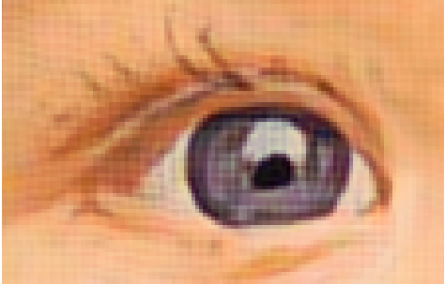
Designing loss functions
Input
Johnson et al. 2016
Match the covariance statistics of deep feature activations.
[Johnson, Alahi, Li, ECCV 2016]
Notes:
But all these problems are pretty much the same: map pixels to pixels.

Slide 29
Structured Losses
Each pixel treated as
independent
Looks at joint configuration
of pixels

Slide 30
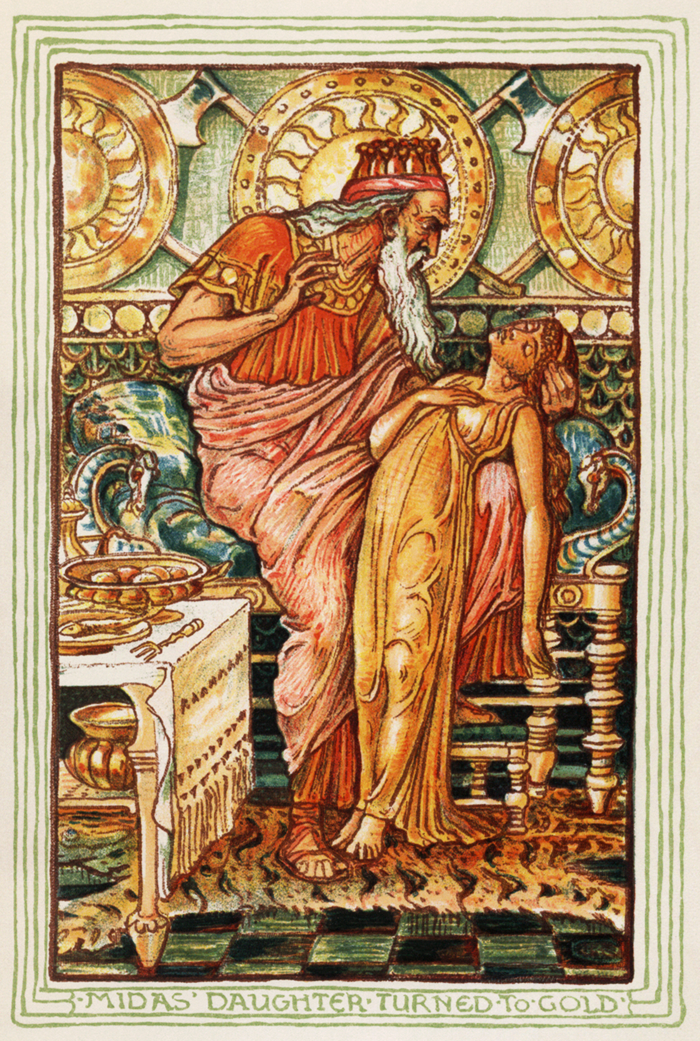
Designing loss functions
Be careful what you wish for!
Notes:
We have to be care not to make Midas’ mistake. If you recall your greek mythology, Midas was a king back in the day, and he was granted a wish, and he wished that everything he touched turned to gold. And then he ended up starving to death because all the food he touched immediately turned to gold. So be careful what you wish for.

Slide 31
Designing loss functions
Image colorization
L2 regression
[Zhang, Isola, Efros, ECCV 2016]
Super-resolution
L2 regression
[Johnson, Alahi, Li, ECCV 2016]
Notes:
So we can carefully engineer our loss functions

Slide 32
Designing loss functions
Image colorization
Cross entropy objective, with colorfulness term
[Zhang, Isola, Efros, ECCV 2016]
Super-resolution
Deep feature covariance matching objective
[Johnson, Alahi, Li, ECCV 2016]
Notes:
So we can carefully engineer our loss functions

Slide 33
Universal loss?
…
…
Notes:
All of these are just predicting pixels from pixels, so shouldn’t there be some universal loss?

Slide 34
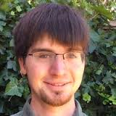
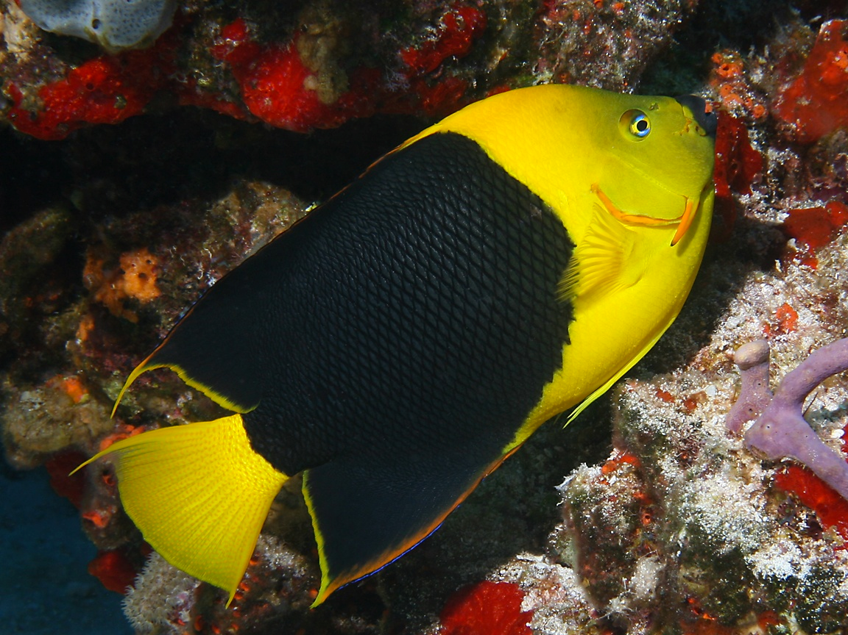
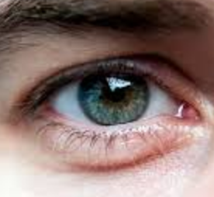
Generated images
“Generative Adversarial Network”
(GANs)
Generated vs Real
(classifier)
…
…
Real photos
[Goodfellow, Pouget-Abadie, Mirza, Xu, Warde-Farley, Ozair, Courville, Bengio 2014]
…
Notes:
motivate with either turk “real vs fake” or graphics
add full citation

Slide 35
Conditional GANs
[Goodfellow et al., 2014]
[Isola et al., 2017]

Slide 36
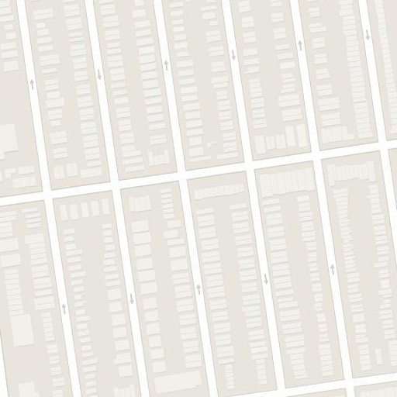
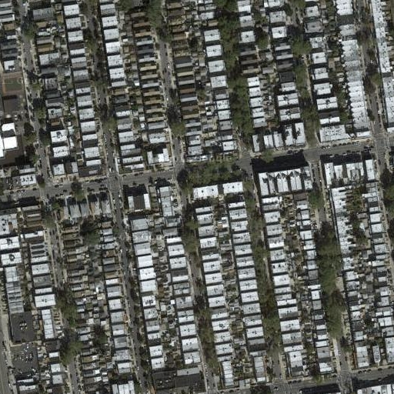
Image-to-Image Translation
“What should I do?”
“How should I do it?”

Slide 37
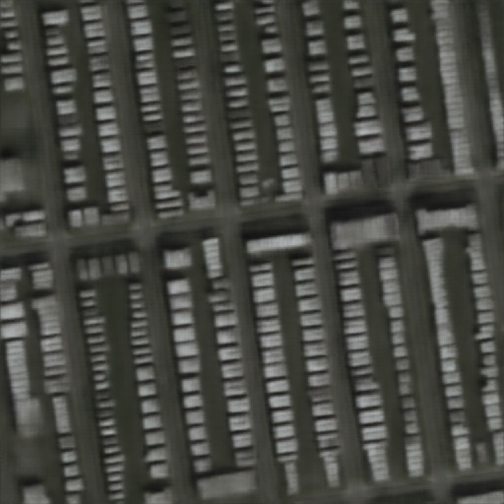
Image-to-Image Translation
“Minimize the distance between each predicted pixel color and its ground truth value.”

Slide 38
Generator
[Goodfellow et al., 2014]

Slide 39
real or fake?
Generator
Discriminator
G tries to synthesize fake images that fool D
D tries to identify the fakes
[Goodfellow et al., 2014]

Slide 40
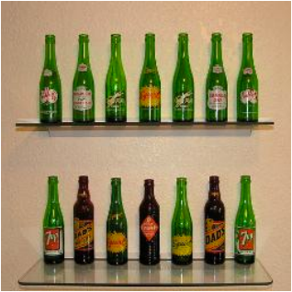
fake (0.9)
real (0.1)
[Goodfellow et al., 2014]

Slide 41
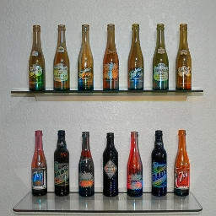
real or fake?
G tries to synthesize fake images that fool D:
[Goodfellow et al., 2014]

Slide 42
real or fake?
G tries to synthesize fake images that fool the best D:
[Goodfellow et al., 2014]

Slide 43
Loss Function
G’s perspective: D is a loss function.
Rather than being hand-designed, it is learned.
[Goodfellow et al., 2014]
[Isola et al., 2017]

Slide 44
real or fake?
[Goodfellow et al., 2014]
Notes:
But what if, given this input, out generator outputs this image? Is it real or is it fake?

Slide 45
real!
(“Aquarius”)
[Goodfellow et al., 2014]

Slide 46
real or fake pair ?
[Goodfellow et al., 2014]
[Isola et al., 2017]

Slide 47
real or fake pair ?
[Goodfellow et al., 2014]
[Isola et al., 2017]

Slide 48
fake pair
[Goodfellow et al., 2014]
[Isola et al., 2017]

Slide 49
real pair
[Goodfellow et al., 2014]
[Isola et al., 2017]

Slide 50
real or fake pair ?
[Goodfellow et al., 2014]
[Isola et al., 2017]

Slide 51
BW → Color
Input
Output
Input
Output
Input
Output
Data from [Russakovsky et al. 2015]

Slide 52
Input
Output
Groundtruth
Data from
[maps.google.com]
Notes:
Again, pixels to pixels!
These are 512x512 but you can run it at any resolution, since it’s fully convolutional.

Slide 53
Input
Output
Groundtruth
Data from [maps.google.com]
Notes:
Note 512x512

Slide 54
Labels → Facades
Input
Output
Data from [Tylecek, 2013]

Slide 55
Labels → Facades
Input
Output
Input
Output
Data from [Tylecek, 2013]

Slide 56
Day → Night
Input
Output
Input
Output
Input
Output
Data from [Laffont et al., 2014]

Slide 57
Edges → Images
Input
Output
Input
Output
Input
Output
Edges from [Xie & Tu, 2015]

Slide 58
Sketches → Images
Input
Output
Input
Output
Input
Output
Trained on Edges → Images
Data from [Eitz, Hays, Alexa, 2012]

Slide 59
#edges2cats [Chris Hesse]

Slide 60
Ivy Tasi @ivymyt
Vitaly Vidmirov @vvid

Slide 61
Hallucinations
Input
Output
Input
Output
Input
Output
Input
Output
Notes:
GAN: when it doesn’t know what to do, when there is no information in the input about how the output should look, it makes stuff up, like these psychedelic colors
L1: when it doesn’t know what to do, it just outputs the most typical response, flat gray mush

Slide 62
Challenges —> Solutions
Output is high-dimensional, structured object
Uncertainty in mapping; many plausible outputs
Lack of supervised training data
—> Use a deep net, D, to analyze output!
“this small bird has a pink breast and crown…”
—> D only cares about “plausibility”, doesn’t hedge

Slide 63
Challenges —> Solutions
Output is high-dimensional, structured object
Uncertainty in mapping; many plausible outputs
Lack of supervised training data
—> Use a deep net, D, to analyze output!
“this small bird has a pink breast and crown…”
—> D only cares about “plausibility”, doesn’t hedge

Slide 64
Paired data
Notes:
However, it requires lots of paired training data, such as, edges and cats.

Slide 65
Paired data
Unpaired data
Notes:
But what if you don’t have access to the corresponding pairs? For example, you want to translate horses to zebras.
In this paper, we learn an image translation, even when we don’t have correspondences.

Slide 66
real or fake pair ?

Slide 67
real or fake pair ?
No input-output pairs!

Slide 68
real or fake?
Usually loss functions check if output matches a target instance
GAN loss checks if output is part of an admissible set

Slide 69
Real!

Slide 70
Real too!
Nothing to force output to correspond to input

Slide 71
Cycle-Consistent Adversarial Networks
[Zhu et al. 2017], [Yi et al. 2017], [Kim et al. 2017]
Notes:
In such cases, given an input horse, all we know is that the output should look like a zebra. We can do this using an adversarial loss on the output. But, is this enough?
Unfortunately, we observed the translator network often ignores the input image completely, and keeps generating random zebras from the target set.
We need another constraint.

Slide 72
Cycle-Consistent Adversarial Networks
Notes:
Here we propose to use the cycle consistency constraint, in the sense that if we translate a sentence from English to French, and then translate it back from French to English, we should arrive back at the original sentence as famously noted by Mark Twain.
The same story here. If we translate a horse to a zebra, and then translate it back, we should get the same horse we started with.

Slide 73
Cycle Consistency Loss
Notes:
Here’s how we implement it.
Given an input image x, we first apply mapping G to translate into domain Y.
Then we apply inverse mapping F to reconstruct the input image x.
We simultaneously optimize G and F to minimize the reconstruction error.

Slide 74
Cycle Consistency Loss
Notes:
We do the same thing in the opposite direction.

Slide 77
Artistic style transfer
[Gatys et al. 2016, …]
…
…

Slide 78
Input
Monet
Van Gogh
Cezanne
Ukiyo-e

Slide 79
Notes:
We can also apply it on video frames, turning a day into night, or everyday street into a video game

Slide 80
Failure case
Notes:
Even our failures || are quite entertaining.
Of course CycleGAN does not always work. Here is a guy riding on a horse. We can create a zebra riding fake news with CycleGAN

Slide 81
Failure case

Slide 82
Applications of CycleGAN
Input MR
Generated CT
Ground truth CT
MRI reconstruction [Quan et al.] arxiv:1709.00753
Cardiac MR images from CT [Chartsias et al. 2017]
Notes:
People have already used CycleGAN in a varities of applications for example, translating MRI to CT scans.
**** adopted CycleGAN to tra medical imaging domain such as MR imaging to CT, or MRI reconstruction

Slide 83
Latest from #CycleGAN
CycleGAN with architectural modifications, by itok_msi
https://qiita.com/itok_msi/items/b6b615bc28b1a720afd7
Notes:
But my favorite is a result I recently saw on Twitter. || As a cat lover, our dream is to transform every dog picture into a cat one. || But if you likes dog, don’t worry. We have the cat->dog transformation as well, just for you.

Slide 84
Challenges —> Solutions
Output is high-dimensional, structured object
Uncertainty in mapping; many plausible outputs
Lack of supervised training data
—> Use a deep net, D, to analyze output!
“this small bird has a pink breast and crown…”
—> D only cares about “plausibility”, doesn’t hedge
—> D doesn’t require paired training instances

Slide 86
Can we generate images from scratch?
Gaussian noise
Synthesized image

Slide 87
Generative adversarial nets (GANs)
Generator net
[Goodfellow et al. 2014]

Slide 88
Generative adversarial nets (GANs)
Generator net
Discriminator net
“fake”
[Goodfellow et al. 2014]

Slide 89
Generative adversarial nets (GANs)
1. Given D, minimize the probability of detection.
2. Given G, maximize classifier accuracy.
Training: iterate between training D and G with backprop.
Global optimum when G reproduces data distribution.

Slide 91
real or fake?
Generator
Discriminator
G tries to synthesize fake images that fool D
D tries to identify the fakes
[Goodfellow et al., 2014]

Slide 92
GANs are implicit generative models
“generative model” of the data x
Noise distribution
Data distribution
GAN
Samples from GAN, at equilibrium, are samples from the data distribution

Slide 93
Randomly generated faces
[BEGAN: Berthelot et al., 2014]

Slide 94
Interpolation in z space
Input A
Interpolation from A to B
Input B

Slide 95
[StackGAN++, Zhang et al. 2017]

Slide 97
Training Data (CIFAR dataset)
[Salimans et al. 2016]
Slide adapted from Ian Goodfellow 2015

Slide 98
Samples
[Salimans et al. 2016]
Slide adapted from Ian Goodfellow 2015

Slide 99
fake (0.9)
real (0.1)
[Goodfellow et al., 2014]

Slide 100
real or fake?
G tries to synthesize fake images that fool D:
[Goodfellow et al., 2014]

Slide 101
real or fake?
G tries to synthesize fake images that fool the best D:
[Goodfellow et al., 2014]

Slide 102
from [Goodfellow, 2016]

Slide 103
from [Goodfellow, 2016]

Slide 104
[Theis et al. 2016]

Slide 105
fake (0.9)
real (0.1)
[Goodfellow et al., 2014]

Slide 106
low score
high score
EBGAN, WGAN, LSGAN, etc

Slide 108
Representation learning

Slide 109
Code online: https://github.com/phillipi
Pix2pix: 144 lines
CycleGAN: 220 lines

