Slide 1
Feature Learning with
Neural Networks
(aka Deep Learning)
CS194: Intro to Computer Vision and Comp. Photo
Alexei Efros, UC Berkeley, Fall 2020

Slide 2
The story so far…
Neurons show increasing specificity higher in the visual pathway
V1 simple and complex cells are orientation-tuned
Convolution with a linear kernel followed by simple non-linearities is a good model for computation in retina, LGN and V1, but beyond that we do not have satisfactory computational models
Good designs of visual systems are likely to be hierarchical and “mostly” feedforward
Notes:
No response to intensity ramps -- important benefit compared to simple comparison of intensities at i and j

Slide 3
Learned filters

Slide 4
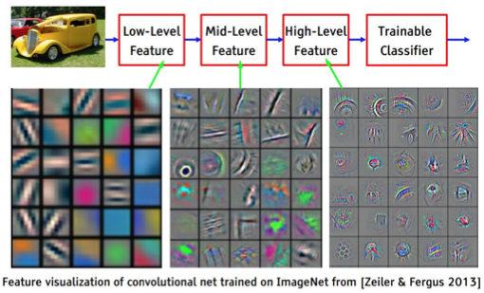
[ slide courtesy Yann LeCun ]
Notes:
TODO sequence: include in feature tour, net intro, or convnet?

Slide 5
Next Step
To learn good features, we need a task!

Slide 6
Quick Background on
Supervised Learning
Slides from Jitendra Malik

Slide 7
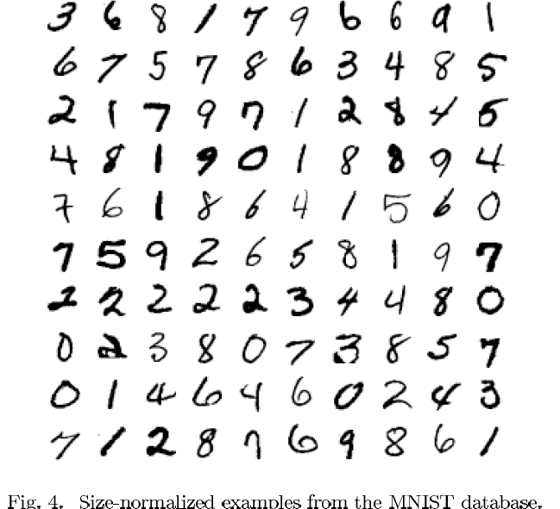

Slide 8
The MNIST DATABASE of handwritten digits yann.lecun.com/exdb/mnist/
Yann LeCun & Corinna Cortes
Has a training set of 60 K examples (6K examples for each digit), and a test set of 10K examples.
Each digit is a 28 x 28 pixel grey level image. The digit itself occupies the central 20 x 20 pixels, and the center of mass lies at the center of the box.
“It is a good database for people who want to try learning techniques and pattern recognition methods on real-world data while spending minimal efforts on preprocessing and formatting.”

Slide 9
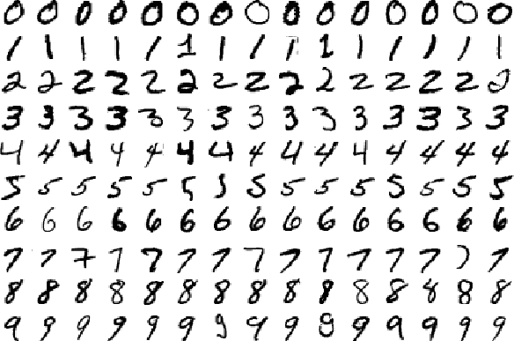
Warm-up Example:
Binary Digit Classification
vs.

Slide 10

Learning Approach to Object Recognition
Collect Training Images
  Positive:
  Negative:
Training Time
  Compute feature vectors for positive and negative example images
  Train a classifier
Test Time
  Compute feature vector on new test image:
  Evaluate classifier

Slide 11
Let us take an example…

Slide 12
Let us take an example…

Slide 13
In feature space, positive and negative examples are just points…

Slide 14
How do we classify a new point?

Slide 15
Nearest neighbor rule
“transfer label of nearest example”

Slide 16
Linear classifier rule

Slide 17
Two kinds of error
Training set error
  We train a classifier to minimize training set error.
Test set error
  At run time, we will take the trained classifier and use it to classify previously unseen examples. The error on these is called test set error.
Overfitting
  If the test set error is much greater than training set error

Slide 18
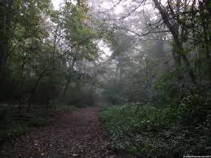
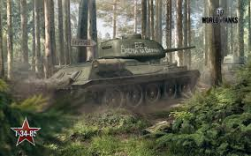
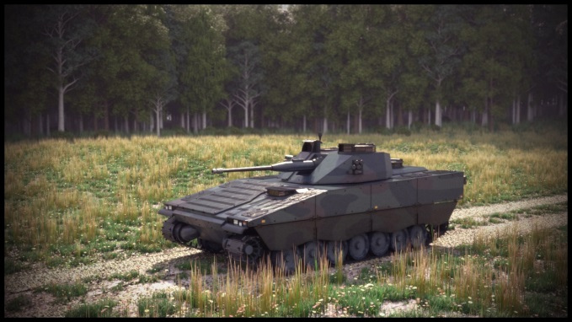
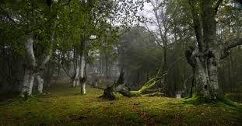
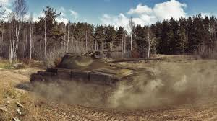
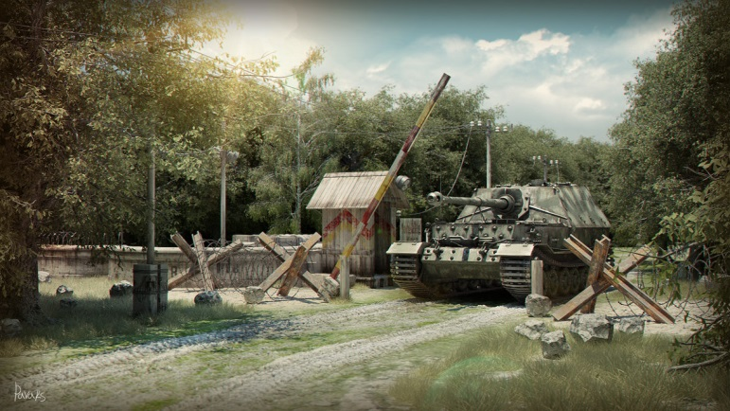
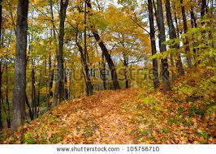
Historical (?) Anecdote
In the 1970s, DARPA wanted to find tanks in photographs…
Positive
Set
Negative
Set

Slide 19
Validation and Cross-Validation
To avoid over-fitting, we can measure error on a held-out set of training data, called the validation set.
What if we can’t spare so much data?
We could divide the data into k-folds, use k-1 of these to train and test on the remaining fold. This is cross-validation
  In the limit, leave-one-out-cross-validation

Slide 20
Different approaches to training classifiers
Nearest neighbor methods
Neural networks
Support vector machines
Randomized decision trees
…

Slide 21
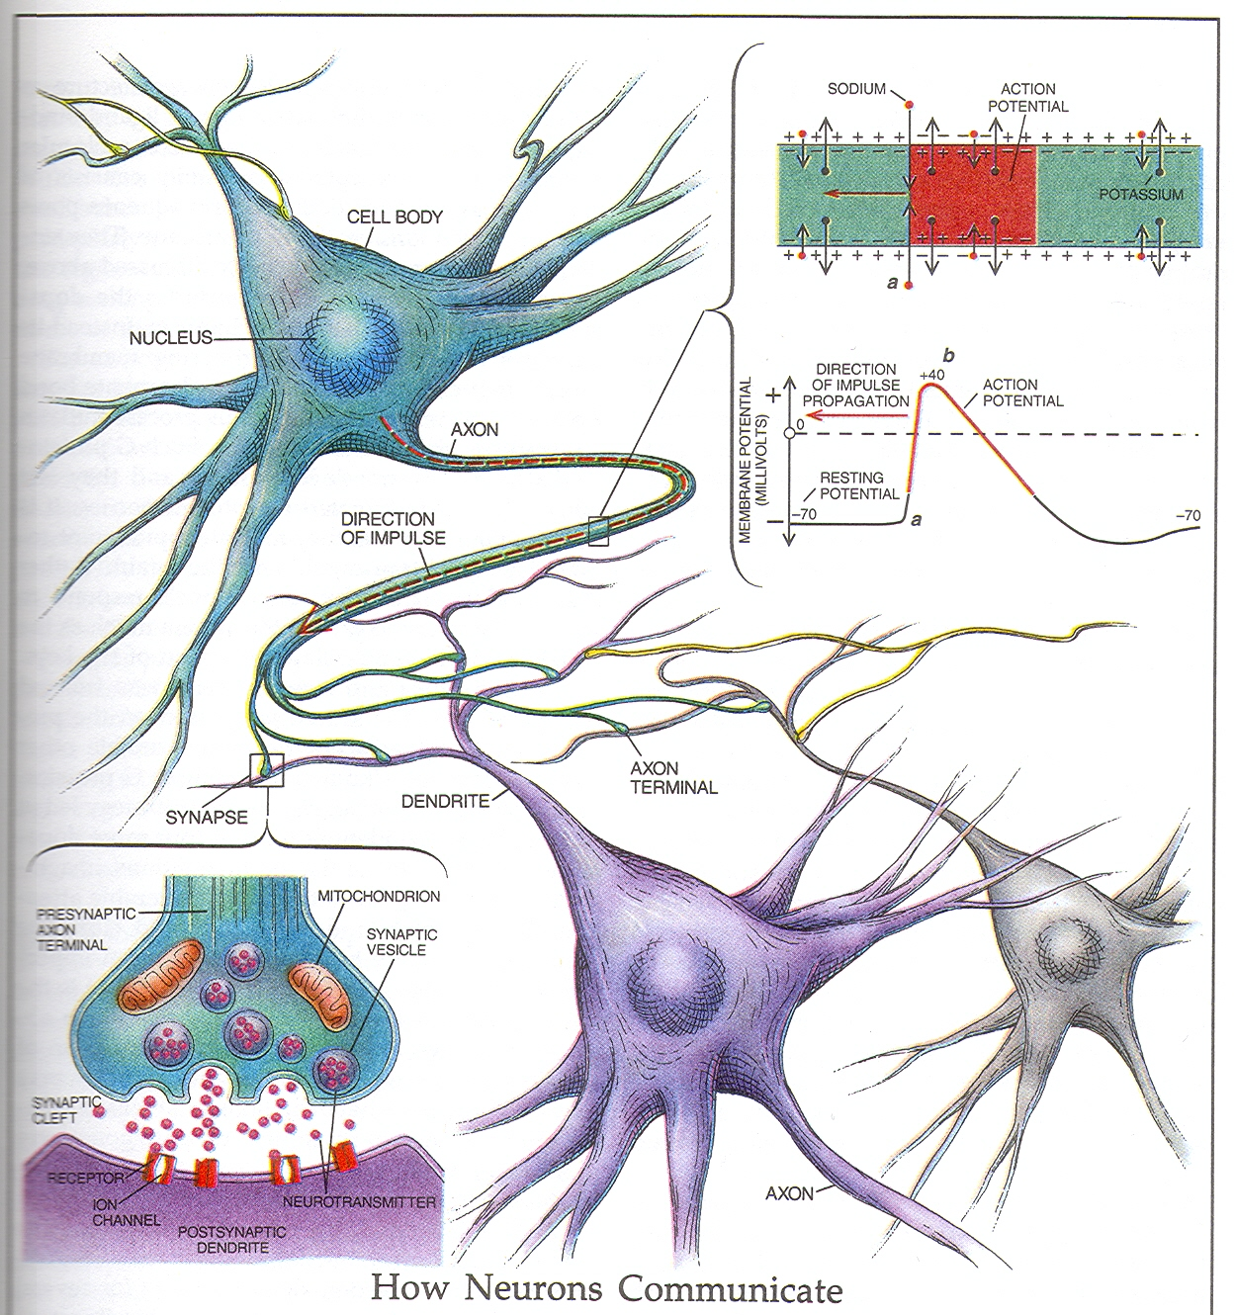
Beware of the
“Half-life of
Knowledge”!

Slide 22
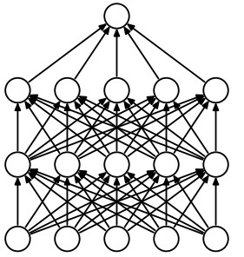
“neural network” model
Each neuron receives inputs from other neurons
The effect of each input line on the neuron is controlled
by a synaptic weight
  The weights can be positive or negative.
The synaptic weights adapt so that the whole network learns to perform useful computations
  Recognizing objects, understanding language, making plans, controlling the body.
You have about neurons each with about weights.
Slide by Geoff Hinton

Slide 23
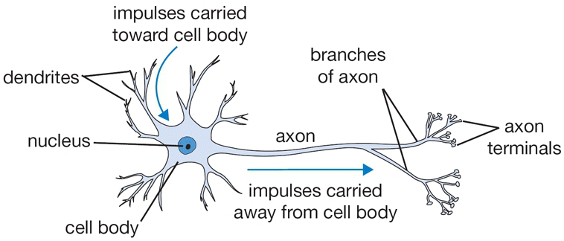
Source: Andrej Karpathy & Fei-Fei Li

Slide 24
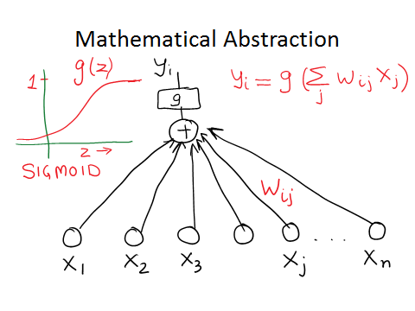
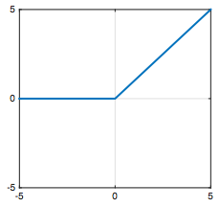


Rectified linear unit
(ReLU)

Slide 25
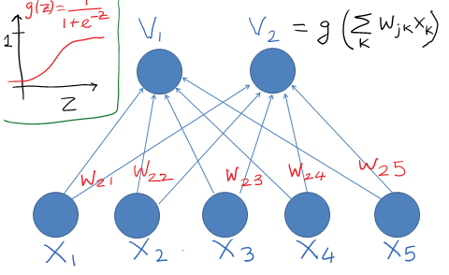
Rectified linear unit
(ReLU)

Slide 26
A very simple way to recognize handwritten shapes
Consider a neural network with two layers of neurons.
  neurons in the top layer represent known shapes.
  neurons in the bottom layer represent pixel intensities.
A pixel gets to vote if it has ink on it.
  Each inked pixel can vote for several different shapes.
The shape that gets the most votes wins.
0 1 2 3 4 5 6 7 8 9
Slide by Geoff Hinton

Slide 27
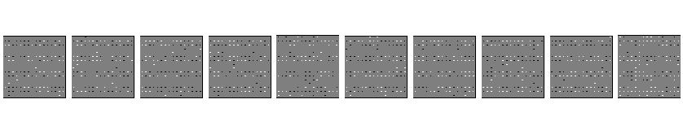
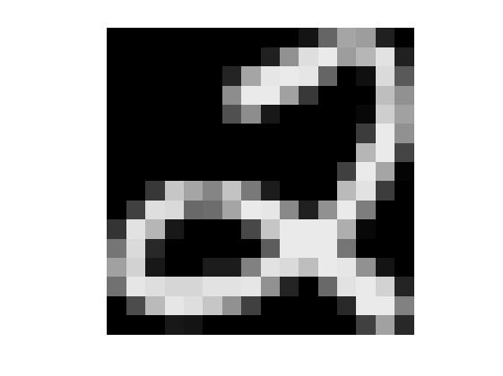
How to display the weights
1 2 3 4 5 6 7 8 9 0
The input image
Give each output unit its own “map” of the input image and display the weight coming from each pixel in the location of that pixel in the map.
Use a black or white blob with the area representing the magnitude of the weight and the color representing the sign.
Slide by Geoff Hinton

Slide 28
How to learn the weights
1 2 3 4 5 6 7 8 9 0
The image
Show the network an image and increment the weights from active pixels to the correct class.
Then decrement the weights from active pixels to whatever class the network guesses.
Slide by Geoff Hinton

Slide 29
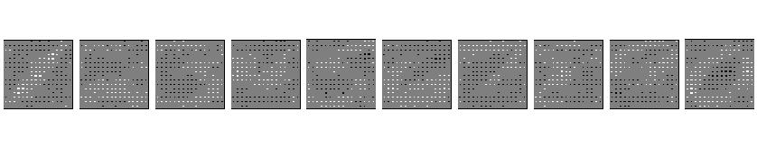
1 2 3 4 5 6 7 8 9 0
The image
Slide by Geoff Hinton

Slide 30
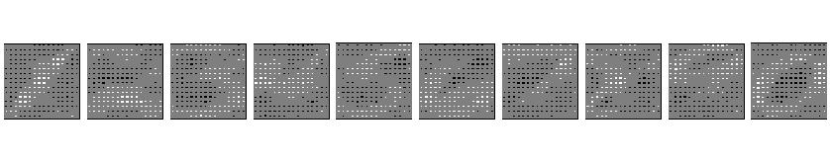
1 2 3 4 5 6 7 8 9 0
The image
Slide by Geoff Hinton

Slide 31
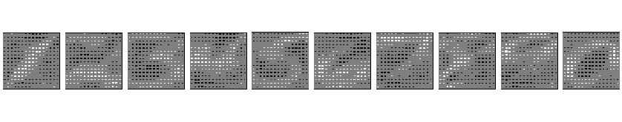
1 2 3 4 5 6 7 8 9 0
The image
Slide by Geoff Hinton

Slide 32
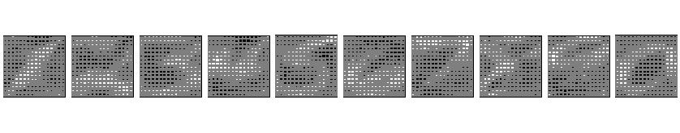
1 2 3 4 5 6 7 8 9 0
The image
Slide by Geoff Hinton

Slide 33
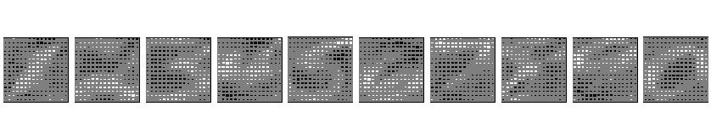
1 2 3 4 5 6 7 8 9 0
The image
Slide by Geoff Hinton

Slide 34
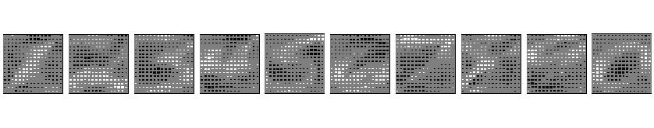
The learned weights
1 2 3 4 5 6 7 8 9 0
The image
Slide by Geoff Hinton

Slide 35
Why the simple learning algorithm is insufficient
A two layer network with a single winner in the top layer is equivalent to having a rigid template for each shape.
  The winner is the template that has the biggest overlap with the ink.
The ways in which hand-written digits vary are much too complicated to be captured by simple template matches of whole shapes.
Slide by Geoff Hinton

Slide 36


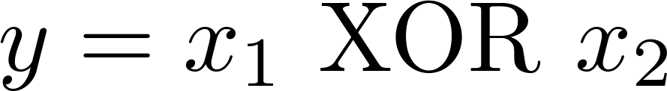
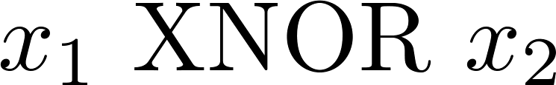

Non-linear classification example: XOR/XNOR
, are binary (0 or 1).
x₂
x₂
x₁
x₁

Slide 37


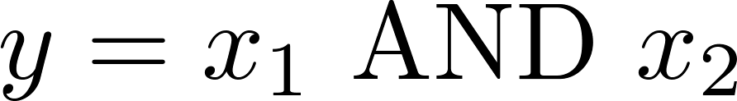





Simple example: AND
1.0
0 | 0
0 | 1
1 | 0
1 | 1

Slide 38
Example: OR function
-10
0 | 0
0 | 1
1 | 0
1 | 1
20
20

Slide 39
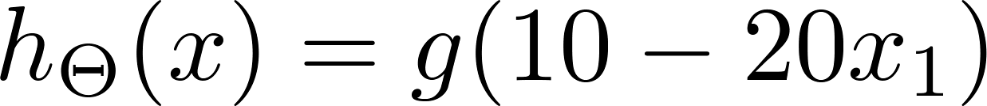
Negation:
0
1

Slide 40








Putting it together:
-30
10
-10
20
-20
20
20
-20
20
0 | 0
0 | 1
1 | 0
1 | 1

Slide 41

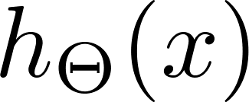



Neural Network learning its own features
Layer 1
Layer 2
Layer 3

Slide 42
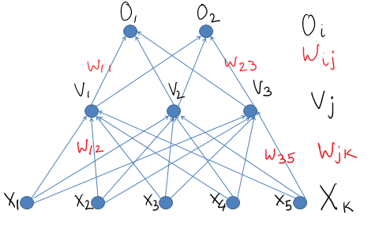

Slide 43
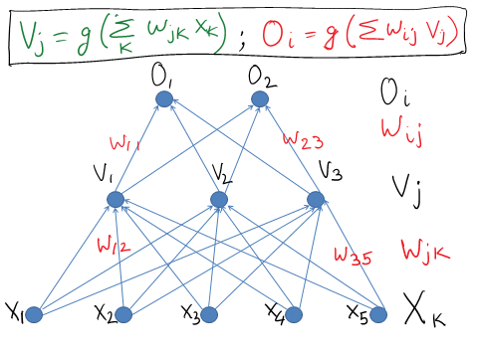

Slide 44
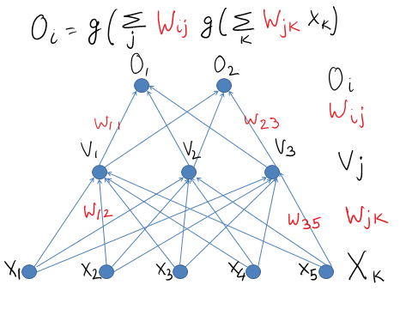
Notes:
Why logistic at each level?

Slide 45
Training a neural network

Slide 46
Training a neural network

Slide 47
Training a neural network
https://www.youtube.com/watch?v=bxe2T-V8XRs

Slide 48
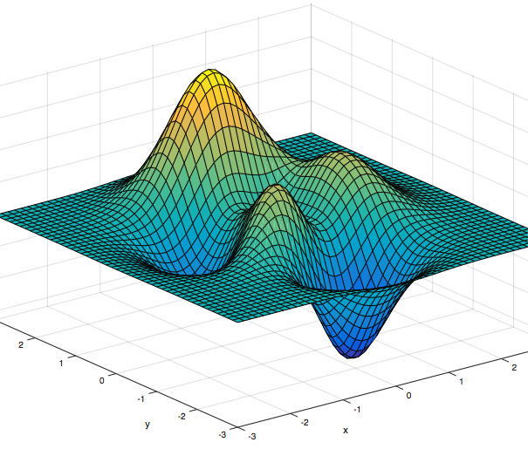

Gradient descent

Slide 49
Convolutional Neural Networks
CS194: Computer Vision and Comp. Photo
Alexei Efros, UC Berkeley, Fall 2020

Slide 50
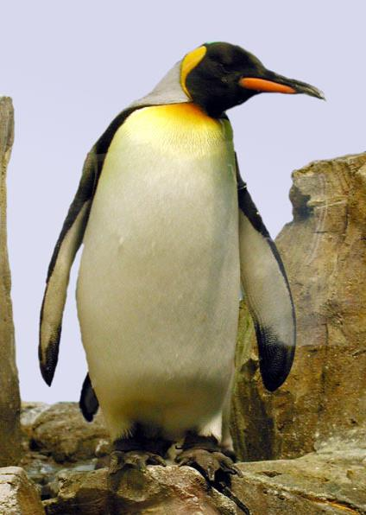

Neural Nets: a particularly useful Black Box
Convolutional Neural Network
“Penguin”
image X
label Y

Slide 51
Classic Object Recognition
Feature extractors
Classifier
Edges
Segments
Texture
“Penguin”
Parts
Colors
image X
label Y
Slide by Philip Isola

Slide 52

Classic Object Recognition
Learned
Feature extractors
Classifier
Edges
Segments
Texture
“Penguin”
Parts
Colors
image X
label Y
Slide by Philip Isola

Slide 53
Learning Features
Learned
Feature extractors
Edges
Texture
Colors
image X
label Y

Slide 54
Neural Network: algorithm + feature + data!
Learned
“Penguin”
image X
label Y
Slide by Philip Isola

Slide 55

Vanilla (fully-connected)
Neural Networks

Slide 56
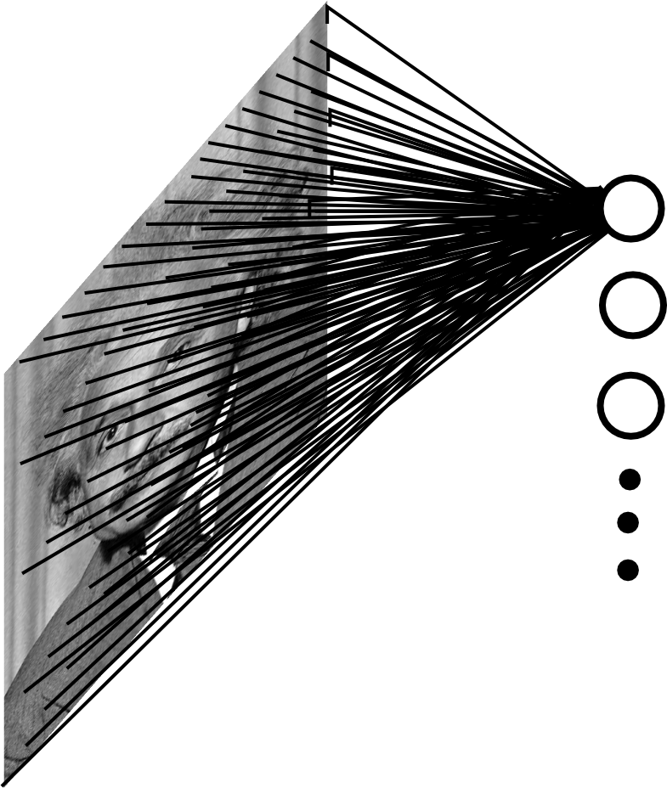

Fully Connected Layer
Example: 200x200 image
40K hidden units
~2B parameters!!!
- Spatial correlation is local
Waste of resources + we have not enough
training samples anyway..
Ranzato

Slide 57
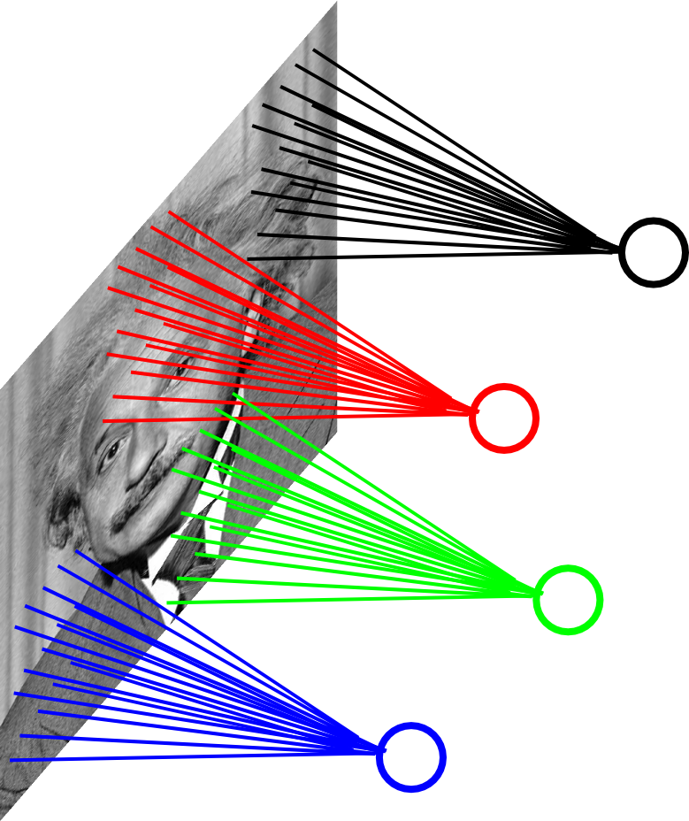
Locally Connected Layer
Example: 200x200 image
40K hidden units
Filter size: 10x10
4M parameters
Note: This parameterization is good when
input image is registered (e.g., face recognition).
Ranzato

Slide 58
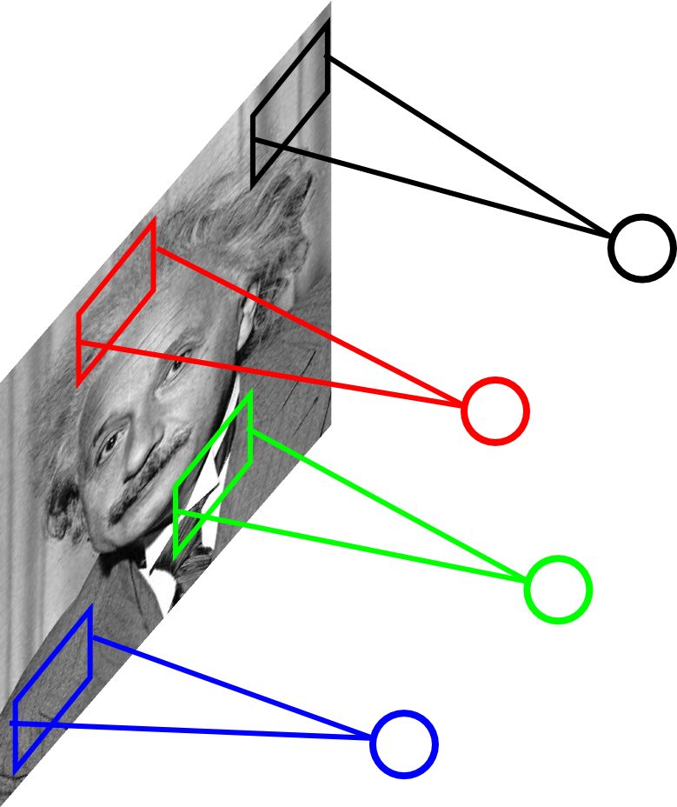
Locally Connected Layer
STATIONARITY? Statistics is similar at
different locations
Example: 200x200 image
40K hidden units
Filter size: 10x10
4M parameters
Ranzato

Slide 59
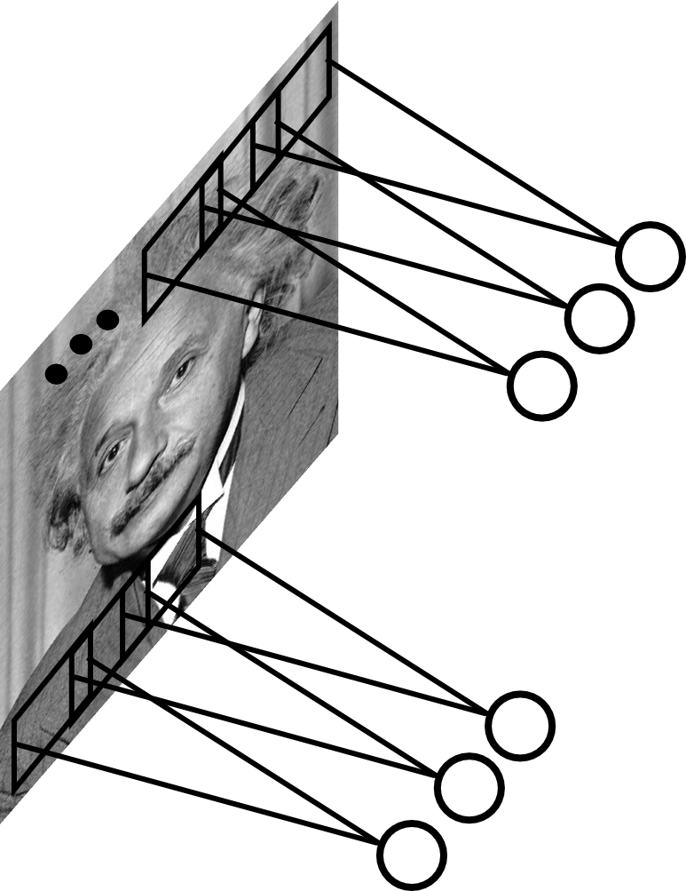
Convolutional Layer
Share the same parameters across different
locations (assuming input is stationary):
Convolutions with learned kernels
Ranzato

Slide 60
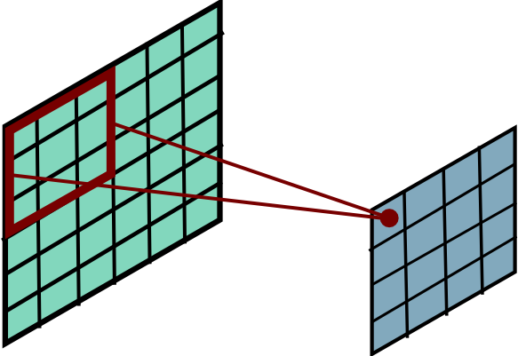
Convolutional Layer
Ranzato

Slide 61
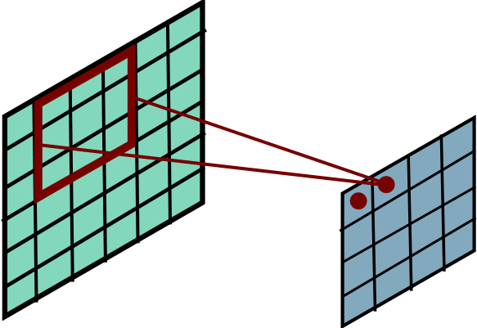
Convolutional Layer
Ranzato

Slide 62
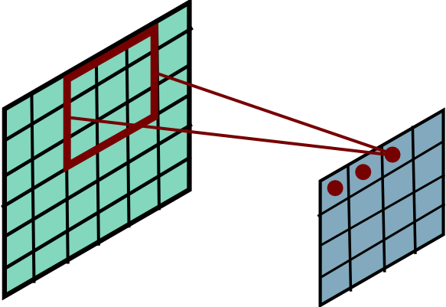
Convolutional Layer
Ranzato

Slide 63
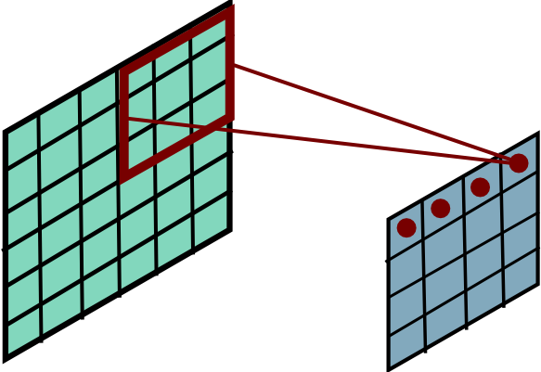
Convolutional Layer
Ranzato

Slide 64
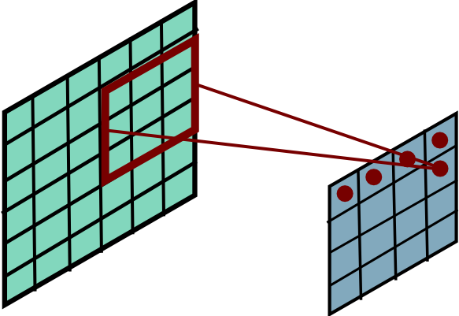
Convolutional Layer
Ranzato

Slide 65
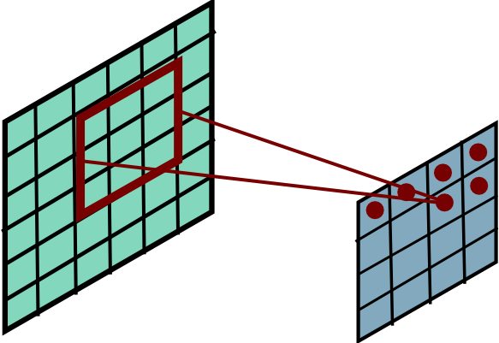
Convolutional Layer
Ranzato

Slide 66
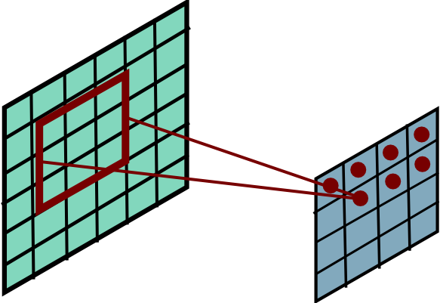
Convolutional Layer
Ranzato

Slide 67
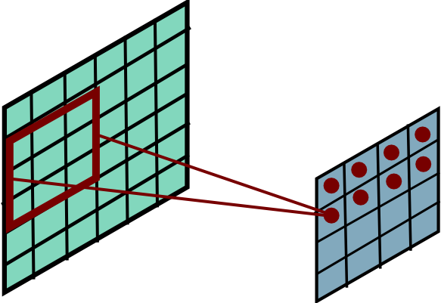
Convolutional Layer
Ranzato

Slide 68
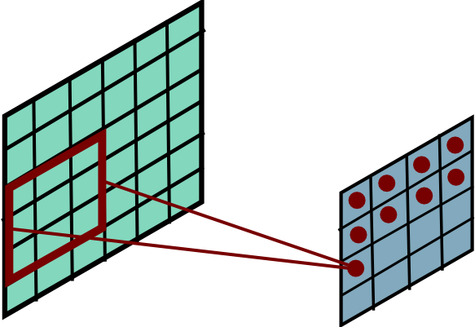
Convolutional Layer
Ranzato

Slide 69
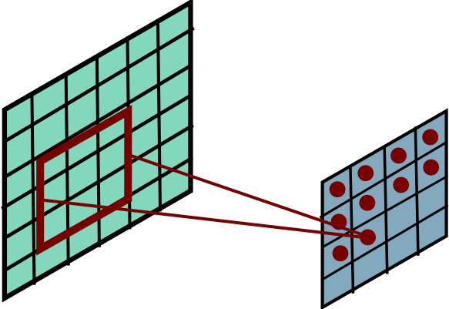
Convolutional Layer
Ranzato

Slide 70
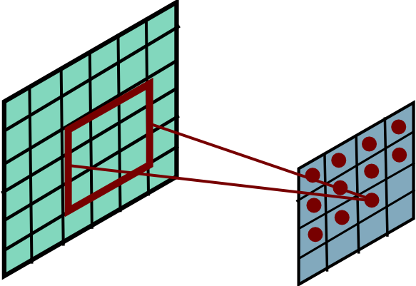
Convolutional Layer
Ranzato

Slide 71
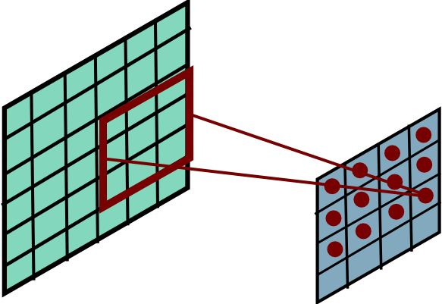
Convolutional Layer
Ranzato

Slide 72

Convolutional Layer
Ranzato

Slide 73

Convolutional Layer
Ranzato

Slide 74

Convolutional Layer
Ranzato

Slide 75

Convolutional Layer
Ranzato

Slide 76


Convolutional Layer
Learn multiple filters.
E.g.: 200x200 image
100 Filters
Filter size: 10x10
10K parameters
Ranzato

Slide 77
before:
output layer
input layer
hidden layer
now:

Slide 78
Convolution Layer
32x32x3 image
32
height
32
width
3
depth

Slide 79
Convolution Layer
32x32x3 image
5x5x3 filter
32
Convolve the filter with the image
i.e. “slide over the image spatially, computing dot products”
32
3

Slide 80
Convolution Layer
Filters always extend the full depth of the input volume
32x32x3 image
5x5x3 filter
32
Convolve the filter with the image
i.e. “slide over the image spatially, computing dot products”
32
3

Slide 81


Convolution Layer
32x32x3 image
5x5x3 filter
32
1 number:
the result of taking a dot product between the filter and a small 5x5x3 chunk of the image
(i.e. 5*5*3 = 75-dimensional dot product + bias)
32
3

Slide 82
Convolution Layer
activation map
32x32x3 image
5x5x3 filter
32
28
convolve (slide) over all spatial locations
32
28
3
1

Slide 83
consider a second, green filter
Convolution Layer
32x32x3 image
5x5x3 filter
activation maps
32
28
convolve (slide) over all spatial locations
32
28
3
1

Slide 84
For example, if we had 6 5x5 filters, we’ll get 6 separate activation maps:
activation maps
32
28
Convolution Layer
32
28
3
6
We stack these up to get a “new image” of size 28x28x6!

