Slide 1
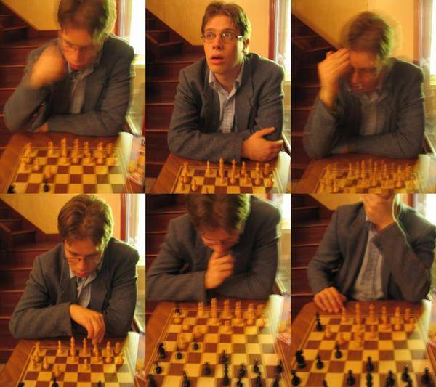
Data-driven methods: Video & Texture
© A.A. Efros
CS194: Intro to Computer Vision & Comp. Photography
Alexei Efros, UC Berkeley, Fall 2020

Slide 2
Michel Gondry train video
http://www.youtube.com/watch?v=0S43IwBF0uM

Slide 3
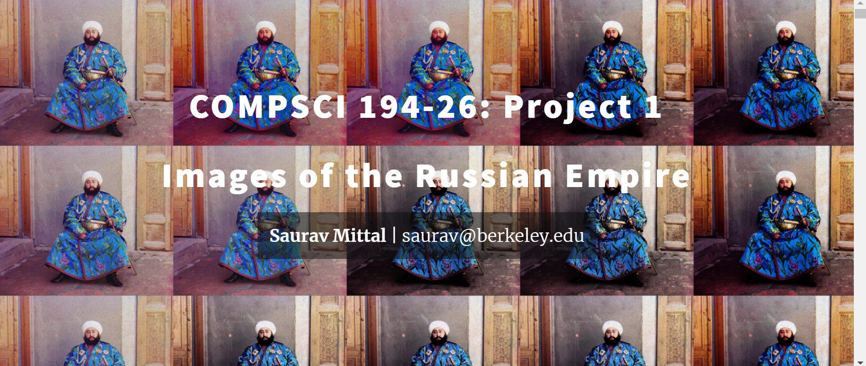
Class Choice award!

Slide 4
Weather Forecasting for Dummies™
Let’s predict weather:
Given today’s weather only, we want to know tomorrow’s
Suppose weather can only be {Sunny, Cloudy, Raining}
The “Weather Channel” algorithm:
Over a long period of time, record:
How often S followed by R
How often S followed by S
Etc.
Compute percentages for each state:
P(R|S), P(S|S), etc.
Predict the state with highest probability!
It’s a Markov Chain

Slide 5
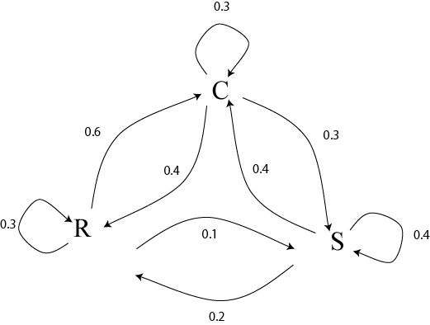
Markov Chain
What if we know today and yestarday’s weather?

Slide 6
Text Synthesis
[Shannon,’48] proposed a way to generate English-looking text using N-grams:
Assume a generalized Markov model
Use a large text to compute prob. distributions of each letter given N-1 previous letters
Starting from a seed repeatedly sample this Markov chain to generate new letters
Also works for whole words
WE NEED
TO
EAT
CAKE

Slide 7
Mark V. Shaney (Bell Labs)
Results (using alt.singles corpus):
“As I've commented before, really relating to someone involves standing next to impossible.”
“One morning I shot an elephant in my arms and kissed him.”
“I spent an interesting evening recently with a grain of salt”

Slide 8
Video Textures
Arno Schödl
Richard Szeliski
David Salesin
Irfan Essa
Microsoft Research, Georgia Tech
Notes:
Hi, video textures is a work that I started last year at Microsoft Research with Richard and David and continued at Georgia Tech with Richard, David and Irfan, my advisor.

Slide 9
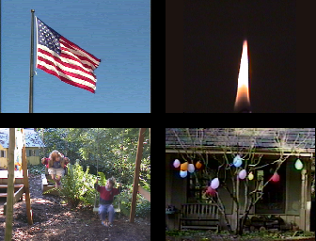
Still photos
Notes:
Everybody knows that a picture is worth a thousand words. Pictures are great, because they are timeless, we can look at them whenever and for as long as we want. But for highly dynamic scenes a single still picture can only hint at the movement involved.

Slide 10
Video clips
Notes:
Videos are better, because they actually show the motion. Unfortunately, video clips have a finite duration, after which they stop, or maybe start over. As you can see here, this causes an ugly discontinuity, which we would like to avoid.

Slide 11
Video textures
Notes:
In this paper, we want to analyze regular video clips and turn them into video textures that play continuously for as long as you like. They combine the timeless quality of a photograph with the motion of a video. We call them video textures because video textures capture a pattern in time, as regular texture capture a pattern in space. They could be used on web pages, for movie backgrounds, training videos or computer games.

Slide 12
Problem statement
video clip
video texture
Notes:
As a reminder, here is our problem again: We want to turn a video clip of finite duration, that stops and starts over, into an infinitely playing video texture.

Slide 13
Our approach
How do we find good transitions?
Notes:
How do we solve this problem? Here is an example of a video texture. Instead of playing the video from the beginning to end, we jump around in the sequence and continuously play pieces of the original video. The red bar shows which frames are currently being played. The arcs show the transitions that we are using to jump from one part of the sequence to another. The arc lights up when we are actually taking the transition.
Of course, we cannot just jump around randomly. This would look as jerky as the original video clip when it starts over. So the question is, how do we find transitions that are not noticeable for the viewer?

Slide 14
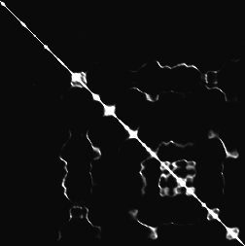
Finding good transitions
Compute L₂ distance D_{i, j} between all frames
vs.
frame i
frame j
Similar frames make good transitions
Notes:
When two frames are very similar, we can jump from one to the other without anybody noticing. So let’s compute the similarity between all pairs of frames in our sequence. We chose to use the L2 intensity difference as a metric because it is simple and worked well.
This matrix shows the difference of every frame against every other frame. The bright diagonal indicates that frames are similar to themselves and also to their neighbors in the sequence. But we also notice that sometimes frames quite far apart in the sequence are also similar to each other. These frame pairs are good candidates for transitions.

Slide 15
Markov chain representation
Similar frames make good transitions
Notes:
We now want to turn this matrix into a Markov chain, whose states are frames, and whose transitions are jumps from one frame to another. We want to make transitions more likely if they connect similar frames. We represent these by fatter arrows in the diagram on the right.

Slide 16
Transition costs
Transition from i to j if successor of i is similar to j
Cost function: C_{i→j} = D_{i+1, j}
Notes:
More specifically, suppose we have just shown frame i, and now want to transition to frame j. We are in fact replacing the successor of frame i with frame j. So the successor of frame i, frame i+1, should be similar to frame j. We define the cost of the transition from i to j as the difference between those two frames.

Slide 17
Transition probabilities
Probability for transition P_{i→j} inversely related to cost:
P_{i→j} ~ exp ( – C_{i→j} / σ² )
high σ
low σ
Notes:
To build the Markov chain, all that is left is turning the cost function into a probability. Low cost should mean high probability and vice versa. We map the cost through an exponential to do that, but any other monotonically decreasing function good be used instead.
At the bottom you can see the effect of the parameter sigma on the generated video. High sigmas produce a more randomly ordered video, low sigmas use only the best transitions, but run the risk of being too repetitive.

Slide 18
Preserving dynamics
Notes:
Let’s look at this example that we generated using the same technique. Something is not working here. The pendulum erratically changes directions. Why is this?

Slide 19
Preserving dynamics
Notes:
Look at the sequence on the top. The pendulum is swinging from left to right. But the center frame matches to both frames on the bottom. While the red sequence shows the same left to right motion as the orange sequence, the blue sequence shows a pendulum swing from right to left, so the transition suddenly reverses the motion! To prevent that, we could explicitly estimate the motion in the image, but there is a much simpler solution. Instead of single frames we compare small subsequences of frames, because then the orange sequence will be similar to the red, but not to the blue sequence.

Slide 20
Preserving dynamics
Cost for transition i→j
C_{i→j} = w_{k} D_{i+k+1, j+k}
Notes:
So let’s make the transition cost a weighted sum over a small window of frames. The window is taken symmetrically around the position of the transition.

Slide 21
Preserving dynamics – effect
Cost for transition i→j
C_{i→j} = w_{k} D_{i+k+1, j+k}
Notes:
If we use this new cost function, our pendulum swings correctly.

Slide 22
Dead ends
No good transition at the end of sequence
Notes:
There is another problem I have not talked about. Let’s look at this sequence. As always, even if there is a good loop, the system can still run all the way to the end of the sequence. In this particular example, at the end a hand comes into the picture. Since the hand never moves out of the picture again, the system has no smooth way to jump back. If it would jump, the hand would suddenly disappear. Instead, the best solution is to stay in the last frame. The system gets stuck in the dead-end.

Slide 23
Future cost
Propagate future transition costs backward
Iteratively compute new cost
F_{i→j} = C_{i→j} + α min_{k} F_{j→k}
Notes:
To solve this problem, we have to anticipate when taking a transition gets us into trouble. We do this by propagating the cost of future transitions backward in time, the future high cost transitions influence the cost of earlier transitions. Let’s look at the formula for a second, in the context of the example. It would compute the minimum cost transition out of frame 4, which has actually pretty high cost, and adds this cost, discounted by some factor alpha, to the transition cost from frame 3 to frame 4. This is done iteratively until all transition costs are propagated through the system. In our example the cost of the transition leading into the dead-end grows and the probability of taking this transition goes down.

Slide 24
Future cost
Propagate future transition costs backward
Iteratively compute new cost
F_{i→j} = C_{i→j} + α min_{k} F_{j→k}
Notes:
To solve this problem, we have to anticipate when taking a transition gets us into trouble. We do this by propagating the cost of future transitions backward in time, the future high cost transitions influence the cost of earlier transitions. Let’s look at the formula for a second, in the context of the example. It would compute the minimum cost transition out of frame 4, which has actually pretty high cost, and adds this cost, discounted by some factor alpha, to the transition cost from frame 3 to frame 4. This is done iteratively until all transition costs are propagated through the system. In our example the cost of the transition leading into the dead-end grows and the probability of taking this transition goes down.

Slide 25
Future cost
Propagate future transition costs backward
Iteratively compute new cost
F_{i→j} = C_{i→j} + α min_{k} F_{j→k}
Notes:
To solve this problem, we have to anticipate when taking a transition gets us into trouble. We do this by propagating the cost of future transitions backward in time, the future high cost transitions influence the cost of earlier transitions. Let’s look at the formula for a second, in the context of the example. It would compute the minimum cost transition out of frame 4, which has actually pretty high cost, and adds this cost, discounted by some factor alpha, to the transition cost from frame 3 to frame 4. This is done iteratively until all transition costs are propagated through the system. In our example the cost of the transition leading into the dead-end grows and the probability of taking this transition goes down.

Slide 26
Future cost
Propagate future transition costs backward
Iteratively compute new cost
F_{i→j} = C_{i→j} + α min_{k} F_{j→k}
Notes:
To solve this problem, we have to anticipate when taking a transition gets us into trouble. We do this by propagating the cost of future transitions backward in time, the future high cost transitions influence the cost of earlier transitions. Let’s look at the formula for a second, in the context of the example. It would compute the minimum cost transition out of frame 4, which has actually pretty high cost, and adds this cost, discounted by some factor alpha, to the transition cost from frame 3 to frame 4. This is done iteratively until all transition costs are propagated through the system. In our example the cost of the transition leading into the dead-end grows and the probability of taking this transition goes down.

Slide 27
Future cost
Propagate future transition costs backward
Iteratively compute new cost
F_{i→j} = C_{i→j} + α min_{k} F_{j→k}
Q-learning
Notes:
The algorithm that we are using is known as Q-learning in the machine learning community. It is commonly used in robotics to teach a robot to find its way through a maze, for example.

Slide 28
Final result

Slide 29
Finding good loops
Alternative to random transitions
Precompute set of loops up front
Notes:
So far I have talked about making random transition choices. In the paper we describe an alternative way to find transitions. We can use a dynamic programming algorithm to precompute a good set of loops that can be played with any conventional video player that supports looping.
You see here three such precomputed loops. For details look into the paper.

Slide 30
Video portrait
c.f. Harry Potter
Notes:
Here we apply the techniques that I have described so far to a video of a woman smiling. A video like this could replace the portrait on people’s home pages.

Slide 31
Region-based analysis
Divide video up into regions
Generate a video texture for each region
Notes:
So far we have processed the image as a whole. Sometimes we can easily divide the image into several regions, compute a video texture for every region individually, and put the result back together. In this example the division was done manually.

Slide 32
User-controlled video textures
User selects target frame range
slow
variable
fast
Notes:
So far the only criterion for selecting transitions was the smoothness of the transition. By augmenting our error function with external constraints, the user can select which part of the video to play by moving the dark band. <play>
These videotextures are generated from a video of a runner, who starts slowly and gradually speeds up. In the left video we prefer frames early in the sequence, so the runner is running slowly. In the right video we prefer late frames, so the runner is running fast. In the middle we change between slow and fast pace. Notice that the motion now matches the slow runner on the left, and now the fast runner on the right.

Slide 33
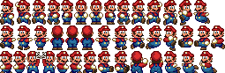
Video-based animation
Like sprites computer games
Extract sprites from real video
Interactively control desired motion
©1985 Nintendo of America Inc.
Notes:
I now want to talk about video-based animation. In computer games, before the advent of inexpensive 3D graphics cards, sprites were the most popular way to generate character animations. A 2D sprite is moved around the screen, and the appearance of the sprite is changed according to its current action, as you can see here with Mario.
We want to extract those sprite appearances from video, automatically select the right appearance over time to generate a good animation, and do all that while the sprite is under interactive control.

Slide 34
Video sprite extraction
Notes:
To try it out, we let a fish swim around in front of a blue screen and extracted the fish sprite and also the velocity of the sprite in every frame.

Slide 35
Video sprite control
Augmented transition cost:
Notes:
We then augmented the cost function. The similarity term penalizes visual discontinuities, just like for the other video textures. Here, it not only involves the image intensity difference, but also takes into account the difference in alpha channel and velocity.
The control term makes the sprite move in the desired direction. We simply penalize the angle between the current sprite velocity and the direction to the goal. We specify the goal interactively by pointing with the mouse.

Slide 36
Video sprite control
Need future cost computation
Precompute future costs for a few angles.
Switch between precomputed angles according to user input
[GIT-GVU-00-11]
Notes:
We encountered a problem very similar to the dead-end problem I talked about earlier. Sometimes the fish in the original video changes direction, and the system needs to jump to maintain the prescribed direction. What if there is no good transition available at his point? We have a situation similar to the dead-end.
As before, we avoid this by computing future cost. Since our error function is different for every swimming direction, we precompute a bunch of future costs for different swimming angles. For interactive control, we then switch between these computed future cost functions, according to the direction that we want the fish to go.
To really get this to work, there are more details than I have time to discuss here. You can find them in an upcoming paper.

Slide 37
Interactive fish
Notes:
This is the result that we get. We processed 8 minutes of fish video to generate the fish animation. The current goal is marked with the red dot, and the bar shows the current frame.

Slide 38
Summary / Discussion
Some things are relatively easy
Notes:
So, how well does all this work in practice? During our experiments, it turned out that many things were surprisingly easy to loop, for example the flag and the portrait are both potentially very complex movements, but we were lucky enough to find good transitions that even without blending or warping already look pretty good.

Slide 39
Discussion
Some are hard
Notes:
Other things pose problems, like for example this meadow. It is similar to the waterfall, in that is never repeats exactly. But the individual grass blades are too fine, neither blending nor morphing work well. The best we can do so far is to live with some intermittent blurring.

Slide 40
“Amateur” by Lasse Gjertsen
http://www.youtube.com/watch?v=JzqumbhfxRo
similar idea:
http://www.youtube.com/watch?v=MsBMG-p1HDM&feature=share&list=PLFFD733D0FF425290

Slide 41
Hyperlapse Videos
https://www.youtube.com/watch?v=Wt_Y04xn84M

Slide 42
“Do As I Do” (ICCV 2003)
https://youtu.be/UMJcpLIAwKg
Efros, Berg, Mori, Malik, “Recognizing Action at a Distance”, ICCV 2003

Slide 43
Texture
Texture depicts spatially repeating patterns
Many natural phenomena are textures
radishes
rocks
yogurt

Slide 44
Texture Synthesis
Goal of Texture Synthesis: create new samples of a given texture
Many applications: virtual environments, hole-filling, texturing surfaces

Slide 45
The Challenge
Need to model the whole spectrum: from repeated to stochastic texture
repeated
stochastic
Both?

Slide 46
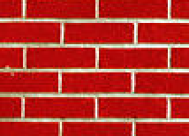
Efros & Leung Algorithm
non-parametric
sampling
p
Input image
Synthesizing a pixel
Assuming Markov property, compute P(p|N(p))
Building explicit probability tables infeasible
Instead, we search the input image for all similar neighborhoods — that’s our pdf for p
To sample from this pdf, just pick one match at random

Slide 47
Some Details
Growing is in “onion skin” order
Within each “layer”, pixels with most neighbors are synthesized first
If no close match can be found, the pixel is not synthesized until the end
Using Gaussian-weighted SSD is very important
to make sure the new pixel agrees with its closest neighbors
Approximates reduction to a smaller neighborhood window if data is too sparse

Slide 48
Neighborhood Window
input

Slide 49
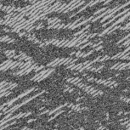
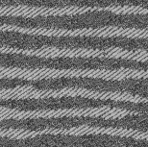
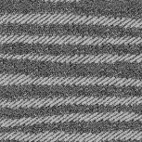
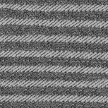
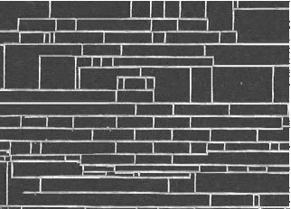
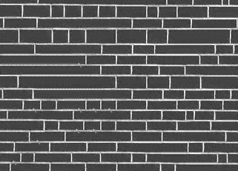
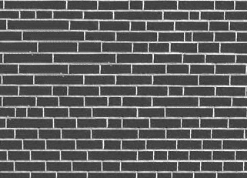
Varying Window Size
Increasing window size

Slide 50
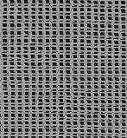
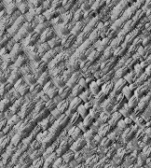
Synthesis Results
french canvas
rafia weave

Slide 51
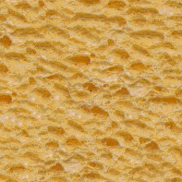
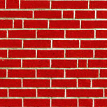
More Results
white bread
brick wall

Slide 52
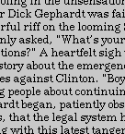
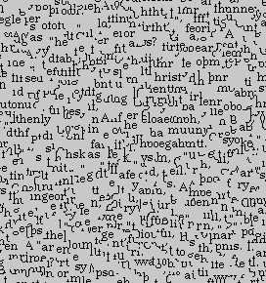
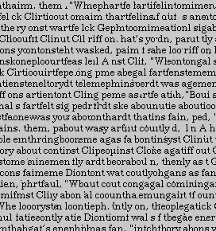
Homage to Shannon

Slide 53
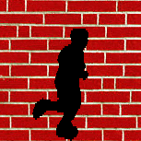
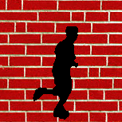
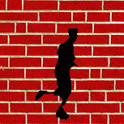
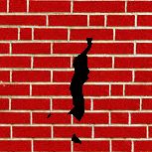
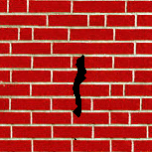
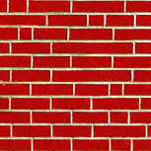
Hole Filling

Slide 54
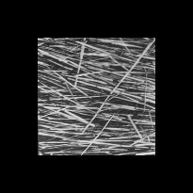
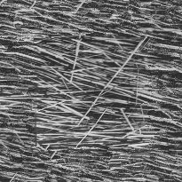
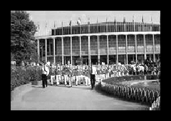
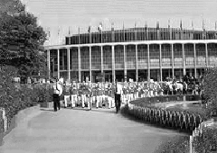
Extrapolation

Slide 55
Summary
The Efros & Leung algorithm
Very simple
Surprisingly good results
Synthesis is easier than analysis!
…but very slow

Slide 56
Image Quilting [Efros & Freeman]
non-parametric
sampling
p
B
Input image
Synthesizing a block
Observation: neighbor pixels are highly correlated
Idea: unit of synthesis = block
Exactly the same but now we want P(B|N(B))
Much faster: synthesize all pixels in a block at once
Not the same as multi-scale!

Slide 57
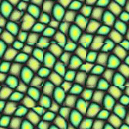
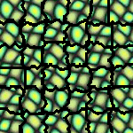
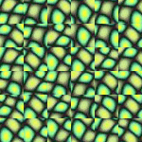
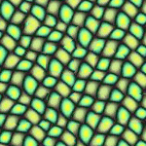
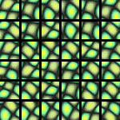
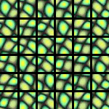
block
Input texture
B1
B2
B1
B2
B1
B2
Random placement
of blocks
Neighboring blocks
constrained by overlap
Minimal error
boundary cut

Slide 58
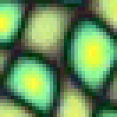
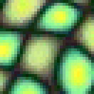
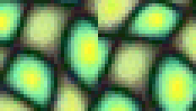
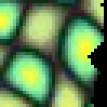
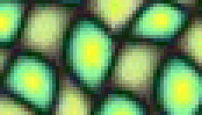
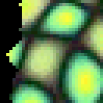
Minimal error boundary
overlapping blocks
vertical boundary
2
_
=
overlap error
min. error boundary

Slide 59
Our Philosophy
The “Corrupt Professor’s Algorithm”:
Plagiarize as much of the source image as you can
Then try to cover up the evidence
Rationale:
Texture blocks are by definition correct samples of texture so problem only connecting them together

Slide 60
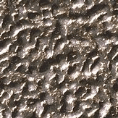
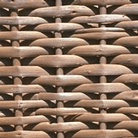
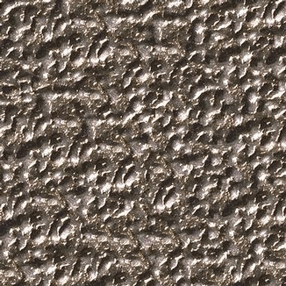
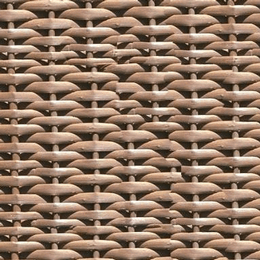

Slide 61
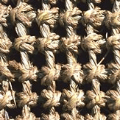
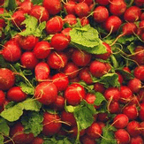
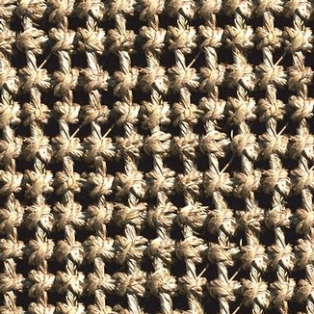

Slide 66
Failures
(Chernobyl
Harvest)

Slide 67
Portilla & Simoncelli
Xu, Guo & Shum
input image
Wei & Levoy
Our algorithm

Slide 68
Portilla & Simoncelli
Xu, Guo & Shum
input image
Wei & Levoy
Our algorithm

Slide 69
Portilla & Simoncelli
Xu, Guo & Shum
input image
Wei & Levoy
Our algorithm

Slide 70
Application: Texture Transfer
Try to explain one object with bits and pieces of another object:
+
=

Slide 71
Texture Transfer
Constraint
Texture sample

Slide 72
Texture Transfer
Take the texture from one image and “paint” it onto another object
Same as texture synthesis, except an additional constraint:
Consistency of texture
Similarity to the image being “explained”

Slide 73
+
=

Slide 75
Image Analogies
Aaron Hertzmann^{1,2}
Chuck Jacobs²
Nuria Oliver²
Brian Curless³
David Salesin^{2,3}
¹New York University
²Microsoft Research
³University of Washington

Slide 76
Image Analogies
A
A’
B
B’

Slide 78
Image Analogies
Goal: Process an image by example
?
:
::
:
A
A’
B
B’
Hertzmann et al. SIGGRAPH 2001

Slide 79
Non-parametric sampling
?
:
::
:
A
A’
B
B’

Slide 80
:
::
A
A’
:
B
B’

Slide 81
:
::
A
A’
:
B
B’

Slide 82
Blur Filter

Slide 83
Edge Filter

Slide 84
Artistic Filters
A
A’
B
B’

Slide 85
Colorization

Slide 86
Texture-by-numbers
A
A’
B
B’

Slide 87
Super-resolution
A
A’

Slide 88
Super-resolution (result!)
B
B’

