Slide 1
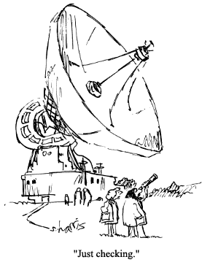
Multiview Geometry:
Stereo & Structure from Motion
CS194: Intro to Computer Vision and Comp. Photo
Alexei Efros, UC Berkeley, Fall 2020

Slide 2
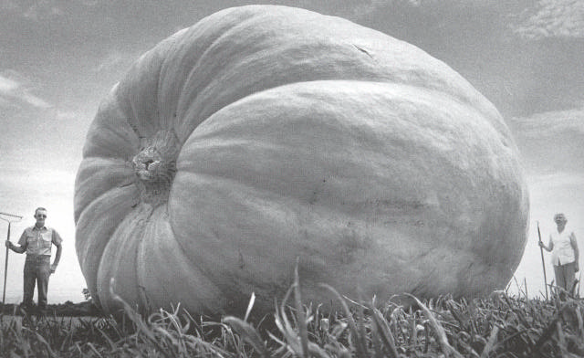
Why multiple views?
Structure and depth are inherently ambiguous from single views.
Images from Lana Lazebnik

Slide 3
Why multiple views?
Structure and depth are inherently ambiguous from single views.
P1
P2
P1’=P2’
Optical center

Slide 4
changing camera center
Does it still work?
synthetic PP
PP1
PP2

Slide 5
Multi-view geometry problems
Structure: Given projections of the same 3D point in two or more images, compute the 3D coordinates of that point
?
Camera 1
Camera 3
R₁,t₁
Camera 2
R₃,t₃
R₂,t₂
Slide credit: Noah Snavely
Notes:
Structure from motion solves the following problem:
Given a set of images of a static scene with 2D points in correspondence, shown here as color-coded points, find…
a set of 3D points P and
a rotation R and position t of the cameras that explain the observed correspondences. In other words, when we project a point into any of the cameras, the reprojection error between the projected and observed 2D points is low.
This problem can be formulated as an optimization problem where we want to find the rotations R, positions t, and 3D point locations P that minimize sum of squared reprojection errors f. This is a non-linear least squares problem and can be solved with algorithms such as Levenberg-Marquart. However, because the problem is non-linear, it can be susceptible to local minima. Therefore, it’s important to initialize the parameters of the system carefully. In addition, we need to be able to deal with erroneous correspondences.

Slide 6
Multi-view geometry problems
Stereo correspondence: Given a point in one of the images, where could its corresponding points be in the other images?
Camera 1
Camera 3
R₁,t₁
Camera 2
R₃,t₃
R₂,t₂
Slide credit: Noah Snavely
Notes:
Structure from motion solves the following problem:
Given a set of images of a static scene with 2D points in correspondence, shown here as color-coded points, find…
a set of 3D points P and
a rotation R and position t of the cameras that explain the observed correspondences. In other words, when we project a point into any of the cameras, the reprojection error between the projected and observed 2D points is low.
This problem can be formulated as an optimization problem where we want to find the rotations R, positions t, and 3D point locations P that minimize sum of squared reprojection errors f. This is a non-linear least squares problem and can be solved with algorithms such as Levenberg-Marquart. However, because the problem is non-linear, it can be susceptible to local minima. Therefore, it’s important to initialize the parameters of the system carefully. In addition, we need to be able to deal with erroneous correspondences.

Slide 7
Multi-view geometry problems
Motion: Given a set of corresponding points in two or more images, compute the camera parameters
Camera 1
?
Camera 2
?
?
Camera 3
R₁,t₁
R₃,t₃
R₂,t₂
Slide credit: Noah Snavely
Notes:
Structure from motion solves the following problem:
Given a set of images of a static scene with 2D points in correspondence, shown here as color-coded points, find…
a set of 3D points P and
a rotation R and position t of the cameras that explain the observed correspondences. In other words, when we project a point into any of the cameras, the reprojection error between the projected and observed 2D points is low.
This problem can be formulated as an optimization problem where we want to find the rotations R, positions t, and 3D point locations P that minimize sum of squared reprojection errors f. This is a non-linear least squares problem and can be solved with algorithms such as Levenberg-Marquart. However, because the problem is non-linear, it can be susceptible to local minima. Therefore, it’s important to initialize the parameters of the system carefully. In addition, we need to be able to deal with erroneous correspondences.

Slide 8
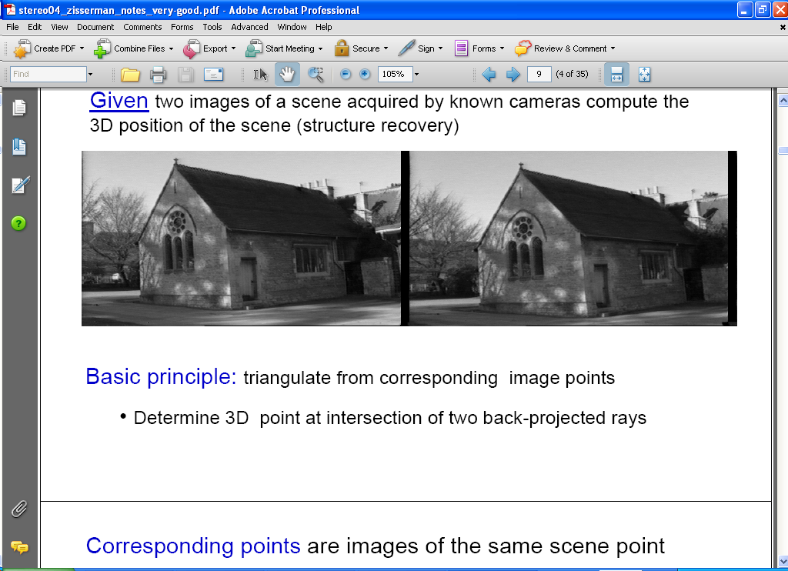
Estimating depth with stereo
Stereo: shape from “motion” between two views
We’ll need to consider:
Info on camera pose (“calibration”)
Image point correspondences
scene point
image plane
optical center
Notes:
8

Slide 9
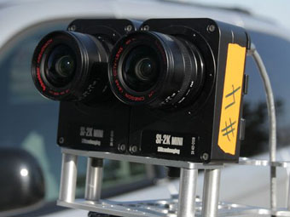
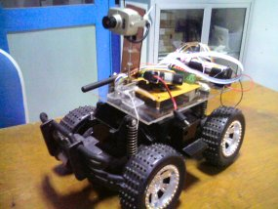
Stereo vision
Two cameras, simultaneous views
Single moving camera and static scene

Slide 10
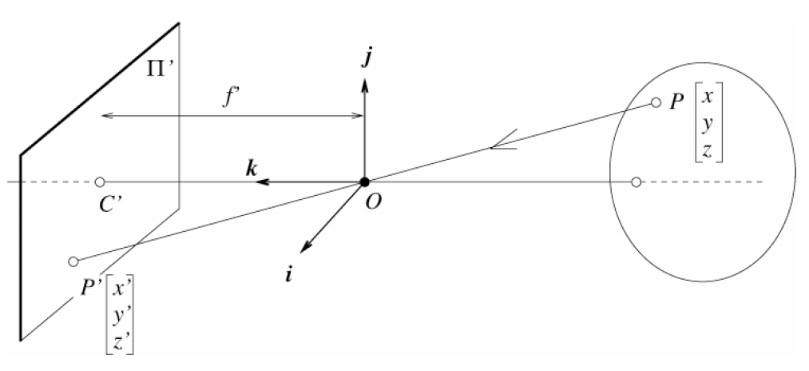
Camera calibration
World frame
Extrinsic parameters:
Camera frame ←→ Reference frame
Intrinsic parameters:
Image coordinates relative to camera ←→ Pixel coordinates
Camera frame
Extrinsic params: rotation matrix and translation vector
Intrinsic params: focal length, pixel sizes (mm), image center point, radial distortion parameters
Grauman
Notes:
10

Slide 11

Oriented and Translated Camera
R
j_{w}
t
k_{w}
O_{w}
i_{w}

Slide 12
Degrees of freedom
5
6
Notes:
How many known points are needed to estimate this?

Slide 13
How to calibrate the camera?

Slide 14
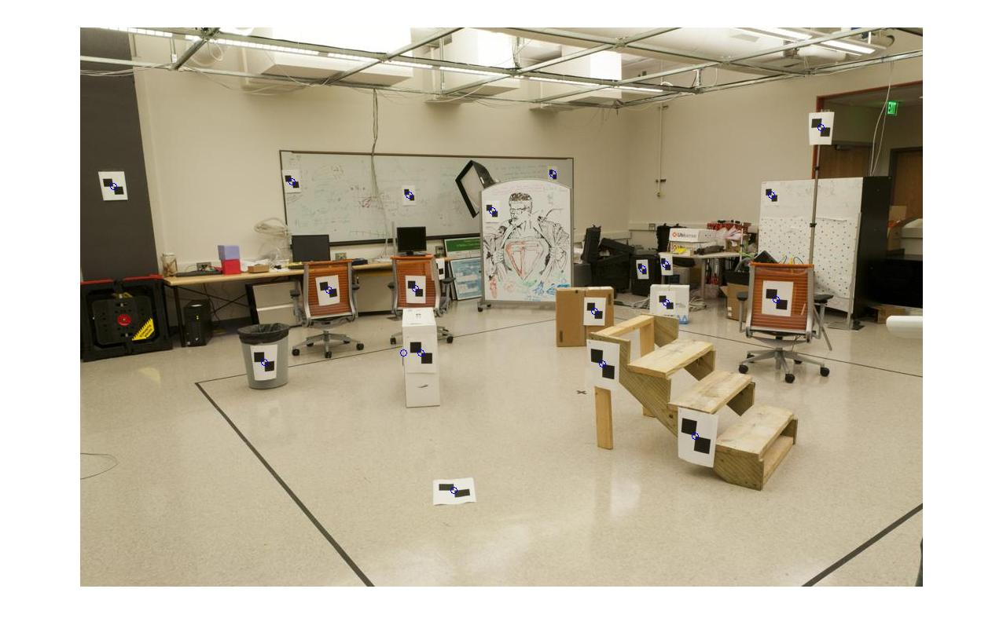
How do we calibrate a camera?
880 214
43 203
270 197
886 347
745 302
943 128
476 590
419 214
317 335
783 521
235 427
665 429
655 362
427 333
412 415
746 351
434 415
525 234
716 308
602 187
312.747 309.140 30.086
305.796 311.649 30.356
307.694 312.358 30.418
310.149 307.186 29.298
311.937 310.105 29.216
311.202 307.572 30.682
307.106 306.876 28.660
309.317 312.490 30.230
307.435 310.151 29.318
308.253 306.300 28.881
306.650 309.301 28.905
308.069 306.831 29.189
309.671 308.834 29.029
308.255 309.955 29.267
307.546 308.613 28.963
311.036 309.206 28.913
307.518 308.175 29.069
309.950 311.262 29.990
312.160 310.772 29.080
311.988 312.709 30.514

Slide 15
Method 1 – homogeneous linear system
Solve for m’s entries using linear least squares
Ax=0 form

Slide 16
Can we factorize M back to K [R | T]?
Yes
Simplest is to use camera calibration packages (there is a good one in OpenCV)

Slide 17



Stereo reconstruction: main steps
  Calibrate cameras
  Compute disparity
  Estimate depth
disparity
Grauman

Slide 18
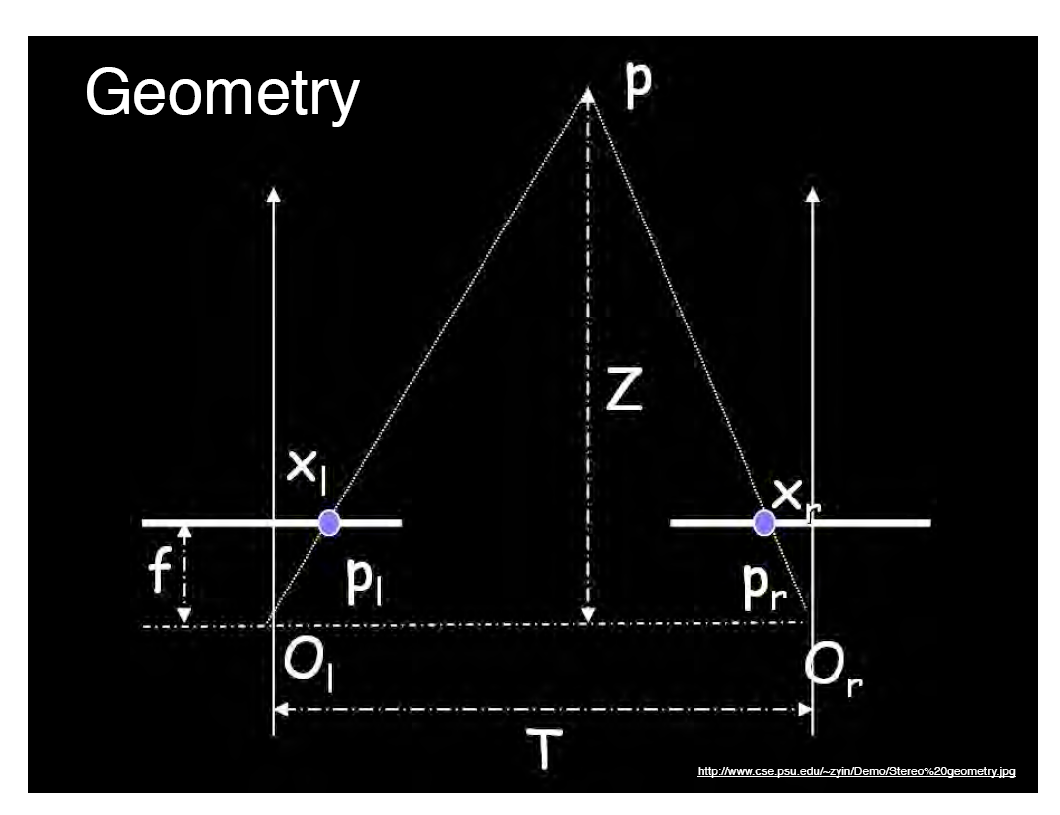
Geometry for a simple stereo system
Assume parallel optical axes, known camera parameters (i.e., calibrated cameras).
Use similar triangles (p_{l}, P, p_{r}) and (O_{l}, P, O_{r}):
want Z
disparity
Grauman
Notes:
18

Slide 19
Disparity example
image I(x,y)
Disparity map D(x,y)
image I´(x´,y´)
(x´,y´)=(x+D(x,y), y)
Grauman

Slide 20
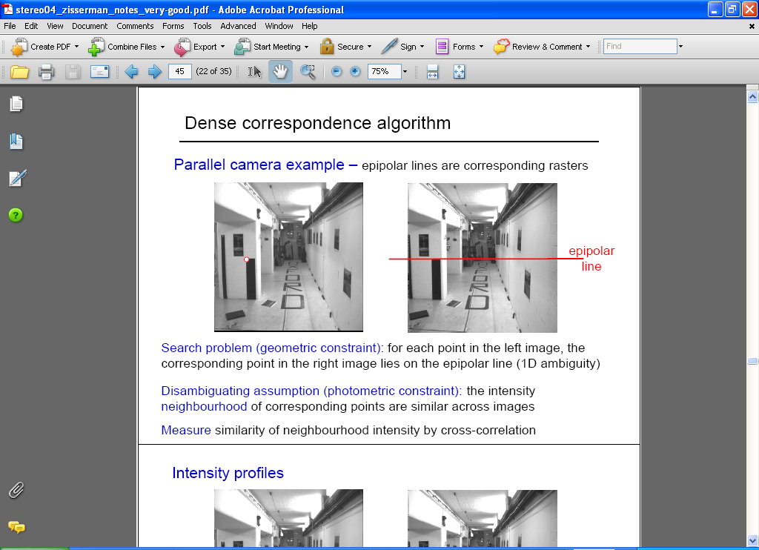
Correspondence problem
Source: Andrew Zisserman

Slide 21
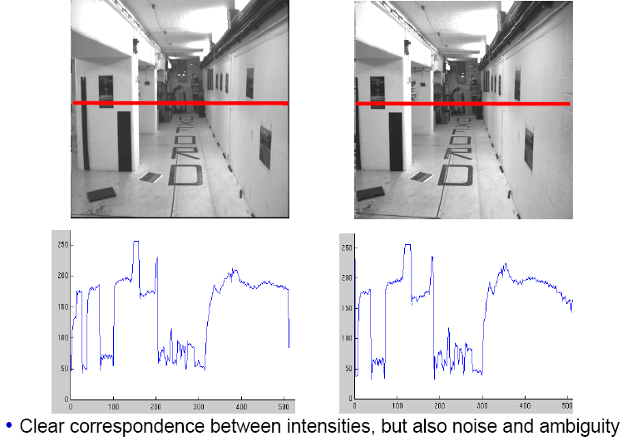
Intensity profiles
Source: Andrew Zisserman

Slide 22
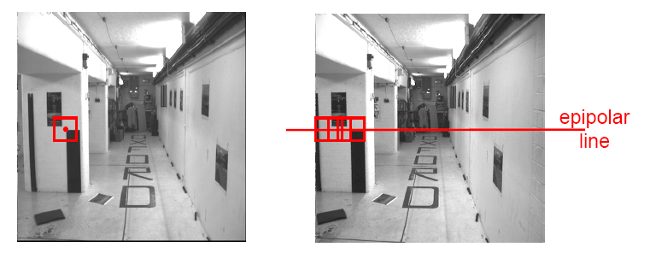
Correspondence problem
Neighborhood of corresponding points are similar in intensity patterns.
Source: Andrew Zisserman

Slide 23
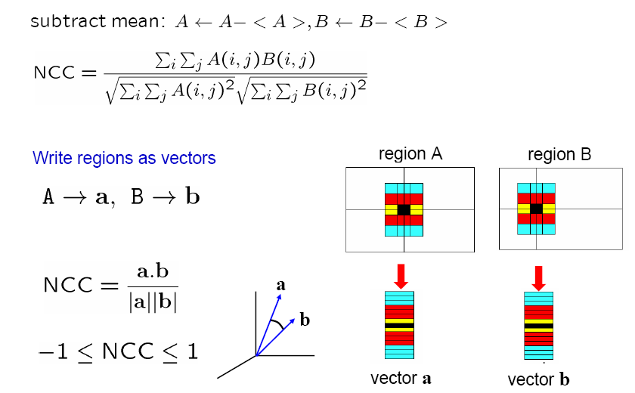
Normalized cross correlation
Source: Andrew Zisserman

Slide 24
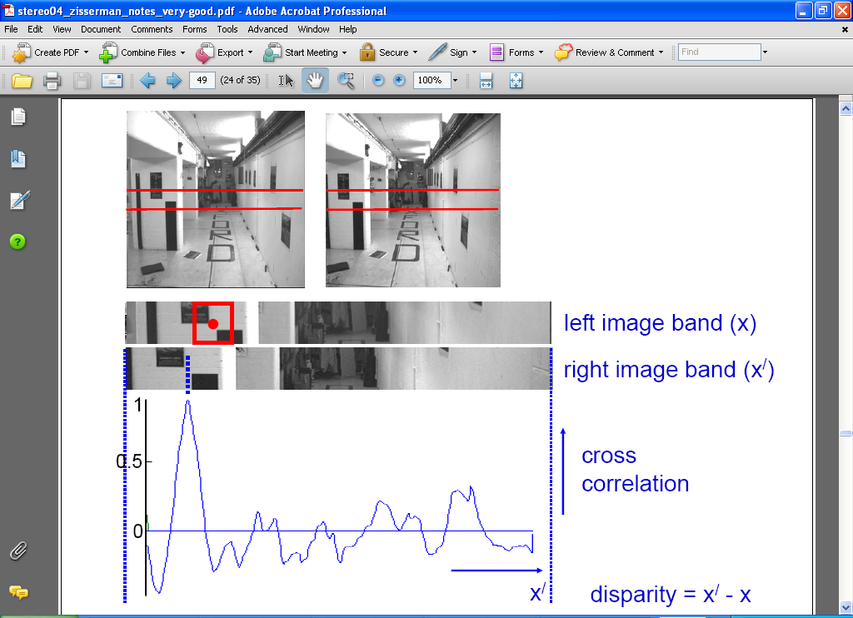
Correlation-based window matching
Source: Andrew Zisserman

Slide 25

Dense correspondence search
For each epipolar line
For each pixel / window in the left image
    compare with every pixel / window on same epipolar line in right image
    pick position with minimum match cost (e.g., SSD, correlation)
Adapted from Li Zhang
Grauman
Notes:
25

Slide 26
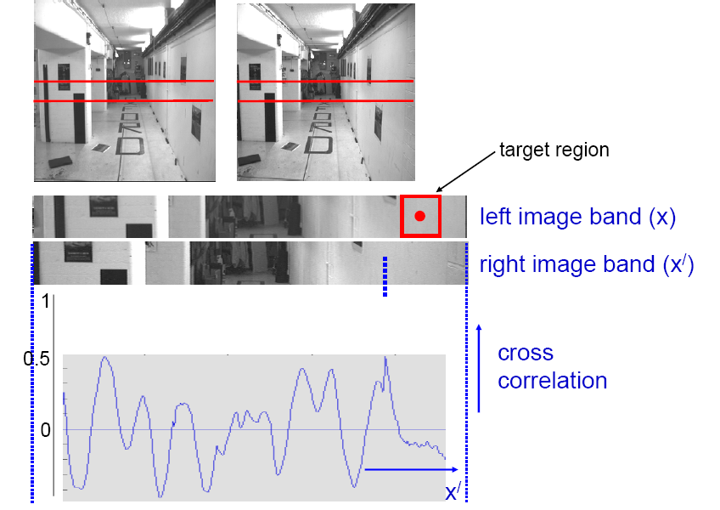
Textureless regions
Textureless regions are non-distinct; high ambiguity for matches.
Source: Andrew Zisserman
Grauman

Slide 27
Effect of window size
Source: Andrew Zisserman
Grauman

Slide 28


Effect of window size
W = 3
W = 20
Want window large enough to have sufficient intensity variation, yet small enough to contain only pixels with about the same disparity.
Figures from Li Zhang
Grauman

Slide 29

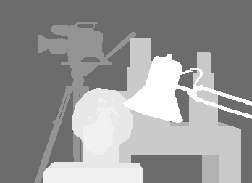
Stereo Results
  Data from University of Tsukuba
Scene
Ground truth

Slide 30


Results with Window Search
Window-based matching
(best window size)
Ground truth

Slide 31

Better methods exist...
Energy Minimization
  Boykov et al., Fast Approximate Energy Minimization via Graph Cuts,
  International Conference on Computer Vision, September 1999.
Ground truth

Slide 32
General case, with calibrated cameras
The two cameras need not have parallel optical axes.

Slide 33
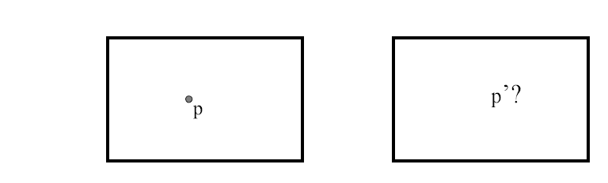
Stereo correspondence constraints
Given p in left image, where can corresponding point p’ be?

Slide 34
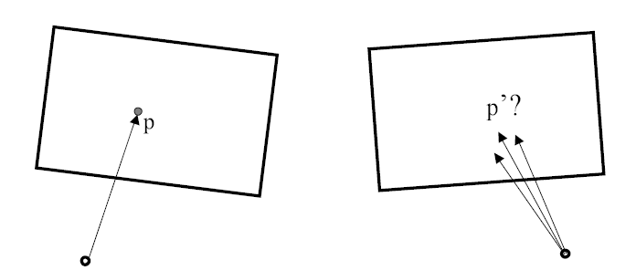
Stereo correspondence constraints
Given p in left image, where can corresponding point p’ be?

Slide 35
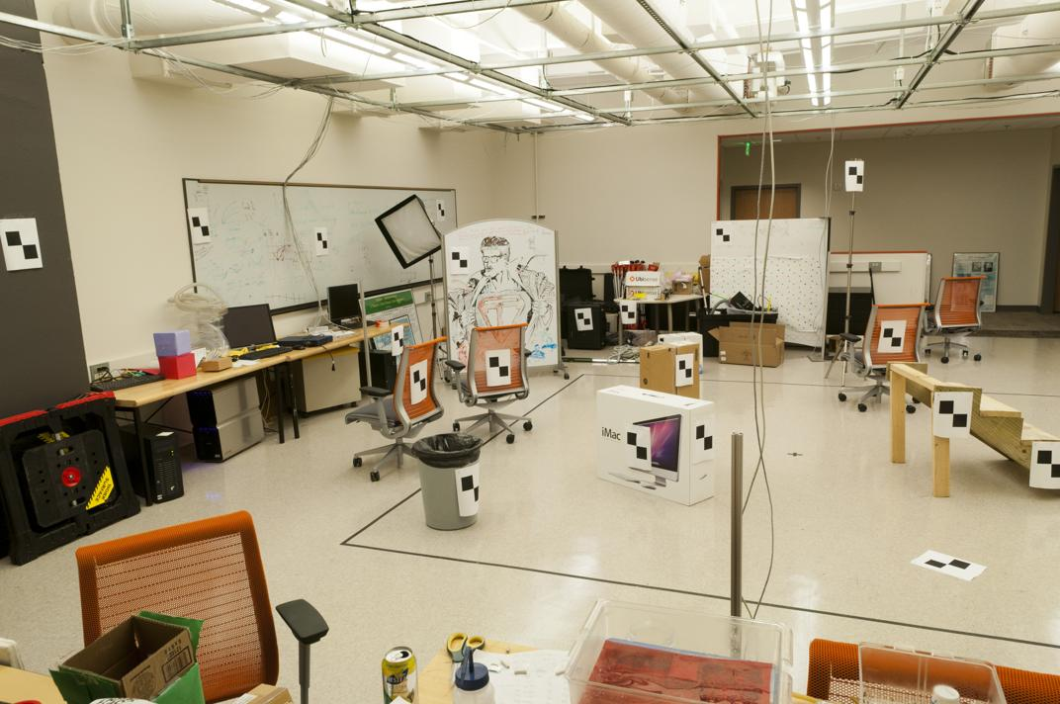
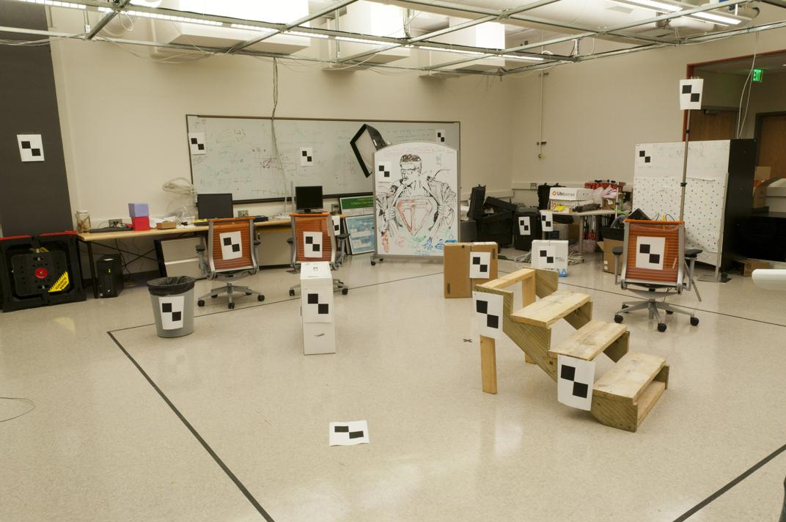
Where do we need to search?
Slide by James Hays

Slide 36
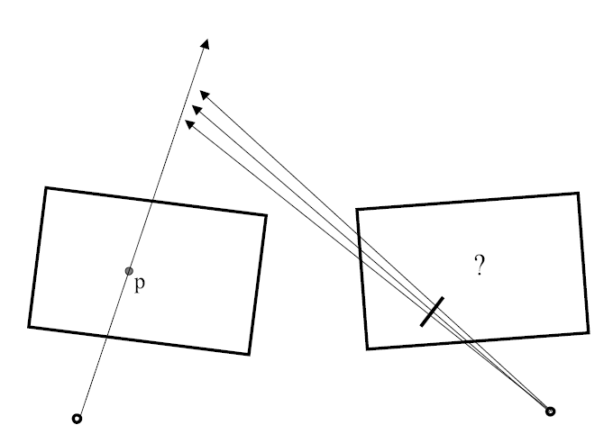
Stereo correspondence constraints

Slide 37
Stereo correspondence constraints
Geometry of two views allows us to constrain where the corresponding pixel for some image point in the first view must occur in the second view.
epipolar line
epipolar line
epipolar plane
Epipolar constraint: Why is this useful?
  Reduces correspondence problem to 1D search along conjugate epipolar lines
http://www.ai.sri.com/~luong/research/Meta3DViewer/EpipolarGeo.html
Adapted from Steve Seitz

Slide 38

Epipolar geometry
X
x
x’
Baseline – line connecting the two camera centers
Epipolar Plane – plane containing baseline (1D family)
Epipoles
= intersections of baseline with image planes
= projections of the other camera center
= vanishing points of the motion direction

Slide 39
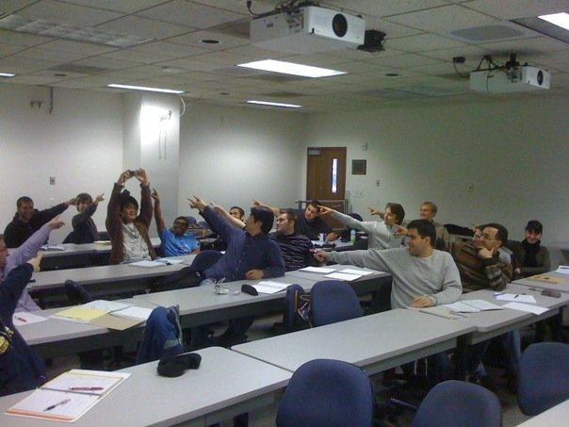
The Epipole
Photo by Frank Dellaert

Slide 40
Epipolar geometry: terms
Baseline: line joining the camera centers
Epipole: point of intersection of baseline with the image plane
Epipolar plane: plane containing baseline and world point
Epipolar line: intersection of epipolar plane with the image plane
All epipolar lines intersect at the epipole
An epipolar plane intersects the left and right image planes in epipolar lines
Grauman

Slide 41

Epipolar constraint
Potential matches for p have to lie on the corresponding
epipolar line l’.
Potential matches for p’ have to lie on the corresponding
epipolar line l.
Source: M. Pollefeys
Notes:
41

Slide 42
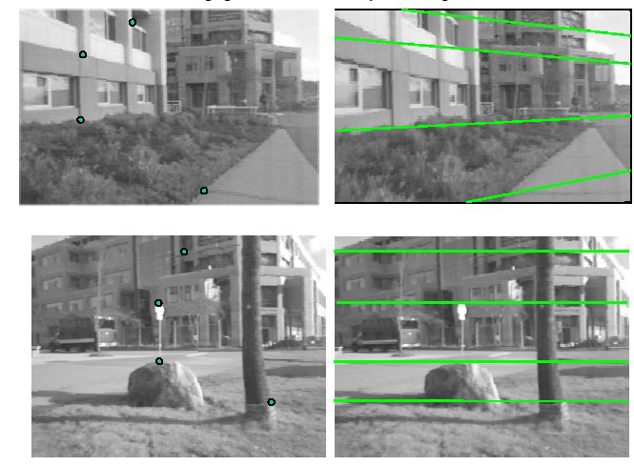
Example

Slide 43



Example: converging cameras
As position of 3d point varies, epipolar lines “rotate” about the baseline
Figure from Hartley & Zisserman
Notes:
43

Slide 44



Example: motion parallel with image plane
Figure from Hartley & Zisserman
Notes:
44

Slide 45
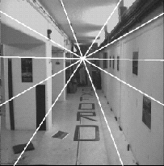
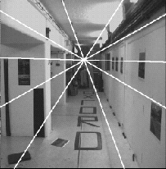
Example: forward motion
e’
e
Epipole has same coordinates in both images.
Points move along lines radiating from e: “Focus of expansion”
Figure from Hartley & Zisserman
Notes:
45

Slide 46
For a given stereo rig, how do we express the epipolar constraints algebraically?
For calibrated cameras, with Essential Matrix
For uncalibrated cameras, with Fundamental Matrix

Slide 47
Epipolar constraint: Calibrated case
X
x
x’
Intrinsic and extrinsic parameters of the cameras are known, world coordinate system is set to that of the first camera
Then the projection matrices are given by K[I | 0] and K’[R | t]
We can multiply the projection matrices (and the image points) by the inverse of the calibration matrices to get normalized image coordinates:

Slide 48
Epipolar constraint: Calibrated case
X
= (x,1)^{T}
x
x’ = Rx+t
t
R
The vectors Rx, t, and x’ are coplanar
Notes:
X’ is X in the second camera’s coordinate system
We can identify the non-homogeneous 3D vectors X and X’ with the homogeneous coordinate vectors x and x’ of the projections of the two points into the two respective images

Slide 49
Epipolar constraint: Calibrated case
X
x
x’ = Rx+t
Recall:
The vectors Rx, t, and x’ are coplanar

Slide 50
Epipolar constraint: Calibrated case
X
x
x’ = Rx+t
Essential Matrix
(Longuet-Higgins, 1981)
The vectors Rx, t, and x’ are coplanar

Slide 51
Epipolar constraint: Calibrated case
X
x
x’
E x is the epipolar line associated with x (l' = E x)
  Recall: a line is given by ax + by + c = 0 or

Slide 52
Epipolar constraint: Calibrated case
X
x
x’
E x is the epipolar line associated with x (l' = E x)
E^{T}x' is the epipolar line associated with x' (l = E^{T}x')
E e = 0 and E^{T}e' = 0
E is singular (rank two)
E has five degrees of freedom

Slide 53
Epipolar constraint: Uncalibrated case
X
x
x’
The calibration matrices K and K’ of the two cameras are unknown
We can write the epipolar constraint in terms of unknown normalized coordinates:

Slide 54
Epipolar constraint: Uncalibrated case
X
x
x’
Fundamental Matrix
(Faugeras and Luong, 1992)

Slide 55
Epipolar constraint: Uncalibrated case
X
x
x’
F x is the epipolar line associated with x (l' = F x)
F^{T}x' is the epipolar line associated with x' (l = F^{T}x')
F e = 0 and F^{T}e' = 0
F is singular (rank two)
F has seven degrees of freedom

Slide 56
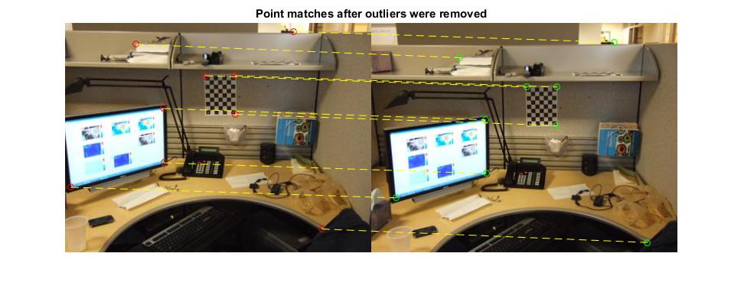
Estimating the fundamental matrix

Slide 57
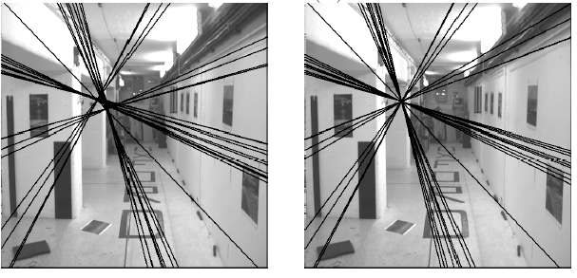
The eight-point algorithm
Solve homogeneous linear system using eight or more matches
Enforce rank-2 constraint (take SVD
of F and throw out the smallest singular value)

Slide 58
Problem with eight-point algorithm

Slide 59
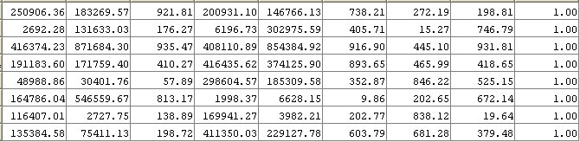
Problem with eight-point algorithm
Poor numerical conditioning
Can be fixed by rescaling the data

Slide 60
The normalized eight-point algorithm
(Hartley, 1995)
Center the image data at the origin, and scale it so the mean squared distance between the origin and the data points is 2 pixels
Use the eight-point algorithm to compute F from the normalized points
Enforce the rank-2 constraint (for example, take SVD of F and throw out the smallest singular value)
Transform fundamental matrix back to original units: if T and T’ are the normalizing transformations in the two images, than the fundamental matrix in original coordinates is T’^{T} F T

Slide 61
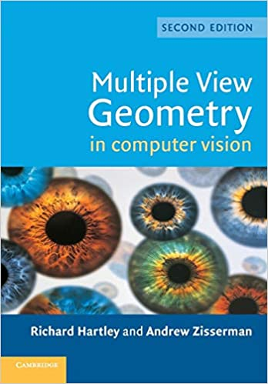
The Bible by Hartley & Zisserman

Slide 62
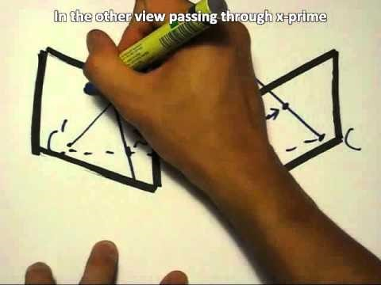
The Fundamental Matrix Song
http://danielwedge.com/fmatrix/
https://www.youtube.com/watch?time_continue=8&v=DgGV3l82NTk&feature=emb_title

Slide 63
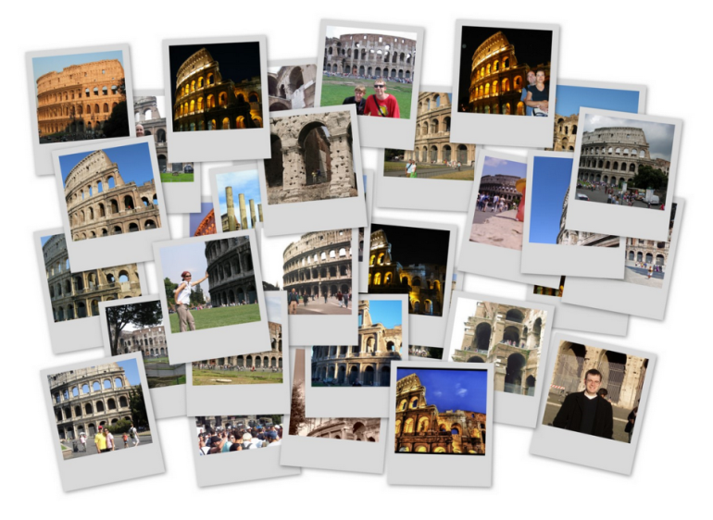
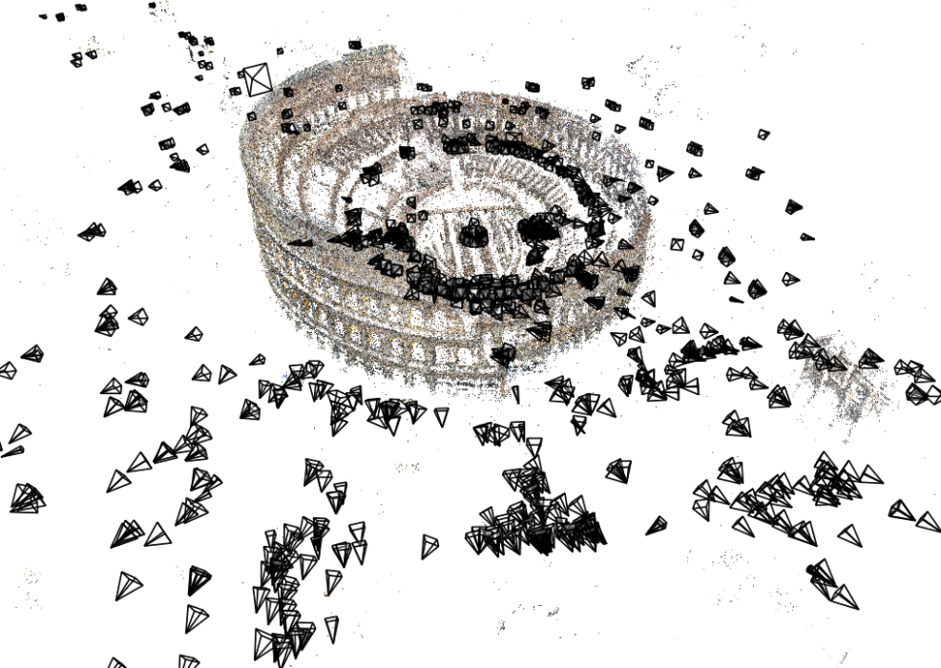
Review: Structure from Motion (SfM)
Given many images, how can we
  a) figure out where they were all taken from?
  b) build a 3D model of the scene?
  This is (roughly) the structure from motion problem

Slide 64
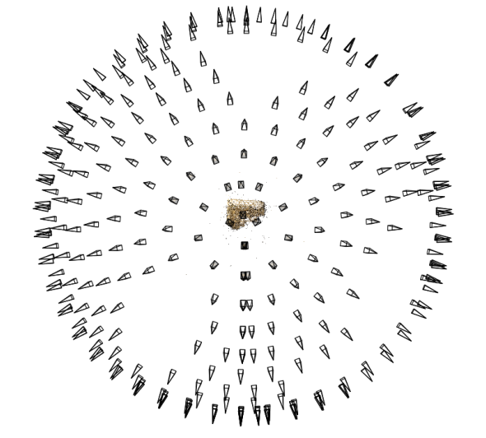
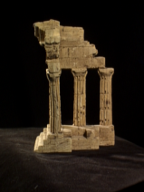
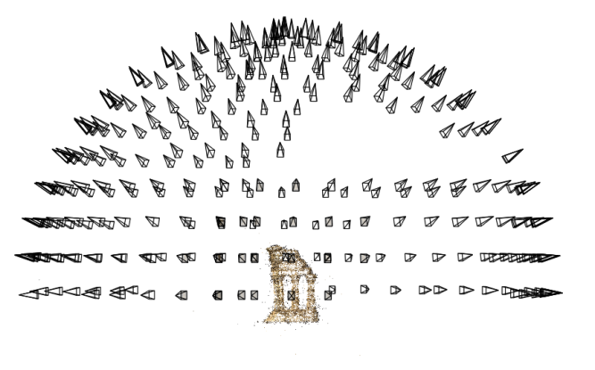
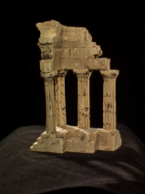
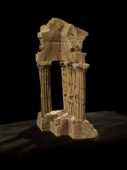
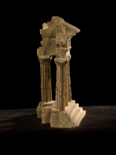
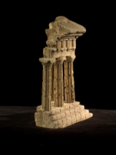
Structure from motion
Reconstruction (side)
(top)
Input: images with points in correspondence p_{i,j} = (u_{i,j},v_{i,j})
Output
  structure: 3D location x_{i} for each point p_{i}
  motion: camera parameters R_{j} , t_{j} possibly K_{j}
Objective function: minimize reprojection error

Slide 65
Camera calibration & triangulation
Suppose we know 3D points and have matches between these points and an image
  How can we compute the camera parameters?
Suppose we have know camera parameters, each of which observes a point
  How can we compute the 3D location of that point?

Slide 66
Structure from motion
SfM solves both of these problems at once
A kind of chicken-and-egg problem
  (but solvable)

Slide 67
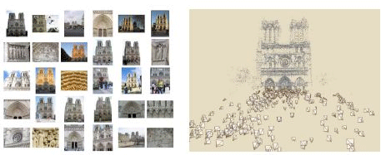
Photo Tourism
Noah Snavely, Steven M. Seitz, Richard Szeliski, "Photo tourism: Exploring photo collections in 3D," SIGGRAPH 2006
https://youtu.be/mTBPGuPLI5Y

Slide 68
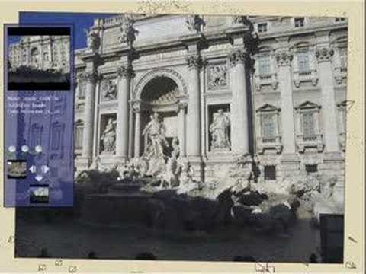

Slide 69
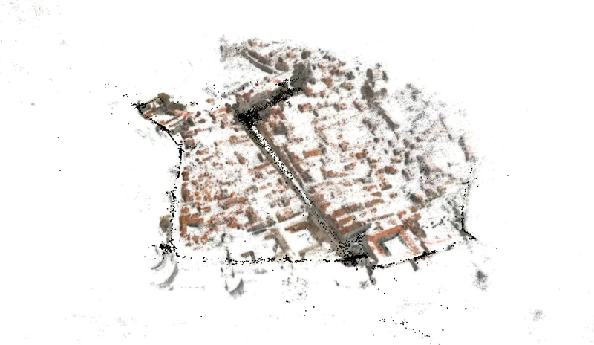
Large-scale structure from motion
Dubrovnik, Croatia. 4,619 images (out of an initial 57,845).
Total reconstruction time: 23 hours
Number of cores: 352

Slide 70
First step: how to get correspondence?
Feature detection and matching

Slide 71
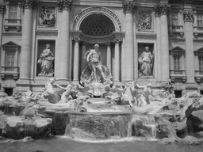
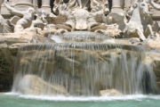
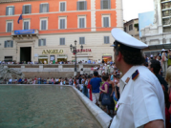
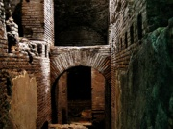

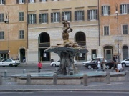
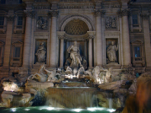
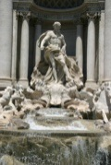

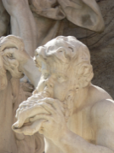
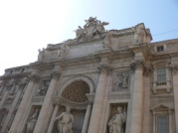





Feature detection
Detect features using SIFT [Lowe, IJCV 2004]
Notes:
So, we begin by detecting SIFT features in each photo.
[We detect SIFT features in each photo, resulting in a set of feature locations and 128-byte feature descriptors…]

Slide 72





Feature detection
Detect features using SIFT [Lowe, IJCV 2004]

Slide 73





Feature matching
Match features between each pair of images
Notes:
Next, we match features across each pair of photos using approximate nearest neighbor matching.

Slide 74



Feature matching
Refine matching using RANSAC to estimate fundamental matrix between each pair
Notes:
The matches are refined by using RANSAC, which is a robust model-fitting technique, to estimate a fundamental matrix between each pair of matching images and keeping only matches consistent with that fundamental matrix.
We then link connected components of pairwise feature matches together to form correspondences across multiple images.
Once we have correspondences, we run structure from motion to recover the camera and scene geometry. Structure from motion solves the following problem:

Slide 75




Correspondence estimation
Link up pairwise matches to form connected components of matches across several images
Image 1
Image 2
Image 3
Image 4
Notes:
The next step of our reconstruction algorithm is to link up matches between pairs of images into correspondences between multiple images, by finding connected components of matches. Suppose among these images, these features are matched only between consecutive pairs of images, perhaps because the scales of the images are so different. During correspondence estimation we link these matches and consider them to be 2D projections of a single 3D point in the scene.

Slide 76


The story so far…
Input images
Feature detection
Matching + track generation
Images with feature correspondence

Slide 77

The story so far…
Next step:
  Use structure from motion to solve for geometry (cameras and points)
First: what are cameras and points?

Slide 78





Points and cameras
Point: 3D position in space ( )
Camera ( ):
  A 3D position ( )
  A 3D orientation ( )
  Intrinsic parameters (focal length, aspect ratio, …)
  7 parameters (3+3+1) in total

Slide 79

Structure from motion
X₄
X₁
X₃
minimize
X₂
g(R, T, X)
X₅
non-linear least squares
X₇
X₆
p_{1,1}
p_{1,3}
p_{1,2}
Camera 1
Camera 3
R₁,t₁
R₃,t₃
Camera 2
R₂,t₂
Notes:
Structure from motion solves the following problem:
Given a set of images of a static scene with 2D points in correspondence, shown here as color-coded points, find…
a set of 3D points P and
a rotation R and position t of the cameras that explain the observed correspondences. In other words, when we project a point into any of the cameras, the reprojection error between the projected and observed 2D points is low.
This problem can be formulated as an optimization problem where we want to find the rotations R, positions t, and 3D point locations P that minimize sum of squared reprojection errors f. This is a non-linear least squares problem and can be solved with algorithms such as Levenberg-Marquart. However, because the problem is non-linear, it can be susceptible to local minima. Therefore, it’s important to initialize the parameters of the system carefully. In addition, we need to be able to deal with erroneous correspondences.

Slide 80


Structure from motion
Minimize sum of squared reprojection errors:
Minimizing this function is called bundle adjustment
  Optimized using non-linear least squares, e.g. Levenberg-Marquardt
predicted
image location
observed
image location
indicator variable:
is point i visible in image j ?

Slide 81

Solving structure from motion
Inputs: feature tracks
Outputs: 3D cameras and points
How do we solve the SfM problem?
Challenges:
  Large number of parameters (1000’s of cameras, millions of points)
  Very non-linear objective function

Slide 82
Solving structure from motion
Inputs: feature tracks
Outputs: 3D cameras and points
Important tool: Bundle Adjustment [Triggs et al. ’00]
  Joint non-linear optimization of both cameras and points
  Very powerful, elegant tool
The bad news:
  Starting from a random initialization is very likely to give the wrong answer
  Difficult to initialize all the cameras at once

Slide 83
Solving structure from motion
Inputs: feature tracks
Outputs: 3D cameras and points
The good news:
  Structure from motion with two cameras is (relatively) easy
  Once we have an initial model, it’s easy to add new cameras
Idea:
  Start with a small seed reconstruction, and grow

Slide 84








Incremental SfM
Automatically select an initial pair of images
Notes:
To help get good initializations for all of the parameters of the system, we reconstruct the scene incrementally, starting from two photographs and the points they observe.

Slide 85








1. Picking the initial pair
We want a pair with many matches, but which has as large a baseline as possible
large baseline
very few matches
lots of matches
small baseline
large baseline
lots of matches

Slide 86

1. Picking the initial pair
Many possible heuristics
E.g.
  Choose the pair with at least 100 matches, such that the ratio
  is as small as possible
  A homography will be a bad fit if there is sufficient parallax (and the scene is not planar)

Slide 87
2. Two-frame reconstruction
Input: two images with correspondence
Output: camera parameters, 3D points
In general, there can be ambiguities if the cameras are uncalibrated (camera intrinsics are unknown)
Usually assume that the only intrinsic parameter is an unknown focal length

Slide 88
2. Two-view reconstruction
Two-view SfM: Given two calibrated images with corresponding points, compute the camera and point positions
Solved by finding the essential matrix between the images

Slide 89
Incremental SfM: Algorithm
  Pick a strong initial pair of images
  Initialize the model using two-frame SfM
  While there are connected images remaining:
    Pick the image which sees the most existing 3D points
    Estimate the pose of that camera
    Triangulate any new points
    Run bundle adjustment

