Slide 1
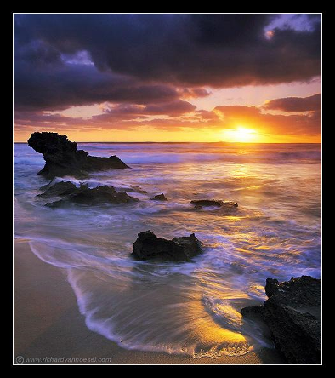
Capturing Light… in human and machine
CS194: Computer Vision and Comp. Photography
Alexei Efros, UC Berkeley, Fall 2021

Slide 2
PHOTOGRAPHY
Etymology
light
drawing
/ writing

Slide 3


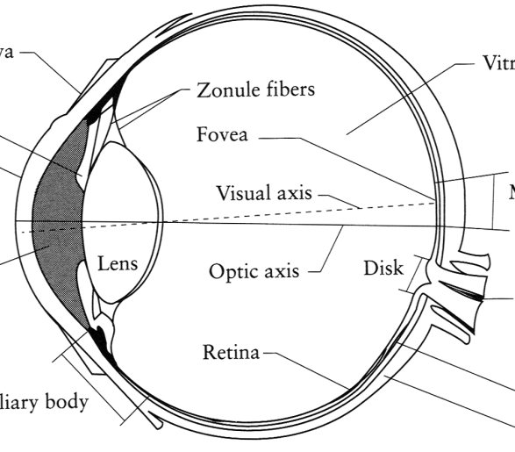
Image Formation
Digital Camera
Film
The Eye

Slide 4
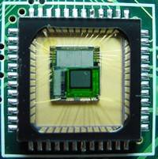
Sensor Array
CMOS sensor

Slide 5
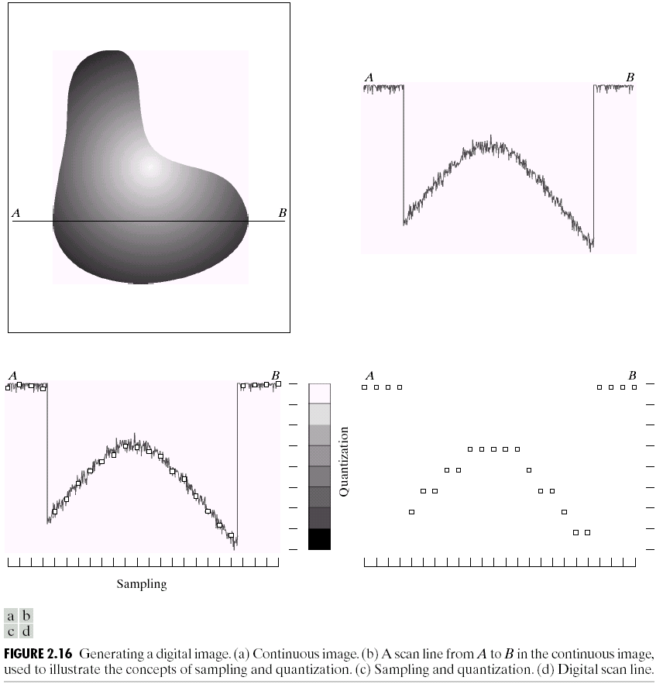
Sampling and Quantization

Slide 6
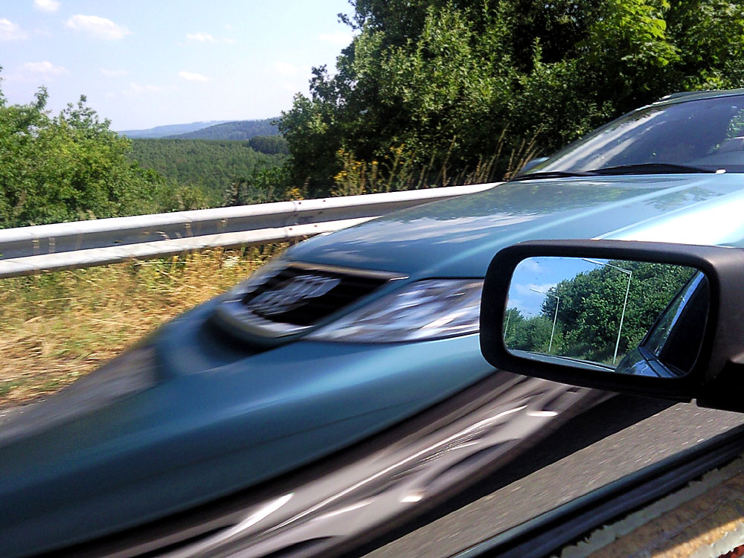

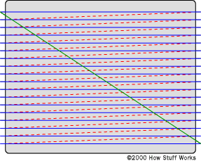
Rolling Shutter
http://en.wikipedia.org/wiki/Rolling_shutter
Notes:
http://en.wikipedia.org/wiki/Rolling_shutter
Even DSLRs have this problem.

Slide 7
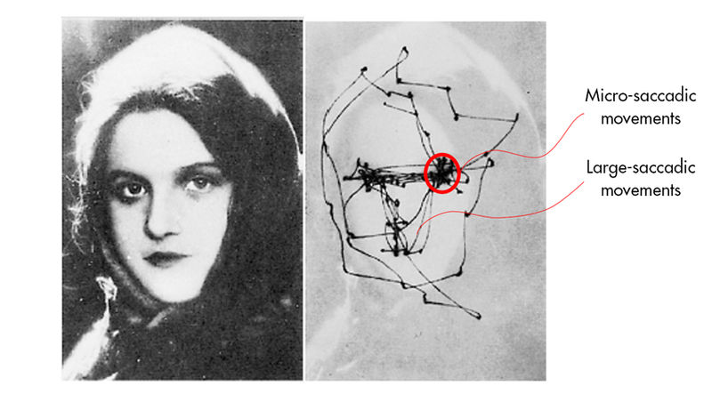
Saccadic eye movement

Slide 8
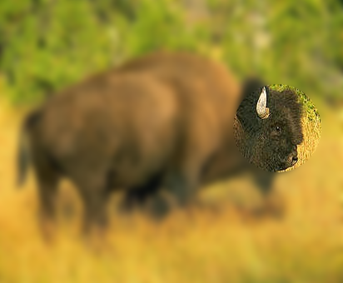
Saccadic eye movement

Slide 9

The Eye
The human eye is a camera!
  Iris - colored annulus with radial muscles
  Pupil - the hole (aperture) whose size is controlled by the iris
  What’s the “film”?
    photoreceptor cells (rods and cones) in the retina
Slide by Steve Seitz

Slide 10
The Retina

Slide 11
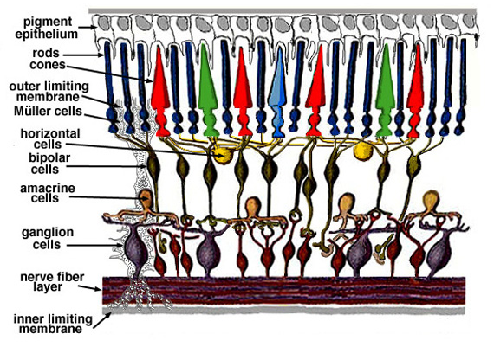
Retina up-close
Light

Slide 12
Two types of light-sensitive receptors
Cones
cone-shaped
less sensitive
operate in high light
color vision
Rods
rod-shaped
highly sensitive
operate at night
gray-scale vision
© Stephen E. Palmer, 2002

Slide 13
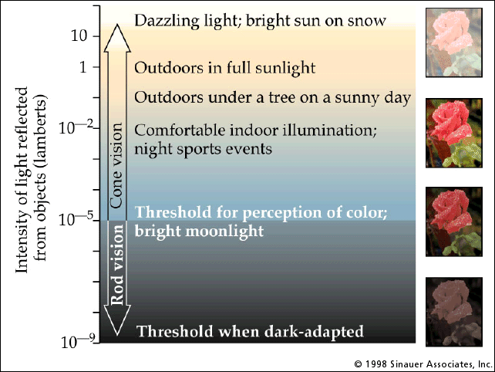
Rod / Cone sensitivity
The famous sock-matching problem…

Slide 14
Distribution of Rods and Cones
Night Sky: why are there more stars off-center?
© Stephen E. Palmer, 2002

Slide 15
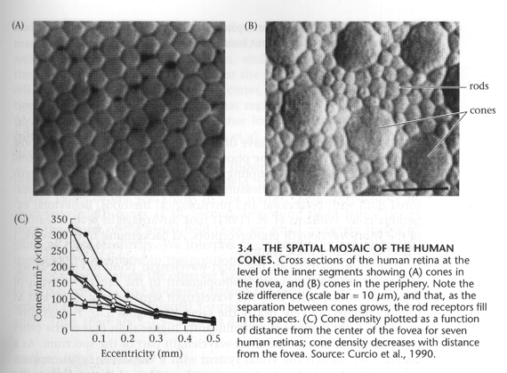
Foundations of Vision, by Brian Wandell, Sinauer Assoc., 1995

Slide 16
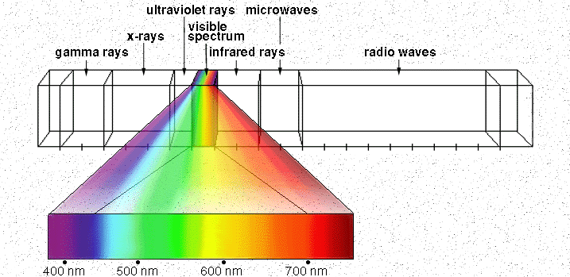

Electromagnetic Spectrum
Human Luminance Sensitivity Function
http://www.yorku.ca/eye/photopik.htm
Notes:
At least 3 spectral bands required (e.g. R,G,B)

Slide 17
Visible Light
Why do we see light of these wavelengths?
…because that’s where the
Sun radiates EM energy
© Stephen E. Palmer, 2002

Slide 18
The Physics of Light
Any patch of light can be completely described
physically by its spectrum: the number of photons
(per time unit) at each wavelength 400 - 700 nm.
© Stephen E. Palmer, 2002

Slide 19
The Physics of Light
Some examples of the spectra of light sources
© Stephen E. Palmer, 2002

Slide 20
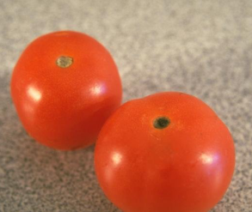
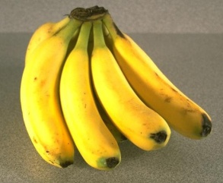
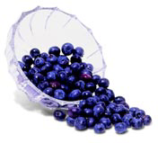
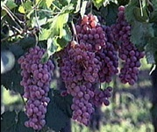
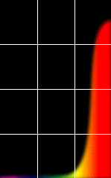
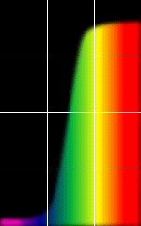
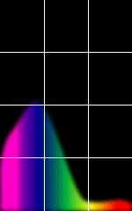
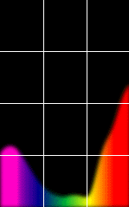
The Physics of Light
Some examples of the reflectance spectra of surfaces
Red
Yellow
Blue
Purple
% Photons Reflected
400 700
400 700
400 700
400 700
Wavelength (nm)
© Stephen E. Palmer, 2002

Slide 21
The Psychophysical Correspondence
There is no simple functional description for the perceived
color of all lights under all viewing conditions, but …...
A helpful constraint:
Consider only physical spectra with normal distributions
mean
area
variance
© Stephen E. Palmer, 2002

Slide 22
The Psychophysical Correspondence
Mean
Hue
# Photons
Wavelength
© Stephen E. Palmer, 2002

Slide 23
The Psychophysical Correspondence
Variance
Saturation
# Photons
Wavelength
© Stephen E. Palmer, 2002

Slide 24
The Psychophysical Correspondence
Area
Brightness
# Photons
Wavelength
© Stephen E. Palmer, 2002

Slide 25
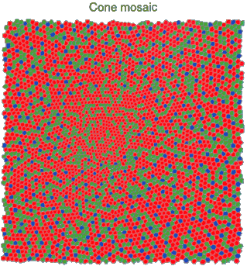
Physiology of Color Vision
Three kinds of cones:
Why are M and L cones so close?
Why are there 3?
© Stephen E. Palmer, 2002

Slide 27
Trichromacy
M
L
Power
S
Wavelength
Rods and cones act as filters on the spectrum
  To get the output of a filter, multiply its response curve by the spectrum, integrate over all wavelengths
    Each cone yields one number
  How can we represent an entire spectrum with 3 numbers?
  We can’t! Most of the information is lost
    As a result, two different spectra may appear indistinguishable
      such spectra are known as metamers
Slide by Steve Seitz

Slide 28
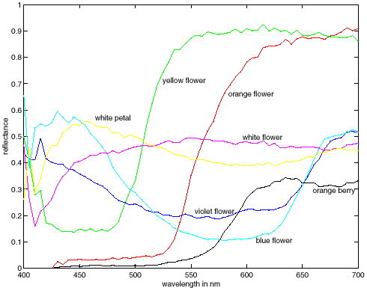
More Spectra
metamers

Slide 29
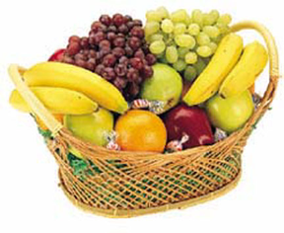
Color Constancy
The “photometer metaphor” of color perception:
Color perception is determined by the spectrum of light
on each retinal receptor (as measured by a photometer).
© Stephen E. Palmer, 2002

Slide 30
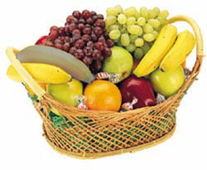
Color Constancy
The “photometer metaphor” of color perception:
Color perception is determined by the spectrum of light
on each retinal receptor (as measured by a photometer).
© Stephen E. Palmer, 2002

Slide 31
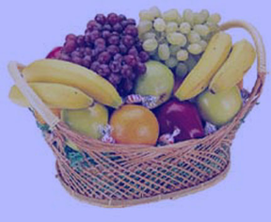
Color Constancy
The “photometer metaphor” of color perception:
Color perception is determined by the spectrum of light
on each retinal receptor (as measured by a photometer).
© Stephen E. Palmer, 2002

Slide 32
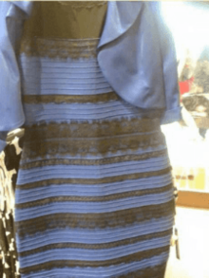
What color is the “The Dress”?
https://en.wikipedia.org/wiki/The_dress

Slide 34
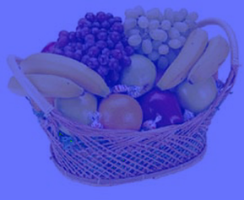
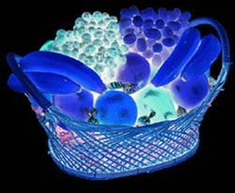
Color Constancy
Do we have constancy over
all global color transformations?
60% blue filter
Complete inversion
© Stephen E. Palmer, 2002

Slide 35
Color Constancy
Color Constancy: the ability to perceive the
invariant color of a surface despite ecological
Variations in the conditions of observation.
Another of these hard inverse problems:
Physics of light emission and surface reflection
underdetermine perception of surface color
© Stephen E. Palmer, 2002

Slide 36
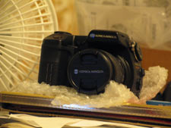
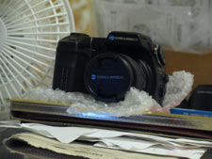
Camera White Balancing
Manual
  Choose color-neutral object in the photos and normalize
Automatic (AWB)
  Grey World: force average color of scene to grey
  White World: force brightest object to white

Slide 37
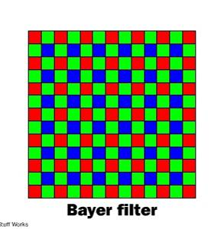
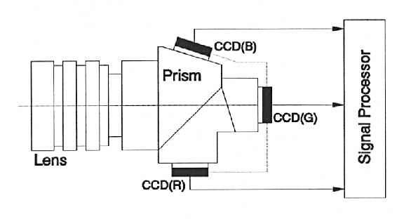
Color Sensing in Camera (RGB)
3-chip vs. 1-chip: quality vs. cost
Why more green?
Why 3 colors?
http://www.cooldictionary.com/words/Bayer-filter.wikipedia
Slide by Steve Seitz

Slide 38
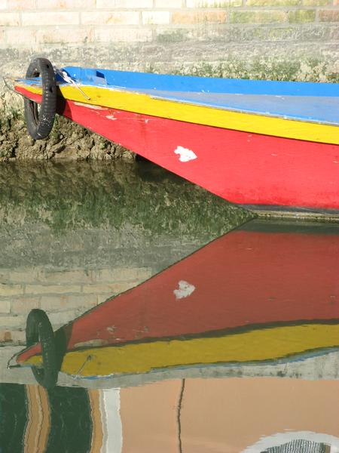
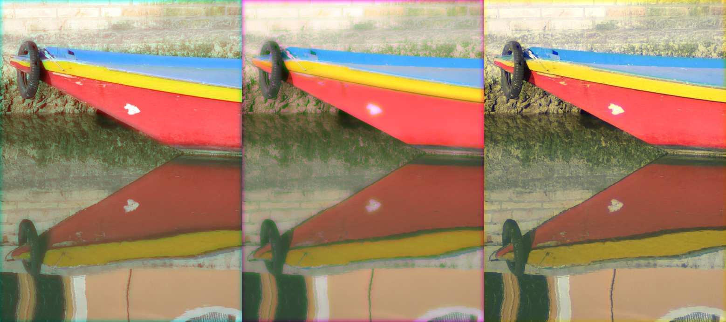
Green is in!
R
G
B

Slide 39


Practical Color Sensing: Bayer Grid
Estimate RGB
at ‘G’ cels from neighboring values
http://www.cooldictionary.com/
words/Bayer-filter.wikipedia
Slide by Steve Seitz

Slide 40
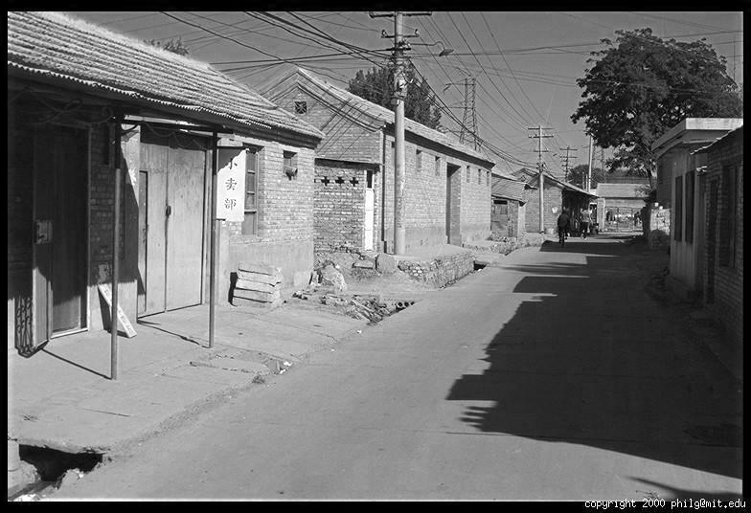
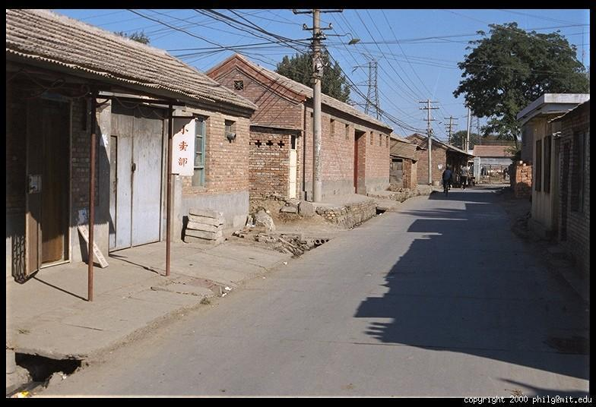
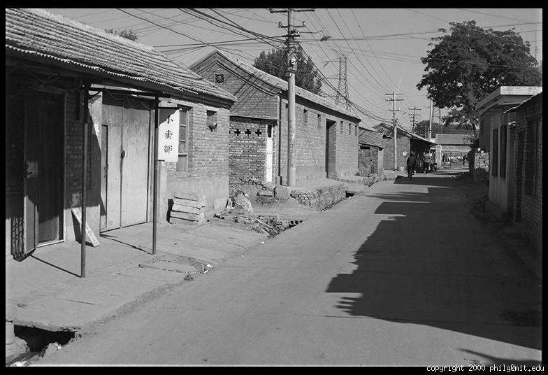
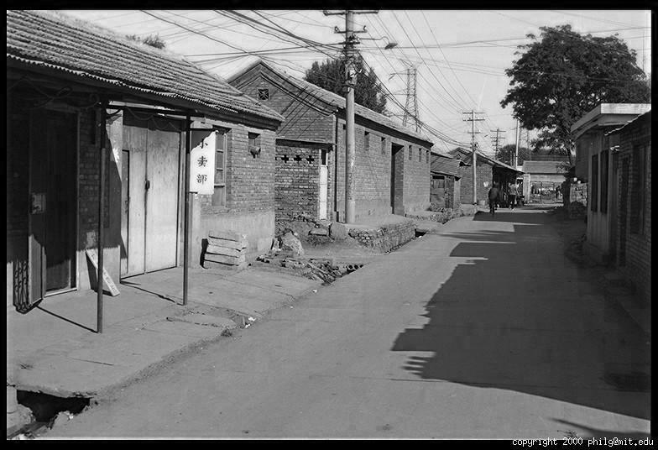
Color Image
R
G
B

Slide 41
Image representation
Images represented as a matrix
Suppose we have a NxM RGB image called “im”
  im(1,1,1) = top-left pixel value in R-channel
  im(y, x, b) = y pixels down, x pixels to right in the b^{th} channel
  im(N, M, 3) = bottom-right pixel in B-channel
imread(filename) returns a uint8 image (values 0 to 255)
  Convert to double format (values 0 to 1) with im2double
column
row
R
0.92 | 0.93 | 0.94 | 0.97 | 0.62 | 0.37 | 0.85 | 0.97 | 0.93 | 0.92 | 0.99
0.95 | 0.89 | 0.82 | 0.89 | 0.56 | 0.31 | 0.75 | 0.92 | 0.81 | 0.95 | 0.91
0.89 | 0.72 | 0.51 | 0.55 | 0.51 | 0.42 | 0.57 | 0.41 | 0.49 | 0.91 | 0.92
0.96 | 0.95 | 0.88 | 0.94 | 0.56 | 0.46 | 0.91 | 0.87 | 0.90 | 0.97 | 0.95
0.71 | 0.81 | 0.81 | 0.87 | 0.57 | 0.37 | 0.80 | 0.88 | 0.89 | 0.79 | 0.85
0.49 | 0.62 | 0.60 | 0.58 | 0.50 | 0.60 | 0.58 | 0.50 | 0.61 | 0.45 | 0.33
0.86 | 0.84 | 0.74 | 0.58 | 0.51 | 0.39 | 0.73 | 0.92 | 0.91 | 0.49 | 0.74
0.96 | 0.67 | 0.54 | 0.85 | 0.48 | 0.37 | 0.88 | 0.90 | 0.94 | 0.82 | 0.93
0.69 | 0.49 | 0.56 | 0.66 | 0.43 | 0.42 | 0.77 | 0.73 | 0.71 | 0.90 | 0.99
0.79 | 0.73 | 0.90 | 0.67 | 0.33 | 0.61 | 0.69 | 0.79 | 0.73 | 0.93 | 0.97
0.91 | 0.94 | 0.89 | 0.49 | 0.41 | 0.78 | 0.78 | 0.77 | 0.89 | 0.99 | 0.93
G
0.92 | 0.93 | 0.94 | 0.97 | 0.62 | 0.37 | 0.85 | 0.97 | 0.93 | 0.92 | 0.99
0.95 | 0.89 | 0.82 | 0.89 | 0.56 | 0.31 | 0.75 | 0.92 | 0.81 | 0.95 | 0.91
0.89 | 0.72 | 0.51 | 0.55 | 0.51 | 0.42 | 0.57 | 0.41 | 0.49 | 0.91 | 0.92
0.96 | 0.95 | 0.88 | 0.94 | 0.56 | 0.46 | 0.91 | 0.87 | 0.90 | 0.97 | 0.95
0.71 | 0.81 | 0.81 | 0.87 | 0.57 | 0.37 | 0.80 | 0.88 | 0.89 | 0.79 | 0.85
0.49 | 0.62 | 0.60 | 0.58 | 0.50 | 0.60 | 0.58 | 0.50 | 0.61 | 0.45 | 0.33
0.86 | 0.84 | 0.74 | 0.58 | 0.51 | 0.39 | 0.73 | 0.92 | 0.91 | 0.49 | 0.74
0.96 | 0.67 | 0.54 | 0.85 | 0.48 | 0.37 | 0.88 | 0.90 | 0.94 | 0.82 | 0.93
0.69 | 0.49 | 0.56 | 0.66 | 0.43 | 0.42 | 0.77 | 0.73 | 0.71 | 0.90 | 0.99
0.79 | 0.73 | 0.90 | 0.67 | 0.33 | 0.61 | 0.69 | 0.79 | 0.73 | 0.93 | 0.97
0.91 | 0.94 | 0.89 | 0.49 | 0.41 | 0.78 | 0.78 | 0.77 | 0.89 | 0.99 | 0.93
B
0.92 | 0.93 | 0.94 | 0.97 | 0.62 | 0.37 | 0.85 | 0.97 | 0.93 | 0.92 | 0.99
0.95 | 0.89 | 0.82 | 0.89 | 0.56 | 0.31 | 0.75 | 0.92 | 0.81 | 0.95 | 0.91
0.89 | 0.72 | 0.51 | 0.55 | 0.51 | 0.42 | 0.57 | 0.41 | 0.49 | 0.91 | 0.92
0.96 | 0.95 | 0.88 | 0.94 | 0.56 | 0.46 | 0.91 | 0.87 | 0.90 | 0.97 | 0.95
0.71 | 0.81 | 0.81 | 0.87 | 0.57 | 0.37 | 0.80 | 0.88 | 0.89 | 0.79 | 0.85
0.49 | 0.62 | 0.60 | 0.58 | 0.50 | 0.60 | 0.58 | 0.50 | 0.61 | 0.45 | 0.33
0.86 | 0.84 | 0.74 | 0.58 | 0.51 | 0.39 | 0.73 | 0.92 | 0.91 | 0.49 | 0.74
0.96 | 0.67 | 0.54 | 0.85 | 0.48 | 0.37 | 0.88 | 0.90 | 0.94 | 0.82 | 0.93
0.69 | 0.49 | 0.56 | 0.66 | 0.43 | 0.42 | 0.77 | 0.73 | 0.71 | 0.90 | 0.99
0.79 | 0.73 | 0.90 | 0.67 | 0.33 | 0.61 | 0.69 | 0.79 | 0.73 | 0.93 | 0.97
0.91 | 0.94 | 0.89 | 0.49 | 0.41 | 0.78 | 0.78 | 0.77 | 0.89 | 0.99 | 0.93

Slide 42
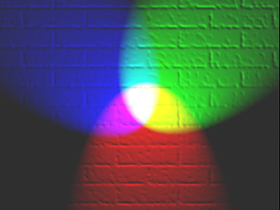
Color spaces
How can we represent color?
http://en.wikipedia.org/wiki/File:RGB_illumination.jpg

Slide 43

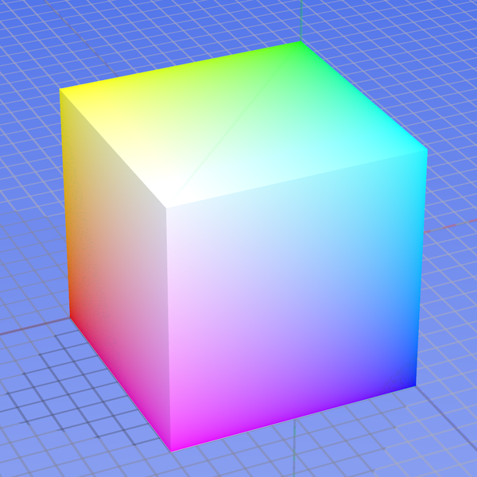
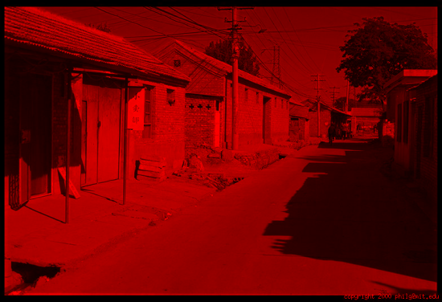
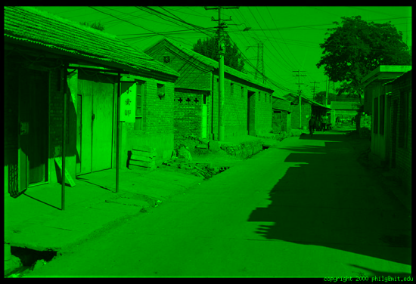
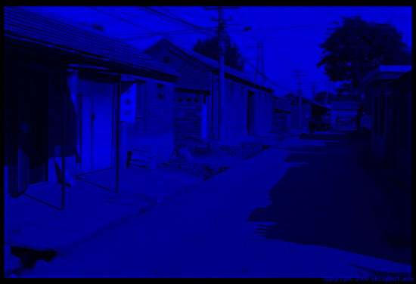
Color spaces: RGB
Default color space
0,1,0
R
(G=0,B=0)
1,0,0
G
(R=0,B=0)
0,0,1
RGB cube
  Easy for devices
  But not perceptual
  Where do the grays live?
  Where is hue and saturation?
B
(R=0,G=0)
Image from: http://en.wikipedia.org/wiki/File:RGB_color_solid_cube.png

Slide 44
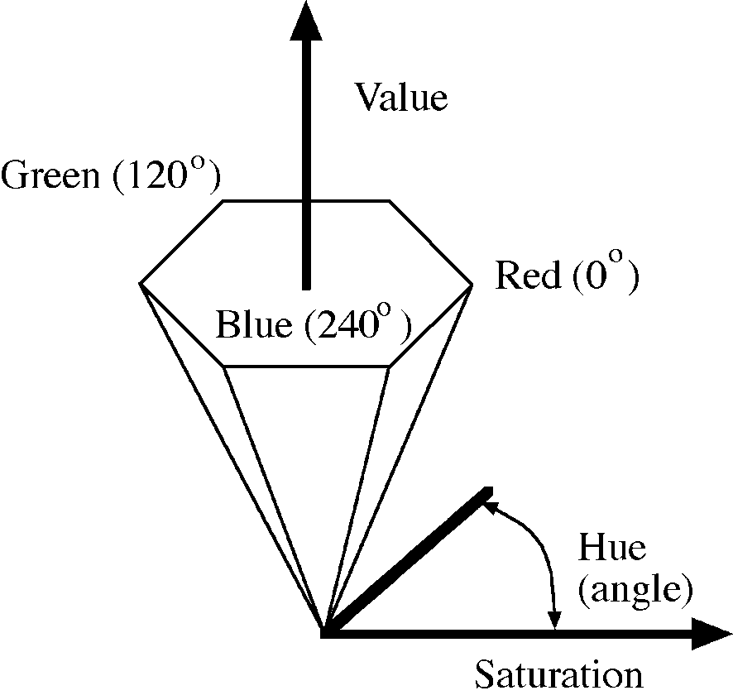
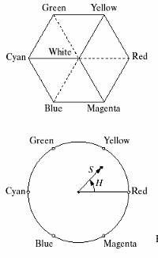
HSV
Hue, Saturation, Value (Intensity)
  RGB cube on its vertex
Decouples the three components (a bit)
Use rgb2hsv() and hsv2rgb() in Matlab
Slide by Steve Seitz

Slide 45
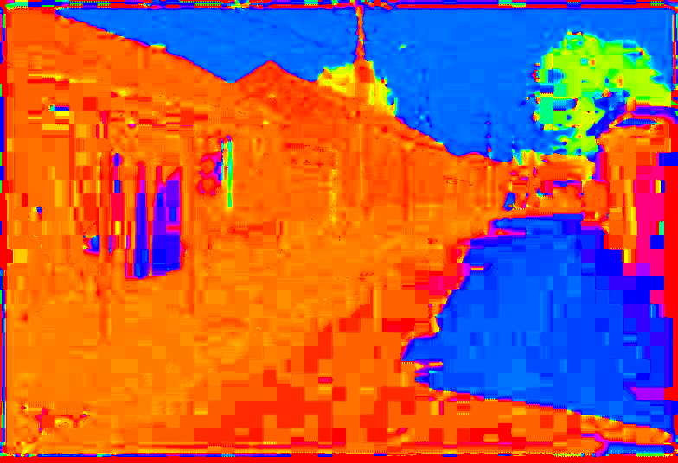
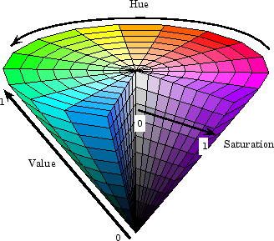
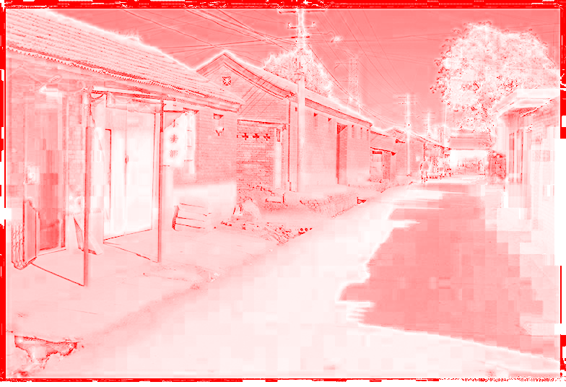
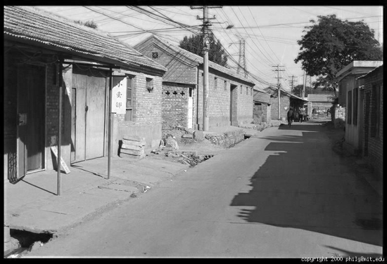
Color spaces: HSV
Intuitive color space
H
(S=1,V=1)
S
(H=1,V=1)
V
(H=1,S=0)

Slide 46
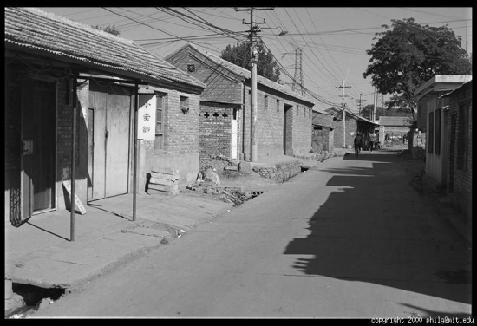



Color spaces: L*a*b*
“Perceptually uniform”* color space
L
(a=0,b=0)
a
(L=65,b=0)
b
(L=65,a=0)

Slide 47



Programming Project #1
Prokudin-Gorskii’s Color Photography (1907)

Slide 48

Programming Project #1

Slide 49


Programming Project #1
How to compare R,G,B channels?
No right answer
  Sum of Squared Differences (SSD):
  Normalized Correlation (NCC):

