Slide 1
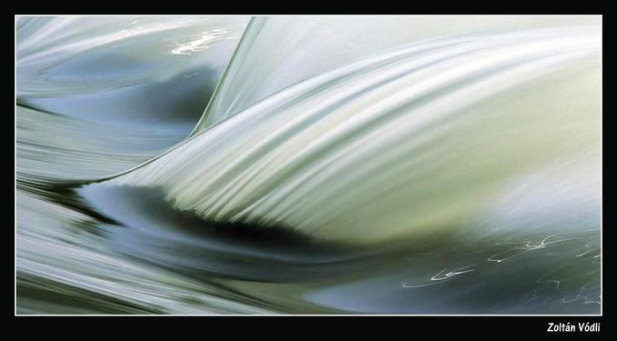
Convolution and Image Derivatives
CS194: Intro to Comp. Vision and Comp. Photo
Alexei Efros, UC Berkeley, Fall 2021

Slide 2
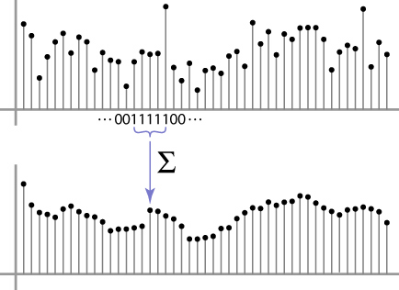
Moving Average
Can add weights to our moving average
Weights […, 0, 1, 1, 1, 1, 1, 0, …] / 5

Slide 3

Weighted Moving Average
bell curve (gaussian-like) weights […, 1, 4, 6, 4, 1, …]

Slide 4


Moving Average In 2D
What are the weights H?
0 | 0 | 0 | 0 | 0 | 0 | 0 | 0 | 0 | 0
0 | 0 | 0 | 0 | 0 | 0 | 0 | 0 | 0 | 0
0 | 0 | 0 | 90 | 90 | 90 | 90 | 90 | 0 | 0
0 | 0 | 0 | 90 | 90 | 90 | 90 | 90 | 0 | 0
0 | 0 | 0 | 90 | 90 | 90 | 90 | 90 | 0 | 0
0 | 0 | 0 | 90 | 0 | 90 | 90 | 90 | 0 | 0
0 | 0 | 0 | 90 | 90 | 90 | 90 | 90 | 0 | 0
0 | 0 | 0 | 0 | 0 | 0 | 0 | 0 | 0 | 0
0 | 0 | 90 | 0 | 0 | 0 | 0 | 0 | 0 | 0
0 | 0 | 0 | 0 | 0 | 0 | 0 | 0 | 0 | 0
Slide by Steve Seitz
Notes:
ones, divide by 9

Slide 5
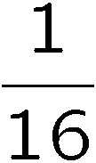
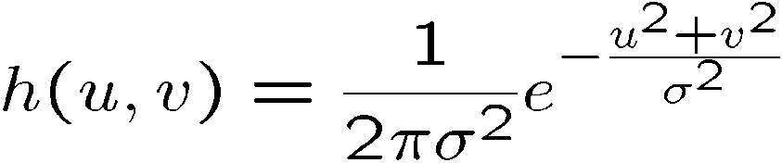
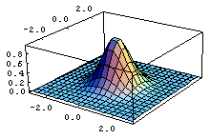
Gaussian filtering
A Gaussian kernel gives less weight to pixels further from the center of the window
This kernel is an approximation of a Gaussian function:
0 | 0 | 0 | 0 | 0 | 0 | 0 | 0 | 0 | 0
0 | 0 | 0 | 0 | 0 | 0 | 0 | 0 | 0 | 0
0 | 0 | 0 | 90 | 90 | 90 | 90 | 90 | 0 | 0
0 | 0 | 0 | 90 | 90 | 90 | 90 | 90 | 0 | 0
0 | 0 | 0 | 90 | 90 | 90 | 90 | 90 | 0 | 0
0 | 0 | 0 | 90 | 0 | 90 | 90 | 90 | 0 | 0
0 | 0 | 0 | 90 | 90 | 90 | 90 | 90 | 0 | 0
0 | 0 | 0 | 0 | 0 | 0 | 0 | 0 | 0 | 0
0 | 0 | 90 | 0 | 0 | 0 | 0 | 0 | 0 | 0
0 | 0 | 0 | 0 | 0 | 0 | 0 | 0 | 0 | 0
1 | 2 | 1
2 | 4 | 2
1 | 2 | 1
Slide by Steve Seitz

Slide 6
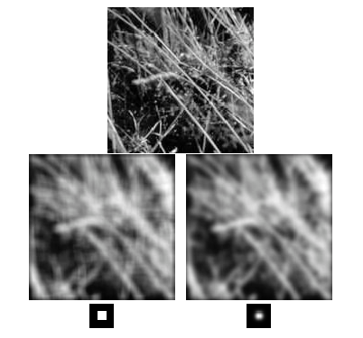
Mean vs. Gaussian filtering
Slide by Steve Seitz

Slide 7

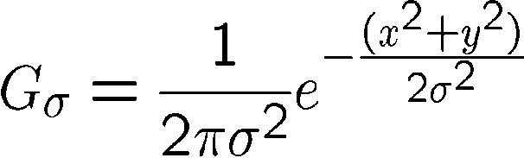
Important filter: Gaussian
Weight contributions of neighboring pixels by nearness
0.003 0.013 0.022 0.013 0.003
0.013 0.059 0.097 0.059 0.013
0.022 0.097 0.159 0.097 0.022
0.013 0.059 0.097 0.059 0.013
0.003 0.013 0.022 0.013 0.003
5 x 5, σ = 1
Slide credit: Christopher Rasmussen
Notes:
7

Slide 8
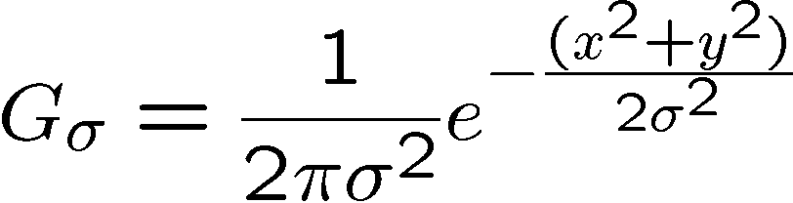
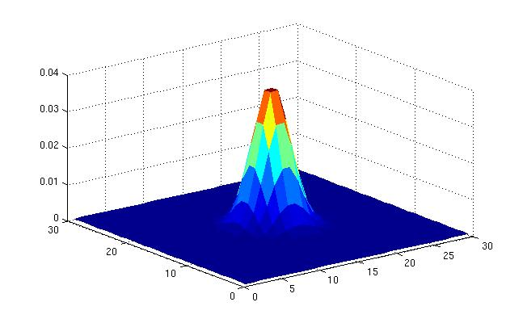
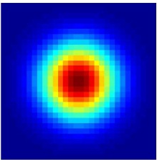
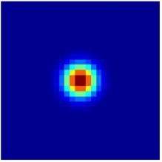
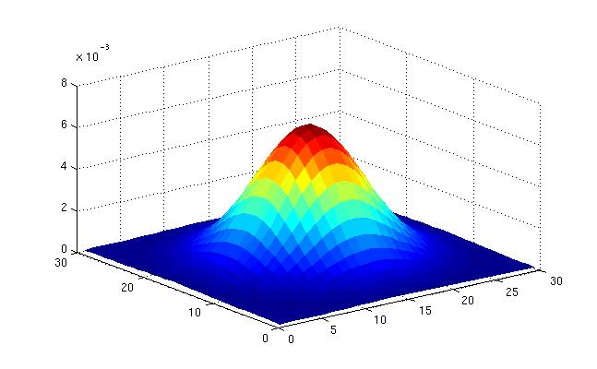
Gaussian Kernel
σ = 2 with 30 x 30 kernel
σ = 5 with 30 x 30 kernel
Standard deviation σ: determines extent of smoothing
Source: K. Grauman

Slide 9
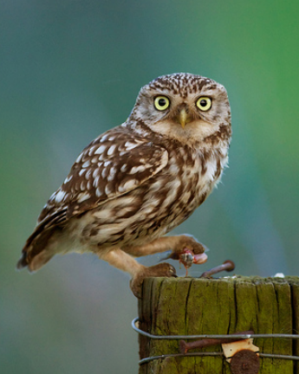
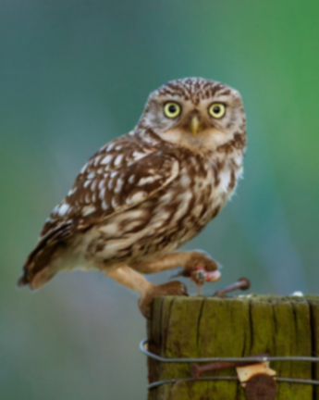

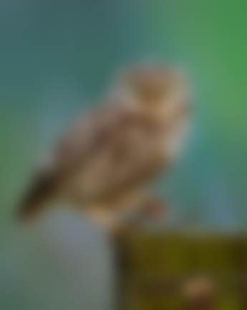

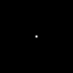




Gaussian filters
= 1 pixel
= 5 pixels
= 10 pixels
= 30 pixels

Slide 10
Choosing kernel width
The Gaussian function has infinite support, but discrete filters use finite kernels
Source: K. Grauman

Slide 11
Practical matters
How big should the filter be?
Values at edges should be near zero
Rule of thumb for Gaussian: set filter half-width to about 3 σ
Side by Derek Hoiem
Notes:
11

Slide 12

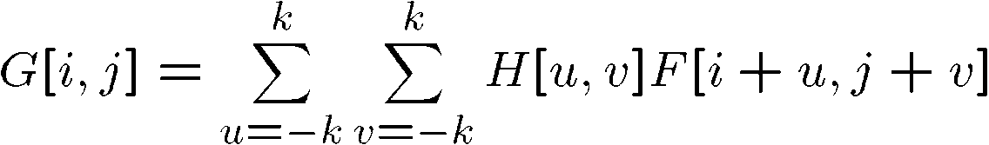
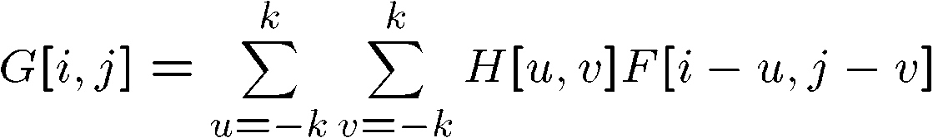

Cross-correlation vs. Convolution
cross-correlation:
A convolution operation is a cross-correlation where the filter is flipped both horizontally and vertically before being applied to the image:
It is written:
Convolution is commutative and associative
Slide by Steve Seitz

Slide 13




Convolution
Adapted from F. Durand

Slide 14






Convolution is nice!
Notation:
Convolution is a multiplication-like operation
  commutative
  associative
  distributes over addition
  scalars factor out
  identity: unit impulse e = […, 0, 0, 1, 0, 0, …]
Conceptually no distinction between filter and signal
Usefulness of associativity
  often apply several filters one after another: (((a * b₁) * b₂) * b₃)
  this is equivalent to applying one filter: a * (b₁ * b₂ * b₃)

Slide 15



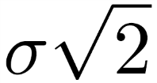
Gaussian and convolution
Removes “high-frequency” components from the image (low-pass filter)
Convolution with self is another Gaussian
  Convolving twice with Gaussian kernel of width = convolving once with kernel of width
*
=
Source: K. Grauman
Notes:
Linear vs. quadratic in mask size

Slide 16

Image half-sizing
This image is too big to
fit on the screen. How
can we reduce it?
How to generate a half-
sized version?

Slide 17



Image sub-sampling
1/8
1/4
Throw away every other row and column to create a 1/2 size image
  - called image sub-sampling
Slide by Steve Seitz

Slide 18
Image sub-sampling
1/2
1/4 (2x zoom)
1/8 (4x zoom)
Aliasing! What do we do?
Slide by Steve Seitz

Slide 19
Sampling an image
Examples of GOOD sampling

Slide 20
Undersampling
Examples of BAD sampling -> Aliasing

Slide 21



Gaussian (lowpass) pre-filtering
G 1/8
G 1/4
Gaussian 1/2
Solution: filter the image, then subsample
  Filter size should double for each ½ size reduction. Why?
Slide by Steve Seitz

Slide 22
Subsampling with Gaussian pre-filtering
Gaussian 1/2
G 1/4
G 1/8
Slide by Steve Seitz

Slide 23
Compare with...
1/2
1/4 (2x zoom)
1/8 (4x zoom)
Slide by Steve Seitz

Slide 24
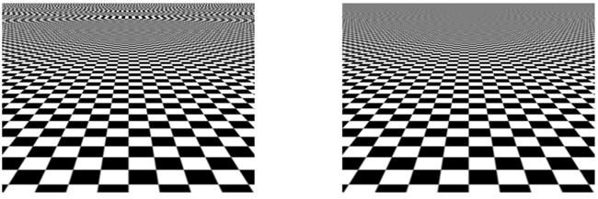
More Gaussian pre-filtering

Slide 25
Iterative Gaussian (lowpass) pre-filtering
G 1/8
G 1/4
Gaussian 1/2
filter the image, then subsample
  Filter size should double for each ½ size reduction. Why?
  How can we speed this up?
Slide by Steve Seitz

Slide 26
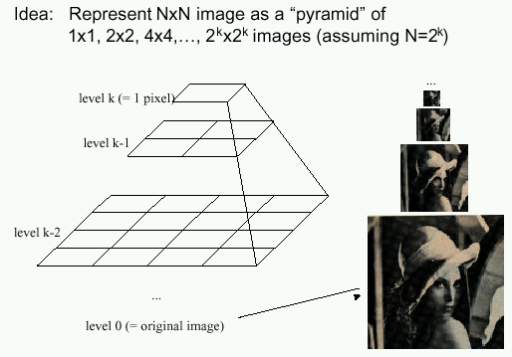
Image Pyramids
Known as a Gaussian Pyramid [Burt and Adelson, 1983]
  In computer graphics, a mip map [Williams, 1983]
  A precursor to wavelet transform
Slide by Steve Seitz

Slide 27
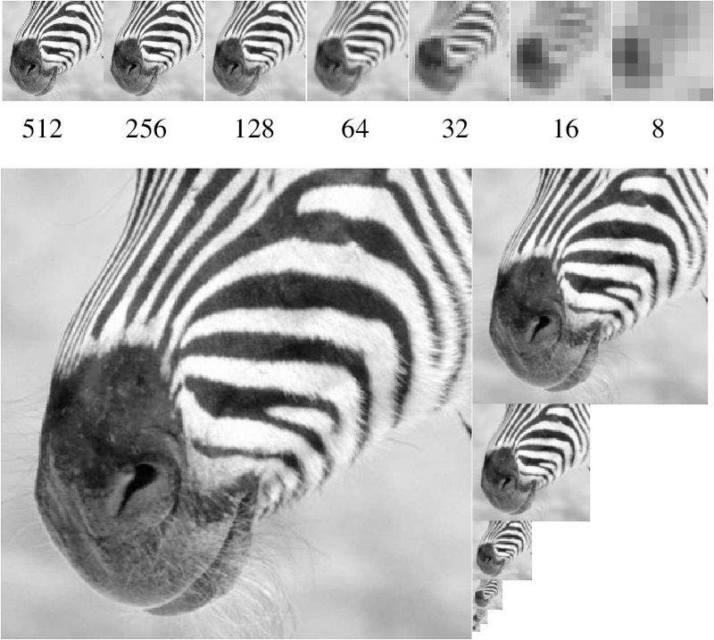
A bar in the big images is a hair on the zebra’s nose; in smaller images, a stripe; in the smallest, the animal’s nose
Figure from David Forsyth

Slide 28
Gaussian pyramid construction
filter mask
Repeat
  Filter
  Subsample
Until minimum resolution reached
  can specify desired number of levels (e.g., 3-level pyramid)
The whole pyramid is only 4/3 the size of the original image!
Slide by Steve Seitz

Slide 29
What are they good for?
Improve Search
  Search over translations
    Classic coarse-to-fine strategy
    Project 1!
  Search over scale
    Template matching
    E.g. find a face at different scales

Slide 30
Taking derivative by convolution

Slide 31
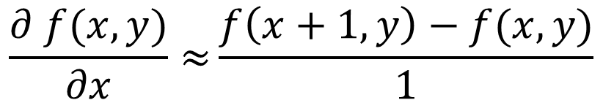
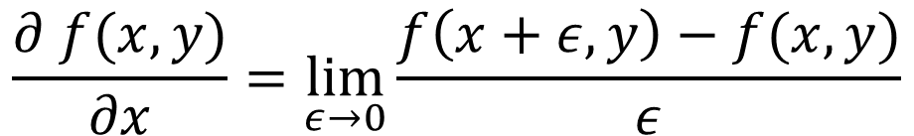
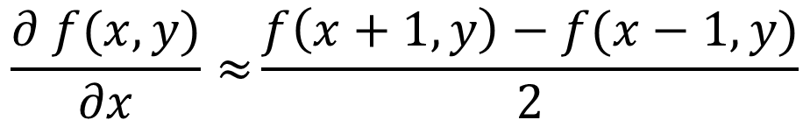
Partial derivatives with convolution
Image is function f(x,y)
$$\frac{∂ f(x,y)}{∂x}=\lim_{ε→0}{\frac{f\left(x+ε,y\right)−f(x,y)}{ε}}$$
Remember:
$$\frac{∂ f(x,y)}{∂x}≈{\frac{f\left(x+1,y\right)−f(x,y)}{1}}$$
Approximate:
-1
1
$$\frac{∂ f(x,y)}{∂x}≈{\frac{f\left(x+1,y\right)−f(x−1,y)}{2}}$$
Another one:
-1
0
1

Slide 32
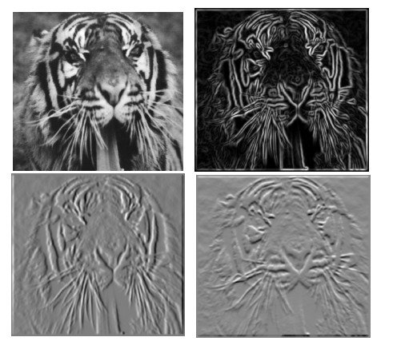
Partial derivatives of an image
-1 1
1 -1
-1 1
or
Which shows changes with respect to x?

Slide 33






Image gradient
The gradient of an image:
The gradient points in the direction of most rapid increase in intensity
How does this direction relate to the direction of the edge?
The edge strength is given by the gradient magnitude
The gradient direction is given by
Source: Steve Seitz
Notes:
give definition of partial derivative: lim h->0 [f(x+h,y) – f(x,y)]/h

Slide 34
Image Gradient

Slide 35
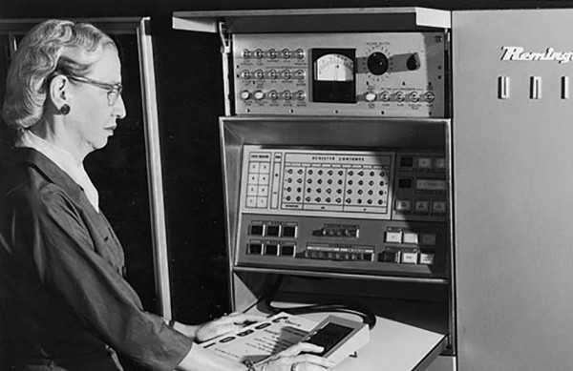
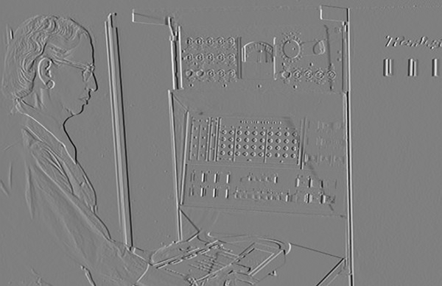
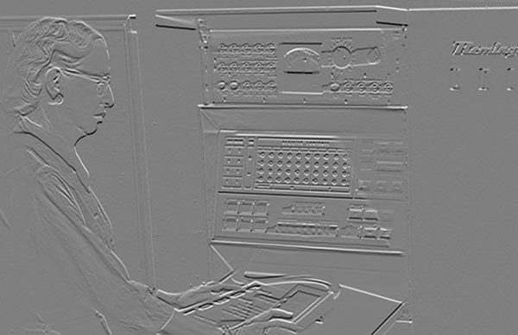
Partial Derivatives

Slide 36
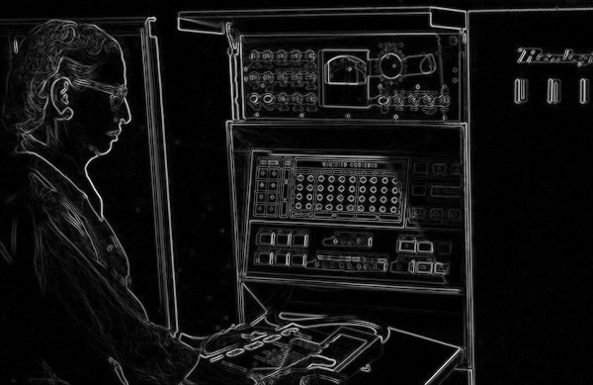
Gradient magnitude

Slide 37
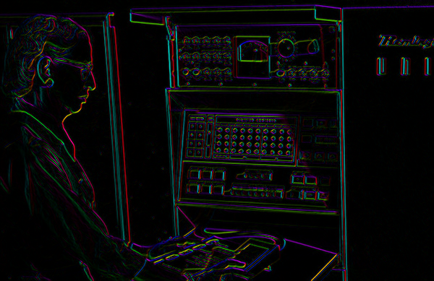

Gradient Orientation
atan2(dy,dx)
I’m making the lightness equal to gradient magnitude
Source: D. Fouhey

Slide 38
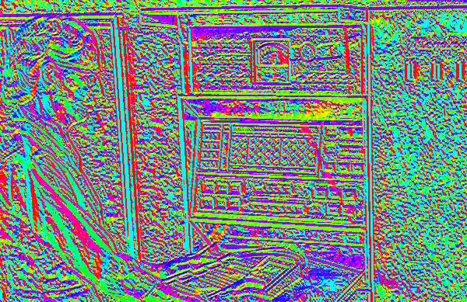
Image Gradient
Now I’m showing all the gradients
Source: D. Fouhey

Slide 39
Image Gradient
Why is there structure at 1 and not at 2?
1
2
Source: D. Fouhey

Slide 40




Effects of noise
Consider a single row or column of the image
  Plotting intensity as a function of position gives a signal
Where is the edge?
Source: S. Seitz
Notes:
How to fix?

Slide 41
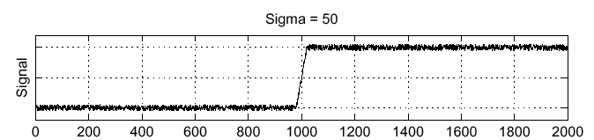
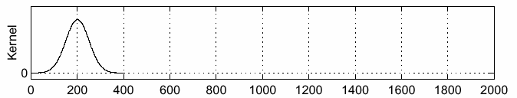
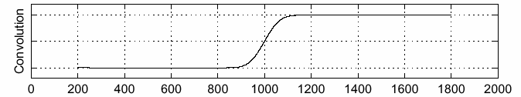
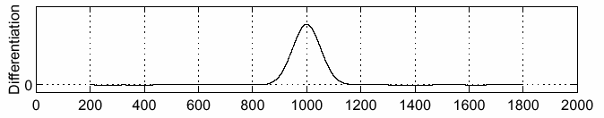
Solution: smooth first
f
g
f * g
To find edges, look for peaks in
Source: S. Seitz

Slide 42

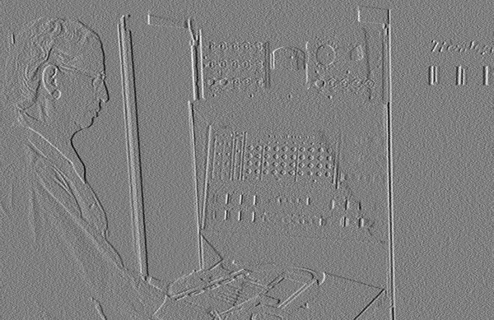
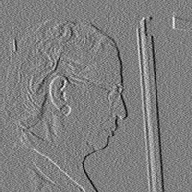

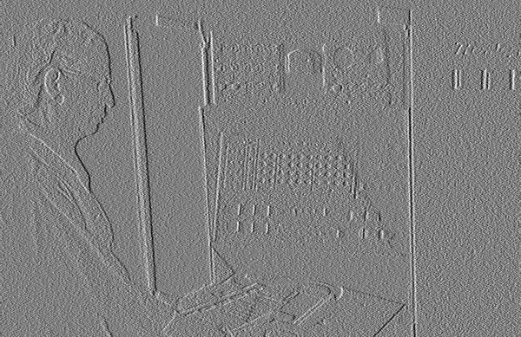
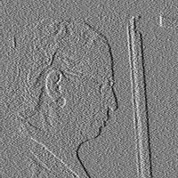
Noise in 2D
Noisy Input
Ix via [-1,01]
Zoom
Source: D. Fouhey

Slide 43

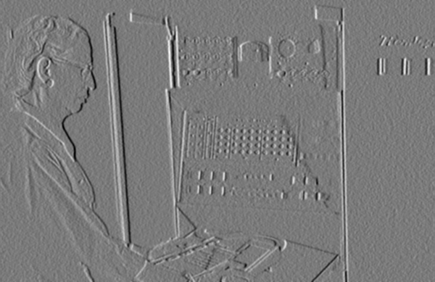
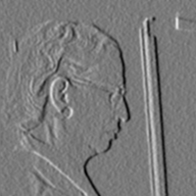



Noise + Smoothing
Smoothed Input
Ix via [-1,01]
Zoom
Source: D. Fouhey

Slide 44
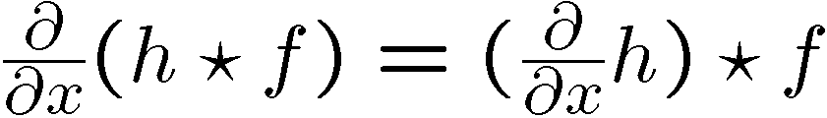
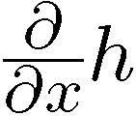
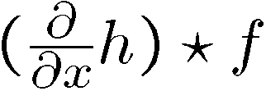

Derivative theorem of convolution
This saves us one operation:

Slide 45


Derivative of Gaussian filter
* [1 -1] =

Slide 46


Derivative of Gaussian filter
x-direction
y-direction
Which one finds horizontal/vertical edges?

Slide 47
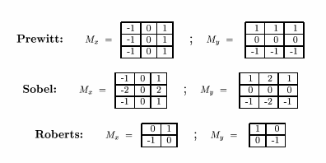
Compare to classic derivative filters
Source: K. Grauman

Slide 48
Filtering: practical matters
What is the size of the output?
(MATLAB) filter2(g, f, shape) or conv2(g,f,shape)
  shape = ‘full’: output size is sum of sizes of f and g
  shape = ‘same’: output size is same as f
  shape = ‘valid’: output size is difference of sizes of f and g
full
same
valid
g
g
g
g
f
f
f
g
g
g
g
g
g
g
g
Source: S. Lazebnik
Notes:
48

Slide 49
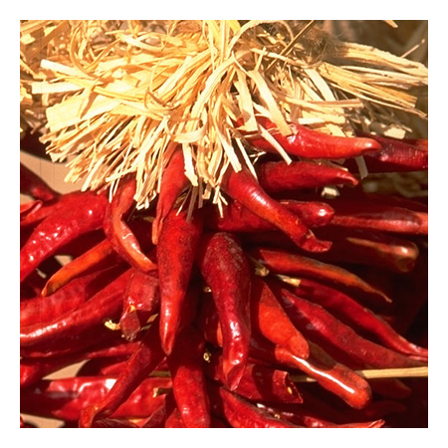
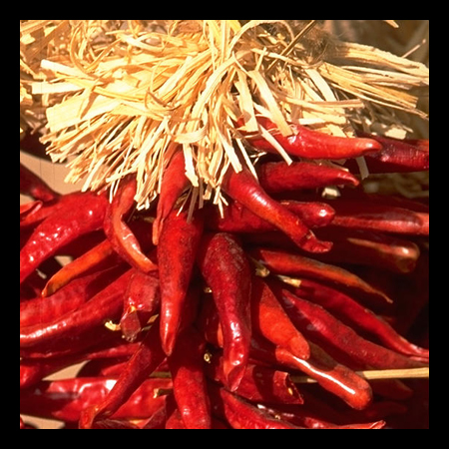
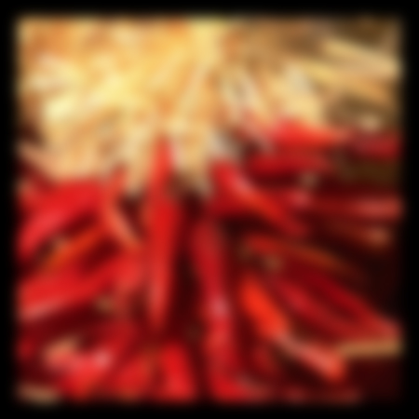
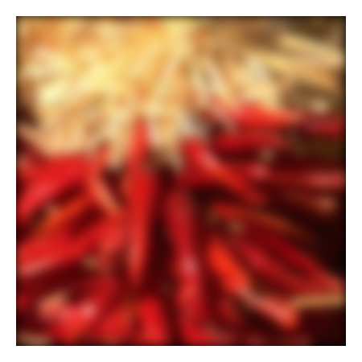









Practical matters
What about near the edge?
  the filter window falls off the edge of the image
  need to extrapolate
  methods:
    clip filter (black)
    wrap around
    copy edge
    reflect across edge
Source: S. Marschner
Notes:
49

Slide 50



Low Pass vs. High Pass filtering
Image
Smoothed
-
Details
=

Slide 51


Filtering – Sharpening
Image
Details
+α
“Sharpened” α=1
=

Slide 52
Filtering – Sharpening
Image
Details
+α
“Sharpened” α=0
=

Slide 53

Filtering – Sharpening
Image
Details
+α
“Sharpened” α=2
=

Slide 54
Filtering – Sharpening
Image
Details
+α
“Sharpened” α=0
=

Slide 55

Filtering – Extreme Sharpening
Image
Details
+α
“Sharpened” α=10
=

Slide 56


Unsharp mask filter
image
blurred
image
unit impulse
(identity)
unit impulse
Gaussian
Laplacian of Gaussian
Notes:
f + a(f - f * g) = (1+a)f-af*g = f*((1+a)e-g)

