Slide 1
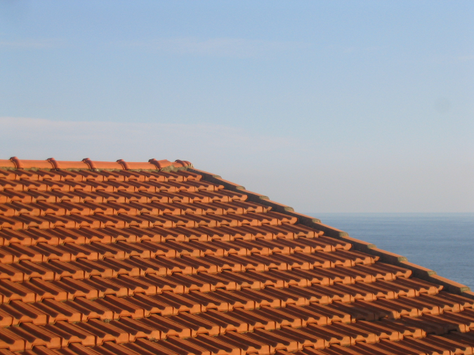
Visual Texture (in human and machine)
Somewhere in Cinque Terre, May 2005
CS194: Intro to Computer Vision and Comp. Photo
Alexei Efros, UC Berkeley, Fall 2021

Slide 2
What is Texture?
Texture depicts spatially repeating patterns
Many natural phenomena are textures
radishes
rocks
yogurt

Slide 3
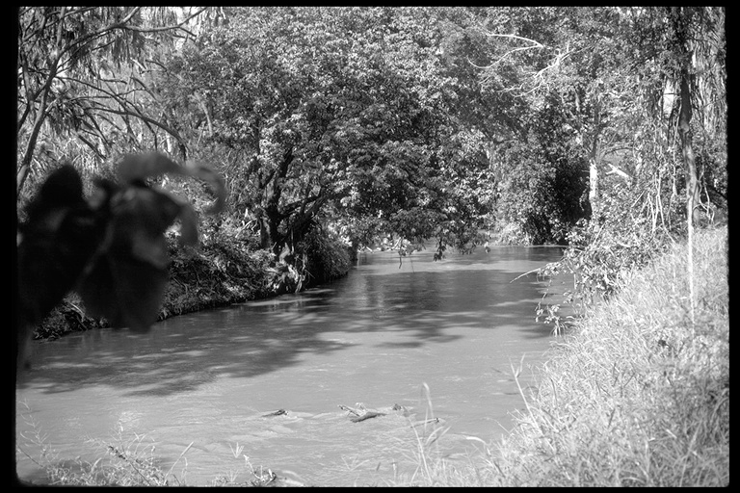
Texture as “stuff”
Source: Forsyth

Slide 4
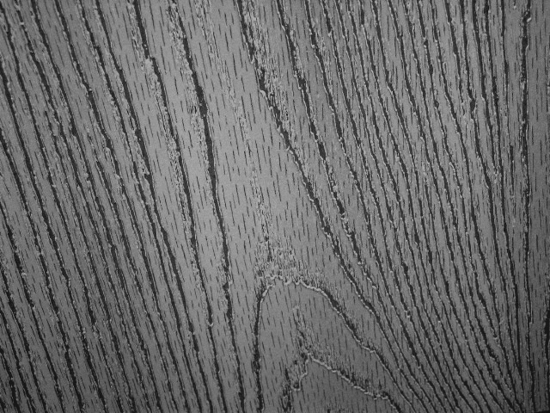
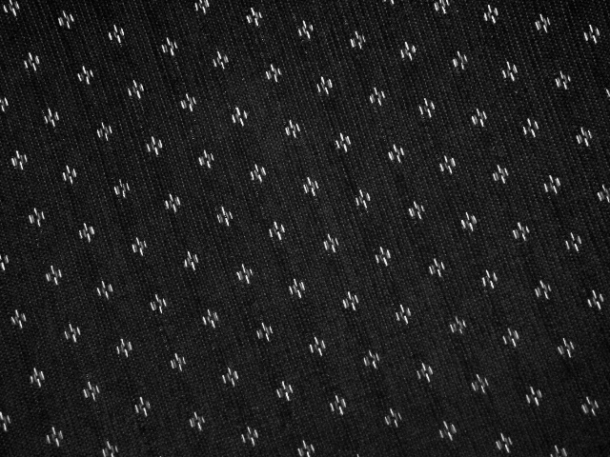
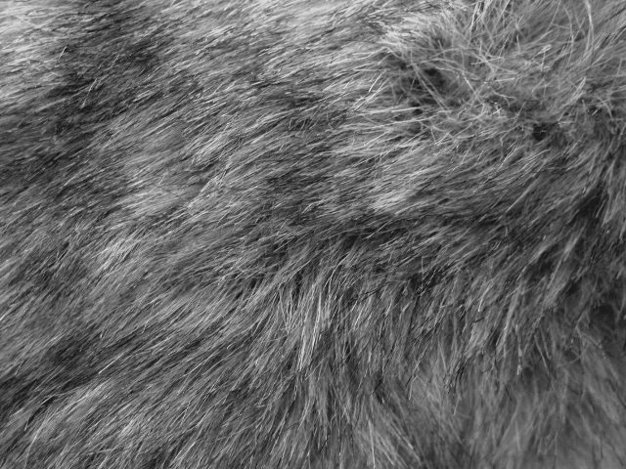
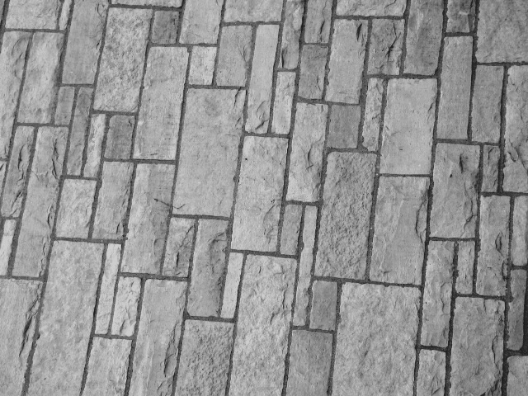
Texture and Material
http://www-cvr.ai.uiuc.edu/ponce_grp/data/texture_database/samples/

Slide 5
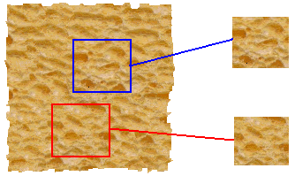
Texture Analysis
“Same” or “different”
ANALYSIS
True (infinite) texture
Compare textures and decide if they’re made of the same “stuff”.

Slide 6
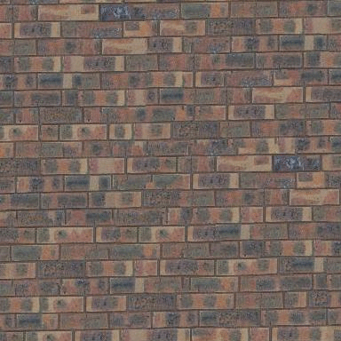
When are two textures similar?

Slide 7
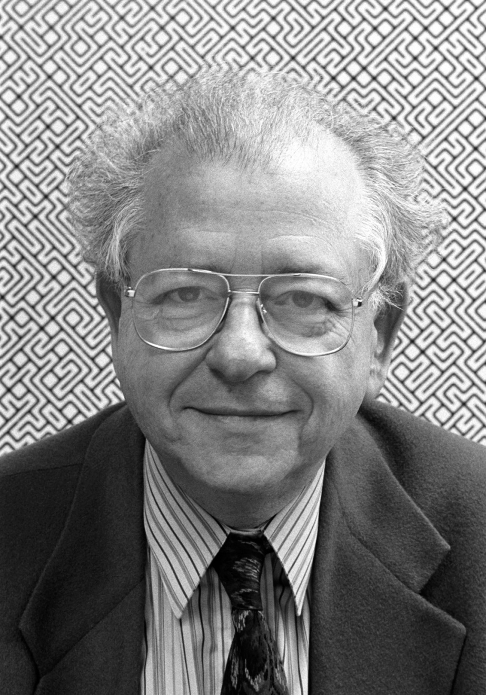
Béla Julesz, father of texture

Slide 8
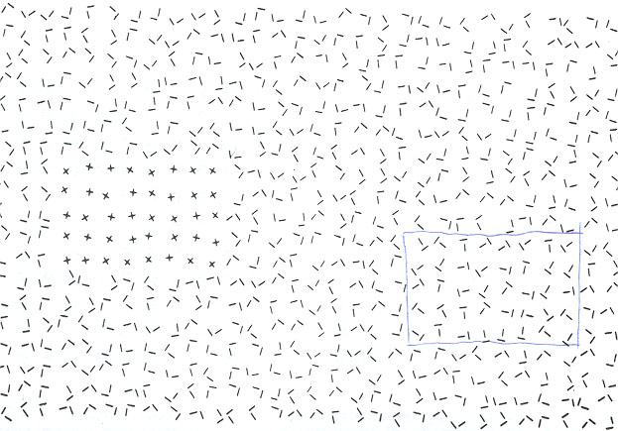
Texton Discrimination (Julesz)
Human vision is sensitive to the difference of some types of elements and
appears to be “numb” on other types of differences.

Slide 9
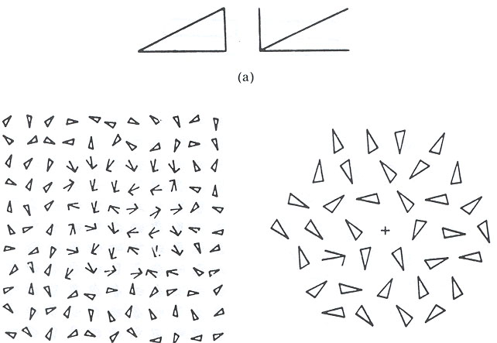
Search Experiment I
The subject is told to detect a target element in a number of background elements.
In this example, the detection time is independent of the number of background elements.

Slide 10
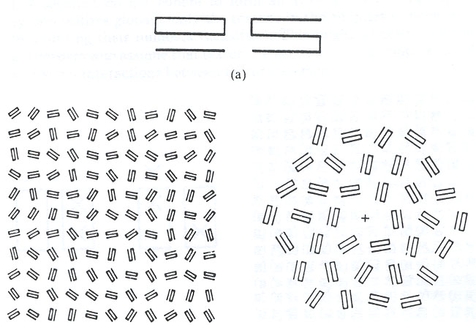
Search Experiment II
In this example, the detection time is proportional to the number of background elements,
And thus suggests that the subject is doing element-by-element scrutiny.

Slide 11
Heuristic (Axiom) I
Julesz then conjectured the following axiom:
Human vision operates in two distinct modes:
1. Preattentive vision
parallel, instantaneous (~100--200ms), without scrutiny,
independent of the number of patterns, covering a large visual field.
2. Attentive vision
serial search by focal attention in 50ms steps limited to small aperture.

Slide 12

Examples
Pre-attentive vision is sensitive to size/width, orientation changes

Slide 13
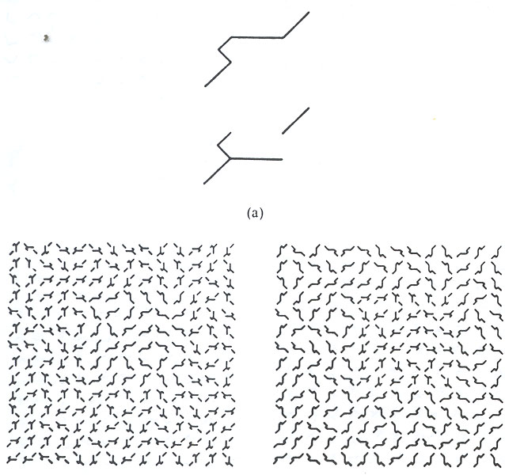
Examples
Sensitive to number
of terminators
Left: fore-back
Right: back-fore
See previous examples
For cross and terminators

Slide 14
Heuristic (Axiom) II
Textons are the fundamental elements in preattentive vision, including
1. Elongated blobs
rectangles, ellipses, line segments with attributes
color, orientation, width, length, flicker rate.
2. Terminators
ends of line segments.
3. Crossings of line segments.
But it is worth noting that Julesz’s conclusions are largely based on ensemble of
artificial texture patterns. It was infeasible to synthesize natural textures for
controlled experiments at that time.

Slide 15
Julesz Conjecture
Textures cannot be spontaneously discriminated if they have the same first-order and second-order statistics and differ only in their third-order or higher-order statistics.
(not quite true)

Slide 16
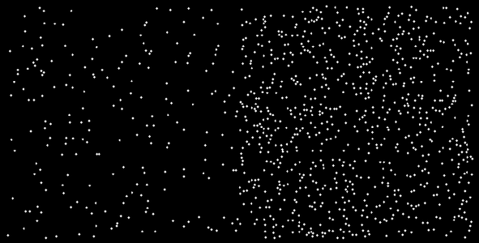
1st Order Statistics
5% white
20% white

Slide 17
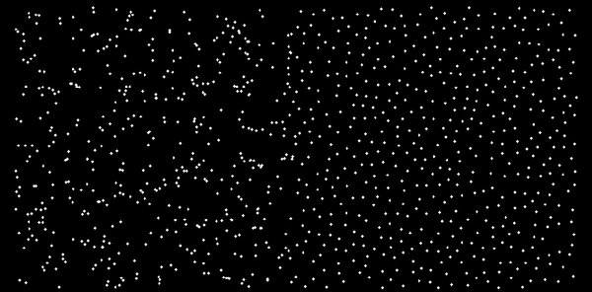
2nd Order Statistics
10% white

Slide 18
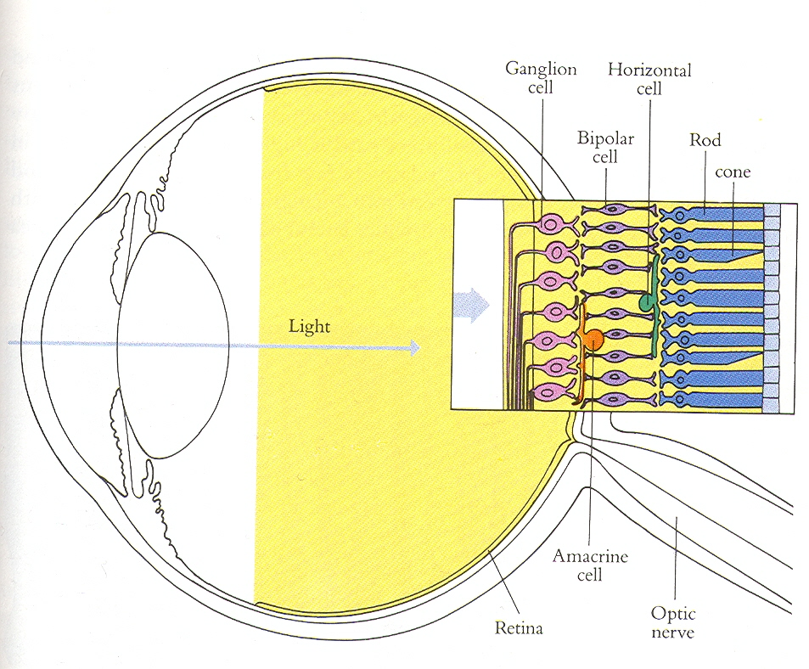

Slide 19
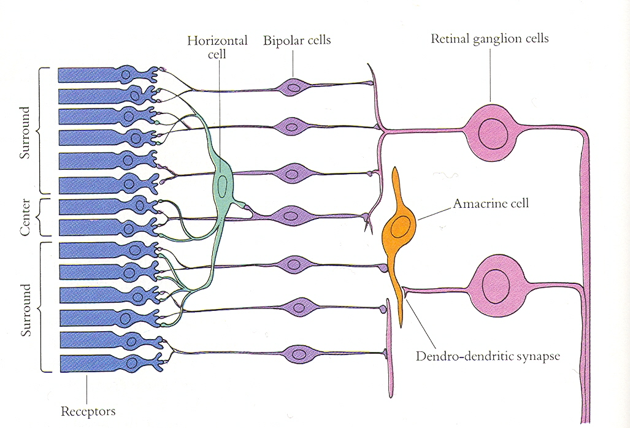

Slide 20
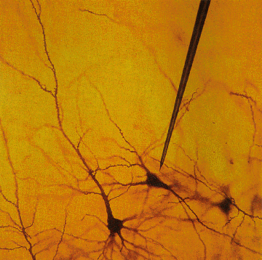
Single Cell Recording
© Stephen E. Palmer, 2002

Slide 21
Single Cell Recording
Microelectrode
Amplifier
Electrical response
(action potentials)
mV
© Stephen E. Palmer, 2002

Slide 22
Retinal Receptive Fields
Receptive field structure in ganglion cells:
On-center Off-surround
Stimulus condition
Electrical response
© Stephen E. Palmer, 2002

Slide 23
Retinal Receptive Fields
Receptive field structure in ganglion cells:
On-center Off-surround
Stimulus condition
Electrical response
© Stephen E. Palmer, 2002

Slide 24
Retinal Receptive Fields
Receptive field structure in ganglion cells:
On-center Off-surround
Stimulus condition
Electrical response
© Stephen E. Palmer, 2002

Slide 25
Retinal Receptive Fields
Receptive field structure in ganglion cells:
On-center Off-surround
Stimulus condition
Electrical response
© Stephen E. Palmer, 2002

Slide 26
Retinal Receptive Fields
Receptive field structure in ganglion cells:
On-center Off-surround
Stimulus condition
Electrical response
© Stephen E. Palmer, 2002

Slide 27
Retinal Receptive Fields
Receptive field structure in ganglion cells:
On-center Off-surround
Stimulus condition
Electrical response
© Stephen E. Palmer, 2002

Slide 28
Retinal Receptive Fields
RF of On-center Off-surround cells
© Stephen E. Palmer, 2002

Slide 29
Retinal Receptive Fields
RF of Off-center On-surround cells
Surround
Center
© Stephen E. Palmer, 2002

Slide 30
Retinal Receptive Fields

Slide 31
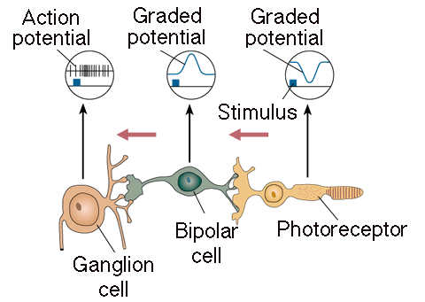
Retinal Receptive Fields
Receptive field structure in bipolar cells
Light
© Stephen E. Palmer, 2002

Slide 32
Retinal Receptive Fields
Receptive field structure in bipolar cells
© Stephen E. Palmer, 2002

Slide 33
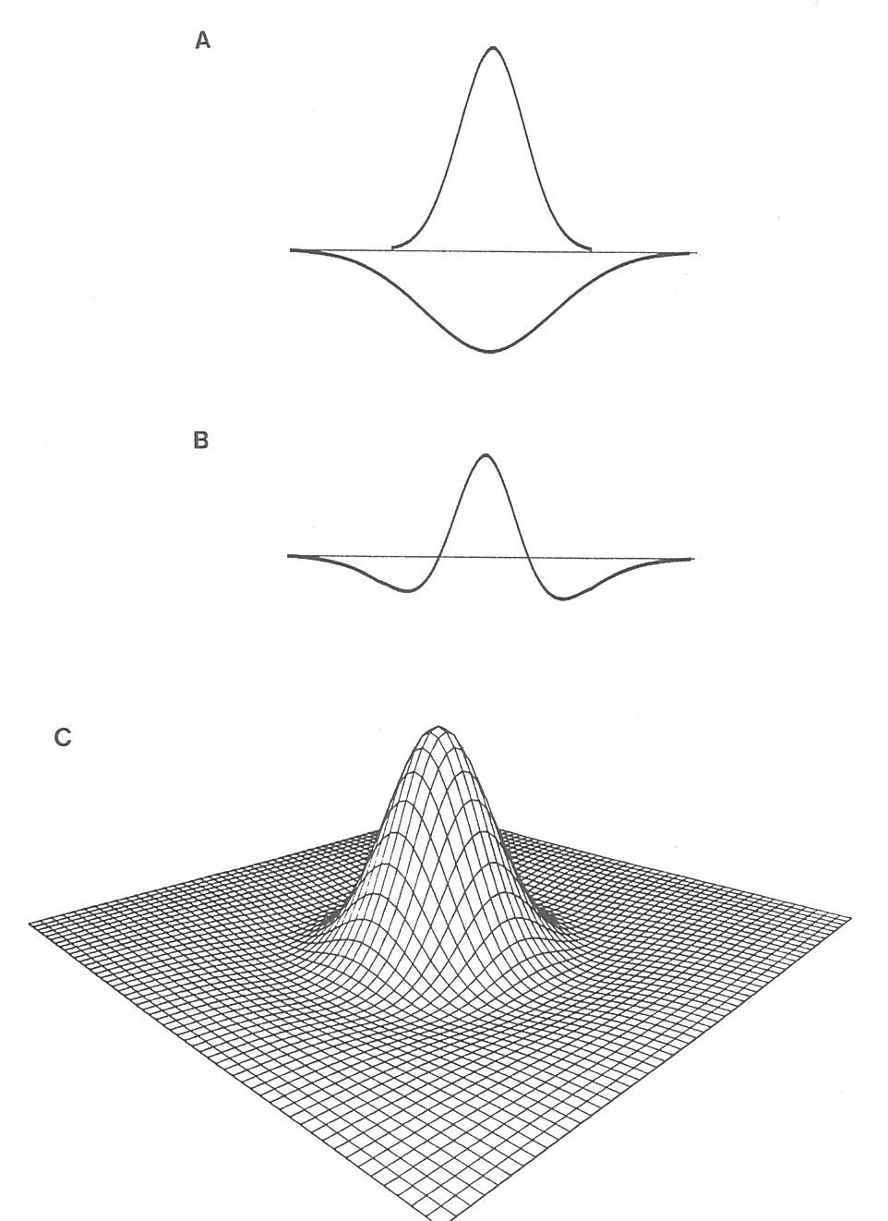

The receptive field of a retinal ganglion cell can be modeled as a “Difference of Gaussians”

Slide 34
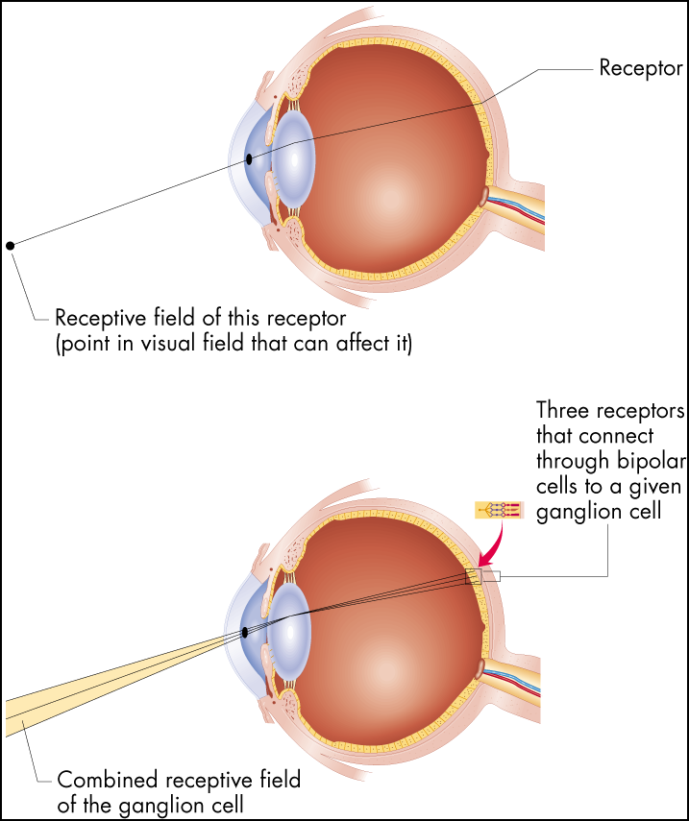
Receptive Fields
Figure 6.16 Receptive fields
The receptive field of a receptor is simply the area of the visual field from which light strikes that receptor. For any other cell in the visual system, the receptive
field is determined by which receptors connect to the cell in question.

Slide 35
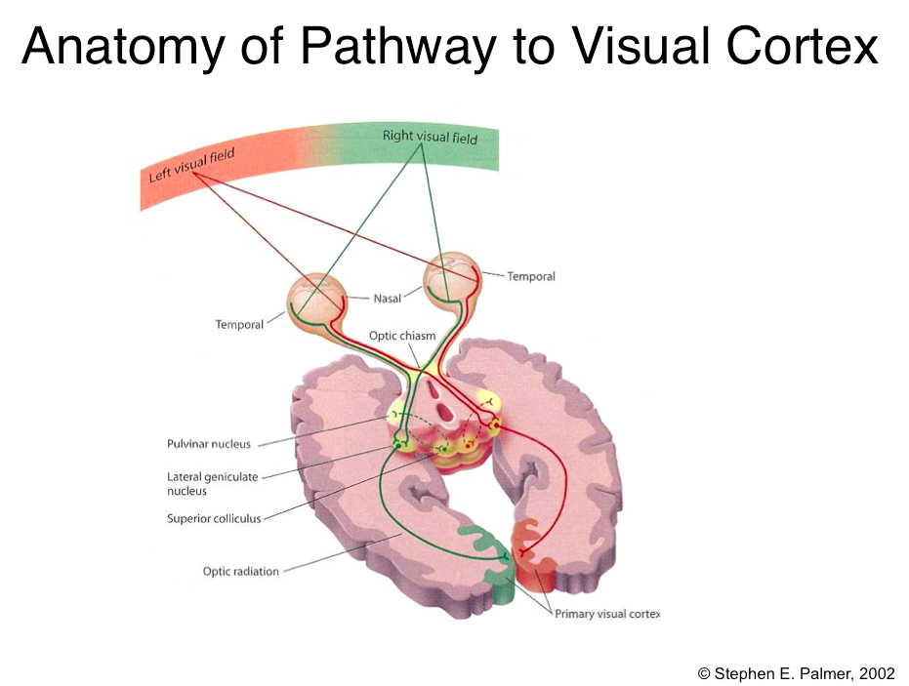

Slide 36
Visual Cortex
Cortical Area V1
aka:
Primary visual cortex
Striate cortex
Brodman’s area 17
© Stephen E. Palmer, 2002

Slide 37
Cortical Receptive Fields
Single-cell recording from visual cortex
David Hubel & Thorston Wiesel
© Stephen E. Palmer, 2002

Slide 38
Cortical Receptive Fields
Single-cell recording from visual cortex
© Stephen E. Palmer, 2002

Slide 39
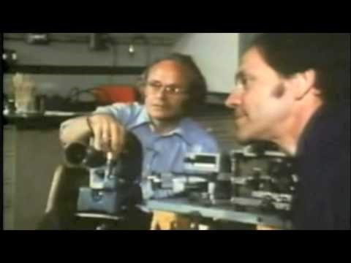
https://www.youtube.com/watch?v=IOHayh06LJ4

Slide 40
Cortical Receptive Fields
Three classes of cells in V1
Simple cells
Complex cells
Hypercomplex cells
© Stephen E. Palmer, 2002

Slide 41
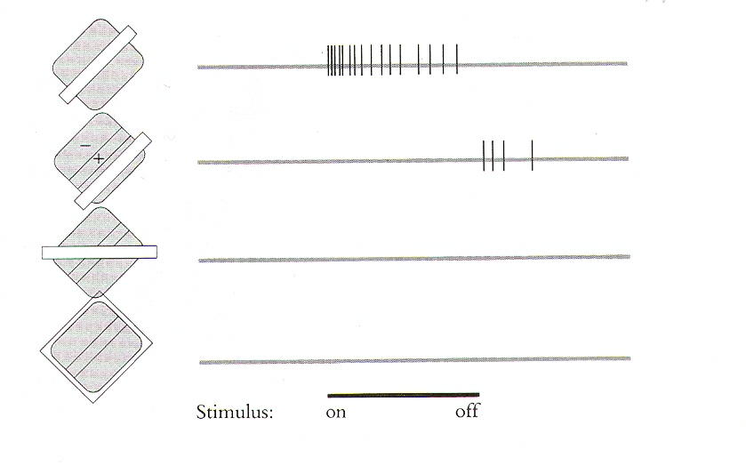
Orientation Selectivity in V1

Slide 42
Cortical Receptive Fields
Simple Cells: “Line Detectors”
© Stephen E. Palmer, 2002

Slide 43
Cortical Receptive Fields
Simple Cells: “Edge Detectors”
© Stephen E. Palmer, 2002

Slide 44
Cortical Receptive Fields
Constructing a line detector
© Stephen E. Palmer, 2002

Slide 45
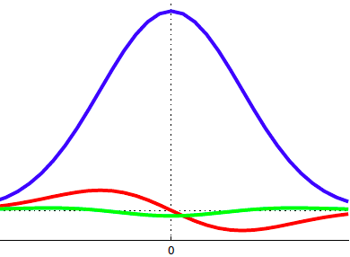
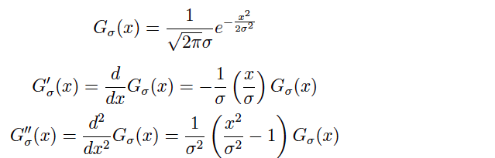
The 1D Gaussian and its derivatives

Slide 46
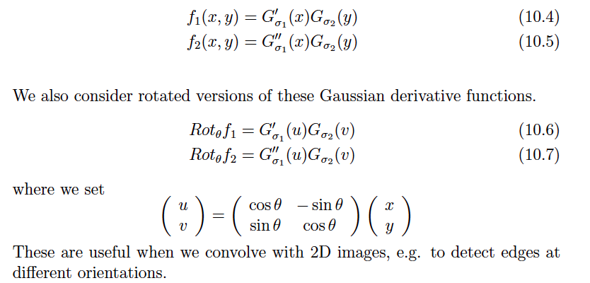
Oriented Gaussian Derivatives in 2D

Slide 47


Oriented Gaussian First and Second Derivatives

Slide 48
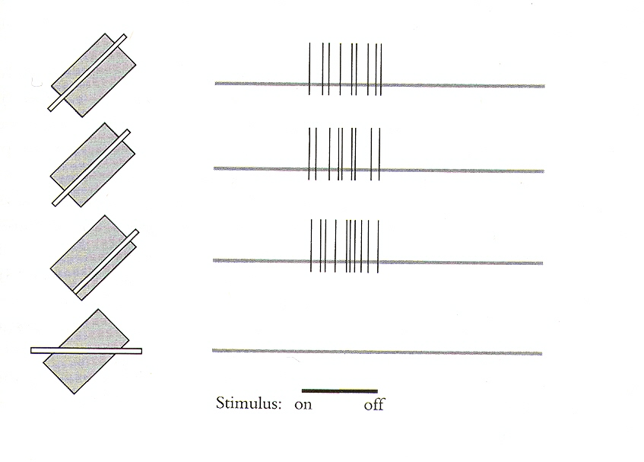
Receptive fields of complex cells

Slide 49
Cortical Receptive Fields
Constructing a Complex Cell
© Stephen E. Palmer, 2002

Slide 50
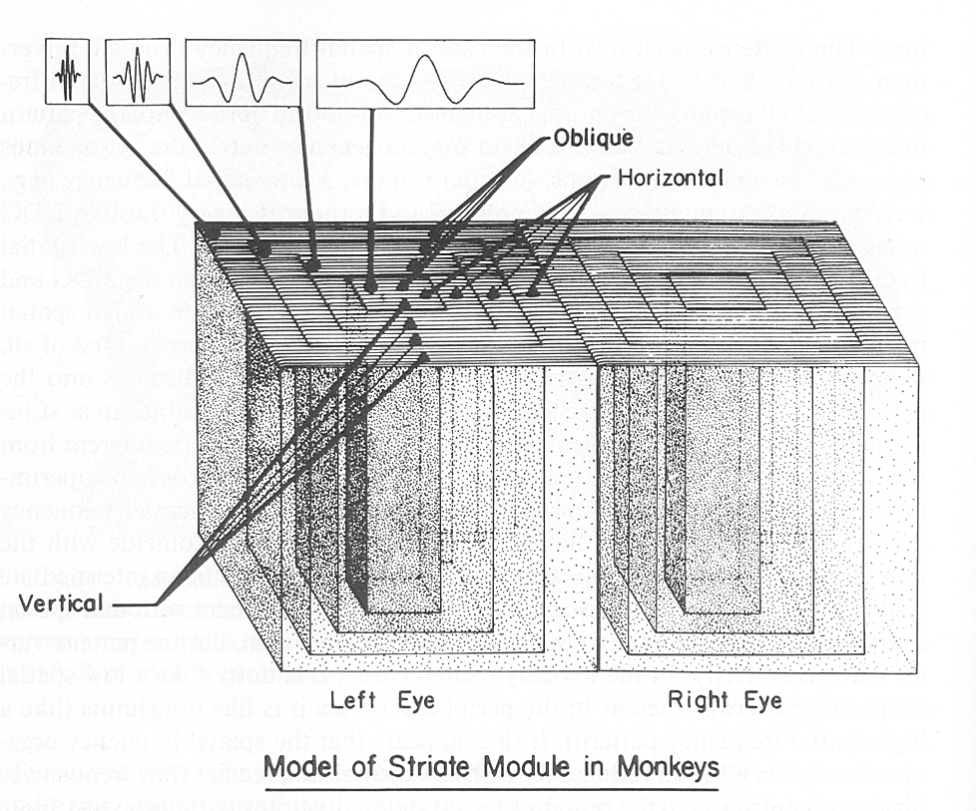
Hypercolumns in visual cortex

Slide 51
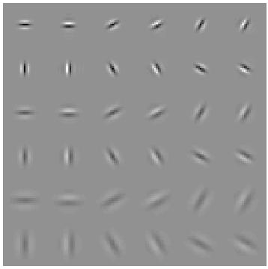
Modeling hypercolumns
Elongated directional Gaussian derivatives
Gabor filters could be used instead
Multiple orientations, scales
Notes:
No response to intensity ramps -- important benefit compared to simple comparison of intensities at i and j

Slide 52
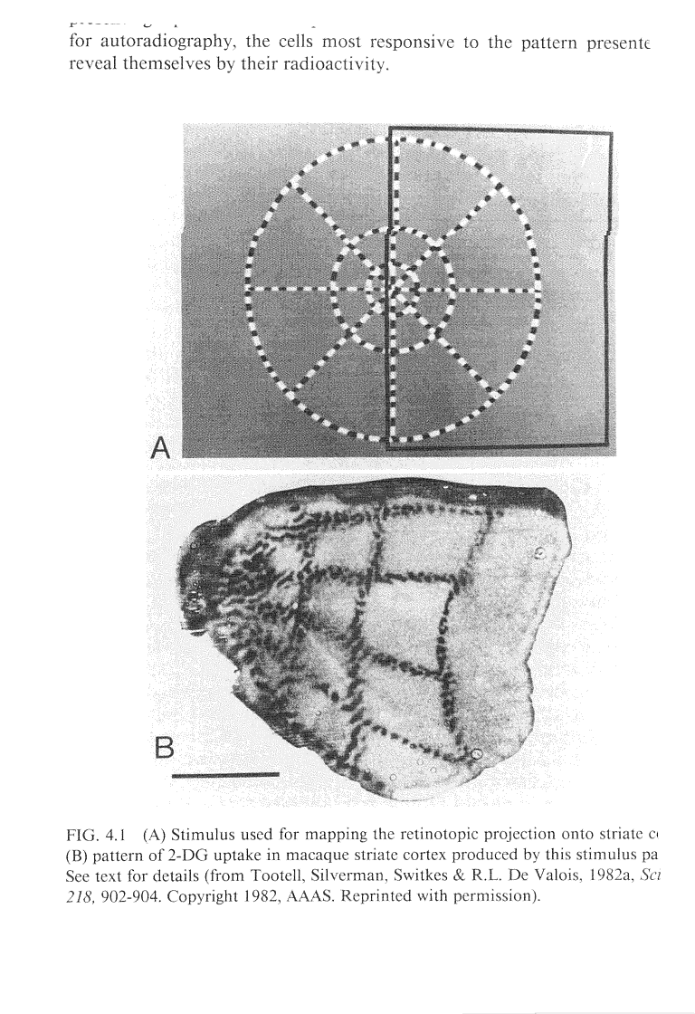
Mapping from Retina to V1

Slide 53
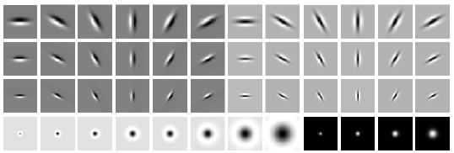
Overcomplete representation: filter banks
LM Filter Bank
Code for filter banks: www.robots.ox.ac.uk/~vgg/research/texclass/filters.html

Slide 54

Image from http://www.texasexplorer.com/austincap2.jpg
Kristen Grauman

Slide 55
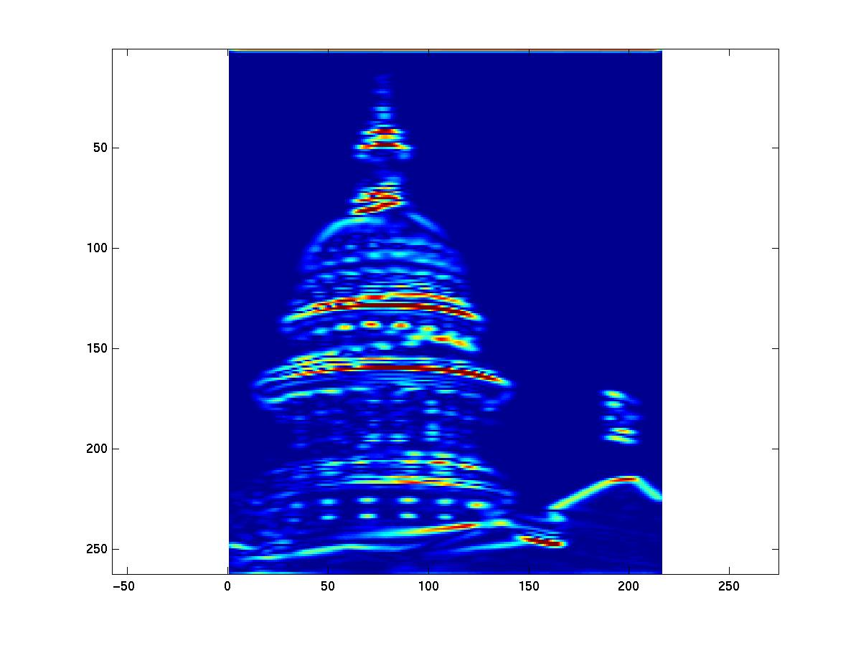
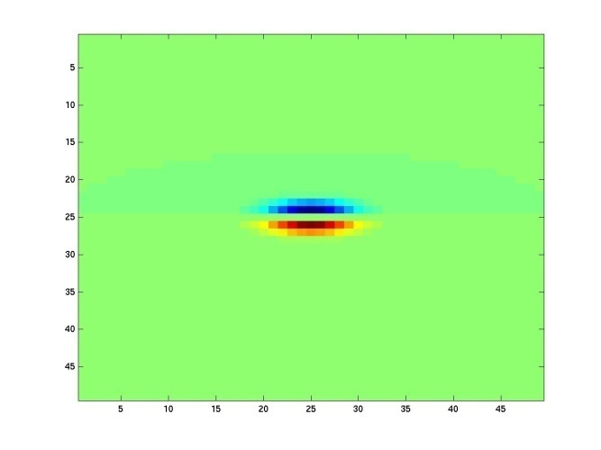
Showing magnitude of responses
Kristen Grauman

Slide 56
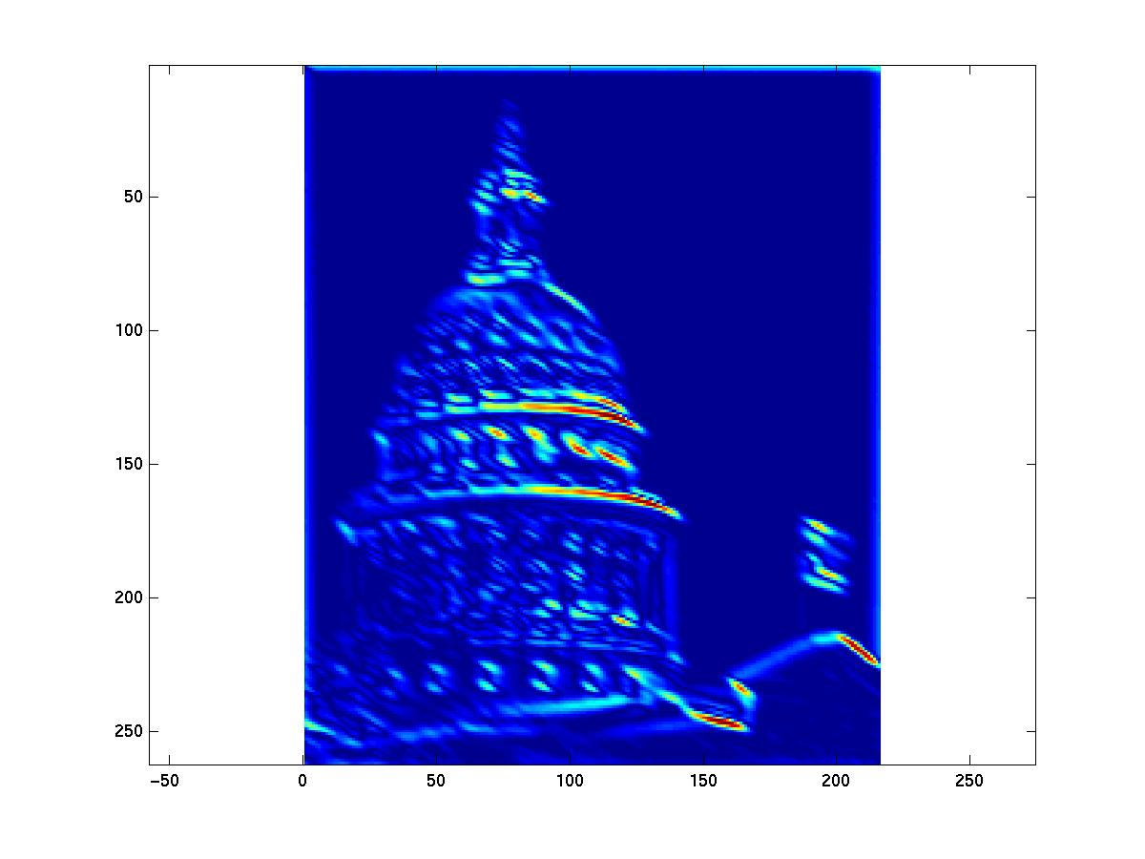
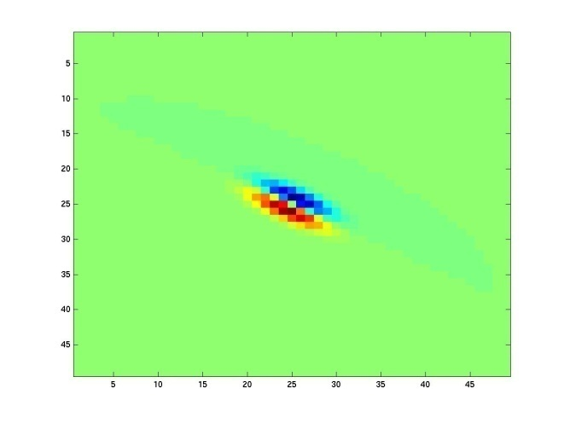
Kristen Grauman
Notes:
2

Slide 57
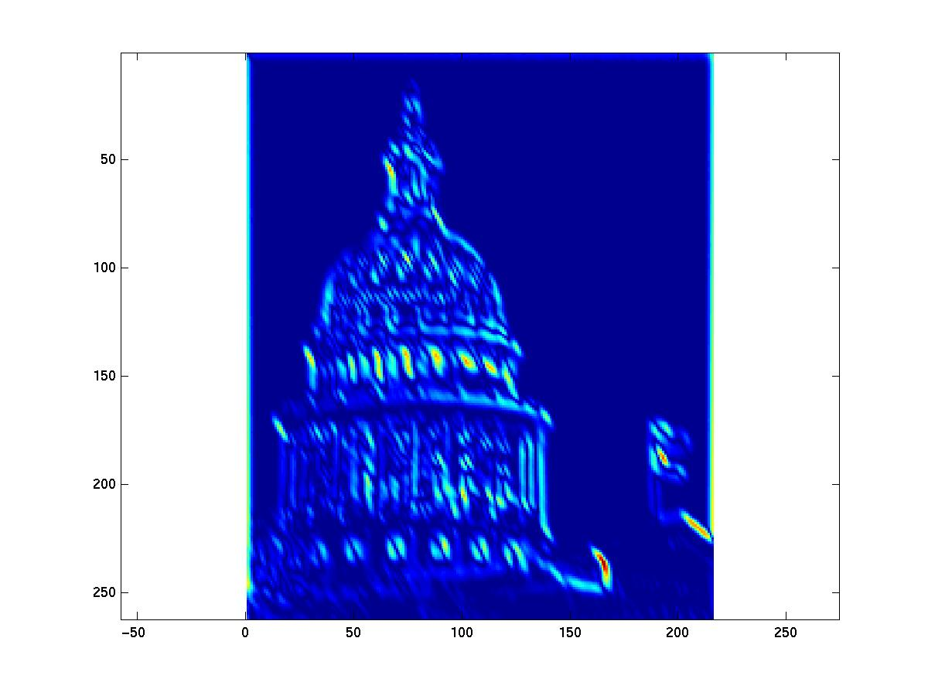
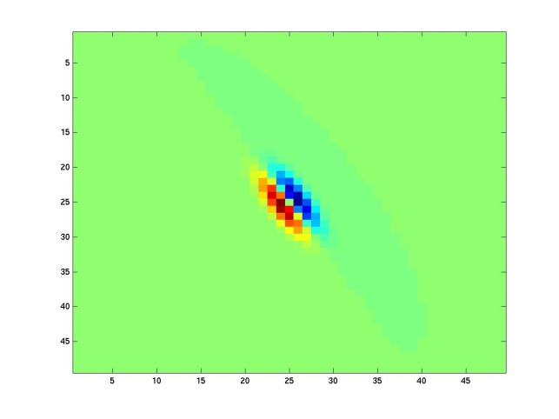
Kristen Grauman
Notes:
3

Slide 58
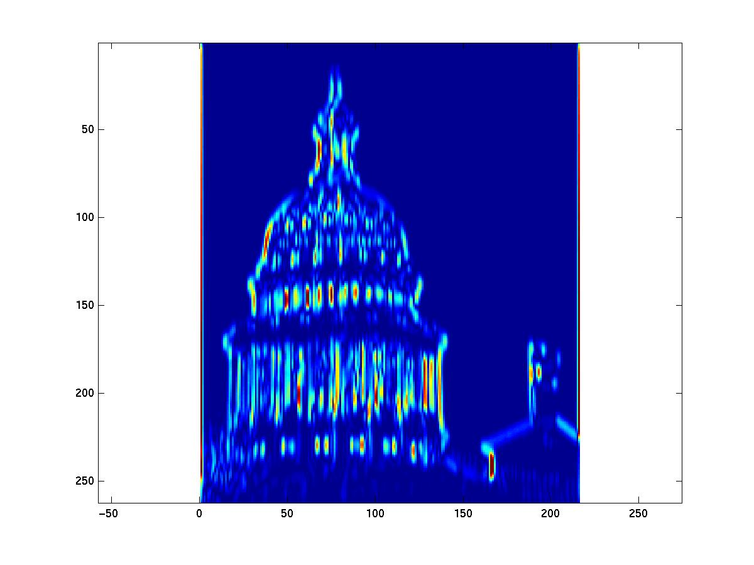
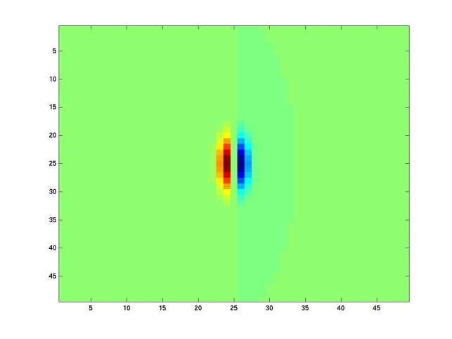
Kristen Grauman
Notes:
4

Slide 59
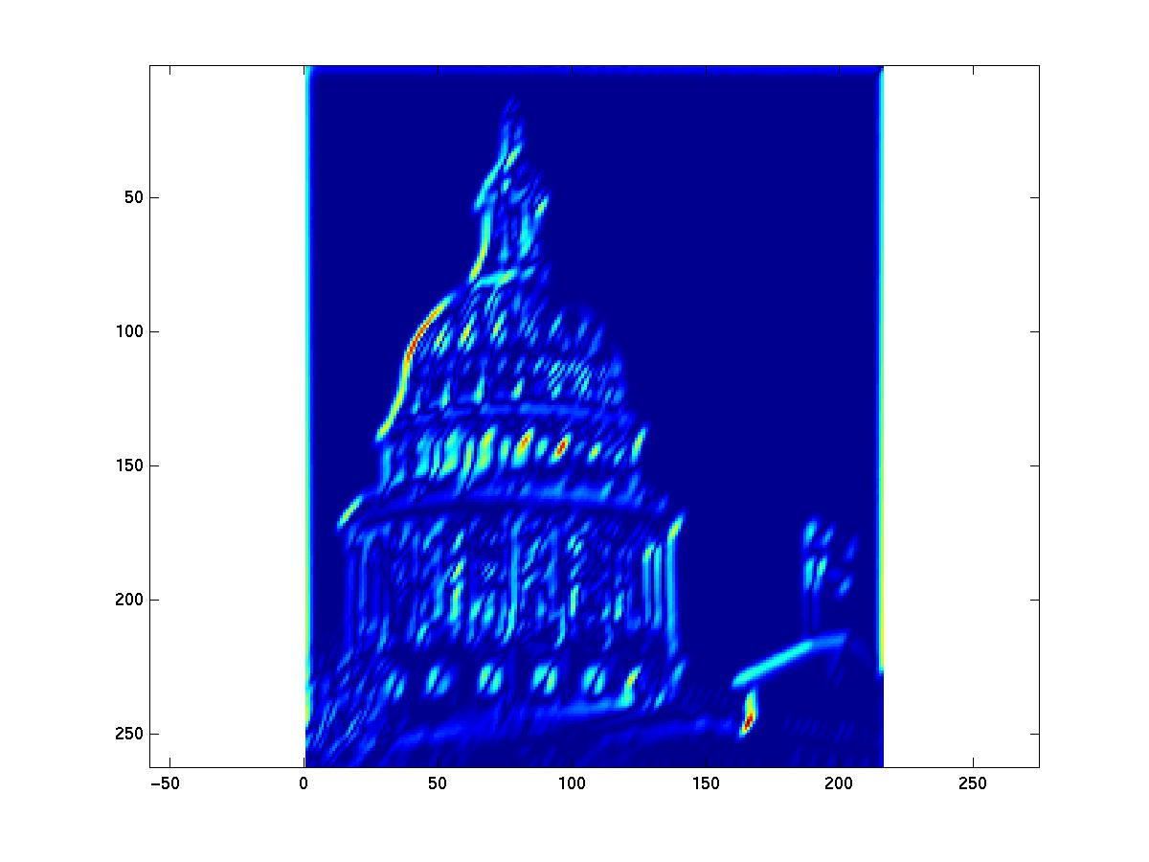
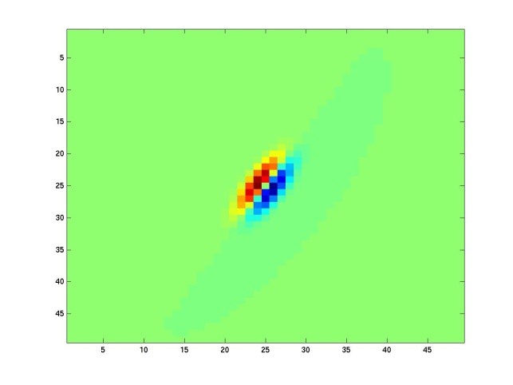
Kristen Grauman

Slide 60
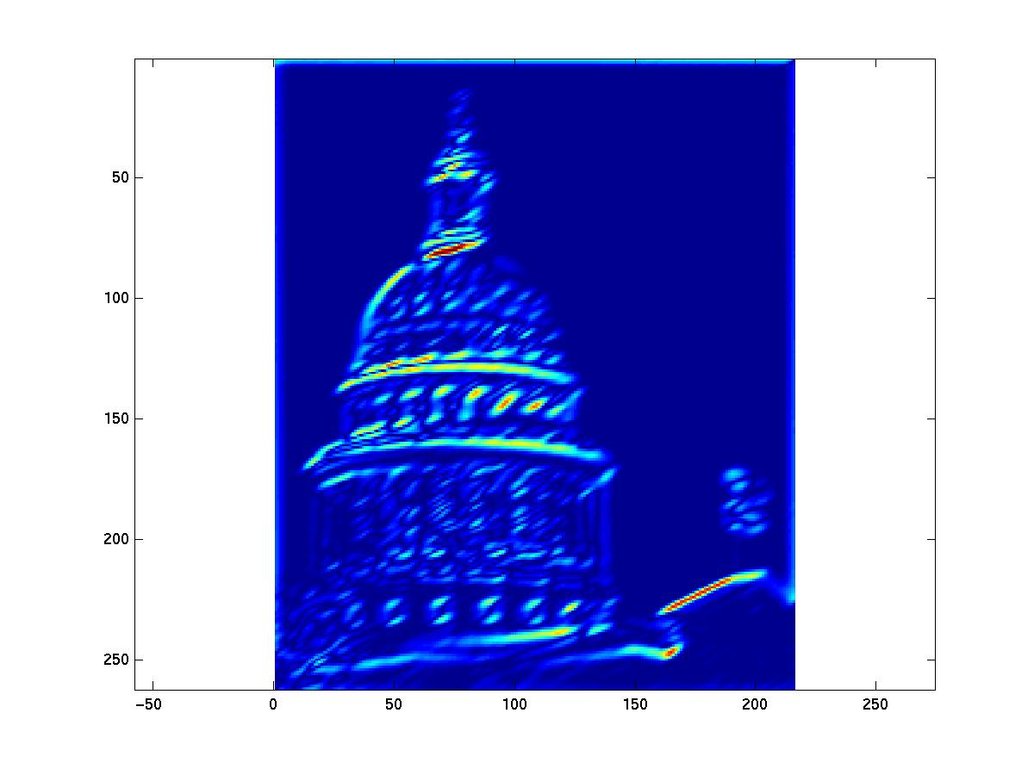
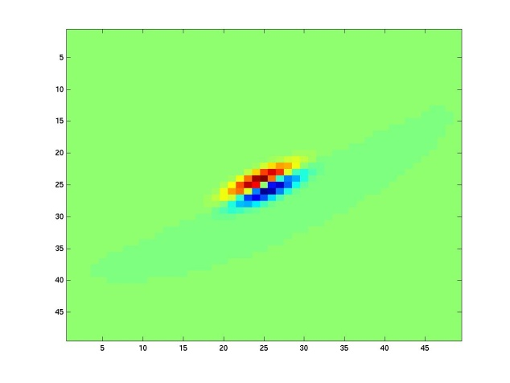
Kristen Grauman
Notes:
6

Slide 61
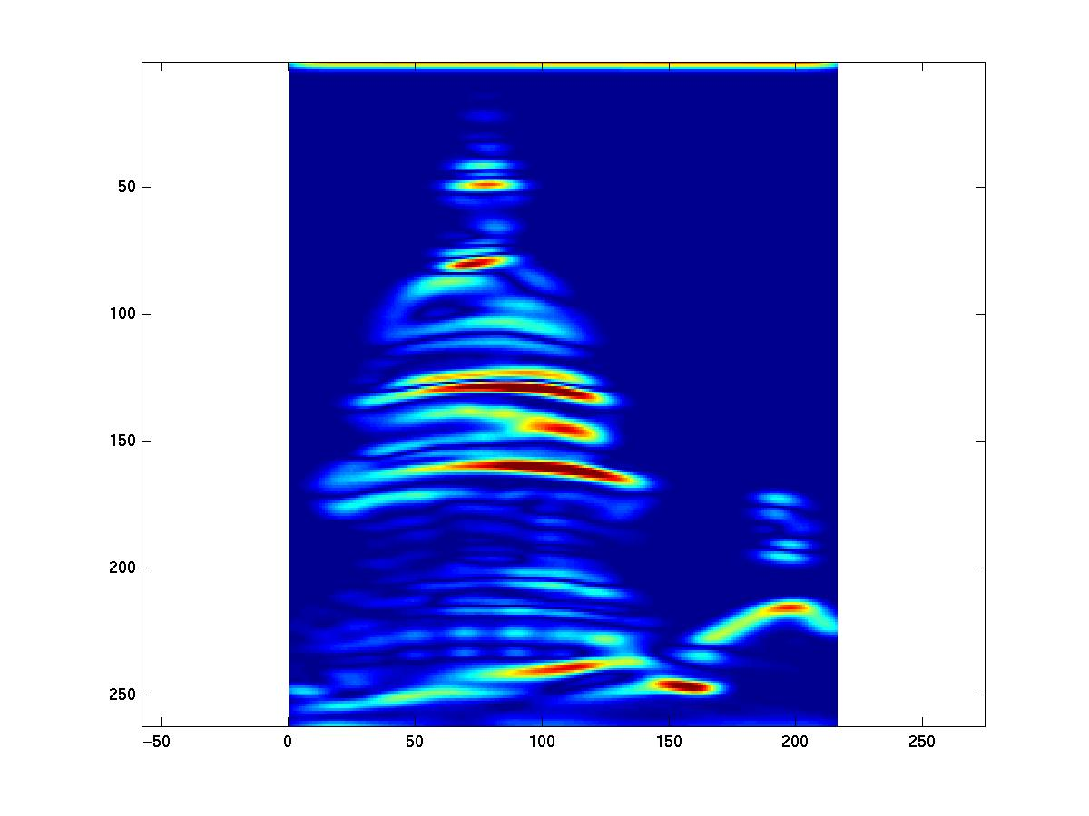
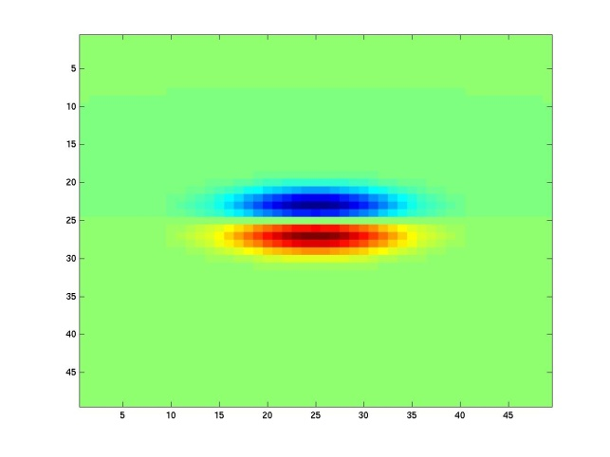
Kristen Grauman
Notes:
7

Slide 62
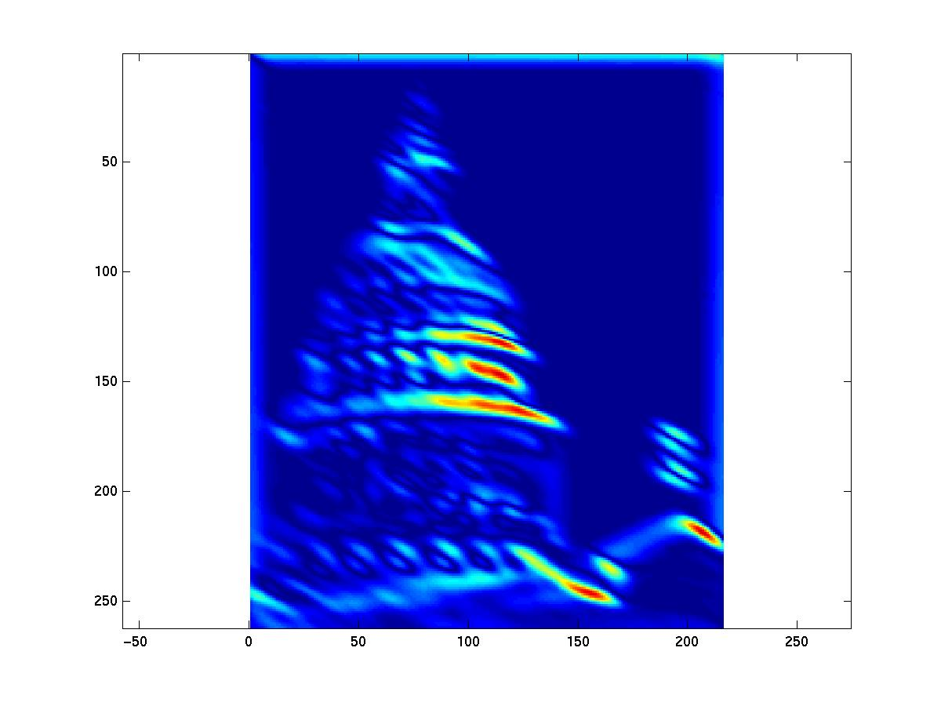
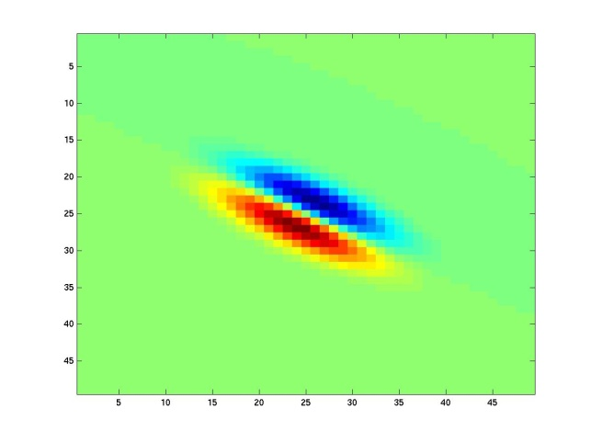
Kristen Grauman
Notes:
8

Slide 63
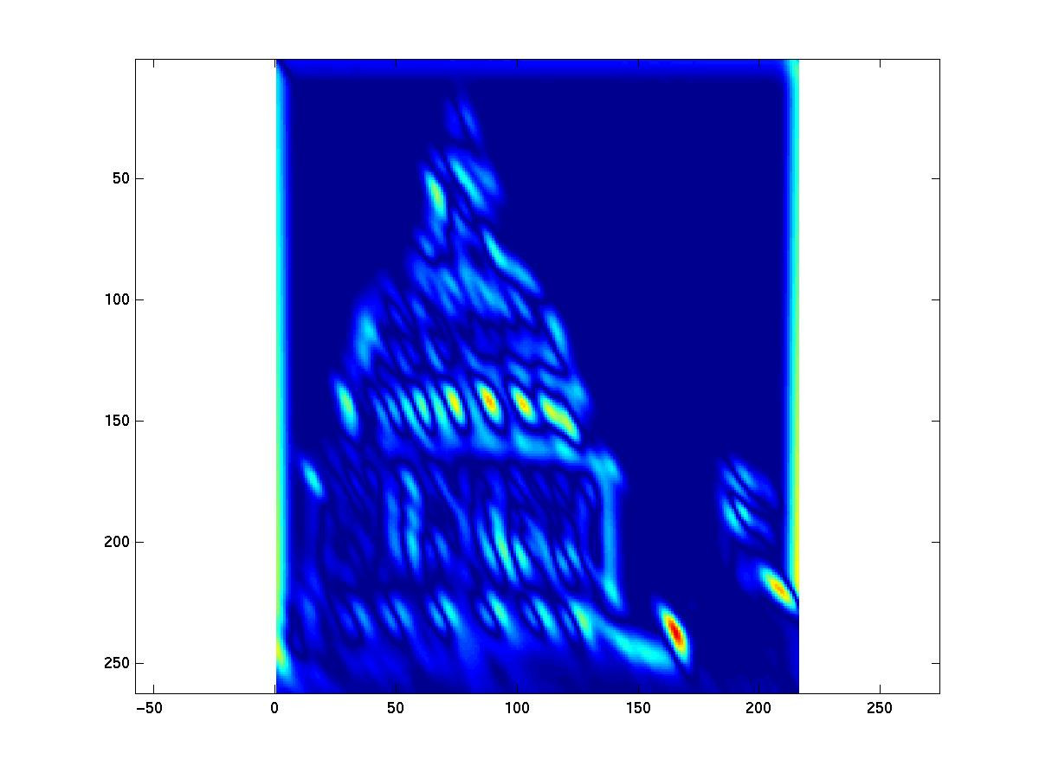
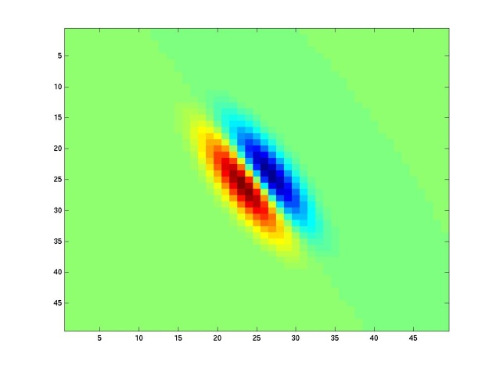
Kristen Grauman
Notes:
9

Slide 64


Kristen Grauman
Notes:
10

Slide 65


Kristen Grauman
Notes:
11

Slide 66


Kristen Grauman
Notes:
12

Slide 67


Kristen Grauman
Notes:
13

Slide 68


Kristen Grauman
Notes:
14

Slide 69


Kristen Grauman
Notes:
15

Slide 70


Kristen Grauman
Notes:
16

Slide 71


Kristen Grauman

Slide 72


Kristen Grauman
Notes:
18

Slide 73


Kristen Grauman

Slide 74
How can we represent texture?
Idea 1: Record simple statistics (e.g., mean, std.) of absolute filter responses

Slide 75






Can you match the texture to the response?
Filters
A
B
1
2
C
3
Mean abs responses

Slide 76
How can we represent texture?
Can be thought of as an single “orientation histogram”
Idea 2: Marginal histograms of filter responses
  one histogram per filter

Slide 77



Multi-scale filter decomposition
Filter bank
Input image

Slide 78

Filter response histograms

Slide 79

Heeger & Bergen, SIGGRAPH‘95
Start with a noise image as output
Main loop:
  Match pixel histogram of output image to input
  Decompose input and output images using multi-scale filter bank (Steerable Pyramid)
  Match subband histograms of input and output pyramids
  Reconstruct input and output images (collapse the pyramids)
Heeger, Bergen, Pyramid-based texture analysis/synthesis, SIGGRAPH 1995

Slide 80


Slide 81


Slide 82


Slide 83

Simoncelli & Portilla ’98+
Marginal statistics are not enough
Neighboring filter responses are highly correlated
  an edge at low-res will cause an edge at high-res
Let’s match 2nd order statistics too!
J Portilla and E P Simoncelli. A Parametric Texture Model based on Joint Statistics of Complex Wavelet Coefficients. Int'l Journal of Computer Vision. 40(1):49-71, October, 2000.

Slide 84

Simoncelli & Portilla ’98+
Match joint histograms of pairs of filter responses at adjacent spatial locations, orientations, and scales.
Optimize using repeated projections onto statistical constraint sufraces

Slide 85



Slide 86
How can we represent texture?
Marginal filter response histograms don’t talk to each other (in a direct way)
Idea 3: Histograms of joint responses (textons)

Slide 87
Filter Response
[r1, r2, …, r38]
We can form a feature vector from the list of responses at each pixel.
Kristen Grauman

Slide 88
What does it capture?
v = F * Patch (where F is filter matrix)

Slide 89



Textons (Malik et al, IJCV 2001)
Cluster vectors of filter responses
Notes:
Discuss how k-means works
Discuss choice of k
pseudo-inverse for reconstruction
Julesz comparison

Slide 90



Textons (cont.)

Slide 91



Object
Bag of ‘words’

Slide 92

Analogy to documents
Of all the sensory impressions proceeding to the brain, the visual experiences are the dominant ones. Our perception of the world around us is based essentially on the messages that reach the brain from our eyes. For a long time it was thought that the retinal image was transmitted point by point to visual centers in the brain; the cerebral cortex was a movie screen, so to speak, upon which the image in the eye was projected. Through the discoveries of Hubel and Wiesel we now know that behind the origin of the visual perception in the brain there is a considerably more complicated course of events. By following the visual impulses along their path to the various cell layers of the optical cortex, Hubel and Wiesel have been able to demonstrate that the message about the image falling on the retina undergoes a step-wise analysis in a system of nerve cells stored in columns. In this system each cell has its specific function and is responsible for a specific detail in the pattern of the retinal image.
China is forecasting a trade surplus of $90bn (£51bn) to $100bn this year, a threefold increase on 2004's $32bn. The Commerce Ministry said the surplus would be created by a predicted 30% jump in exports to $750bn, compared with a 18% rise in imports to $660bn. The figures are likely to further annoy the US, which has long argued that China's exports are unfairly helped by a deliberately undervalued yuan. Beijing agrees the surplus is too high, but says the yuan is only one factor. Bank of China governor Zhou Xiaochuan said the country also needed to do more to boost domestic demand so more goods stayed within the country. China increased the value of the yuan against the dollar by 2.1% in July and permitted it to trade within a narrow band, but the US wants the yuan to be allowed to trade freely. However, Beijing has made it clear that it will take its time and tread carefully before allowing the yuan to rise further in value.
sensory, brain,
visual, perception,
retinal, cerebral cortex,
eye, cell, optical
nerve, image
Hubel, Wiesel
China, trade,
surplus, commerce,
exports, imports, US,
yuan, bank, domestic,
foreign, increase,
trade, value

Slide 93



Slide 94

Patch Features
…

Slide 95
dictionary formation
…

Slide 96
Clustering (usually k-means)
…
Vector quantization
Slide credit: Josef Sivic

Slide 97
Feature Representation
Visual words, aka textons, aka keypoints:
K-means clustered pieces of the image
Various Representations:
  Filter bank responses (textons)
  Image Patches
  SIFT descriptors
Either image-specific or “universal” dictionary

Slide 98

Image representation
frequency
…..
codewords

Slide 99









learning
recognition
codewords dictionary
feature detection
& representation
image representation
category
decision
category models
(and/or) classifiers

Slide 100










Scene Classification (Renninger & Malik)
beach
mountain
forest
city
street
farm
kitchen
livingroom
bedroom
bathroom

Slide 101
Texton Histogram Matching

Slide 102


Object Detection can be very fast
On a task of judging animal vs no animal, humans can make mostly correct saccades in 150 ms (Kirchner & Thorpe, 2006)
  Comparable to synaptic delay in the retina, LGN, V1, V2, V4, IT pathway.
  Doesn’t rule out feed back but shows feed forward only is very powerful
Detection and categorization are practically simultaneous (Grill-Spector & Kanwisher, 2005)

Slide 103
Discrimination of Basic Categories
texture model

Slide 104
Discrimination of Basic Categories
texture model
chance

Slide 105
Discrimination of Basic Categories
texture model
37 ms
chance

Slide 106
Discrimination of Basic Categories
texture model
50 ms
chance

Slide 107
Discrimination of Basic Categories
texture model
69 ms
chance

Slide 108
Discrimination of Basic Categories
texture model
37 ms
50 ms
69 ms
chance

Slide 109

Scene Recognition using Texture

Slide 110


Slide 111

Why these filters?

Slide 112
Learned filters

