Slide 1
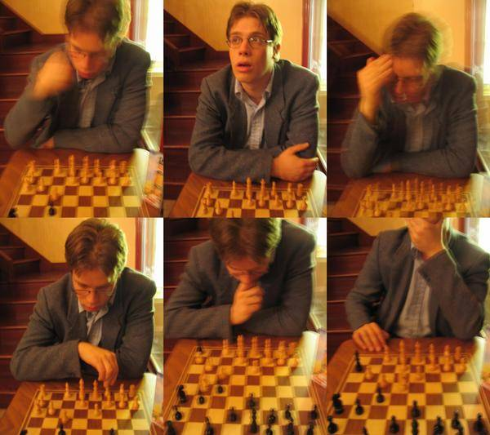
Video & Texture Synthesis
© A.A. Efros
CS194: Intro to Computer Vision & Comp. Photography
Alexei Efros, UC Berkeley, Fall 2021

Slide 2
Michel Gondry train video
http://www.youtube.com/watch?v=0S43IwBF0uM

Slide 3
Weather Forecasting for Dummies™
Let’s predict weather:
  Given today’s weather only, we want to know tomorrow’s
  Suppose weather can only be {Sunny, Cloudy, Raining}
The “Weather Channel” algorithm:
  Over a long period of time, record:
    How often S followed by R
    How often S followed by S
    Etc.
  Compute percentages for each state:
    P(R|S), P(S|S), etc.
  Predict the state with highest probability!
  It’s a Markov Chain

Slide 4
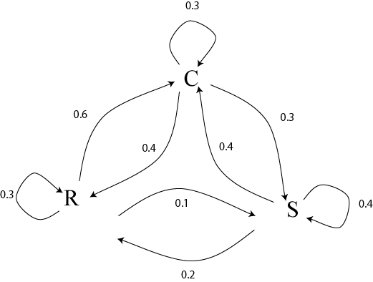
Markov Chain
What if we know today and yestarday’s weather?

Slide 5
Text Synthesis
[Shannon,’48] proposed a way to generate English-looking text using N-grams:
  Assume a generalized Markov model
  Use a large text to compute prob. distributions of each letter given N-1 previous letters
  Starting from a seed repeatedly sample this Markov chain to generate new letters
  Also works for whole words
WE NEED
TO
EAT
CAKE

Slide 6
Mark V. Shaney (Bell Labs)
Results (using alt.singles corpus):
  “As I've commented before, really relating to someone involves standing next to impossible.”
  “One morning I shot an elephant in my arms and kissed him.”
  “I spent an interesting evening recently with a grain of salt”

Slide 7
Video Textures
Arno Schödl
Richard Szeliski
David Salesin
Irfan Essa
Microsoft Research, Georgia Tech
Notes:
Hi, video textures is a work that I started last year at Microsoft Research with Richard and David and continued at Georgia Tech with Richard, David and Irfan, my advisor.

Slide 8
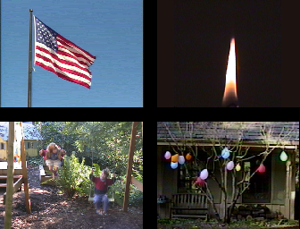
Still photos
Notes:
Everybody knows that a picture is worth a thousand words. Pictures are great, because they are timeless, we can look at them whenever and for as long as we want. But for highly dynamic scenes a single still picture can only hint at the movement involved.

Slide 9

Video clips
Notes:
Videos are better, because they actually show the motion. Unfortunately, video clips have a finite duration, after which they stop, or maybe start over. As you can see here, this causes an ugly discontinuity, which we would like to avoid.

Slide 10

Video textures
Notes:
In this paper, we want to analyze regular video clips and turn them into video textures that play continuously for as long as you like. They combine the timeless quality of a photograph with the motion of a video. We call them video textures because video textures capture a pattern in time, as regular texture capture a pattern in space. They could be used on web pages, for movie backgrounds, training videos or computer games.

Slide 11
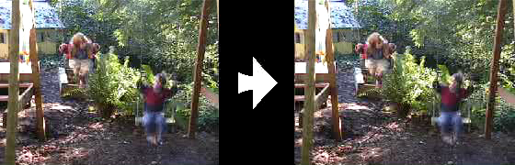
Problem statement
video clip
video texture
Notes:
As a reminder, here is our problem again: We want to turn a video clip of finite duration, that stops and starts over, into an infinitely playing video texture.

Slide 12

Our approach
How do we find good transitions?
Notes:
How do we solve this problem? Here is an example of a video texture. Instead of playing the video from the beginning to end, we jump around in the sequence and continuously play pieces of the original video. The red bar shows which frames are currently being played. The arcs show the transitions that we are using to jump from one part of the sequence to another. The arc lights up when we are actually taking the transition.
Of course, we cannot just jump around randomly. This would look as jerky as the original video clip when it starts over. So the question is, how do we find transitions that are not noticeable for the viewer?

Slide 13
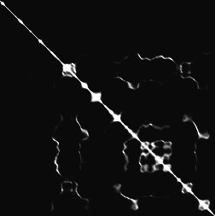
Finding good transitions
Compute L₂ distance D_{i, j} between all frames
vs.
frame i
frame j
Similar frames make good transitions
Notes:
When two frames are very similar, we can jump from one to the other without anybody noticing. So let’s compute the similarity between all pairs of frames in our sequence. We chose to use the L2 intensity difference as a metric because it is simple and worked well.
This matrix shows the difference of every frame against every other frame. The bright diagonal indicates that frames are similar to themselves and also to their neighbors in the sequence. But we also notice that sometimes frames quite far apart in the sequence are also similar to each other. These frame pairs are good candidates for transitions.

Slide 14
Markov chain representation
Similar frames make good transitions
Notes:
We now want to turn this matrix into a Markov chain, whose states are frames, and whose transitions are jumps from one frame to another. We want to make transitions more likely if they connect similar frames. We represent these by fatter arrows in the diagram on the right.

Slide 15
Transition costs
Transition from i to j if successor of i is similar to j
Cost function: C_{i→j} = D_{i+1, j}
Notes:
More specifically, suppose we have just shown frame i, and now want to transition to frame j. We are in fact replacing the successor of frame i with frame j. So the successor of frame i, frame i+1, should be similar to frame j. We define the cost of the transition from i to j as the difference between those two frames.

Slide 16

Transition probabilities
Probability for transition P_{i→j} inversely related to cost:
P_{i→j} ~ exp ( – C_{i→j} / σ² )
high σ
low σ
Notes:
To build the Markov chain, all that is left is turning the cost function into a probability. Low cost should mean high probability and vice versa. We map the cost through an exponential to do that, but any other monotonically decreasing function good be used instead.
At the bottom you can see the effect of the parameter sigma on the generated video. High sigmas produce a more randomly ordered video, low sigmas use only the best transitions, but run the risk of being too repetitive.

Slide 17
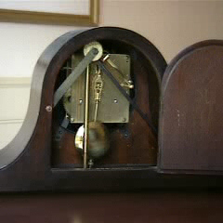
Preserving dynamics
Notes:
Let’s look at this example that we generated using the same technique. Something is not working here. The pendulum erratically changes directions. Why is this?

Slide 18
Preserving dynamics
Notes:
Look at the sequence on the top. The pendulum is swinging from left to right. But the center frame matches to both frames on the bottom. While the red sequence shows the same left to right motion as the orange sequence, the blue sequence shows a pendulum swing from right to left, so the transition suddenly reverses the motion! To prevent that, we could explicitly estimate the motion in the image, but there is a much simpler solution. Instead of single frames we compare small subsequences of frames, because then the orange sequence will be similar to the red, but not to the blue sequence.

Slide 19
Preserving dynamics
Cost for transition i→j
C_{i→j} = w_{k} D_{i+k+1, j+k}
Notes:
So let’s make the transition cost a weighted sum over a small window of frames. The window is taken symmetrically around the position of the transition.

Slide 20
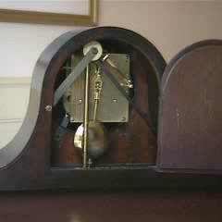
Preserving dynamics – effect
Cost for transition i→j
C_{i→j} = w_{k} D_{i+k+1, j+k}
Notes:
If we use this new cost function, our pendulum swings correctly.

Slide 21
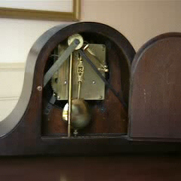
Dead ends
No good transition at the end of sequence
Notes:
There is another problem I have not talked about. Let’s look at this sequence. As always, even if there is a good loop, the system can still run all the way to the end of the sequence. In this particular example, at the end a hand comes into the picture. Since the hand never moves out of the picture again, the system has no smooth way to jump back. If it would jump, the hand would suddenly disappear. Instead, the best solution is to stay in the last frame. The system gets stuck in the dead-end.

Slide 22
Future cost
Propagate future transition costs backward
Iteratively compute new cost
F_{i→j} = C_{i→j} + α min_{k} F_{j→k}
Notes:
To solve this problem, we have to anticipate when taking a transition gets us into trouble. We do this by propagating the cost of future transitions backward in time, the future high cost transitions influence the cost of earlier transitions. Let’s look at the formula for a second, in the context of the example. It would compute the minimum cost transition out of frame 4, which has actually pretty high cost, and adds this cost, discounted by some factor alpha, to the transition cost from frame 3 to frame 4. This is done iteratively until all transition costs are propagated through the system. In our example the cost of the transition leading into the dead-end grows and the probability of taking this transition goes down.

Slide 23
Future cost
Propagate future transition costs backward
Iteratively compute new cost
F_{i→j} = C_{i→j} + α min_{k} F_{j→k}
Notes:
To solve this problem, we have to anticipate when taking a transition gets us into trouble. We do this by propagating the cost of future transitions backward in time, the future high cost transitions influence the cost of earlier transitions. Let’s look at the formula for a second, in the context of the example. It would compute the minimum cost transition out of frame 4, which has actually pretty high cost, and adds this cost, discounted by some factor alpha, to the transition cost from frame 3 to frame 4. This is done iteratively until all transition costs are propagated through the system. In our example the cost of the transition leading into the dead-end grows and the probability of taking this transition goes down.

Slide 24
Future cost
Propagate future transition costs backward
Iteratively compute new cost
F_{i→j} = C_{i→j} + α min_{k} F_{j→k}
Notes:
To solve this problem, we have to anticipate when taking a transition gets us into trouble. We do this by propagating the cost of future transitions backward in time, the future high cost transitions influence the cost of earlier transitions. Let’s look at the formula for a second, in the context of the example. It would compute the minimum cost transition out of frame 4, which has actually pretty high cost, and adds this cost, discounted by some factor alpha, to the transition cost from frame 3 to frame 4. This is done iteratively until all transition costs are propagated through the system. In our example the cost of the transition leading into the dead-end grows and the probability of taking this transition goes down.

Slide 25
Future cost
Propagate future transition costs backward
Iteratively compute new cost
F_{i→j} = C_{i→j} + α min_{k} F_{j→k}
Notes:
To solve this problem, we have to anticipate when taking a transition gets us into trouble. We do this by propagating the cost of future transitions backward in time, the future high cost transitions influence the cost of earlier transitions. Let’s look at the formula for a second, in the context of the example. It would compute the minimum cost transition out of frame 4, which has actually pretty high cost, and adds this cost, discounted by some factor alpha, to the transition cost from frame 3 to frame 4. This is done iteratively until all transition costs are propagated through the system. In our example the cost of the transition leading into the dead-end grows and the probability of taking this transition goes down.

Slide 26
Future cost
Propagate future transition costs backward
Iteratively compute new cost
F_{i→j} = C_{i→j} + α min_{k} F_{j→k}
Q-learning
Notes:
The algorithm that we are using is known as Q-learning in the machine learning community. It is commonly used in robotics to teach a robot to find its way through a maze, for example.

Slide 27
Final result

Slide 28
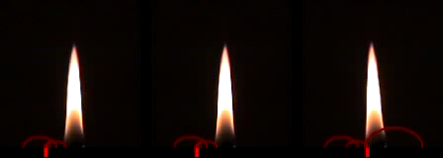
Finding good loops
Alternative to random transitions
Precompute set of loops up front
Notes:
So far I have talked about making random transition choices. In the paper we describe an alternative way to find transitions. We can use a dynamic programming algorithm to precompute a good set of loops that can be played with any conventional video player that supports looping.
You see here three such precomputed loops. For details look into the paper.

Slide 29
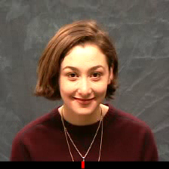
Video portrait
c.f. Harry Potter
Notes:
Here we apply the techniques that I have described so far to a video of a woman smiling. A video like this could replace the portrait on people’s home pages.

Slide 30
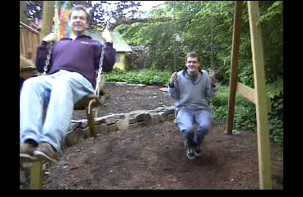
Region-based analysis
Divide video up into regions
Generate a video texture for each region
Notes:
So far we have processed the image as a whole. Sometimes we can easily divide the image into several regions, compute a video texture for every region individually, and put the result back together. In this example the division was done manually.

Slide 31
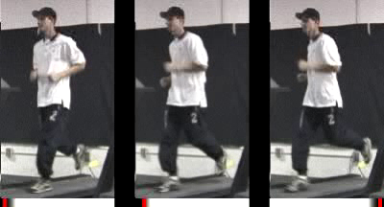
User-controlled video textures
User selects target frame range
slow
variable
fast
Notes:
So far the only criterion for selecting transitions was the smoothness of the transition. By augmenting our error function with external constraints, the user can select which part of the video to play by moving the dark band. <play>
These videotextures are generated from a video of a runner, who starts slowly and gradually speeds up. In the left video we prefer frames early in the sequence, so the runner is running slowly. In the right video we prefer late frames, so the runner is running fast. In the middle we change between slow and fast pace. Notice that the motion now matches the slow runner on the left, and now the fast runner on the right.

Slide 32
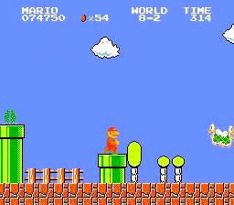
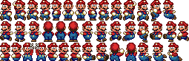
Video-based animation
Like sprites
computer games
Extract sprites
from real video
Interactively control desired motion
©1985 Nintendo of America Inc.
Notes:
I now want to talk about video-based animation. In computer games, before the advent of inexpensive 3D graphics cards, sprites were the most popular way to generate character animations. A 2D sprite is moved around the screen, and the appearance of the sprite is changed according to its current action, as you can see here with Mario.
We want to extract those sprite appearances from video, automatically select the right appearance over time to generate a good animation, and do all that while the sprite is under interactive control.

Slide 33
Video sprite extraction
Notes:
To try it out, we let a fish swim around in front of a blue screen and extracted the fish sprite and also the velocity of the sprite in every frame.

Slide 34
Video sprite control
Augmented transition cost:
Notes:
We then augmented the cost function. The similarity term penalizes visual discontinuities, just like for the other video textures. Here, it not only involves the image intensity difference, but also takes into account the difference in alpha channel and velocity.
The control term makes the sprite move in the desired direction. We simply penalize the angle between the current sprite velocity and the direction to the goal. We specify the goal interactively by pointing with the mouse.

Slide 35

Video sprite control
Need future cost computation
Precompute future costs for a few angles.
Switch between precomputed angles according to user input
[GIT-GVU-00-11]
Notes:
We encountered a problem very similar to the dead-end problem I talked about earlier. Sometimes the fish in the original video changes direction, and the system needs to jump to maintain the prescribed direction. What if there is no good transition available at his point? We have a situation similar to the dead-end.
As before, we avoid this by computing future cost. Since our error function is different for every swimming direction, we precompute a bunch of future costs for different swimming angles. For interactive control, we then switch between these computed future cost functions, according to the direction that we want the fish to go.
To really get this to work, there are more details than I have time to discuss here. You can find them in an upcoming paper.

Slide 36
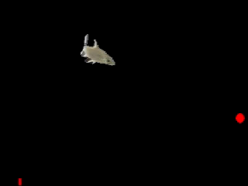
Interactive fish
Notes:
This is the result that we get. We processed 8 minutes of fish video to generate the fish animation. The current goal is marked with the red dot, and the bar shows the current frame.

Slide 37
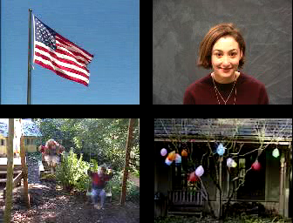
Summary / Discussion
Some things are relatively easy
Notes:
So, how well does all this work in practice? During our experiments, it turned out that many things were surprisingly easy to loop, for example the flag and the portrait are both potentially very complex movements, but we were lucky enough to find good transitions that even without blending or warping already look pretty good.

Slide 38
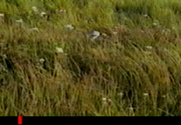
Discussion
Some are hard
Notes:
Other things pose problems, like for example this meadow. It is similar to the waterfall, in that is never repeats exactly. But the individual grass blades are too fine, neither blending nor morphing work well. The best we can do so far is to live with some intermittent blurring.

Slide 39
“Amateur” by Lasse Gjertsen
http://www.youtube.com/watch?v=JzqumbhfxRo
similar idea:
http://www.youtube.com/watch?v=MsBMG-p1HDM&feature=share&list=PLFFD733D0FF425290

Slide 40
Hyperlapse Videos
https://www.youtube.com/watch?v=Wt_Y04xn84M

Slide 41
“Do As I Do” (ICCV 2003)
https://youtu.be/UMJcpLIAwKg
Efros, Berg, Mori, Malik, “Recognizing Action at a Distance”, ICCV 2003

Slide 42
Texture
Texture depicts spatially repeating patterns
Many natural phenomena are textures
radishes
rocks
yogurt

Slide 43
Texture Synthesis
Goal of Texture Synthesis: create new samples of a given texture
Many applications: virtual environments, hole-filling, texturing surfaces

Slide 44

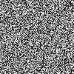

The Challenge
Need to model the whole spectrum: from repeated to stochastic texture
repeated
stochastic
Both?

Slide 45

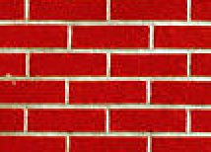
Efros & Leung Algorithm
non-parametric
sampling
p
Input image
Synthesizing a pixel
Assuming Markov property, compute P(p|N(p))
  Building explicit probability tables infeasible
  Instead, we search the input image for all similar neighborhoods — that’s our pdf for p
  To sample from this pdf, just pick one match at random

Slide 46
Some Details
Growing is in “onion skin” order
  Within each “layer”, pixels with most neighbors are synthesized first
  If no close match can be found, the pixel is not synthesized until the end
Using Gaussian-weighted SSD is very important
  to make sure the new pixel agrees with its closest neighbors
  Approximates reduction to a smaller neighborhood window if data is too sparse

Slide 47

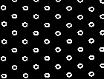
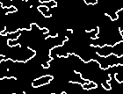
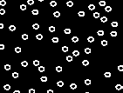
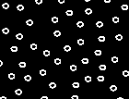
Neighborhood Window
input

Slide 48

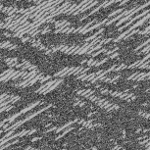
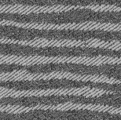
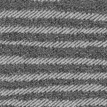
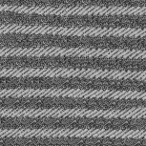

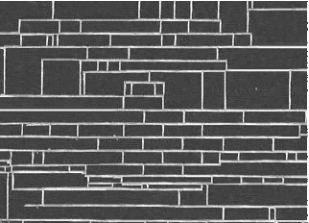
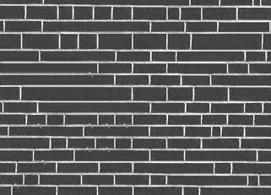
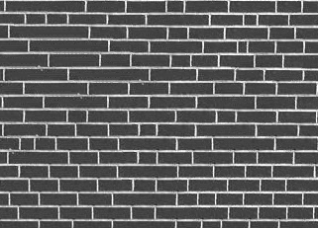
Varying Window Size
Increasing window size

Slide 49


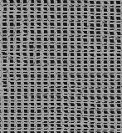
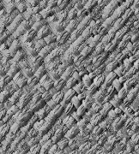
Synthesis Results
french canvas
rafia weave

Slide 50
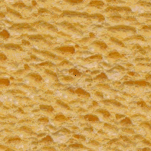
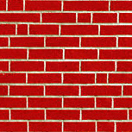
More Results
white bread
brick wall

Slide 51
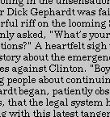
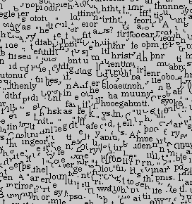
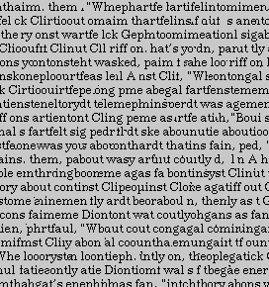
Homage to Shannon

Slide 52
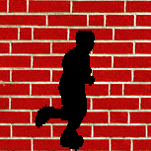
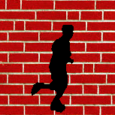
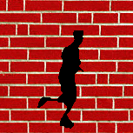
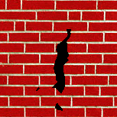
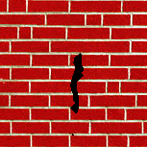
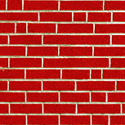
Hole Filling

Slide 53
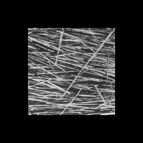
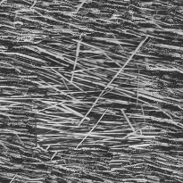
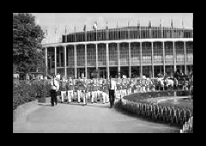
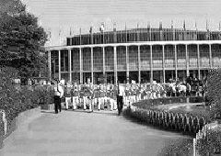
Extrapolation

Slide 54
Summary
The Efros & Leung algorithm
  Very simple
  Surprisingly good results
  Synthesis is easier than analysis!
  …but very slow

Slide 55
Image Quilting [Efros & Freeman]
non-parametric
sampling
p
B
Input image
Synthesizing a block
Observation: neighbor pixels are highly correlated
Idea: unit of synthesis = block
  Exactly the same but now we want P(B|N(B))
  Much faster: synthesize all pixels in a block at once
  Not the same as multi-scale!

Slide 56

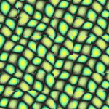
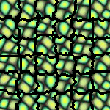
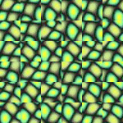



block
Input texture
B1
B2
B1
B2
B1
B2
Random placement
of blocks
Neighboring blocks
constrained by overlap
Minimal error
boundary cut

Slide 57








Minimal error boundary
overlapping blocks
vertical boundary
2
_
=
overlap error
min. error boundary

Slide 58
Our Philosophy
The “Corrupt Professor’s Algorithm”:
  Plagiarize as much of the source image as you can
  Then try to cover up the evidence
Rationale:
  Texture blocks are by definition correct samples of texture so problem only connecting them together

Slide 59





Slide 60





Slide 62





Slide 63



Slide 64






Slide 65
Failures
(Chernobyl
Harvest)

Slide 66




Application: Texture Transfer
Try to explain one object with bits and pieces of another object:
+
=

Slide 67
Texture Transfer
Constraint
Texture sample

Slide 68

Texture Transfer
Take the texture from one image and “paint” it onto another object
Same as texture synthesis, except an additional constraint:
  Consistency of texture
  Similarity to the image being “explained”

Slide 69




+
=

Slide 70




Slide 71
Image Analogies
Aaron Hertzmann^{1,2}
Chuck Jacobs²
Nuria Oliver²
Brian Curless³
David Salesin^{2,3}
¹New York University
²Microsoft Research
³University of Washington

Slide 72




Image Analogies
A
A’
B
B’

Slide 74



Image Analogies
Goal: Process an image by example
?
:
::
:
A
A’
B
B’
Hertzmann et al. SIGGRAPH 2001

Slide 75


Non-parametric sampling
?
:
::
:
A
A’
B
B’

Slide 76

:
::
A
A’
:
B
B’

Slide 77
:
::
A
A’
:
B
B’

Slide 78

Blur Filter

Slide 79

Edge Filter

Slide 80




Artistic Filters
A
A’
B
B’

Slide 81

Colorization

Slide 82




Texture-by-numbers
A
A’
B
B’

Slide 83







Layout
Photo
Sky
Output₃
Rock
Sand
Sea
SPADE, Park et al., CVPR 2019
training set
Notes:
In this setting, the input image contains layout of the scene, along with the material type at each region.
----------------------------
Then the output image should be a photorealistic image that follows the input layout.
Clearly, the input layout does not contain any pixels that look photorealistic. Therefore, it must be learned from the dataset (---) during training.

Slide 84





GAN loss
Output
Minimize Difference
pix2pix (Isola et al., CVPR 2017), pix2pixHD (Wang et al., CVPR 2018), SPADE (Park et al., CVPR 2019)
Notes:
So here’s our method for training such a model. Given an input image from the training set, and the output of our model,
-----------------
We compare it with the ground-truth photo, and optimize our model to match that photo.
-----------------
On top of that, we will use the adversarial loss to enhance photorealism.
-----------------
We train our model on a large dataset of paired examples. Given a photograph, we use human annotation to draw the layout of each photo. Our model is trained to do the inverse operation, going from layout to photo.

Slide 85




input
results
Results of pix2pixHD (Wang et al., CVPR 2018) on the Cityscapes dataset
Notes:
So let’s look at the results of such approach. There is an existing works named pix2pix and its follow up pix2pixHD that uses this formulation.
--------------
Given these input layouts of the Cityscapes dataset,
--------------
we get these results. It produces quite realistic outputs.

Slide 86



input
results
reference
Results of pix2pixHD (Wang et al., CVPR 2018) on the COCO-stuff dataset
Notes:
However, on more challenging dataset, we found that the results become quite bad
--------------
compared to the real photographs. The new dataset contains more than 150 labels, instead of just 20 labels of the Cityscapes dataset. It seemed mysterious that the outputs don’t achieve photorealism at all, so I began debugging this.

Slide 87





input
results
sky
grass
Results of pix2pixHD (Wang et al., CVPR 2018) on the COCO-stuff dataset
Notes:
As the simplest case, I created some toy layouts, where all pixels belong to the same sky class.
---------------
I pass it to the trained network of pix2pixHD
---------------
and I get a gray image, which means I get zeros everywhere!
--------------
Exact same thing happened with another toy layout of grass label. I also get zeros everywhere. It looked like the model is ignoring the input, and just outputting zeros. Why is this happening?

Slide 88







somehow show that the semantic information is lost
Problem with standard approaches
conv
normalization
Notes:
After some investigation, I found that the issue was in the architecture.
-----------------------------
A standard deep network consists of convolutional layers followed by normalization layers, which works by making each layer-output zero mean and unit variance. We know normalization yields nice properties for image recognition, such as smoother gradient flow, or invariance to input scaling.

Slide 89





Problem with standard approaches
conv
normalization
grass
Notes:
However, normalization causes too much invariance, if the input is uniform!
--------------------------
It’s because the output of convolution is also uniform,
-------------------------
And after normalization, everything becomes zero! In other words, the input signal is completely lost in the middle of the network.

Slide 90



My simple fix
sky
grass
Notes:
Therefore, I started the fix by
----------------
providing the input over and over, after every normalization layer of the generator network.
---------------
By doing so, I could get the correct textures for the uniform layouts….........

Slide 91

How did we achieve all this? The key is SPADE.
Up to previous slides, we stated the goal, background,
and what we are better about. Now let’s describe
how we achieved it.
SPADE(SPatially Adaptive Denormalization. Park et al., CVPR2019)
conv
conv
conv
modulation
Normalization
Notes:
Now let’s take a closer look at how we provided the input signal.
------------------------
After normalization, we try to undo the harm,
-----------------------
by modulating the normalized activations by re-adjusting the mean and variance, based on the input layout.
-----------------------
The modulation is implemented with a few convolutional layers.
-----------------------
We named this module Spatially Adaptive Denormalization, or SPADE in short.

Slide 92

input
SPADE (Ours)
pix2pixHD
Notes:
In the end, we could achieve much better realism
----------
than the previous method.

Slide 93

Notes:
…………..
Using SPADE, we built a fun UI and presented it at SIGGRAPH. Basically, it looks like the Microsoft Paint app. But instead of the color palette, we provide semantic palette of material types like ocean, sky, rock, and sand. Our app generates photorealistic images with the appearance of photographs, but respecting the user-drawn layout.

Slide 94

Parametric Texture Synthesis
input image
SYNTHESIS
True (infinite) texture
generated image
Come up with a parametric generative model of the “infinite texture”

Slide 95

Heeger & Bergen, SIGGRAPH‘95

Slide 96



Multi-scale filter decomposition (steerable pyramid)
Filter bank
Input image

Slide 97

Step 1: Convolve with filterbank
input
Noise image

Slide 98

Step 2: match per--channel histograms
input
Noise image

Slide 99
Step 3: collapse pyramid and repeat!
input
Noise image

Slide 100






Texture Synthesis
Image Space
Model Space
Images with equal
model response
Slide by Portilla & Simoncelli (2000)
Notes:
Stole this slide from Eero, because I think it gives a good intuition about what we are doing.

Slide 102


Slide 103


Slide 104

Simoncelli & Portilla ’98+
Marginal statistics are not enough
Neighboring filter responses are highly correlated
  an edge at low-res will cause an edge at high-res
Let’s match 2nd order statistics too!
J Portilla and E P Simoncelli. A Parametric Texture Model based on Joint Statistics of Complex Wavelet Coefficients. Int'l Journal of Computer Vision. 40(1):49-71, October, 2000.

Slide 105

Simoncelli & Portilla ’98+
Match joint histograms of pairs of filter responses at adjacent spatial locations, orientations, and scales.
Optimize using repeated projections onto statistical constraint sufraces

Slide 106



Slide 107
Texture Synthesis
Image Space
Model Space
Images with equal
model response
Slide by Portilla & Simoncelli (2000)
Notes:
Stole this slide from Eero, because I think it gives a good intuition about what we are doing.

Slide 108


CNN as features
2.3
7.1
3.8
Convolutional Neural Network
Gatys et al. (NIPS 2015)
Notes:
Our work takes this one step further, instead of just modelling early vision in our texture model, we use a fully trained CNN that can be seen as a functional model of the ventral stream.

Slide 109










CNN - Multiscale Filter Bank
# features
pool4
512
pool3
256
pool2
128
pool1
64
conv1_1
64
Notes:
Can think of CNN as a multi scale non-linear filter bank.
Each feature map is the output of a complex non-linear image filter.
Spatial extend decreases but number of features increase (effective downsampling by a factor of 2 after each pooling)

Slide 110













CNN - Texture Features
Notes:
For texture model we need spatial summary statistics
F is matrix of vectorised feature maps
We compute correlations between feature responses, where the average is taken over the spatial extend of the image.
Mathematically we take dot products between vectorised feature maps (gram matrix)
each entry in gram matrix is the correlation between two features in response to a particular texture

Slide 111








CNN - Texture Features
Gram Matrices
# features
512
256
128
64
64
Notes:
For texture model we need spatial summary statistics
We compute correlations between feature responses, where the average is taken over the spatial extend of the image.
Mathematically we take dot products between vectorised feature maps (gram matrix)
each entry in gram matrix is the correlation between two features in response to a particular texture

Slide 112



Texture Synthesis
Notes:
In short: we will do gradient descent on the pixels but I will elaborate a little on the details.
First show the example texture to the network, compute feature maps, compute gram matrices from the feature maps and store them

Slide 113
Texture Synthesis
Notes:
Then show white noise image and also get the gram matrices
Then we can compute some distance measure between both gram matrices, we use elementwise mean squared distance
Do that on each layer you include in your model and define a total loss function as a weighted sum of the losses on each layer

Slide 114
Texture Synthesis
Notes:
Can compute derivative of this loss wrt layers activations

Slide 115
Texture Synthesis
Notes:
then pass that derivative down just using normal back propagation

Slide 116

Texture Synthesis
Notes:
and do that for all layers to get the gradient of the total loss wrt pixel values

Slide 117

Texture Synthesis
Notes:
gradient descent on the image

Slide 118

Texture Synthesis
Notes:
until the loss converges.
In general the forward/backward pass of the network gives you the function value and the gradient and you can use that as an input into the optimiser of your choice. (we use LBFGS, seems to work well)

Slide 119








Test Julesz’ Conjecture
Notes:
Test Julesz conjecture - which one is original and which one is synthesised

Slide 120


Object Recognition
is just Texture Recognition
Convolutional Neural Network
“Shetland
Sheepdog”
image X
label Y

Slide 121



Object Recognition
is just Texture Recognition
Convolutional Neural Network
“Shetland
Sheepdog”
image X
label Y
Gatys et al, 2017

Slide 122




A Neural Algorithm of Artistic Style
Gatys, Ecker, Bethge (arXiv 2015)

Slide 123


Slide 124

Van Gogh (1889)

Slide 125

Picasso (1910)

Slide 126

Munch (1893)

Slide 127

Turner (1805)

Slide 128

Kandinsky (1913)

Slide 129













CNN - Multiscale Nonlinear Filter Bank
# features
conv5_2
512
conv4_2
512
conv3_2
256
conv2_2
128
conv1_2
64
Notes:
Can think of CNN as a multi scale non-linear filter bank.
Each feature map is the output of a complex non-linear image filter.
Spatial extend decreases but number of features increase (effective downsampling by a factor of 2 after each pooling)

Slide 130






CNN - Image Reconstruction
Mahendran & Vedaldi (2014)
Notes:
Can think of CNN as a multi scale non-linear filter bank.
Each feature map is the output of a complex non-linear image filter.
Spatial extend decreases but number of features increase (effective downsampling by a factor of 2 after each pooling)

Slide 131










CNN - Texture Features
Gatys et al. (NIPS 2015)
Notes:
Can think of CNN as a multi scale non-linear filter bank.
Each feature map is the output of a complex non-linear image filter.
Spatial extend decreases but number of features increase (effective downsampling by a factor of 2 after each pooling)

Slide 132






CNN - Texture Synthesis
Gatys et al. (NIPS 2015)
Notes:
Can think of CNN as a multi scale non-linear filter bank.
Each feature map is the output of a complex non-linear image filter.
Spatial extend decreases but number of features increase (effective downsampling by a factor of 2 after each pooling)

Slide 133



Artistic Style Transfer

Slide 134



Artistic Style Transfer

Slide 135
Artistic Style Transfer

Slide 136

Artistic Style Transfer

Slide 137
Artistic Style Transfer

Slide 138
Artistic Style Transfer

Slide 139
Artistic Style Transfer

Slide 140
Artistic Style Transfer

Slide 141
Artistic Style Transfer

Slide 142


Artistic Style Transfer

Slide 143
Artistic Style Transfer

Slide 144

Artistic Style Transfer

Slide 145




Relative Weighting of Content and Style
1e-4
1e-3
1e-2
1e-1
Notes:
Used normalised VGG-Network
Used LBFG-S optimiser (seems to work best)

Slide 146


Different Reconstruction Layers
Conv2_2
Conv4_2

Slide 147
Different Reconstruction Layers
Conv2_2
Conv4_2

Slide 148

Different Reconstruction Layers
Original
Conv2_2
Conv4_2

Slide 149


General Style Transfer

Slide 150


General Style Transfer

Slide 151

The DeepArt Project

Slide 152


Slide 153


Slide 154


Slide 155



Slide 157


GANs as Texture Synthesis?
Conjecture: GANs might be learning the “right” features to match for natural images

