Slide 1
Convolutional Neural Networks
CS194: Computer Vision and Comp. Photo
Angjoo Kanazawa/Alexei Efros, UC Berkeley, Fall 2021

Slide 2
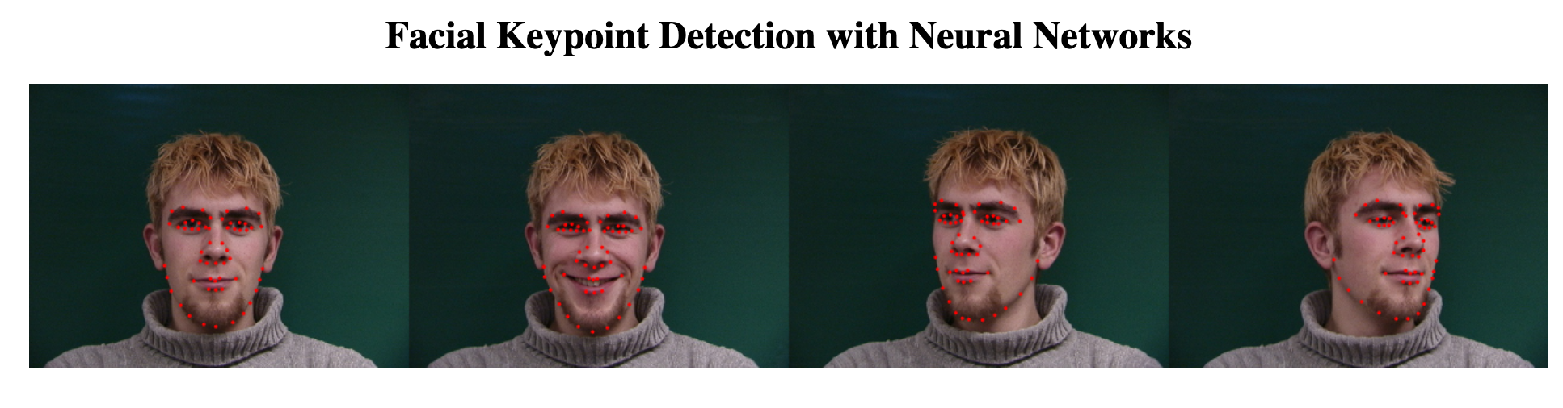
Project 5
Will be released today, in any moment
You need to implement things in pytorch
If you have NOT done pytorch before, you must go to the discussion by Tim/Vickie on Thursday 1-2pm
Notes:
Otherwise there’s not much we can help you with later on if you don’t know the basics
Kaggle competition! 5 submission per day
Test set is split in two (private & public) so you can’t overfit to the test set

Slide 3
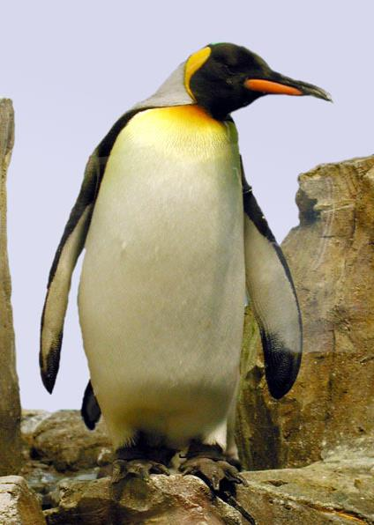

Neural Nets: a particularly useful Black Box
Convolutional Neural Network
“Penguin”
image X
label Y

Slide 4
Classic Object Recognition
Feature extractors
Classifier
Edges
Segments
Texture
“Penguin”
Parts
Colors
image X
label Y
Slide by Philip Isola

Slide 5

Classic Object Recognition
Learned
Feature extractors
Classifier
Edges
Segments
Texture
“Penguin”
Parts
Colors
image X
label Y
Slide by Philip Isola

Slide 6
Learning Features
Learned
Feature extractors
Edges
Texture
Colors
image X
label Y

Slide 7
Neural Network: algorithm + feature + data!
Learned
“Penguin”
image X
label Y
Slide by Philip Isola

Slide 8

Vanilla (fully-connected)
Neural Networks

Slide 9
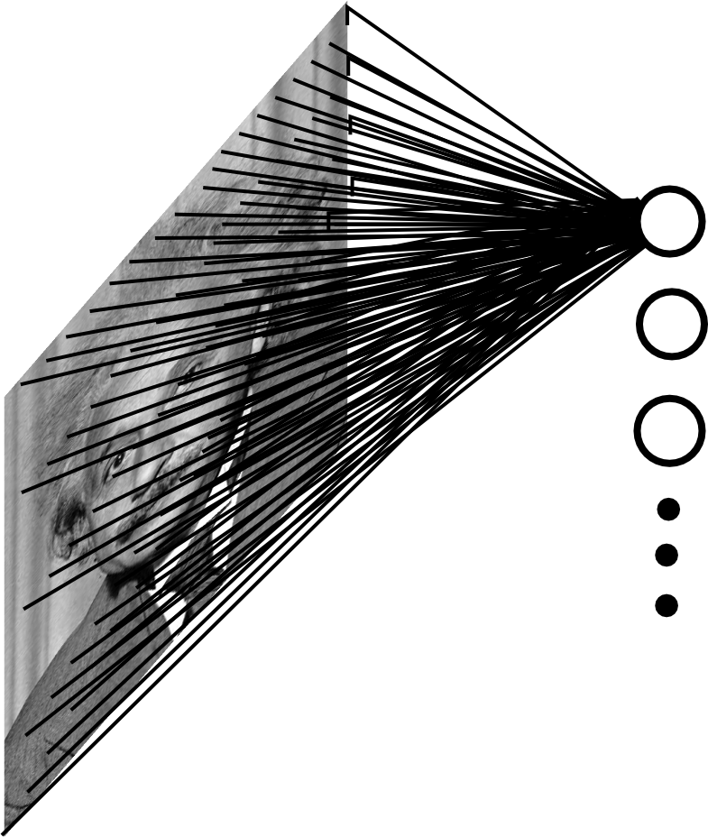

Fully Connected Layer
Example: 200x200 image
40K hidden units
~2B parameters!!!
- Spatial correlation is local
Waste of resources + we have not enough
training samples anyway..
Ranzato

Slide 10
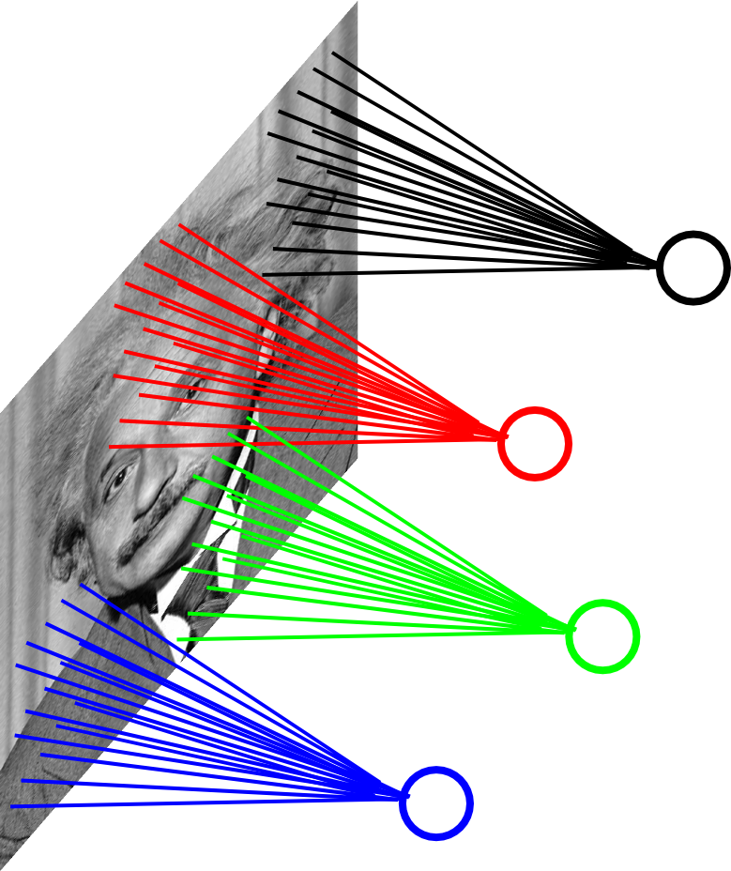
Locally Connected Layer
Example: 200x200 image
40K hidden units
Filter size: 10x10
4M parameters
Note: This parameterization is good when
input image is registered (e.g., face recognition).
Ranzato

Slide 11
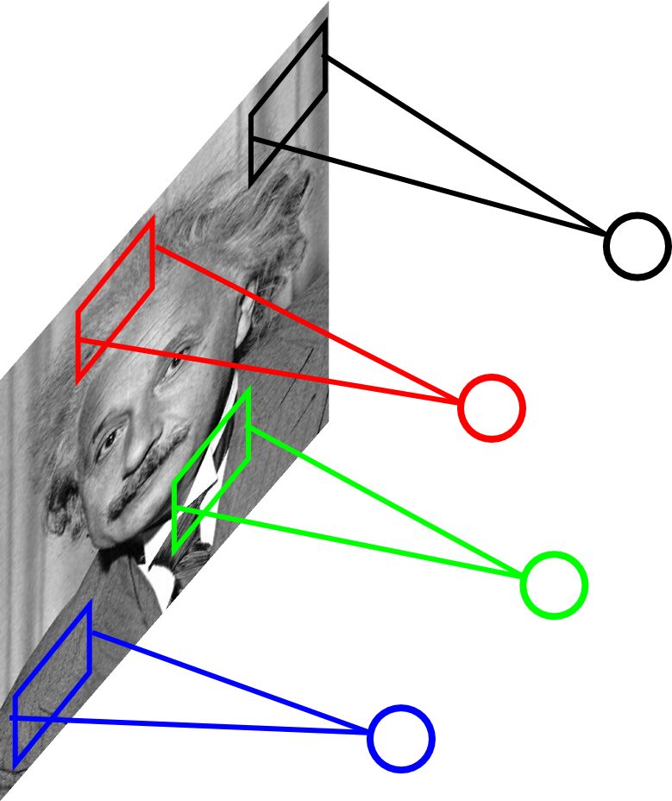
Locally Connected Layer
STATIONARITY? Statistics is similar at
different locations
Example: 200x200 image
40K hidden units
Filter size: 10x10
4M parameters
Ranzato

Slide 12
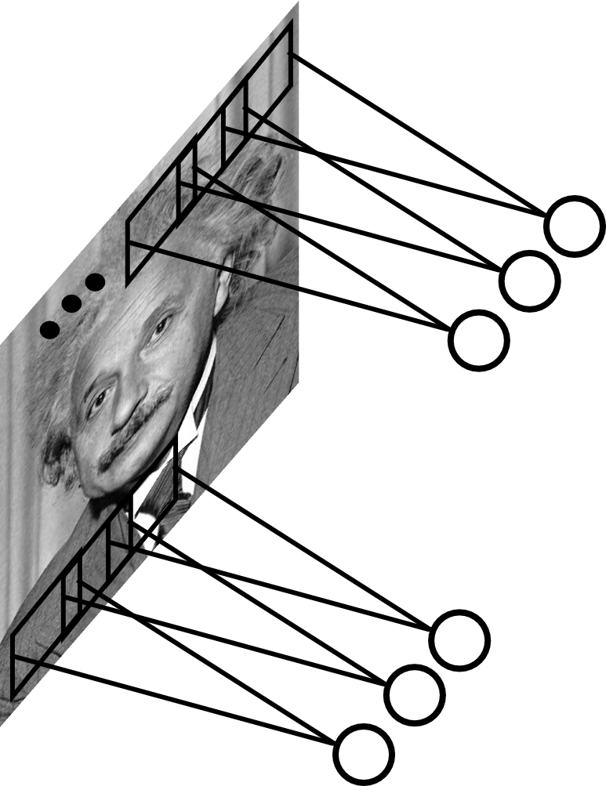
Convolutional Layer
Share the same parameters across different
locations (assuming input is stationary):
Convolutions with learned kernels
Ranzato

Slide 13
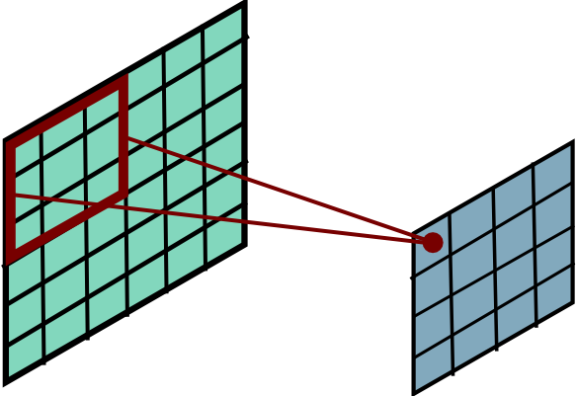
Convolutional Layer
Ranzato

Slide 14
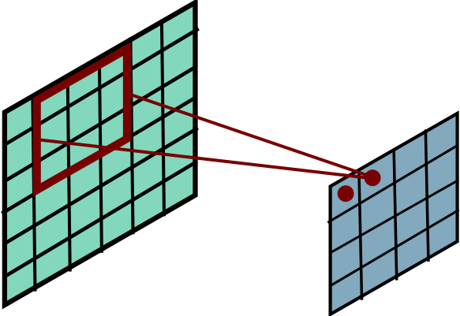
Convolutional Layer
Ranzato

Slide 15
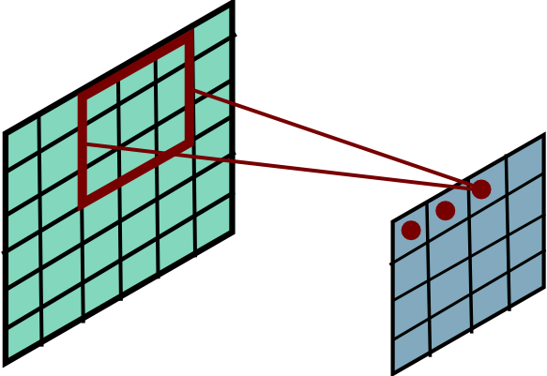
Convolutional Layer
Ranzato

Slide 16
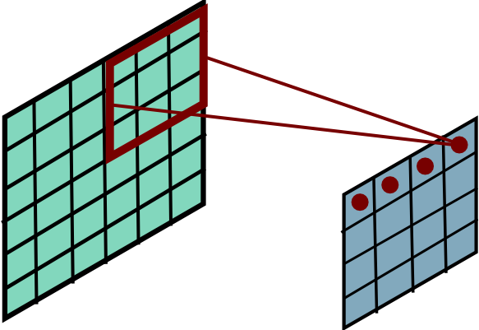
Convolutional Layer
Ranzato

Slide 17
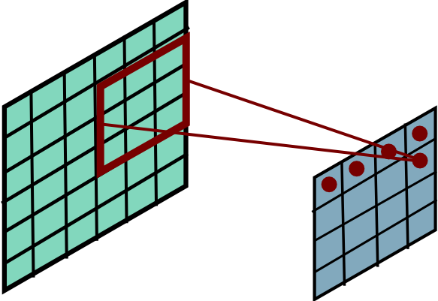
Convolutional Layer
Ranzato

Slide 18
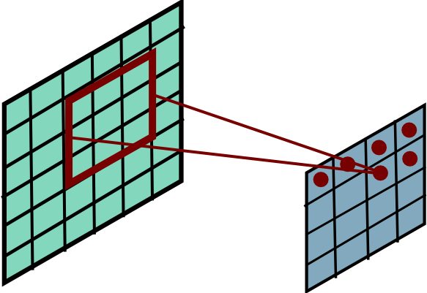
Convolutional Layer
Ranzato

Slide 19
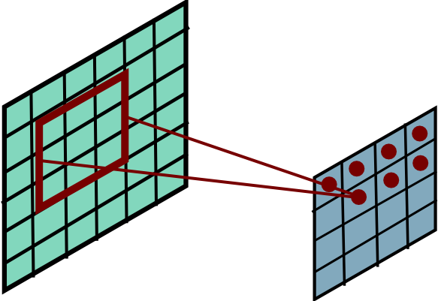
Convolutional Layer
Ranzato

Slide 20
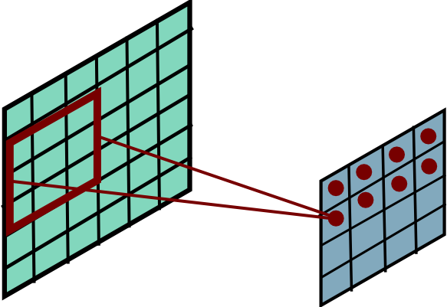
Convolutional Layer
Ranzato

Slide 21
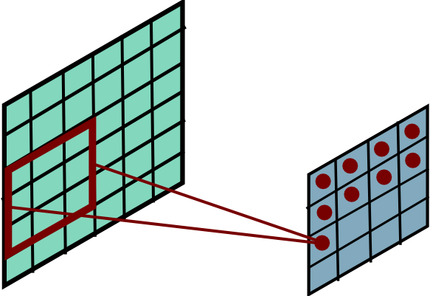
Convolutional Layer
Ranzato

Slide 22
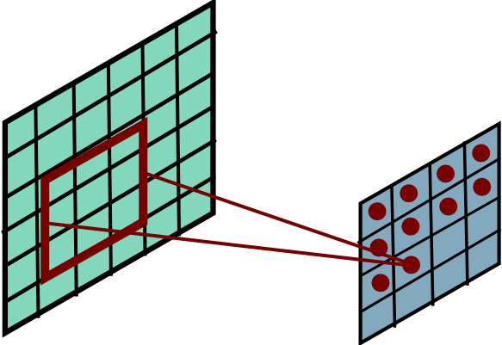
Convolutional Layer
Ranzato

Slide 23
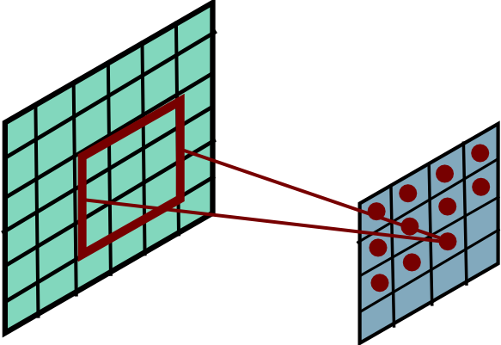
Convolutional Layer
Ranzato

Slide 24
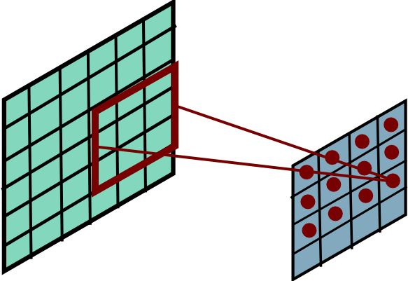
Convolutional Layer
Ranzato

Slide 25
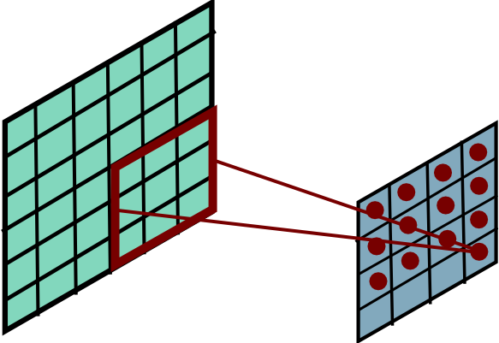
Convolutional Layer
Ranzato

Slide 26
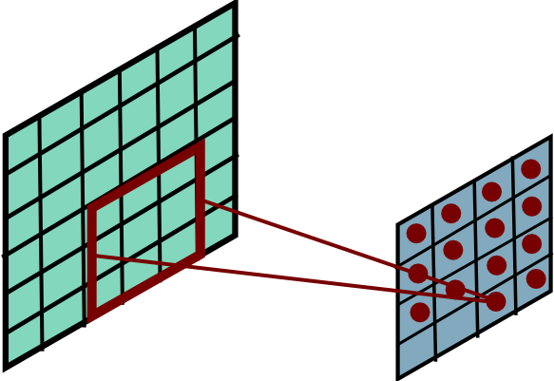
Convolutional Layer
Ranzato

Slide 27
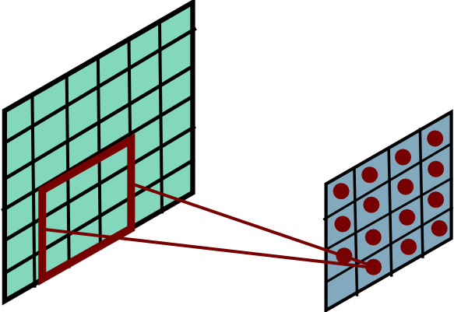
Convolutional Layer
Ranzato

Slide 28
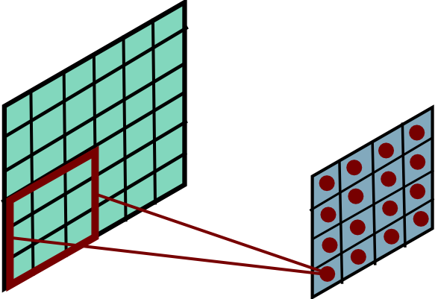
Convolutional Layer
Ranzato
Notes:
Btw, is this convolution, or cross-correlation?

Slide 29
Convolution Layer
One neuron, that looks at 5x5 region and outputs a sheet of activation map
1x28x28 activation map
3x32x32 image
3x5x5 filter
28
convolve (slide) over all spatial locations
32
28
32
1
3
Notes:
15 min

Slide 30
Convolution Layer
One neuron, that looks at 5x5 region and outputs a sheet of activation map
1x28x28 activation map
3x32x32 image
3x5x5 filter
28
convolve (slide) over all spatial locations
32
28
32
1
3
Convolution Layer vs Image Filtering:
>1 input and output channels
Forget about convolution vs cross-correlation (Why?)

Slide 31
Convolution Layer:
two 1x28x28 activation map
3x32x32 image
Add a second (green) filter:
3x5x5 filter
28
28
convolve (slide) over all spatial locations
32
28
32
1
1
3

Slide 32
Convolution Layer
6 activation maps,
each 1x28x28
3x32x32 image
Can keep on adding new, say 6 filters, each 3x5x5
Convolution Layer
32
32
6x3x5x5 filters
Stack activations to get a 6x28x28 output image!
3

Slide 33
Convolution Layer
6 activation maps,
each 1x28x28
3x32x32 image
Also 6-dim bias vector:
Convolution Layer
32
32
6x3x5x5 filters
Stack activations to get a 6x28x28 output image!
3

Slide 34
Convolution Layer
28x28 grid, at each point a 6-dim vector
3x32x32 image
Also 6-dim bias vector:
Convolution Layer
32
32
6x3x5x5 filters
Stack activations to get a 6x28x28 output image!
3

Slide 35
Convolution Layer: With many images
2x6x28x28
Batch of outputs
2x3x32x32
Batch of images
Also 6-dim bias vector:
Convolution Layer
32
32
3
6x3x5x5 filters

Slide 36
Convolution Layer
N x C_{out} x H’ x W’
Batch of outputs
N x C_{in} x H x W
Batch of images
Bias: C_{out}-dim vector:
Convolution Layer
H
W
C_{out}
C_{in}
Weights:
C_{out} x C_{in}x K_{w} x K_{h}

Slide 37
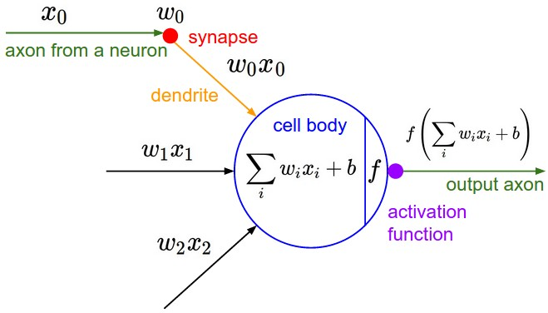
The brain/neuron view of CONV Layer
32
E.g. with 5 filters,
CONV layer consists of neurons arranged in a 3D grid
(28x28x5)
There will be 5 different neurons all looking at the same region in the input volume
28
32
28
3
5

Slide 38
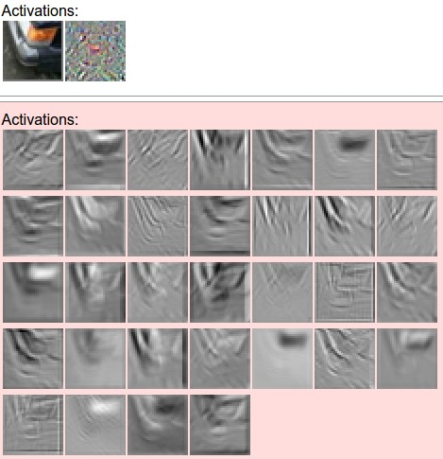
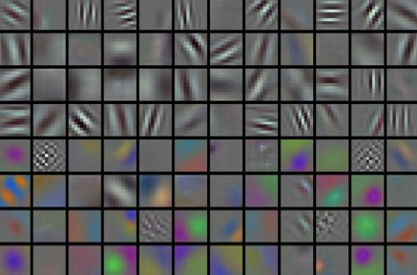
convolving the first filter in the input gives the first slice of depth in output volume

Slide 39
Compared with MLPs
Activation maps
Vectorize
/flatten
fc
output
Notes:
What’s the difference between convnets that only looks at each channel? -> output is going to be C*C_before. This just sums the response across channels.

Slide 40
CNNs in practice
FC layers (MLPs)
…
Vectorize
/flatten
output
Conv layers (they still need to go through non-linearity!!)
Notes:
What’s the difference between convnets that only looks at each channel? -> output is going to be C*C_before. This just sums the response across channels.

Slide 41
What needs to be learned?
FC layers (MLPs)
…
Vectorize
/flatten
output
Conv layers (they still need to go through non-linearity!!)
Notes:
What’s the difference between convnets that only looks at each channel? -> output is going to be C*C_before. This just sums the response across channels.

Slide 42
What needs to be learned?
Conv, Relu
Input:
B, C_in, H, W
Output
B, C_out, H, W
C_out, C_in, K, K
Notes:
What’s the difference between convnets that only looks at each channel? -> output is going to be C*C_before. This just sums the response across channels.

Slide 43

We’re still doing matrix multiplications, just localized & shared
Recall one neuron in FC layer:
With Conv layer:
col2im
im2col
w takes the entire image!
Now w takes (overlapping) patches

Slide 44
Convnet nitty gritties
Notes:
15 min

Slide 45
Convolution Spatial Dimensions
Input: 7x7
Filter: 3x3
Q: How big is output?
7
7

Slide 46
Convolution Spatial Dimensions
Input: 7x7
Filter: 3x3
Q: How big is output?
7
7

Slide 47
Convolution Spatial Dimensions
Input: 7x7
Filter: 3x3
Q: How big is output?
7
7

Slide 48
Convolution Spatial Dimensions
Input: 7x7
Filter: 3x3
Q: How big is output?
7
7

Slide 49
Convolution Spatial Dimensions
Input: 7x7
Filter: 3x3
Output: 5x5
7
7

Slide 50
Convolution Spatial Dimensions
Input: 7x7
Filter: 3x3
Output: 5x5
In general:
Input: W
Filter: K
Output: W – K + 1
Problem: Feature maps “shrink” with each layer!
7
7

Slide 51
Convolution Spatial Dimensions
Input: 7x7
Filter: 3x3
Output: 5x5
0 | 0 | 0 | 0 | 0 | 0 | 0 | 0 | 0
0 |  |  |  |  |  |  |  | 0
0 |  |  |  |  |  |  |  | 0
0 |  |  |  |  |  |  |  | 0
0 |  |  |  |  |  |  |  | 0
0 |  |  |  |  |  |  |  | 0
0 |  |  |  |  |  |  |  | 0
0 |  |  |  |  |  |  |  | 0
0 | 0 | 0 | 0 | 0 | 0 | 0 | 0 | 0
In general:
Input: W
Filter: K
Padding: P
Problem: Feature maps “shrink” with each layer!
Solution: padding
Add zeros around the input

Slide 52
Convolution Spatial Dimensions
Input: 7x7
Filter: 3x3
Output: 5x5
0 | 0 | 0 | 0 | 0 | 0 | 0 | 0 | 0
0 |  |  |  |  |  |  |  | 0
0 |  |  |  |  |  |  |  | 0
0 |  |  |  |  |  |  |  | 0
0 |  |  |  |  |  |  |  | 0
0 |  |  |  |  |  |  |  | 0
0 |  |  |  |  |  |  |  | 0
0 |  |  |  |  |  |  |  | 0
0 | 0 | 0 | 0 | 0 | 0 | 0 | 0 | 0
In general:
Input: W
Filter: K
Padding: P
Output: W – K + 1 + 2P
Very common: “same padding”
Set P = (K – 1) / 2
Then output size = input size

Slide 53
Receptive Fields
For convolution with kernel size K, each element in the output depends on a K x K receptive field in the input
Input
Output

Slide 54
Receptive Fields
Each successive convolution adds K – 1 to the receptive field size
With L layers the receptive field size is 1 + L * (K – 1)
Input
Output
Careful – ”receptive field wrt to the input”
vs “receptive field wrt the previous layer”

Slide 55
Receptive Fields
Each successive convolution adds K – 1 to the receptive field size
With L layers the receptive field size is 1 + L * (K – 1)
Input
Output
Problem: For large images we need many layers for each output to “see” the whole image image

Slide 56
Receptive Fields
Each successive convolution adds K – 1 to the receptive field size
With L layers the receptive field size is 1 + L * (K – 1)
Input
Output
Problem: For large images we need many layers for each output to “see” the whole image image
Solution: Downsample inside the network

Slide 57
Strided Convolution
Input: 7x7
Filter: 3x3
Stride: 2

Slide 58
Strided Convolution
Input: 7x7
Filter: 3x3
Stride: 2

Slide 59
Strided Convolution
Input: 7x7
Filter: 3x3
Stride: 2
Output: 3x3

Slide 60
Strided Convolution
Input: 7x7
Filter: 3x3
Stride: 2
Output: 3x3
In general:
Input: W
Filter: K
Padding: P
Stride: S
Output: (W – K + 2P) / S + 1

Slide 61
Can we do stride 3?
Input: 7x7
Filter: 3x3
Stride: 3?
Output: 3x3
Output: (N-F) / S + 1
e.g. N = 7, F = 3:
stride 1 => (7 - 3)/1 + 1 = 5
stride 2 => (7 - 3)/2 + 1 = 3
stride 3 => (7 - 3)/3 + 1 = 2.33 ☹

Slide 62
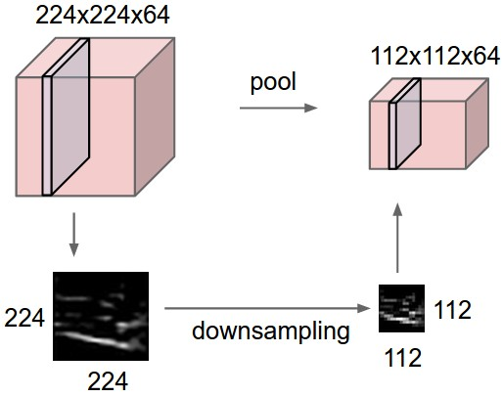
Pooling Layers: Downsampling
64 x 224 x 224
64 x 112 x 112
Hyperparameters:
Kernel Size
Stride
Pooling function

Slide 63
Max Pooling
64 x 224 x 224
Single depth slice
2 | 3 | 2 | 4
5 | 6 | 6 | 8
3 | 2 | 1 | 0
1 | 2 | 3 | 4
x
Max pooling with 2x2 kernel size and stride 2
6 | 8
3 | 4
Introduces invariance to small spatial shifts
No learnable parameters!
y

Slide 64
Average Pooling
64 x 224 x 224
Single depth slice
2 | 3 | 2 | 4
5 | 6 | 6 | 8
3 | 2 | 1 | 0
1 | 2 | 3 | 4
x
Avg pooling with 2x2 kernel size and stride 2
4 | 5
2 | 2
Introduces invariance to small spatial shifts
No learnable parameters!
y

Slide 65
Pooling Summary
Input: C x H x W
Hyperparameters:
Kernel size: K
Stride: S
Pooling function (max, avg)
Output: C x H’ x W’ where
H’ = (H – K) / S + 1
W’ = (W – K) / S + 1
Learnable parameters: None!
Common settings:
max, K = 2, S = 2
max, K = 3, S = 2 (AlexNet)

Slide 66
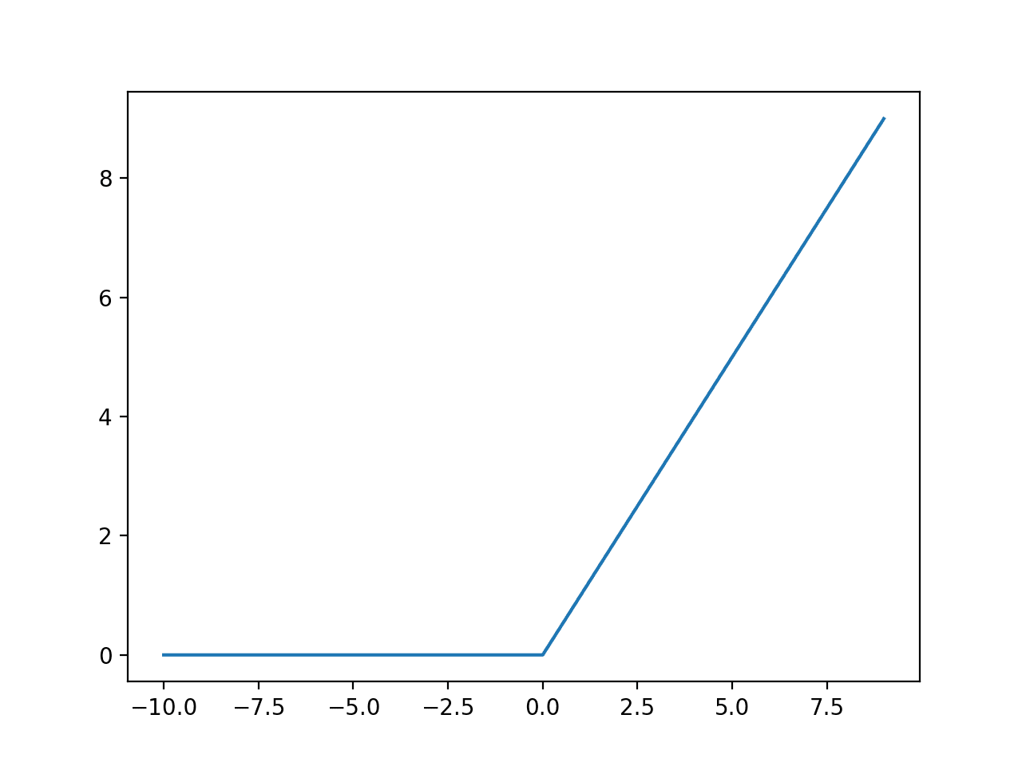

Normalization
You want the inputs to be in a similar range → low variance
Why do we need to normalize our data?
Extreme example:
sometimes pixel range is [0, 255], sometimes it’s [0, 1]
What is the problem?
Network activations will be completely different!!
Notes:
Network activations will be completely different!!

Slide 67
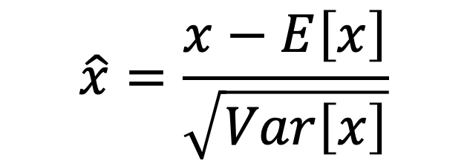
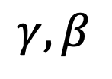
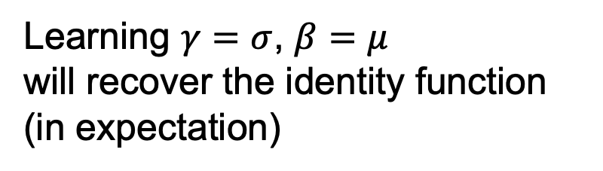
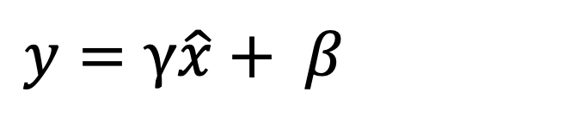
How to normalize
$$\hat{x}=\frac{x−E\left[x\right]}{\sqrt{Var\left[x\right]}}$$
Is this differentiable?
Yes! so we can use it as an operator in our networks and backprop through it!
But now the data is always zero mean, unit variance…
$y=$ $γ\hat{x}+ β$
Learning $γ=σ$, $β=μ$
will recover the identity function (in expectation)
Sol: Add scale and shift parameters:
$$γ,β$$
Slide modified from David Fouhey
Notes:
What does this mean though?

Slide 68
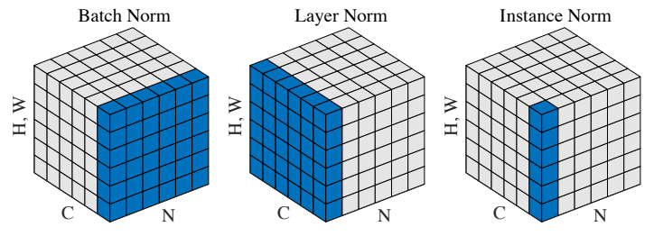
How to normalize
Next Q: from what do you compute the mean & variance?
BatchNorm computes mean and var from each batch
Depends on the batch, so need to keep a running average and store these.
LayerNorm/InstanceNorm do not need this.
Notes:
What are the possible ways to normalize data?

Slide 69
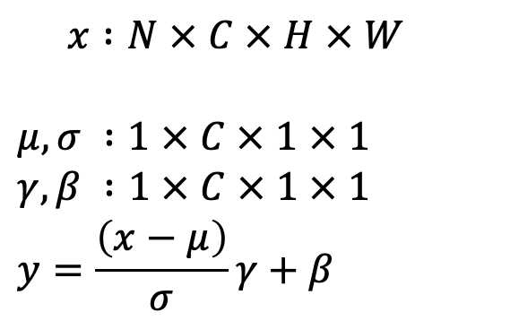
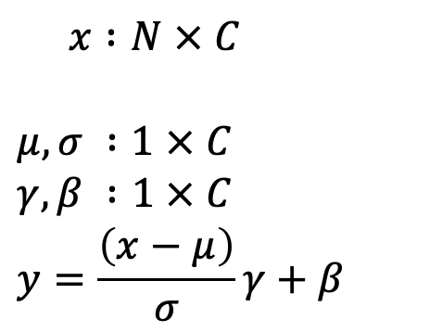
Batch Normalization for ConvNets
Batch Normalization for fully-connected networks
Batch Normalization for
convolutional networks
(Spatial Batchnorm, BatchNorm2D)
$x :N × C$
$$μ,σ :1 × C$$
$$γ,β :1 × C$$
$$y=\frac{\left(x−μ\right)}{σ}γ+β$$
$x :N × C × H × W$
$$μ,σ :1 × C × 1 × 1$$
$$γ,β :1 × C × 1 × 1$$
$$y=\frac{\left(x−μ\right)}{σ}γ+β$$
Normalize
Normalize

Slide 70
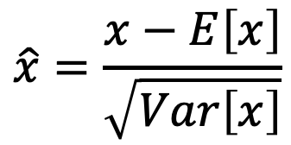
Normalization
Conv
Usually inserted after Fully Connected or Convolutional layers, and before nonlinearity.
BN
ReLU
Conv
$$\hat{x}=\frac{x−E\left[x\right]}{\sqrt{Var\left[x\right]}}$$
BN
ReLU

Slide 71
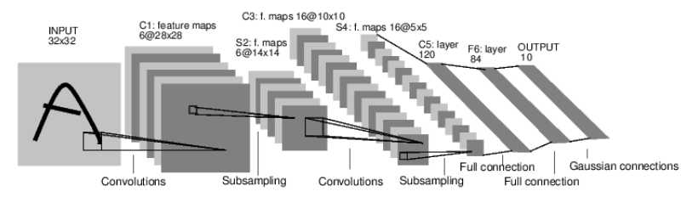
Case Study: Lenet-5
Task: 10 digit classification
LeCun et al. 1998
Conv filters were 5x5, applied at stride 1
Subsampling (Pooling) layers were 2x2 applied at stride 2
i.e. architecture is [CONV-POOL-CONV-POOL-CONV-flatten-FC-output]
Notes:
30 min total
Ask: What is the Size of the convolution filter?
What was the subsampling rate or the stride of the pooling (subsampling layers?)
Nonlinearity was tanh

Slide 72
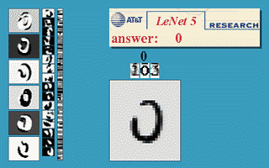
LeNet5 demo
LeCun et al. 1998

Slide 73
Case Study: AlexNet
[Krizhevsky, Sutskever, Hinton, NeurIPS 2012]
Task: ImageNet 1000-class classification
HxW
C
227x 227
3

Slide 74
Case Study: AlexNet
[Krizhevsky, Sutskever, Hinton, NeurIPS 2012]
Input: 227x227x3 images
First layer (CONV1): 96 11x11 filters applied at stride 4
Q: What is the output volume size after Conv1?
Hint:
(227-11)/4 + 1 = 55
A: 55x55x96
Q: how many parameters in this layer?
A: (3*11*11) * 96
Notes:
GTX 580 GPU had 3GB of memory, GTX1080/2080 11GB
What is the # of params with bias?

Slide 75
Case Study: AlexNet
[Krizhevsky, Sutskever, Hinton, NeurIPS 2012]
Input: 227x227x3 images
After Conv1: 55x55x96
Second layer: Pool1: 3x3 at stride 2
Q: What is the output volume size after Pool1?
A: (55-3)/2 + 1 = 27
27x27x96
Q: how many parameters in this layer?
A: 0!!!
Notes:
GTX 580 GPU had 3GB of memory, GTX1080/2080 11GB
What is the # of params with bias?

Slide 76
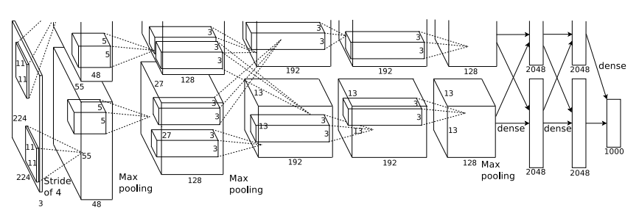
AlexNet
Q: Which part of the network incurs
high memory usage?
Large # of parameters?
high FLOPs?
Most of the memory usage is in the early convolution layers
Nearly all parameters are in the fully-connected layers
Most floating-point ops occur in the convolution layers

Slide 77
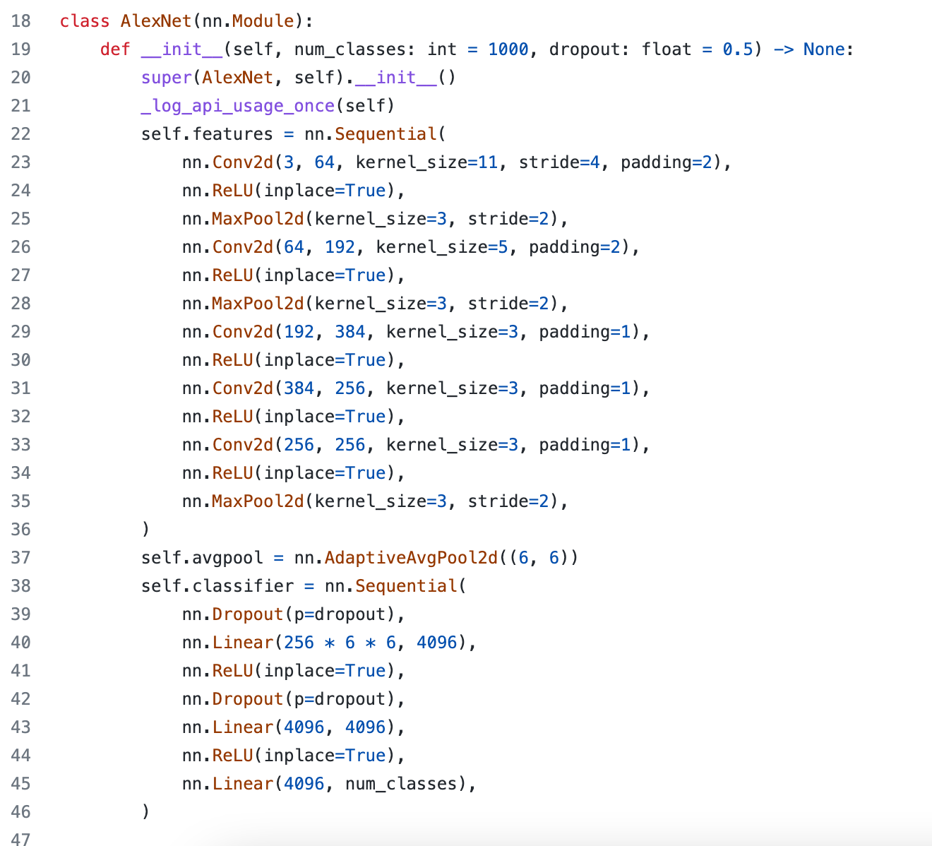
In pytorch
https://github.com/pytorch/vision/blob/main/torchvision/models/alexnet.py#L18

Slide 78
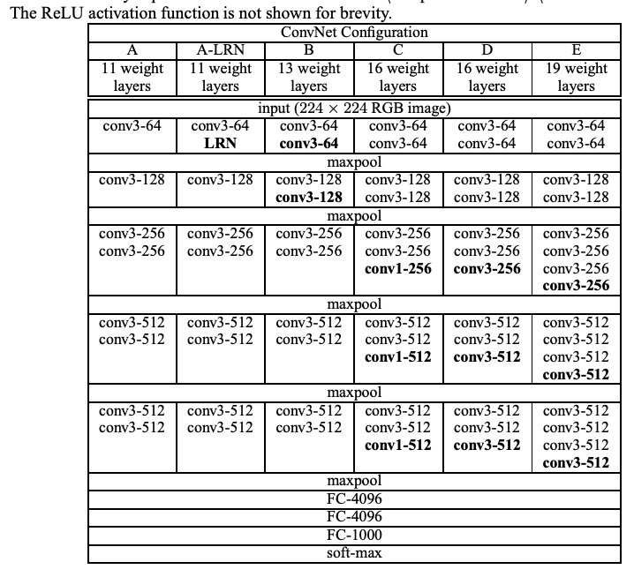

VGGNet [Simonyan and Zisserman 2015]
Input: 224x224x3
Simplified design rules:
All kernel size 3x3
Always ReLu
All max pool are 2x2, stride 2
After pool, double the # of channels
Notes:
Studies the effect of depth on accuracy
Shows that 3x3 conv is enough by making it deeper
74.5% top-1 accuracy, today it’s around 90% top-1 accuracy now

Slide 79
VGGNet [Simonyan and Zisserman 2015]
Input: 224x224x3
Simplified design rules:
All kernel size 3x3
Always ReLu
All max pool are 2x2, stride 2
After pool, double the # of channels
Option 1:
Conv(5x5, C -> C)
Params: 25C²
FLOPs: 25C²HW
Option 2:
Conv(3x3, C -> C)
Conv(3x3, C -> C)
Params: 18C²
FLOPs: 18C²HW
Two 3x3 conv has same receptive field as a single 5x5 conv, but has fewer parameters and takes less computation!
Slide adapted from Johnson & Fouhey
Notes:
Studies the effect of depth on accuracy
Shows that 3x3 conv is enough by making it deeper
74.5% top-1 accuracy, today it’s around 90% top-1 accuracy now

Slide 80
Problem: Deep Networks very hard to train!

Slide 81
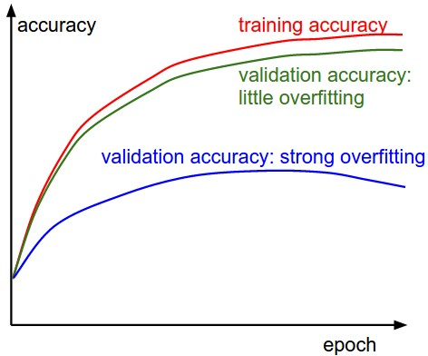
Measuring performance over train/val sets

Slide 82
Measuring performance over train/val sets

Slide 83
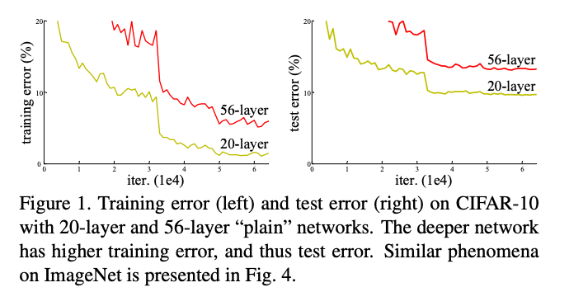
Naively adding more layers
!= better performance
Q: is this over fitting?
No! (hypothesis) it’s a matter of optimization
[He et al. CVPR 2016]
Notes:
Not! bc overfitting, training loss is higher. → Due to optimization difficulty
Deeper networks can emulate shallow networks, by using the same set of layers and setting the extra layers to identity. So it should do as well, but it doesn’t → They don’t learn identity functions to emulate shallow models

Slide 84
Naively adding more layers
!= better performance
Deeper networks can emulate shallow networks.
How?
By making the extra layers to model the identity function.
But it’s difficult to do this as y= sig(w*x + b)
[He et al. CVPR 2016]
Notes:
Not! bc overfitting, training loss is higher. → Due to optimization difficulty
Deeper networks can emulate shallow networks, by using the same set of layers and setting the extra layers to identity. So it should do as well, but it doesn’t → They don’t learn identity functions to emulate shallow models

Slide 85
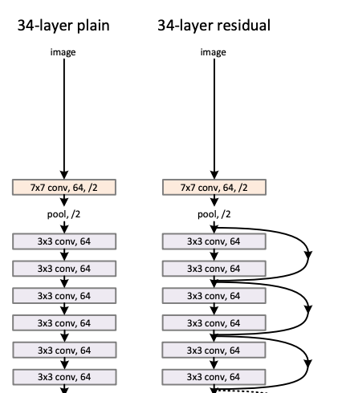

ResNet [He et al. CVPR 2016]
Input: 224x224x3
ResNet Block:
Notes:
Quick reduction in spatial dimension at least in this design
81% from 75%

Slide 86
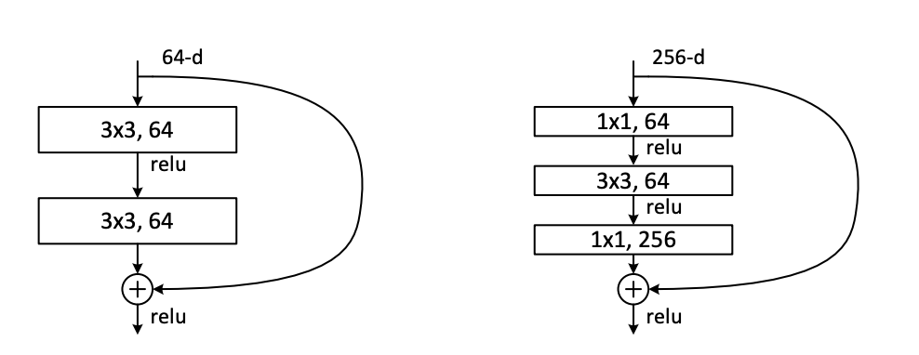
ResNet [He et al. CVPR 2016]
Can be made very deep: ResNet-50, 101, 152
And converge well
Bottleneck design:
Reduce by 1x1
Conv by 3x3
Restore by 1x1
Notes:
Quick reduction in spatial dimension at least in this design
81% from 75%

Slide 87
ImageNet Classification Challenge top-5 error
152 Layer
152 Layer
152 Layer
19 Layer
22 Layer
Shallow
8 Layer
8 Layer
Lin et al
Sanchez & Perronnin
Krizhevsky et al (AlexNet)
Zeiler & Fergus
Simonyan & Zisserman (VGG)
Szegedy et al (GoogLeNet)
He et al (ResNet)
Shao et al
Hu et al
(SENet)
Russakovsky et al

Slide 88
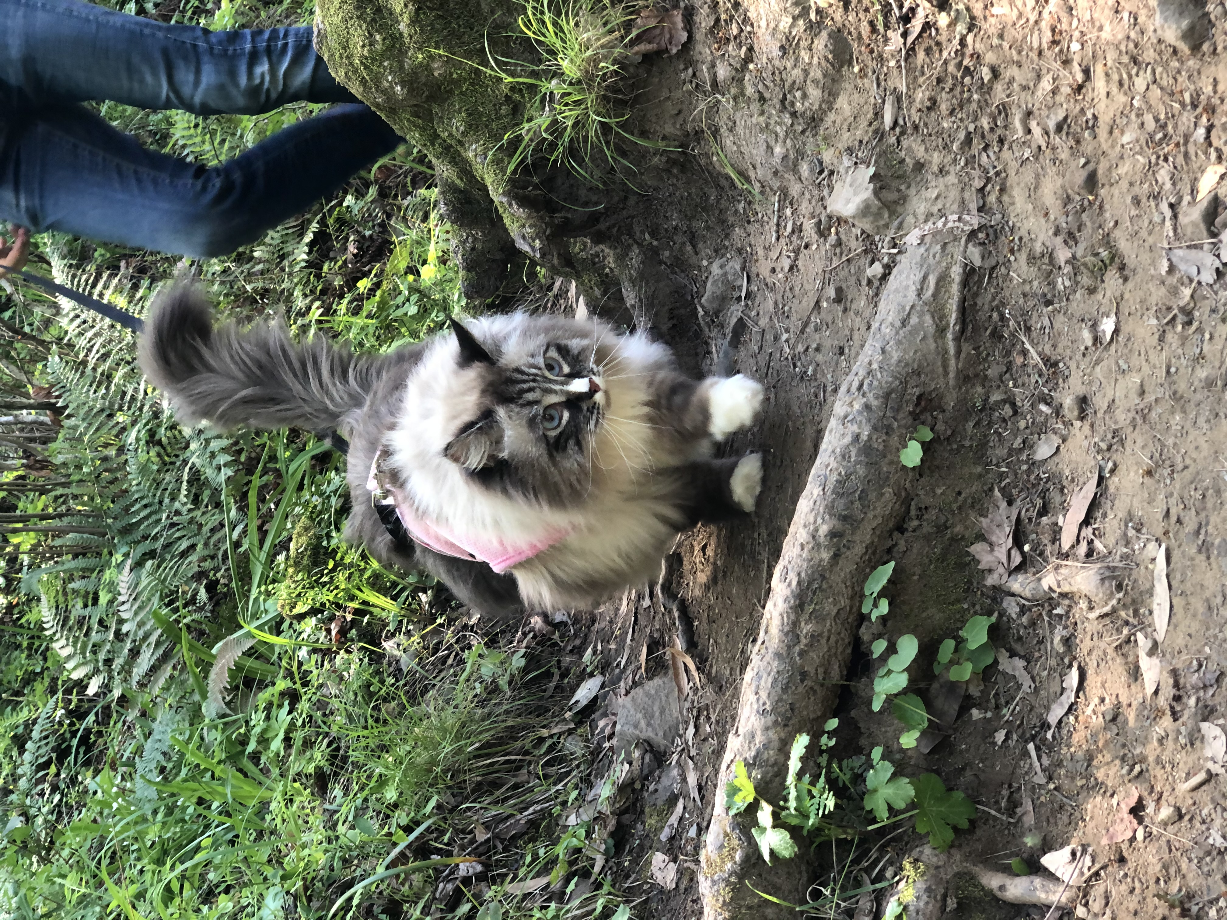
Bottom line: CNN workflow
CNN
Input:
HxWxC
Output:
1 x 1 x F
Convert HxW image into a F-dimensional vector
What’s the probability this image has a cat? (F=1)
Which of 1000 categories is this image? (F=1000)
Where are the X,Y coordinates of 5 cat face keypoints? (F=28*2 = 56)
Slide modified from David Fouhey
Notes:
15 min

Slide 89
Example: Image classification
Output:
1 x 1 x F
CNN
P(image is class #1)
Input:
HxWxC
P(image is class #2)
P(image is class #F)
Slide modified from David Fouhey

Slide 90
Example: Keypoint detection
Output:
1 x 1 x 2K
CNN
X coord of keypoint #1
Input:
HxWxC
Y coord of keypoint #1
X coord of keypoint #K
Y coord of keypoint #K
Slide modified from David Fouhey

Slide 91
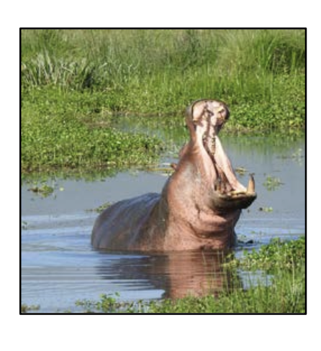
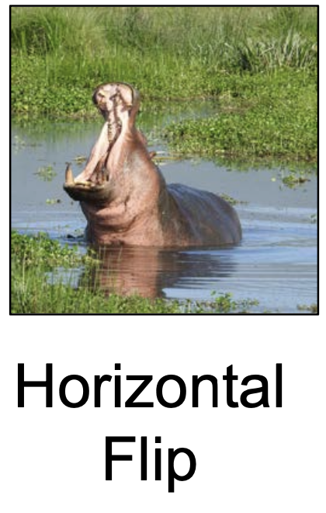
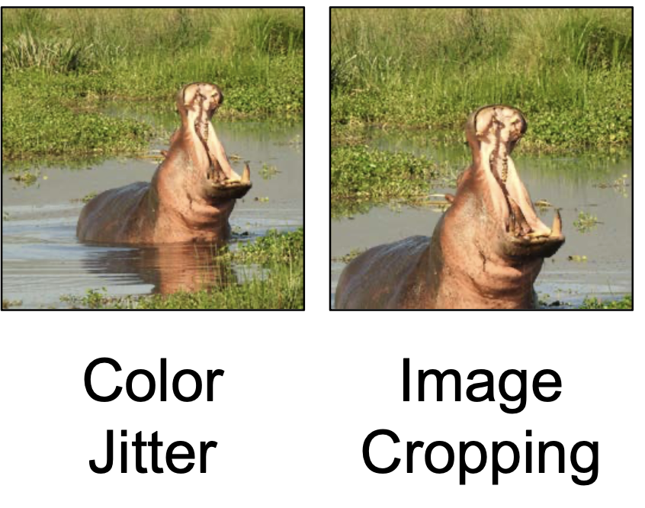
What if your data is not big enough?
Slide by David Fouhey

Slide 92
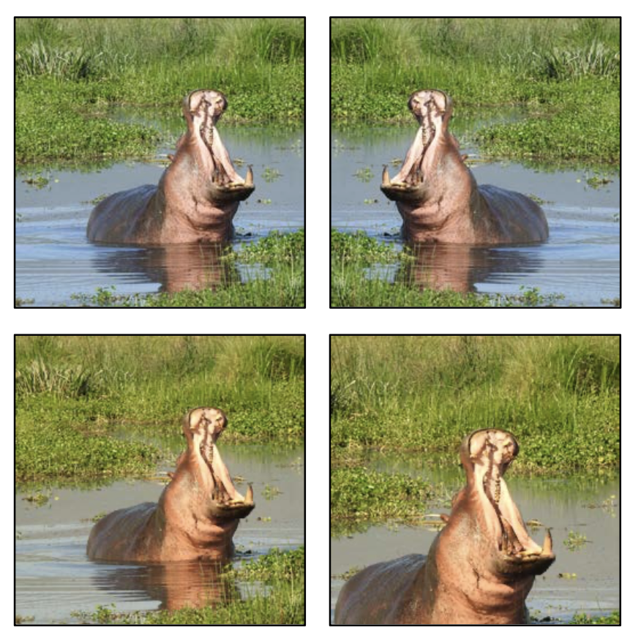
Data Augmentation
Apply transformations (on the fly) to increase training data
Can mix multiple transformations at once
Make sure you don’t change the meaning of the output
Slide modified from David Fouhey

Slide 93
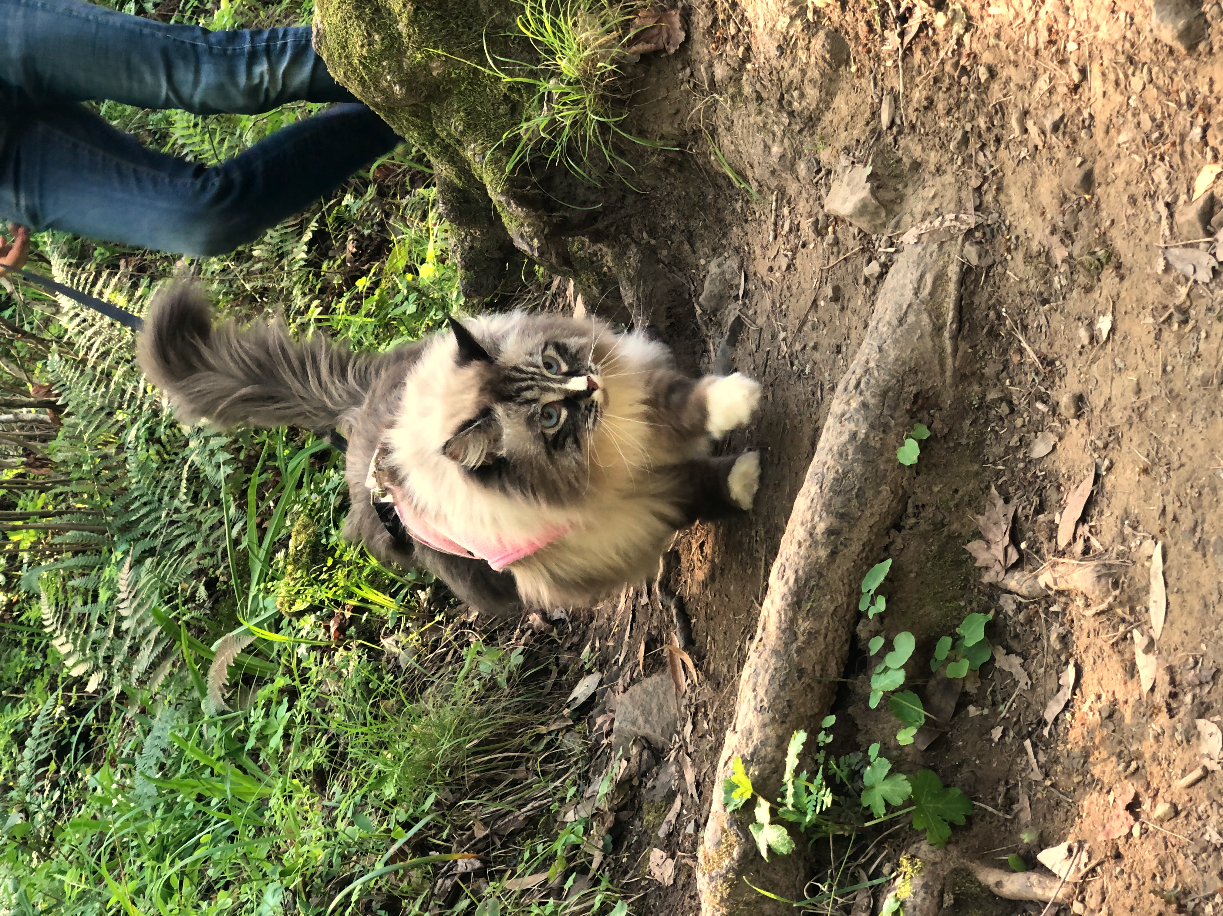
Sometimes labels need to be transformed too
Original
After flip + color aug
For certain tasks, make sure to transform the output accordingly!!
Right eye
Left eye
Defined wrt to the cat

Slide 94
Sometimes labels need to be transformed too
Original
After flip + color aug
For certain tasks, make sure to transform the output accordingly!!
Right eye
Left eye
Defined wrt to the cat

Slide 95
Very common bug
Original
After flip + color aug
For certain tasks, make sure to transform the output accordingly!!
Right eye
Left eye
WRONG! Flipped without updating the label!!
Defined wrt to the cat
Notes:
If you do this half of the time left eye is on the right side and vise versa

Slide 96
Very common bug
Original
After flip + color aug
For certain tasks, make sure to transform the output accordingly!!
Right eye
Left eye
Correct
Defined wrt to the cat

Slide 97

How to train your network
Notes:
10 min

Slide 98
Basic setup
Get your dataset
Design your CNN architecture
Train + update weights with pytorch/tf…

Slide 99
Sanity Check #1
Make sure you can memorize a single data point: (x_{i}, y_{i}).
Train your CNN on only 1 image
It must be able to get very low training loss
If you can’t do this, it means something is wrong in your loss function, label, network/pytorch setup
It should also overfit to a single data fairly quickly. If it takes many iterations to do this that’s also bad news bears

Slide 100

A good starting point
DeepPose: Human Pose Estimation via Deep Neural Networks
[Toshev and Szegedy 2014]

