Slide 1
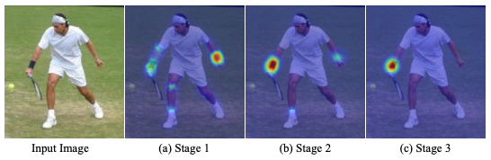
Convolutional Neural Networks II
Figure from Convolutional Pose Machines, Wei et al. CVPR 2016
CS194: Computer Vision and Comp. Photo
Angjoo Kanazawa/Alexei Efros, UC Berkeley, Fall 2021

Slide 2
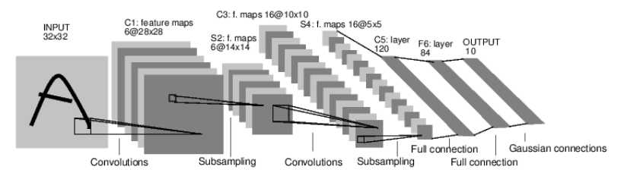
Case Study: Lenet-5
Task: 10 digit classification
LeCun et al. 1998
Conv filters were 5x5, applied at stride 1
Subsampling (Pooling) layers were 2x2 applied at stride 2
i.e. architecture is [CONV-POOL-CONV-POOL-CONV-flatten-FC-output]
Notes:
30 min total
Ask: What is the Size of the convolution filter?
What was the subsampling rate or the stride of the pooling (subsampling layers?)
Nonlinearity was tanh

Slide 3
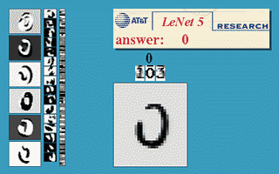
LeNet5 demo
LeCun et al. 1998

Slide 4
Case Study: AlexNet
[Krizhevsky, Sutskever, Hinton, NeurIPS 2012]
Task: ImageNet 1000-class classification
HxW
C
227x 227
3

Slide 5
Case Study: AlexNet
[Krizhevsky, Sutskever, Hinton, NeurIPS 2012]
Input: 227x227x3 images
First layer (CONV1): 96 11x11 filters applied at stride 4
Q: What is the output volume size after Conv1?
Hint: (N-K)/S + 1
(227-11)/4 + 1 = 55
A: 55x55x96
Q: how many parameters in this layer?
A: (3*11*11) * 96
Notes:
GTX 580 GPU had 3GB of memory, GTX1080/2080 11GB
What is the # of params with bias?

Slide 6
Case Study: AlexNet
[Krizhevsky, Sutskever, Hinton, NeurIPS 2012]
Input: 227x227x3 images
After Conv1: 55x55x96
Second layer: Pool1: 3x3 at stride 2
Q: What is the output volume size after Pool1?
A: (55-3)/2 + 1 = 27
27x27x96
Q: how many parameters in this layer?
A: 0!!!
Notes:
GTX 580 GPU had 3GB of memory, GTX1080/2080 11GB
What is the # of params with bias?

Slide 7
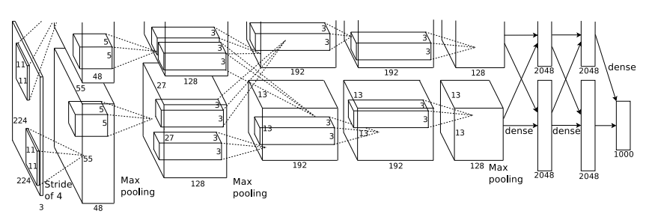
AlexNet
Q: Which part of the network incurs
high memory usage?
Large # of parameters?
high FLOPs?
Most of the memory usage is in the early convolution layers
Nearly all parameters are in the fully-connected layers
Most floating-point ops occur in the convolution layers

Slide 8
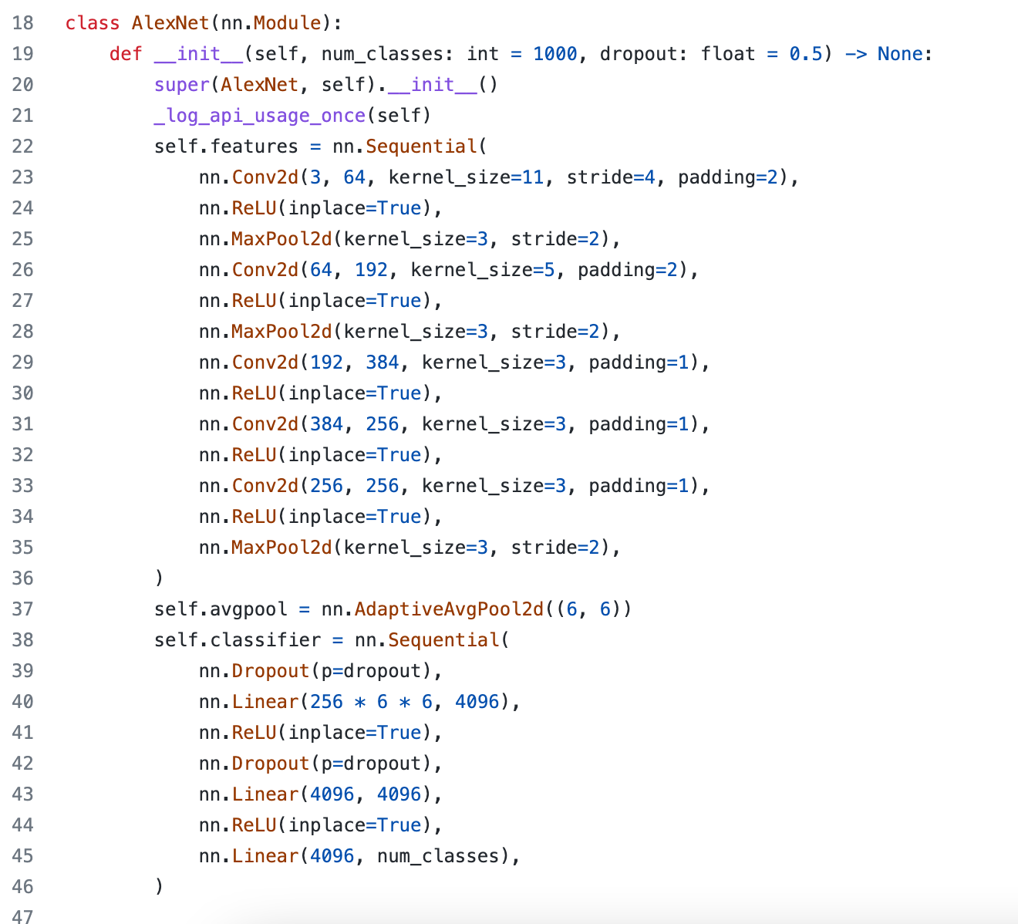
In pytorch
https://github.com/pytorch/vision/blob/main/torchvision/models/alexnet.py#L18

Slide 9
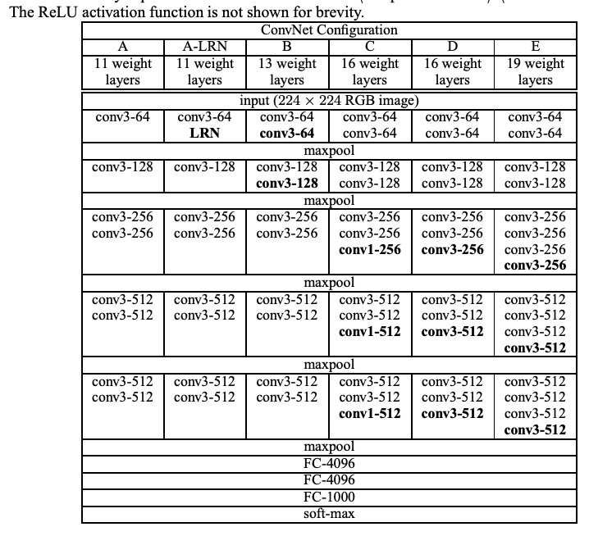

VGGNet [Simonyan and Zisserman 2015]
Input: 224x224x3
Simplified design rules:
All kernel size 3x3
Always ReLu
All max pool are 2x2, stride 2
After pool, double the # of channels
Notes:
Studies the effect of depth on accuracy
Shows that 3x3 conv is enough by making it deeper
74.5% top-1 accuracy, today it’s around 90% top-1 accuracy now

Slide 10
VGGNet [Simonyan and Zisserman 2015]
Input: 224x224x3
Simplified design rules:
All kernel size 3x3
Always ReLu
All max pool are 2x2, stride 2
After pool, double the # of channels
Option 1:
Conv(5x5, C -> C)
Params: 25C²
FLOPs: 25C²HW
Option 2:
Conv(3x3, C -> C)
Conv(3x3, C -> C)
Params: 18C²
FLOPs: 18C²HW
Two 3x3 conv has same receptive field as a single 5x5 conv, but has fewer parameters and takes less computation!
Slide adapted from Johnson & Fouhey
Notes:
Studies the effect of depth on accuracy
Shows that 3x3 conv is enough by making it deeper
74.5% top-1 accuracy, today it’s around 90% top-1 accuracy now

Slide 11
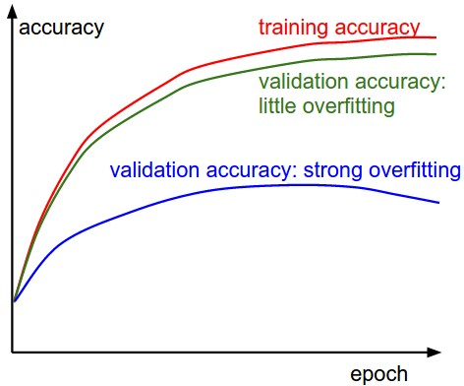
Measuring performance over train/val sets
Source: https://cs231n.github.io/neural-networks-3/

Slide 12
Measuring performance over train/val sets
Source: https://cs231n.github.io/neural-networks-3/

Slide 13
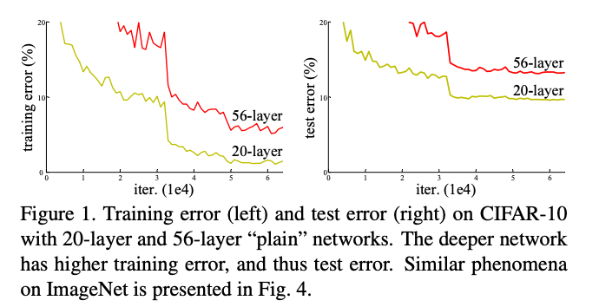
Naively adding more layers
!= better performance
Q: is this over fitting?
No! (hypothesis) it’s a matter of optimization
[He et al. CVPR 2016]
Notes:
Not! bc overfitting, training loss is higher. → Due to optimization difficulty
Deeper networks can emulate shallow networks, by using the same set of layers and setting the extra layers to identity. So it should do as well, but it doesn’t → They don’t learn identity functions to emulate shallow models

Slide 14
Naively adding more layers
!= better performance
[He et al. CVPR 2016]
Deeper networks can emulate shallow networks.
How?
By making the extra layers to learn the identity function.
But they don’t seem to learn identity by default
Notes:
Not! bc overfitting, training loss is higher. → Due to optimization difficulty
Deeper networks can emulate shallow networks, by using the same set of layers and setting the extra layers to identity. So it should do as well, but it doesn’t → They don’t learn identity functions to emulate shallow models

Slide 15
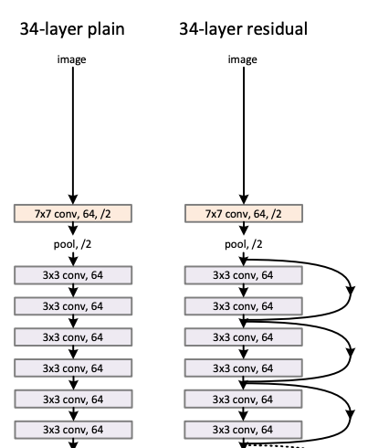

ResNet [He et al. CVPR 2016]
Input: 224x224x3
ResNet Block:
Notes:
Quick reduction in spatial dimension at least in this design
81% from 75%

Slide 16
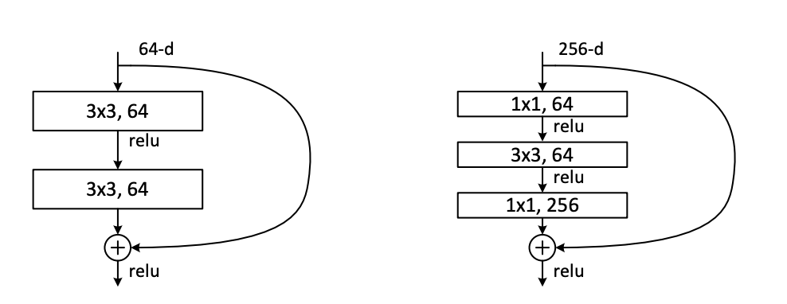
ResNet [He et al. CVPR 2016]
Can be made very deep: ResNet-50, 101, 152
And converge well
Bottleneck design:
Reduce by 1x1
Conv by 3x3
Restore by 1x1
Notes:
Quick reduction in spatial dimension at least in this design
81% from 75%

Slide 17
ImageNet Classification Challenge top-5 error
152 Layer
152 Layer
152 Layer
19 Layer
22 Layer
Shallow
8 Layer
8 Layer
Lin et al
Sanchez & Perronnin
Krizhevsky et al (AlexNet)
Zeiler & Fergus
Simonyan & Zisserman (VGG)
Szegedy et al (GoogLeNet)
He et al (ResNet)
Shao et al
Hu et al
(SENet)
Russakovsky et al

Slide 18

How to train your network
Notes:
10 min

Slide 19
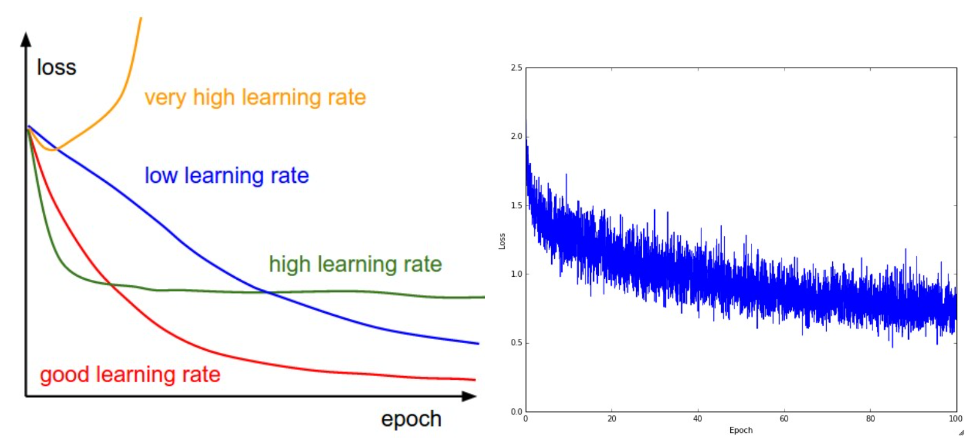
Training diagnosis
https://cs231n.github.io/neural-networks-3/

Slide 20
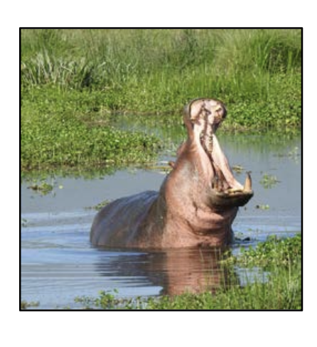
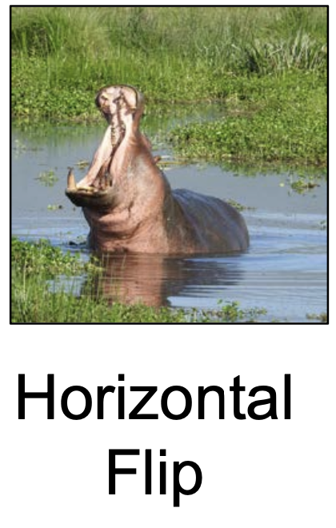
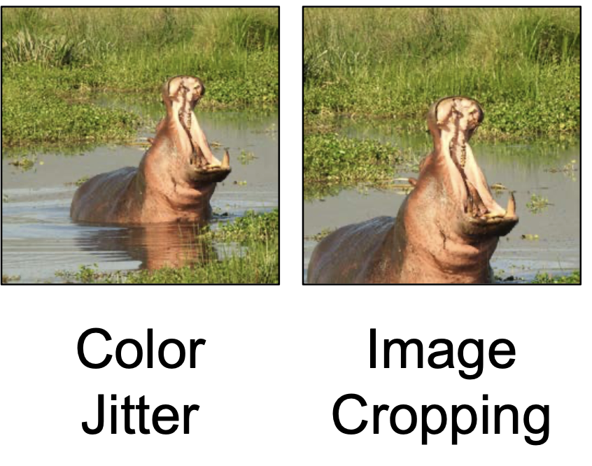
What if your data is not big enough?
Slide by David Fouhey

Slide 21
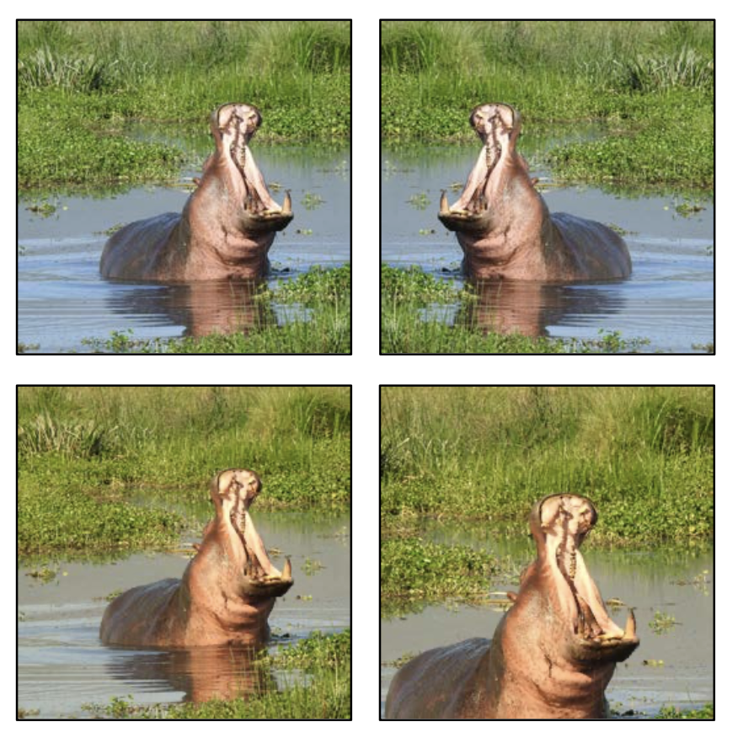
Data Augmentation
Apply transformations (on the fly) to increase training data
Can mix multiple transformations at once
Make sure you don’t change the meaning of the output
Slide modified from David Fouhey

Slide 22
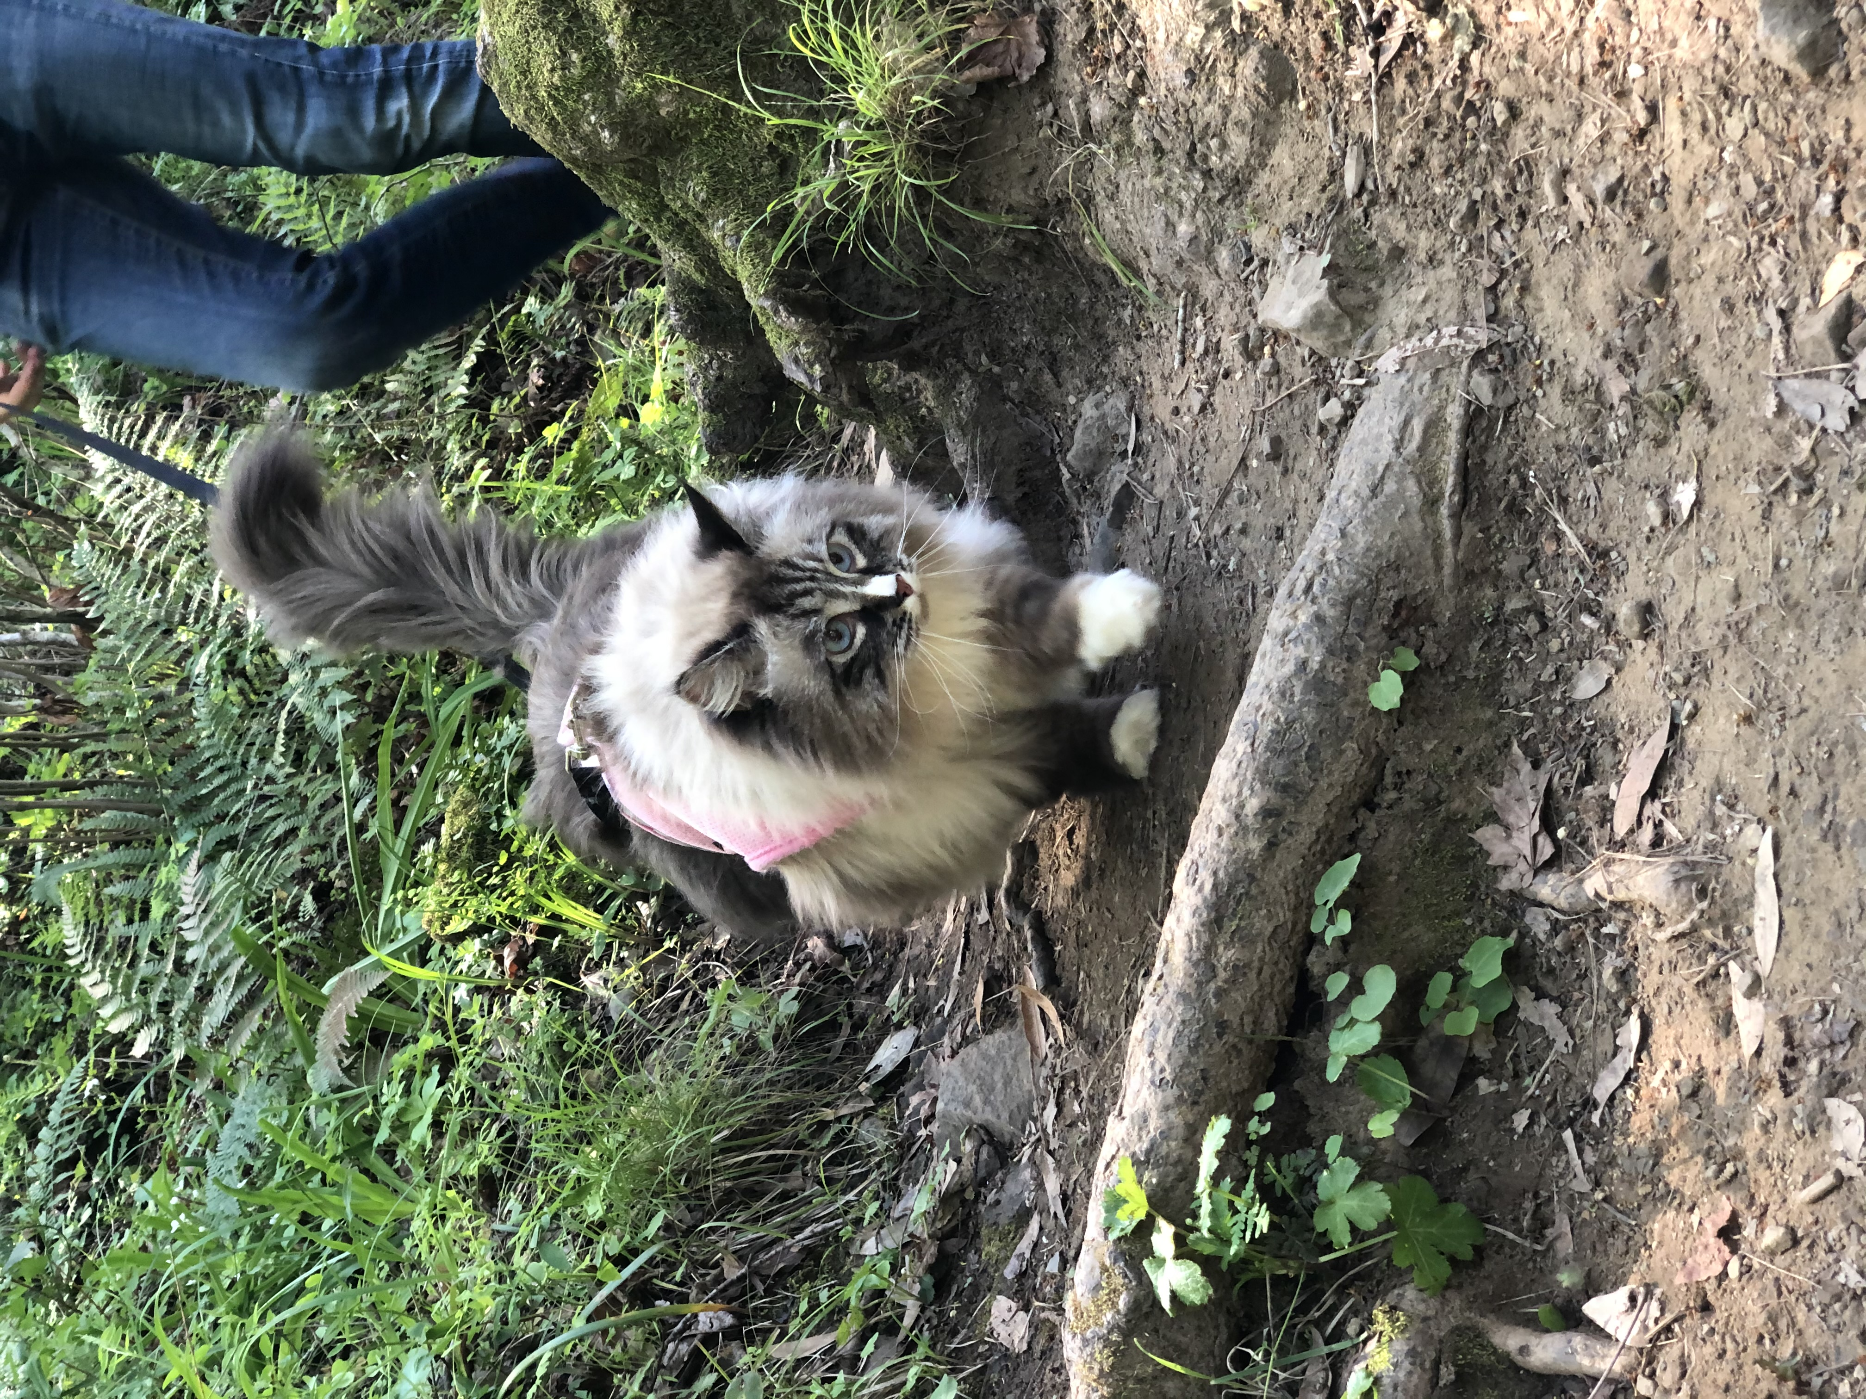
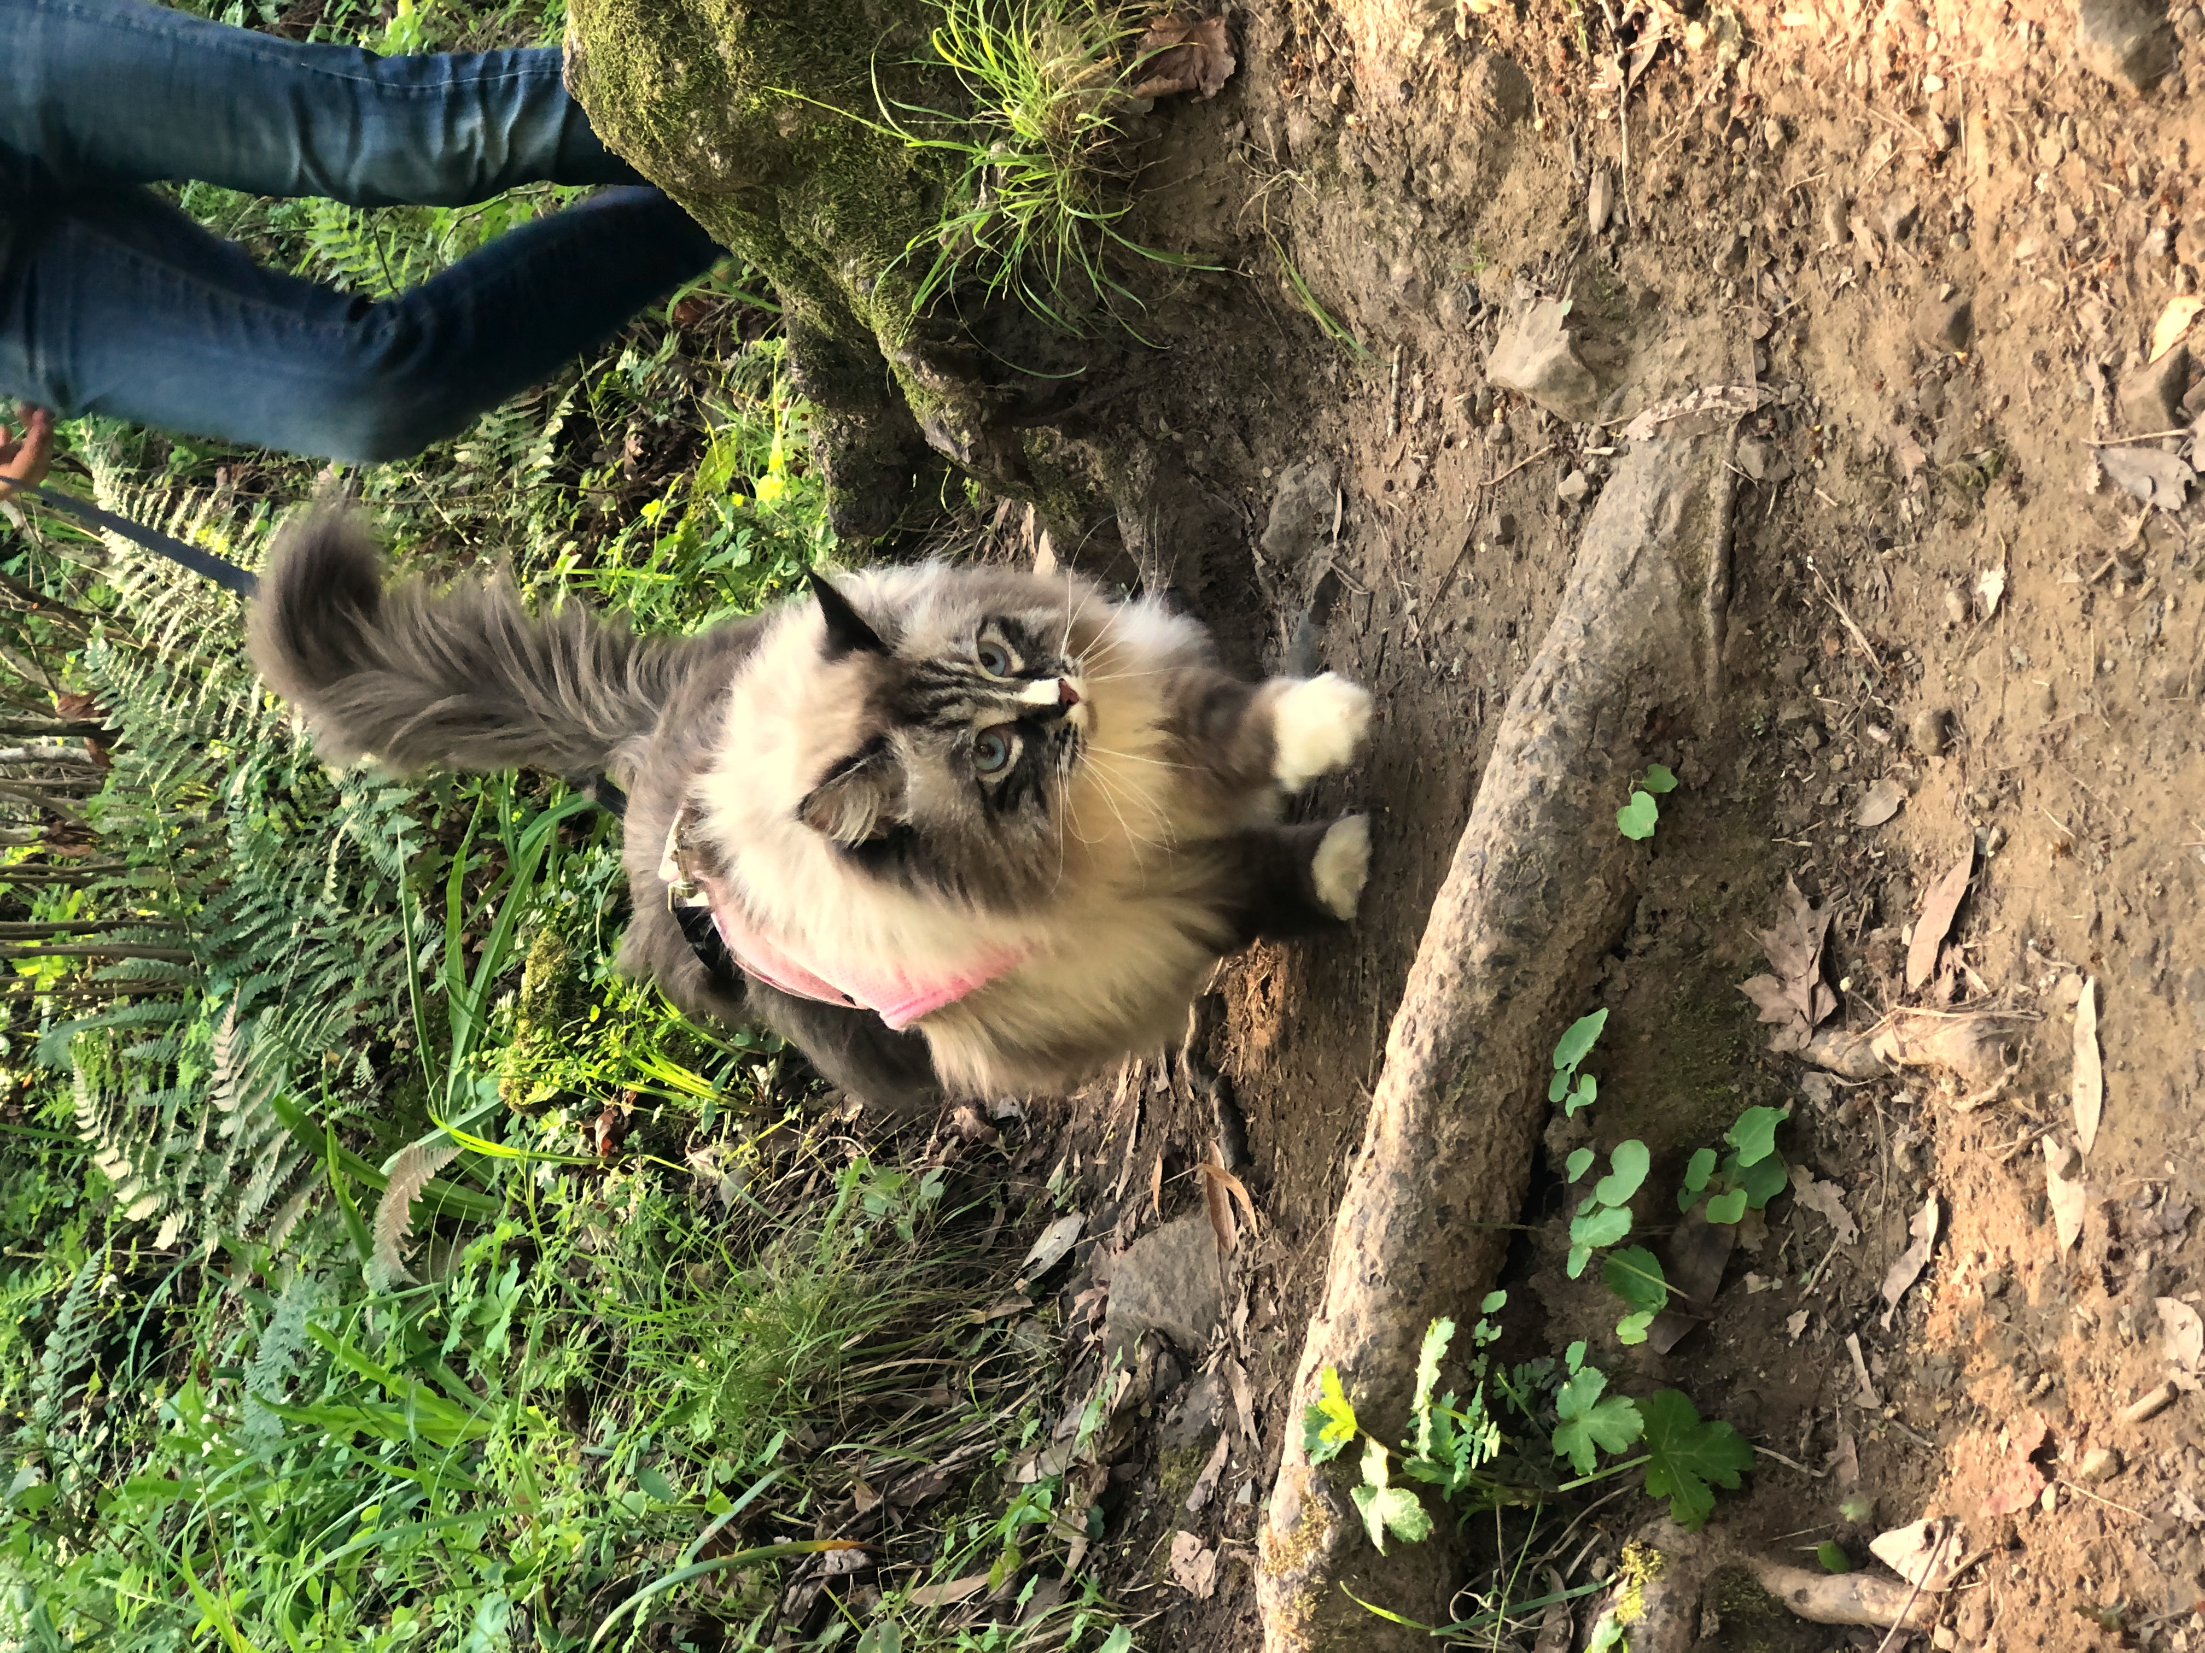
Sometimes labels need to be transformed too
Original
After flip + color aug
For certain tasks, make sure to transform the output accordingly!!
Right eye
Left eye
Defined wrt to the cat

Slide 23
Sometimes labels need to be transformed too
Original
After flip + color aug
For certain tasks, make sure to transform the output accordingly!!
Right eye
Left eye
Defined wrt to the cat

Slide 24
Very common bug
Original
After flip + color aug
For certain tasks, make sure to transform the output accordingly!!
Right eye
Left eye
WRONG! Flipped without updating the label!!
Defined wrt to the cat
Notes:
If you do this half of the time left eye is on the right side and vise versa

Slide 25
Very common bug
Original
After flip + color aug
For certain tasks, make sure to transform the output accordingly!!
Right eye
Left eye
Correct
Defined wrt to the cat

Slide 26
“You need a lot of a data if you want to train/use CNNs”

Slide 27
Transfer Learning
“You need a lot of a data if you want to train/use CNNs”
NOT ALWAYS

Slide 28
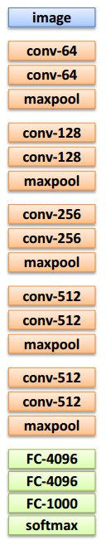
Transfer Learning with CNNs
1. Train on
Imagenet

Slide 29
Transfer Learning with CNNs
1. Train on
Imagenet
2. If small dataset: fix all weights (treat CNN as fixed feature extractor), retrain only the classifier
i.e. swap the Softmax layer at the end

Slide 30
Transfer Learning with CNNs
1. Train on
Imagenet
2. If small dataset: fix all weights (treat CNN as fixed feature extractor), retrain only the classifier
i.e. swap the Softmax layer at the end
3. If you have medium sized dataset, “finetune” instead: use the old weights as initialization, train the full network or only some of the higher layers
retrain bigger portion of the network, or even all of it.

Slide 31
Transfer Learning with CNNs
1. Train on
Imagenet
2. If small dataset: fix all weights (treat CNN as fixed feature extractor), retrain only the classifier
i.e. swap the Softmax layer at the end
3. If you have medium sized dataset, “finetune” instead: use the old weights as initialization, train the full network or only some of the higher layers
retrain bigger portion of the network, or even all of it.
tip: use only ~1/10th of the original learning rate in finetuning to player, and ~1/100th on intermediate layers

Slide 32
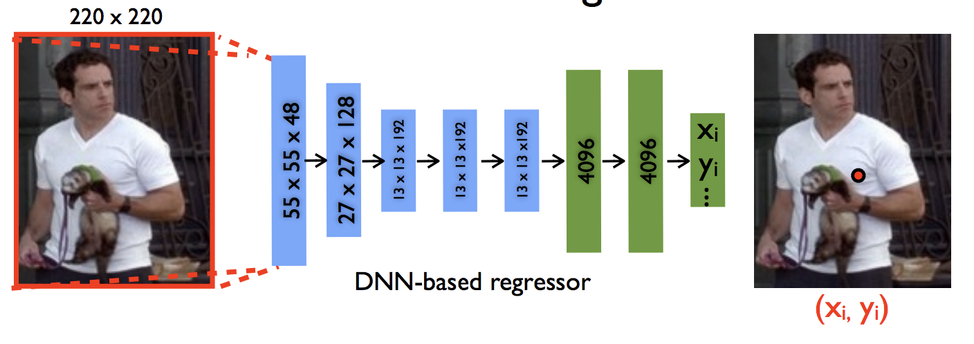
Project 5 starting point (default)
DeepPose: Human Pose Estimation via Deep Neural Networks
[Toshev and Szegedy 2014]

Slide 33
Regression Objective
2
x'₁
x₁
y'₁
y₁
CNN
-
…
…
x'_{n}
x_{n}
y'_{n}
y_{n}
This is what you should do before bells & whistles.
But this is not what the SoTA models do in practice

Slide 34
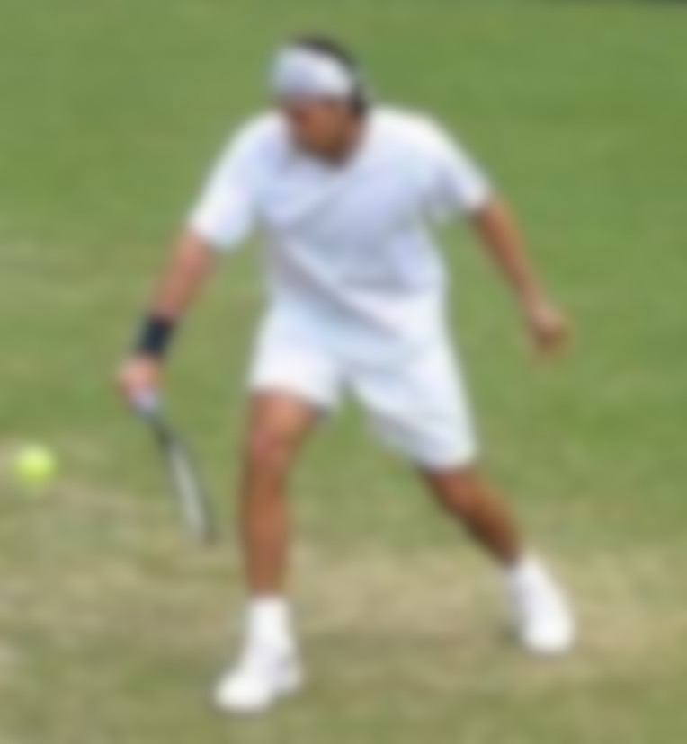
Downsides of regression objective
Locally a lot of things look similar!!
With regression objective you have to commit to ONE location and only get one training signal on how correct that location was.

Slide 35
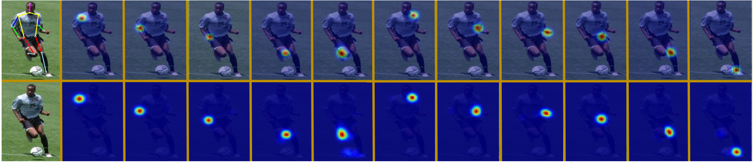
Belief/Confidence map formulation
[Thompson et al. NeurIPS 2014, CVPR 2015, Convolutional Pose Machine, Wei et al. CVPR 2016,
(figure credit: Ning et al TMM 2017)…]
For K keypoints, train model to predict K many sheets (h x w) of scores of how likely the pixel is k-th keypoint
Notes:
11 parts here

Slide 36
Problem
So far, we’ve only seen examples that output a vector representation out of an image.
How do we do dense (per-pixel) predictions?

Slide 37
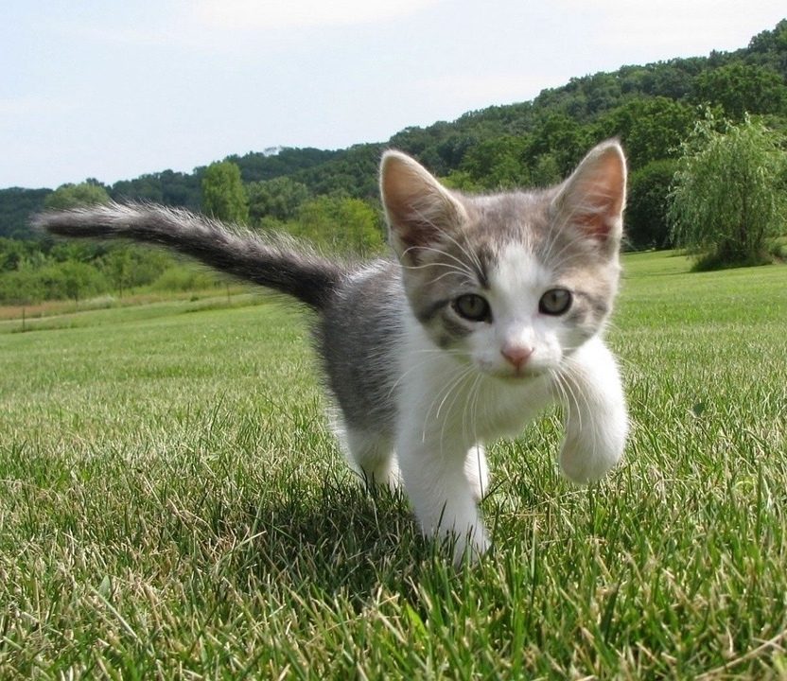
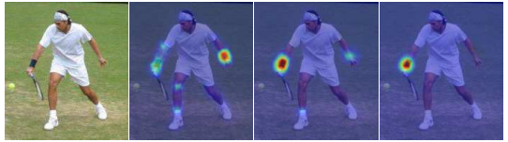
Dense Prediction
Image Synthesis!
(next lecture)
Needed for many things:
Semantic Segmentation
Keypoint detection
GRASS, CAT, TREE, SKY
Does this pixel contain right wrist?

Slide 38
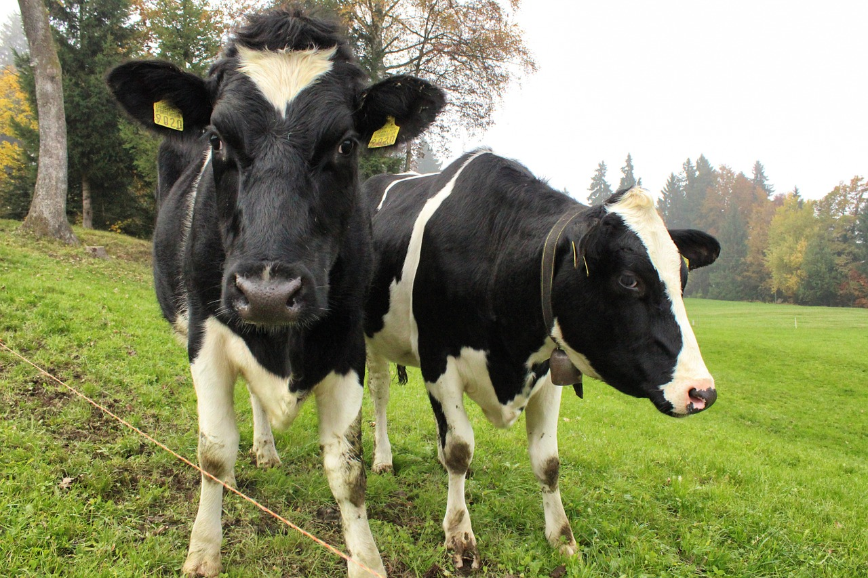
Idea 1: Dense prediction by Sliding Window
Extract patch
Classify center pixel with CNN
Full image
Cow
Cow
Grass
What is the Problem?
Very inefficient! Not reusing shared features between overlapping patches
Farabet et al, “Learning Hierarchical Features for Scene Labeling,” TPAMI 2013
Pinheiro and Collobert, “Recurrent Convolutional Neural Networks for Scene Labeling”, ICML 2014

Slide 39
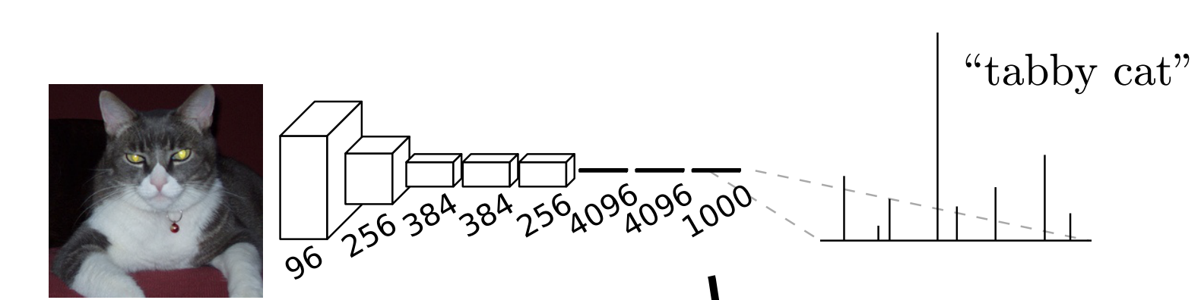
Instead, make the whole network convolutional!
Think of the last few fully connected network as a convolutions with kernels (receptive field) that cover the entire image
➔ can turn it into 1x1 convs

Slide 40
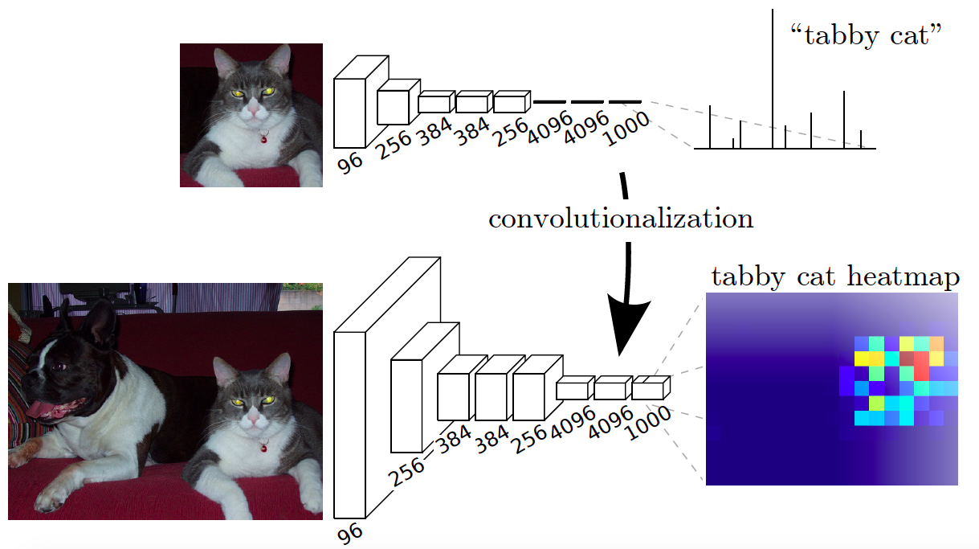
Fully convolutional networks
Design a network with only convolutional layers, make predictions for all pixels at once
Convert all FC into 1x1 convolutions
J. Long, E. Shelhamer, and T. Darrell, Fully Convolutional Networks for Semantic Segmentation, CVPR 2015
Slide courtesy of Lana Lezebnik
Notes:
Convert all fc into 1x1 convolution

Slide 41
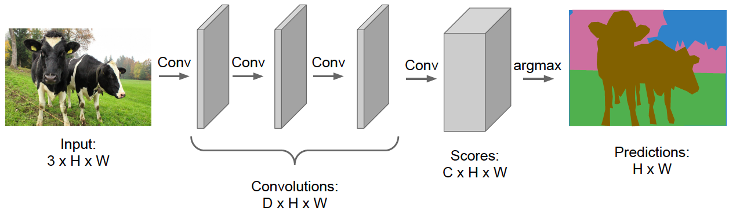
Fully convolutional networks
Design a network with only convolutional layers, make predictions for all pixels at once
Ideally, we want convolutions at full image resolution, but implementing that naively is too expensive
Slide courtesy of Lana Lezebnik
Source: Stanford CS231n

Slide 42
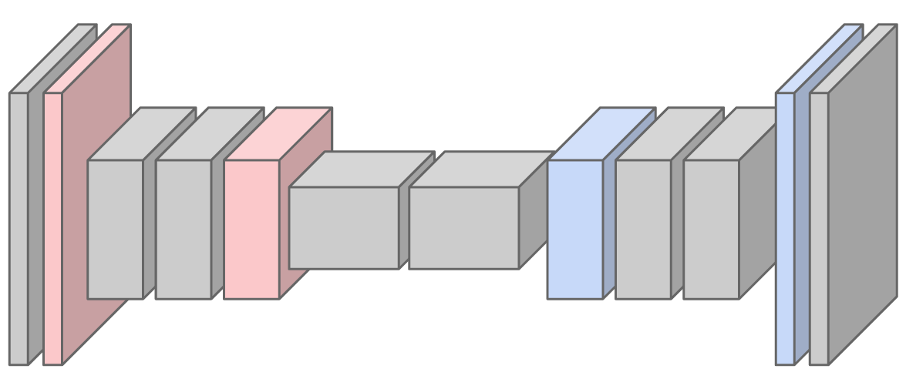
Fully convolutional networks
Design a network with only convolutional layers, make predictions for all pixels at once
Ideally, we want convolutions at full image resolution, but implementing that naively is too expensive
  Solution: first downsample, then upsample
Slide courtesy of Lana Lezebnik
Source: Stanford CS231n

Slide 43
How to upsample with convnets?

Slide 44
There are a few ways
I will begin by the first thing people tried
Then a much simpler, natural solution that’s more used in practice

Slide 45
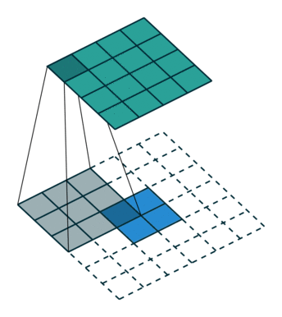
Upsampling in a deep network
Transposed or backwards-strided convolution: “paint” in the output feature map with the learned filter
  Multiply input value by filter, place result in the output, sum overlapping value
Animation: https://github.com/vdumoulin/conv_arithmetic

Slide 46
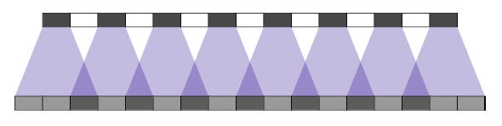




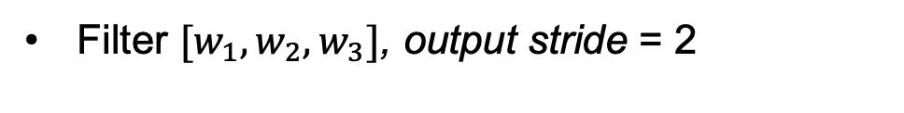





Upsampling in a deep network
Filter ${[w_{1},w}_{2},w_{3}]$, output stride = 2
$$x_{1}$$
$$x_{2}$$
$$x_{3}$$
$$x_{4}$$
$$x_{5}$$
$$x_{6}$$
$$x_{7}$$
$$x_{8}$$
input
stride 2
output
$${w_{1}x}_{1}$$
Animation: https://distill.pub/2016/deconv-checkerboard/
Slide courtesy of Lana Lezebnik

Slide 47

Upsampling in a deep network
Filter ${[w_{1},w}_{2},w_{3}]$, output stride = 2
$$x_{1}$$
$$x_{2}$$
$$x_{3}$$
$$x_{4}$$
$$x_{5}$$
$$x_{6}$$
$$x_{7}$$
$$x_{8}$$
input
stride 2
output
$${w_{2}x}_{1}$$
Animation: https://distill.pub/2016/deconv-checkerboard/
Slide courtesy of Lana Lezebnik

Slide 48

Upsampling in a deep network
Filter ${[w_{1},w}_{2},w_{3}]$, output stride = 2
$$x_{1}$$
$$x_{2}$$
$$x_{3}$$
$$x_{4}$$
$$x_{5}$$
$$x_{6}$$
$$x_{7}$$
$$x_{8}$$
input
stride 2
output
$${w_{3}x}_{1}+{w_{1}x}_{2}$$
Animation: https://distill.pub/2016/deconv-checkerboard/
Slide courtesy of Lana Lezebnik

Slide 49

Upsampling in a deep network
Filter ${[w_{1},w}_{2},w_{3}]$, output stride = 2
$$x_{1}$$
$$x_{2}$$
$$x_{3}$$
$$x_{4}$$
$$x_{5}$$
$$x_{6}$$
$$x_{7}$$
$$x_{8}$$
input
stride 2
output
$${w_{2}x}_{2}$$
Animation: https://distill.pub/2016/deconv-checkerboard/
Slide courtesy of Lana Lezebnik

Slide 50

Upsampling in a deep network
Filter ${[w_{1},w}_{2},w_{3}]$, output stride = 2
$$x_{1}$$
$$x_{2}$$
$$x_{3}$$
$$x_{4}$$
$$x_{5}$$
$$x_{6}$$
$$x_{7}$$
$$x_{8}$$
input
stride 2
output
$${w_{3}x}_{2}+{w_{1}x}_{3}$$
Animation: https://distill.pub/2016/deconv-checkerboard/
Slide courtesy of Lana Lezebnik

Slide 51
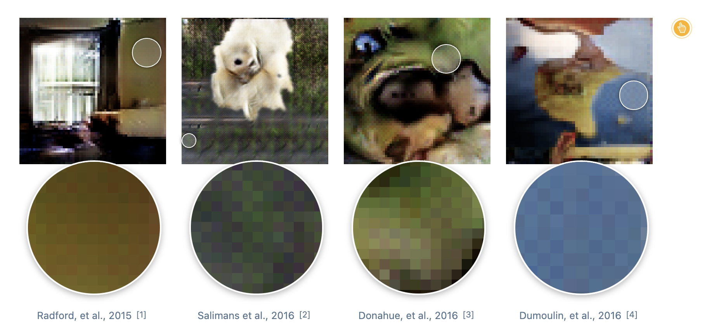
But this is generates checkerboard like artifacts!
Because of overlap.
You can try to prevent overlap (play around with the distill page), but it gets complicated with multiple layers

Slide 52
Simpler, effective solution
(often used in practice)
Upsample, followed by a regular Convolution
Any differentiable upsampling
Conv Layer
Input:
B x C_{in} x H x W
After upsample, factor 2:
B x C_{in} x 2H x 2W
After conv:
B x C_{out} x 2H x 2W

Slide 53
How to Upsample
Bed of Nails
Nearest Neighbor
Bilinear Interpolation
1
0
2
0
1
1
2
2
1.00
1.25
1.75
2.00
1
2
0
0
0
0
1
2
1
1
2
2
1
2
1.50
1.75
2.25
2.50
3
4
3
0
4
0
3
4
3
3
4
4
3
4
2.50
2.75
3.25
3.50
0
0
0
0
3
3
4
4
3.00
3.25
3.75
4.00
Input
C x 2 x 2
Output
C x 4 x 4
Input
C x 2 x 2
Output
C x 4 x 4
Input
C x 2 x 2
Output
C x 4 x 4

Slide 54
Recall from Morphing Lecture: Inverse warping
T⁻¹(x,y)
y
y’
x
x
x’
f(x,y)
g(x’,y’)
Get each pixel g(x’,y’) from its corresponding location
(x,y) = T⁻¹(x’,y’) in the first image
Q: what if pixel comes from “between” two pixels?
A: Interpolate color value from neighbors
  nearest neighbor, bilinear, Gaussian, bicubic
  Check out interp2 in Matlab / Python

Slide 55
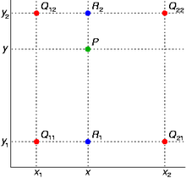
Recall: Bilinear Interpolation
http://en.wikipedia.org/wiki/Bilinear_interpolation
Help interp2

Slide 56
Fully Convolutional Network
Rule of thumb: every upsample is a factor of 2
Design network as a bunch of convolutional layers, with downsampling and upsampling inside the network!
Med-res:
D₂ x H/4 x W/4
Med-res:
D₂ x H/4 x W/4
Input:
3 x H x W
Low-res:
D₃ x H/4 x W/4
High-res:
D₁ x H/2 x W/2
High-res:
D₁ x H/2 x W/2
Predictions:
H x W
Downsampling:
Pooling, strided convolution
Upsampling:
Various choices
Long, Shelhamer, and Darrell, “Fully Convolutional Networks for Semantic Segmentation”, CVPR 2015
Noh et al, “Learning Deconvolution Network for Semantic Segmentation”, ICCV 2015
Notes:
Once you get to higher res, you do 1x1 predictionsRule of thumb

Slide 57
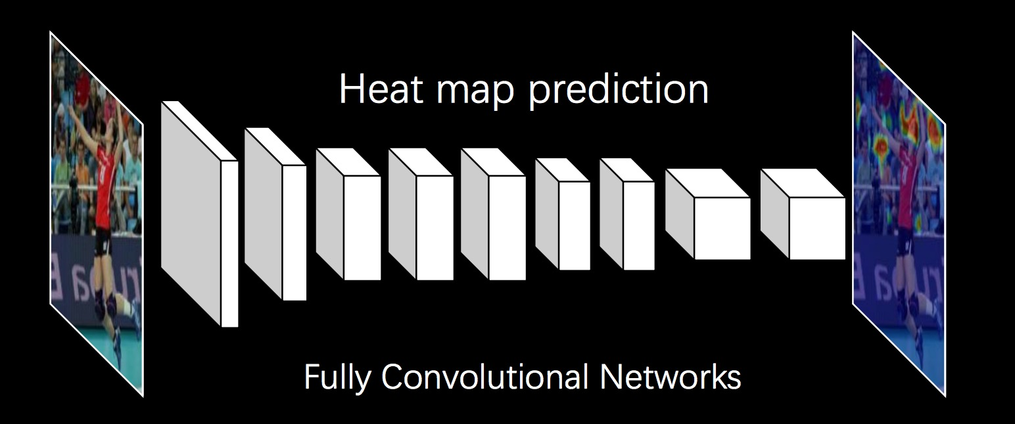
Application to pose detection:
Predict heat maps
Target: K+1 x H x W
Gaussian around (x,y) for k-th keypoint in the k-th channel
K+1 for K parts + background
Notes:
What other problems?

Slide 58
Training Loss
L2 loss on the target heatmap (peaky gaussian around the gt keypoint)
Target “belief map” : K+1 x H x W
Gaussian around (x,y) for k-th keypoint in the k-th channel
- Mask RCNN applies softmax across a heatmap and trains with cross-entropy
Notes:
Often includes background K+1

Slide 59
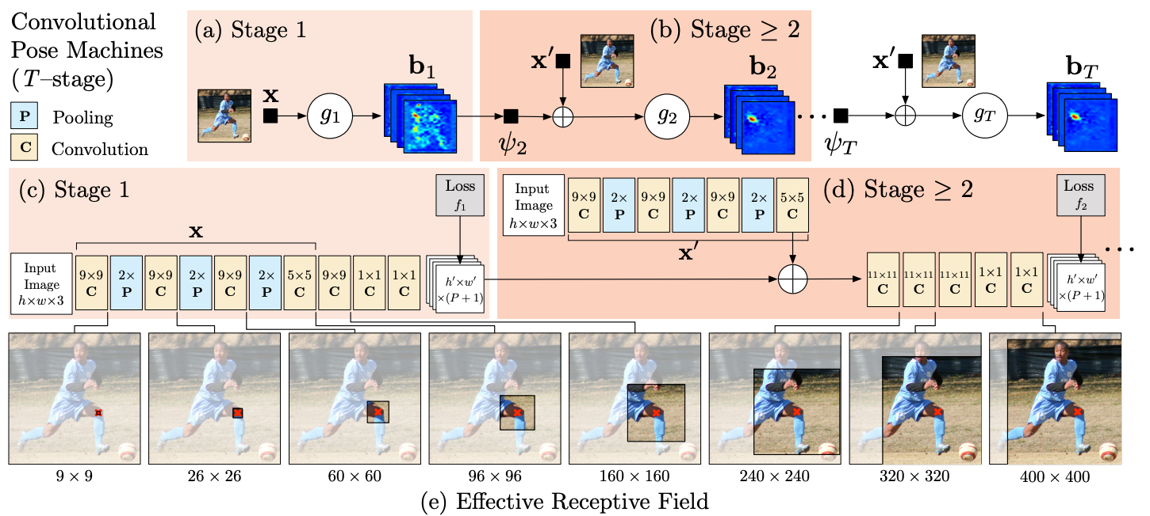
Convolutional Pose Machines
[Wei et al CVPR 2016]
Base architecture for OpenPose
Notes:
In practice this is ran over multiple scales.
Input is 368x368, accuracy increases as receptive field size improves
Openpose is about grouping keypoint predictions of multiple people)
Learn long-range dependency between parts through context + larger receptive field

Slide 60
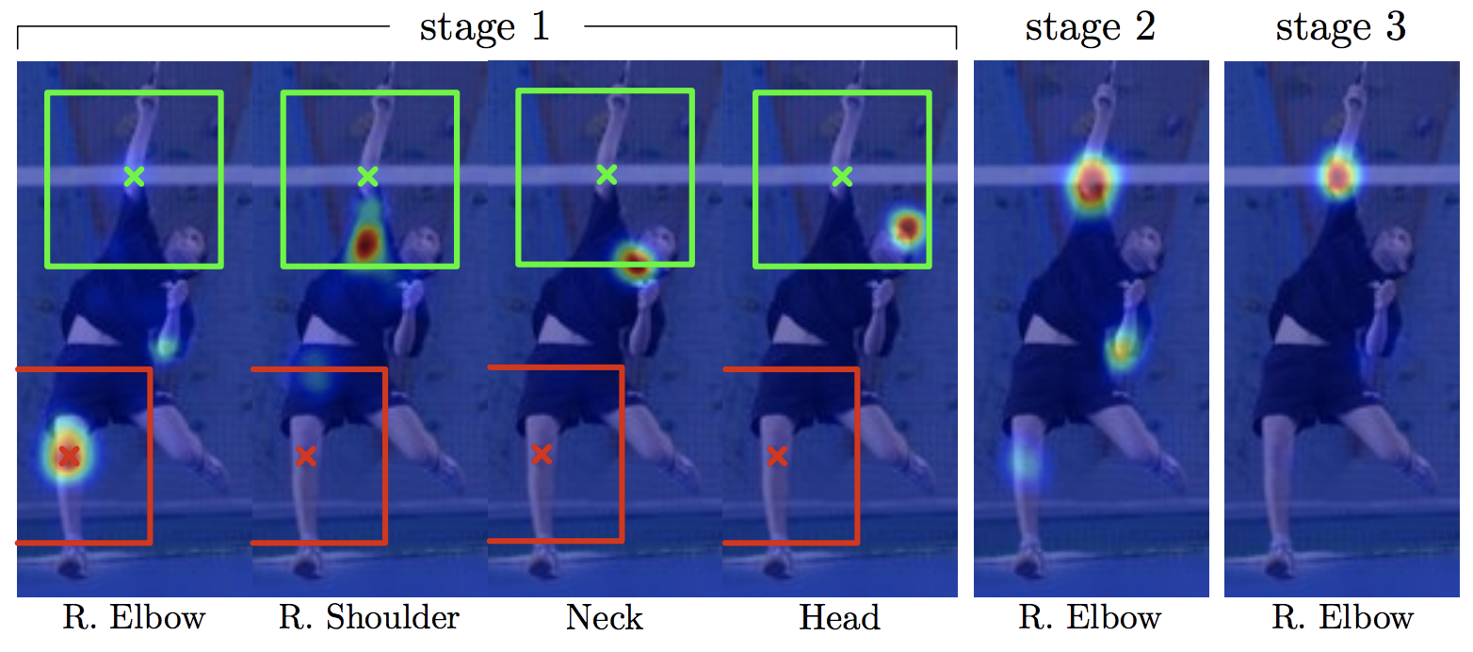
Convolutional Pose Machines
[Wei et al CVPR 2016]

Slide 61
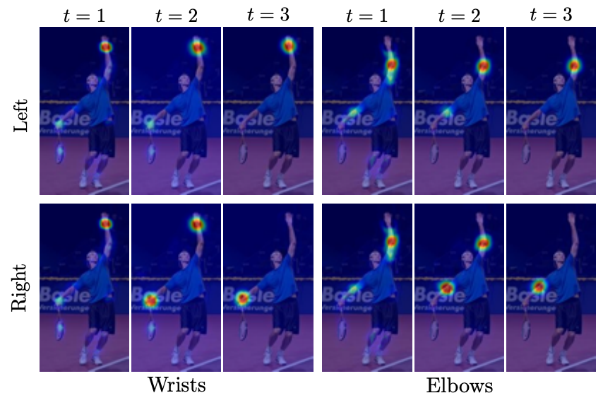
Convolutional Pose Machines
[Wei et al CVPR 2016]

Slide 62
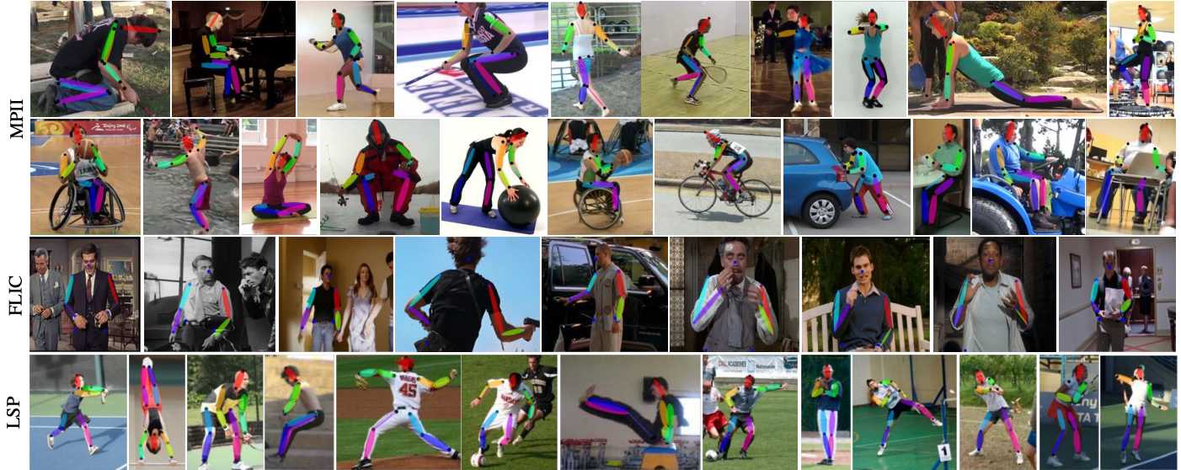
Results

Slide 63
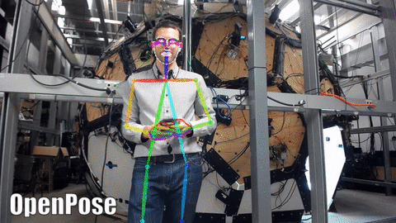
OpenPose
Great opensource tool, builds on convolutional pose machine architecture, adapted to multiple people
Zhe Cao, Gines Hidalgo, Tomas Simon, Shih-En Wei, Yaser Sheikh ‘16-17

Slide 64
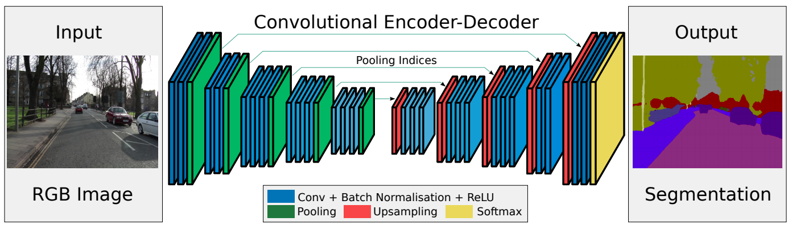
Examples for segmentation: SegNet
Drop the FC layers,
get better results
V. Badrinarayanan, A. Kendall and R. Cipolla, SegNet: A Deep Convolutional Encoder-Decoder Architecture for Image Segmentation, PAMI 2017

Slide 65
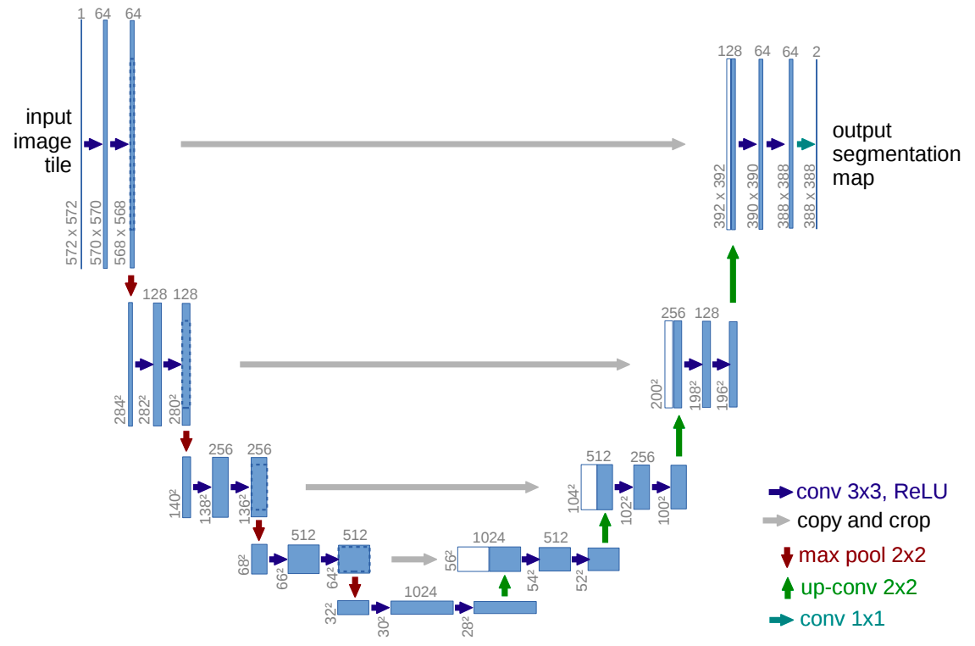
Other upsampling networks: U-Net
Like FCN, fuse upsampled higher-level feature maps with higher-res, lower-level feature maps
Unlike FCN, fuse by concatenation, predict at the end
O. Ronneberger, P. Fischer, T. Brox U-Net: Convolutional Networks for Biomedical Image Segmentation, MICCAI 2015
Slide courtesy of Lana Lezebnik

Slide 66
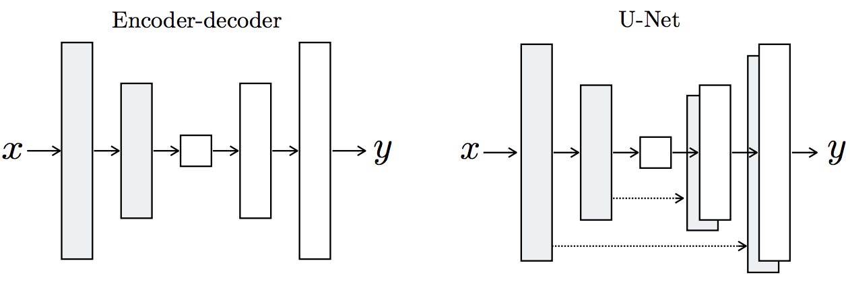
Summary of upsampling architectures
Slide courtesy of Lana Lezebnik
Figure source

Slide 67
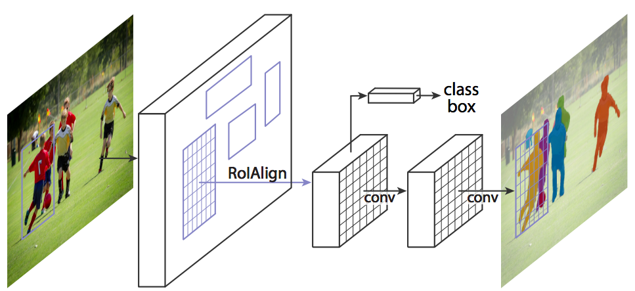
Mask R-CNN
Mask R-CNN = Faster R-CNN + FCN on RoIs
Classification+regression branch
Mask branch: separately predict segmentation for each possible class
K. He, G. Gkioxari, P. Dollar, and R. Girshick, Mask R-CNN,
ICCV 2017 (Best Paper Award)

Slide 68
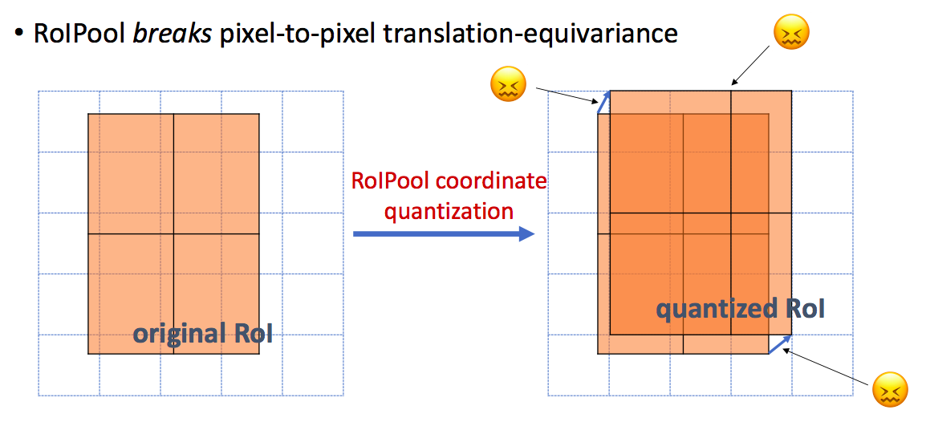
RoIAlign vs. RoIPool
RoIPool: nearest neighbor quantization
K. He, G. Gkioxari, P. Dollar, and R. Girshick, Mask R-CNN,
ICCV 2017 (Best Paper Award)

Slide 69
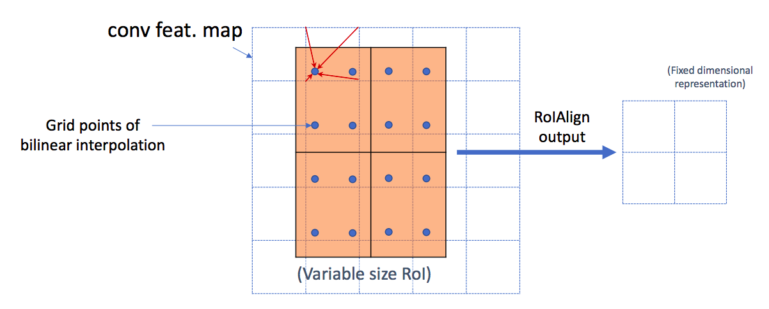
RoIAlign vs. RoIPool
RoIPool: nearest neighbor quantization
RoIAlign: bilinear interpolation
K. He, G. Gkioxari, P. Dollar, and R. Girshick, Mask R-CNN,
ICCV 2017 (Best Paper Award)

Slide 70
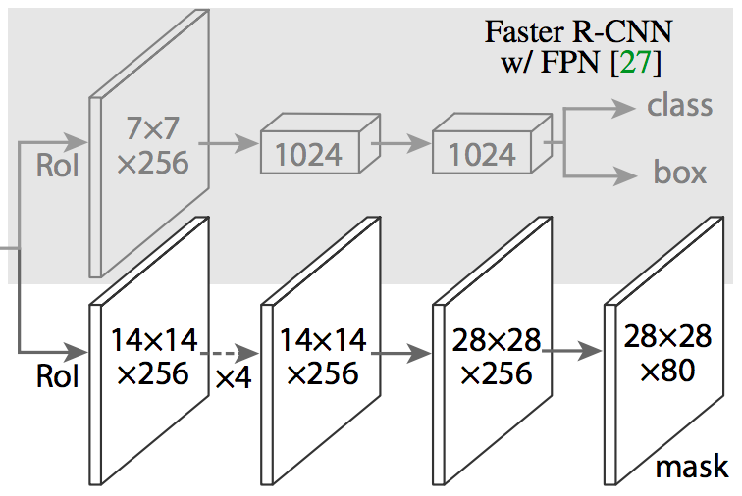
Mask R-CNN
From RoIAlign features, predict class label, bounding box, and segmentation mask
Feature Pyramid Networks (FPN) architecture
K. He, G. Gkioxari, P. Dollar, and R. Girshick, Mask R-CNN,
ICCV 2017 (Best Paper Award)

Slide 71
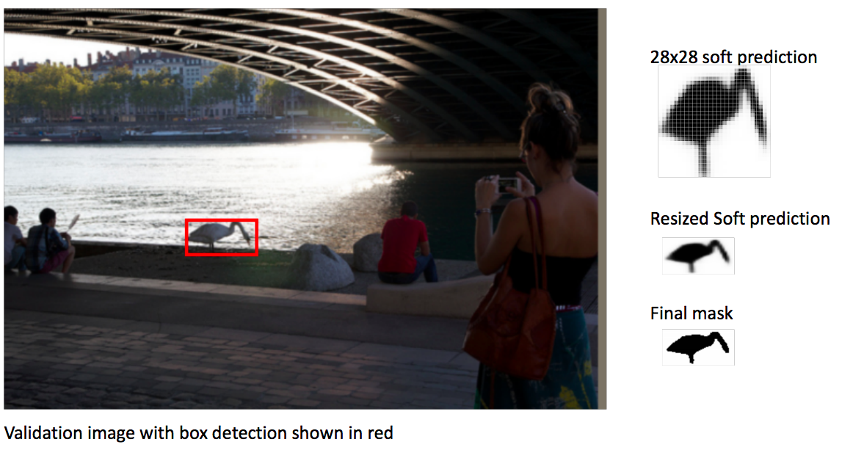
Mask R-CNN
K. He, G. Gkioxari, P. Dollar, and R. Girshick, Mask R-CNN,
ICCV 2017 (Best Paper Award)

Slide 72
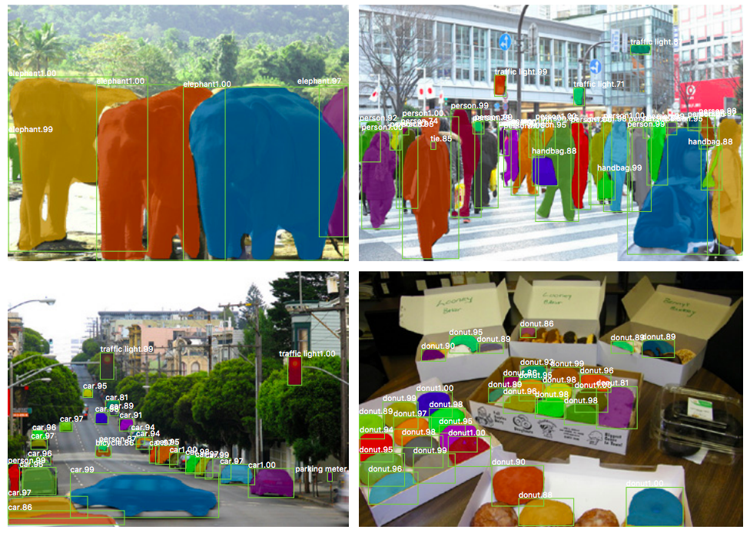
Example results

Slide 73
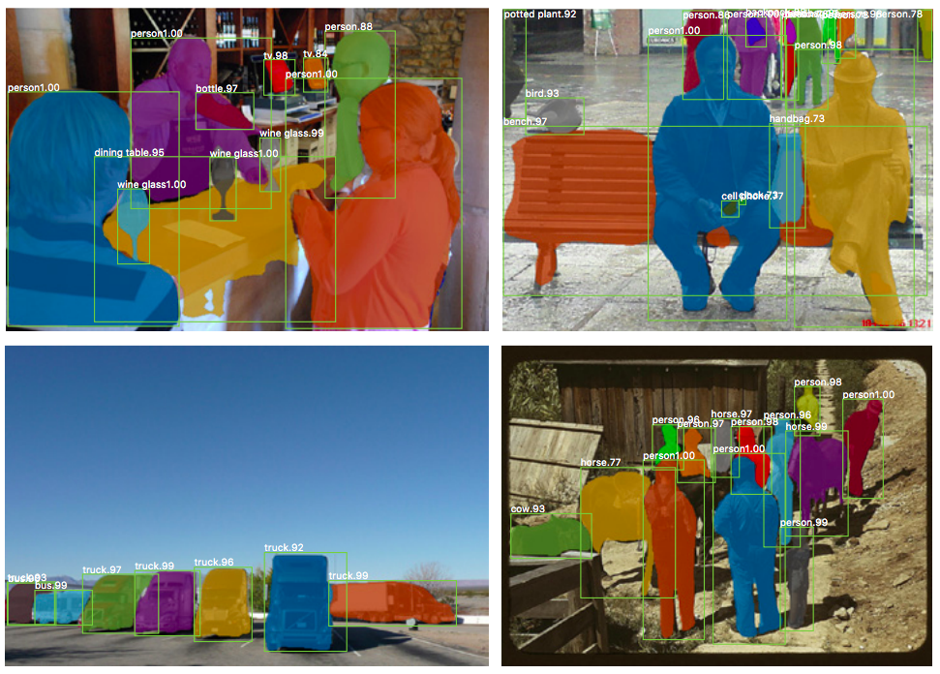
Example results

Slide 74
Other dense prediction tasks
Depth estimation
Surface normal estimation
Colorization
Image synthesis (next week)
….

Slide 75
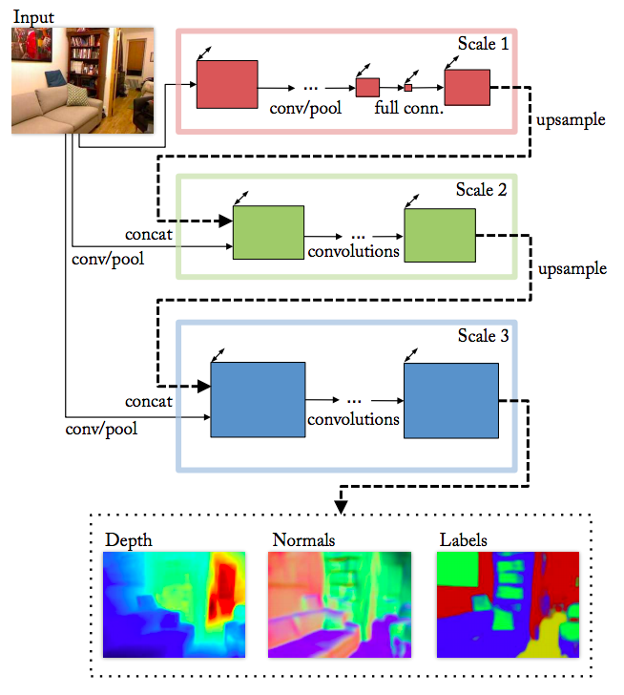

Depth and normal estimation
Predicted depth
Ground truth
D. Eigen and R. Fergus, Predicting Depth, Surface Normals and Semantic Labels with a Common Multi-Scale Convolutional Architecture, ICCV 2015
Slide courtesy of Lana Lezebnik

Slide 76

Depth and normal estimation
Predicted normals
Ground truth
D. Eigen and R. Fergus, Predicting Depth, Surface Normals and Semantic Labels with a Common Multi-Scale Convolutional Architecture, ICCV 2015
Slide courtesy of Lana Lezebnik

Slide 77

Latest: Midas, DPT
Great tool for final project!
Towards Robust Monocular Depth Estimation: Mixing Datasets for Zero-shot Cross-dataset Transfer
René Ranftl, Katrin Lasinger, David Hafner, Konrad Schindler, Vladlen Koltun, PAMI 2020

Slide 78

Colorization (self-supervised learning)

