Slide 1
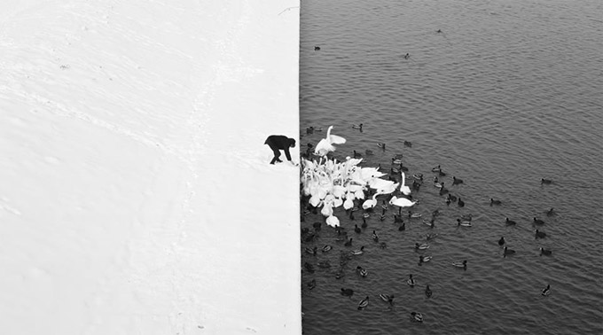
Edge Detection
Winter in Kraków photographed by Marcin Ryczek
CS194: Image Manipulation, Comp. Vision, and Comp. Photo
Alexei Efros, UC Berkeley, Spring 2020

Slide 2

Edge detection
Goal: Identify sudden changes (discontinuities) in an image
  Intuitively, most semantic and shape information from the image can be encoded in the edges
  More compact than pixels
Ideal: artist’s line drawing (but artist is also using object-level knowledge)
Source: D. Lowe

Slide 3

Origin of edges
Edges are caused by a variety of factors:
surface normal discontinuity
depth discontinuity
surface color discontinuity
illumination discontinuity
Source: Steve Seitz

Slide 4
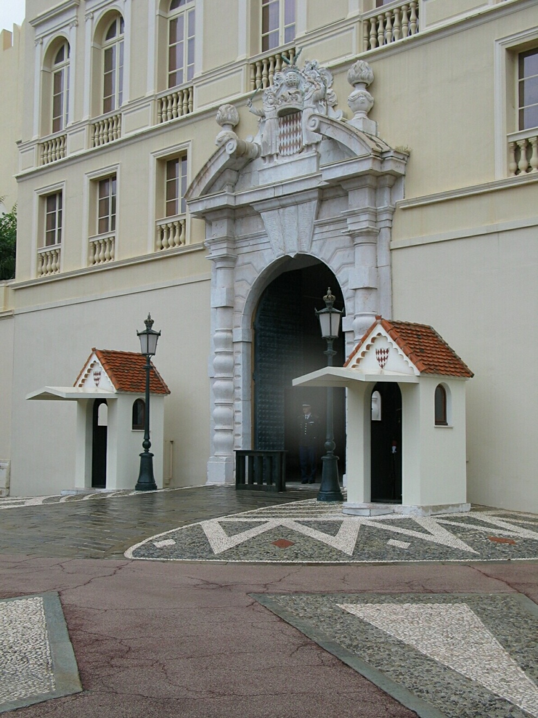
Closeup of edges

Slide 5
Closeup of edges

Slide 6
Closeup of edges

Slide 7
Closeup of edges

Slide 8

Characterizing edges
An edge is a place of rapid change in the image intensity function
intensity function
(along horizontal scanline)
image
first derivative
edges correspond to
extrema of derivative

Slide 9


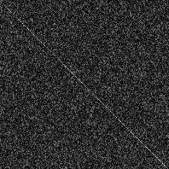

There is ALWAYS a tradeoff between smoothing and
good edge localization!
Image with Edge
Edge Location
Image + Noise
Derivatives detect edge and noise
Smoothed derivative removes noise, but blurs edge

Slide 10

The Canny edge detector
norm of the gradient

Slide 11

The Canny edge detector
thresholding

Slide 12

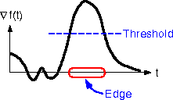
The Canny edge detector
How to turn these thick regions of the gradient into curves?
thresholding

Slide 13

Non-maximum suppression
Check if pixel is local maximum along gradient direction, select single max across width of the edge

Slide 14

Non-Local Maxima Suppression
1.0
Gradient magnitude at center pixel
is lower than the gradient magnitude
of a neighbor in the direction of the gradient
→ Discard center pixel (set magnitude to 0)
1.5
2
2
Gradient magnitude at center pixel
is greater than gradient magnitude
of all the neighbors in the direction
of the gradient
→ Keep center pixel unchanged
4.1
2.5

Slide 15
Non-maximum suppression
  requires checking interpolated pixels p and r

Slide 16
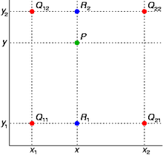
Bilinear Interpolation
http://en.wikipedia.org/wiki/Bilinear_interpolation
Help interp2

Slide 17

The Canny edge detector
Problem: pixels along this edge didn’t survive the thresholding
thinning
(non-maximum suppression)

Slide 18
Hysteresis thresholding
Use a high threshold to start edge curves, and a low threshold to continue them.
Source: Steve Seitz

Slide 19
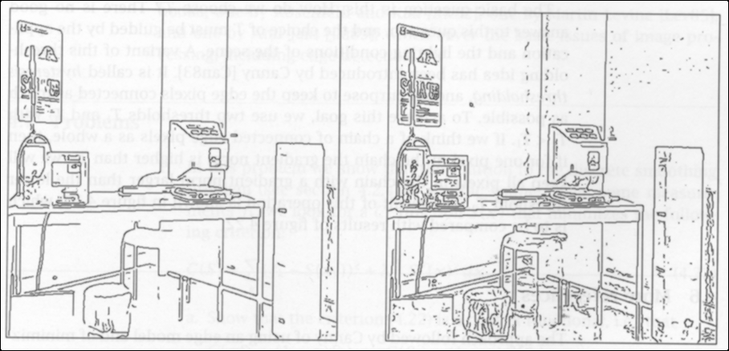
T = 15
T = 5
Two thresholds applied to gradient magnitude

Slide 20
Hysteresis Thresholding
Weak pixels but connected
Weak pixels but isolated
Very strong edge response.
Let’s start here
Weaker response but it is
connected to a confirmed
edge point. Let’s keep it.
Continue….
Note: Darker squares illustrate stronger edge response (larger M)

Slide 21
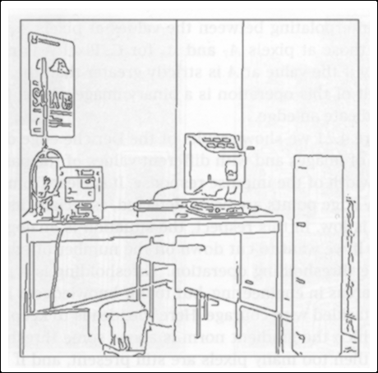
T=15
T=5
Hysteresis
T_{h}=15 T_{l} = 5
Hysteresis
thresholding

Slide 22
Recap: Canny edge detector
Filter image with derivative of Gaussian
Find magnitude and orientation of gradient
Non-maximum suppression:
  Thin wide “ridges” down to single pixel width
Linking and thresholding (hysteresis):
  Define two thresholds: low and high
  Use the high threshold to start edge curves and the low threshold to continue them
MATLAB: edge(image, ‘canny’);
J. Canny, A Computational Approach To Edge Detection, IEEE Trans. Pattern Analysis and Machine Intelligence, 8:679-714, 1986.

Slide 23






Edge detection is just the beginning…
image
human segmentation
gradient magnitude
Berkeley segmentation database:
http://www.eecs.berkeley.edu/Research/Projects/CS/vision/grouping/segbench/

Slide 24

two-tone images

Slide 25


Slide 26


Slide 27
“attached shadow” contour
hair (not shadow!)
“cast shadow” contour
inferred external contours

Slide 28


Slide 29


Slide 30


