Slide 1
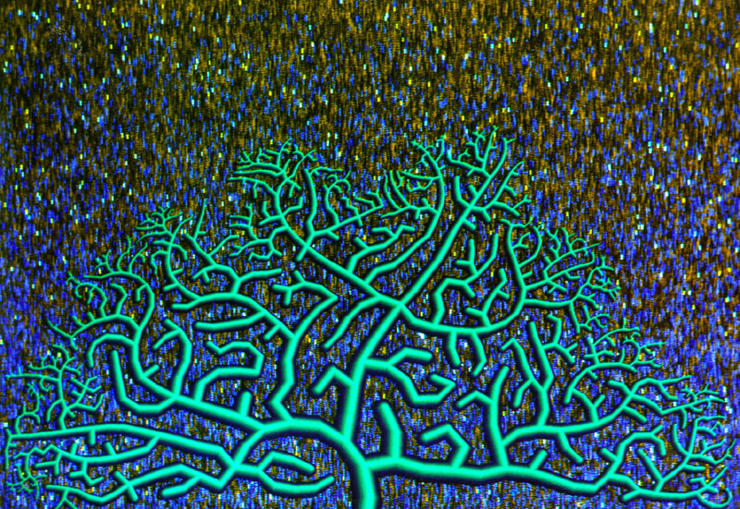
CNM 190 Advanced Digital Animation Lec 08 : Procedural Modeling Basics
Jeff Ventrella, www.ventrella.com
Dan Garcia, EECS (co-instructor)
Jeremy Huddleston, EECS (co-instructor)

Slide 2
Overview
Dan on Procedural Modeling Basics
Great references
A note before starting
What IS it?
Why would you use it?
What are its varied flavors?
Control vs Chaos
Randomness, Perlin Noise
Fractals & L-systems
Genetic algorithms
How do we do it?
Conclusion

Slide 3
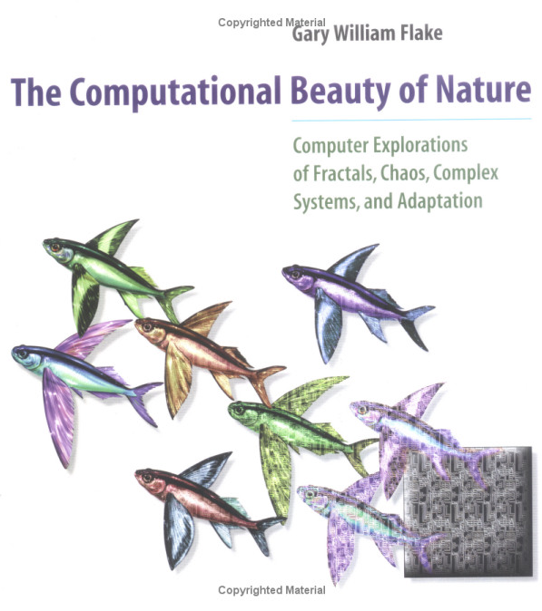
Great references
“Texturing & Modeling : A procedural approach” (2/e)
David S. Ebert, F. Kenton Musgrave, Darwyn Peachey Ken Perlin & Steven Worley
Morgan Kaufman, 1998
“The Computational Beauty of Nature”
Gary William Flake
MIT Press, 2000

Slide 4
A note before starting
This is a mixed group of programmers and non-programmers
I’m aiming this presentation at the non-programmers for whom much of this might be new, to bring us all up to the same level of discourse (roughly)
I ask patience of the programmers, however, hopefully there is new information for all students

Slide 5
What IS it?
en.wikipedia.org/wiki/Procedural_modeling
“Procedural modeling is an umbrella term for a number of techniques in computer graphics to create 3D models (and textures) from sets of rules. L-Systems, fractals, and generative modeling are procedural modeling techniques since they apply algorithms for producing scenes. The set of rules may either be embedded into the algorithm, configurable by parameters, or the set of rules is separate from the evaluation engine.” “Although all modeling techniques on a computer require algorithms to manage & store data at some point…” “procedural modeling focuses on creating a model from a rule set, rather than editing the model by mouse.”

Slide 6
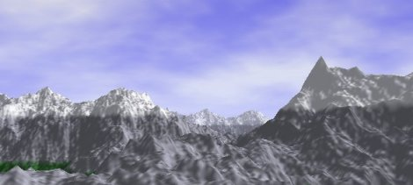
Why would you use it?
en.wikipedia.org/wiki/Procedural_modeling
“Procedural Modeling is applied when it would be too cumbersome (or impossible!) to create a model using general 3D modelers, or when more specialized tools are required. This is the case for plants & landscapes.”
Paul Martz, martz@frii.com
garden of the metal

Slide 7
What are its varied flavors?
Algorithm- or Data-driven geometry
…and animation (we’ll talk about later)
Fractals
Objects, landscapes, coastlines
Particle Systems
Simulations
Hair, fur, water, clouds, natural phenomena
Genetic Algorithms
More?

Slide 8
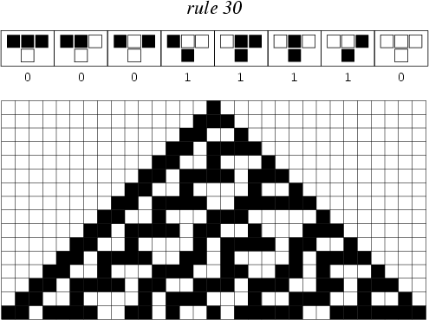
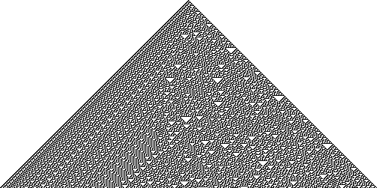
Control vs Chaos
How much do you let randomness control your geometry?
None at all means you’ll always get predictable results
You can constrain randomness
You can either randomize or set the initial seed, which can give repeatable randomness
Or you can give in to chaos, setting initial conditions and letting it run
Sometimes deterministic rules generates chaotic sequence… emergent randomness!
Control
Chaos
Life1D Rule 30

Slide 9
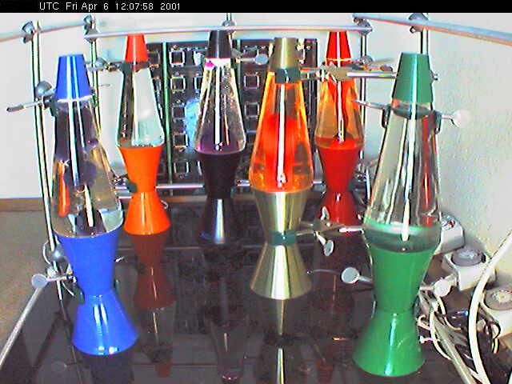
What is (pseudo) randomness?
en.wikipedia.org/wiki/Random_number_generator
Almost every programming language has a built in random() and seed()
They usually return a uniformly-distributed floating point number [0,1). E.g., in Python:
>>> from random import *
>>> random()
0.72936670465656062
That’s pretty good for almost every CG use
For other applications (e.g., crypto), often use “natural randomness” from physical processes.
See www.lavarnd.org
E(x)
x
0
1

Slide 10
What is the seed?
The seed()allows for repeatability!
>>> seed(0) # Arg => initialization
>>> random()
0.84442185152504812
>>> random()
0.75795440294030247
>>> random()
0.420571580830845
>>> seed(0)
>>> random()
0.84442185152504812

Slide 11
What is the seed’s argument?
Seeding allows for multiple repeatable paths!
>>> seed(0)
>>> random()
0.84442185152504812
>>> seed(1)
>>> random()
0.13436424411240122
>>> seed(0)
>>> random()
0.84442185152504812
>>> seed(1)
>>> random()
0.13436424411240122

Slide 12
How do we constrain it?
Scale the random variables down so its effect isn’t felt much, and range changes
>>> r = random() # [0, 1)
>>> h = avg + 2*r*c - c # height
What does the distribution of h look like?
If we want our noise to vary between -1 and 1, as we often do, how would we do that?
E(x)
x
avg-c
avg
avg+c

Slide 13
Another way to use random
osr2.berkeley.edu/Public/STUDENT.DATA/PUBLICATIONS/UG/ugsp06.html
What if we want a characters distribution to resemble demographics of Cal ugrads?
54%
46%
How can we use random()?

Slide 14
Simple, slice up [0,1)!
Just use range = to that of distribution!
>>> g = random() # [0, 1) gender
>>> e = random() # [0, 1) ethnic
And then use if … else from data!
>>> if g < .46: # 46% male
... MakeCharacter(male)
... else:
... MakeCharacter(female)
…and similarly for ethnicity, height, etc

Slide 15
Perlin Noise Background
mrl.nyu.edu/~perlin/doc/oscar.html
Ken Perlin, NYU Prof
In 1983 he “invented” the idea of CG noise
In 1985 he wrote the seminal SIGGRAPH paper (top 10 most influential in CG!)
In 1986 it started being adopted by all!
In 1997 he received an Oscar for his work

Slide 16
Perlin Noise Basics I
freespace.virgin.net/hugo.elias/models/m_perlin.htm
Idea… start w/noise from random()
Smoothly interpolate
…We have a continuous function of F(t), yay!

Slide 17
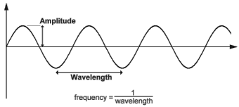
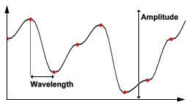
Perlin Noise Basics II
freespace.virgin.net/hugo.elias/models/m_perlin.htm
Amplitude and frequency
…which for a Noise wave
…is controllable via: AMP * F(FREQ * t)

Slide 18
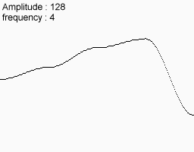
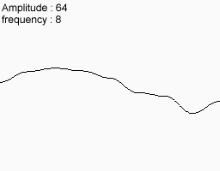
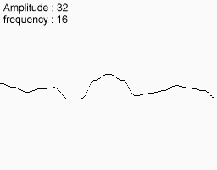
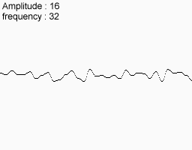
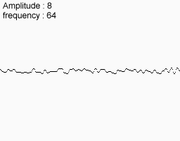
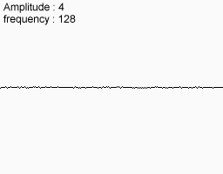
Perlin Noise Basics III
freespace.virgin.net/hugo.elias/models/m_perlin.htm
Now, take combinations of these AMP and FREQ octaves and sum them together.
Note that here we double the FREQ and halve the AMP, so the high frequencies affect the result much less than the low
+
+
+
=
+
+
Perlin noise fractal 1D mountain

Slide 19
Perlin Noise Basics IV
freespace.virgin.net/hugo.elias/models/m_perlin.htm
This also works in 2D
…and for 3D, and for 4D!
+
+
+
=
+
+
Perlin noise fractal 2D mountain (or texture!)
genesis

Slide 20
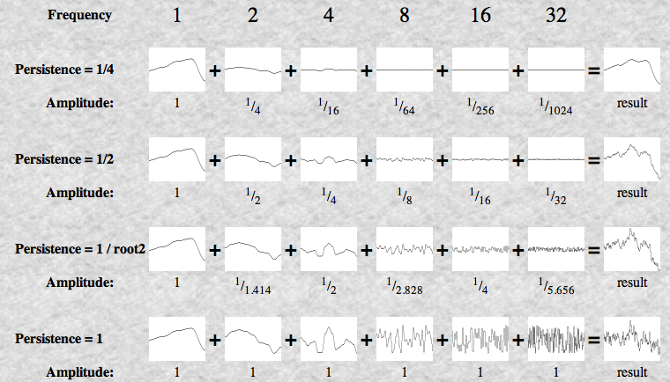
Perlin Noise Basics V
freespace.virgin.net/hugo.elias/models/m_perlin.htm
How should you attenuate the AMP as you’re increasing FREQ? How rocky will your mountain be?
Introduce Persistence
Frequency = 2^{i}
Amplitude = persistence^{i}

Slide 21
Perlin Noise Details
freespace.virgin.net/hugo.elias/models/m_perlin.htm
How many octaves?
Up to you, not more than you can see
How to interpolate?
Linear, cosine, cubic, many spline options
Can smooth noise
Average with neighbors
Center random @ [-1, 1]
You can turn noise up or down and it just “fuzzes out” to zero when the scale is small

Slide 22
Perlin Noise Final Thoughts
www.noisemachine.com/talk1/
Perlin summarizes history and context in an online talk (link shown above)
“Making Noise”, 1999
He thinks of noise like salt
Noise [salt]
is boring
F(blah) [food without salt]
can be boring
F(noise, blah)
can be really tasty
We’ll see this again in CNM190 when we cover procedural textures (I.e., shaders)

Slide 23
Fractal Geometry Overview
A shape recursively constructed, or self-similar. How similar?
Exact
Quasi
Statistical
Fractals are also found in nature, so can be used to model
Clouds, snow flakes, mountains, rivers
Sierpinski pyramids

Slide 24
Fractal Geometry Simplicity
en.wikipedia.org/wiki/Dragon_curve
The beauty of them is also how little code is required to author!
Base case
Draw a straight line and choose an “up”
Recursive case
Break every line in 2, bend them to make a right angle, and set the “left” line up and the “right” line down.
Dragon curve
dragon, dan’s fractals, ucbugg 2d

Slide 25
Fractal Geometry in 3D
en.wikipedia.org/wiki/Menger_sponge
It’s just as simple in 3D
Dan’s Menger cube:
Base case (n=0)
Spit out cube
Recursive case (n)
Scale down the world by a third
I.e., scale (1/3,1/3,1/3)
Move to the rims of the cube, leaving middles empty (20 in total)
I.e., Translate (blah)
Call yourself recursively with the n-1 case
siercube, ucbugg 3d

Slide 26
Lindenmayer system (L-system)
en.wikipedia.org/wiki/L-system
Formal grammar often used to model the growth of plant development
These can also be used to specify / generate fractals
Simply put, it’s a series of rewriting rules that can succinctly describe fractal geometry using turtle graphics
Weeds

Slide 27
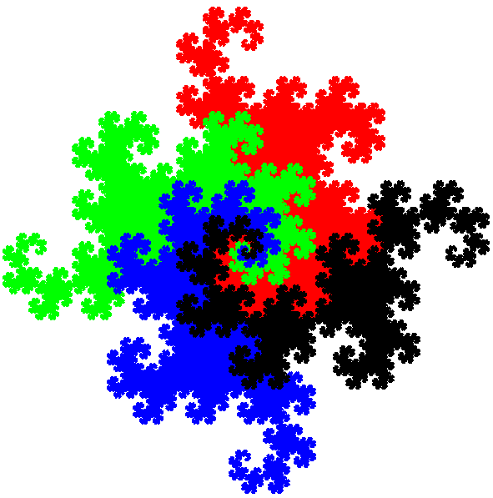
L-system example : C-Curve
en.wikipedia.org/wiki/Dragon_curve
Angle 90 degrees
Initial string FX
F means move forward, in Turtle graphics mode
String rewriting rules
X  X+YF+
Y  -FX-Y
Example
1 : FX  F
2 : FX+YF+  F+F+
3 : FX+YF++-Fx-YF+  F+F+F-F
Dragon curve

Slide 28
Particle systems
en.wikipedia.org/wiki/Particle_systems
Typically used to simulate fuzzy phonomena
Smoke, Explosions, Water, Sparks, Dust, Stars
Emitter controls particle generation, simulation
What is involved with the geometry?
Typically output as textured billboard quad
Or, single pixel
Or, metaball (for gooey materials)
YouTube: Cosmic Voyage (1080p)

Slide 29
Genetic Algorithms
web.genarts.com/karl/
Karl Sims blew away his colleagues with his 1994 seminal work on evolved creatures
evolved virtual creatures

Slide 30
Genetic Algorithms
web.genarts.com/karl/papers/siggraph91.html
Genotype is the genetic information that codes the creation of an individual
Phenotype is the individual
Selection is the process by which fitness of phenotypes is determined
Reproduction is the process by which new genotypes are generated from existing ones
There must be probabilistic mutations with some frequency
panspermia

Slide 31
How do we do it in Renderman?
renderman.pixar.com/products/whatsrenderman/
www.cs.berkeley.edu/~ddgarcia/renderman/
Easy!
Renderman supports a library that you can compile with your C program that will help you output RIB
RIB is the intermediate file that Renderman reads
The result of a render is a tiff file (or multiple tiffs)

Slide 32
How do we do it in Maya?
Easy!
Every action you perform in Maya is available in the Script Editor
You can generate this text explicitly through a program using the techniques we just discussed. E.g., Name it Foo.mel
Or you can use MEL as a programming language (it looks like C) and do all your scripting there!
Open this in Maya (double-click, or use the Script Editor)

Slide 33
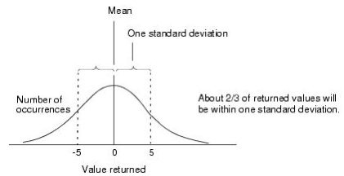
I must program to randomize?
Maya has randomness at many levels
Demo of Maya’s help, specifically “Random Number Functions”
It has most of the functions built-in!
seed()
rand()
gauss()
noise()
gauss(5)

Slide 34
Set Dressing
en.wikipedia.org/wiki/Set_dressing
“The process of selecting, designing, adapting to, or modifying the performance space for a given purpose. This includes the use of stagecraft elements as well as the structure of the stage and its components.”

Slide 35
Set Dressing : Hand vs Procedural
en.wikipedia.org/wiki/Set_dressing
Which elements of the scene below were placed by hand and which were placed procedurally?
In general, when would you author code to place set elements? How much randomness would you allow?

Slide 36
Procedural Tree Set Dressing I
Consider the problem of placing trees in a forest in a natural way
How would you place them so that they don’t overlap?
What are some ideas?

Slide 37
Procedural Tree Set Dressing II
Random Trees
Pick random points and remove if new tree is too close to existing tree
Start with trees regularly spaced and then perturb (wiggle)
Add “relax” step which treats each point as having “negative gravity” to push away nearby points
Find out what “right” answer is (check forestry research) or by looking at real forests and simulate
Voronoi diagram of random points

Slide 38
Conclusion
There’s a wonderful world of procedural geometry waiting for you to discover!
Let the mathematician in you run wild!
Take a look at some of the wonderful sculptures by Prof Séquin on the 6th floor for inspiration

