Slide 1
CS252 Graduate Computer Architecture
Spring 2014
Lecture 10: Memory
Krste Asanovic
krste@eecs.berkeley.edu
http://inst.eecs.berkeley.edu/~cs252/sp14

Slide 2
Last Time in Lecture 9
VLIW Machines
Compiler-controlled static scheduling
Loop unrolling
Software pipelining
Trace scheduling
Rotating register file
Predication
Limits of static scheduling

Slide 3
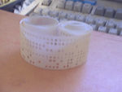

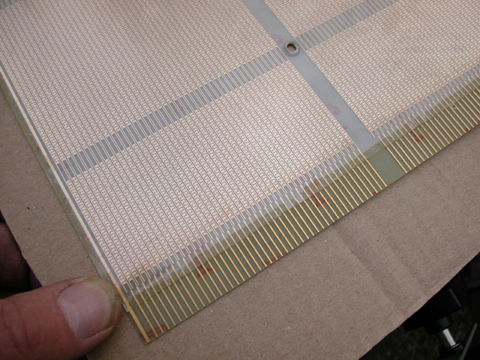
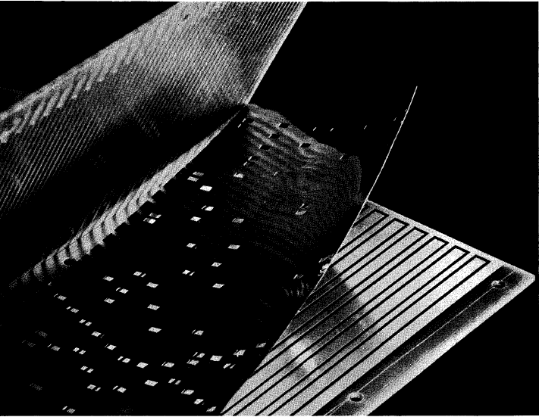
Early Read-Only Memory Technologies
Punched cards, From early 1700s through Jaquard Loom, Babbage, and then IBM
Punched paper tape, instruction stream in Harvard Mk 1
Diode Matrix, EDSAC-2 µcode store
IBM Balanced Capacitor ROS
IBM Card Capacitor ROS

Slide 4
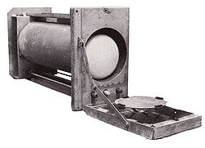
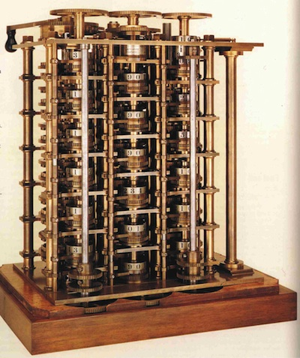
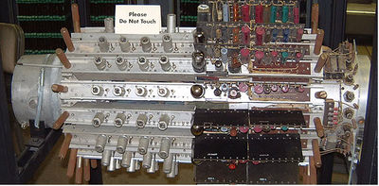
Early Read/Write Main Memory Technologies
Babbage, 1800s: Digits stored on mechanical wheels
Williams Tube, Manchester Mark 1, 1947
Mercury Delay Line, Univac 1, 1951
Also, regenerative capacitor memory on Atanasoff-Berry computer, and rotating magnetic drum memory on IBM 650

Slide 5
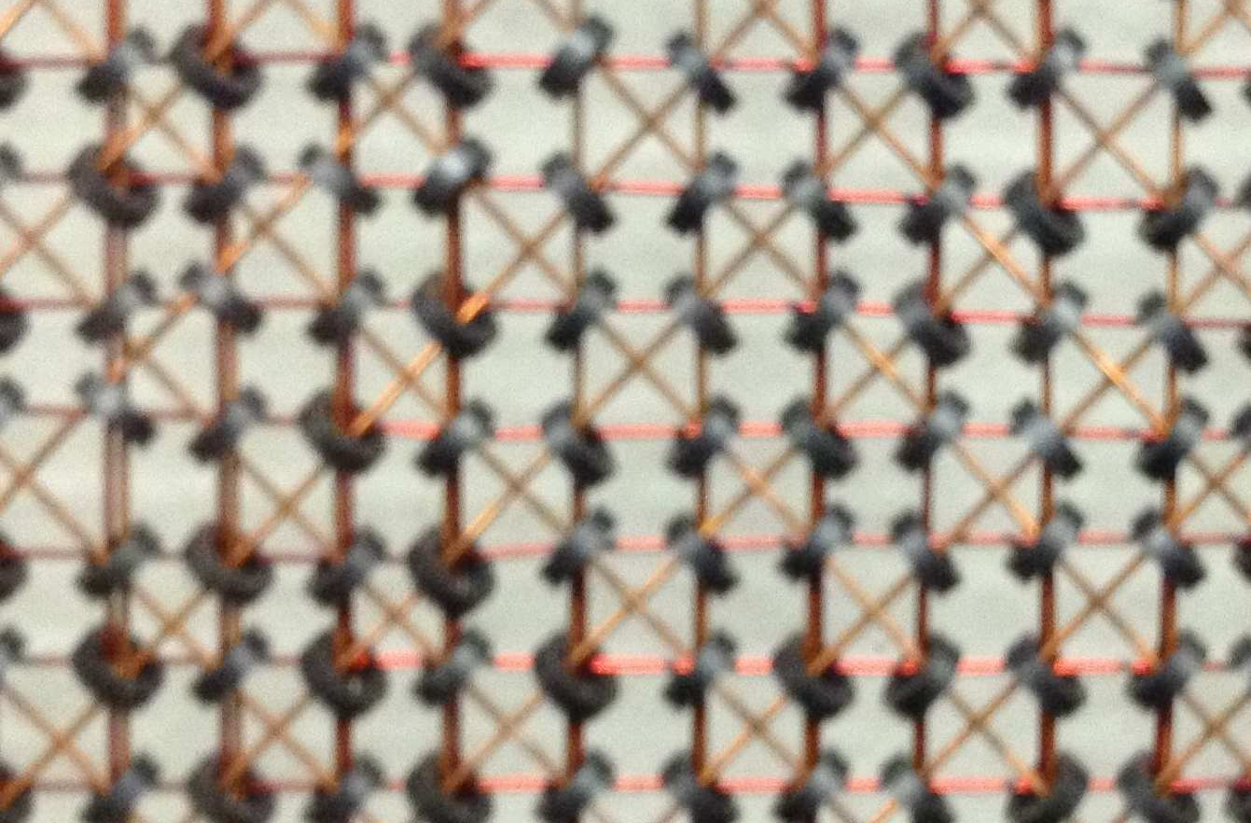
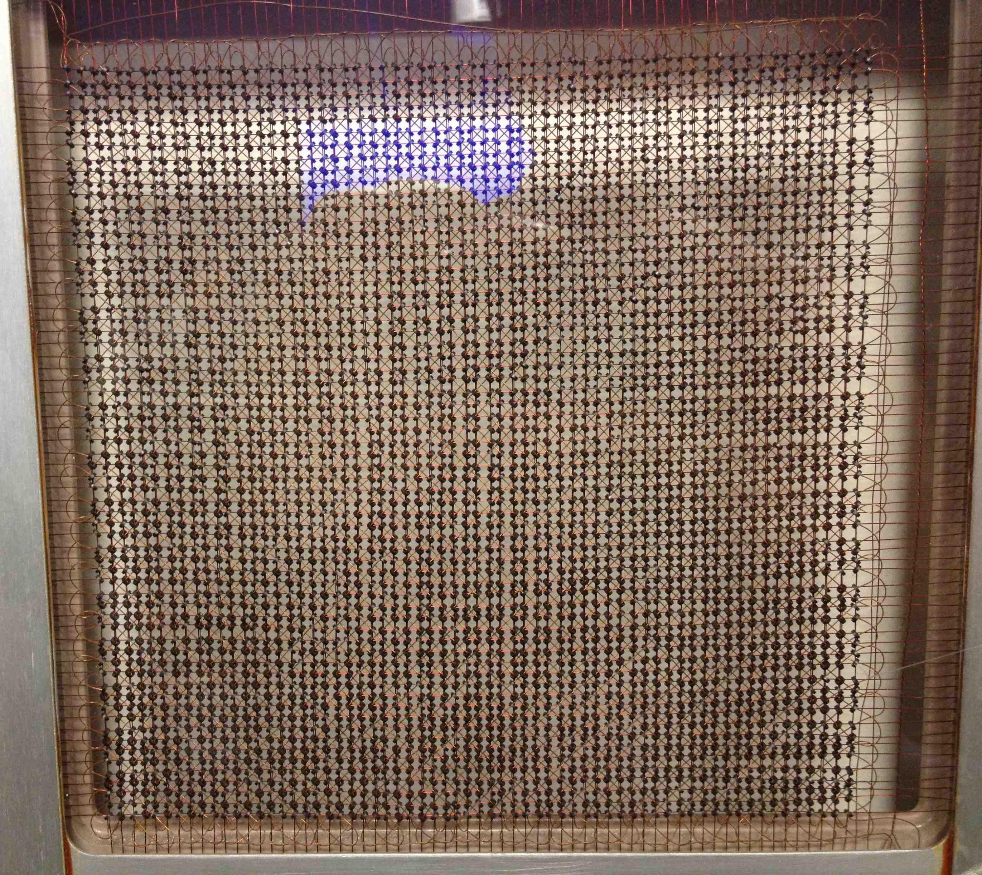
MIT Whirlwind Core Memory

Slide 6
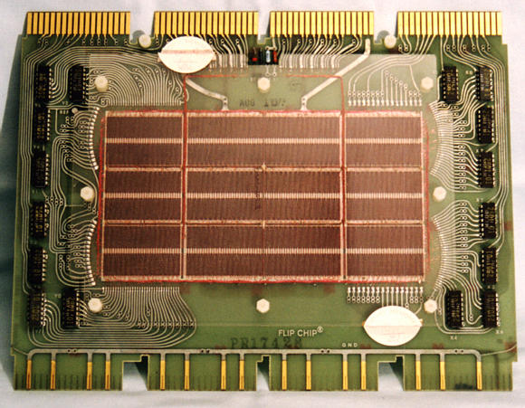
Core Memory
Core memory was first large scale reliable main memory
  invented by Forrester in late 40s/early 50s at MIT for Whirlwind project
Bits stored as magnetization polarity on small ferrite cores threaded onto two-dimensional grid of wires
Coincident current pulses on X and Y wires would write cell and also sense original state (destructive reads)
Robust, non-volatile storage
Used on space shuttle computers
Cores threaded onto wires by hand (25 billion a year at peak production)
Core access time ~ 1µs
DEC PDP-8/E Board,
4K words x 12 bits, (1968)
Notes:
Early machines had things like mercury delay lines (jse)
Photo from David Gesswein djg@pdp8.net

Slide 7
Semiconductor Memory
Semiconductor memory began to be competitive in early 1970s
  Intel formed to exploit market for semiconductor memory
  Early semiconductor memory was Static RAM (SRAM). SRAM cell internals similar to a latch (cross-coupled inverters).
First commercial Dynamic RAM (DRAM) was Intel 1103
  1Kbit of storage on single chip
  charge on a capacitor used to hold value
Semiconductor memory quickly replaced core in ‘70s

Slide 8
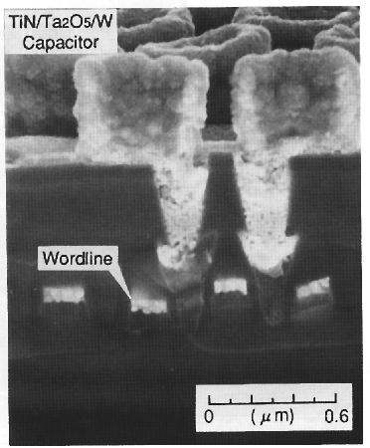
One-Transistor Dynamic RAM [Dennard, IBM]
1-T DRAM Cell
word
access transistor
TiN top electrode (V_{REF})
V_{REF}
Ta₂O₅ dielectric
bit
Storage
capacitor (FET gate, trench, stack)
poly
word
line
W bottom
electrode
access transistor

Slide 9
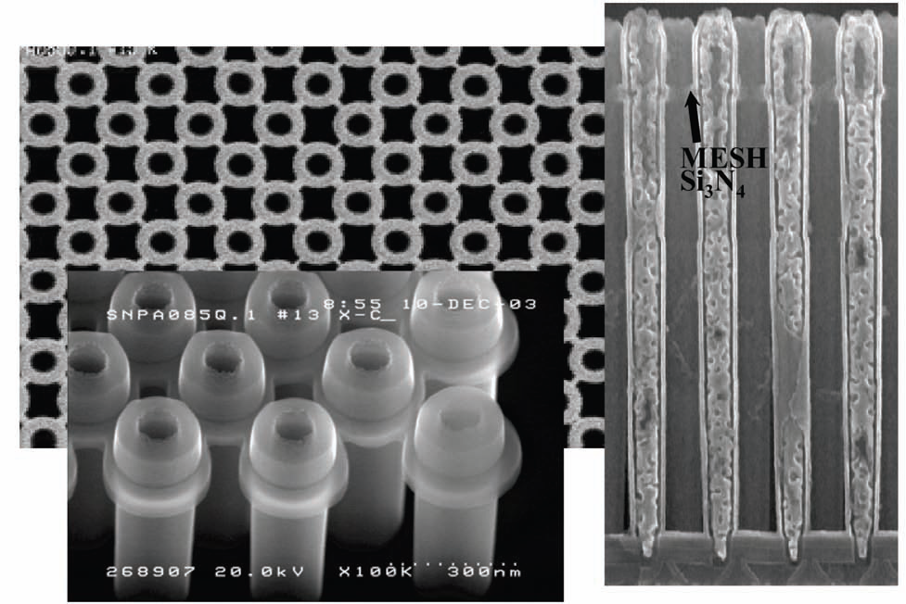
Modern DRAM Cell Structure
[Samsung, sub-70nm DRAM, 2004]

Slide 10
DRAM Conceptual Architecture
bit lines
Col.
1
Col.
2^{M}
word lines
Row 1
N
Row Address Decoder
Row 2^{N}
Memory cell
(one bit)
M
Column Decoder & Sense Amplifiers
N+M
Data
D
Bits stored in 2-dimensional arrays on chip
Modern chips have around 4-8 logical banks on each chip
  each logical bank physically implemented as many smaller arrays

Slide 11
DRAM Physical Layout
[ Vogelsang, MICRO-2010 ]

Slide 12
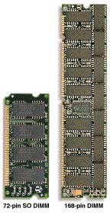
DRAM Packaging
(Laptops/Desktops/Servers)
~7
Clock and control signals
DRAM chip
Address lines multiplexed row/column address
~12
Data bus
(4b,8b,16b,32b)
DIMM (Dual Inline Memory Module) contains multiple chips with clock/control/address signals connected in parallel (sometimes need buffers to drive signals to all chips)
Data pins work together to return wide word (e.g., 64-bit data bus using 16x4-bit parts)

Slide 13
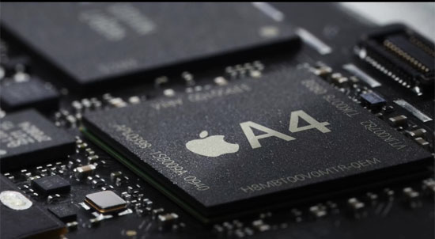
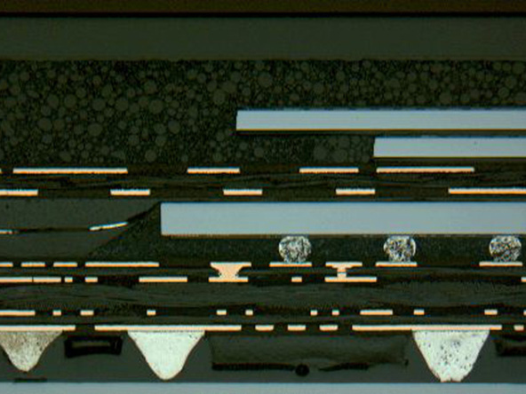
DRAM Packaging, Mobile Devices
[ Apple A4 package on circuit board]
Two stacked DRAM die
Processor plus logic die
[ Apple A4 package cross-section, iFixit 2010 ]

Slide 14
DRAM Operation
Three steps in read/write access to a given bank
Row access (RAS)
  decode row address, enable addressed row (often multiple Kb in row)
  bitlines share charge with storage cell
  small change in voltage detected by sense amplifiers which latch whole row of bits
  sense amplifiers drive bitlines full rail to recharge storage cells
Column access (CAS)
  decode column address to select small number of sense amplifier latches (4, 8, 16, or 32 bits depending on DRAM package)
  on read, send latched bits out to chip pins
  on write, change sense amplifier latches which then charge storage cells to required value
  can perform multiple column accesses on same row without another row access (burst mode)
Precharge
  charges bit lines to known value, required before next row access
Each step has a latency of around 15-20ns in modern DRAMs
Various DRAM standards (DDR, RDRAM) have different ways of encoding the signals for transmission to the DRAM, but all share same core architecture
Notes:
Use RAS/CAS to reduce average latency.

Slide 15
Memory Parameters
Latency
  Time from initiation to completion of one memory read (e.g., in nanoseconds, or in CPU or DRAM clock cycles)
Occupancy
  Time that a memory bank is busy with one request
  Usually the important parameter for a memory write
Bandwidth
  Rate at which requests can be processed (accesses/sec, or GB/s)
All can vary significantly for reads vs. writes, or address, or address history (e.g., open/close page on DRAM bank)

Slide 16
Processor-DRAM Gap (latency)
µProc 60%/year
1000
CPU
Processor-Memory
Performance Gap:
(growing 50%/yr)
100
Performance
10
DRAM
7%/year
DRAM
1
1986
1988
1987
1989
1990
1991
1992
1993
1994
1995
1980
1996
1981
1982
1983
1984
1985
1997
1998
1999
2000
Time
Four-issue 3GHz superscalar accessing 100ns DRAM could execute 1,200 instructions during time for one memory access!
Notes:
Why doesn’t DRAM get faster?

Slide 17
Physical Size Affects Latency
CPU
Big Memory
CPU
Small Memory
Signals have further to travel
Fan out to more locations

Slide 18
Two predictable properties of memory references:
Temporal Locality: If a location is referenced it is likely to be referenced again in the near future.
Spatial Locality: If a location is referenced it is likely that locations near it will be referenced in the near future.

Slide 19
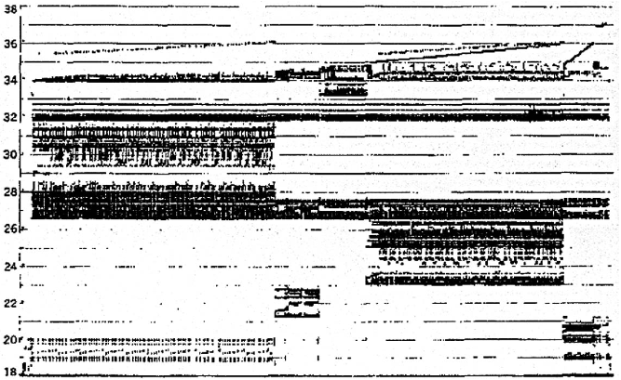
Memory Reference Patterns
Temporal
Locality
Memory Address (one dot per access)
Spatial
Locality
Time
Donald J. Hatfield, Jeanette Gerald: Program Restructuring for Virtual Memory. IBM Systems Journal 10(3): 168-192 (1971)

Slide 20
Memory Hierarchy
Small, fast memory near processor to buffer accesses to big, slow memory
  Make combination look like a big, fast memory
Keep recently accessed data in small fast memory closer to processor to exploit temporal locality
  Cache replacement policy favors recently accessed data
Fetch words around requested word to exploit spatial locality
  Use multiword cache lines, and prefetching

Slide 21
Management of Memory Hierarchy
Small/fast storage, e.g., registers
  Address usually specified in instruction
  Generally implemented directly as a register file
    but hardware might do things behind software’s back, e.g., stack management, register renaming
Larger/slower storage, e.g., main memory
  Address usually computed from values in register
  Generally implemented as a hardware-managed cache hierarchy (hardware decides what is kept in fast memory)
    but software may provide “hints”, e.g., don’t cache or prefetch
Notes:
Secondary characteristic:
Some machines (PDP-10) have overlain the registers on memory (jse)

Slide 22
Important Cache Parameters (Review)
Capacity (in bytes)
Associativity (from direct-mapped to fully associative)
Line size (bytes sharing a tag)
Write-back versus write-through
Write-allocate versus write no-allocate
Replacement policy (least recently used, random)

Slide 23
Improving Cache Performance
Average memory access time (AMAT) =
Hit time + Miss rate x Miss penalty
To improve performance:
  reduce the hit time
  reduce the miss rate
  reduce the miss penalty
What is best cache design for 5-stage pipeline?
Biggest cache that doesn’t increase hit time past 1 cycle (approx 8-32KB in modern technology)
[ design issues more complex with deeper pipelines and/or out-of-order superscalar processors]
Notes:
Design the largest primary cache without slowing down the clock
Or adding pipeline stages.

Slide 24
Causes of Cache Misses: The 3 C’s
Compulsory: first reference to a line (a.k.a. cold start misses)
  misses that would occur even with infinite cache
Capacity: cache is too small to hold all data needed by the program
  misses that would occur even under perfect replacement policy
Conflict: misses that occur because of collisions due to line-placement strategy
  misses that would not occur with ideal full associativity

Slide 25
Effect of Cache Parameters on Performance
Larger cache size
  reduces capacity and conflict misses
  hit time will increase
Higher associativity
  reduces conflict misses
  may increase hit time
Larger line size
  reduces compulsory and capacity (reload) misses
  increases conflict misses and miss penalty
Notes:
Requested line first….
The following could be in the slide…
spatial locality reduces compulsory misses and capacity reload misses
fewer lines may increase conflict miss rate
larger lines may increase miss penalty

Slide 26
Multilevel Caches
Problem: A memory cannot be large and fast
Solution: Increasing sizes of cache at each level
DRAM
CPU
L2$
L1$
Local miss rate = misses in cache / accesses to cache
Global miss rate = misses in cache / CPU memory accesses
Misses per instruction = misses in cache / number of instructions
Notes:
MPI makes it easier to compute overall performance (jse)

Slide 27
Presence of L2 influences L1 design
Use smaller L1 if there is also L2
  Trade increased L1 miss rate for reduced L1 hit time
  Backup L2 reduces L1 miss penalty
  Reduces average access energy
Use simpler write-through L1 with on-chip L2
  Write-back L2 cache absorbs write traffic, doesn’t go off-chip
  At most one L1 miss request per L1 access (no dirty victim write back) simplifies pipeline control
  Simplifies coherence issues
  Simplifies error recovery in L1 (can use just parity bits in L1 and reload from L2 when parity error detected on L1 read)

Slide 28
Inclusion Policy
Inclusive multilevel cache:
  Inner cache can only hold lines also present in outer cache
  External coherence snoop access need only check outer cache
Exclusive multilevel caches:
  Inner cache may hold lines not in outer cache
  Swap lines between inner/outer caches on miss
  Used in AMD Athlon with 64KB primary and 256KB secondary cache
Why choose one type or the other?
Notes:
New slide (jse)

Slide 29
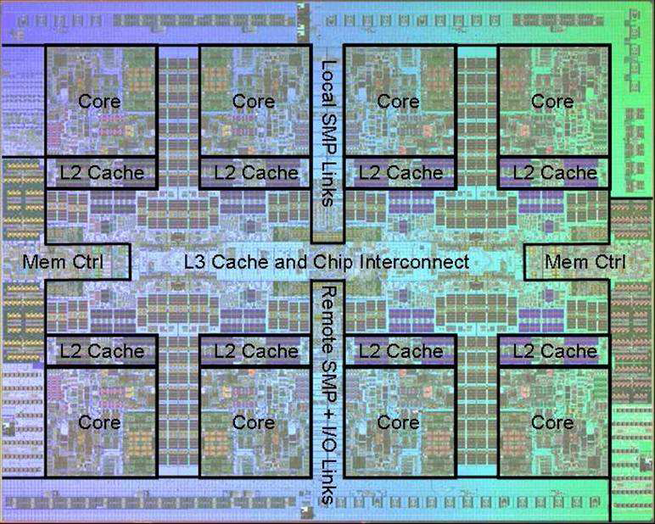
Power 7 On-Chip Caches [IBM 2009]
32KB L1 I$/core
32KB L1 D$/core
3-cycle latency
256KB Unified L2$/core
8-cycle latency
32MB Unified Shared L3$
Embedded DRAM (eDRAM)
25-cycle latency to local slice

Slide 30
Prefetching
Speculate on future instruction and data accesses and fetch them into cache(s)
  Instruction accesses easier to predict than data accesses
Varieties of prefetching
  Hardware prefetching
  Software prefetching
  Mixed schemes
What types of misses does prefetching affect?
Notes:
Reduces compulsory misses, can increase conflict and
capacity misses.

Slide 31
Issues in Prefetching
Usefulness – should produce hits
Timeliness – not late and not too early
Cache and bandwidth pollution
L1 Instruction
Unified L2 Cache
CPU
L1 Data
RF
Prefetched data

Slide 32
Hardware Instruction Prefetching
Instruction prefetch in Alpha AXP 21064
  Fetch two lines on a miss; the requested line (i) and the next consecutive line (i+1)
  Requested line placed in cache, and next line in instruction stream buffer
  If miss in cache but hit in stream buffer, move stream buffer line into cache and prefetch next line (i+2)
Prefetched
instruction line
Req
line
Stream
Buffer
CPU
Unified L2 Cache
L1 Instruction
RF
Req
line
Notes:
Need to check the stream buffer if the requested line is in there.
Never more than one 32-byte line in the stream buffer.

Slide 33
Hardware Data Prefetching
Prefetch-on-miss:
  Prefetch b + 1 upon miss on b
One-Block Lookahead (OBL) scheme
  Initiate prefetch for block b + 1 when block b is accessed
  Why is this different from doubling block size?
  Can extend to N-block lookahead
Strided prefetch
  If observe sequence of accesses to line b, b+N, b+2N, then prefetch b+3N etc.
Example: IBM Power 5 [2003] supports eight independent streams of strided prefetch per processor, prefetching 12 lines ahead of current access
Notes:
HP PA 7200 uses OBL prefetching
Tag prefetching is twice as effective as prefetch-on-miss in
reducing miss rates.

Slide 34
Software Prefetching
  for(i=0; i < N; i++) {
  prefetch( &a[i + 1] );
  prefetch( &b[i + 1] );
  SUM = SUM + a[i] * b[i];
  }
Notes:
Cache should be non-blocking or lockup-free.
By that we mean that the processor can proceed while the prefetched
Data is being fetched; and the caches continue to supply instructions
And data while waiting for the prefetched data to return.

Slide 35
Software Prefetching Issues
Timing is the biggest issue, not predictability
  If you prefetch very close to when the data is required, you might be too late
  Prefetch too early, cause pollution
  Estimate how long it will take for the data to come into L1, so we can set P appropriately
  Why is this hard to do?
  for(i=0; i < N; i++) {
  prefetch( &a[i + P] );
  prefetch( &b[i + P] );
  SUM = SUM + a[i] * b[i];
  }
Must consider cost of prefetch instructions

Slide 36
Compiler Optimizations
Restructuring code affects the data access sequence
  Group data accesses together to improve spatial locality
  Re-order data accesses to improve temporal locality
Prevent data from entering the cache
  Useful for variables that will only be accessed once before being replaced
  Needs mechanism for software to tell hardware not to cache data (“no-allocate” instruction hints or page table bits)
Kill data that will never be used again
  Streaming data exploits spatial locality but not temporal locality
  Replace into dead cache locations
Notes:
Miss-rate reduction without any hardware changes.
Hardware designer’s favorite solution.

Slide 37
Acknowledgements
This course is partly inspired by previous MIT 6.823 and Berkeley CS252 computer architecture courses created by my collaborators and colleagues:
  Arvind (MIT)
  Joel Emer (Intel/MIT)
  James Hoe (CMU)
  John Kubiatowicz (UCB)
  David Patterson (UCB)

